Slide 1
Executive Audit Summary for Roseville Area Schools ISD #623
Presented by: CliftonLarsonAllen LLP
Troy Gabler, CPA - Principal
Grace Trocinske, CPA - Director

Slide 2
Audit Results Year Ended 6/30/2025
Audit Opinion
Audit Opinion
The financial statements are fairly reported. We issued what is known as a “clean” or “unmodified” audit report.
Yellow Book Compliance
No compliance issues were noted in our review of laws, regulations, contracts and grants that could have significant financial impacts to the district.
Internal Controls
Our audit did not disclose any matters required to be reported in accordance with Governmental Auditing Standards.

Slide 3
Audit Results Year Ended 6/30/2025
Single Audit
No findings were noted which would be required to be reported under the Uniform Guidance.
Minnesota Legal Compliance
Uniform Financing Accounting and Reporting Standards
  Minnesota Statutes § 6.65; 123B.77, subd. 3 to be in compliance with uniform financial accounting and reporting standards, which includes ensuring the District’s UFARS Turnaround Report showing no errors before the submission of final audited UFARS data to the Minnesota Department of Education (MDE).

Slide 4
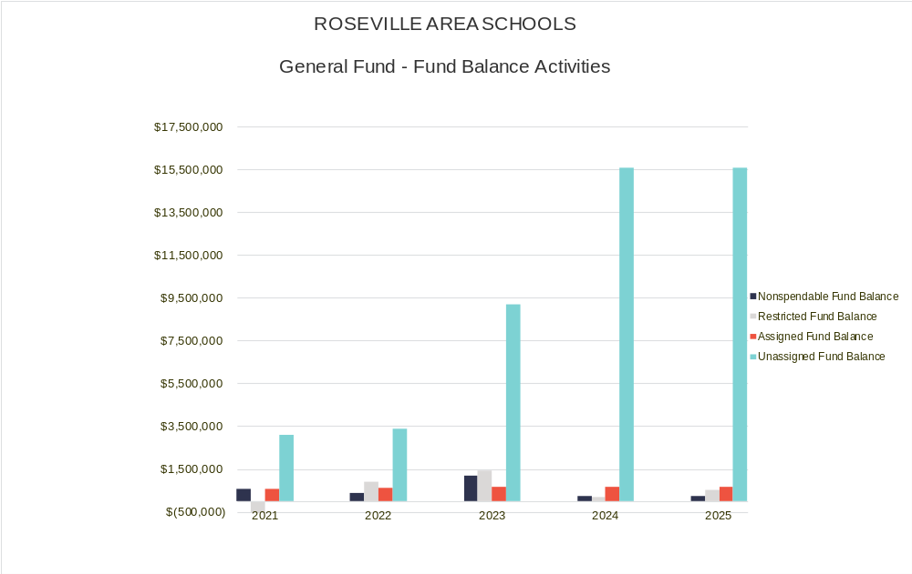
Financial Results

Slide 5
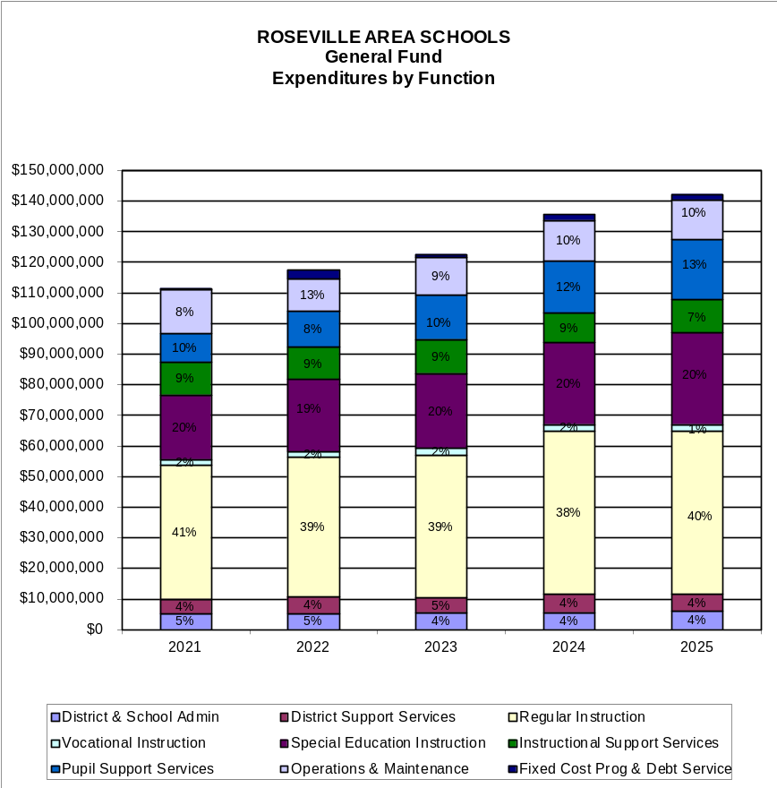
Financial Results

Slide 6
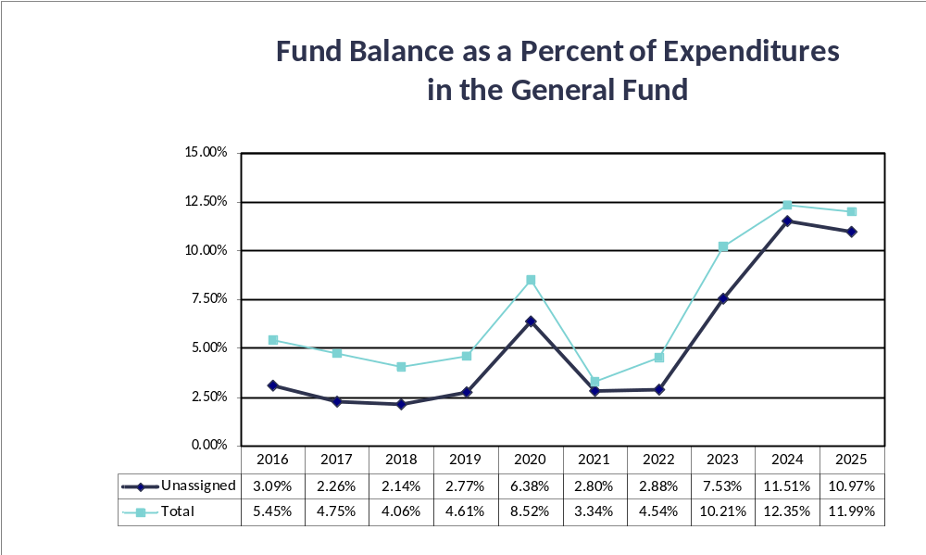
Financial Results

Slide 7
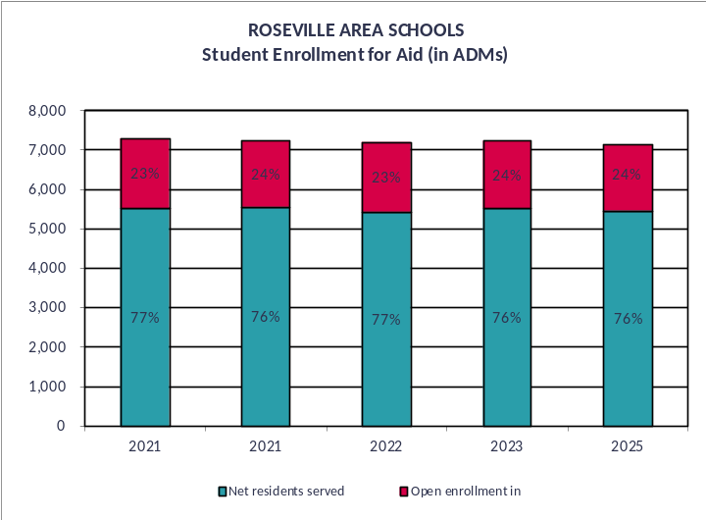
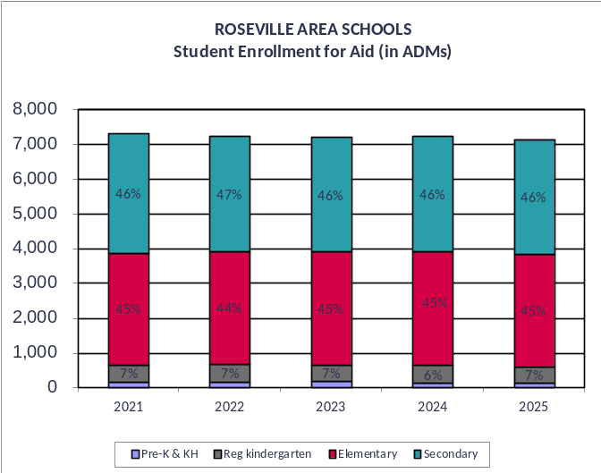
Financial Results

Slide 8
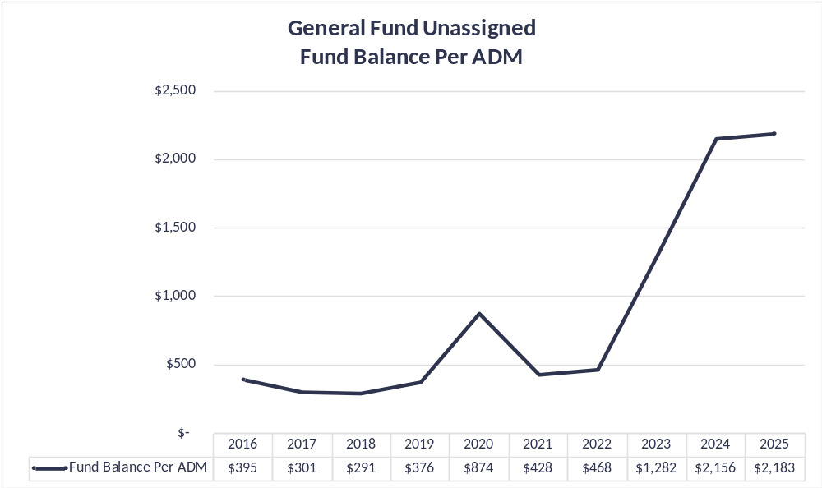
Financial Results

Slide 9
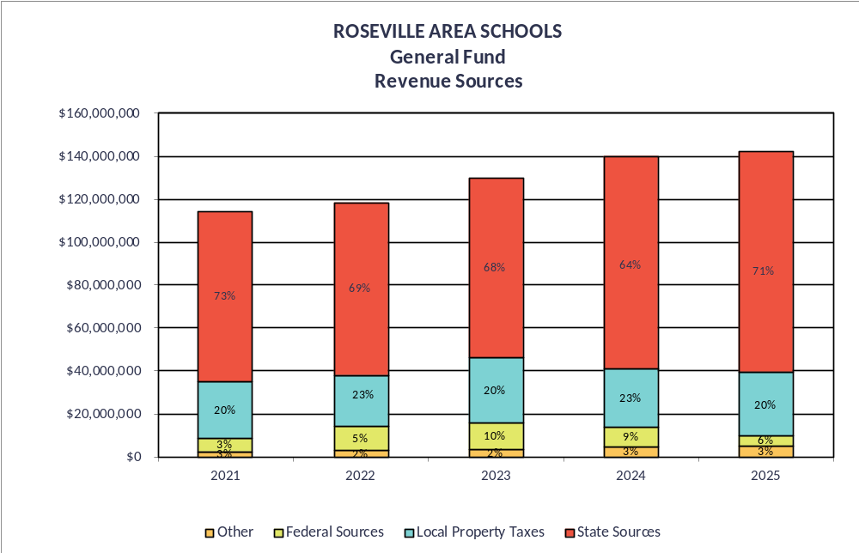
Financial Results

Slide 10
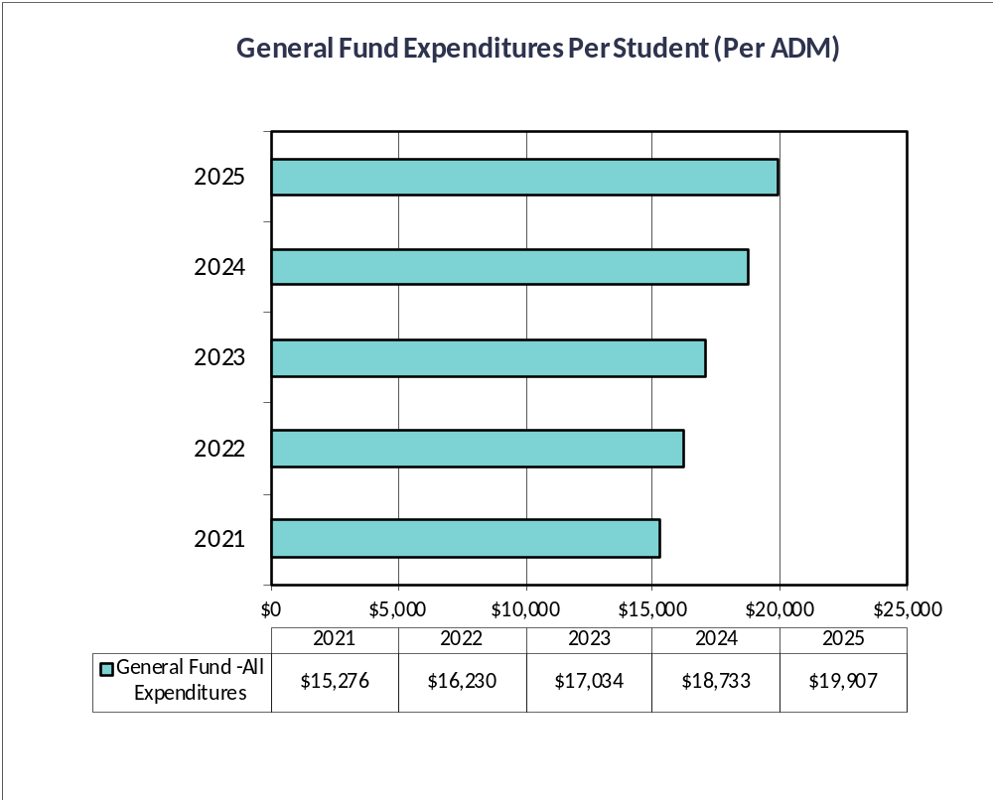
Financial Results

Slide 11
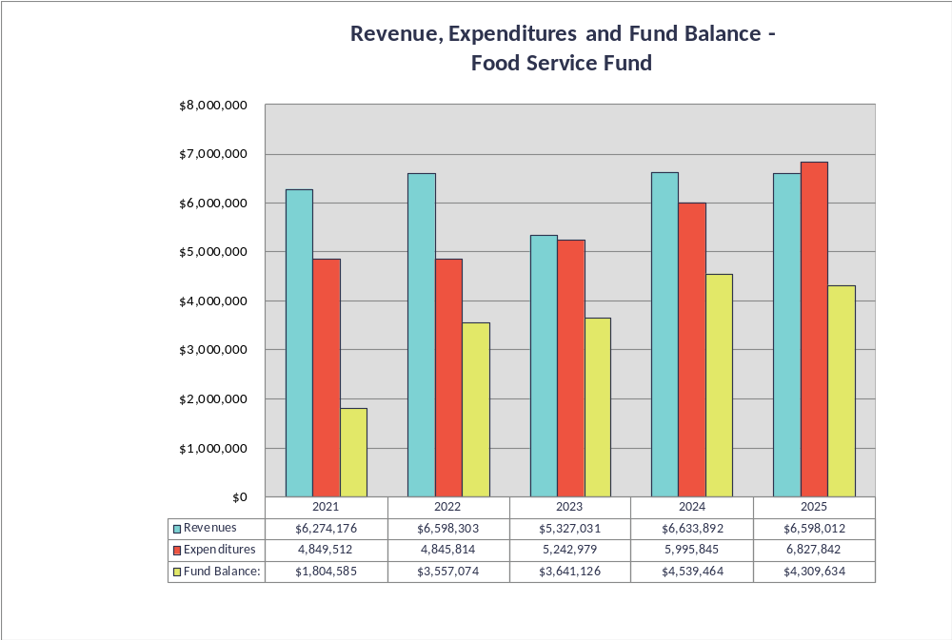
Financial Results

Slide 12
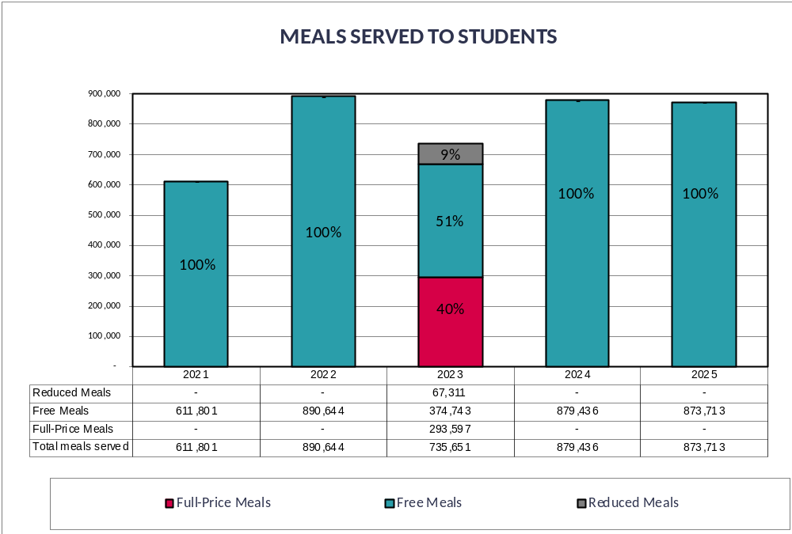
Financial Results

Slide 13
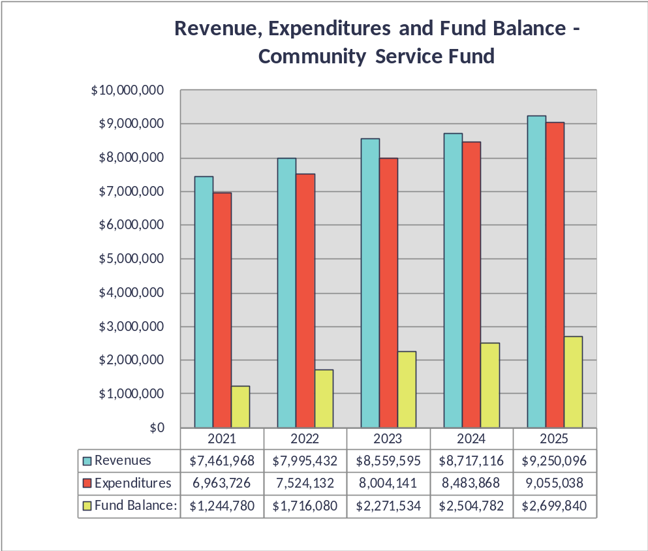
Financial Results

Slide 14
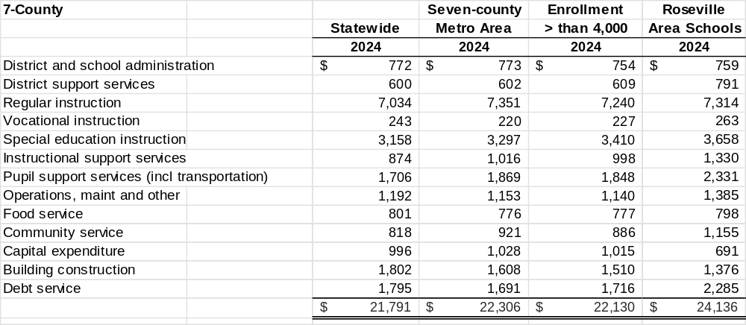
Financial Results

Slide 15
Upcoming GASB Standards
Fiscal Year 2026:
  GASB 103 – Financial Reporting Model Improvements
    Likely will change language in management’s discussion and analysis and budgetary comparison information in the required supplementary information (RSI).
  GASB 104 – Disclosure of Certain Capital Assets
    To improve transparency and consistency in how governments disclose certain capital assets in their financial statements.
    Separate reporting by asset class
    Updated disclosures on capital assets held for sale

Slide 16
Questions and Feedback
We welcome any questions pertaining to the audit, audit reports, and letters.
We appreciate the opportunity to serve as the auditors for Roseville Area Schools and welcome any feedback relative to our performance.

Slide 17
Thank you!
Troy Gabler
Principal
763-516-7742
Troy.Gabler@claconnect.com
Grace Trocinske
Director
612.215.1888
Grace.Trocinske@claconnect.com

