Slide 1


Slide 2

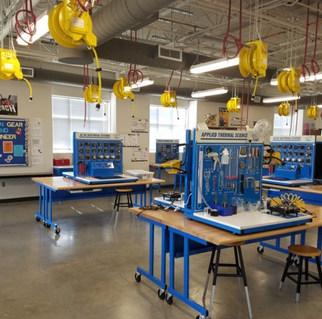
Miller Career & Technology Center serves as a central site for students to take specialized CTE courses not available at their home campus.

Slide 3
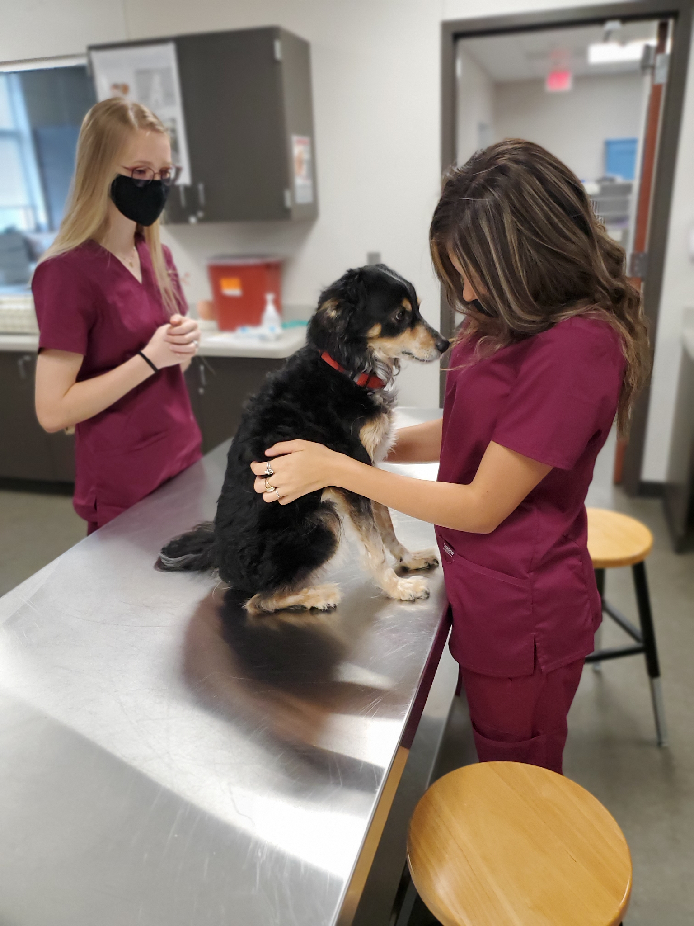
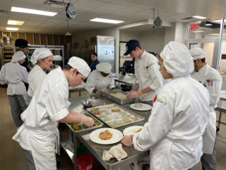
MCTC Courses
Architectural Design
Auto Tech
Computer Technician
Network Engineering
Cybersecurity
Digital Audio
Education
Construction Trades
Manufacturing Engineering
Veterinary Science
Culinary Arts

Slide 4
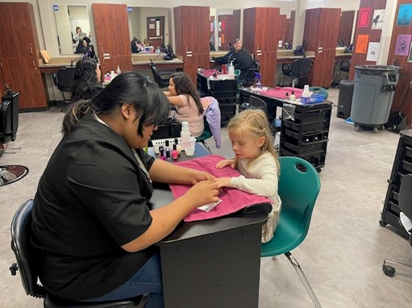
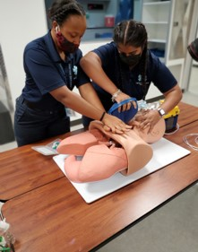
MCTC Courses Continued
Cosmetology
Law Enforcement
Legal Studies
Clinical Rotations
Emergency Medical Technician (EMT)
Dental Assisting
Pharmacy Tech
Practicum in Engineering

Slide 5

Request your Miller course on the Miller tile in MyKaty.
The tile is open from
January 26th at 7 am through
February 27th at 11:59 pm.

Slide 6
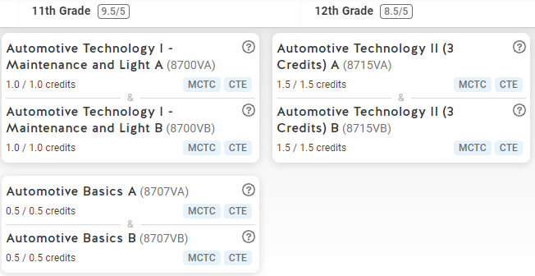

Miller Career & Technology Center courses are available in SchooLinks.
Be sure to update your SchooLinks high school plan to include MCTC courses.

Slide 7
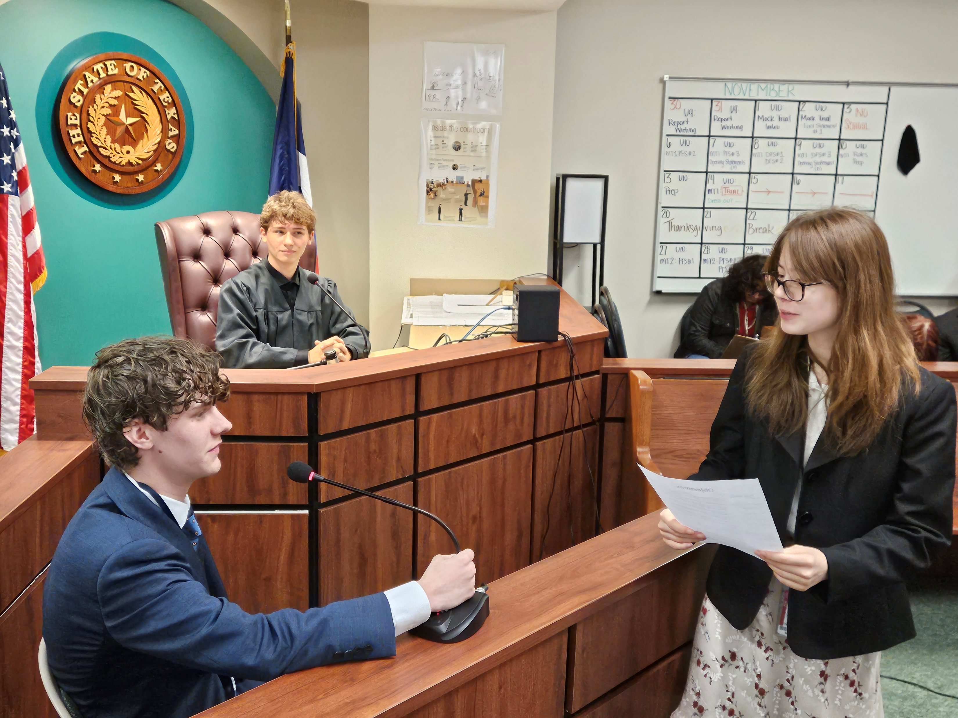
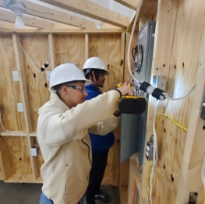
Preview Nights
Preview Night for current 9th, 10th, and 11th graders
January 26th from 6:00 to 7:30 pm
Preview Night for current 6th, 7th, and 8th graders
February 18th from 6:00 to 7:30 pm

Slide 8




Follow MCTC on Social Media!
@MCTC_RealWorld
MCTC_RealWorld
Miller Career & Technology Center
mctc.katyisd.org

