Slide 1
Douglas County School District
General Fund Analysis
FY2015 - FY2026

Slide 2
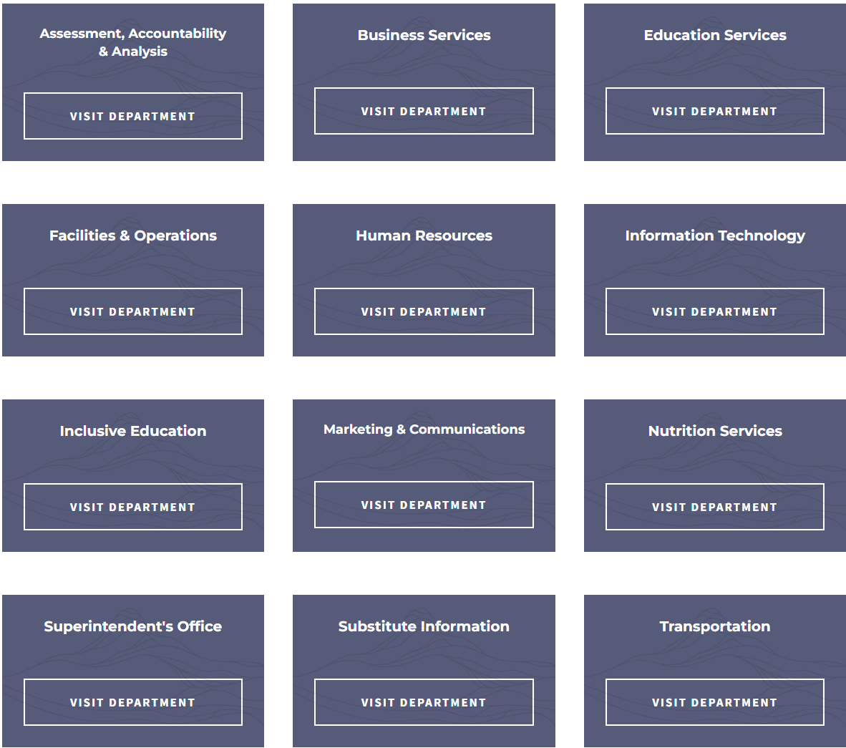
Agenda
Ending Fund Balance Trends
Enrollment Trends
Staffing Trends
Financial Trends

Slide 3
Financial Picture
FY2025 - $1.4 million deficit
  $948,911 – General Fund Deficit
  $476,339 – SpEd Deficit
FY2026 - $5.7 million projected deficit
  $59,233,467 – Total GF Revenue (based on Q1 enrollment)
  $64,936,282 – Final Budget Expenditures (based on final budget)
FY2026 - $7.1 million deficit

Slide 4
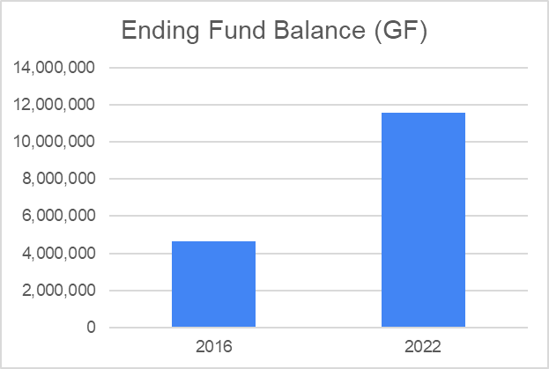
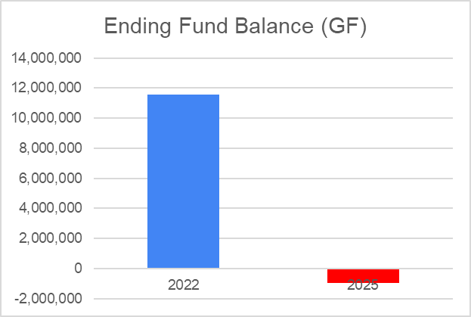
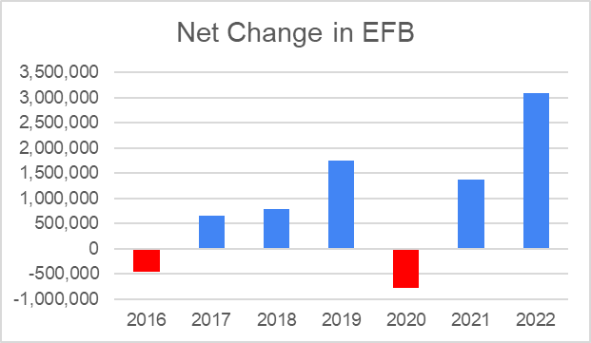
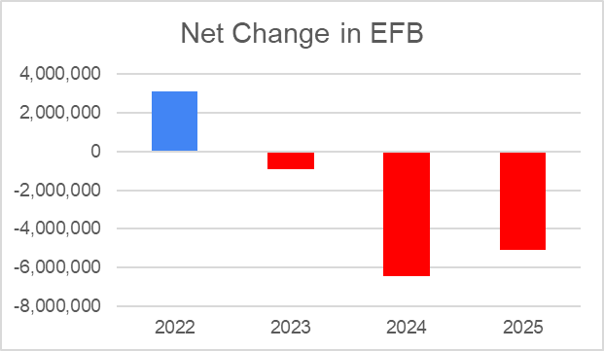
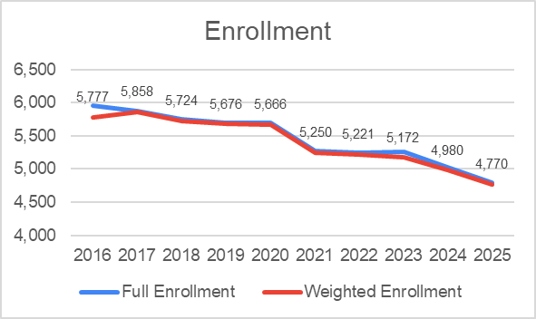
Ending Fund Balance
FY2022 - $11,558,853 Ending Fund Balance (EFB)
FY2025 – ($948,911)
  Decline of $12,507,765 over 4 years
FY2016 - $4,658,644 (EFB)
FY2022 - $11,558,853 (EFB)
  EFB grew by approximately $7 million despite declining enrollment of
Notes:
Despite experiencing declining and declining revenue, DCSD was able to manage a positive fund balance in excess of $11 million through FY2022. From FY2022 – FY2025, this surplus was spent and was negative in FY2025.

Slide 5
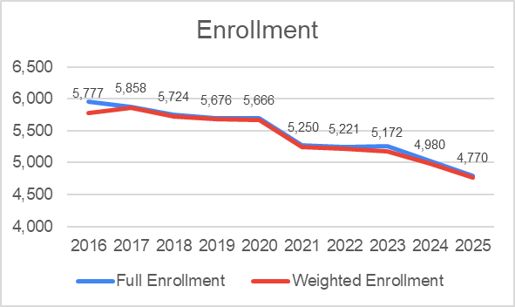
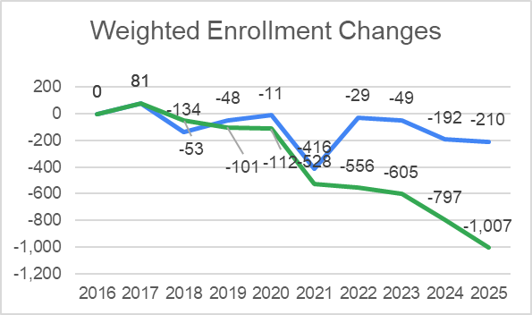
Students
FY2016 to FY2026
  Weighted Enrollment 1,007 decrease
  ≈ 17.4% decrease
  Sharp decrease from 2020 – 2021?
Staffing changes should generally parallel enrollment unless revenue increases to offset
  Under PCFP approx. 99% of revenue leaves with students
  District cannot cut certain fixed costs which can adversely impact staffing decisions

Slide 6
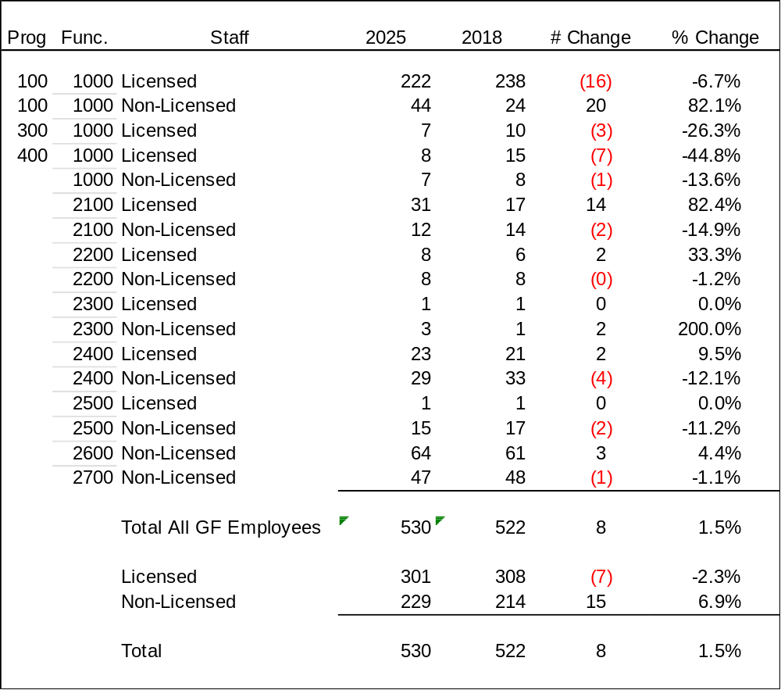
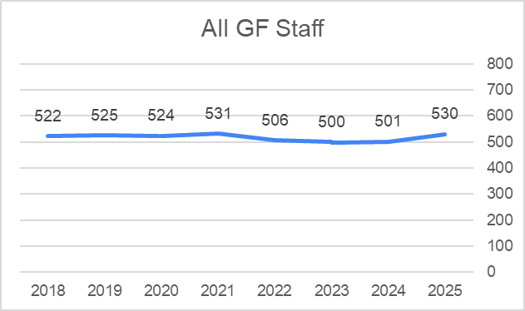
Staffing
General Fund Trends & Analysis
Enrollment decreased by ≈ 17.43% while staff increased by 1.5%
Managed staff reductions of 17% would be approx 89 positions or 8 - 10 per year.
-17.43%
2016 & 2017 Staffing unavailable

Slide 7
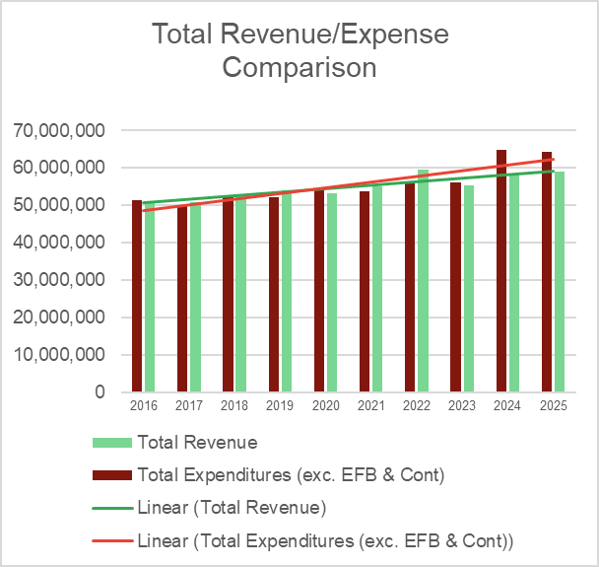
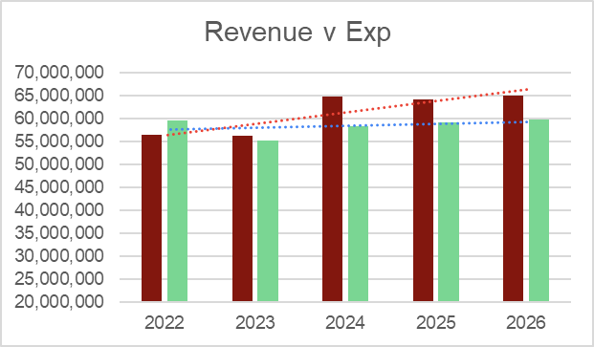
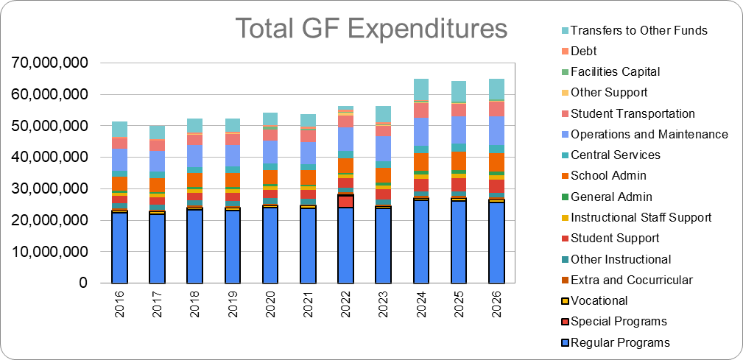
Financial
General Fund Trends & Analysis
Revenue decreased from $59,494,527 in FY2022 to $59,087,573 in FY2025
  (-$406,954)
Expenditures increased from $56,399,594 in FY2022 to $64,206,437 in FY2025 or
  (+$7,806,843)
Expenditures have outpaced Revenue with larger deficits after the funding formula change
Structural deficit starting in FY2021

Slide 8
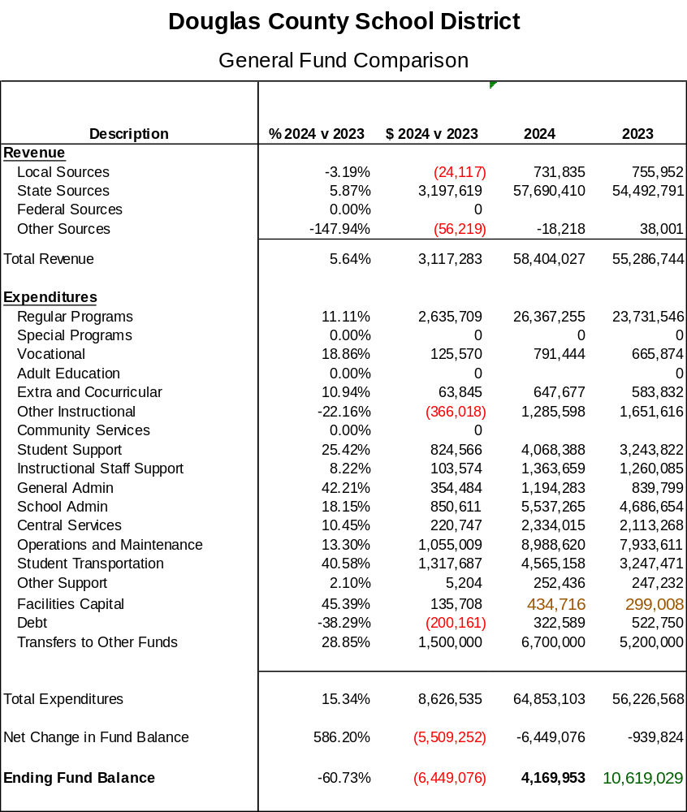
FY2023 & 24
Revenue increased by $3.1 million
Expenditures increased by $8.6 million

Slide 9
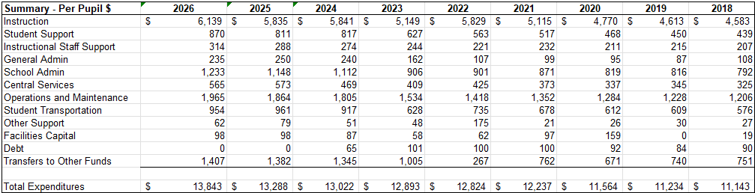
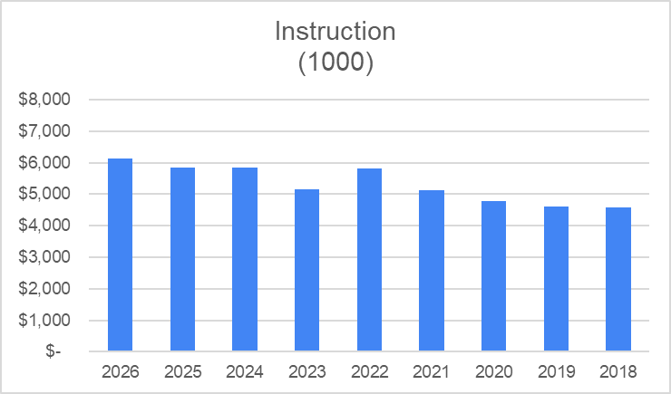
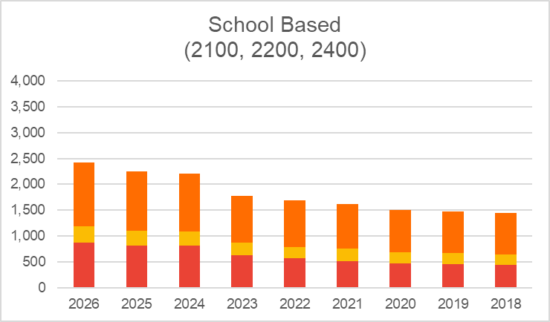
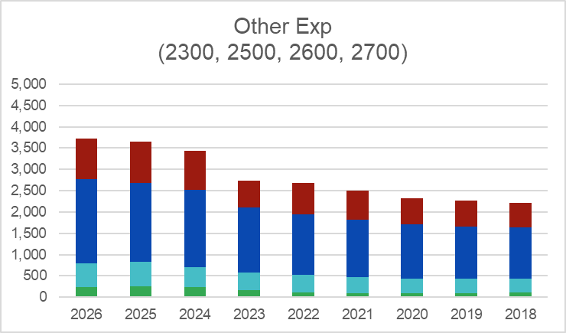
Financial
General Fund Trends
& Analysis - Per Pupil $

Slide 10
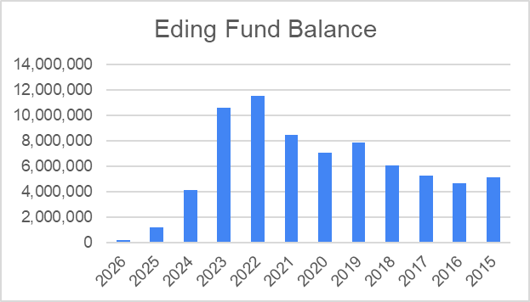
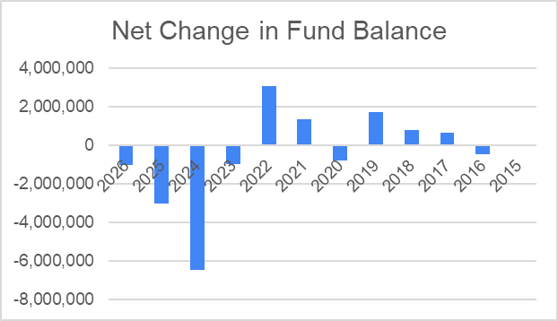
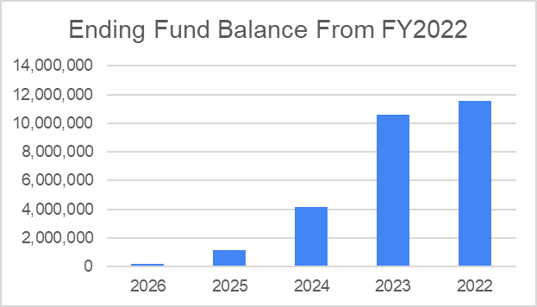
Ending Fund Balance

Slide 11
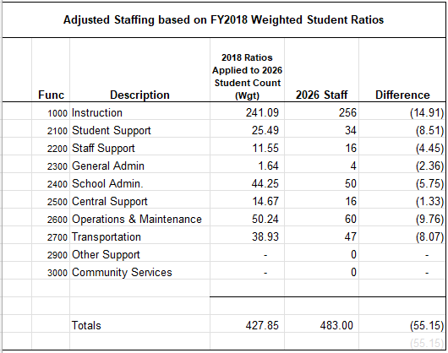
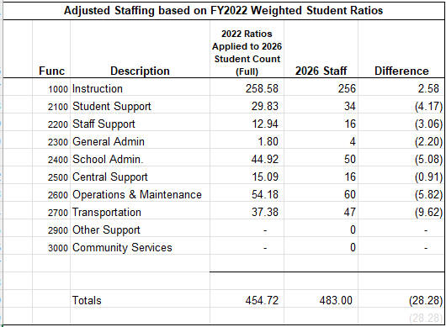
Other Analysis

Slide 12
This presentation is not an official document. No decisions are prescribed in this document nor has the information been audited or verified. Due to the limited time to prepare and review the document, it is possible there may be errors or omissions with respect to the data, calculations, and tables. Users should conduct their own independent verification of the information contained in this, and related, documents to ensure reasonability and draw their own conclusion.

Slide 13
Other Analysis

Slide 14

Budget Consensus
Create Superintendent’s Finance Committee
Review/Quantify Estimated Deficit
Identify areas for potential reduction
Gain community consensus on reductions and prioritize

