Slide 1
Financial Highlights
As of November 30, 2025
One Minute Report – Click Below

Slide 2

Highlights of Interim Financial Report (unaudited)
November 30, 2025

Slide 3





Posted on Our Website
Finance / Monthly Finance Reports (hcde-texas.org)
Linked from State Comptroller’s website
http://www.texastransparency.org/local/schools.php

Slide 4
Top 13 Highlight points for November 2025
$1,354 in tax revenue this month
Next Debt Svc payment is Feb 2026
GF Revenues at 19%
GF Expenditures at 23%
$35M in Equity(F Bal) as of November 2025
$27,913 November Donations
Values at $688B as Projected
Choice at $2.4M Benefit Variance
Ed Foundation at $446K in Equity
20% small business - November 2025
99% Irvington Project
Phase I Projects – just pending retainage release and closeout
Arbitrage payment due on Jan 31st - $87,487.80
Information updates from a system of personnel and controls: 8 accountant and all previous students.
Outlook Trend : Finance - Tax Revenues being received – Projected to utilize fund balance for operations given unrealized revenues (Unassigned projected $24M)
Revenues and exp. Below target
Operations - Normal Operations
Legislative - Assessing Impact to HCDE
Finance - Assessing grant awards pending

Slide 5




HCDE receives financial reporting awards
HCDE received the ASBO Award for FY 24-25 & FY 25-26 Annual Budget
HCDE received the ASBO Award for Financial Reporting FY 23-24
HCDE received the GFOA Award for FY 24-25 Annual Budget
HCDE received the GFOA Award for Certificate of Financial Reporting for FY 23-24
HCDE submitted for two awards from TASBO
AOM Purchasing Award
AEFP Financial Performance
Projected for December 2025

Slide 6
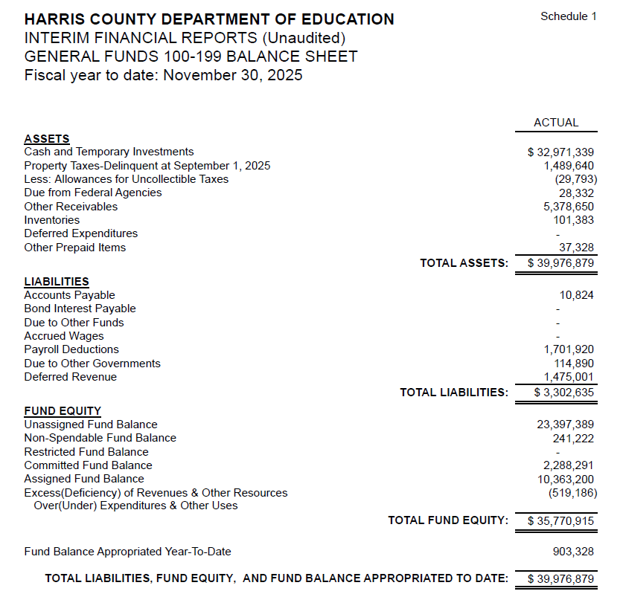
INTERIM FINANCIAL REPORT
(unaudited)
GENERAL FUND
Balance Sheet as of November 30, 2025
Total Assets:
$ 39,976,879
Total Liabilities:
$ 3,302,635
Total Fund Equity:
$35,770,915

Slide 7
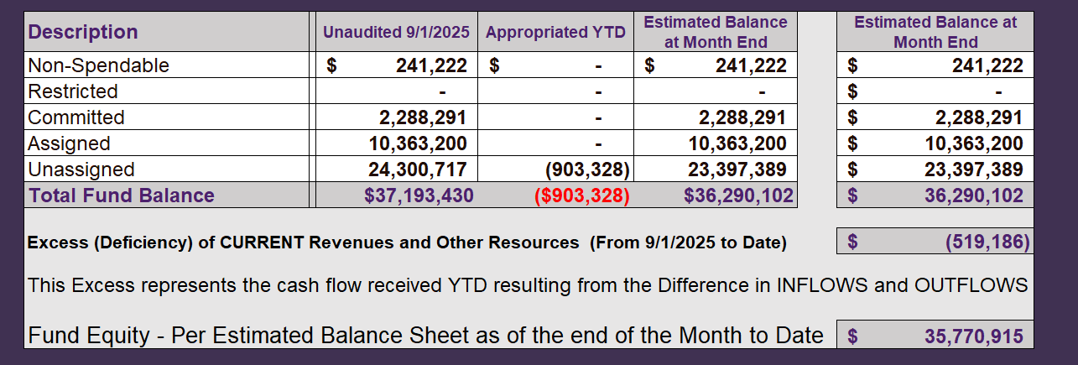
INTERIM FINANCIAL REPORT (unaudited)
ASST. SUPERINTENDENT FOR BUSINESS SERVICES MESSAGE
As of November 30, 2025
The ESTIMATED General Fund balance at 11/30/2025 is $35,770,915 after current appropriations.
As year end adjustments are completed, a budget amendment will be submitted to the board for items assigned, restricted and committed that will roll forward into FY 2025.

Slide 8
INTERIM FINANCIAL REPORT (unaudited)
As of November 30, 2025
Financial Ratios
Level One - Indicator of Financial Strength
Level Two - Indicator of Efficient Leverage
Level Three - Indicators of Efficiency
Level Four - Indicators of Revenue Growth

Slide 9
INTERIM FINANCIAL REPORT (unaudited)
As of November 30, 2025
Indicators of Financial Strength
Percent of Fund Balance to G/F
Expenditures Ratio
What is the percent of rainy-day fund balance?
(*) Unadjusted
Working Capital Ratio
What is the cash flow availability for the organization?
Unassigned Fund Balance $23,397,389
Total G/F Expenditures $15,369,216
Goal : > 30% of G/F Exp.
Benchmark: 10% to 29%
Danger: Under 10%
Goal : >$15,000,000
Benchmark : $10M to $15M
Danger : Under < $10M
Total Current Assets
Less Total Current Liabilities
$39,976,879-$3,302,635= $36,674,243
152% FY26
173% FY25
$37M FY26
$29M FY25
Budgeted 29%
Details on Schedule 3
Budgeted $33M
Details on Schedule 1

Slide 10
INTERIM FINANCIAL REPORT (unaudited)
As of November 30, 2025
Indicators of Efficient Leverage Reserves
Unassigned Fund Balance Ratio
How much is available in reserves?
Debt to Income Ratio
What is the ability of HCDE to cover
its debt payments?
Goal: <25% of annual revenue
Benchmark: 25% to <49%
Danger: Over > 50%
Unassigned Fund Balance $23,397,389
Total Fund Balance $36,674,243
Goal: <75%
Benchmark: 50% to 75%
Danger: <50%
Annual Principal and Interest Payments on
Term Debt and Capital Leases : $0
G/F Revenue Less Facility $14,850,030-2,174,649
Charges :
64% FY26
93% FY25
0% FY26
0% FY25
Budgeted 30%
Details on Schedule 1
Budgeted 5%
Details on Schedule 5

Slide 11
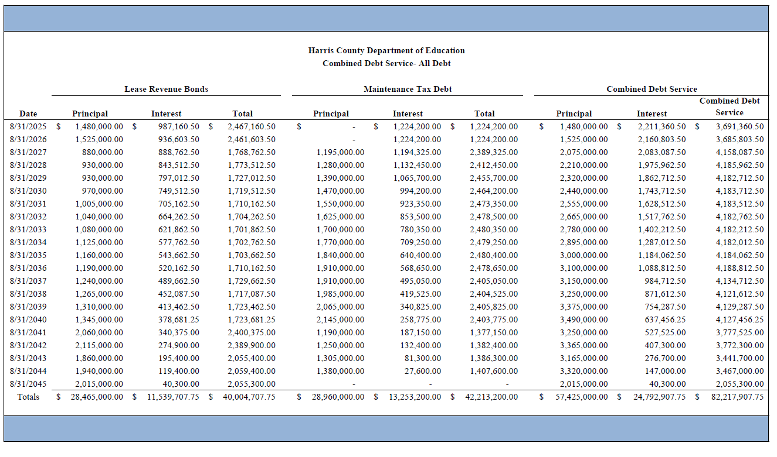
Combined Debt

Slide 12
INTERIM FINANCIAL REPORT (unaudited)
As of November 30, 2025
Indicators of Efficiency
Tax Revenue to Total Revenue Ratio
How efficient is HCDE at leveraging local
taxes? (Current)
Indirect Cost to Tax Ratio
How much dependency on indirect cost from grants?
Current Tax Revenue $2,036
Total Revenue $24,876,881
Indirect Cost General Fund $381,446
Total General Fund Revenues $14,850,030
Goal: <20% of revenue
Benchmark: 20% to 30%
Danger: Over >30%
Goal: >5%
Benchmark: 2% to 5%
Danger: Under < 2%
0% FY26
0% FY25
2.6% FY26
4.8% FY25
Budgeted 20%
Details on Schedule 2
Budgeted 3.6%
Details on Schedule 3

Slide 13
INTERIM FINANCIAL REPORT (unaudited)
As of November 30, 2025
Indicators of Revenue Growth
Fee for Service Revenue Ratio
How are revenues spread across all Funds?
Fee for Service Revenue Growth Ratio
What is the market growth for fee on services?
Total Fee for Service Revenues (G/F) $11,456,340
Total Revenues $24,876,881
Fee for Service Current Year Less Fee for Services Last Year $11,456,340-4,679,690
Fees for Service Last Year $4,679,690
Goal: >30% of annual revenue Benchmark: 10% to 29%
Danger: Under 10%
Goal: >3% of + growth
Benchmark: 0% to 3%
Danger: Under 0%
46% FY26
23% FY25
144% FY26
-45% FY25
Budgeted 39%
Details on Schedule 14
Budgeted 17%
Details on Schedule 14

Slide 14
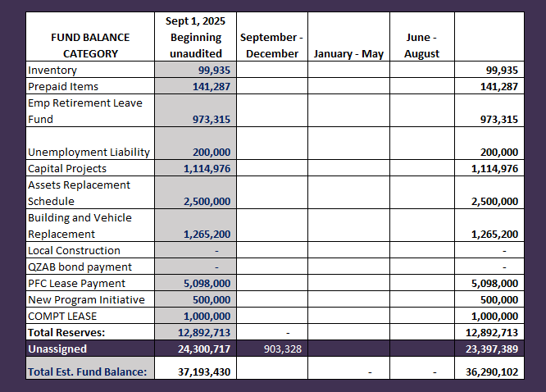
FY 2025-2026
Fund Balance
-
Budgeted Activity
Previous BAs
Durotech Change Order | $903,328

Slide 15
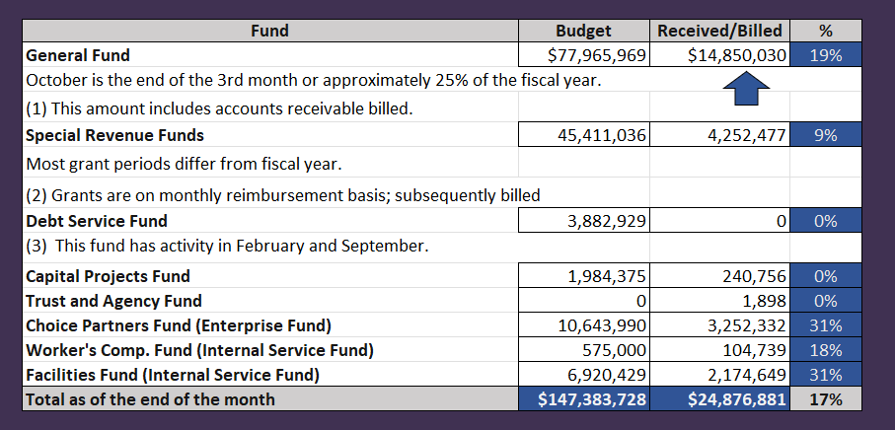
INTERIM FINANCIAL REPORT (unaudited)
GENERAL, SPECIAL REVENUE, DEBT SERVICE FUNDS, CAPITAL PROJECTS,
AND INTERNAL SERVICE FUNDS
REVENUES (INFLOWS)
Budget to Actual for period ending November 30, 2025

Slide 16
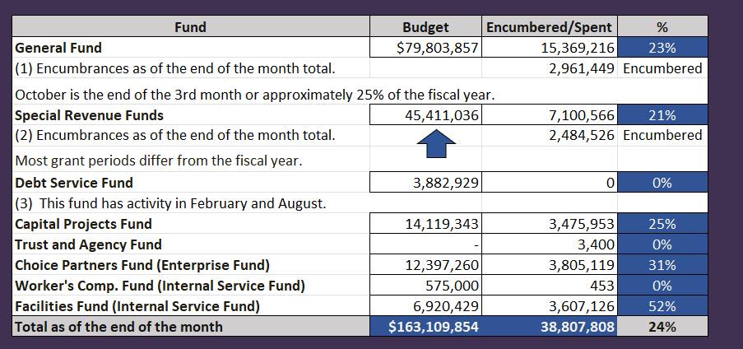
INTERIM FINANCIAL REPORT (unaudited)
GENERAL, SPECIAL REVENUE, DEBT SERVICE FUNDS, CAPITAL PROJECTS,
AND INTERNAL SERVICE FUNDS
Expenditures (OUTFLOWS)
Budget to Actual for period ending November 30, 2025

Slide 17
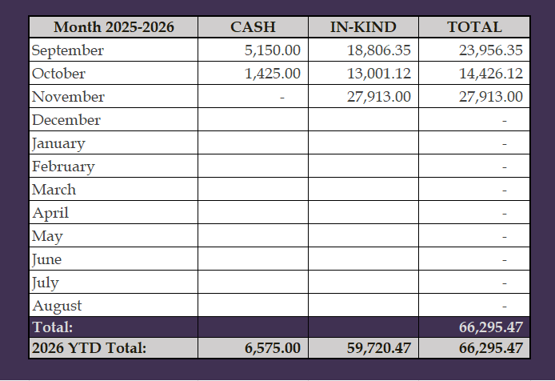
INTERIM FINANCIAL REPORT (unaudited)
FY 2025-26 Donations Report
All Funds as of November 30, 2025

Slide 18
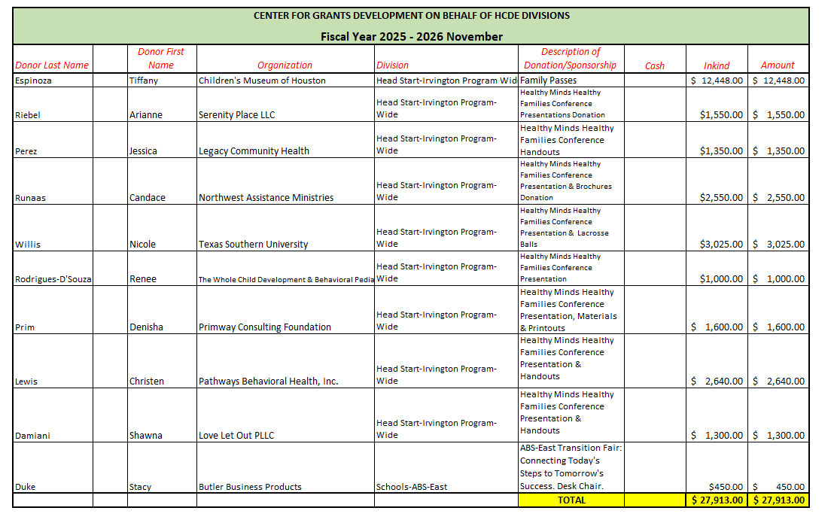
INTERIM FINANCIAL REPORT (unaudited)
FY 2025-26 Donations Report
All Funds as of November 30, 2025

Slide 19
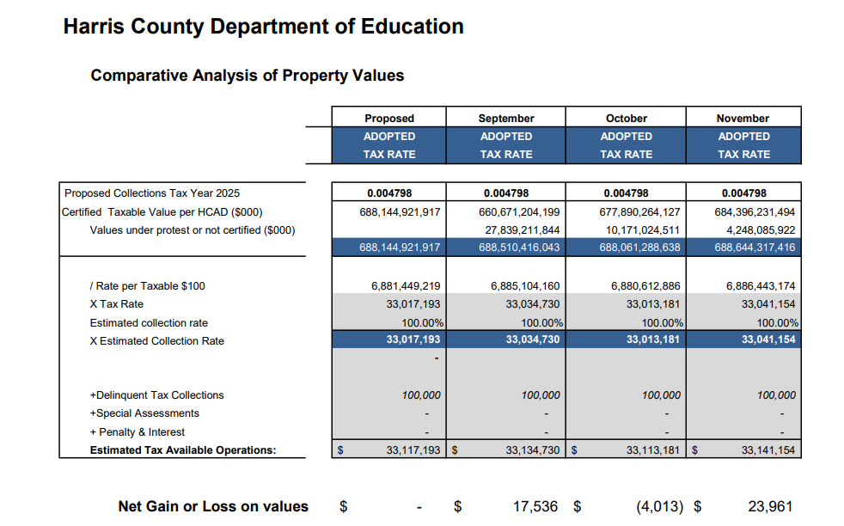
INTERIM FINANCIAL REPORT (unaudited)
TAX COLLECTIONS COMPARATIVE ANALYSIS
Fiscal Year-To-Date as of November 30, 2025
$688B
$688B
See Tax Calculator at:
https://hcde-texas.org/transparency/tax-rate/

Slide 20
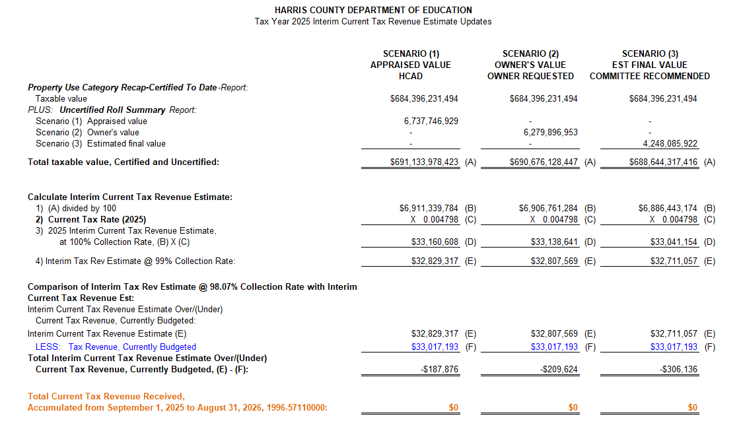
INTERIM FINANCIAL REPORT (unaudited) TAX COLLECTIONS
Fiscal Year-To-Date as of November 30, 2025
(3rd month / 12 months)

Slide 21
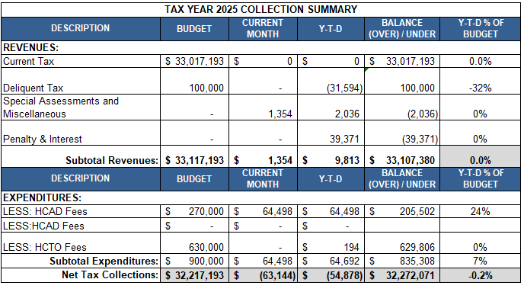
INTERIM FINANCIAL REPORT (unaudited) TAX COLLECTIONS
Fiscal Year-To-Date as of November 30, 2025
(3rd month / 12 months)
a) 2024 Approved Tax Rate = $0.004799/$100 Property Assessment/Appraisal - --> Annual Tax on a $259,375 - $51,875 = $207,500/100
x .004799 = $9.958 (net of 20% homestead exception.)
b) $850,000/$32,184,041 = 2.64% Collection and assessment costs

Slide 22
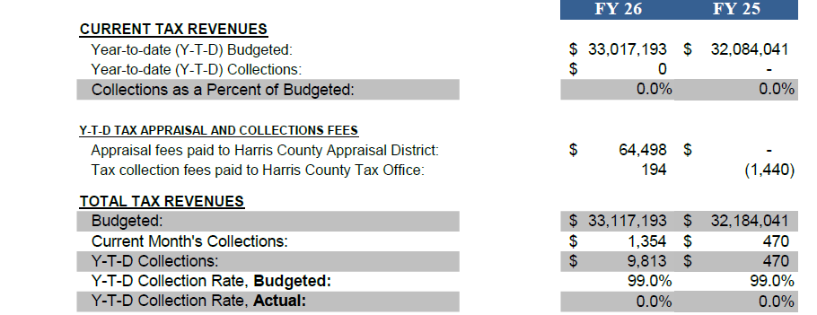
INTERIM FINANCIAL REPORT (unaudited) TAX COLLECTIONS
Fiscal Year-To-Date as of November 30, 2025
(3rd month / 12 months)
a) 2024 Approved Tax Rate = $0.004799/$100 Property Assessment/Appraisal - --> Annual Tax on a $259,375 - $51,875 = $207,500/100
x .004799 = $9.958 (net of 20% homestead exception.)
b) $850,000/$32,184,041 = 2.64% Collection and assessment costs

Slide 23
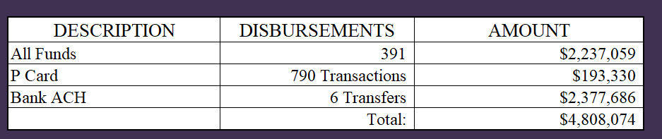
INTERIM FINANCIAL REPORT (unaudited)
DISBURSEMENT – ALL FUNDS
November 30, 2025
Notes:
All Purchase Orders and Payment Authorizations are reviewed before disbursement.
All Procurement Card charges are reviewed by cardholder, supervisor, and business office staff each month.
A report on CH Local Expenditures is included in the monthly report.

Slide 24
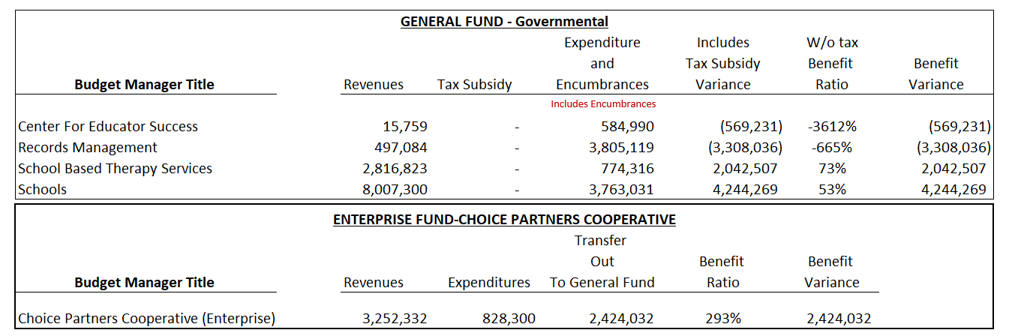
INTERIM FINANCIAL REPORT (unaudited)
Segment Division Data
As of November 30, 2025

Slide 25
HIGHLIGHTS OF BUDGET AMENDMENT REPORT
December 17th, Board Meeting
(unaudited)
No Budget Amendments for the month of November

Slide 26

Education Foundation Update
November 30, 2025

Slide 27
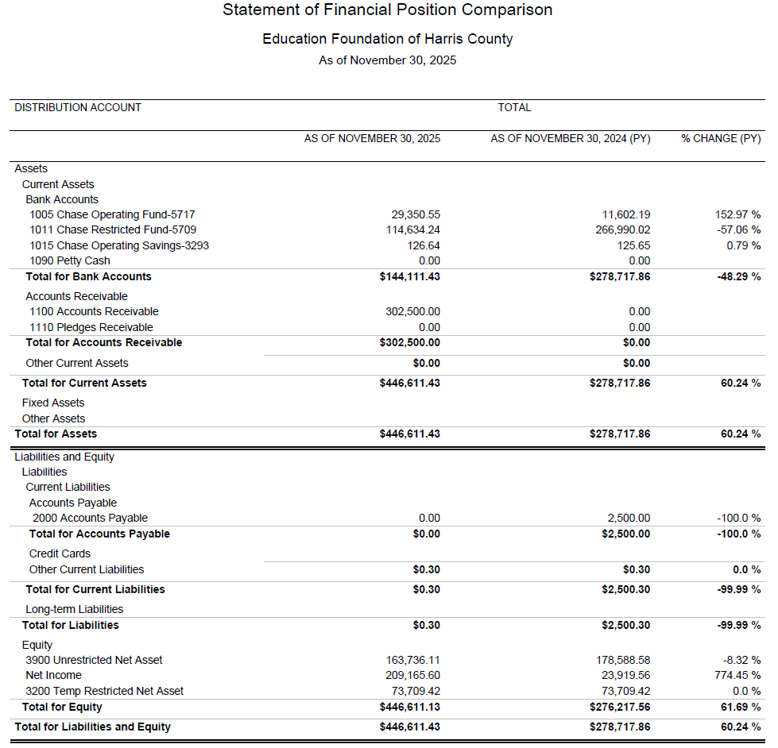
Statement of Financial Position
Net Equity
$446,611

Slide 28
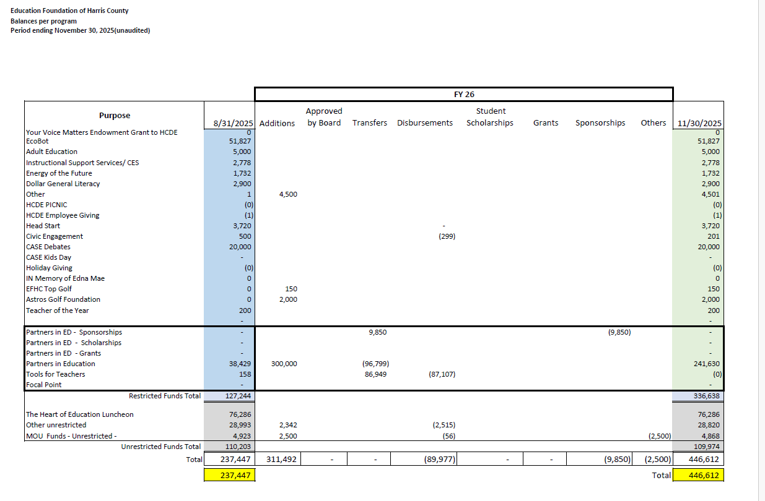
Summary of Foundation Programs

Slide 29
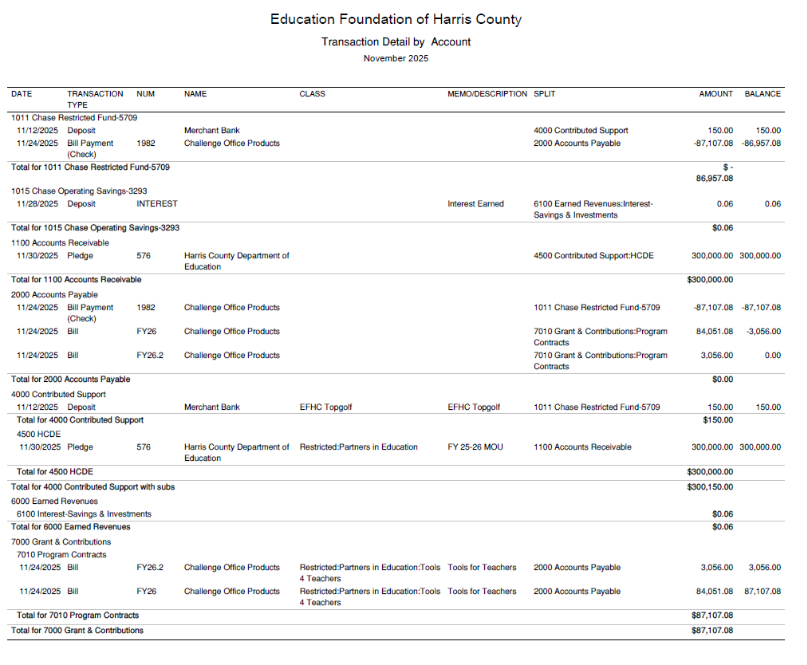
Transaction Detail by Inflow & Outflow

Slide 30
PFC & LEASE REVENUE PROJECTS UPDATE
November 30, 2025

Slide 31
Small Business Report FY2025-26
09/01/25 to 08/31/26
Submitted by:
Dr. Edna E. Johnson,
Procurement Services Director

Slide 32
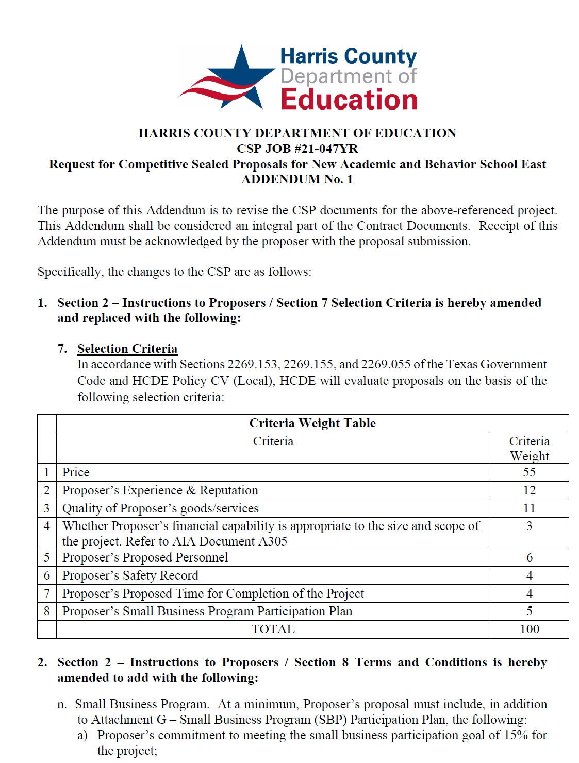
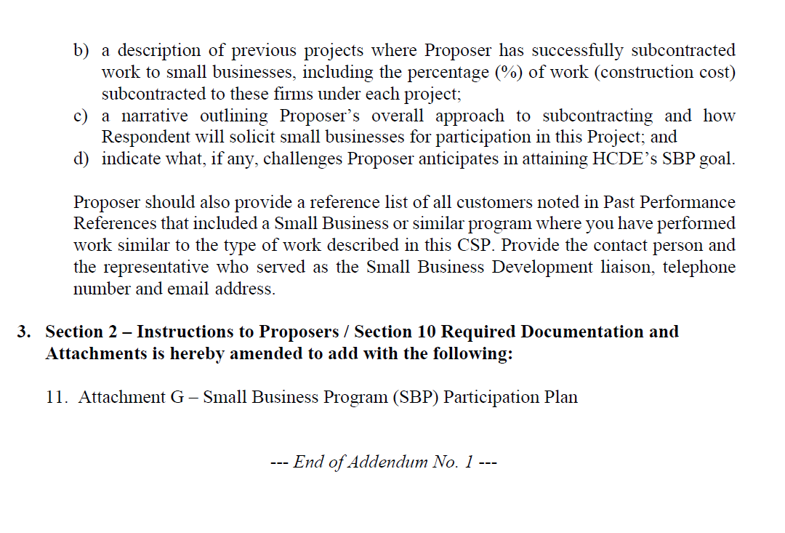
Small Business
for Construction
Launch industry's first collaboration feature
This is our plan as we launch the industry's first collaboration feature

Slide 33
Content
Small Business Expenditures for FY2025-26 Year to Date (09/01/25 to 11/30/2025)
Graphic
List of Small Businesses

Slide 34
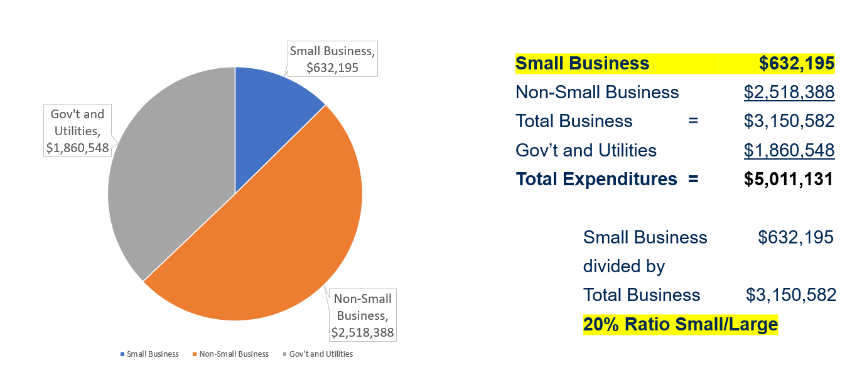
Expenditures FY 2025-26
(09/01/25 to 11/30/2025)

Slide 35
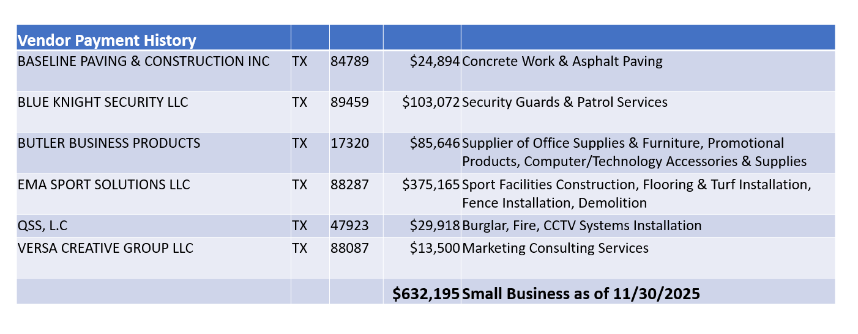
List of Small Businesses
FY 2025-26

Slide 36
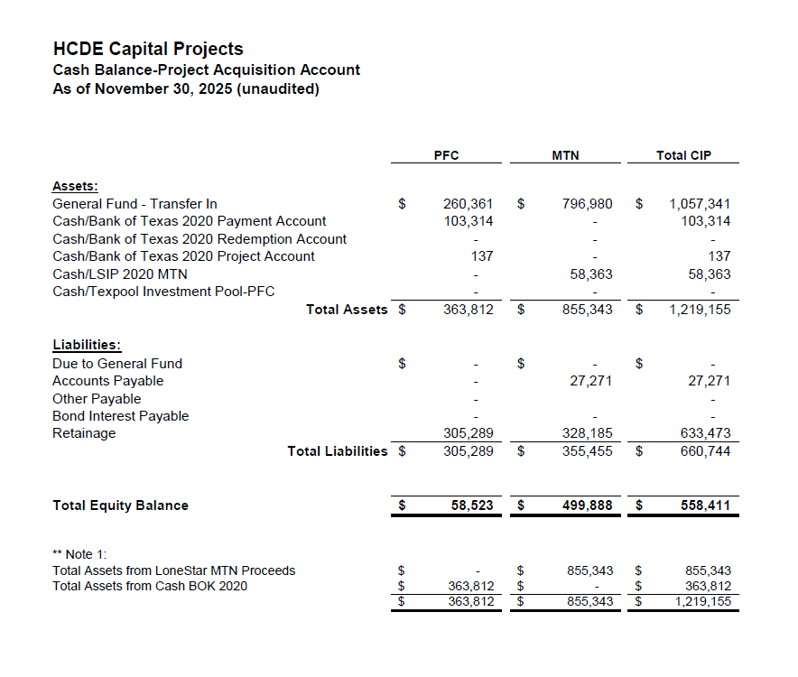

AB East School Contract $12,358,000 Awarded
Adult Ed Center Contract $15,121,000 Awarded on Oct 2021 Board Mtg
HP East Contract $7,271,000 Awarded on Nov 2021
Irvington – $11,172,589 Awarded on Jan 2024
Cash Balance –
Project Acquisition Account
As of November 30, 2025
36

Slide 37
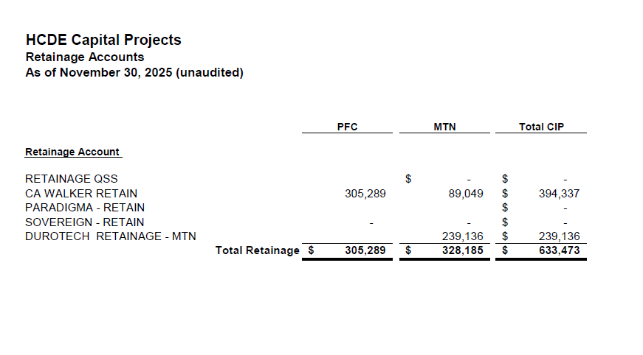
2020 MTN NOTES/2020 PFC BONDS
Pending Retainage Payable
Retainage Payable
Project Acquisition Account
As of November 30, 2025
37

Slide 38
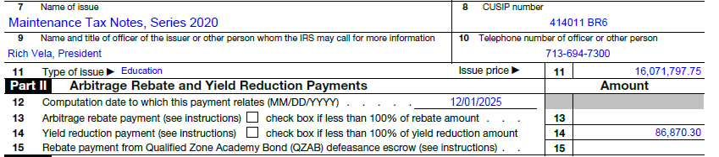
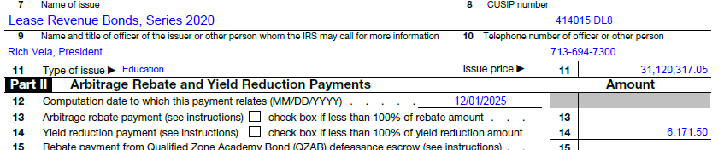
Arbitrage Calculations for 2020 Bond Issues
Calculations have been prepared for the 5th year required review.
HCDE as estimating a payment of $101,809 to the IRS for arbitrage interest above the bond yield. Final calculations were received and payments are $86,870.30 related with Maintenance Notes and $6,171.50 related with PFC.

Slide 39
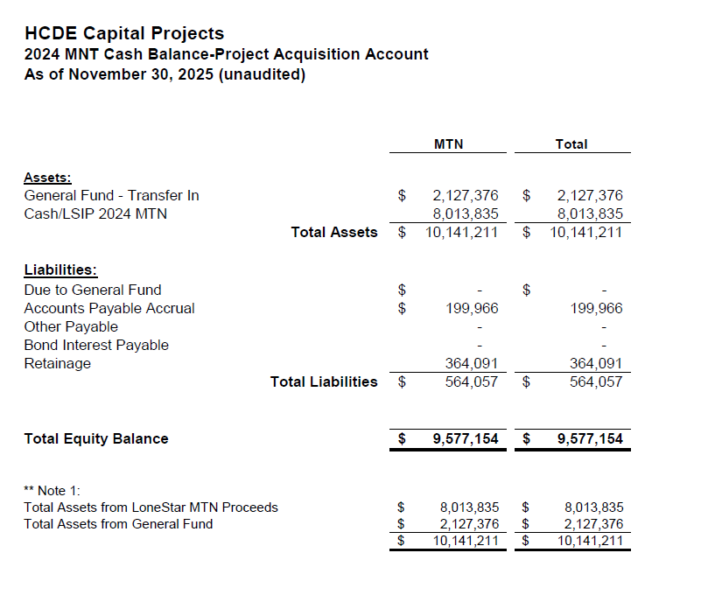
AB West $333,000 March 2024 Board Mtg
HS Barrett Station $470,000 March 2024 Board Mtg
Fortis Academy $650,000 March 2024 Board Mtg
Irvington – $9,860,000 March 2024 Board Mtg
Post Oak - $5,000,000 March 2024 Board Mtg
$16,313,000
Cash Balance –
2024 Maintenance Notes
As of November 30, 2025
39

Slide 40
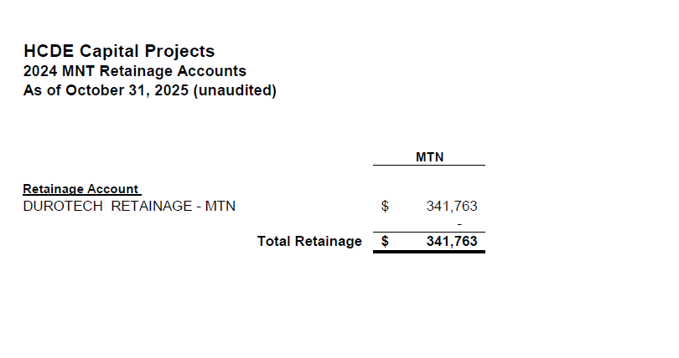
AB West $333,000 March 2024 Board Mtg
HS Barrett Station $470,000 March 2024 Board Mtg
Fortis Academy $650,000 March 2024 Board Mtg
Irvington – $9,860,000 March 2024 Board Mtg
Post Oak - $5,000,000 March 2024 Board Mtg
$16,313,000
Retainage Payable
2024 Maintenance Notes
As of November 30, 2025
40

Slide 41
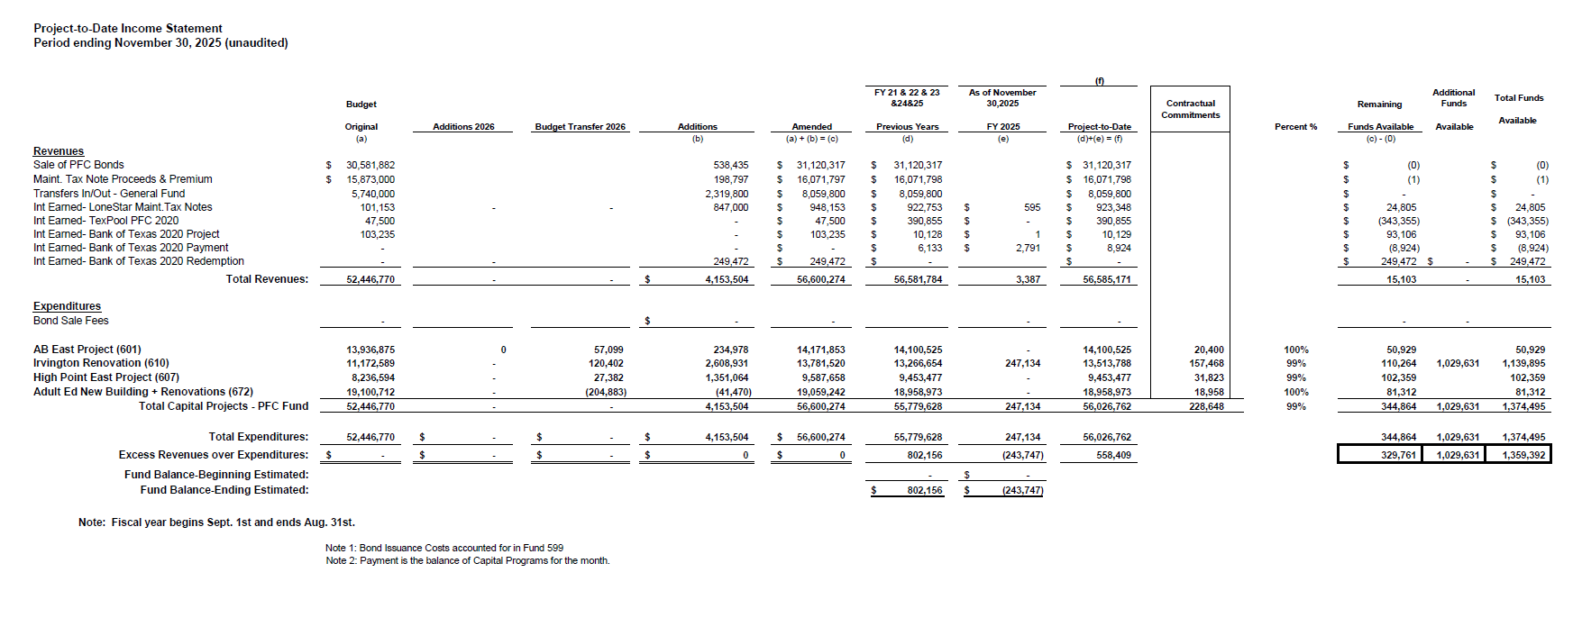
Income Statement– Project Acquisition Account
As of November 30, 2025
Arbitrage payment due on Jan 31st - $93,041.80
41

Slide 42
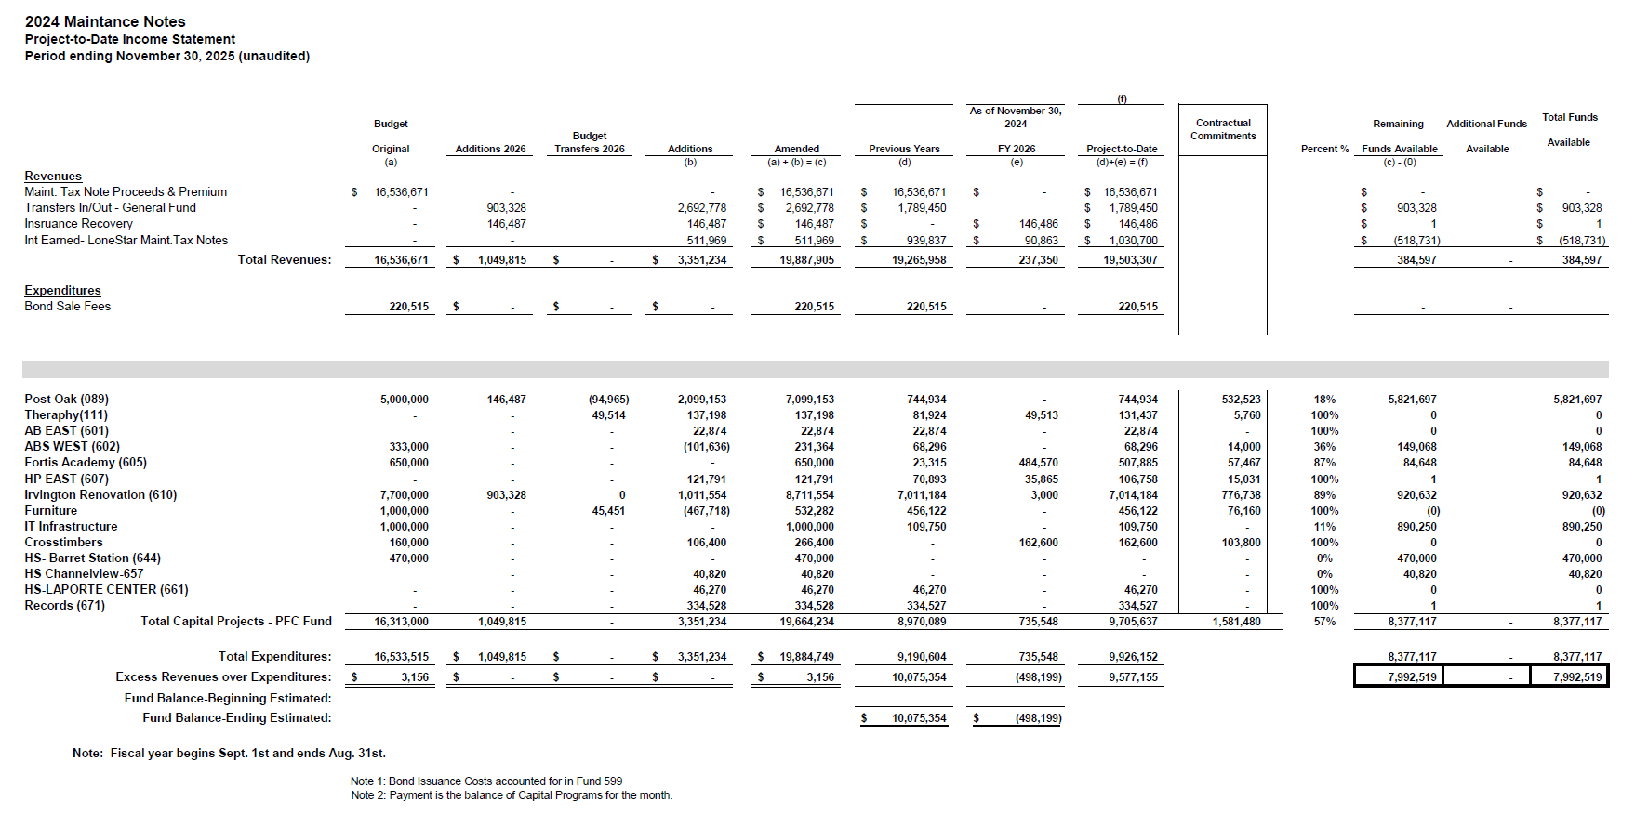
Income Statement– 2024 MNT NOTES
As of November 30, 2025
42

Slide 43
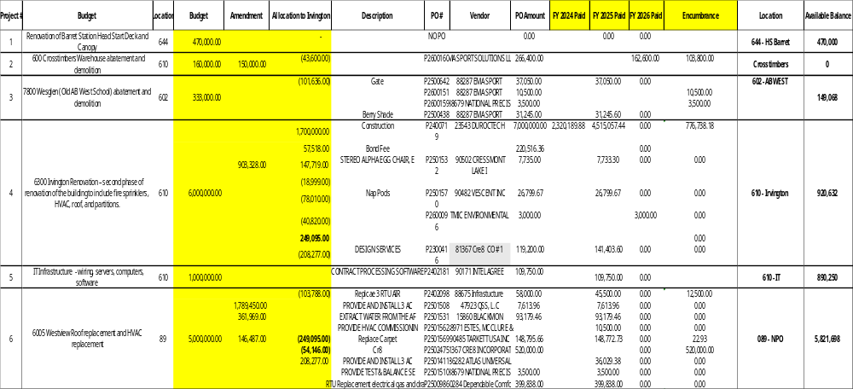
Maintenance Notes 2024 – Projects
43

Slide 44
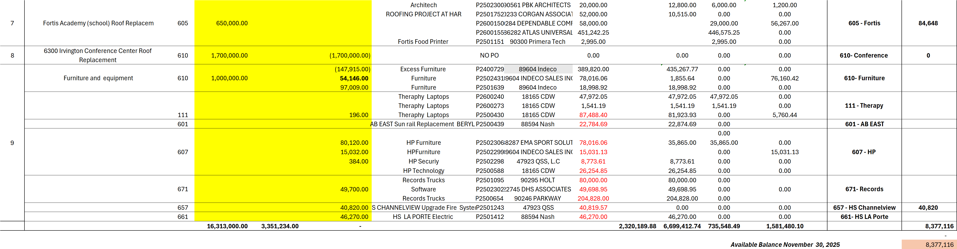
Maintenance Notes 2024 – Projects
44

Slide 45
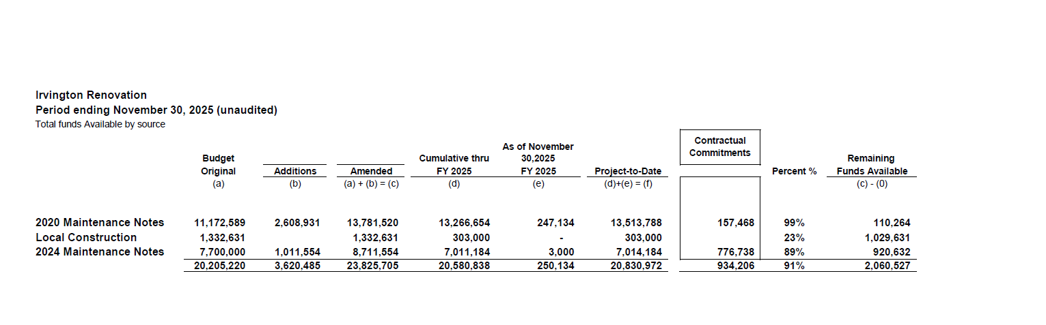
Irvington Renovation – Funds by Source
As of November 30, 2025

Slide 46
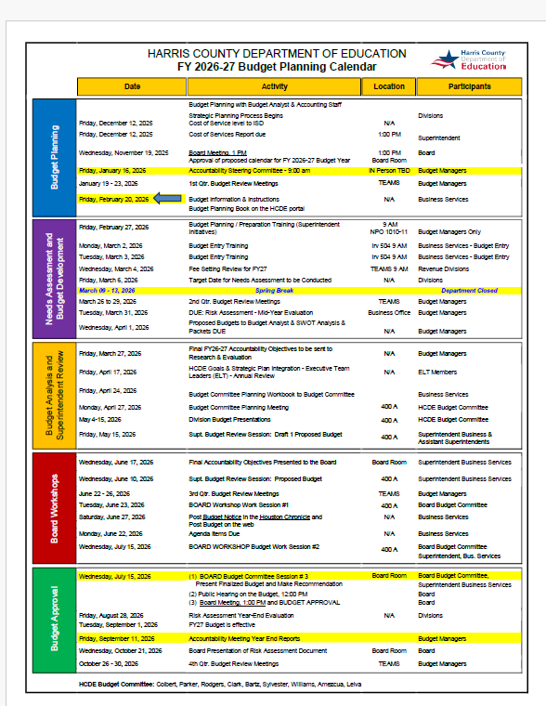

Slide 47


Interim Financial Report (unaudited)
I certify that the foregoing information is true and accurate to the best of my knowledge.
/s/ Jesus J. Amezcua, RTSBA,CPA, Ph.D., CPFIM, Asst. Supt. for Business Support Services
/s/ Marcia Leiva, MBA Chief Accounting Officer

