Slide 1
Kate Bond Middle School
Annual Title 1 Parent Meeting
Dr. Christopher Murrah, Principal
Taquanya Thompson, PLC Coach

Slide 2

Annual Title 1 Parent Meeting
Welcome!

Slide 3
Title 1 Parent Meeting Agenda
Title 1 Information for Parents:
Purpose of the Meeting
What Is Title 1?
What Does it Mean to Be a Title 1 School?
KBMS Mission Statement
KBMS Progress
KBMS School Achievement Data
School Improvement Plan (SIP)
Parents’ Right to Know
Teachers Qualifications
KBMS Family Engagement Plan
KBMS School Compact
Code of Conduct Compact
Parental Involvement
Reporting Student Progress
School Contact Information
Special Entertainment…
-KBMS Cheerleaders
-KBMS Band and Majorettes
Closing Remarks……………….….Dr. Christopher Murrah
Notes:
Dr. Murrah

Slide 4
Purpose of Meeting
Federal guidelines require Title I schools to hold an Annual Parent Meeting to explain and discuss the Title I School-wide program and requirements.
Kate Bond Middle is a Title I School.

Slide 5
WHAT IS TITLE 1?
Title I is the largest federal aid program for our nation’s schools.
The goal of Title I is to provide a high-quality education for every child.
Title I resources are directed to schools with high poverty levels.
Title I program serves millions of children in elementary and secondary schools each year.
Shelby County Schools has roughly 190 schools operating under the Title I program.

Slide 6
What does it mean to be a
Title I School?
Being a Title I school means receiving federal funding (Title I dollars) to supplement the school’s existing programs.
These dollars are used for…
  Identifying students experiencing academic difficulties and providing timely assistance to help these student’s meet the State’s challenging content standards.
  Purchasing supplemental staff/programs/materials/supplies
  Conducting parental Involvement meetings/trainings/activities
  Recruiting/Hiring/Retaining Highly Qualified Teachers
Notes:
Discuss:
How being in a Title I school means more money to help students who are struggling in school
- Give examples of how Title I monies will be used to assist students at the school.
Give examples of how Title I monies will be used to assist parents.

Slide 7

KBMS Mission Statement
Through our rigorous and engaging academic program,
Kate Bond Middle School will produce creative thinkers who can identify and solve complex and relevant problems, communicate well, understand passions, strengths, and challenges, and be responsible citizens in a diverse world.
Notes:
Speak to the School’s Mission Statement and point out our ratings.

Slide 8
Our School Achievement Data
Our All In Learning and TNReady data from the 2024-2025 school year was used to develop the goals and strategies in the School Improvement Process.
Our school achievement data can be found in our School Improvement Plan (SIP).
The SIP includes the most current data and is reviewed throughout the school year.
Our school uses data to align the curriculum to State and District academics standards. Our instructional practices are adjusted based on the findings of the assessment data gathered during the school year.

Slide 9
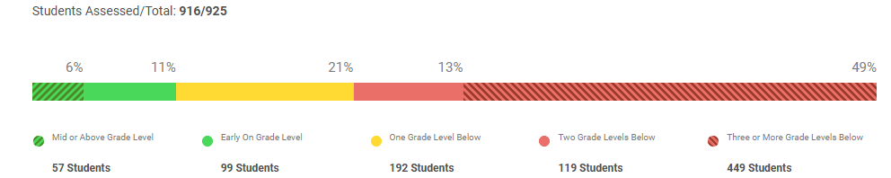
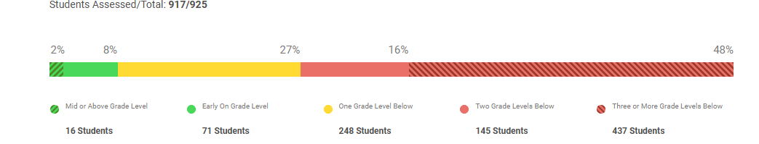
FALL - iReady Data
iReady is a comprehensive assessment and instruction program that empowers educators with the resources they need to help all students succeed. ... Provides user-friendly dashboards and clear reports with actionable data that give teachers a foundational understanding of students' strengths and areas of need.
Reading
17% - 156 students
Math
10% - 87 students

Slide 10
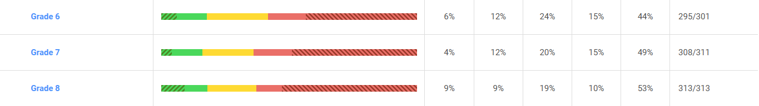
Reading Scores by
Grade Level
18% - 53 students
16% - 49 students
18% - 56 students

Slide 11
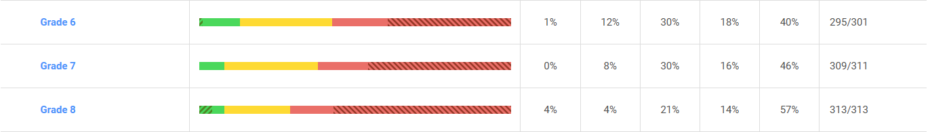
Math Scores by Grade Level
13% - 38 students
8% - 25 students
8% - 25 students

Slide 12
School Improvement Plan
The SIP is a ‘road map or unique plan’, refined annually, that defines a school’s targeted work to raise achievement for all of its students.
Our School’s Goals for 2025-2026
Increase the ELA, Math, & S. Studies scores by 5 pts.
ELA – 15.7% to 22.0% - 206 students
Math – 12.7% to 18% - 169 students
Social Studies – 22% to 27% - 253 students
Science – 20% to 25% - 234 students
Notes:
If we take TNReady…. This will be our goals

Slide 13
Parents’ Right to Know
Parents have the right to request and receive timely information regarding the professional qualifications of their teachers and paraprofessionals.
Parents must be notified if their child is assigned to, or taught, for four (4) or more consecutive weeks by a teacher who does not meet state certification requirements for the grade level or subject area taught.
Parents should be provided information regarding the level of achievement of their child on State required academic assessments.
To that extend that it is feasible, information must be in a language that parents can understand.

Slide 14
TEACHER QUALIFICATIONS
Teachers are considered ‘highly qualified’ under the ESSA ACT if they demonstrate subject knowledge in the core content areas, hold at least a bachelor’s degree, and have been issued a license from the State Department of Education.
All teachers at Kate Bond Middle School are
‘highly qualified’ teachers.
Notes:
Discuss:
ESSA –Every Student Succeeds Act was signed by President Obama

Slide 15



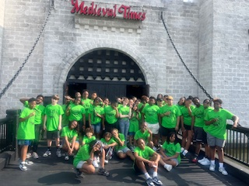
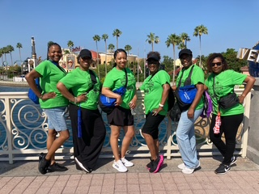
End of Year
Out of Town Trip
Branson, MO
Ms. Hill
Orlando, FL
2024-2025

Slide 16

Backpack Giveaway

Slide 17
Kate Bond Middle School Family Engagement Plan
Kate Bond Middle School has a special responsibility to our parents and the community by providing opportunities for you to get involved and share the responsibility of promoting success in our children.
To ensure that our parents participate in the development and implementation of the school’s program, Kate Bond Middle School will do the following:
Develop jointly with parents a written school level family engagement plan and parent-school compact showing how parents, school, and students share responsibilities.
The family engagement plan and parent-school compact will be uploaded on the KBMS website.
Convene an annual meeting at flexible times and invite all parents to attend virtually, in order to explain the components and requirements of Title I Program.
Provide regular and flexible virtual parent meetings, P.T.O. meetings, and “Family Nights” in the area of Literacy, Math, Science, and Social Studies.
Provide parents with timely information about upcoming events and program through the use of SchoolStatus Connect, Black Board, text, email, and the KBMS Facebook page.

Slide 18
Kate Bond Middle School Family Engagement Plan
At Kate Bond Middle School, we value relationships with our students, their families, and the community at large. We know that ongoing, meaningful partnerships between all stakeholders work for the betterment of our students. Ongoing communication with parents and guardians supports our students in achieving academic success and experiencing personal growth.
Notes:
-

Slide 19
Kate Bond Middle School Family Engagement Plan
In order to actively and meaningfully engage our families in the academic lives of their students, Kate Bond Middle School pledges the following:
• KBMS families and school personnel will jointly develop and modify our Family Engagement Plan, the School-Parent Compact, and the School Improvement Plan, based on the academic and personal needs of our current student body.
•Communicate the academic status of our school, new programs, policy changes, Title I information, upcoming events, etc.
•Routinely communicate to families via School Messenger, SchoolStatus Connect, personal phone calls, virtual conferences, routine progress reporting, and our school website..

Slide 20
Kate Bond Middle School Family Engagement Plan
Communicate in a timely manner in a manner that meets the lingual needs of all families.
Invite parents and guardians to participate in regularly scheduled school-based activities, events, and committees such as the School Improvement Plan, the Positive Behavioral Interventions and Supports (PBIS) Committee, the Site-Based Council, athletic events, and school programs.
Host events, meetings, parent training, and committee work at times when it is most conducive for parents to attend (e.g. morning and evening times).
Upload copies of the student handbook, this Family Engagement Plan, the Parent-School Compact, and the Parents’ Rights to Know documents on the school’s website.

Slide 21
Kate Bond Middle School Family Engagement Plan
Parents play an important role in the success of the children. Our parents can fulfill this by:
Attending meetings, program, workshops, and other school activities.
Participating in school & district sponsored parent-teacher conference.
Serving on a committee and participating in the decision-making process.
Responding to memos, surveys, and questionnaires expressing ideas and concerns.
Serving as a volunteer at the school.
Ensuring that your child studies at home and completes homework assignments.
Voicing concerns and providing feedback at parent meetings.

Slide 22
What is the School-Parent Compact?
The School-Parent Compact is a written agreement that outlines how the parents, the entire staff and the students will share the responsibility for improved student academic achievement, as well as describes how the school and parents will build and develop a partnership that will help children achieve the state’s high standards.
You, as Title I Parents, have the right to be involved in the development of the School-Parent Compact.
A copy of the school-parent compact has been uploaded on the KBMS website.

Slide 23
Student Code of Conduct
Policy #6022
The Shelby County Board of Education accepts the responsibility for establishing and maintaining proper standards of discipline and behavior in the public schools. In order to maintain good order and ensure an environment conducive to learning, the Board considers behavior or conduct occurring on school property or at any school sponsored activity occurring off school property which interferes with the above to be offenses.
*This Student Code of Conduct, and a list of the offenses, will be uploaded on the school’s website.*

Slide 24
Parental Involvement
Family Engagement Events
8/14 Partners in Education Meeting/SRAE Parent Information Meeting 5:00 - 6:30 PM
9/4 Hispanic Heritage Night 5:30-7:00 PM (Bundled with Parent Teacher Conferences)
10/23 Partners in Education Meeting/Bullying Prevention Event – 5:00 - 6:30 PM
11/13 Coffee and Donuts with the Principal – 10:00 AM
12/18 Hope and Hot Chocolate-Holiday Community Resource Fair 5:00 – 7:00 PM (Coordinate with Bogue and Fason)
1/27 Partners in Education Meeting/Parent & Caregiver Education 5:00 - 6:30 PM (Bundled with Parent Teacher Conferences)
2/12 Cookies with the Principal – 5:00 PM
2/26 Black History Month Celebration (*time to be determined)
3/26-Pi’ Night Pizza Party (Quarter 4 kickoff, math focused with pizza, financial literacy presentation) 5:00 - 6:30 PM
4/16 Partners in Education Meeting/Parent & Caregiver Education – 5:00 - 6:30 PM
5/14 Safe Summer Kick-Off with Sycamore View Boys and Girls Club - 5:30 - 6:30 PM

Slide 25
Reporting Student Progress
The teachers of KBMS will communicate students progress in several ways:
Mid - Nine Weeks Progress Reports
Report Cards – each 9 weeks
Phone calls/ texts/ emails to parents
SchoolStatus Connect
PowerSchool
Parent Teacher Conferences
- Tuesday, January 27,, 2024 … 4-7 pm
*You can also schedule a conference with your child’s teacher by setting up an appointment via email or by calling the school office @ 901-416-0640.
Notes:
Schmidt

Slide 26
School Contact Information
Dr. Christopher Murrah, Principal
murrahc@scsk12.org
Melody Harrison, Assistant Principal
harrisonms@scsk12.org
Sourou Jones, Assistant Principal
joness8@scsk12.org
Teresa Stokes, Assistant Principal
schmidtt@scsk12.org
Taquanya Thompson, PLC Coach
thompsontp@scsk12.org
Angela Jones, Family Engagement Specialist
jonesad4@scsk12.org
Notes:
Murrah

Slide 27

Backpack Giveaway

Slide 28
Special Entertainment
Orchestra
Drumline
Band
KBMS Cheerleaders

Slide 29
Sign-In
Please type your name and your child’s name/grade level in the chat box, if you haven’t already done so.
Thank you.
Notes:
Thompson

