Slide 1


Test Administrator Training
WIDA ACCESS
&
WIDA Alternate ACCESS
Testing Window January 26 – March 19, 2026

Slide 2
What’s New!
New name, updated tests, new standards!
Assessment name has been updated to ‘WIDA ACCESS’, previously it was ACCESS for ELLs. This name change coincides with the updates to the WIDA ACCESS to align with the 2020 WIDA English Language Development Standards.
The WIDA ACCESS Online and Paper test administration experience for grades 1-12 this school year will not be any different from last year
  All changes on the backend and related to questions and item types (e.g. Standard 1, which focuses on social and instructional language, is now incorporated throughout the test)
WIDA ACCESS for Kindergarten has had many updates
  Fewer test materials to manage (no more activity board and fewer cards!)
  All four domains connect to a single new storyline
  Each language domain is administered once, with no starting or skipping rules
No updates to WIDA Alt ACCESS – was updated in the 2023-24 school year
Due to new assessments, there will likely be a delay in the release of test results
Accessibility and accommodations:
Updated Braille accommodation that now includes the Speaking domain
New Low Vision Script accommodation for WIDA ACCESS for Kindergarten
Video translations for the ACCESS Online Test Administrator Script – American Sign Language (ASL), (Translated Directions accommodation) are now available in WIDA Secure Portal
Streaming audio now available within WIDA AMS for the WIDA ACCESS Paper Listening and Speaking domains
    CDs will still be included with ACCESS Paper test materials
    Note: if administering Braille, you MUST use the CD that comes with the Braille Test Materials Kit and not the streaming audio

Slide 3

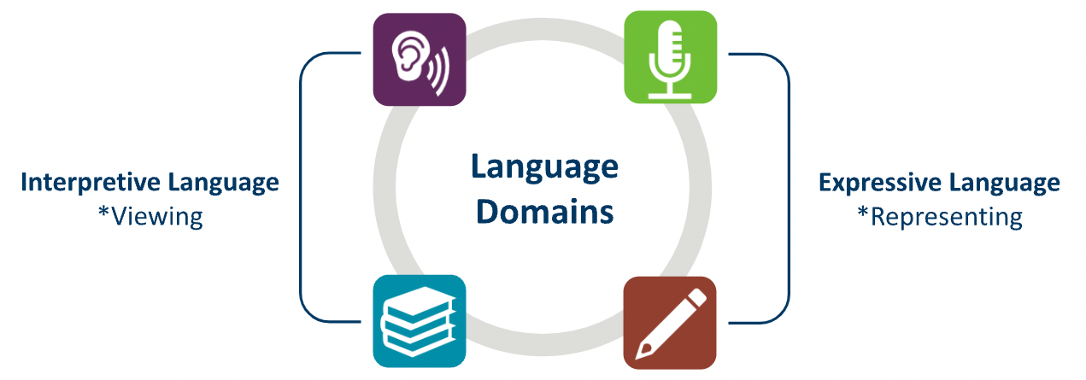
Test Overview & Structure:
WIDA ACCESS
WIDA Alternate ACCESS
WIDA English Language Development Standards
What is WIDA ACCESS?
WIDA ACCESS and WIDA Alternate ACCESS are English language proficiency assessments based on the Minnesota Standards for English Language Development, developed by the WIDA Consortium.
WIDA ACCESS & WIDA Alternate ACCESS is used to meet federal and state requirements.
These assessments are used to monitor English learners’ progress as they develop academic language skills in reading, writing, listening, and speaking.
How is WIDA ACCESS structured?
There are four language domains assessed by the ACCESS assessments: Listening, Reading, Writing, and Speaking
The WIDA ACCESS is administered fully online for grades 1 – 12
  Exceptions: The Writing domain for grades 1-5 has a paper component and Paper Accommodations (based on IEPs)
The WIDA ACCESS for Kindergarten is a paper assessment given in a one-on-one setting
WIDA Alternate ACCESS is a paper assessment given in a one-on-one setting to our students with the most significant cognitive disabilities (Grades K-12, indicated on IEP)
Listening
Speaking
Reading
Writing

Slide 4
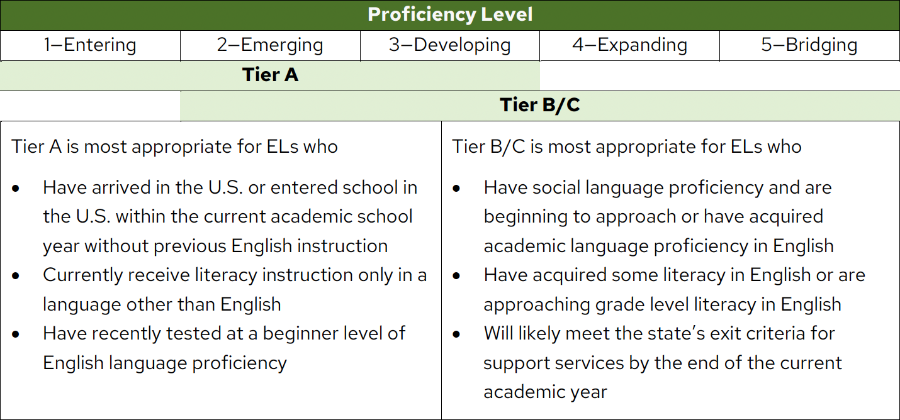
Test Structure:
Grade Clusters:
ACCESS testing is broken up into grade clusters. While, for example, a grade 2 and a grade 3 student will take the same assessment they will each be scored based on their individual grade level.
Note: Paper ACCESS Grade Clusters now fully match Online ACCESS Grade Clusters
WIDA ACCESS Grade Clusters
K | 1 | 2-3 | 4-5 | 6-8 | 9-12
WIDA Alternate ACCESS Grade Clusters
K-2 | 3-5 | 6-8 | 9-12
WIDA ACCESS Tier Placement:
Online ACCESS: Tier for Listening and Reading domains predetermined and embedded in student’s test. Tiers for Speaking and Writing generated from WIDA AMS after students complete the 1st two domains, tier placement found in Tier Report.
Paper ACCESS: Tier placement is predetermined. SACs find Paper ACCESS Tier level on Accommodation Google Sheet. No school staff may change a student’s Tier Placement.

Slide 5

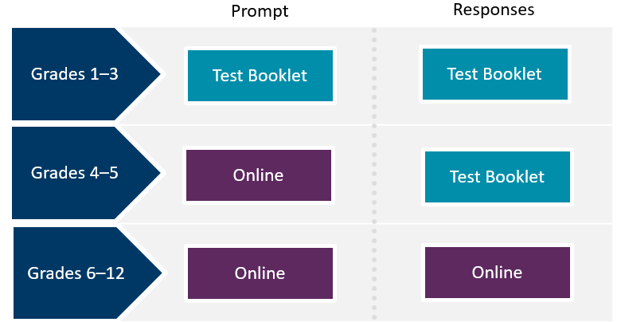
Structure of Online ACCESS
Order of Administration:
The Online ACCESS is stage adaptive, meaning students will progress through the test based on their performance.
Students must first take the Listening and Reading domains because their performance on those domains determines their Tier placement on the remaining two domains (Speaking and Writing).
The Listening and Reading domains may be administered on the same day. This is discouraged for younger students.
Once students complete their Listening and Reading domains, they may take the Speaking and Writing in either order.
All domains cannot be administered on the same day.
The Writing domain is unique:
Students in Grades 1-3 take the entire Writing domain in a paper/pencil format. Writing prompts are read to the students by the Test Administrator and students enter their responses into a paper test booklet.
Students in Grades 4-5 are given the Writing prompts online but handwrite their responses into a paper test booklet.
Students in Grades 6-12 take the Writing domain fully online (as with other domains)
Default Writing Modes:

Slide 6
Test Administrators
Selecting Test Administrators for WIDA ACCESS
Any of the following individuals can administer the WIDA ACCESS Paper (except Speaking) and WIDA ACCESS Online:
Licensed teachers or administrators who work in the school
Licensed teachers or administrators who work in the district
Paraprofessionals who work in the school
School district personnel employed by the school district
Licensed substitute teachers
  Long term substitute teachers may be Test Administrators, daily substitute teachers may NOT
For Kindergarten ACCESS and the ACCESS Paper Speaking domain:
The Test Administrator must be a licensed teacher. It is strongly recommended that the Test Administrator is trained in second language acquisition because this background supports the scoring of the domain that the Test Administrator is required to do.
For WIDA Alternate ACCESS:
MDE strongly recommends that the Test Administrator is someone who is familiar with the student’s response mode, who works with the student during instruction, and with whom the student feels comfortable. If possible, it is best if the person who is familiar with the student is also a licensed teacher who is trained in second language acquisition because this background supports the scoring of the domains that the Test Administrator is required to do. In addition, typically only one Test Administrator is administering the entire test.
Case Managers and ELL staff should work together to determine who is the best person to administer the WIDA Alternate ACCESS for each student.
EL teachers are allowed to do some of the ACCESS test administration, but the administration schedule should not be disruptive to the EL services they need to provide.

Slide 7
Staff Roles & Responsibilities
Test Administrators (TA)
Attends training provided by SAC and completes required WIDA and LMS trainings
Review information in the Test Administrators Manual
Become familiar with procedures for providing test accommodations and supports (based on IEP and 504 Plans) – Provide said accommodation(s)
Read the directions exactly as written in the Test Directions Scripts
Administer the WIDA ACCESS while maintaining test security
  Ensure that all test materials are secure
For paper testing materials:
  Properly account for test material security throughout testing
  Ensure that pre-ID labels are attached correctly to test booklets or that student data is properly bubbled in (if there is no pre-ID label)
Create a welcoming and positive testing environment

Slide 8
Required Test Administrator Training
Required:
Attend SAC provided ACCESS training
Complete the following training courses based on which test mode they will administer:
Test Administration | Trainings in WIDA Secure Portal - under Assessment Training | Trainings in the LMS - under Courses
WIDA ACCESS for Kindergarten | WIDA ACCESS for Kindergarten: Administration and Scoring All modules Pass the certification quiz | Test Security Training
Grades 1-12 WIDA ACCESS Online | WIDA ACCESS Online Administration All content in Module 1 All starred tasks on the Training Tasks for Modules 2-4 Pass the certification quiz | Test Security Training Active Monitoring for Statewide Assessments
Grades 1-12 WIDA ACCESS Paper | WIDA ACCESS Paper Administration All content in Module 1 All starred tasks on the Training Tasks for Modules 2-4 Pass the certification quiz Speaking for Grades 1-5: Scoring WIDA ACCESS Paper and/or Speaking for Grades 6-12: Scoring WIDA ACCESS Paper All modules (including recommended practice) Pass certification quiz | Test Security Training Active Monitoring for Statewide Assessments
Grades 1-12 WIDA ACCESS Braille | WIDA ACCESS Paper Administration All content in Module 1 All starred tasks on the Training Tasks for Modules 2-4 Pass the certification quiz Speaking for Grades 1-5: Scoring WIDA Screener and WIDA ACCESS Braille and/or Speaking for Grades 6-12: Scoring WIDA Screener and WIDA ACCESS Braille All modules (including recommended practice) Pass certification quiz | Test Security Training
WIDA Alternate ACCESS | WIDA Alternate ACCESS: Administration and Scoring All modules Pass the certification quiz | Test Security Training

Slide 9
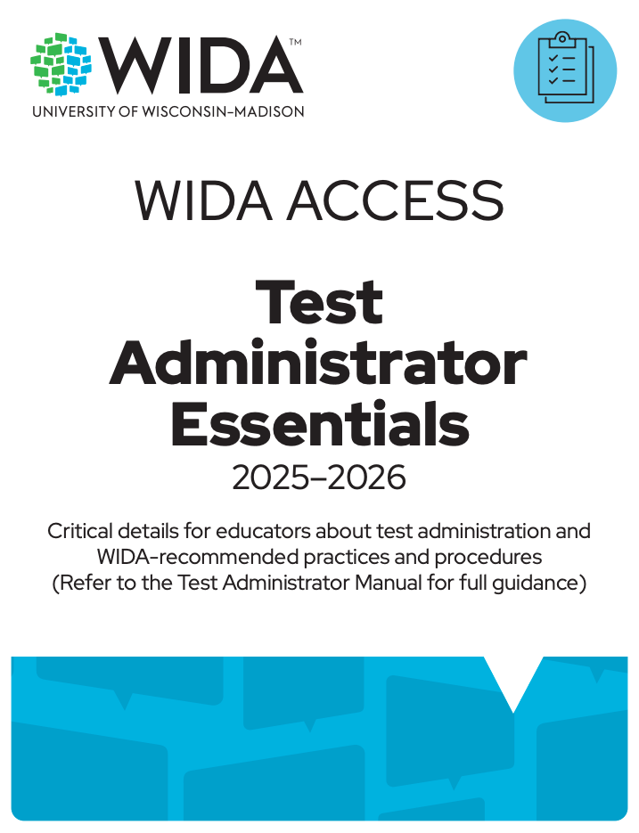
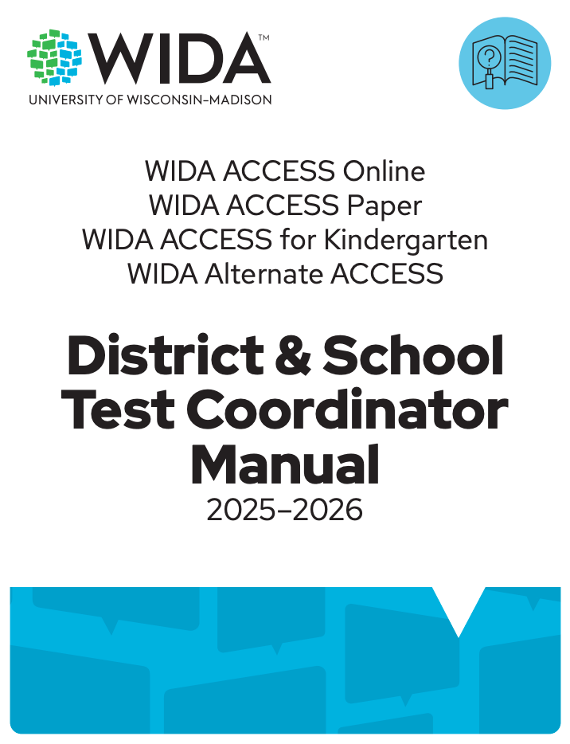
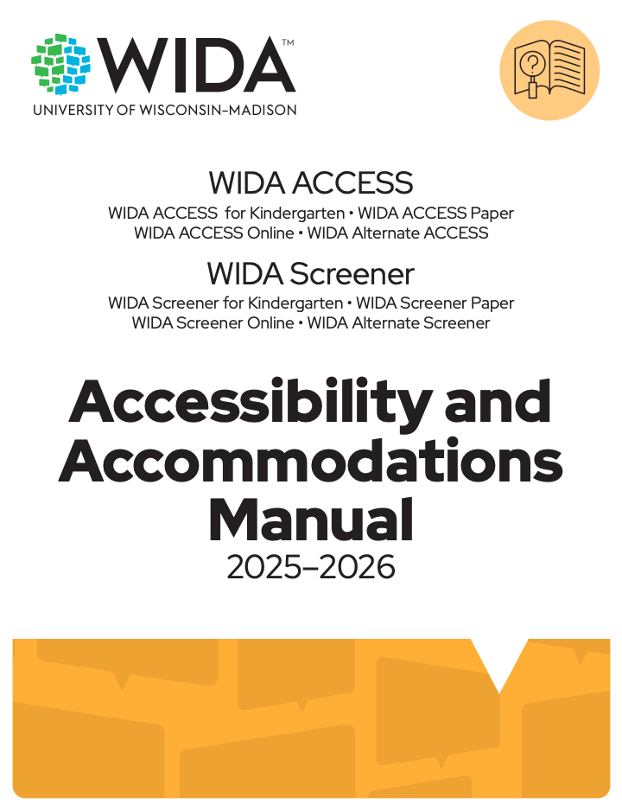
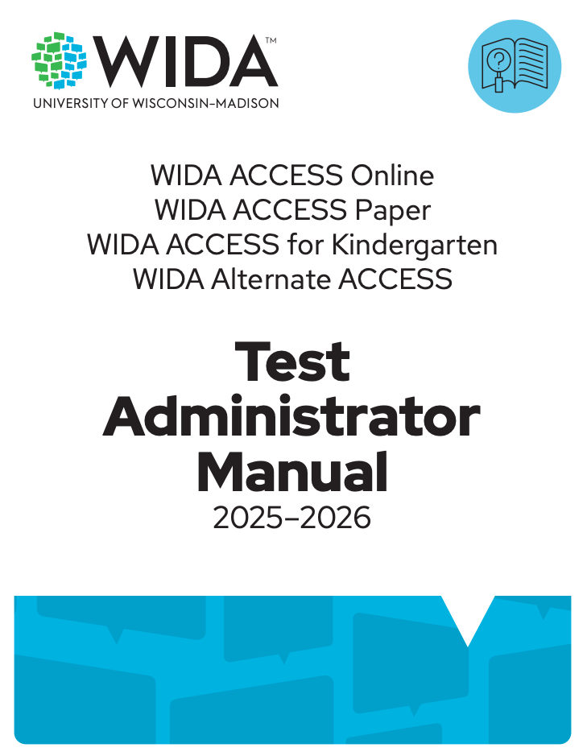
Manuals and User Guides
Test Administrator Essentials
Brief resource for Test Administrators, provides tips as they prepare for testing online, on paper, for kindergarten or alternate access. Lists what materials are needed on test day, reminders to share with students for each domain of the assessment, etc.
- Concise version of the Test Administrator Manual
- SACs should share this with their Test Administrators
ACCESS Manuals
ACCESS manuals contain the information needed for the Test Administrator and SACs to administer and coordinate the test
- Details on material handling, test structure, timing, testing processes, etc.
- Information on Accommodations
- SACs must give a copy of the Test Administrator Manual to their Test Administrators (recommend a digital copy)
A physical copy of the Test Coordinator Manual and the Test Administrator Manual will arrive in your initial material order
Manuals and User Guide available on WIDA Secure Portal and SPPS/REA Test Coordination > ACCESS Test Information

Slide 10
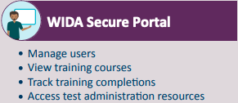
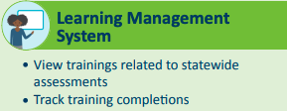



Websites & Accounts
Training sites:
https://portal.wida.us/
https://mn.mypearsonsupport.com/training/
  Are both password protected:
  SACs give testing staff access
  Username: @spps.org email address
SPPS/REA Test Coordination:
Student Testing App:
ACCESS Test Coordination
SPPS and MN specific resources
Links to WIDA sites
Training resources
Manuals
Accommodation information
Link to ACCESS Family Information site
https://www.spps.org/about/departments/research-evaluation-assessment/test-coordination/access

Slide 11
Test Security and Information
School Test Administrator Training
Please make sure you signed in on the provided training sign-in sheet
Training guidance can be found on the SPPS/REA ACCESS Test Coordination website under “For Test Administrators” – includes interactive guide for figuring out which trainings to take
  https://www.spps.org/about/departments/research-evaluation-assessment/test-coordination/access
Test Administrators may NOT have access to secure testing materials until fully trained
  This includes completing all required WIDA and LMS trainings
Please note:
Test Administrators are impartial observers during the test administration
Reproducing or paraphrasing an item in an email or other writing is a security breach
Cell phones and wearable technology (e.g. smartwatches, fitness trackers, Bluetooth headphones) or any other device that can electronically send, receive or capture information is strictly prohibited
Dictionaries may not be used
All instructional posters and graphics in the testing room must be covered or removed
Process for managing and securing materials
  Test tickets (for the Online ACCESS) are secure and must be collected from students before leaving the testing room
  Scratch paper (NOT allowed for Speaking domain) is also secure and must be collected from students before leaving the testing room and then securely destroyed
What to do for misadministrations, irregularities and TARs (Test Administration Reports), see page 47
How to reach SAC if needed
Access to basic tech troubleshooting information
‘Testing – Do NOT Disturb’ signs must be posted outside of all testing rooms
Cell phone/device policy poster must be posted inside and outside of all testing rooms

Slide 12
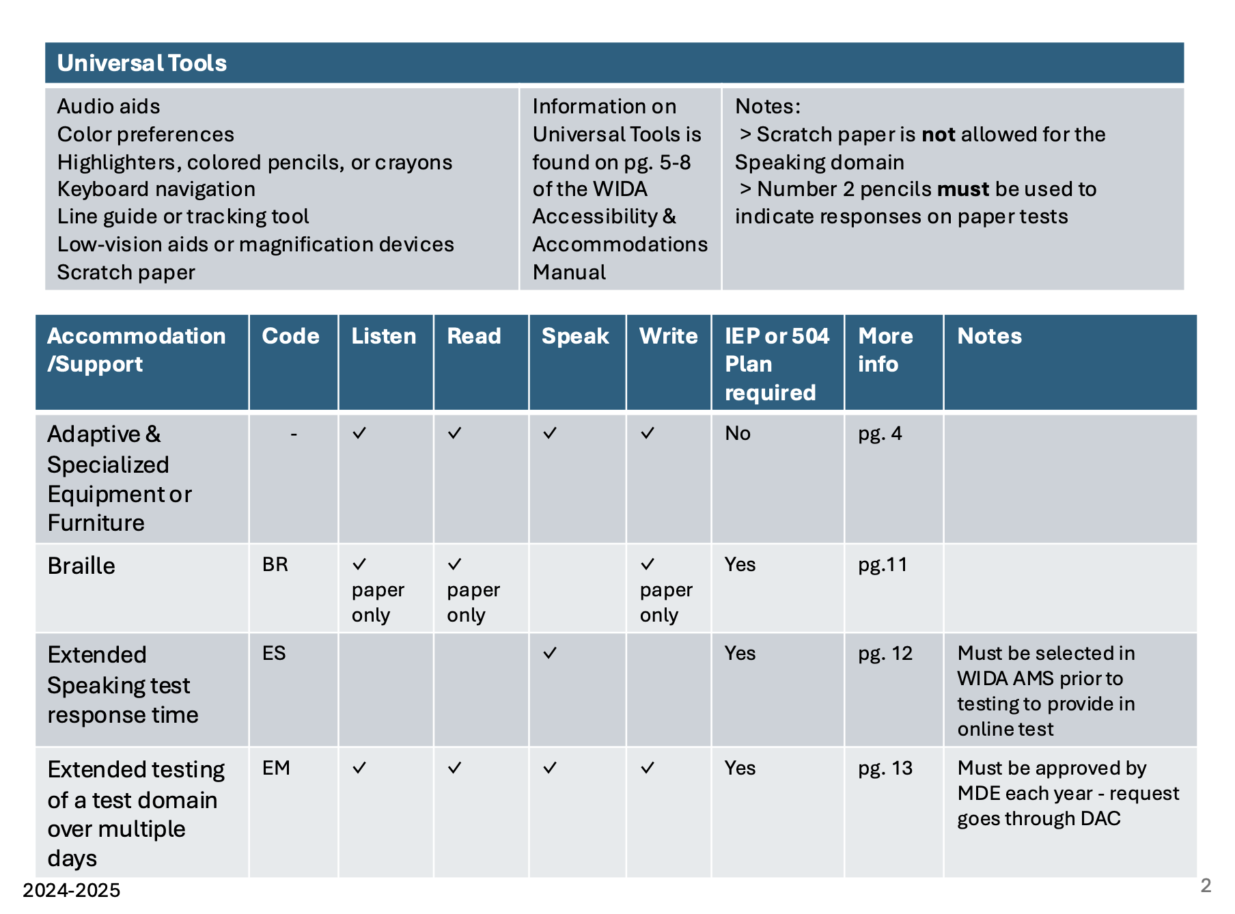
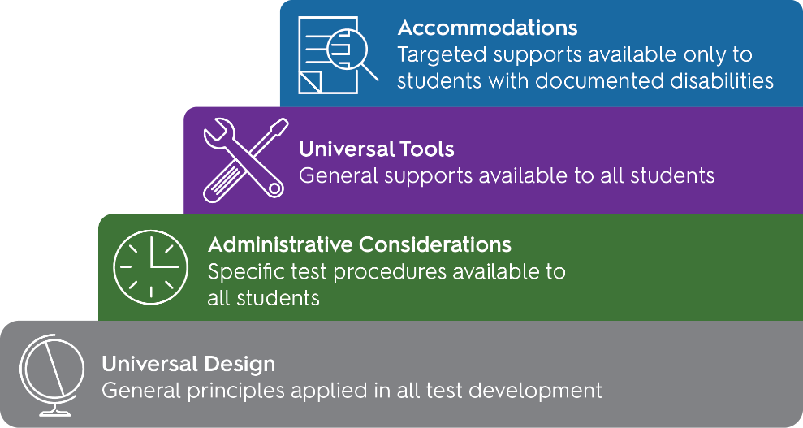
Accommodations - providing
Which accommodation:
SACs have access to a spreadsheet (updated weekly) that lists which accommodation or support a student has
  SACs will communicate this information to Test Administrators
What and how:
The WIDA Accessibility and Accommodations Manual describes all the accommodations and supports along with how to implement them
  Some accommodations have additional guidance in the appendixes of the WIDA Accessibility and Accommodations Manual
  A resource for a quick overview is the Chart of ACCESS Accommodations and Supports
Accommodation Updates:
Audio for the Listening & Speaking Paper ACCESS will be available in WIDA AMS in addition to the CDs
Both resources are available on the SPPS/REA Test Coordination website under ‘Accommodations
The Speaking domain has been added to the Braille test materials
New accommodation available for Kindergarten: Low Vision Script
WIDA provided American Sign Language (ASL) videos now available for use with the Interpreter Signs Test Directions accommodation

Slide 13
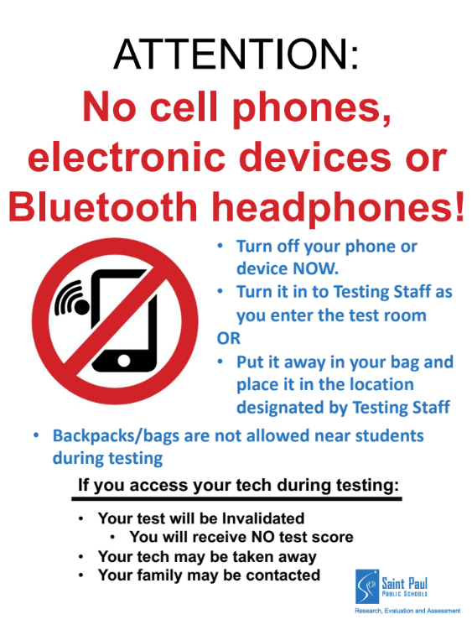
Test Security and Information cont.
Test Security – Items (test questions)
All test items are secure
Discussions of items are not allowed with students or co-workers (or anyone)
Test items and student tests are not allowed to be reviewed by teachers or school staff
  Exception: Test Administrators for the Kindergarten ACCESS, Paper ACCESS – Speaking domain, and WIDA Alternate ACCESS interpret and score the assessments/domains they administer
Discussion of test items via emails, discussions on social media, or other written forms of communication is not allowed
Materials allowed on student’s testing desk/space
iPad or laptop for Online ACCESS – cannot be used for any other activity during test session (external keyboard is required for Writing domain on iPad (gr. 6-12))
  Headphone/headset
Test Ticket for logging into Online ACCESS
Scratch paper and pencil – allowed for all domains EXCEPT Speaking
Paper test booklets
Items approved for accommodations and/or supports
Cell phones, Bluetooth headphones and other technology:
Students may not have any electronic devices at any point during the testing session
Students who access technology while testing may have their test domain invalidated
  Report any infraction via a TAR
Do not allow any backpacks, bags, coats, etc. in the students’ testing space
All devices should either not enter the room or be turned to the Test Administrator
Post this notice inside and outside of the testing rooms

Slide 14
Test Scheduling
For both Online and Paper ACCESS
  Grades 1–12 ACCESS, each domain must be completed in the same day in which it was started and cannot be scheduled across multiple days. Do not start a testing a domain if a student will not be able to finish it (e.g., before a lunch break or the end of the day)
    The only exceptions to not completing a domain within one day are illness, emergency, or technology related issues
      Complete TAR to document incident and complete the domain ASAP
  Never administer different domain tests to a single testing group. For example, don’t have one student take the Listening test while another student takes the Reading, Writing, or Speaking test.
    If administering a Listening and Reading session: all students must start on Listening, then once all have completed Listening all students in the session may start Reading
  Do NOT wait to the end of the testing window to administer the ACCESS! Start as soon as possible to ensure time for makeups (illnesses, snow days, etc.)
  For Online ACCESS only
  All grades and tiers can test together for Listening and Reading. If you test across grade-level clusters (for example, if you test third and fourth graders together), have test administrators use the script for the lowest grade-level cluster, as that script uses simpler language to explain the test. Test times vary, so have a plan for students who finish early.
  Students initially uploaded in January to WIDA AMS are assigned to generic Test Registrations
  New students must be added to Test Registrations
  Group students according to your school’s needs, test sessions do not need to match how they are grouped in WIDA AMS Test Registrations
For Paper ACCESS only
The Speaking Domain must be administered in an individual setting
For Kindergarten ACCESS and WIDA Alternate ACCESS
Both assessments must be administered in an individual setting

Slide 15
Test Scheduling continued
Online Testing Sessions
In general, testing groups can include multiple grades and tiers but testing sessions must be domain specific - See page 17 for Test Administrator to Student ratios.
Administer each language domain test in a single test administration session
Do not test all domains in one day
  If more than one domain is scheduled in a day, plan breaks between domain tests, avoid breaks within testing sessions
} Writing Domain →
CAUTION: PAY ATTENTION TO FORM & TIER
Grades 1 -3: No test session in WIDA AMS → It’s a completely paper test
The Writing domain has two Tiers: A and B/C
Students must be tested in groups organized by grade-level and tier
  Grade 1 – Tier A
  Grade 1 – Tier B/C
  Grade 2-3 – Tier A
  Grade 2-3 – Tier B/C
Grades 4 & 5: Defaults to Handwriting session → Prompts on device and responses are entered into a paper test booklet
Test Sessions appear as ’Writing Gr. 4-5 HW’ in WIDA AMS
Ensure that students have the correct Tier level test booklet for entering their responses
  Grade 4-5 – Tier A
  Grade 4-5 – Tier B/C
Grades 6 – 12: Defaults to Online session → Prompts and responses are both on the student’s device
Test sessions appear as ‘Writing Gr. 6-8’ or ‘Writing Gr. 9-12’ in WIDA AMS
Note: There is the option to have individual students change testing format (very rare)
  Grades 4-5 to fully online Writing
  Grades 6-12 to Writing prompts online and handwriting their responses
  To do this the student must be removed from original test session in WIDA AMS and then added to the appropriate new test session or the assessment can be changed for a whole Test Registration

Slide 16
Test Scheduling continued
Test Timing and Group Type
WIDA ACCESS for Kindergarten
Administration Format | Approximate administration time | Recommended scheduled testing time | Scoring Process
Individually administered | 40 minutes | 55 minutes | Scored by the test administrator
WIDA ACCESS Paper
Administration Format | Approximate administration time | Recommended scheduled testing time | Scoring Process
Group: Listening, Reading, Writing Individually: Speaking | Listening: 20-40 minutes Reading: 50 minutes Speaking: 15-30 minutes Writing: 35-40 minutes | Listening: 60 minutes Reading: 70 minutes Speaking: 45 minutes Writing: 50-55 minutes | Centrally Scored by DRC: Listening, Reading, Writing Scored by the test administrator: Speaking
WIDA ACCESS Online
Administration Format | Approximate administration time | Recommended scheduled testing time | Scoring Process
Group - See next page for group size ratios | Listening: 35-50 minutes Reading: 45 minutes Speaking: 35 minutes Writing: 50-75 minutes | Listening: 65 minutes Reading: 60 minutes Speaking: 50 minutes Writing: 70-90 minutes | Centrally Scored by DRC
WIDA Alternate ACCESS
Administration Format | Approximate administration time | Recommended scheduled testing time | Scoring Process
Individually administered | Listening: 30 minutes Reading: 30 minutes Speaking: 30 minutes Writing: 30 minutes | Listening: 40 minutes Reading: 40 minutes Speaking: 40 minutes Writing: 40 minutes | Scored by the test administrator
No session should start later than an hour and a half before the end of the school day to ensure students who end up needing extra time do not run into the end of the school day.

Slide 17
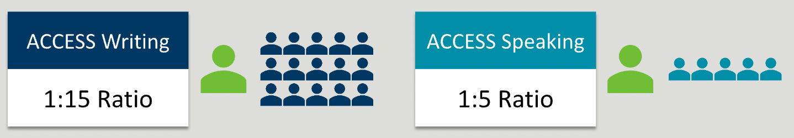
Test Scheduling continued
ACCESS Online Testing Group Sizes
As Required by MDE
Listening | Reading | Speaking | Writing
At least one Test Administrator per 30 students | At least one Test Administrator per 30 students | No more than 5 students (per Test Administrator) - factor in testing space | No more than 15 students (per Test Administrator)
Note: Online Speaking Tier Pre-A is always administered to students individually

Slide 18
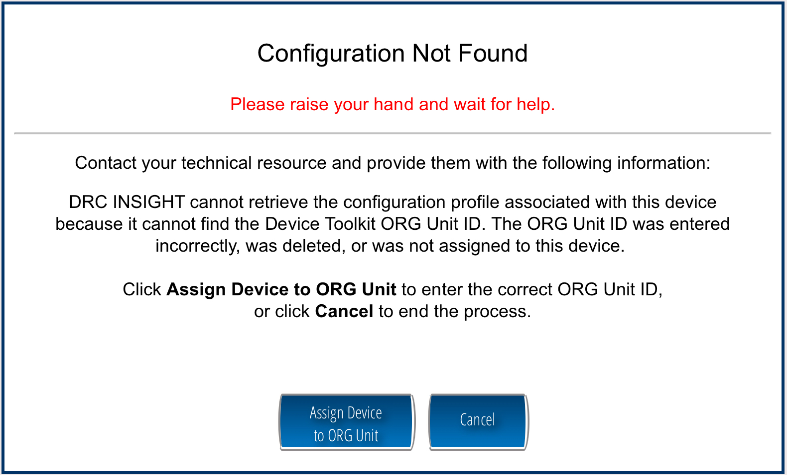
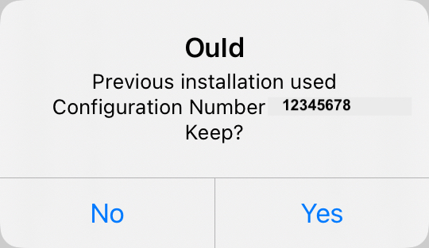
Preparing Student iPads
Testing App: DRC Insight
DRC Insight will be automatically pushed out onto student iPads
If DRC Insight is not on the iPad, it can be installed via Self
Service
DRC Insight app must be reinstalled/updated every school year
System requirements: iOS 17.3 or higher
Register App
DRC Insight must be registered to your school to work
If upon opening the app “Configuration Not Found” appears
  Select ‘Assign Device to ORG Unit’
  Enter your schools ORG Unit and an iPad name (preferred:
  student’s first initial and last name - e.g. jlang)
  Select ‘Add’
  Once your school’s name appears select ‘Register’
Handout with more detailed directions available on the REA Test Coordination website
Have students open DRC Insight at least a week before testing to double check all is working technically
NOTE: the below image will appear every time a student opens the app after registering - They must select ‘Yes’
To find your school’s ORG Unit:
Go to SPPS/REA Test Coordination website > ACCESS Test Information
Under Websites, select Org Unit Folder
Find your schools Org Unit Doc.
Students may also test on school computers
Log on to the computer using ‘wida’ for both the username and password
Register the computer using the same steps taken for registering an iPad
Cross Website Tracking must be turned on for DRC Insight to work properly
If not automatically enabled: go to Settings > DRC Insight > switch Cross Website Tracking on

Slide 19
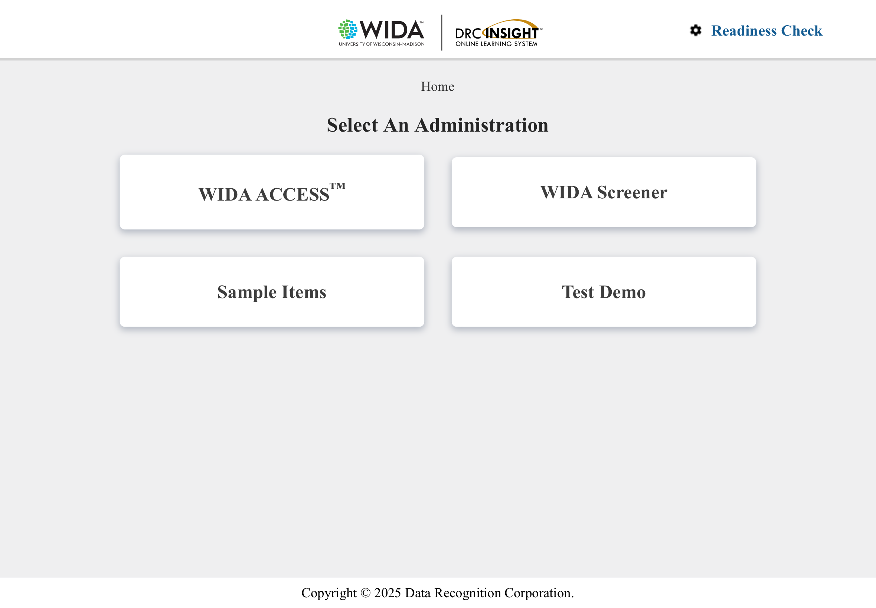
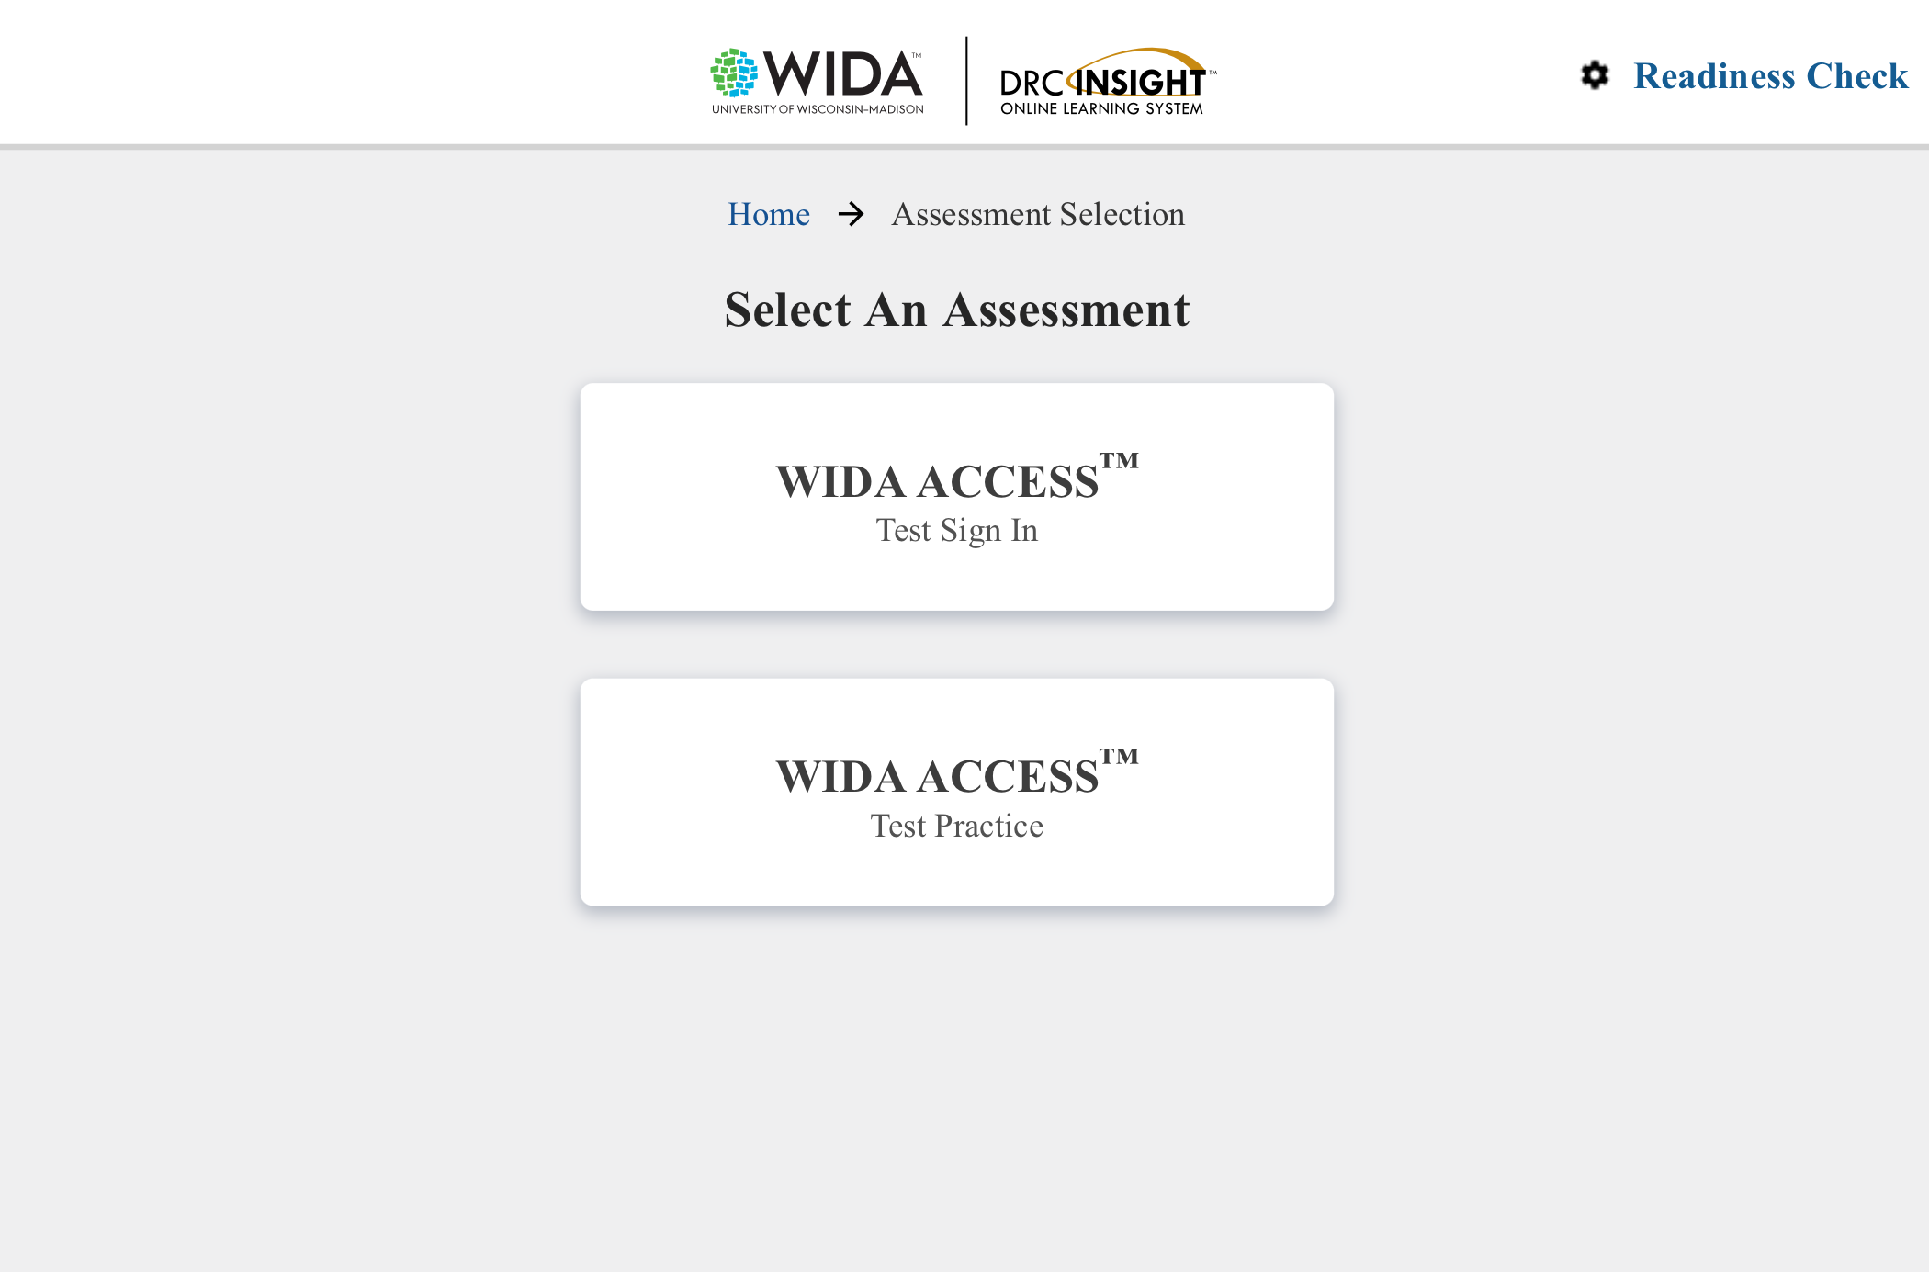
Preparing Students for testing
Test Practice
Testing App: DRC Insight
  Open app on student iPad (confirm Org Unit)
  Select WIDA ACCESS
  Select WIDA ACCESS– Test Practice
  Select Domain, then Grade Cluster
    Accommodated Test Practice options available
  No Username or Password required
  Select Yes to pop-up about Self-Lock
Sample Items
Select Sample Items
Select Sample Items again
Select Grade Cluster and then Domain
Accommodated Sample Items available
No Username or Password required
Test Demo
Select Test Demo
Select ACCESS for ELLs
Select Grade Cluster
Most videos auto-play
  Test Demo is good for group preparation on using DRC Insight
Two WIDA Preparation websites:
Preparing for ACCESS Testing: wida.wisc.edu/assess/access/preparing-students
Preparing to Administer Alternate ACCESS: wida.wisc.edu/assess/alt-access/preparing
  Includes WIDA Alt ACCESS Sample Items

Slide 20
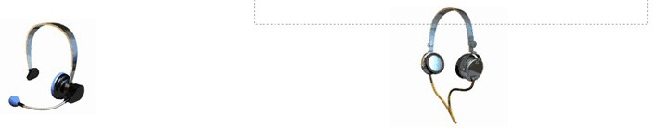
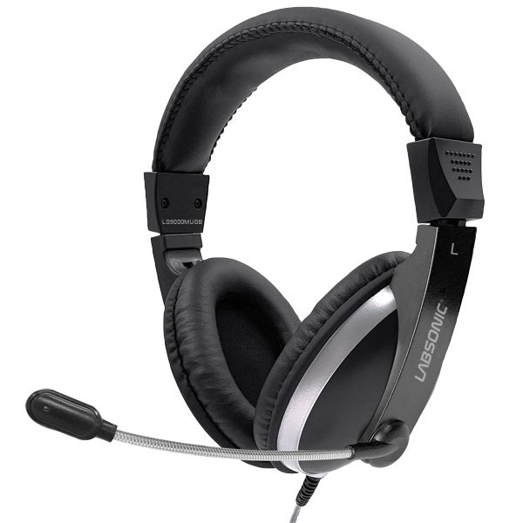
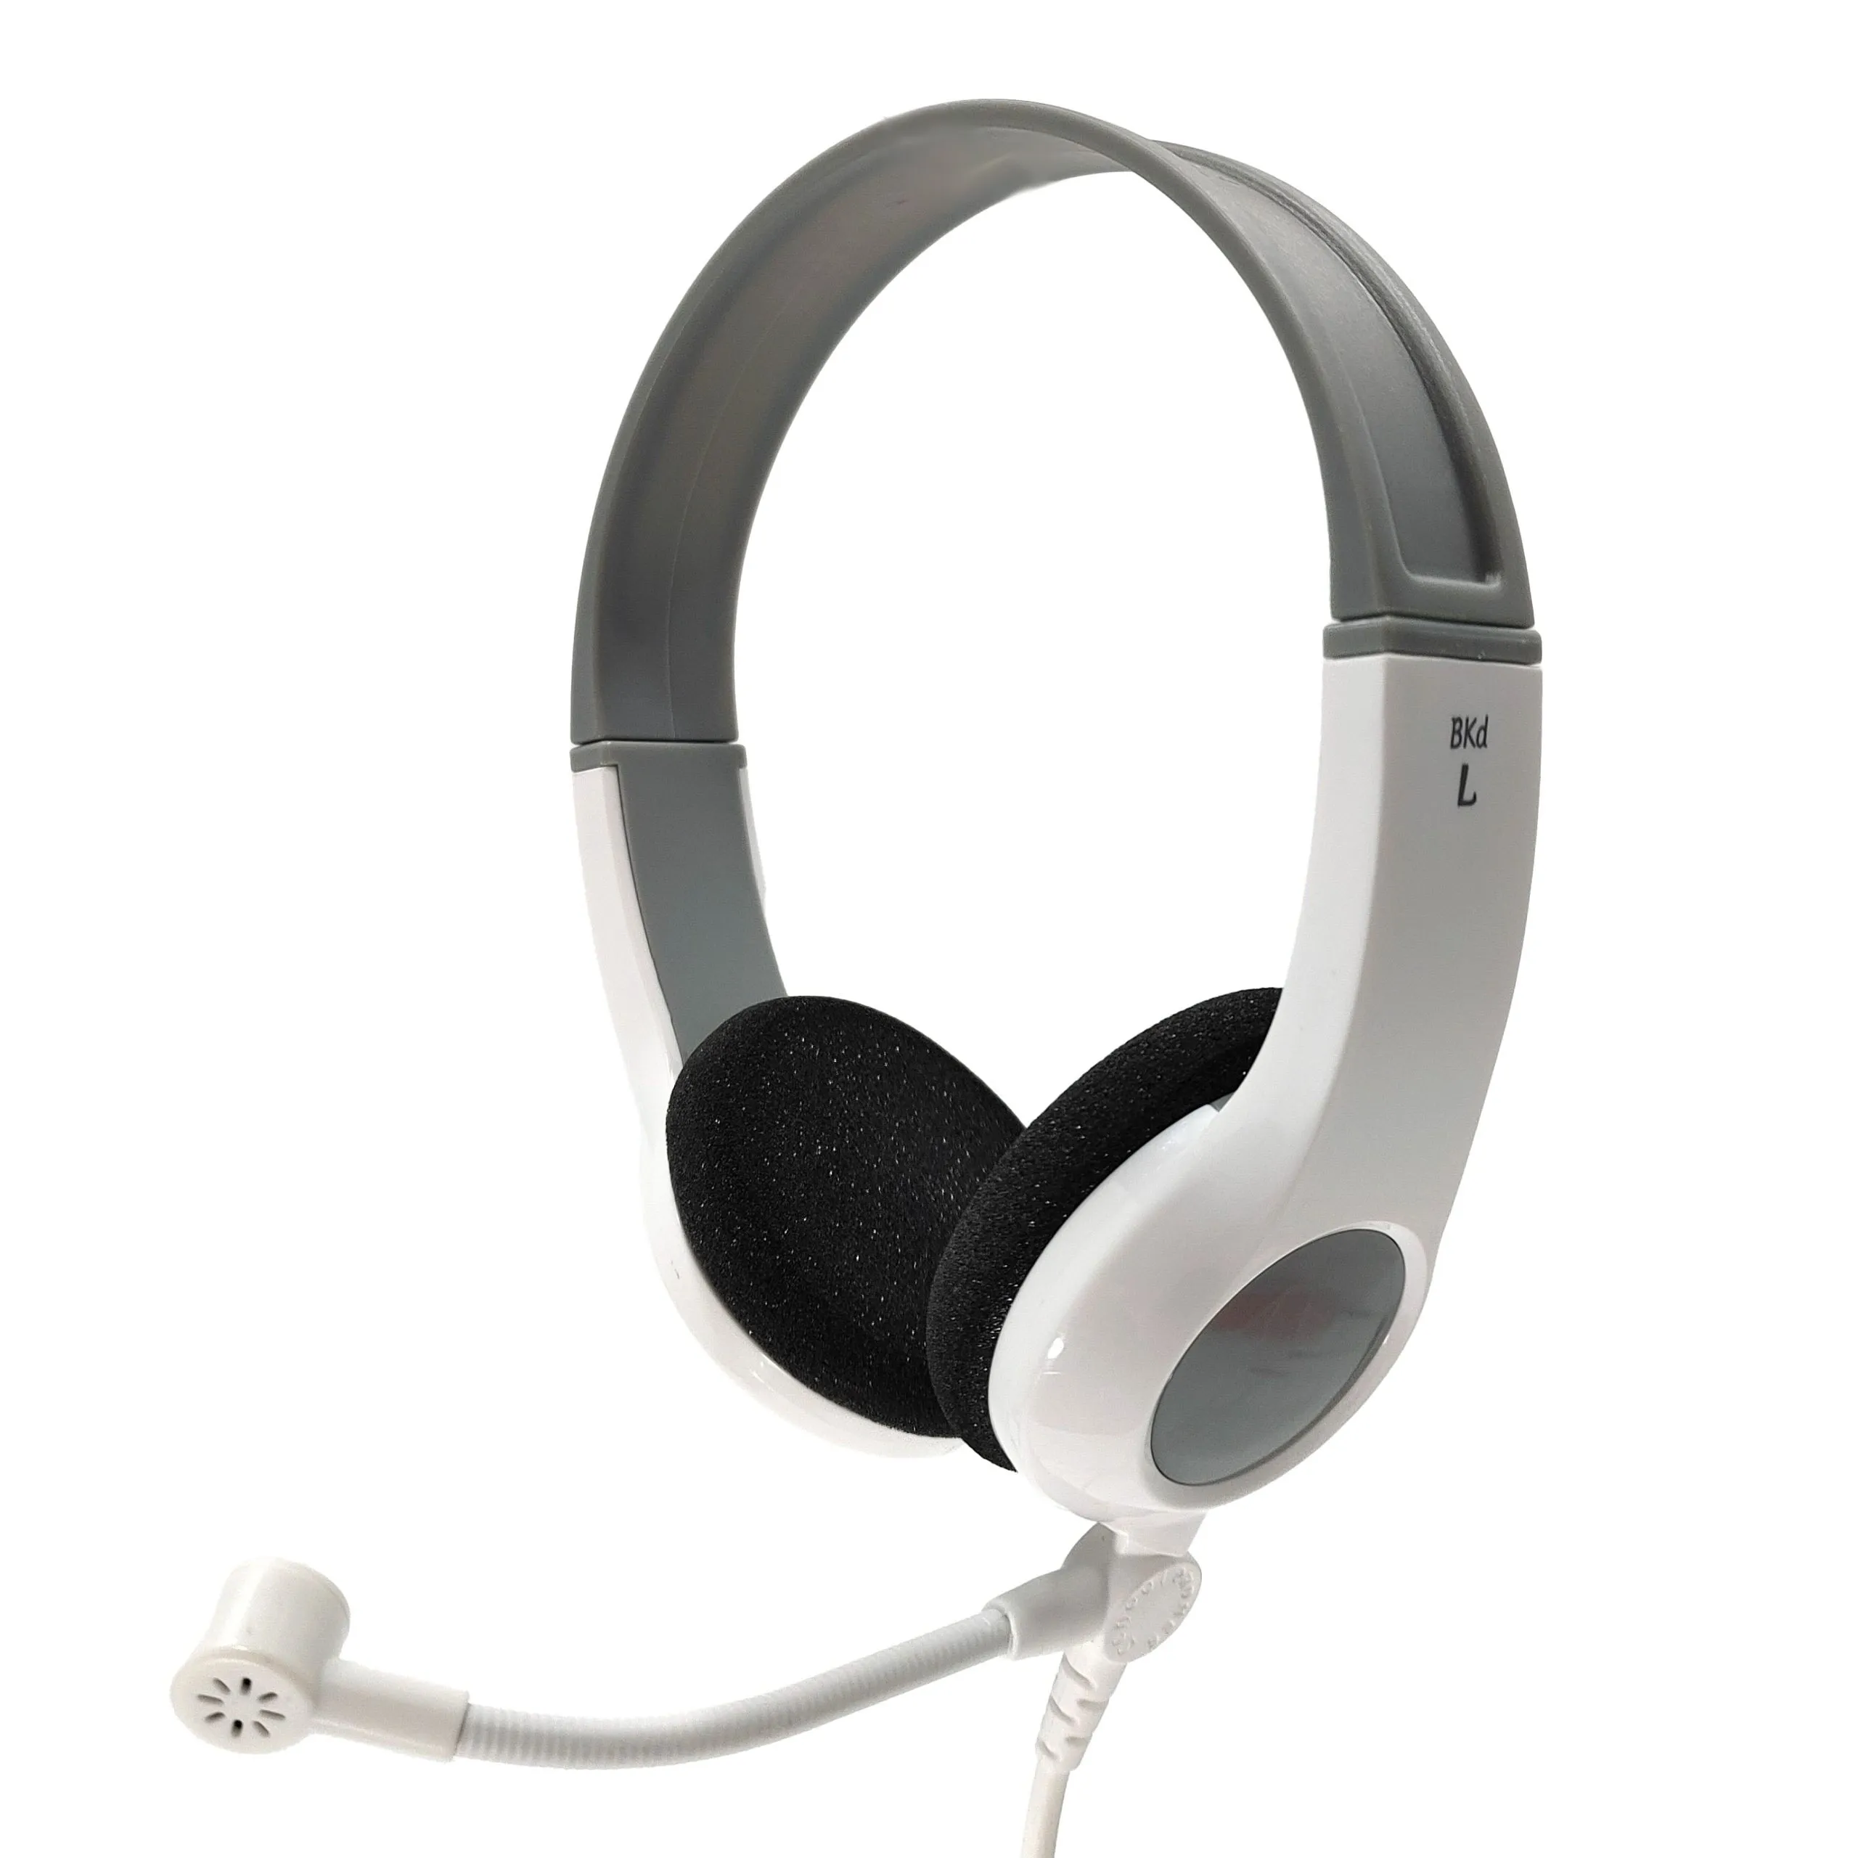
Preparing Test Materials: Online - Headsets
Schools are responsible for supplying headphones and headsets for testing
Headsets (with microphone)
  Required for the Speaking domain to record student responses
  Headphones (without mics)
  Used for the other 3 domains (Listening, Reading, and Writing)
  MDE REQUIRES and WIDA recommends:
  Smaller groups of 3–5 students for the Speaking test, since background noise can interfere with testing
  Test administrators should make sure there are at least 2–3 computers between each student, or students are seated approximately 4–6 feet apart
  Students should be seated far enough apart so they can speak at a normal volume without disrupting other students
Bluetooth headphones are not allowed as they have the ability to connect to and receive information from a device other than the testing device, which cannot be verified by the Test Administrator during testing.
  Note: There are exceptions for amplification devices, including personal hearing aids that use Bluetooth capabilities.
Suggestions for headsets:
To use currently owned headsets:
USB-C to 3.5 mm adapters available through eProcurement
SchoolPhones: Durable & Modular School Headphones for Older Students – BKD
Cable type: USB-C Audio Cable
Add SpringBoom Microphone
Labsonic LS9000MUSB-C School Headset – USB-C Plug
Contact: Kelly Rogan at ACP Direct
Email kelly@acpdirect.com
Phone: 800-238-8009 ext. 1022
Fax: 800-238-3117
PO Box 703168
Dallas, TX 753168

Slide 21

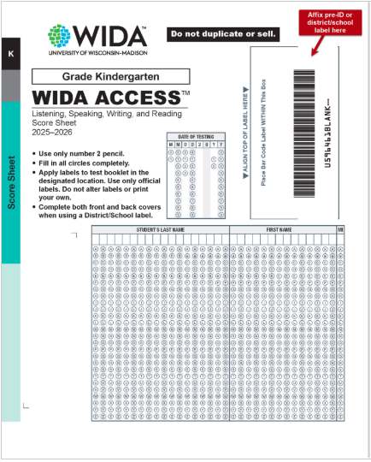
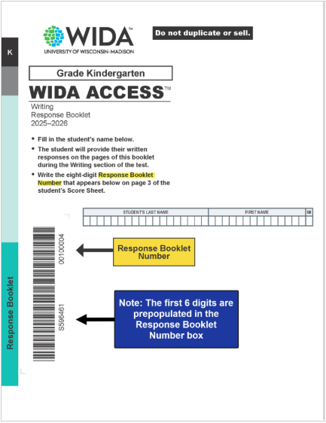
Preparing Test Materials: Kindergarten
Test Materials
Test Administrator Script
Storybook
Score Sheet
Response Booklet
Cards
Test Administrator Manual
WIDA ACCESS
for
Kindergarten
Test
Administrator
Script
WIDA ACCESS
for Kindergarten
Cards
NEW!
Updates for 2025-26:
Redesign aligns with the 2020 edition of the WIDA ELD Standards Framework
  Updated scoring rubrics
  Training course updated – Speaking & Writing anchor examples and scoring practice
New Features:
  Single storyline, no activity board, all domains administered only once
  No starting or skipping rules
  New item types in all domains
  Separate score sheet and student response booklet
Additional information:
  Not timed – takes an average of 40-55 minutes to administer
  Designated, optional breaks for students
  Stopping rules that respond to student performance
    Students are not expected to test past their language abilities
  ’Expect’ boxes establish scoring guidelines

Slide 22
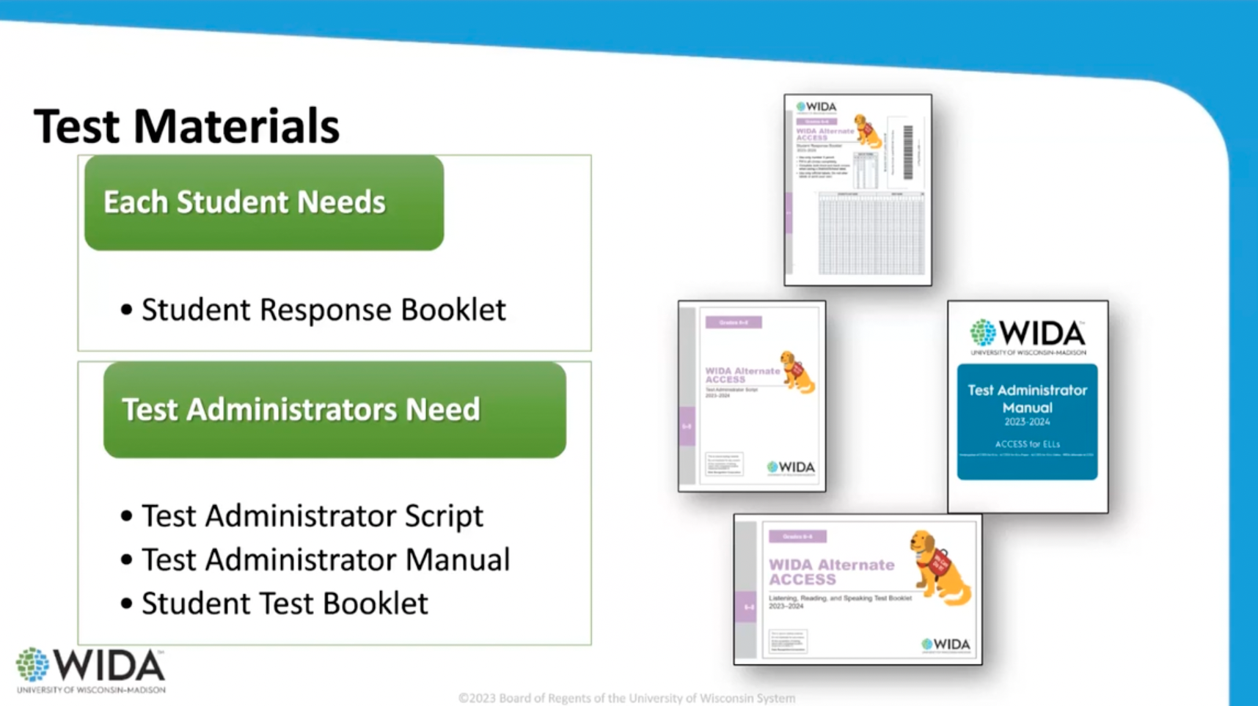
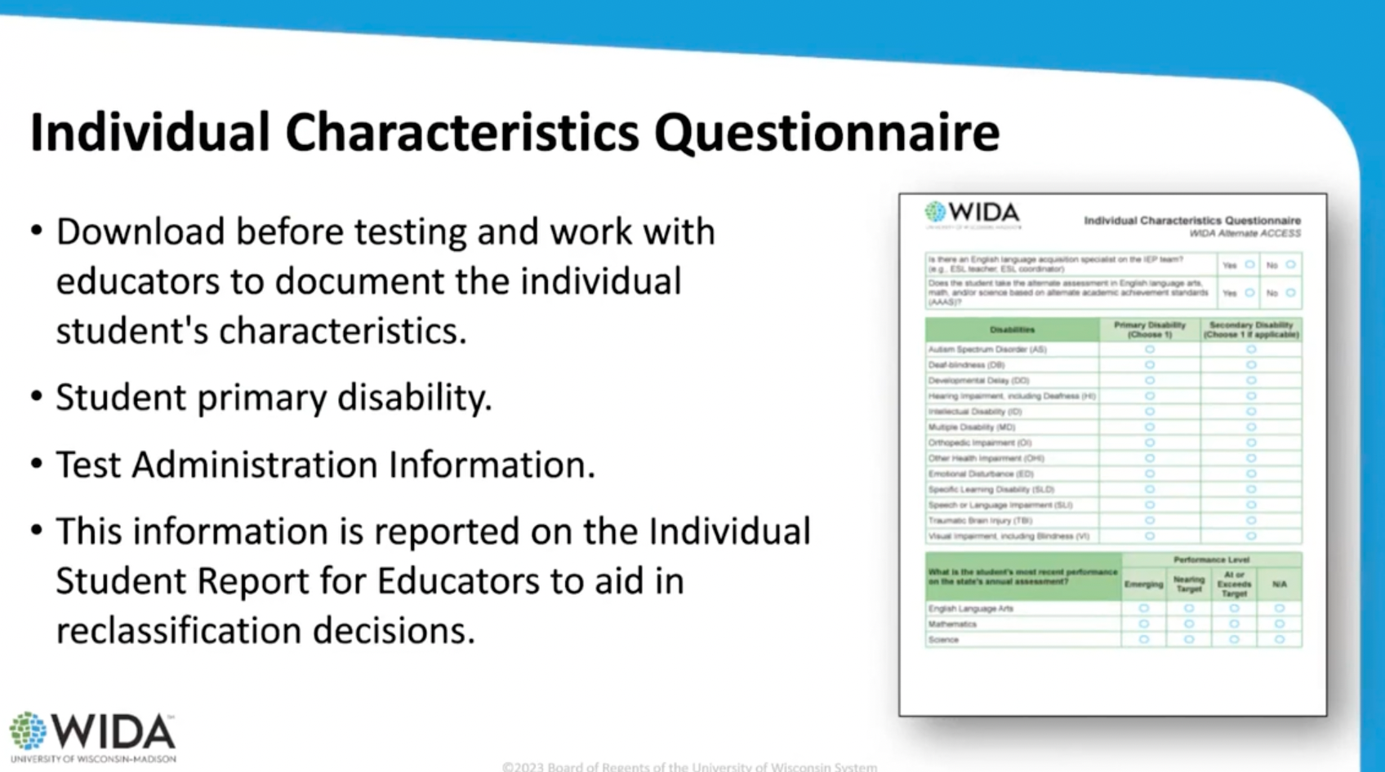
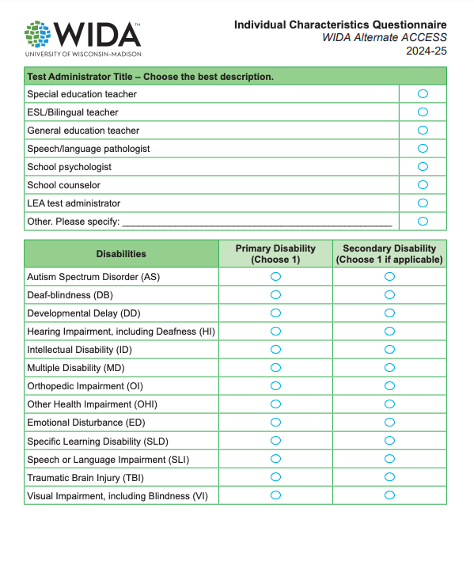
Preparing Test Materials: Alt ACCESS
Materials should be distributed to the WIDA Alt ACCESS Test Administrator prior to test day for preparation – but must be kept secure at all times (true for KG ACCESS as well)
Only authorized staff may handle secure test materials
Place all secure materials in locked storage
Do not leave materials unattended before or after testing
Do not share WIDA Alternate ACCESS test information with students prior to or after testing
Do not copy any test booklets or other secure materials

Slide 23
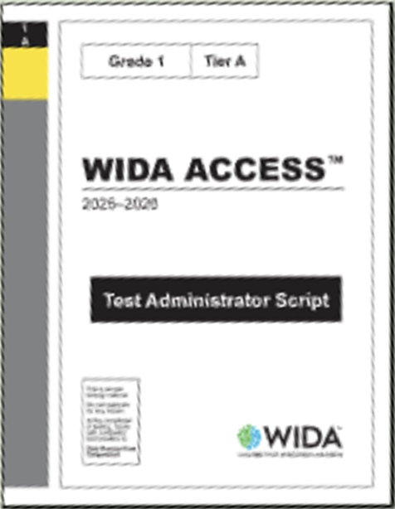
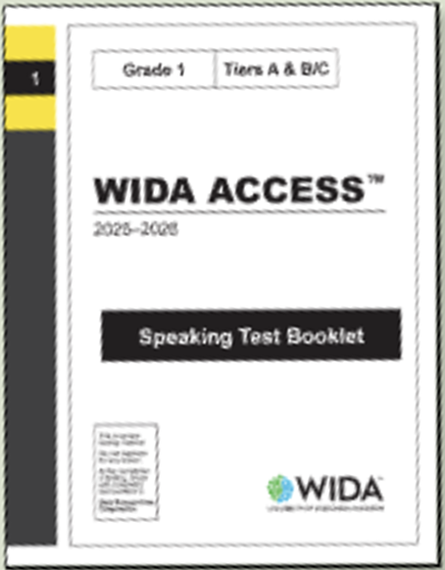
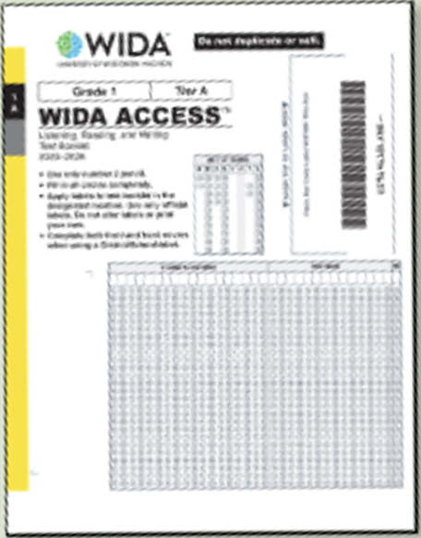

Preparing Test Materials: Paper ACCESS
Test Materials
Test Administrator Script
Listening, Reading, and Writing Test Booklet
Speaking Test Booklet
Listening and Speaking CD
Test Administrator Manual
Updates for 2025-26:
Redesign aligns with the 2020 edition of the WIDA ELD Standards Framework
  Updated scoring rubrics
WIDA and DRC are offering audio streaming within WIDA AMS as an alternative to the Listening and Speaking CDs
  CDs will still be included in the WIDA ACCESS Paper materials
  Braille tests must use the CD (not streaming audio)
Reliability Monitoring:
MDE requires at least 10% of Paper Speaking tests (at each school) be monitored for inter-rater reliability
Please see page 44 for more information

Slide 24
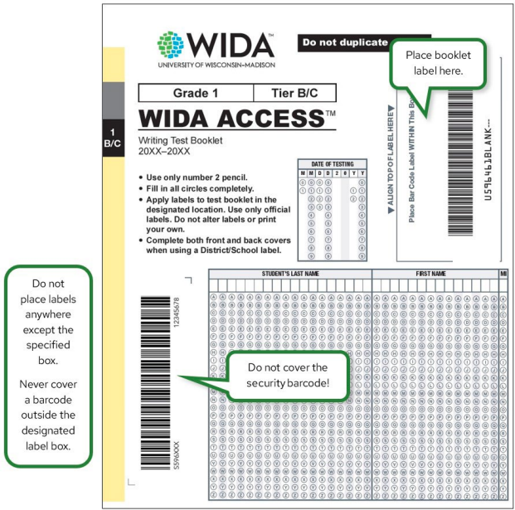
Preparing Test Materials: Test Booklets
Front Cover of Test Booklet
Enter test date on ALL booklets
01292026
1
2
3
Fill in bubbles if you do not have a correct label
This is applicable for all:
KG WIDA ACCESS Score Sheets (NOT the KG Response Booklet)
Gr. 1-5 Online WIDA ACCESS Writing Booklets
Paper WIDA ACCESS Listening, Reading, & Writing Booklets
WIDA Alt ACCESS Student Response Booklets

Slide 25
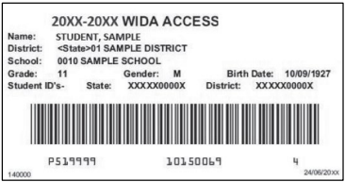
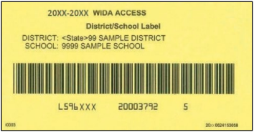
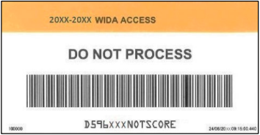
Preparing Test Materials: Test Booklets cont.
Three types of Test Booklet Labels
A. Pre-ID B. District/School C. Do Not Process
A. Pre-ID Label
Pre-ID labels have individual student information in addition to school and district information
With these labels, you don’t need to complete student demographic information on the front and back covers of the test booklet
However, you must still indicate the date of testing on the front cover
B. District/School Label
Use for students who do not receive Pre-ID Labels
Complete Student Demographic Information on the front and back of the test booklet
C. Do Not Process Label
Use these labels for damaged booklets or unique situations in which student responses should not be scored
Place the Do Not Process label directly on top of an existing label
Blank test booklets do not need Do Not Process labels. Return unused booklets without any label

Slide 26
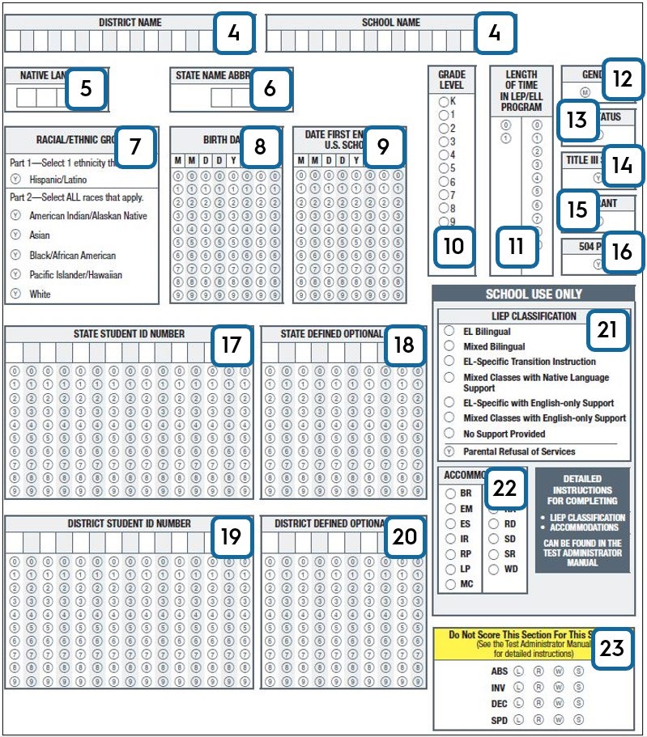
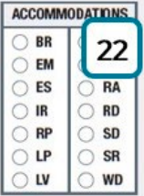
Preparing Test Materials: Test Booklets cont.
Back Cover of Test Booklet
S A I N T P A U L S C H O
H AM L I N E
X
M N
X
X
X
X
X
X
X
X
X
1 2 3 4 5 6 7 8 9 1 2 3 4
MARSS #
X
1 2 3 4 5 6
CIF #
Start numbers on Left Side
MARSS/State ID: 13 digits
District Student ID/CIF: 6 digits (NOT PersonID)
Never fill out unless explicitly told to do so by a DAC

Slide 27
Family Communication
ACCESS announcement letter - required
All schools must send out a message in their regular form of family communication (e.g. Principal’s newsletter, weekly update, Seesaw, or Schoology, etc.) announcing that the ACCESS will be administered - must include:
REA: ACCESS Family Test Information website
spps.org/about/departments/research-evaluation-assessment/test-coordination/access-family-information
Parent Fact Sheets
Score guides
Parent/Guardian Guide and Refusal for Student Participation in Statewide Testing
All documents available in multiple languages
Links to MDE Family State Testing websites

Slide 28
Parent/Guardian Refusals
Federal and state statutes require all eligible students participate in statewide assessments. It is considered an unethical practice to exclude students from the assessments by actively encouraging students or Parents/guardians to refuse testing.
How do families know about opt outs:
Per MDE, Districts must post the current year’s complete form on the district website and include it in the district’s student handbook
  SPPS posts the form on both the ACCESS and MCA Family information websites and the complete form is in the District Student Handbook
In order for parents/guardians to make fully informed decisions regarding their child’s participation in statewide assessments, districts must provide complete and transparent information when asked by parents/guardians if they can refuse testing; this information must be provided upon request in a timely manner. However, districts are not required to send out specific communications regarding parent/guardian refusals.
  In the ACCESS announcement letters from SPPS it states, “If you have questions about your student’s participation, please reach out to your child’s principal.”
Per MDE, only written forms of refusal are accepted (e.g. MDE Form, written letters, and emails) Texts, phone calls, and verbal notification NOT accepted
School staff may NOT:
Discourage families or students from testing
Pre-fill out the refusal form
  ONLY a parent or guardian should be completing this form
No school generated forms → if providing a family with a form, it must be both pages of MDE’s Statewide Assessments: Parent/Guardian Participation Guide and Refusal Information
Schools are not required nor expected to provide alternative educational opportunities while other students are testing for students whose families refused testing.

Slide 29
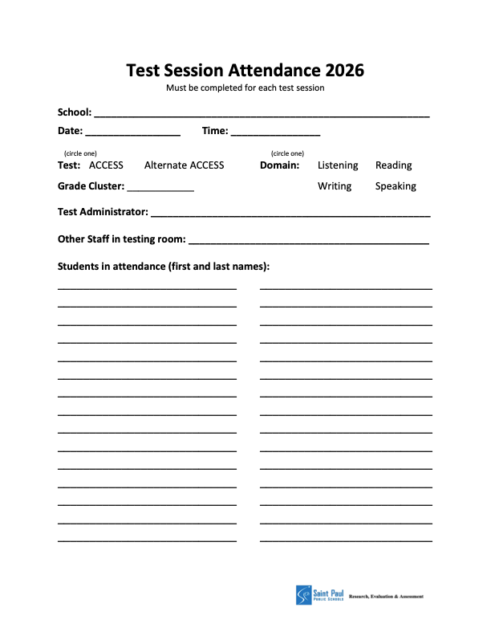
Monitoring Progress
Tracking session attendance:
Per MDE, we must track which students test with which Test Administrator for all test sessions, ideas for tracking:
Test Session Attendance Form, one per test session- available on REA Testing website
  Smaller version available for small group testing
The Roster from WIDA AMS
  1st page(s) when printing test tickets, print new roster for each test session
Google Sheets/Excel
Test Monitoring in WIDA AMS: SPPS does NOT use this feature
If DRC Insight is asking for a Test Monitoring code during student login, contact SAC immediately

Slide 30
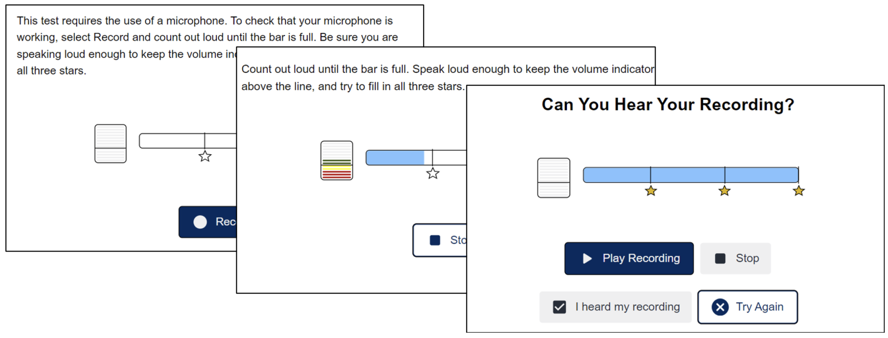
Microphone Check
Speaking Domain – Online ACCESS
Students begin the test with a microphone check. On-screen instructions guide them through the process of recording their voices and listening to what they’ve recorded to ensure the system is correctly capturing audio.
If the microphone check is unsuccessful, verify that the student’s headset is working and not muted. Help students adjust their headsets as necessary to ensure they’re speaking directly into the microphone. Then have students repeat the microphone check. It is very important that students do not proceed to the test directions unless they have heard their voices replayed during the microphone check.

Slide 31
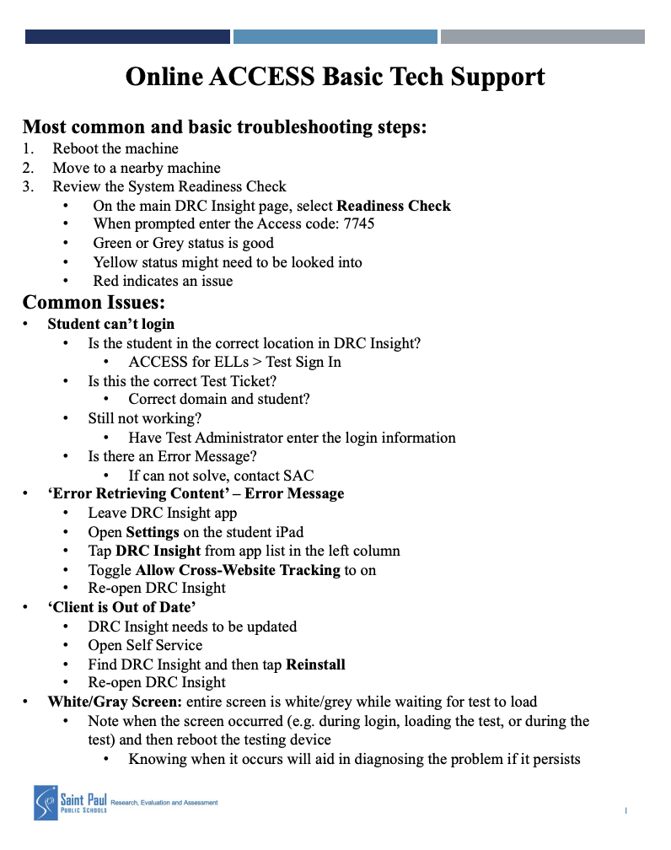
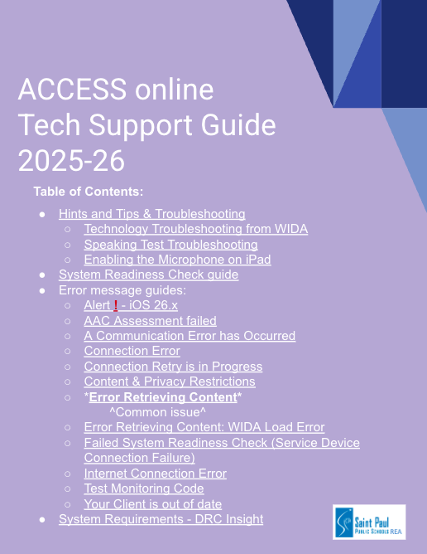
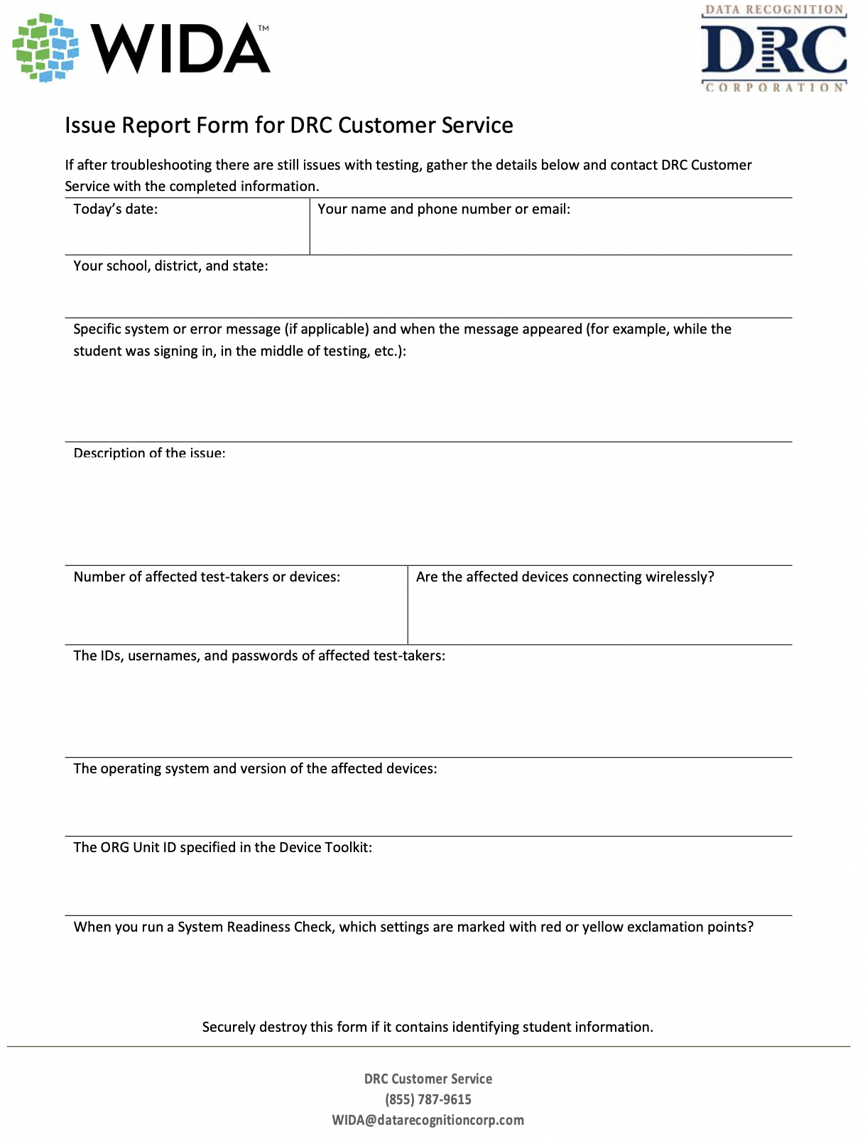
Tech Support
Basic Troubleshooting Guide:
Good resource for Test Administrators to have on hand
Tech. Support Guide:
Created using resources from DRC and based on Error Messages we have experienced in past administrations.
Guide will be updated if new issues occur.
WIDA Issue
Report Form:
Used to gather the information most likely needed for troubleshooting
Available on the last page of the Basic Troubleshooting Guide
If you need further assistance, contact Jessica Lang – note the following information
  If there is an Error Message – what is it?
  How many students are affected? And who?
  What domain are they testing?
  What devices are they testing on?
Sometimes issues will need a higher level of care. Depending on the issue we may need to reach out to SPPS Tech Services or WIDA DRC customer support. – DAC will advise when to contact

Slide 32
Reliability Monitoring
Speaking Domain – Paper ACCESS
MDE requires that at least 10 percent of Speaking tests be monitored for inter-rater reliability. In cases where fewer than 10 students take the paper Speaking test at any given school, at least one test should be scored by a second rater at each school. The second rater is not required to be a licensed teacher, but they must complete all training requirements for administering the paper Speaking test.
Districts must keep documentation of this monitoring for one year following the academic school year in which testing took place. (Send to DAC)
All SPPS sites have less than 10 students taking the paper Speaking test. Each school administering the Paper ACCESS-Speaking Domain must administer 1 test scored by a second rater.
Three Resources for further information:
Maintaining Rater Reliability in Scoring the ACCESS for ELLs 2.0 Paper Speaking Test
Rater Reliability Calculator—ACCESS Paper Speaking
Using the Rater Reliability Calculator
All resources are posted on the WIDA Minnesota website under
‘Manuals, Guides and Test Materials’ : https://wida.wisc.edu/about/consortium/mn
What documentation to submit to DAC (via upload to Google Documentation Folder)
Rater Reliability Calculator—ACCESS Paper Speaking
  Spreadsheet
  Include Test Administrator and second rater’s names
DELETE THIS PAGE IF NO PAPER ACCESS ACCOMMODATIONS AT YOUR SCHOOL

Slide 33
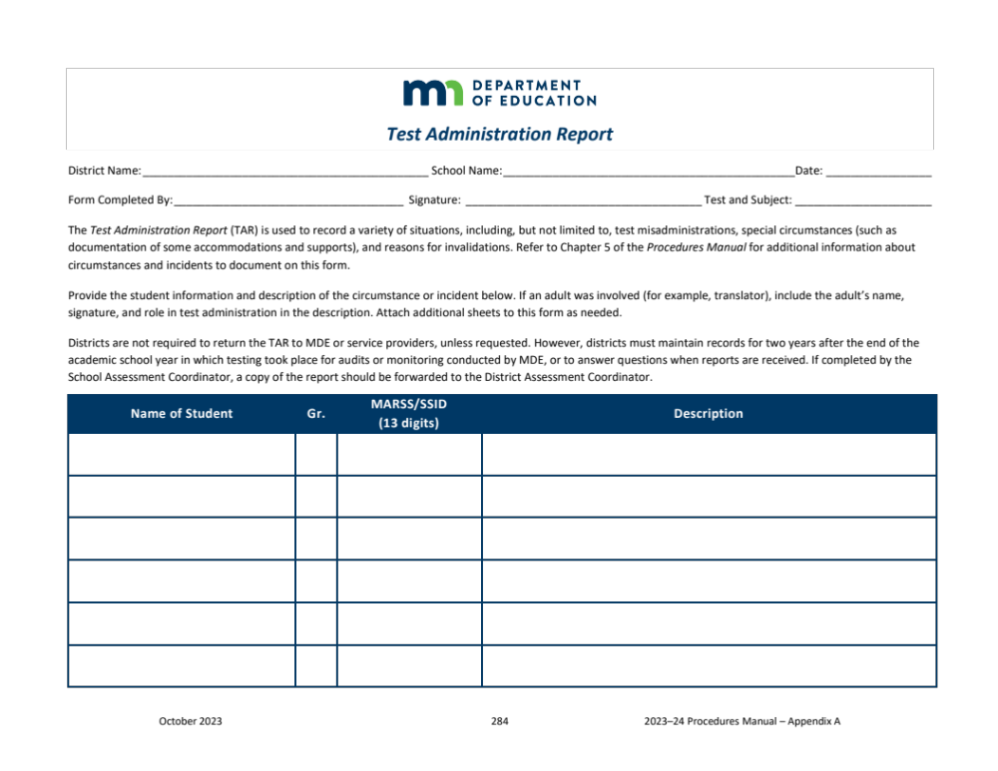
Test Administration Report (TAR)
  TAR is used to record test misadministrations and reasons for possible invalidations
  Test Administrator completes the TAR and gives it to the SAC ASAP (within 24 hours of incident)
  Blank TAR form is available on REA website: spps.org/about/departments/research-evaluation-assessment/test-coordination
Examples of misadministrations
  Student engages in inappropriate behavior or action that results in a test being invalidated
  Student refuses to take an assessment or cheats on an assessment, requiring the assessment to be invalidated
  Student’s responses are transferred by staff incorrectly to a scorable answer document or onscreen (online)

Slide 34

MDE Site Monitoring
MDE Site Visit Checklist
MDE has compiled a list that outlines the areas that MDE monitors will observe or discuss during a monitoring visit of ACCESS or MCA administrations. Areas of observation:
Interview with District/School Assessment Coordinator
Observations
The posting and accuracy of the school’s testing calendar
The MDE Minnesota Assessment Monitoring Checklist is available on the REA web site: spps.org/about/departments/research-evaluation-assessment/test-coordination
MDE also requires District staff to conduct random, unannounced observations of testing rooms to confirm adherence to state and district assessment policies and procedures
  District staff will visit a few schools during the ACCESS testing window

Slide 35
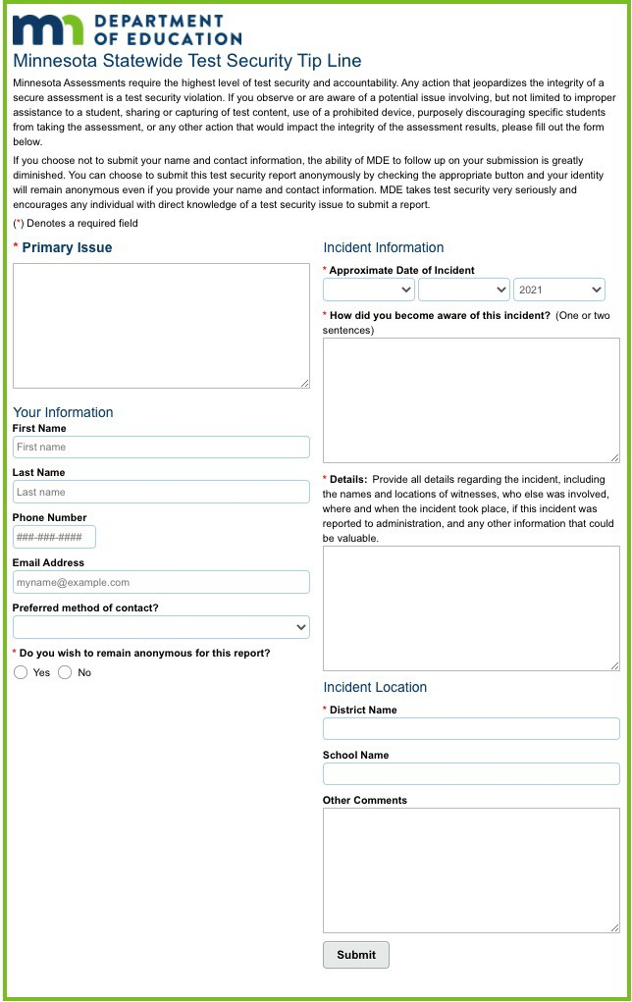
MDE Test Security Tip Line
MDE Tip Line – open to the public
https://pub.education.mn.gov/tip/
MDE has a Test Security Tip Line
Educators, parents, students and others can report suspected incidents of cheating, improper or unethical behavior on any Statewide assessments
Links to the Test Security Tip Line are available in two places on the MDE web site https://education.mn.gov/MDE/
˗ View the Statewide Testing page
(MDE > Districts, Schools and Educators > Teaching and Learning > Statewide Testing)
- Under ‘Reporting Testing Administration Concerns’
˗ View the Family Test Security page
(MDE > Students and Families > Programs and Initiatives > Statewide Testing > Student Participation)

Slide 36
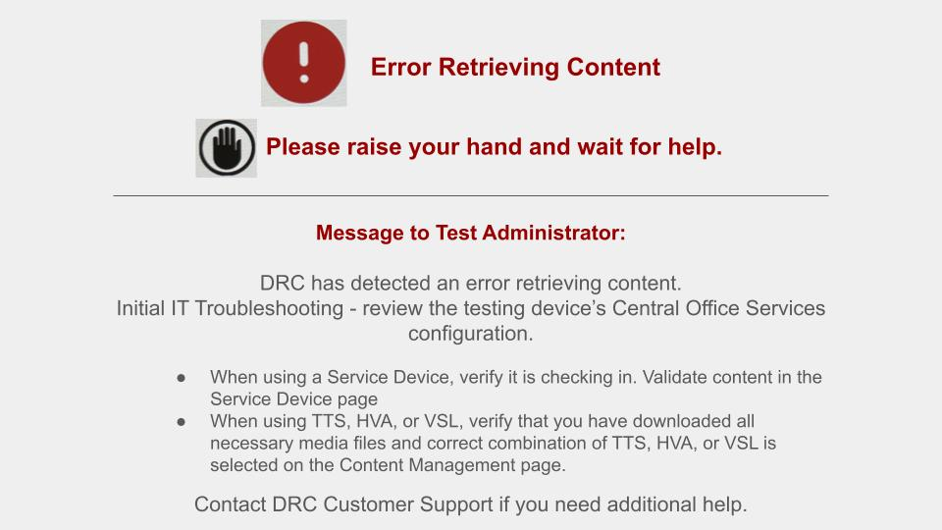
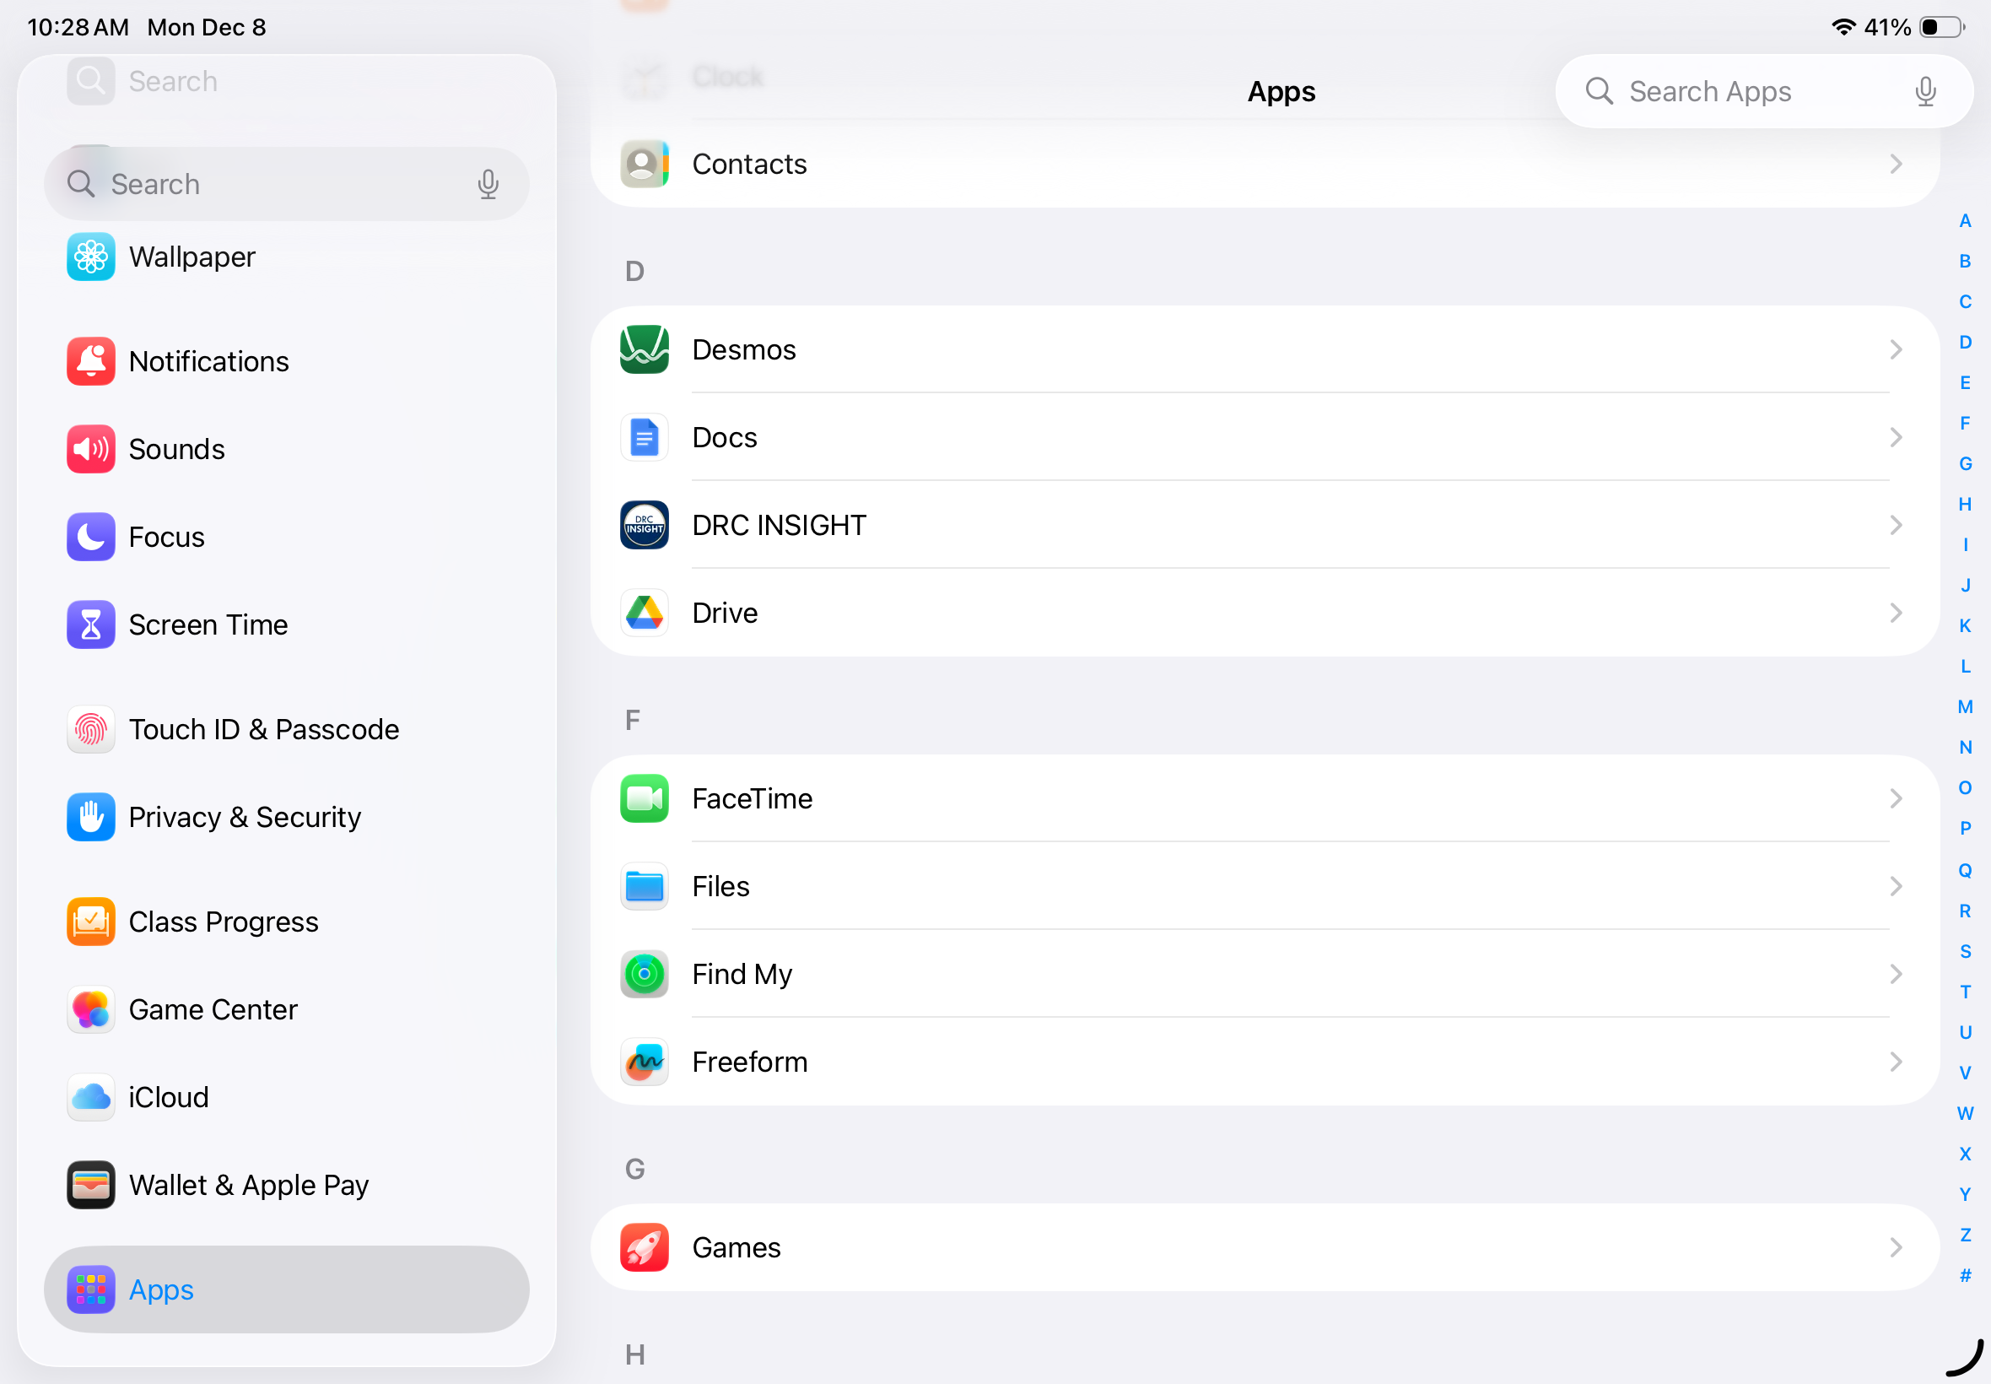
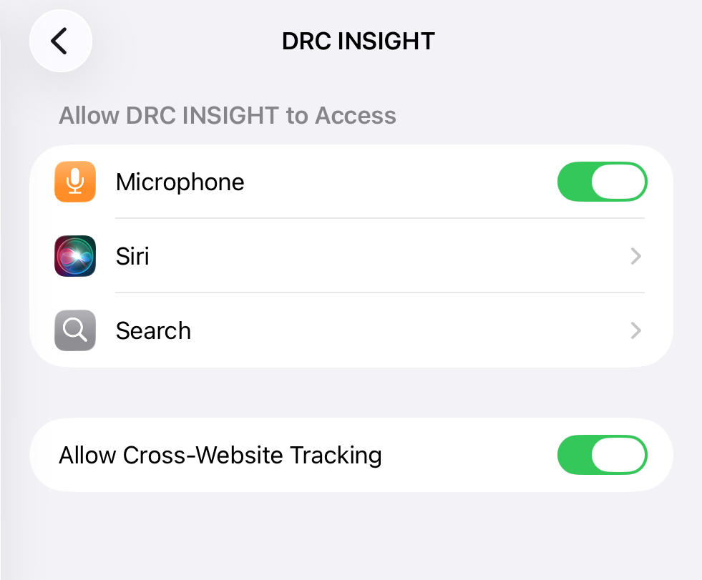
Appendix: Error Retrieving Content
Note: Hopefully won’t be an issue this year. DRC made a work around and our TS team implemented it.
Solution:
On the student's iPad:
Open Settings
Select Apps
Select DRC INSIGHT
Enable Allow Cross-Website Tracking

