Slide 1
FPS FAMILY ACADEMY:
DIGITAL CITIZENSHIP

Slide 2


What is Digital Citizenship
Teaching students responsible and ethical use of technology.
Understanding how to navigate the digital world safely,
respectfully and productively.
  Online Safety and Security
  Critical thinking
  Positive Online Behavior
  Digital Footprint Awareness
  Respect and Etiquette
How we implement Digital Citizenship
Policy: Establishing clear district procedures for appropriate technology use
Curriculum: Incorporating digital and media literacy into classroom lessons
Culture: Building district-wide principles of respect and responsibility

Slide 3


Securly provides a layered safety net protecting students from digital dangers and helping schools manage digital learning environments effectively.
    Securly Filter
    Cloud-based web filtering to block inappropriate content
    and ensure compliance for the Children’s Internet Protection Act.
    Classroom Management
    Tools for teachers to manage student devices, minimize distractions,
    and increase engagement during class lessons.
    Securly Home
    A parent-facing app for managing school-issued devices at home, allowing parents to set rules, schedule offline time, and view usage reports.
Notes:
CIPA (Children’s Internet Protection Act) – federal law requiring school district receiving federal funding to filter inappropriate online content and educate minors on internet safety and digital citizenship, by having a filtering policy. Internet Safety Policy (ISP)
COPPA (Children’s Online Privacy Protection Act)).
Home - Securly Home helps parents stay informed and support safe technology use by providing visibility into online activity on school-issued devices whether student use is at school or at home.

Slide 4

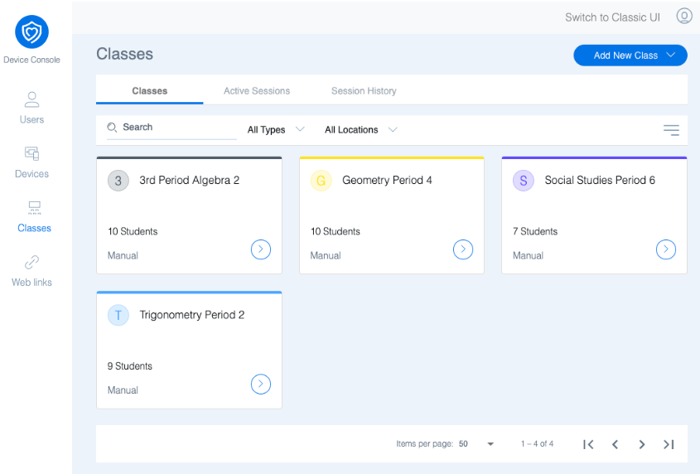
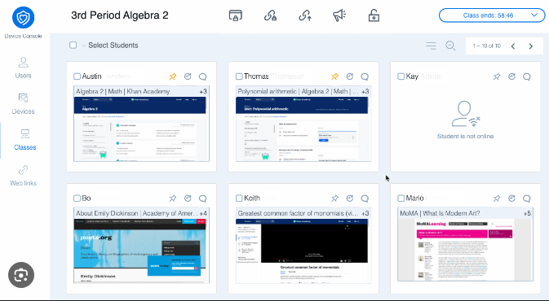
Classroom Management
Securly Classroom is a learning support tool used by teachers during class time
Classroom helps teachers:
Keep students focused on learning during class lessons
See student screens in real time to provide timely
instructional support
Limit distractions by guiding which website are used
Share learning resources quickly while the whole class
  Securly Classroom supports classroom management
  only on school-issued devices during instructional time.
  *currently available for grades 3rd – 12th
Notes:
Tools for teachers to manage student devices, minimize distractions, and increase engagement during class lessons.
Teachers can close distracting tabs, websites or even lock screens during lessons or tests.

Slide 5

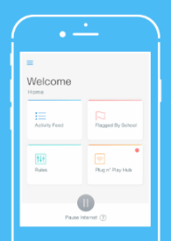

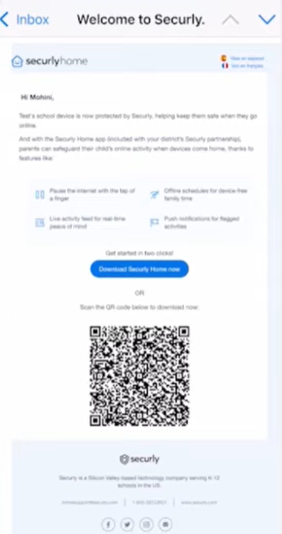

Securly Home
How Does Parents/Guardians Get a Securly Home Account?
Parents/Guardian of students who have a valid email address on file with the school can setup a Securly Home account in any of the following ways:
  Click the link in the Securly Welcome Email
  Visit www.securly.com
  Download the Securly mobile app on Apple or Android devices

Slide 6

Securly Home – Key Features
Real- time Activity Feed:
See what websites, searches, and videos your child access on their school issued device
Flagged Activity Alerts:
Automatically notices of alert flags for concerning activity based on flagged terms
Content Controls and Rules:
Setup additional blocks or allow specific categories of websites while at home
Pause Internet with One Tap:
Instantly turn off internet access on the student’s school device
Offline Scheduling:
Set a regular schedule to automatically disable internet access, i.e., homework time,
evenings, bedtime
Weekly Email Reports:
Even without accessing the Securly Home App, parents/guardians will receive a
summary of their child’s online activity each week, i.e. Sites visited, searches, etc..
Notes:
Activity Feed – 30 days of activity, per student. Provides information of websites visited, searches, and videos watched. Video links can be access through the Activity Feed.
Stories allow parents to view curated activity for each student for that day. Story activity refreshed daily at 4 p.m.
Flagged activity - Bulling, self violence, or violence
Rules – managing filtering options when the device is not at school

Slide 7

Franklin Pierce Schools
Student 1:1 Devices
Laptops are checked out to students in grade KG - 12 each
school year.
Laptops are collected at the end of year to ensure devices prepared
for the upcoming school year.
Student Acceptable Use Agreement
  Each school year the Information Technology office sends the
  Acceptable Use Agreement (AUA) electronically to families.
The agreement outlines expectation for responsible
device and internet use:
  Internet Access and Filtering
  Digital Citizenship
  Device Care
  Prohibited Activity
  Safety and Security
Notes:
Accidents do happen, which is why we offer an optional device protection plan.

Slide 8



Optional Device Protection
FPS offers an optional $10 Optional Protection Plan
For the cost of a latte or two, this plan offers peace of mind.
It helps families avoid costly repair or replacement fees by covering up to three accidental incidents during the school year.
  $10 covers per year, per student
  Does not cover loss, theft or intentional damage
  Option Device Protection is available to all students
    Take-home schools
    Classroom-model schools
  Payment is accepted at the school’s main office

Slide 9

Responsible Social Media
Social media is where young people learn, create, and connect.
It offers belonging and self-expression, but also risks (comparison, misinformation, safety issues).
Kids don’t need perfection—they need guidance and conversation. Parents play a powerful role as coaches, not just monitors.
We aim for supported and intentional use.

Slide 10
Responsible Social Media
Ask curious, judgment-free questions about apps, friends, and trends.
Let kids teach you what they enjoy—this builds trust.
Share your own digital habits and values.
Create a “no shame” policy so kids can ask for help safely.

Slide 11
Responsible Social Media
Create a Family Media Agreement with shared expectations.
Ensure boundaries match the child's age and maturity.
Talk about balance: schoolwork, sleep, offline hobbies.
Encourage intentional use: “Why am I opening this app right now?”

Slide 12
Responsible Social Media
Review privacy settings and friend lists regularly.
Practice “pause before posting.”
Teach red flags: bullying, pressure, strangers.
Model mindful use—no doom-scrolling or tech at meals.

Slide 13
Social Media Tips
Use the “3 Cs”: Content, Contact, Conduct.
Create a phone parking spot for consistent routines. Normalize digital breaks during meals and transitions.
Co-browse for 10 minutes to build trust.
Teach “Pause, Screenshot, Tell” for online problems.

Slide 14
QUESTIONS?
¿PREGUNTAS?

Slide 15
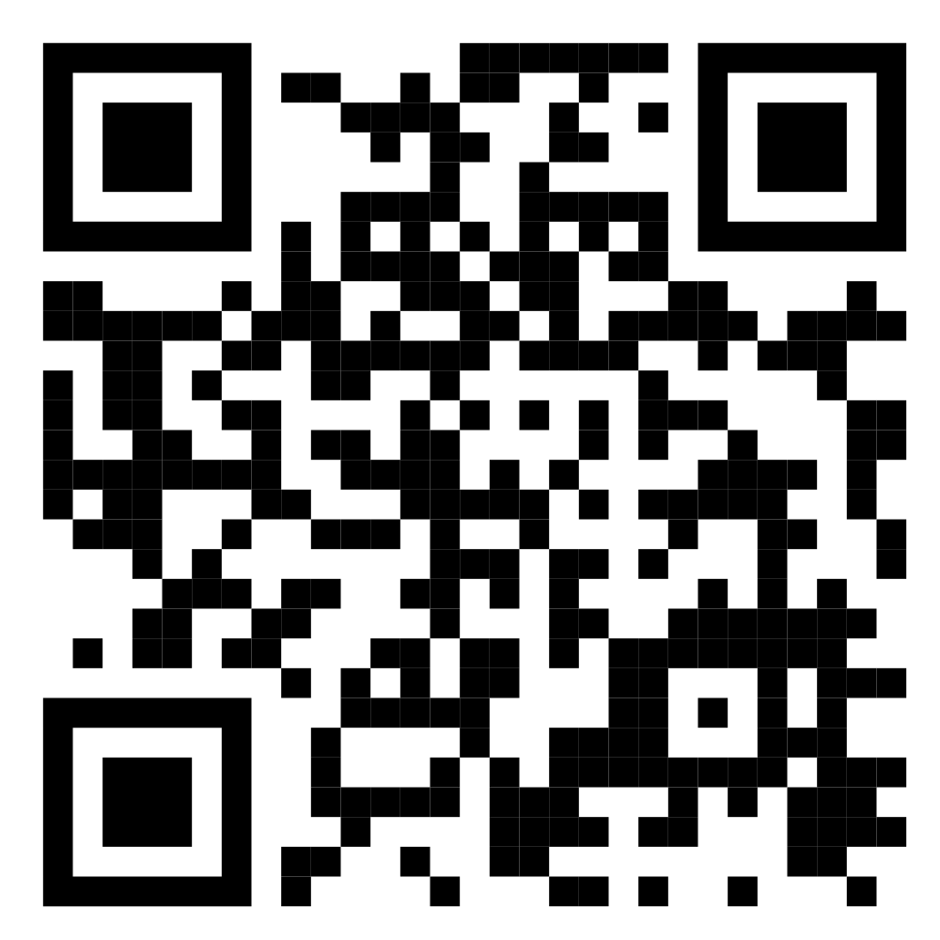
UPCOMING COURSES
January 12: Family Engagement
February 9: Standards-Based Grading and Culturally Responsive Education

