Slide 1
FPS FAMILY ACADEMY:
FAMILY ACCESS

Slide 2
FAMILY ACCESS IN QMLATIV
Family Access via Skyward's Qmlativ provides essential information about your student(s)
As a parent or a guardian you can:
  View and update student contact information, including emergency contacts
  Check your student's schedule and attendance
  Review assignments, grades, report cards, and academic progress
  And more...

Slide 3
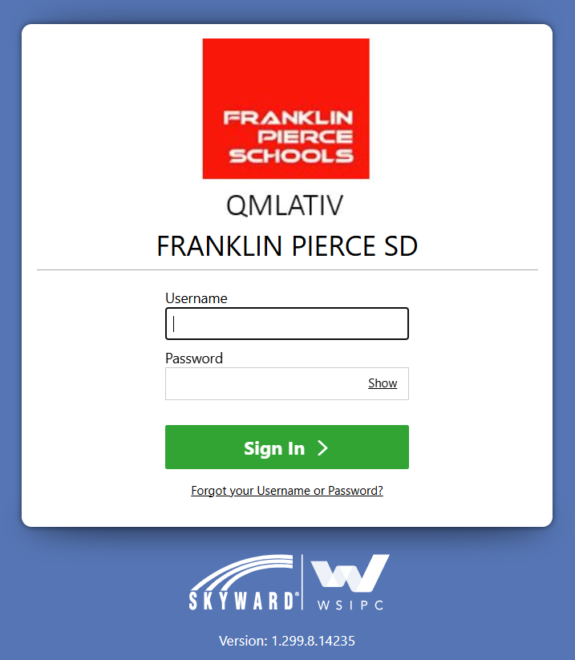
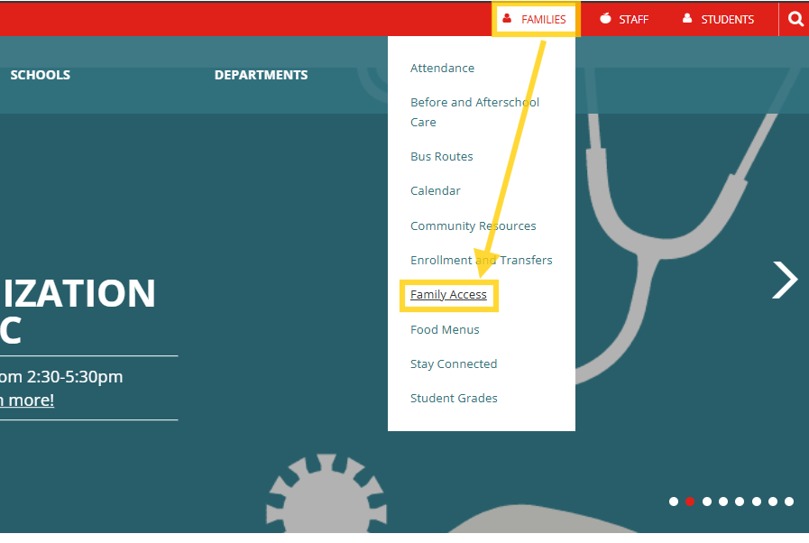
How to Login
Upon student enrollment Parents & Guardian are sent an email notice with username, password, and instructions for logging into Family Access.
If you did not receive this notice or are uncertain which email the school has on record, please contact your student’s school office.
From the district website
top main menu options, select
"Families".
From the drop down select
"Family Access".
fpschools.org

Slide 4
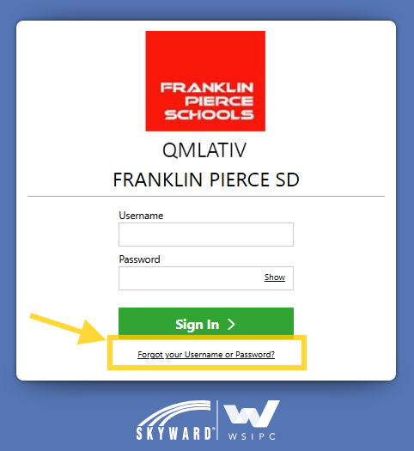
Forgot Password
If you do not remember your Family Access password, from the login page click the "Forgot your Username or Password?" Link.
An email message containing your
login information and instructions for resetting your password will be sent.

Slide 5
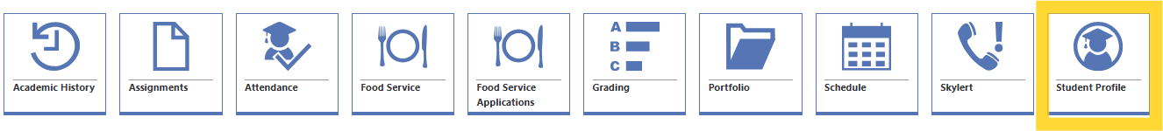
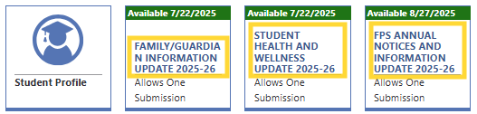
Student Profile
The Student Profile tile provides a view of contact information, including emergency contacts.
Annual update forms are available to completed each school year:
  Family/Guardian Information Update
  Health and Wellness Update
  FPS Annual Notice and Information Update
  Once forms are submitted, contact your student's school office to update information.

Slide 6
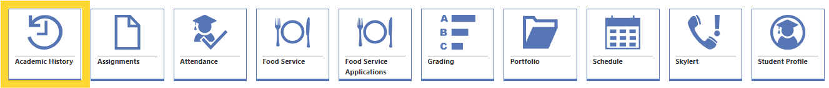
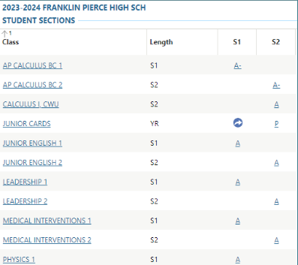
Academic History
The Academic History tile allows parents/guardians to view student's historical grade records for all previous school years in the district.

Slide 7
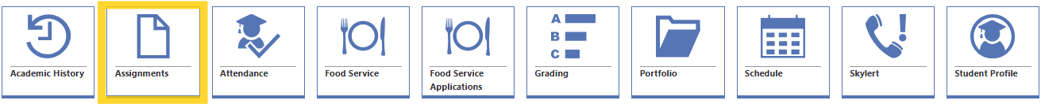
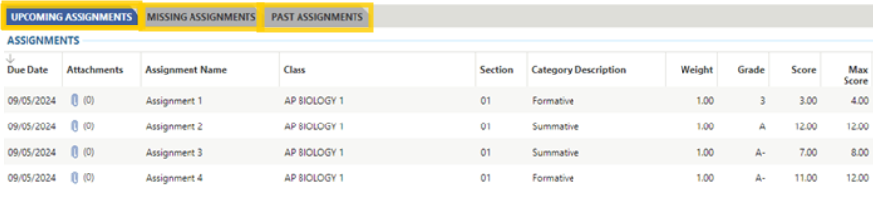
Assignments
The Assignments tile allows parents/guardians to view upcoming, past, and missing assignments. Here you can see the grade/score given for assignments, what class the assignment belongs to, due date, and any attachments for the assignment.

Slide 8

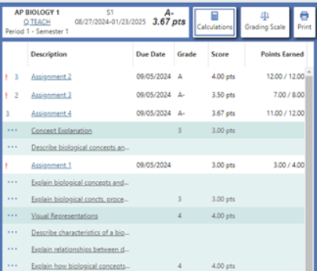
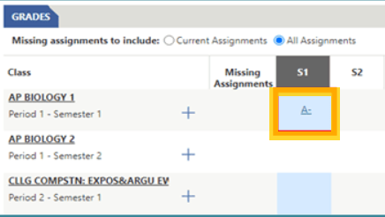
Grading
The Grading tile allows parents/guardians to view grades for each class for students in 6th-12th grade.
  Click the grade shown to view grade details which highlight assignment description, standards, points eared, calculation details and grading scale can be found by following the step below.

Slide 9

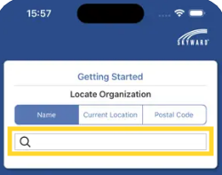
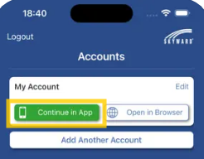
Skyward App
Available for download from the Apple App Store and Google Play Store.
Type “Franklin Pierce” in the search field and
select “Wsipc-Franklin Pierce School District, Tacoma, WA”
Select "Continue in App"

Slide 10

FPS FAMILY ACADEMY:
PARENTSQUARE

Slide 11
PARENTSQUARE
ParentSquare is a hub for communication from your child’s classroom, grade-level, school, and district
As a parent or a guardian you can:
  Control when you receive notifications from the classroom, school, or district
  View posts made by teachers, administrators, and the district
  Receive and send messages regarding your student
  Communicate about your student's absence

Slide 12
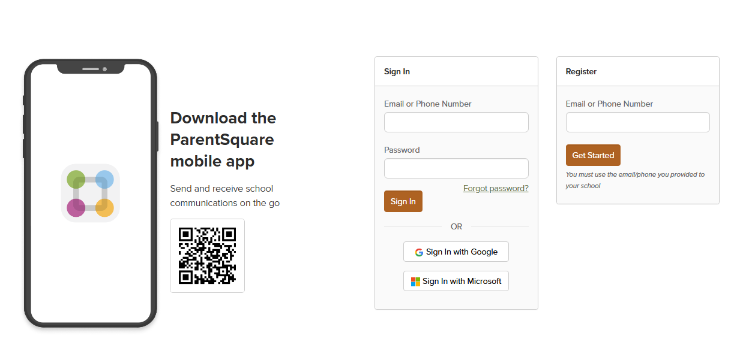
Activate Your Account
Go to parentsquare.com
Enter your phone number or email under Register

Slide 13
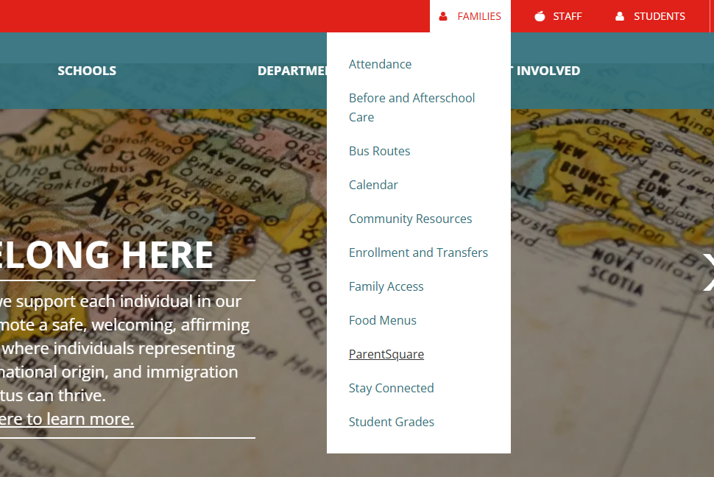
How to Login
  From the District website:
  Menu options in red bar, select "Families“
  Select “ParentSquare“
  parentsquare.com

Slide 14
Update Notification Settings
From Home, click your name and select Manage Account.
Click Notification Settings.
Choose your preferred notification settings:
  General Announcements & Messages by Email, Text or App and frequency for posts (Off, Instant or Digest)
  School Alerts (On or Off)
After you've made selections, future messaging will send based on your preferences.

Slide 15
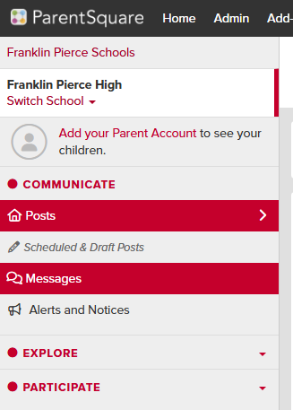
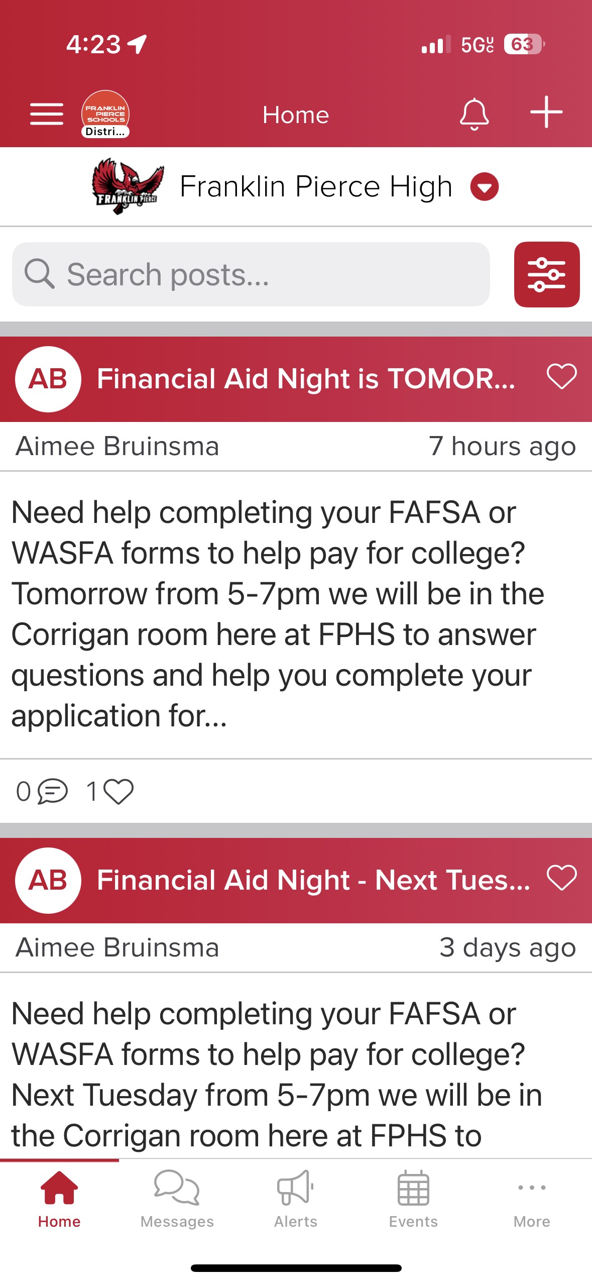
View and send messages

Slide 16
QUESTIONS?
¿PREGUNTAS?

Slide 17
UPCOMING COURSES
December 8: Digital Citizenship
January 12: Family Engagement
February 9: Standards-Based Grading and Culturally Responsive Education

