Slide 1




Studio Shodwe
Kindness
Be the reason someone smiles today

Slide 2

Objective
Students will understand what kindness looks like and commit to one kind action they can take this week.
#KINDNESS
Notes:
-Students share aloud or write on sticky notes.
-Briefly discuss common words and patterns.

Slide 3
Campus Matrix
Insert Matrix Here
#KINDNESS

Slide 4


What Is Kindness?
Acting sympathetic or helpful
#KINDNESS

Slide 5

#Kindness
Warmup-
What’s one word that comes to mind when you hear kindness?
#KINDNESS
Notes:
-Students share aloud or write on sticky notes.
-Briefly discuss common words and patterns.

Slide 6


What would you do?
Read the following scenarios and discuss these questions with a partner. Be prepared to share your answers with the class.
  What would a kind response look like?
  Why does kindness matter in this moment?
#KINDNESS

Slide 7
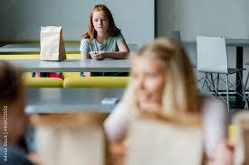

Scenario #1
A classmate is sitting alone at lunch
#KINDNESS

Slide 8


Scenario #2
You see someone being laughed at after getting an answer wrong in class.
#KINDNESS

Slide 9

Insert Video Here
#KINDNESS

Slide 10
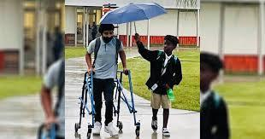
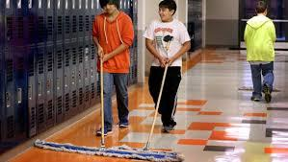
#KINDNESS
Think of one act of kindness that you can commit to this week.
Write it down on an index card.
Share aloud with your classmates and place it on the Kindness Wall designated by your teacher.
Kindness Commitment

Slide 11


Home Connection
Family Kindness List:
Work with your family on a list of 10 things each of you can do to show kindness to each other.
#KINDNESS

Slide 12
PBIS REWARDS
Insert School Mascot here
Teachers: Please pass out PBIS awards to students who show kindness. Examples are:
A student encourages another student who is struggling with an assignment.
2) A student compliments another student’s work.
#KINDNESS

