Slide 1



Kindness
GRADES 3rd -5th

Slide 2

Today we will…
Define kindness
Identify what kindness looks like
Apply kindness in your community

Slide 3
Insert Video Here

Slide 4

What is Kindness?
Acting sympathetic or helpful

Slide 5
One KIND word can change your entire day.

Slide 6




What does Kindness look like?
Showing appreciation
Speaking kind words
Thinking about ways to make others feel better
Helping others

Slide 7
Kindness is a universal language that can be spoken by everyone.

Slide 8

How would YOU show kindness?
A student in your grade gets teased all the time for the way they look. There are several kids who often call them unkind names. They do not have many friends and spend most of their time alone.
GIVE A HUG
SAY KIND WORDS
WRITE AN ENCOURAGING LETTER/NOTE
STAND UP FOR THEM

Slide 9
How would YOU show kindness?
Several students at recess thought it was fun to make jokes about other kids’ families. You realized that not everyone was laughing and one person started crying.
GIVE A HUG
SAY KIND WORDS
WRITE AN ENCOURAGING LETTER/NOTE
STAND UP FOR THEM

Slide 10
How do you feel when someone is kind to you?
HAPPY
NERVOUS
UNCOMFORTABLE
LOVED

Slide 11

8 Reasons to be KIND
Kindness can change lives
Kindness is habit-forming
Kindness adds meaning to our lives
Kindness ends sadness
Kindness is free
Kindness feels good
Kindness makes us better people
Kindness helps makes friends

Slide 12

Kindness Rocks!
Guide your class in a game of Kindness “Hot Potato”.
Form a large circle in the room.
Pass a ball (or lightweight item) around the circle.
Recite the tune, “Kindness rock, kindness rock, who has the kindness rock?”
At the end of the chant, the person holding the ball will complete one of the prompt options on the following slide.

Slide 13
Kindness Rocks!
The person holding the potato must choose one of the following prompts:
Give another classmate a compliment.
Share about a time you showed kindness to another classmate.
Share about a time that another classmate showed kindness to you.
What does being kind look like to you?

Slide 14
Kindness is spreading sunshine in someone’s life regardless of the weather.

Slide 15
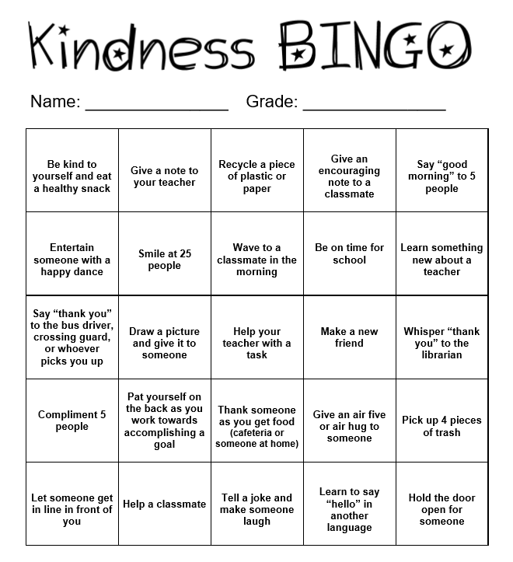
Cultivating Kindness in the Community
In order to cultivate a culture of kindness in the community, try to complete at least 20 of the activities on this Kindness BINGO card.

Slide 16
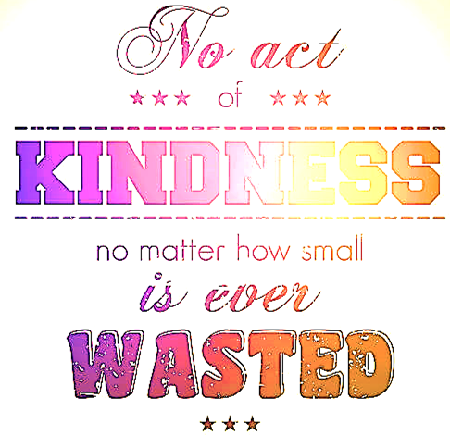

Slide 17
How will YOU show Kindness today?

