Slide 1
Teaching and Learning Report: Math
Kelly Jansen • Assistant Superintendent
Jolaine Mast • Director of Teaching and Learning • Elementary
Mark McIlmoyle • Director of Teaching and Learning • Secondary
Laura Larsen • Teaching and Learning Supervisor • Elementary
Ian Bronson • Teaching and Learning Supervisor • Secondary

Slide 2
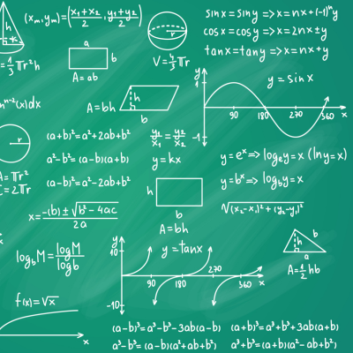
Math update Agenda:
Student Performance Data
Secondary Mathematics
Elementary Mathematics
Next Steps
Questions

Slide 3


Student Performance Data
What does the data tell us?

Slide 4
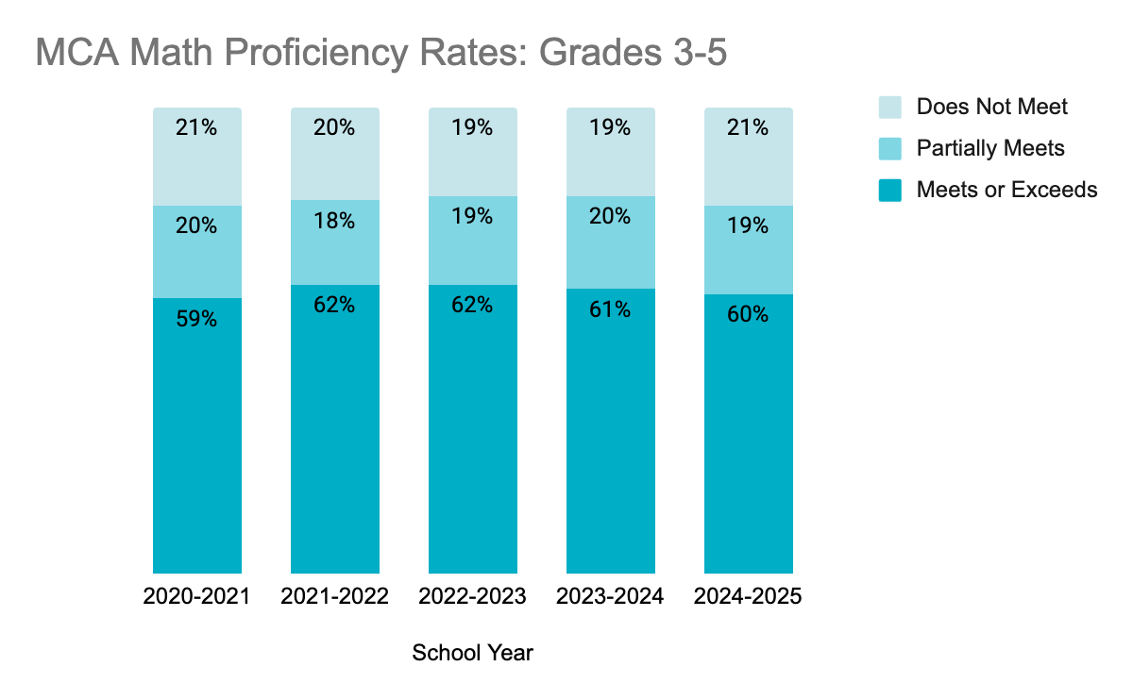
Math proficiency has been consistently around 60% over the past five years.

Slide 5
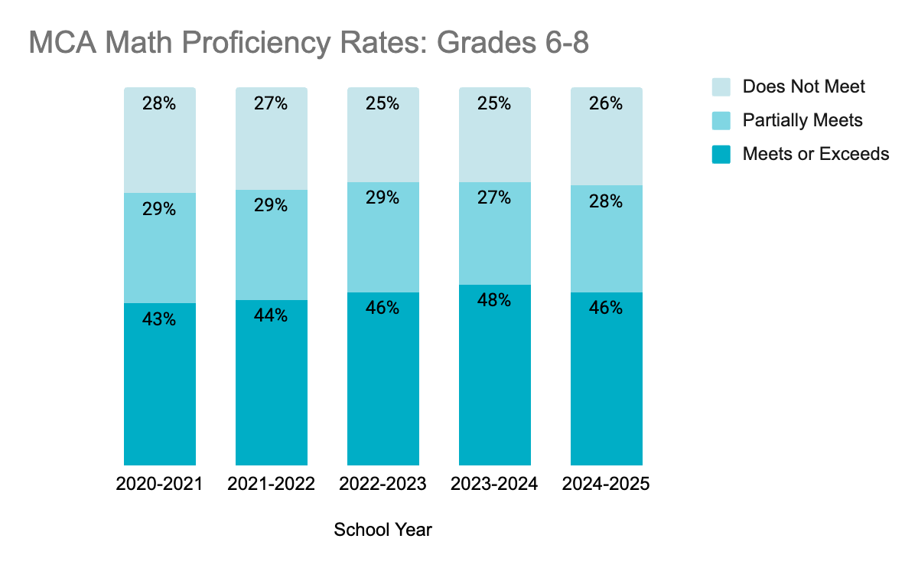
Math proficiency has consistently been around 46% over the past five years.

Slide 6
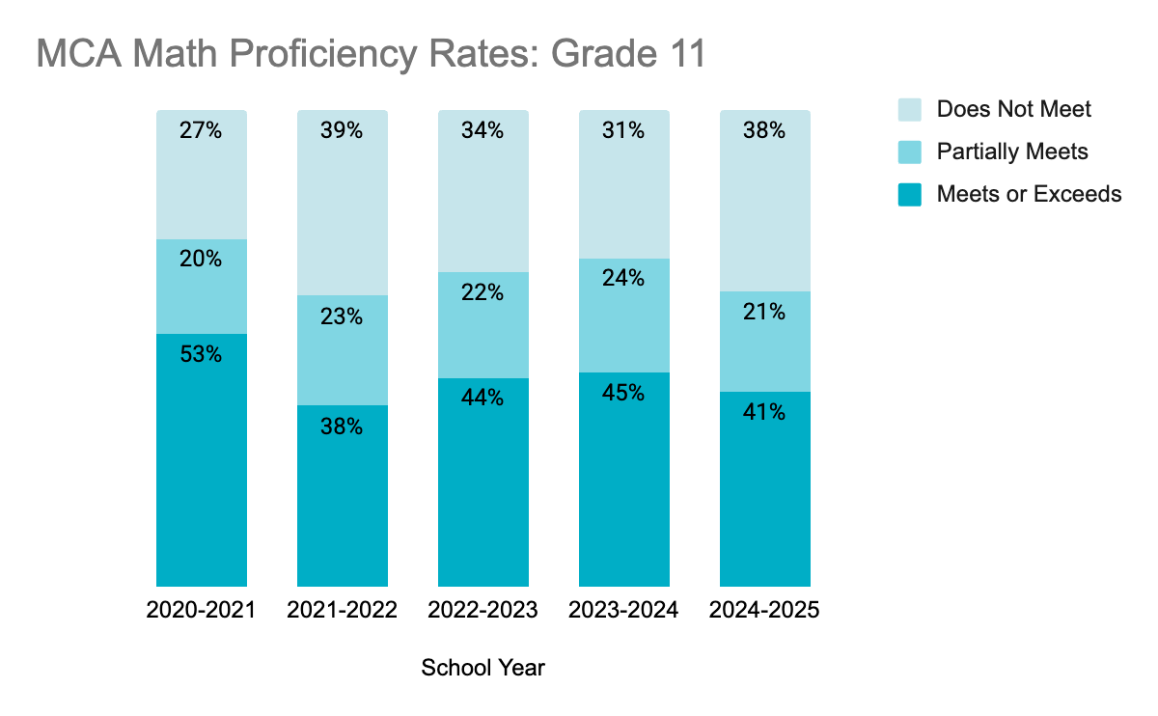
Math proficiency in grade 11 has the most variability compared to Grades 3-5 and 6-8.
Notes:
Students who meet or exceeds standards in 11th grade show readiness for college level courses and can bypass remedial courses at MN State Colleges and Universities.

Slide 7
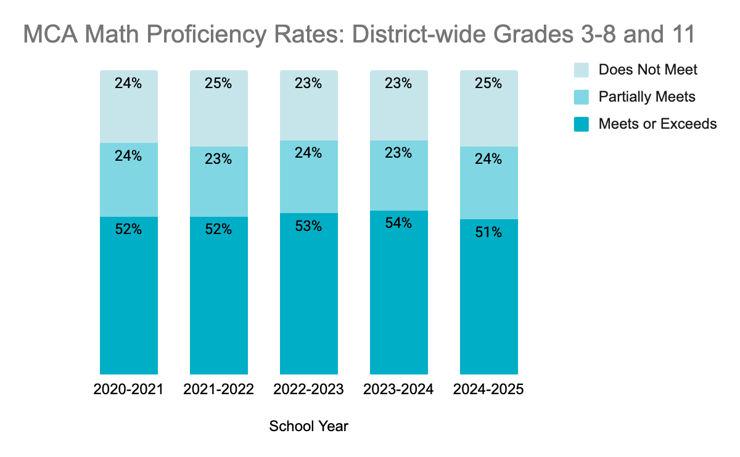
Math proficiency overall has been consistent.
Notes:
Data visualization tip: Include full scale 0-100%

Slide 8
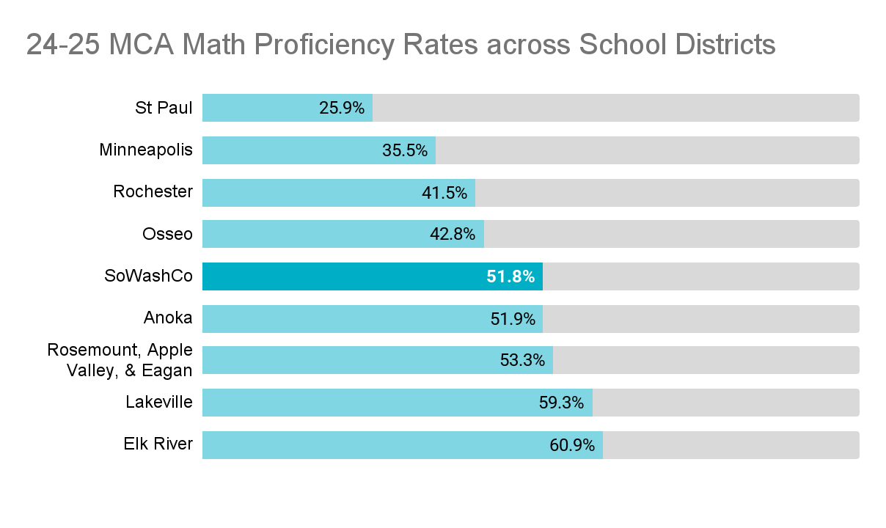
Our performance on Math MCAs compared to other metro area districts is in the middle.

Slide 9
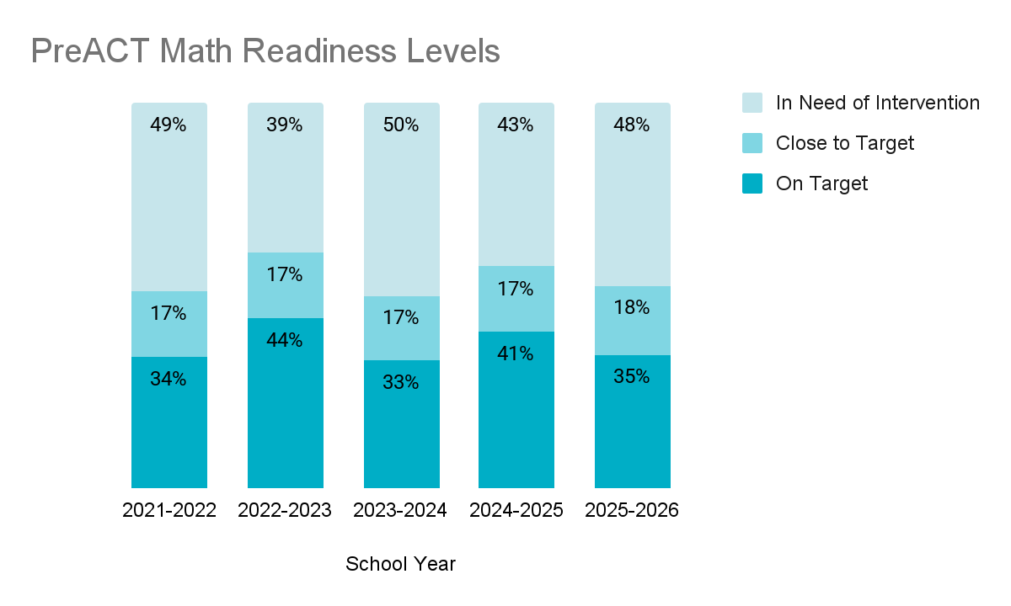
PreACT is a predictor of ACT performance.

Slide 10
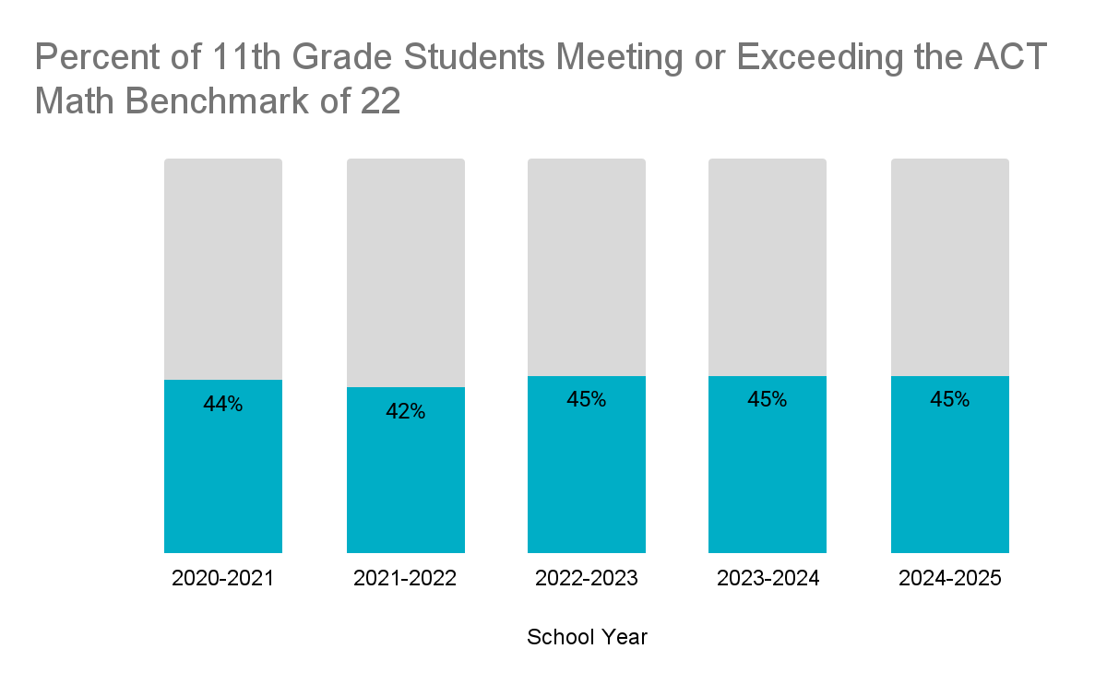
Meeting the Benchmark on the ACT indicates that students are well prepared for a college freshman level math course.

Slide 11
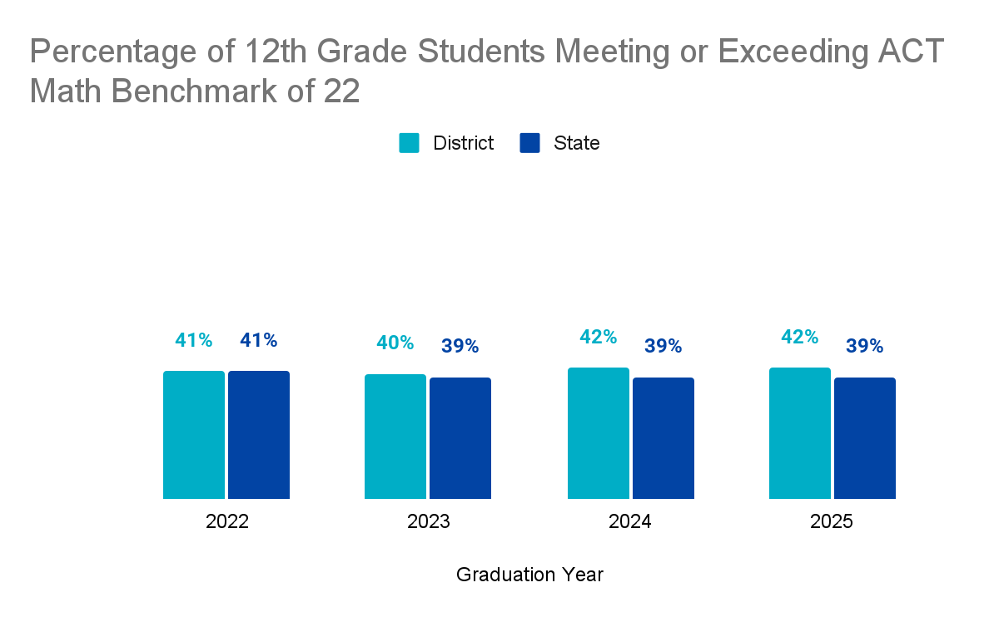
This graph shows how SoWashCo compares to the state on the ACT.

Slide 12
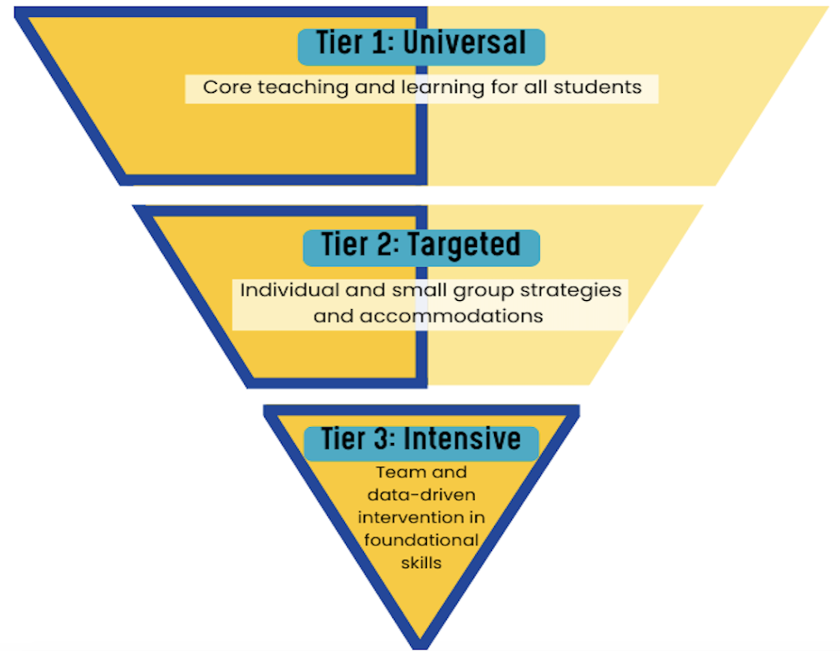
Mathematics in SoWashCo
Solid Tier One Core Instruction
Using Data to Plan Instruction
Strong Unit Planning Practices
Research-Based Curricular Resources

Slide 13
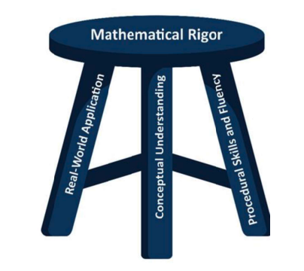
New MN Math Standards!
Pursue Mathematical Rigor with an equal intensity on:
Conceptual Understanding
Real-World Application
Procedural Skills and Fluency

Slide 14
Elementary Implementation Timeline
Task | Initial Implementation | Continued Implementation | Full Implementation
Year | 2025 - 26 | 2026 - 27 | 2027 - 28
SoWashCo FOCUS | Teams meet Trimester 3 | Teams focus on NEW standards | New standards using Bridges 3rd Edition Math MCA-IV assess new standards

Slide 15
Secondary Implementation Timeline
Task | Initial Implementation | Full Implementation | Continuous Improvement
Year | 2025 - 26 | 2026 - 27 | 2027 - 28
SoWashCo FOCUS | Build Scope and Sequence | Implement Scope and Sequence | Math MCA-IV assess new standards

Slide 16
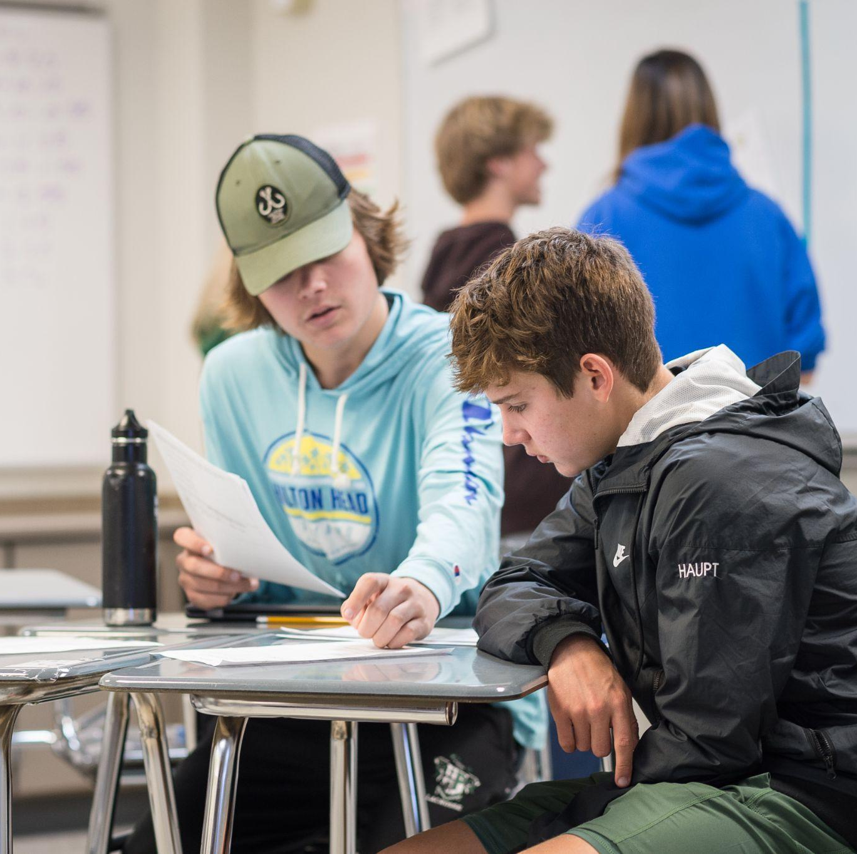
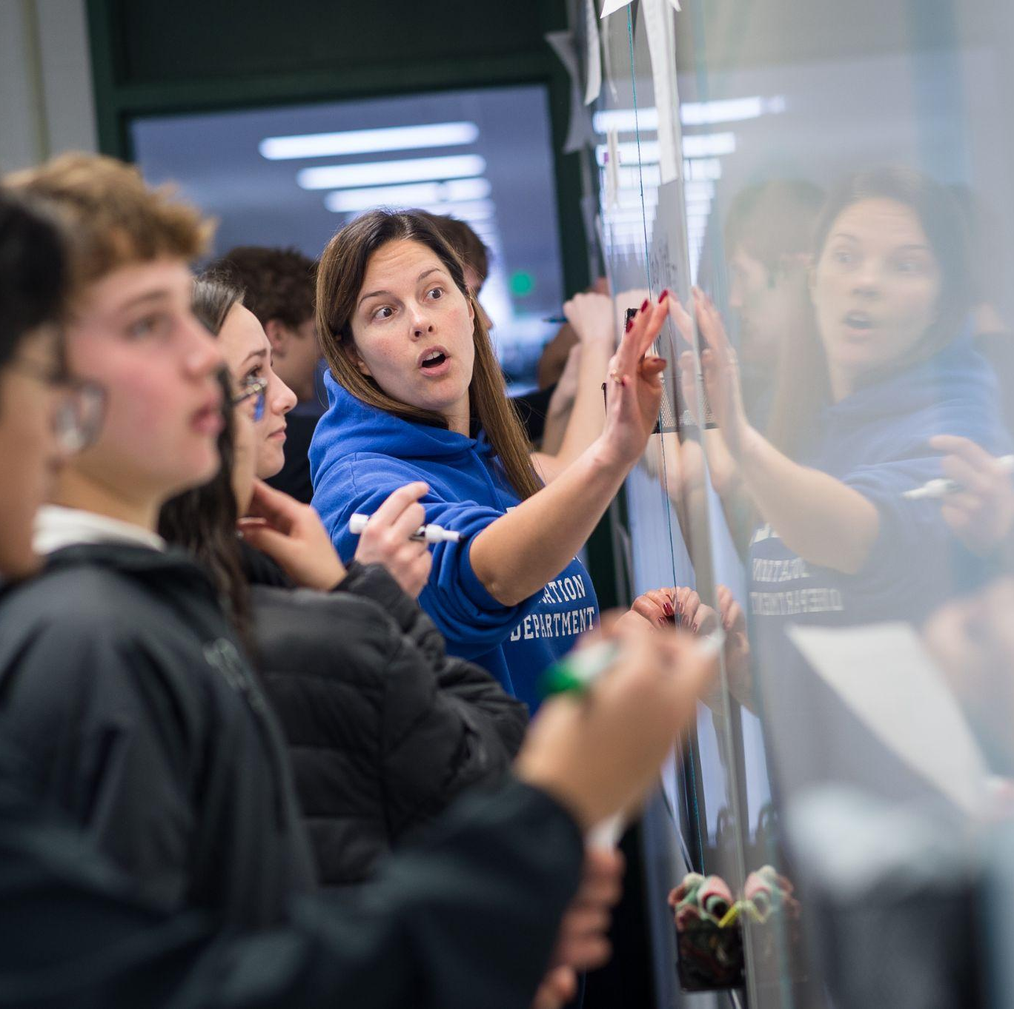
Secondary Mathematics

Slide 17
A snapshot into our schools:
Secondary Math Teachers Reflect on the new Math Standards and…
their work with colleagues as part of the Standard and Instruction Review Cycle (SIRC) and the Scope and Sequence Planning teams.

Slide 18


Slide 19
Implementing Math at the Secondary Level:
Grade level teams are collaboratively developing Scope and Sequence Plans for each required Math course:
Math 6
Pre-Algebra (7th grade*)
Middle School Algebra (8th grade)
Intermediate Algebra (9th grade)
Geometry (10th grade)
Algebra 2 (11th grade)
*Designates the typical grade level progression.
Notes:
REMEMBER TO ACKNOWLEDGE the AP / I

Slide 20
Implementing Math at the Secondary Level:
What is the focus of the Scope and Sequence Planning Work?
The placement and progression of the standards and benchmarks.
Developing specific learning targets.
Teachers work collaboratively across the district to address the benchmarks.

Slide 21

Implementing Math at the Secondary Level:
Middle School Math Resources for:
Math 6
Pre-Algebra
Middle School
Algebra

Slide 22

Implementing Math at the Secondary Level:
High School Math Resources for:
Intermediate Algebra
Geometry
Algebra 2

Slide 23
Implementing Math at the Secondary Level:
Why did the SIRC team select these resources?
Seamless embedding in Schoology
Digital access to all Minnesota standards and benchmarks
The resource is well laid out for students and teachers
Connection to Real Life math problems

Slide 24
Elementary Mathematics

Slide 25

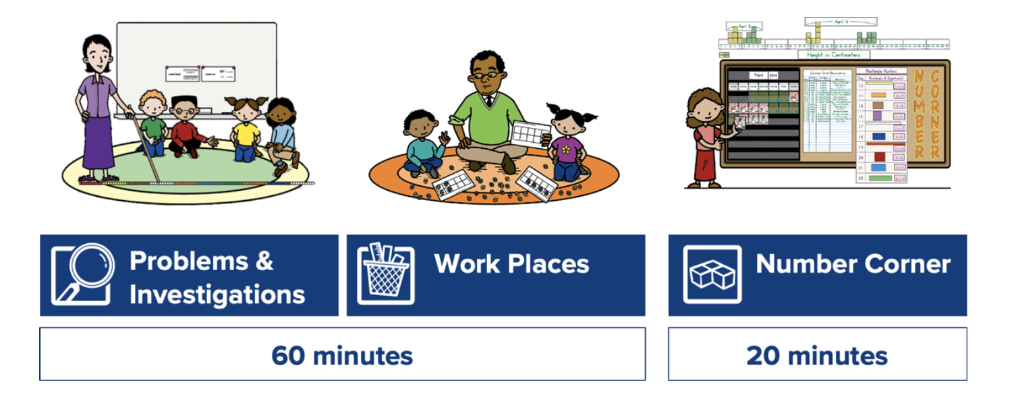
Bridges in Mathematics Components
New component for 25-26!

Slide 26

Concept Quests for K-5 Students
Problem-solving tasks that spark curiosity, encourage perseverance, and build math confidence.
Reinforces and extends grade-level learning with horizontal enrichment.

Slide 27
Concept Quests Tasks
Tasks should foster mathematical rigor.
Variety of access points
Choose strategies that make sense to them
  Explore conceptual underpinnings
Comparing/contrasting solution strategies
  Find efficiencies and consolidate understanding

Slide 28
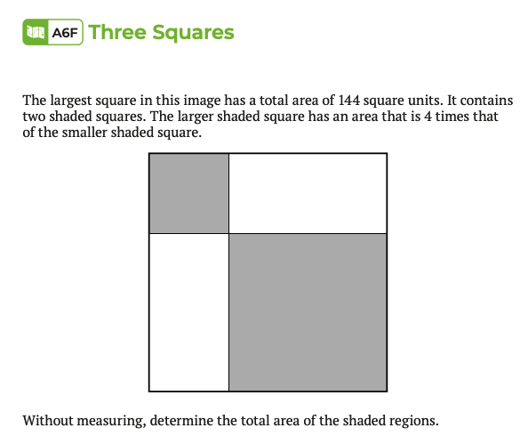
Concept Quests Task Example
3rd Grade Example
Aligns with Unit 6 (Geometry)

Slide 29
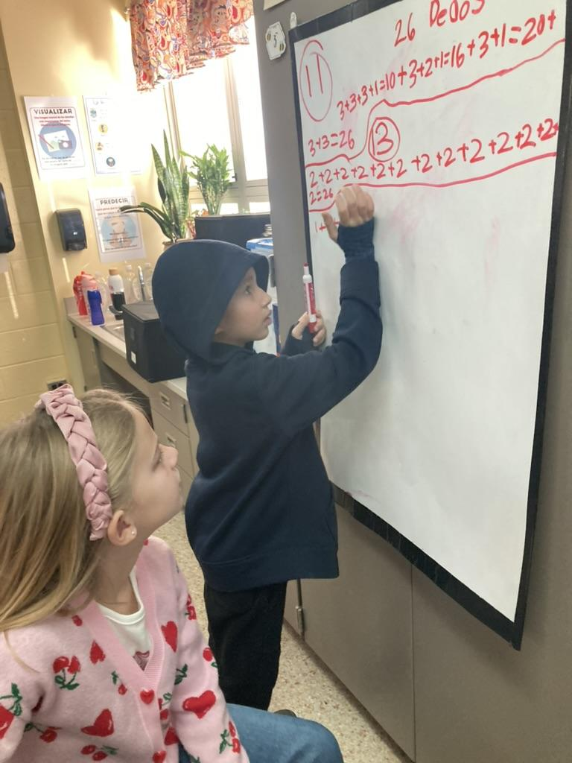
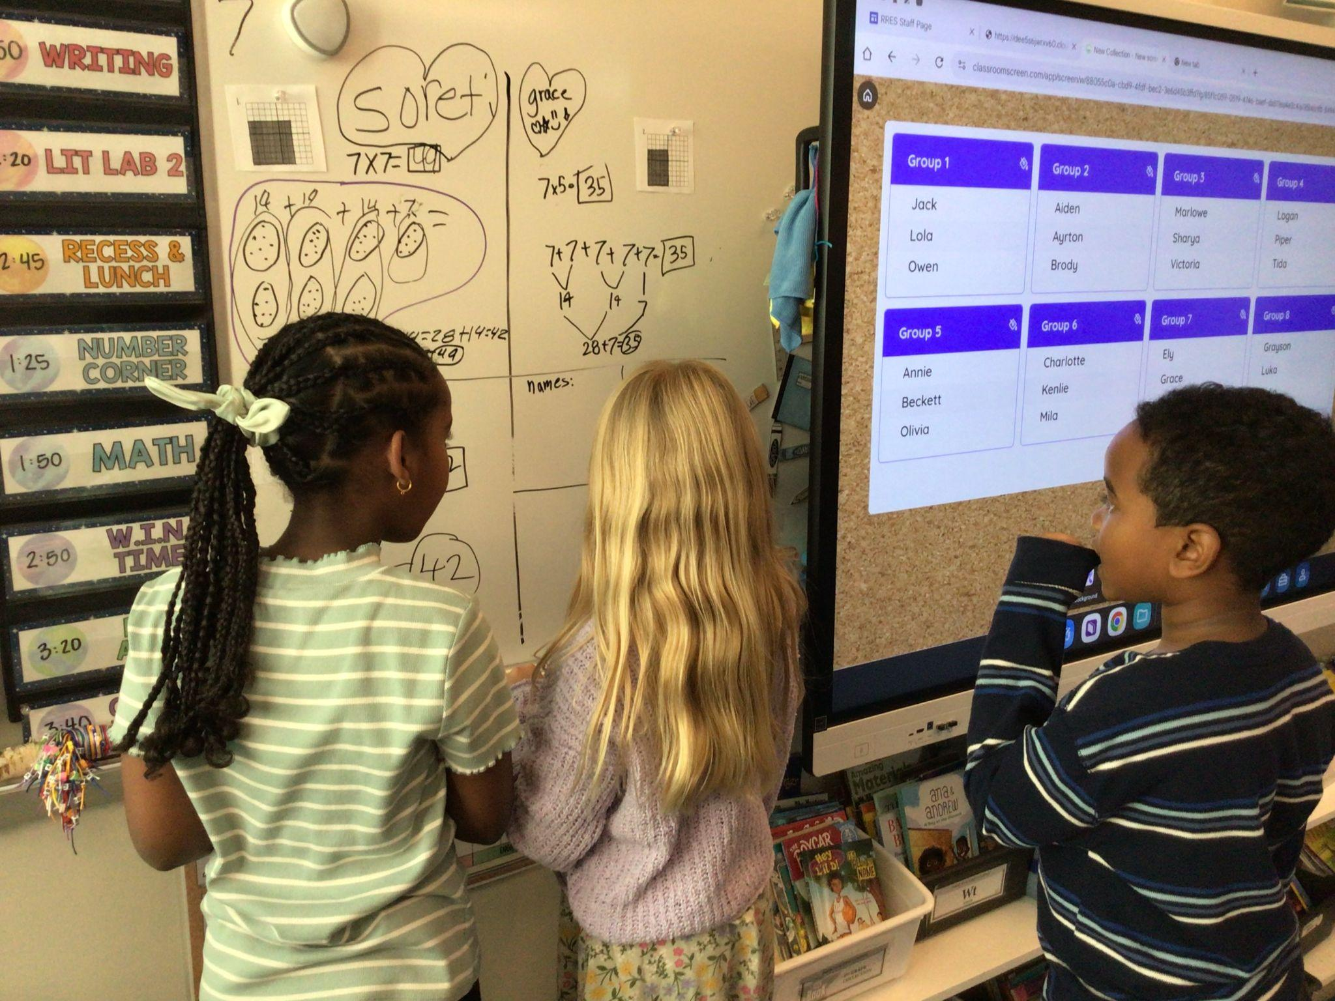
Tasks in Action
Give rich, rigorous thinking tasks
Frequently form visibly random groups
Use vertical non-permanent surfaces

Slide 30


Slide 31
Questions?

Slide 32
Thank you

