Slide 1

City of Medford
Tax Classification Hearing
Fiscal Year 2026
Jared Yagjian, MAA
Medford Board of Assessors
November 18, 2025

Slide 2
Purpose of the Hearing
To adopt the City’s Tax Policy by allocating or classifying the tax levy among the property types

Slide 3
Action Required by the City Council
Vote for a single tax rate or maintain up to the 175% shift of the tax levy from the Residential class to the Commercial/Industrial and Personal Property classes
Vote whether to adopt a residential exemption
Vote whether to adopt a small commercial exemption

Slide 4
FY26 Budgeted Revenue as amended ($221.8m)

Slide 5
Property Assessment Review
Arm’s-length sales data from Calendar Year 2024 were used to establish the Fiscal Year 2026 Assessments. MGL requires that Assessors value properties at a median assessment to sales (ASR) ratio of 90% to 110%
The Massachusetts Department of Revenue certified Medford’s assessed values for real property and personal property on October 17, 2025

Slide 6
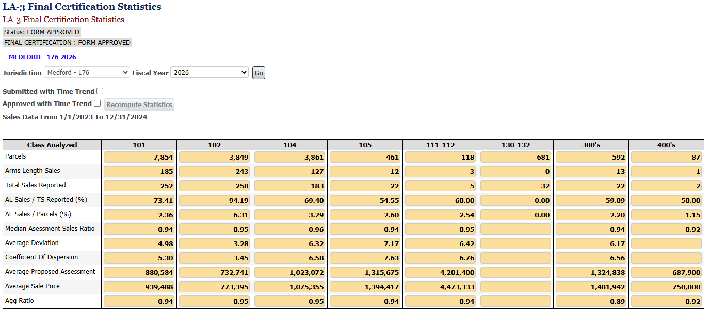
Property Assessment Review (continued)
Source: DLS LA-3 Final Certification Statistics

Slide 7
Property Assessment Review (continued)
Percentage Change in Average Assessments by Property Type
Property Type | FY 25 Average | FY 26 Average | Percentage Change
Single Family | $ 804,889 | $ 860,609 | 6.92%
Condominium | $ 578,211 | $ 610,936 | 5.66%
Two Family | $ 973,750 | $ 1,018,827 | 4.63%
Three Family | $ 1,105,853 | $ 1,182,090 | 6.89%
Apartments | $ 6,419,575 | $ 7,440,075 | 15.90%
Commercial | $ 1,995,783 | $ 2,075,889 | 4.01%
Industrial | $ 2,321,172 | $ 2,390,749 | 3.00%
Personal Property | $ 639,300 | $ 769,958 | 20.44%
*The percentage change is inclusive of new growth in each property type. Calculated from LA-4 data.

Slide 8
FY 2026 Average Assessed Values in Surrounding Communities
Municipality | Single Family | Condominiums | Two Family | Three Family | Apartment | Commercial | Industrial
Arlington | $1,119,993 | $670,337 | $1,164,892 | $1,230,854 | $4,869,809 | $1,424,364 | $1,420,238
Everett | #VALUE! | #VALUE! | #VALUE! | #VALUE! | #VALUE! | #VALUE! | #VALUE!
Malden | $666,317 | $449,436 | $860,936 | $991,891 | $5,873,547 | $1,864,505 | $2,631,519
Medford | $860,609 | $610,936 | $1,018,827 | $1,182,090 | $7,440,075 | $2,075,889 | $2,390,749
Somerville | #VALUE! | #VALUE! | #VALUE! | #VALUE! | #VALUE! | #VALUE! | #VALUE!
Stoneham | $801,126 | $448,806 | $795,765 | $932,833 | $12,955,581 | $1,552,035 | $2,168,490
Winchester | $1,649,878 | $784,874 | $1,299,081 | $1,477,539 | $13,327,864 | $1,586,609 | $3,080,407
Notes:
Everett and Somerville have not reported as of 11/13/2025. Will update prior to hearing.

Slide 9
Percent Change Fiscal Year 2025 to Fiscal Year 2026 of Assessed Values in Surrounding Communities
Municipality | Single Family | Condominiums | Two Family | Three Family | Apartment | Commercial | Industrial
Arlington | 3.99% | 5.55% | 2.94% | 2.74% | 3.71% | 6.31% | 2.42%
Everett | #VALUE! | #VALUE! | #VALUE! | #VALUE! | #VALUE! | #VALUE! | #VALUE!
Malden | 5.87% | 5.33% | 7.06% | 6.97% | 8.61% | 8.89% | 10.37%
Medford | 6.92% | 5.66% | 4.63% | 6.89% | 15.90% | 4.01% | 3.00%
Somerville | #VALUE! | #VALUE! | #VALUE! | #VALUE! | #VALUE! | #VALUE! | #VALUE!
Stoneham | 4.62% | 7.61% | 5.02% | 6.28% | 19.14% | 3.18% | 3.48%
Winchester | 3.36% | 5.11% | 4.02% | 8.61% | 5.87% | 5.26% | 6.98%
% Change is inclusive of new growth
Notes:
Everett and Somerville have not reported as of 11/13/2025. Will update prior to hearing.

Slide 10
New Growth
New Growth is defined by the DOR as a dollar increase in the annual levy limit that reflects additions to the community’s tax base since the last fiscal year
New Growth was certified on October 17, 2025 at $280,388,145 in Assessed Value, or $3,534,431 in Tax Levy Growth
(based on the FY25 tax rates)
Residential new growth made up $1,313,886 while commercial, industrial and personal property new growth totaled $2,220,545

Slide 11
New Growth
Property Class | New Growth Valuation | PY Tax Rate | Tax Levy Growth
SINGLE FAMILY (101) | 17,424,100
CONDOMINIUM (102) | 12,628,002
TWO & THREE FAMILY (104 & 105) | 14,918,000
MULTI - FAMILY (111-125) | 101,175,500
VACANT LAND (130-132 & 106) | 0
ALL OTHERS (103, 109, 012-018) | 3,159,608
TOTAL RESIDENTIAL | 149,305,210 | 8.80 | 1,313,886
OPEN SPACE | 0
OPEN SPACE - CHAPTER 61, 61A, 61B | 0
TOTAL OPEN SPACE | 0
COMMERCIAL | 26,293,245
COMMERCIAL - CHAPTER 61, 61A, 61B | 0
TOTAL COMMERCIAL | 26,293,245 | 16.94 | 445,408
INDUSTRIAL | 2,120,500 | 16.94 | 35,921
PERSONAL PROPERTY | 102,669,190 | 16.94 | 1,739,216
TOTAL REAL & PERSONAL | 280,388,145 |  | 3,534,431

Slide 12
New Growth Value

Slide 13
New Growth Value Trends

Slide 14
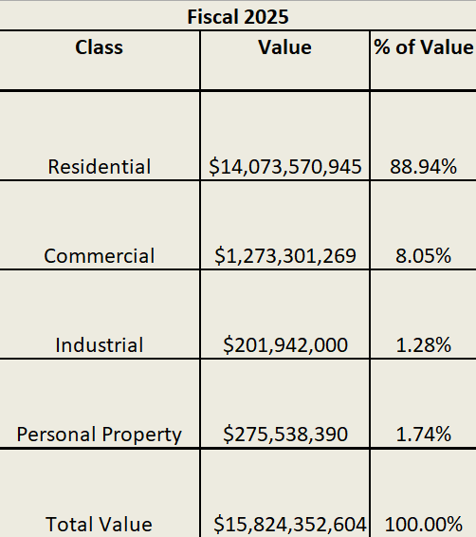
Fiscal 2026 Value by Class
Fiscal 2026
Class | Value | % of Value
Residential | $14,987,529,174 | 88.81%
Commercial | $ 1,322,534,507 | 7.84%
Industrial | $207,995,200 | 1.23%
Personal Property | $358,030,330 | 2.12%
Total Value | $16,876,089,211 | 100.00%

Slide 15
How the Tax Rate is Calculated*
 | FY2026 Property Tax Levy |  |  |  | $160,857,343
 | ______________________ |  |  |  | ______________ | = | 0.009532
 | FY2026 City Taxable Valuation |  |  |  | $16,876,089,211
 | $9.53 per thousand dollars of assessed value if a uniform rate is selected
 | The Full Shift of 175% will yield a $8.63 residential tax rate and a
 | $16.68 Commercial/Industrial/Personal Property Tax Rate
*All rates are estimates until Medford receives DOR approval for FY26. Shift may need to be rounded for levy limit purposes.

Slide 16
Historical Percent of Levy by Class
Fiscal Year | Residential Percentage of Levy | CIP Percentage of Levy
2017 | 80.01 | 19.99
2018 | 80.68 | 19.32
2019 | 81.52 | 18.48
2020 | 81.98 | 18.02
2021 | 81.64 | 18.36
2022 | 82.16 | 17.84
2023 | 82.05 | 17.95
2024 | 80.75 | 19.25
2025 | 80.68 | 19.32
2026 | 80.42 | 19.58

Slide 17
Selection of Minimum Residential Factor
A residential factor of 1 will result in the taxation of all property at the same rate (single tax rate)
A residential factor of less than 1 increases the share of the levy raised by Commercial, Industrial and Personal Property (CIP) owners and reduces the share paid by residential property owners (split tax rate)
The minimum residential factor for the City of Medford for Fiscal Year 2026 is .905494, as calculated by the Massachusetts Department of Revenue guidelines

Slide 18
Residential Factor/Split Rate*
MGL Ch. 40 § 56 allows a shift of up to 1.75 of the tax burden between the classes of property
Adoption of a Residential Factor(RF) of 1.0 results in a single tax rate
Adoption of a RF of .905494 results in a maximum split tax rate
The impact on the Property Class Rate is as follows:
CIP Factor | Residential | CIP | Residential Levy | Com/Ind/PP Levy
1.00 | $9.53 | $9.53 | $142,856,209 | $18,001,134
1.50 | $8.93 | $14.30 | $133,855,641 | $27,001,702
1.75 | $8.63 | $16.68 | $129,355,358 | $31,501,985
*All rates are estimates until Medford receives DOR approval for FY26.

Slide 19
FY 26 Average Property Tax Bill Examples
Single Tax Rate: Tax Bill
Avg. Single Family House Value = $860,609 x $9.53/1000 = $8,202
Avg. Commercial Value = $2,075,889 x $9.53/1000 = $19,783
Split Rate with CIP 150%: Tax Bill
Avg. Single Family House Value = $860,609 x $8.93/1000 = $7,685
Avg. Commercial Value = $2,075,889 x $14.30/1000 = $29,685
Split Rate with CIP 175%: Tax Bill
Avg. Single Family House Value = $860,609 x $8.63/1000 = $7,427
Avg. Commercial Value = $2,075,889 x $16.68/1000 = $34,626
*Average Tax Bills are rounded
**All rates are estimated until Medford receives DOR approval for FY26

Slide 20
Historical Recap of Average
Single-Family Tax Bill
Fiscal Year | Average Single-Family Value | Percentage Value Change YOY | Average Single Family Tax Bill (Split Rate: CIP 175%) | $ Change YOY | % Change YOY
2016 | $424,189 | 7.53% | $4,747 | $132 | 2.86%
2017 | $475,910 | 12.19% | $5,026 | $279 | 5.88%
2018 | $508,238 | 6.79% | $5,204 | $178 | 3.54%
2019 | $565,215 | 11.21% | $5,426 | $222 | 4.27%
2020 | $615,010 | 8.81% | $5,646 | $220 | 4.05%
2021 | $612,965 | -0.33% | $5,768 | $122 | 2.16%
2022 | $654,409 | 6.76% | $5,903 | $135 | 2.34%
2023 | $718,458 | 9.79% | $6,215 | $312 | 5.29%
2024 | $768,849 | 7.01% | $6,551 | $336 | 5.41%
2025 | $804,888 | 4.69% | $7,083 | $532 | 8.12%
2026 | $860,609 | 6.92% | $7,427 | $344 | 4.86%

Slide 21
Residential Exemption
This option must be established early in the fiscal year so that residents can apply prior to the setting of the tax rate
Must be owner-occupied, primary residence to qualify and must apply with an application as well as supporting documents
The reduced value remains within the residential levy percent resulting in a higher residential tax rate
Residential properties above the breakeven would see an increase in property taxes
Using FY26 calculations and assumptions:
  The 35% Exemption had a breakeven of approximately $1,038,727
  The Residential tax rate would increase to $12.29 per $1000 with this exemption.
As of FY26, 20 of 351 communities have adopted a residential exemption:
  Barnstable, Boston, Brookline, Cambridge, Chelsea, Concord, Eastham, Everett, Malden, Mashpee, Nantucket, Oak Bluffs, Provincetown, Somerville, Tisbury, Truro, Waltham, Watertown, Wellfleet, West Tisbury (10 of the 20 communities are located on Cape and Islands)

Slide 22
Granting a Small Commercial Exemption
The City Council may adopt a small commercial exemption
This exemption is for commercial parcels (property class three) occupied by businesses with an average annual employment of not more than (10) people during the previous calendar year and with assessed values of less than $1,000,000
The intent of the exemption is to give a tax reduction to small commercial property owners at the expense of the larger commercial and industrial parcels
Council can choose an exemption that reduces the taxable valuation of each eligible parcel by a percentage of up to 10%

Slide 23
Classification Vote Summary
Selection of a Minimum Residential Factor
  A Factor of 1 yields a single rate and would result in a $9.53 rate
  A Factor of .905494 yields a split tax rate of $8.63 for residential and $16.68 for Commercial/Industrial/Personal Property
Vote on whether to adopt a Residential Exemption
  With a low number of non-owner-occupied properties, this shifts a portion of the residential levy from lower-valued residential properties to higher valued properties
  This decision must be made early in the fiscal year to allow for applications and tax rate setting
Vote on whether to adopt a Small Commercial Exemption
  This exemption is for commercial properties valued under $1 million and occupied by business(s) with less than ten employees
  This exemption benefits property owners, typically not small business tenants
  This shifts up to 10% of the value of those properties to other commercial and industrial properties
  This decision must be made early in the fiscal year to allow for applications and tax rate setting

