Slide 1

2021-22
District Annual Report
Public Hearing
Nederland ISD
February 20, 2023

Slide 2
8 Sections to the 2021-22 District Annual Report
2021-22 Texas Academic Performance Report (PDF TAPR)
  For the District and each Campus in the District
PEIMS Financial Standard Report (2020-21 Financial Actual Report)
  For the District and each Campus in the District
2021-22 District Accreditation Status
Campus Performance Objectives
Report on Violent or Criminal Incidents on Campuses
Student Performance in Postsecondary Institutions
  For each High School Campus in the District
Progress Toward Board-adopted HB 3 Goals
  For the District and each Campus in the District
2021-22 TAPR Glossary

Slide 3
Section 1
2021-22 Texas Academic Performance Report (TAPR)
Compiled by TEA for every district and campus using
  PEIMS
  Student Assessment Data
2021-22 TAPR is published as a PDF
  Includes a wide range of information on the performance of students in each district and campus in the state
  Performance is shown disaggregated by student groups, including ethnicity and socioeconomic status
  Provides extensive information on school and district staff, programs, and student demographics

Slide 4
Section 1
2021-22 Texas Academic Performance Report (TAPR)
Cover Page
  2022 Accountability Rating
    A, B, C or Not Rated: Senate Bill 1365
    Reported for the District and for each Campus
  2022 Special Education Determination Status
    Only reported on the district’s TAPR
  2022 Armed Services Vocational Aptitude Battery (ASVAB) Test
    Only reported on the district’s TAPR and only reported if the district did not offer the ASVAB Test or offered an ASVAB Alternative Test
  2022 Distinction Designations
    Reported for the District and for each Campus

Slide 5
Section 1
2021-22 Texas Academic Performance Report (TAPR)
STAAR Performance – reported for 2022 and 2021
  All 3 performance rates
    Approaches Grade Level or Above
    Meets Grade Level or Above
    Masters Grade Level
  Reported for
    Each Assessment
    All Grades All Subjects
    All Grades by Subject
STAAR – Academic Growth – reported for 2022 and 2019
  Only calculated in Reading (Grades 4-8 and English II) and Math (Grades 4-8 and Algebra I)
  Reported by Grade and Subject
  Because Academic Growth requires consecutive years of STAAR performance, it could not be calculated for 2020 or 2021 (due to the cancellation of STAAR in 2020)

Slide 6
Section 1
2021-22 Texas Academic Performance Report (TAPR)
Bilingual Education/English as a Second Language
  Includes STAAR performance (disaggregated by various program instructional models) for students identified as current Emergent Bilinguals (EBs) or English Learners (ELs)
    Reported for 2022 and 2021
STAAR Participation
  Reported for 2022 and 2021

Slide 7
Section 1
2021-22 Texas Academic Performance Report (TAPR)
Attendance, Graduation, and Dropout Rates – reported for 2020-21 and 2019-20 (the most recent years for which data have been reported to TEA)
  Attendance Rate
  Annual Dropout Rate (Gr. 7-8 and Gr. 9-12)
  4-year Longitudinal Graduation Rates (State and Federal Rates)
  5-year Extended Longitudinal Graduation Rates (State)
  6-year Extended Longitudinal Graduation Rates (State)
  Graduation Plan Rates (Longitudinal and Annual)
Graduation Profile – 2020-21 Graduates

Slide 8
Section 1
2021-22 Texas Academic Performance Report (TAPR)
College, Career and Military Readiness (CCMR)
  CCMR Graduates
  College Ready Graduates
  Career/Military Ready Graduates
CCMR-Related Indicators
  TSIA Results
  CTE Coherent Sequence
  Completed and Received Credit for College Prep Courses
  AP/IB Results
  SAT/ACT Results
Other Postsecondary Indicators
  Advanced Dual-Credit Course Completion
  Graduates Enrolled in Texas Institutions of Higher Education (TX IHE)
  Graduates in TX IHE Completing One Year Without Enrollment in a Developmental Education Course
  The most recent data for these measures are from the 2020-21 school year. Therefore, performance on these measures is reported for the 2020-21 and 2019-20 school years.

Slide 9
Section 1
2021-22 Texas Academic Performance Report (TAPR)
Student Information
  Student enrollment (including enrollment by grade level, by ethnicity, by certain student identification indicators, and students with disabilities by primary eligibility category) and other student information (including graduation information, retention rates, and class size information)
Staff Information
  Staff information (including total staff, staff by classification, teachers by ethnicity and gender, teachers by highest degree held and years of experience, experience of campus leadership, staff salary, and teacher turnover rate information)
Program Information
  Student Enrollment by Program
  Teachers by Program (population served)

Slide 10
Section 2
PEIMS Financial Standard Reports (2020-21 Financial Actual Reports)
2020-21 Actual Financial Data
(District)
Revenues
Expenditures
Disbursements
Tax Rates
Fund Balance
2020-21 Actual Financial Data
(Campus)
Expenditures by Object
Expenditures by Function
Program Expenditures by Program
  2020-21 is the most recent year for which these data are available.

Slide 11
Section 3
2021-22 District Accreditation Status
Generally, each year TEA assigns one of four accreditation statuses to each district in the state:
  Accredited
  Accredited-Warned
  Accredited-Probation
  Not Accredited-Revoked
In assigning an accreditation status to a district, TEA considers
  Academic accountability ratings
  Financial accountability ratings
  Data integrity
  Program-area deficiencies identified through Results Driven Accountability (RDA)
Due to the impact of COVID and the unique challenges faced by schools in the 2019-20 and 2020-21 school years, the Commissioner has decided not to assign accreditation statuses until the 2022-23 school year
Therefore, the district was not assigned an accreditation status for 2021-22

Slide 12
Section 4
Campus Performance Objectives
Campus Improvement Plans (CIP)
  Each campus has developed and is implementing a CIP, as required by TEC §11.253
  Each CIP includes performance objectives (approved by the Board) that are based on data analysis and needs assessments – including data reported in annual TAPR reports
  Each campus periodically measures progress toward its performance objectives
  Updated CIPs for the 2021-22 school year (which show each campus’s progress toward meeting its performance objectives) are posted on the district’s website and are available for review at the district’s central office or at the applicable campus

Slide 13
Section 5
Report on Violent or Criminal Incidents
TEC Section 39.306 requires each district to publish, as part of its Annual Report, a report on violent or criminal incidents that occur at each campus
The report must include
  Number, rate and type of violent or criminal incidents that occurred on each campus (to the extent permitted under FERPA)
  Descriptions of school violence prevention and violence intervention policies and procedures used to protect students
  Findings from evaluations (if any) conducted under the Safe and Drug-Free Schools and Communities Act
The district’s report for the 2021-22 school year is available for review at the district’s central office and at each campus in the district

Slide 14
Section 5
Report on Violent or Criminal Incidents
As required by TEA, the district has taken the following actions prior to the start of the 2022-23 school year:
  Conduct a Summer Targeted Partial Safety Audit
  Conduct an Exterior Door Safety Audit
  Convene the district’s Safety and Security Committee to review:
    the multi-hazard emergency operations plan (EOP)
    and, as a component of the EOP, the district’s active threat plan
  Ensure all campus staff (including substitutes) are trained on their specific district and campus safety procedures
  Schedule all mandatory drills for the school year
  Ensure all threat assessment team members are trained
  Review and, as necessary, update access control procedures
Additional descriptions of school violence prevention and violence intervention policies and procedures that the district is using to protect students are available in the District Improvement Plan and the corresponding Campus Improvement Plans (which are posted on the districts’s website)

Slide 15
Section 6
Student Performance in Postsecondary Institutions
TEC Section 39.306 requires each district to publish, as part of its Annual Report, a report on student performance in postsecondary institutions during the first year enrolled after graduation from high school
These data are compiled by the Texas Higher Education Coordinating Board (THECB)
The most current report is for 2018-19 High School Graduates
  Student performance is measured by the Grade Point Average (GPA) earned by 2018-19 high school graduates who attended public four-year and two-year institutions of higher education in fiscal year 2019
  For each student, the grade points and college-level semester credit hours earned by the student in Fall 2019, Spring 2020, and Summer 2020 are added together and averaged to determine the GPA

Slide 16
Section 7
Progress of the District and Each Campus Toward Meeting Board-adopted HB 3 Goals
TEC Section 39.306 requires each district to include, as part of its Annual Report, the progress of the district and each campus in the district toward meeting the goals set in the district's:
  early childhood literacy and mathematics proficiency plans adopted under TEC §11.185; and
  CCMR plans adopted under TEC §11.186
The progress made by the district and each campus as of the end of the 2021-22 school year is summarized in the HB 3 Progress Report provided to the Board [as part of this presentation or reference the meeting at which the HB 3 Progress Report was provided]

Slide 17
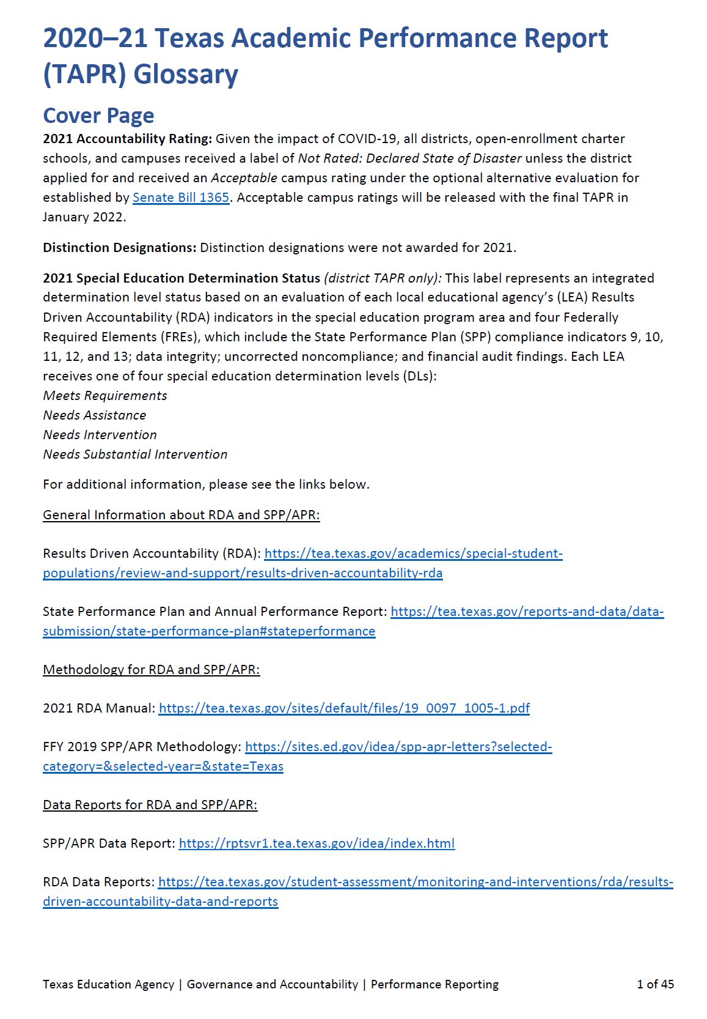
Section 8
TAPR Glossary
Each year, TEA prepares and publishes a TAPR Glossary
The TAPR Glossary provides definitions, describes methodologies, and lists sources for each data point in the TAPR
A Spanish version of the TAPR Glossary is scheduled for release in late winter

Slide 18
Resources and Availability of Annual Report
The District’s TAPR will be posted on the district’s website within 2 weeks after this meeting
Paper copies will also be available at the district’s central office and on each campus in the district
For questions or more information, contact:
Name | Dr. Steven Beagle
Position | Assistant Superintendent for Curriculum & Instruction
Phone | (409) 724-2391
Email | sbeagle@nederlandisd.org

