Slide 1

Trinity County Office of Education
2022/23 Adopted Budget and Multiyear Projection 2022/23 through 2024/25
Gretchen Deichler
Assistant Superintendent Business Services
gretchend@tcoek12.org
(530) 623-2861 ext 229

Slide 2
Overview
Look back in time…
General Fund Assumptions for 2022/23 Proposed Budget and Multiyear Projection
Staff Assumptions
Average Daily Attendance Trends
  Countywide Historical Data
General Fund Revenue & Expenditures
General Fund Multiyear Projection 2021/22– 2024/25
Special Reserve Funds Multiyear Projections 2021/22 – 2024/25
Summary of Criteria and Standards

Slide 3
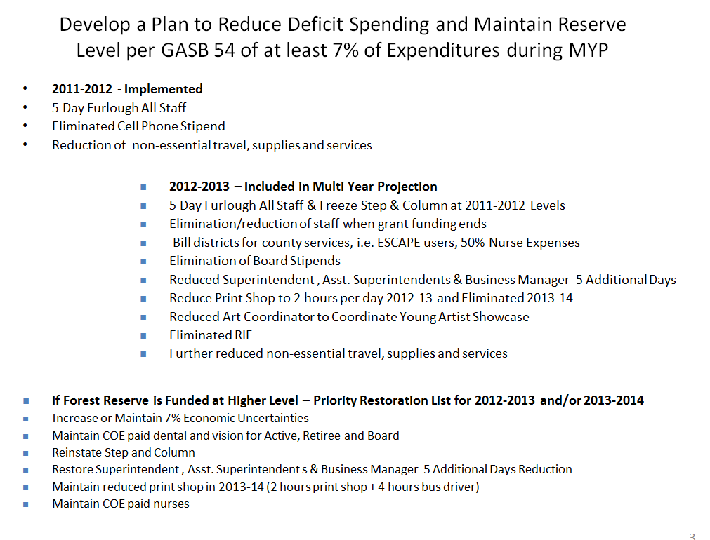
Look back in time…
My first year as CBO at TCOE

Slide 4
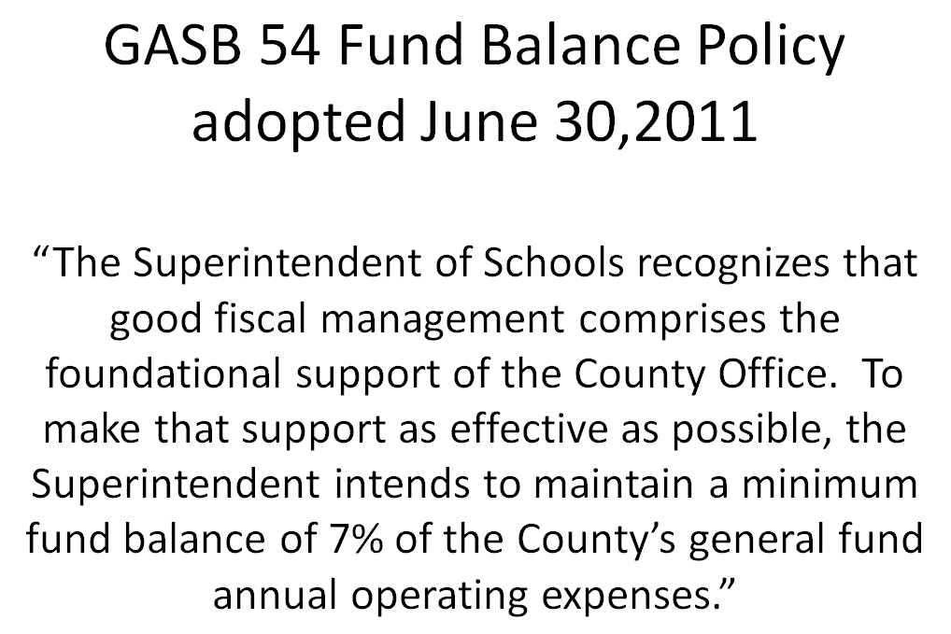
Look back in time…
My first year as CBO at TCOE

Slide 5
General Fund Assumptions 2022/23 Budget and Multiyear Projections
Funded LCFF COLA by Dept. of Finance
2022/23 6.56%
2022/23 5.38%
2023/24 4.02%
 | 2022/23 | 2023/24 | 2024/25
9 districts @ | $134,317 | $141,543 | $147,233
1 base @ | $805,906 | $849,264 | $7883,404
EC 2575.2 | $200,000 | $200,000 | $200,000
ADA @ | $86.00 | $90.63 | $94.28
This does not include the additional $175K per district in the May Revision and was NOT included in the revenue projections pending signed budget.

Slide 6
Other Assumptions
 | 2022/23 | 2023/24 | 2024/25
STRS Employer Rates (Approximate) | 19.10% | 19.10% | 19.10%
PERS Employer Rates (Approximate) | 25.37% | 25.20% | 24.60%
State Unemployment Insurance | .50% | .50% | .20%
Lottery – Unrestricted per ADA | $163 | $163 | $163
Lottery – Prop. 20 per ADA | $65 | $65 | $65
Mandated Block Grant for COE K-8 per ADA 9-12 per ADA Countywide | $34.94 $67.31 $1.10 | $36.82 $70.93 $1.13 | $38.30 $73.78 $1.16

Slide 7
TCOE Staffing Assumptions 2021/22 through 2024/25
Bargaining Unit | 2021/22 2nd Interim | 2022/23 | 2023/24 | 2024/25
Certificated Management | 4 FTE | 3.5 FTE Deputy Supt .5 FTE July-Dec then VACANT | 3 FTE | 3 FTE
Classified Management | 4 FTE | 3.5 FTE ASBS retires Jan 2023 | 3 FTE | 3 FTE
CSEA Classified | 28 FTE | 32.6 FTE New – 3 Speech Language Path Asst New – ERMHS (was certificated counselor) New part-time Sp Ed PreK Para New part-time Oral Health Specialist New part-time Health Specialist (includes VACANT IT Specialist & Business Staff) | 31.9 FTE Less part-time Speech Proctor | 31.5 FTE Less part-time Health Specialist
Classified Unrepresented | .94 FTE | .94 FTE | .94 FTE | .94 FTE
CTA / Other Certificated | 8.4 FTE | 7.2 FTE Less Mental Health Clinician, CTE Teacher and School Counselor(moved to Classified as ERMHS) Plus part-time Sp Ed Pre-K Teacher and full-time UPK Instructional Leader | 7.2 FTE | 7.2 FTE

Slide 8
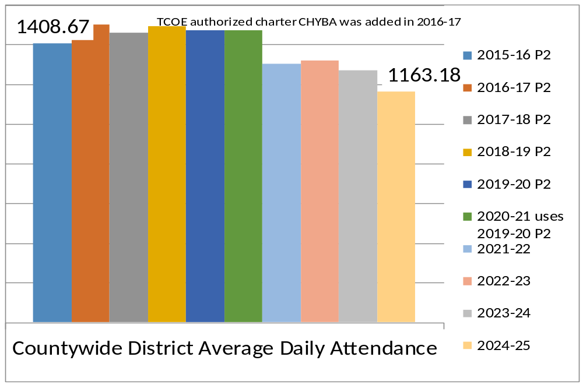
TCOE Countywide P2 Projections
Note that CHYBA projections increase by 129 students from 21/22 to 24/25 and if this doesn’t materialize than countywide enrollment will be affected.

Slide 9
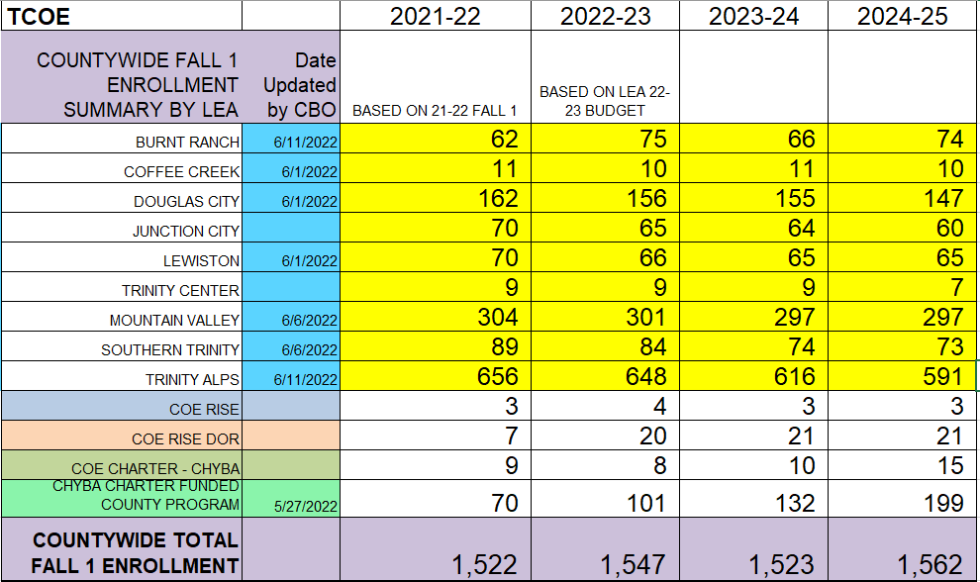
Trinity Countywide Fall 1
Enrollment Trends

Slide 10
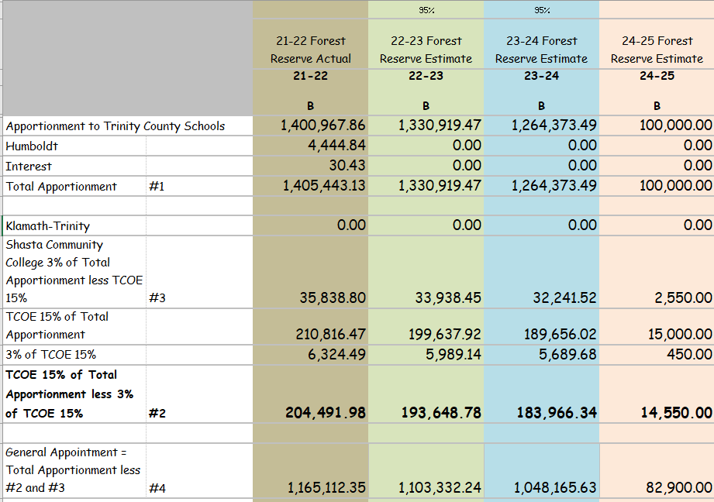
Forest Reserve Projections
Trinity COE in BOLD below

Slide 11

Trinity COE Ending Fund Balance Trends

Slide 12
TCOE General Fund Multiyear Projection 2021/22 – 2024/25
 | 2021/2022 | 2022/2023 | 2023/2024 | 2024/2025
Beginning Fund Balance | 1,532,554 | 1,731,735 | 1,120,791 | 710,387
Revenues | + 7,699,275 | + 7,952,948 | + 7,239,490 | + 7,344,043
Expenditures | - 7,500,094 | - 8,563,892 | - 7,649,894 | - 7,493,910
Ending Fund Balance | 1,731,735 | 1,120,791 | 710,387 | 560,520
Components of Ending Fund Balance (EFB)
Non Spendable – Prepaid, Stores & Rev. Cash | 2,477 | 2,477 | 2,477 | 2,477
Restricted – LEA Medi-Cal, CalHOPE, Lottery, Special Ed, Mental Health, Expanded Learning, Title IV E, School Readiness, Afterschool Admin. COE Covid Mitigation & Safe School | 924,848 53% of EFB | 646,974 58% of EFB | 284,366 40% of EFB | 254,856 45% of EFB
Economic Uncertainties = 2 District LCFF | 252,096 | 268,340 | 283,086 | 294,466
Unappropriated | 552,314 | 203,000 | 140,458 | 8,721
Change from Beg. to Ending Fund Balance | 199,181 | (610,944) | (410,404) | (149,867)

Slide 13
Special Reserve Fund 17 Multiyear Projection 2021/22 – 2024/25
 | 2021/22 | 2022/23 | 2023/24 | 2024/25
Beginning Fund Balance | 1,749,511 | 1,894,943 | 2,045,269 | 2,208,781
Interest (actual and assumptions will increase at 1st Interim) | + 2,168 | + 1,895 | + 2,045 | + 2,209
Estimated Revenues – Current Year Forest Reserve | + 204,492 | + 193,649 | + 183,966 | + 14,550
Transfer In from General Fund | + 0 | + 0 | + 0 | + 0
Revenues | + 206,660 | + 2195,544 | + 186,012 | + 16,759
Transfers Out for One-Time Use of Forest Reserve COVID Vaccine Stipends Equipment for TCCS Classroom Retirement Offer Transfer to General Fund | 16,010 0 - 45,218 | 0 0 45,218 | 0 0 - 22,500 | 0 0 - 0 -100,000
Expenditures | -61,228 | - 45,218 | - 22,500 | - 100,000
Ending Fund Balance | 1,894,943 | 2,045,269 | 2,208,781 | 2,125,540
Components of Ending Fund Balance
TCOE Technology Upgrades & Equipment | 23,265 | 28,265 | 33,265 | 38,265
Forest Reserve | 1,002,378 | 1,150,810 | 1,163,845 | 1,178,395
Special Education Reserves
Special Education Low Incidence | 81,181 | 81,181 | 81,181 | 81,181
Economic Uncertainties | 552,586 | 554,481 | 554,631 | 556,840
Unappropriated | 235,533 | 230,533 | 375,859 | 270,859

Slide 14
Special Reserve Fund 20 Revenues and Expenditures for Post Retirement Benefits Multiyear Projection 2021/22 - 2024/25
 | 2021/2022 | 2022/2023 | 2023/2024 | 2024/2025
Beg Fund Balance | 69,036 | 75,401 | 82,396 | 89,460
Transfer In from General Fund for Future Retiree Benefits + Transfer from Special Reserve for Incentive + Interest | + 56,109 | + 56,739 | + 34,091 | + 11,662
Transfer Out to General Fund for Current Year Retiree Benefits | - 49,744 | - 49,744 | - 27,026 | - 2,640
End Fund Balance | 75,401 | 82,396 | 89,460 | 98,481
Number of Retirees | 4 | 4 | 4 | 1

Slide 15

General Fund
TCOE projects deficit spending during the multiyear projection decreasing the fund balance and requiring a transfer from Special Reserve in 2024/25.
Reserve levels exceed state minimum 4% and TCOE local 10%.
  June 30, 2022 – 12%
  June 30, 2023 – 13%
  June 30, 2024 – 11%
Review during 2022/23 during each reporting period to assure sustainability.

Slide 16
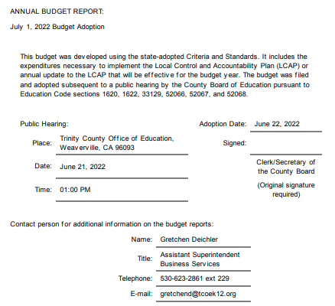
Summary of Criteria and Standards for 2021/22 Budget

Slide 17
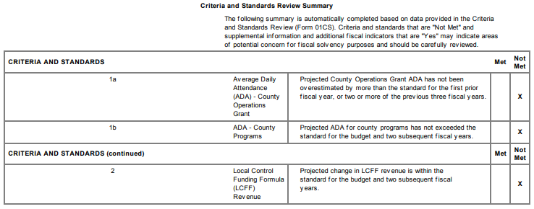
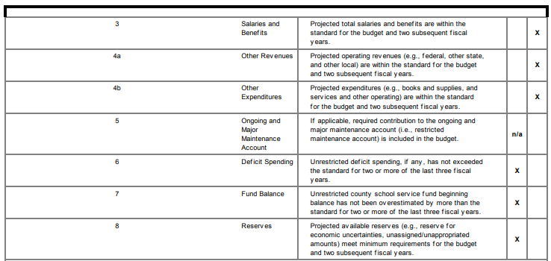

Slide 18
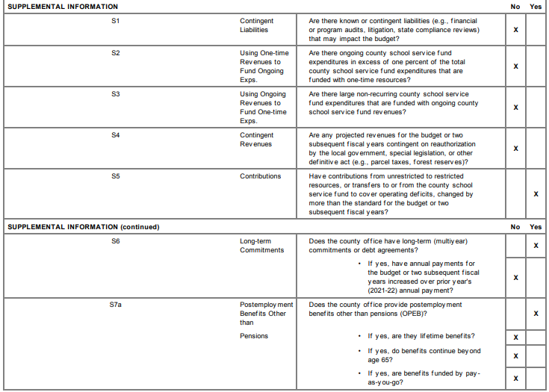

Slide 19
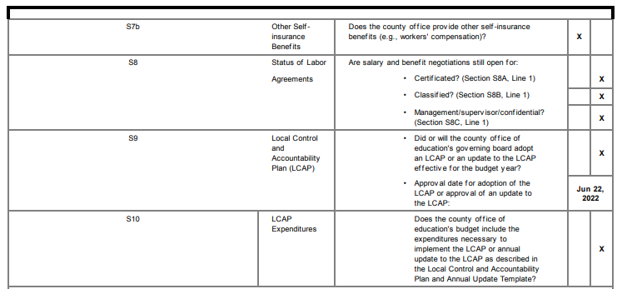

Slide 20
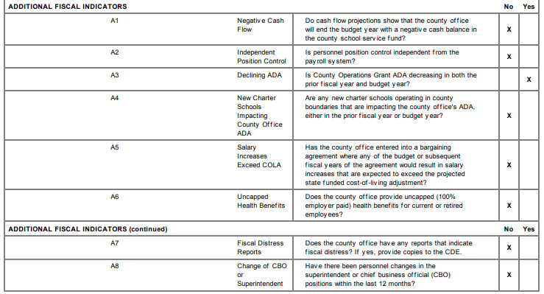

Slide 21

The 45 day budget revisions will be presented at the August board meeting since the July meeting has been cancelled for lack of business.
The First Interim Financial Report will be presented in December, 2022 by Cindy Blanchard.

