Slide 1
Trinity County Office of Education
2023/2024 1st Interim

Slide 2
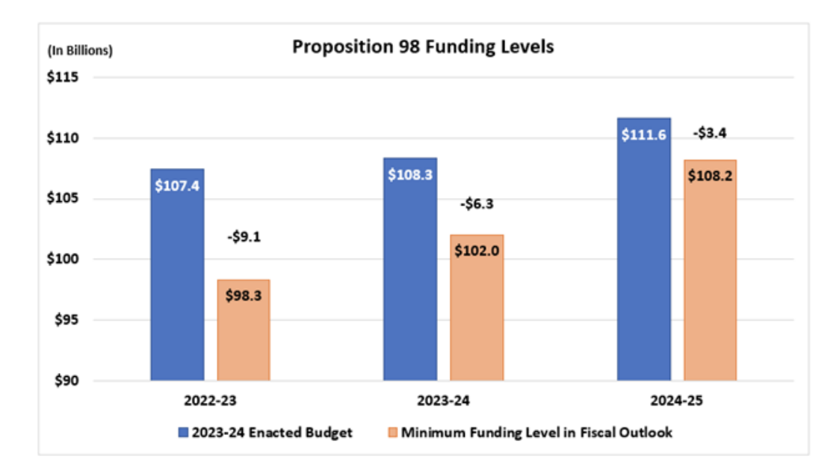
State Economy, noted in billions

Slide 3

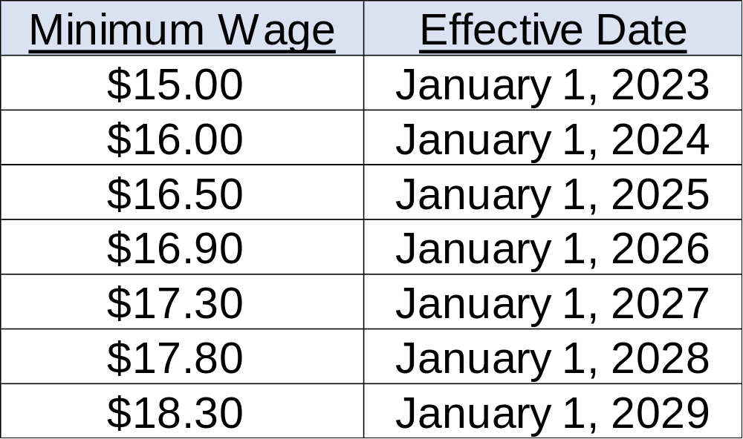
Fast Food Workers Minimum Pay $20.00, effective April 1, 2024
Rate are noted as per hour

Slide 4
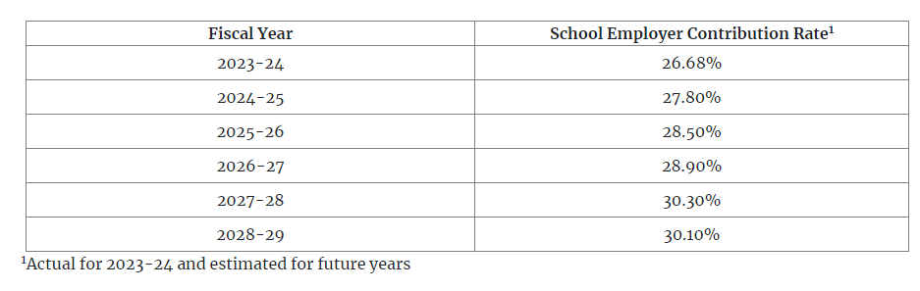
PERS Estimated Rates,
STRS is still estimated to stay at 19.1%

Slide 5
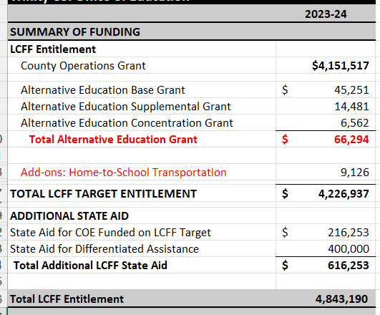
TCOE’s LCFF

Slide 6
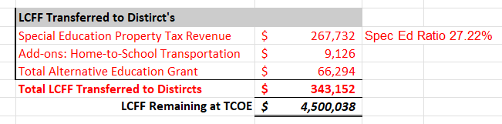
Amount Transferred To Districts

Slide 7
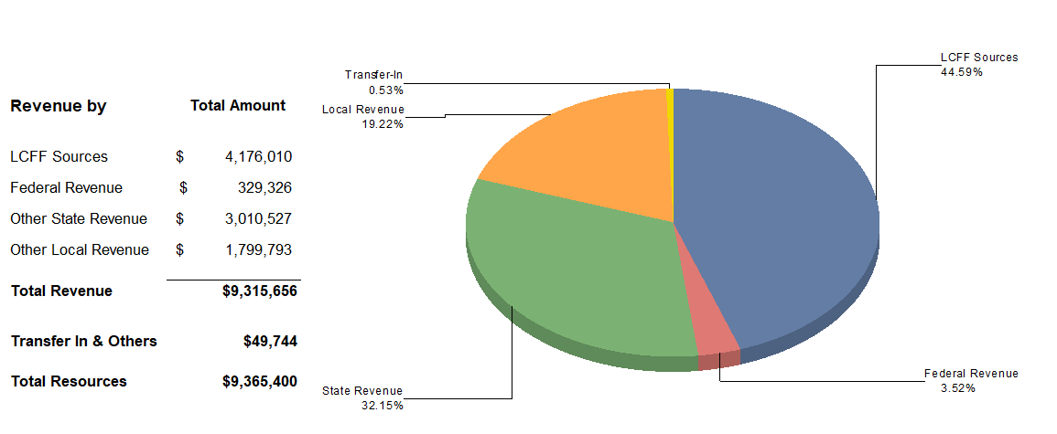
General fund Revenues

Slide 8
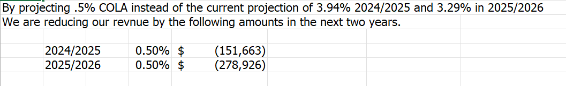
Current LCFF, COLA 8.22%
Upcoming COLA for LCFF????

Slide 9
Funding Sources
County Office of Education currently has over 60 grants/funding sources to manage!!

Slide 10
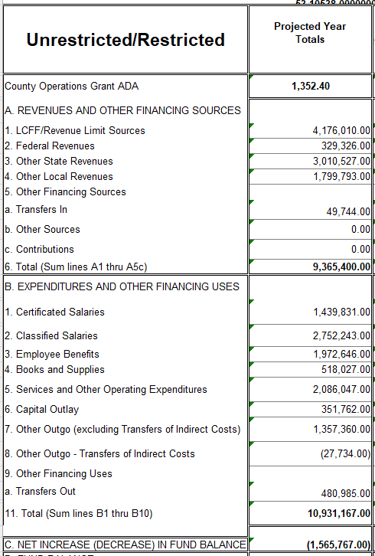
General Fund
Current fiscal year has the transfer of $400,000 to Def Maint.
Plus $350,000 to our Reserves accounts.

Slide 11
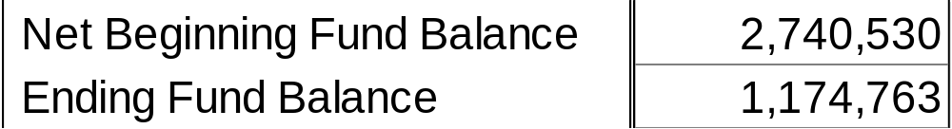
Ending Fund Balance In General Fund

Slide 12
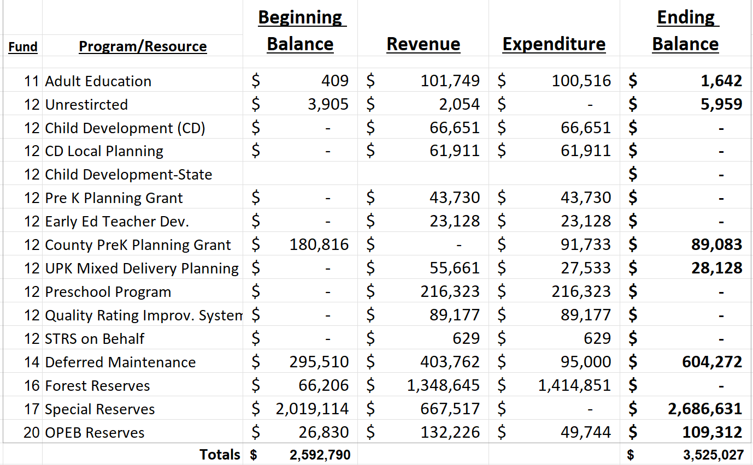
Other funds
Check out how many different resources we have with in our fund 12!!
A total in fund 12 of $559,264 in revenue!!
Currently this is one of our biggest growing programs.

Slide 13
Our reserves will increase by $667,517
Deferred Maintenance will increase by $308,762

Slide 14

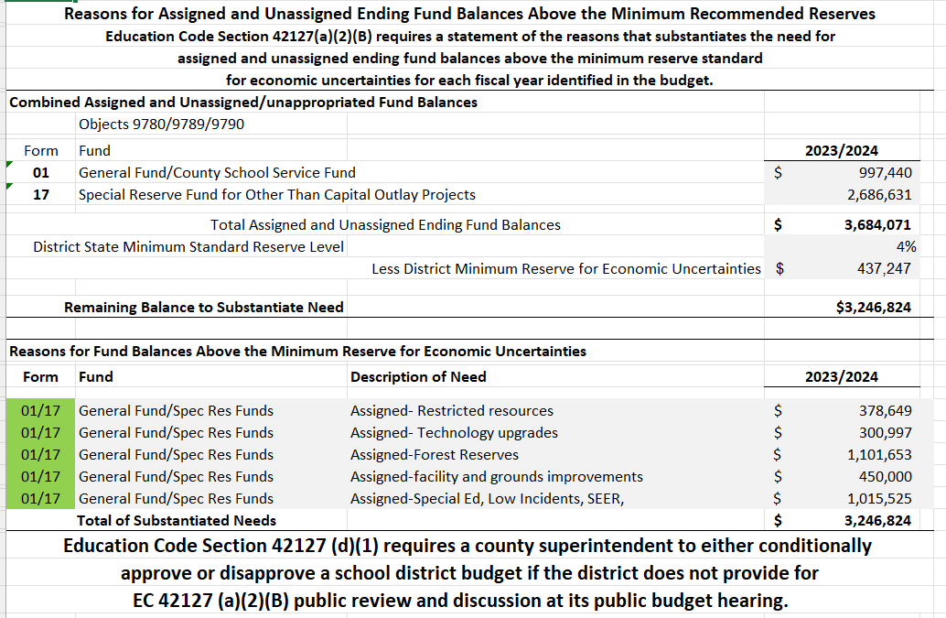
Reserves Estimates at Year End

Slide 15
Certification of Financial Condition

