Slide 1


2019 Nederland ISD Bond Project
November 2022

Slide 2
Nederland High School

Slide 3
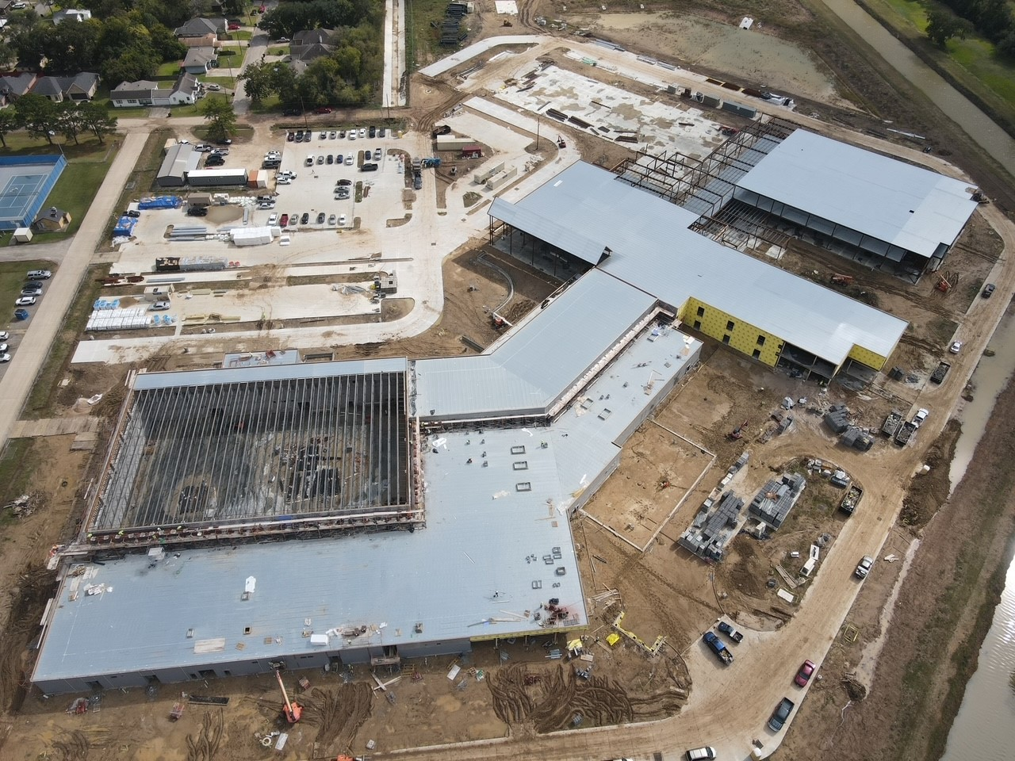
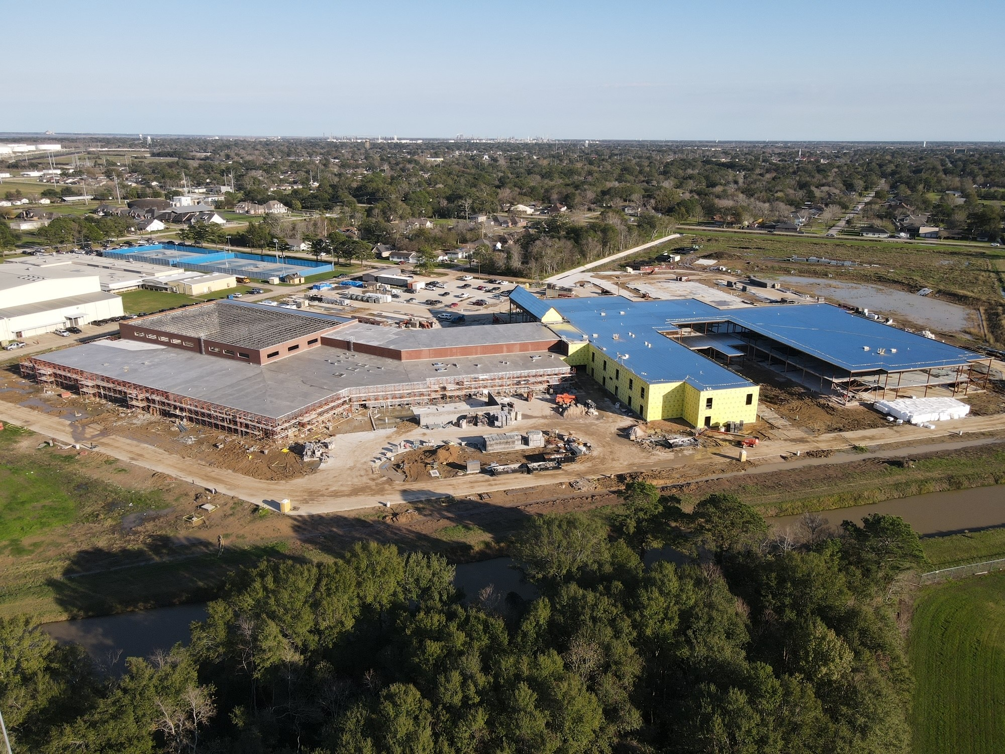
Nederland High School
Detention Pond
Area A Classrooms
Area B
Classrooms
Area D
Area C Classrooms
Commons Area
Area E Science Lab
Kitchen/
Cafeteria
Mechanical Pad
Gym / Lockers

Slide 4
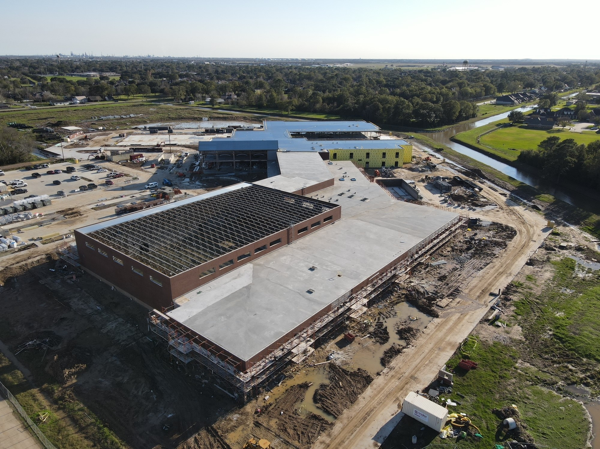
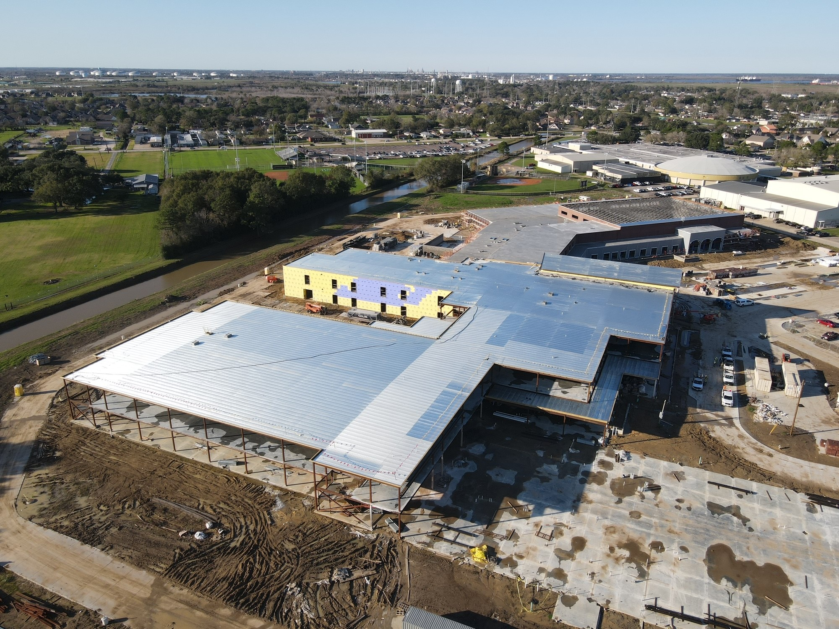
Nederland High School
Continuing brick low/high roof situations
Ready for Tectum to be installed over gym roof
Area C southside finished screwing down metal roof deck

Slide 5
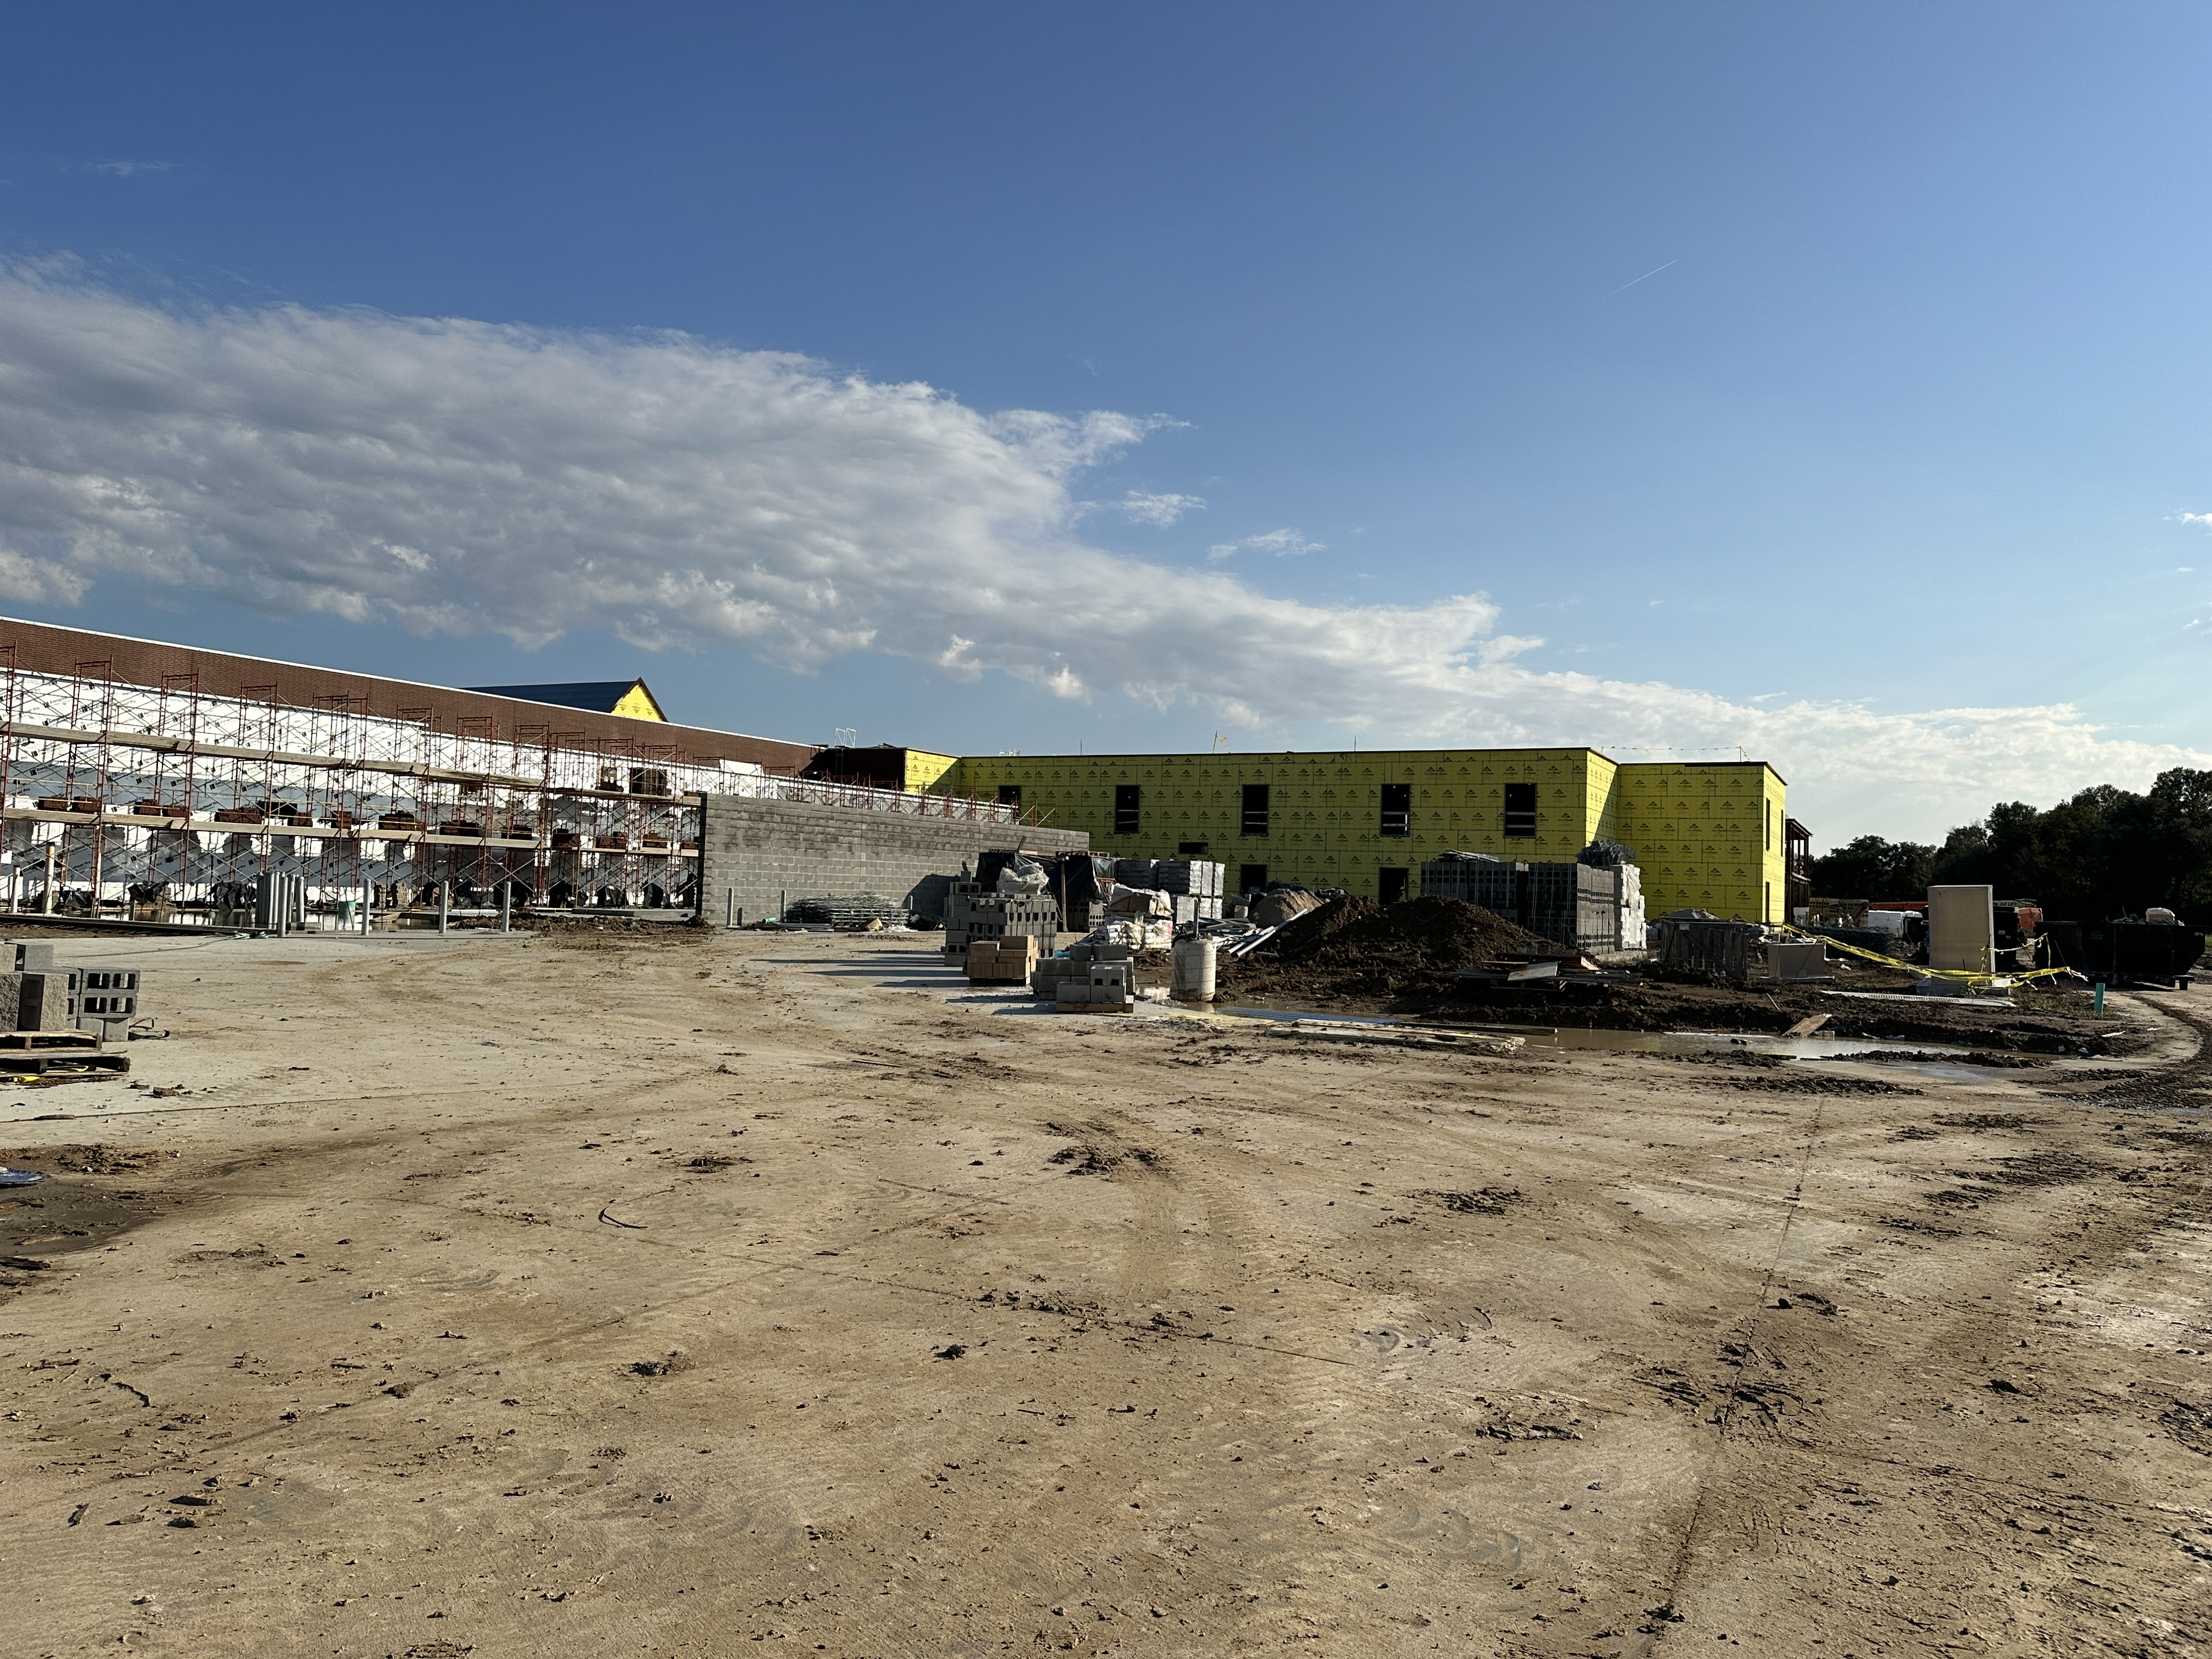
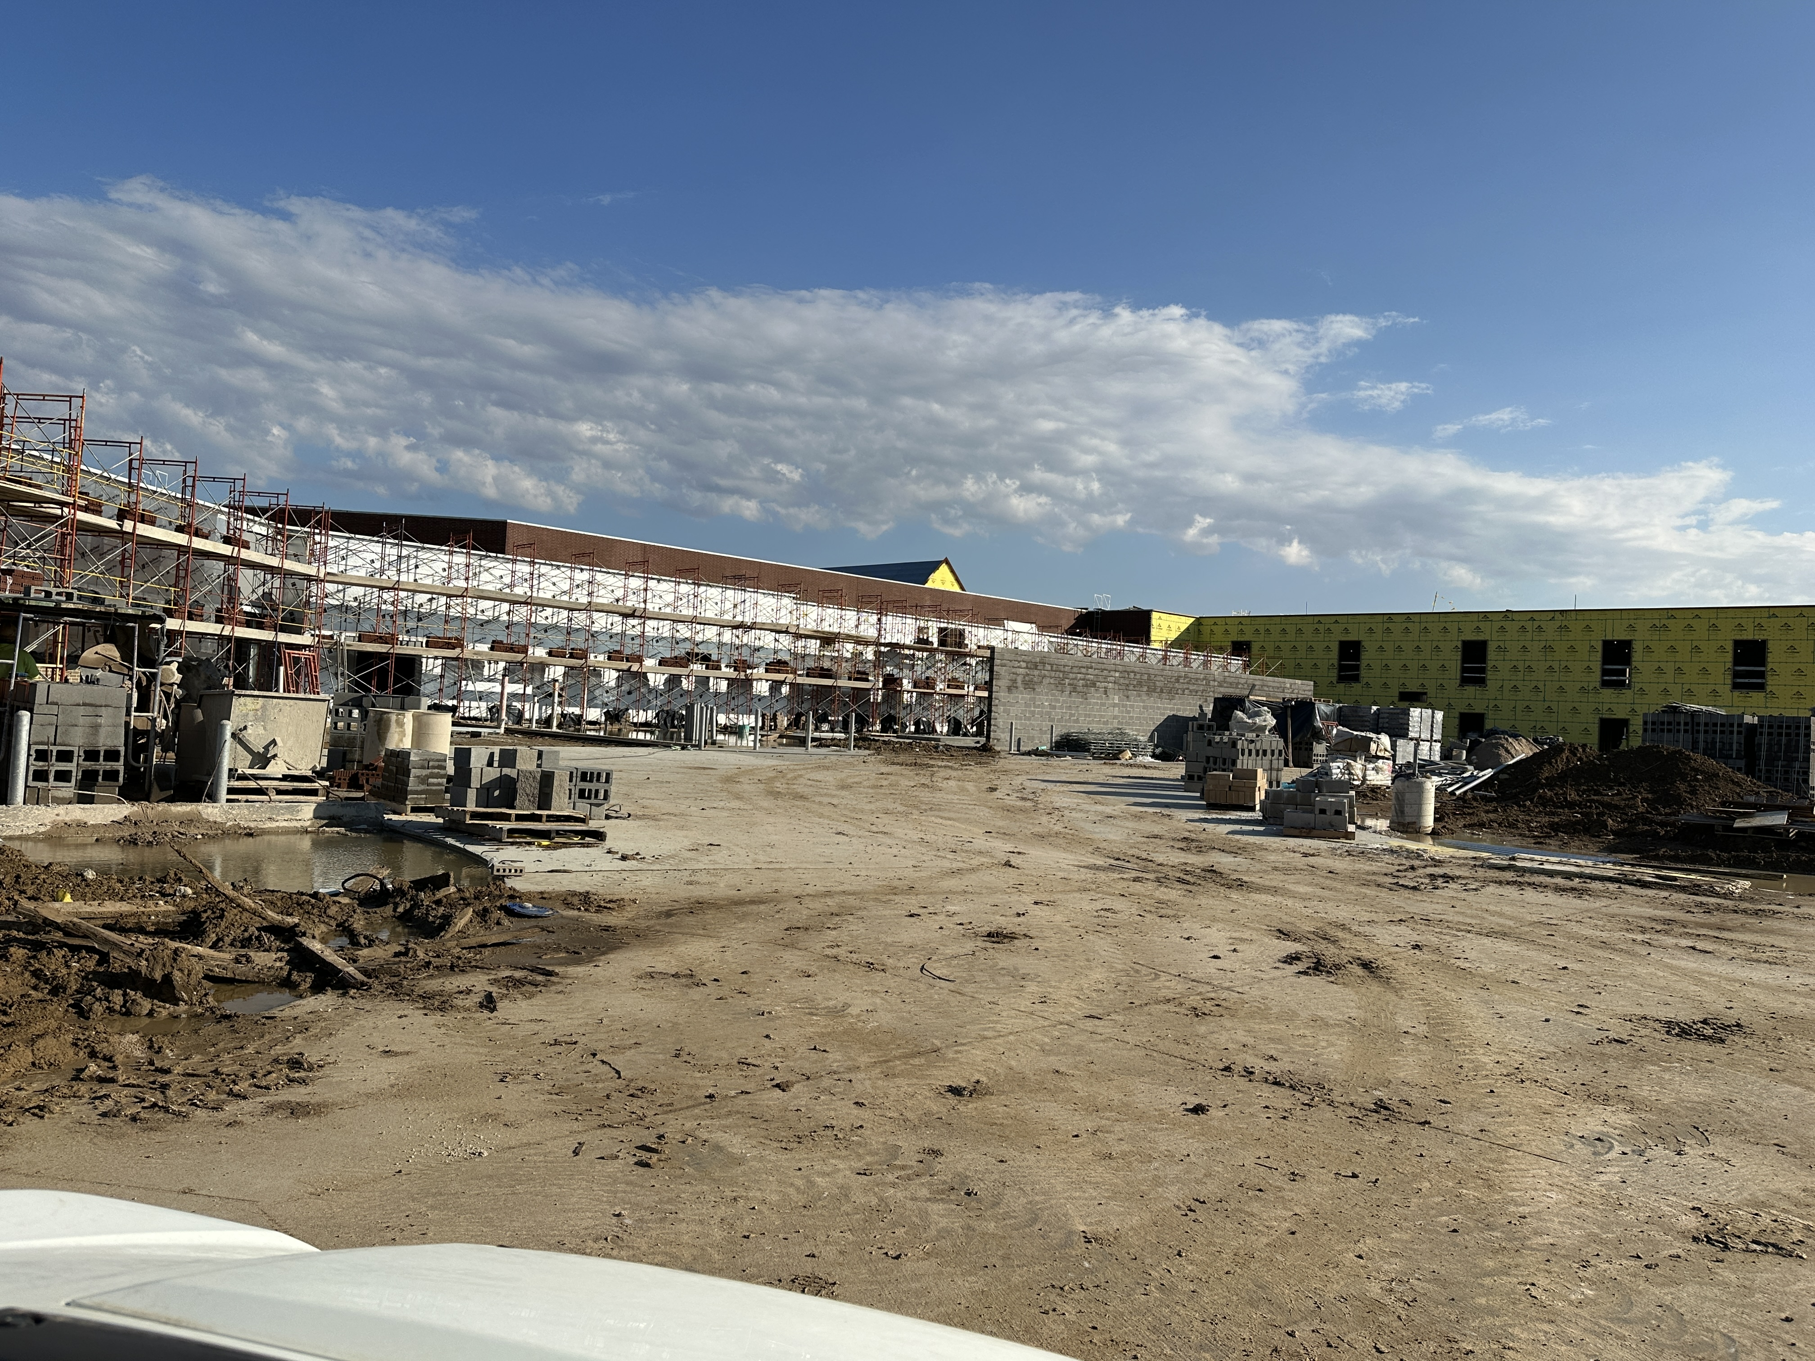
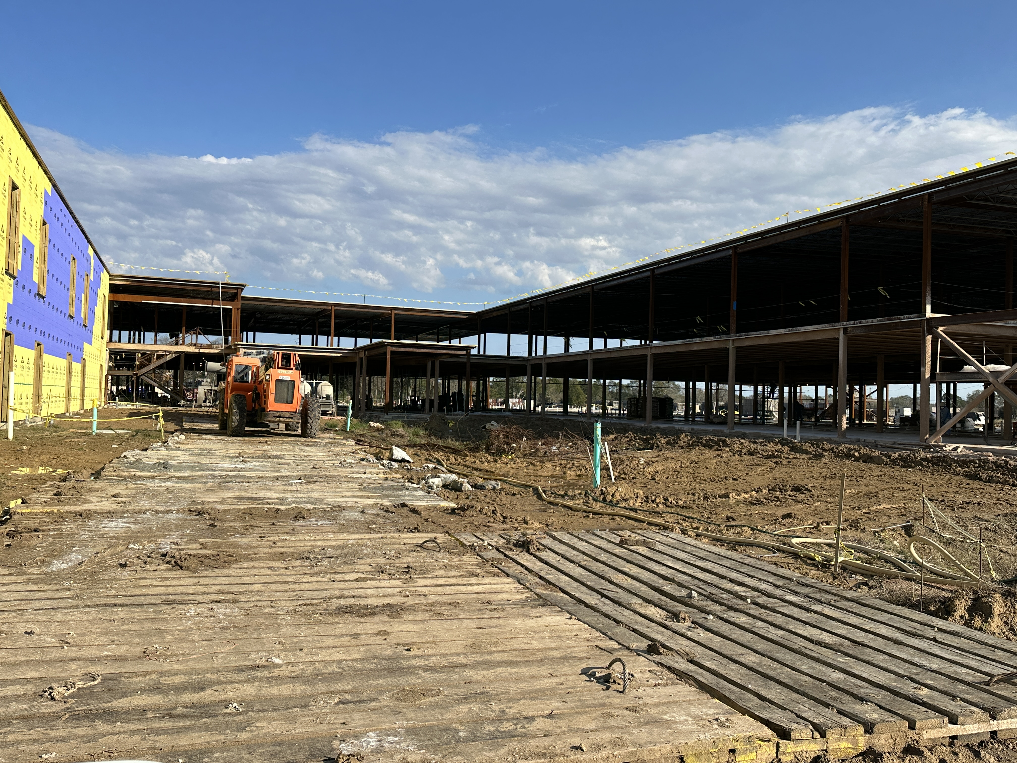
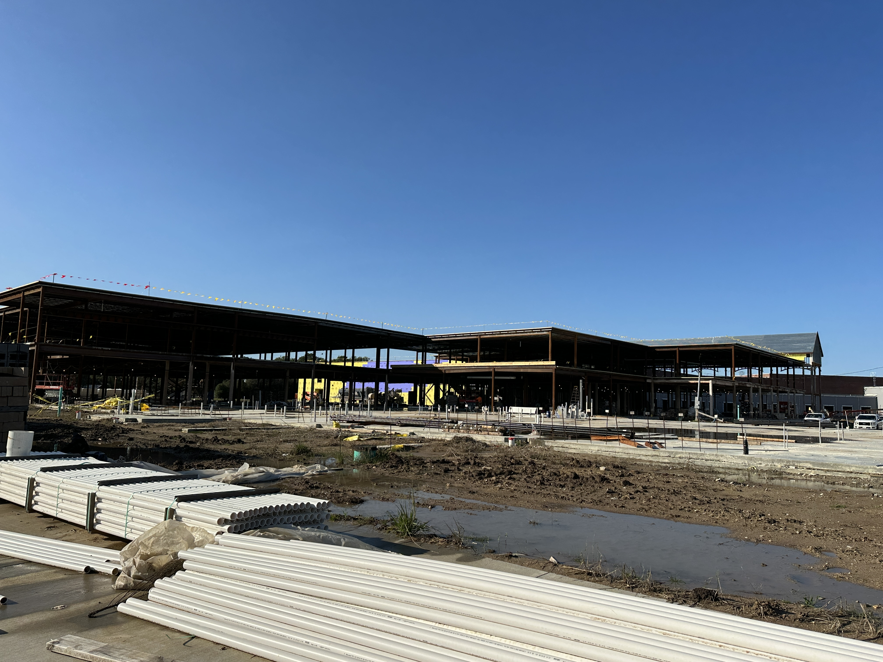
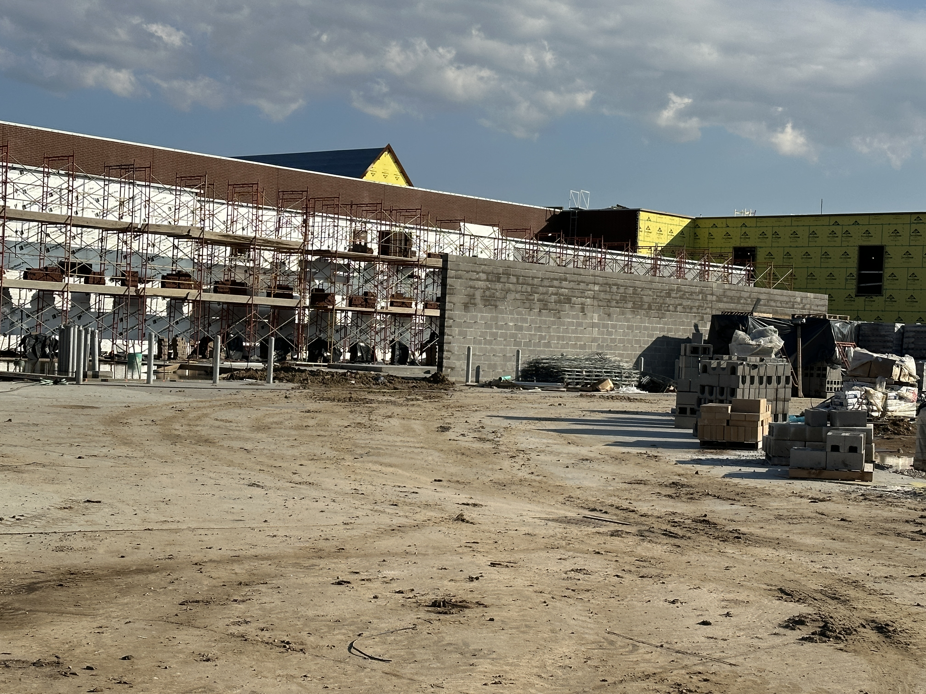
Nederland High School
Continue install perimeter blocking
Rough in mechanical yard and pour concrete
Making changes in mechanical yard due to Entergy changes

Slide 6
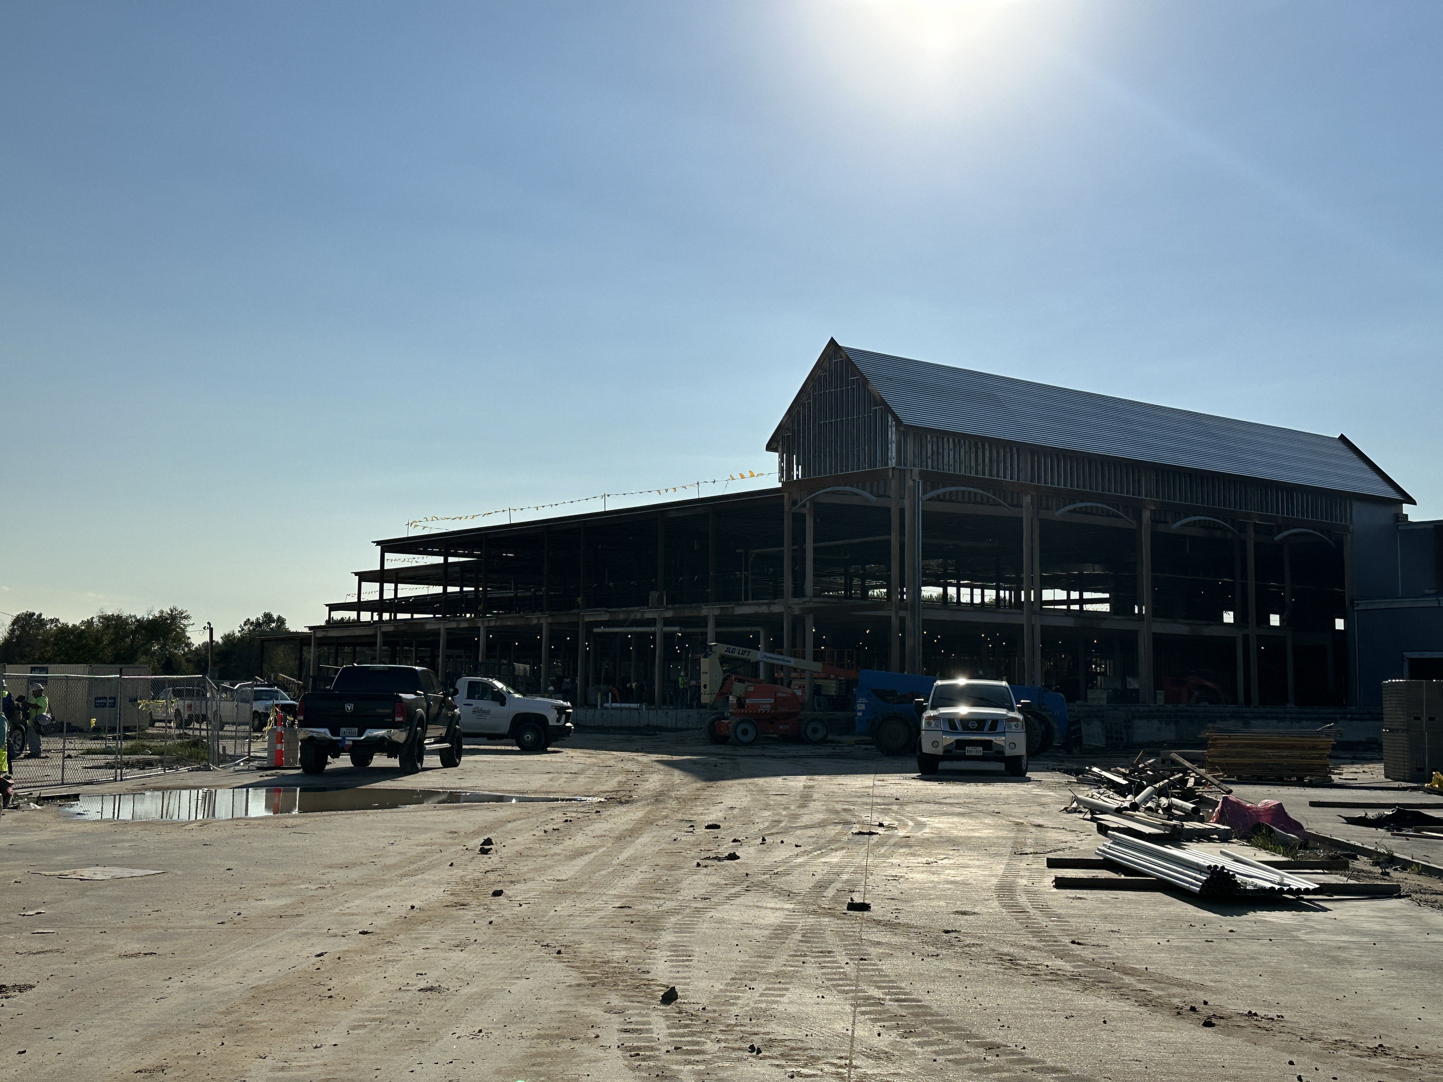
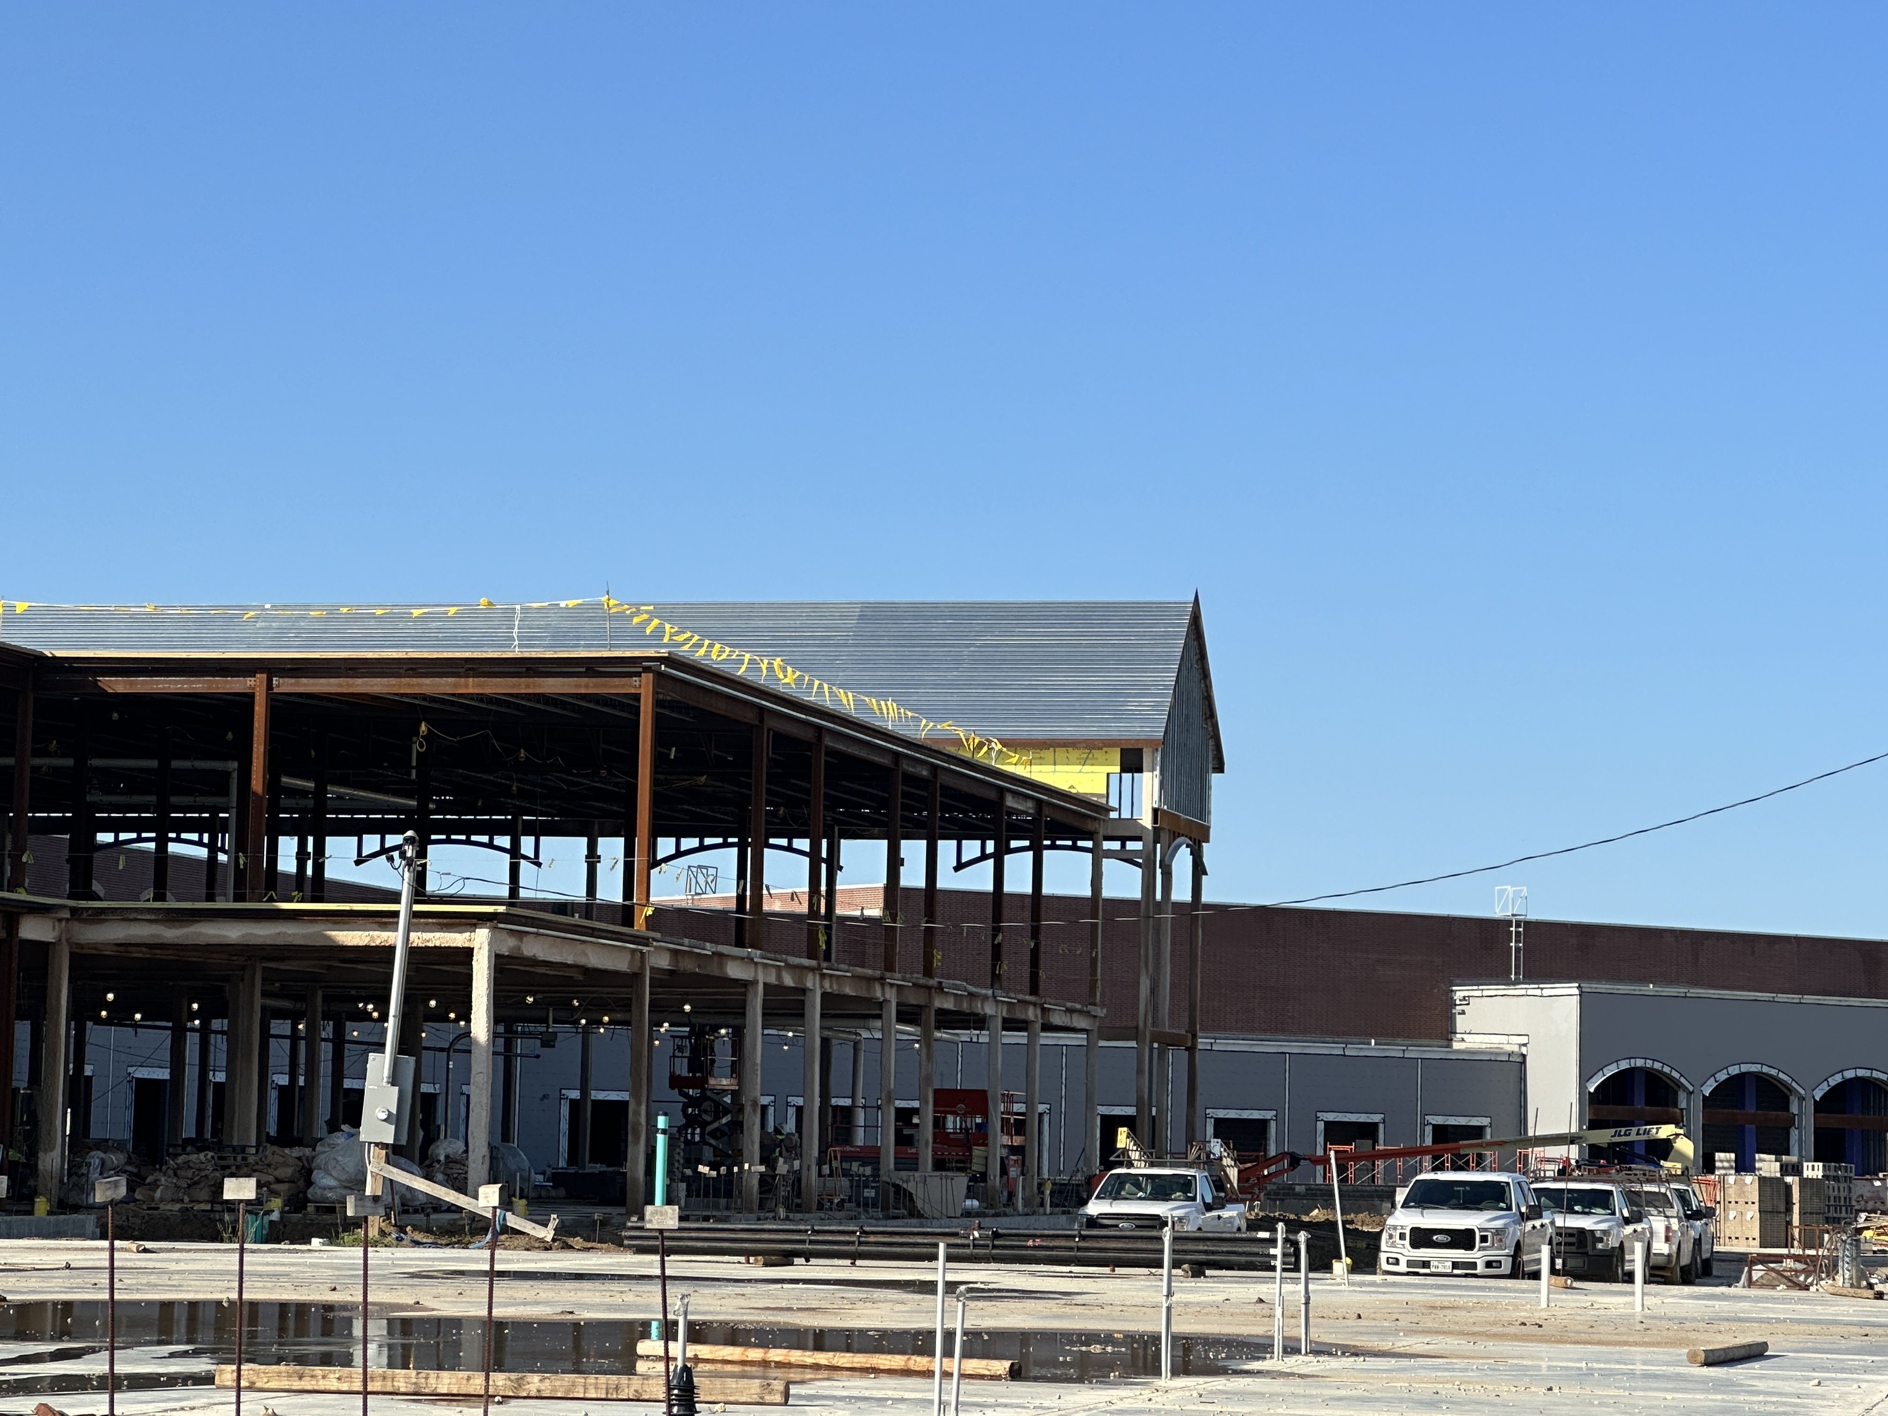
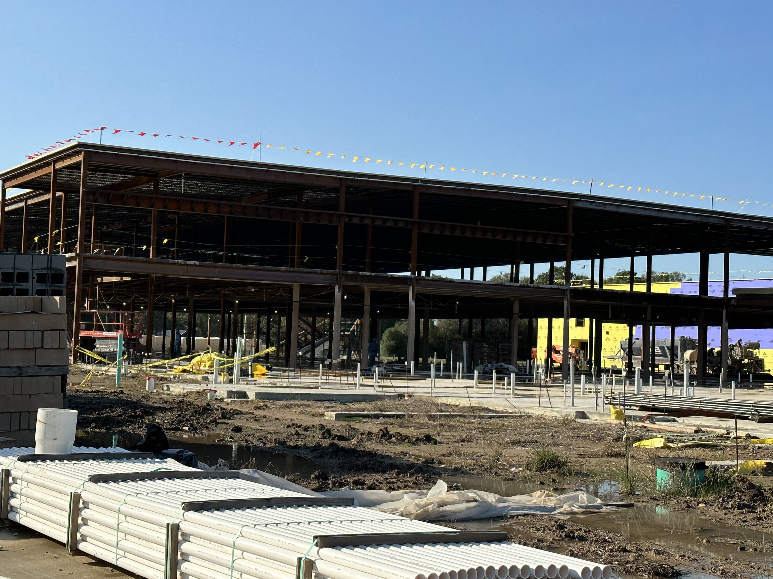
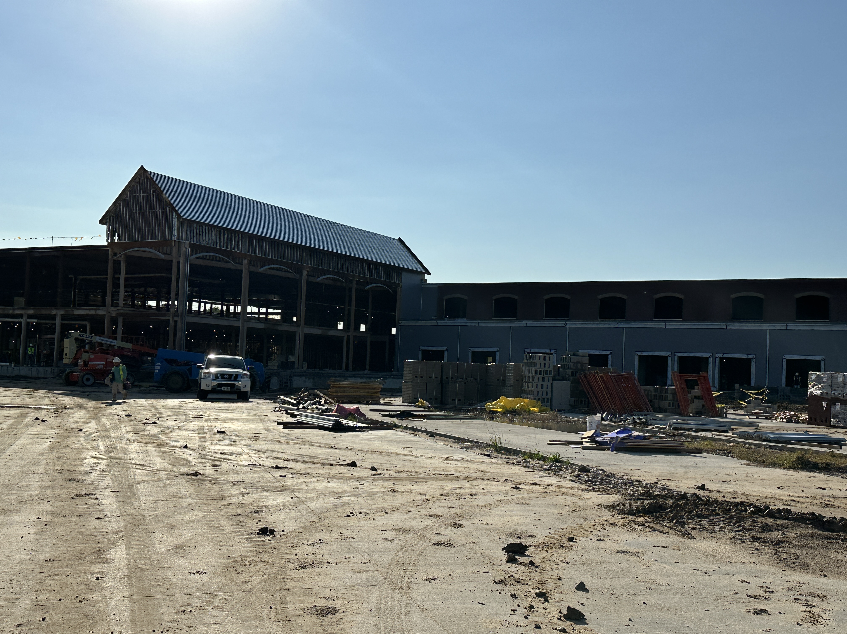
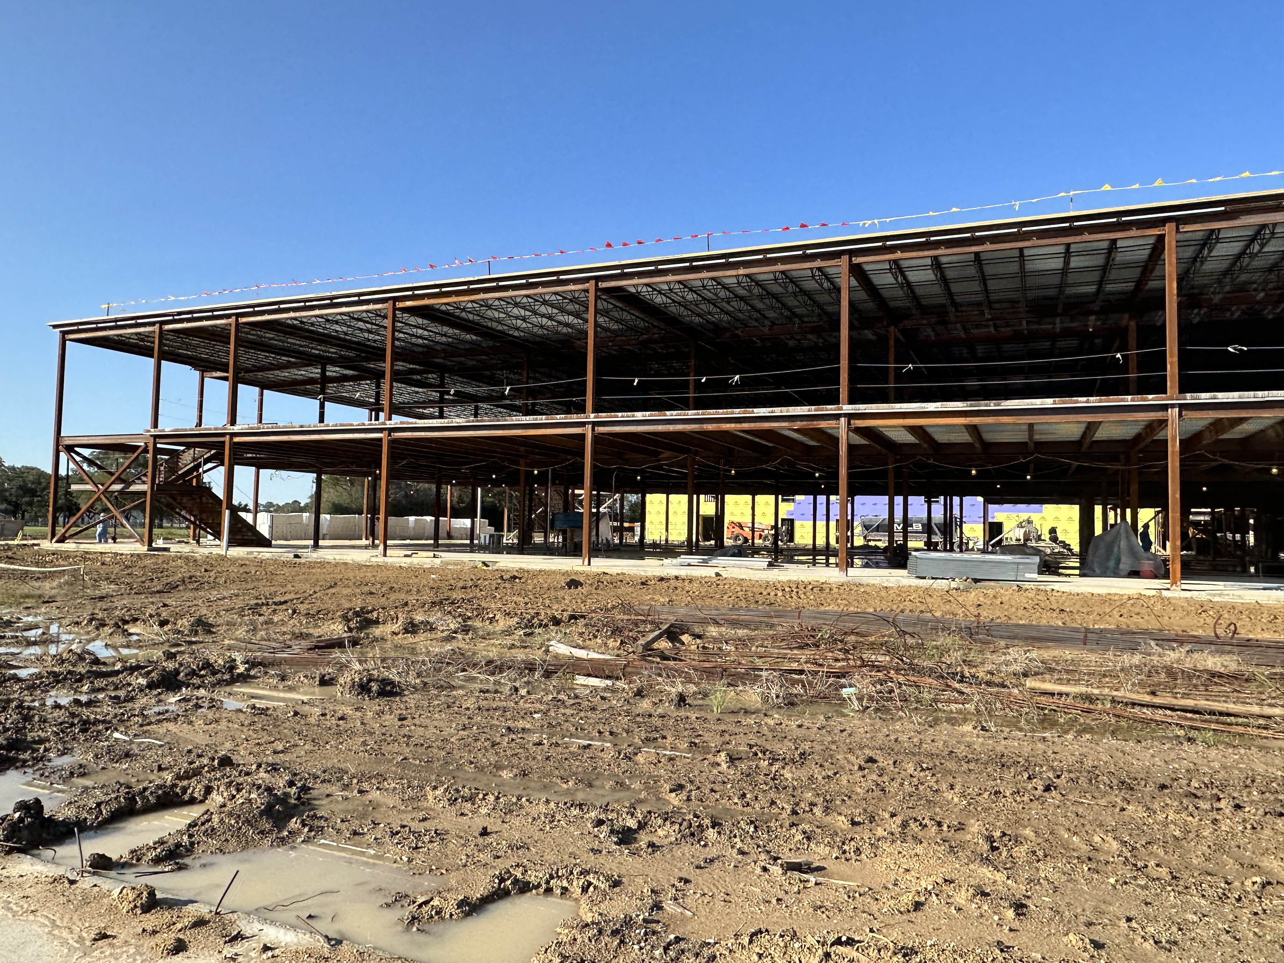
Nederland High School
2nd story floor decking installation
Preparing perimeter blocking

Slide 7
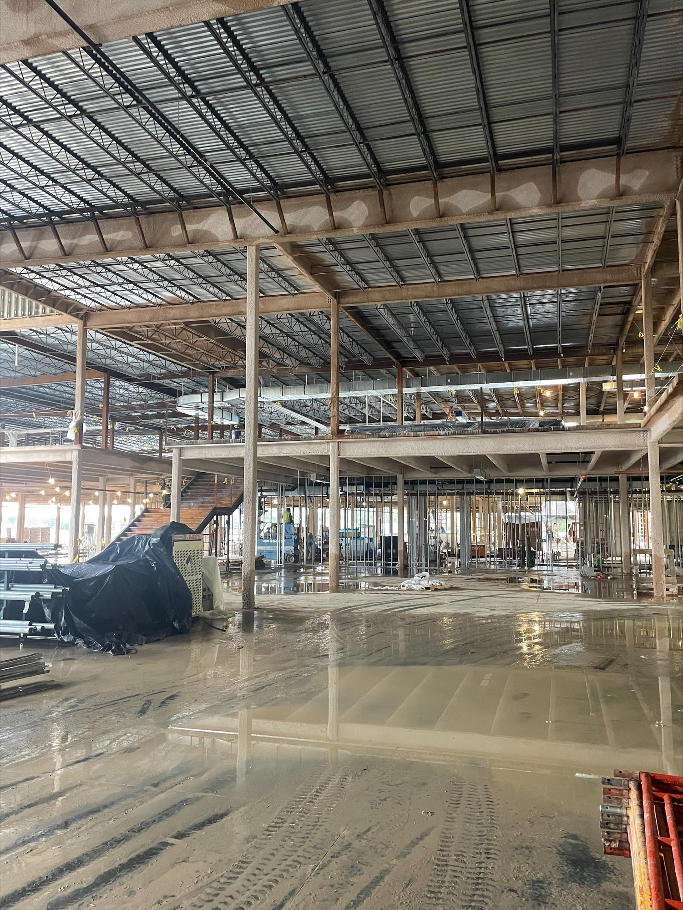
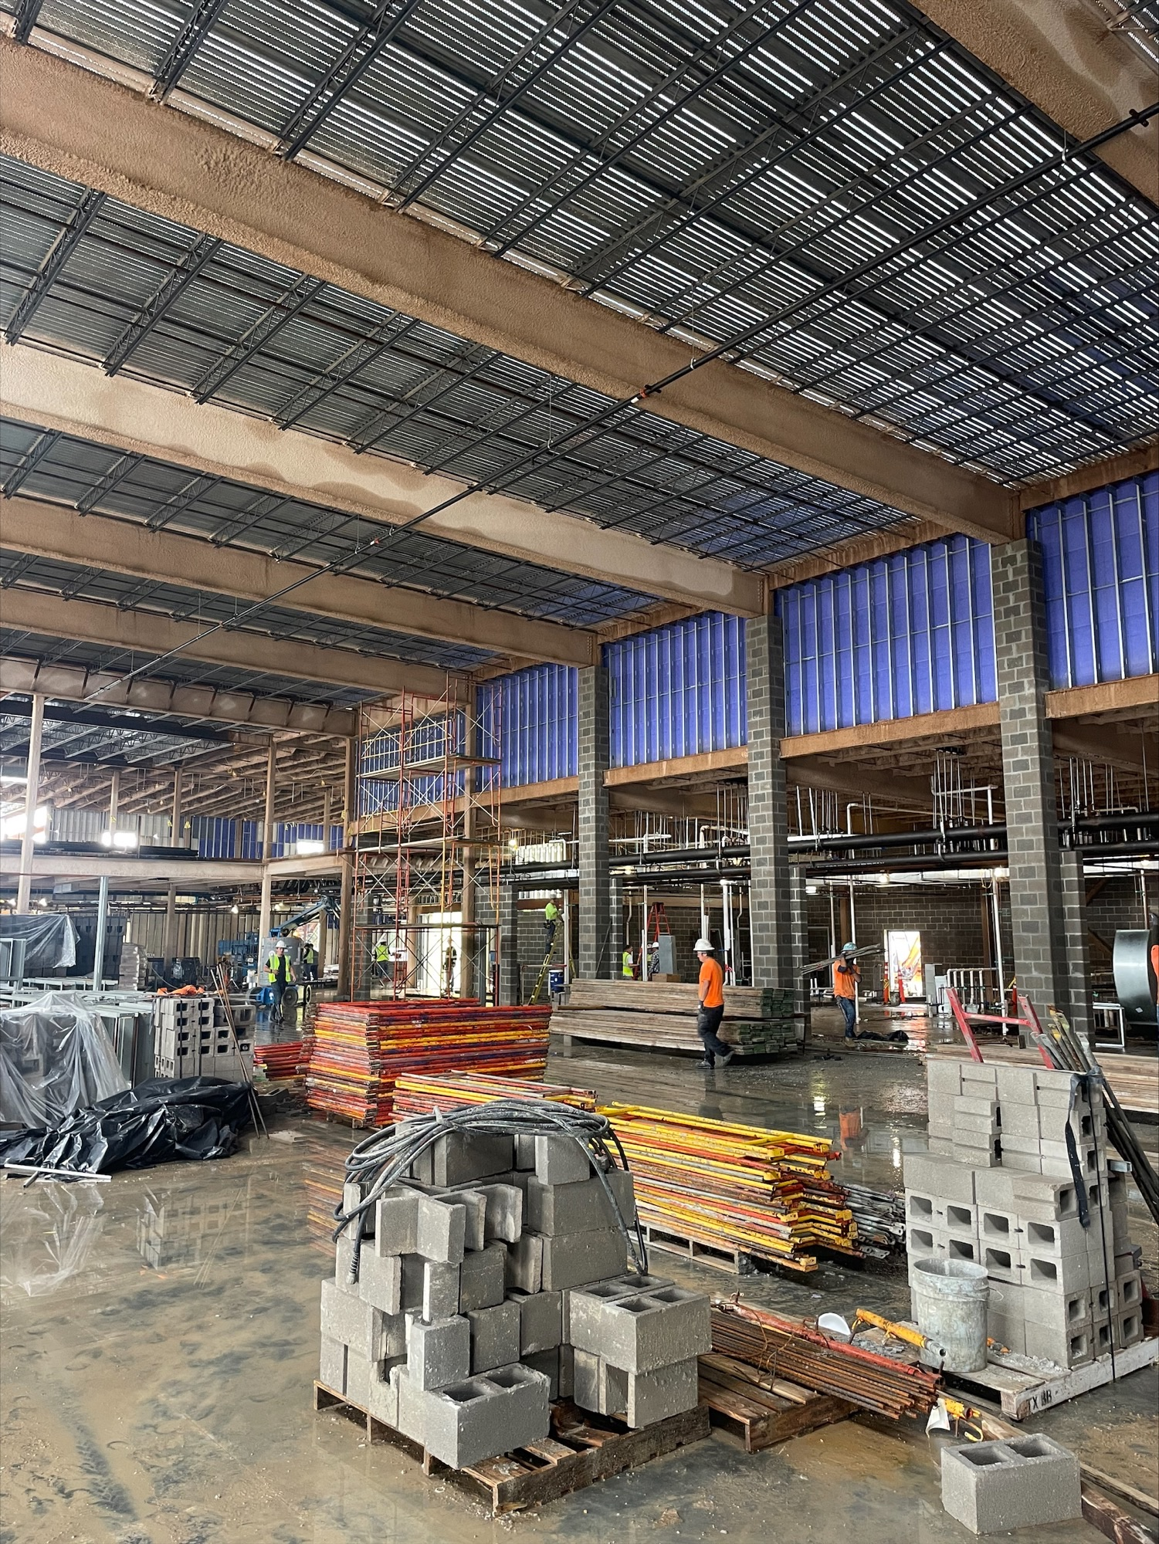
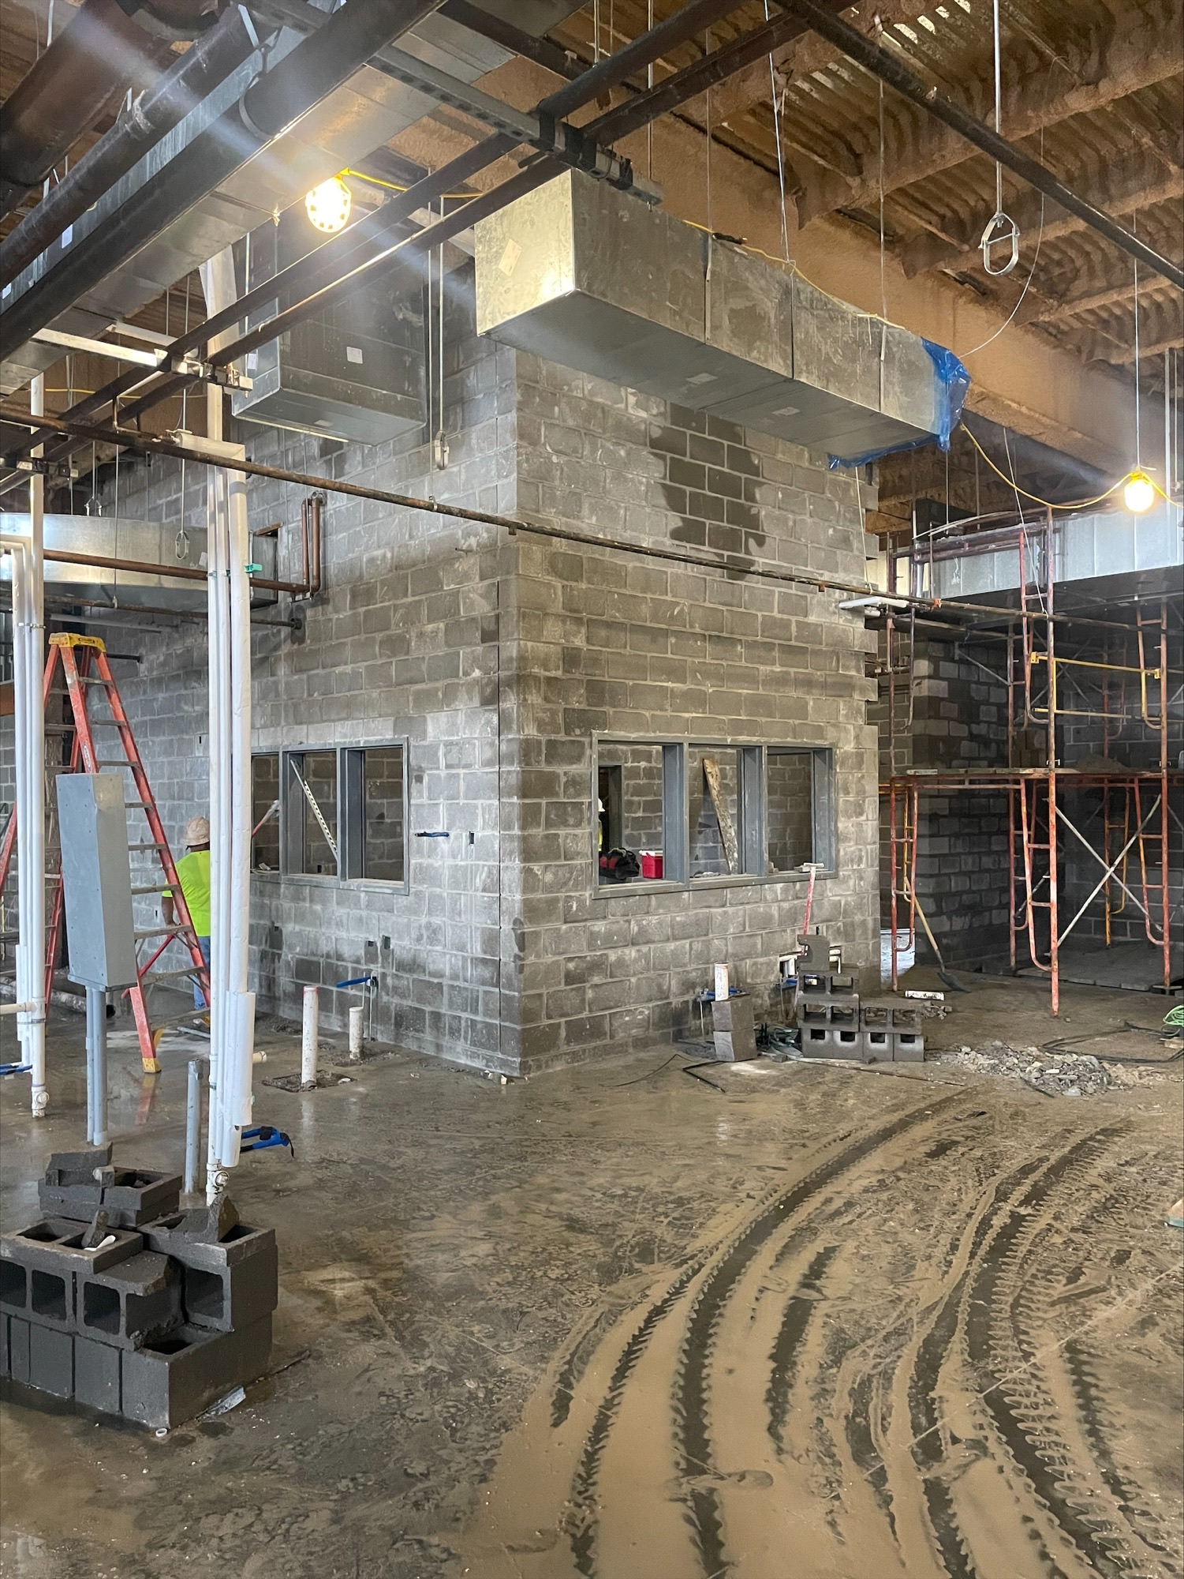
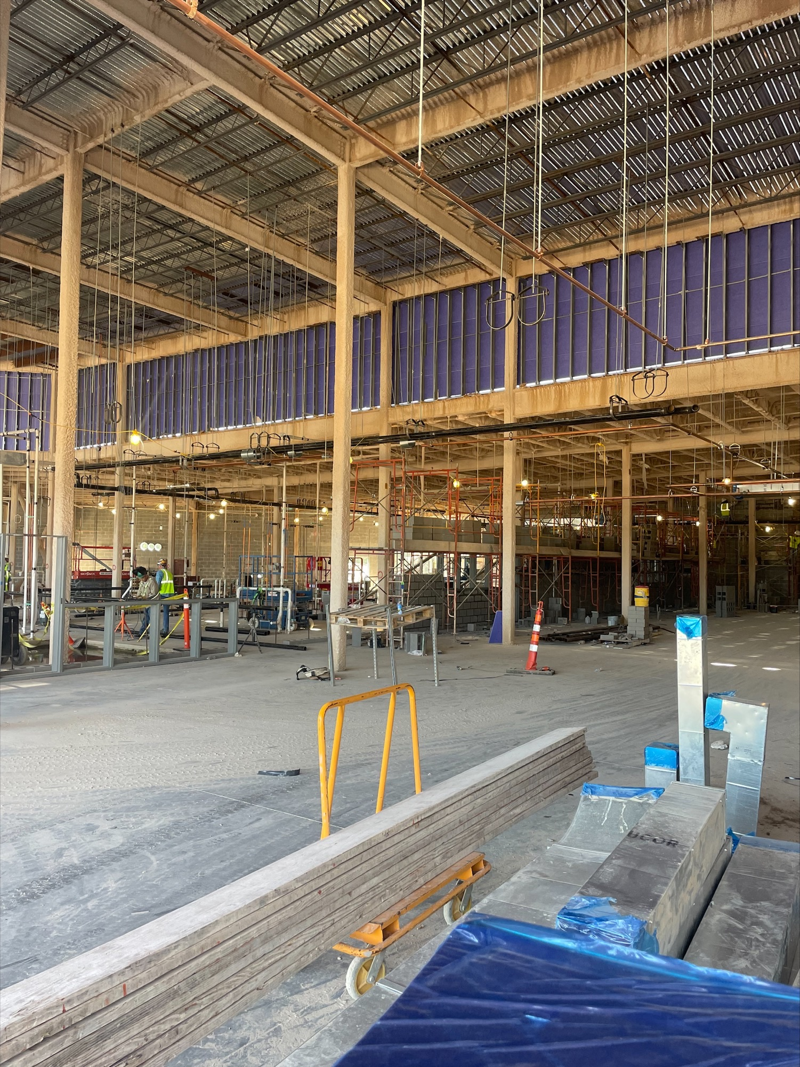
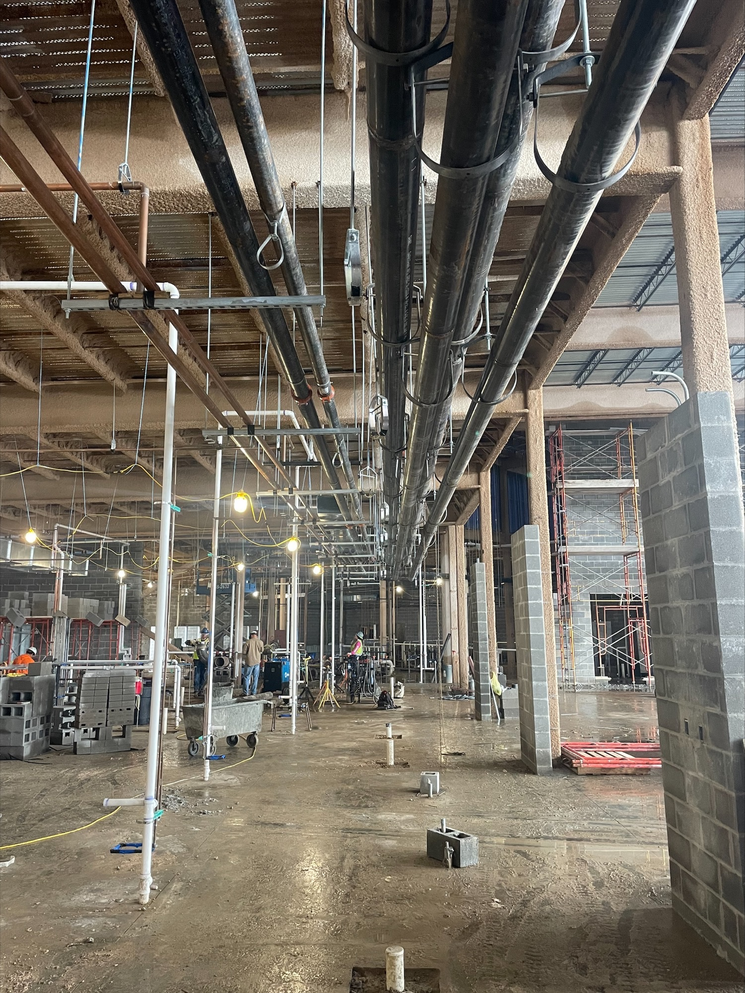
Nederland High School
Kitchen Office
All pictures are the Commons Area and Kitchen

Slide 8

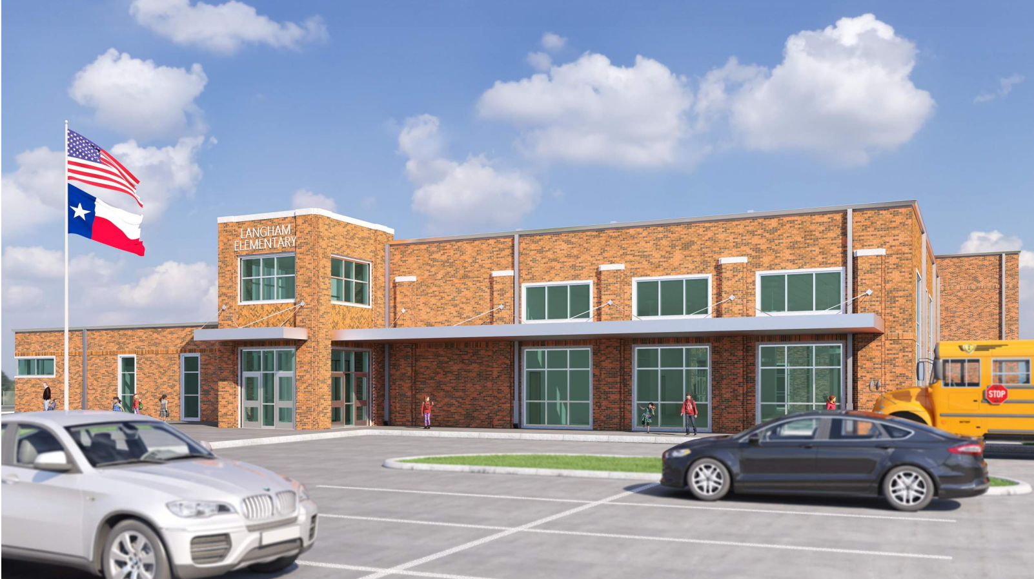
Langham Elementary School

Slide 9
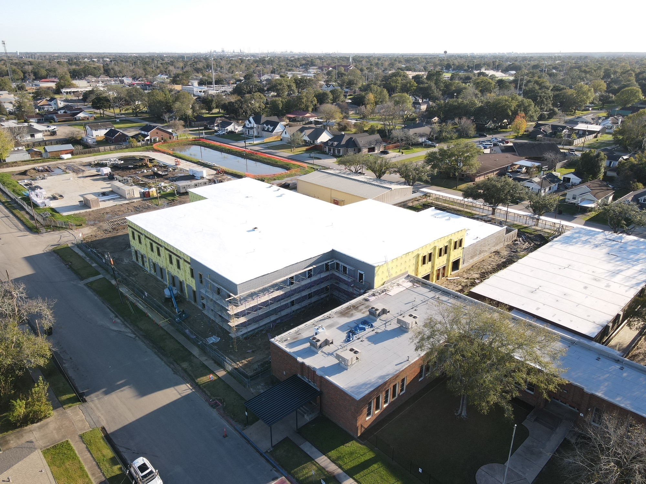
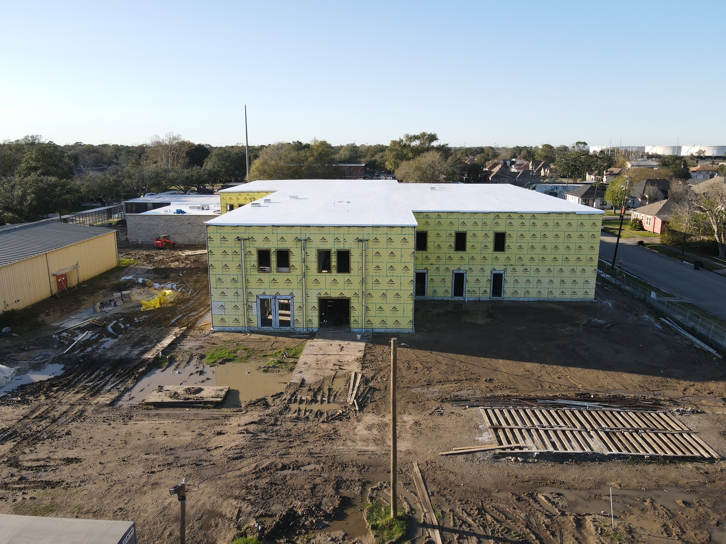
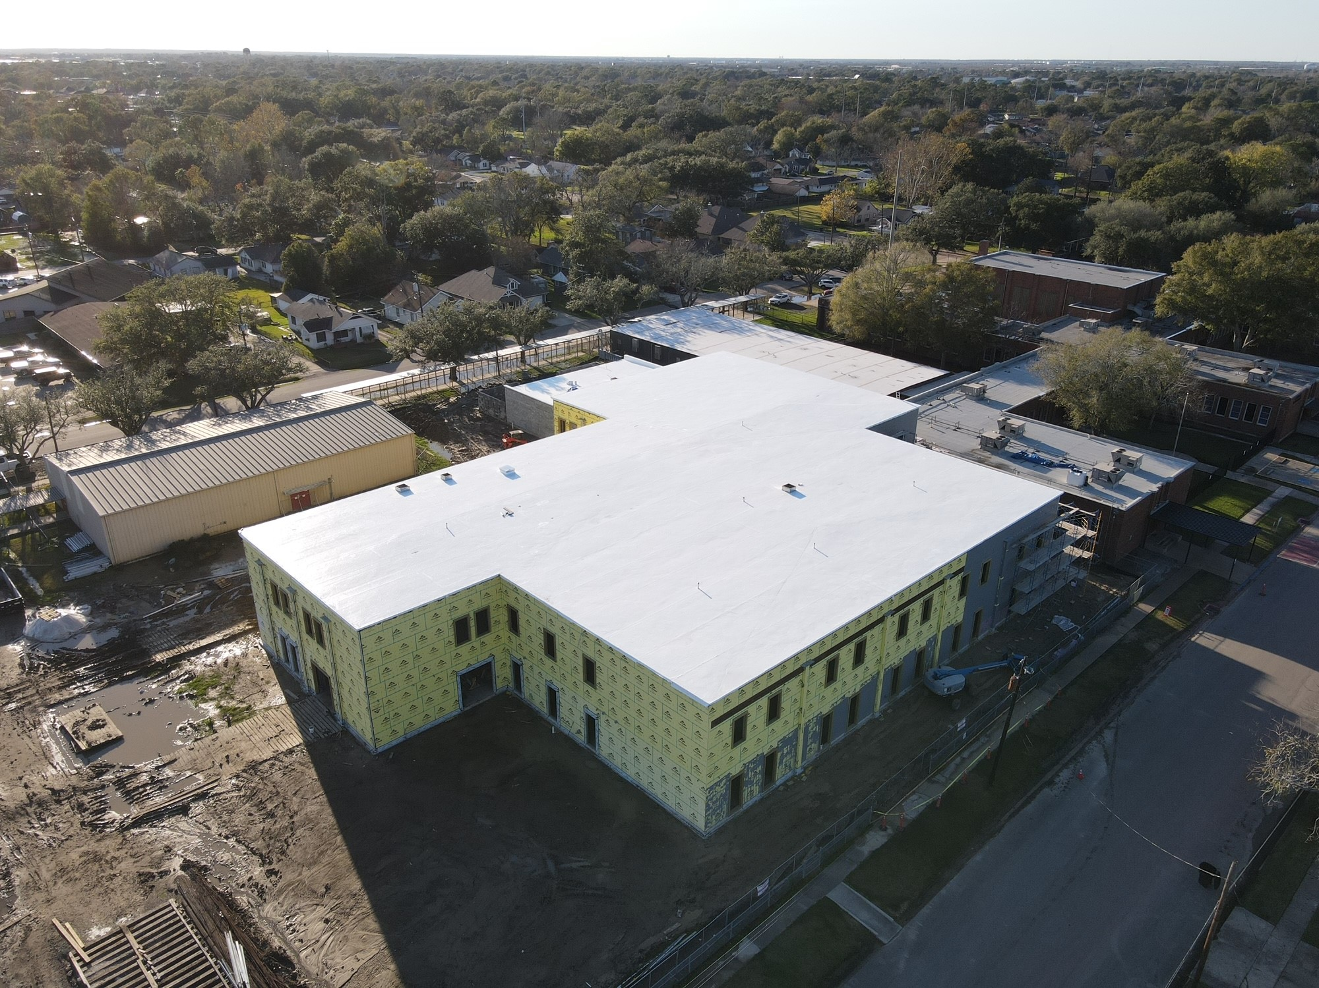
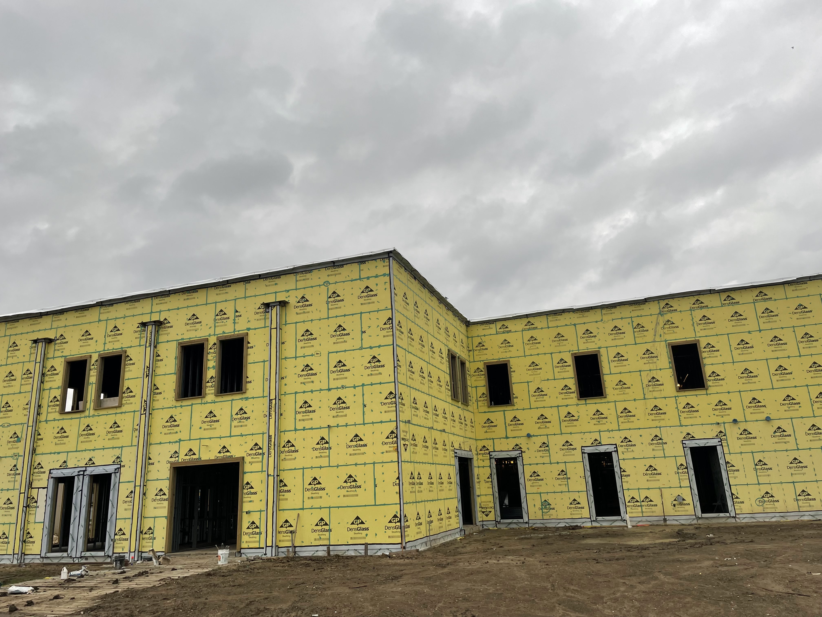
Langham Elementary School
Continue weather barrier installation
Installing brick ties

Slide 10
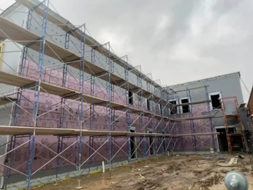
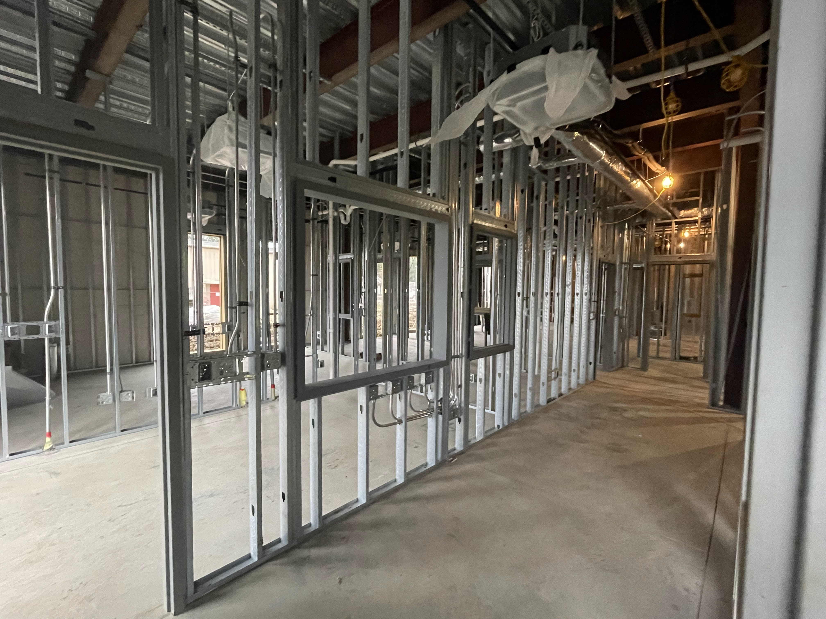
Langham Elementary School
Continue preparing walls for brick veneer
Continue framing 2nd floor Metal Stud Walls
Running Ducts
Staff RR D121

Slide 11
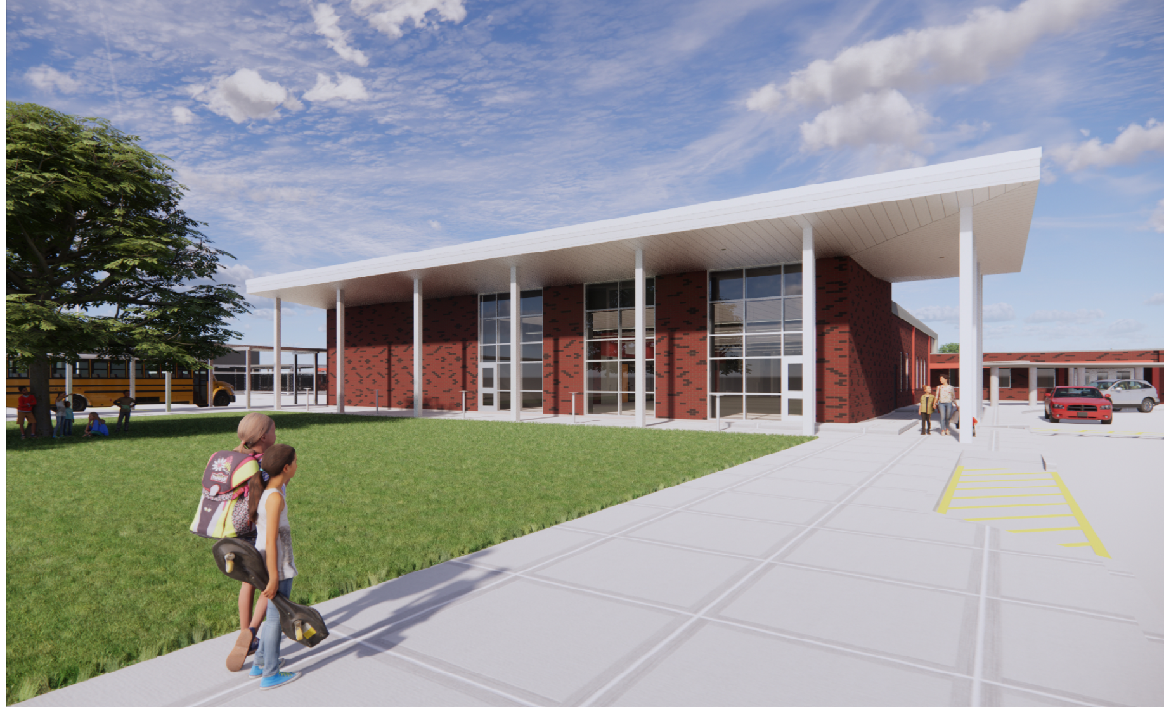
Hillcrest Elementary School

Slide 12
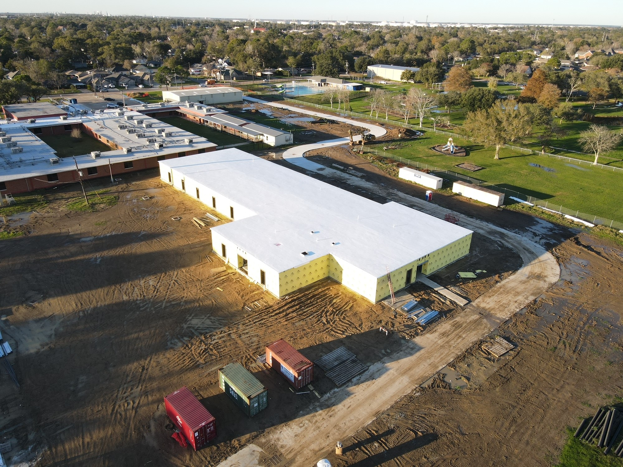
Hillcrest Elementary School
Continue Waterpoofing

Slide 13
Hillcrest Elementary School
Interior Metal Stud Walls
Installing HVAC Ducts
Continue Electrical Work

Slide 14
Highland Park Elementary School

Slide 15
Highland Park Elementary School
Continue waterproofing
Getting ready for installation of block

Slide 16
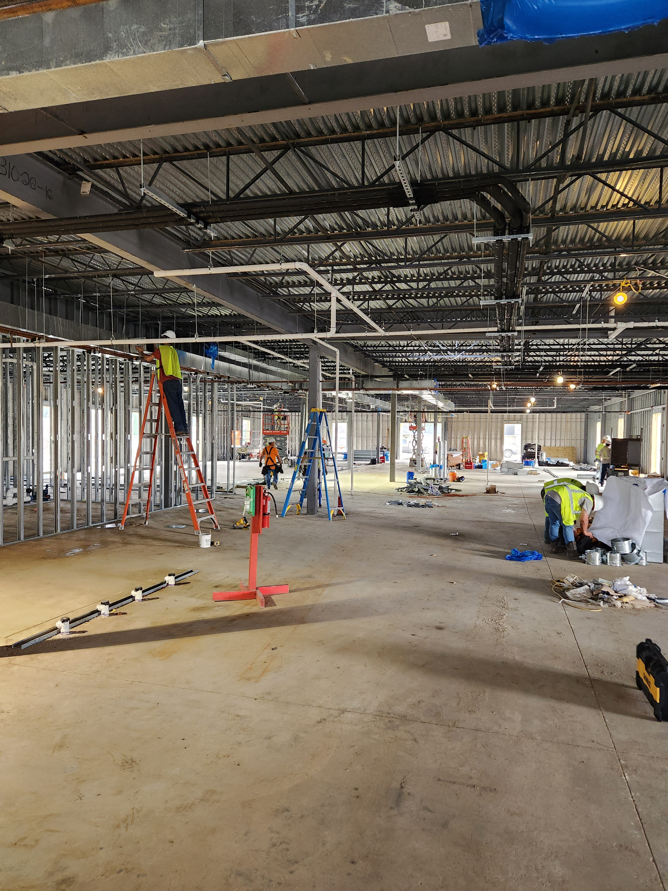
Highland Park Elementary School
Interior Mechanical Work
Plumbing Work
Electrical Work
Installation of Metal Studs

Slide 17
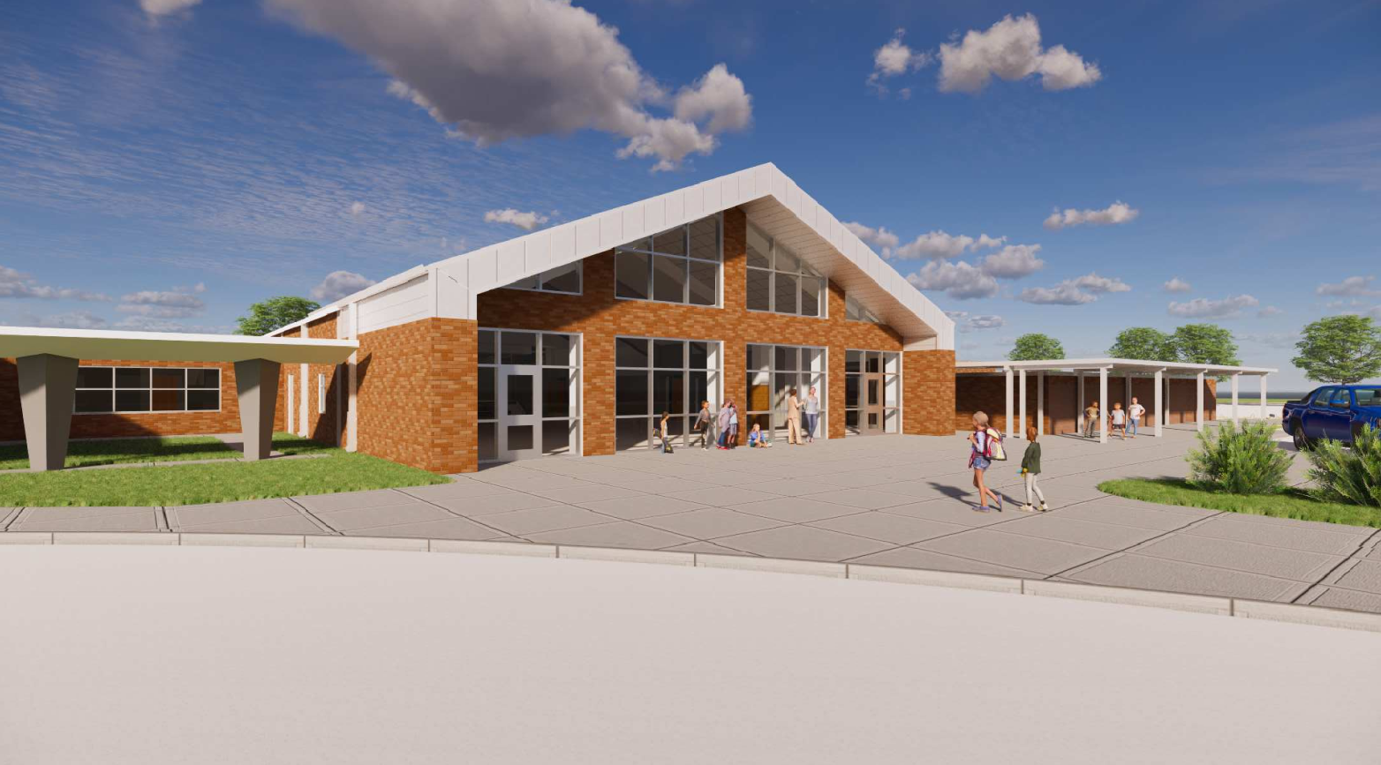
Helena Park Elementary School

Slide 18
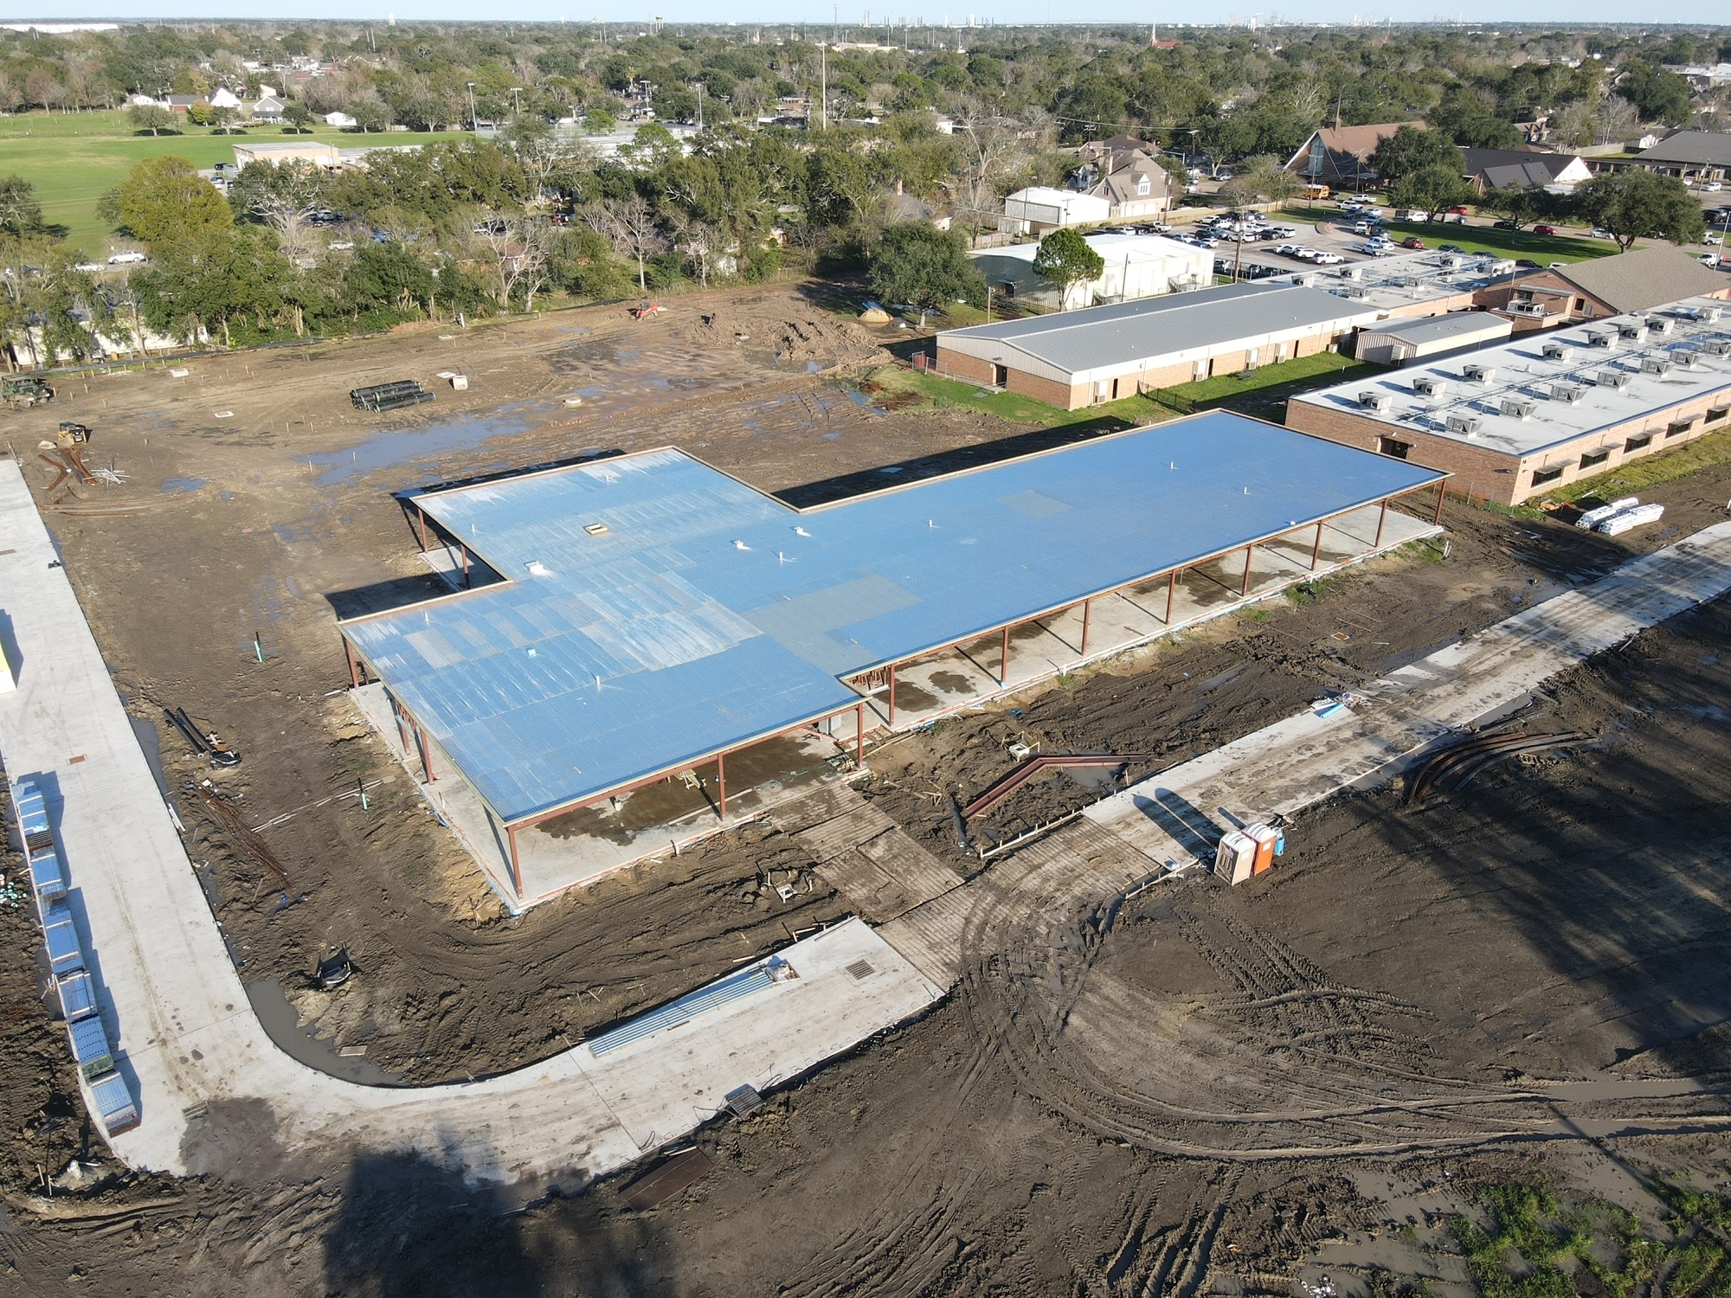
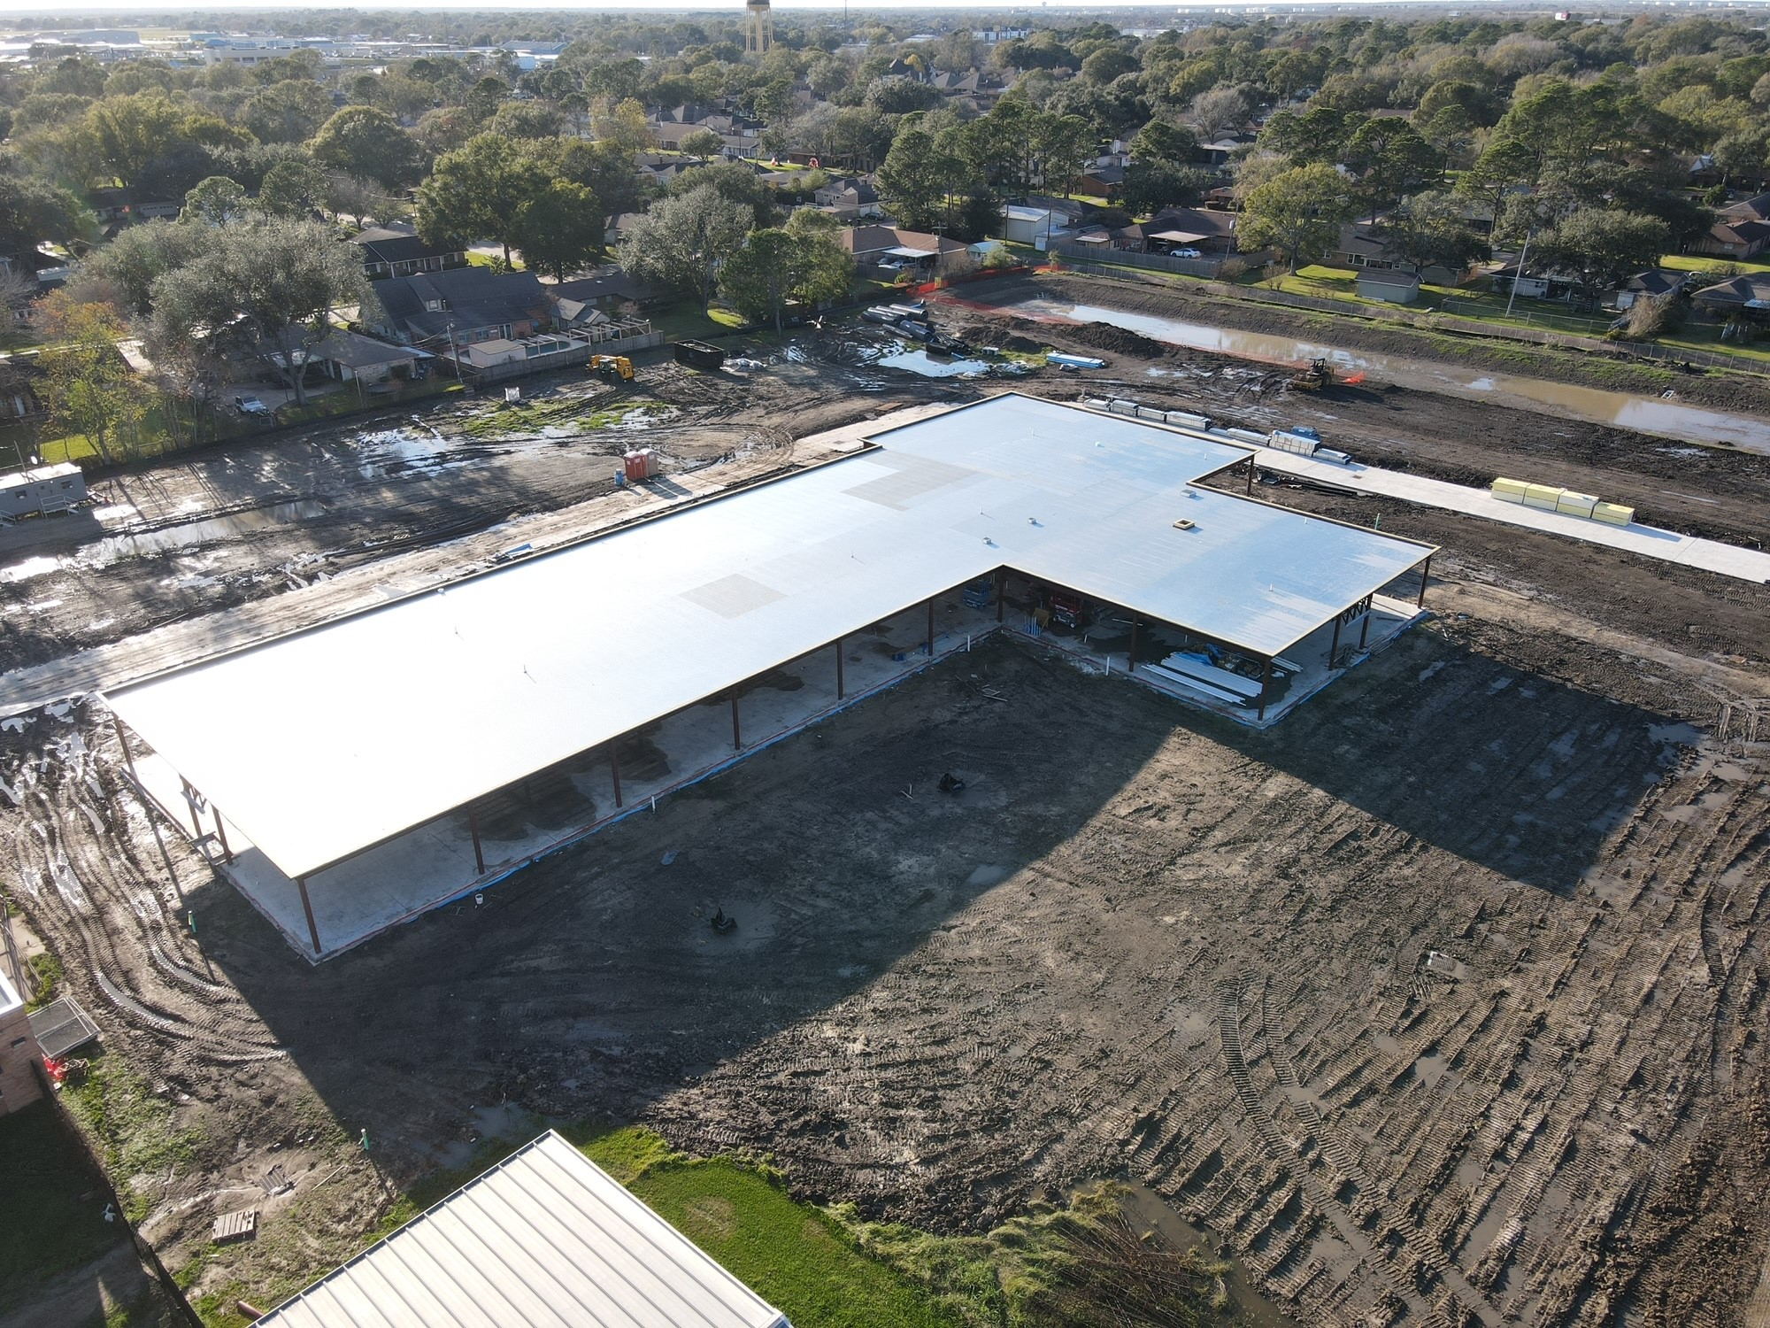
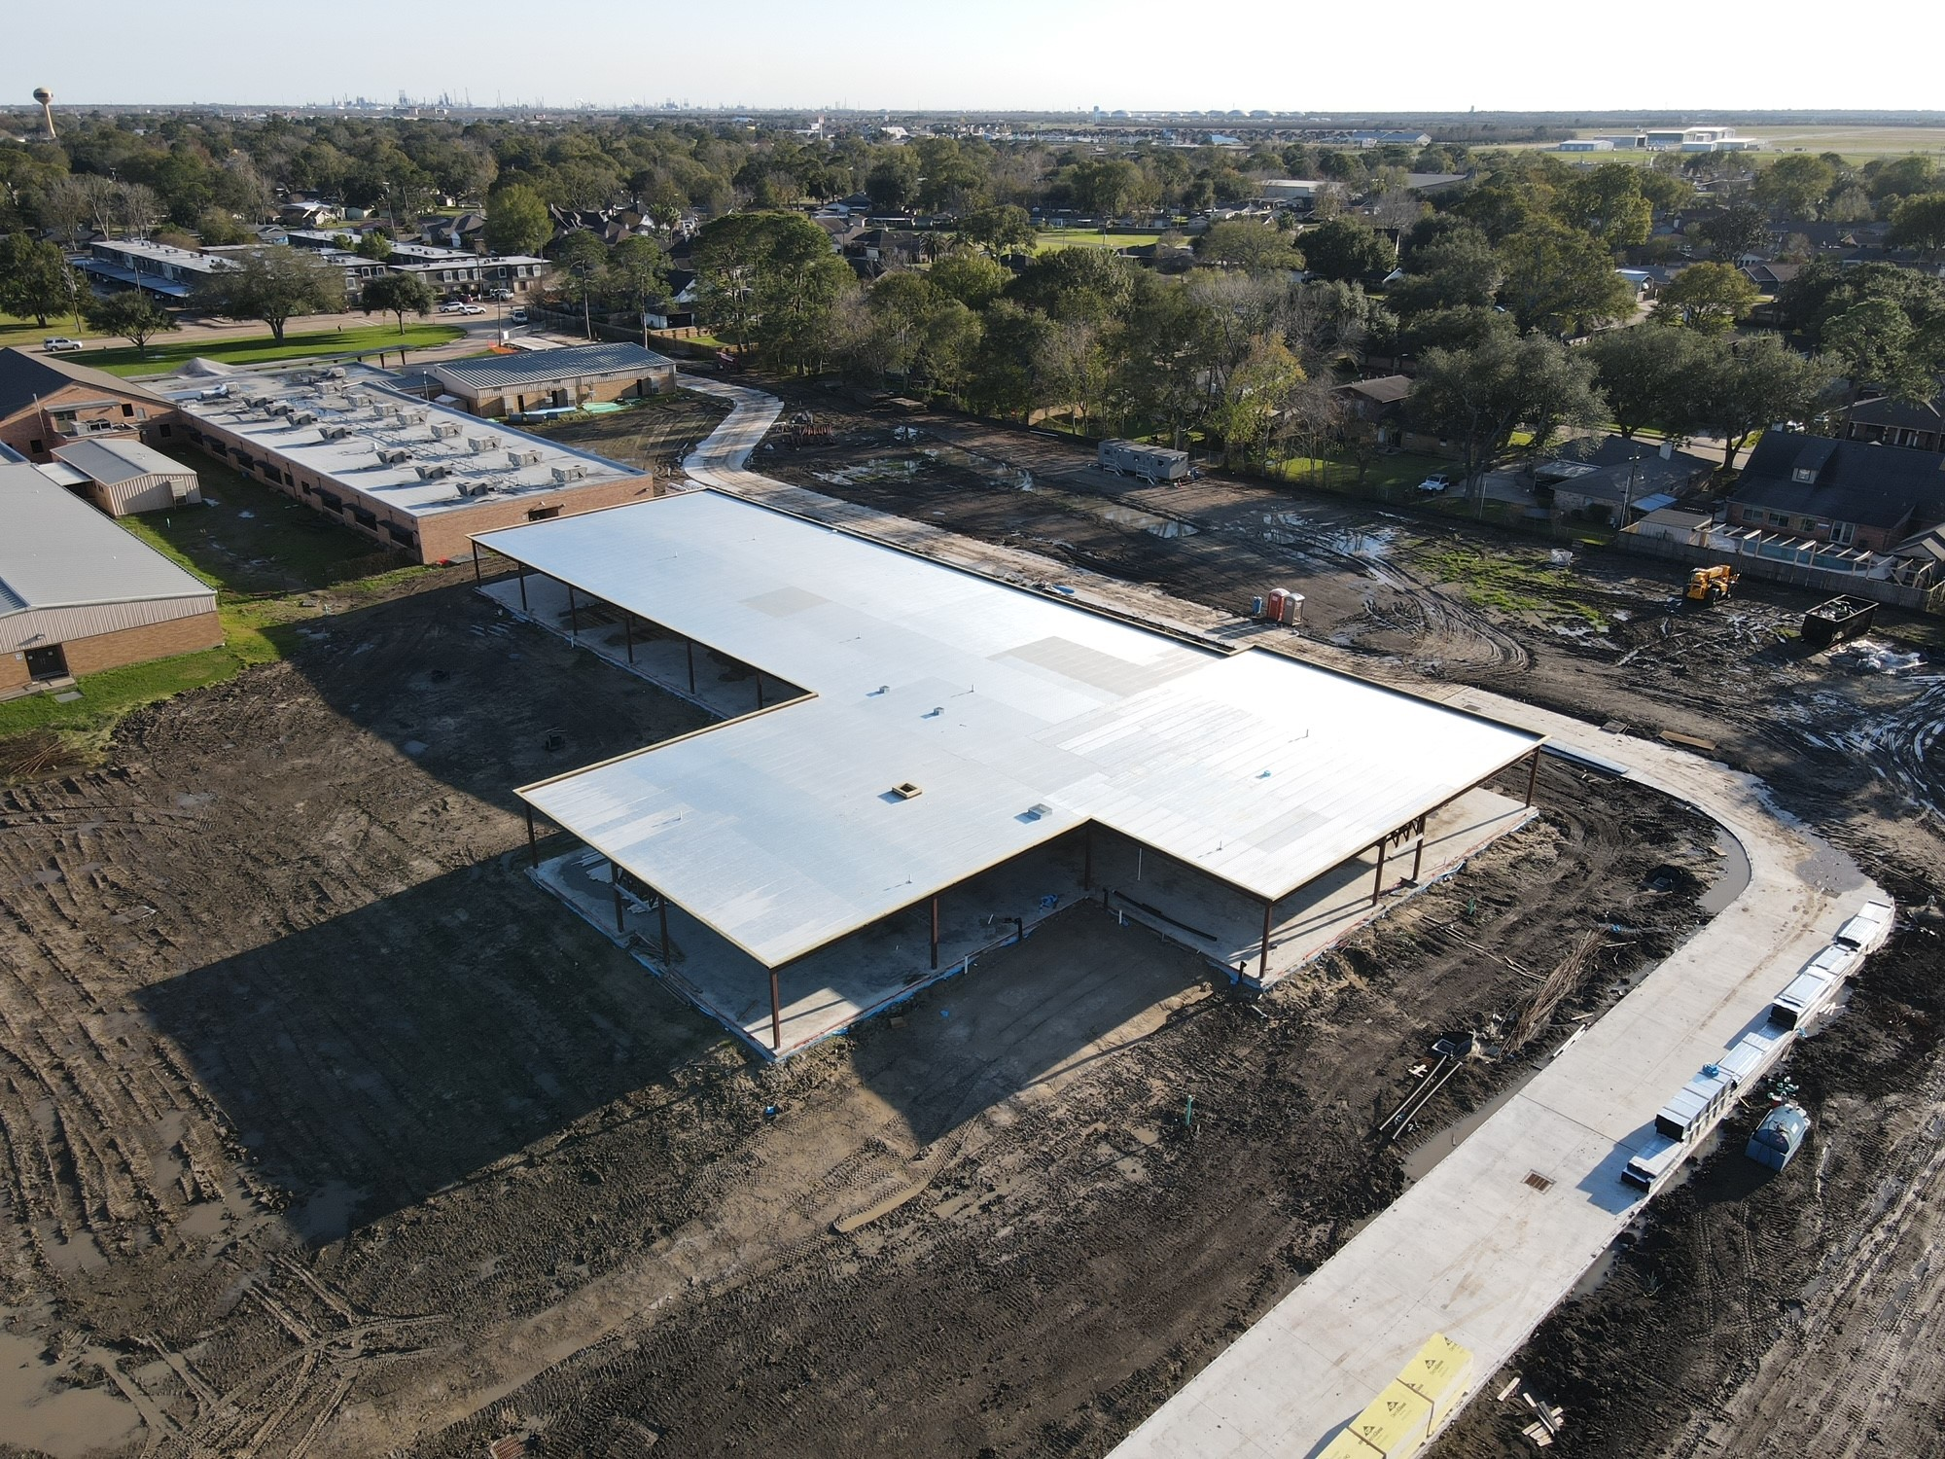
Helena Park Elementary School
Installing mechanical hangers
Continuing work on Iron frame
Continuing work on fire lane road
Preparing for metal deck installation

Slide 19
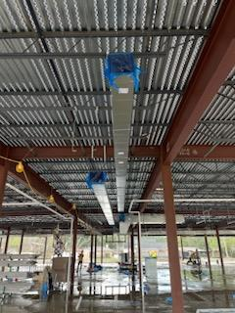
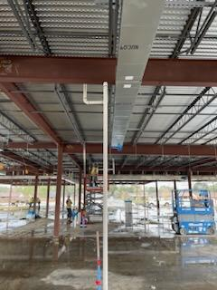
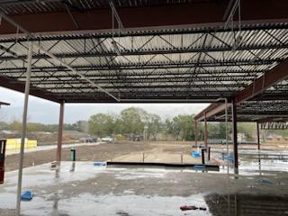
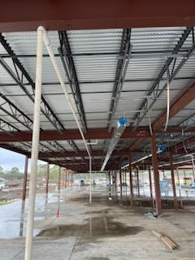
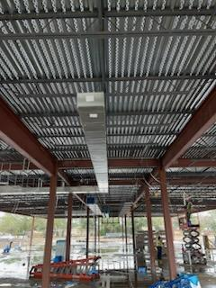
Helena Park Elementary School
Installing metal hangers
Installing duct work
Continue electrical and plumbing work

Slide 20
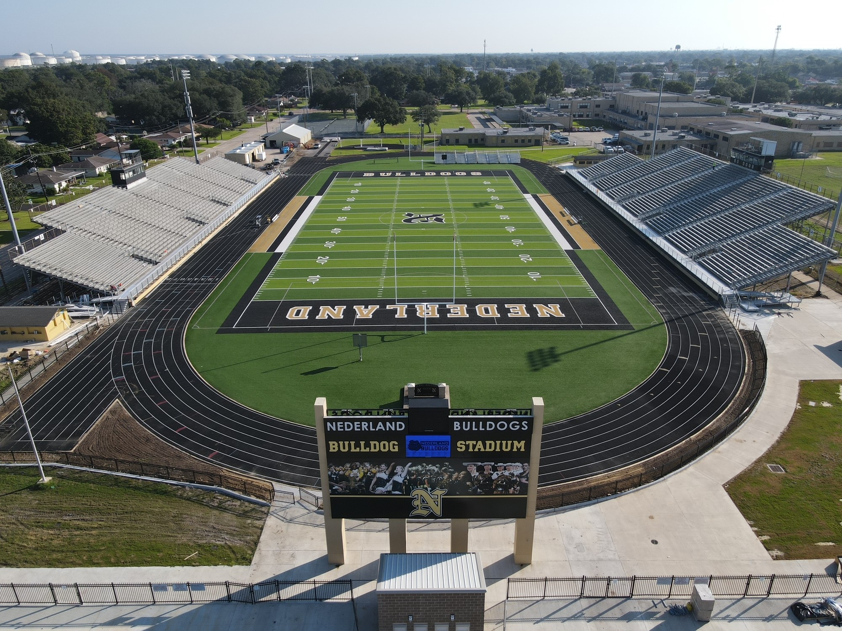
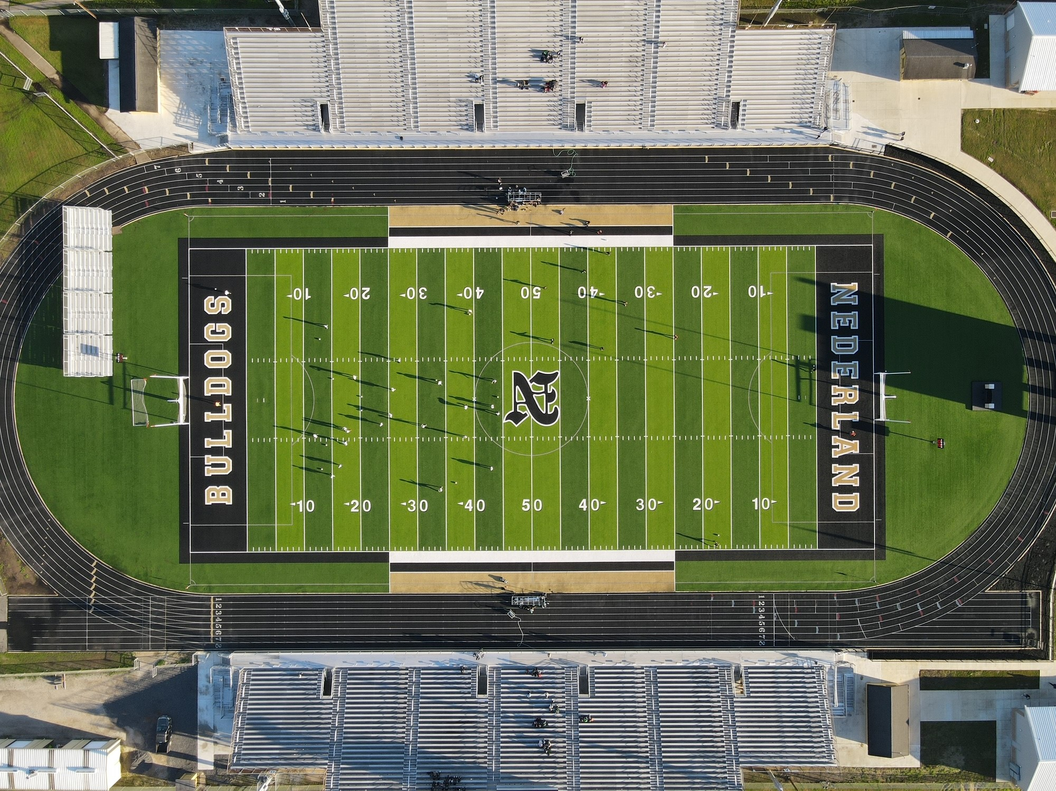
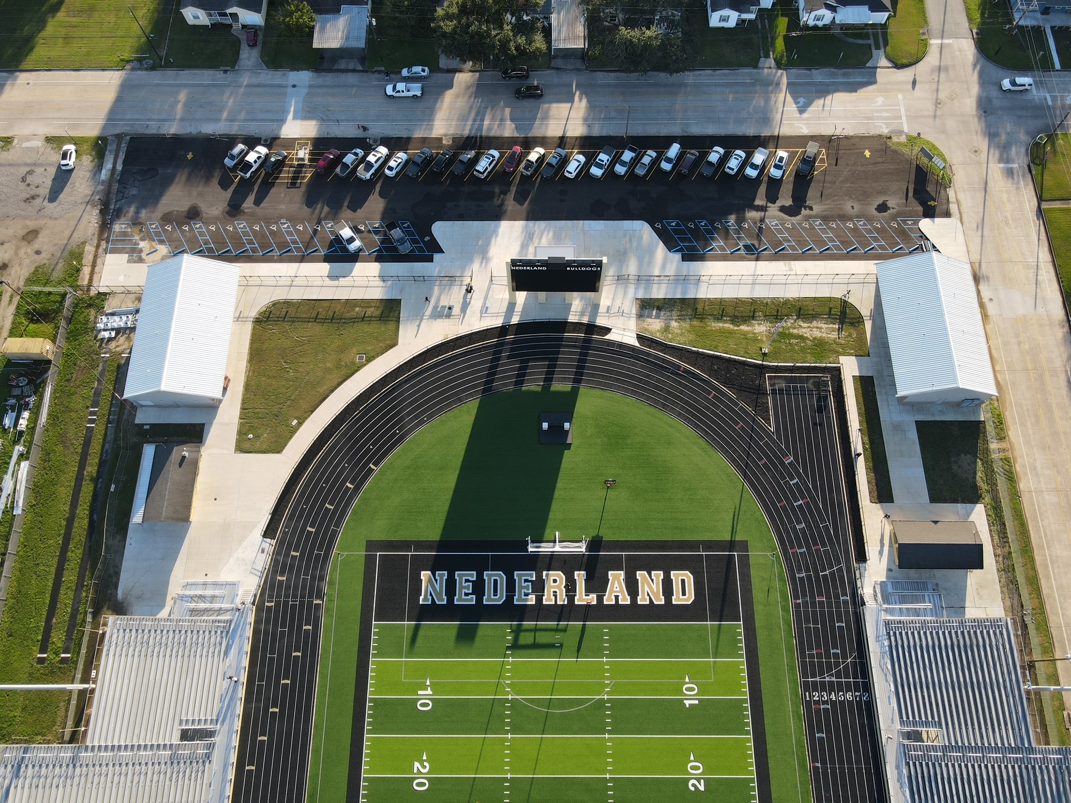
Nederland Bulldog Stadium

Slide 21


