Slide 1
2019 Nederland ISD Bond Project
January 2023

Slide 2
Nederland High School

Slide 3
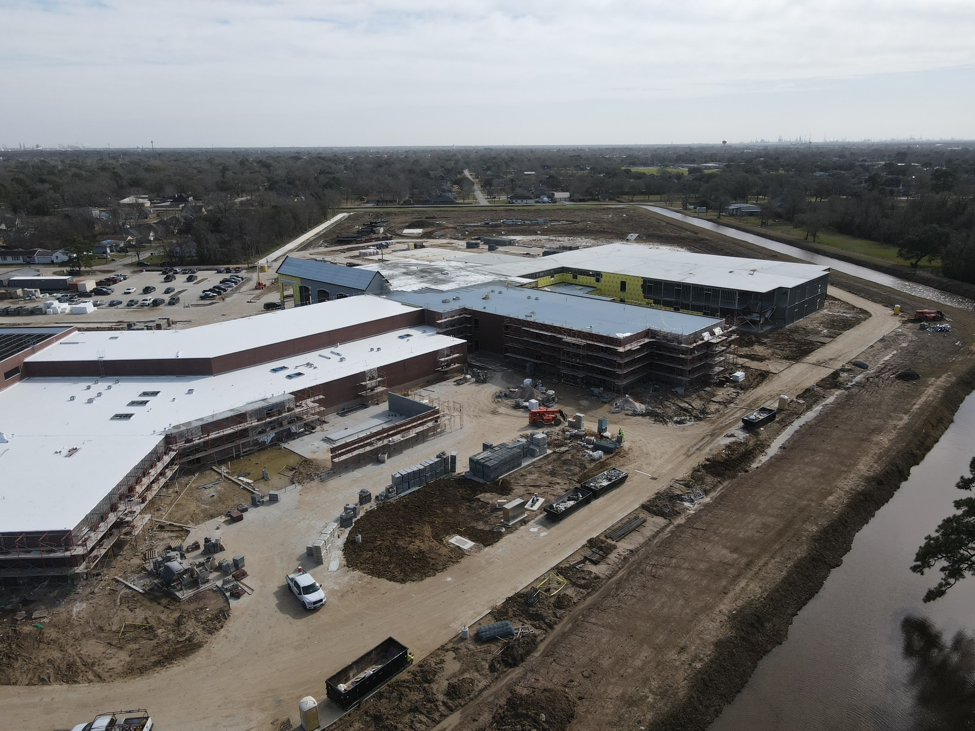
Nederland High School
Gym / Lockers

Slide 4
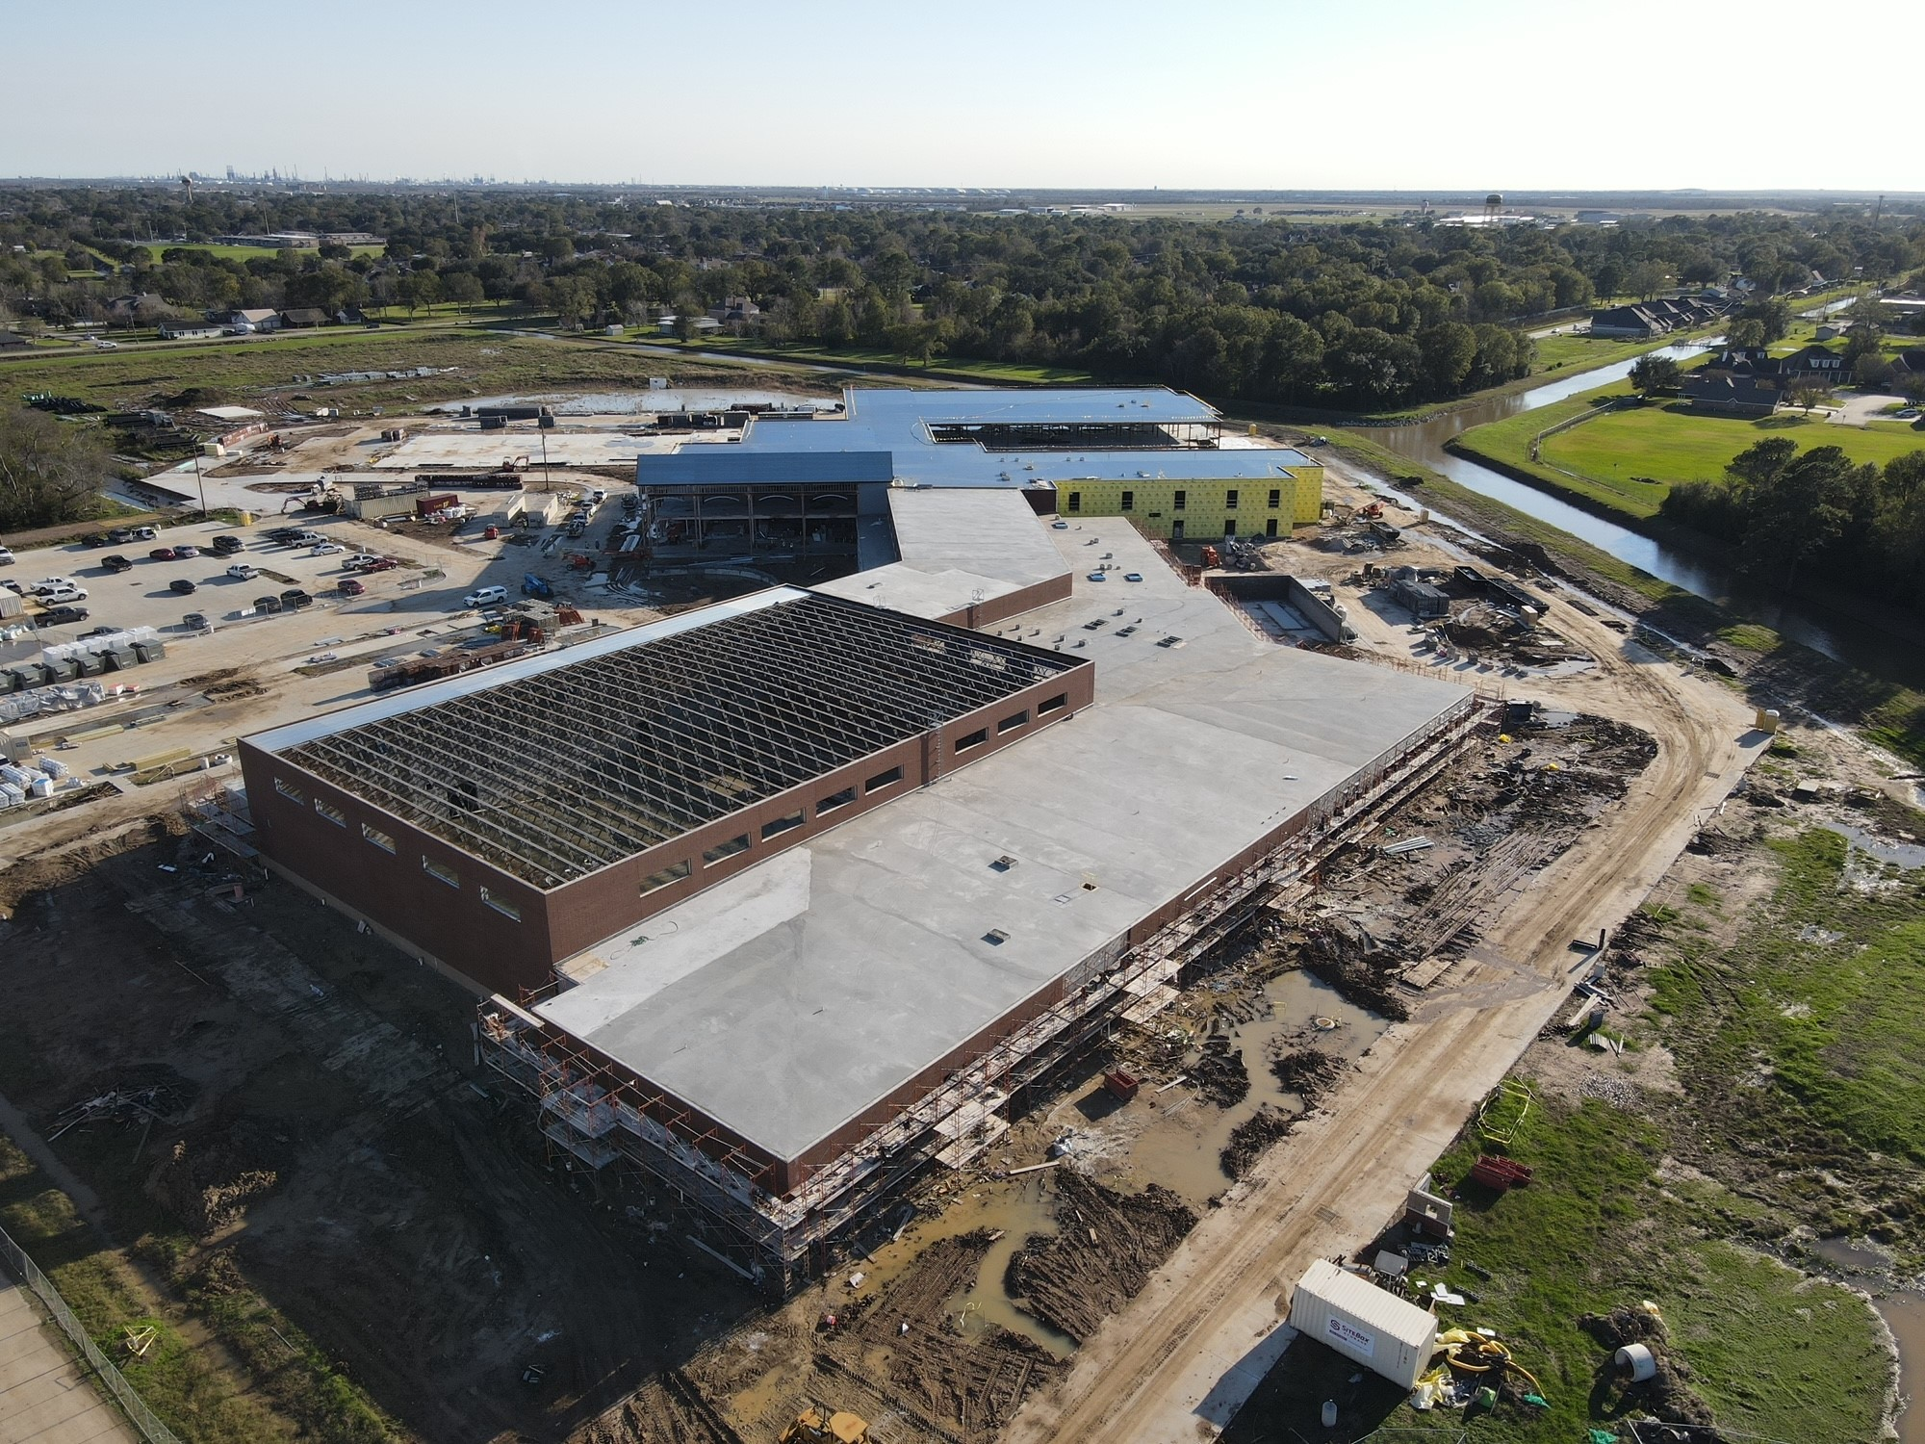
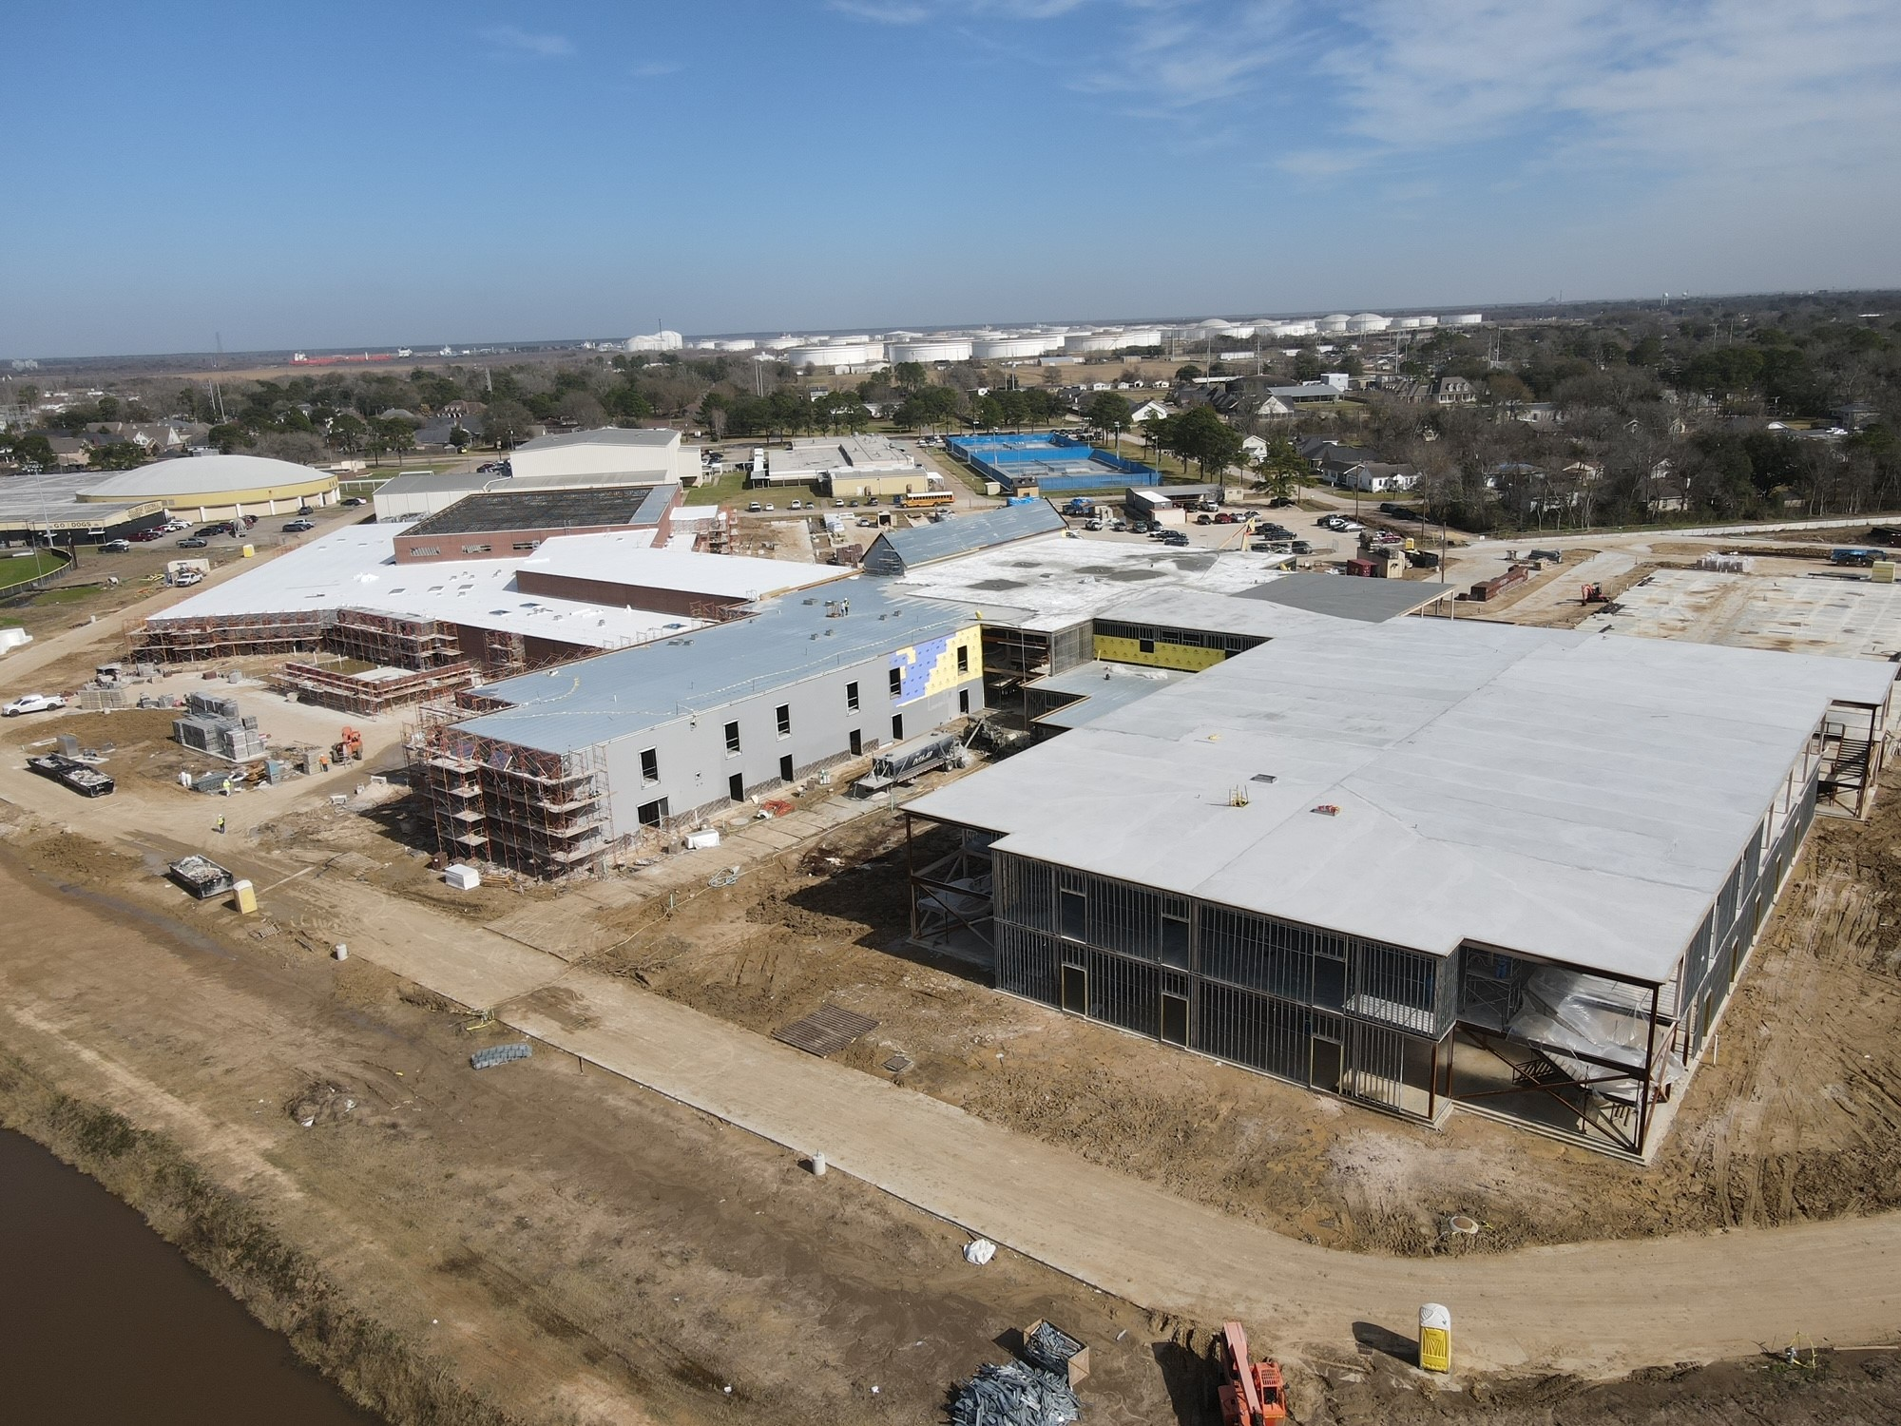
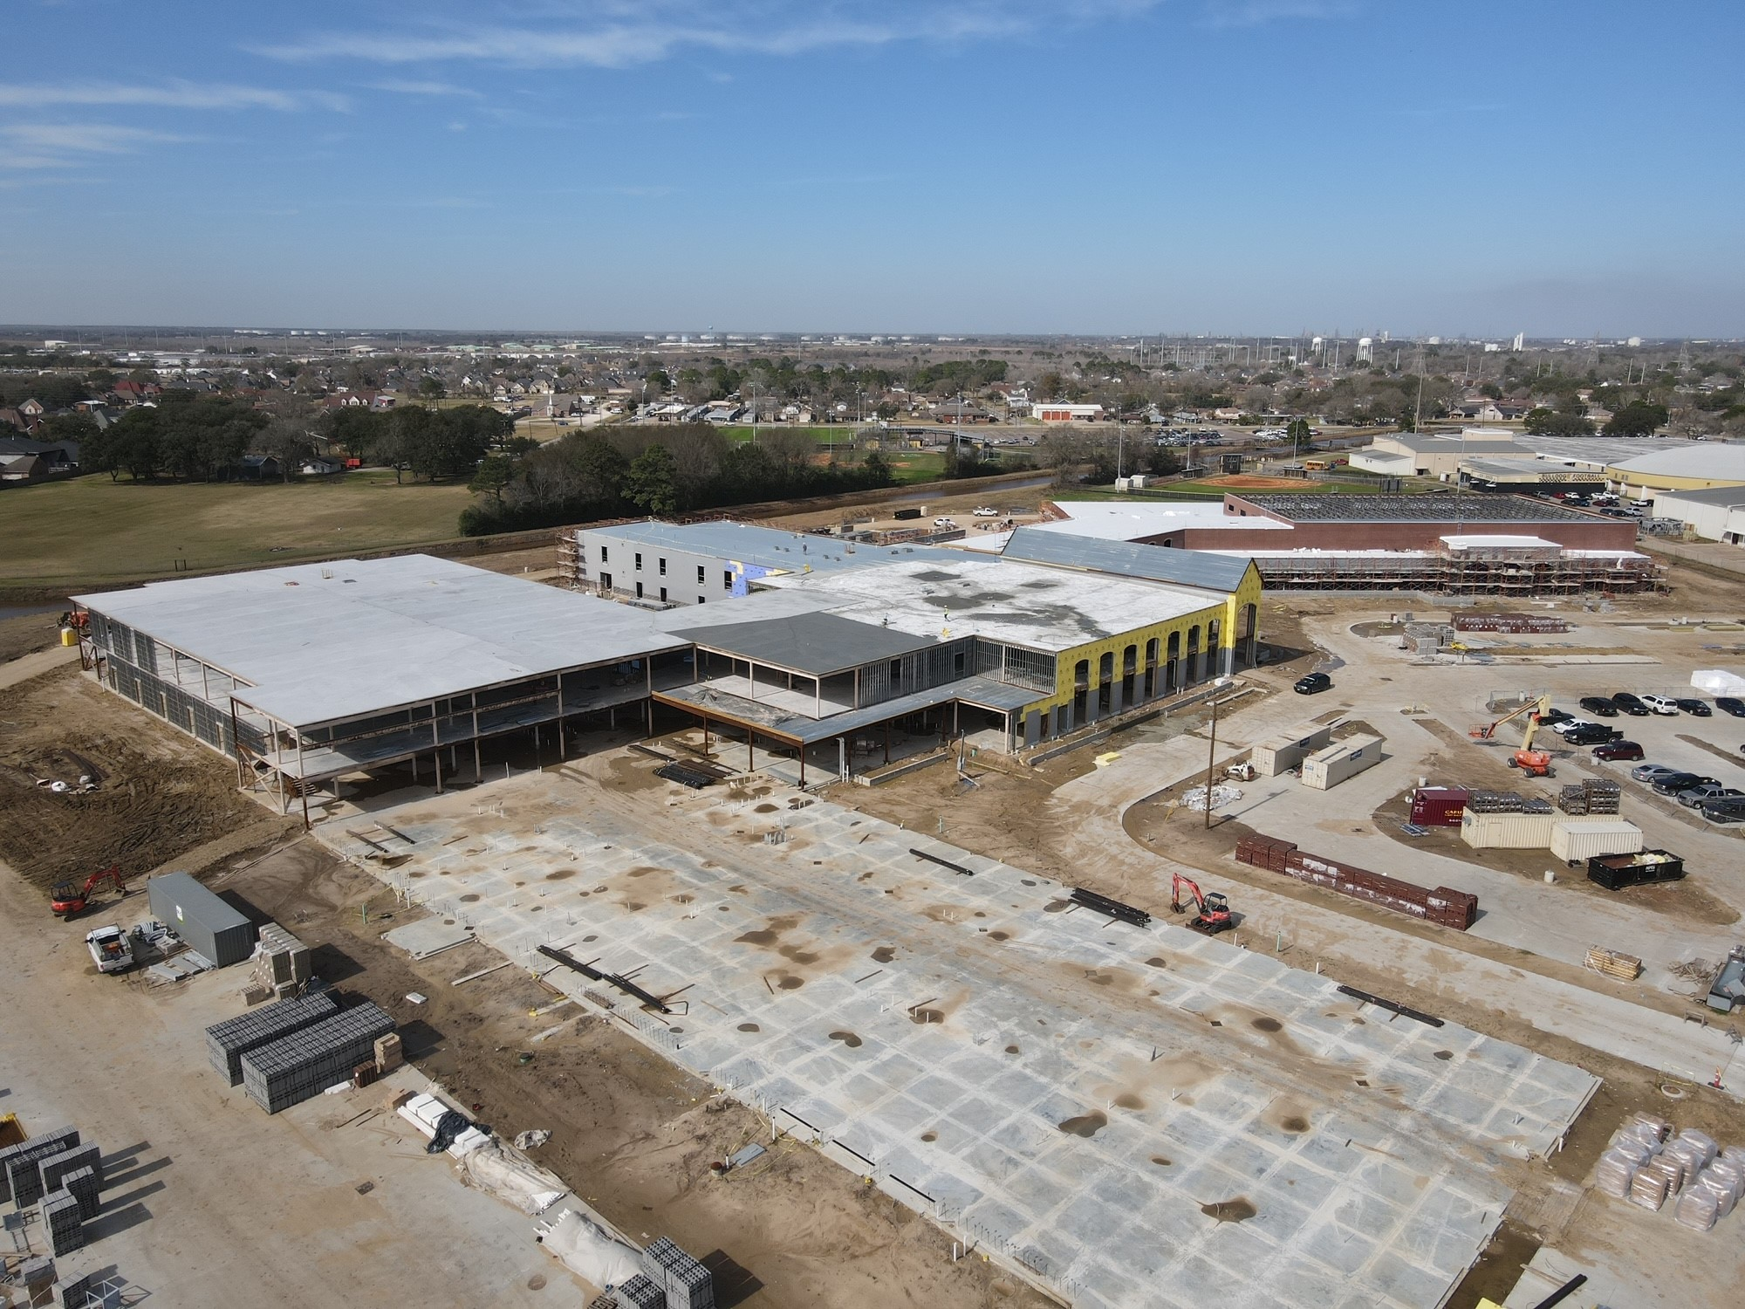
Nederland High School
Ready for Tectum to be installed over gym roof
LWIC is Complete
Brick installation following WP

Slide 5
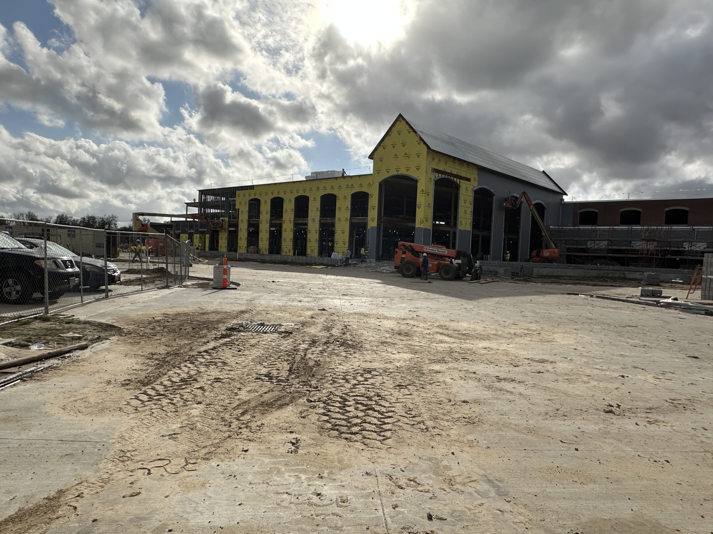
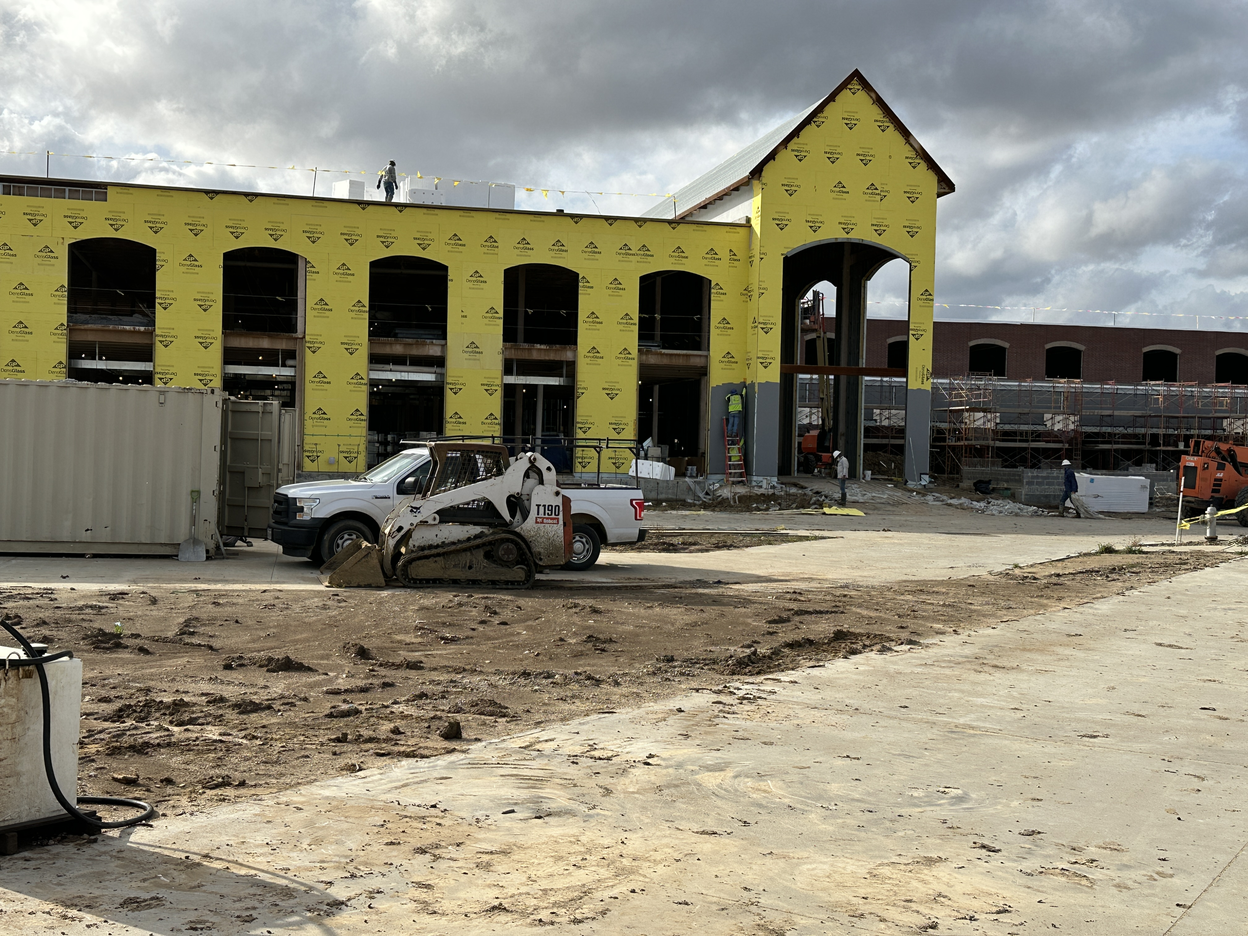
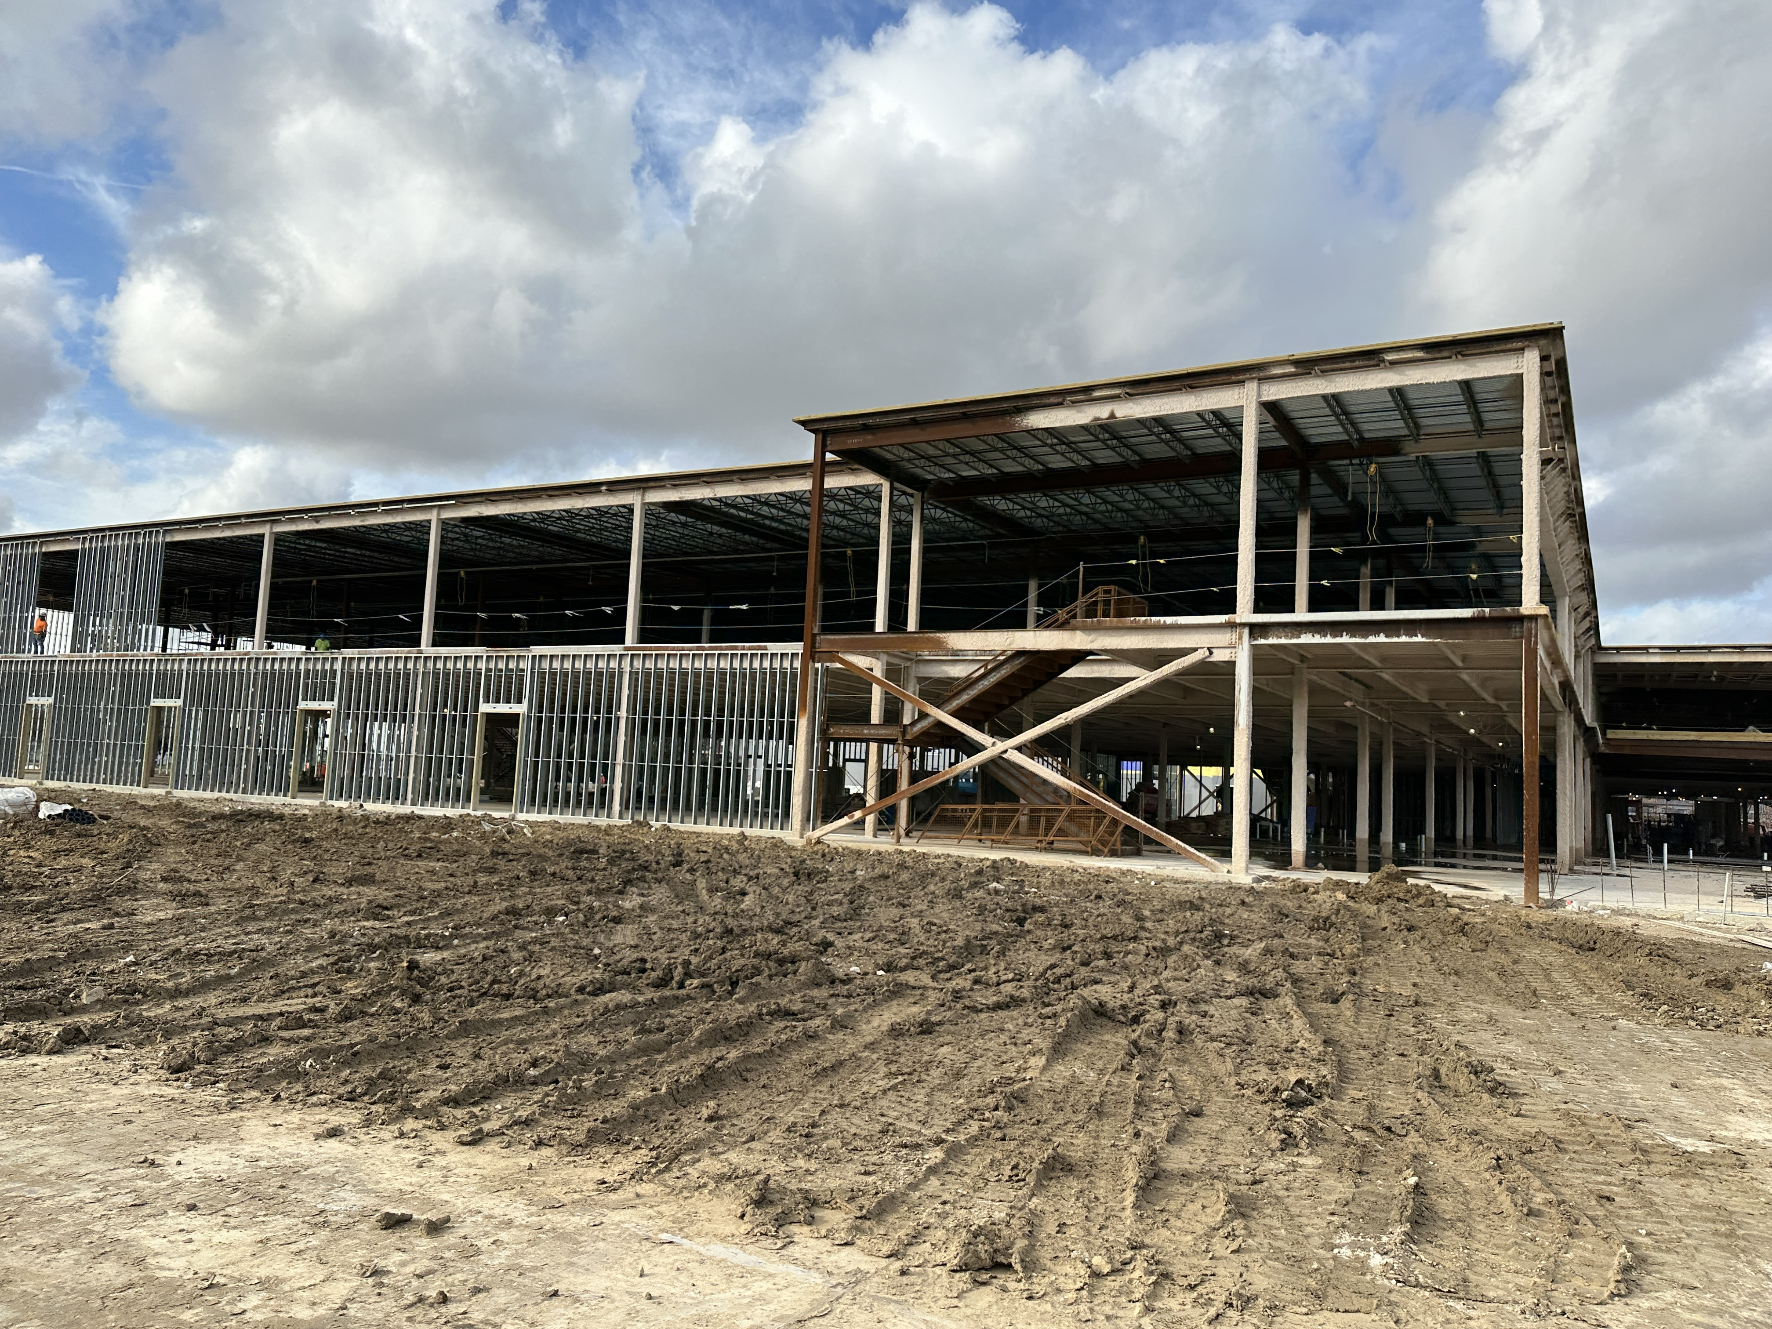
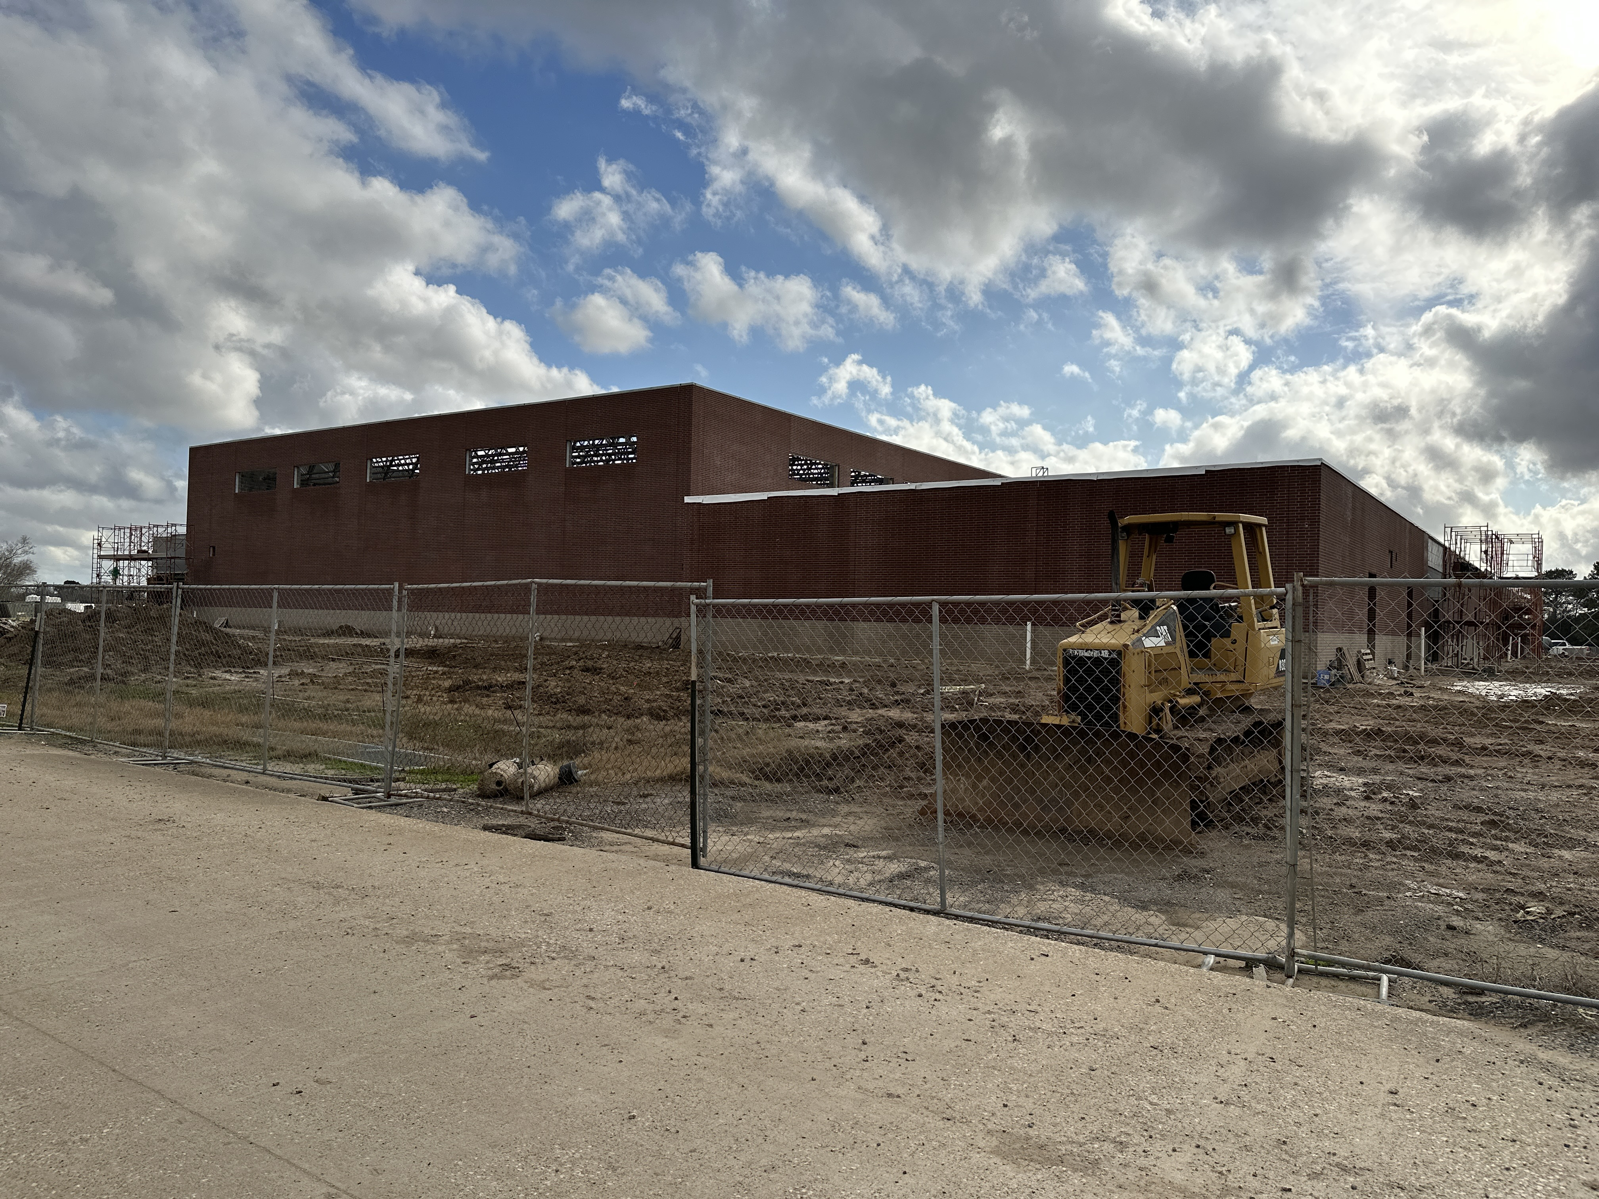
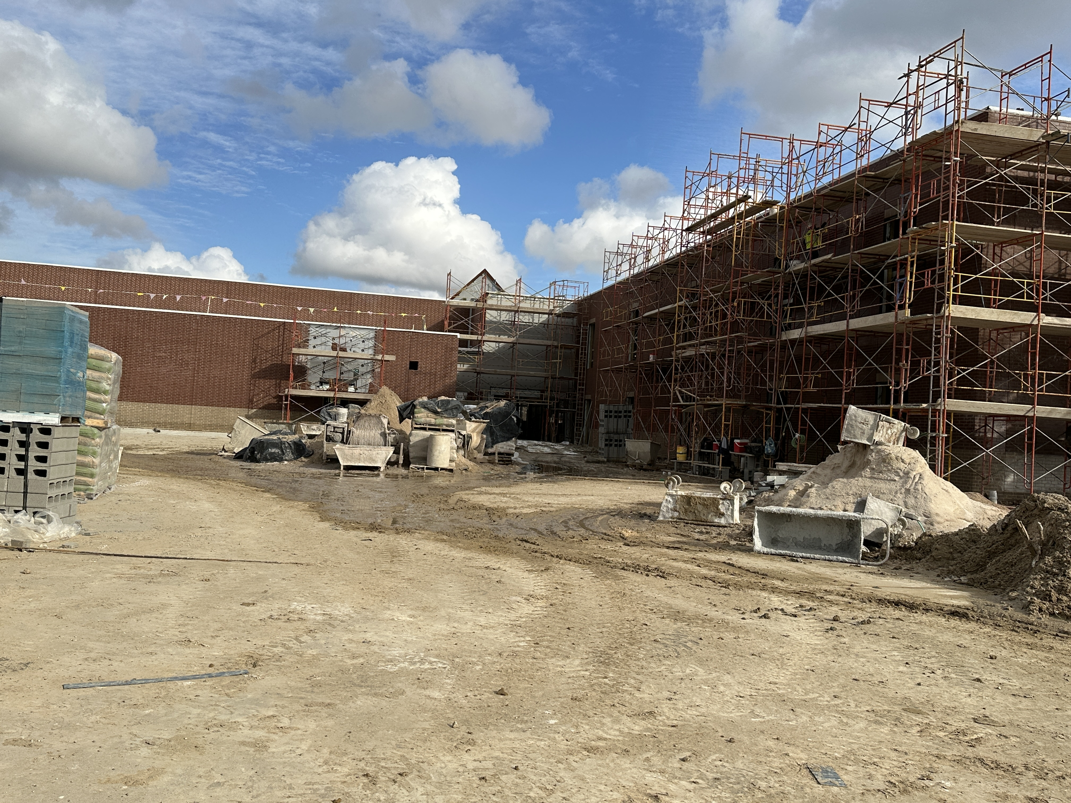
Nederland High School
Installing DensGlass
Waterproofing Front Entrance

Slide 6
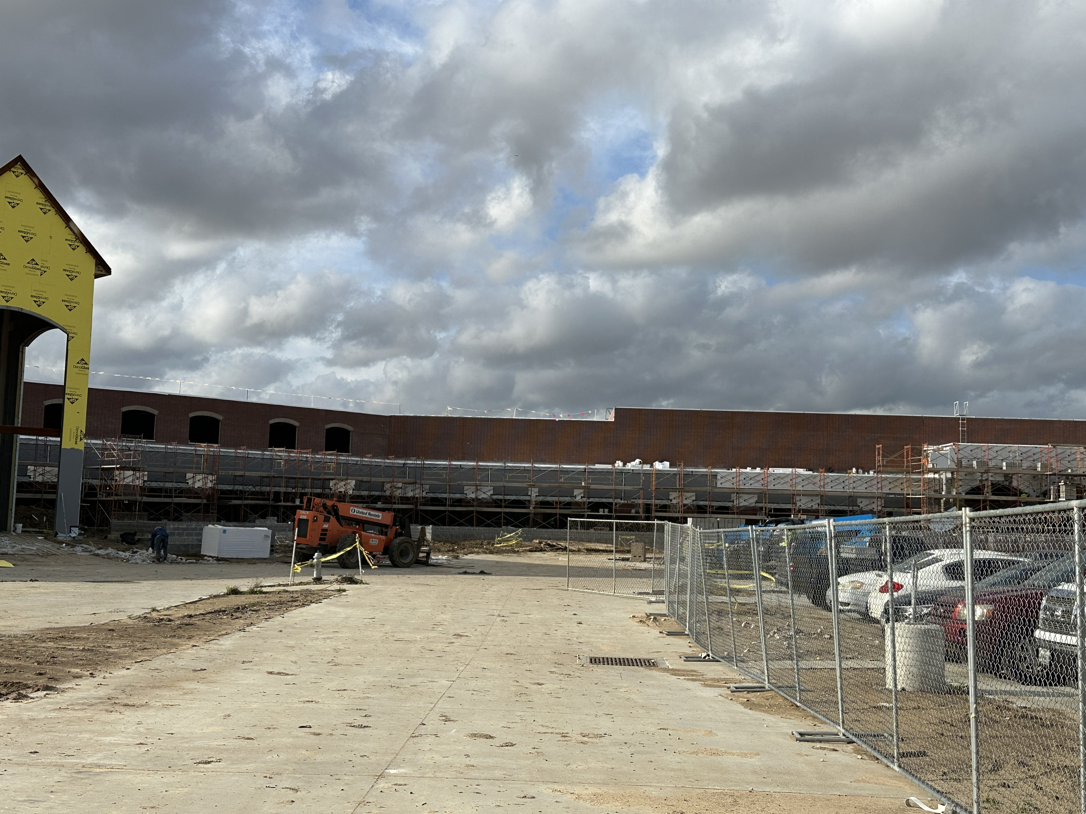
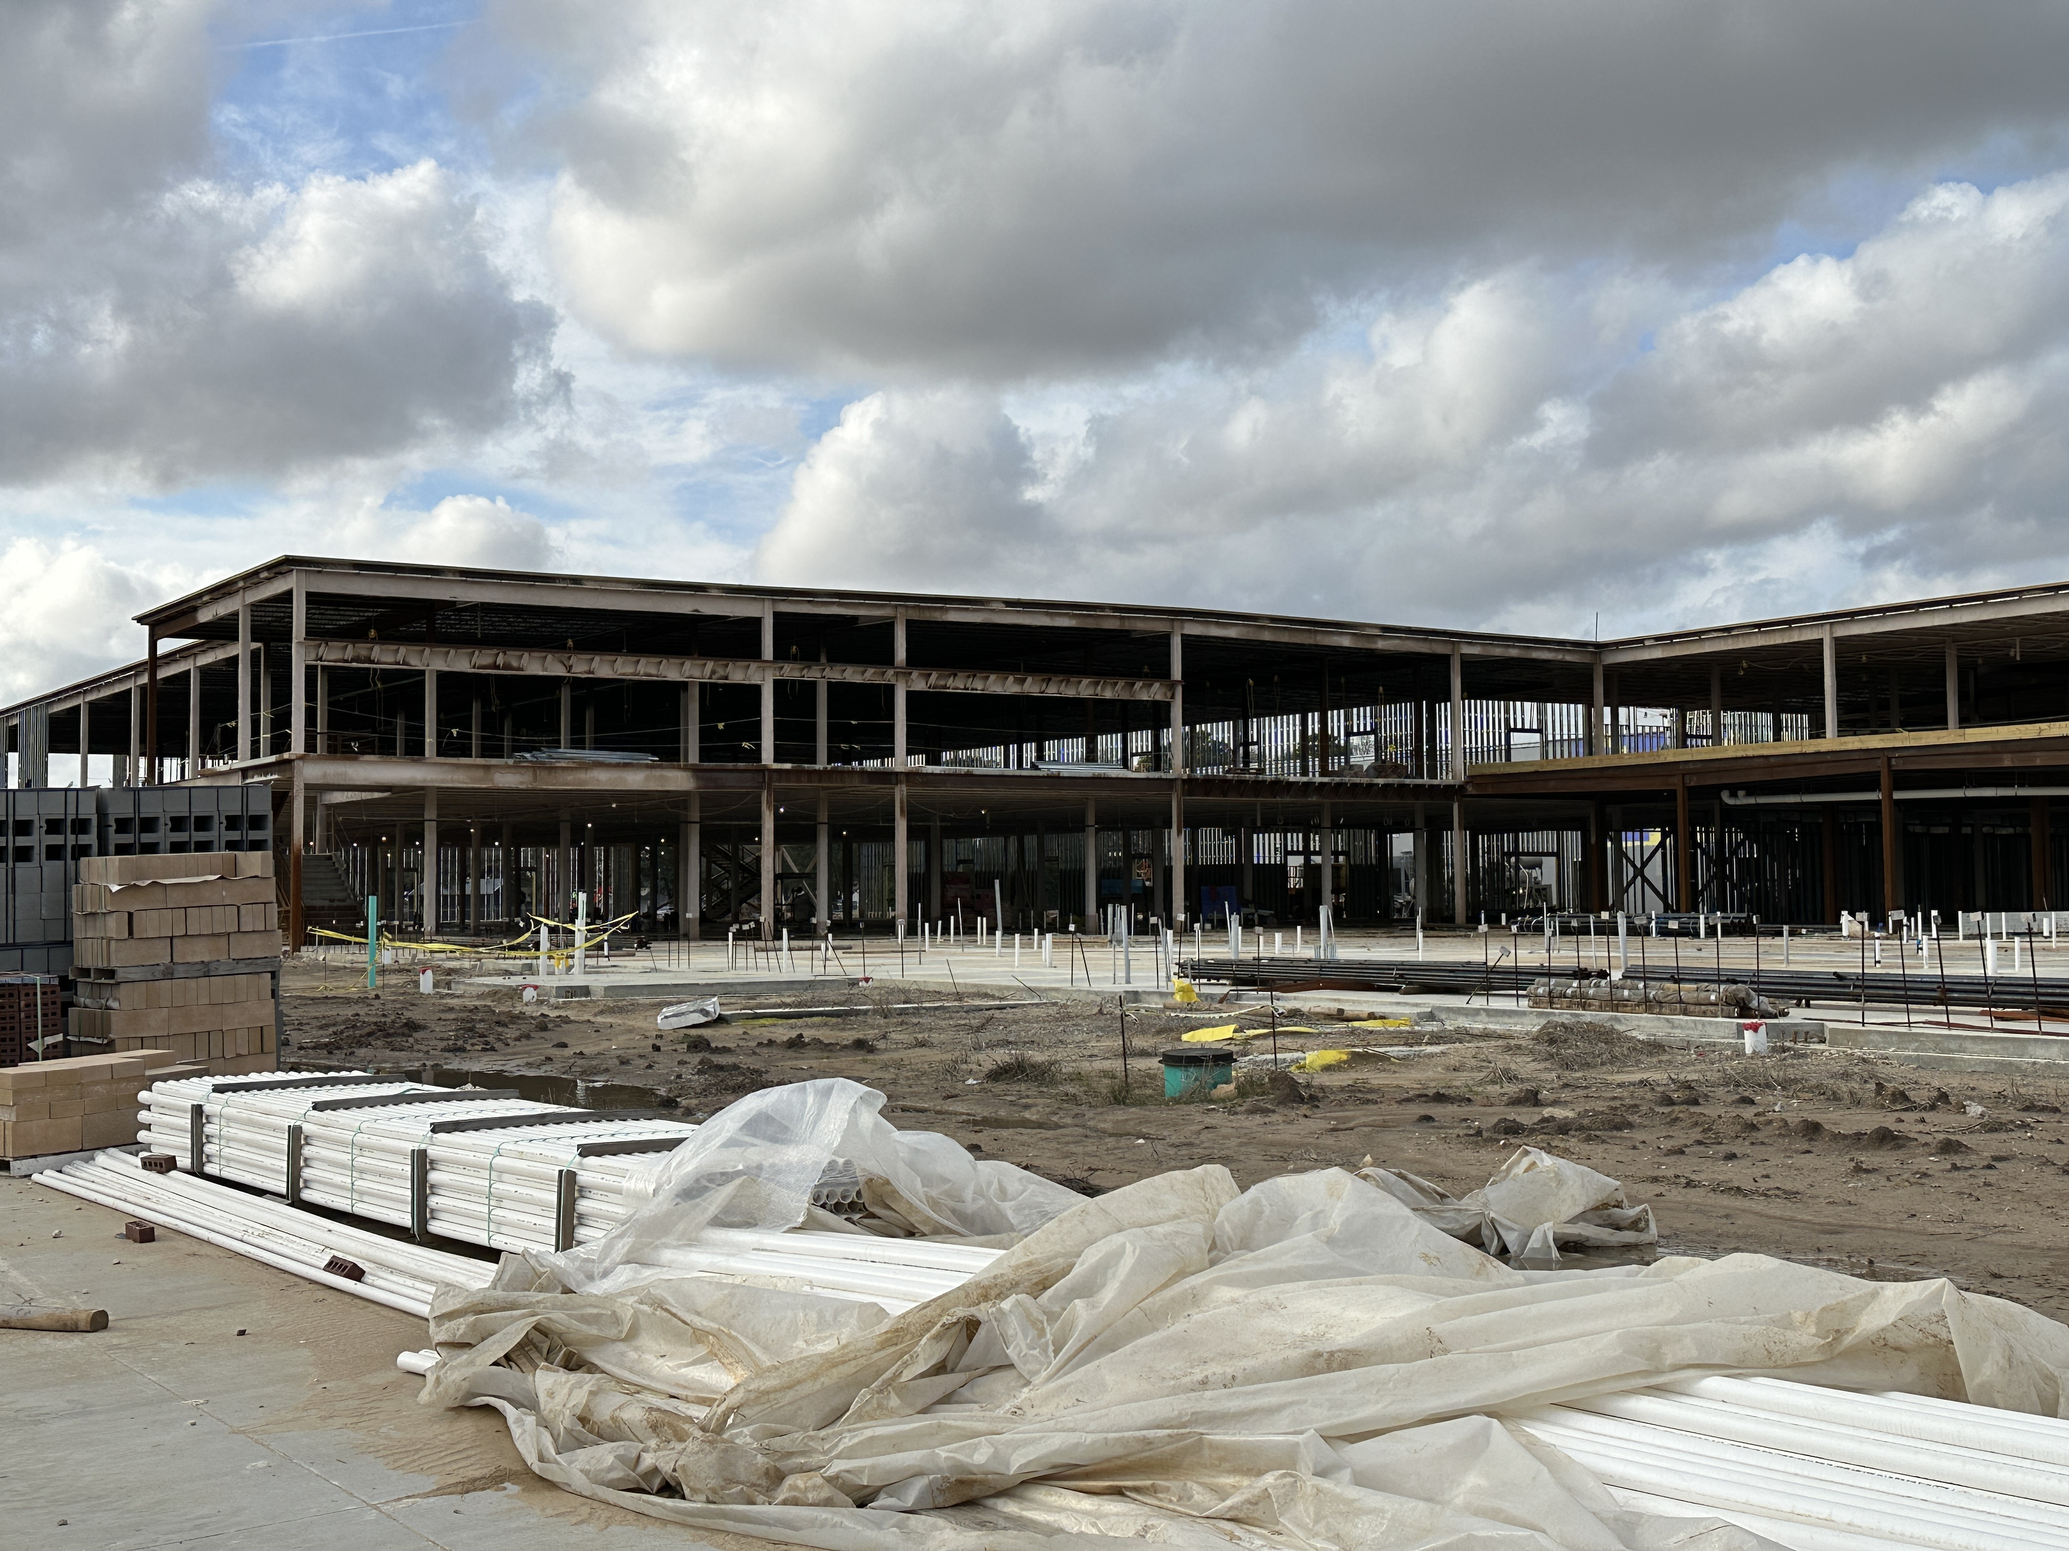
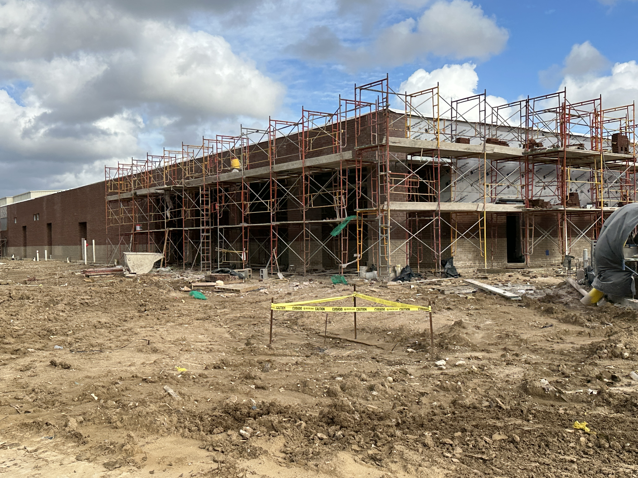
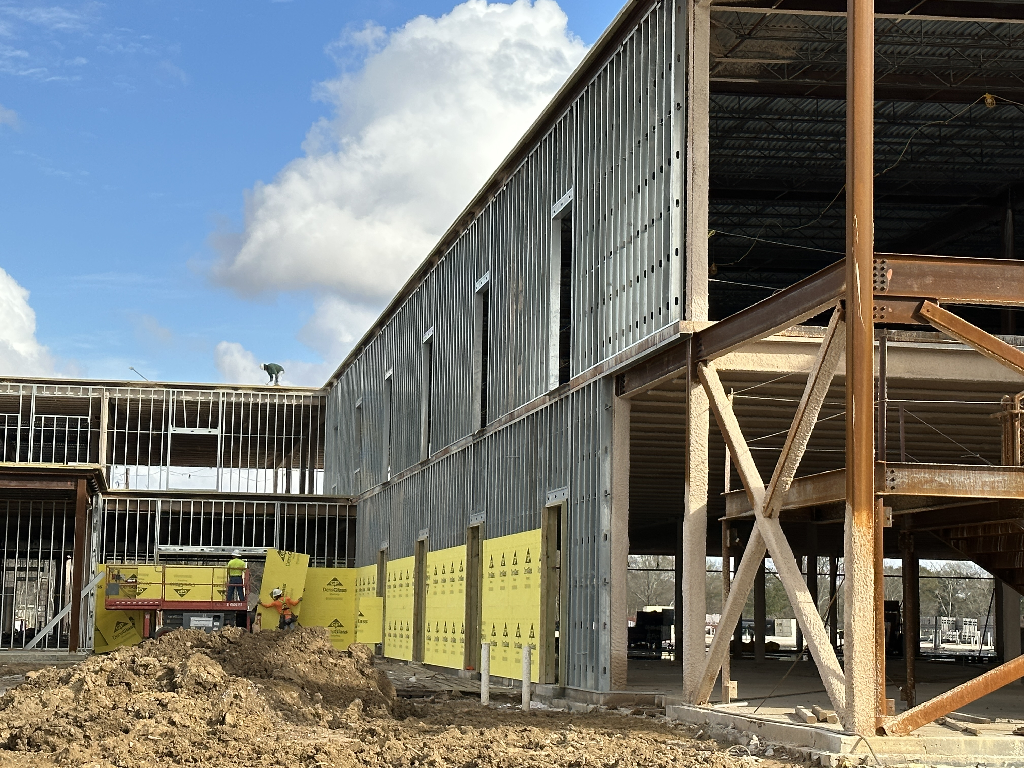
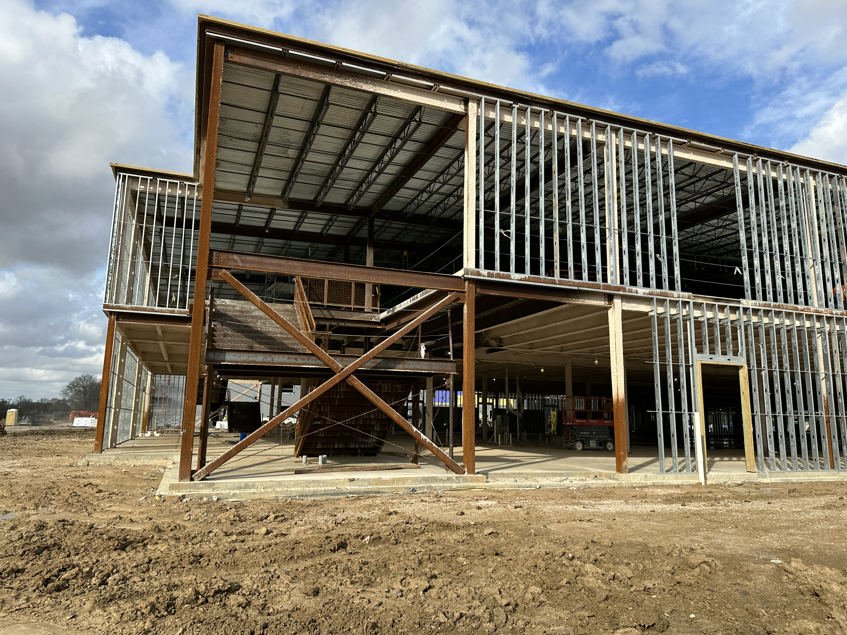
Nederland High School
Exterior Framing in Area B
Installing Brick in Area J

Slide 7
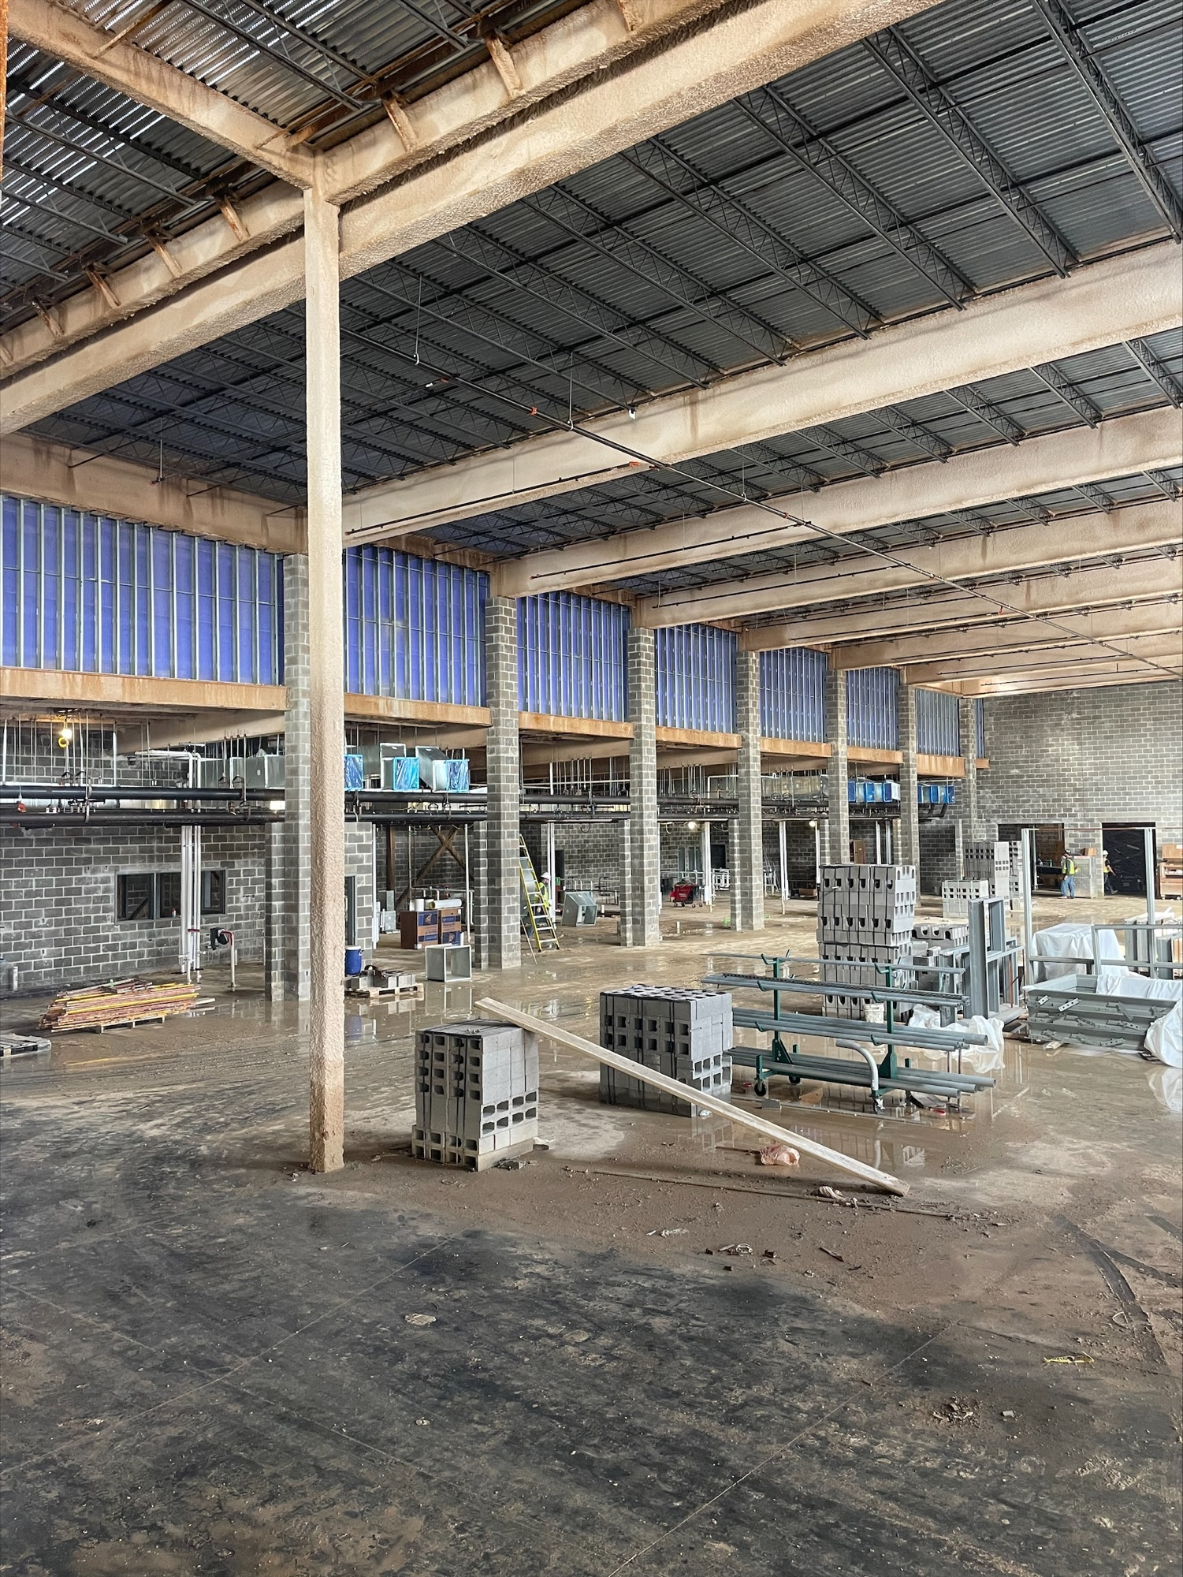
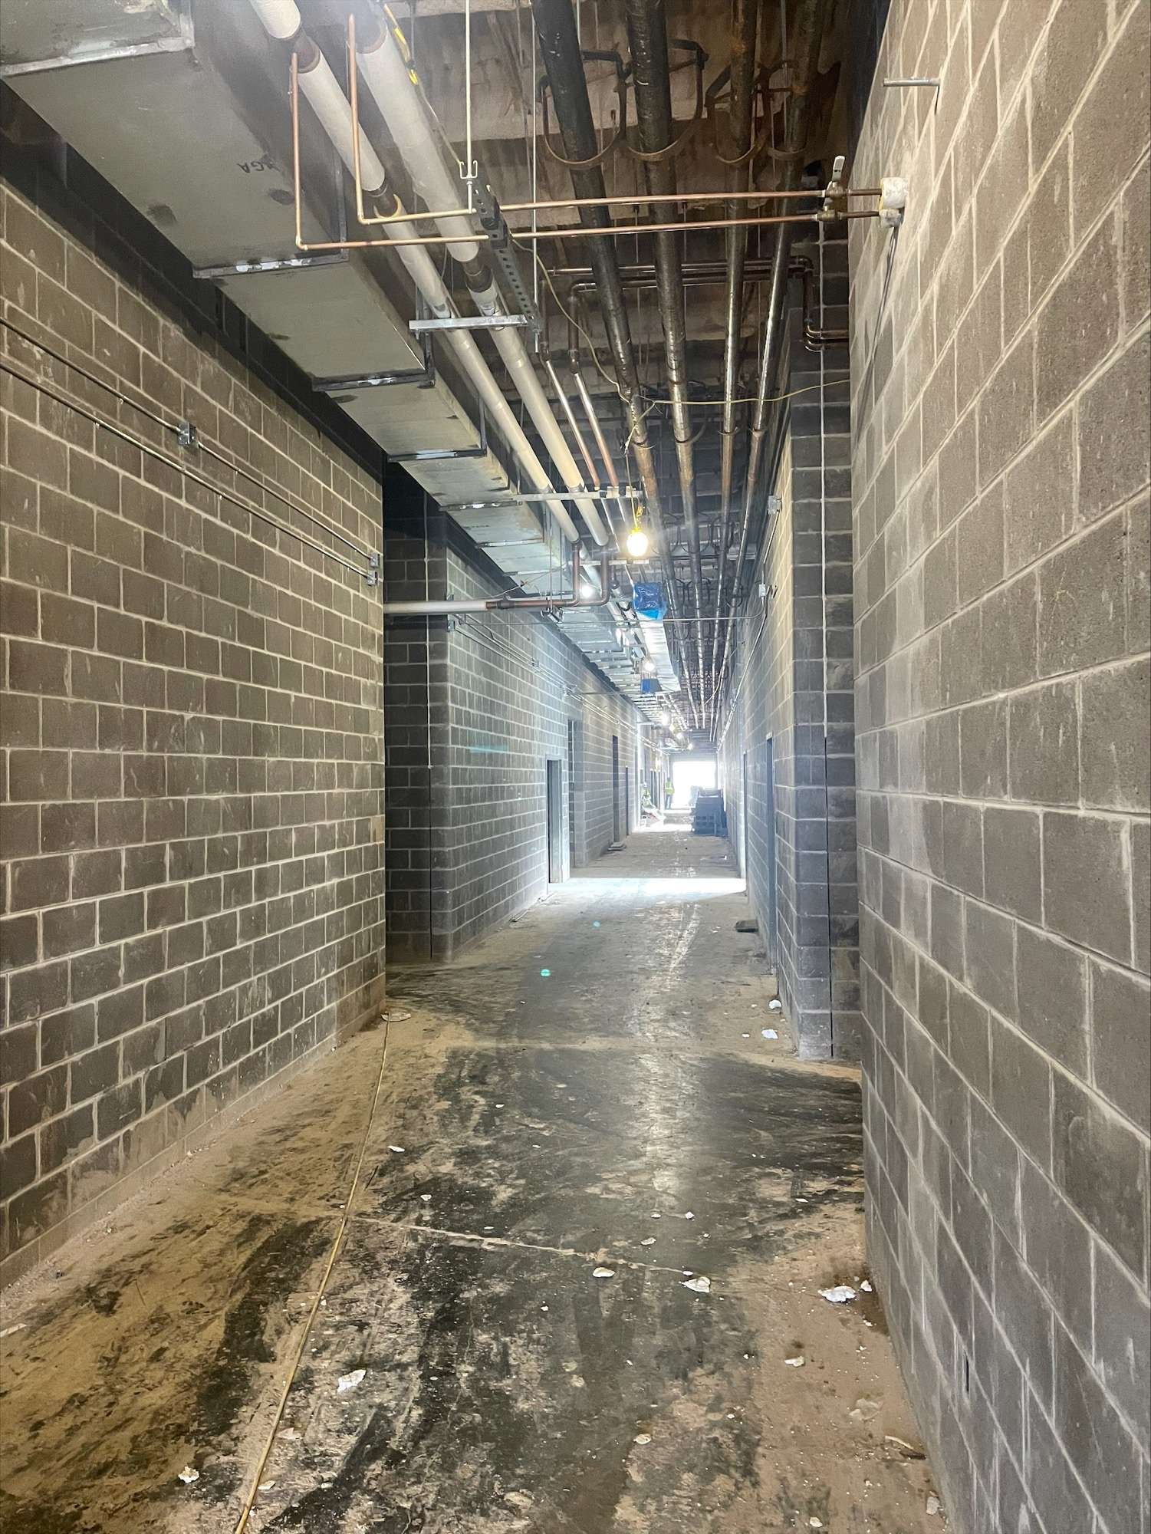
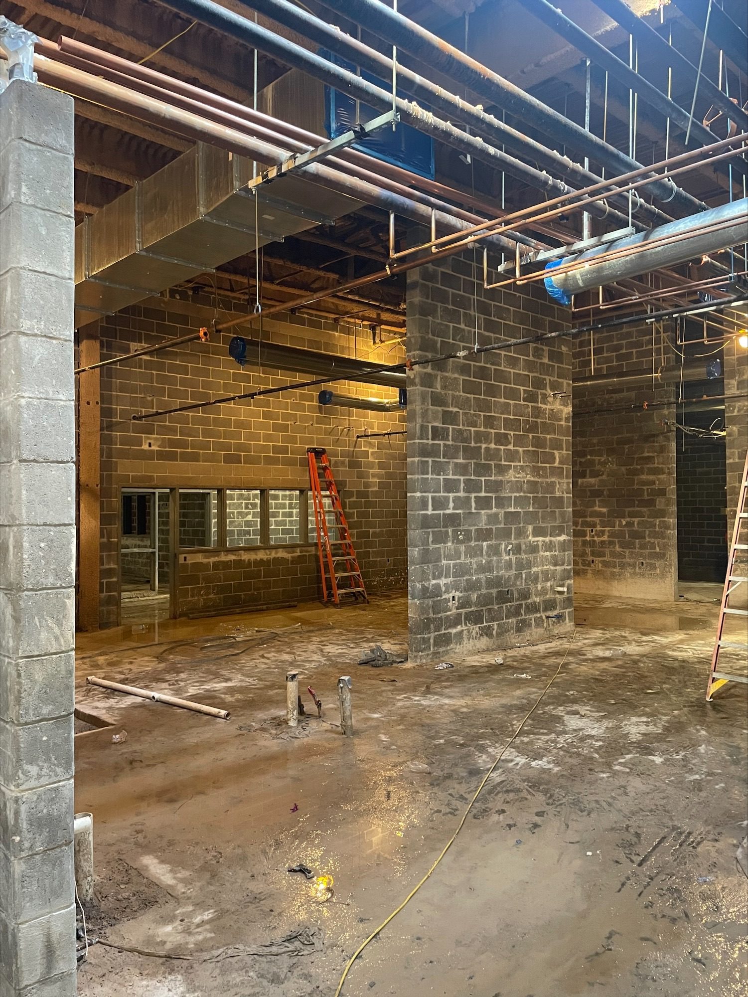
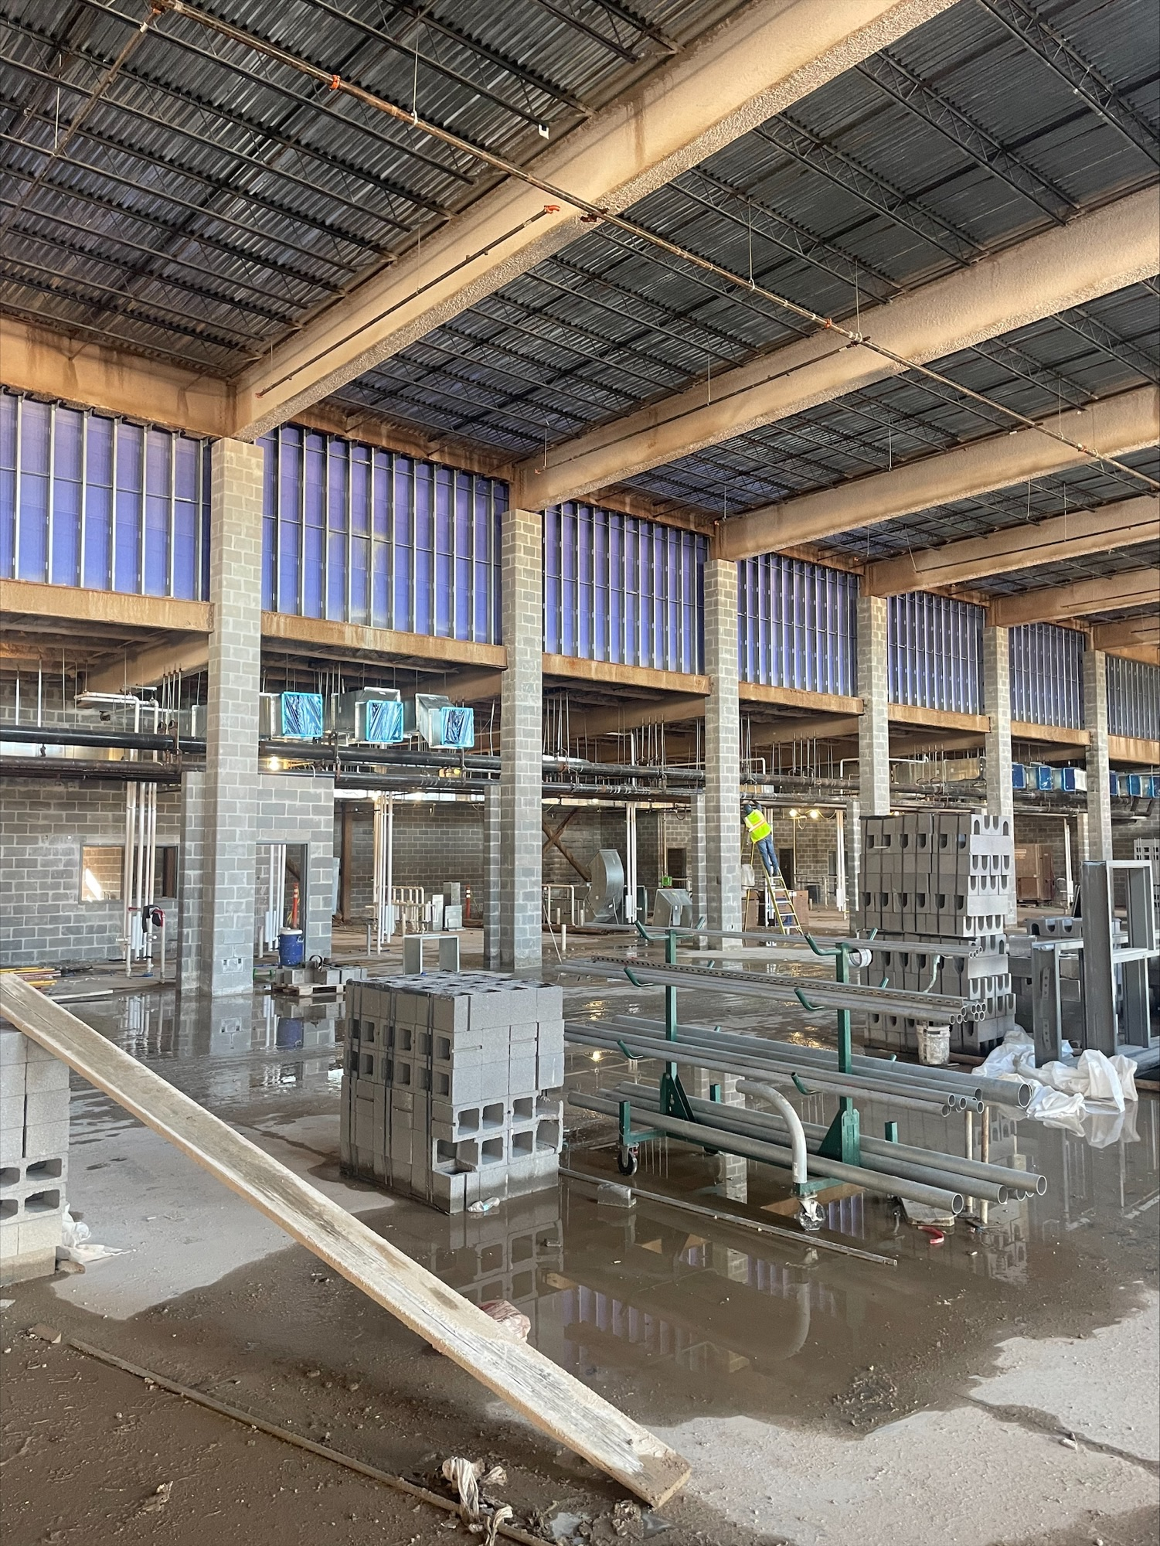
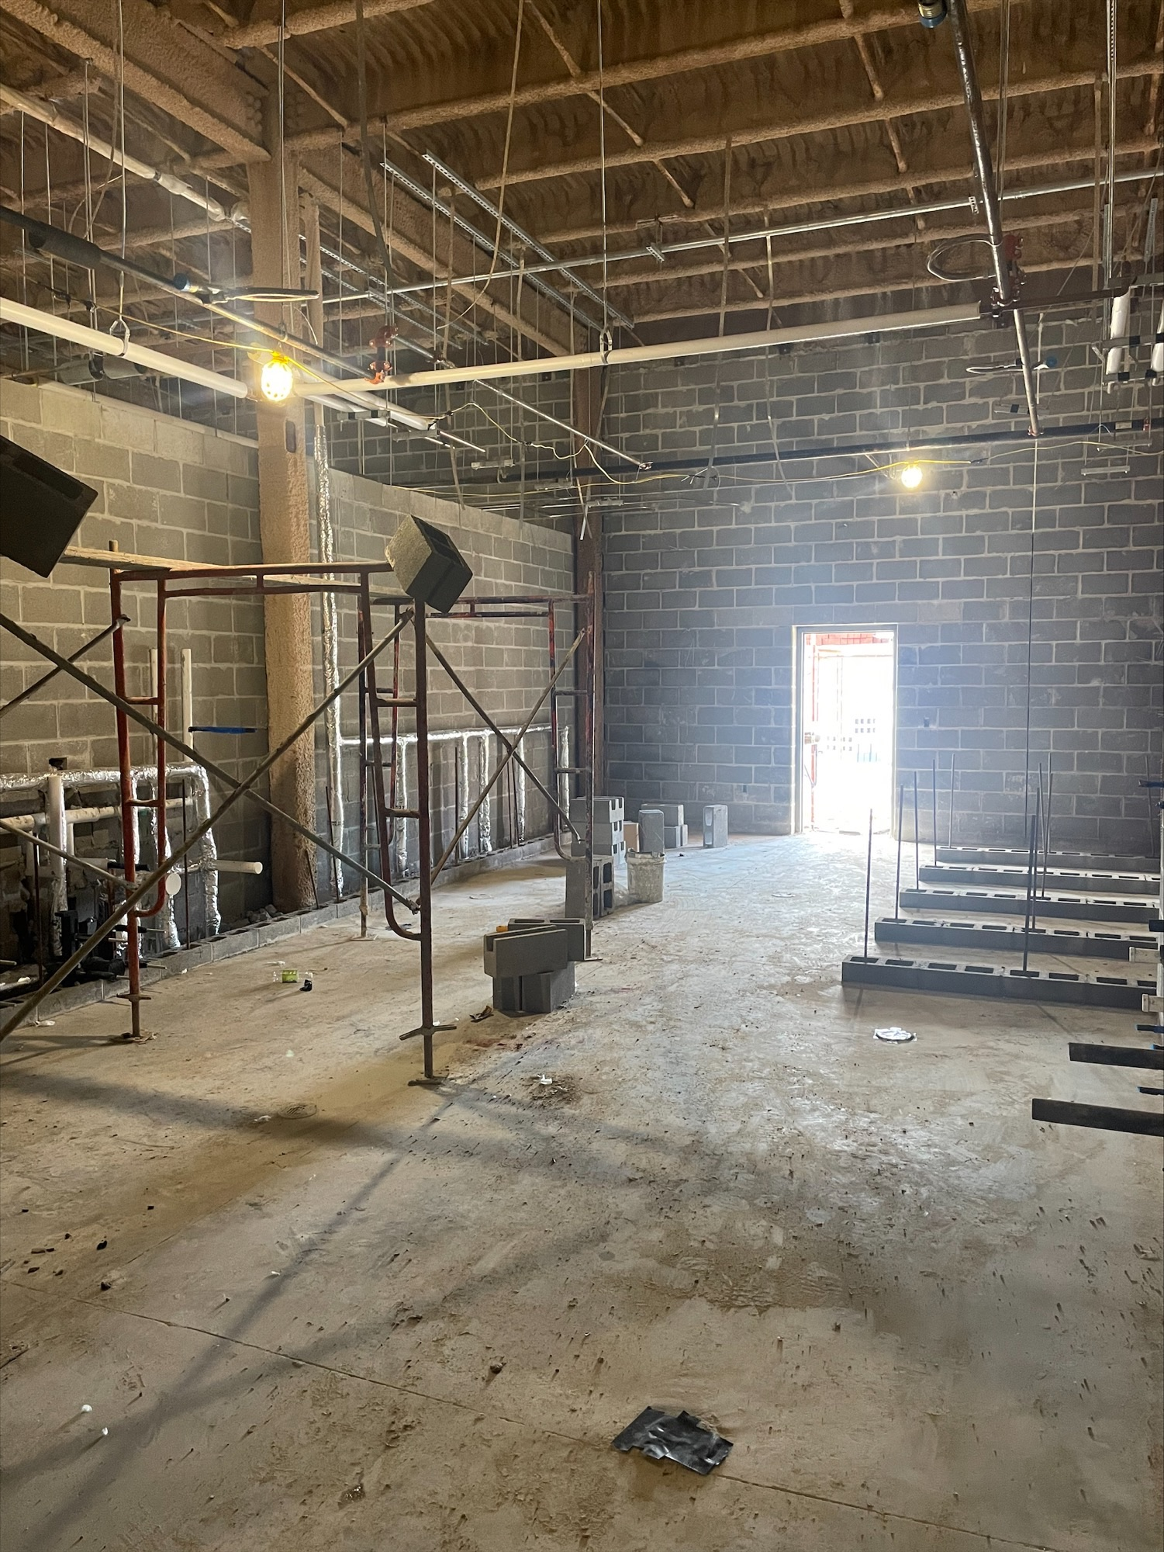
Nederland High School
Kitchen Office
All pictures are the Commons Area and Kitchen
Restroom

Slide 8

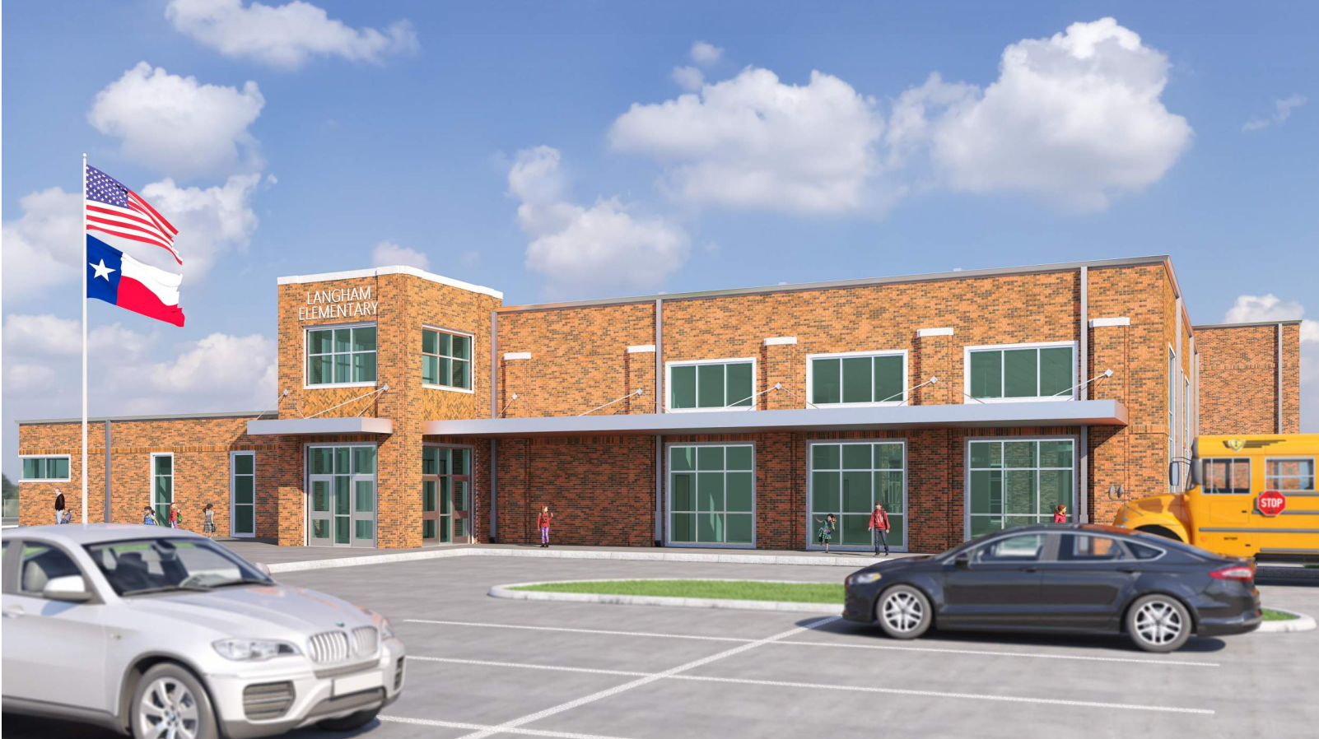
Langham Elementary School

Slide 9
Langham Elementary School
Continue weather barrier installation
Installing brick ties
Preparing for brick installation

Slide 10
Langham Elementary School
Continue preparing walls for brick veneer
Continue framing 2nd floor Metal Stud Walls
Running Ducts
Staff RR D121

Slide 11
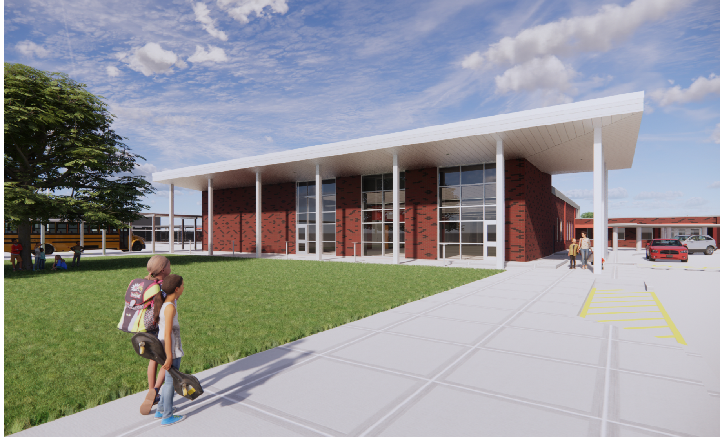
Hillcrest Elementary School

Slide 12
Hillcrest Elementary School
Sheathing Completed
Begin Waterproofing

Slide 13
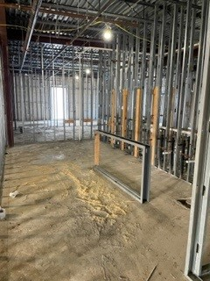
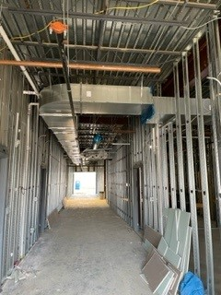
Hillcrest Elementary School
Interior Metal Stud Walls
Installing HVAC Ducts
Continue Electrical Work

Slide 14
Highland Park Elementary School

Slide 15
Highland Park Elementary School
Continue waterproofing
Getting ready for installation of ISO Board & Brick

Slide 16
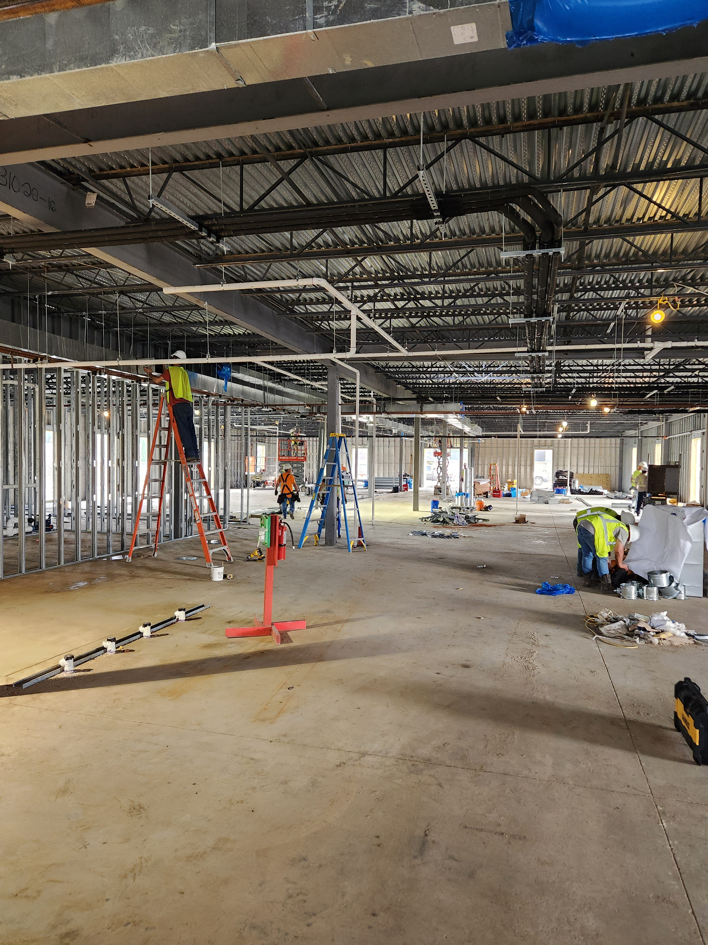
Highland Park Elementary School
Interior Mechanical Work
Plumbing Work
Electrical Work
Installation of Metal Studs

Slide 17
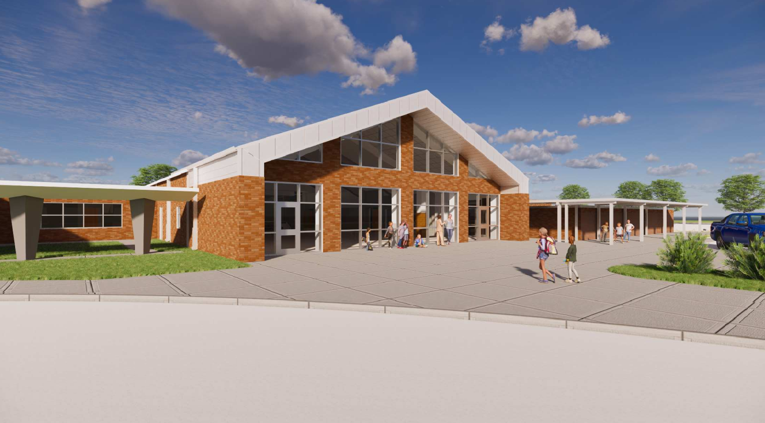
Helena Park Elementary School

Slide 18
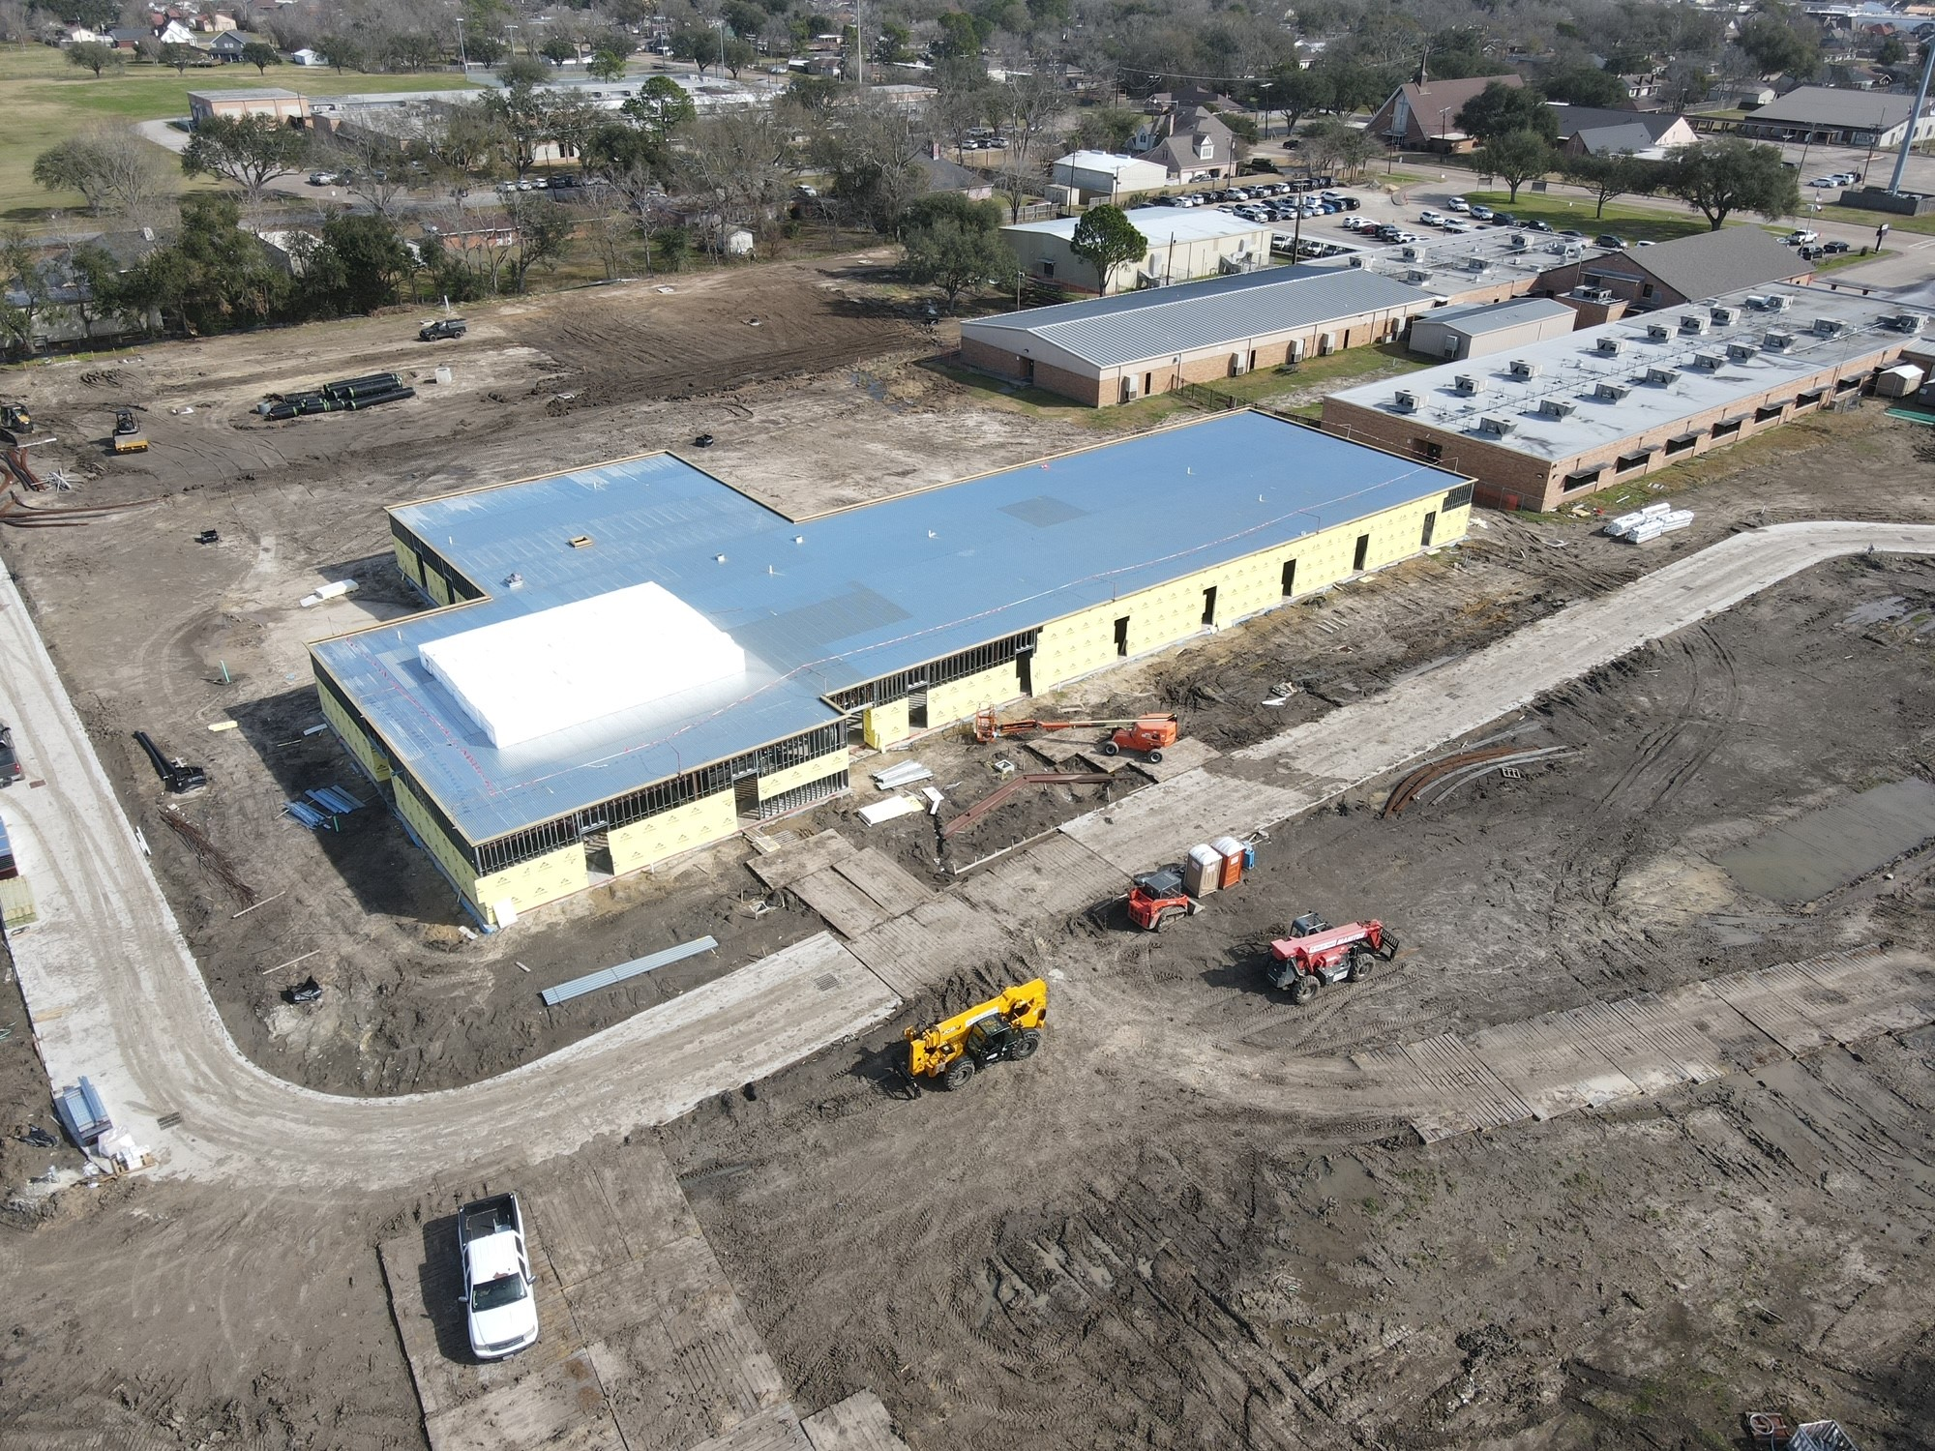
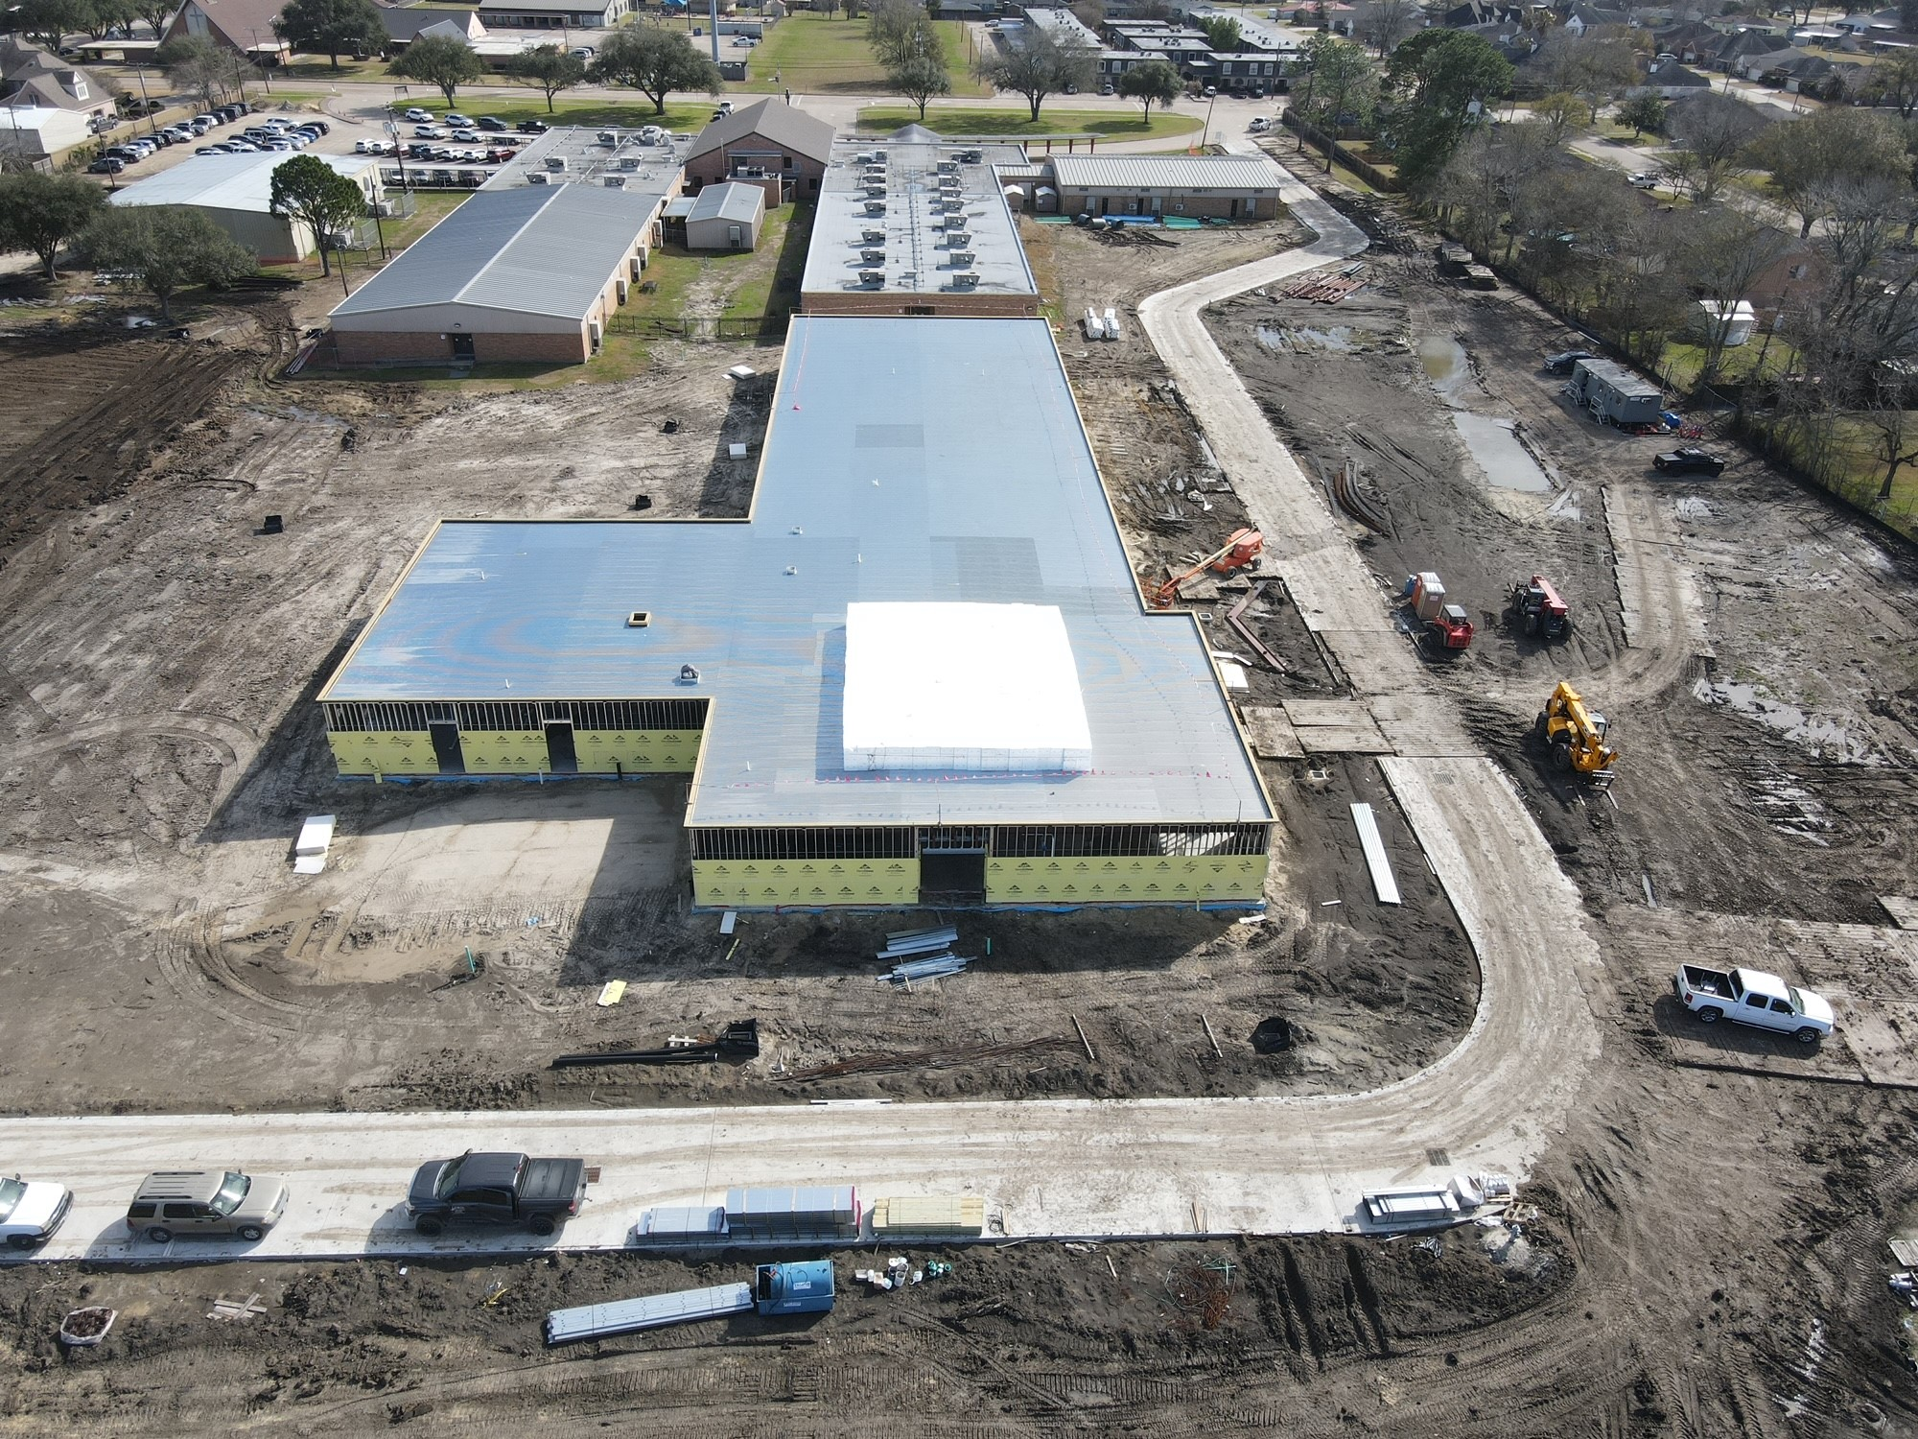
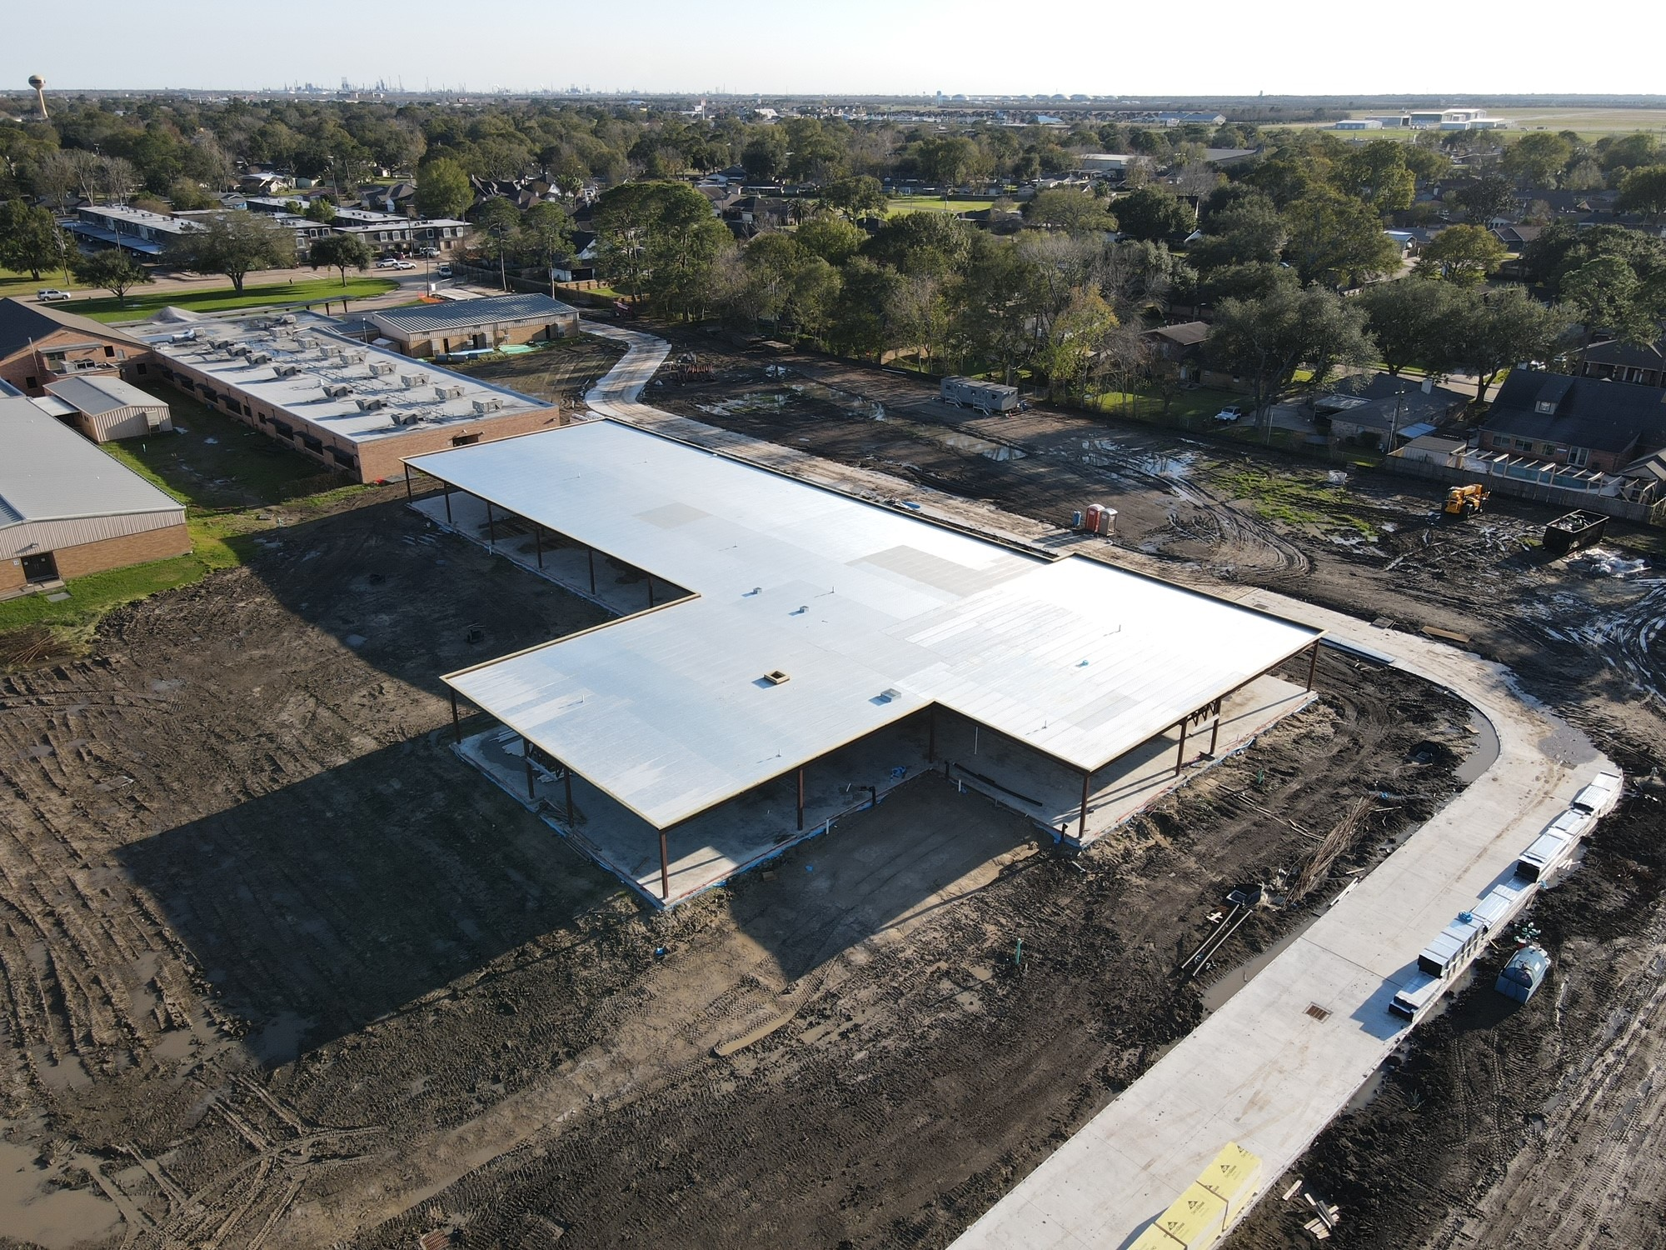
Helena Park Elementary School
Installing mechanical hangers
Bring Parking Lot up to grade
Continuing work on fire lane road
Complete LWIC and Roof Cap

Slide 19
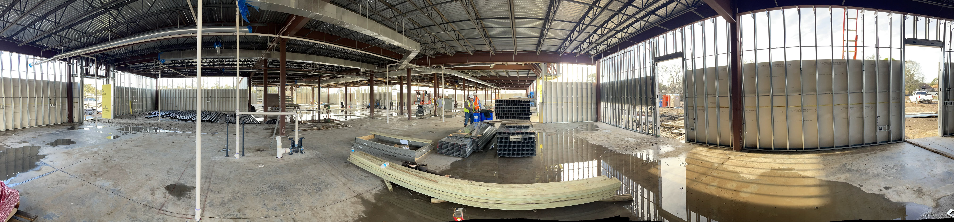
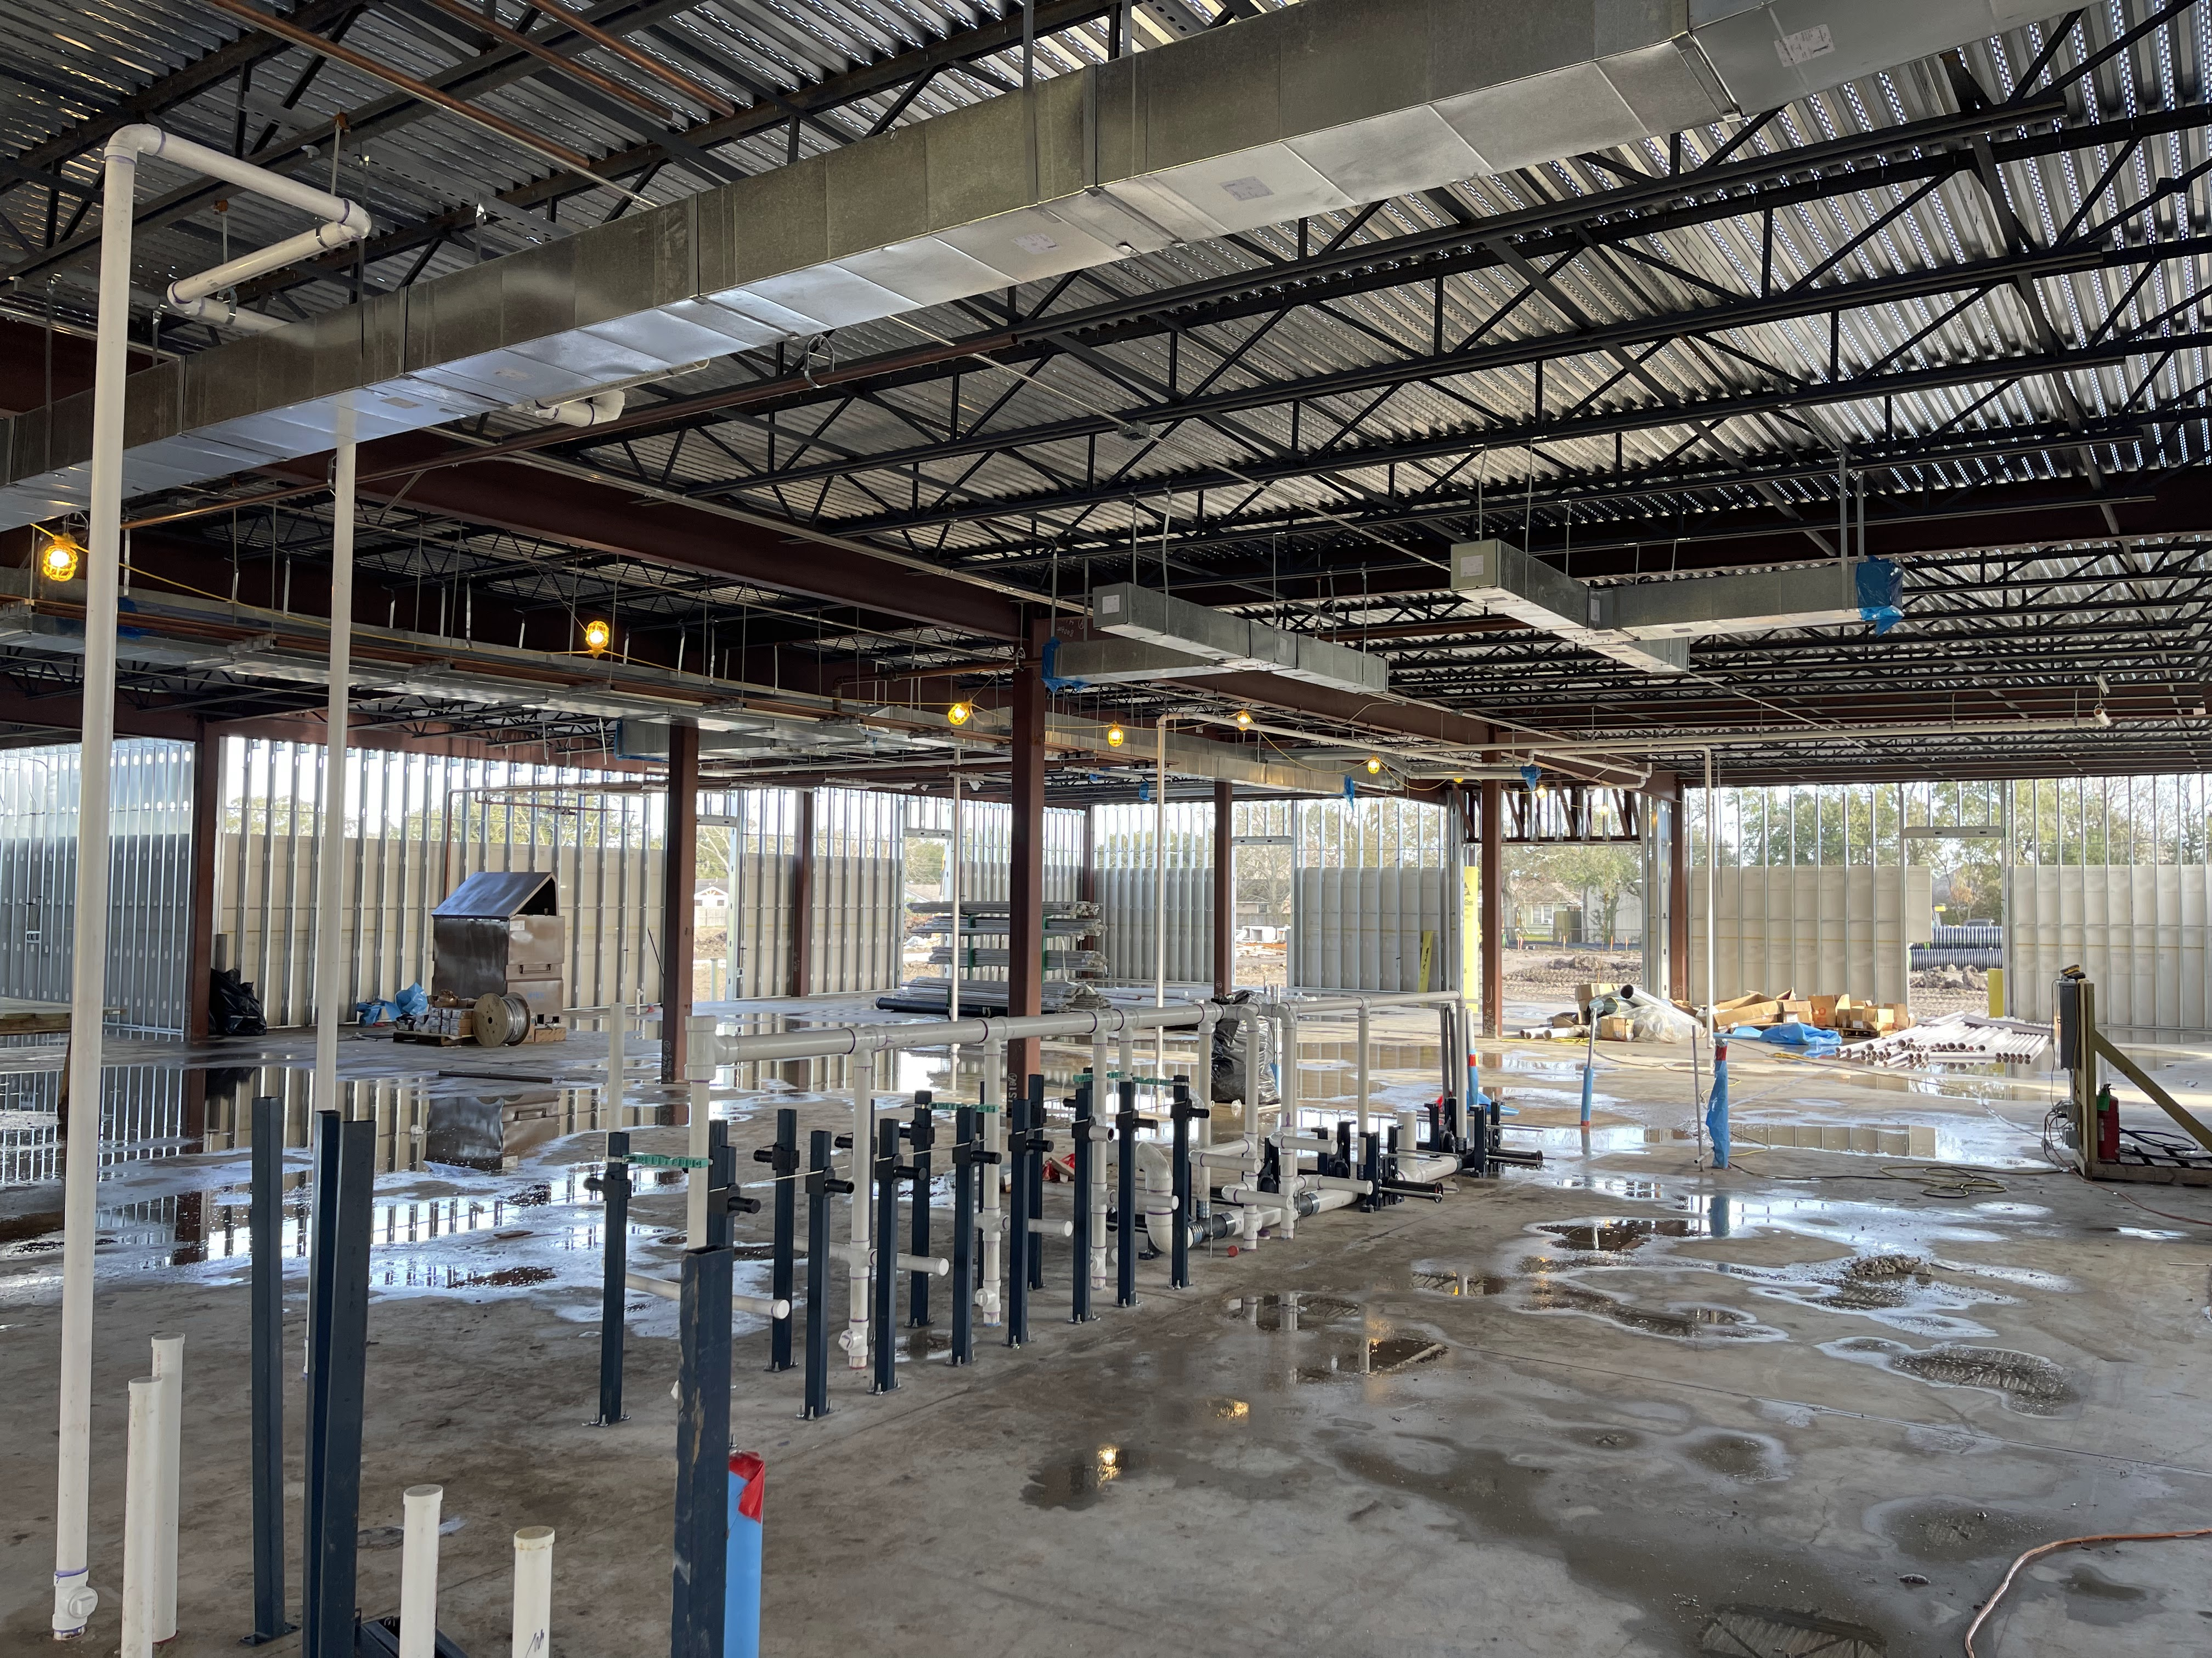
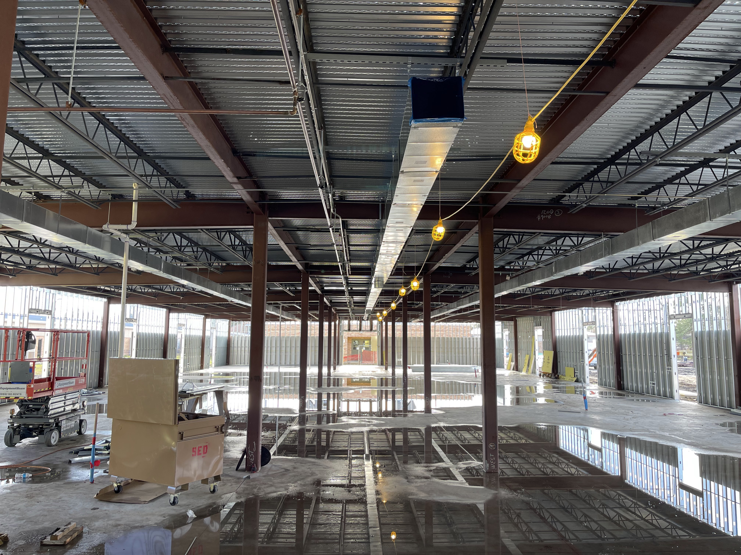
Helena Park Elementary School
Installing metal hangers
Installing duct work
Continue electrical and plumbing work

Slide 20
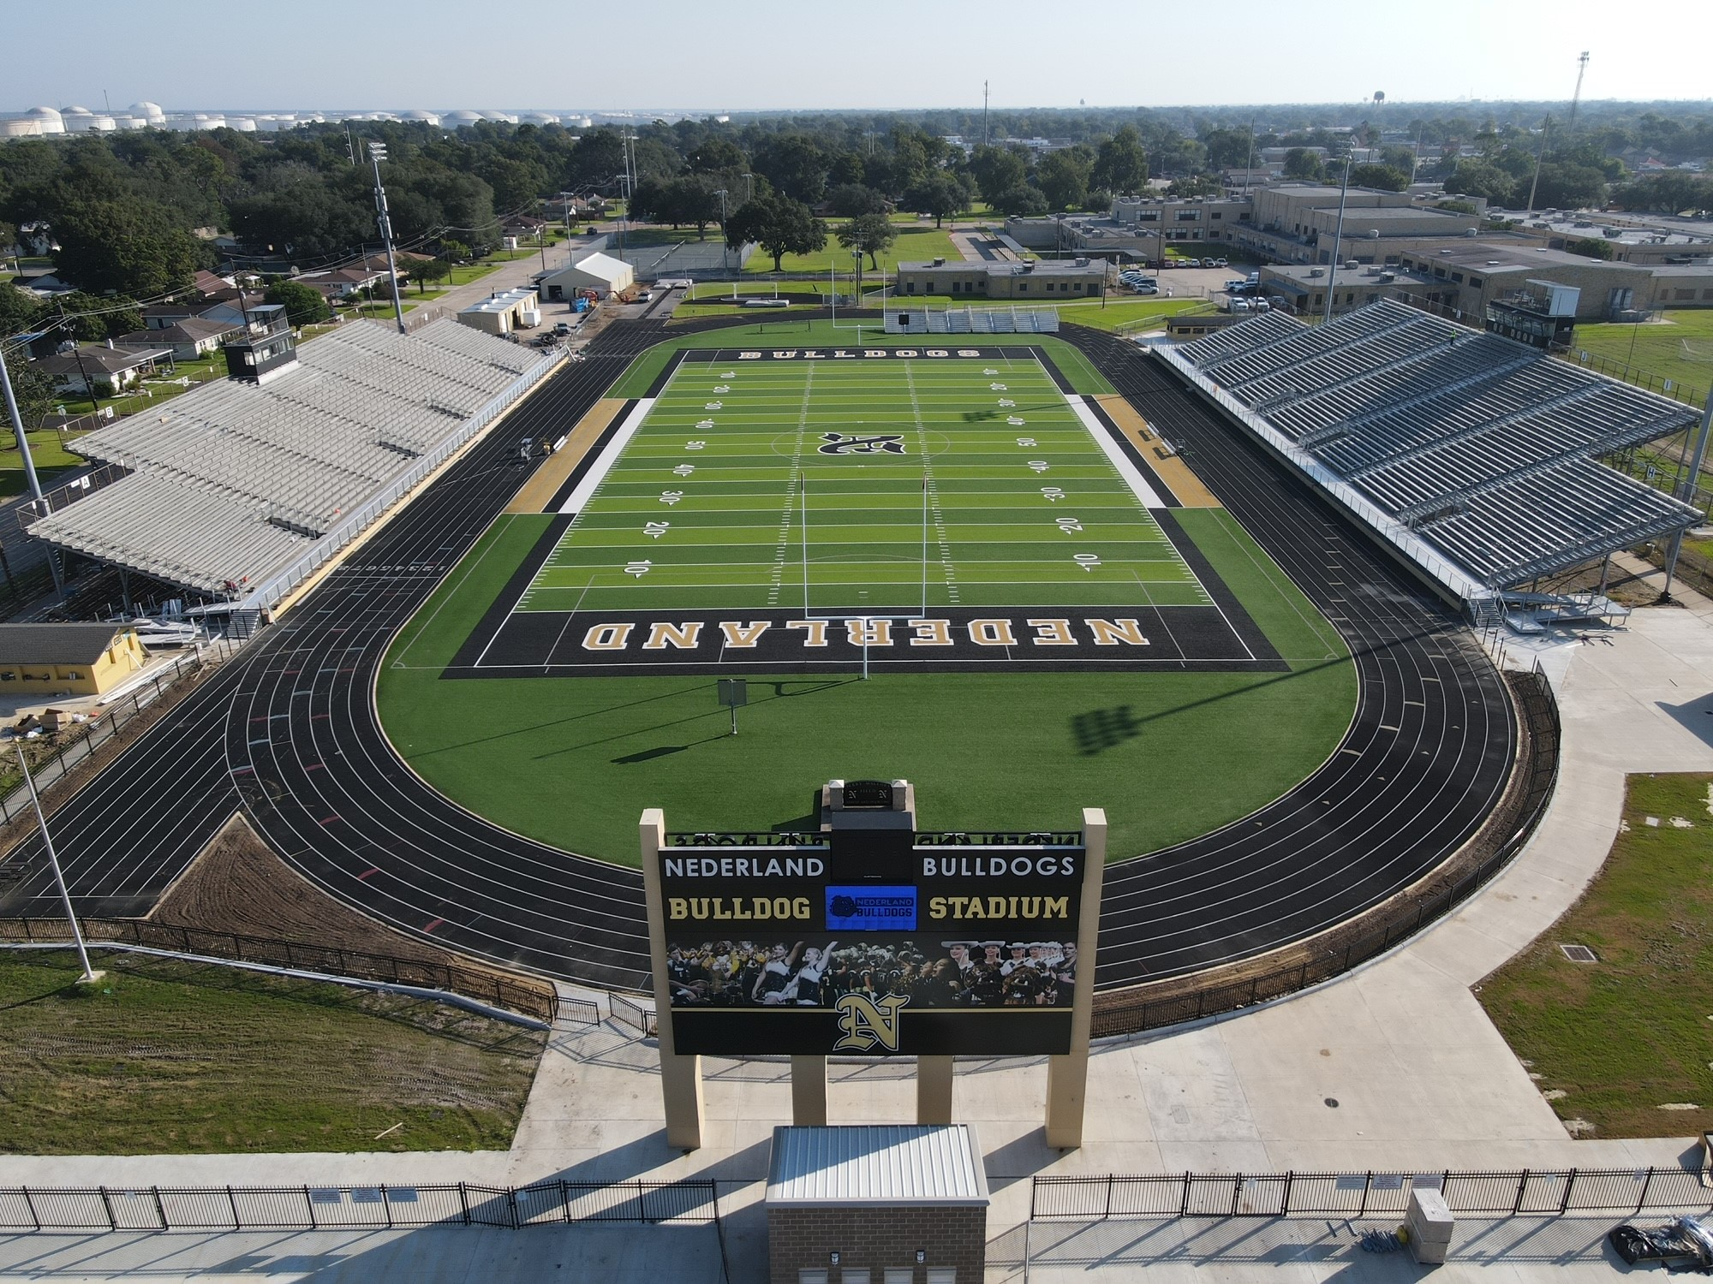
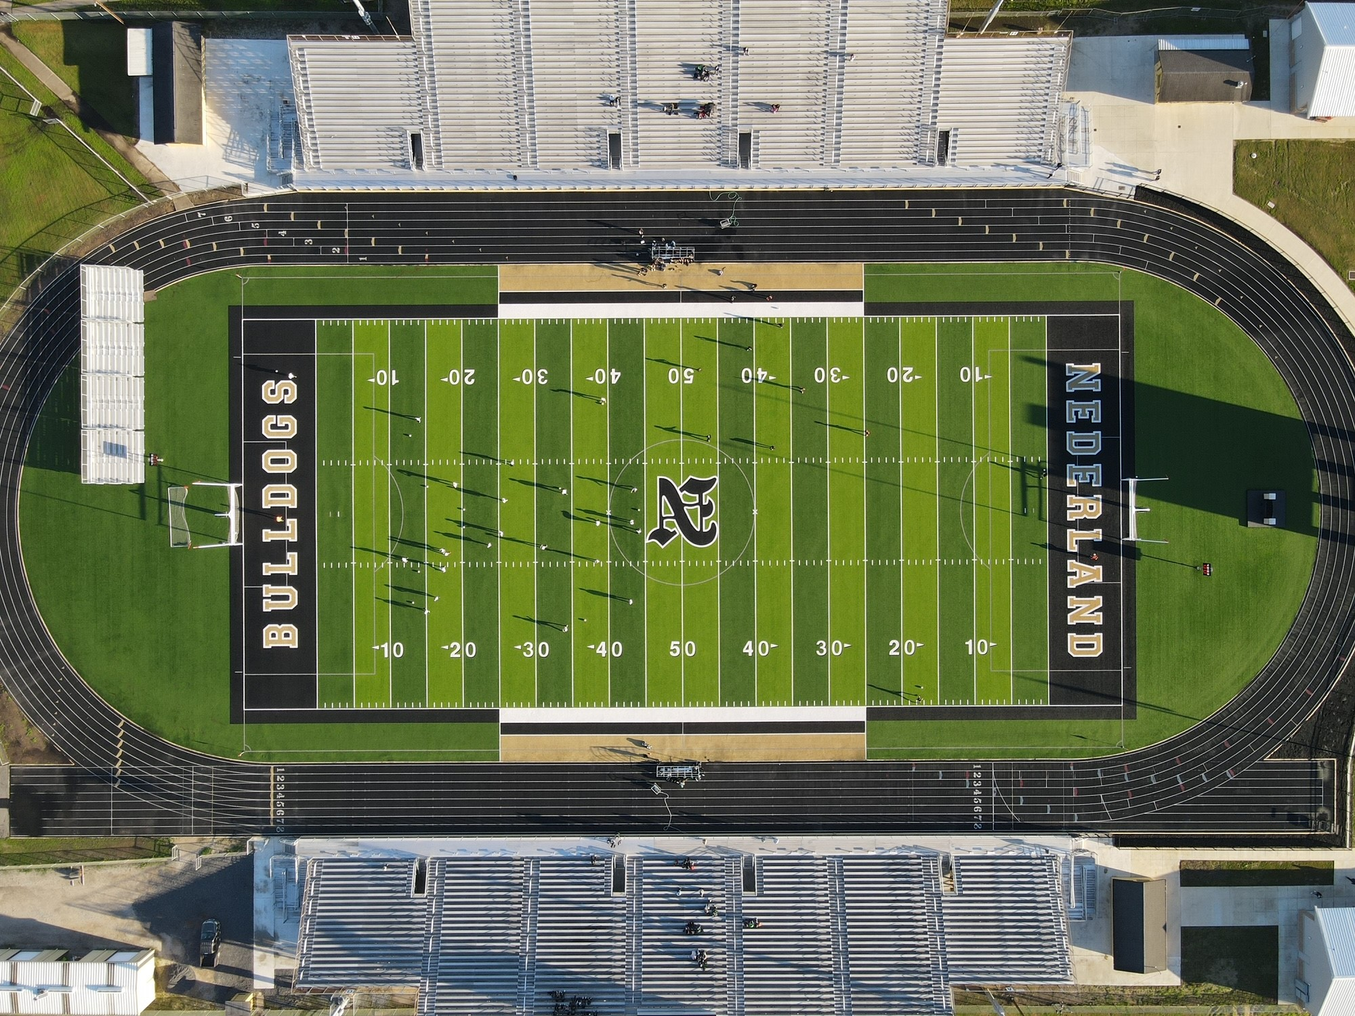
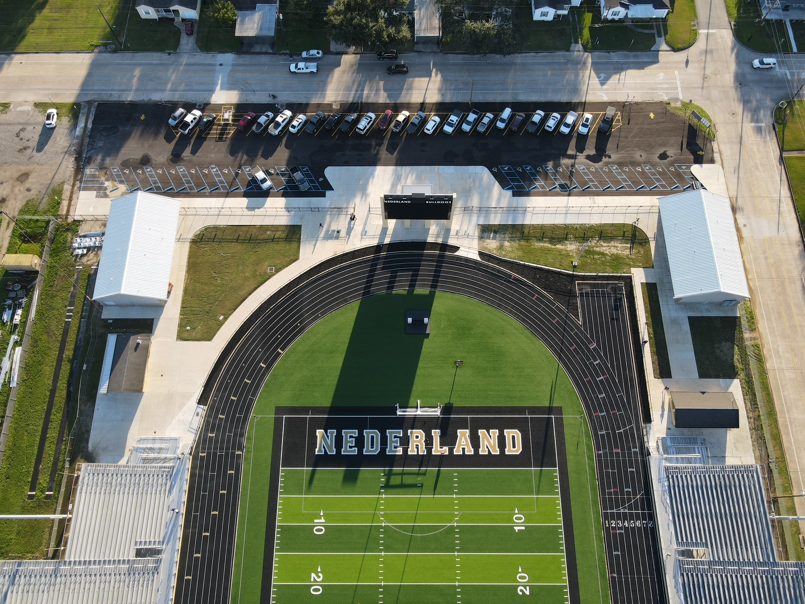
Nederland Bulldog Stadium

