Slide 1




2019 Nederland ISD Bond Project
February 2023

Slide 2

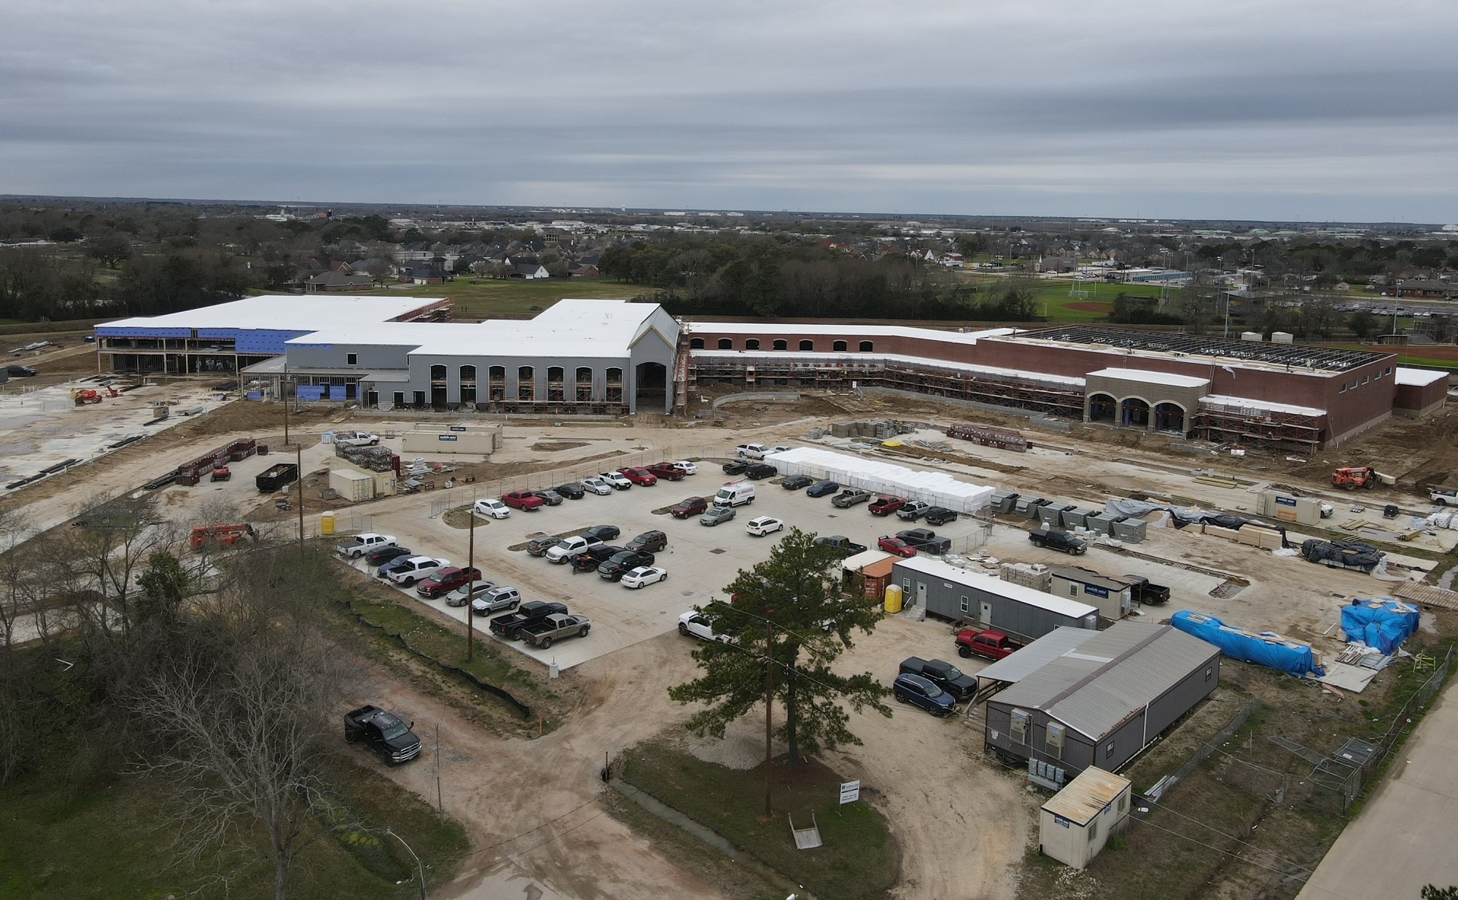
Nederland High School

Slide 3
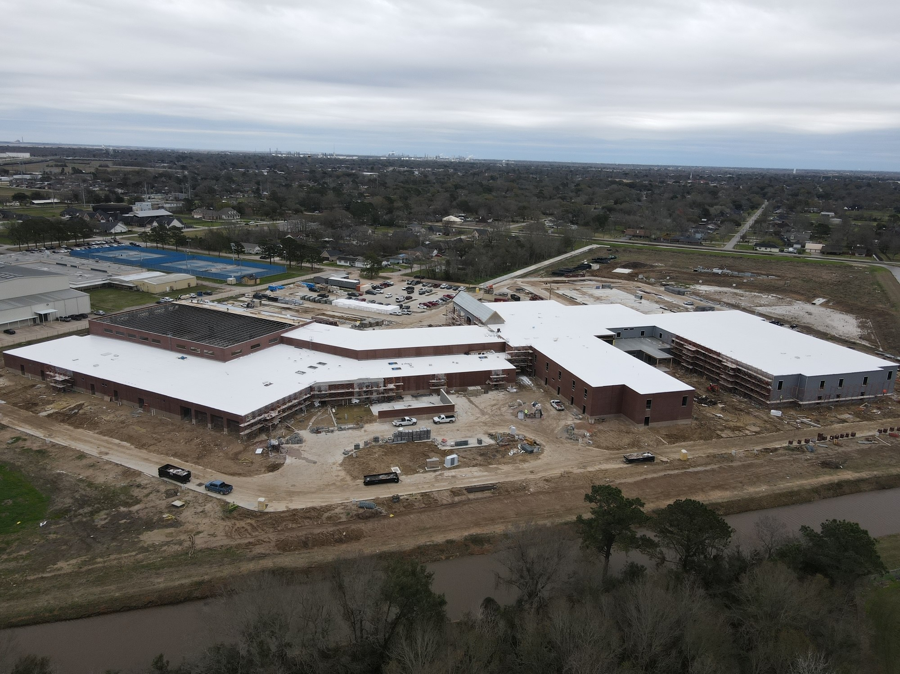
Nederland High School

Slide 4
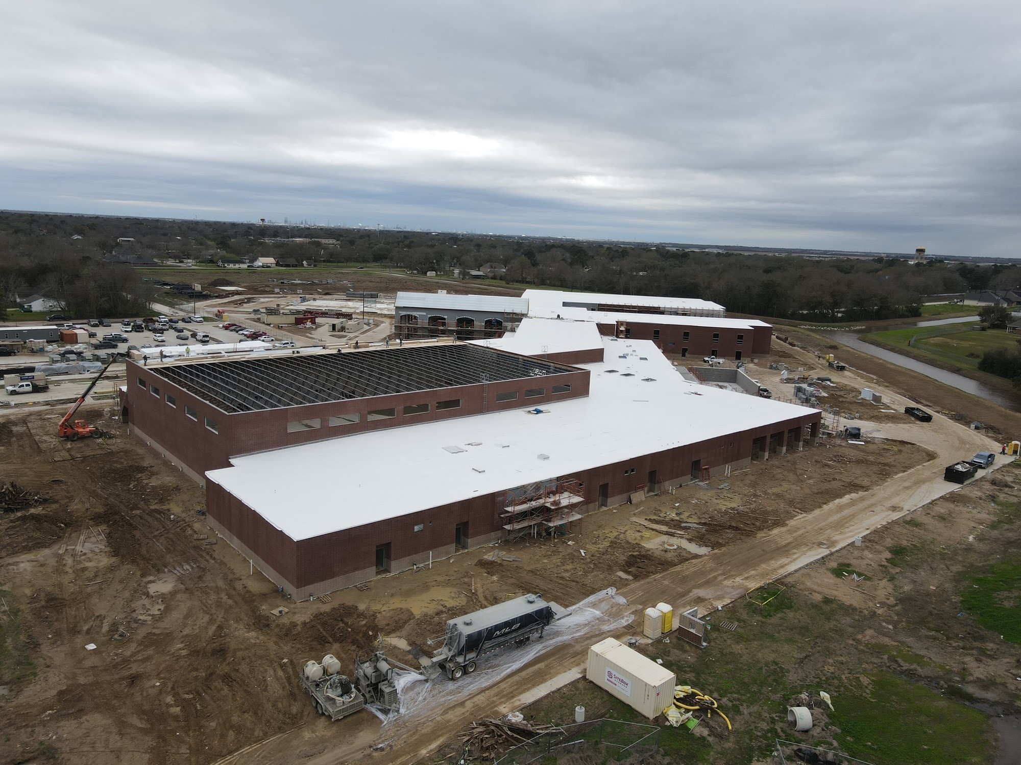
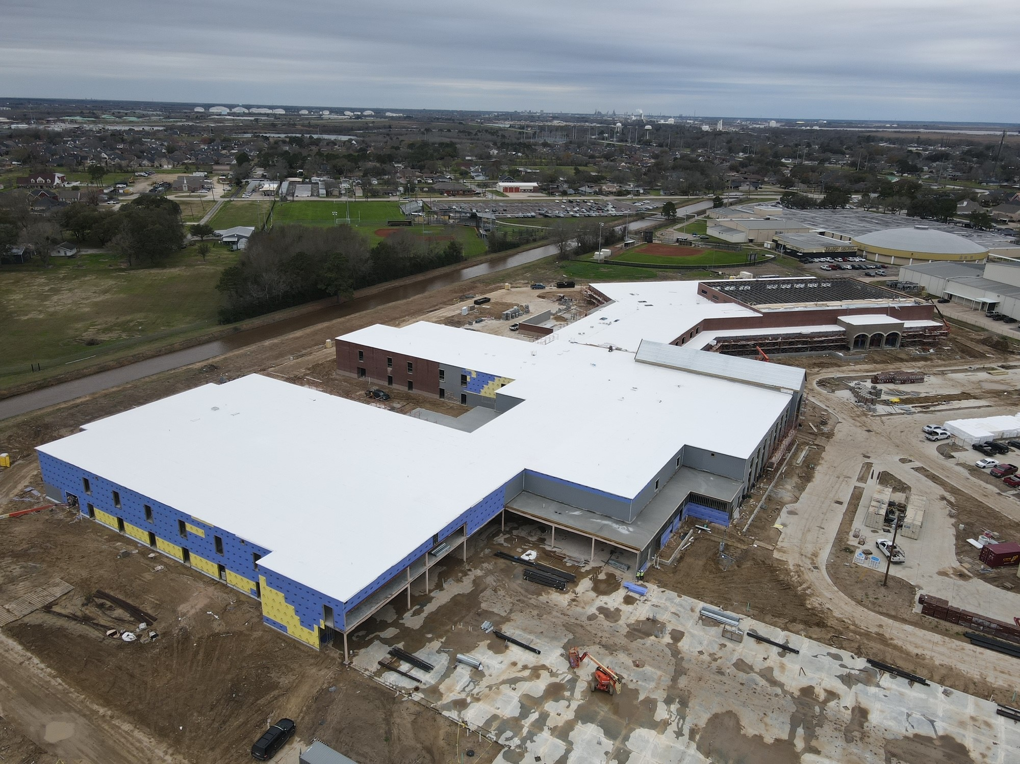
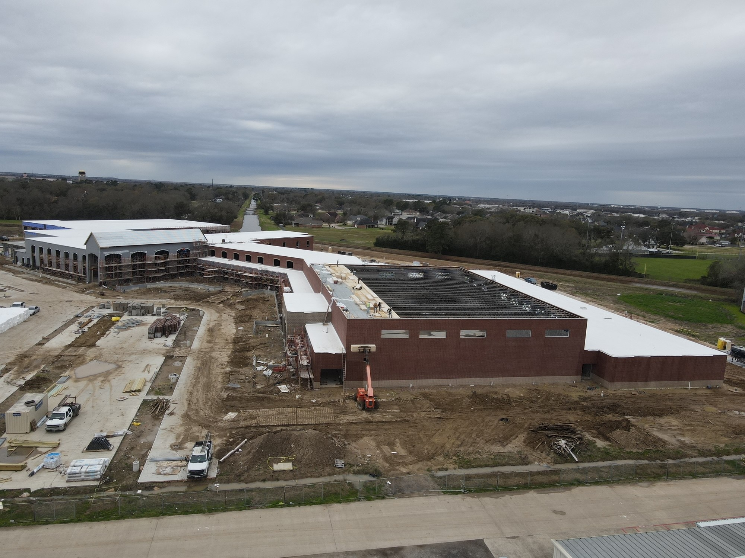
Nederland High School
Sheathing of Building complete with WP following
Brick Work Continues at Area D Curtain Wall (Front Office)

Slide 5
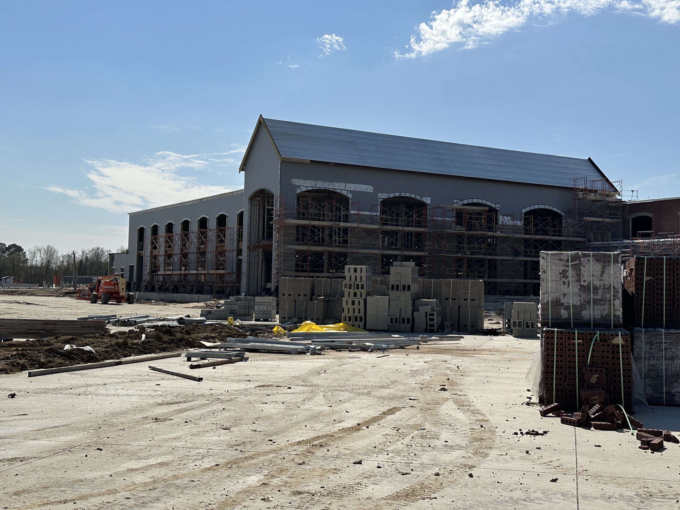
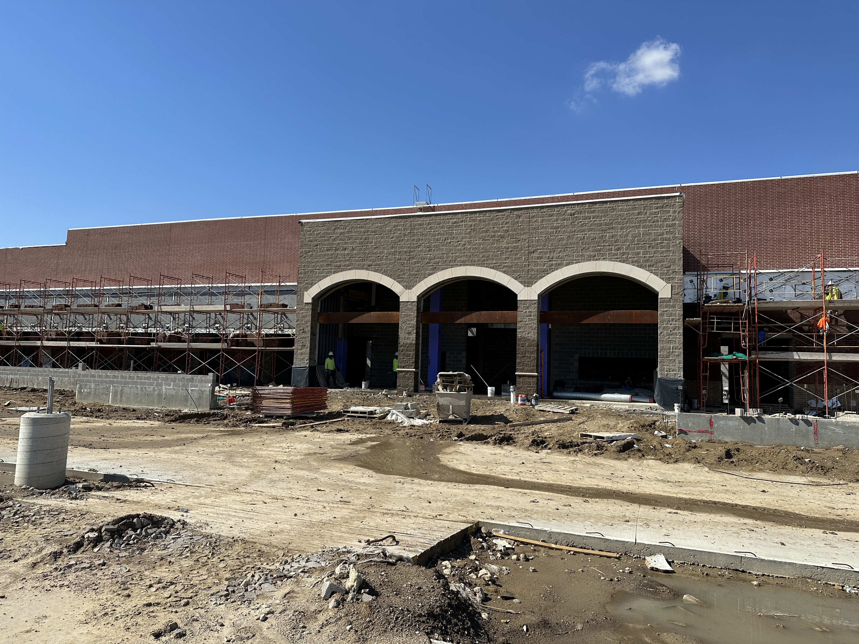
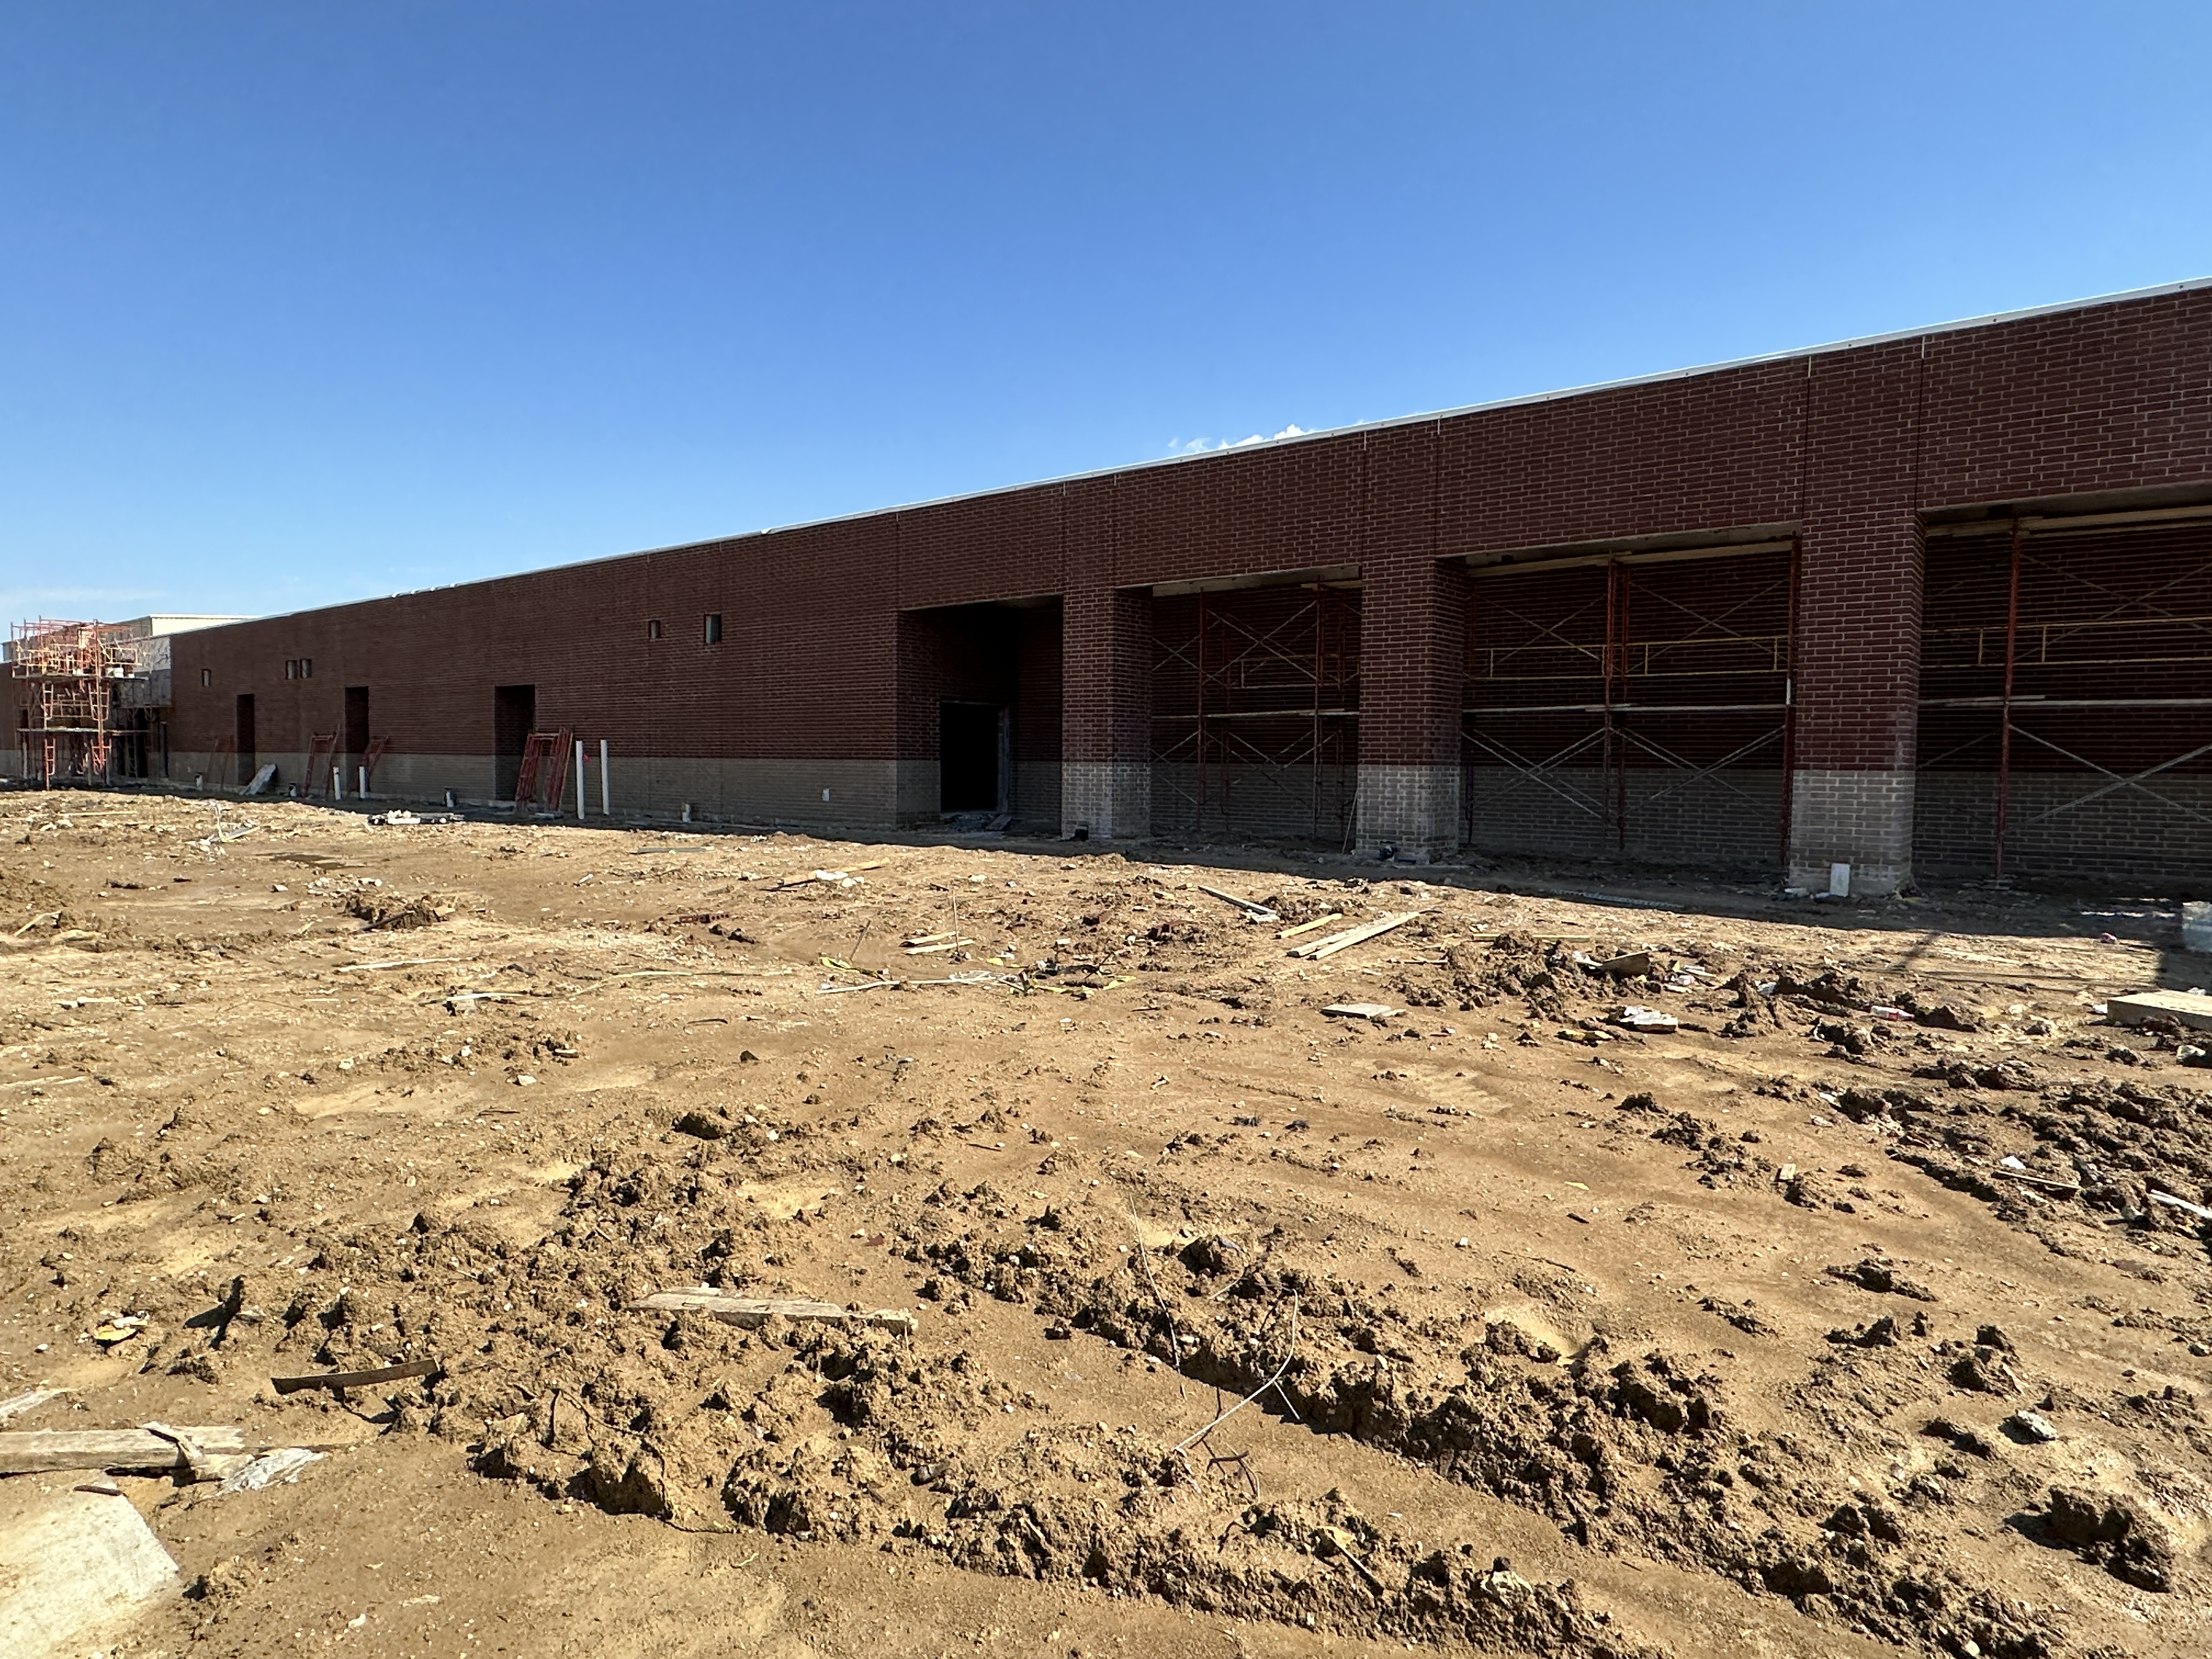
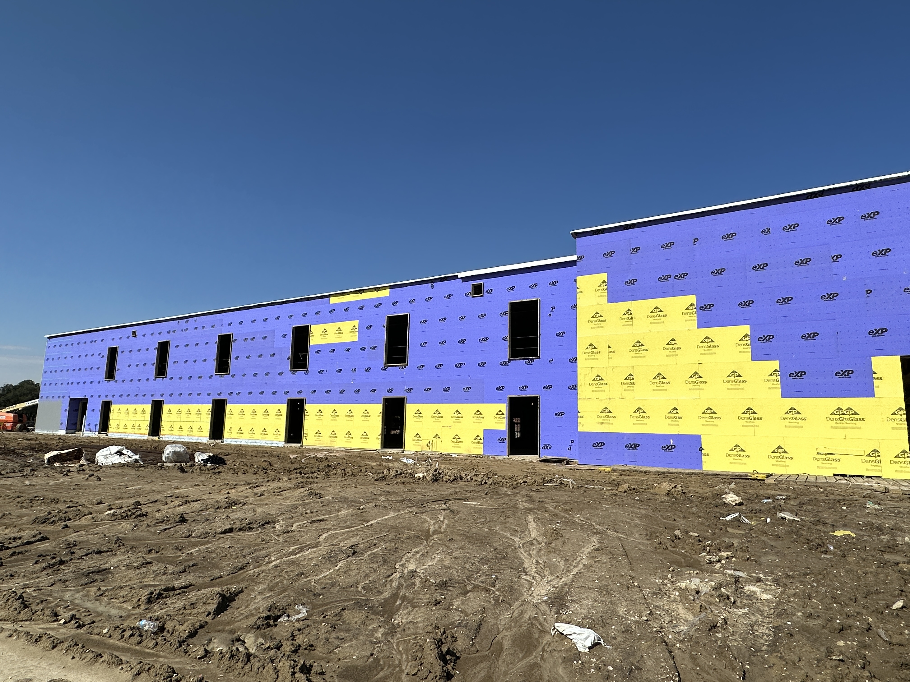
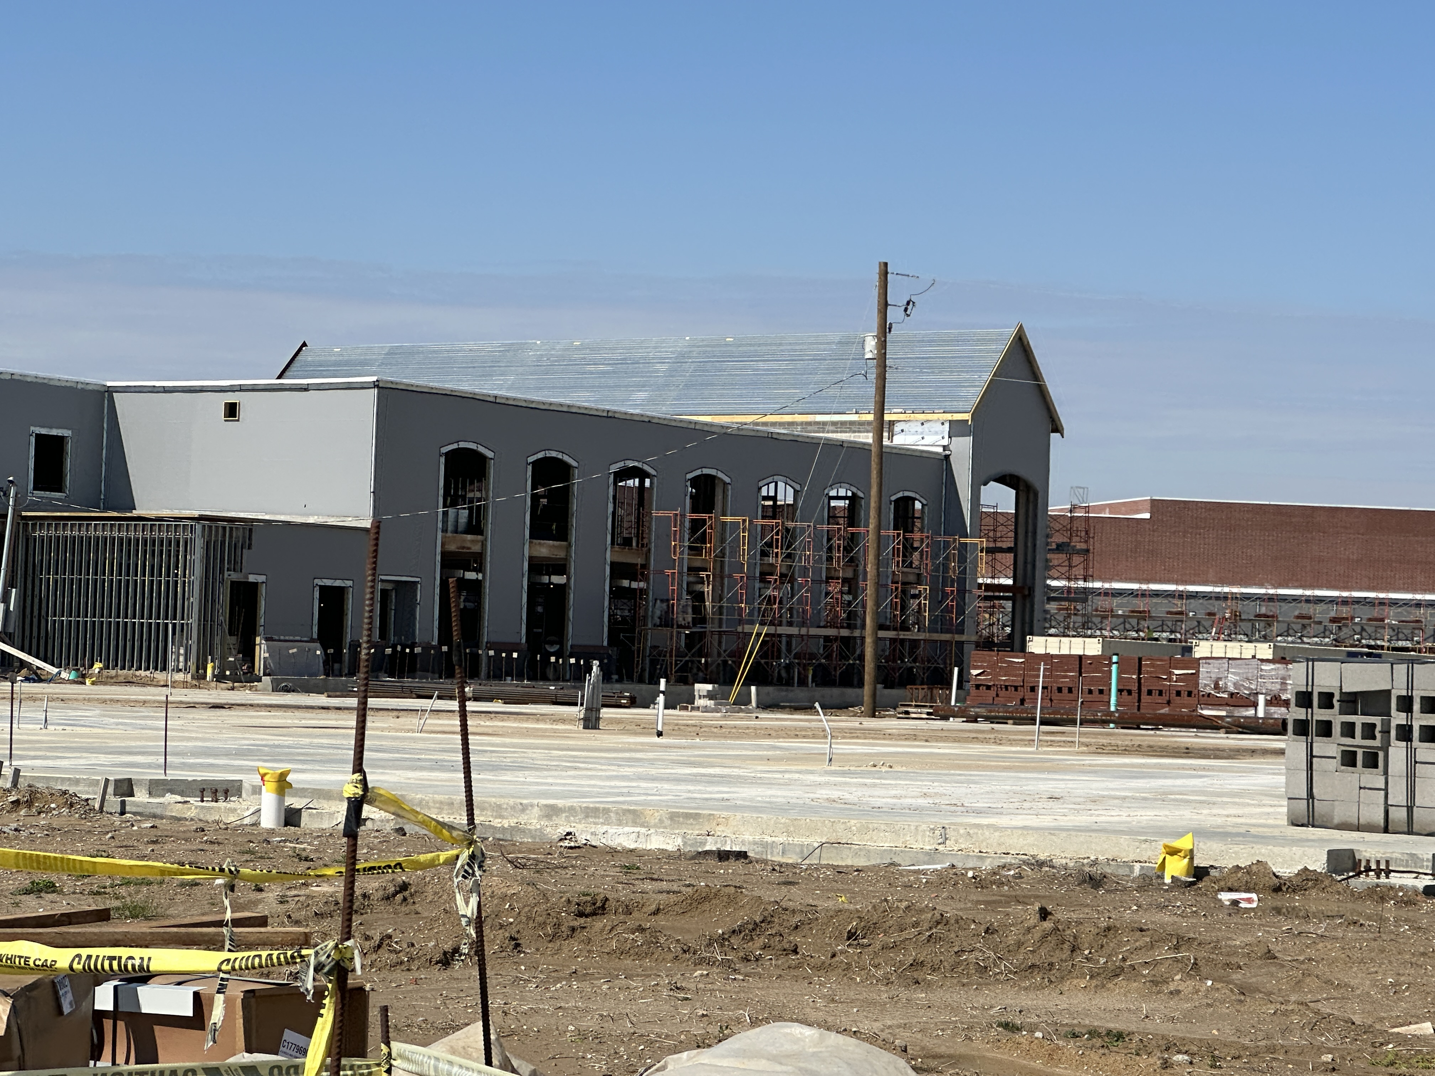
Nederland High School
Entrance into Gym above
Final section of Waterproofing

Slide 6
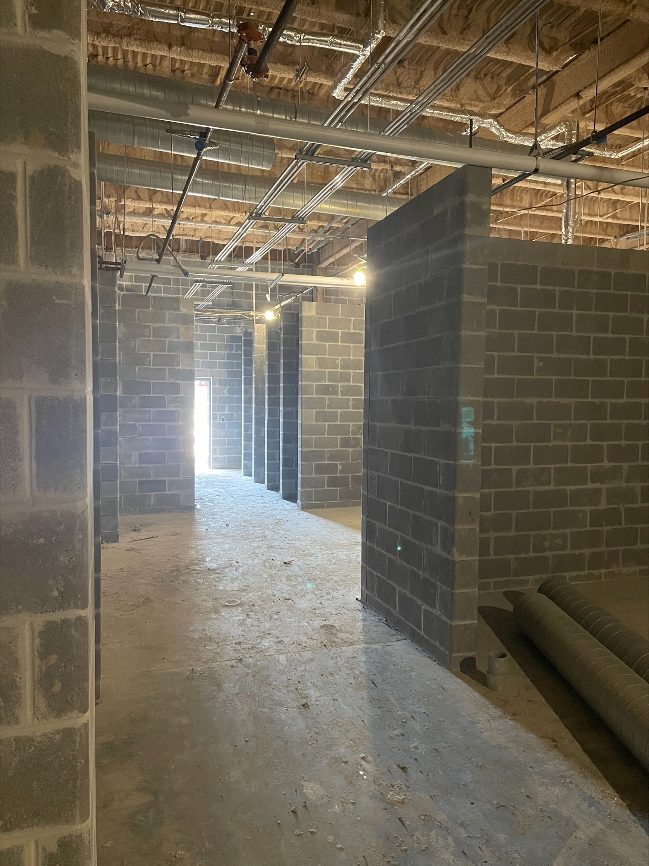
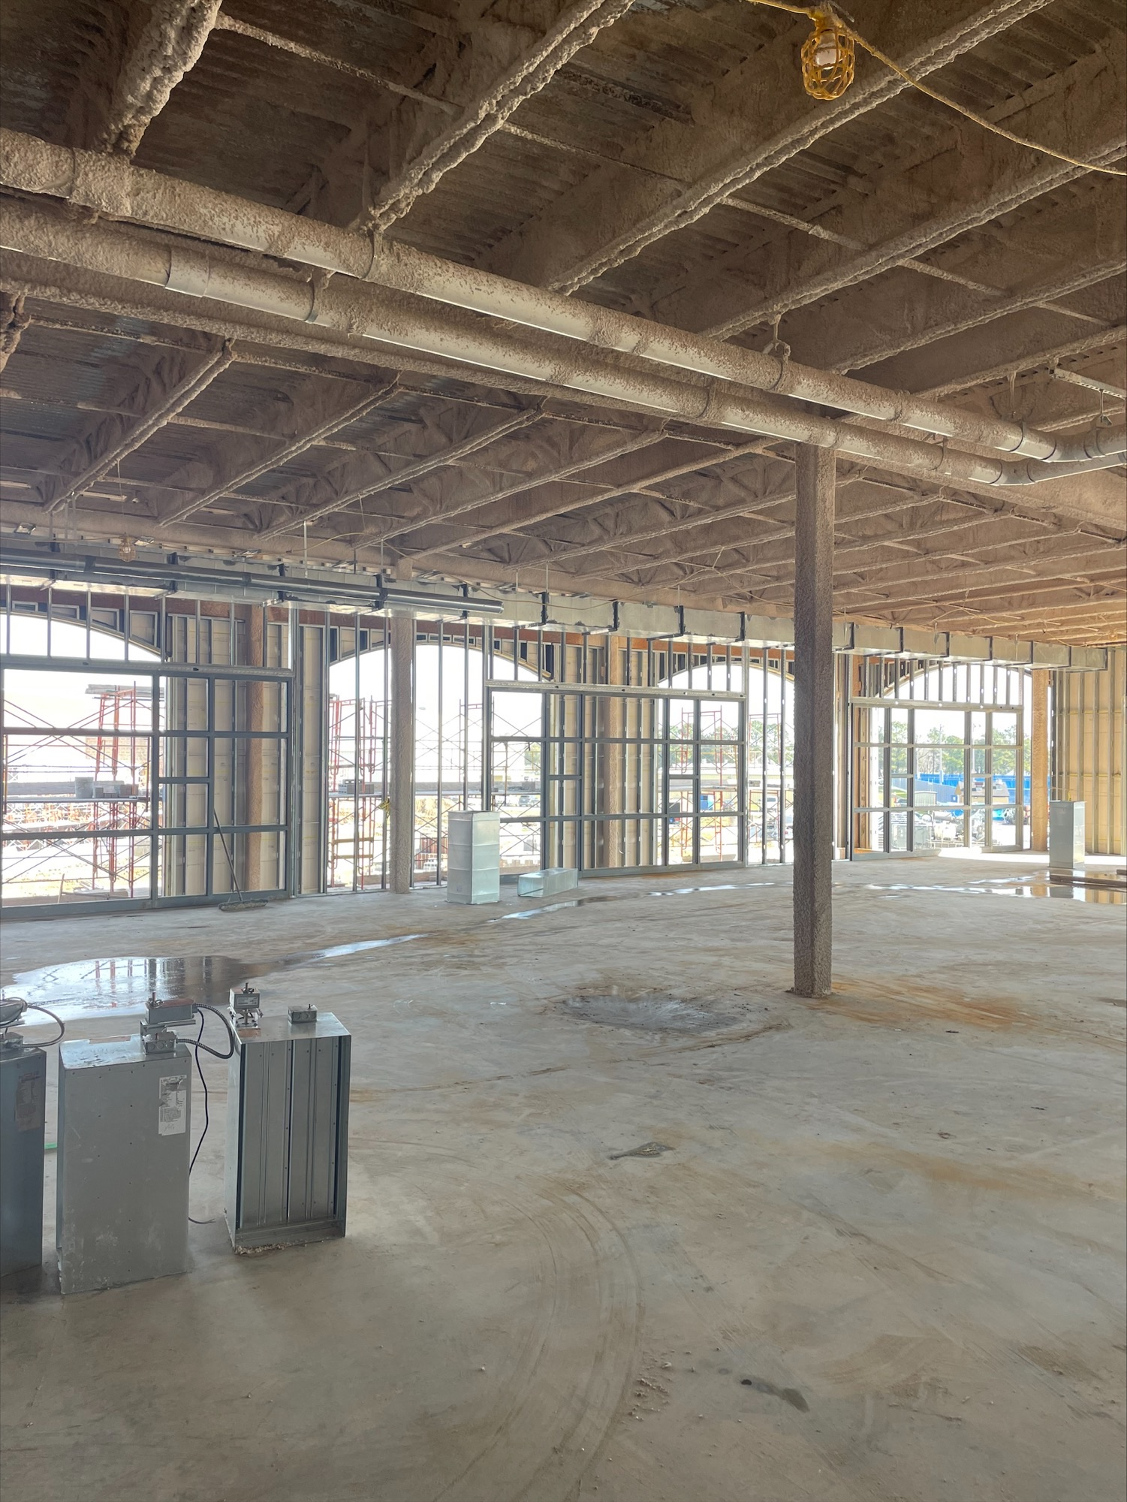
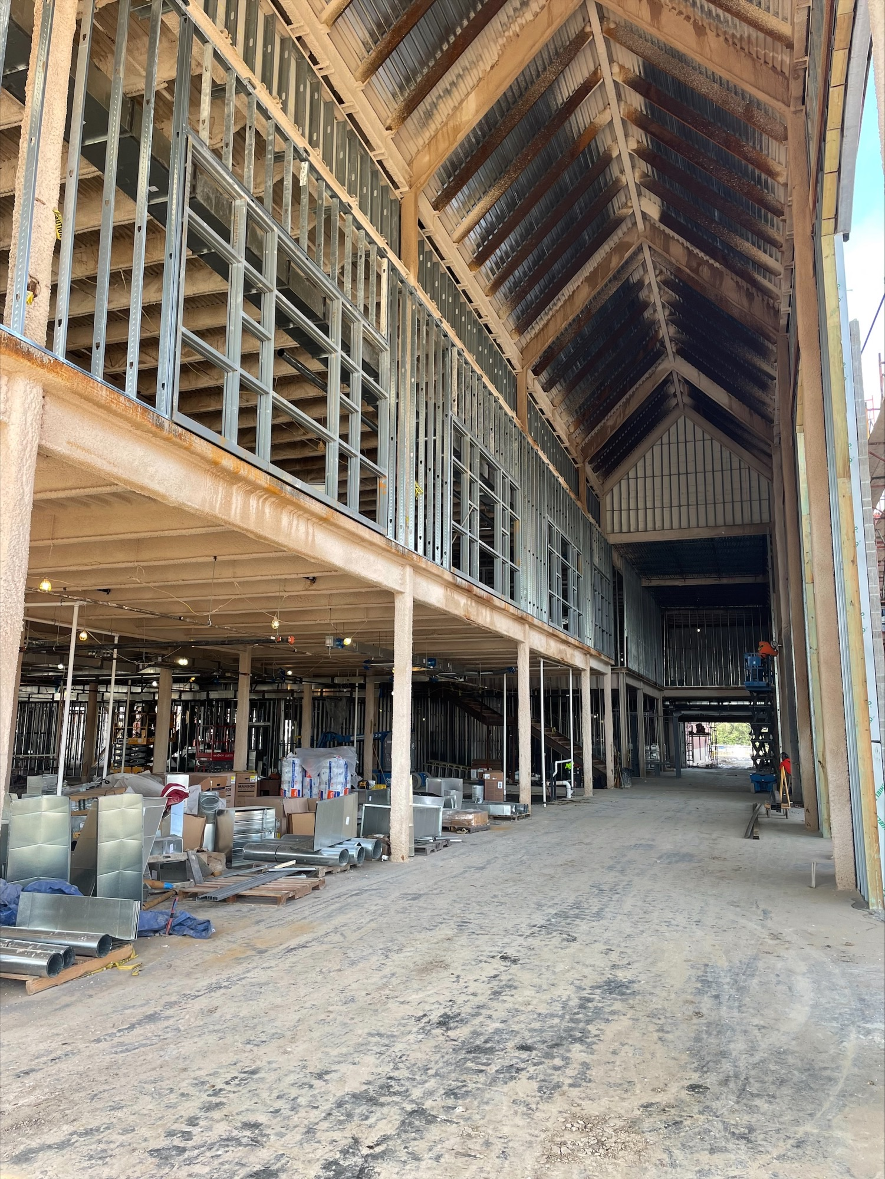
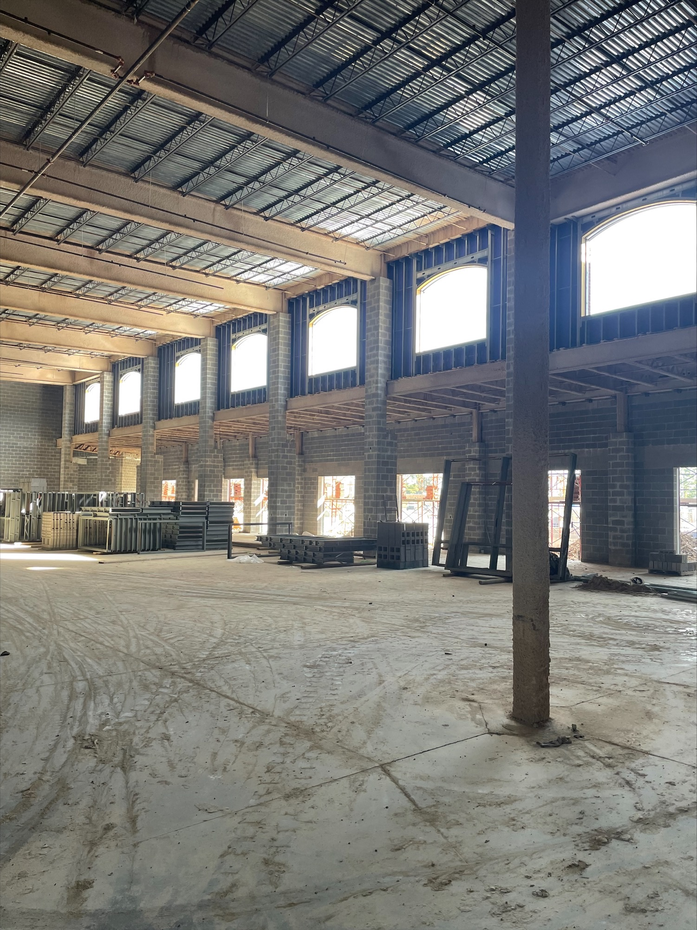
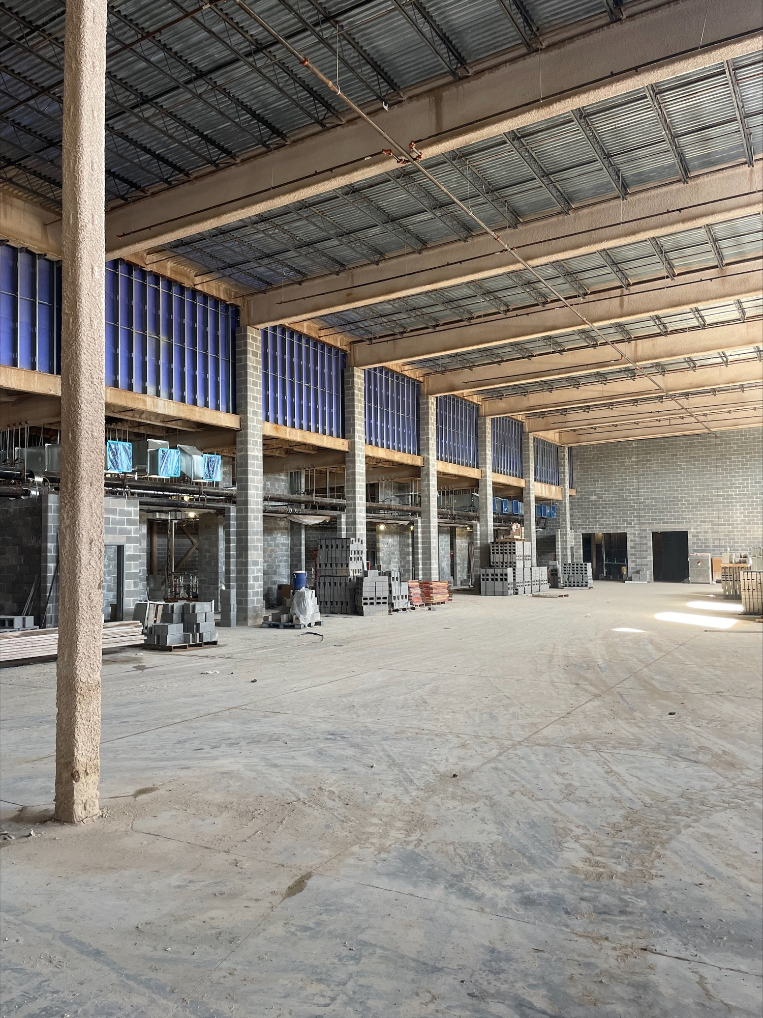
Nederland High School
Front entrance into school above, curtain wall to the right.
All pictures are the Commons Area and Kitchen

Slide 7

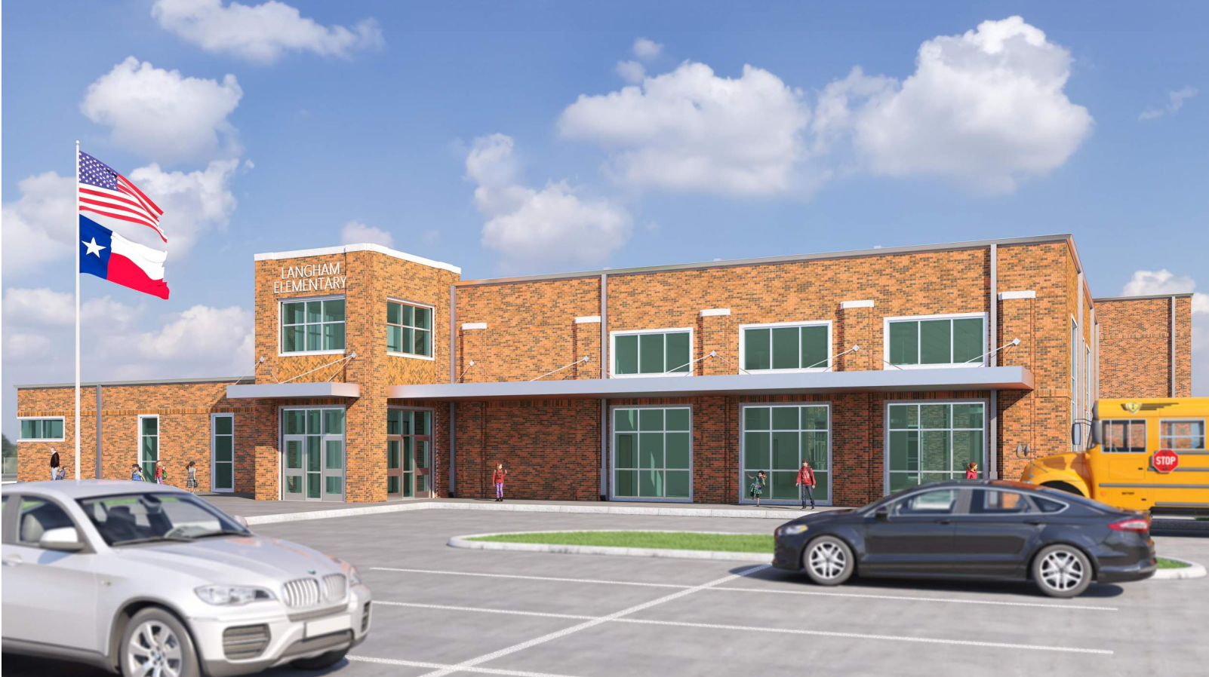
Langham Elementary School

Slide 8
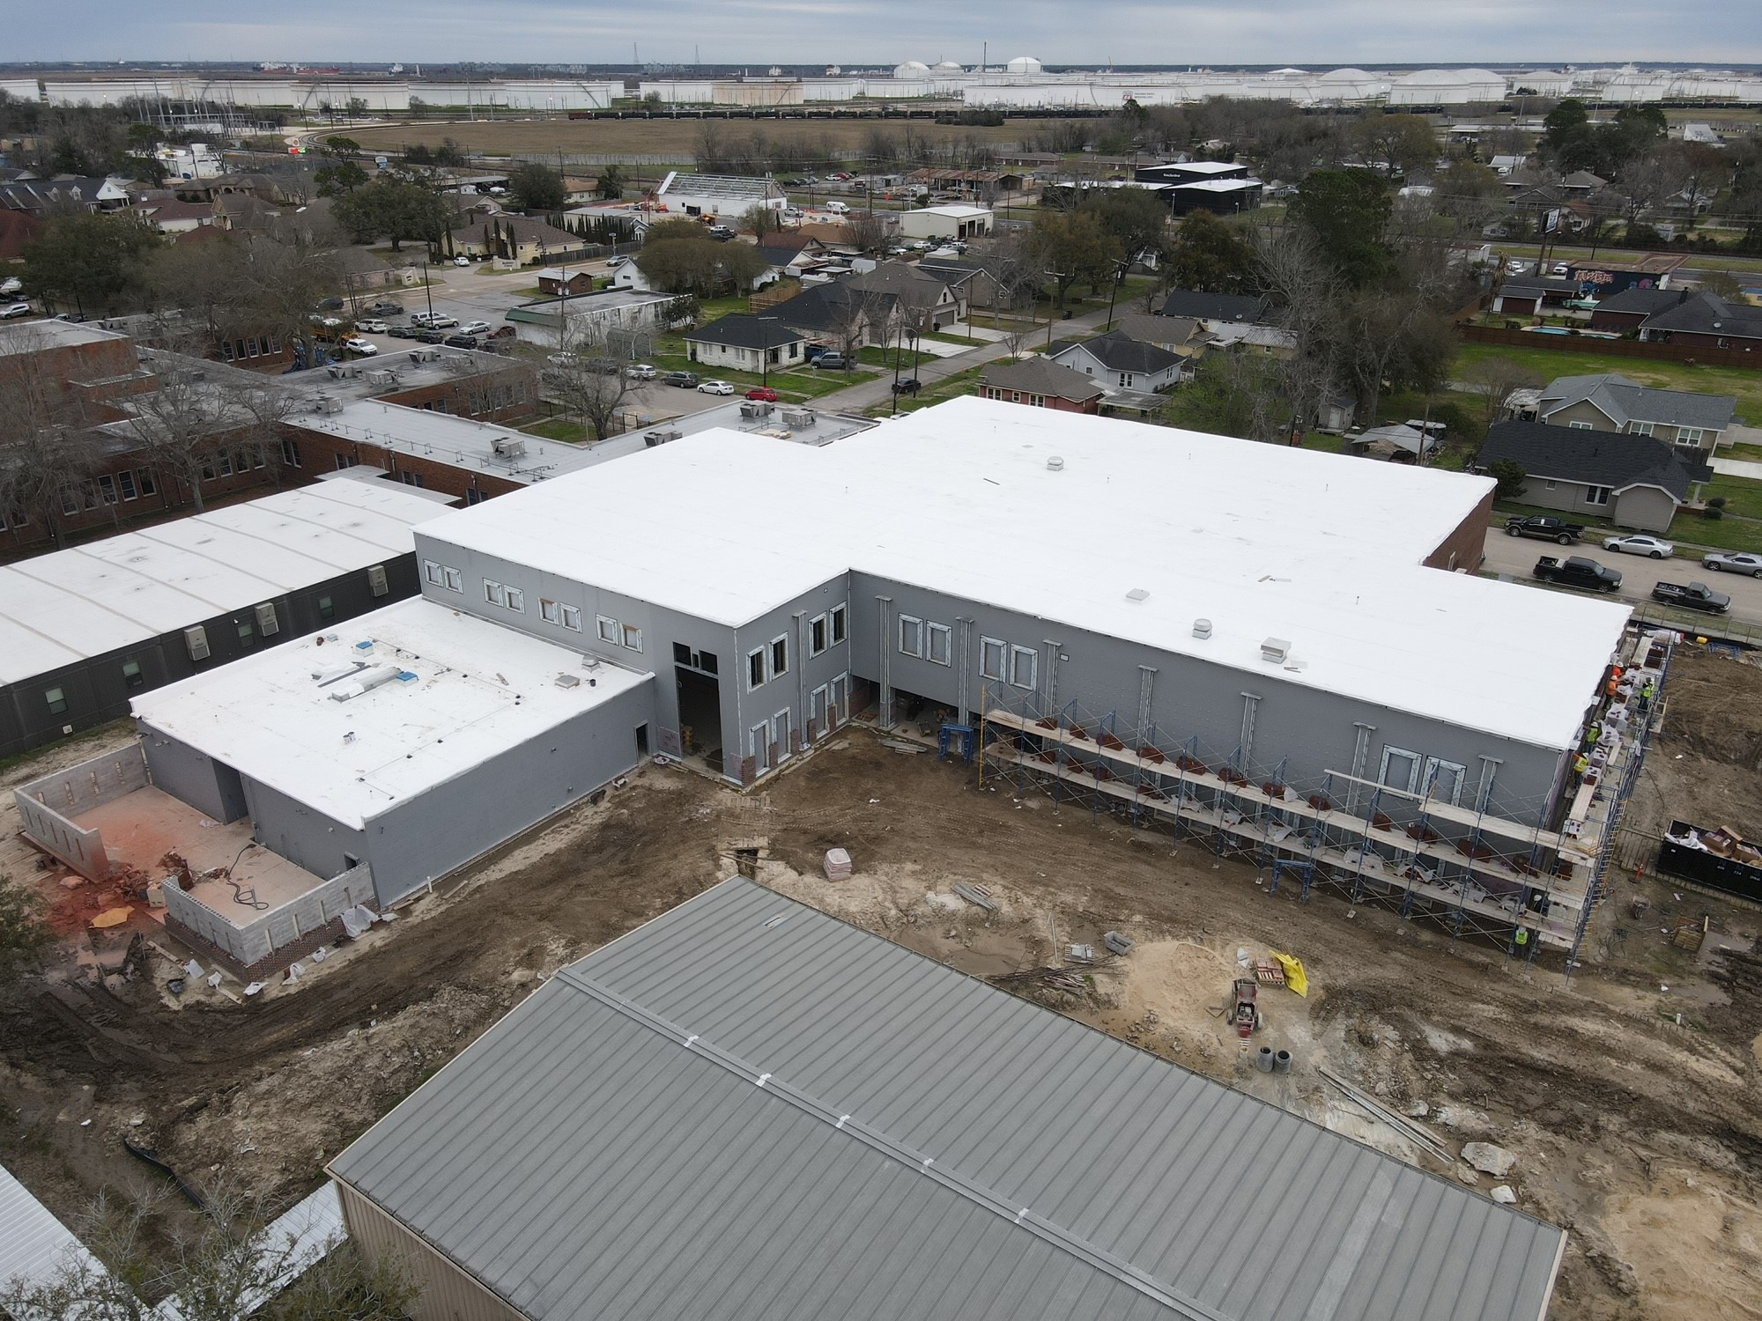
Langham Elementary School
Waterproofing complete
Continuing with Brick installation
Storm Sewer / paving to continue

Slide 9
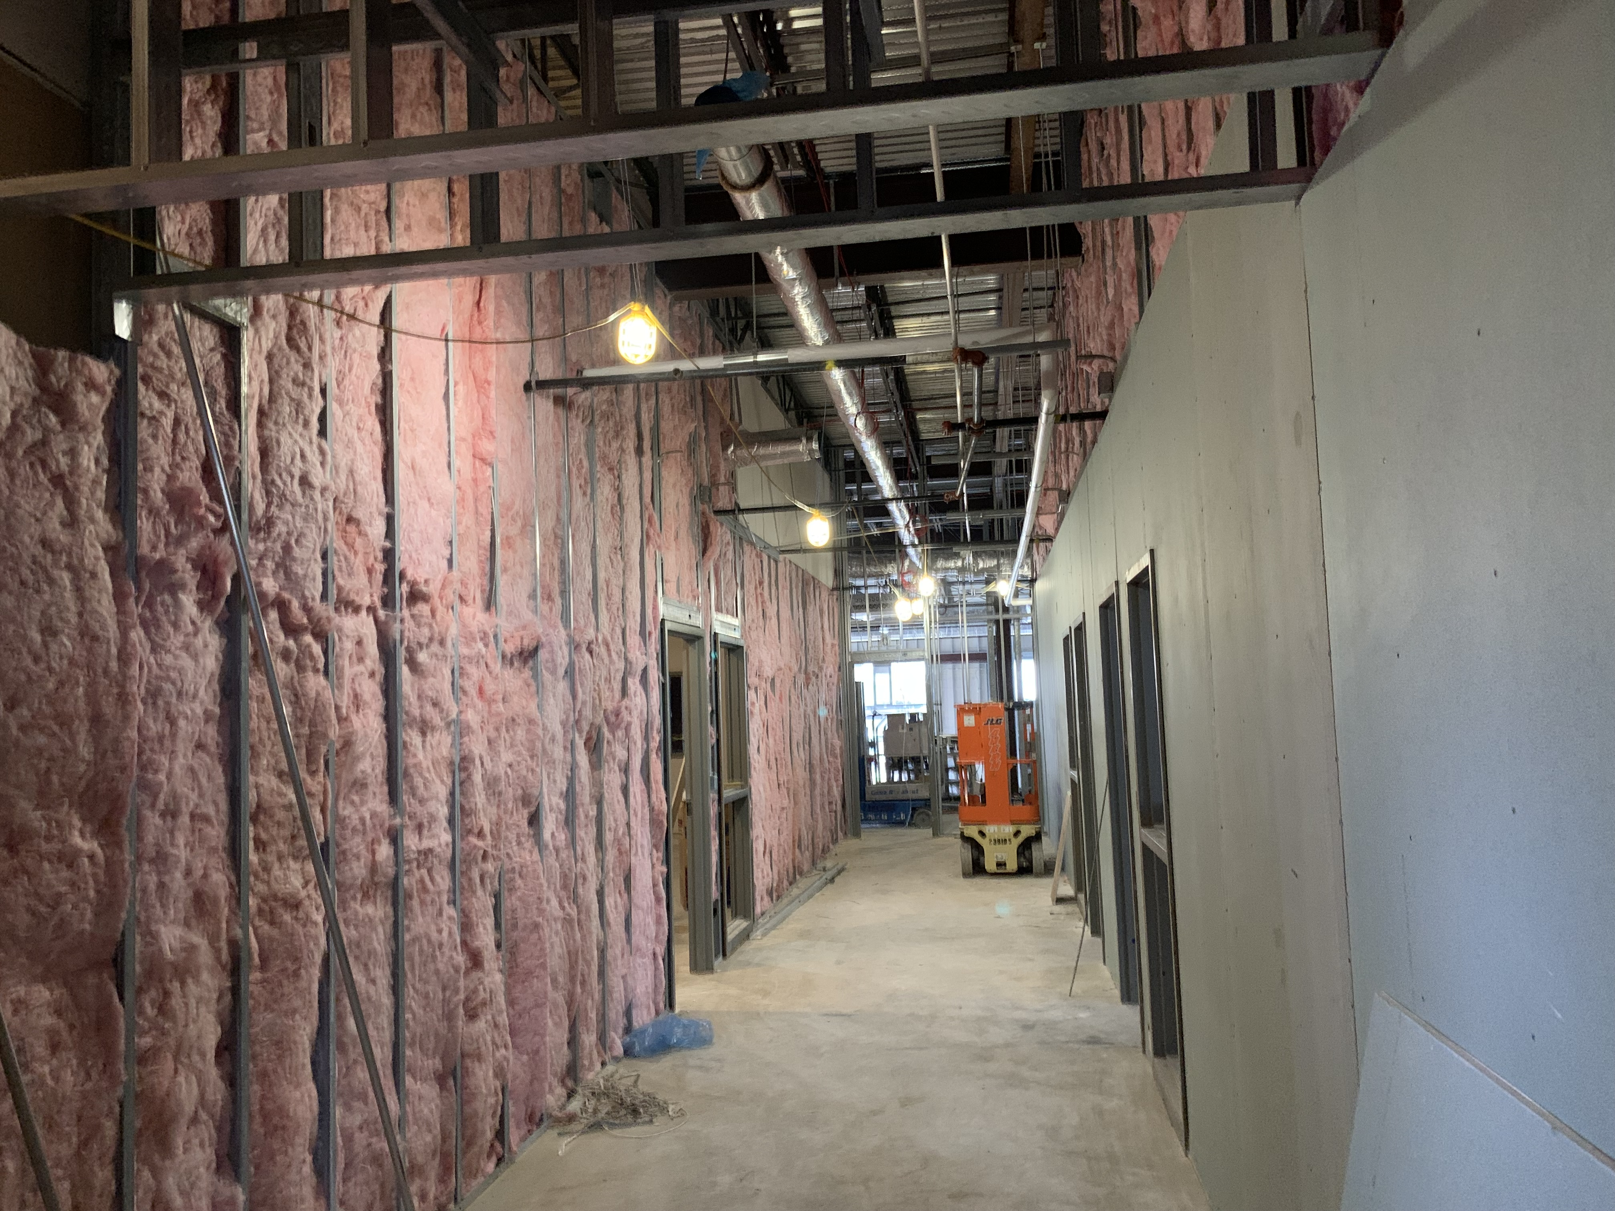
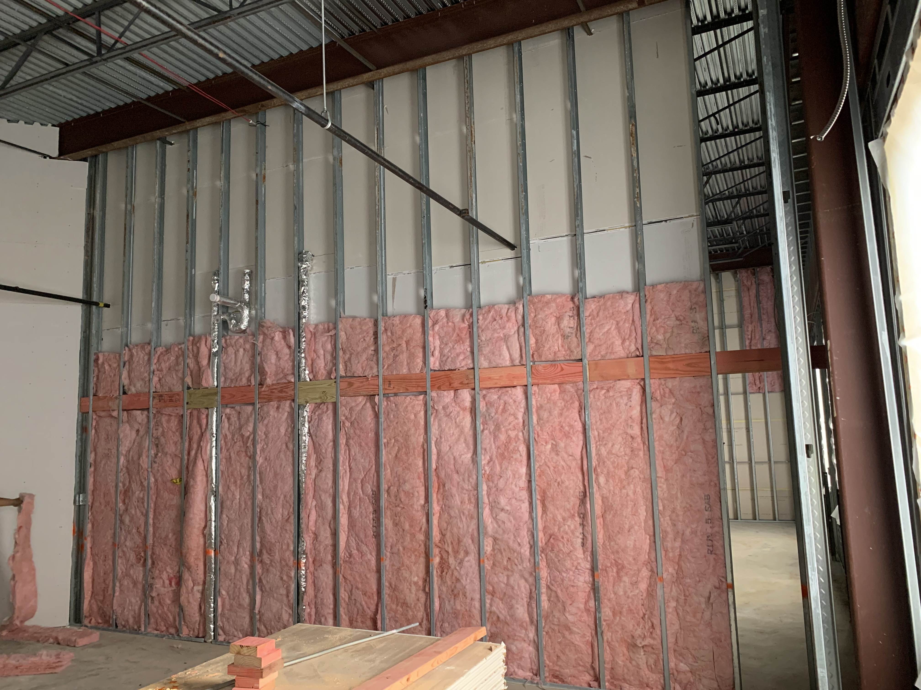
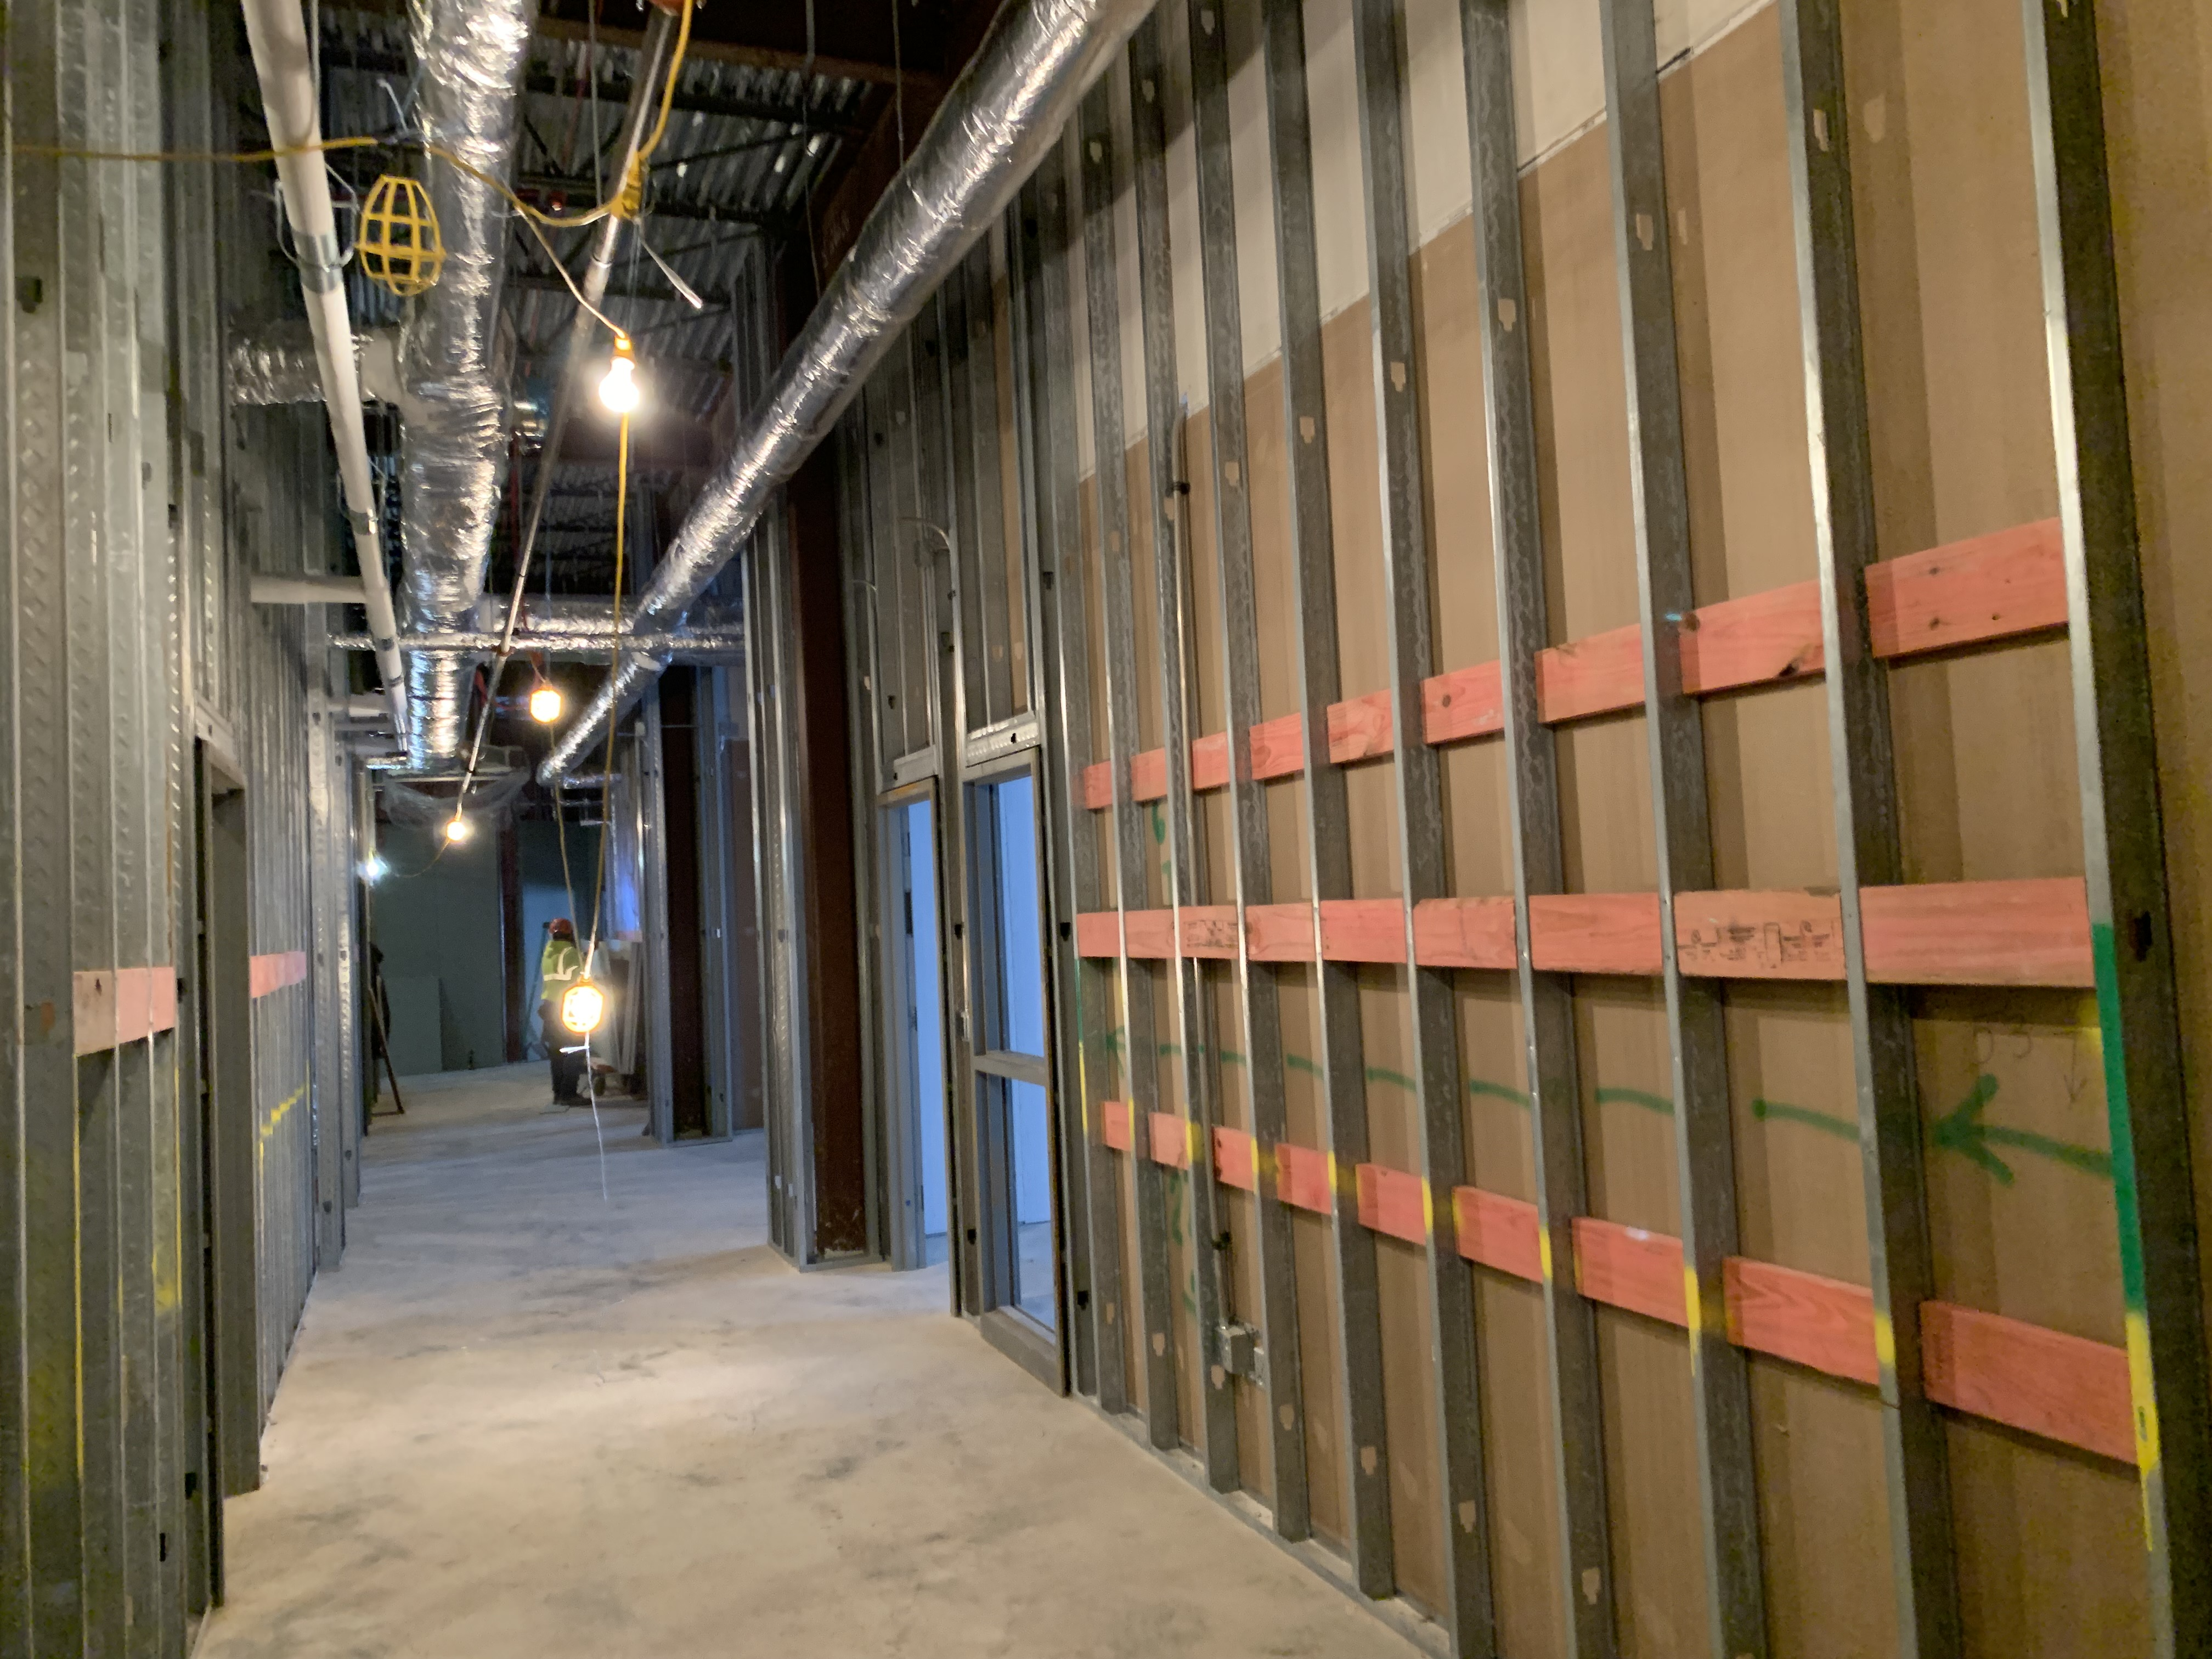
Langham Elementary School
Insulation and sheetrock install
Continue framing 2nd floor Metal Stud Walls
Finishing Duct work
Staff RR D121

Slide 10
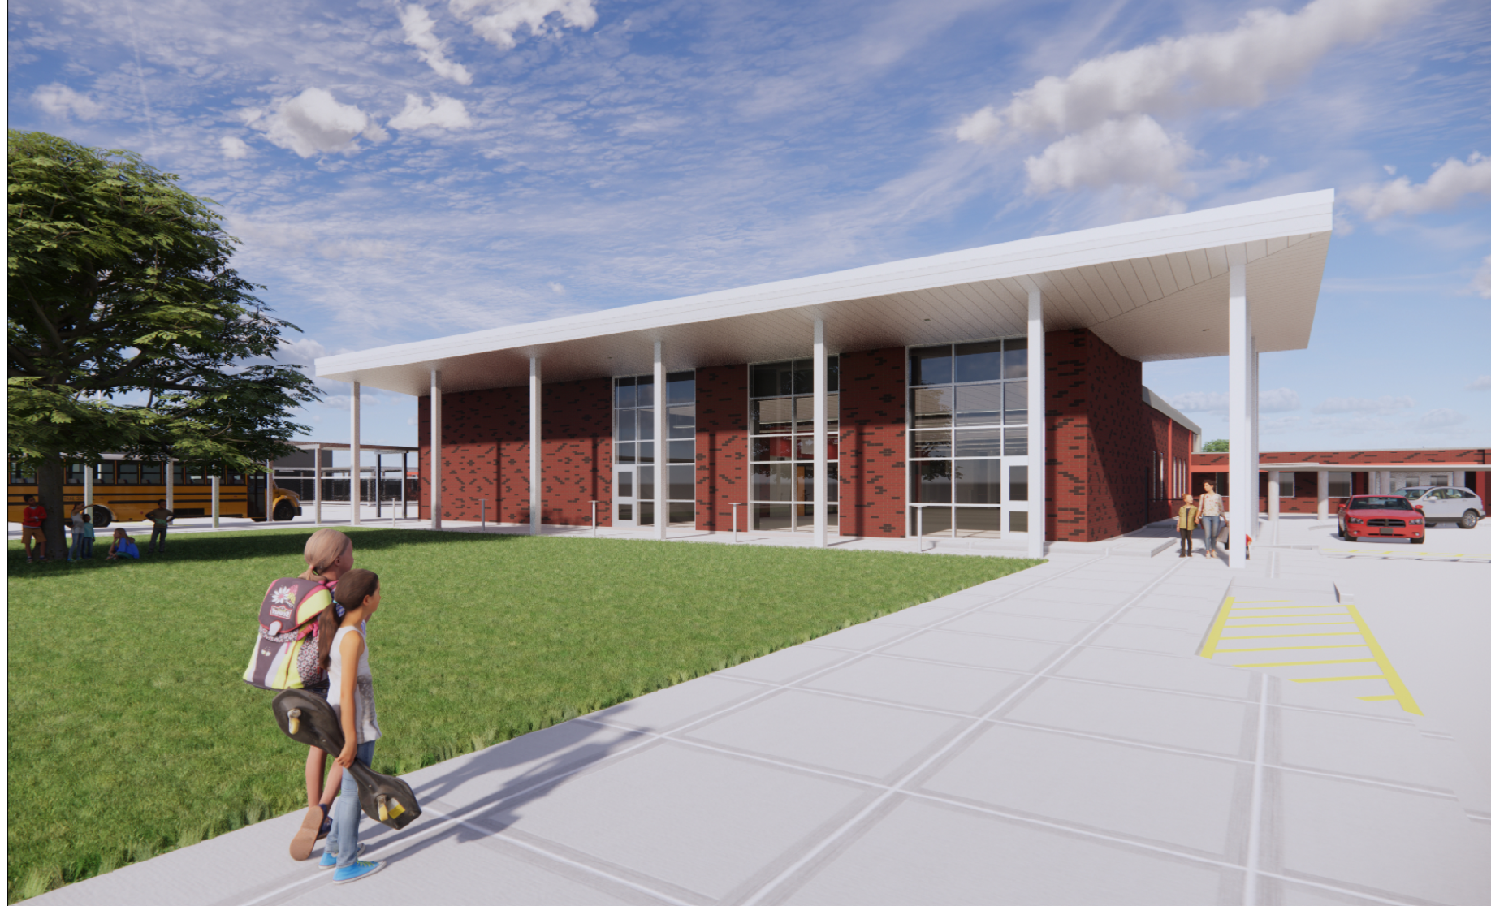
Hillcrest Elementary School

Slide 11
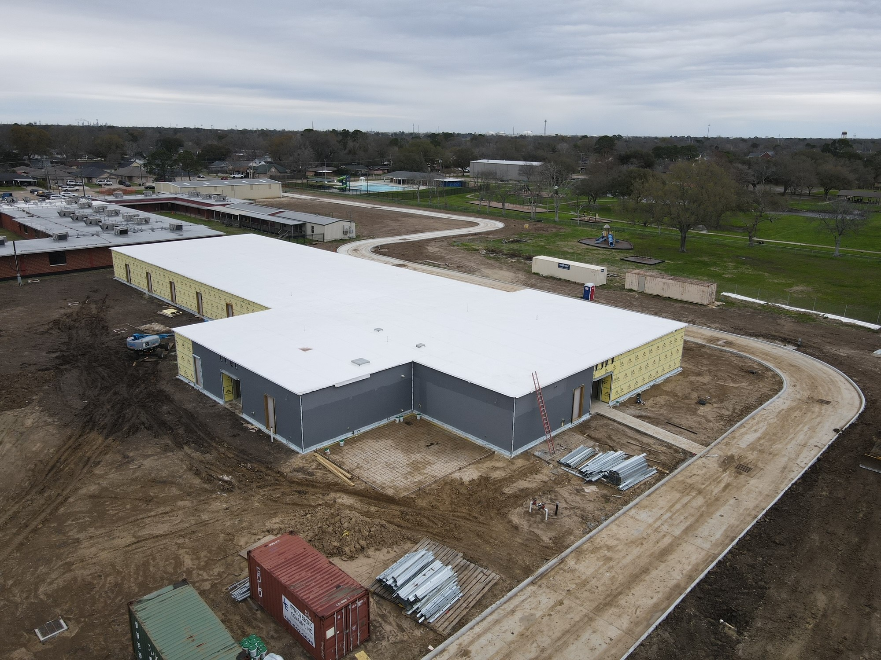
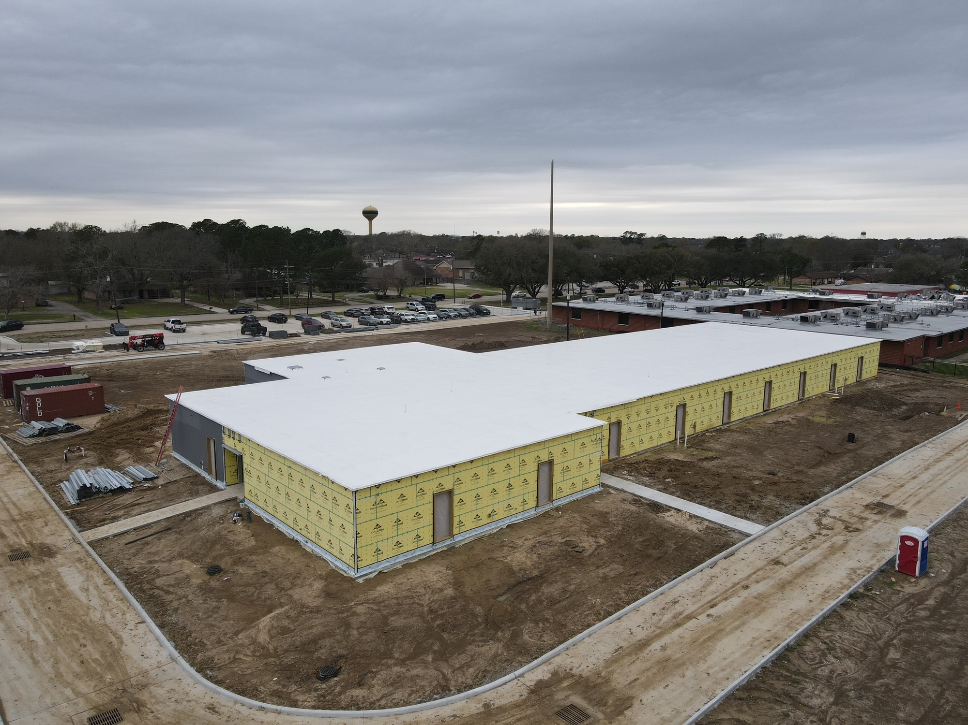
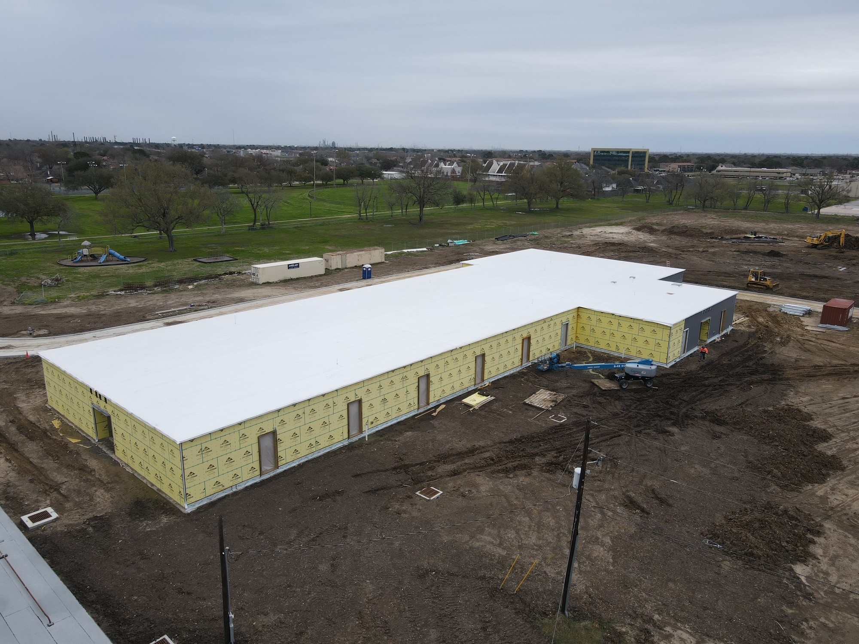
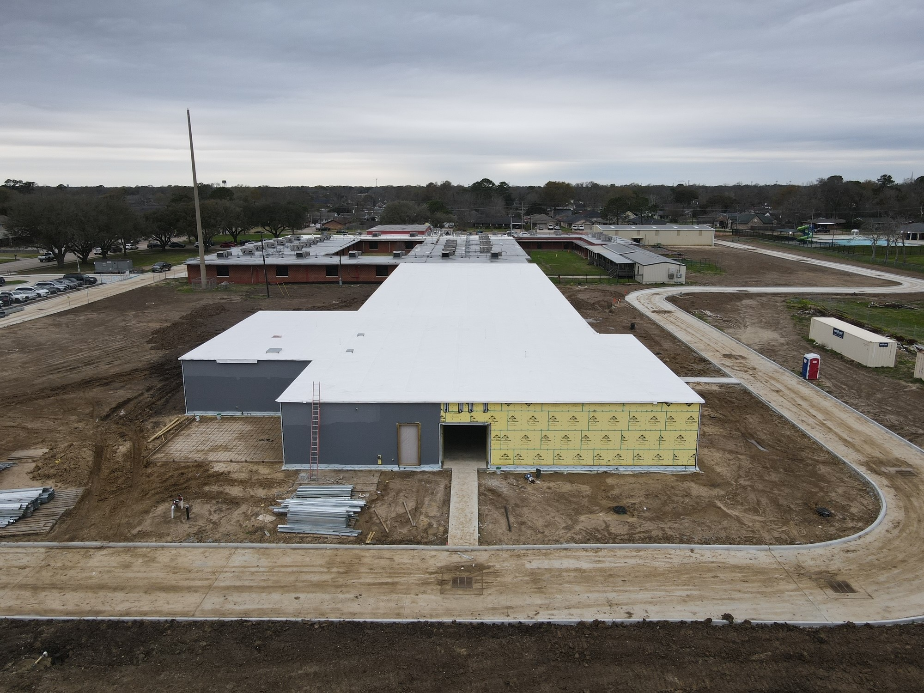
Hillcrest Elementary School
Complete Waterproofing
Start brick Work
Storm Sewer Tie In

Slide 12
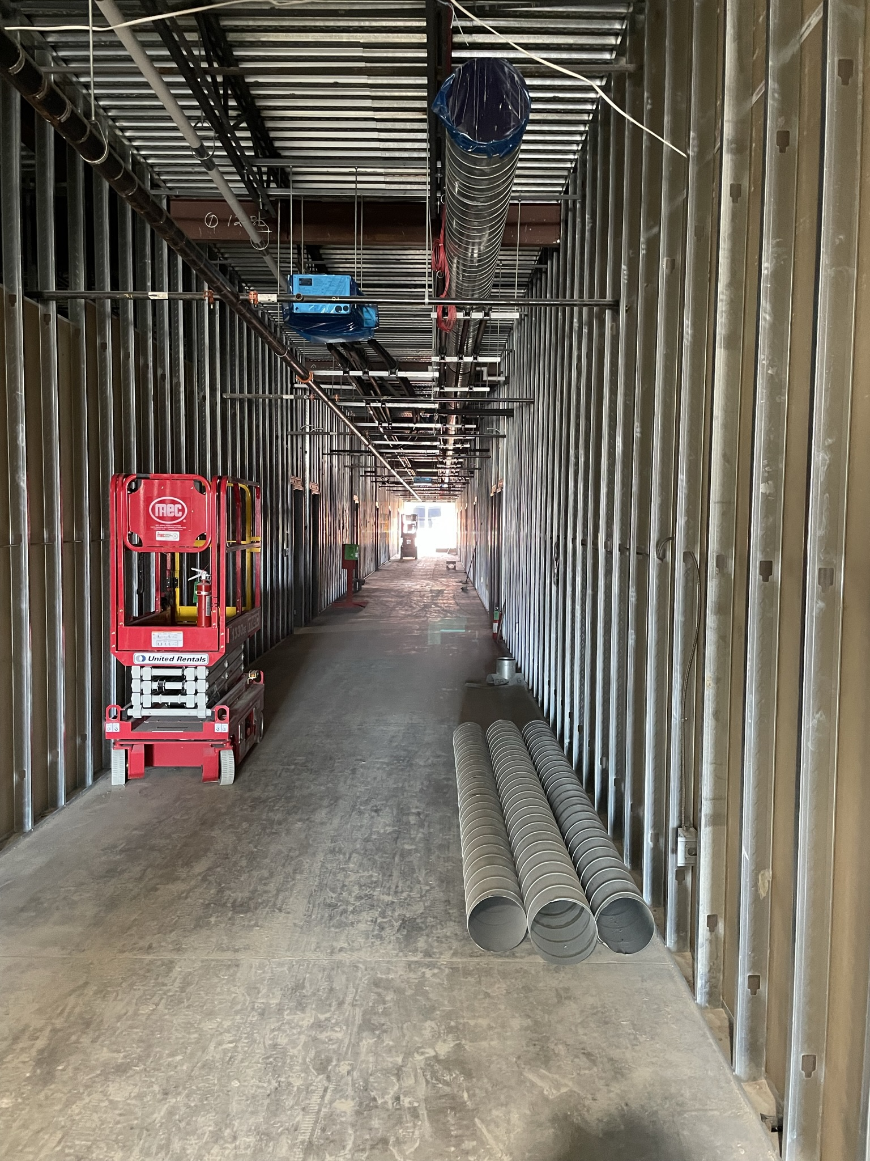
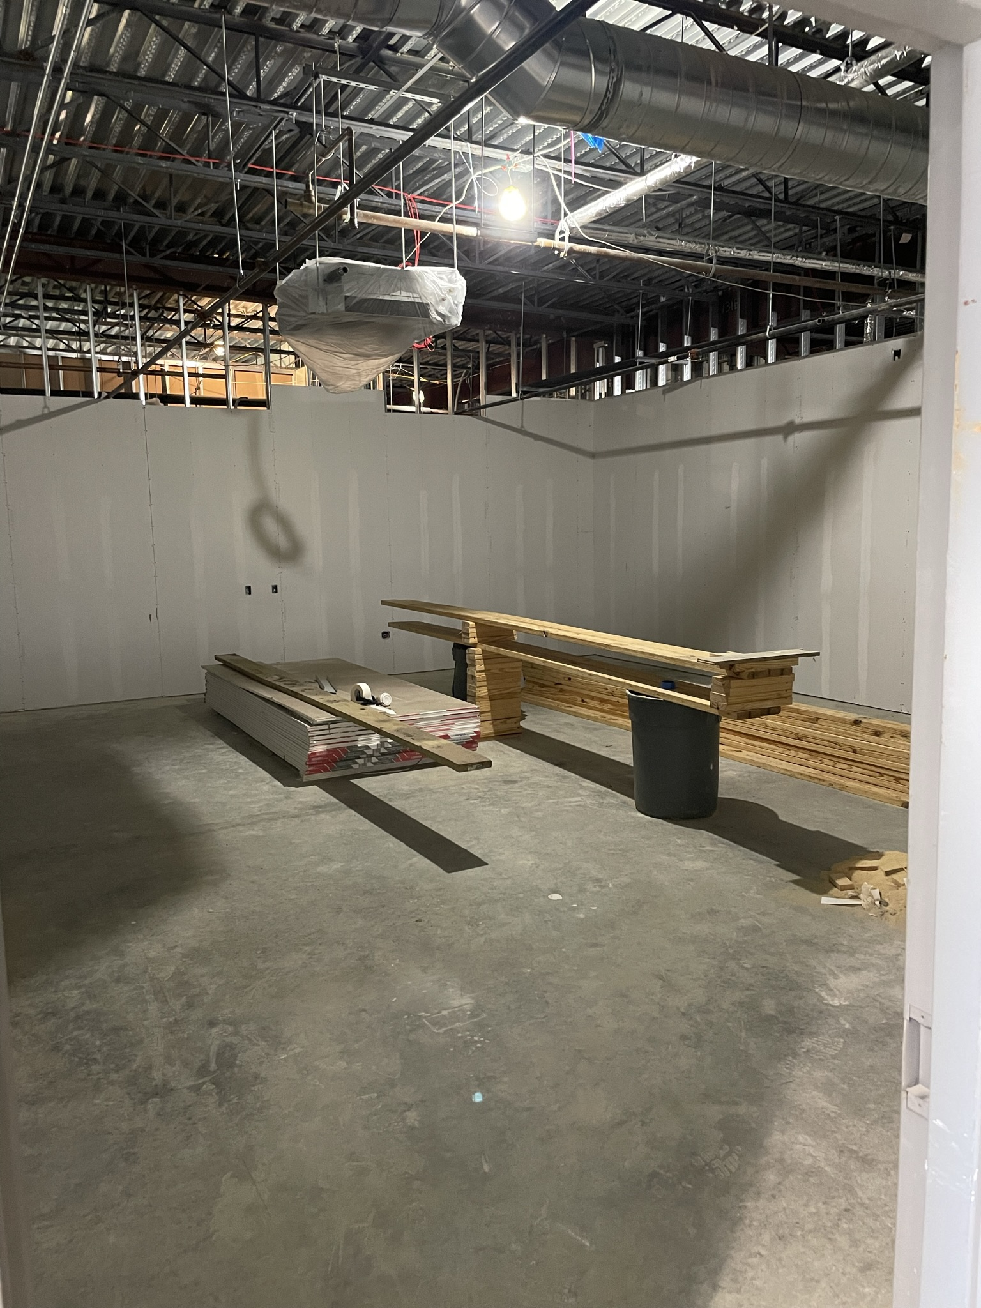
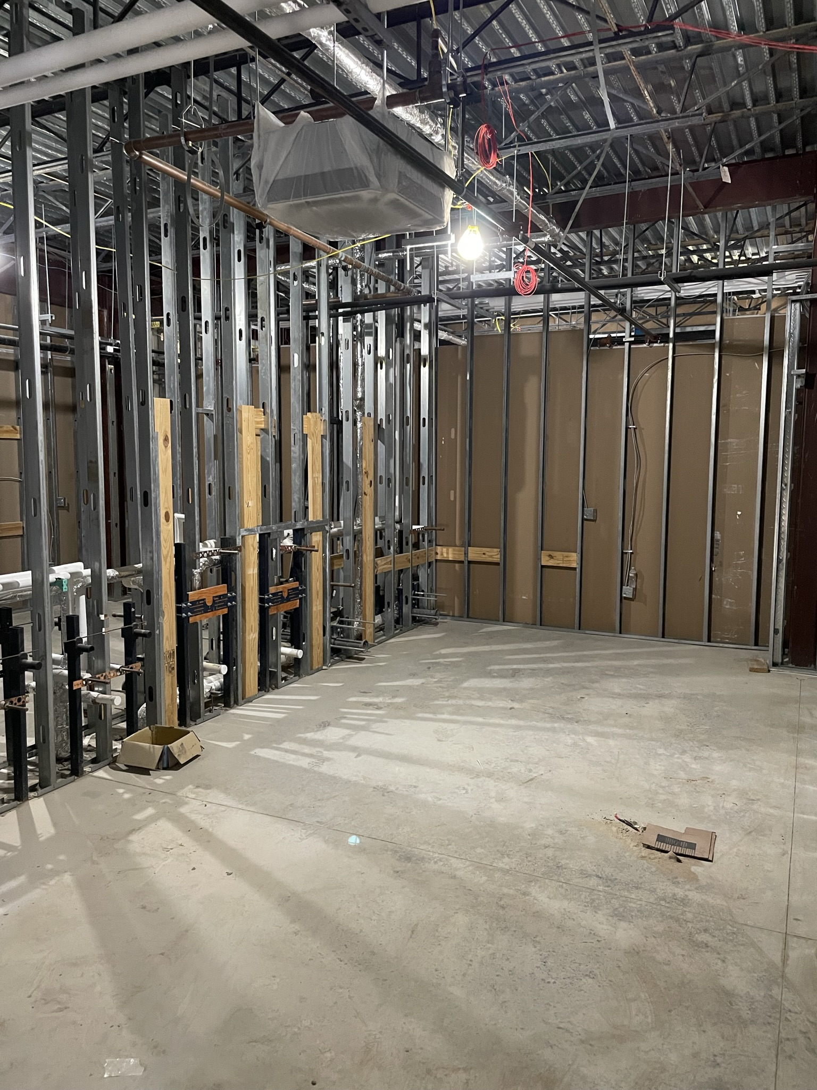
Hillcrest Elementary School
Hang Insulation & Drywall
Installing HVAC Ducts
Continue Electrical Work

Slide 13
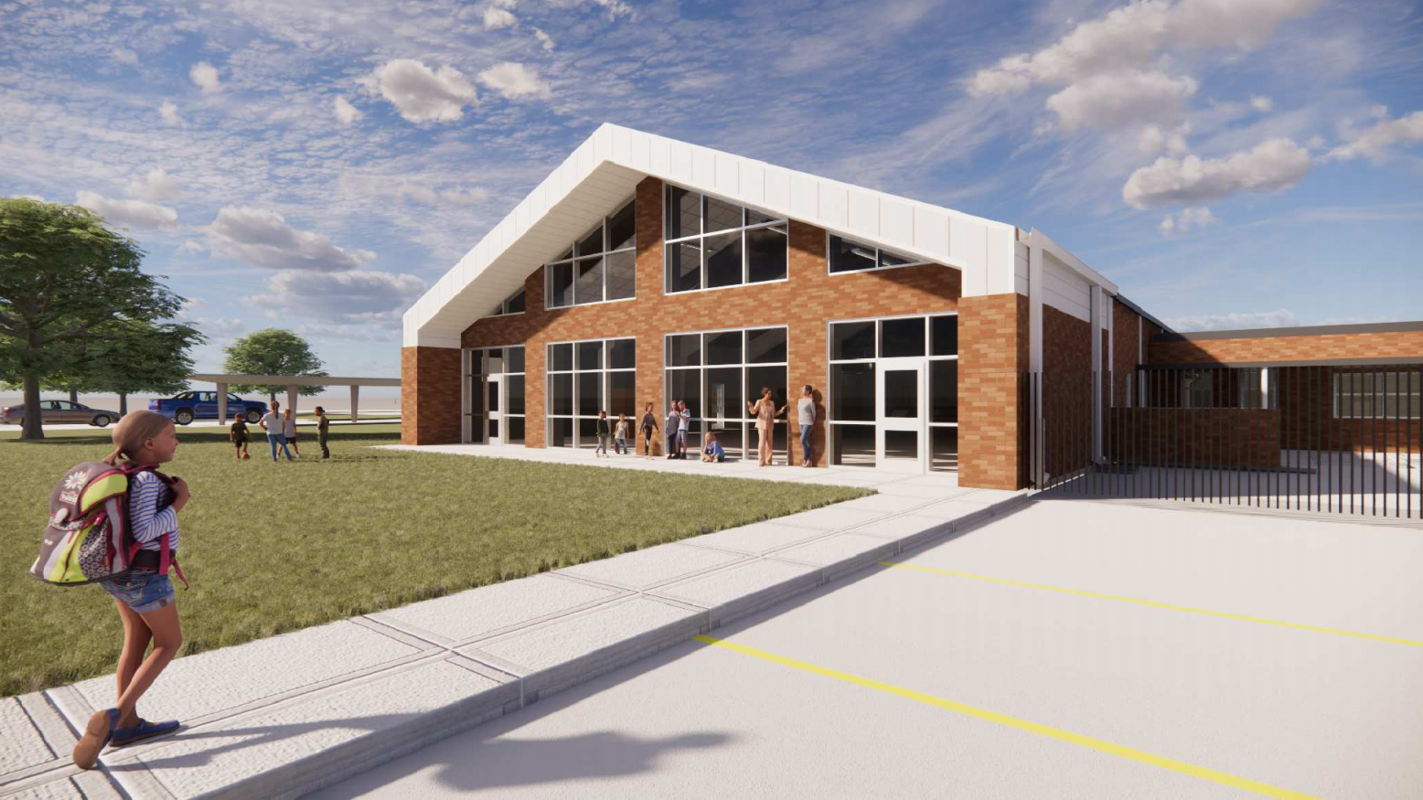
Highland Park Elementary School

Slide 14
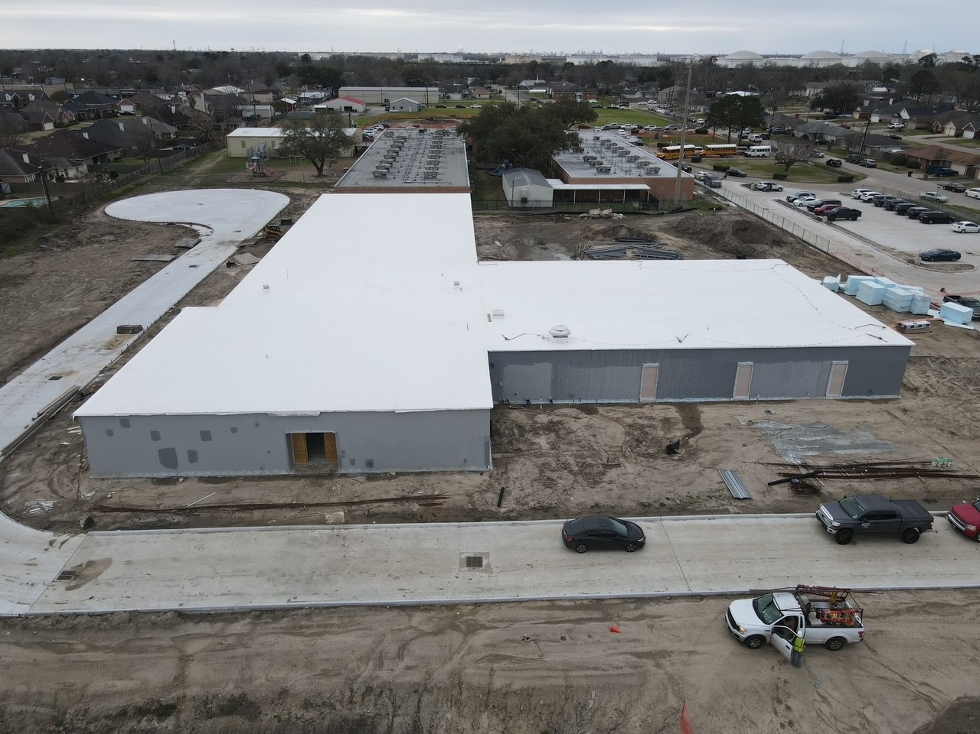
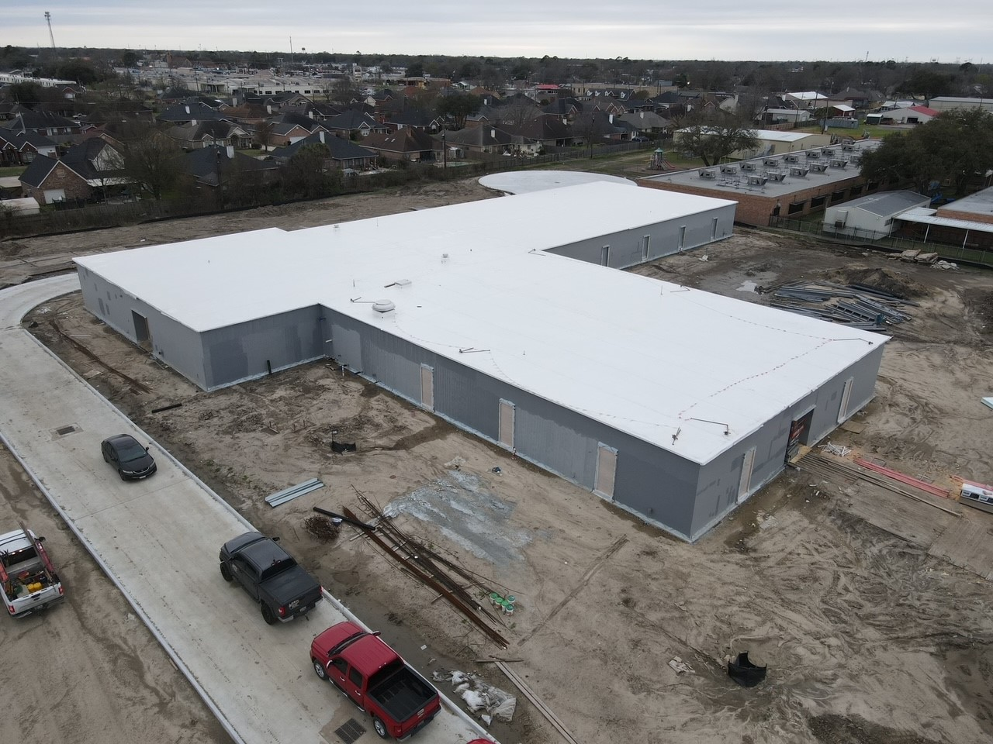
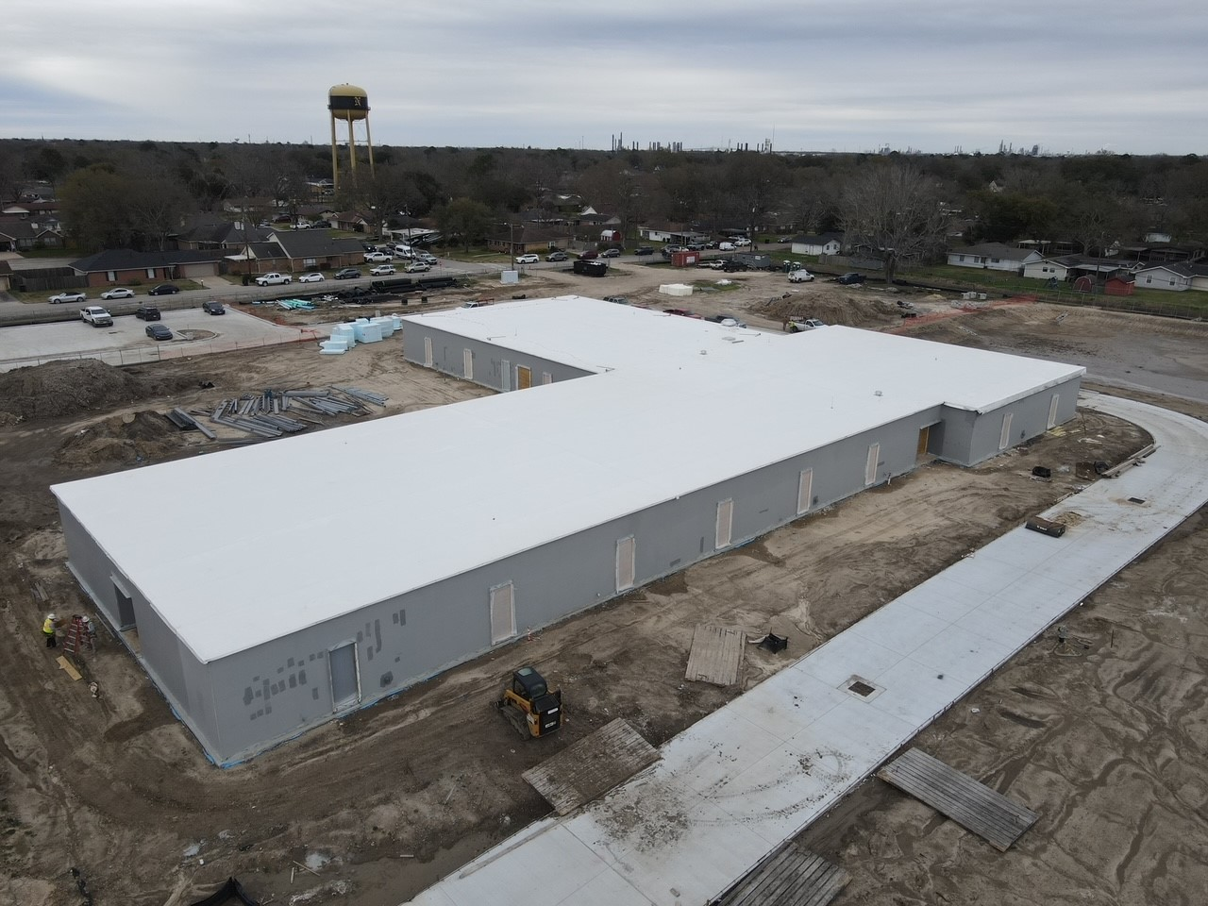
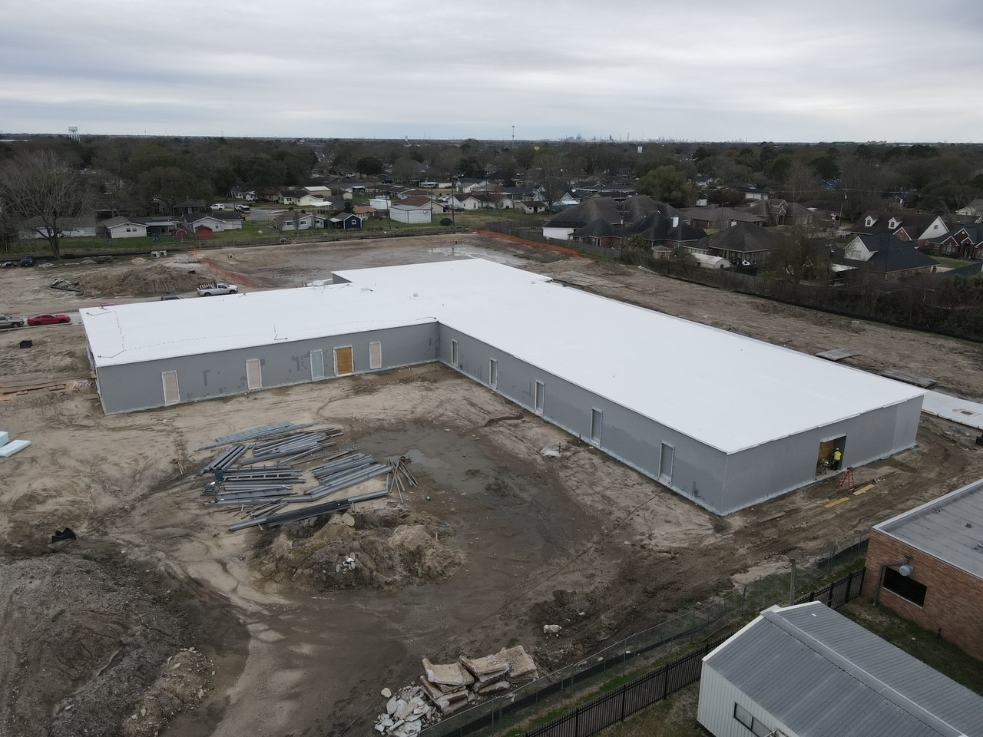
Highland Park Elementary School
Waterproofing Complete
Start brick work
Ring Road complete (Top Left)

Slide 15
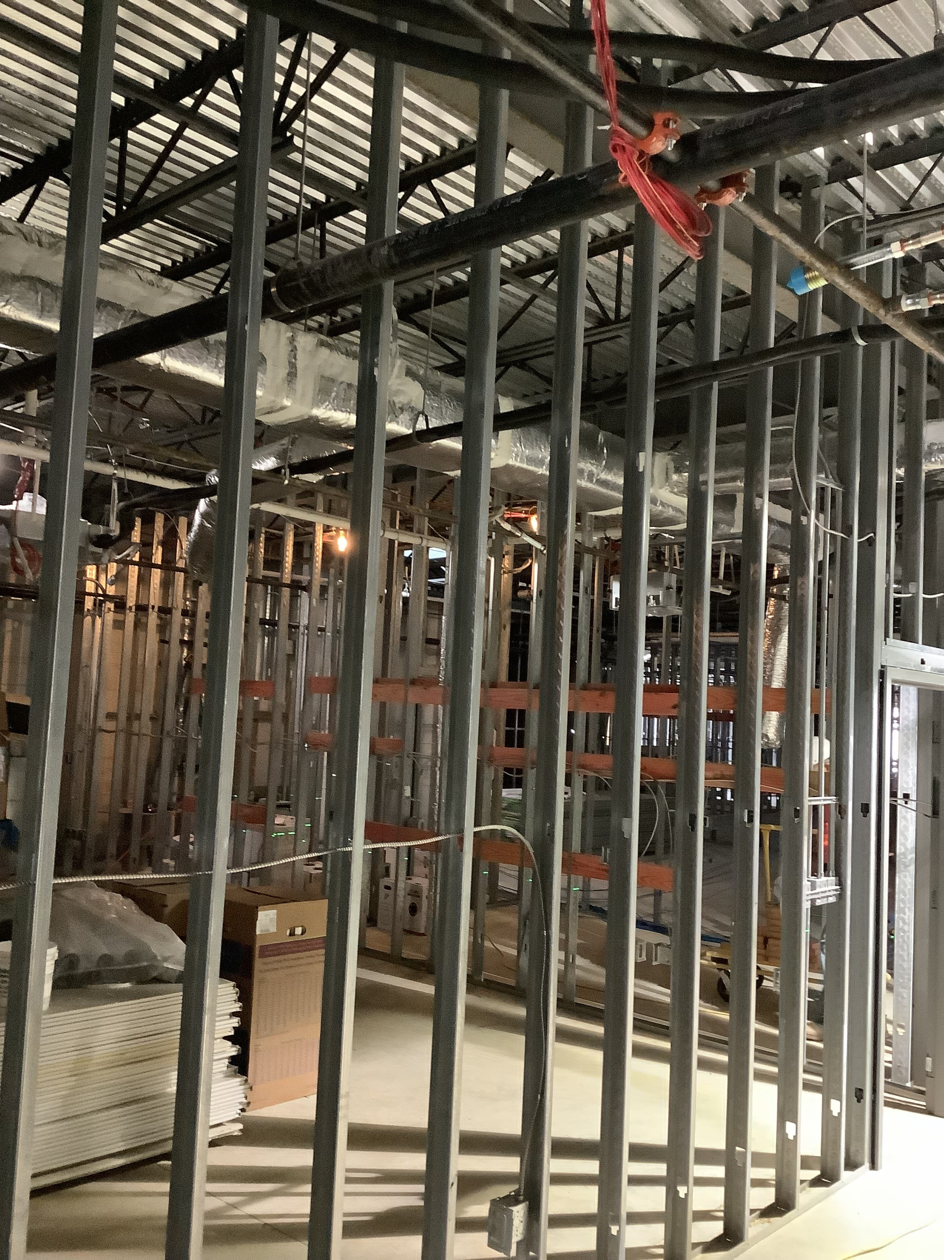
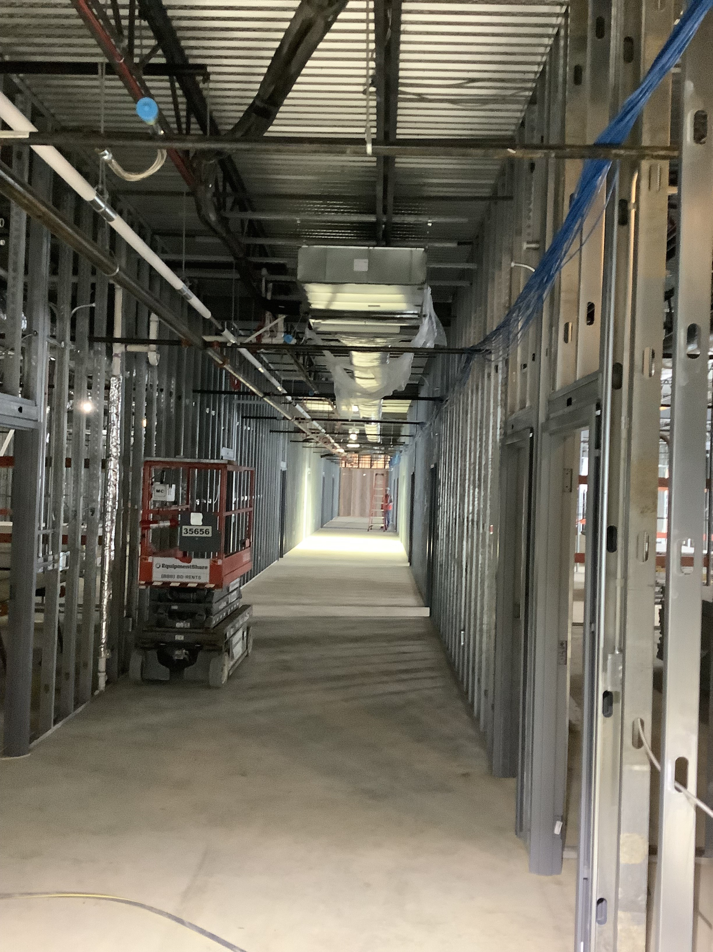
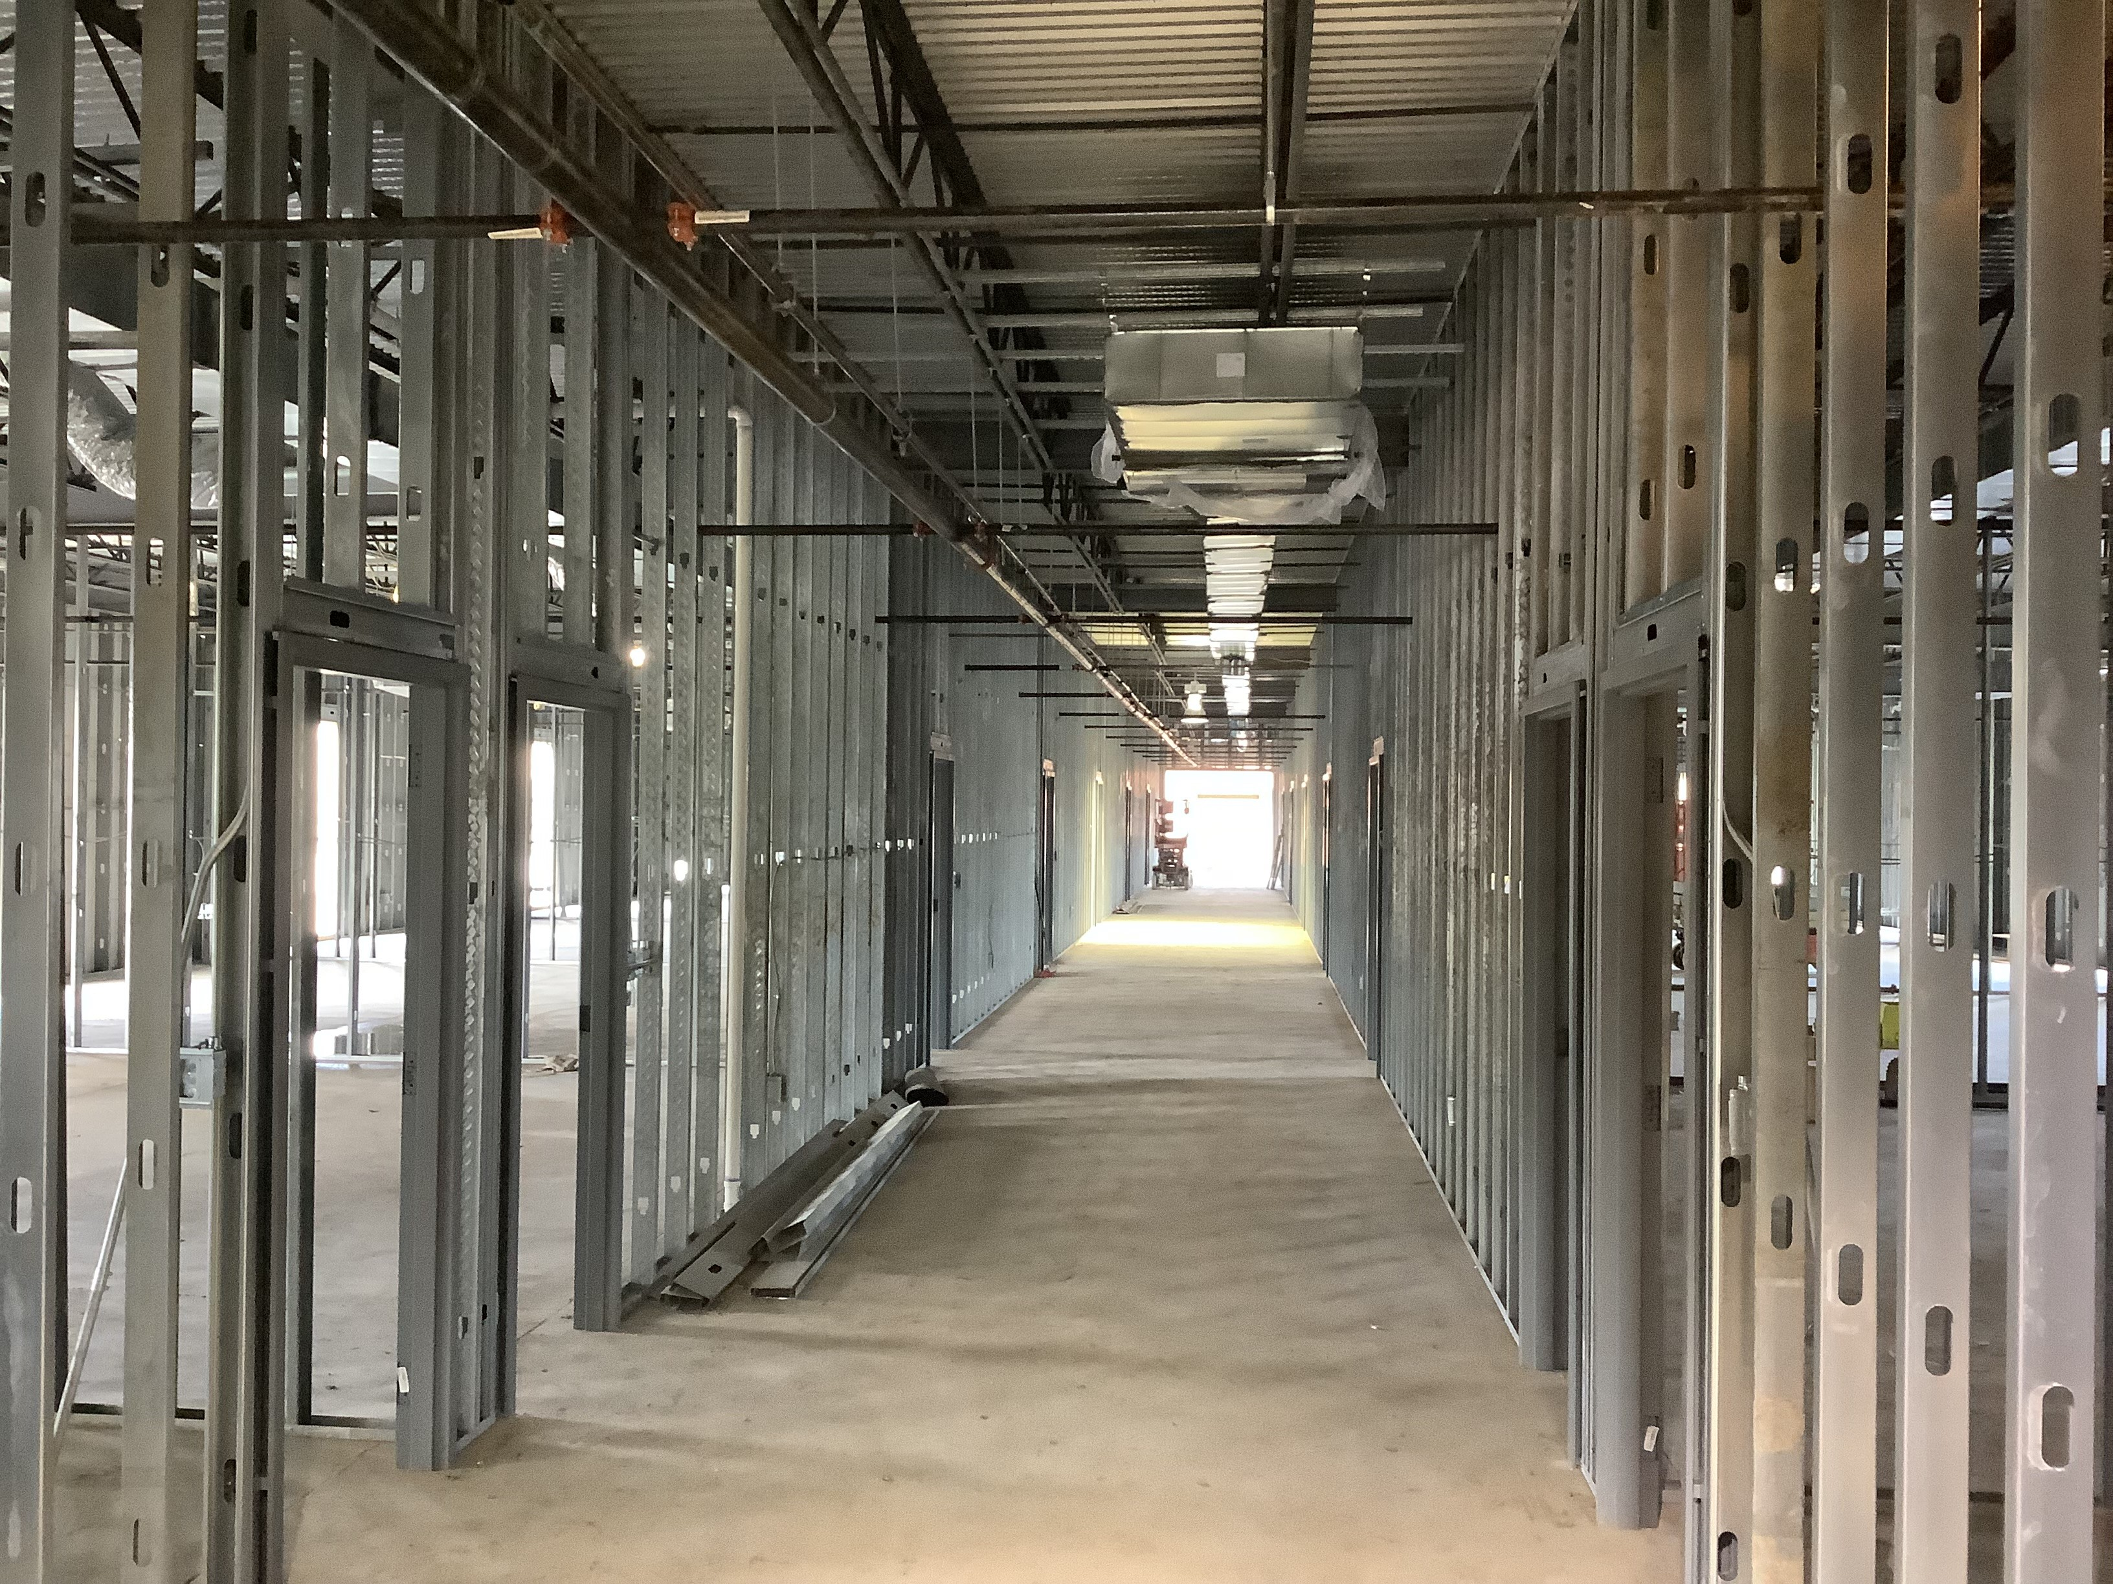
Highland Park Elementary School
Interior Mechanical Work
Plumbing Work
Electrical Work
Installation of Metal Studs

Slide 16
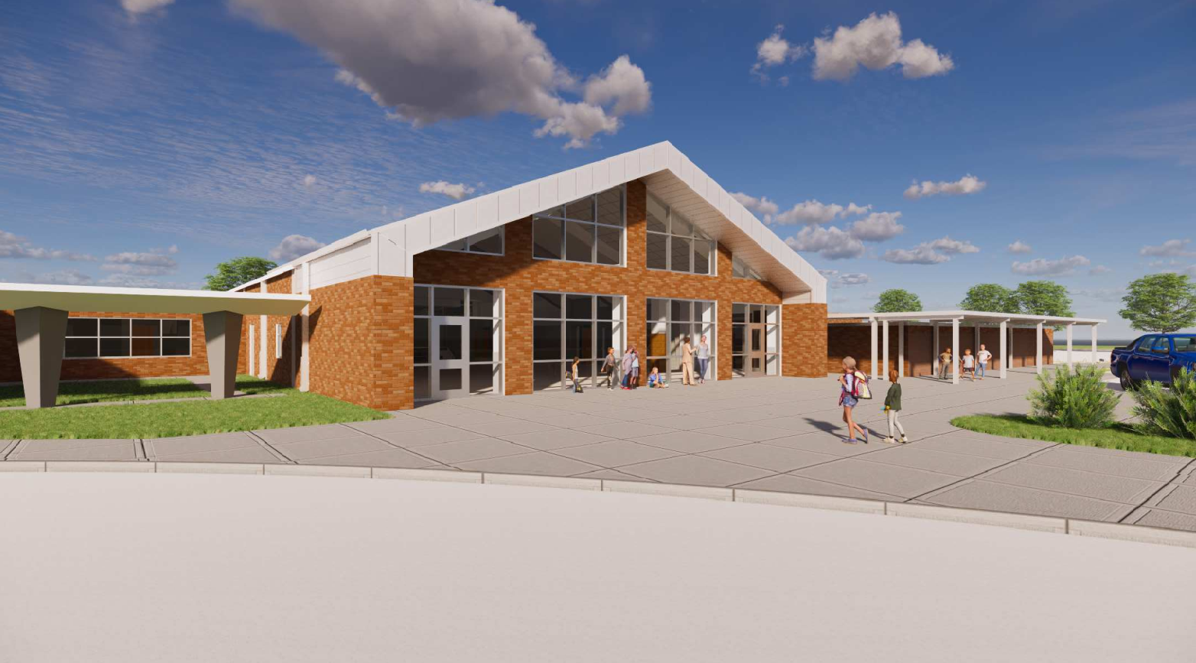
Helena Park Elementary School

Slide 17
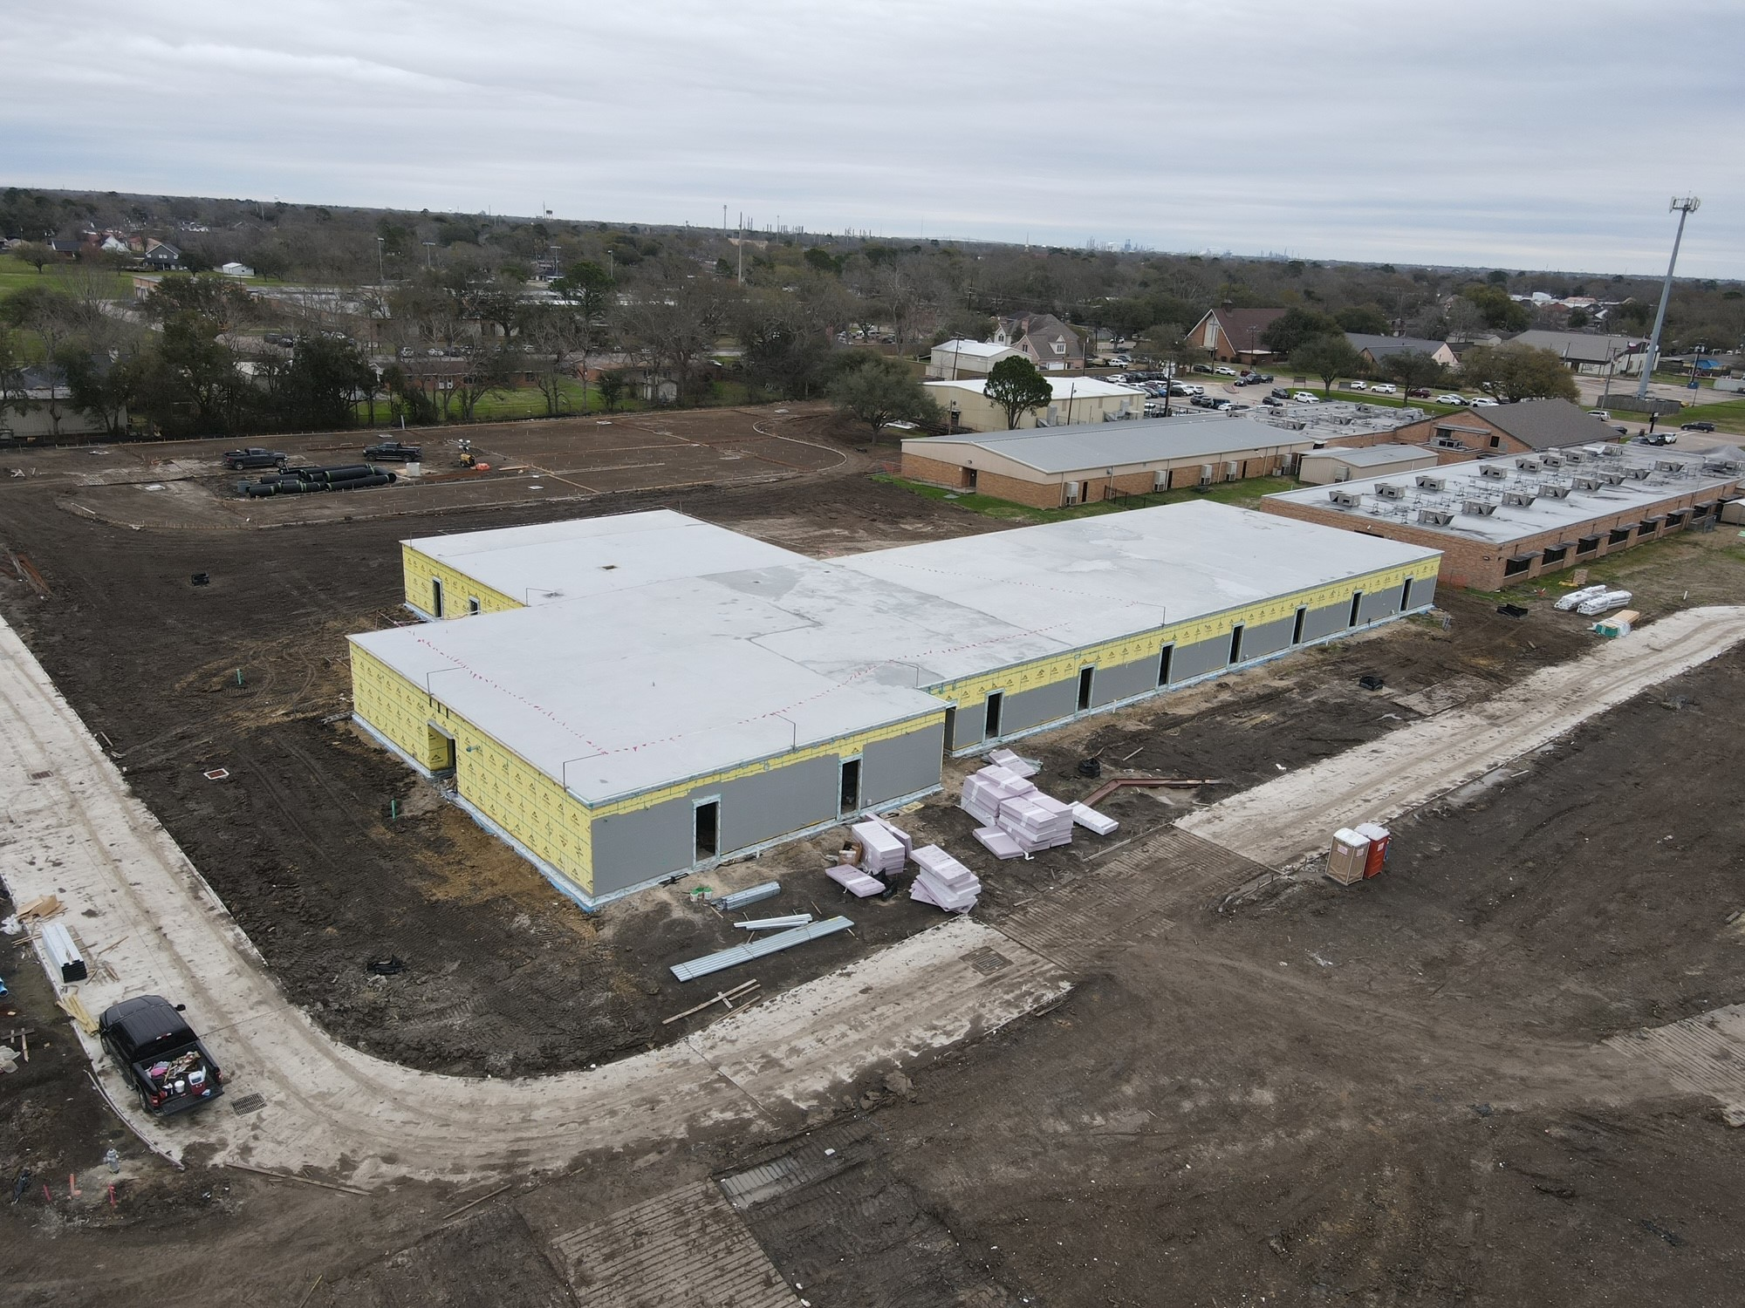
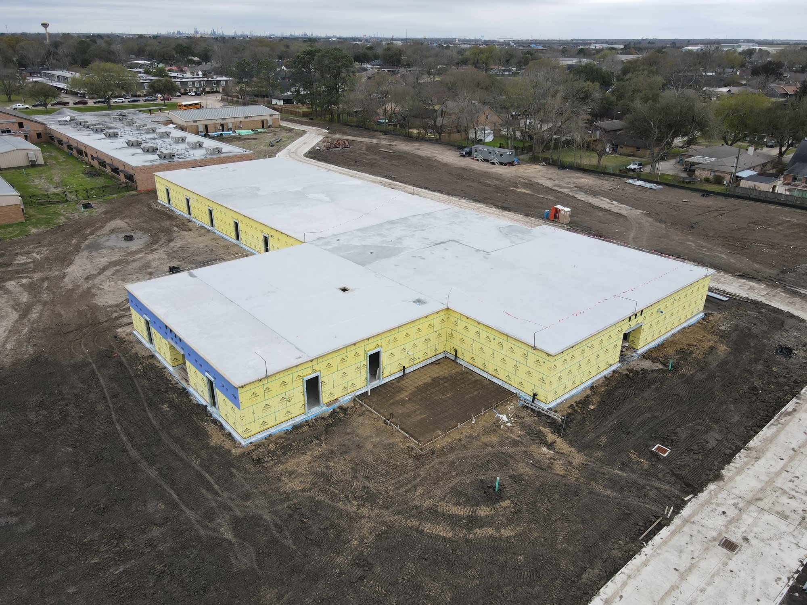
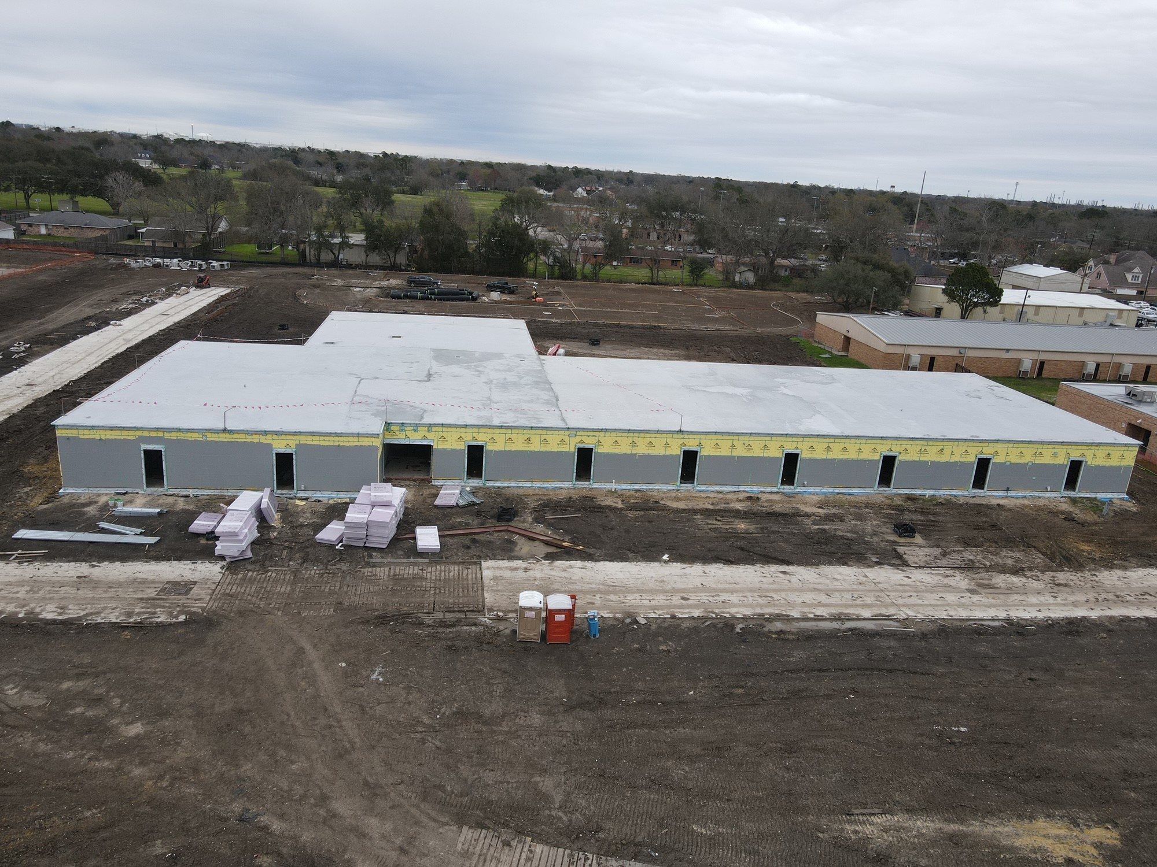
Helena Park Elementary School
650 yards of paving poured Friday & Saturday (Top Left)
Roof cap to be complete this week
Complete waterproofing
Begin Brick

Slide 18
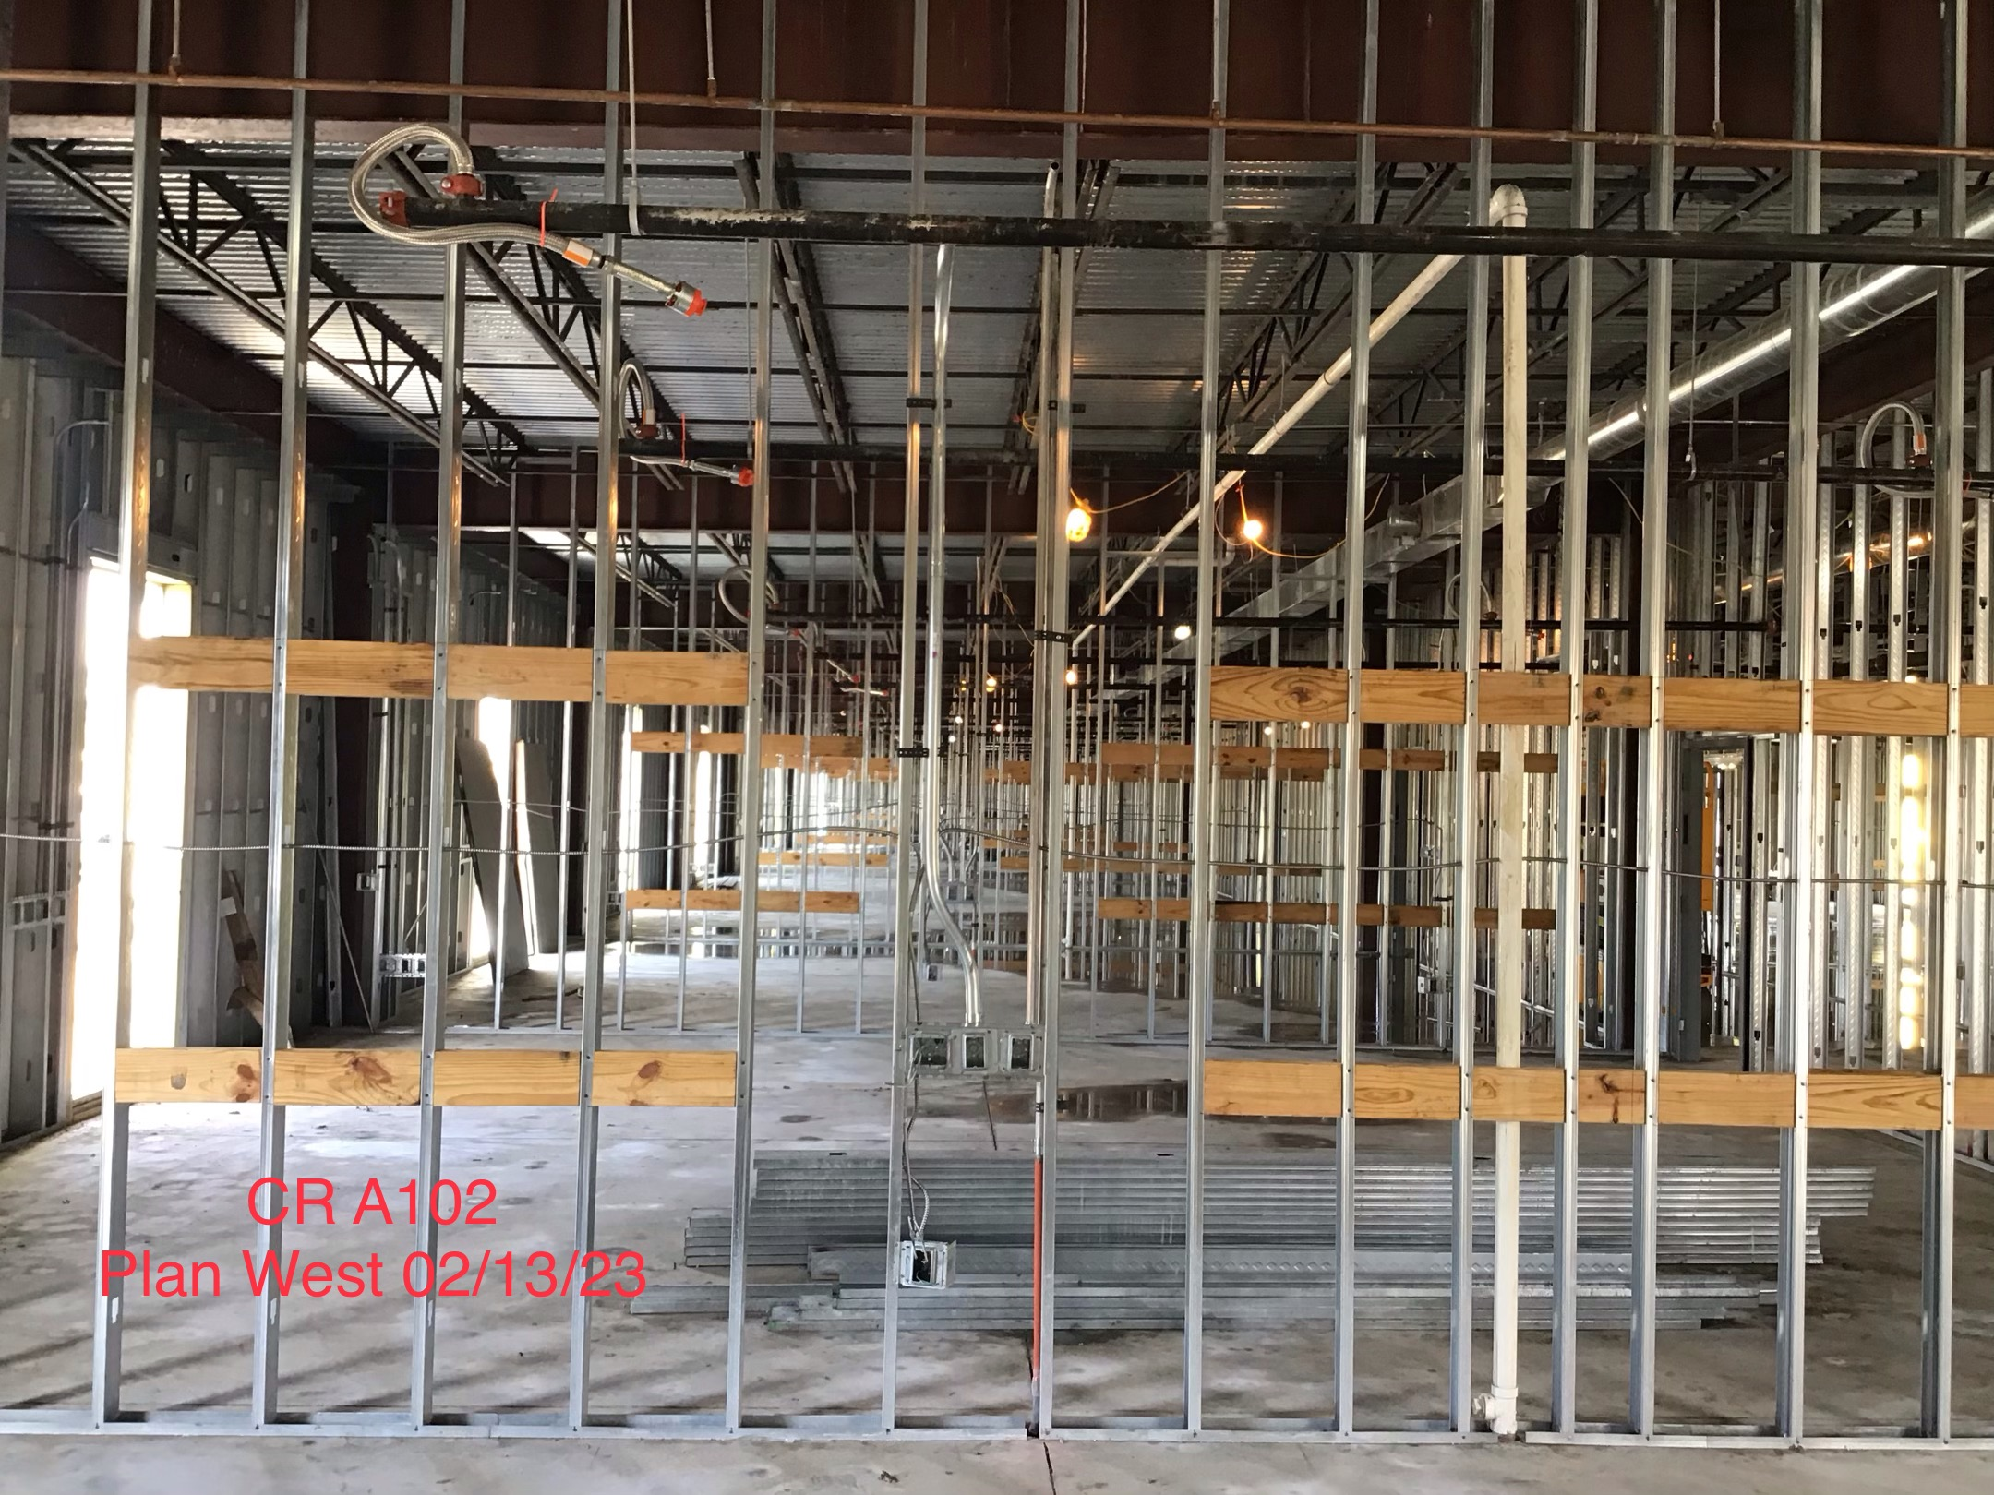
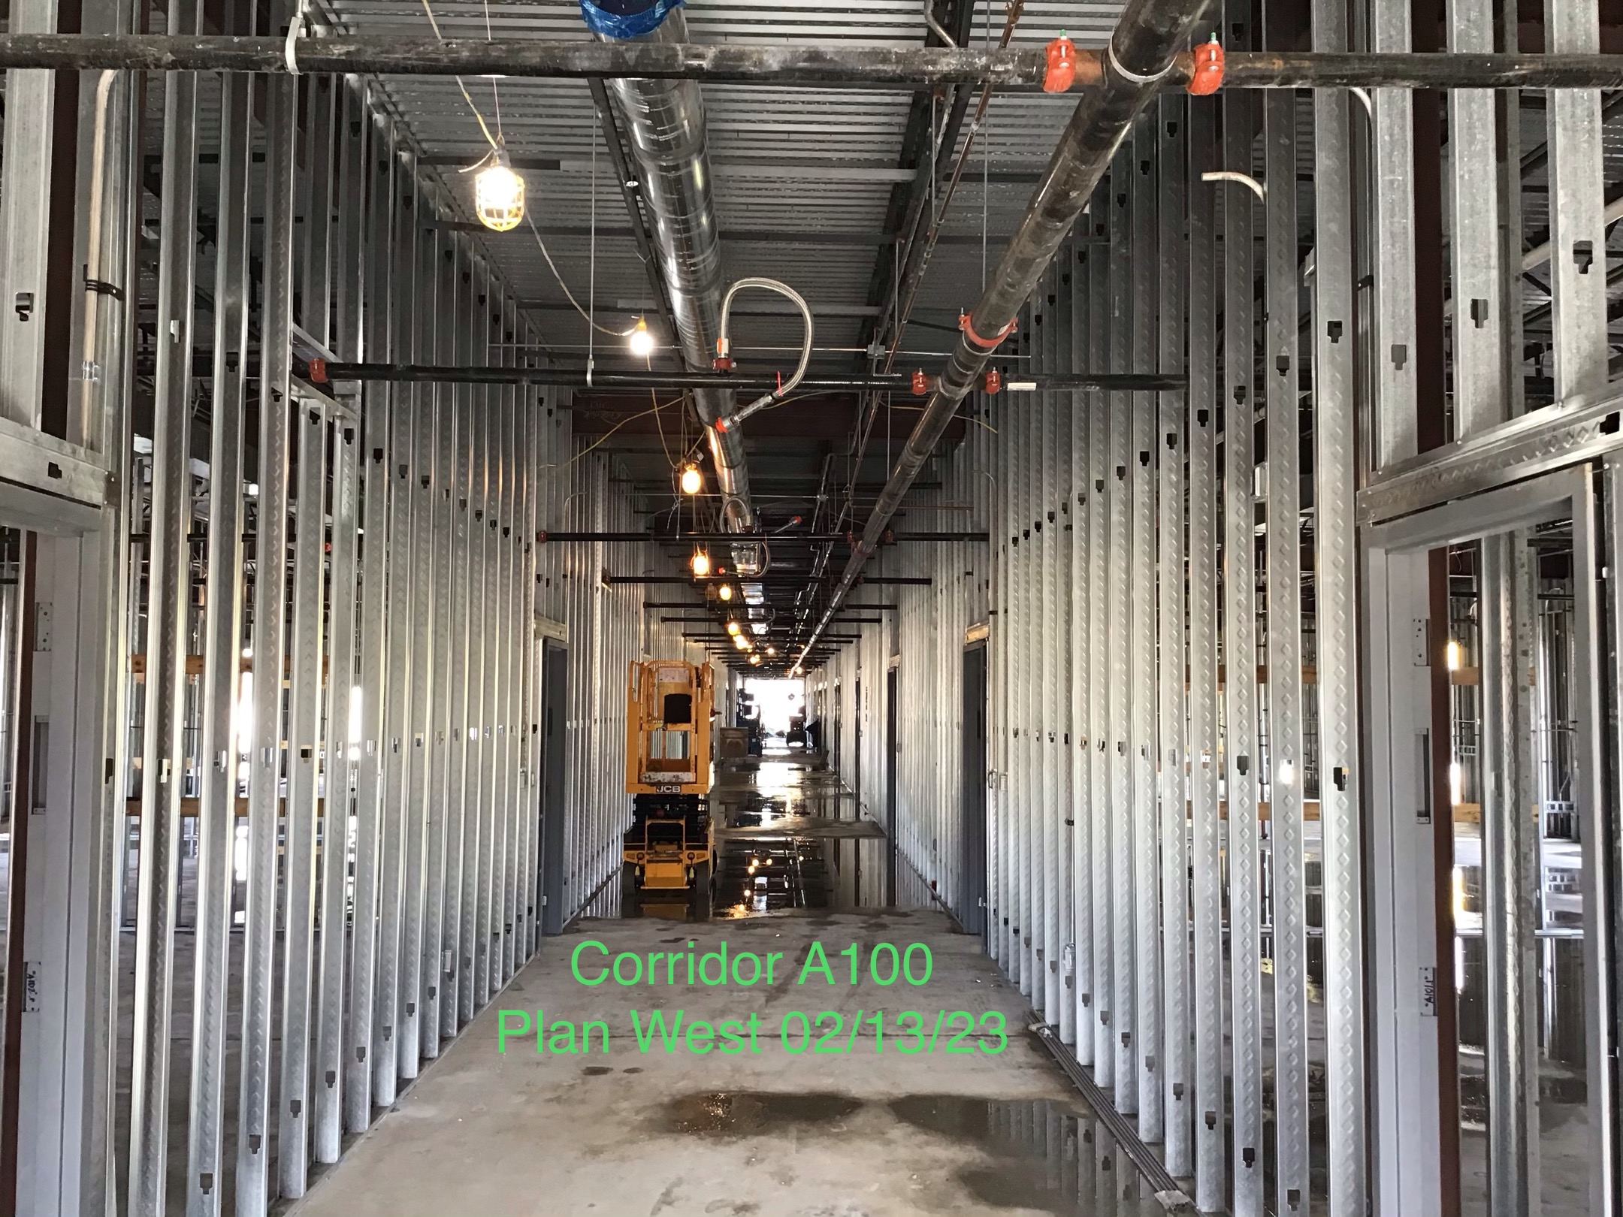
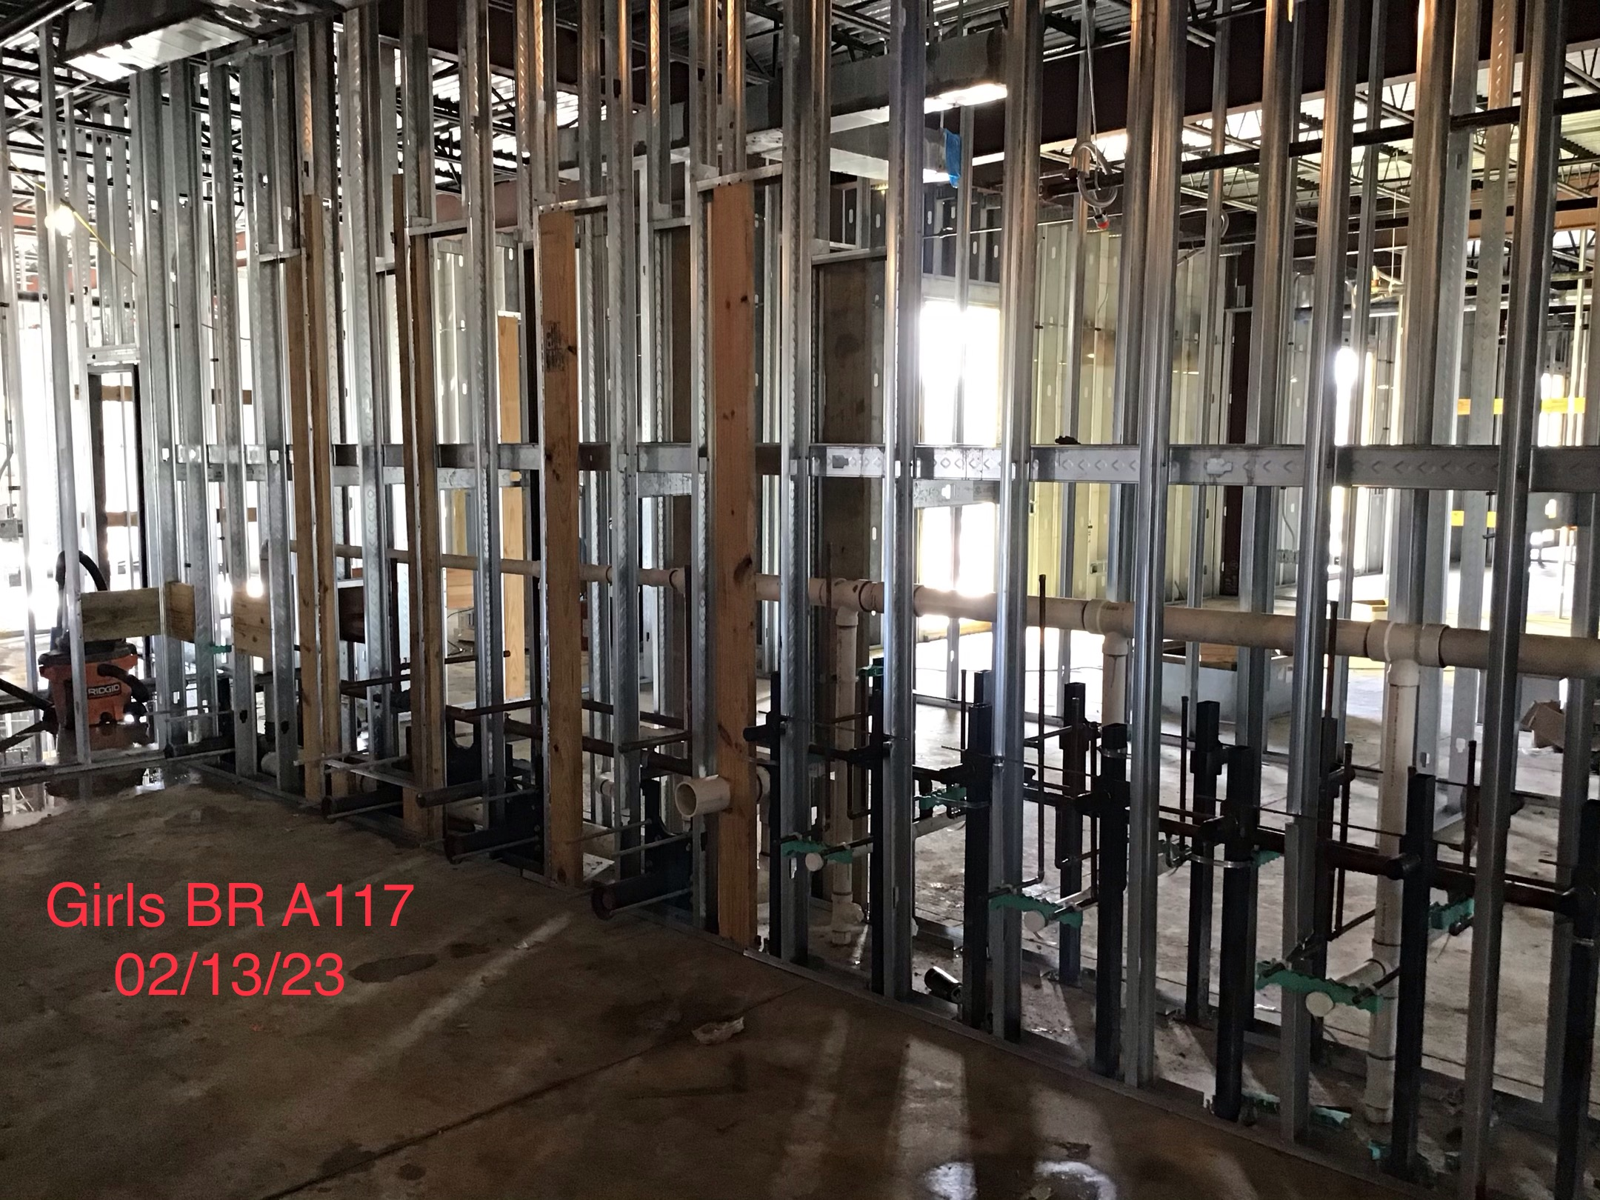
Helena Park Elementary School
Installing metal hangers
Installing duct work
Continue electrical and plumbing work

Slide 19
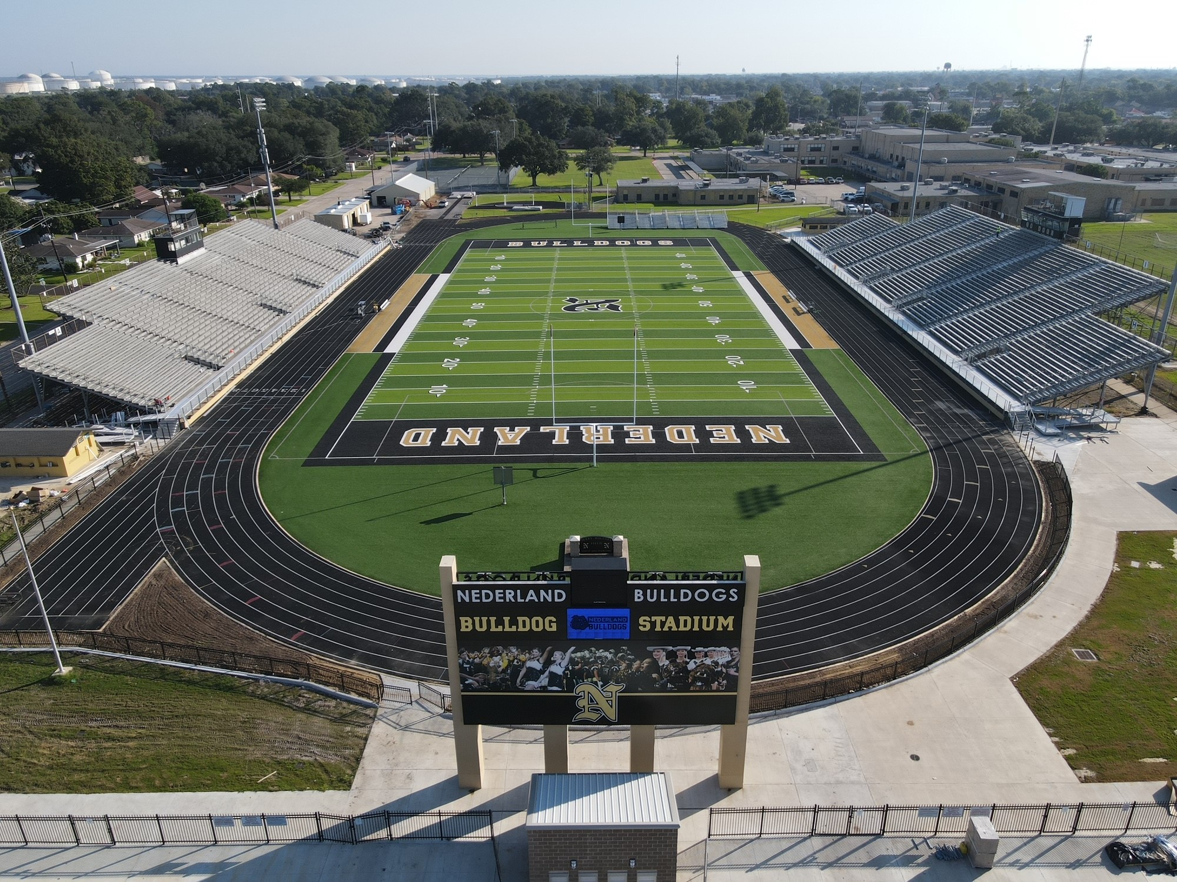
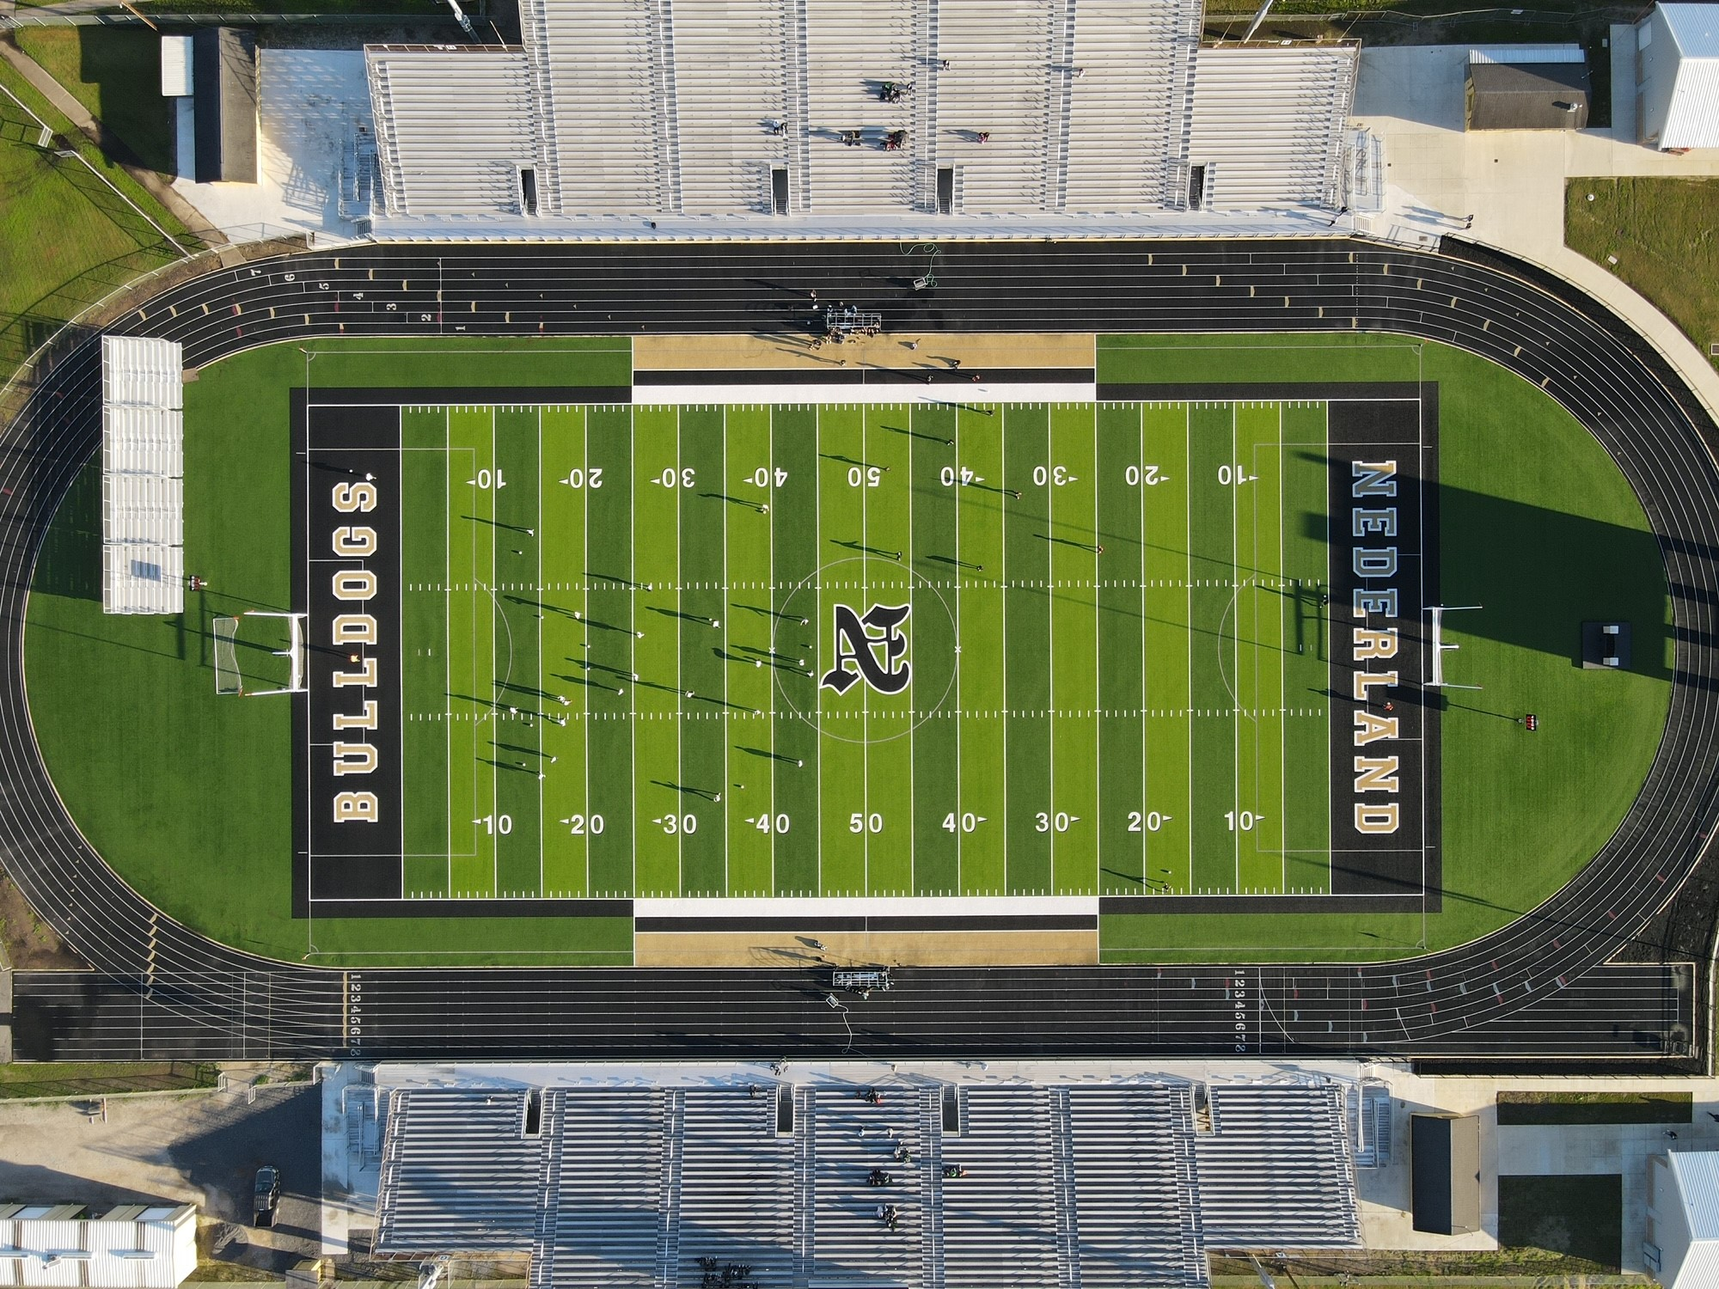
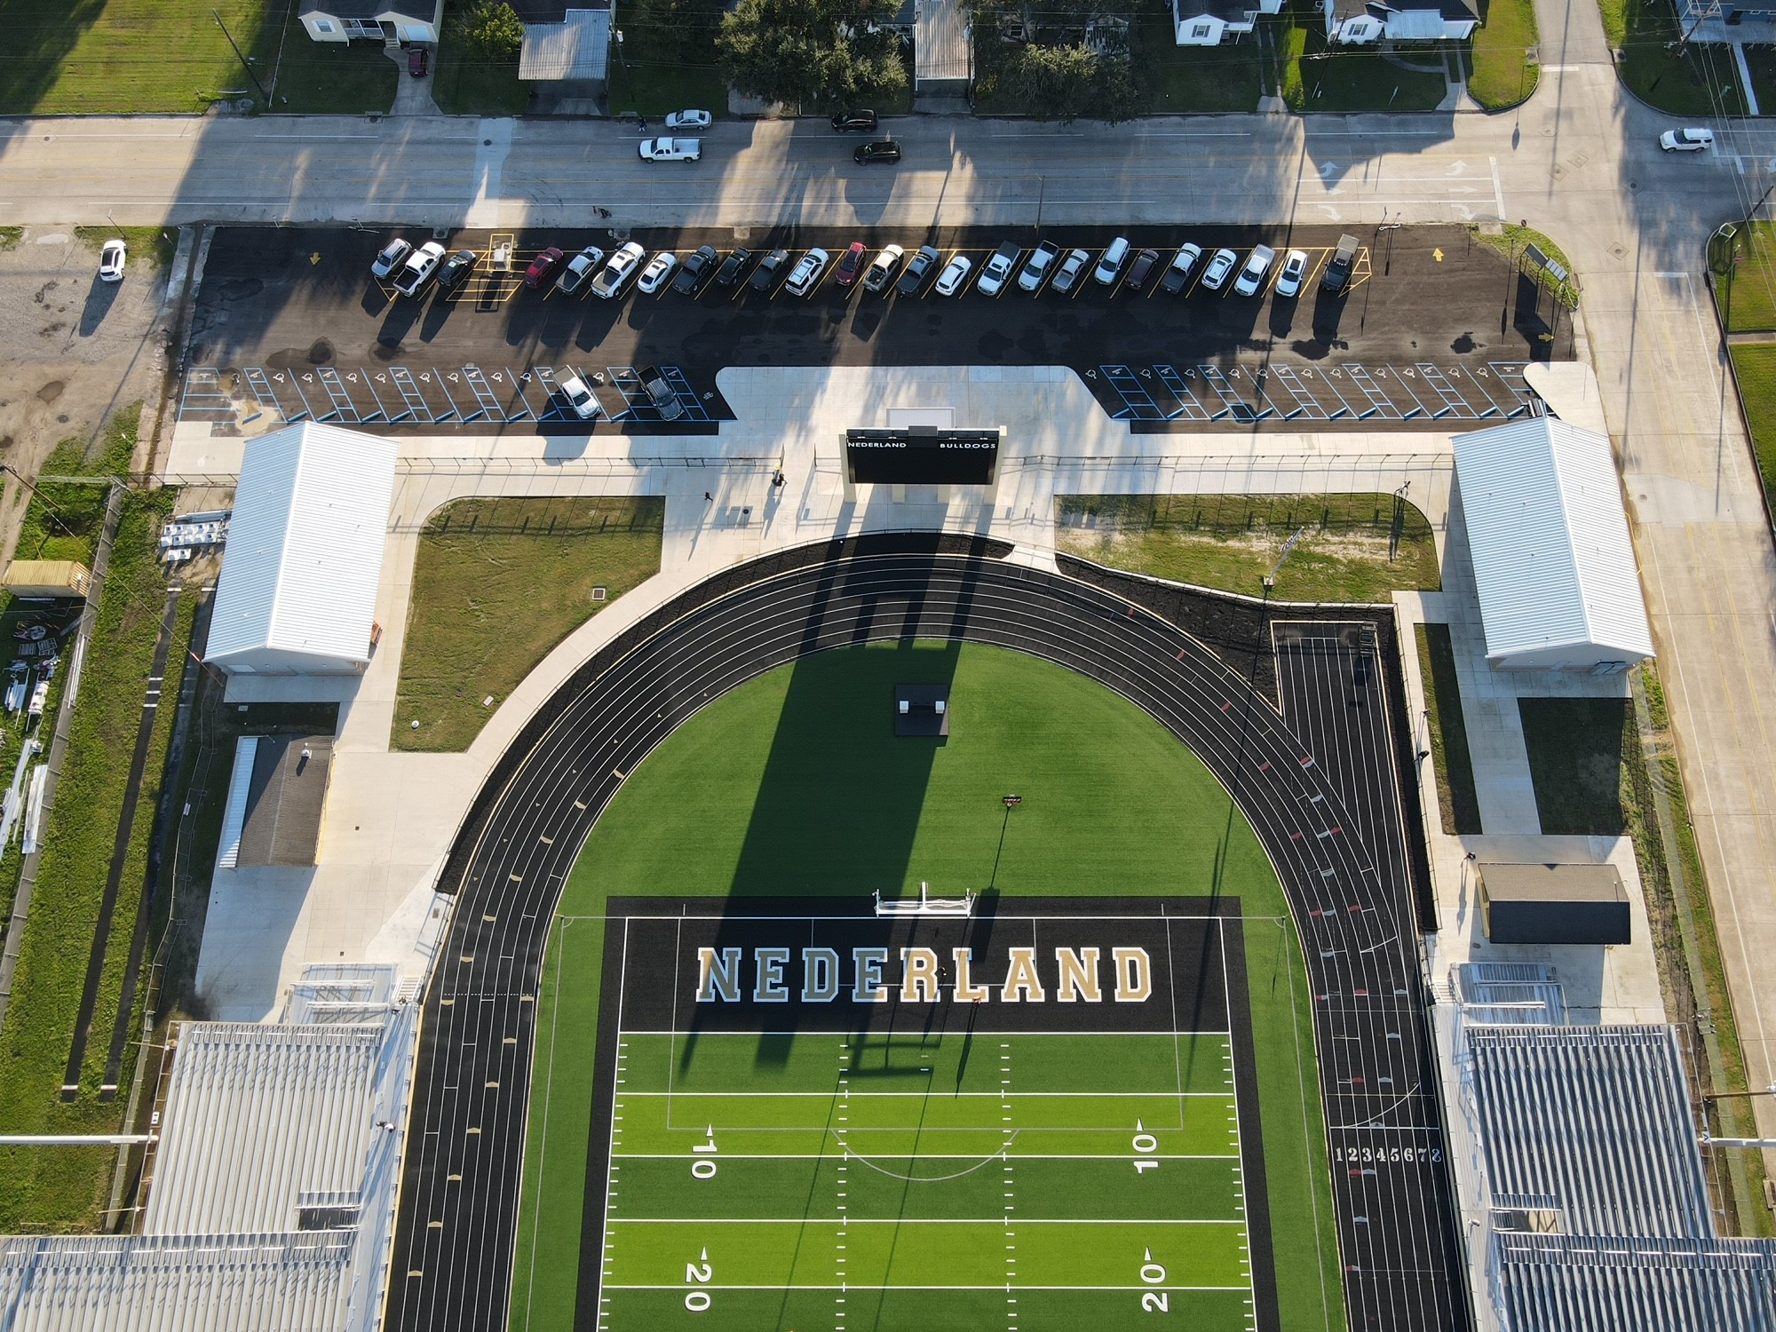
Nederland Bulldog Stadium

Slide 20


