Slide 1




2019 Nederland ISD Bond Project
March 2023

Slide 2

Nederland High School

Slide 3
Nederland High School

Slide 4
Nederland High School

Slide 5
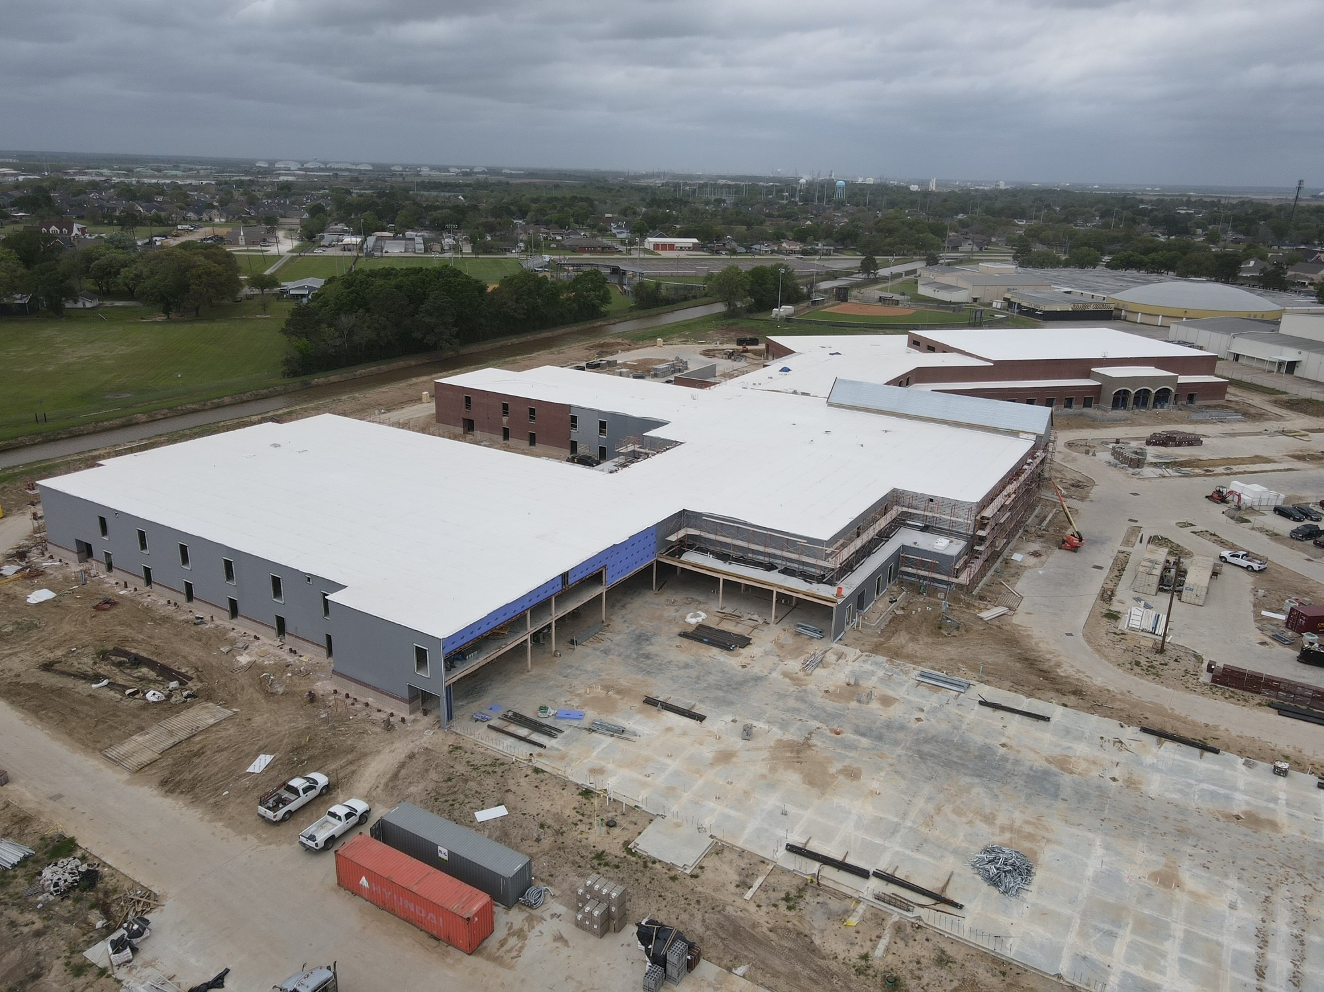
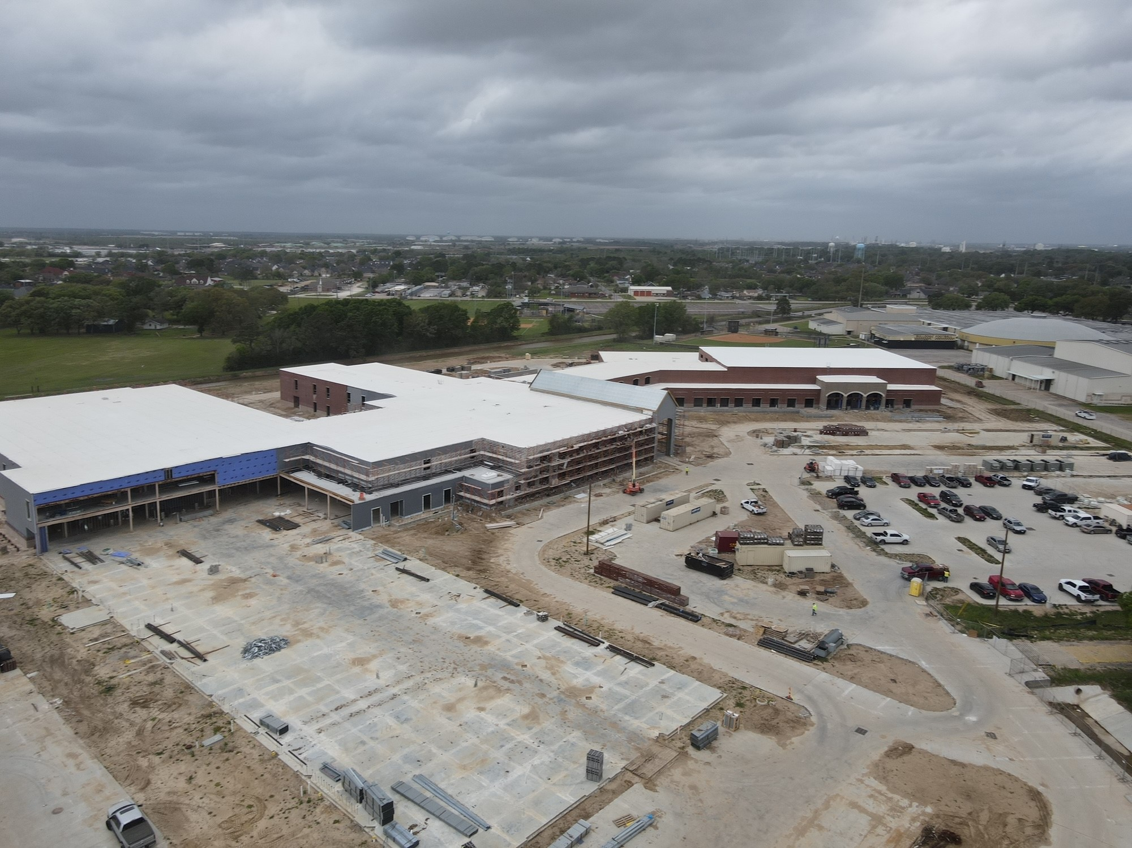
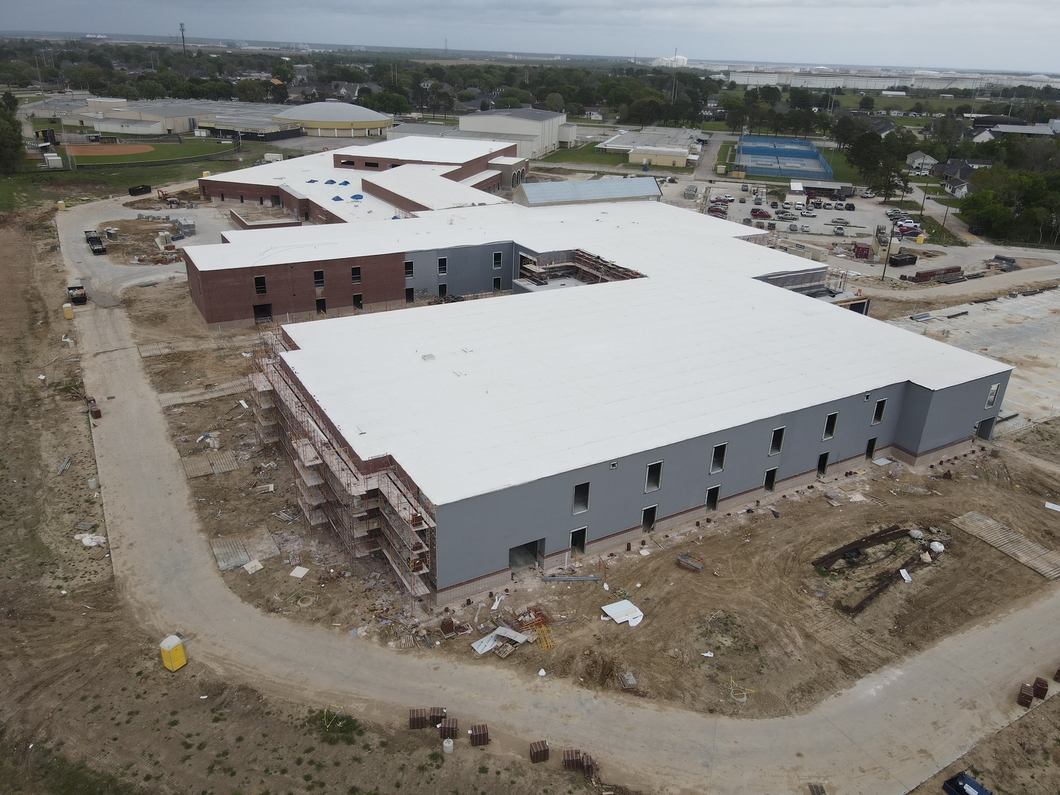
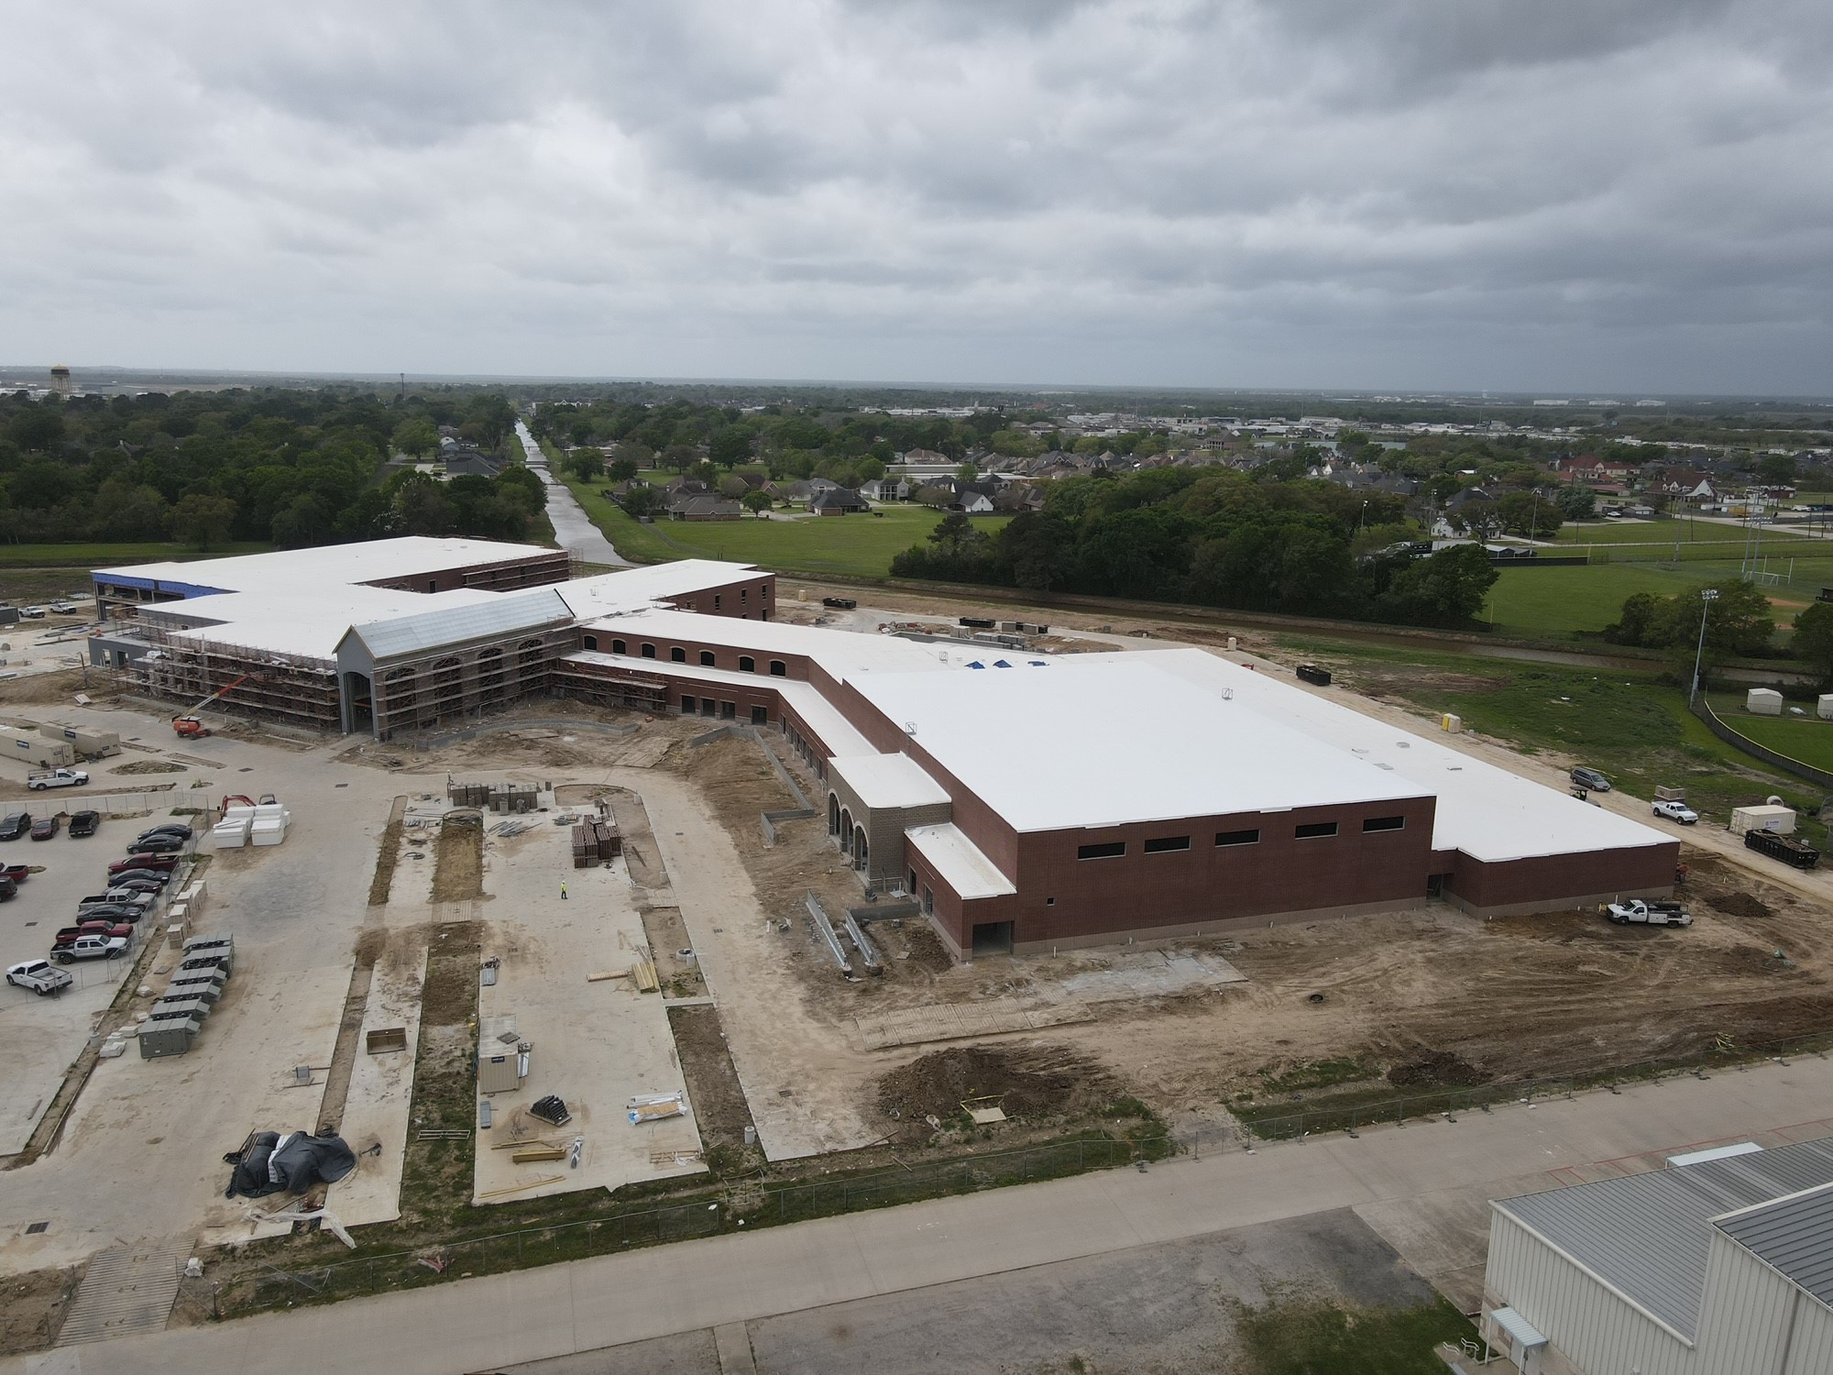
Nederland High School

Slide 6
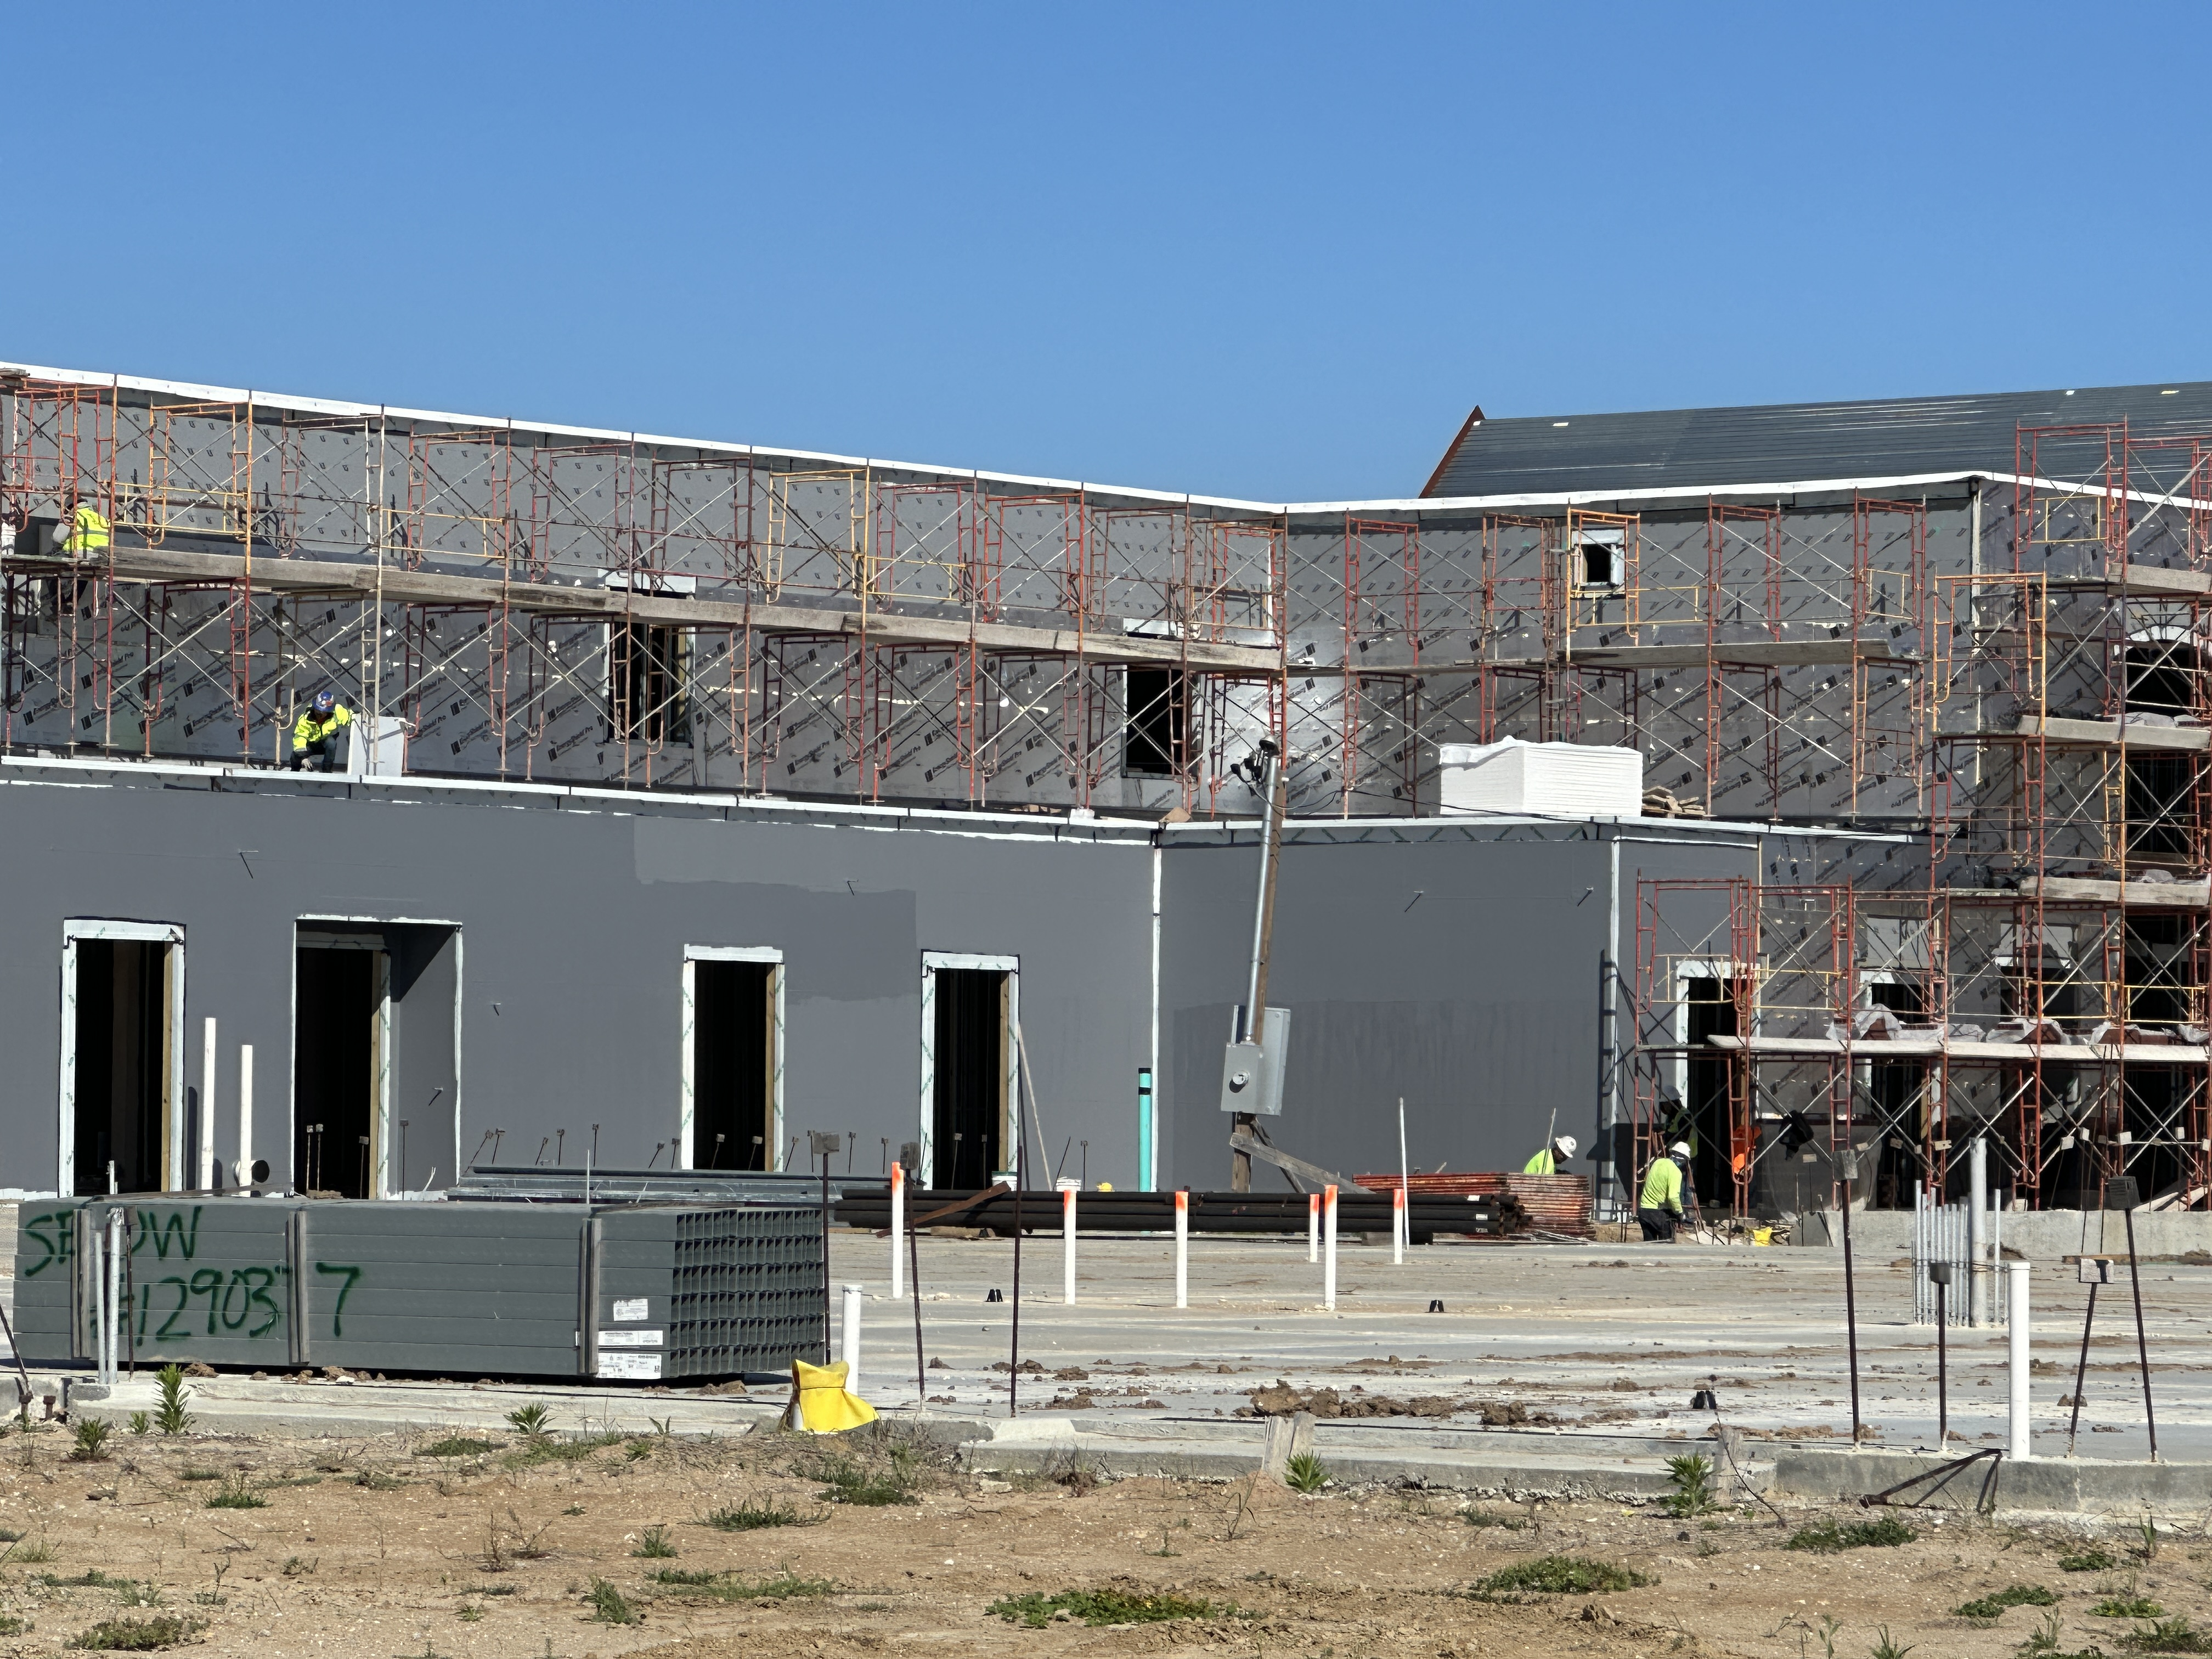
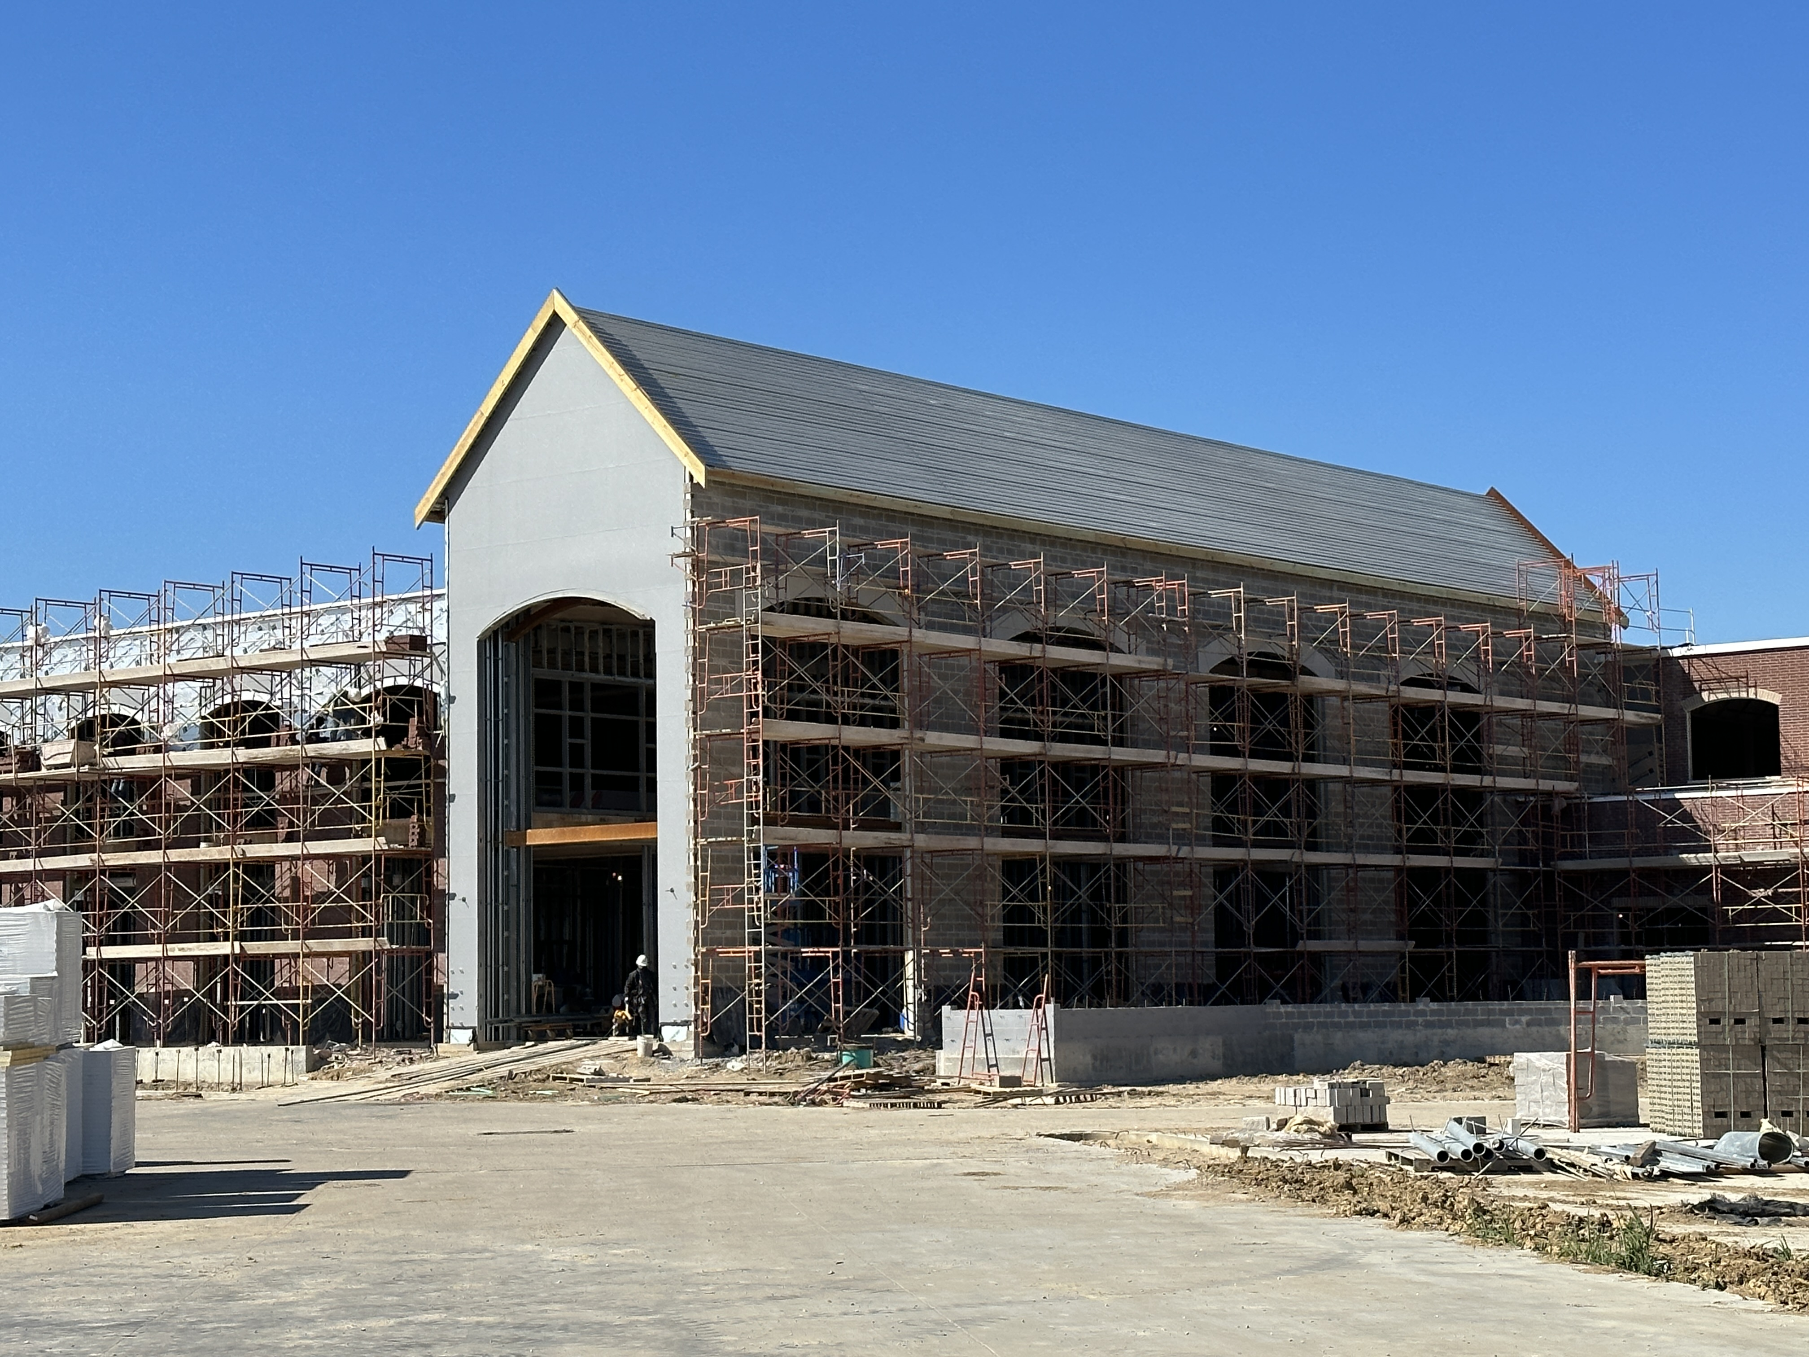
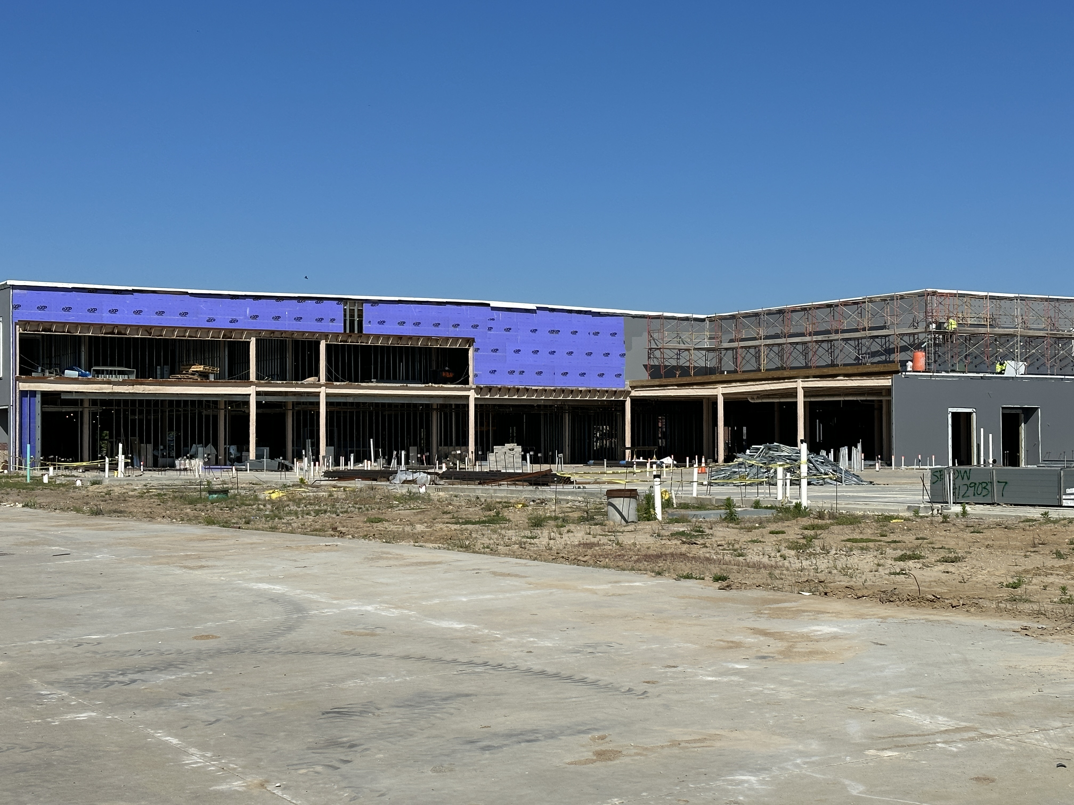
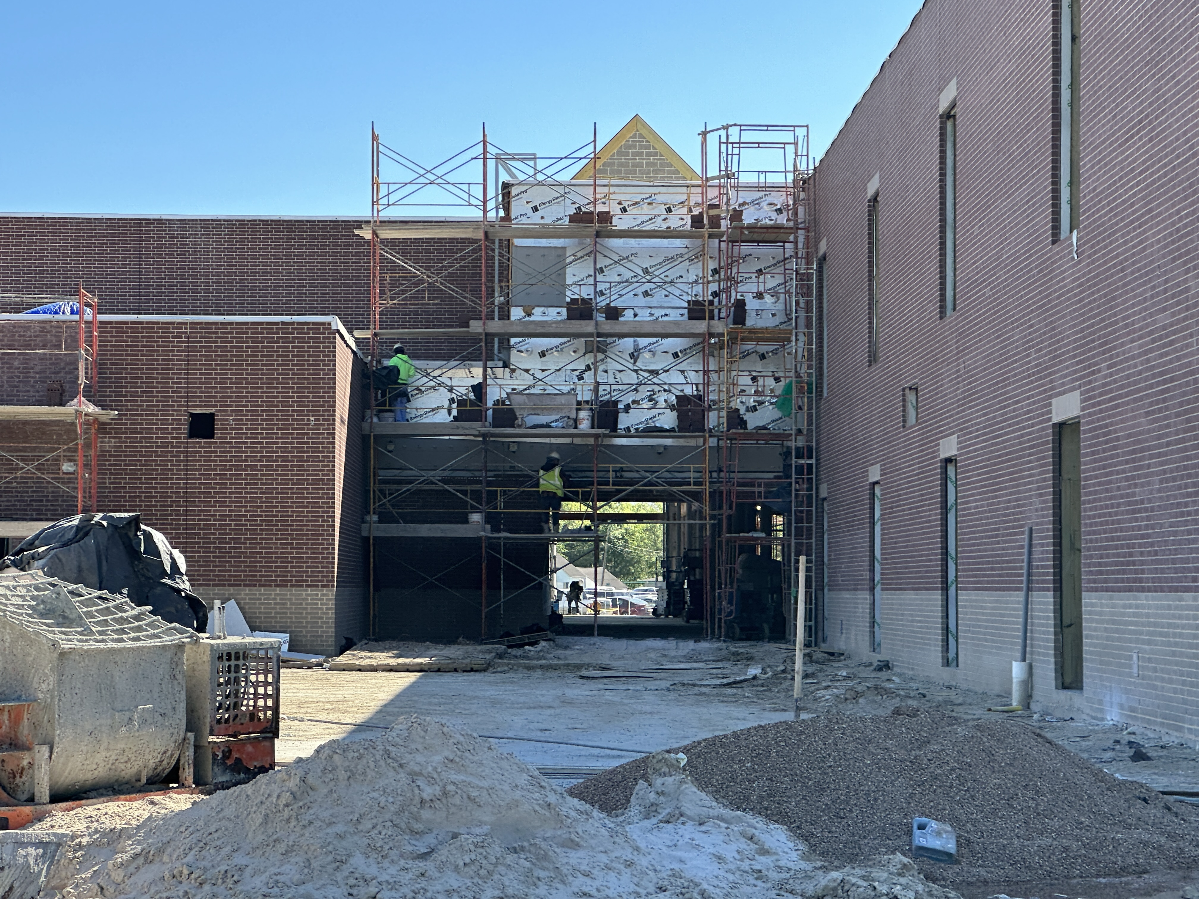
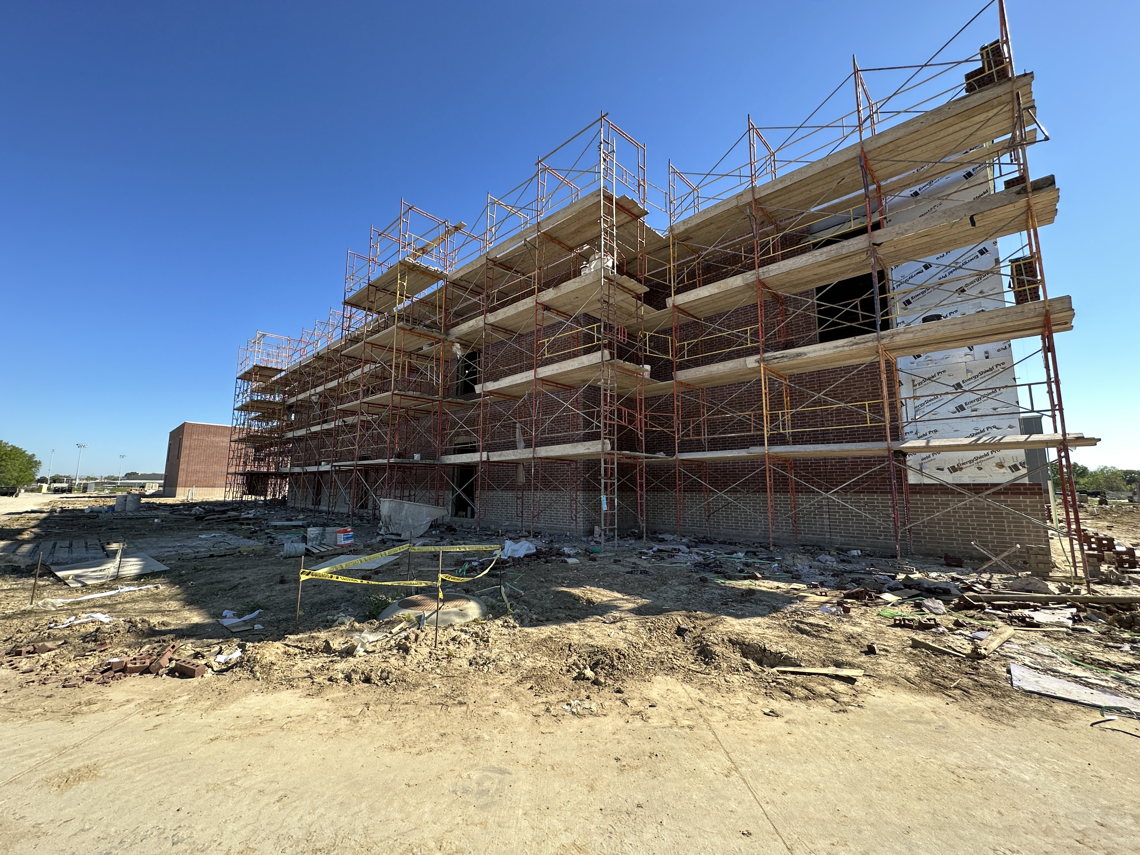
Nederland High School
Brick installation around front entrance
Window Frame installation to begin
Flat work around building
Service yard to be poured

Slide 7
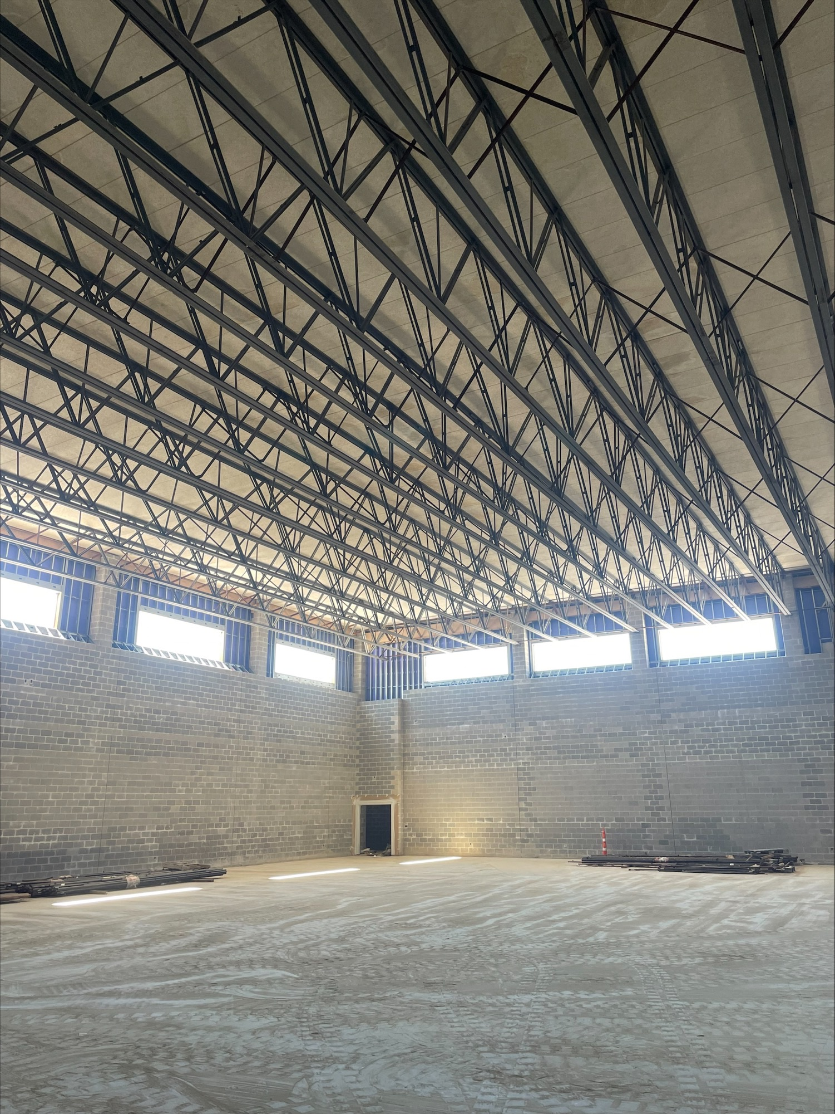
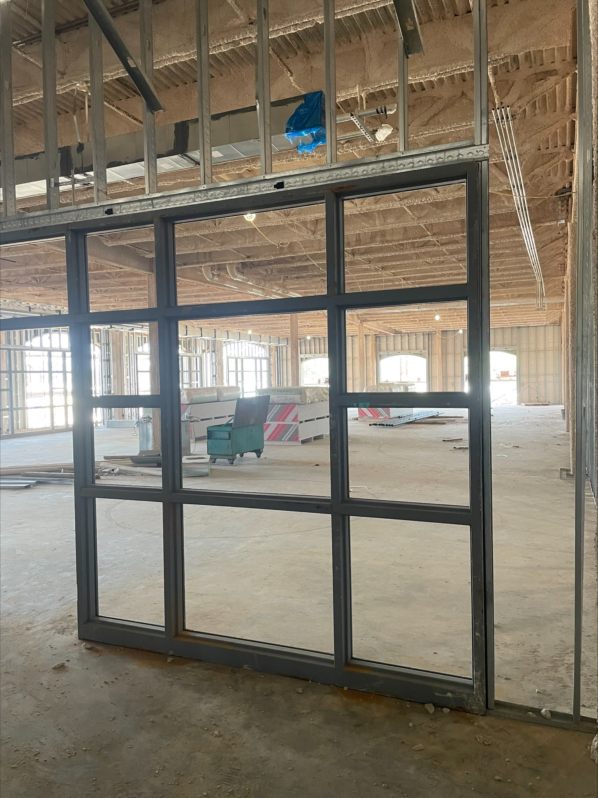
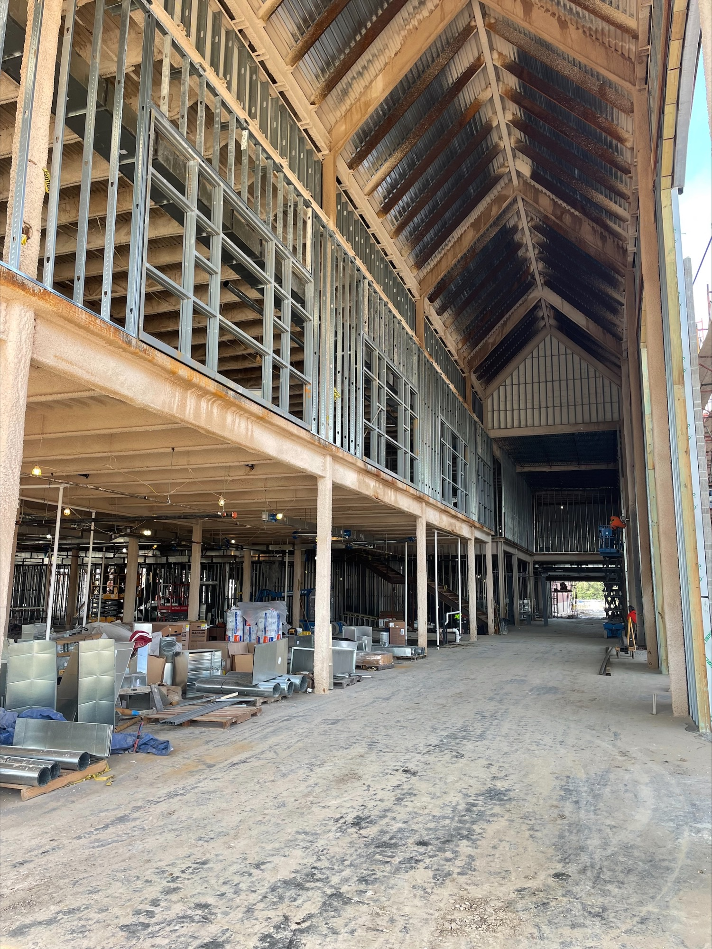
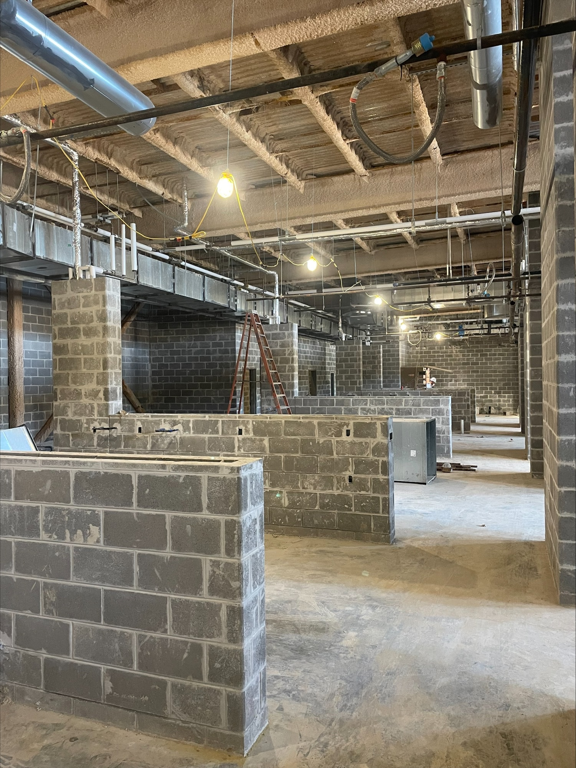
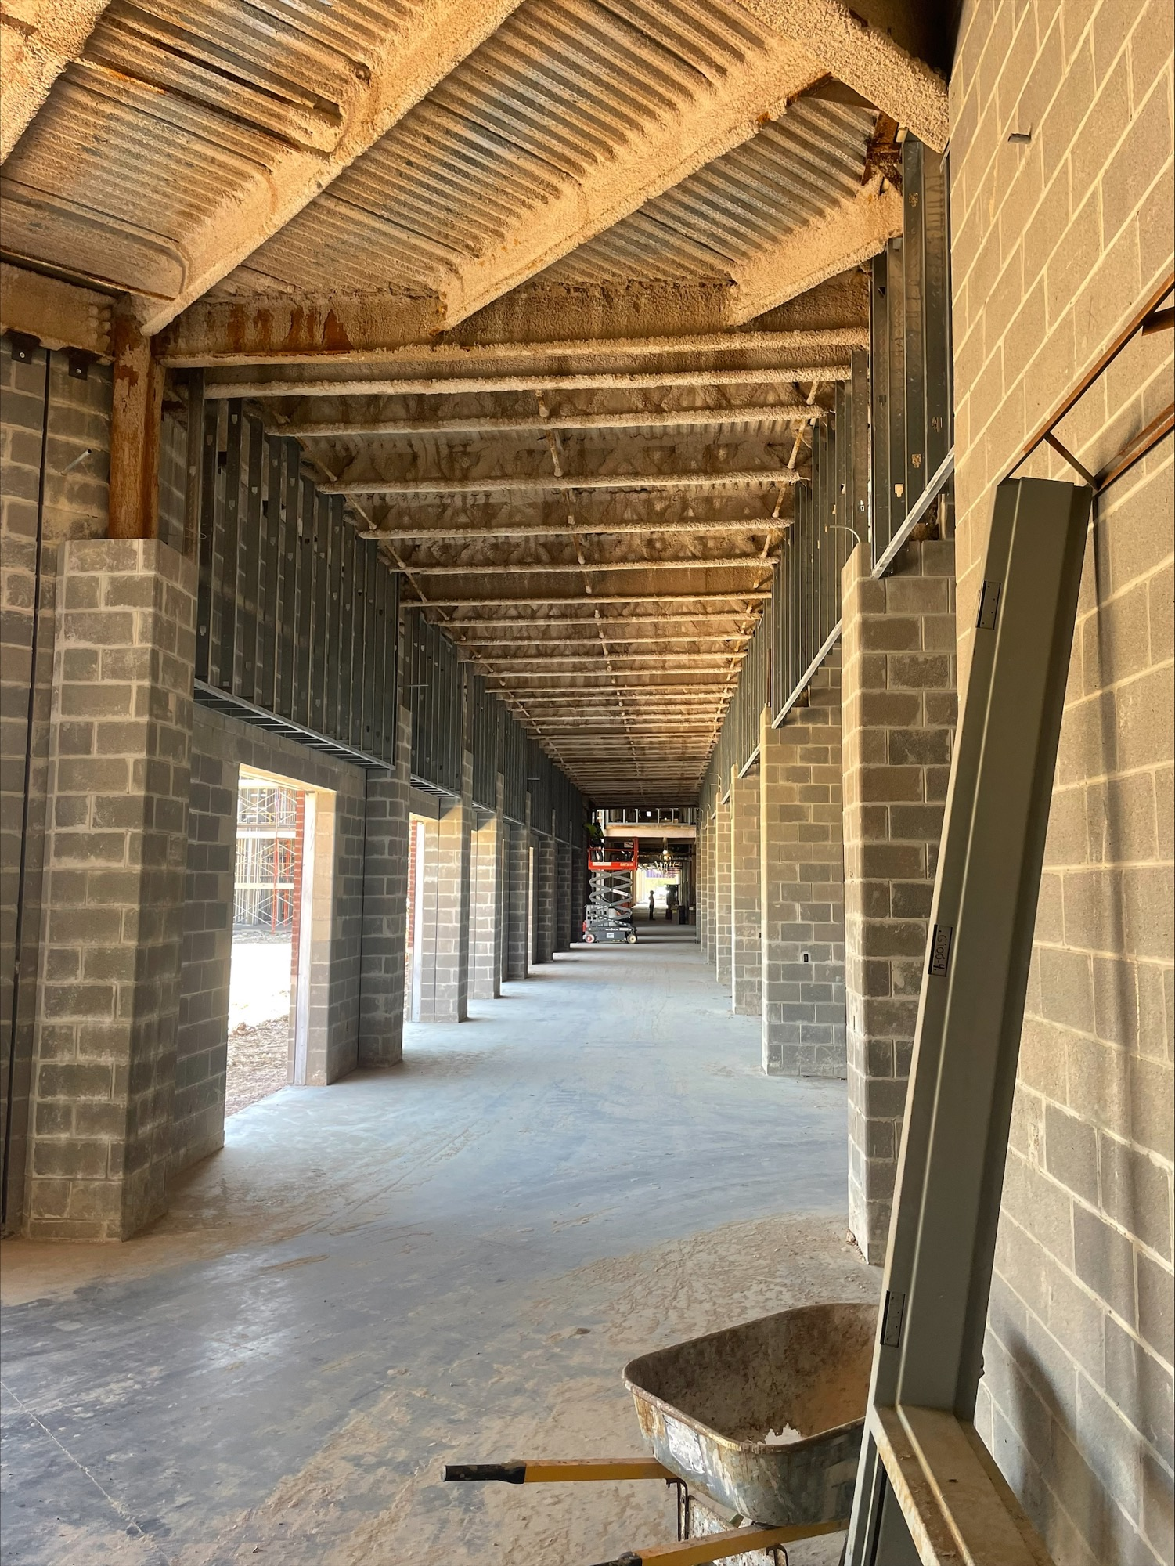
Nederland High School
Top Left: Gymnasium
Middle: Front Entrance
Top Right: Looking into Library
Bottom Left: Kitchen
Bottom Right: Main Corridor

Slide 8

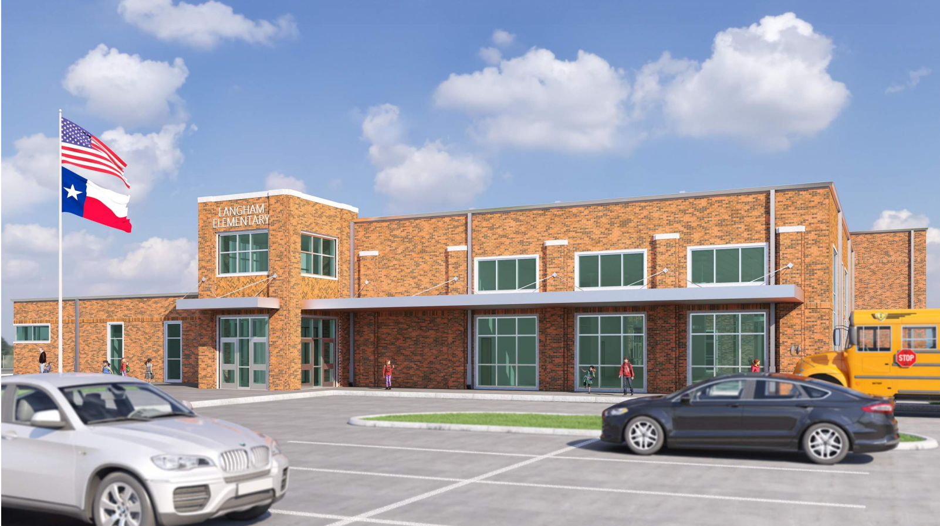
Langham Elementary School

Slide 9
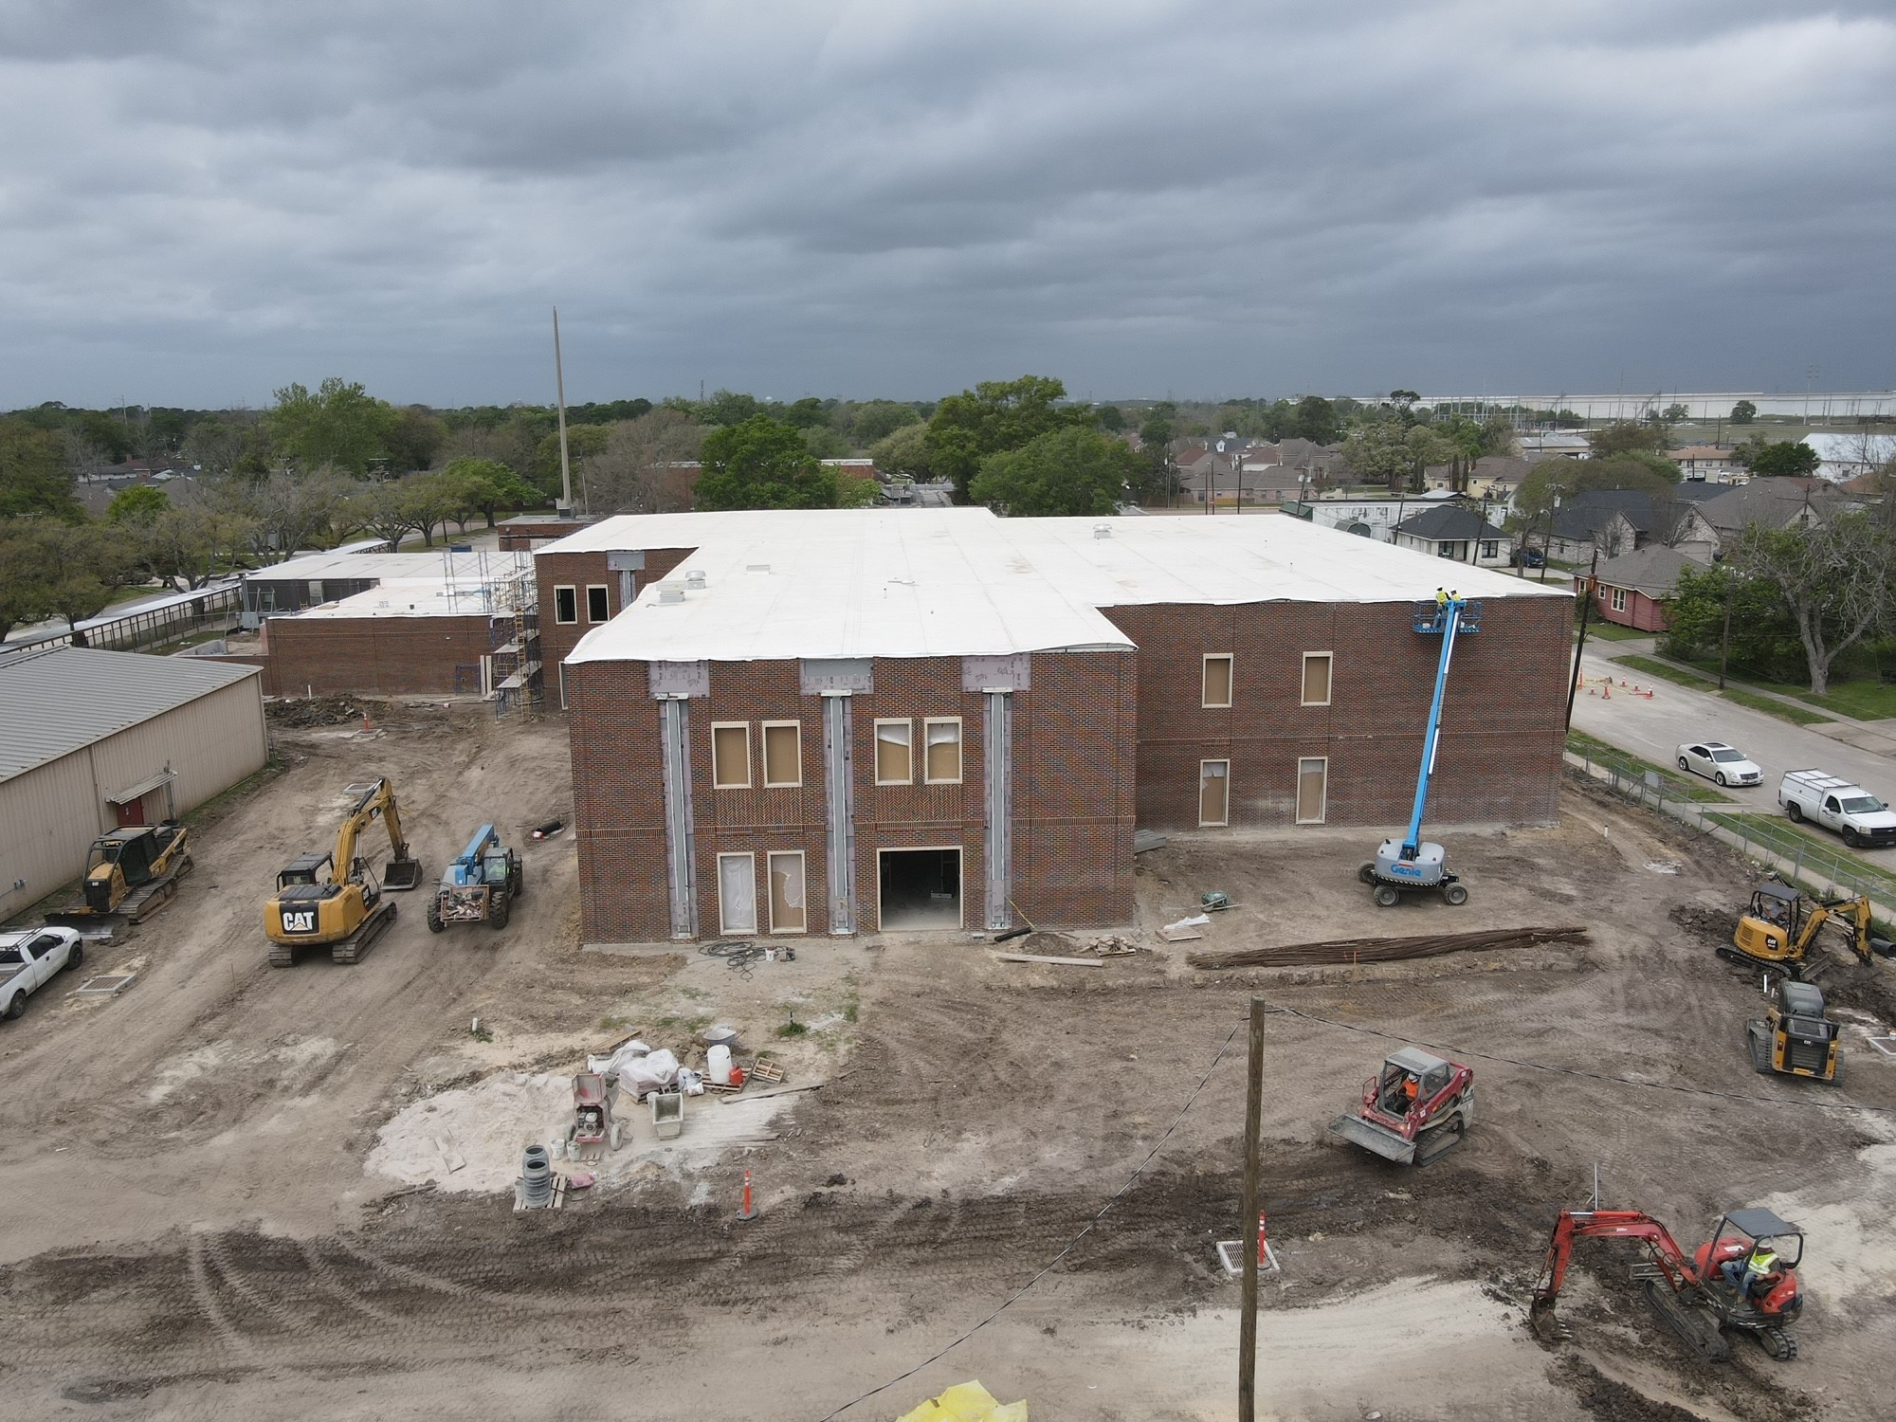
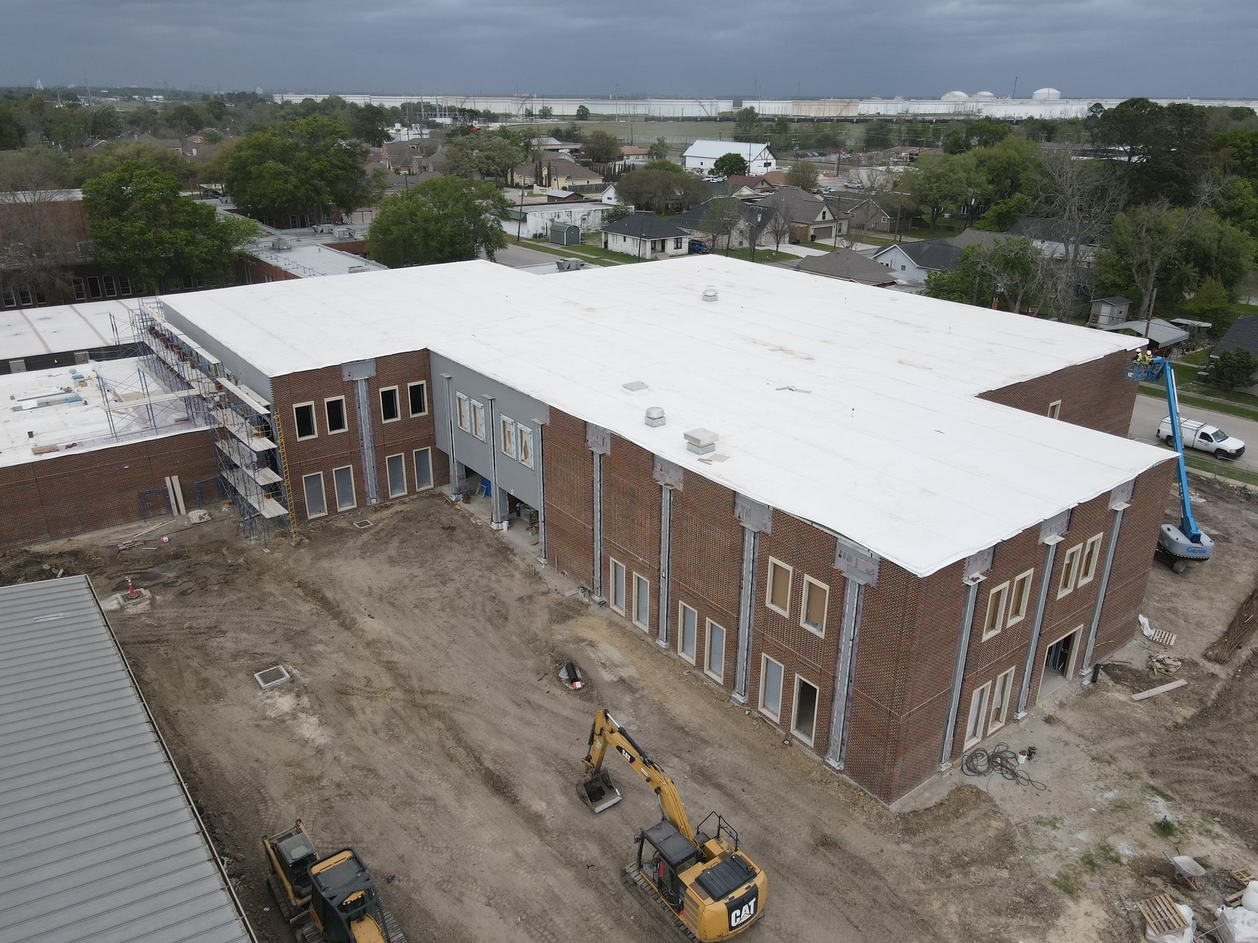
Langham Elementary School
Continuing with Brick installation
Storm Sewer / Paving to continue
Window Installation
Transformer to be set
Perimeter Flashing

Slide 10
Langham Elementary School
Insulation and sheetrock install
Restroom Tile
MEP Top Outs

Slide 11
Hillcrest Elementary School

Slide 12
Hillcrest Elementary School
Window Frame Installation
Brick Arrival – Tomorrow Per Acme Brick
Storm Sewer Tie In – Ave H & 27th St.
Kitchen Remodel

Slide 13
Hillcrest Elementary School
Hang Insulation & Drywall
Tape/Float
Installing HVAC Ducts
Continue Electrical Work

Slide 14
Hillcrest Elementary School – Renovations
Kitchen Demo / Remodel

Slide 15
Highland Park Elementary School

Slide 16
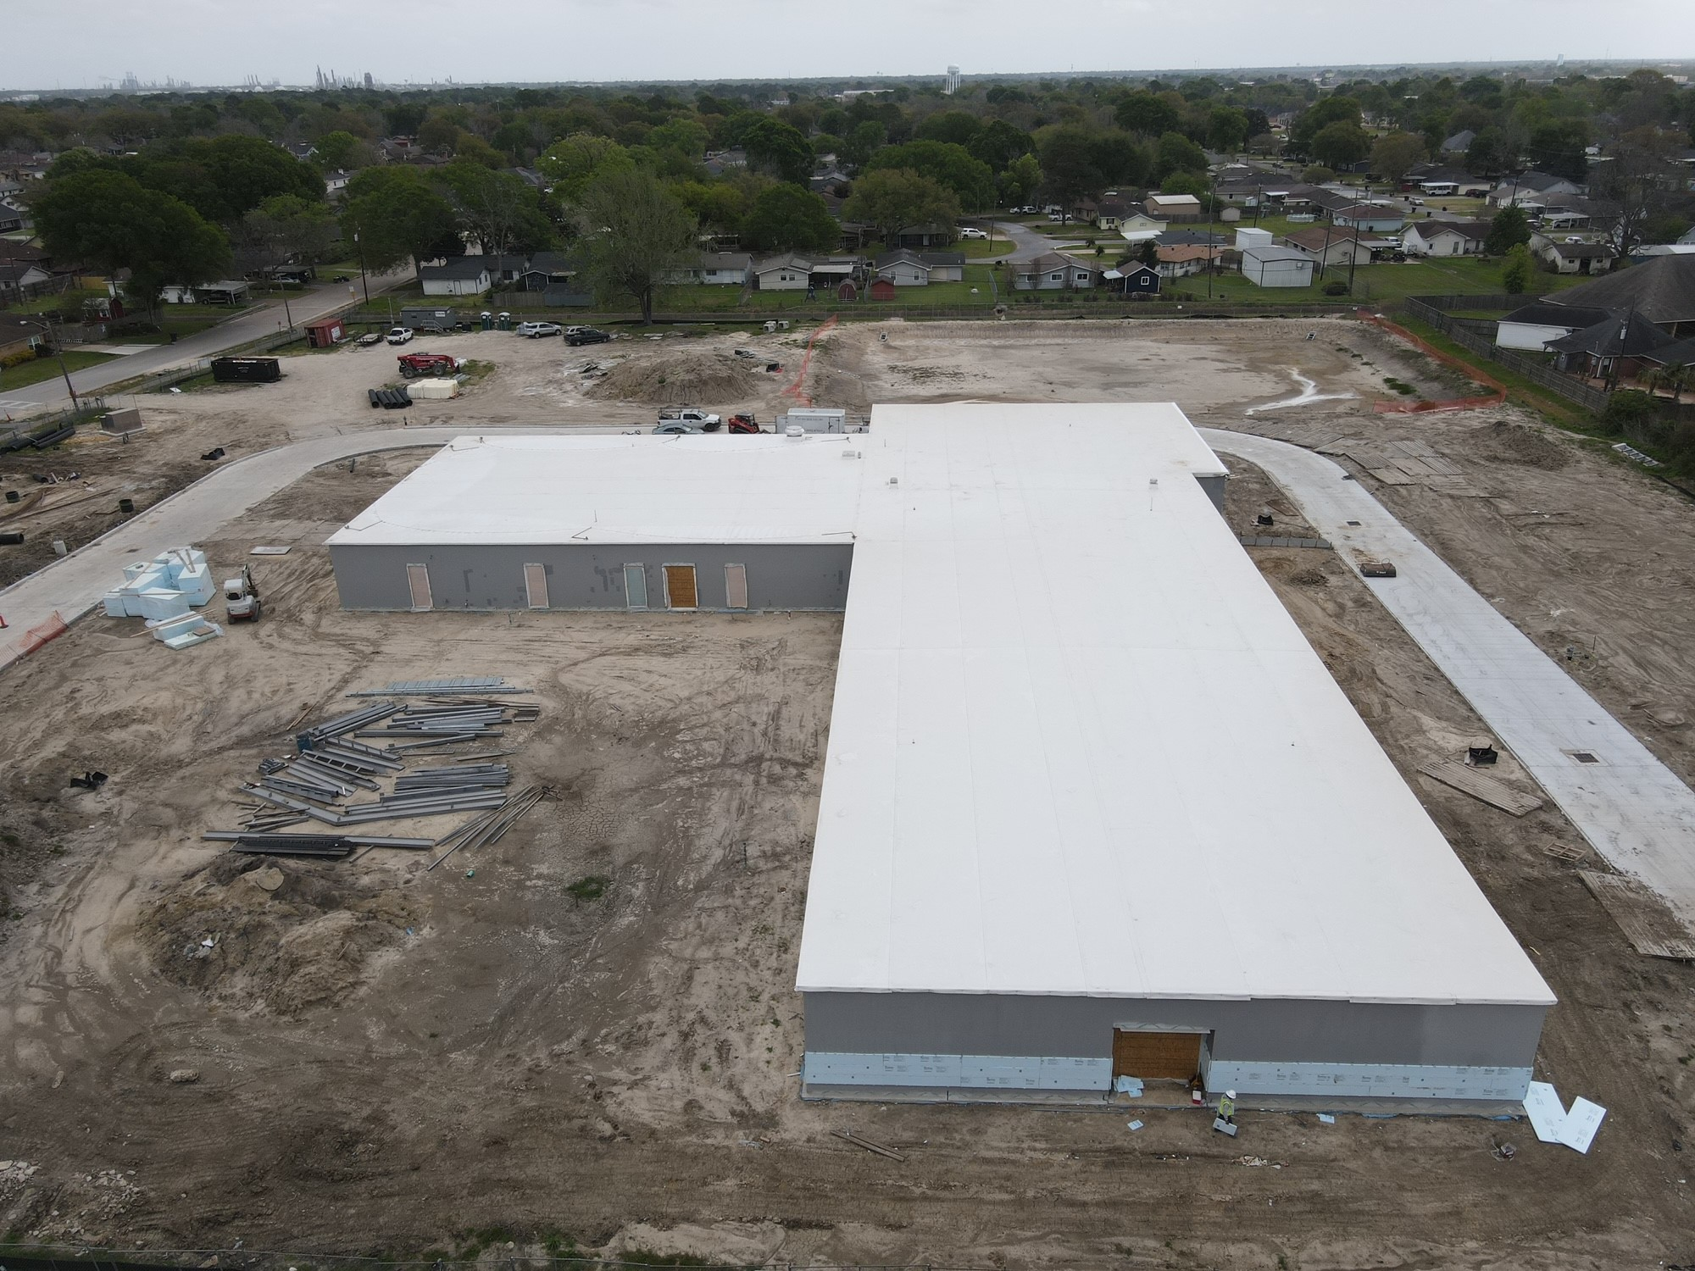
Highland Park Elementary School
Kitchen Remodel
Start brick work – Delivered Today
Service Yard
Set Transformer

Slide 17
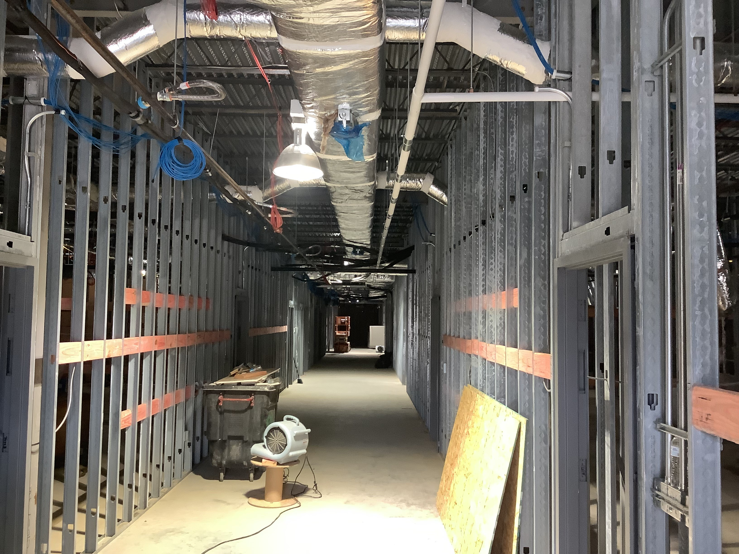
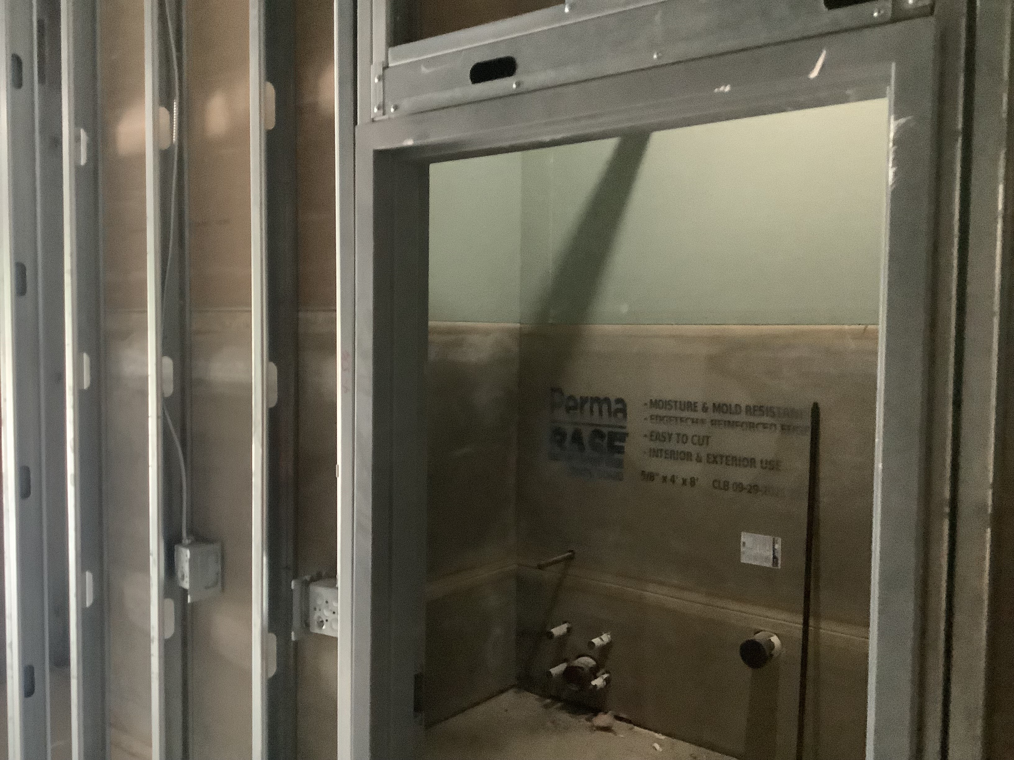
Highland Park Elementary School
Interior Blocking
Hang Insulation / Drywall
Tape/ Float

Slide 18
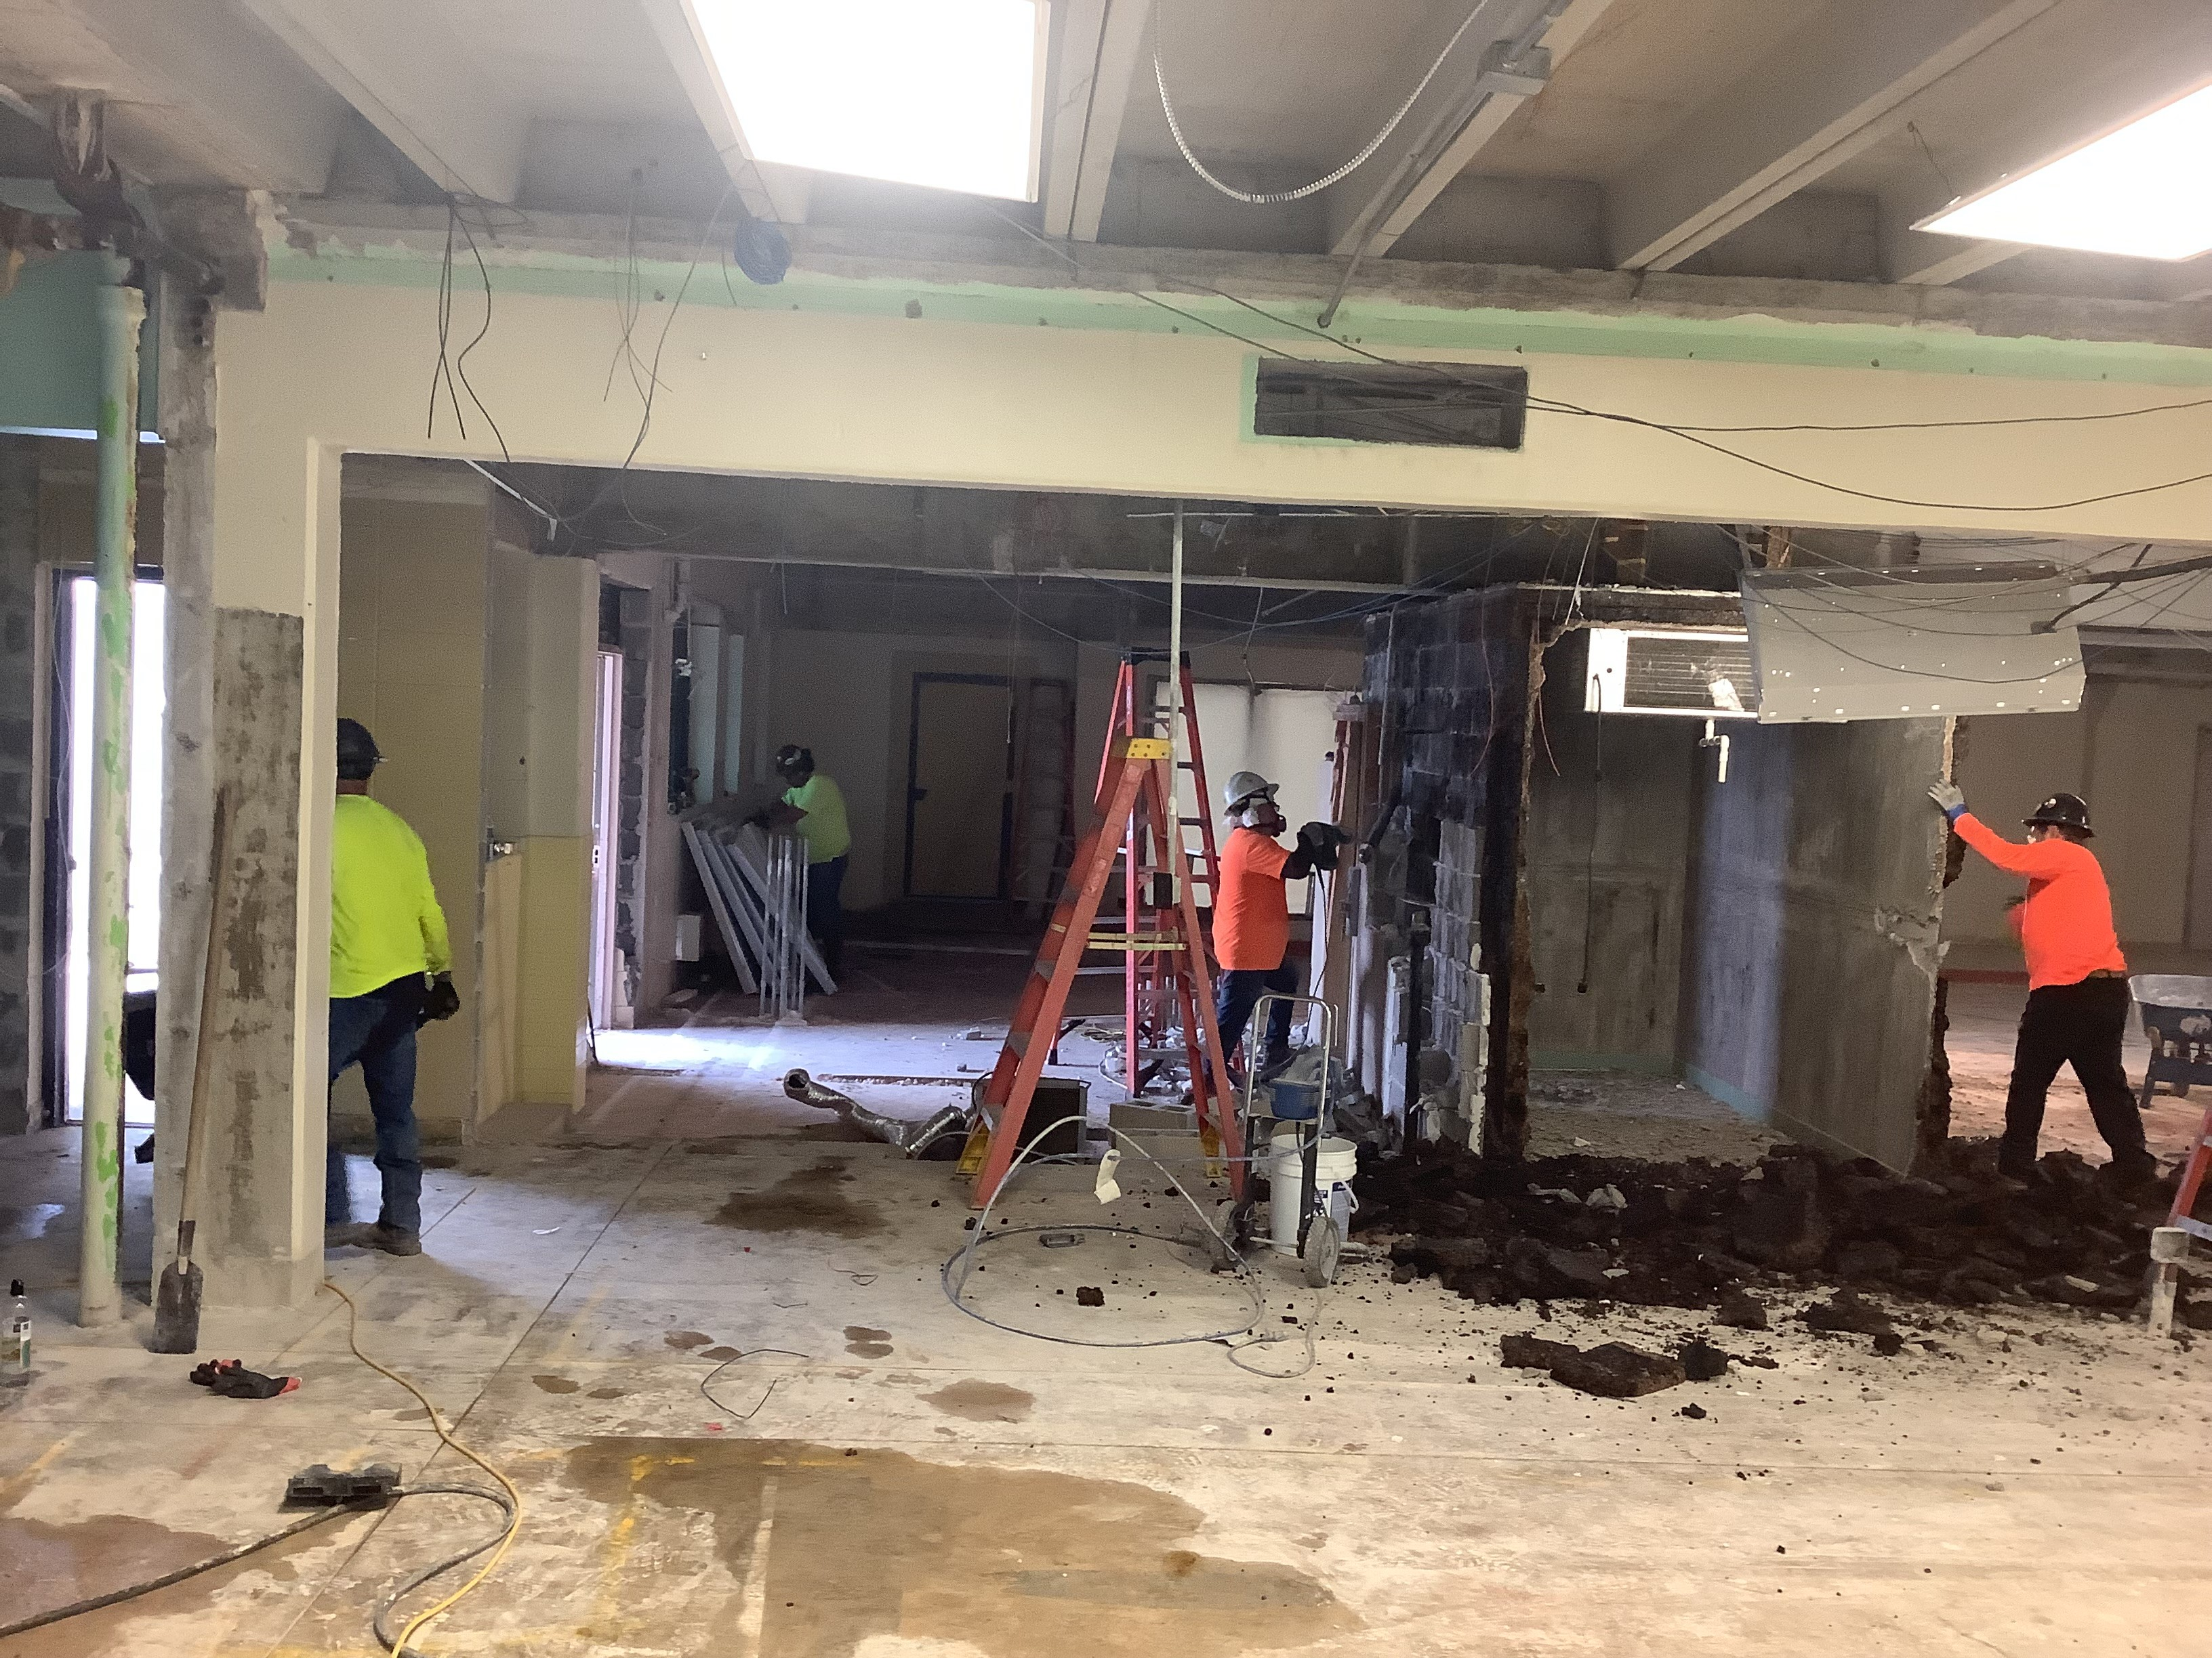
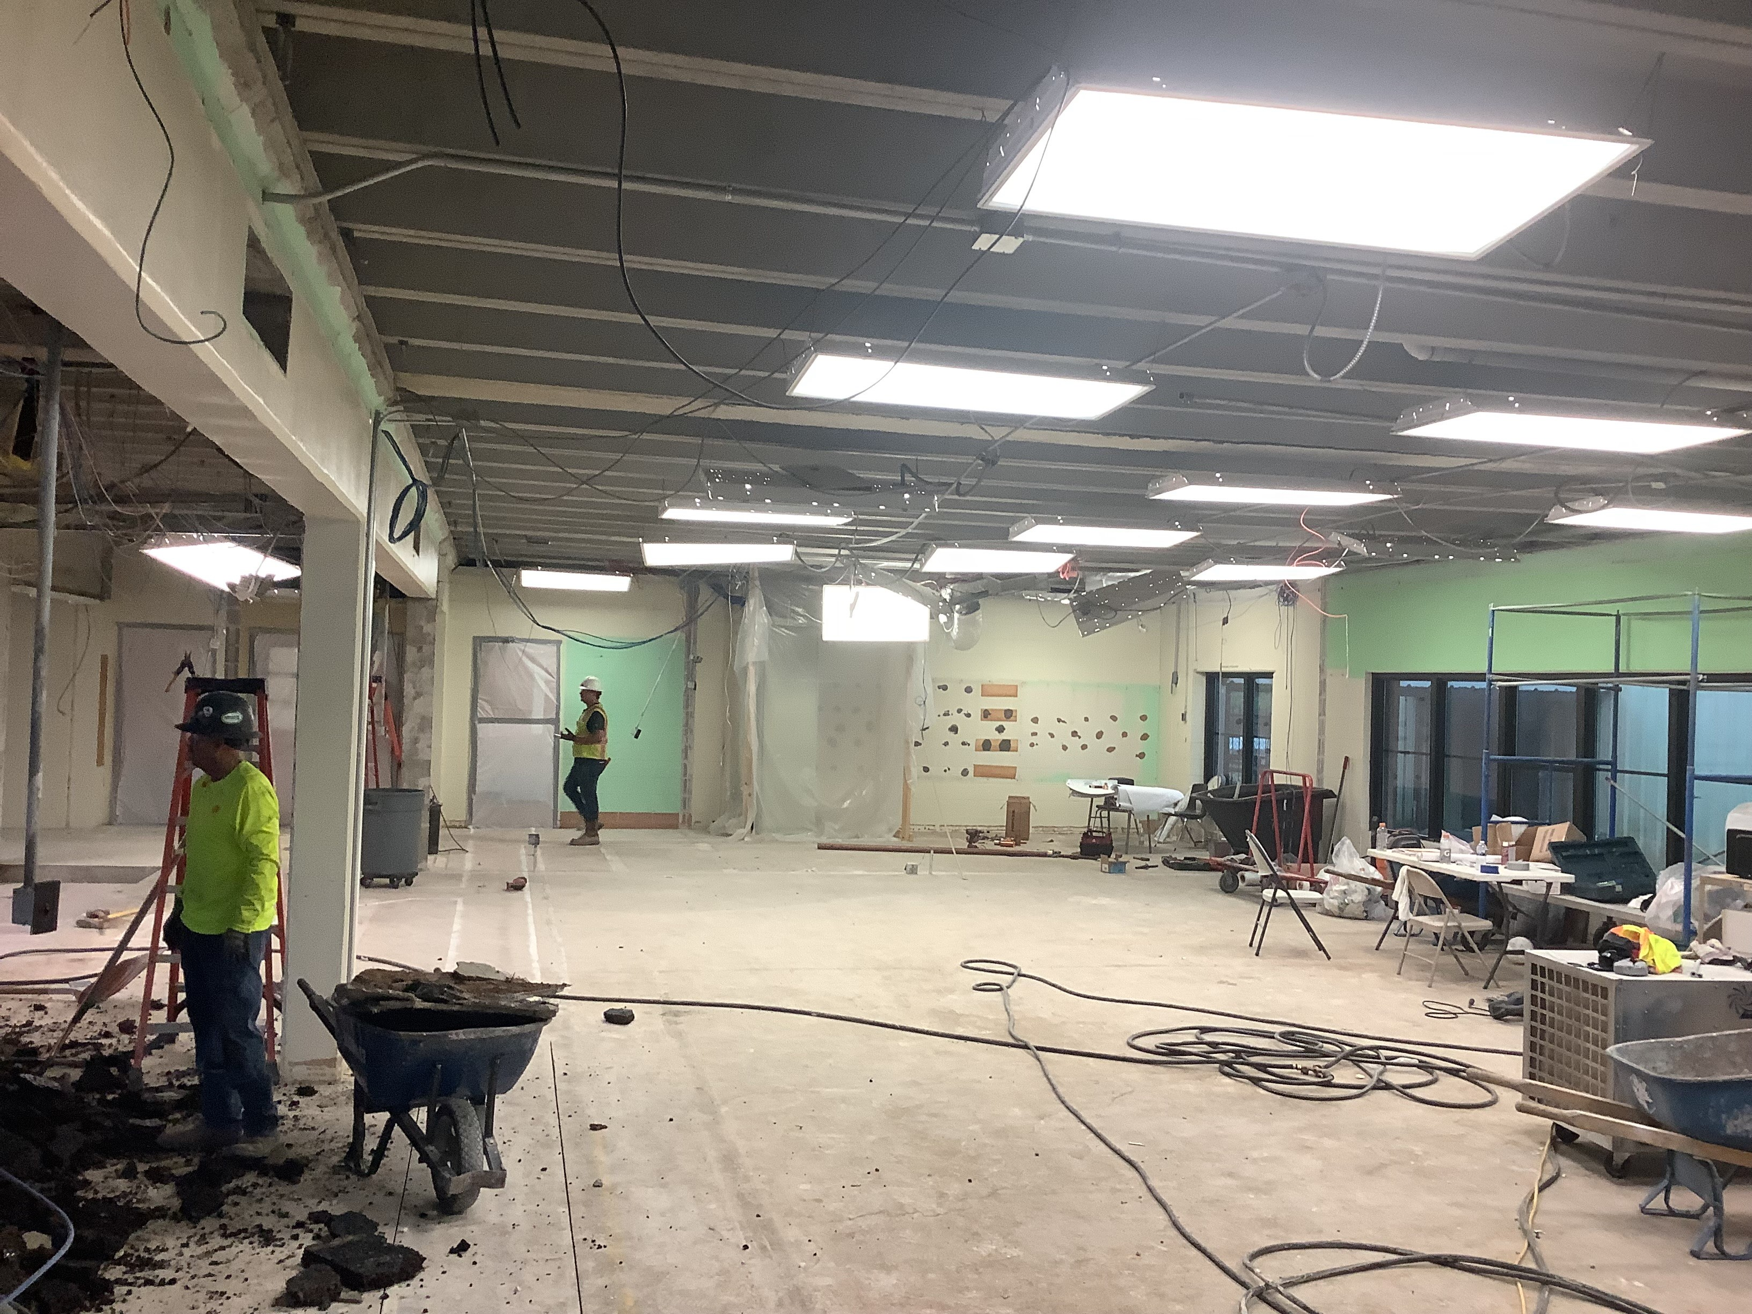
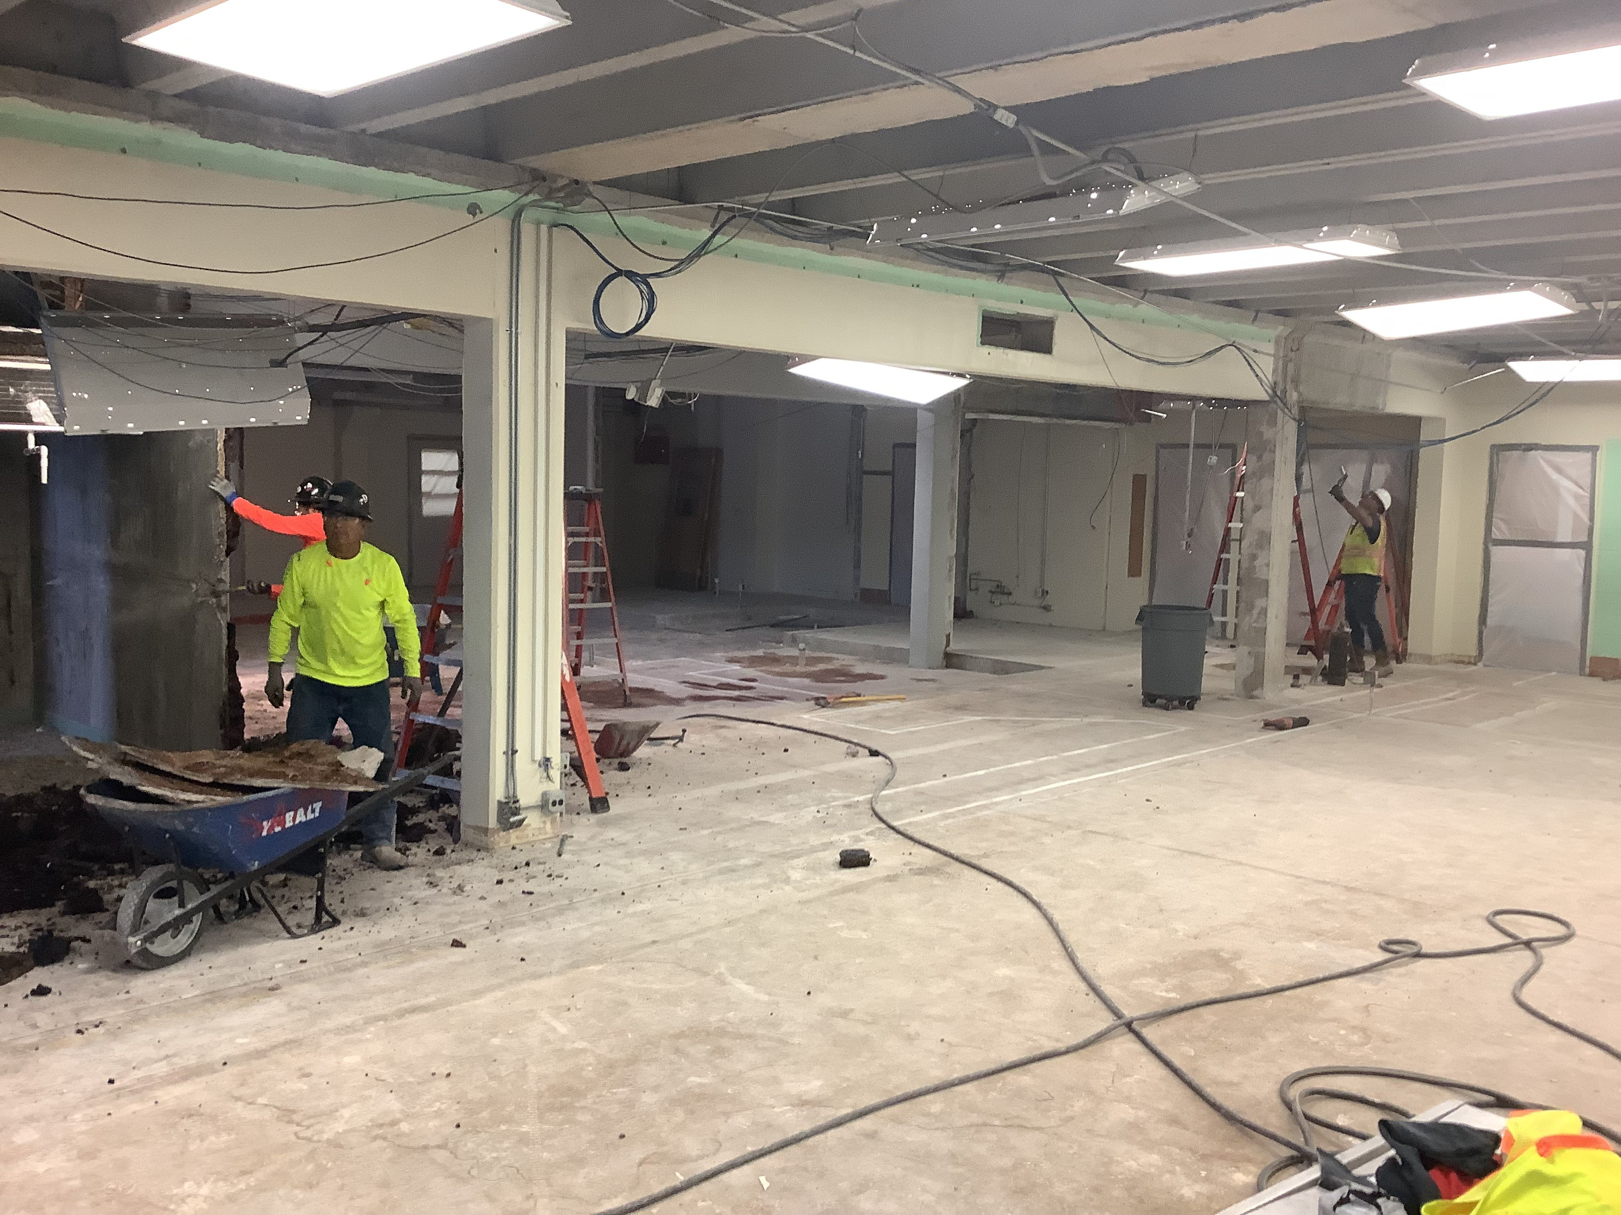
Highland Park Elementary School - Renovations
Kitchen Demo / Remodel

Slide 19
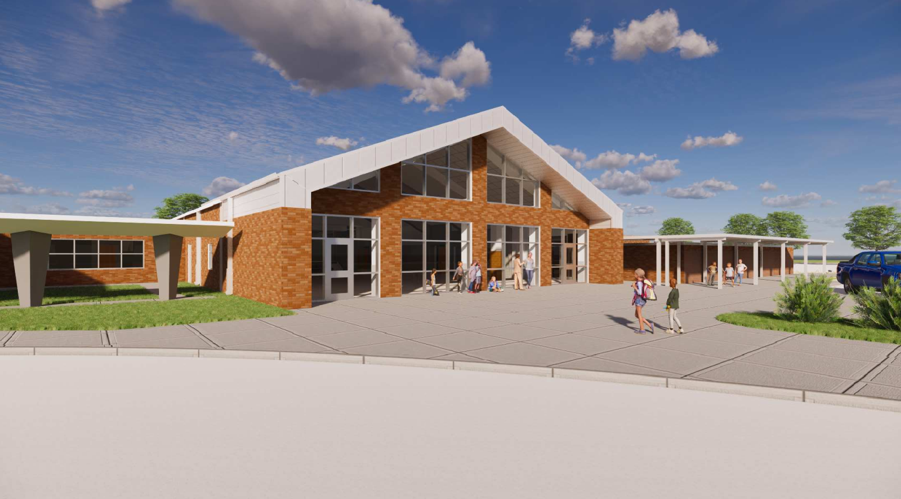
Helena Park Elementary School

Slide 20
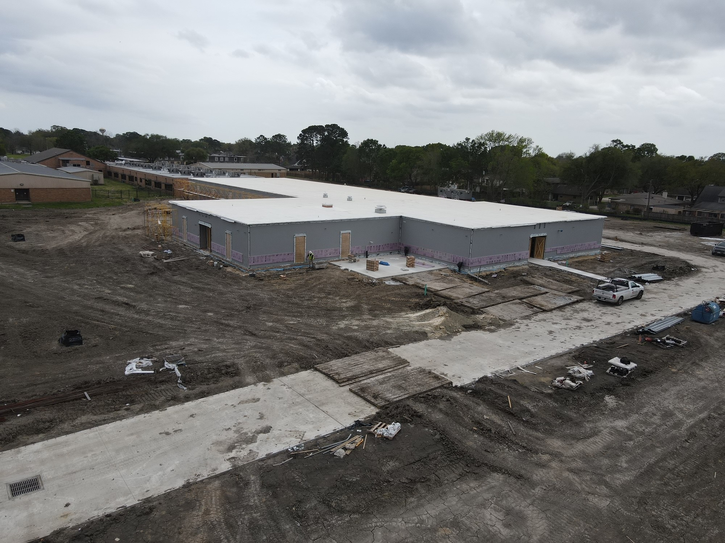
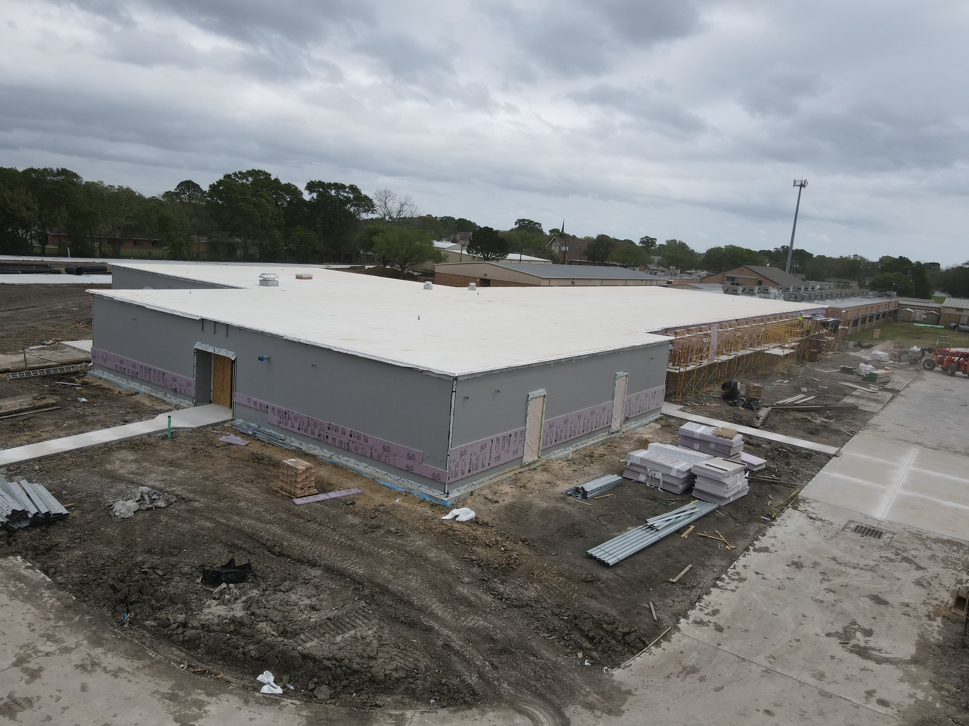
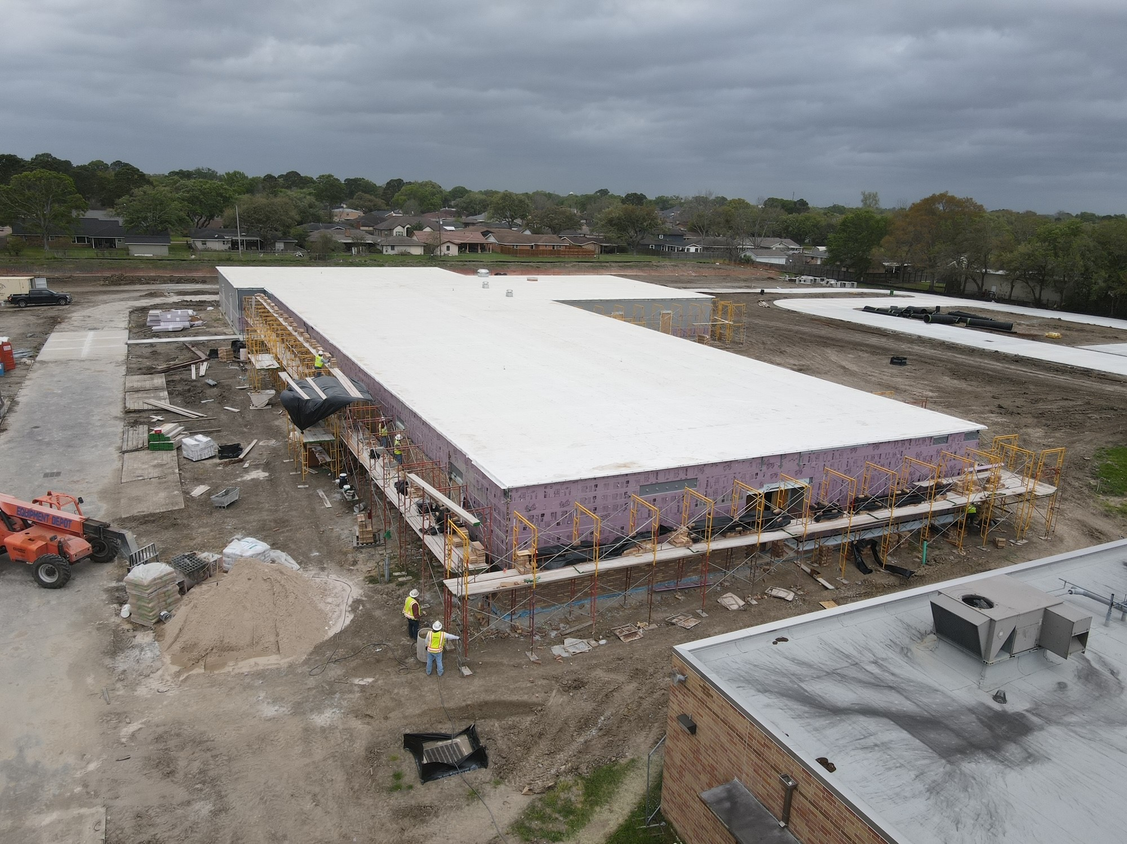
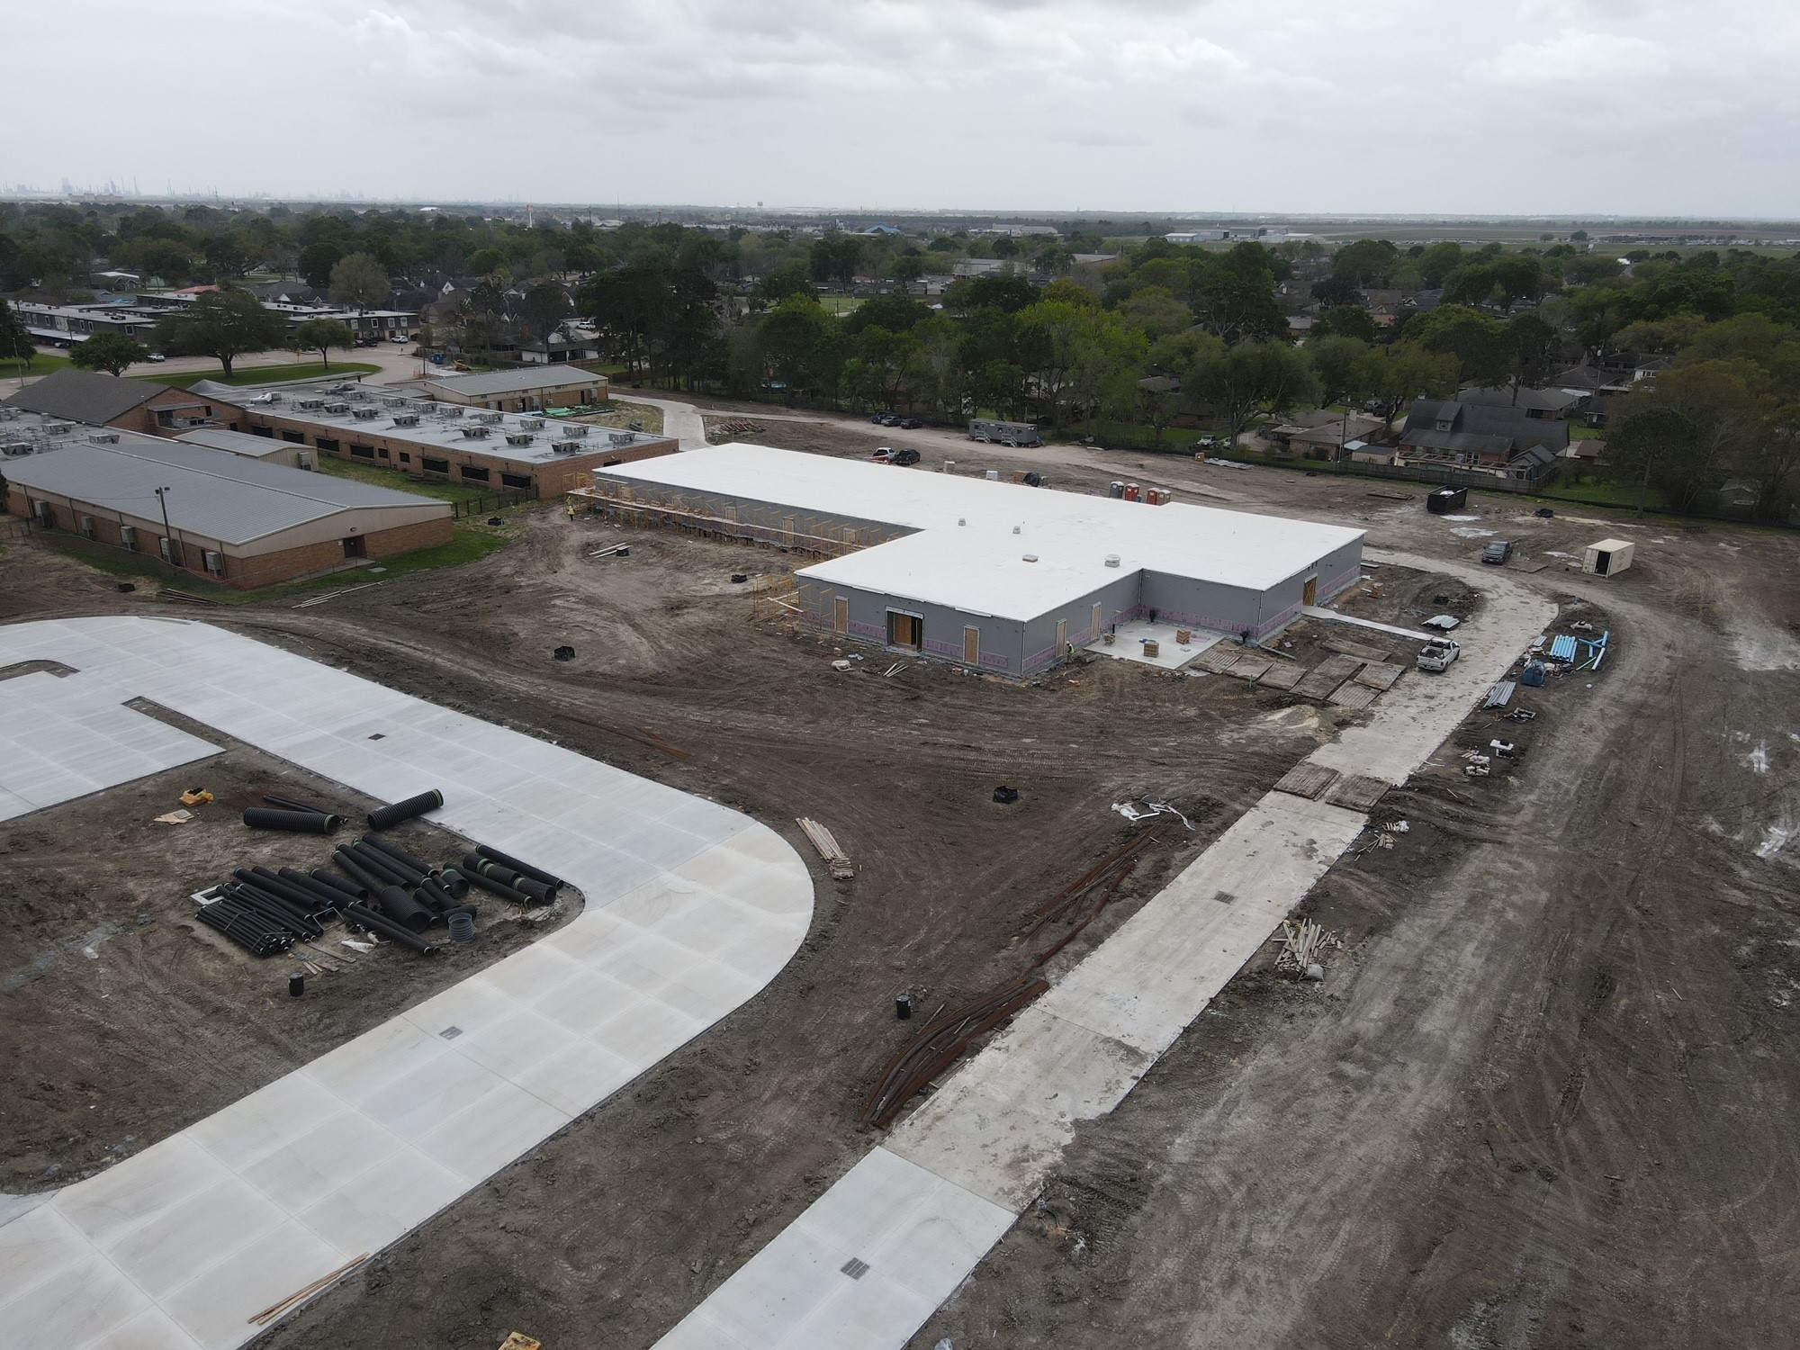
Helena Park Elementary School
Brick Installation
Sidewalks
Gym Addition
Parking Lot Demo

Slide 21
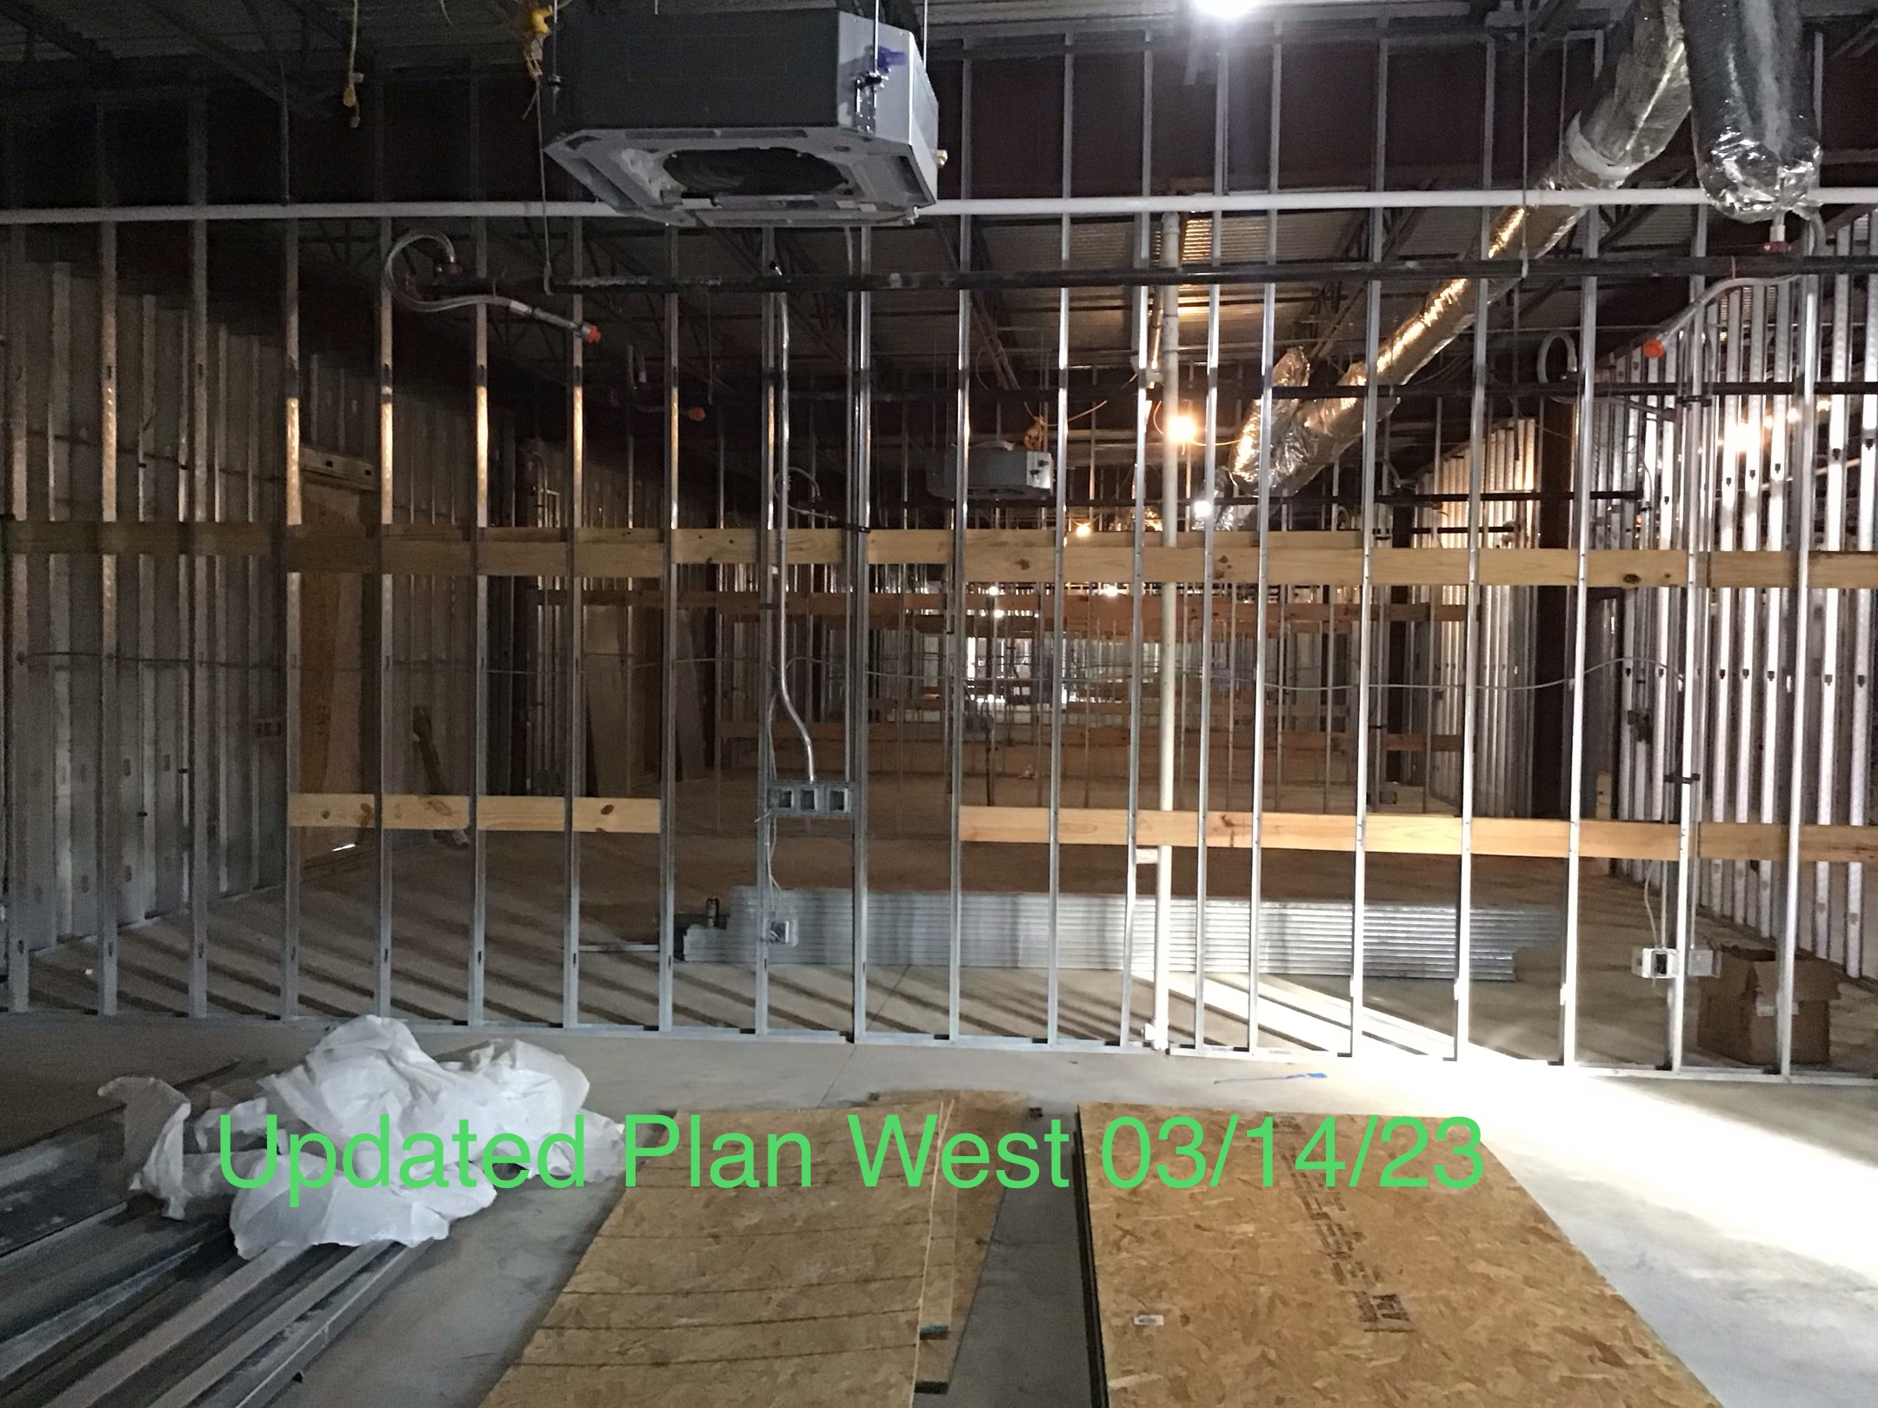
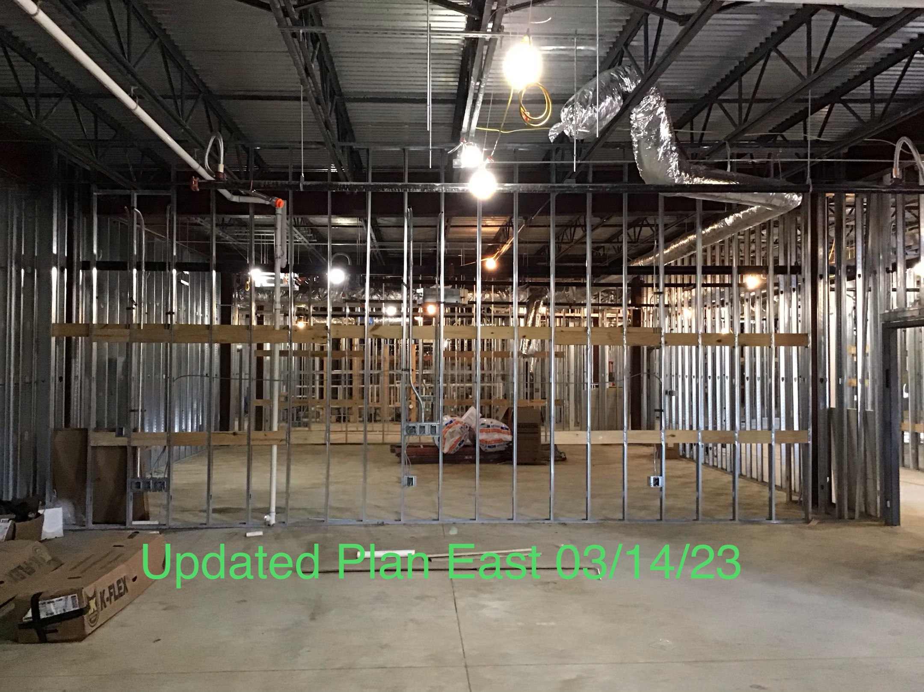
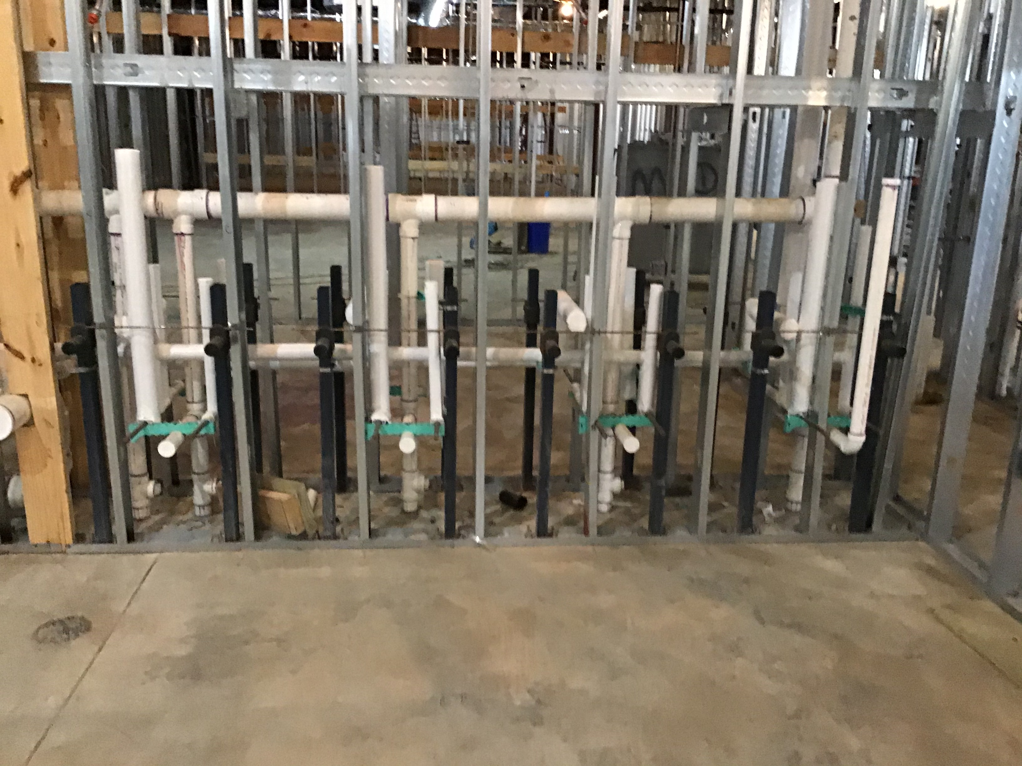
Helena Park Elementary School
Installing duct work
Metal Stud Framing
Interior Blocking
Plumbing Top Outs

Slide 22
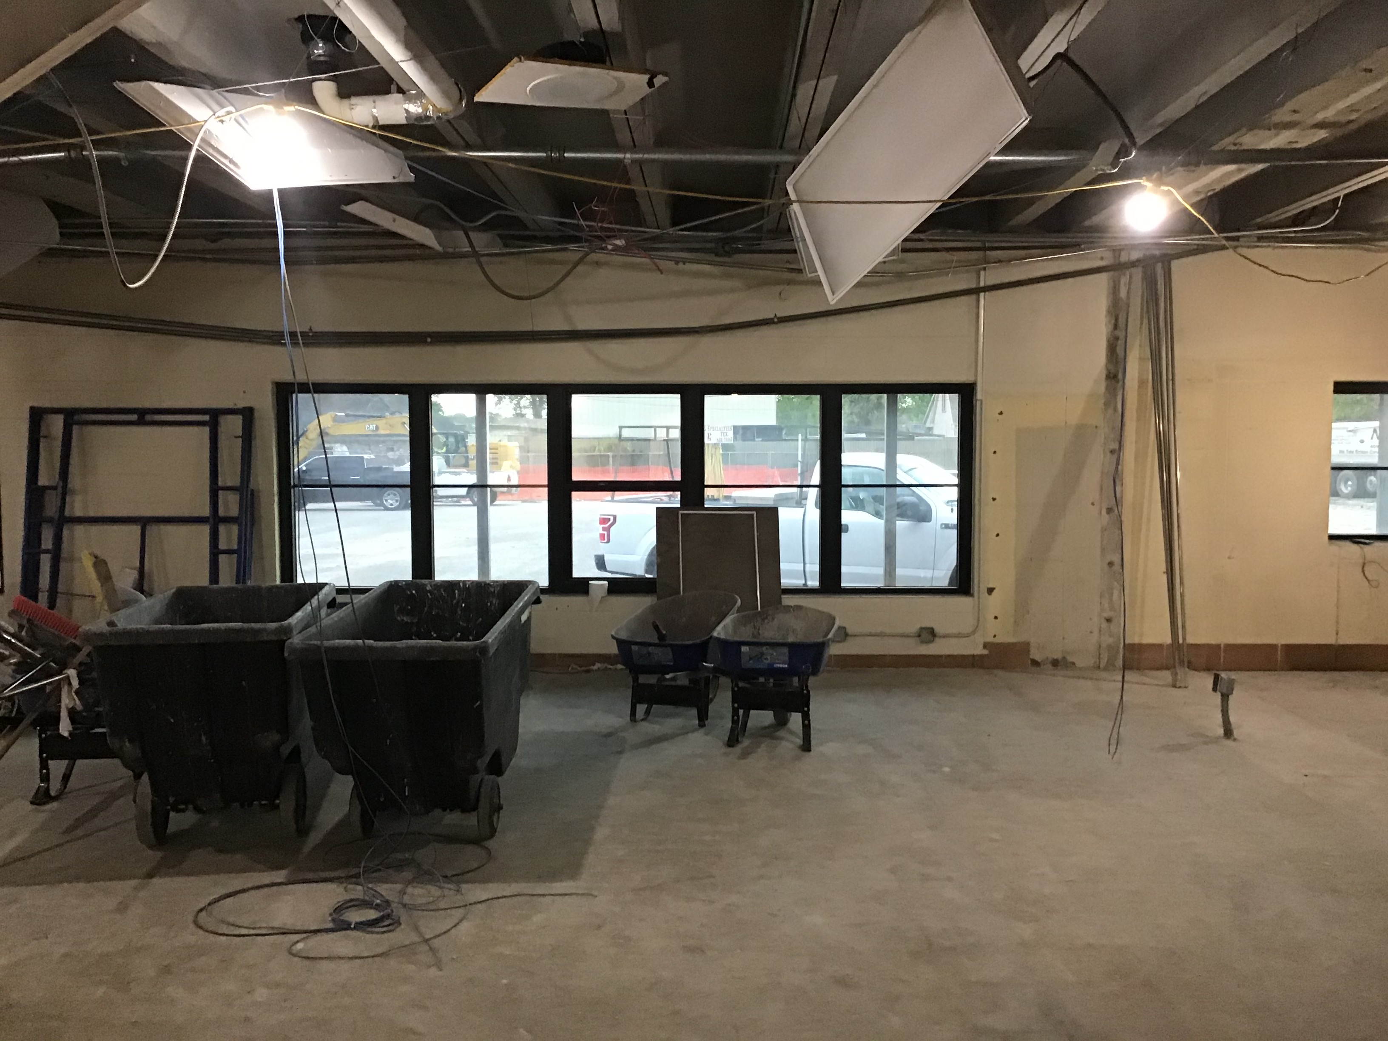
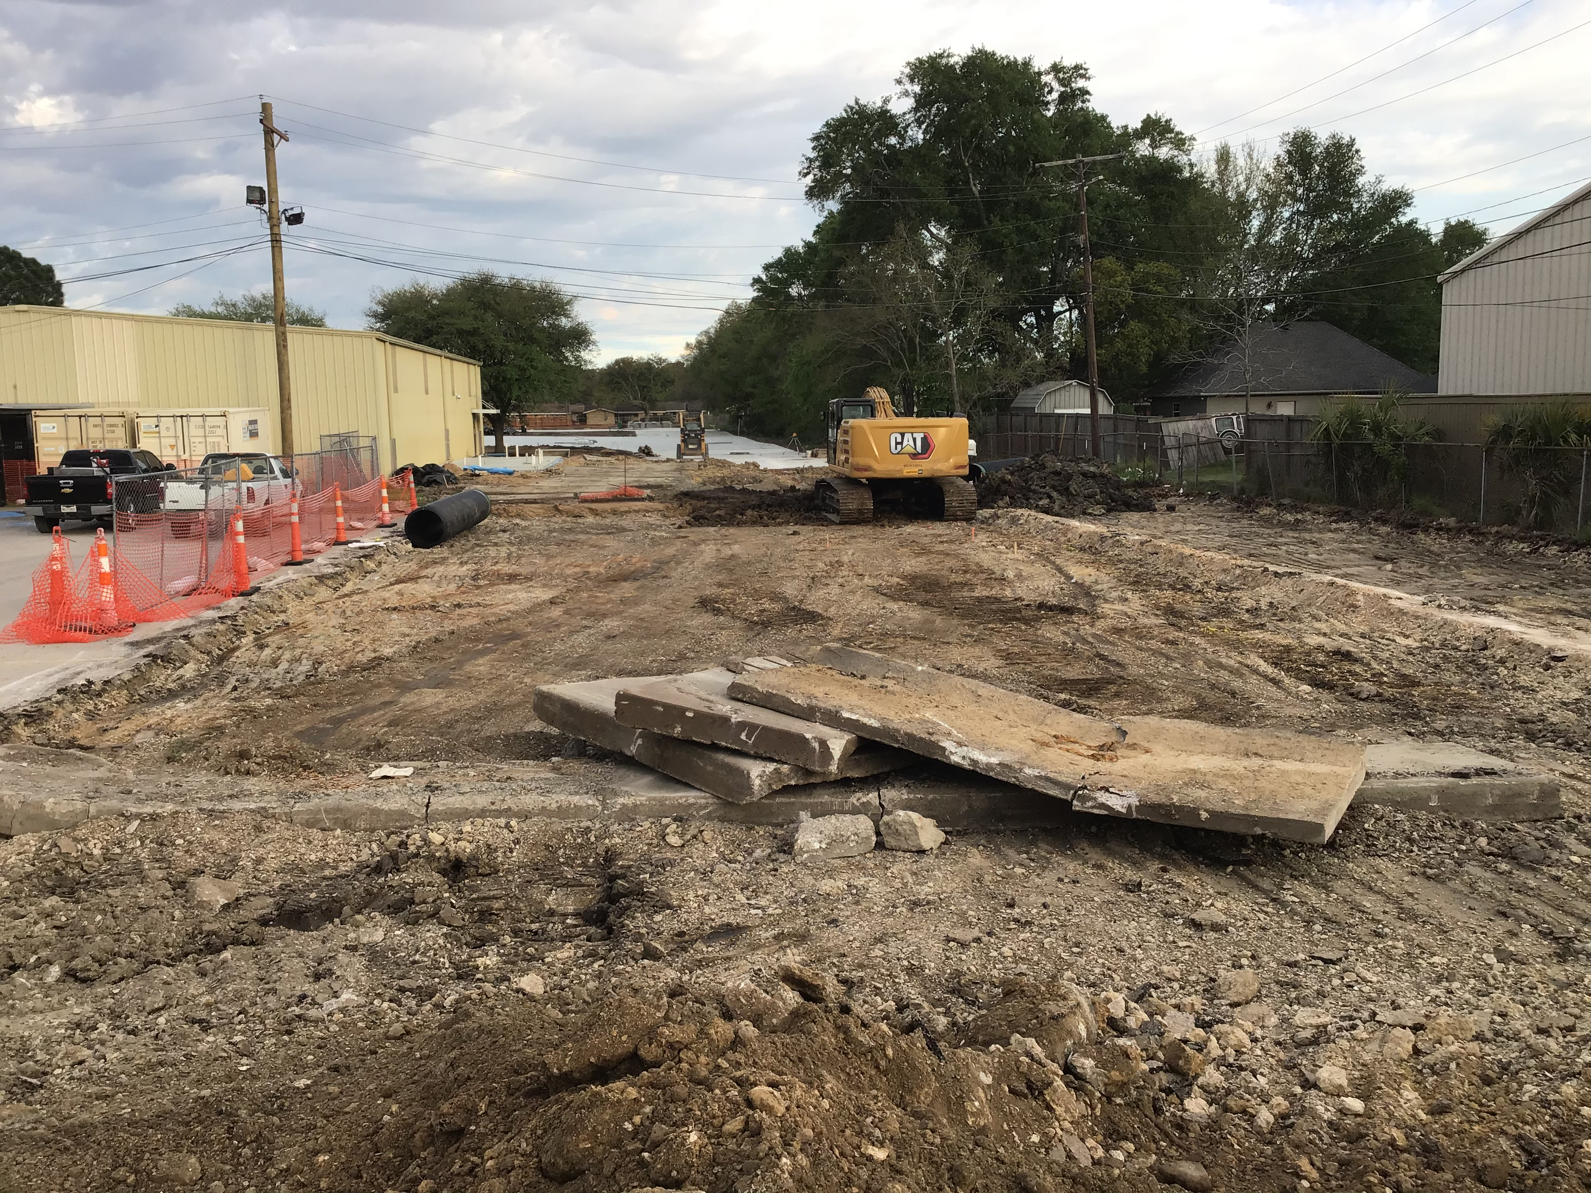
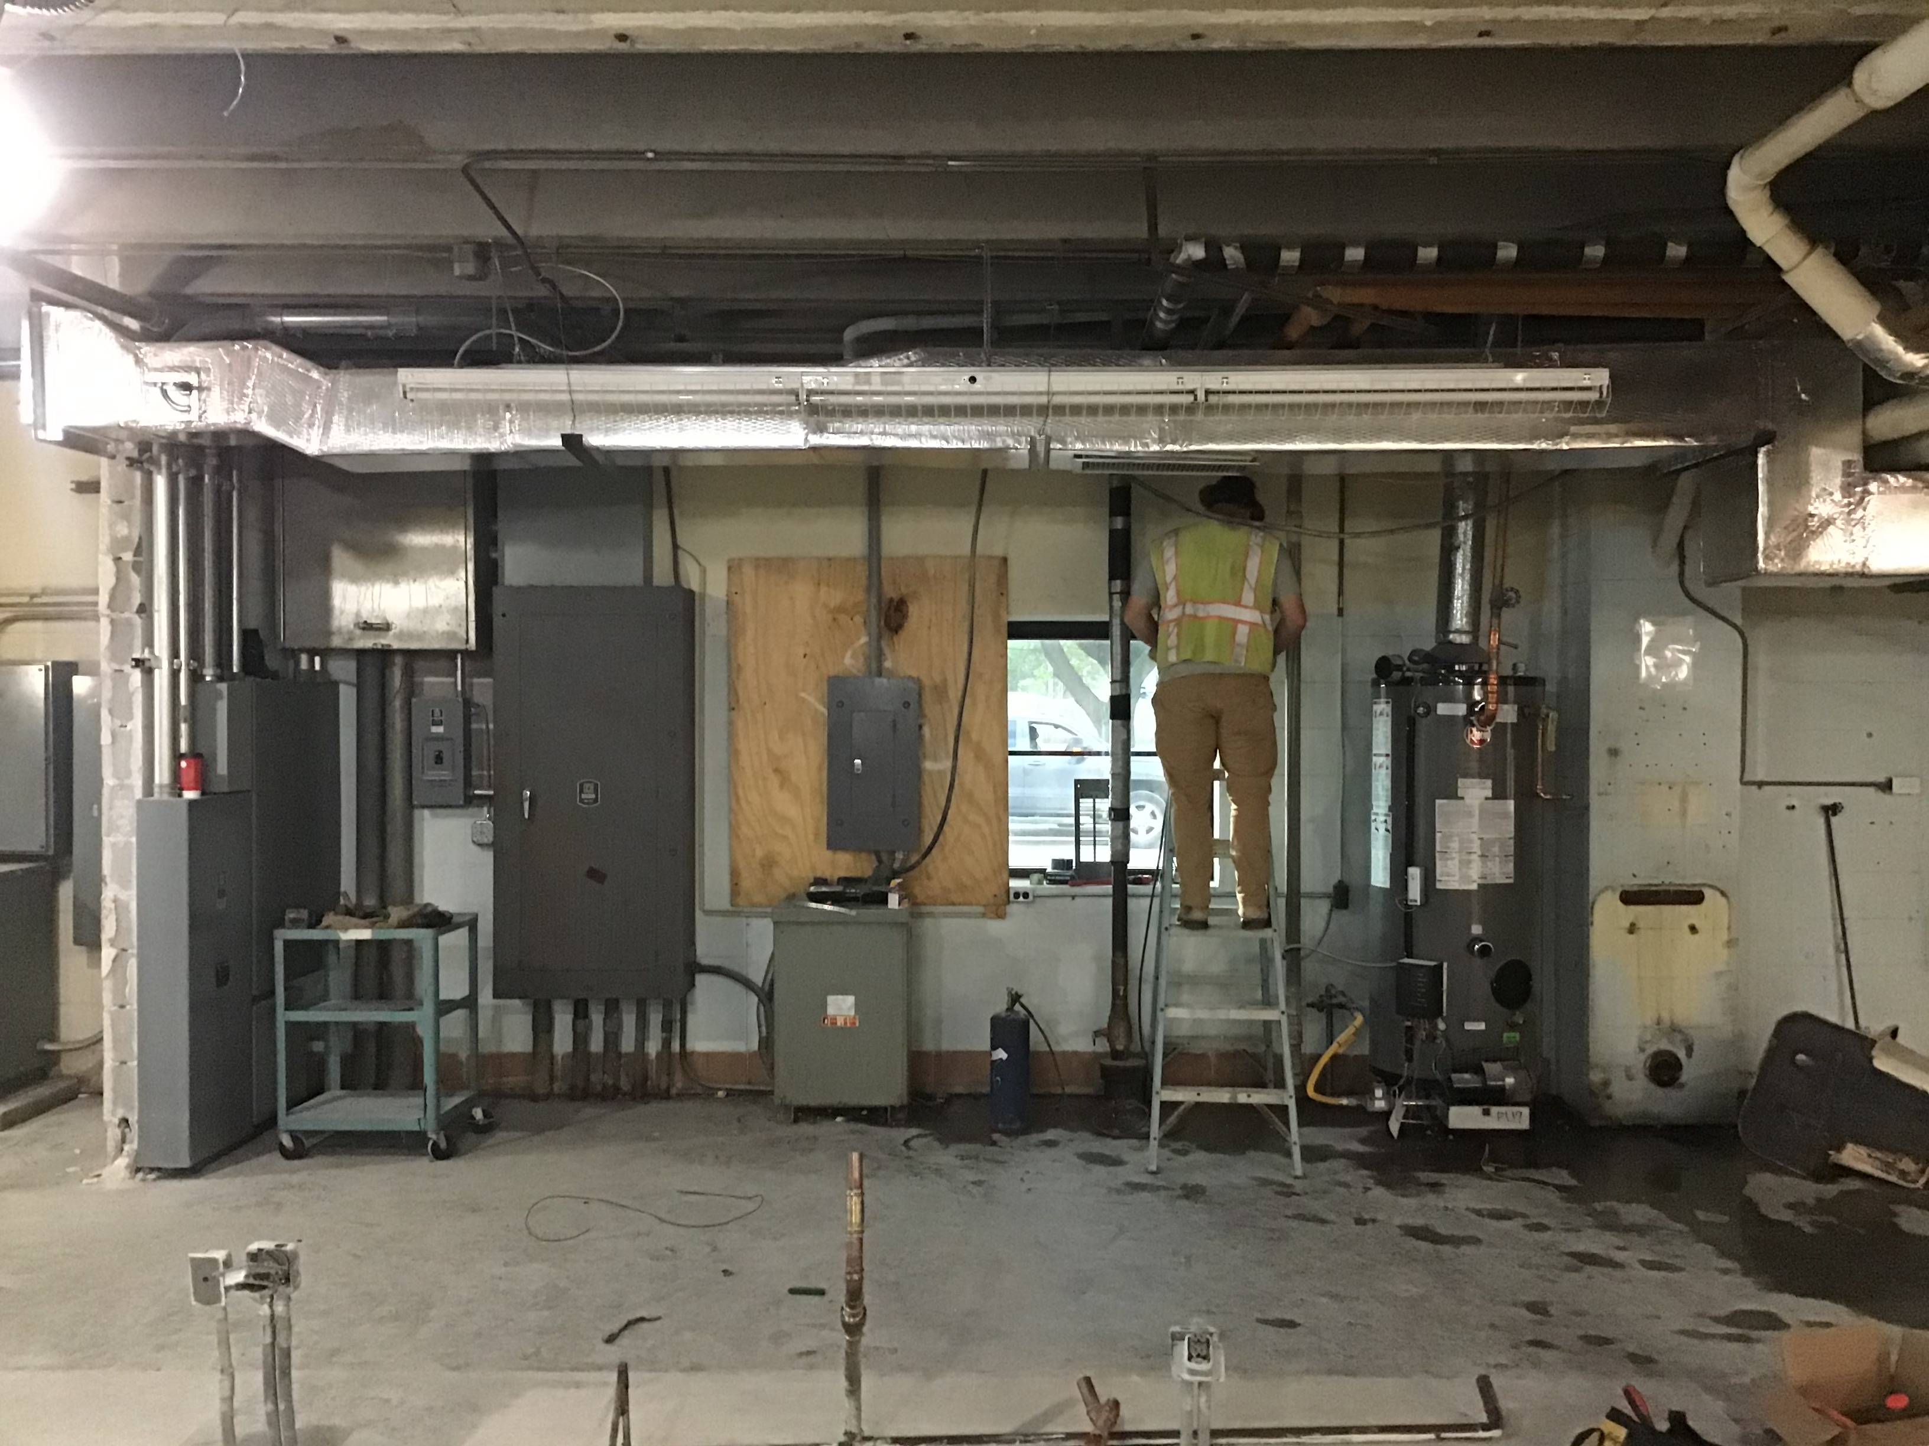
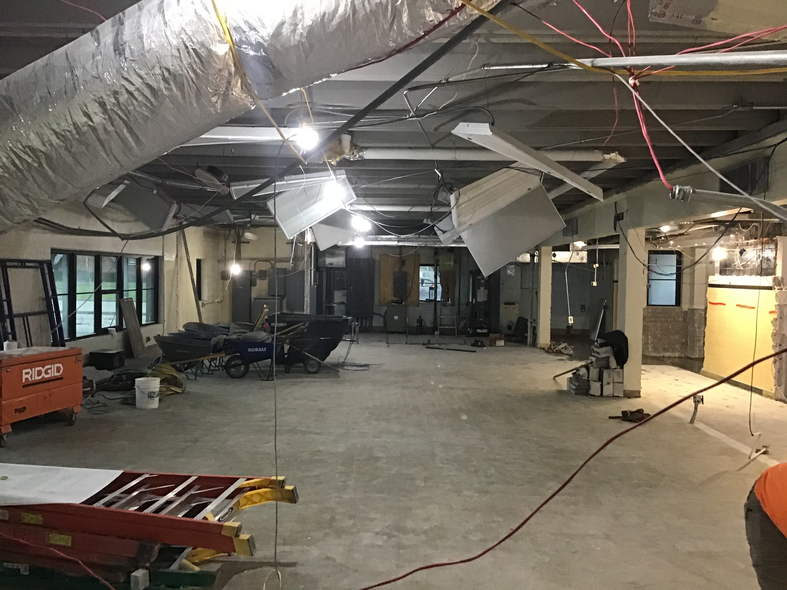
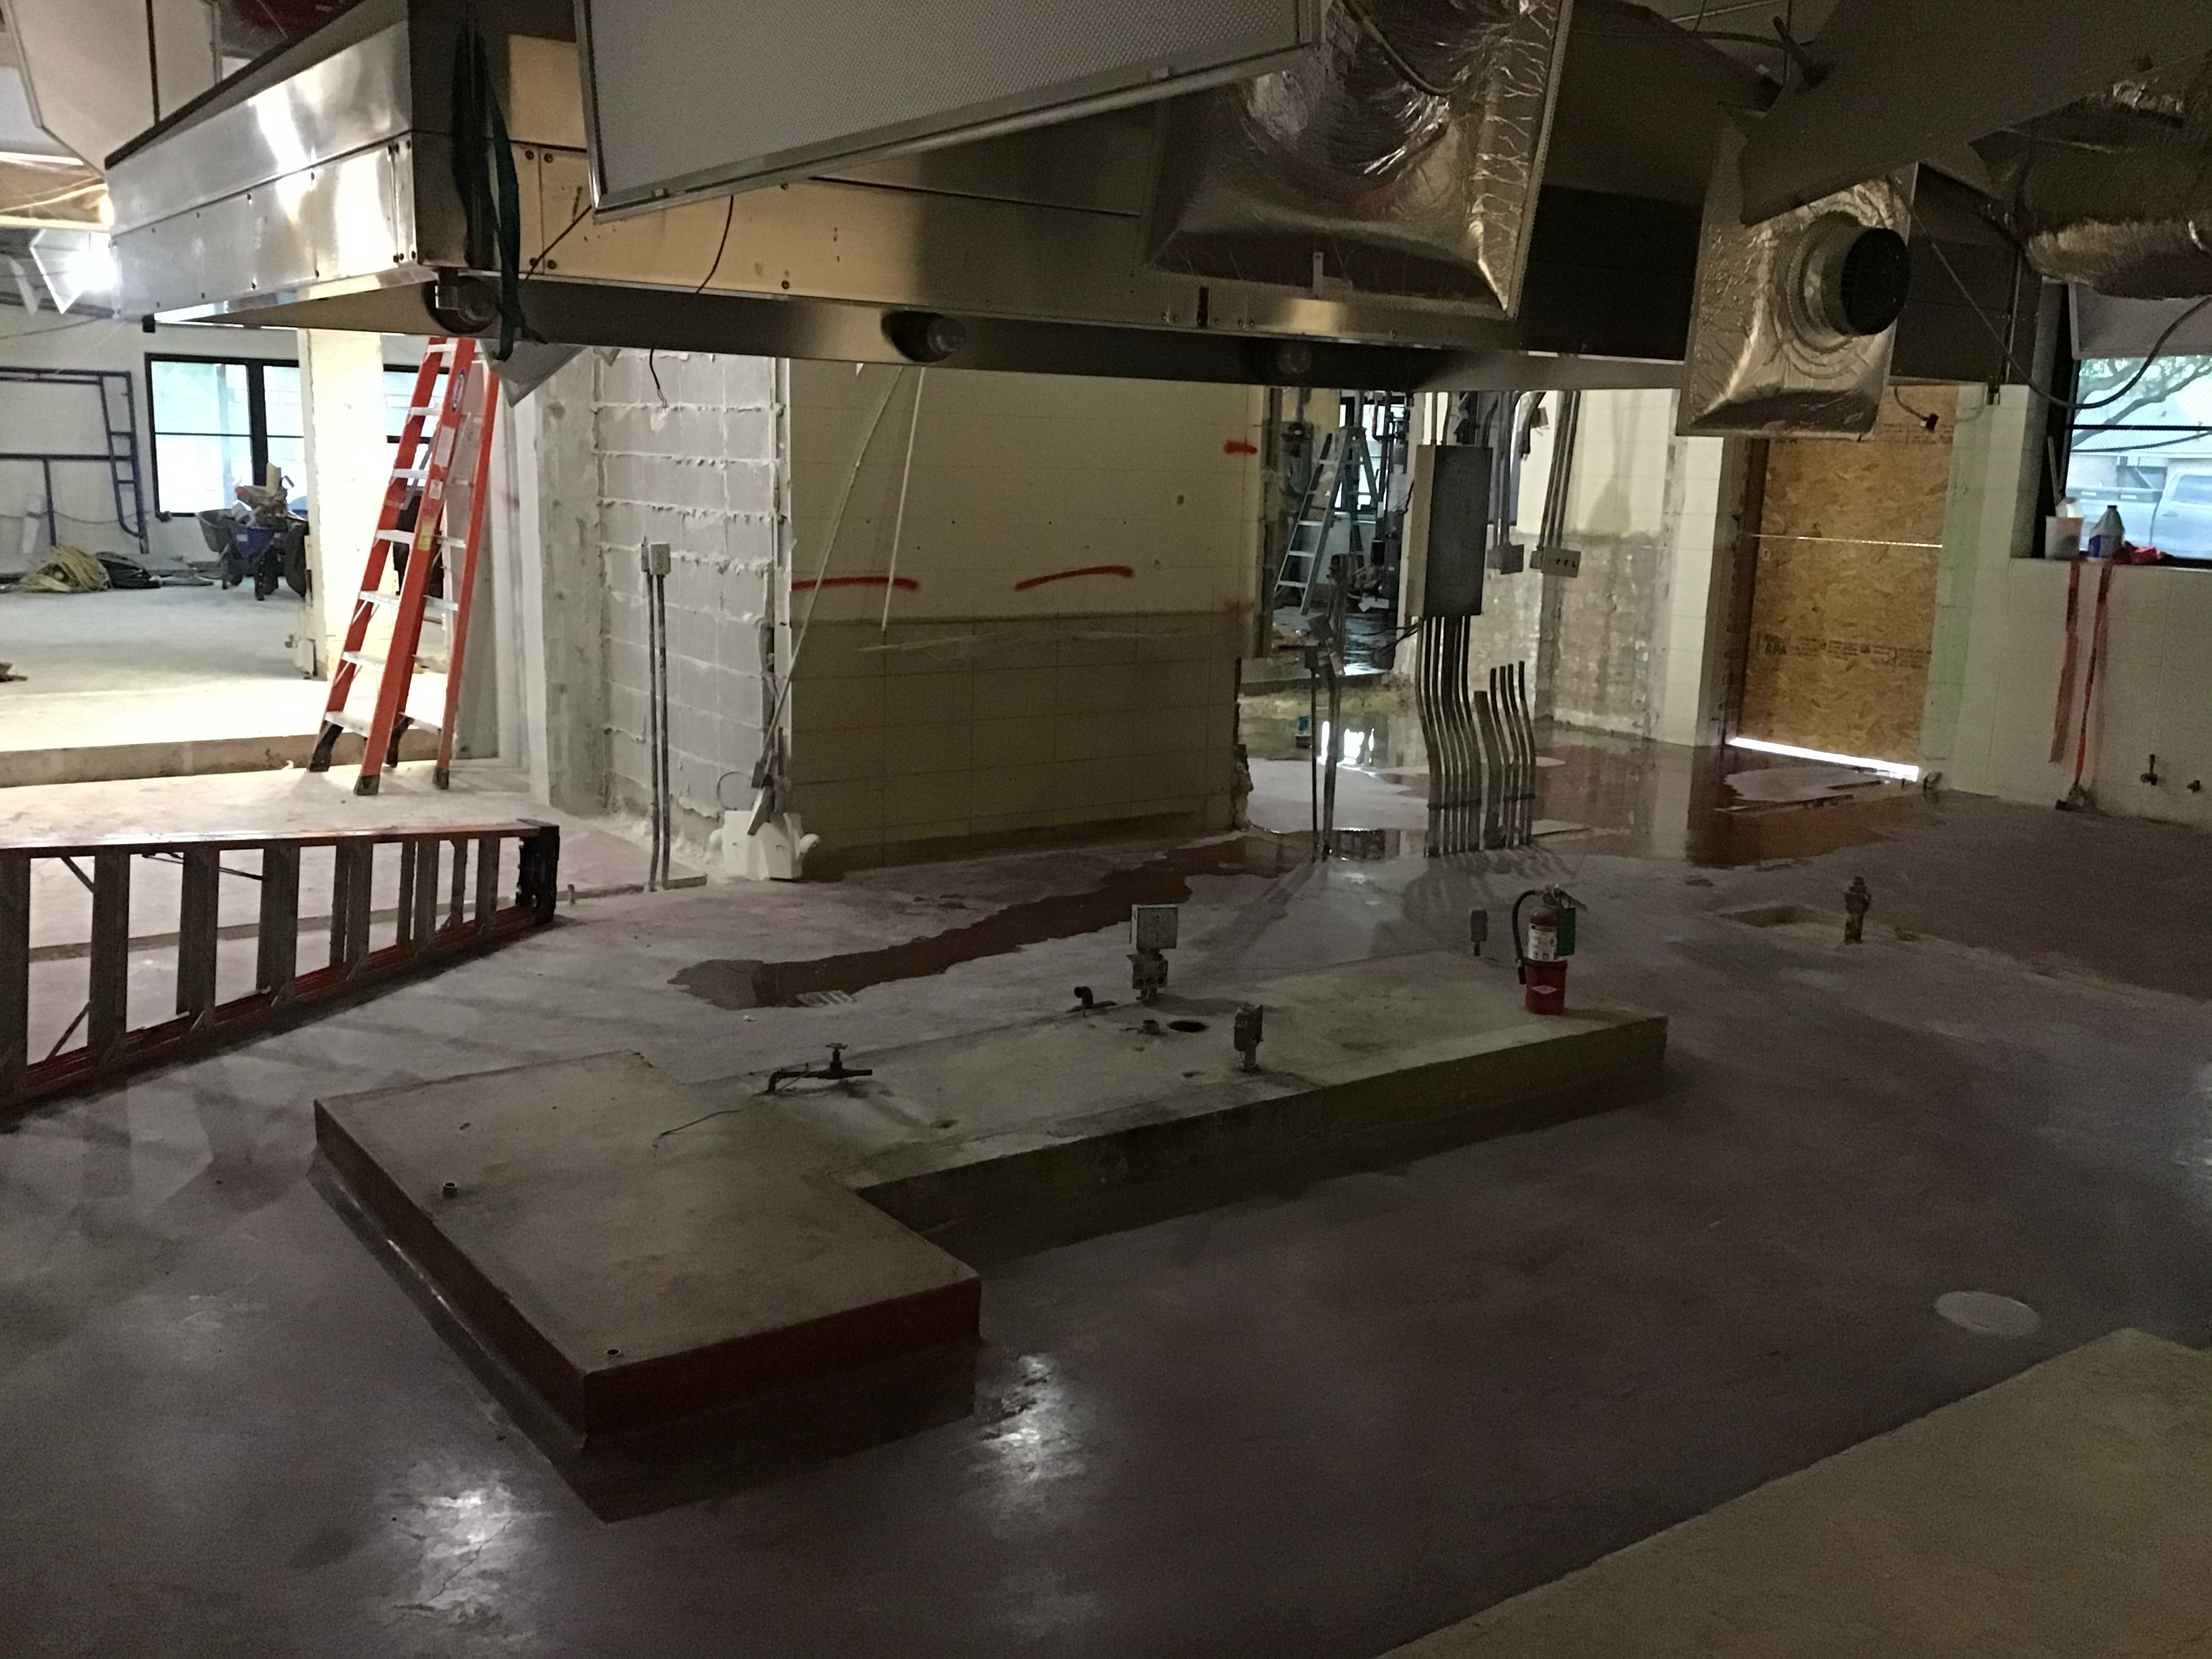
Helena Park Elementary School - Renovations
Kitchen Demo / Remodel

Slide 23
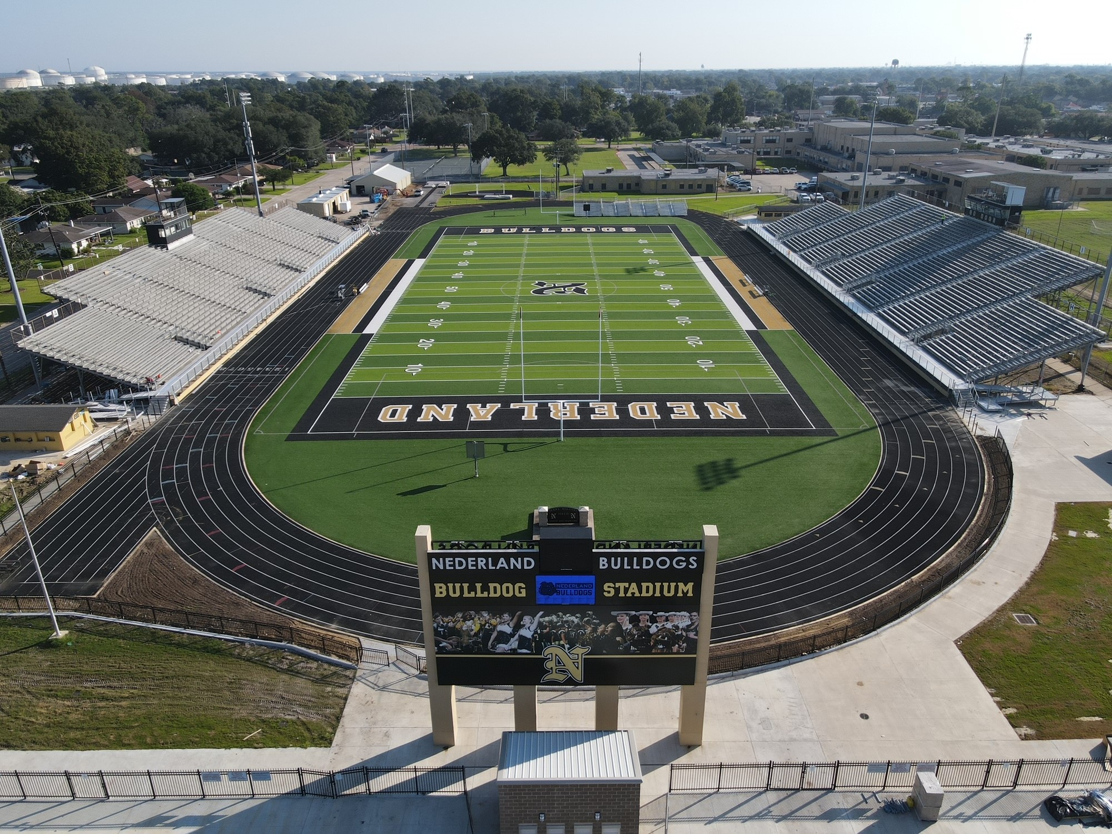
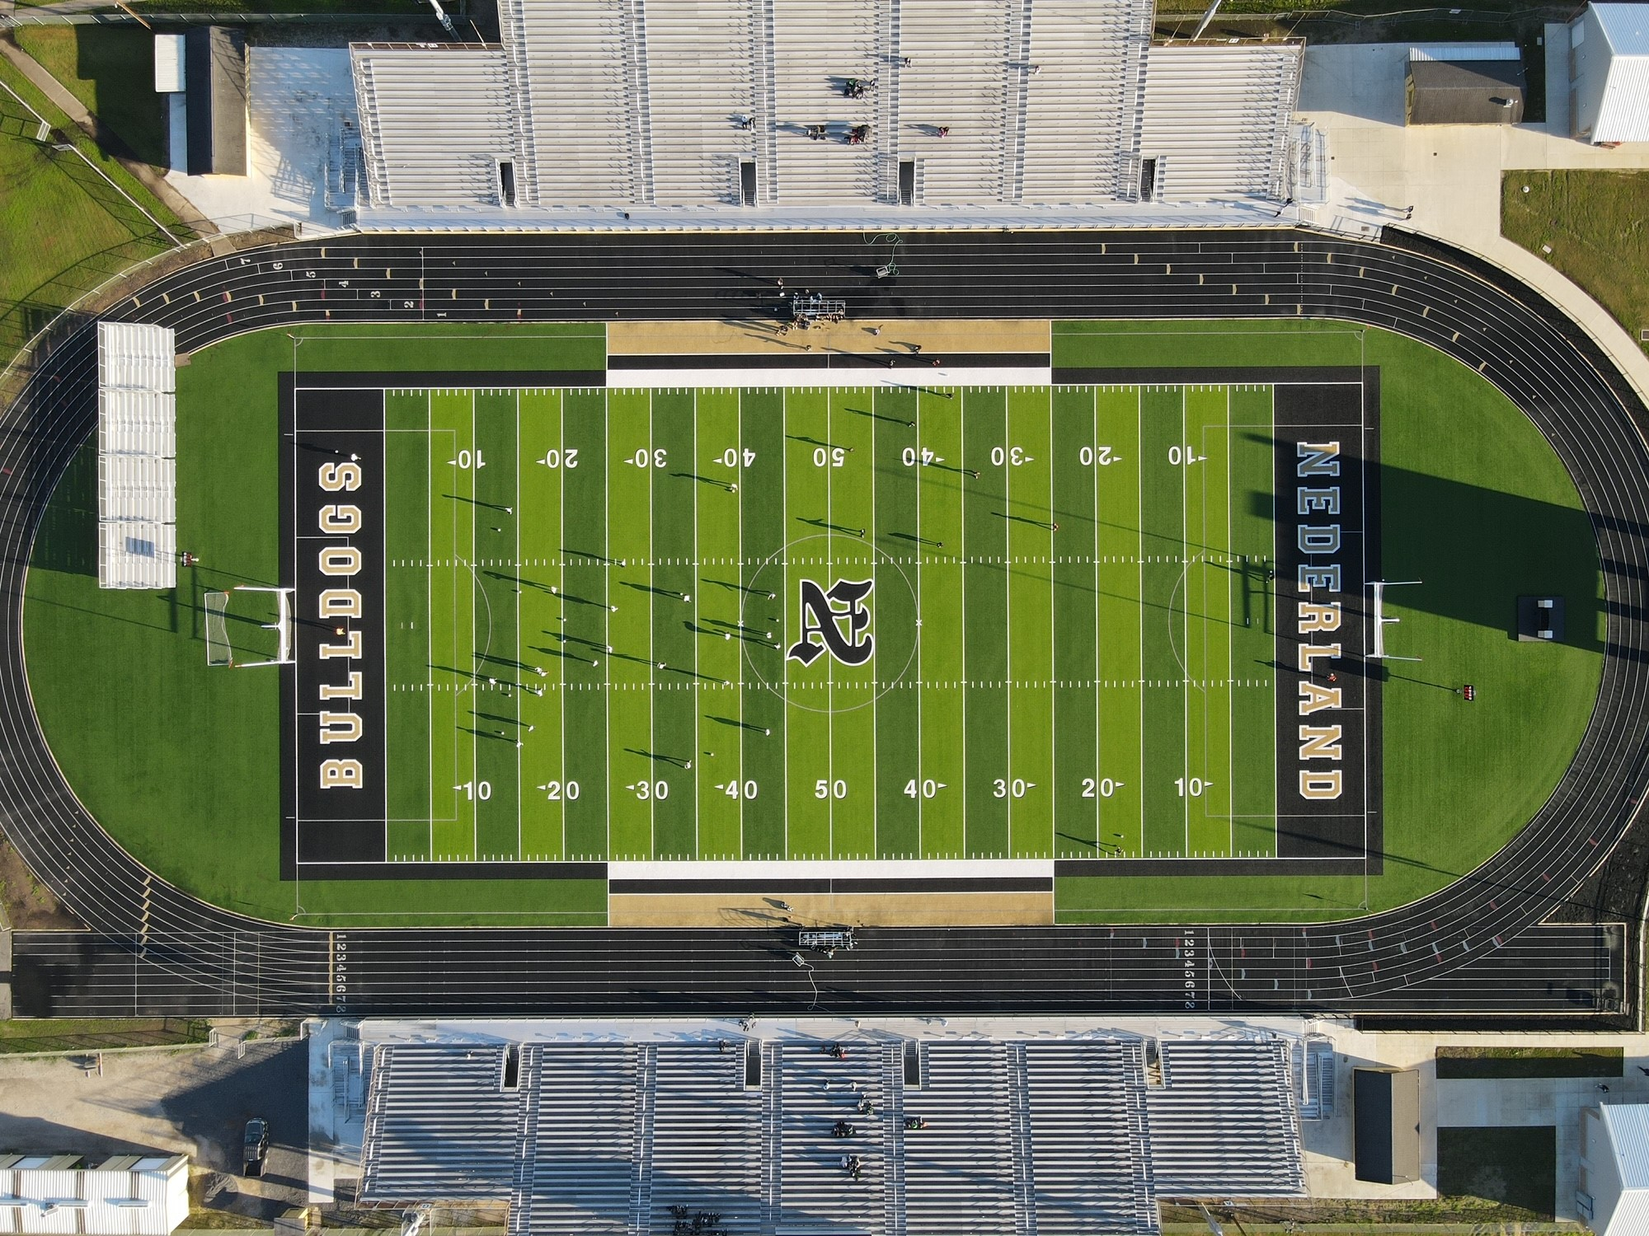
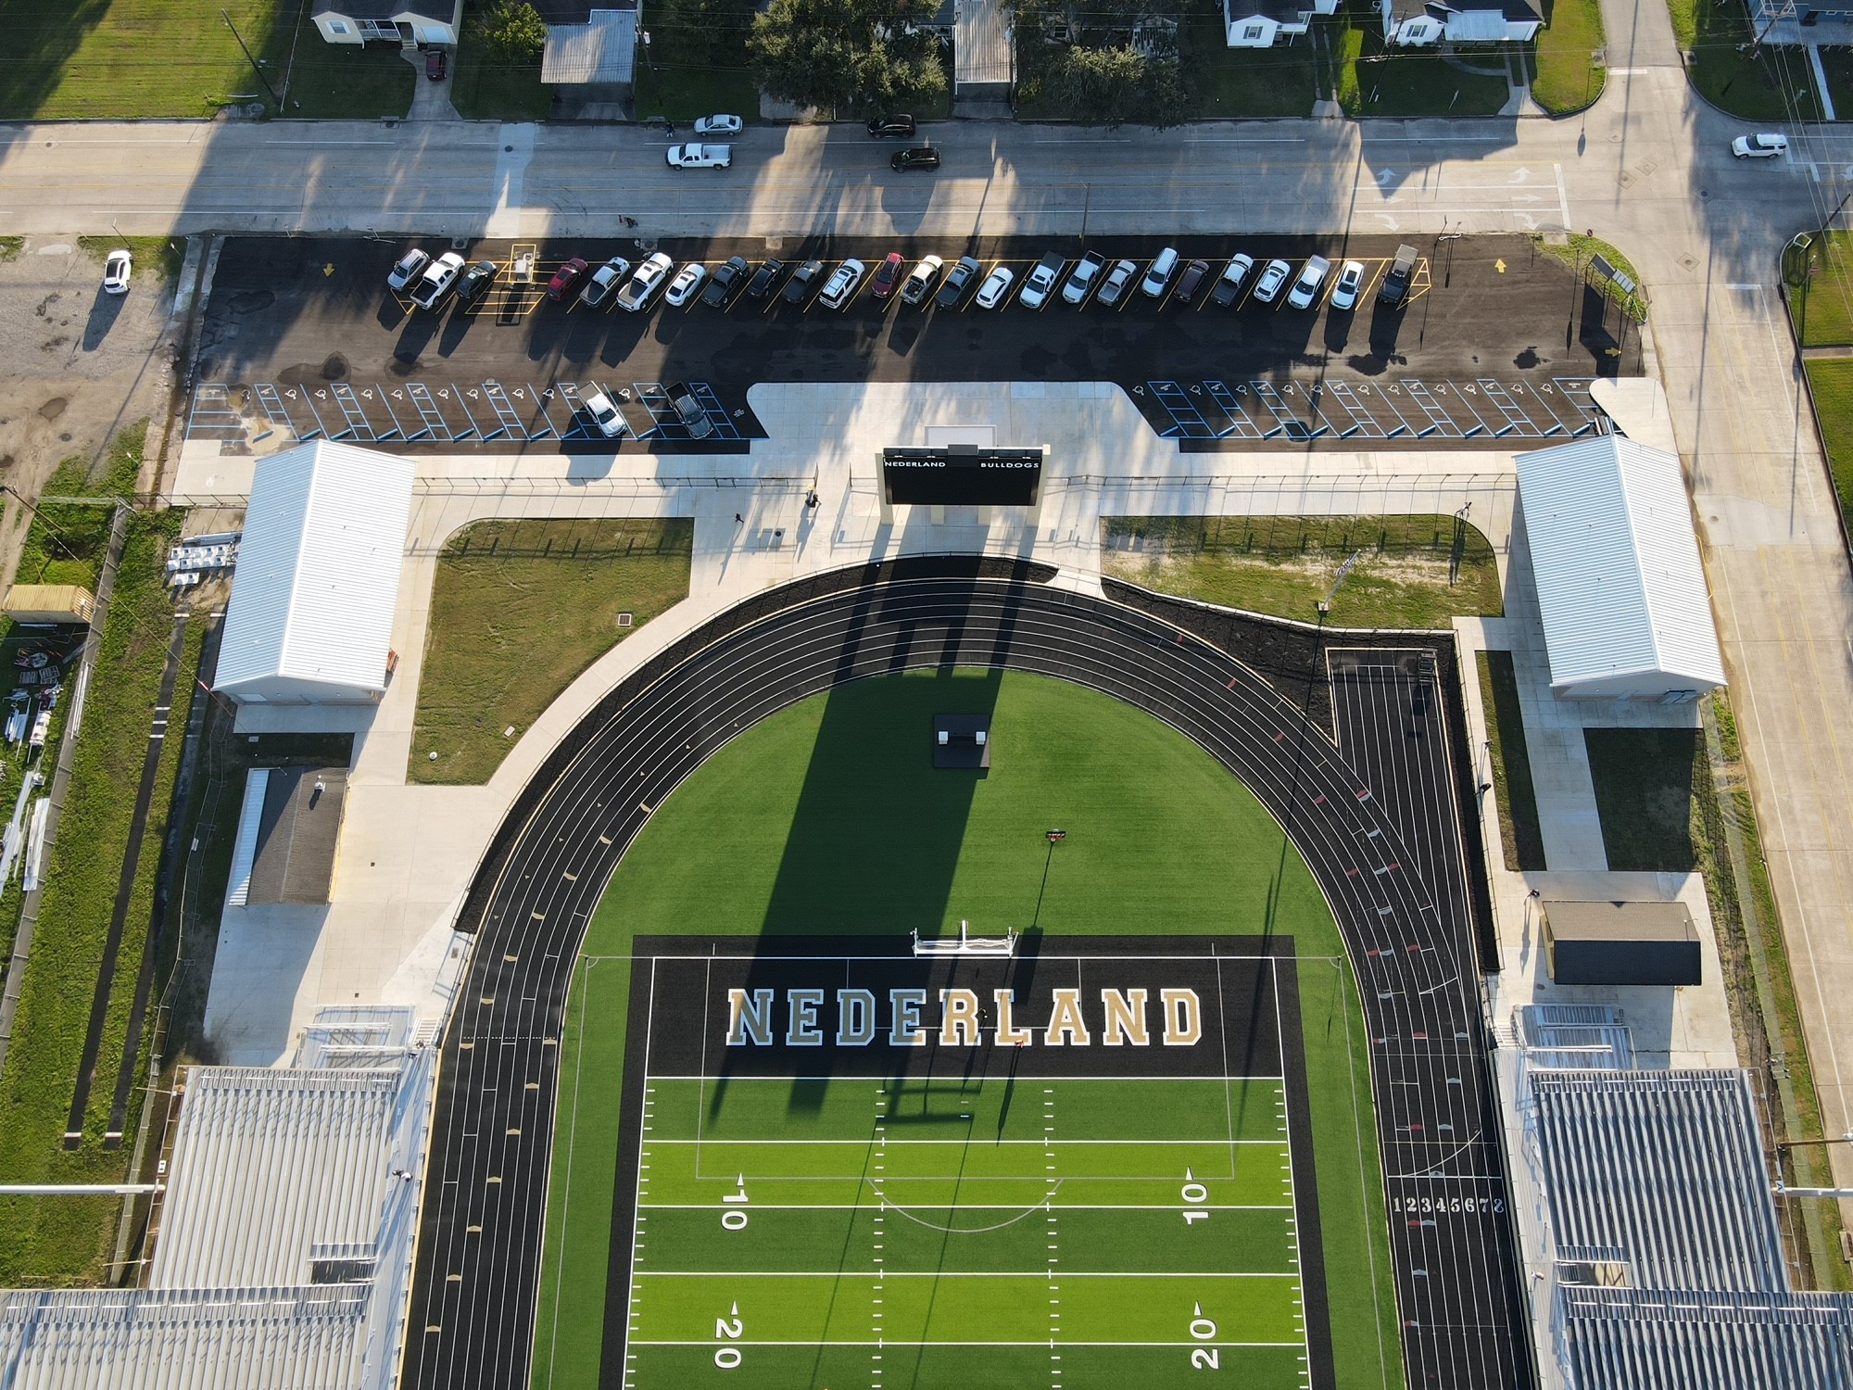
Nederland Bulldog Stadium

Slide 24


