Slide 1




2019 Nederland ISD Bond Project
June 2023

Slide 2

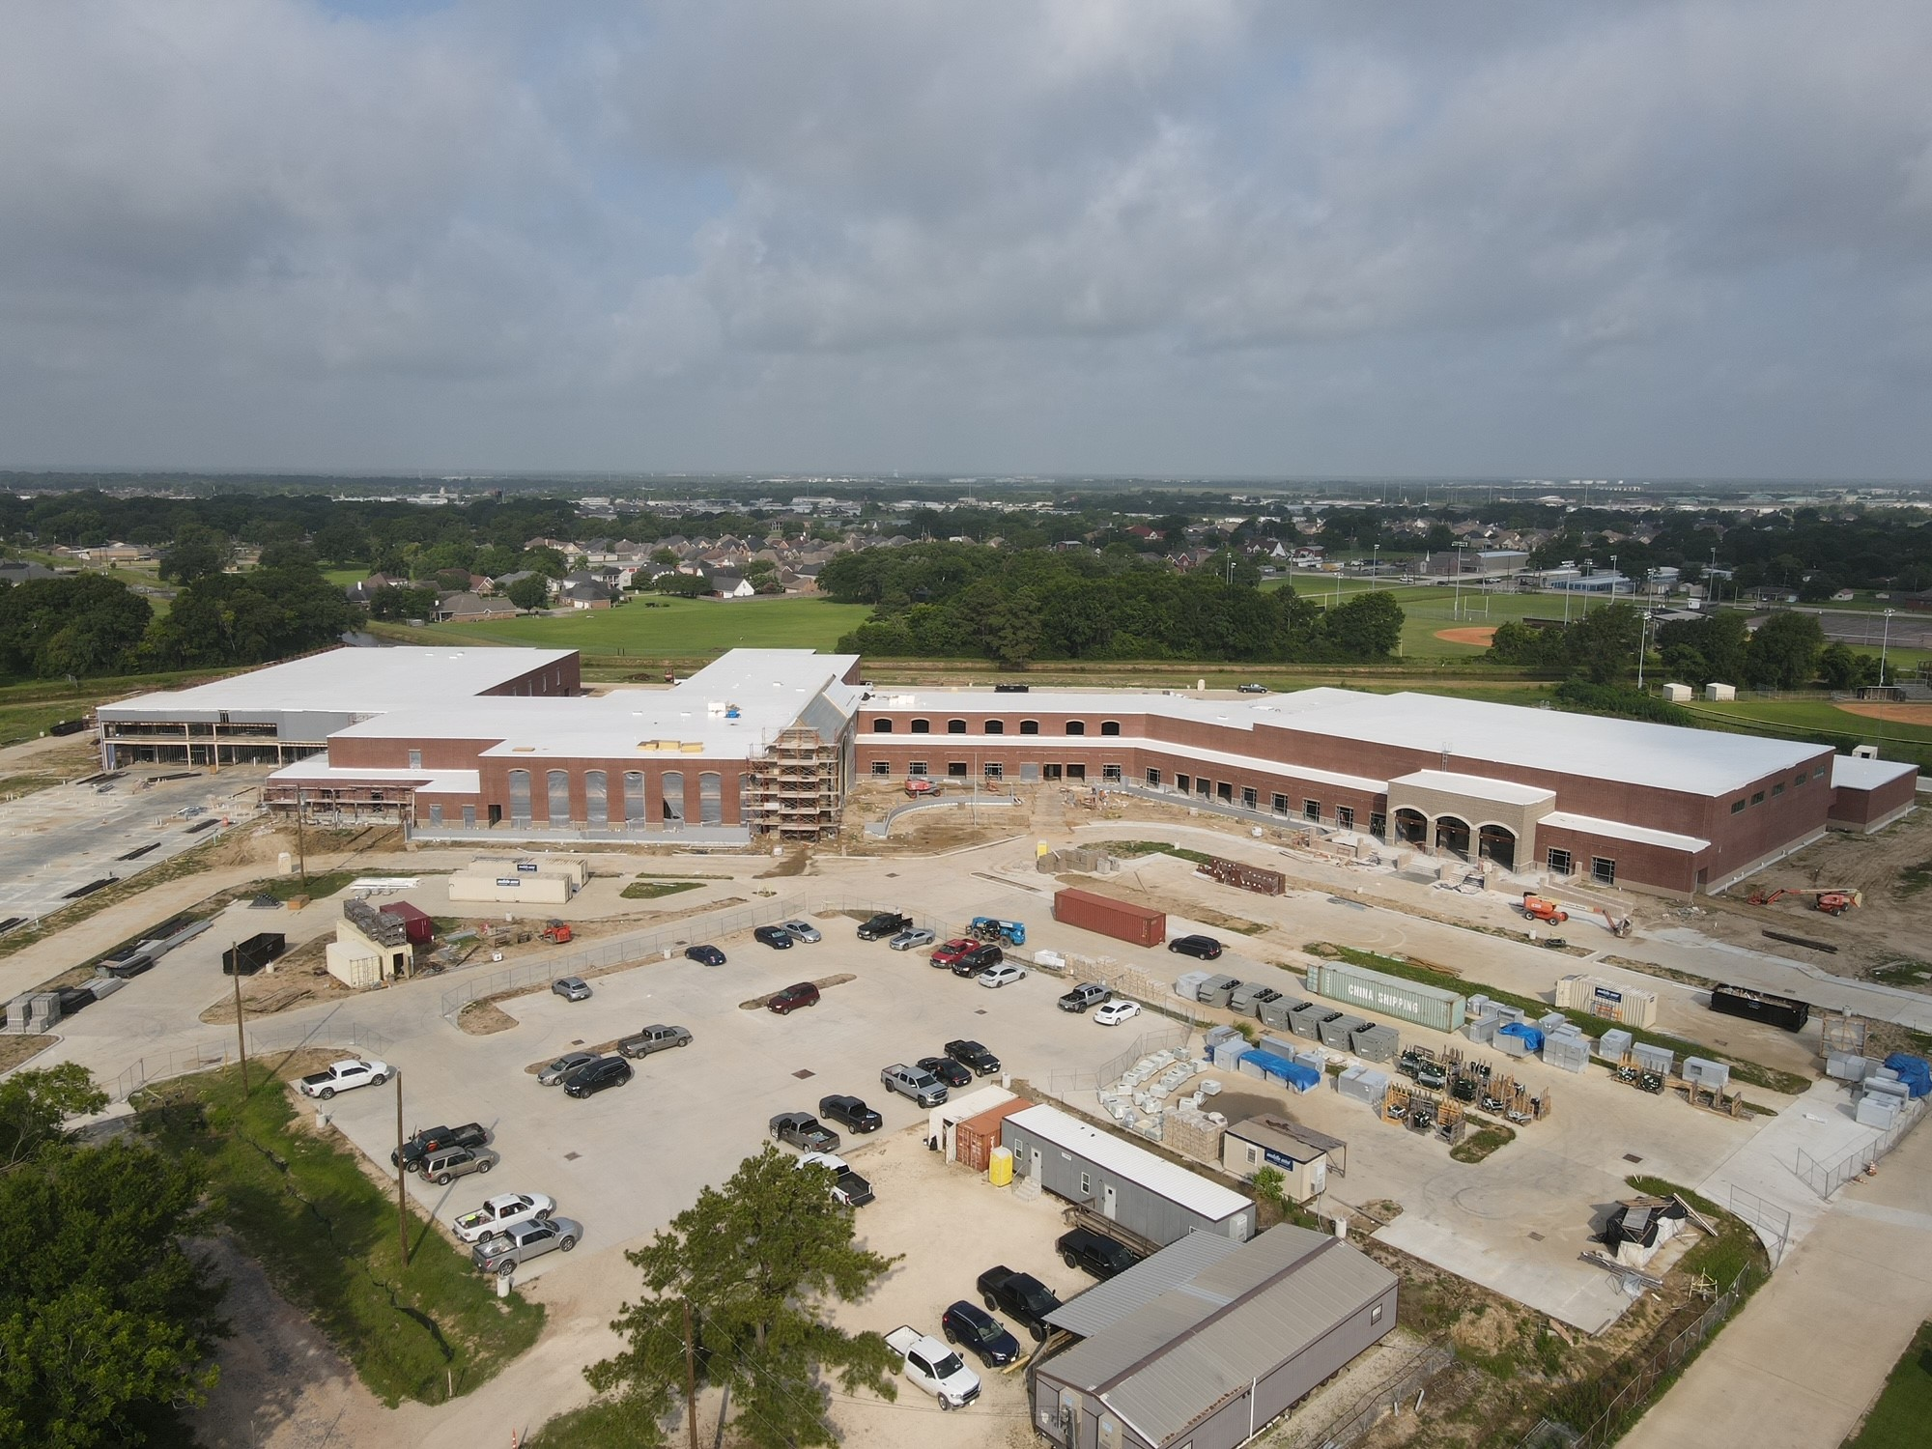
Nederland High School

Slide 3
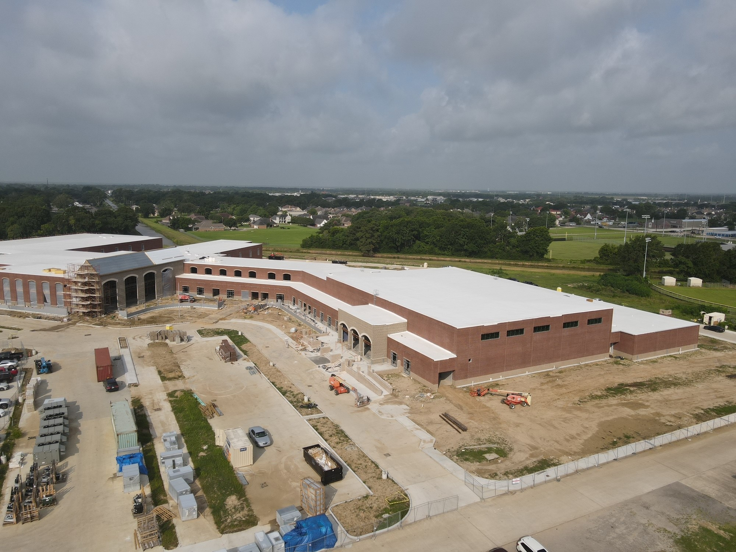
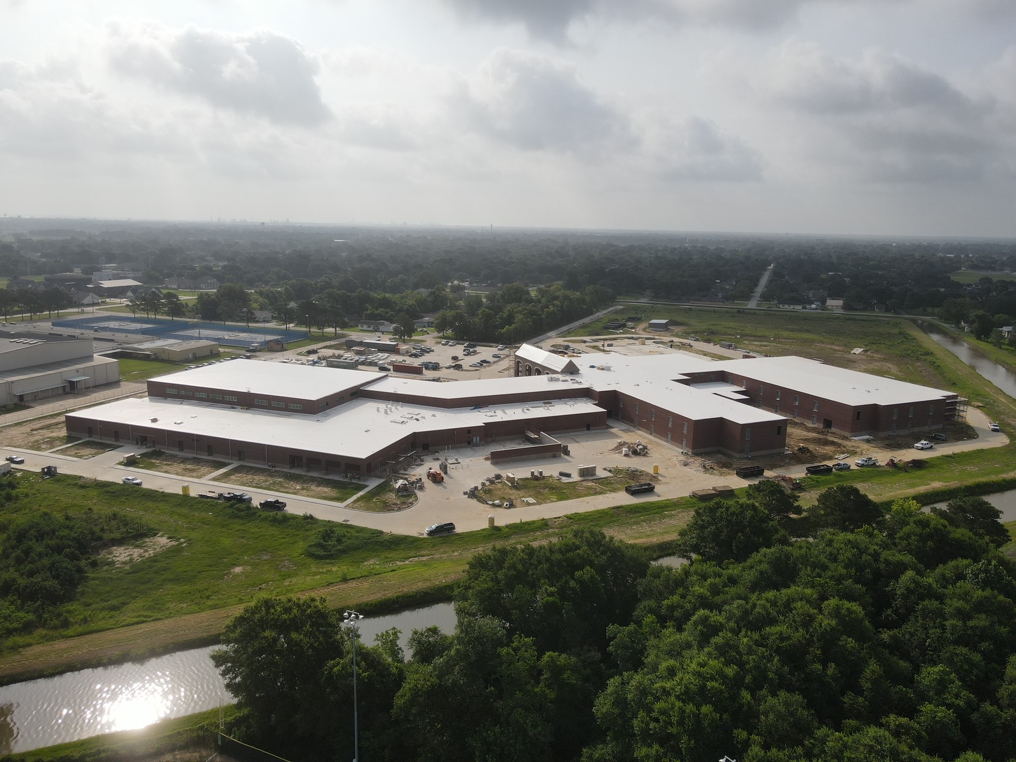
Nederland High School

Slide 4
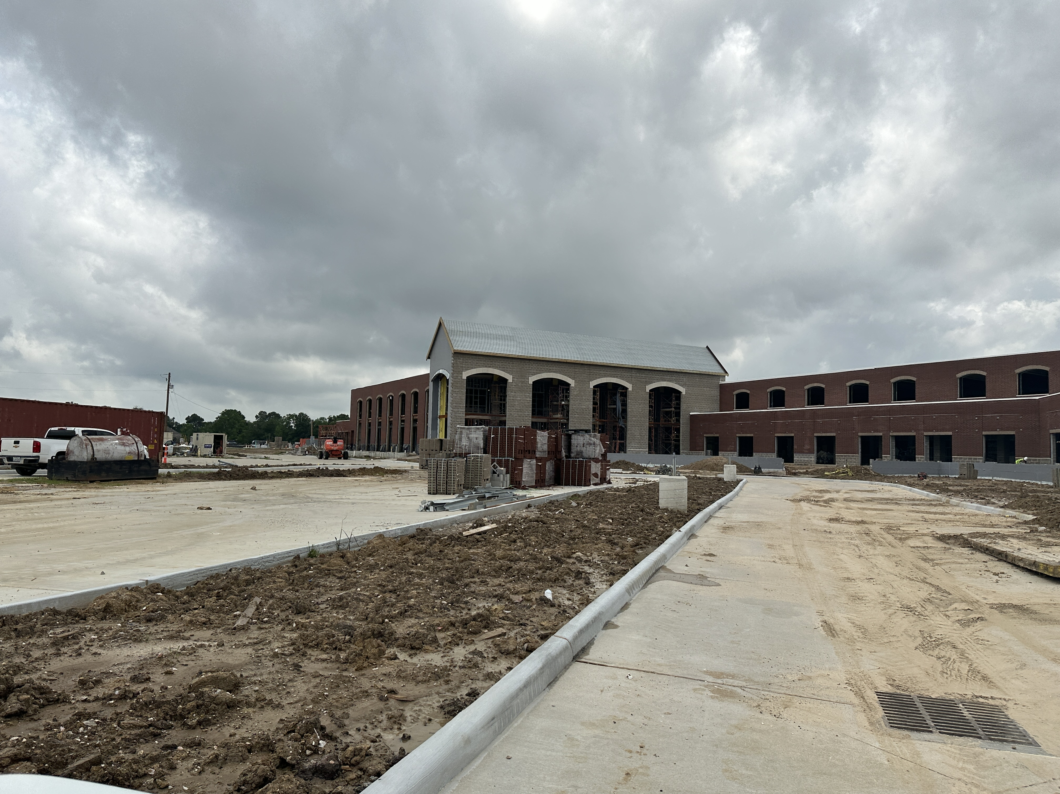
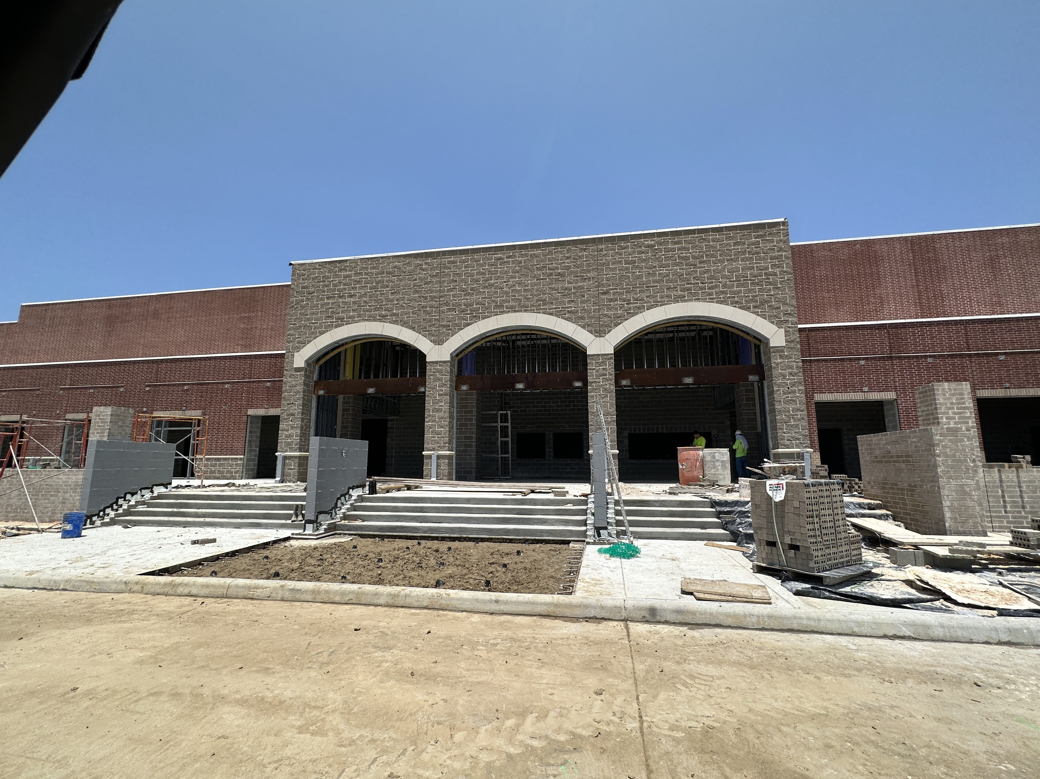
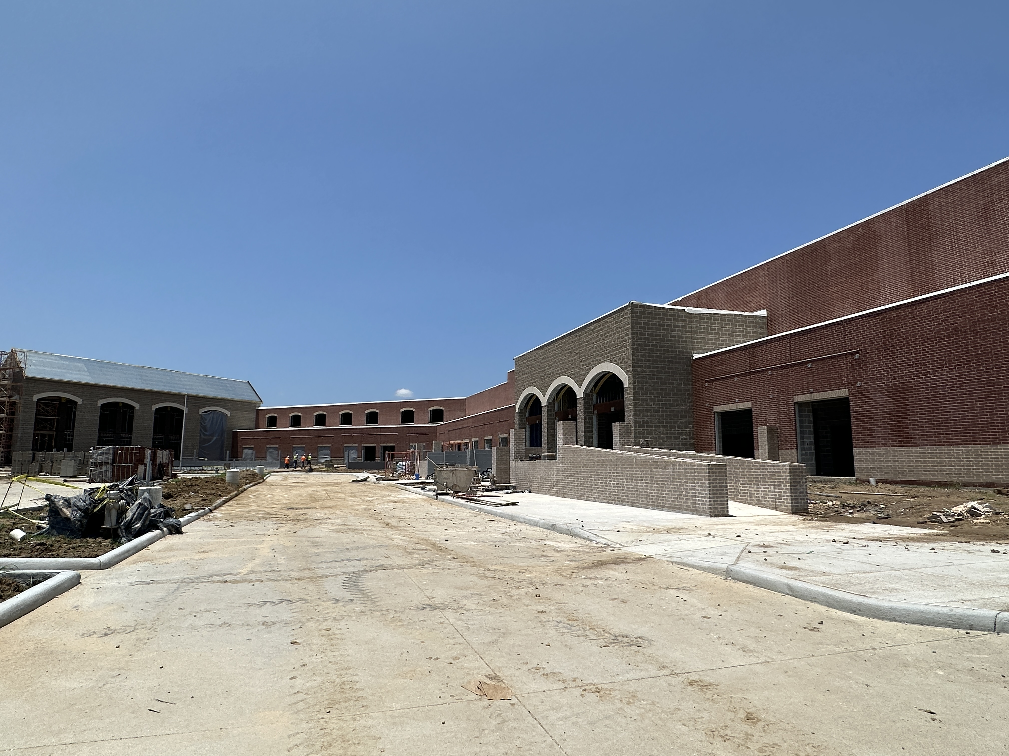
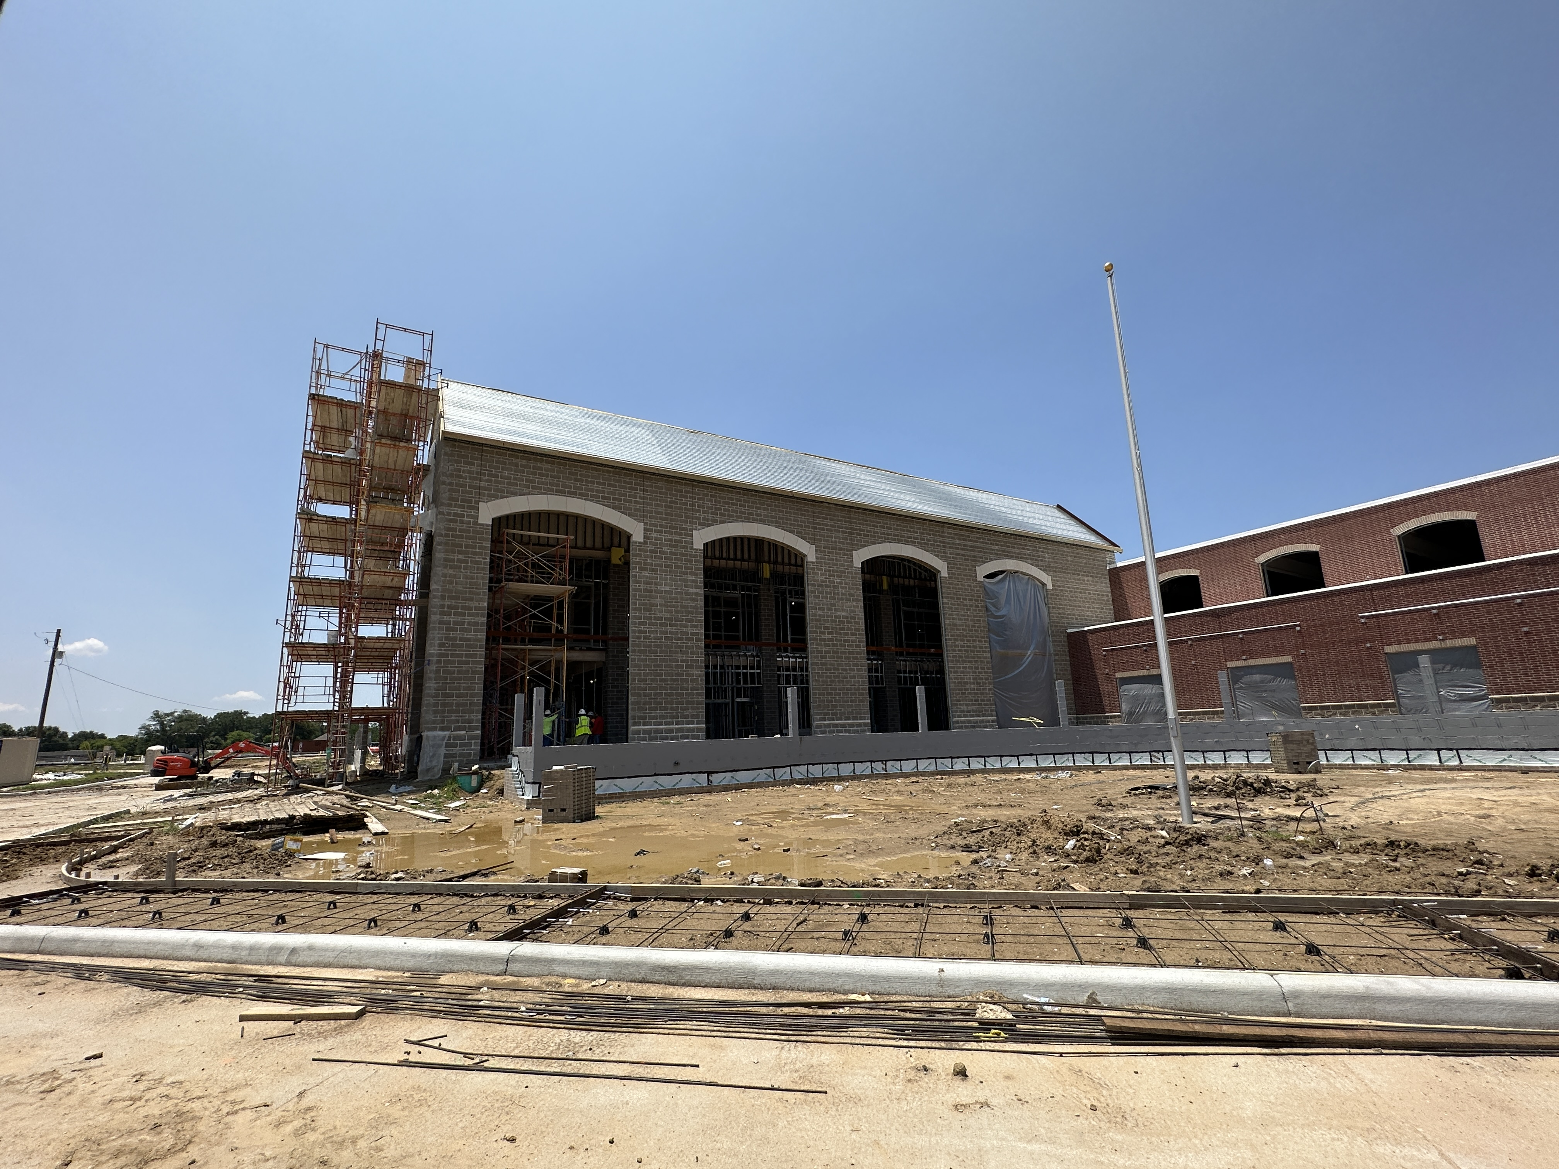
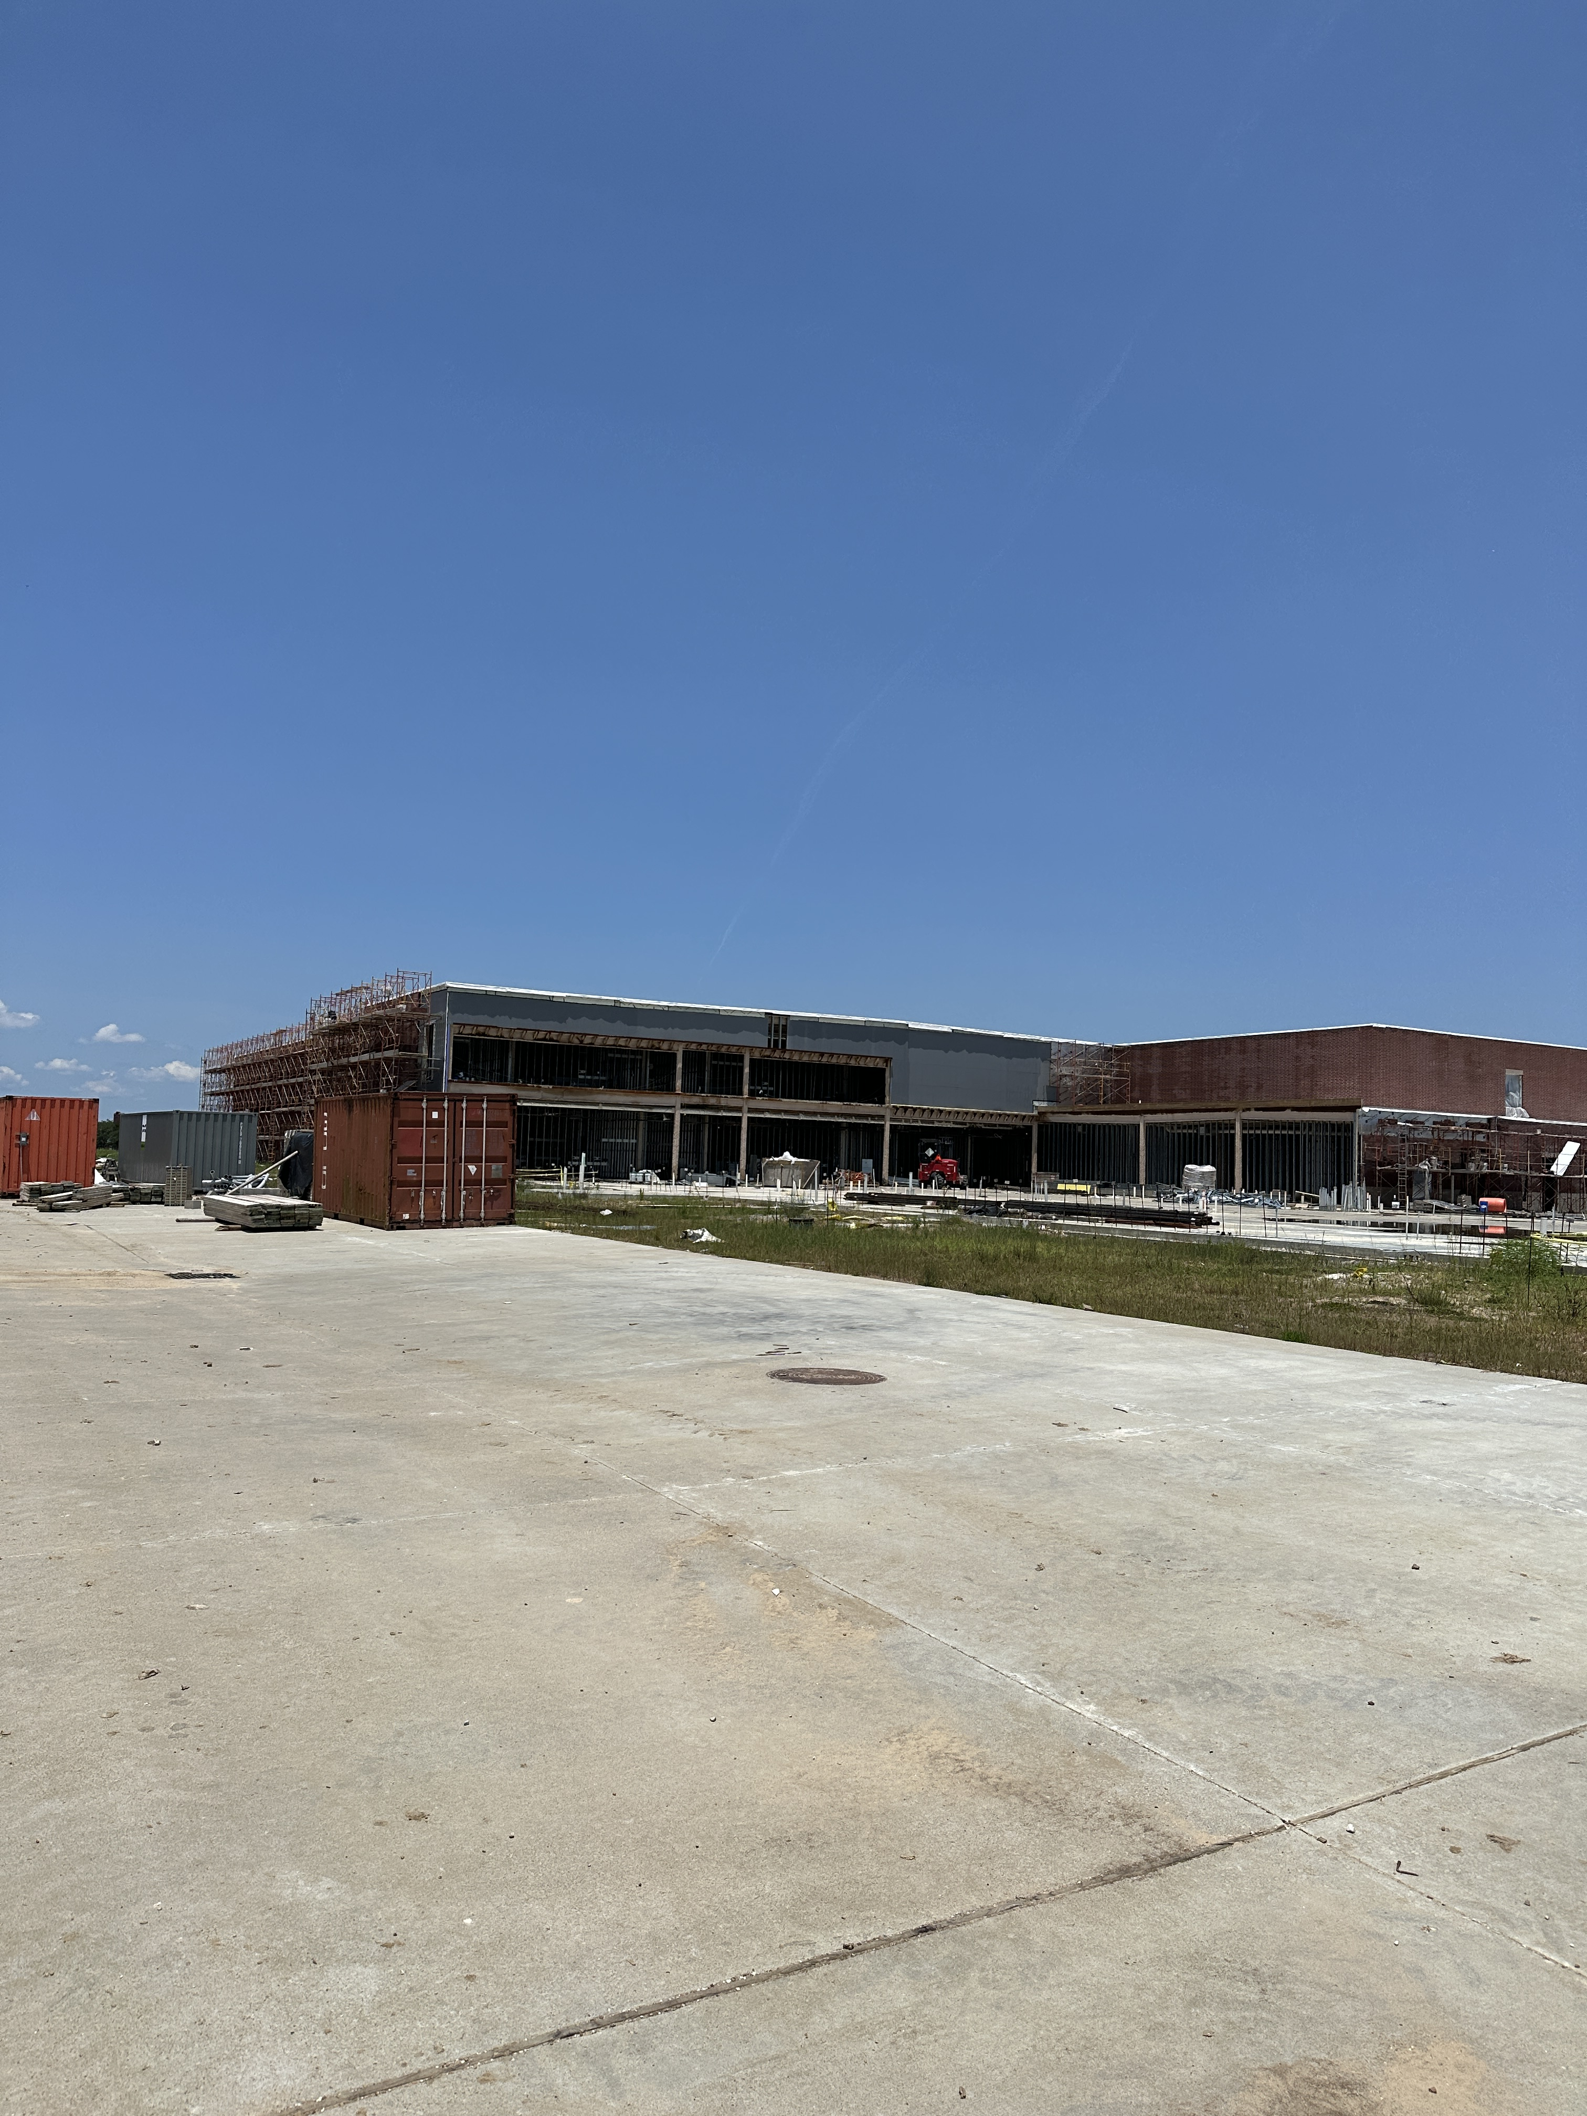
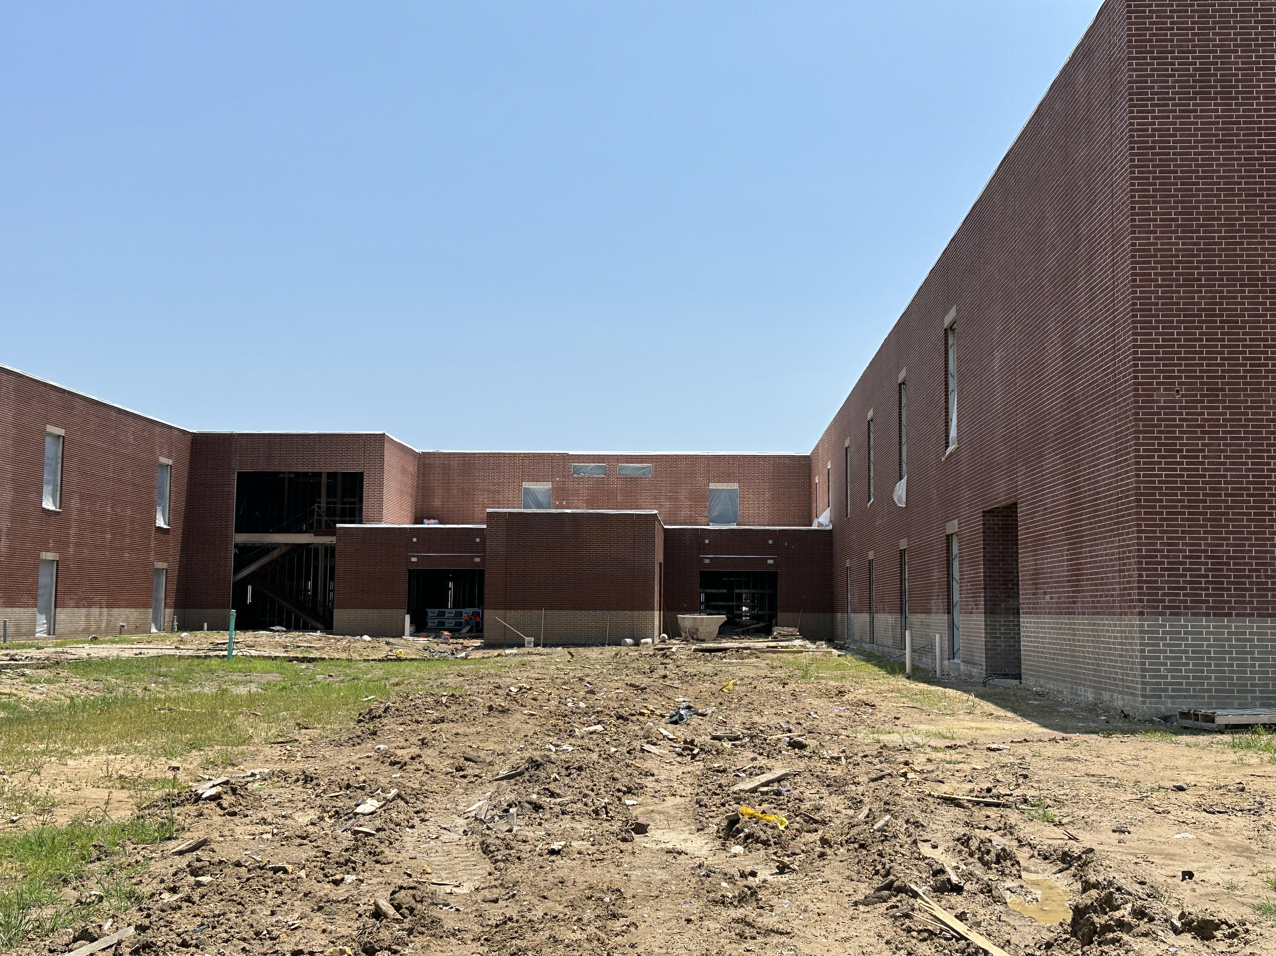
Nederland High School
Gymnasium Entrance
Masonry & Cast Stone at School Entrance
Window Installation around building

Slide 5
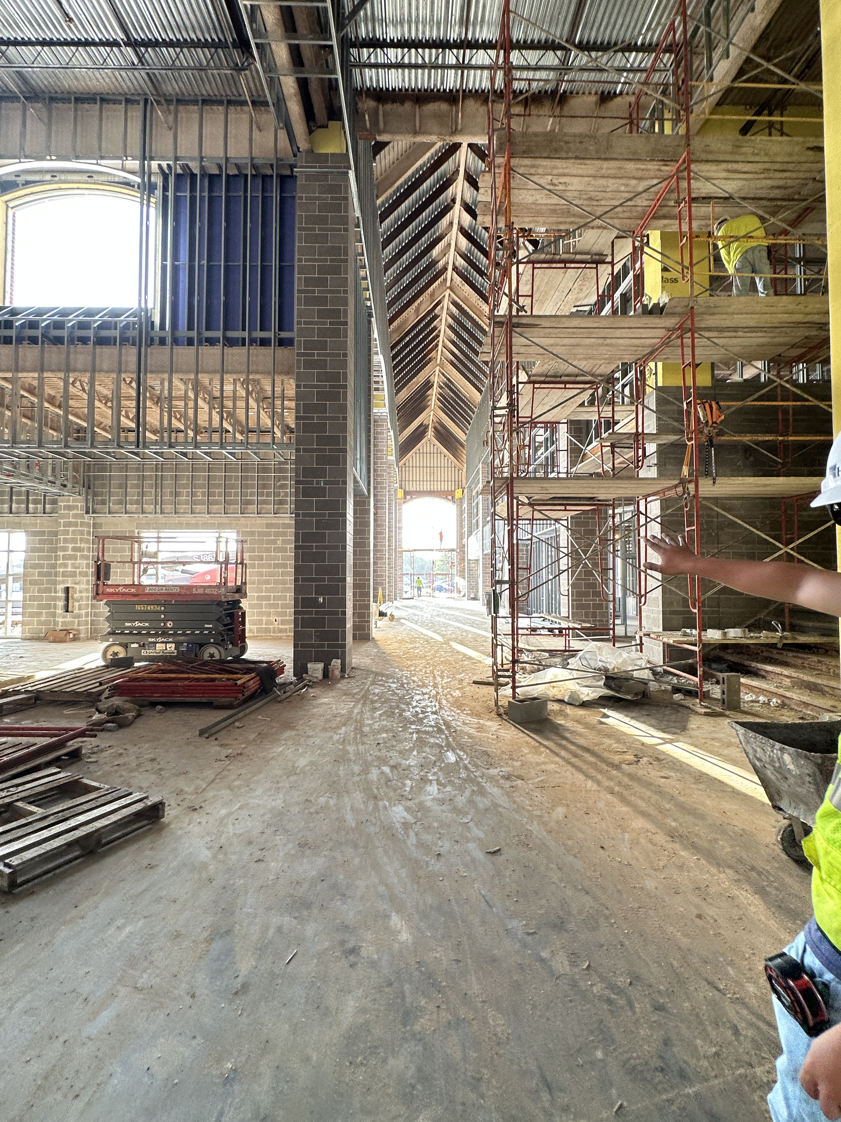
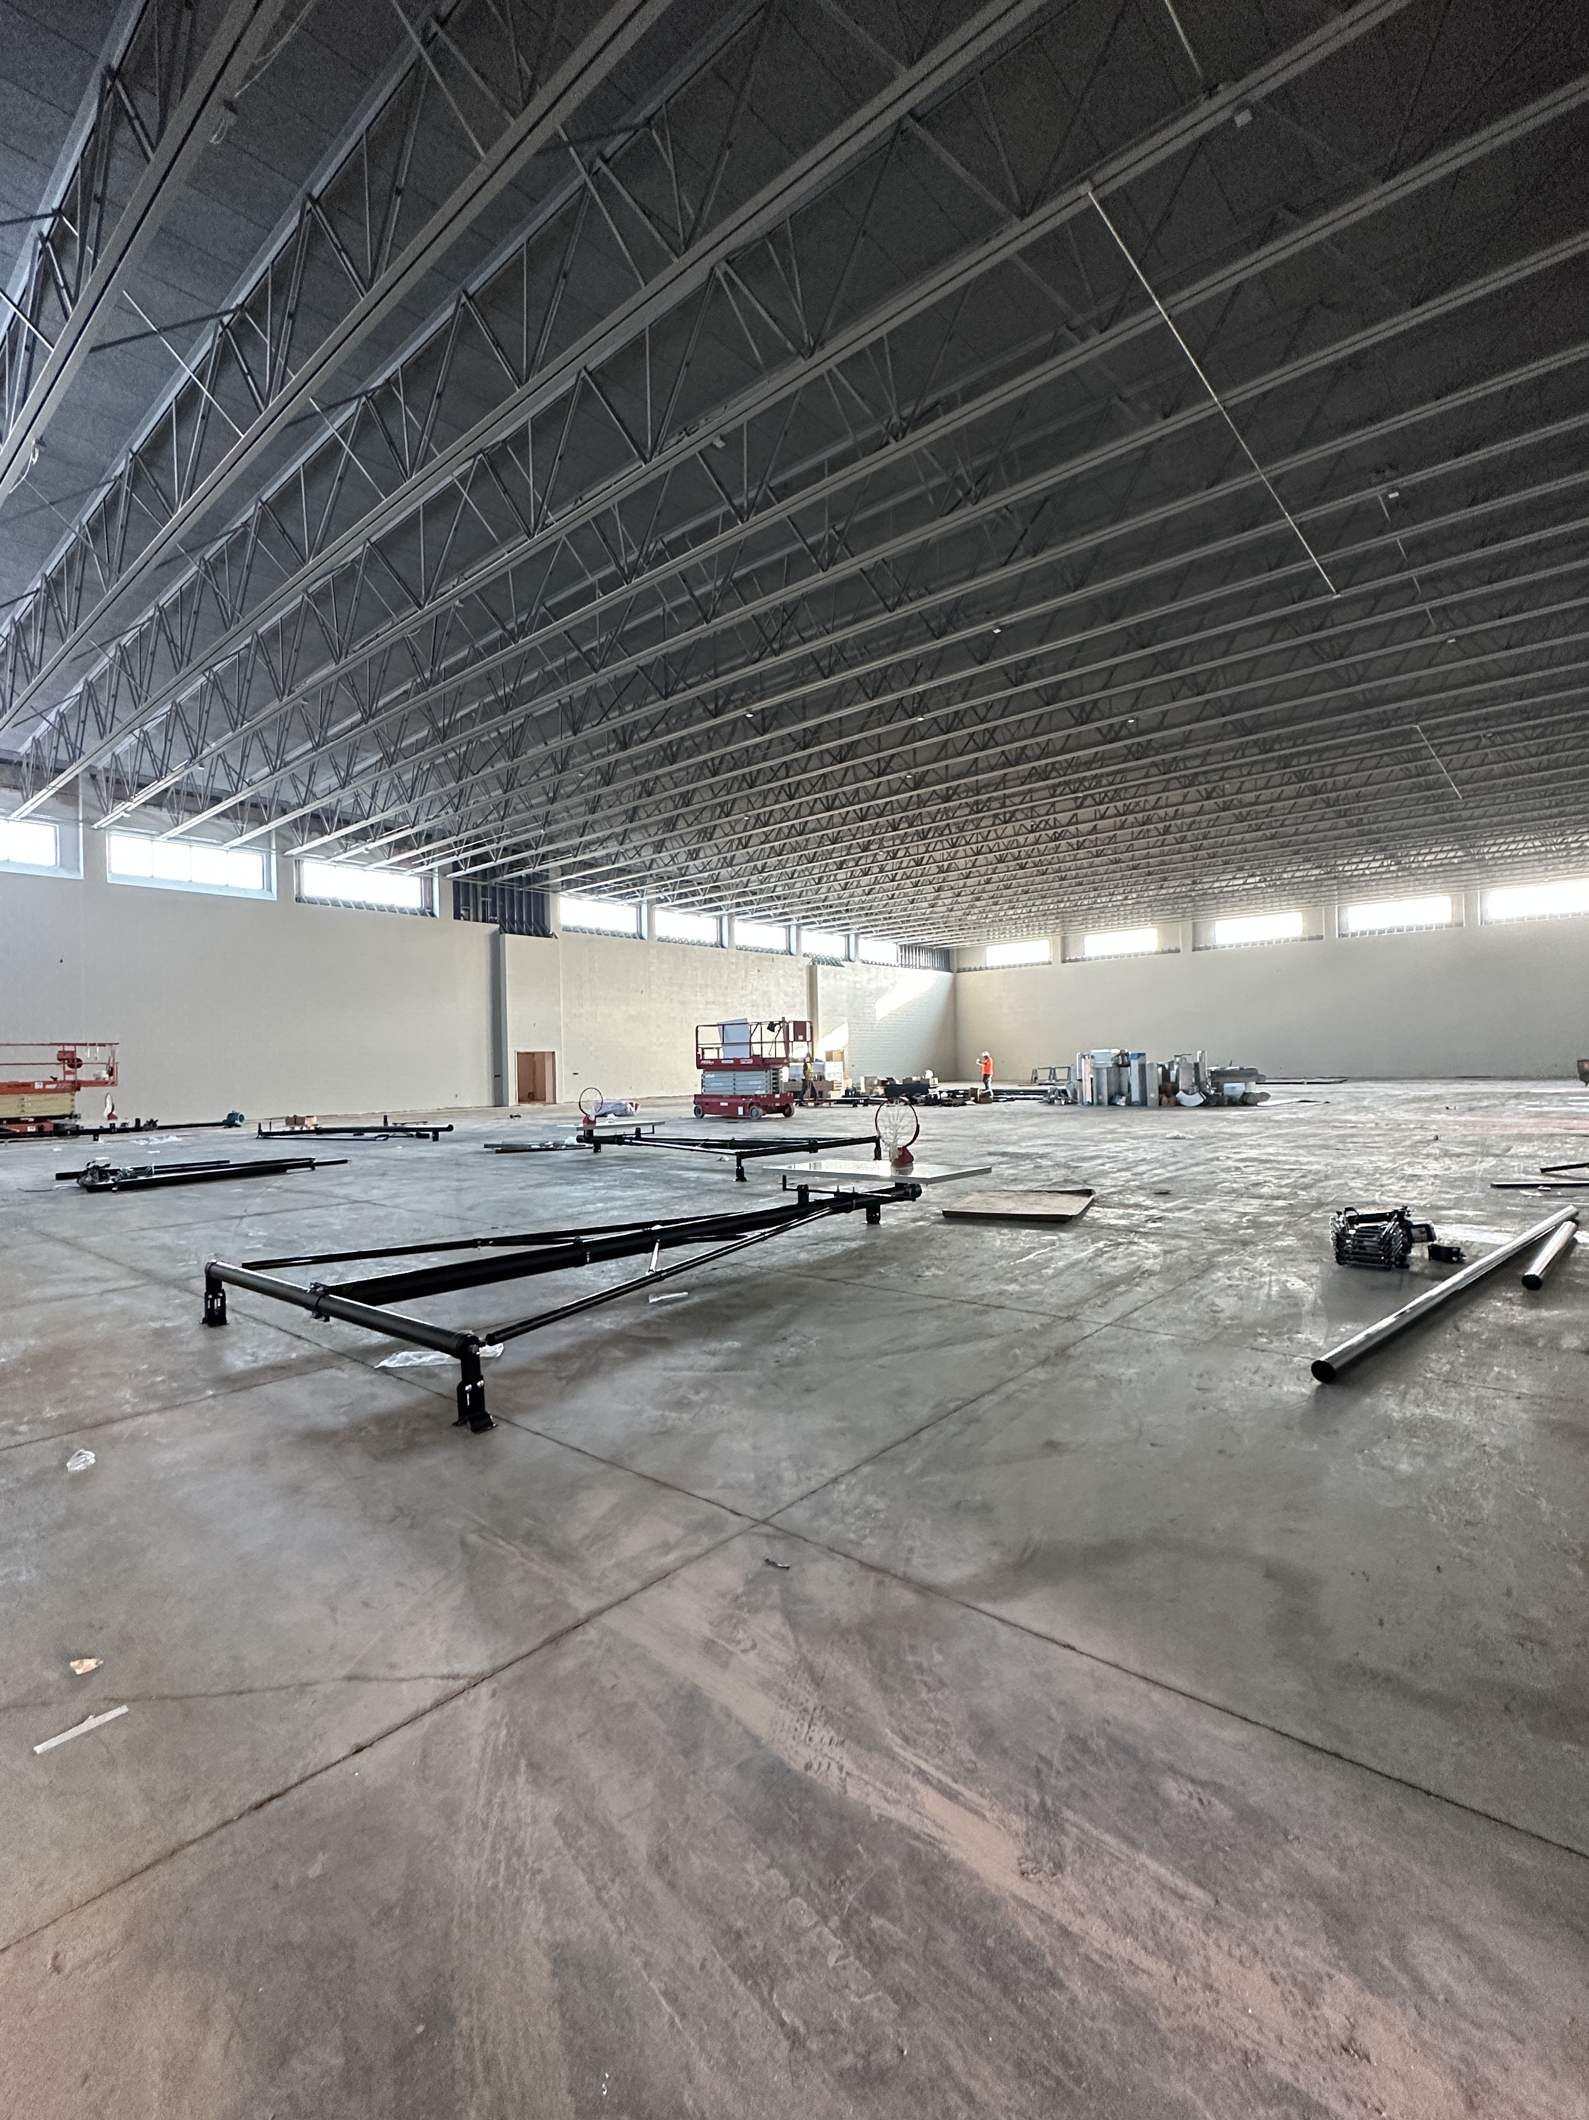
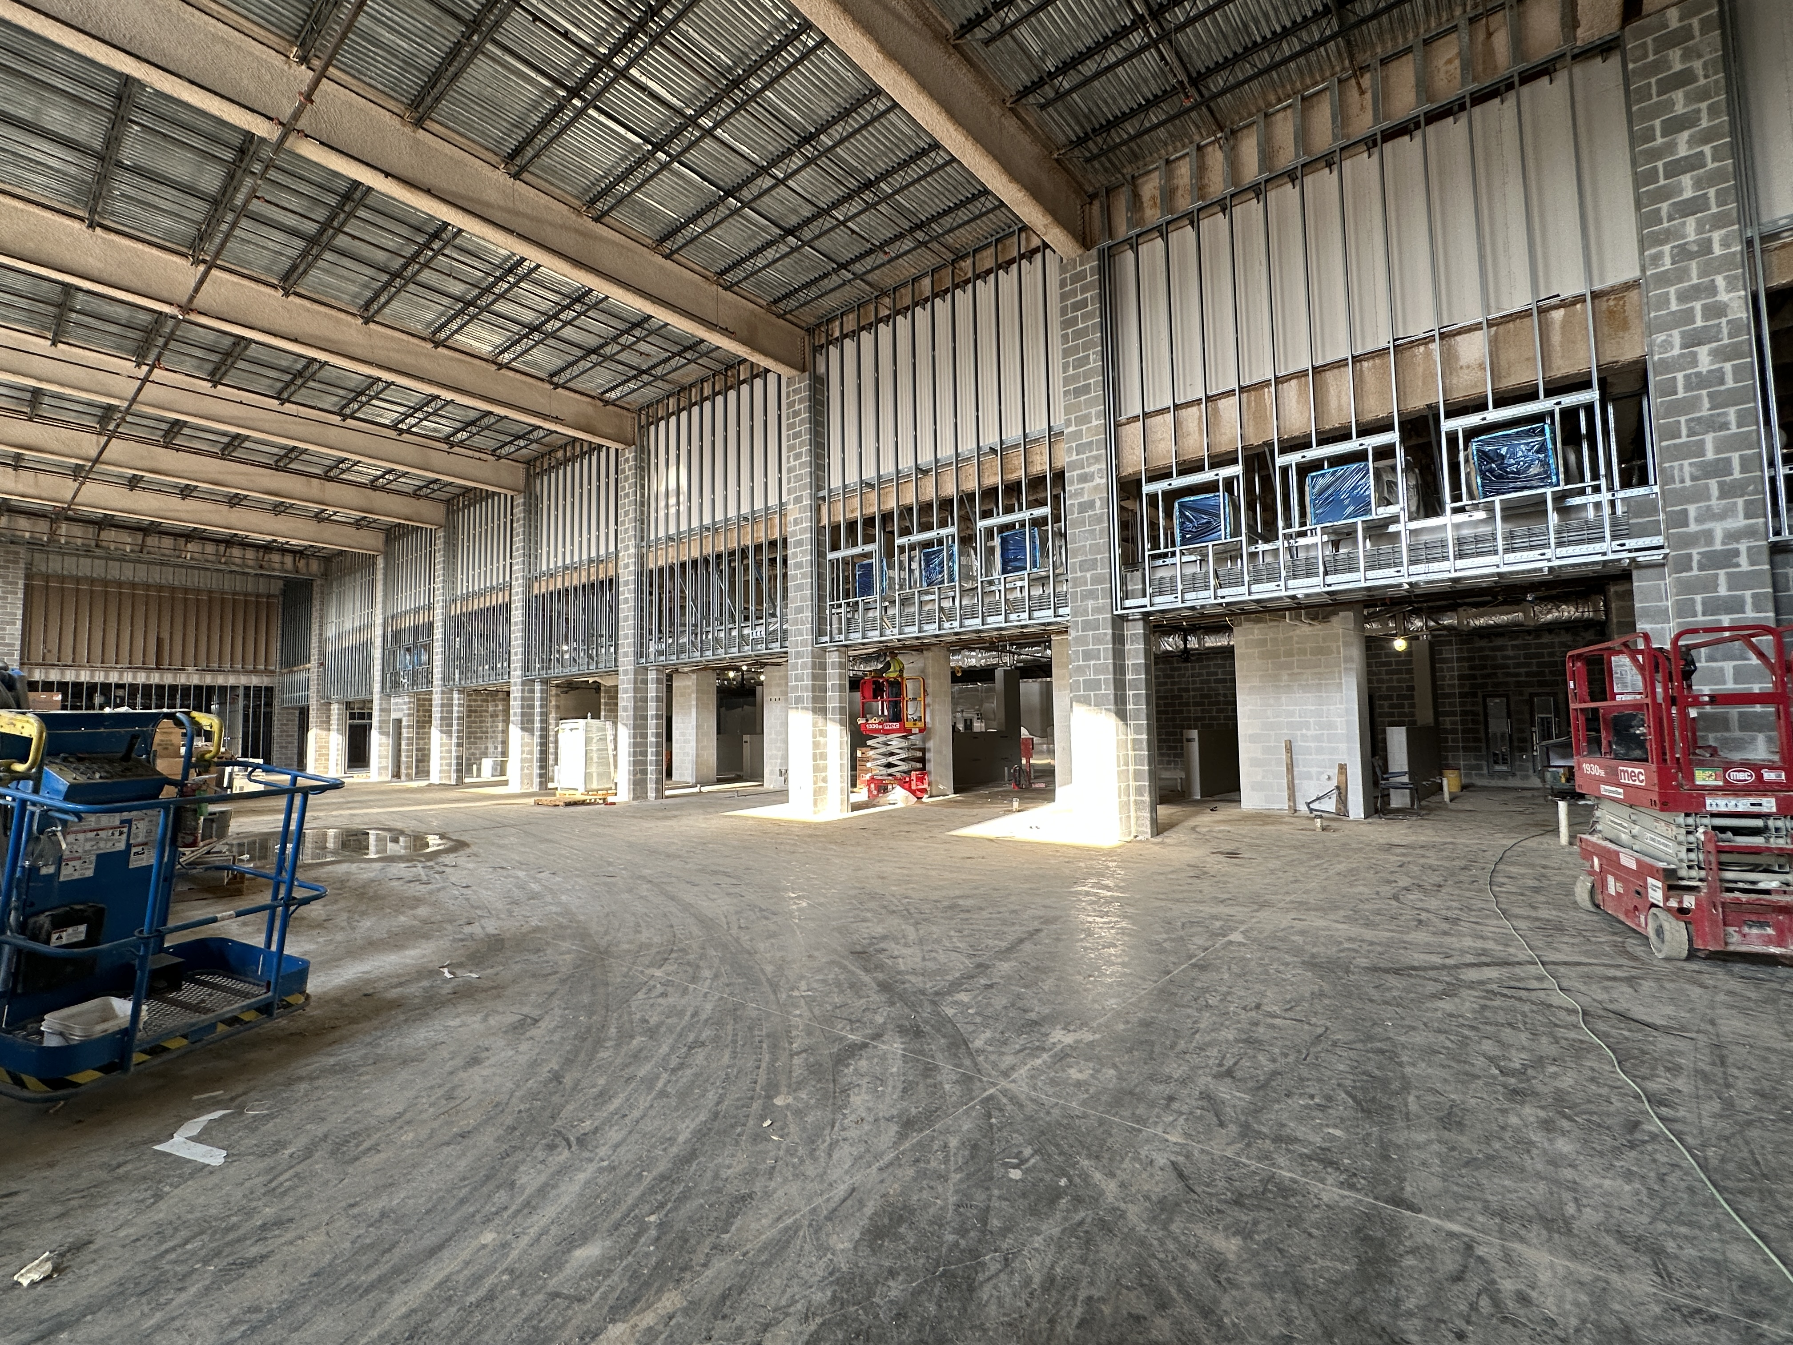
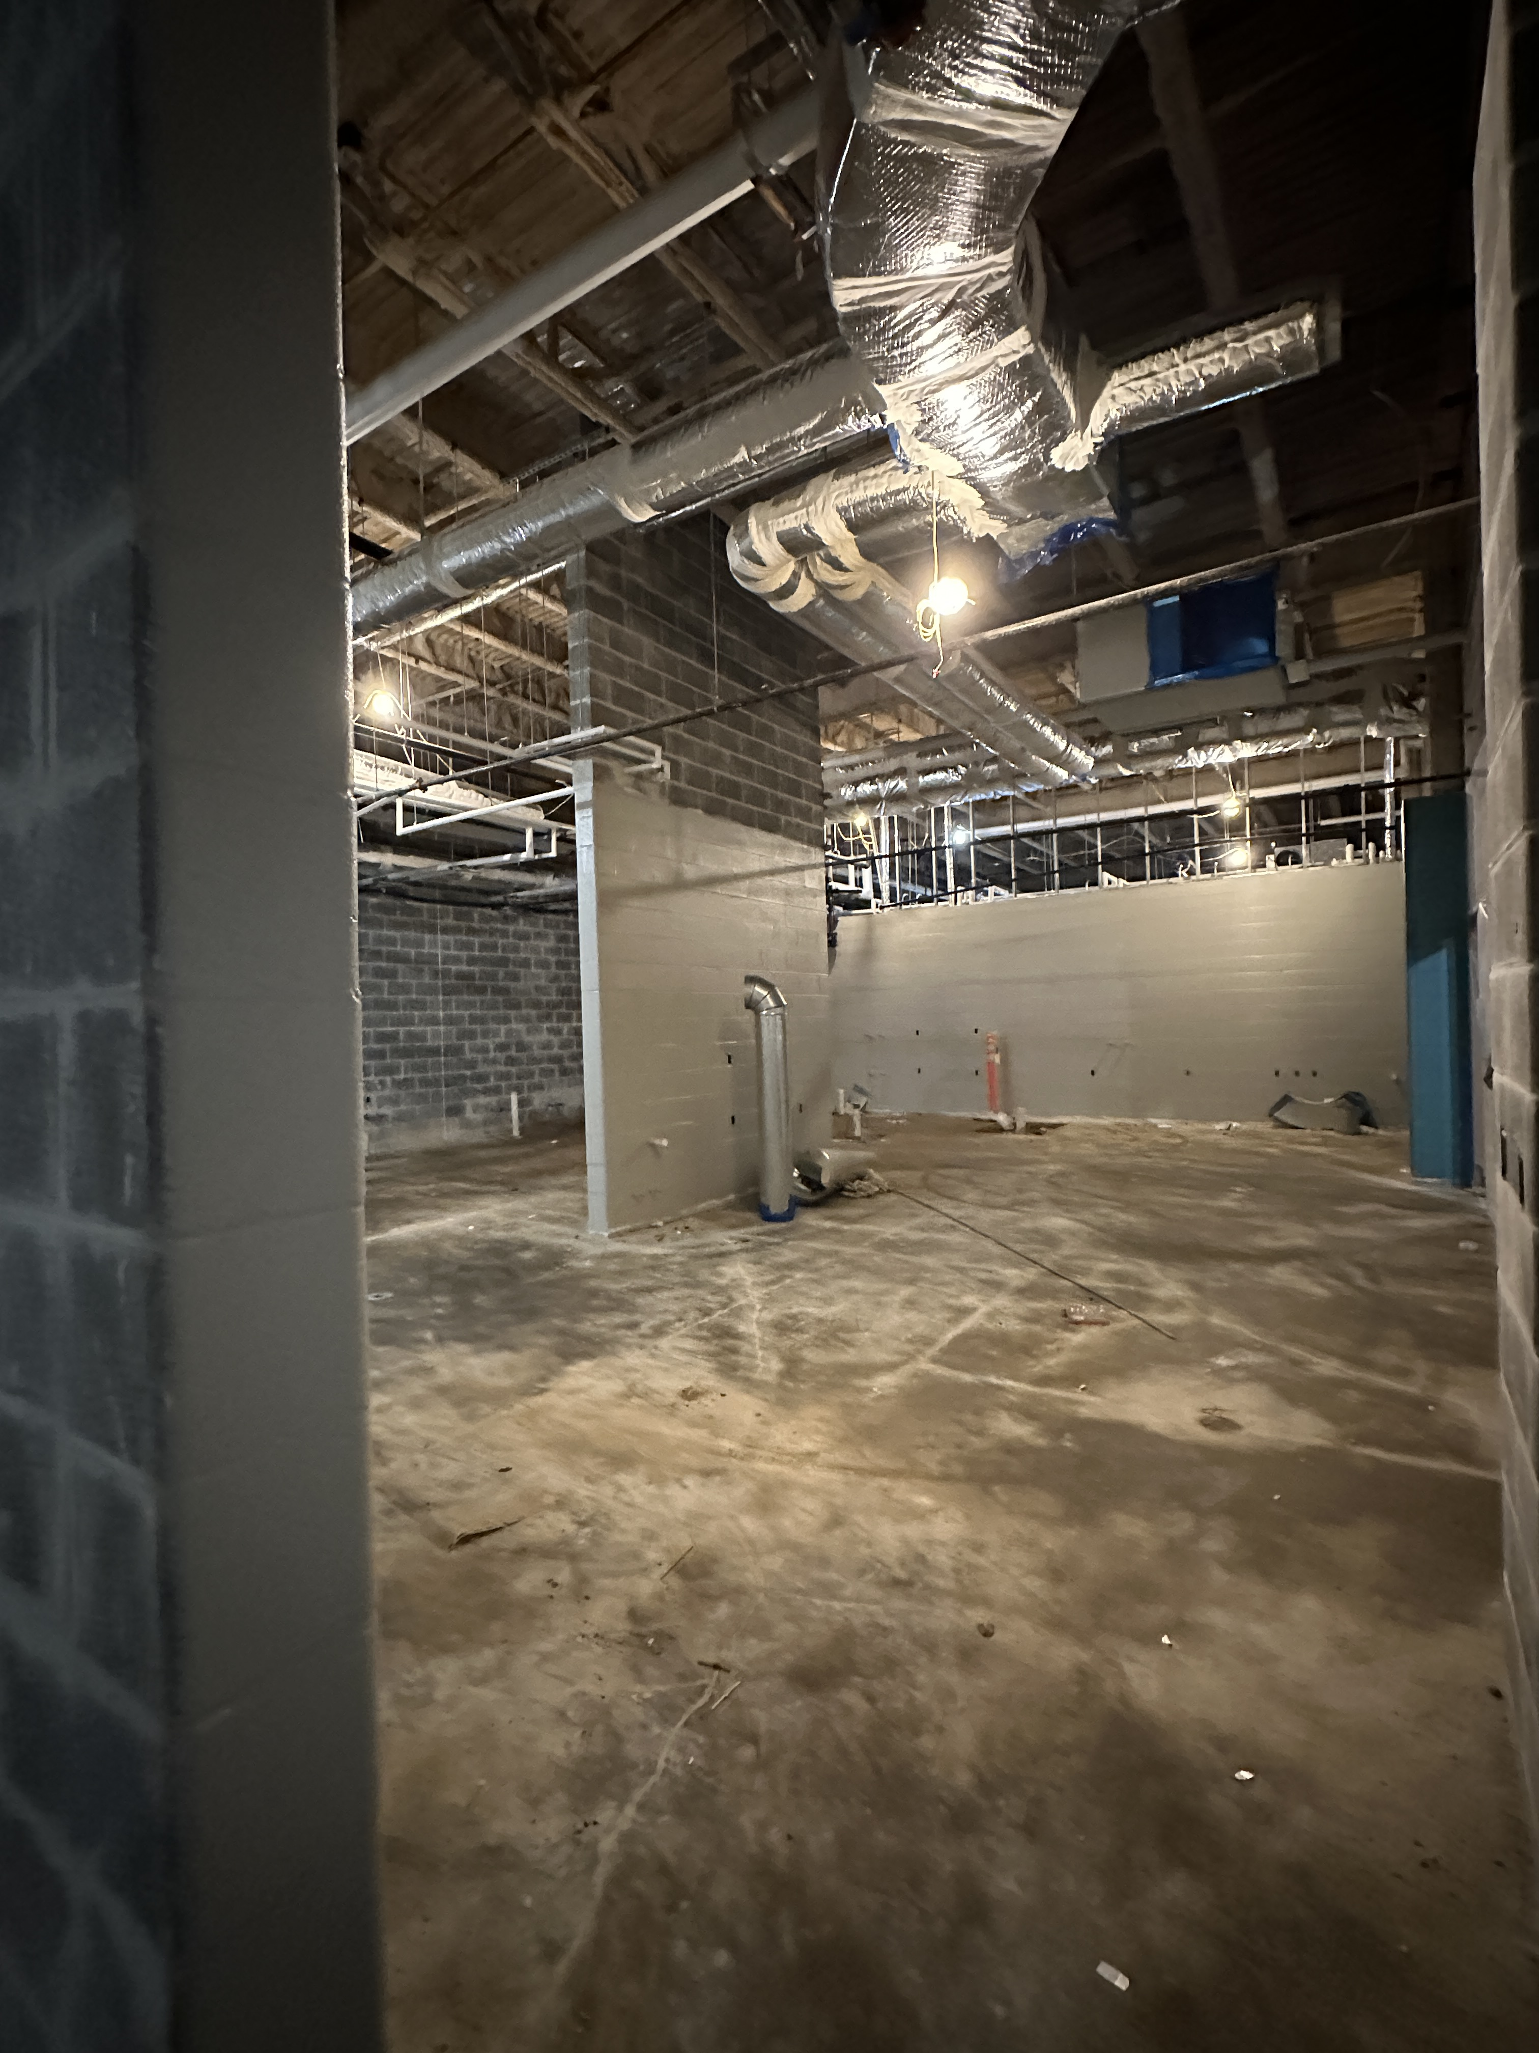
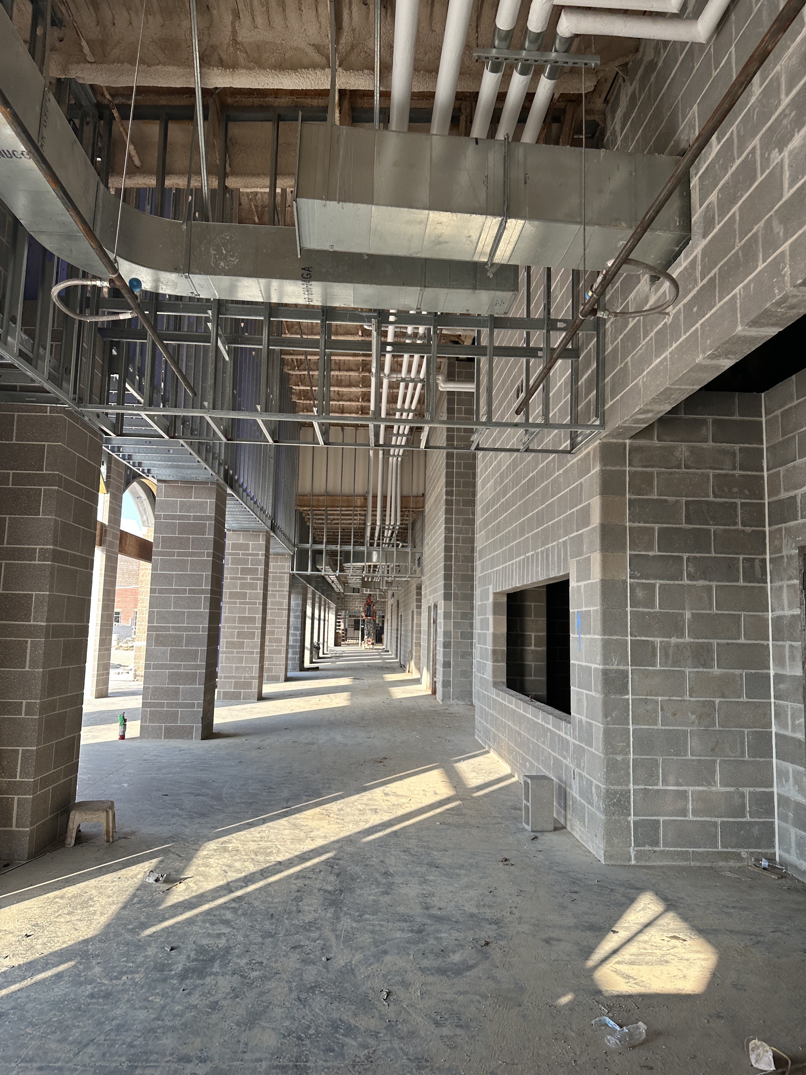
Nederland High School
Cafeteria / Kitchen
Gym
Top Left: Gable Entrance
Middle: Cafeteria
Top Right: Gymnasium
Bottom Left: Culinary Arts
Bottom Right: Corridor connecting cafeteria and gymnasium
Culinary Arts

Slide 6

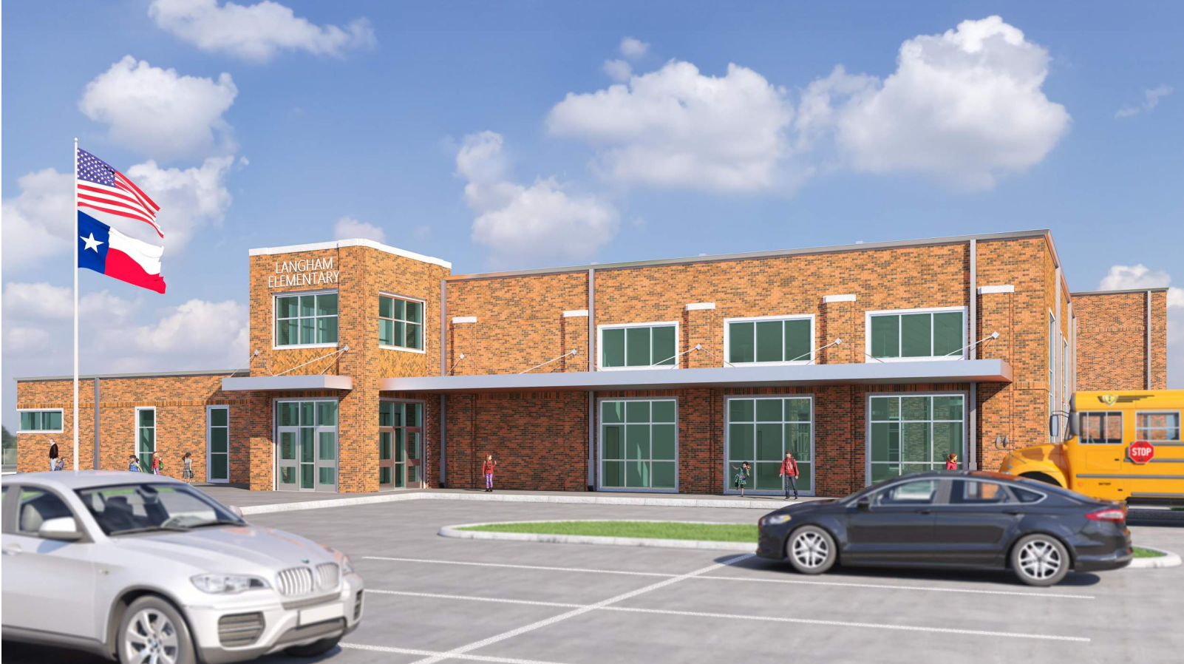
Langham Elementary School

Slide 7
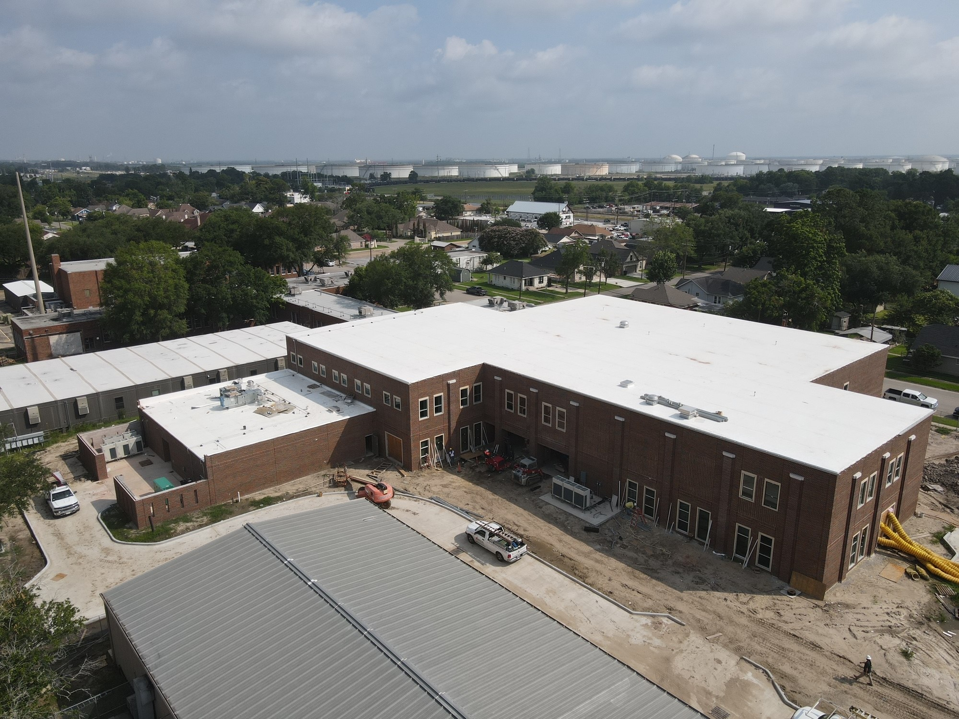
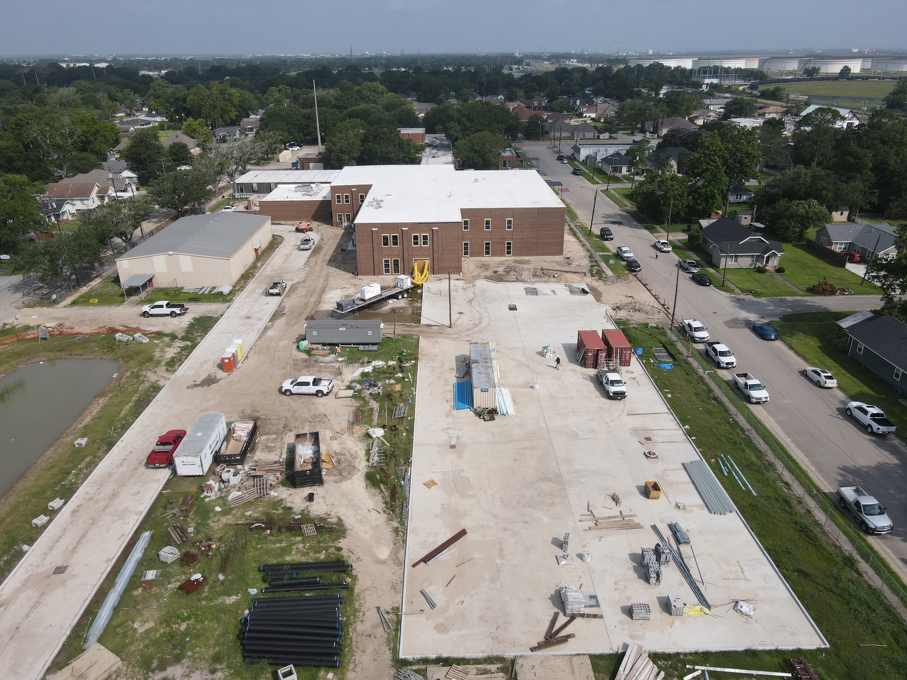
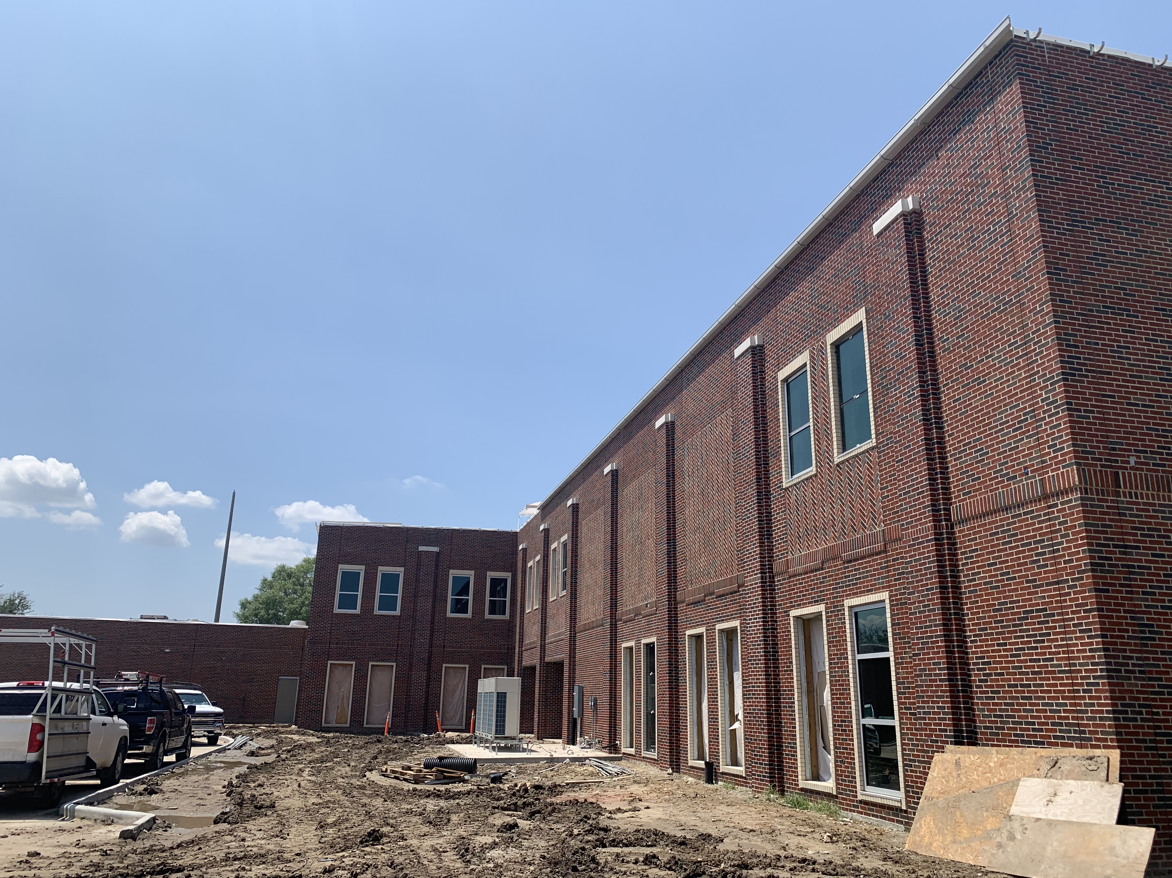
Langham Elementary School
Windows complete
Begin Final Storm Sewer
Remove Portables
Flooring & Tile in building

Slide 8
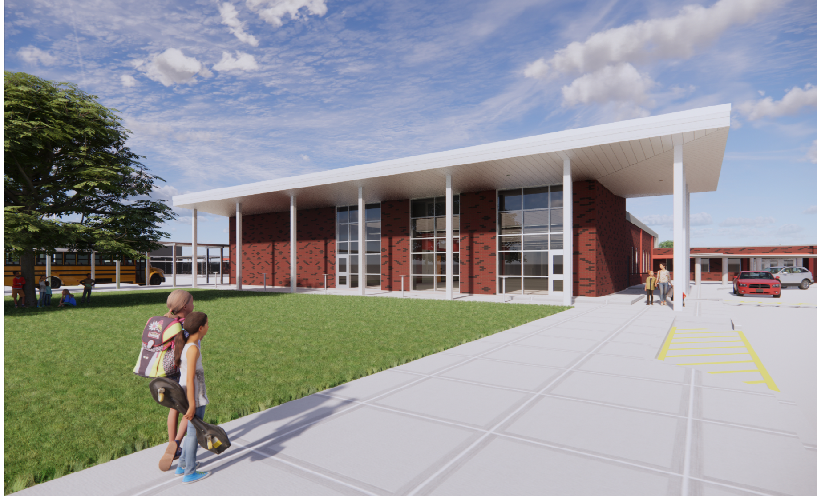
Hillcrest Elementary School

Slide 9
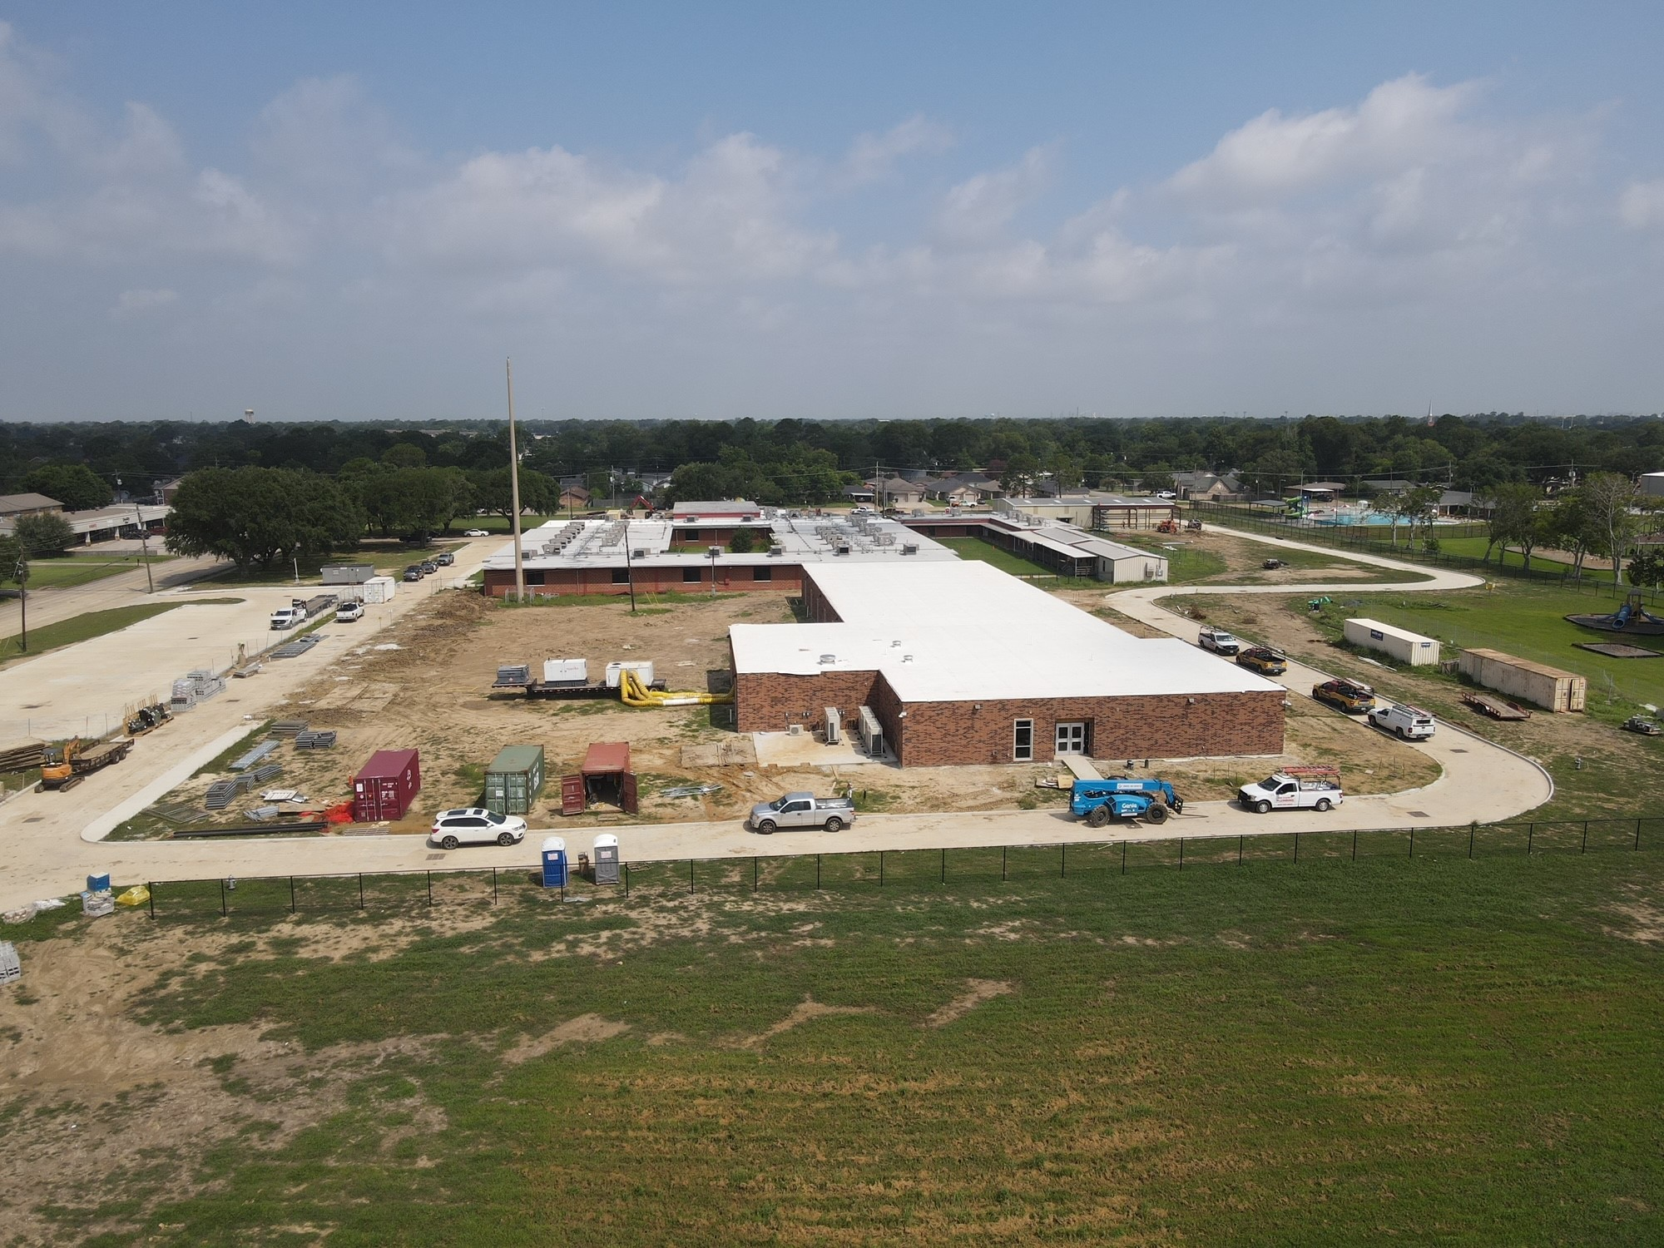
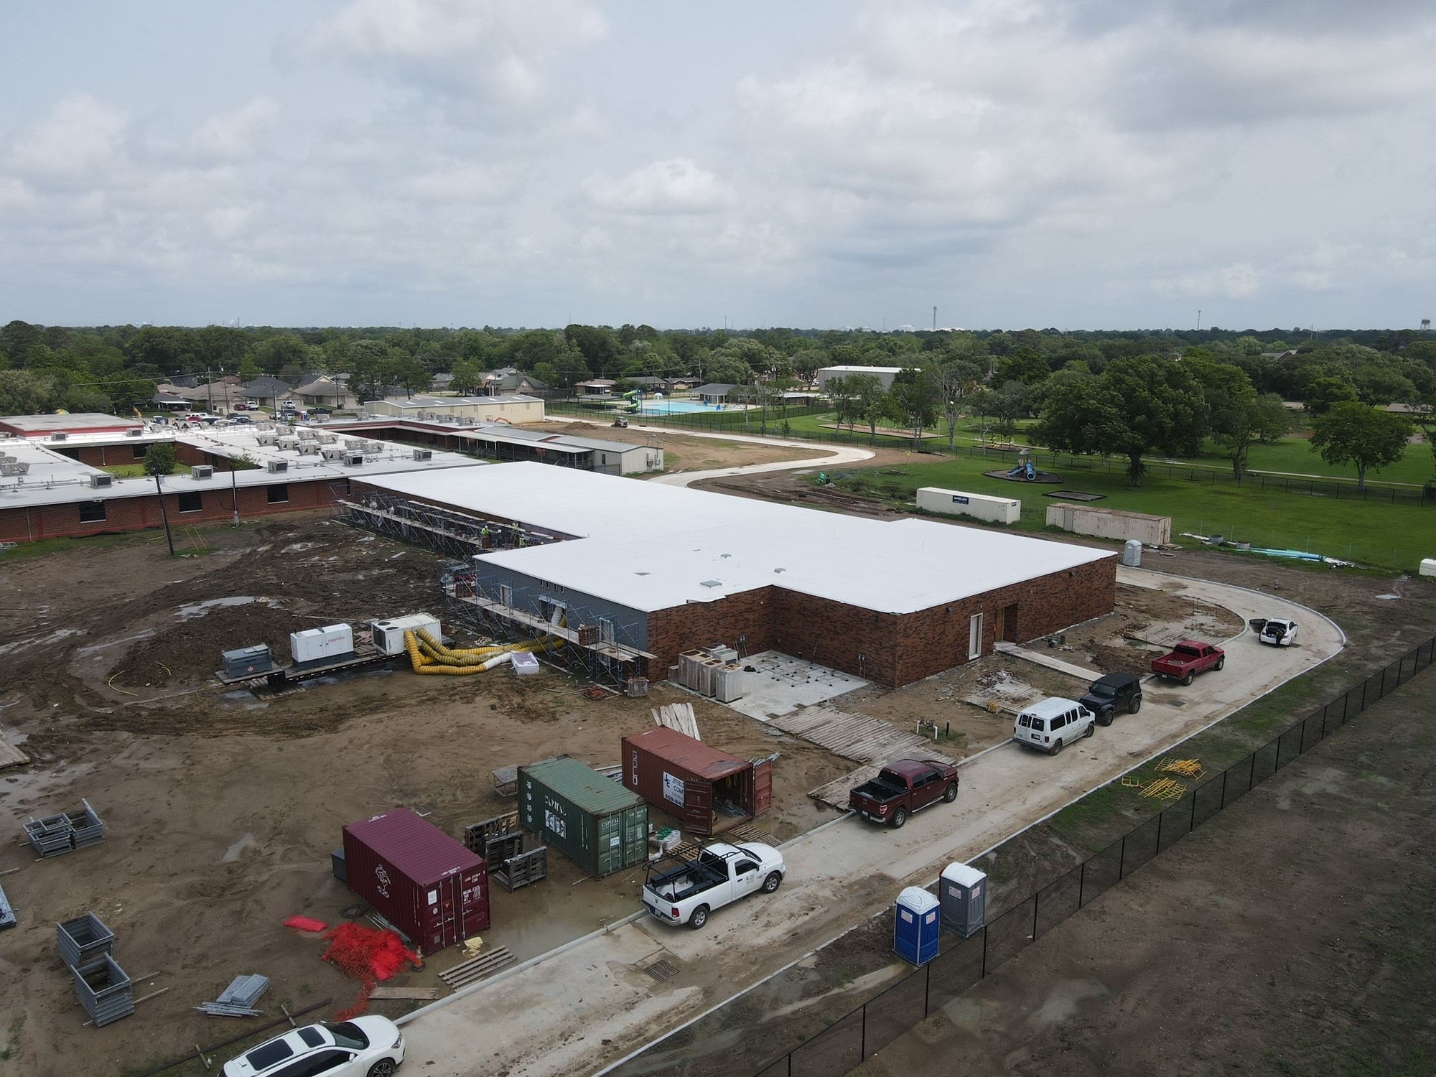
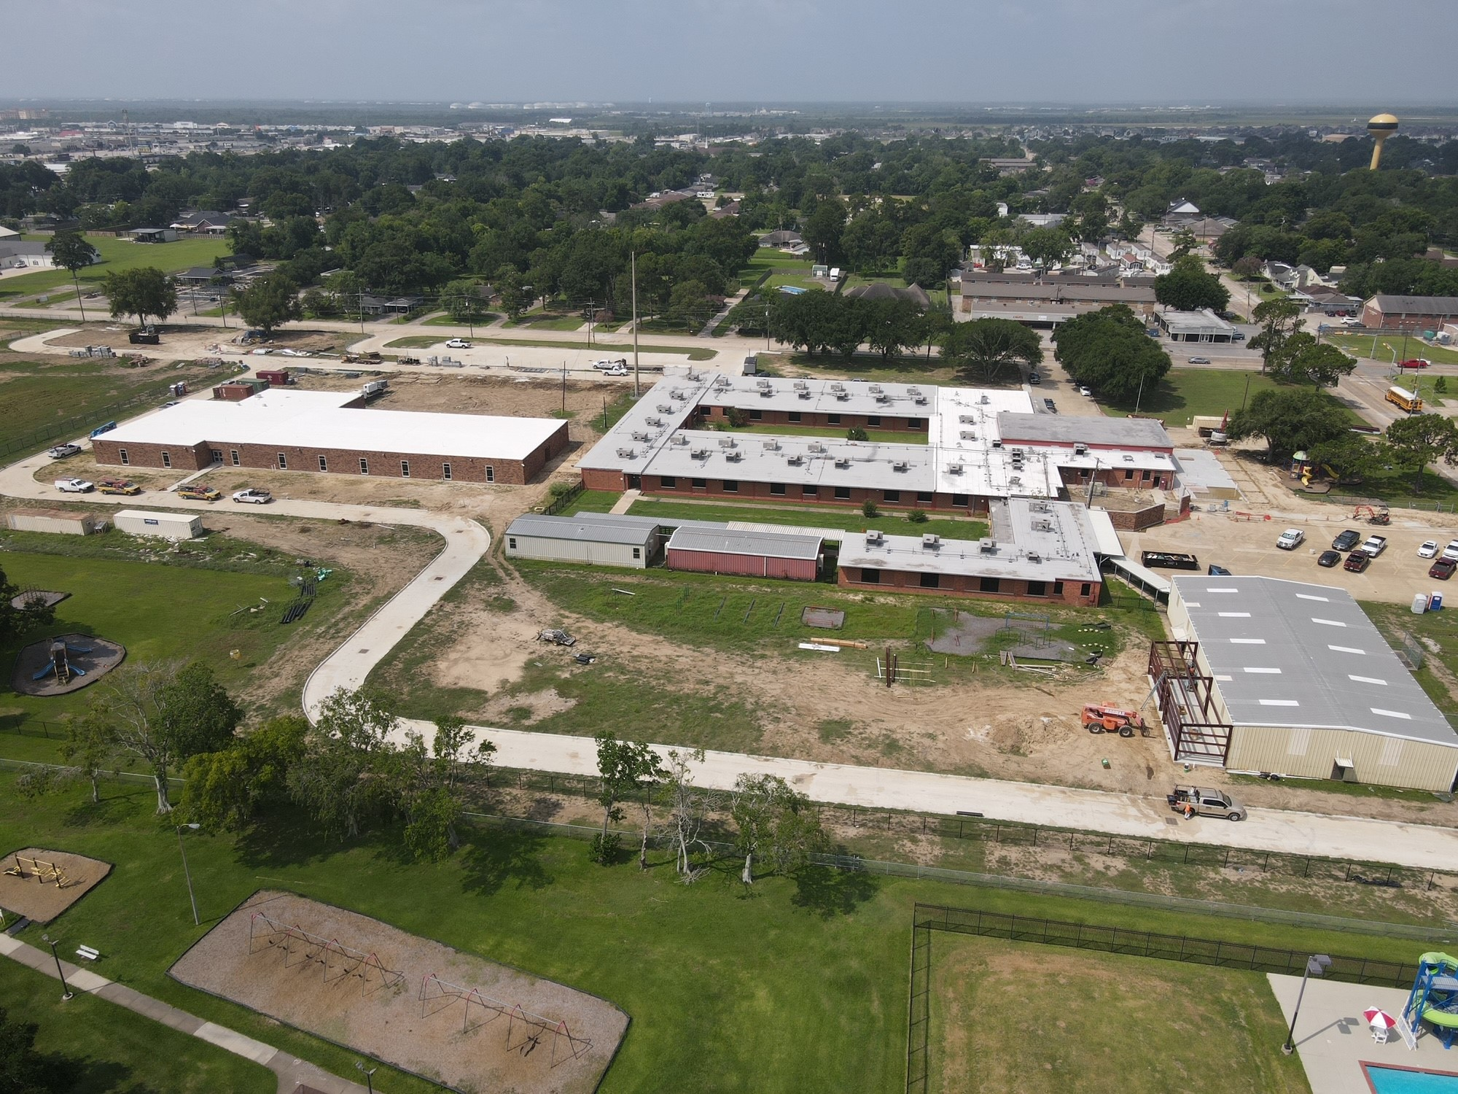
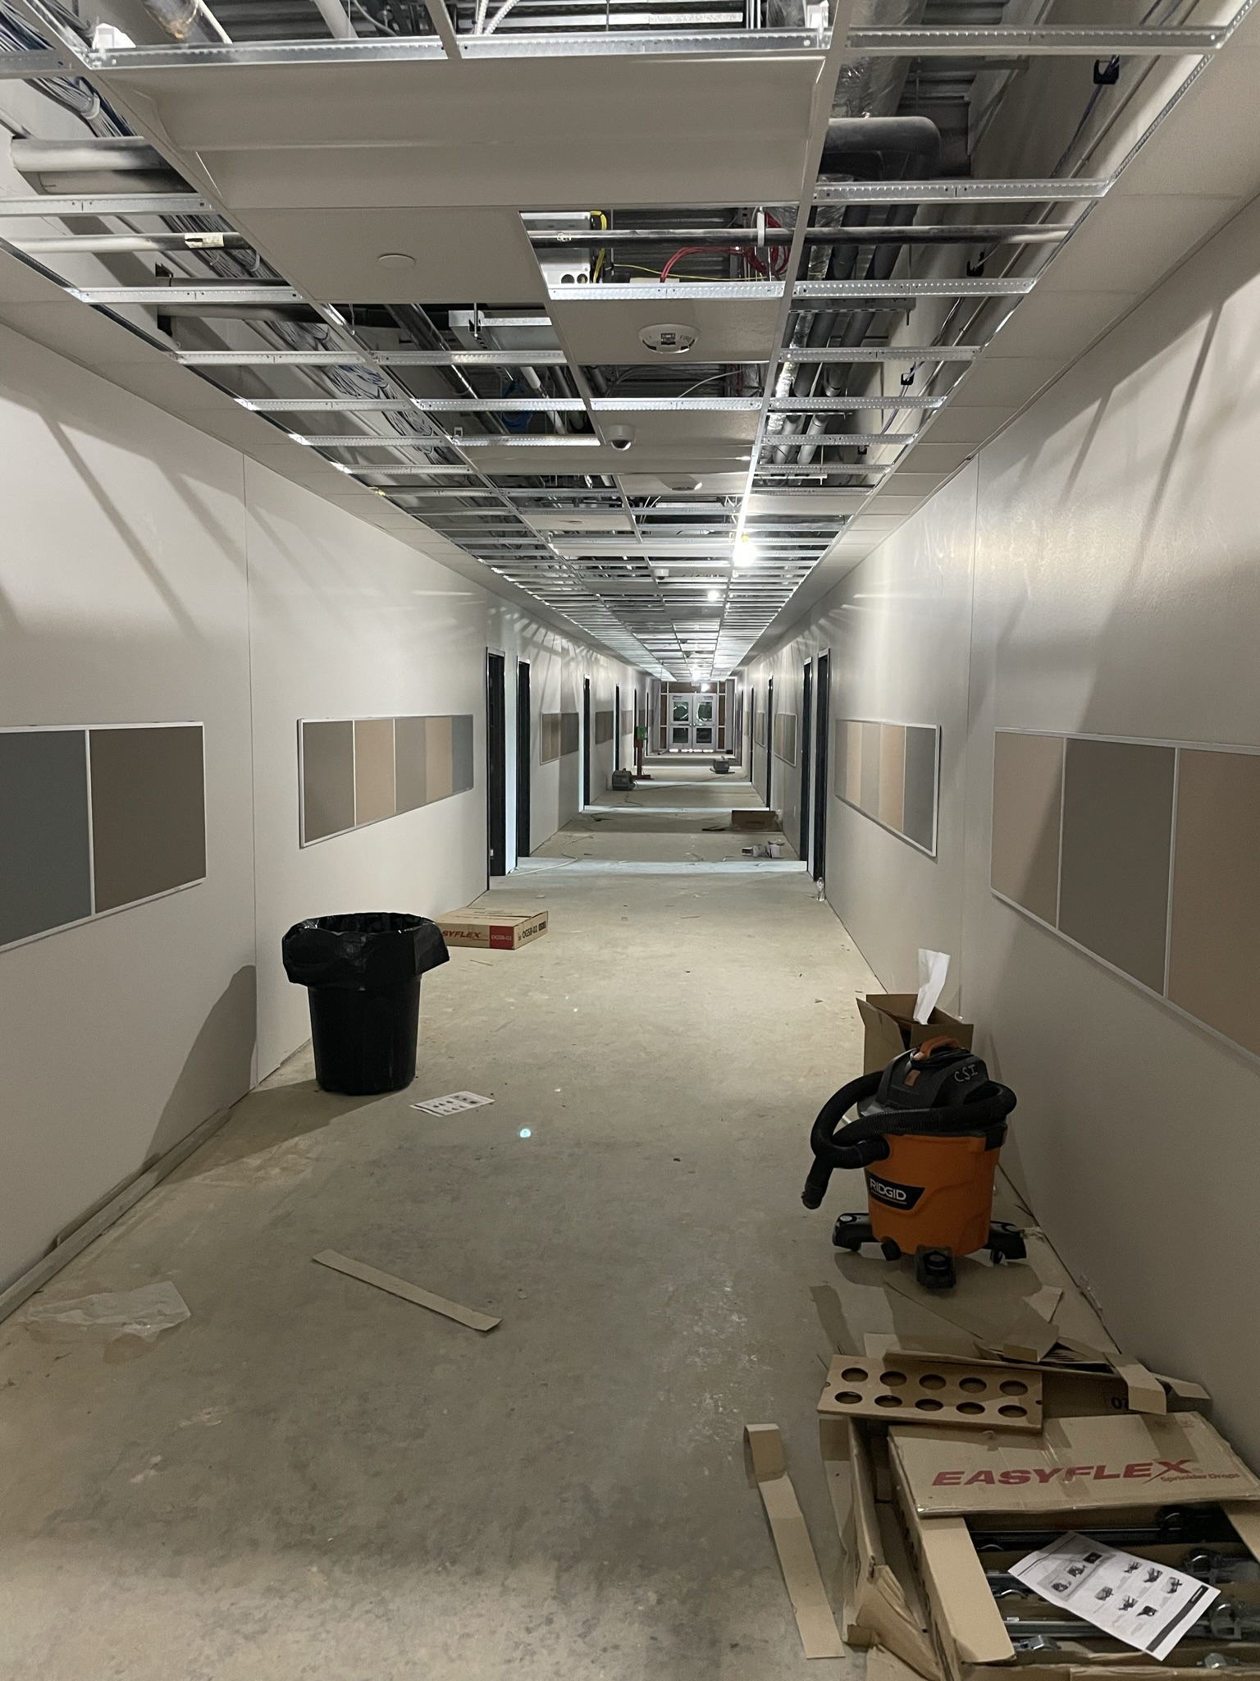
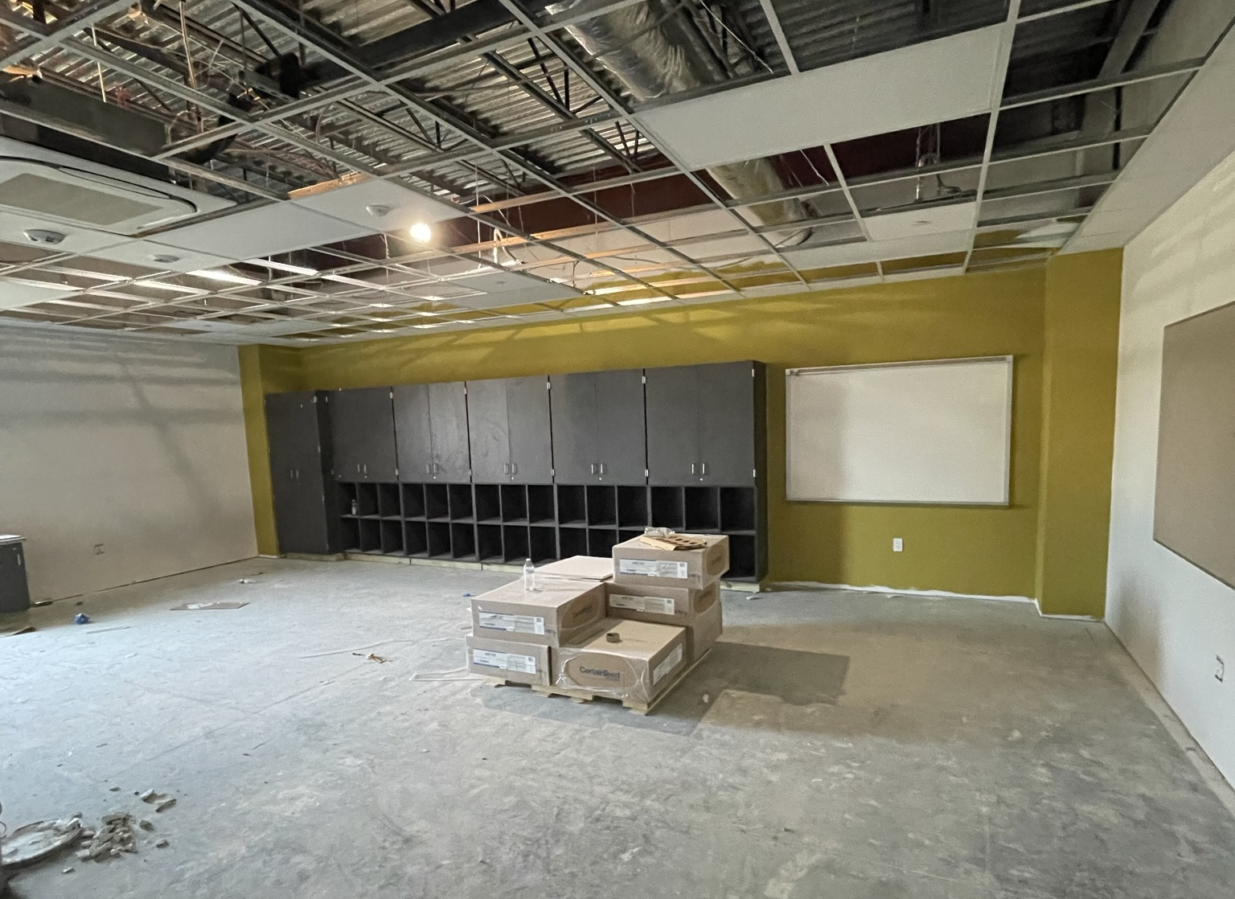
Hillcrest Elementary School
Windows are complete
Complete Flooring and Ceiling Tile
Erect Cafeteria Foundation
Turn on Permanent power

Slide 10
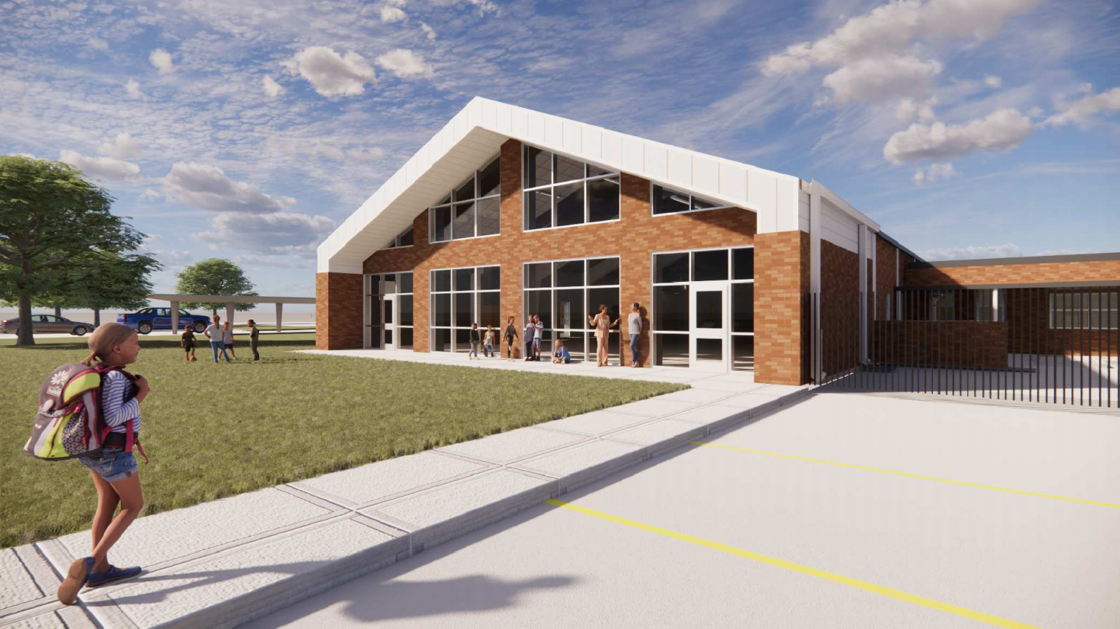
Highland Park Elementary School

Slide 11
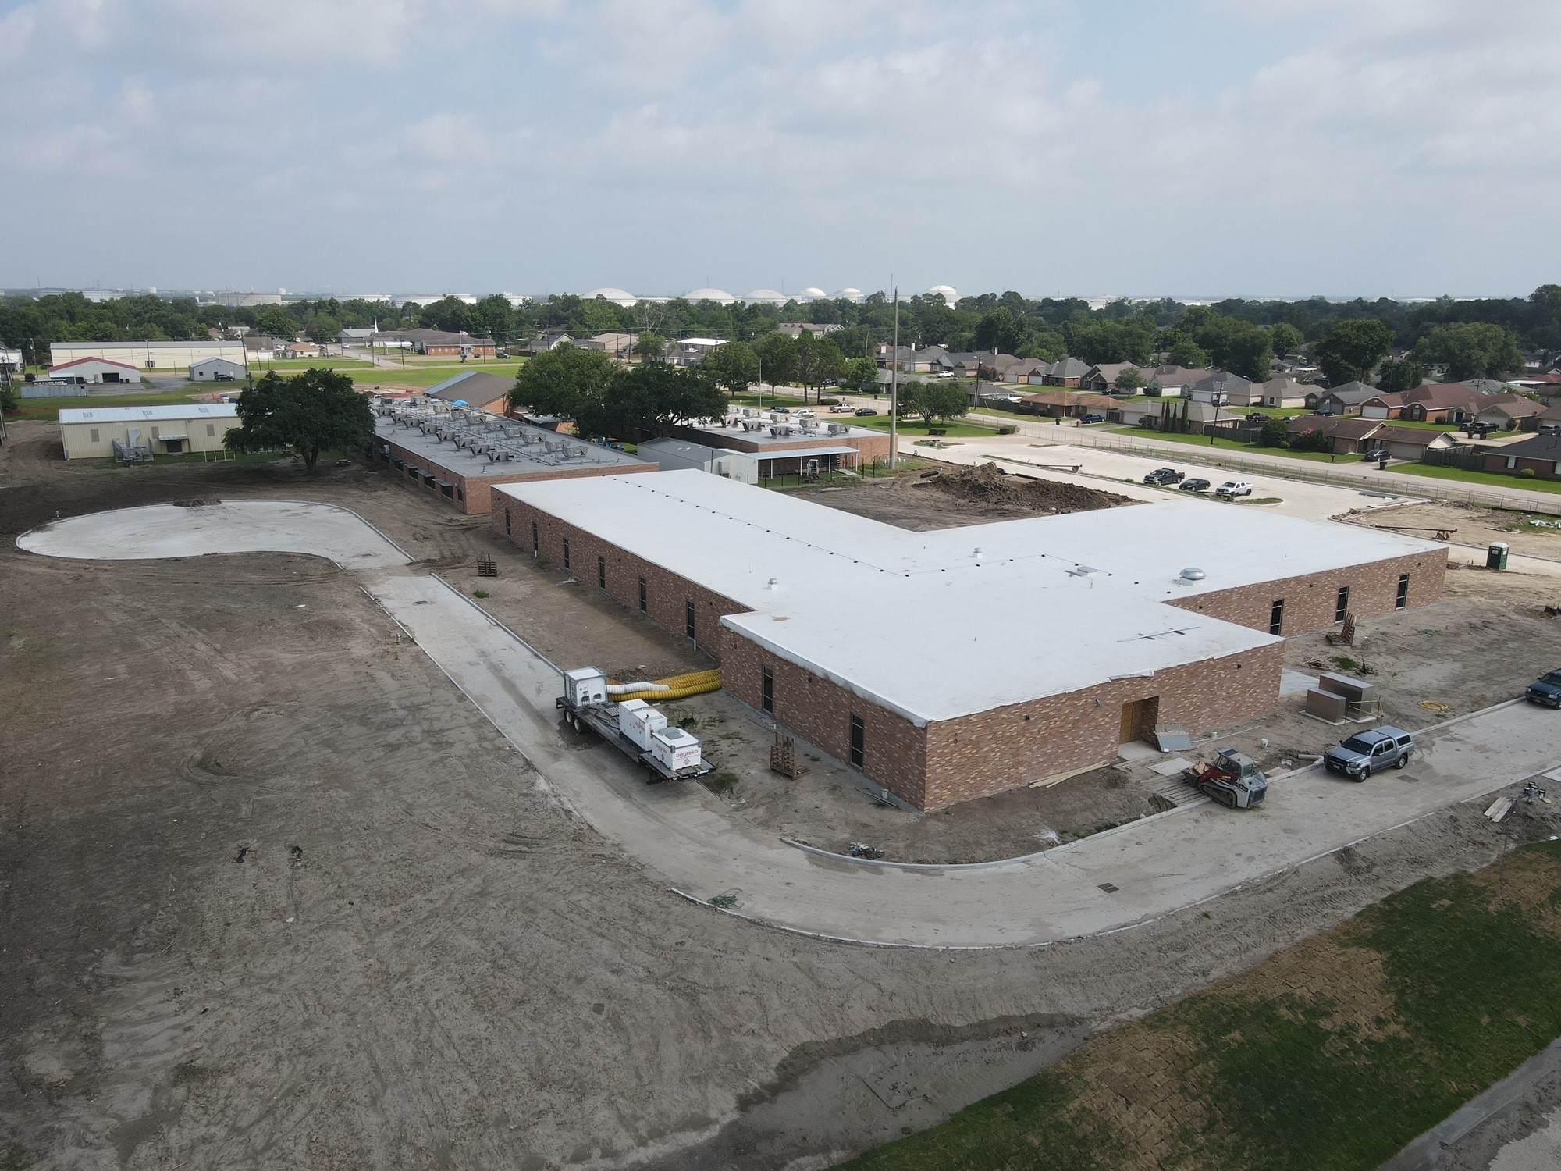
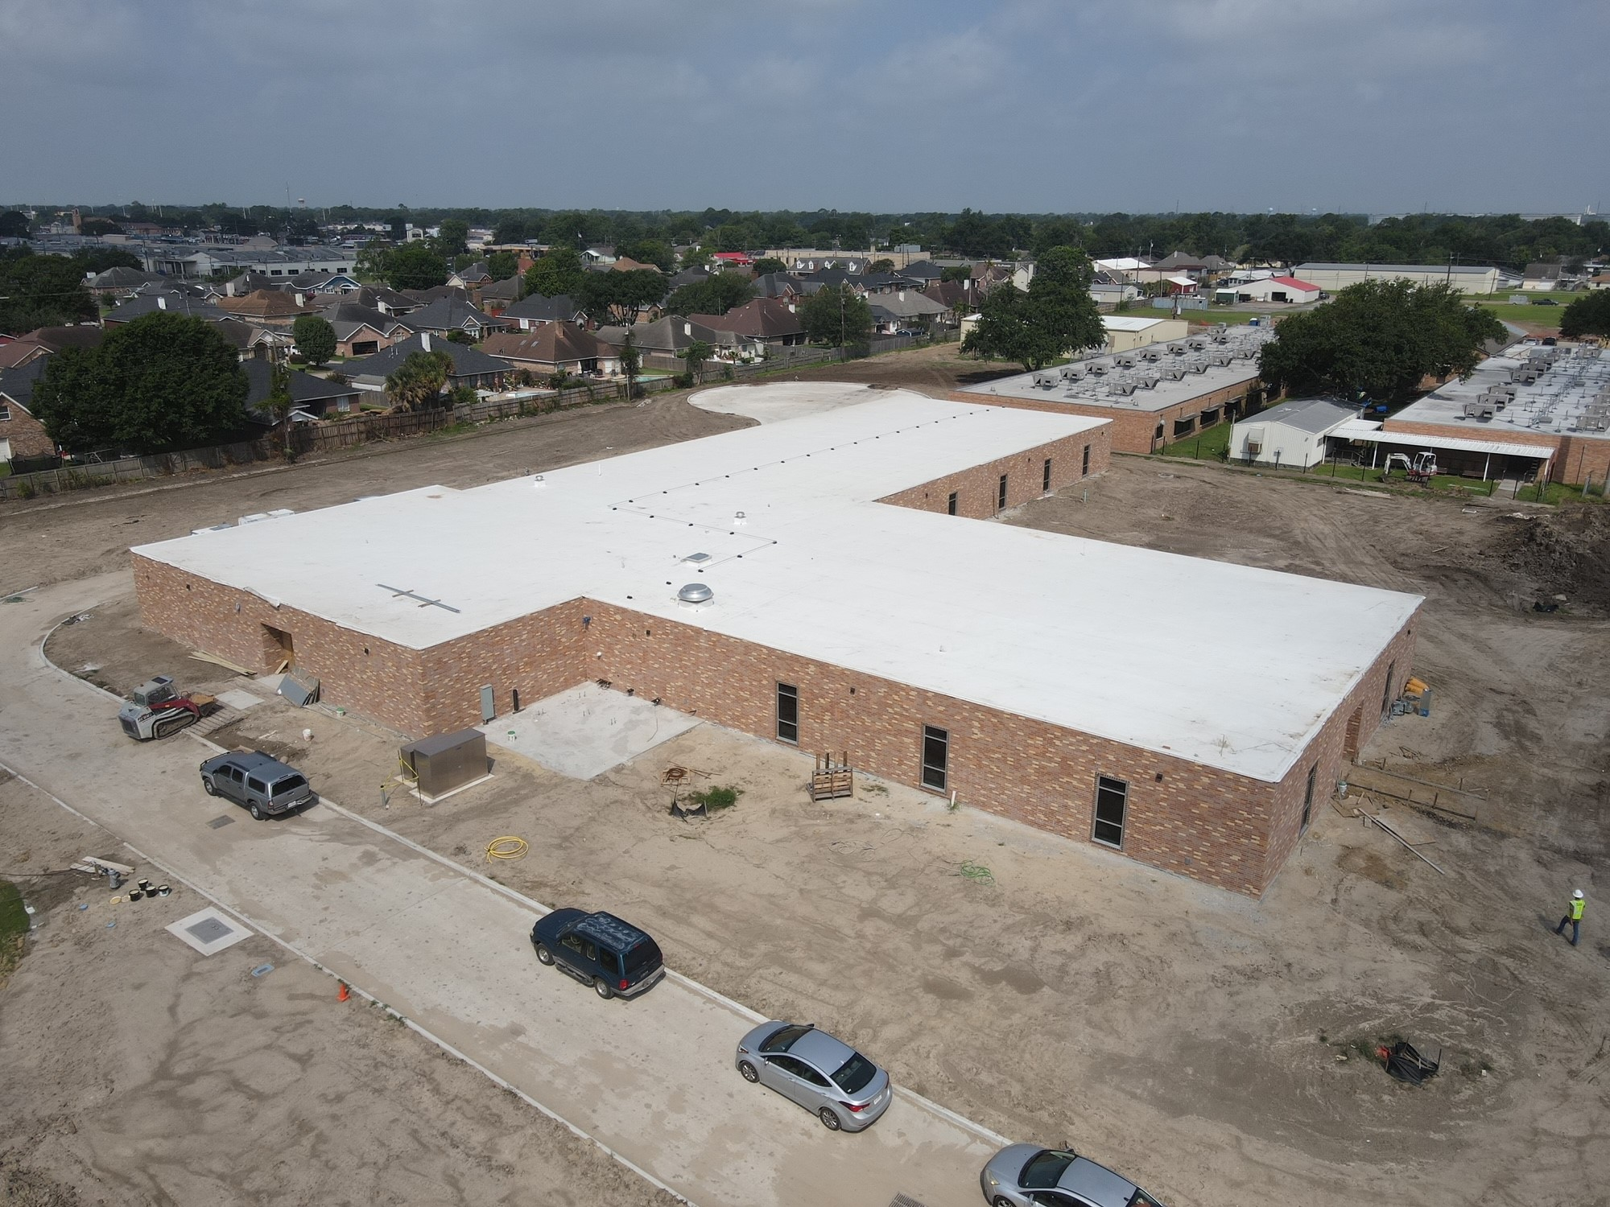
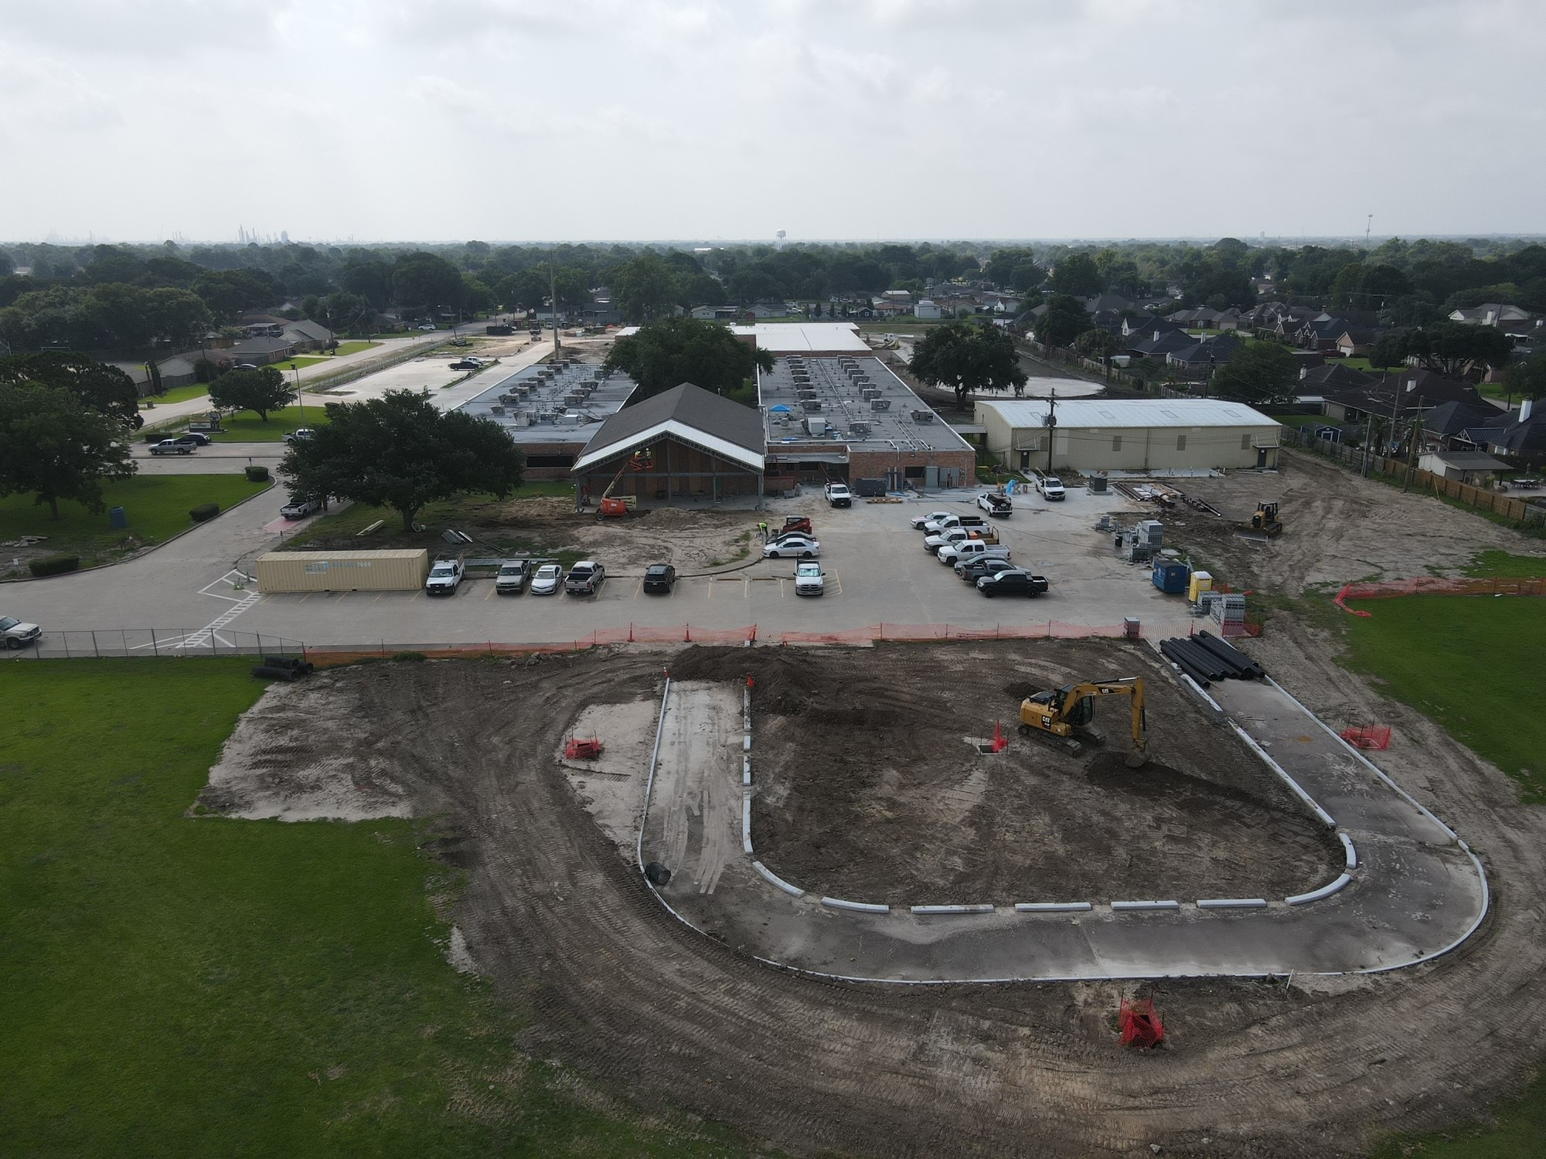
Highland Park Elementary School
Complete Final Grading
Finish out Cafeteria Addition
Complete kitchen renovations
Flooring & Tile in new addition

Slide 12
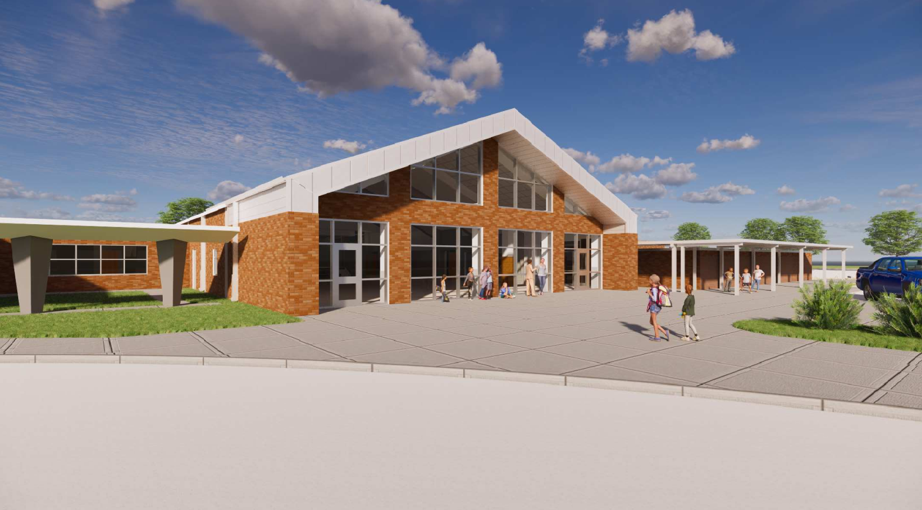
Helena Park Elementary School

Slide 13
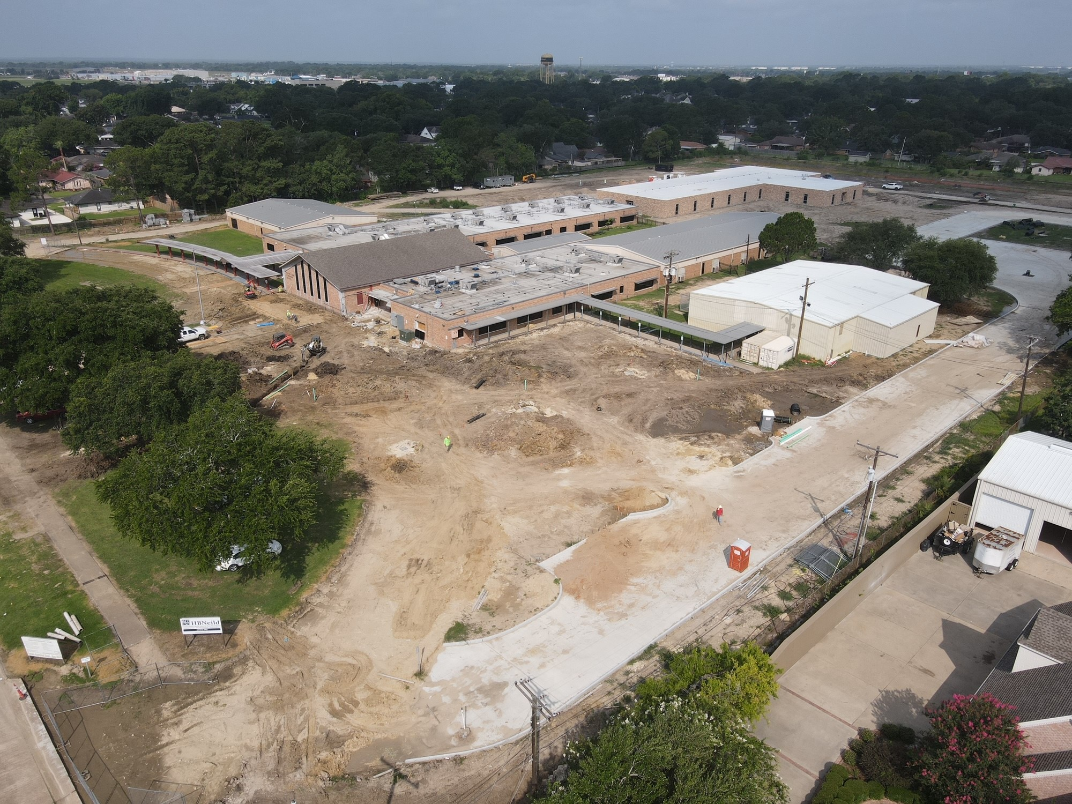
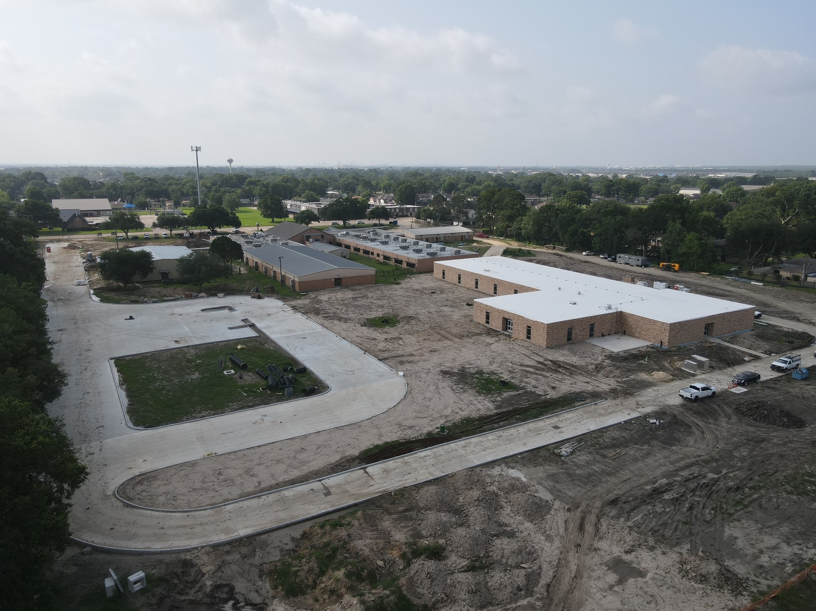
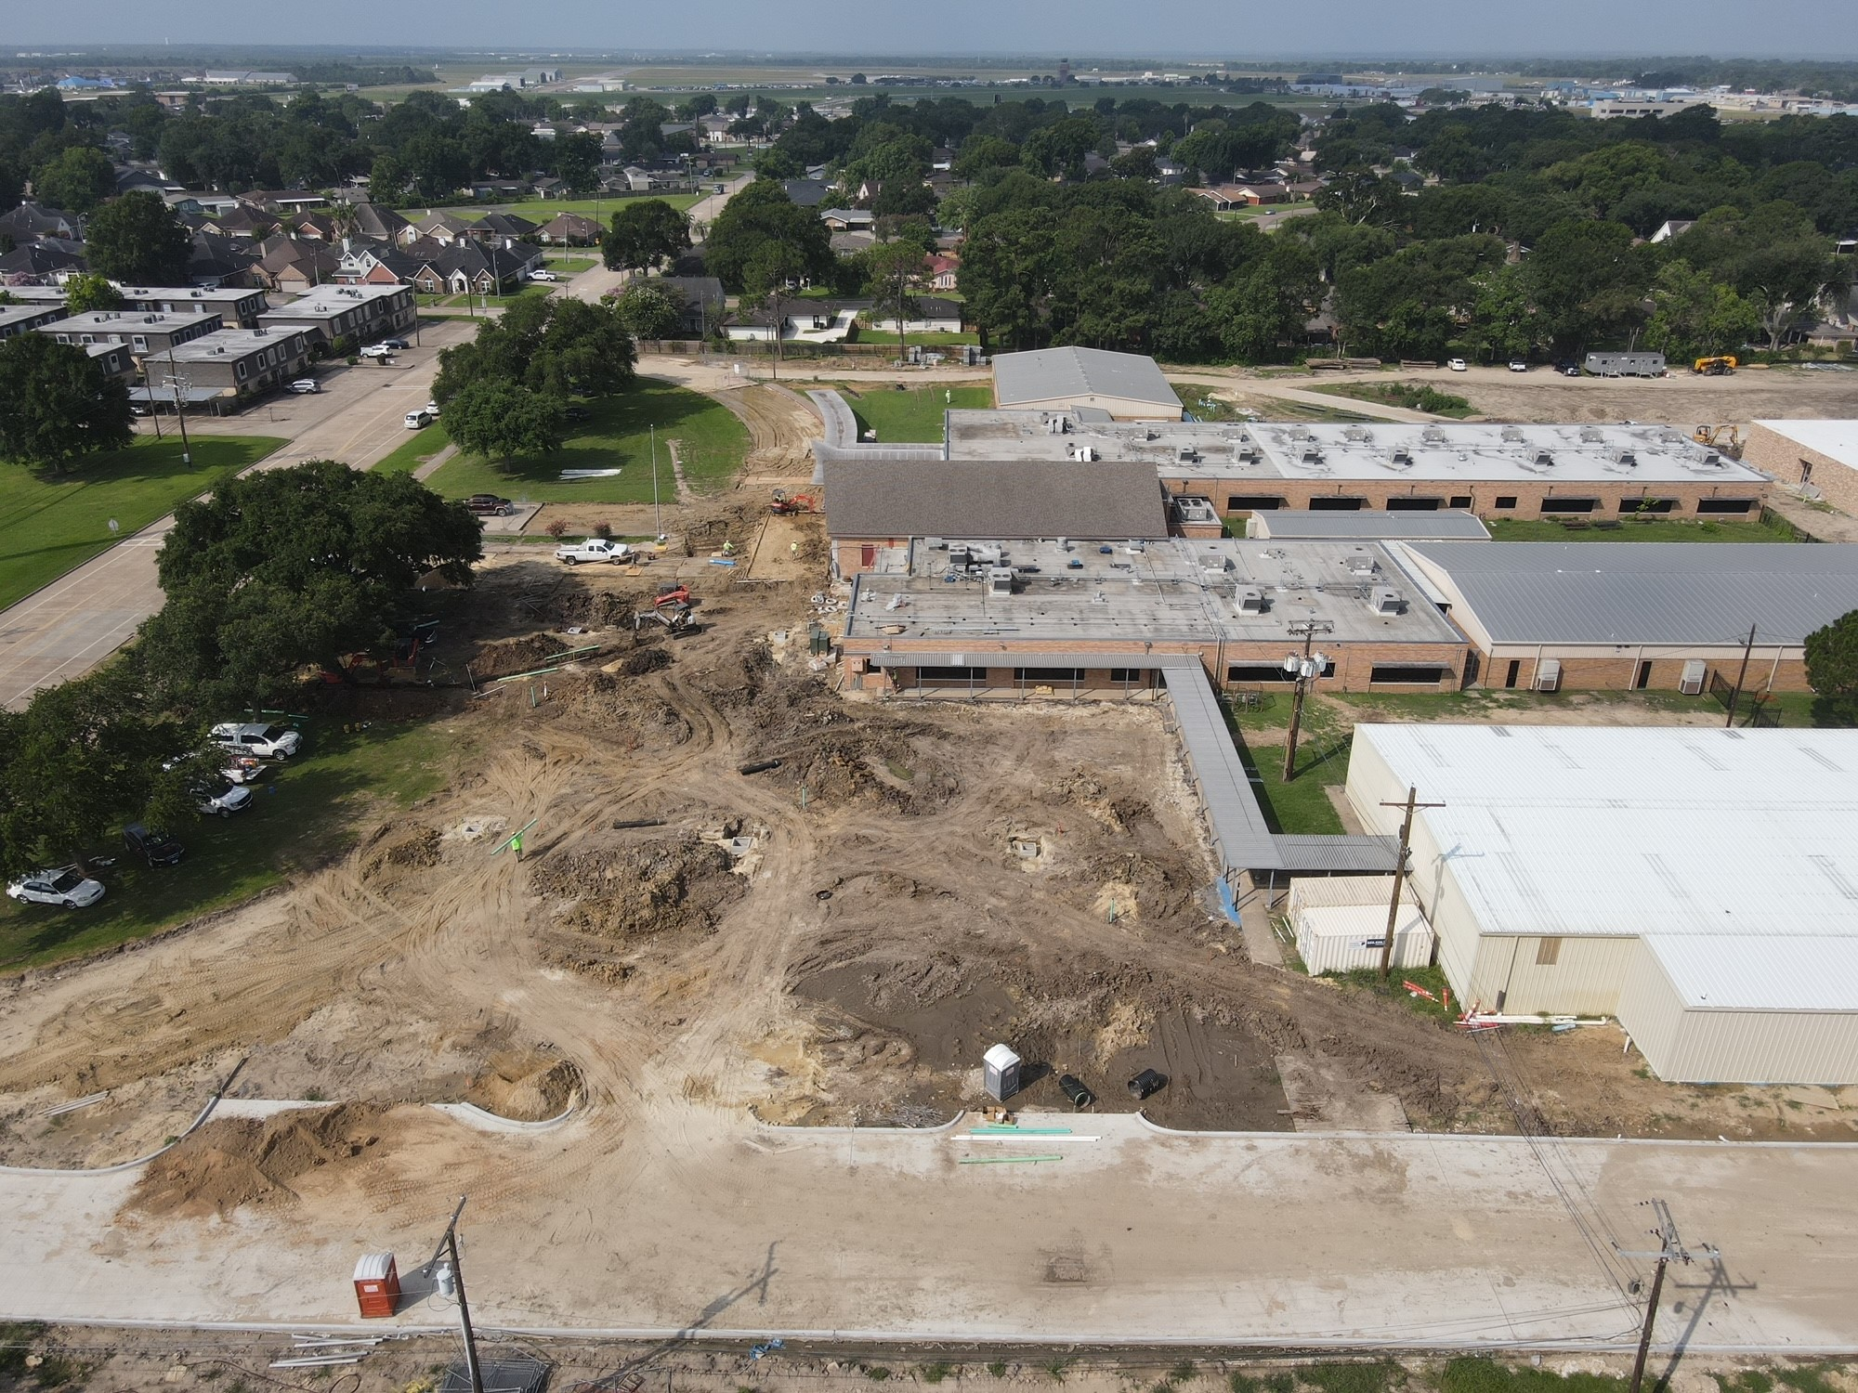
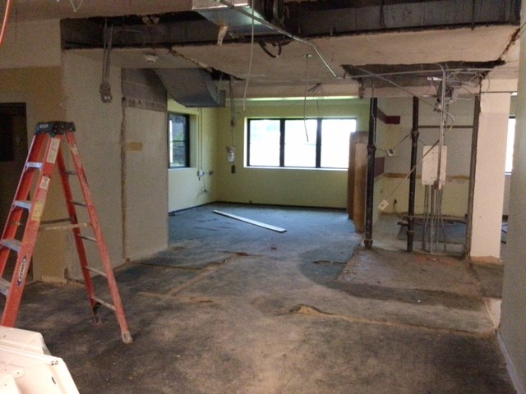
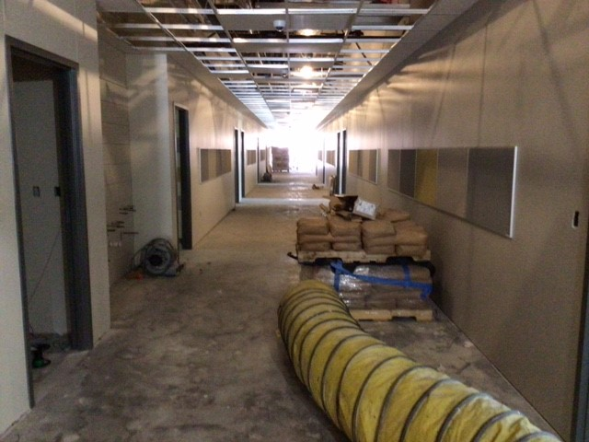
Helena Park Elementary School
Re-Pour front entrance driveway
Pour & Erect canopies
Erect Cafeteria Extension
Flooring & Tile in new addition

Slide 14
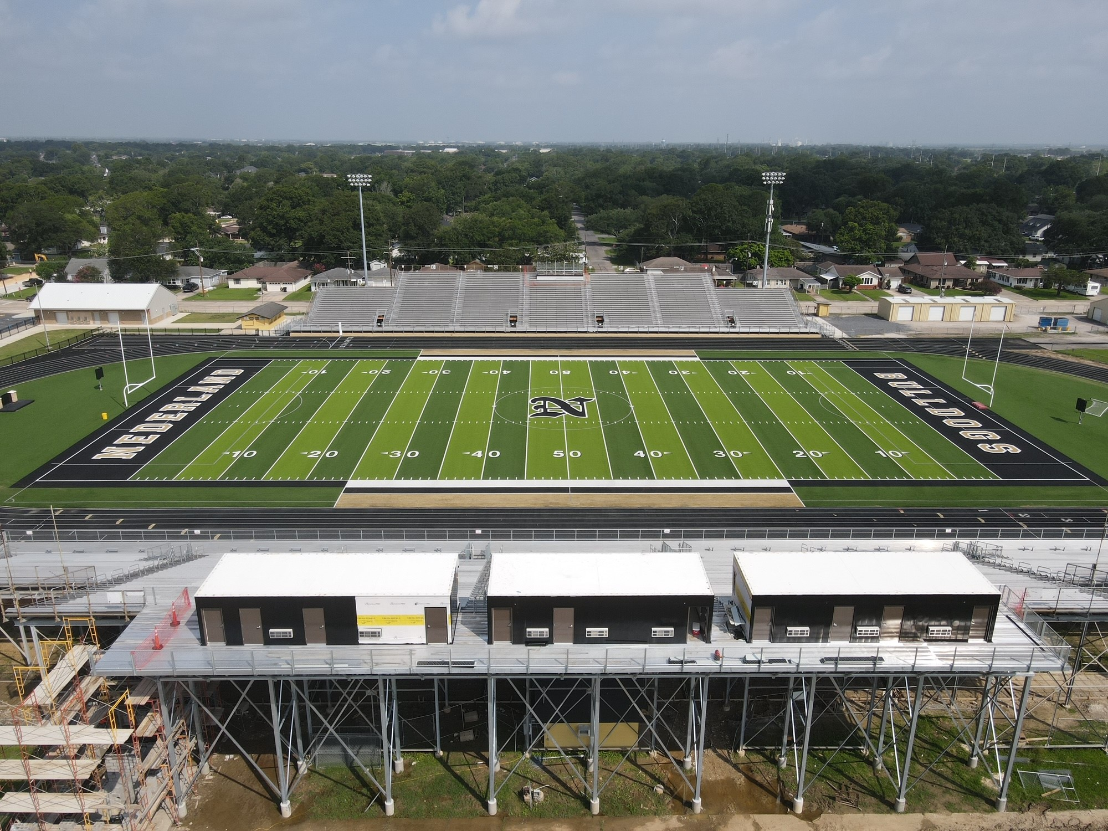
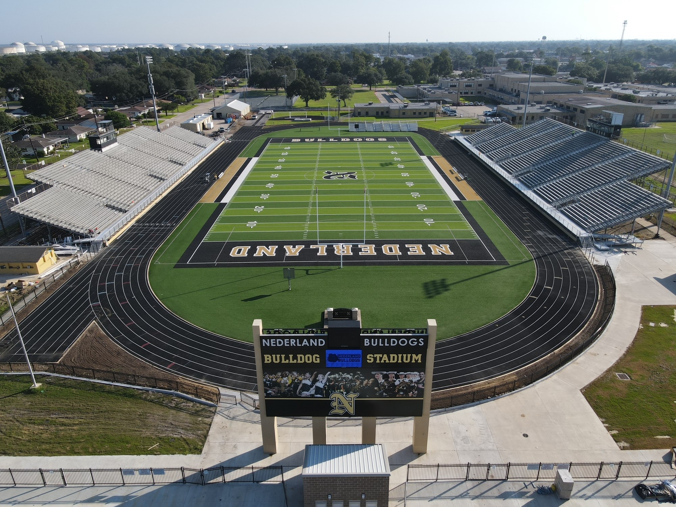
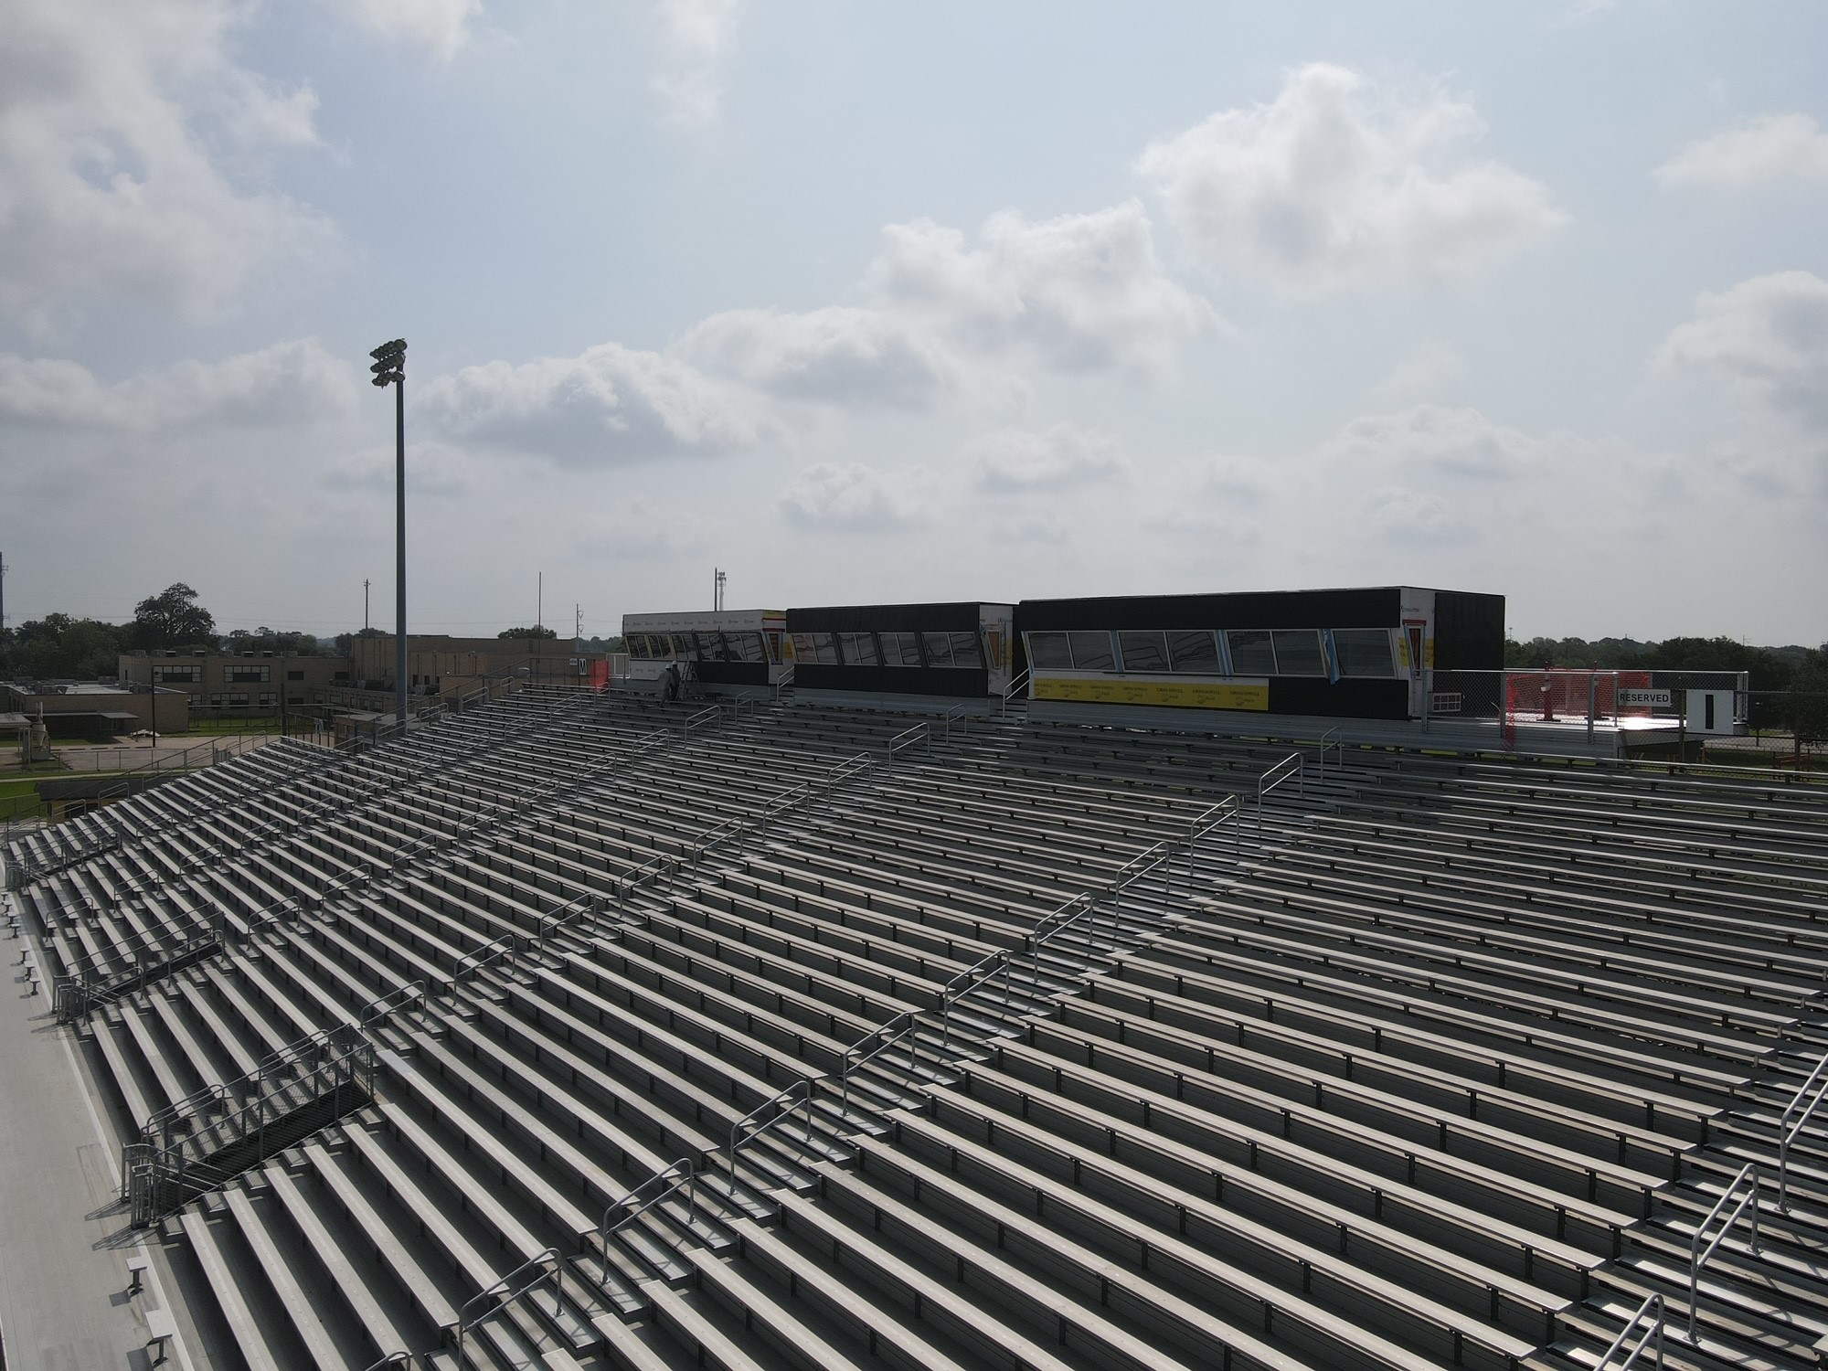
Nederland Bulldog Stadium

Slide 15
CO Wilson Middle School

Slide 16
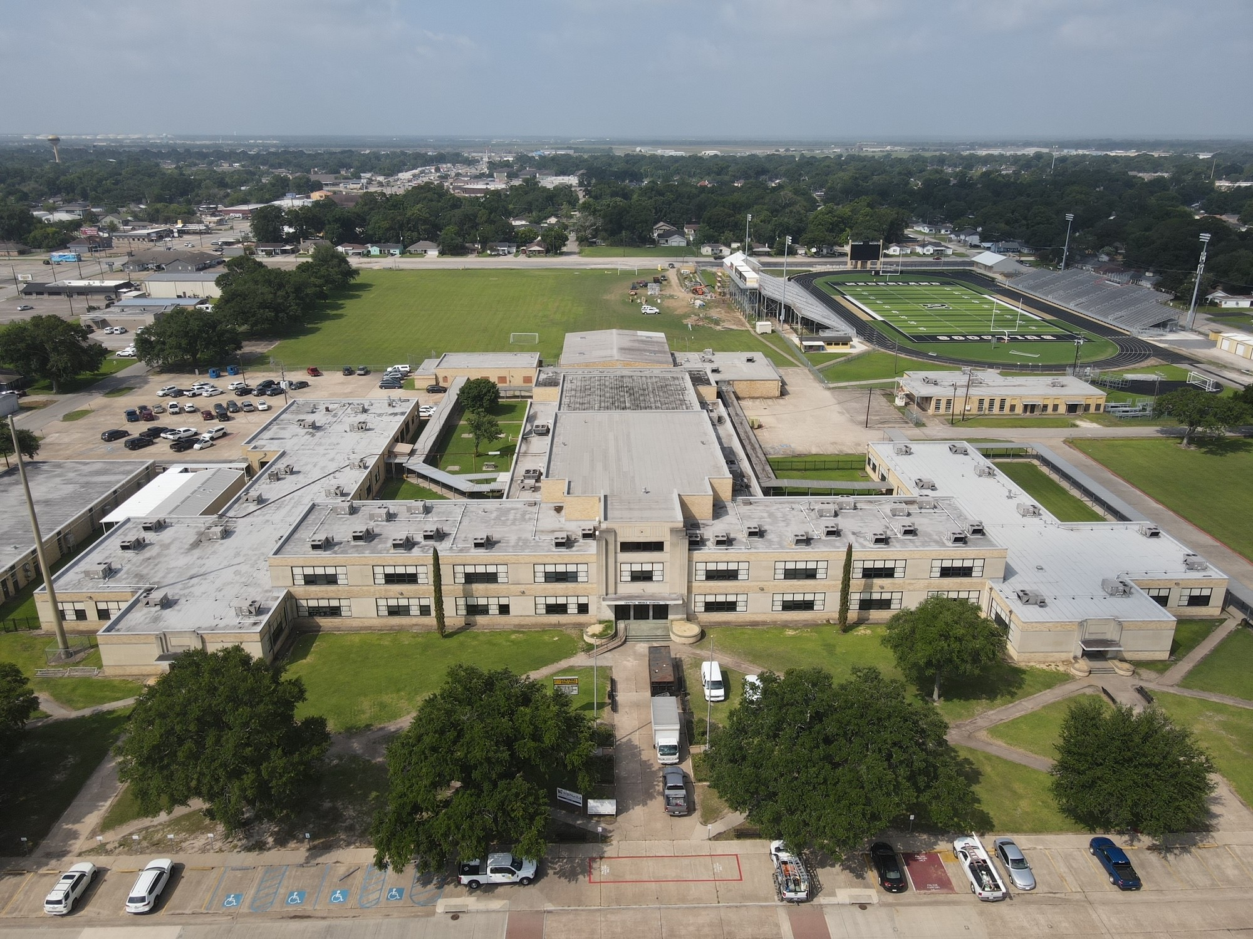
Central Middle School

Slide 17


