Slide 1




2019 Nederland ISD Bond Project
August 2023

Slide 2

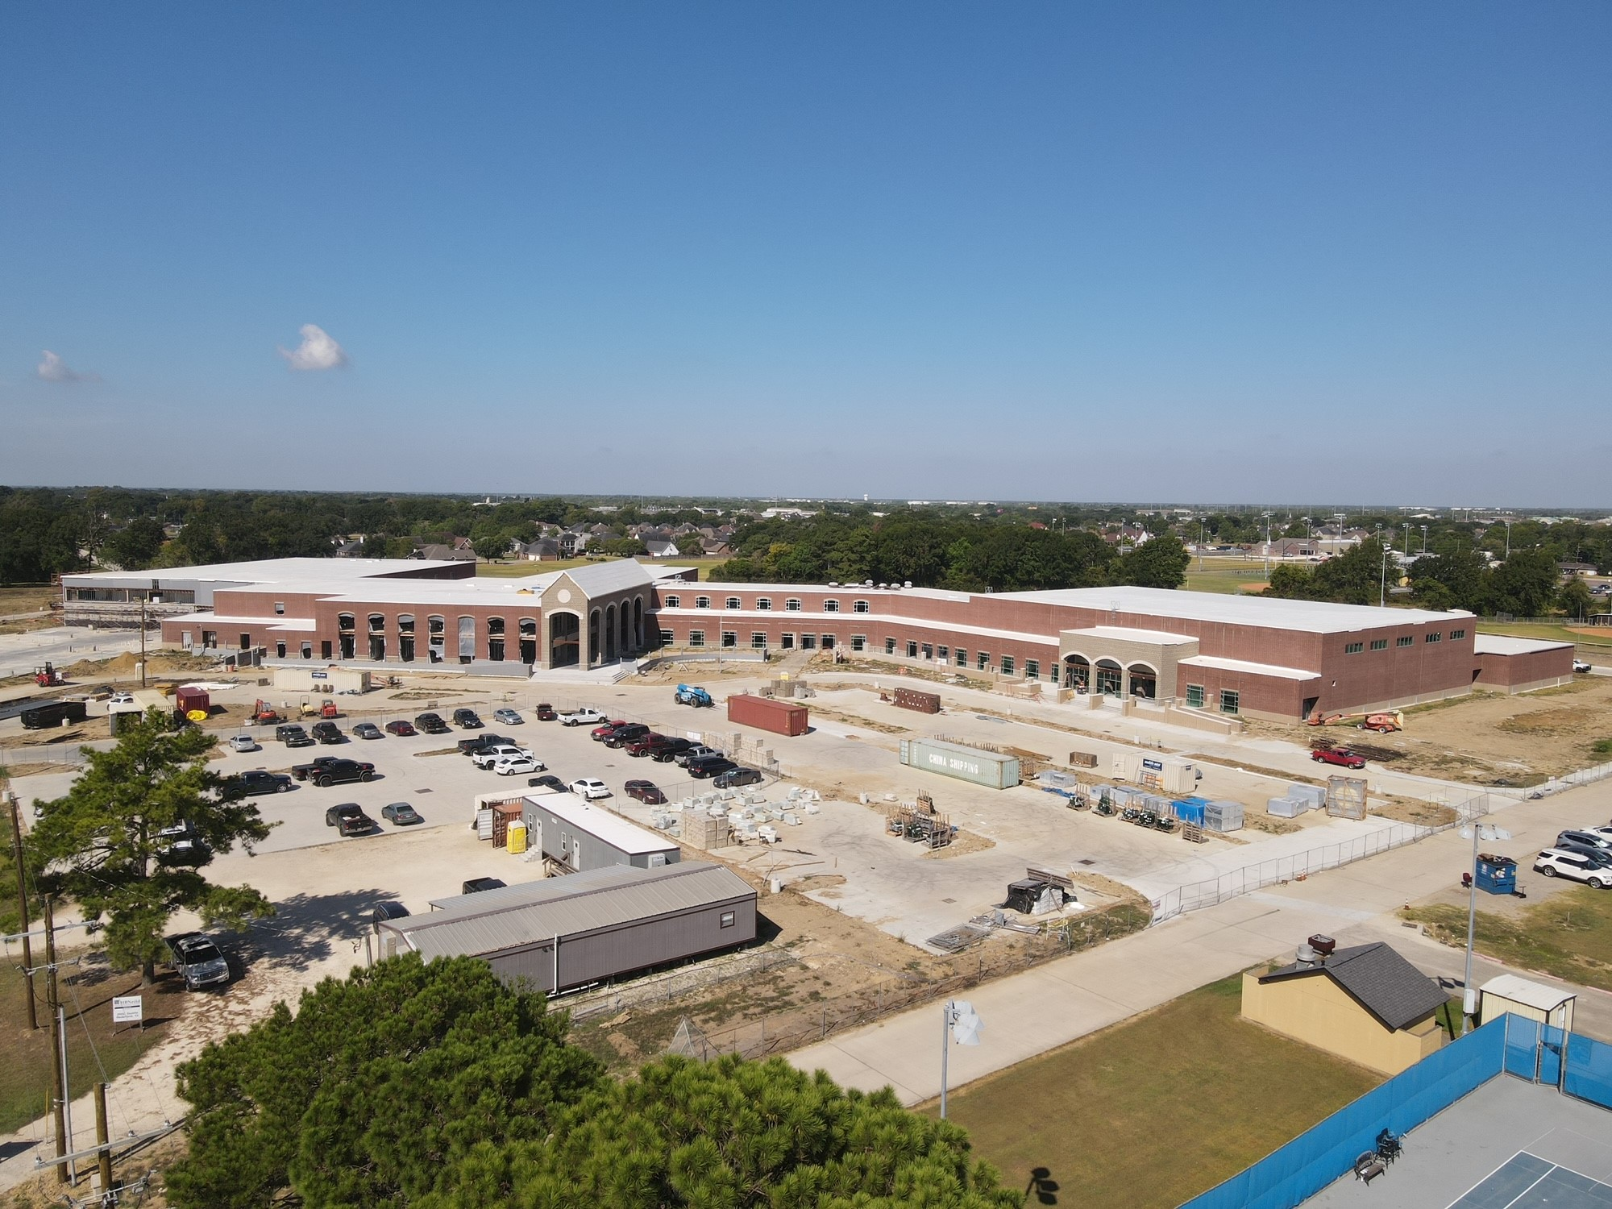
Nederland High School

Slide 3
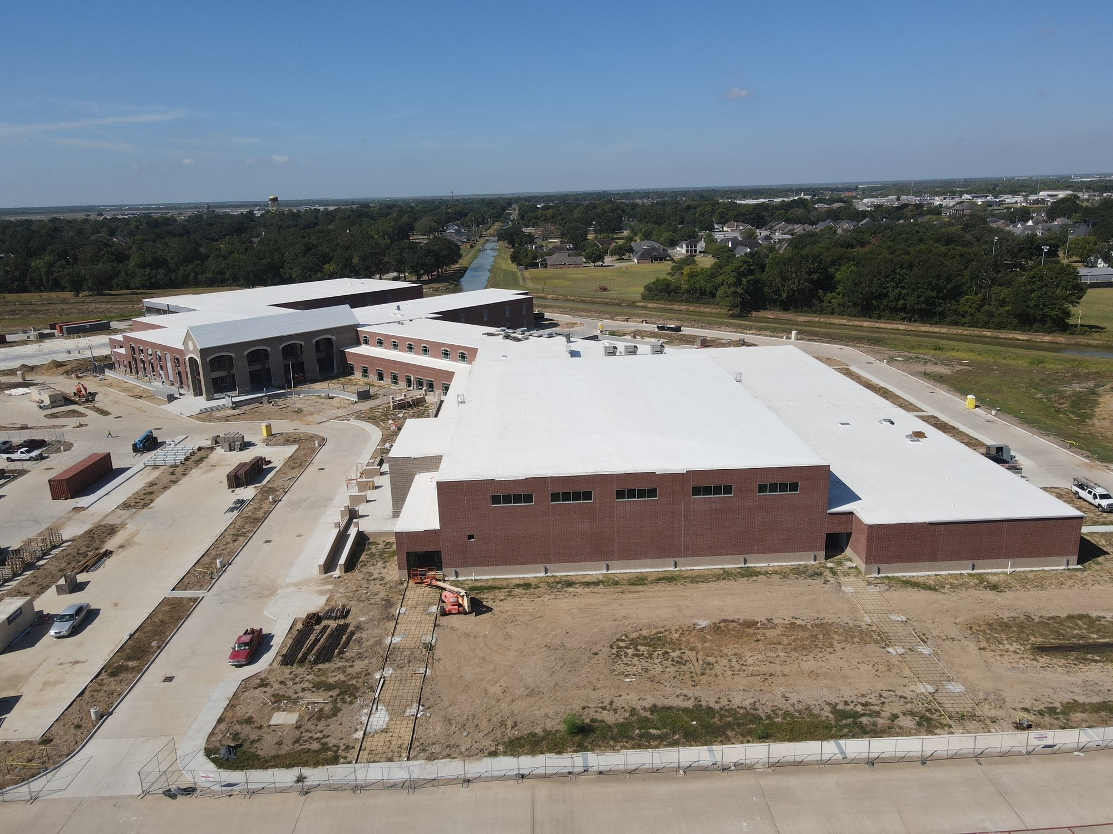
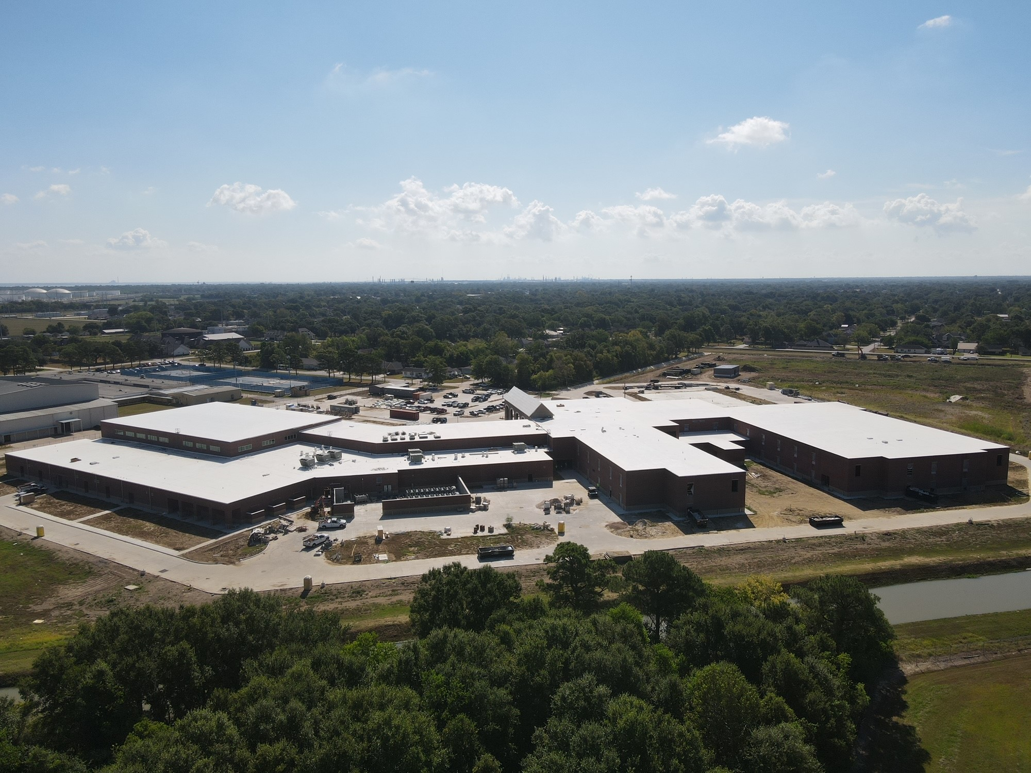
Nederland High School

Slide 4
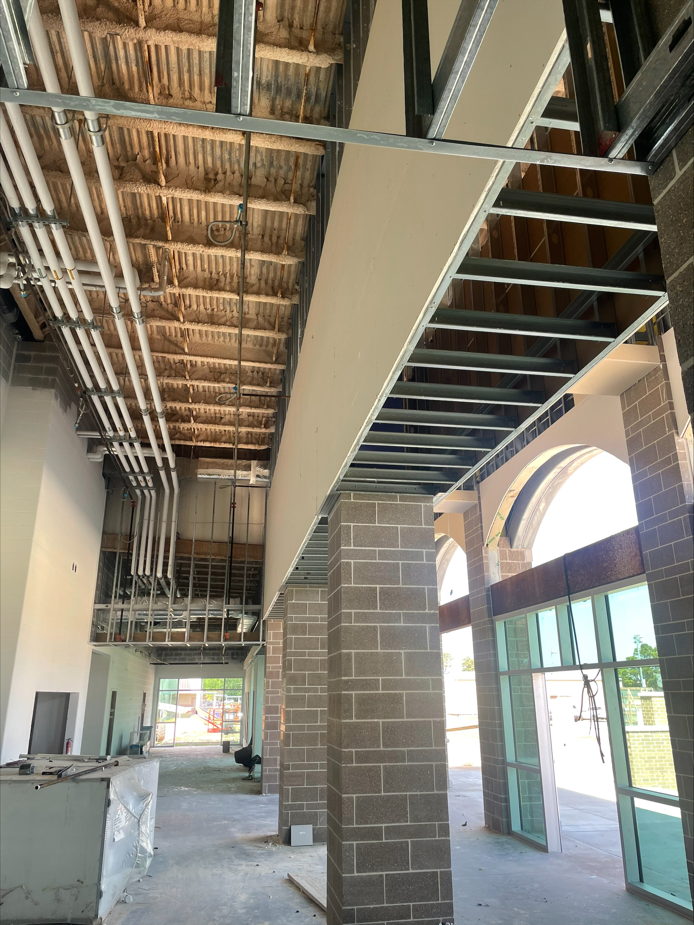
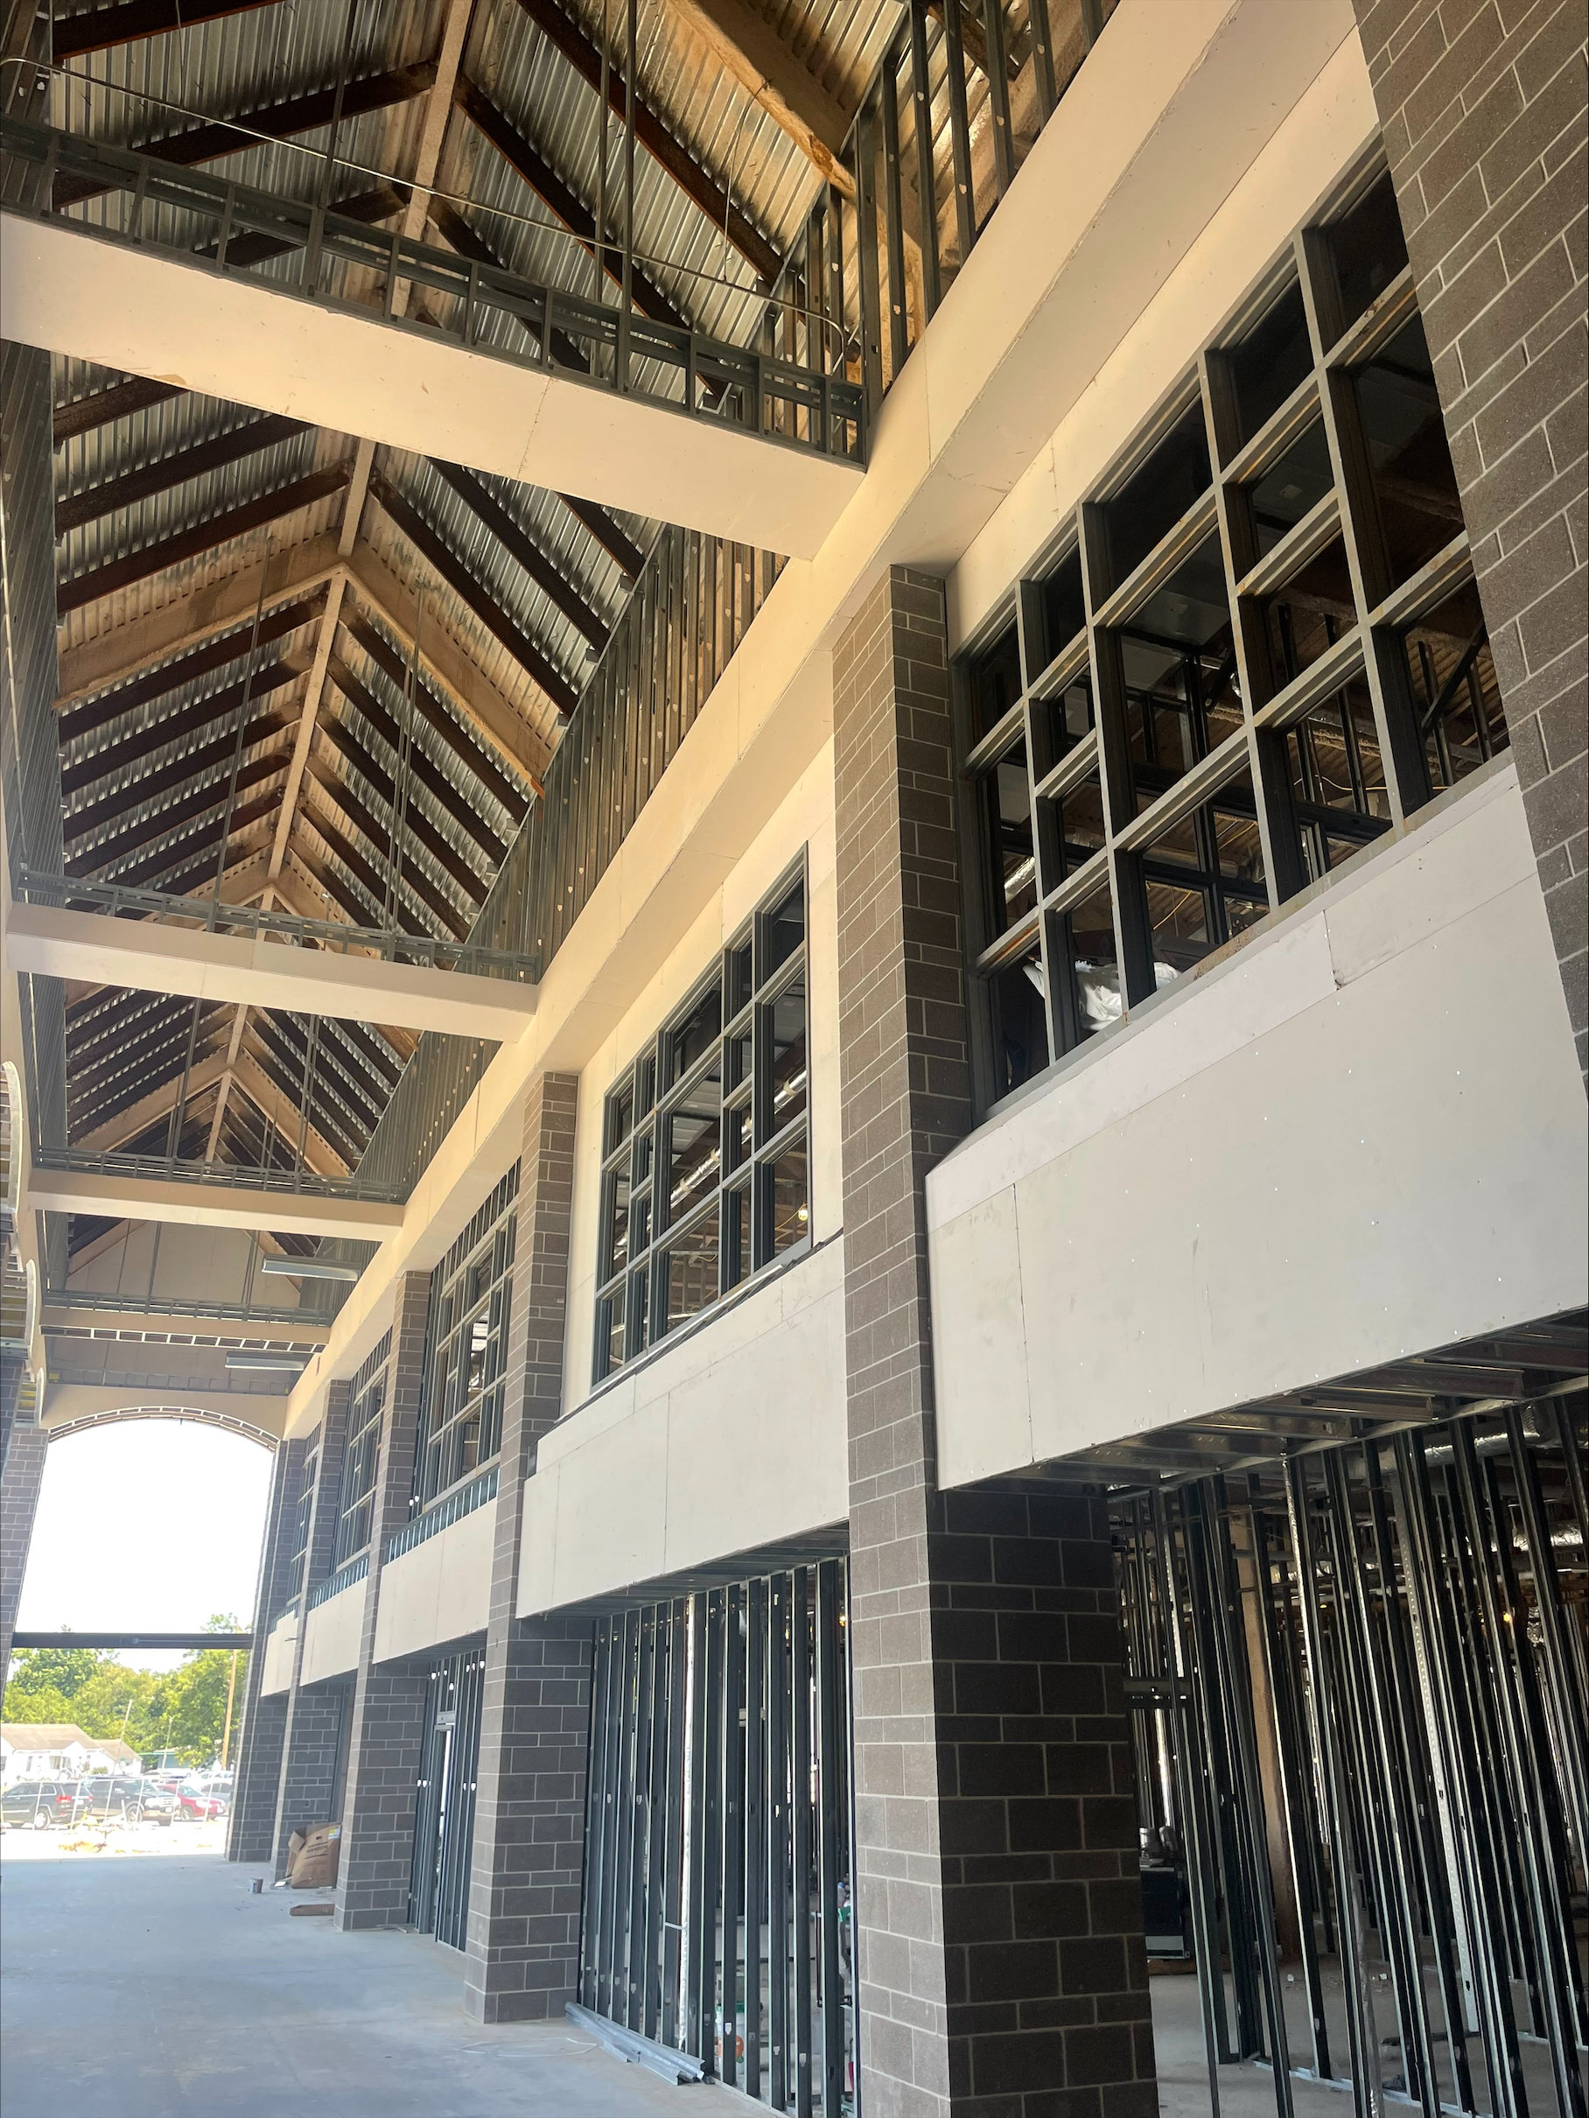
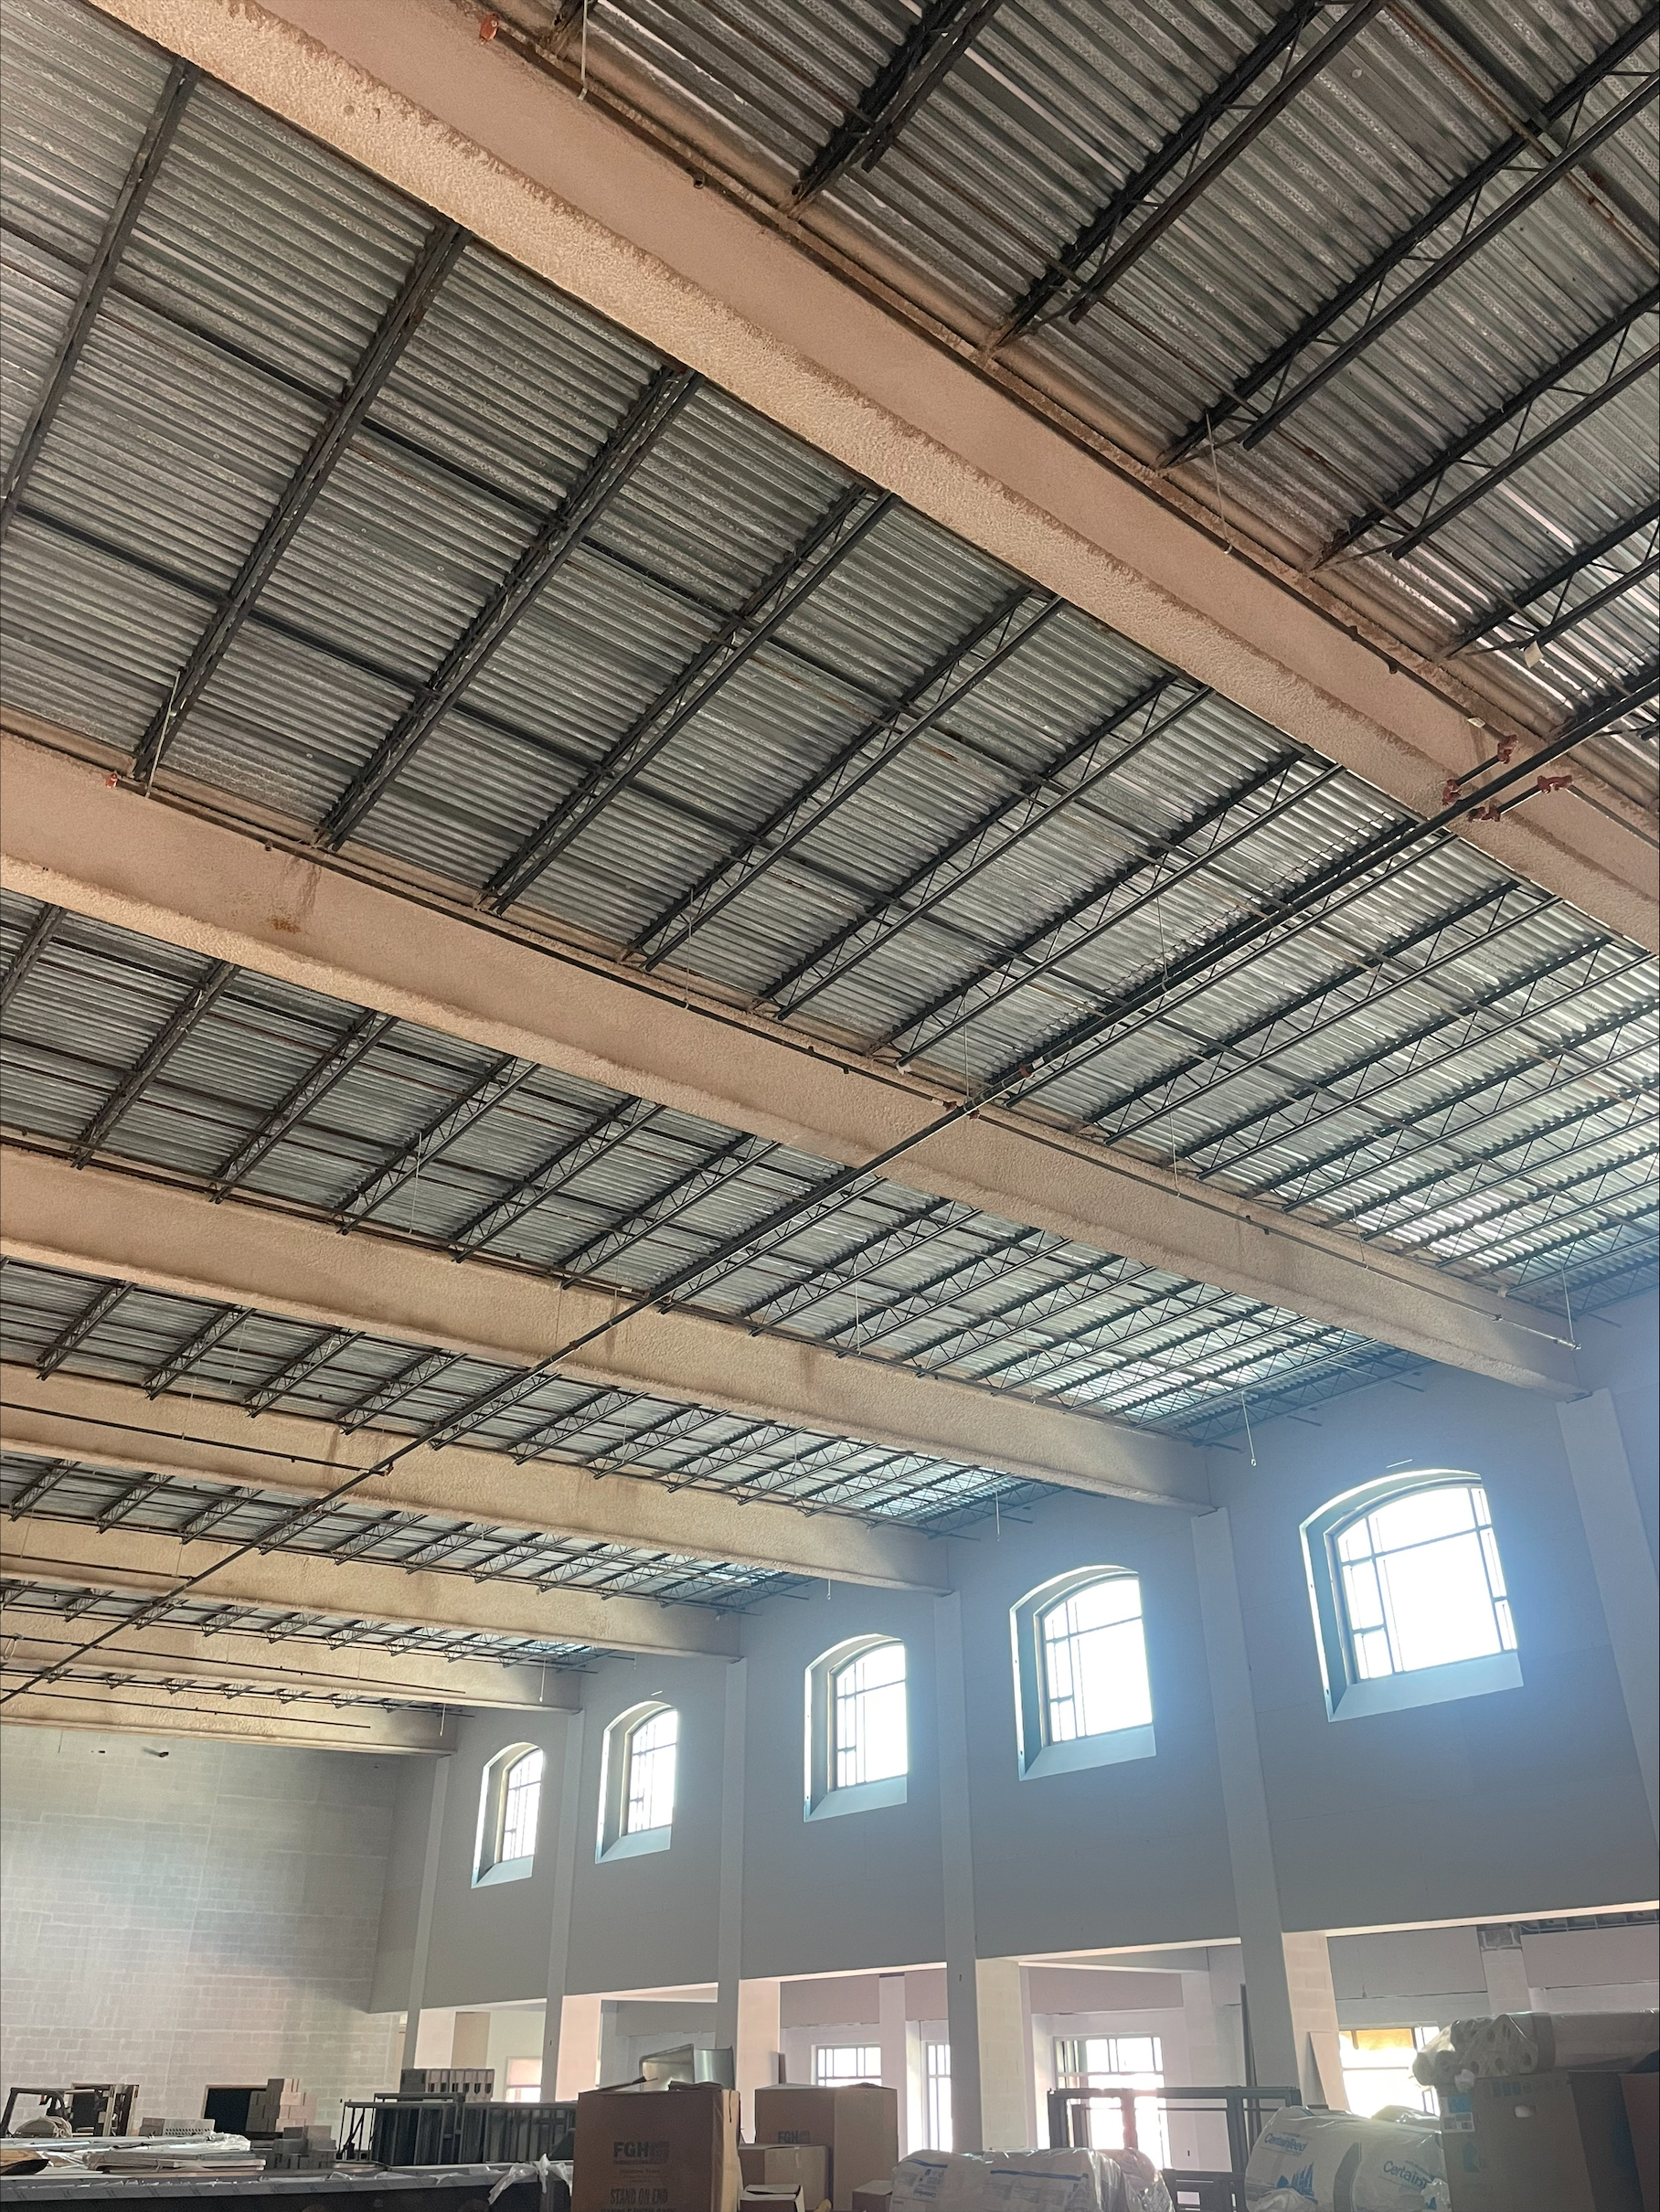
Nederland High School
HVAC piping
Exterior Glazing
CMU Paint
Receive PEMB

Slide 5

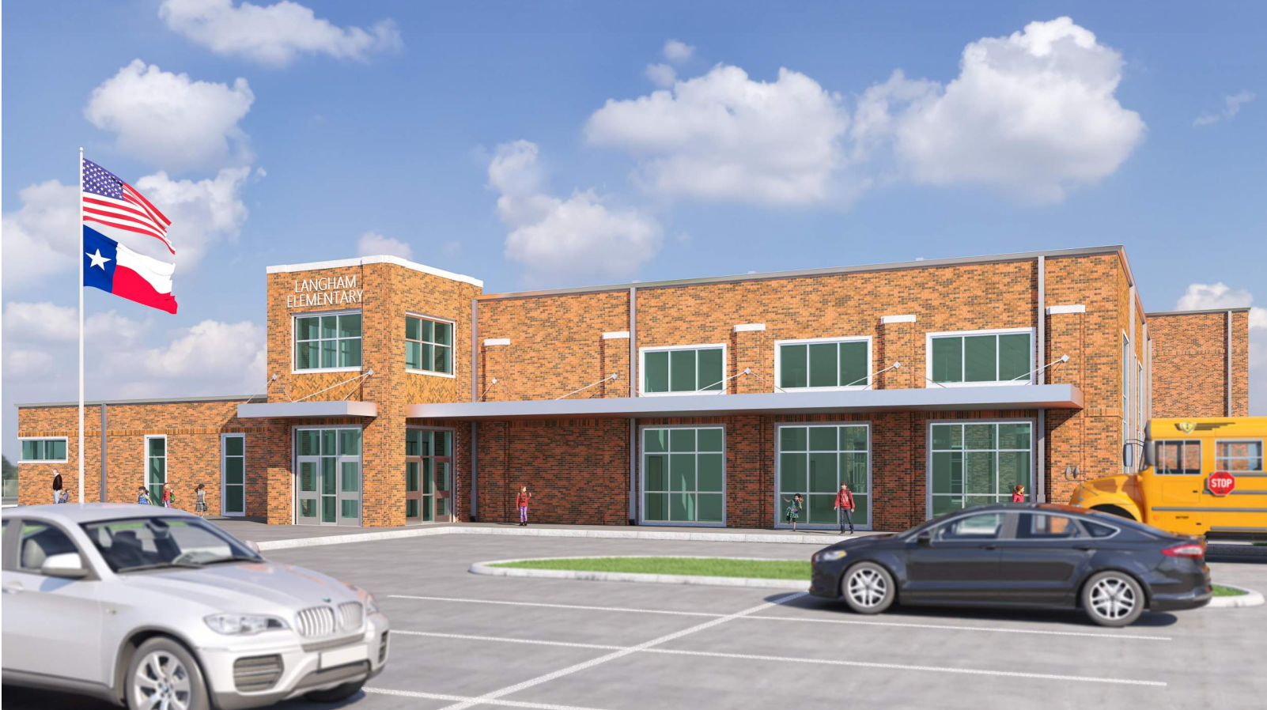
Langham Elementary School

Slide 6
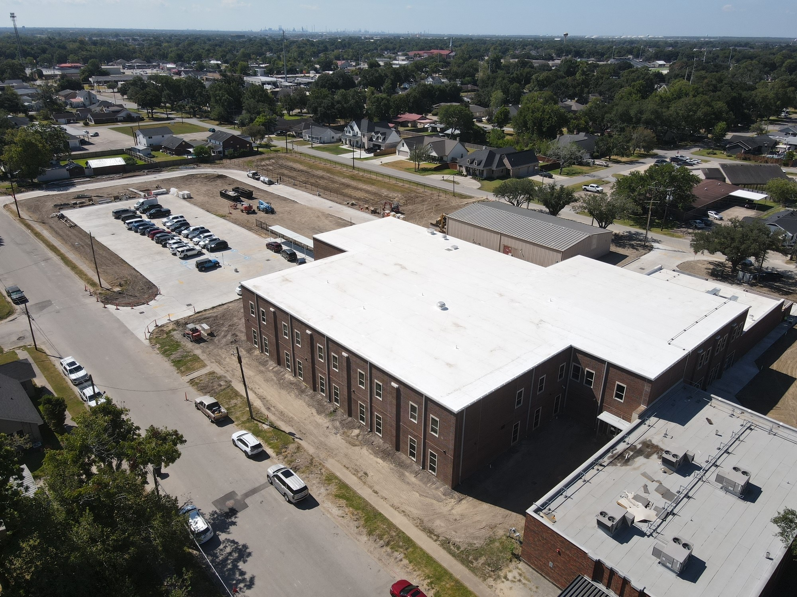
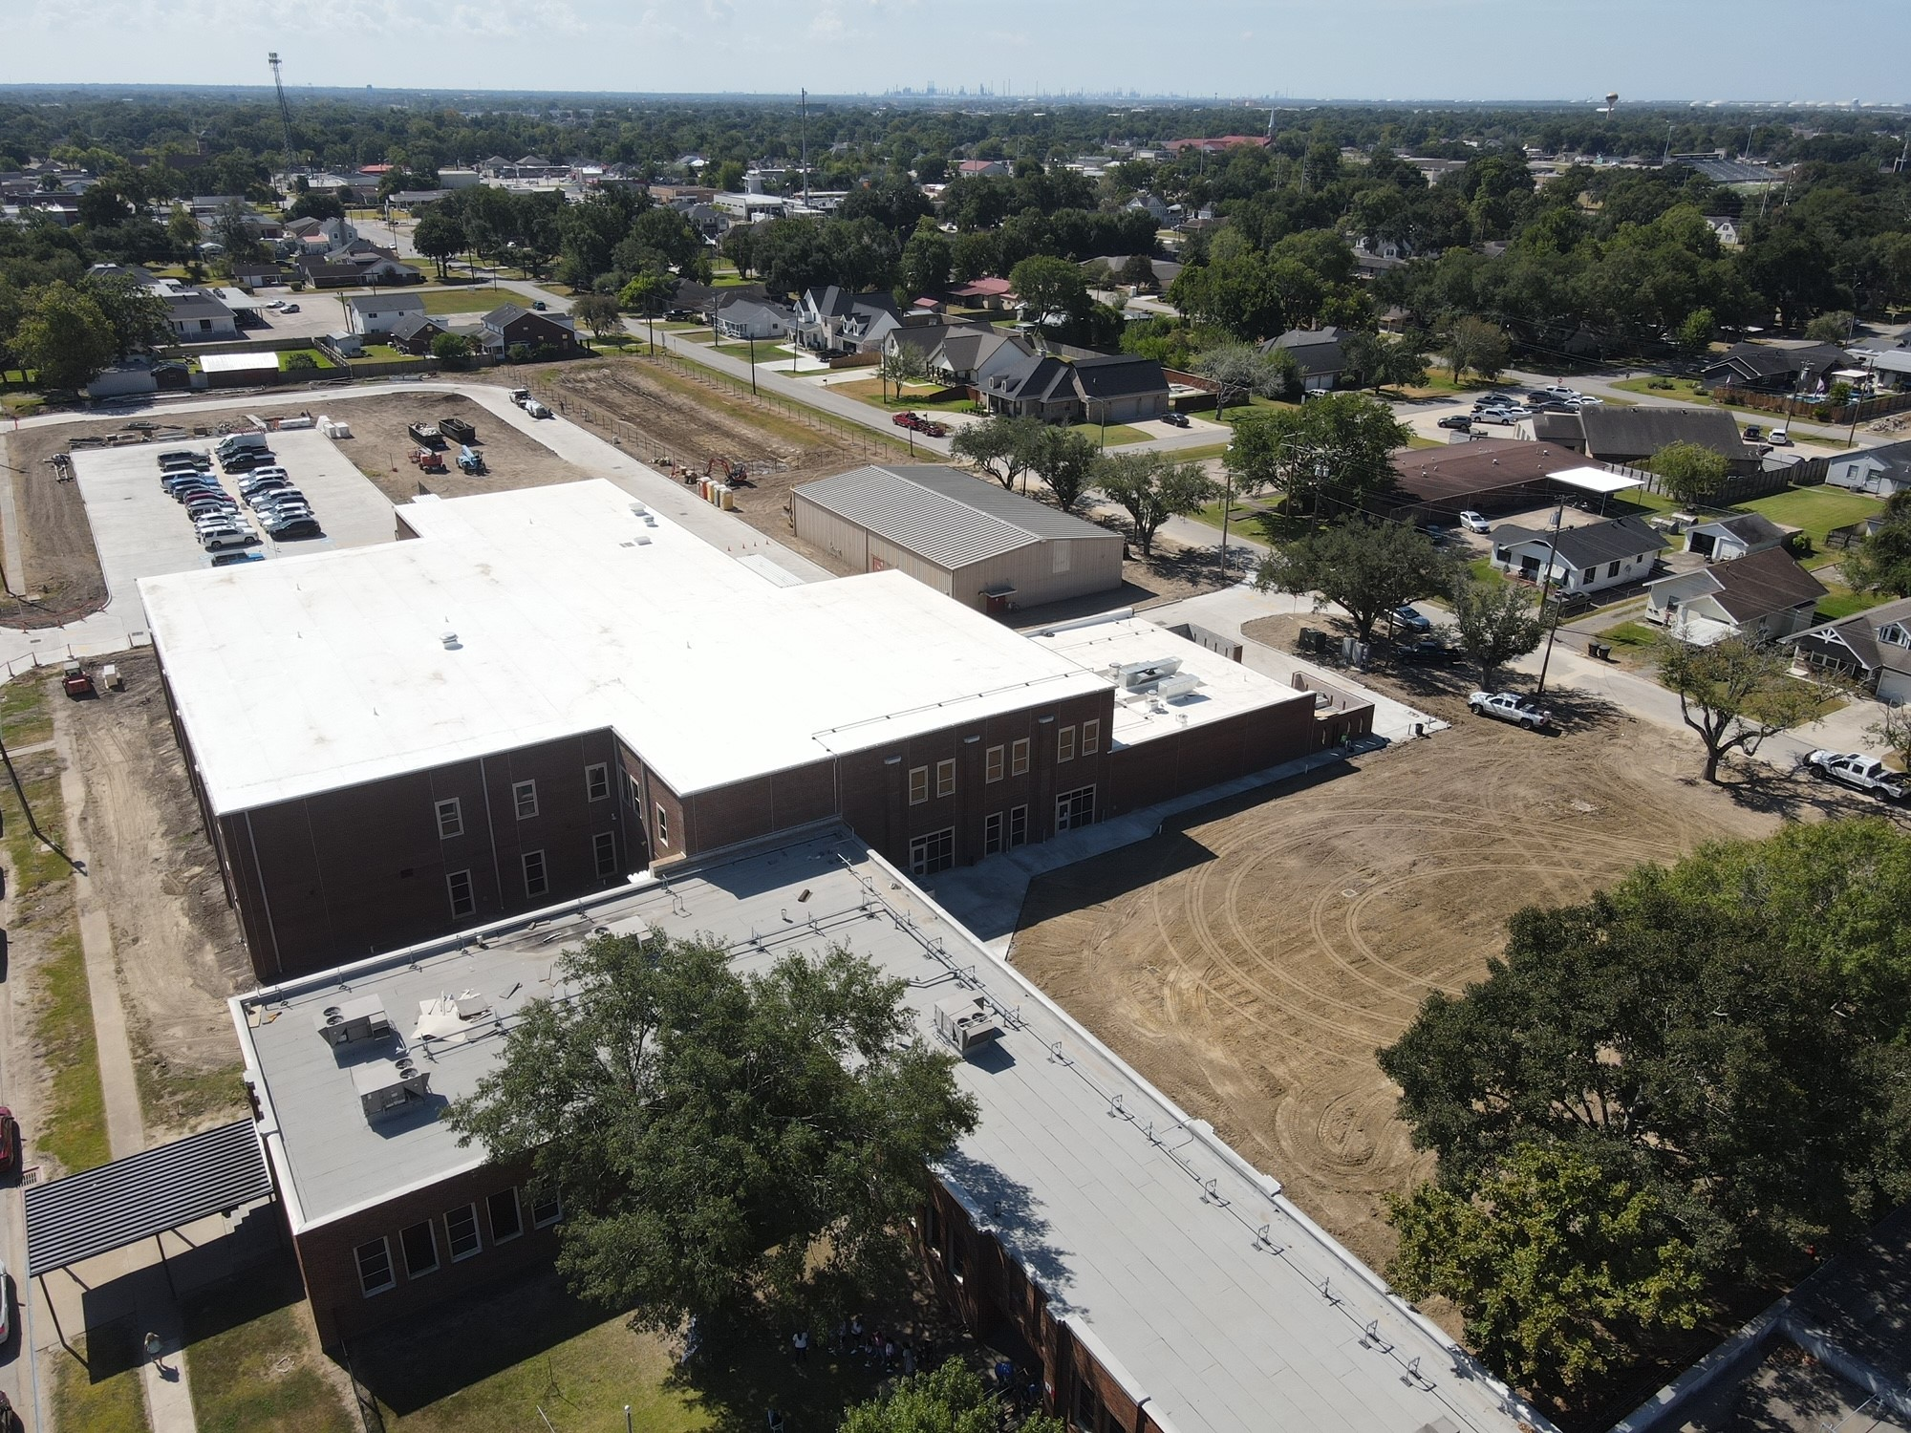
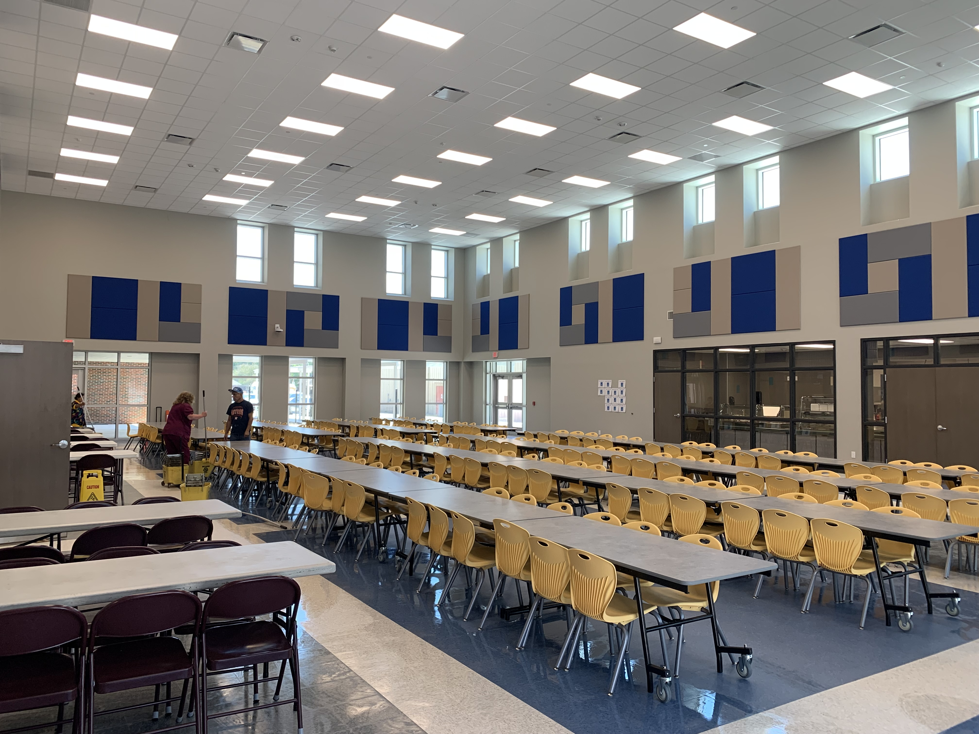
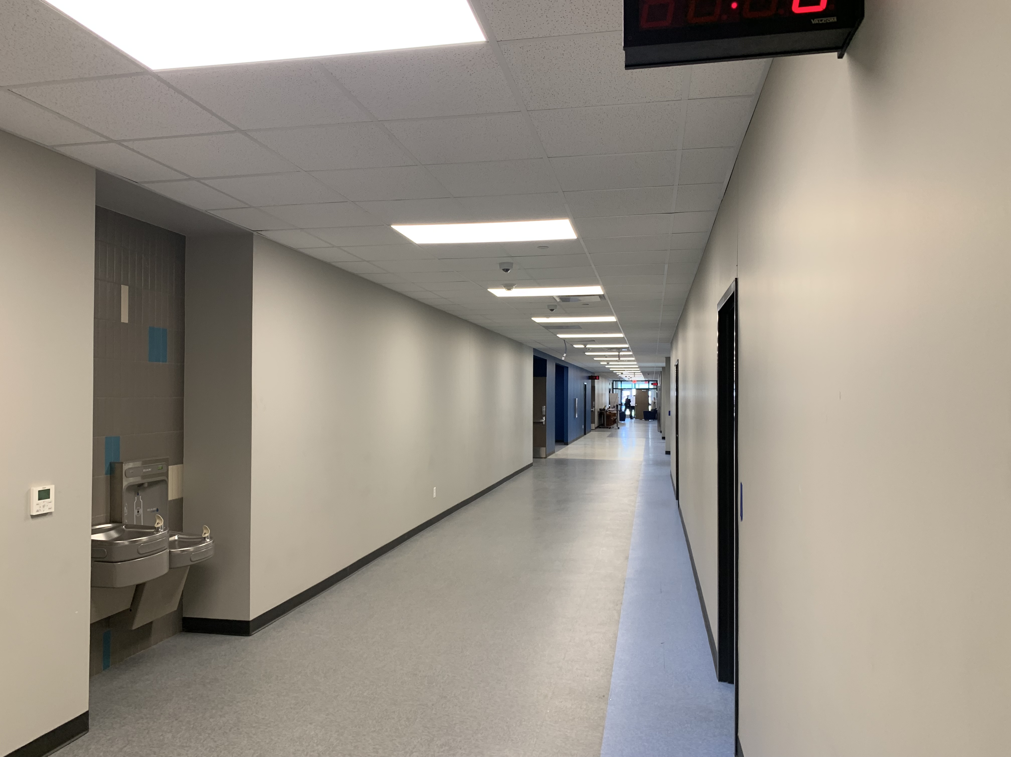
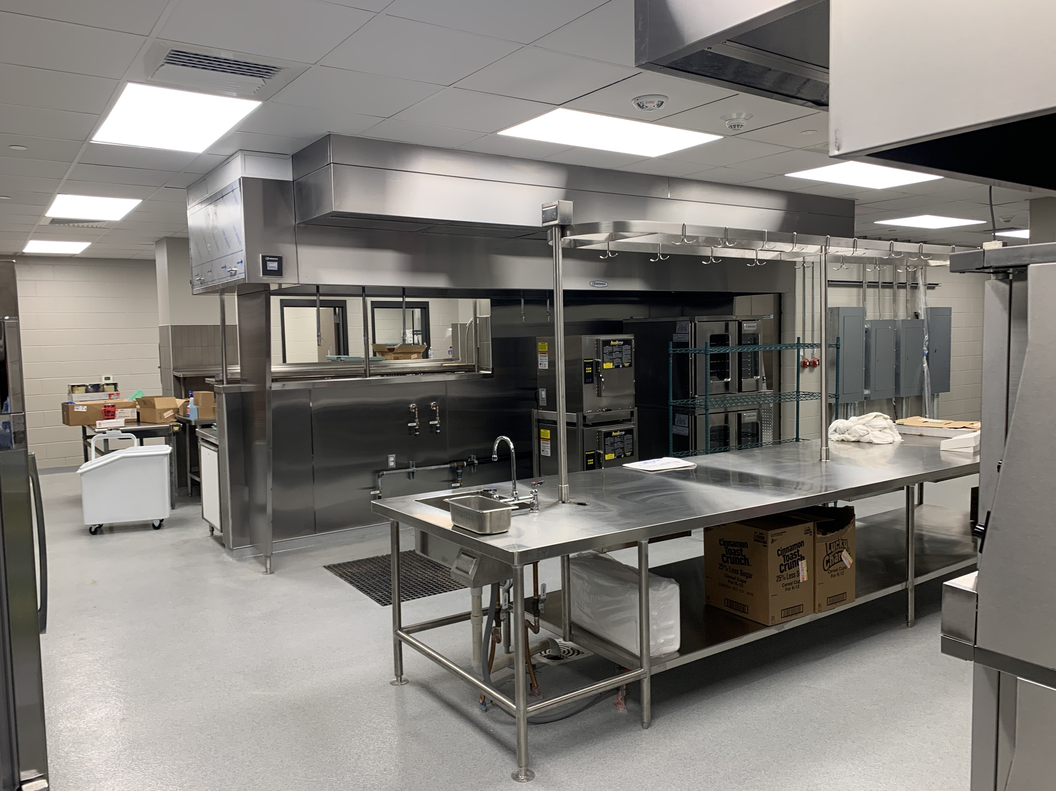
Langham Elementary School
Complete Cabinet Installation
Wax Floors
Complete Fencing / Gates
Landscape & Sod

Slide 7
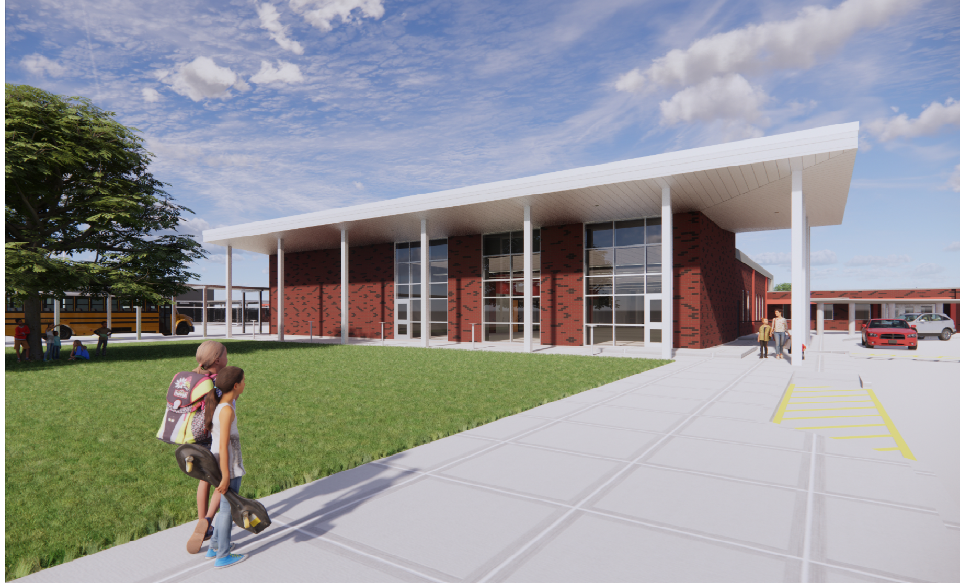
Hillcrest Elementary School

Slide 8
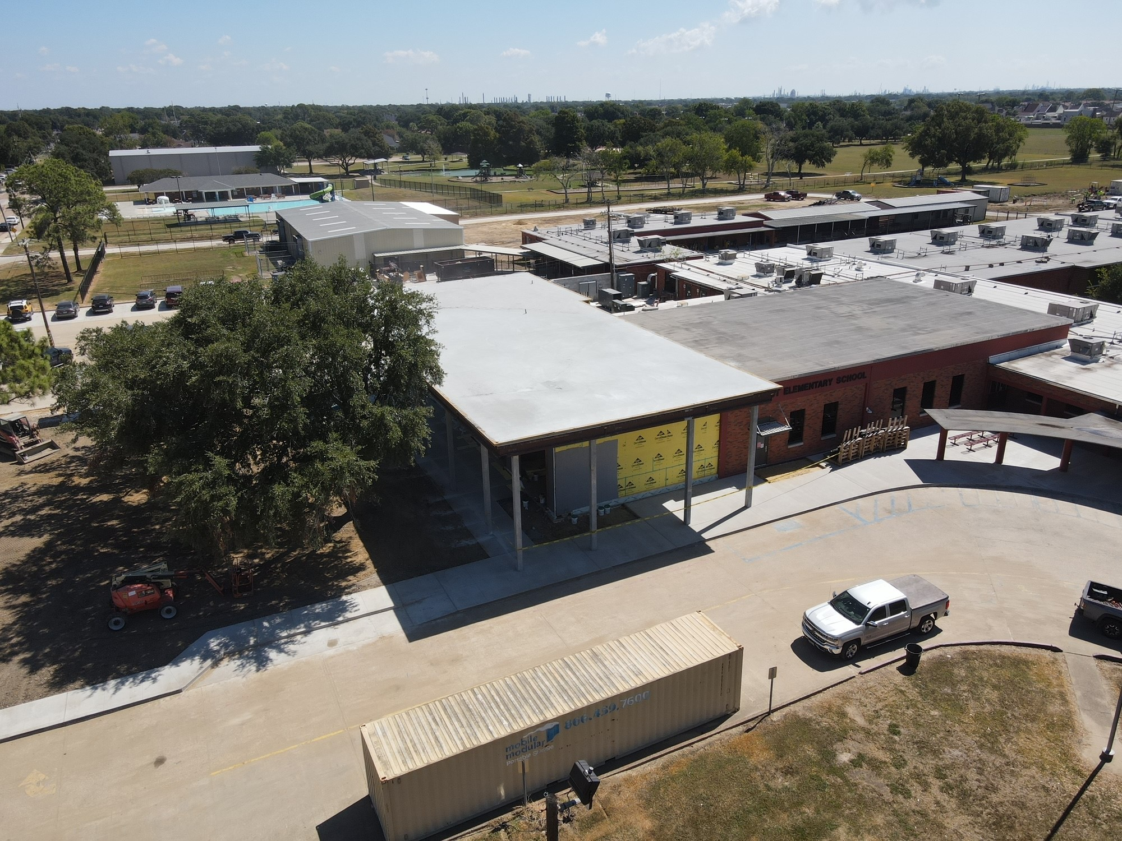
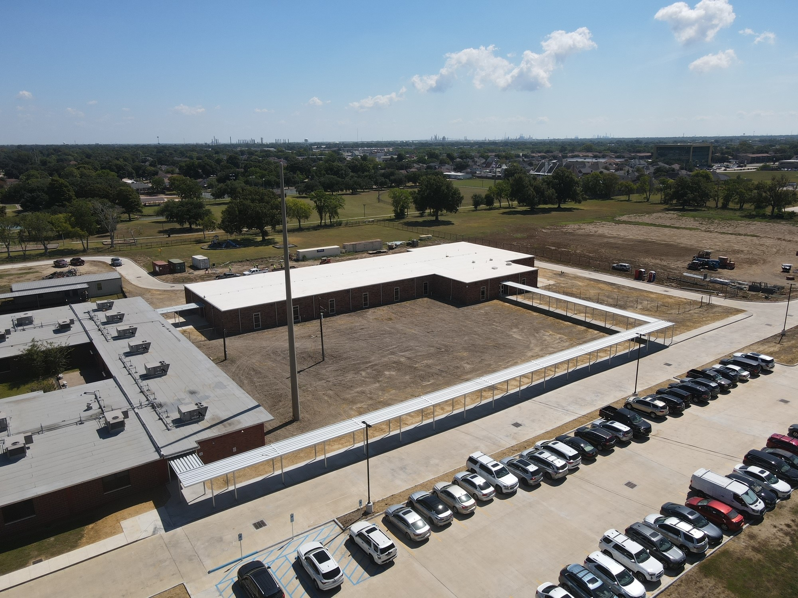
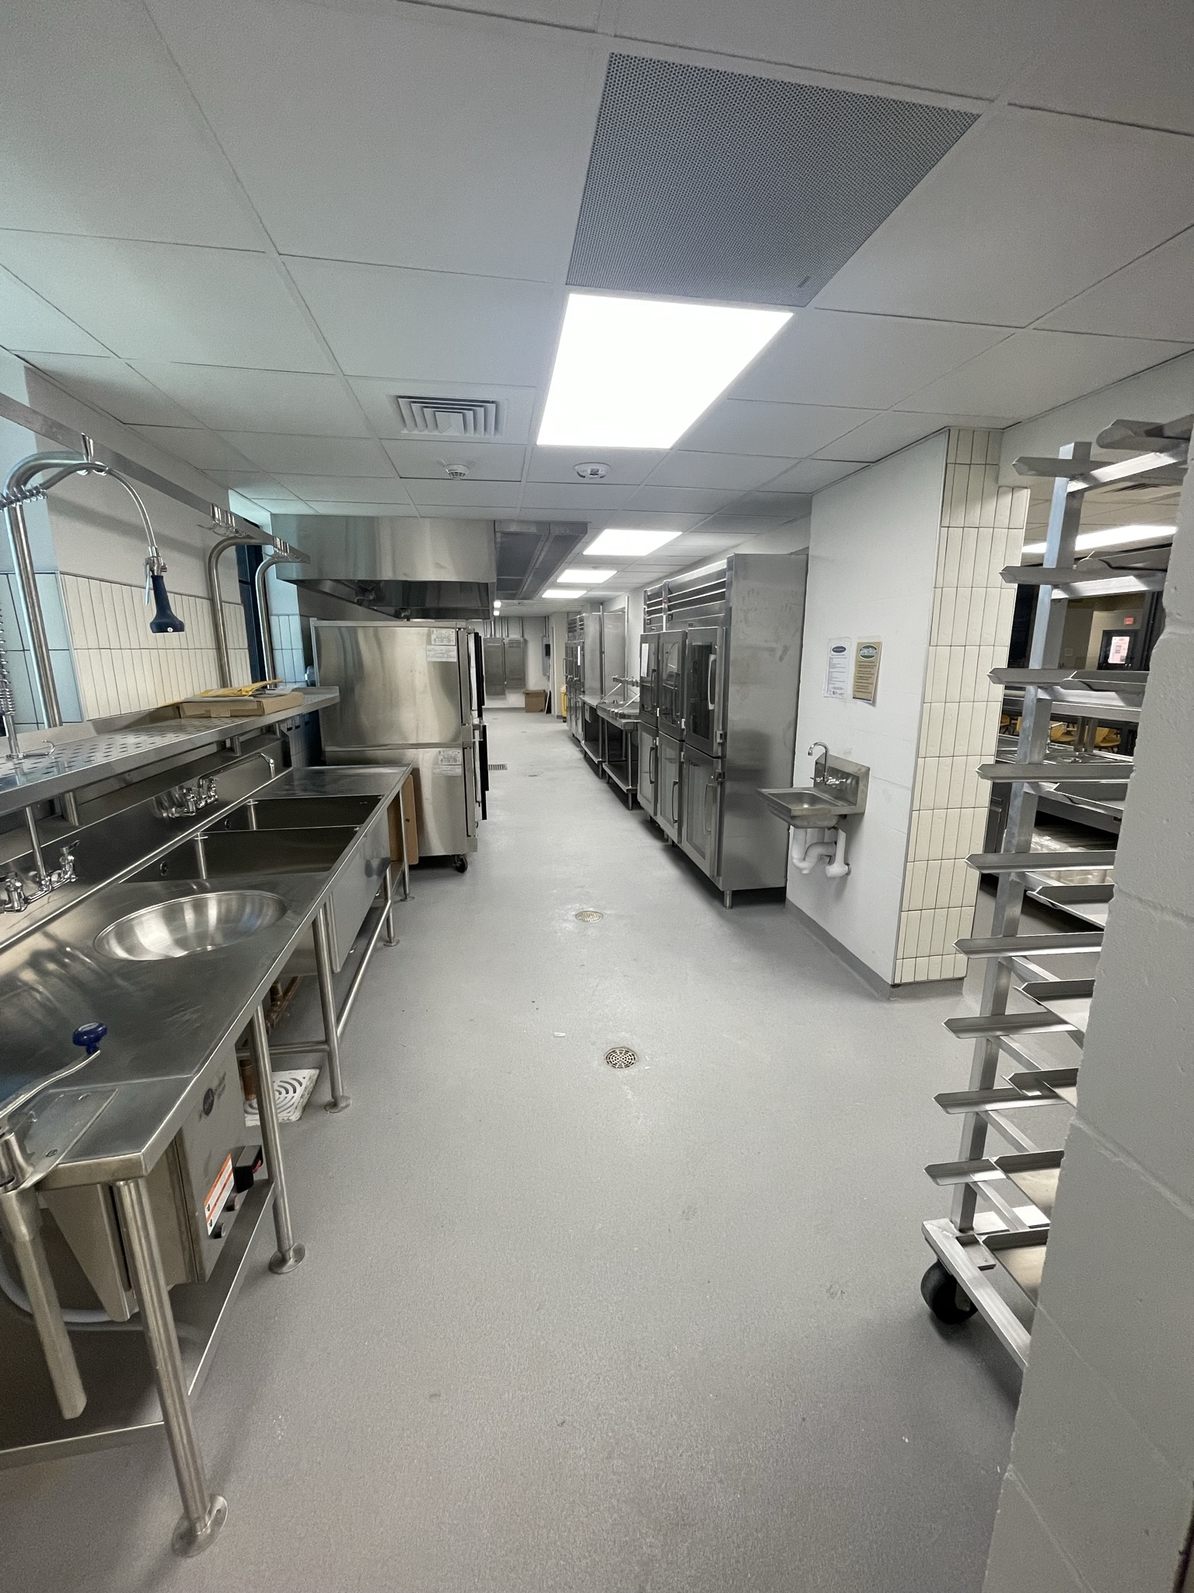
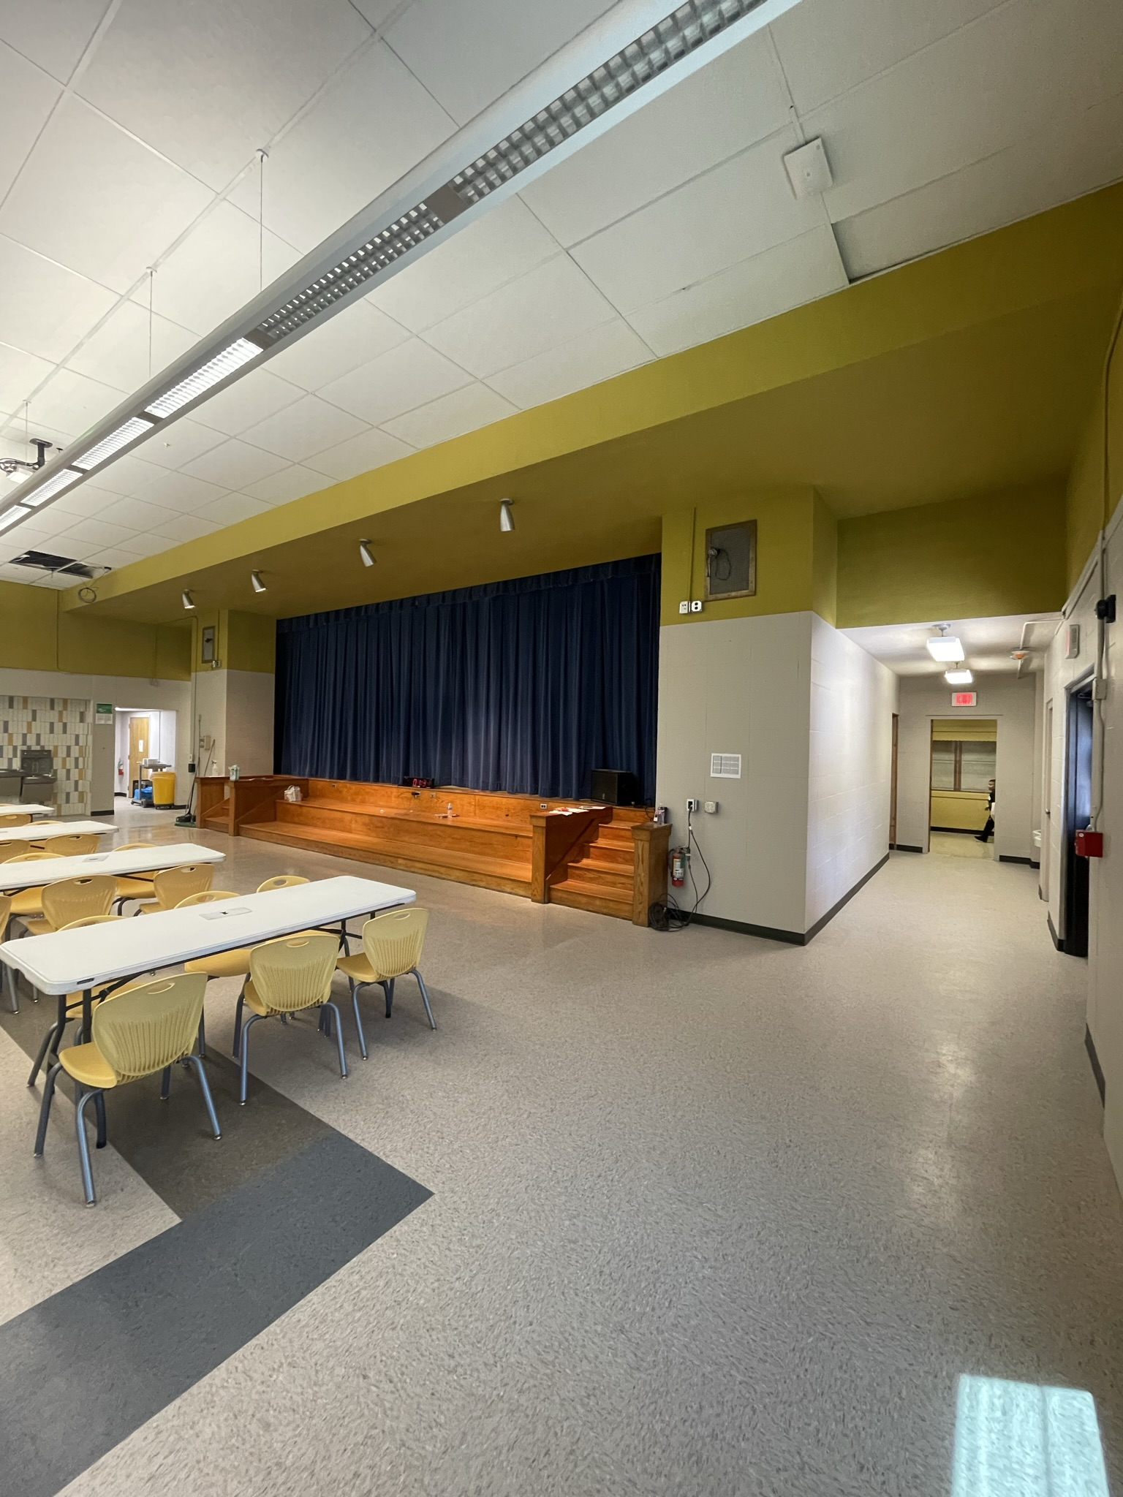
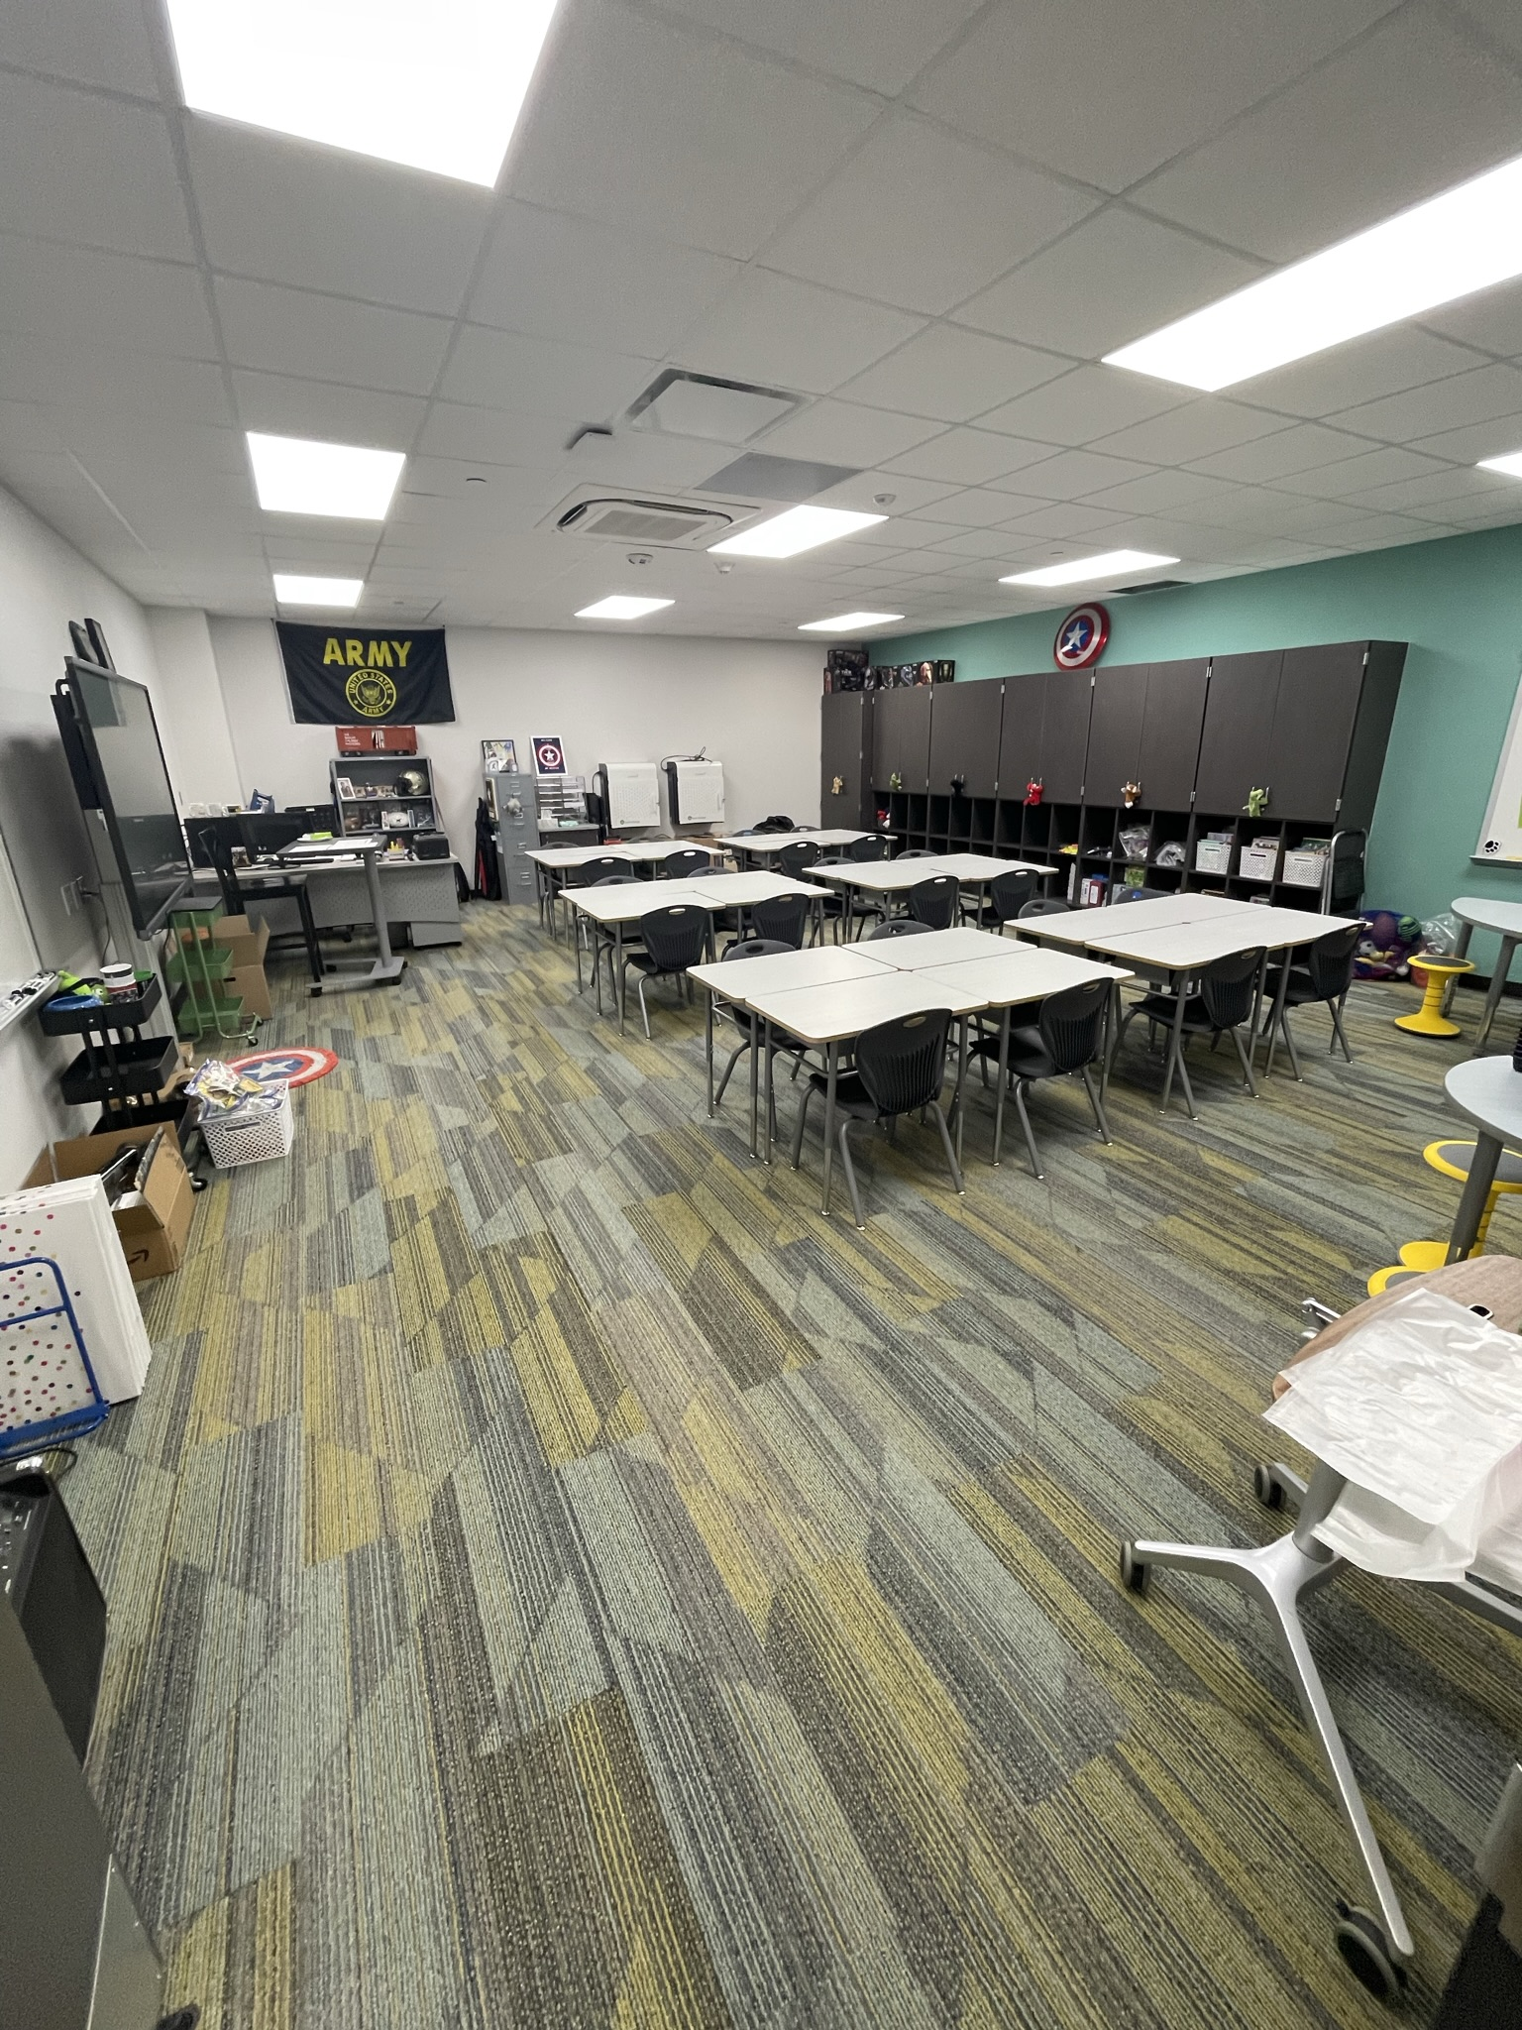
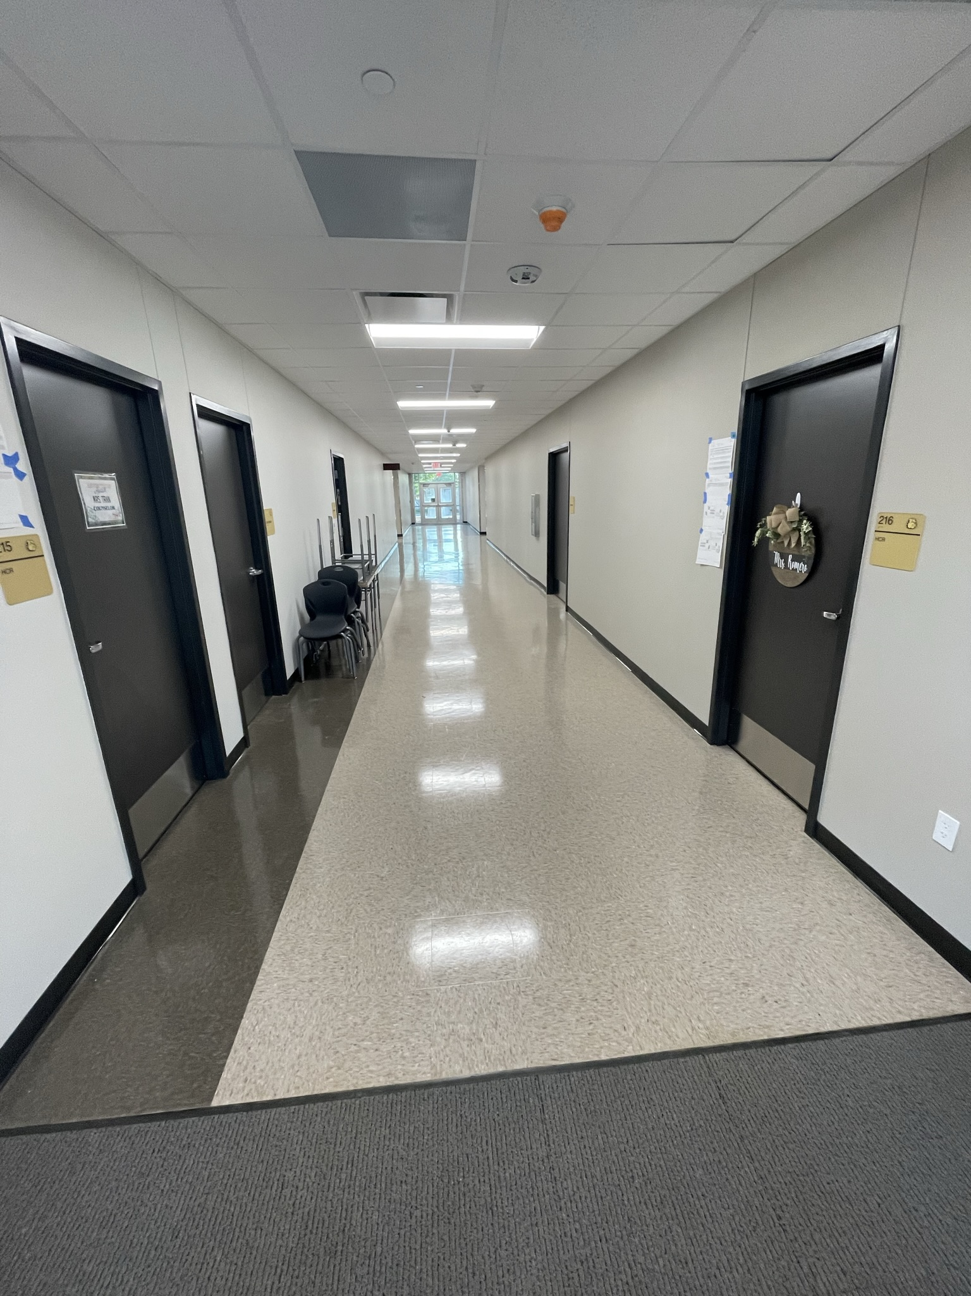
Hillcrest Elementary School
Café/kitchen extension
  Brick Work
  Exterior Windows
  Soffit
  Cooler/Freezer
Complete Fence & Gates
Landscape & Sod

Slide 9
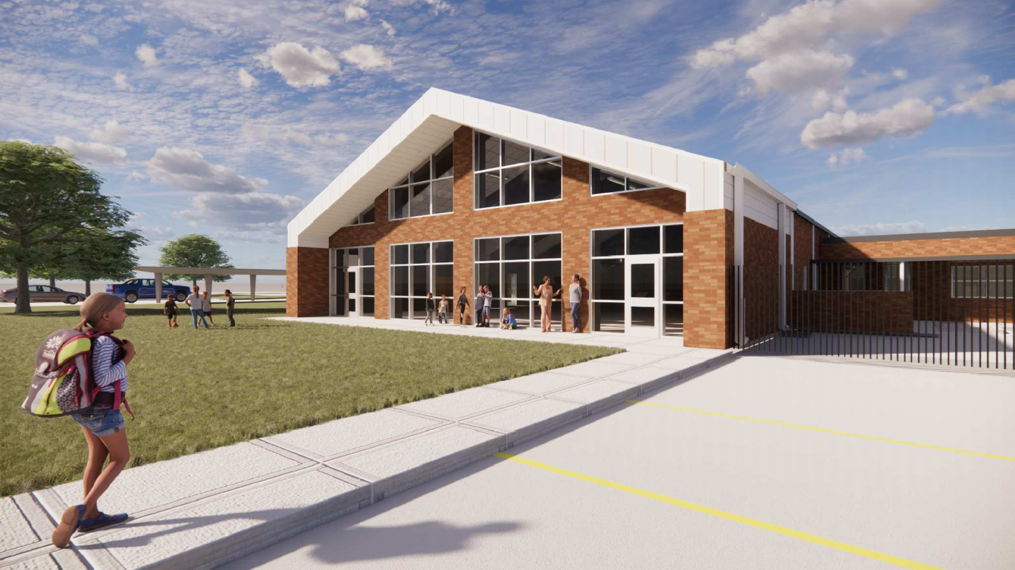
Highland Park Elementary School

Slide 10
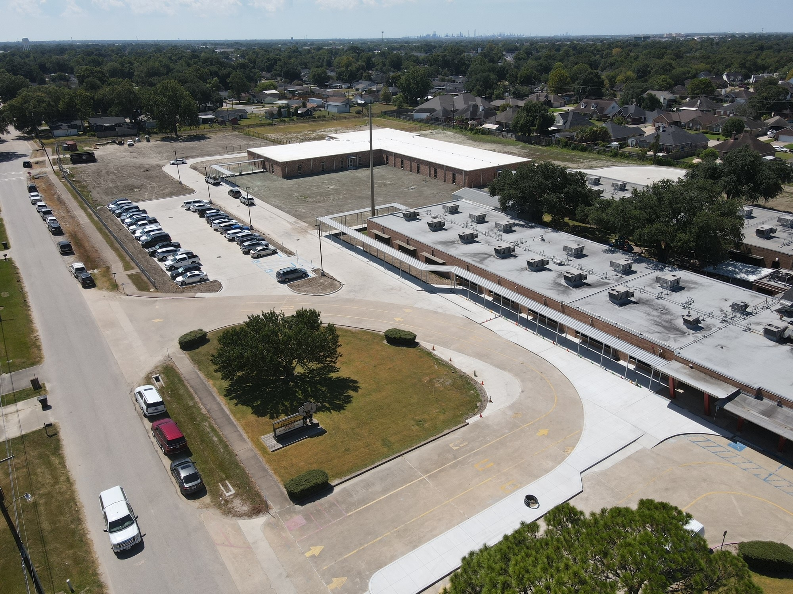
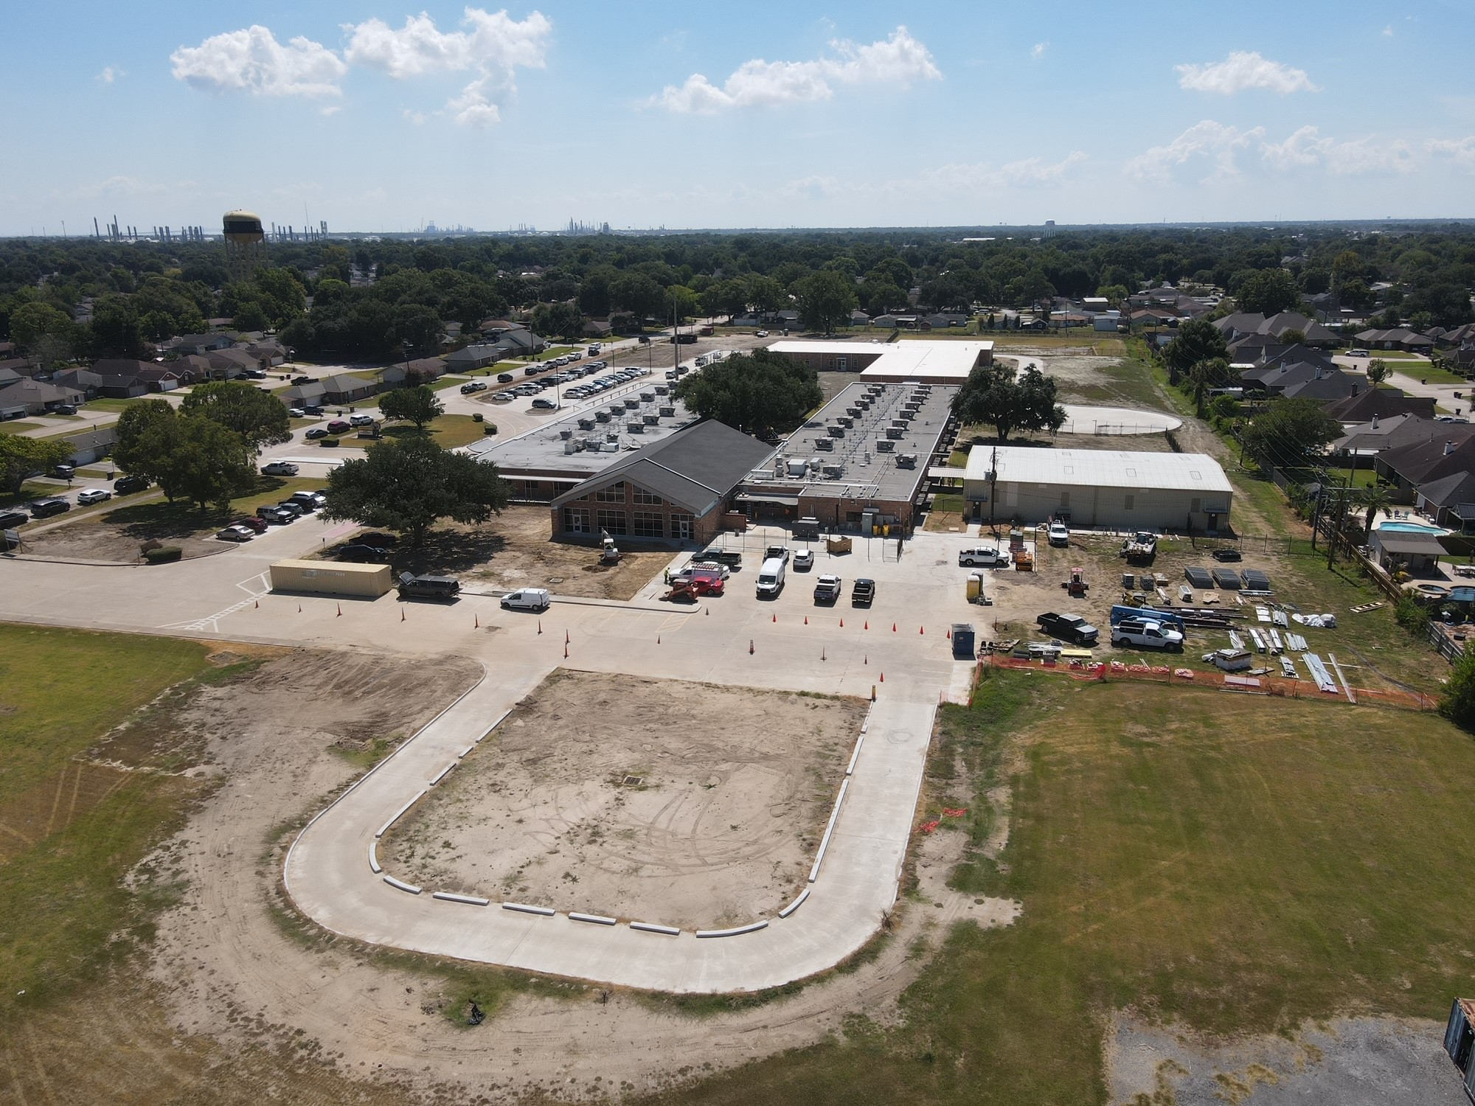
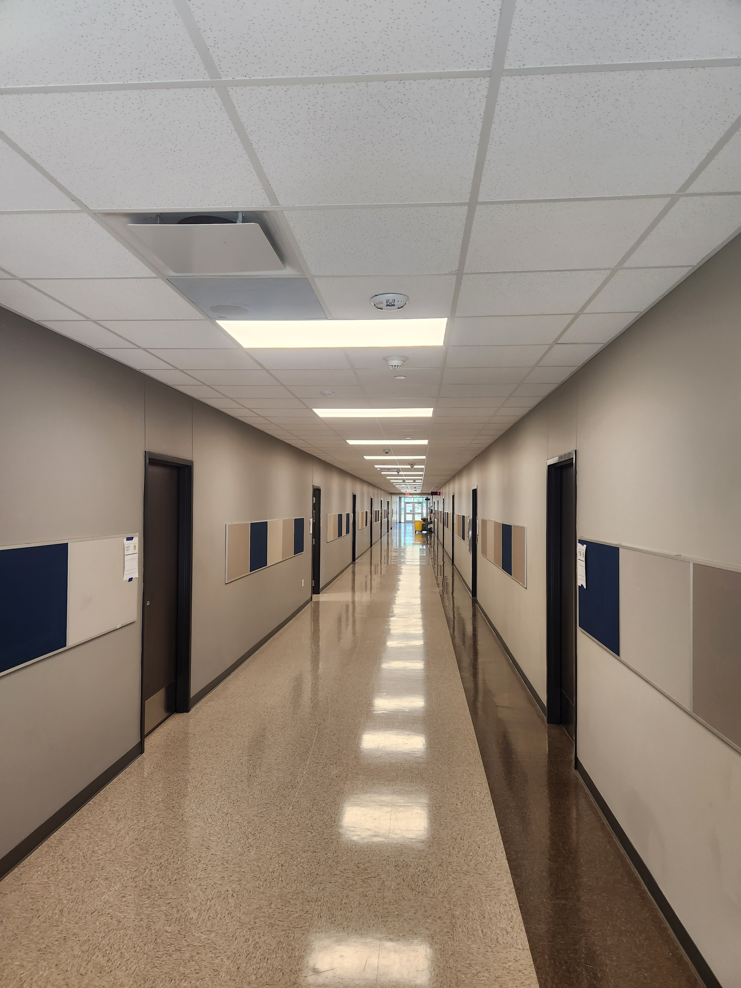
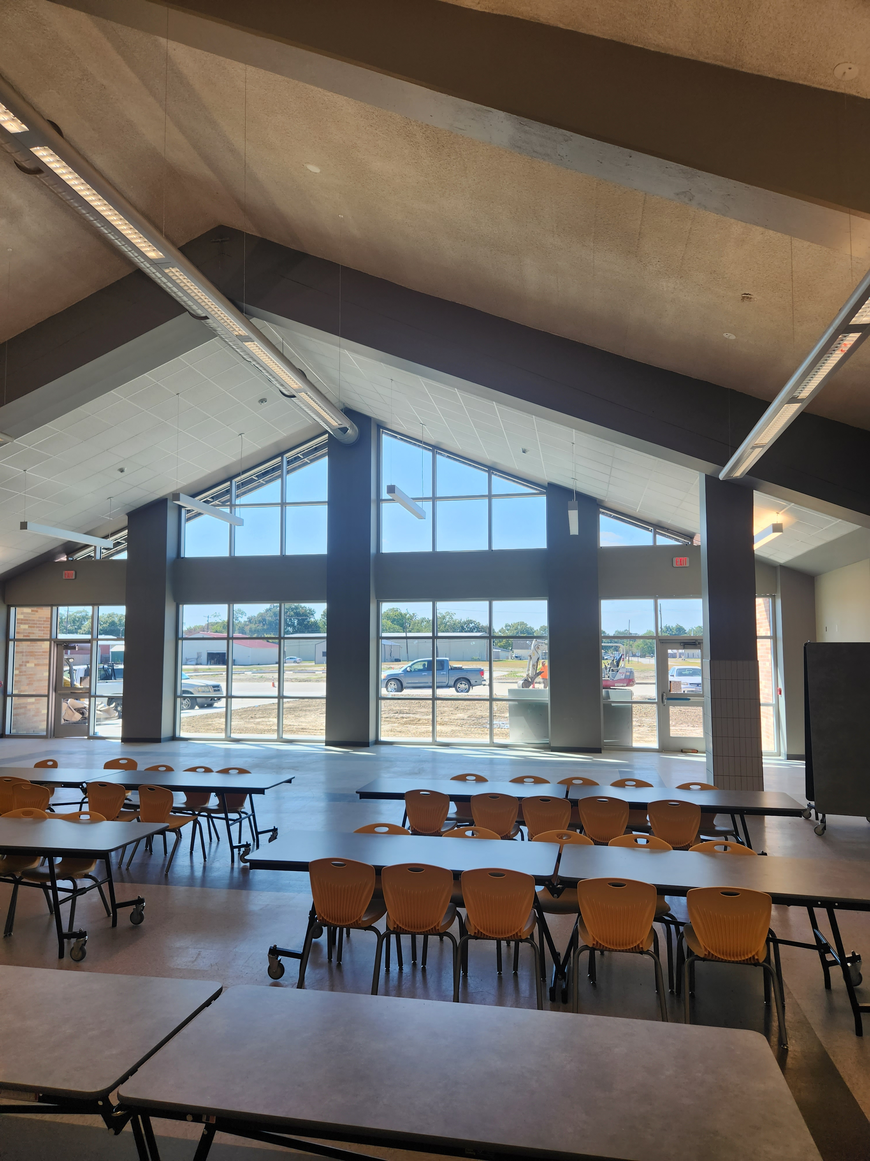
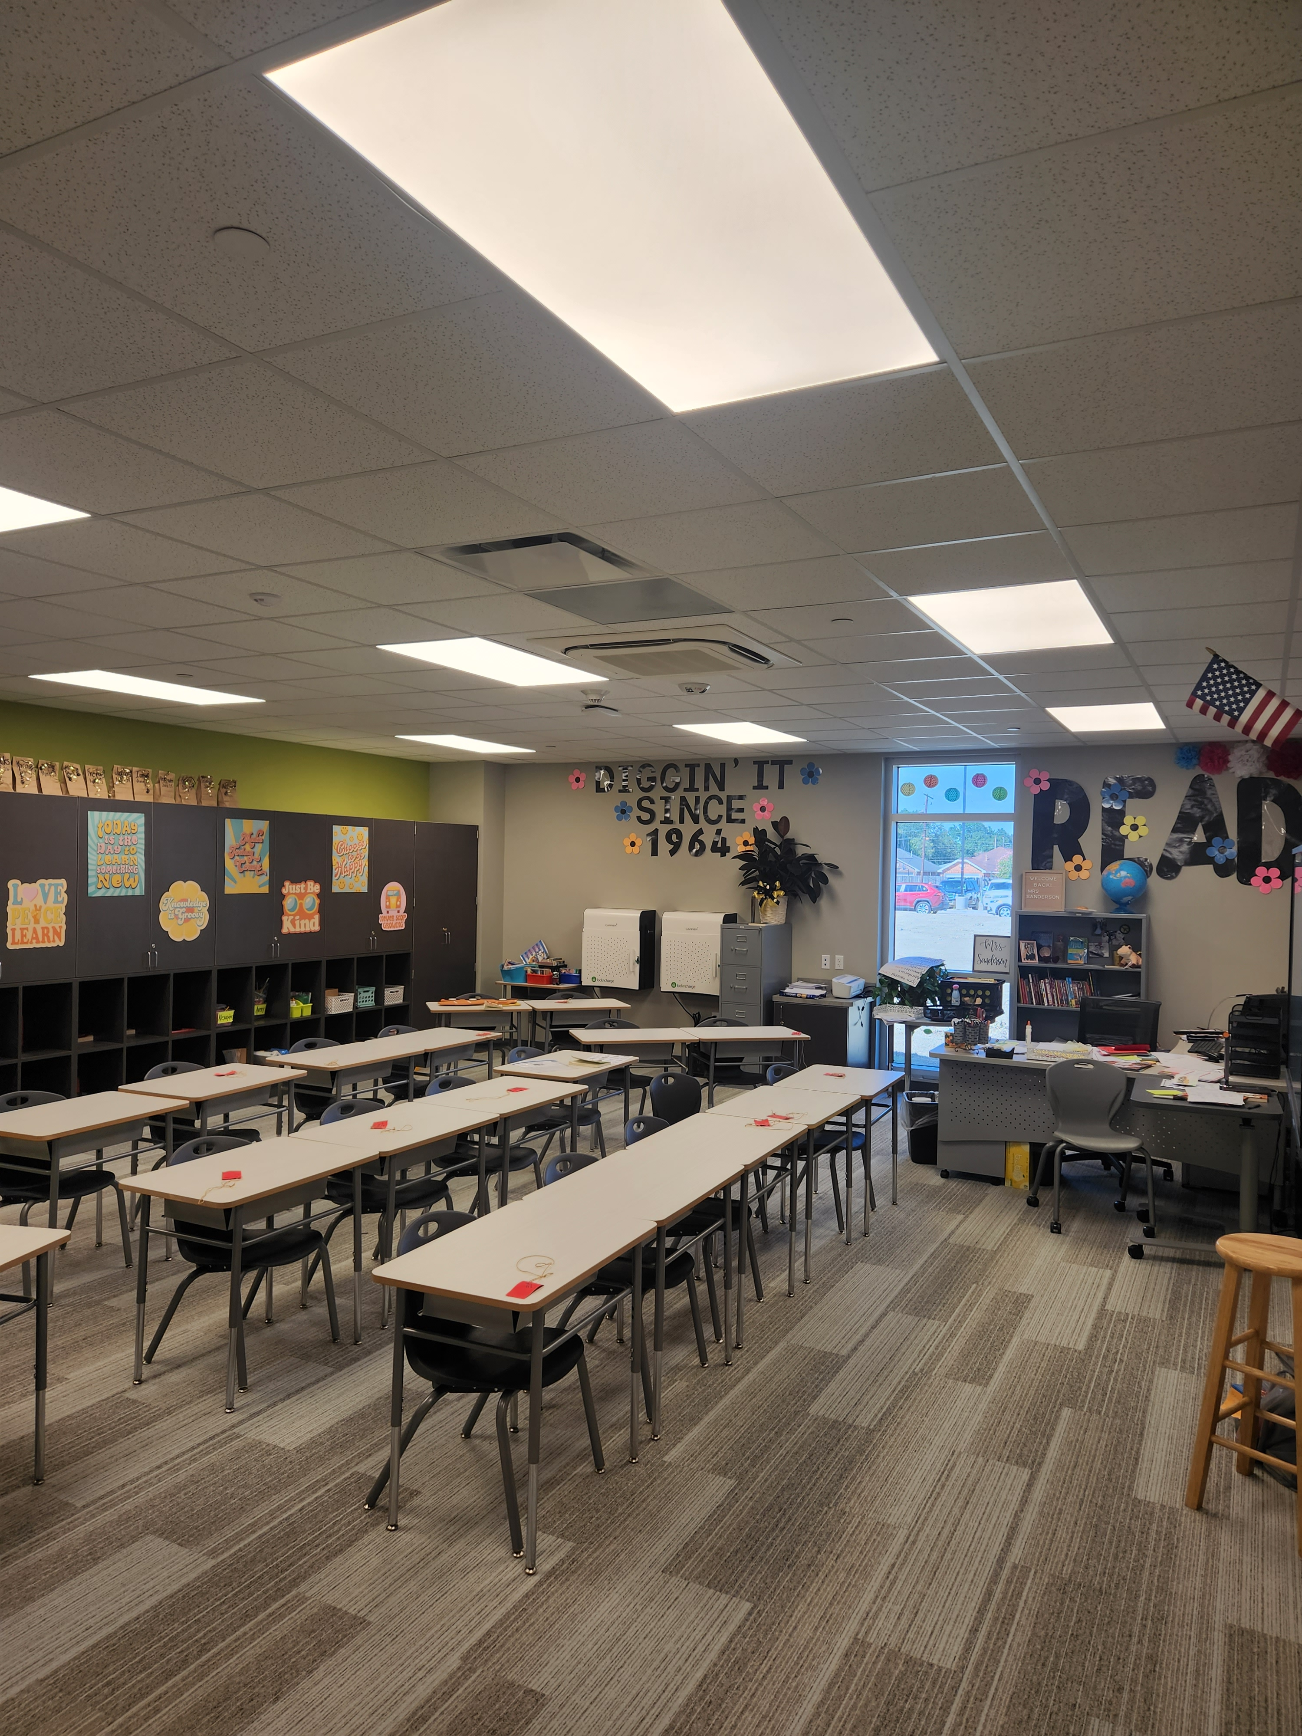
Highland Park Elementary School
Complete Cabinet Install
Landscape & Sod
Complete Fence & Gates
Complete Signage Install

Slide 11
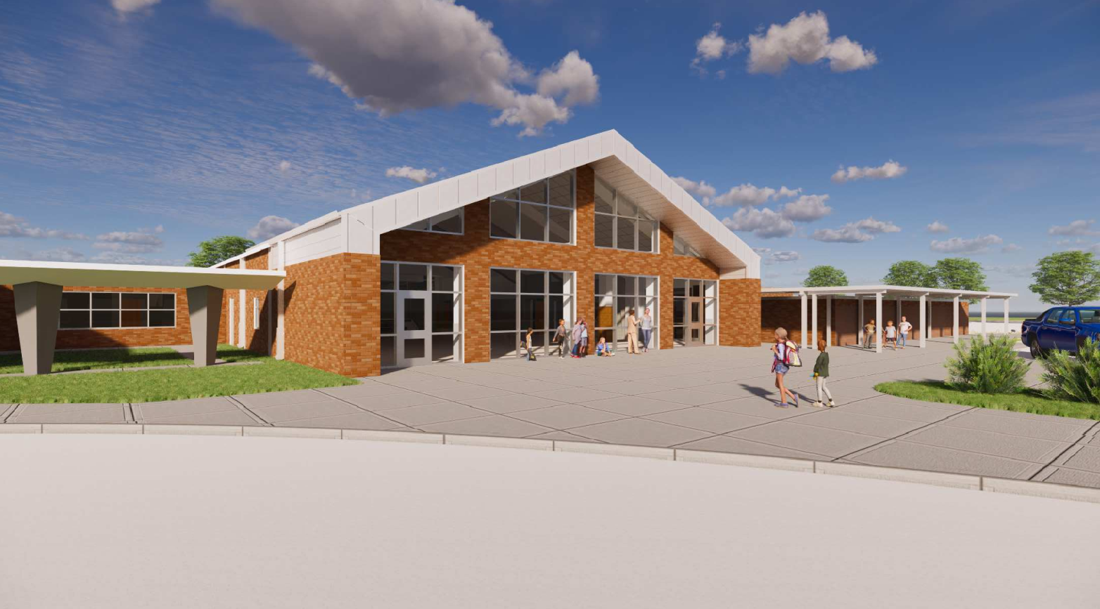
Helena Park Elementary School

Slide 12
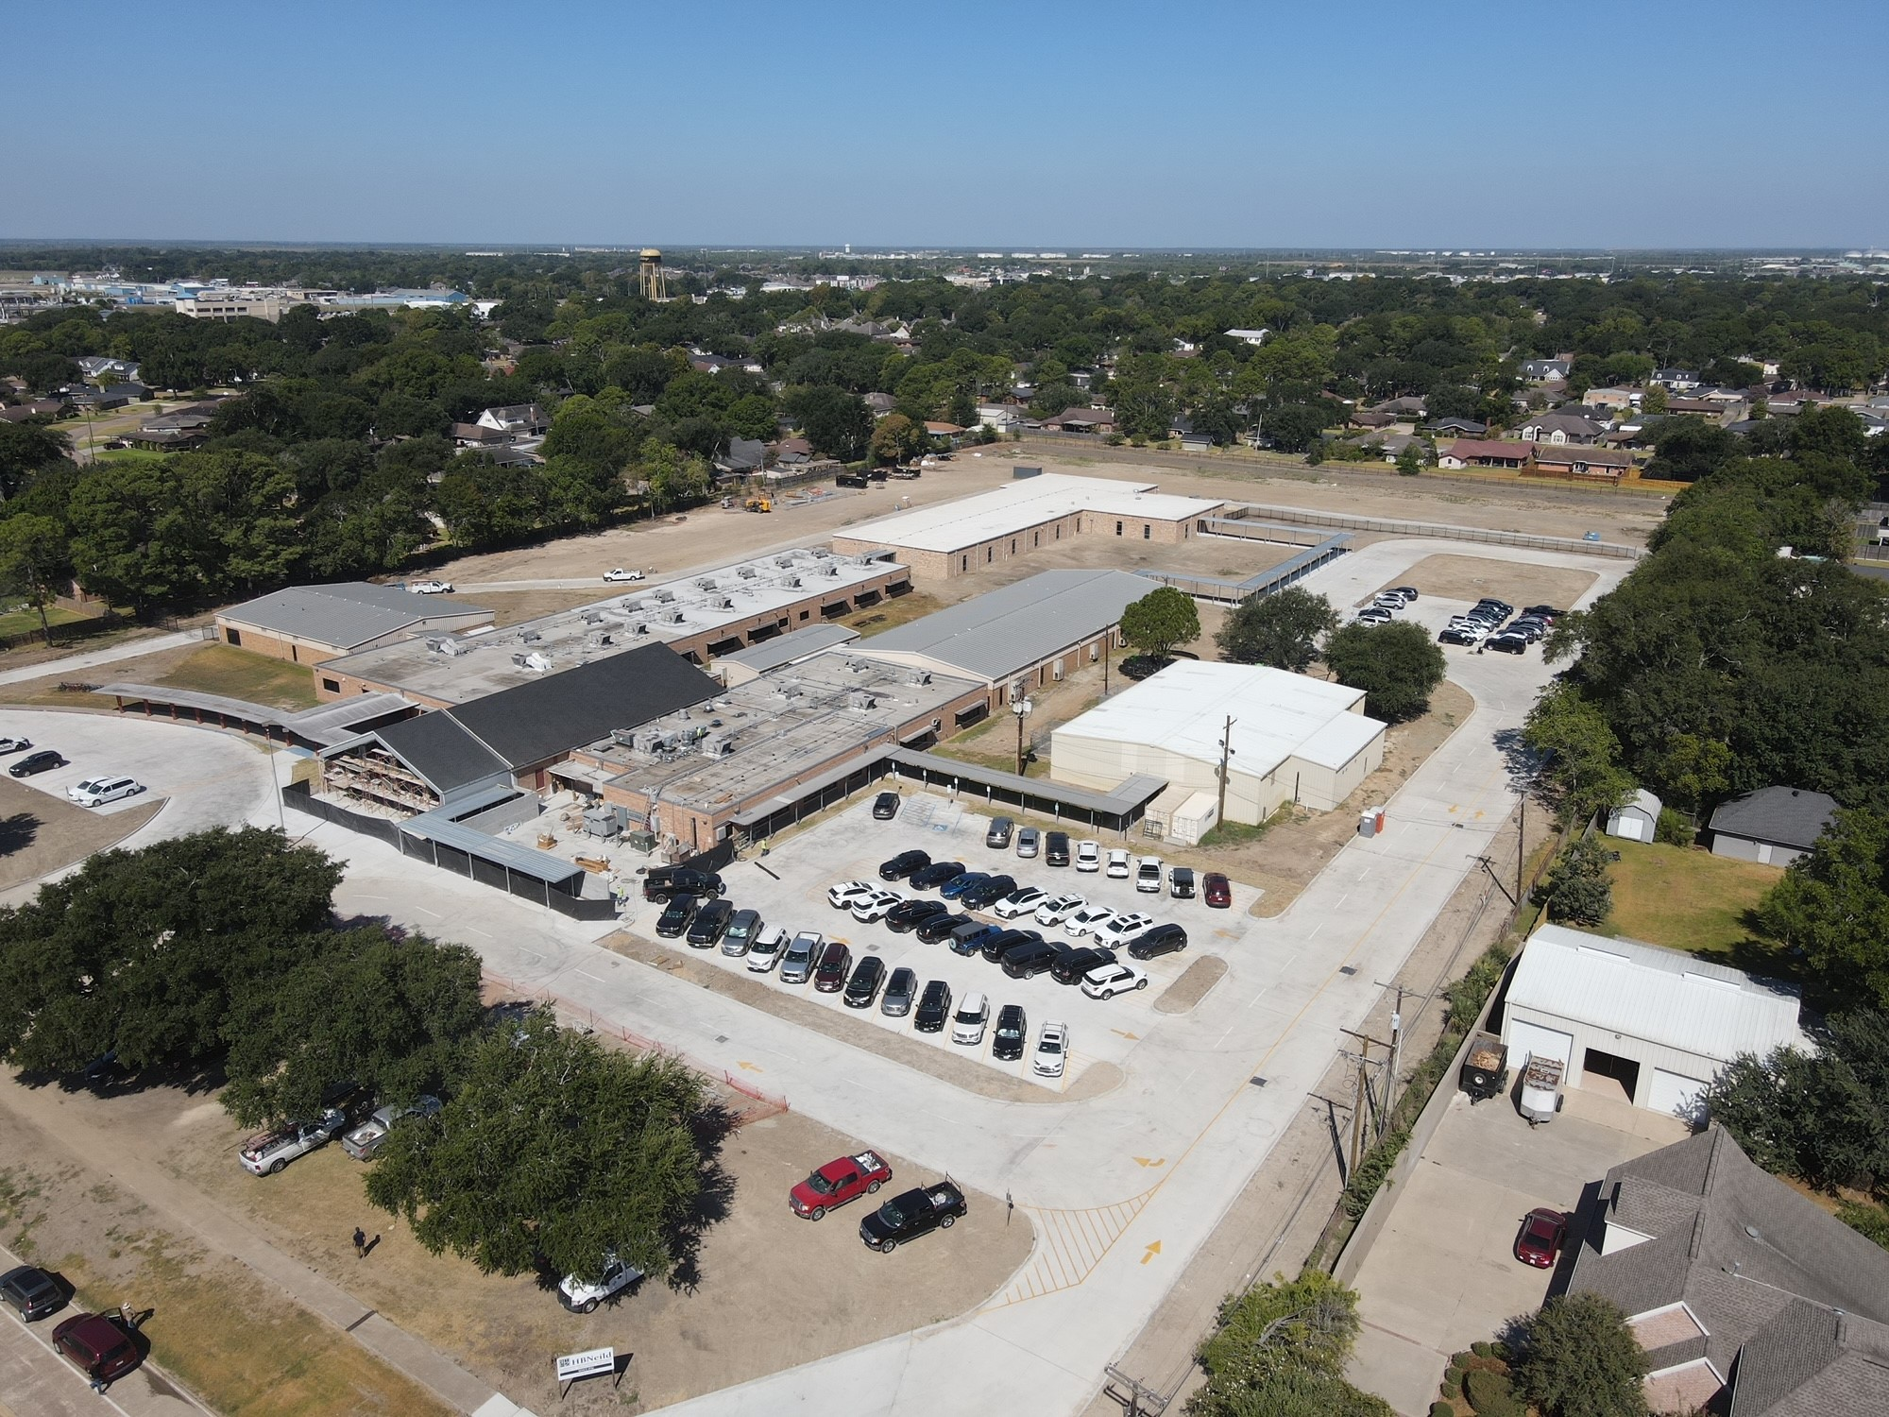
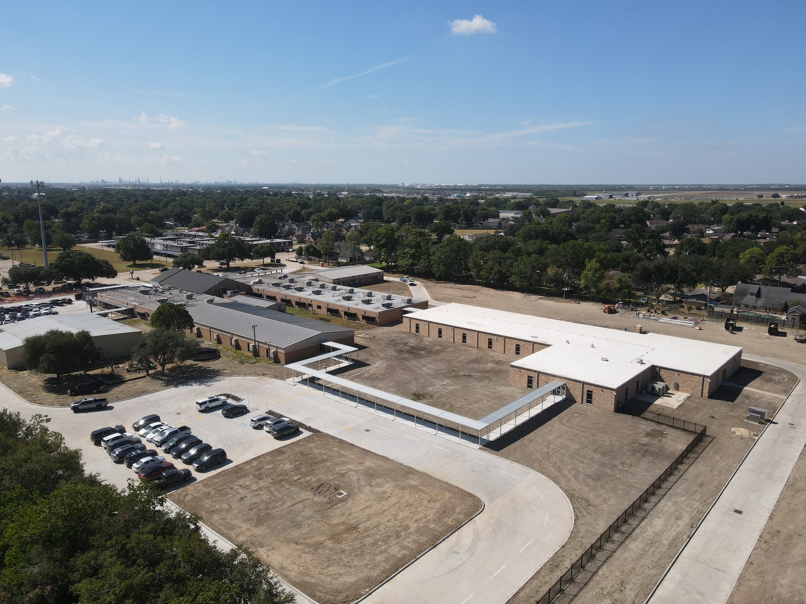
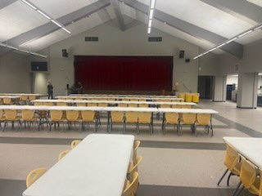
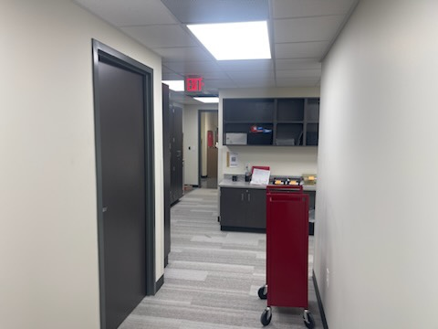
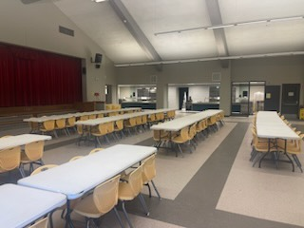
Helena Park Elementary School
Café Extension
  Brick Work
  Exterior Windows
  Soffit Panel
Complete Fencing & Gates
Landscape & Sod

Slide 13
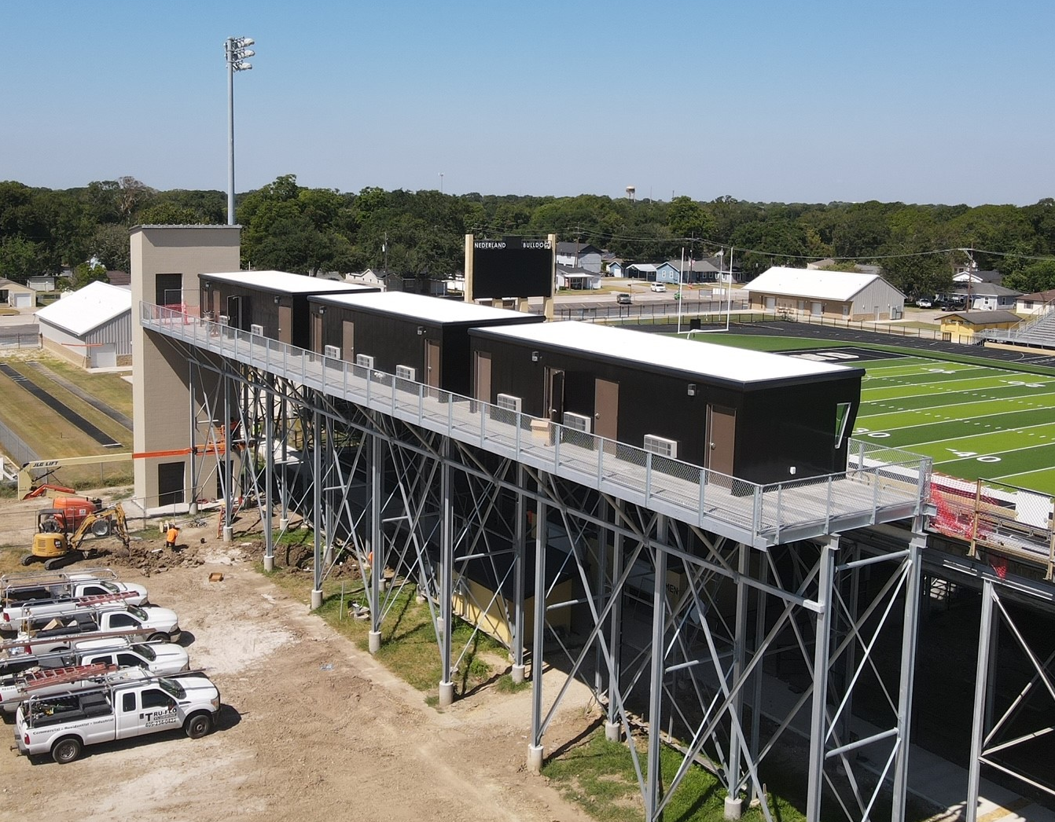
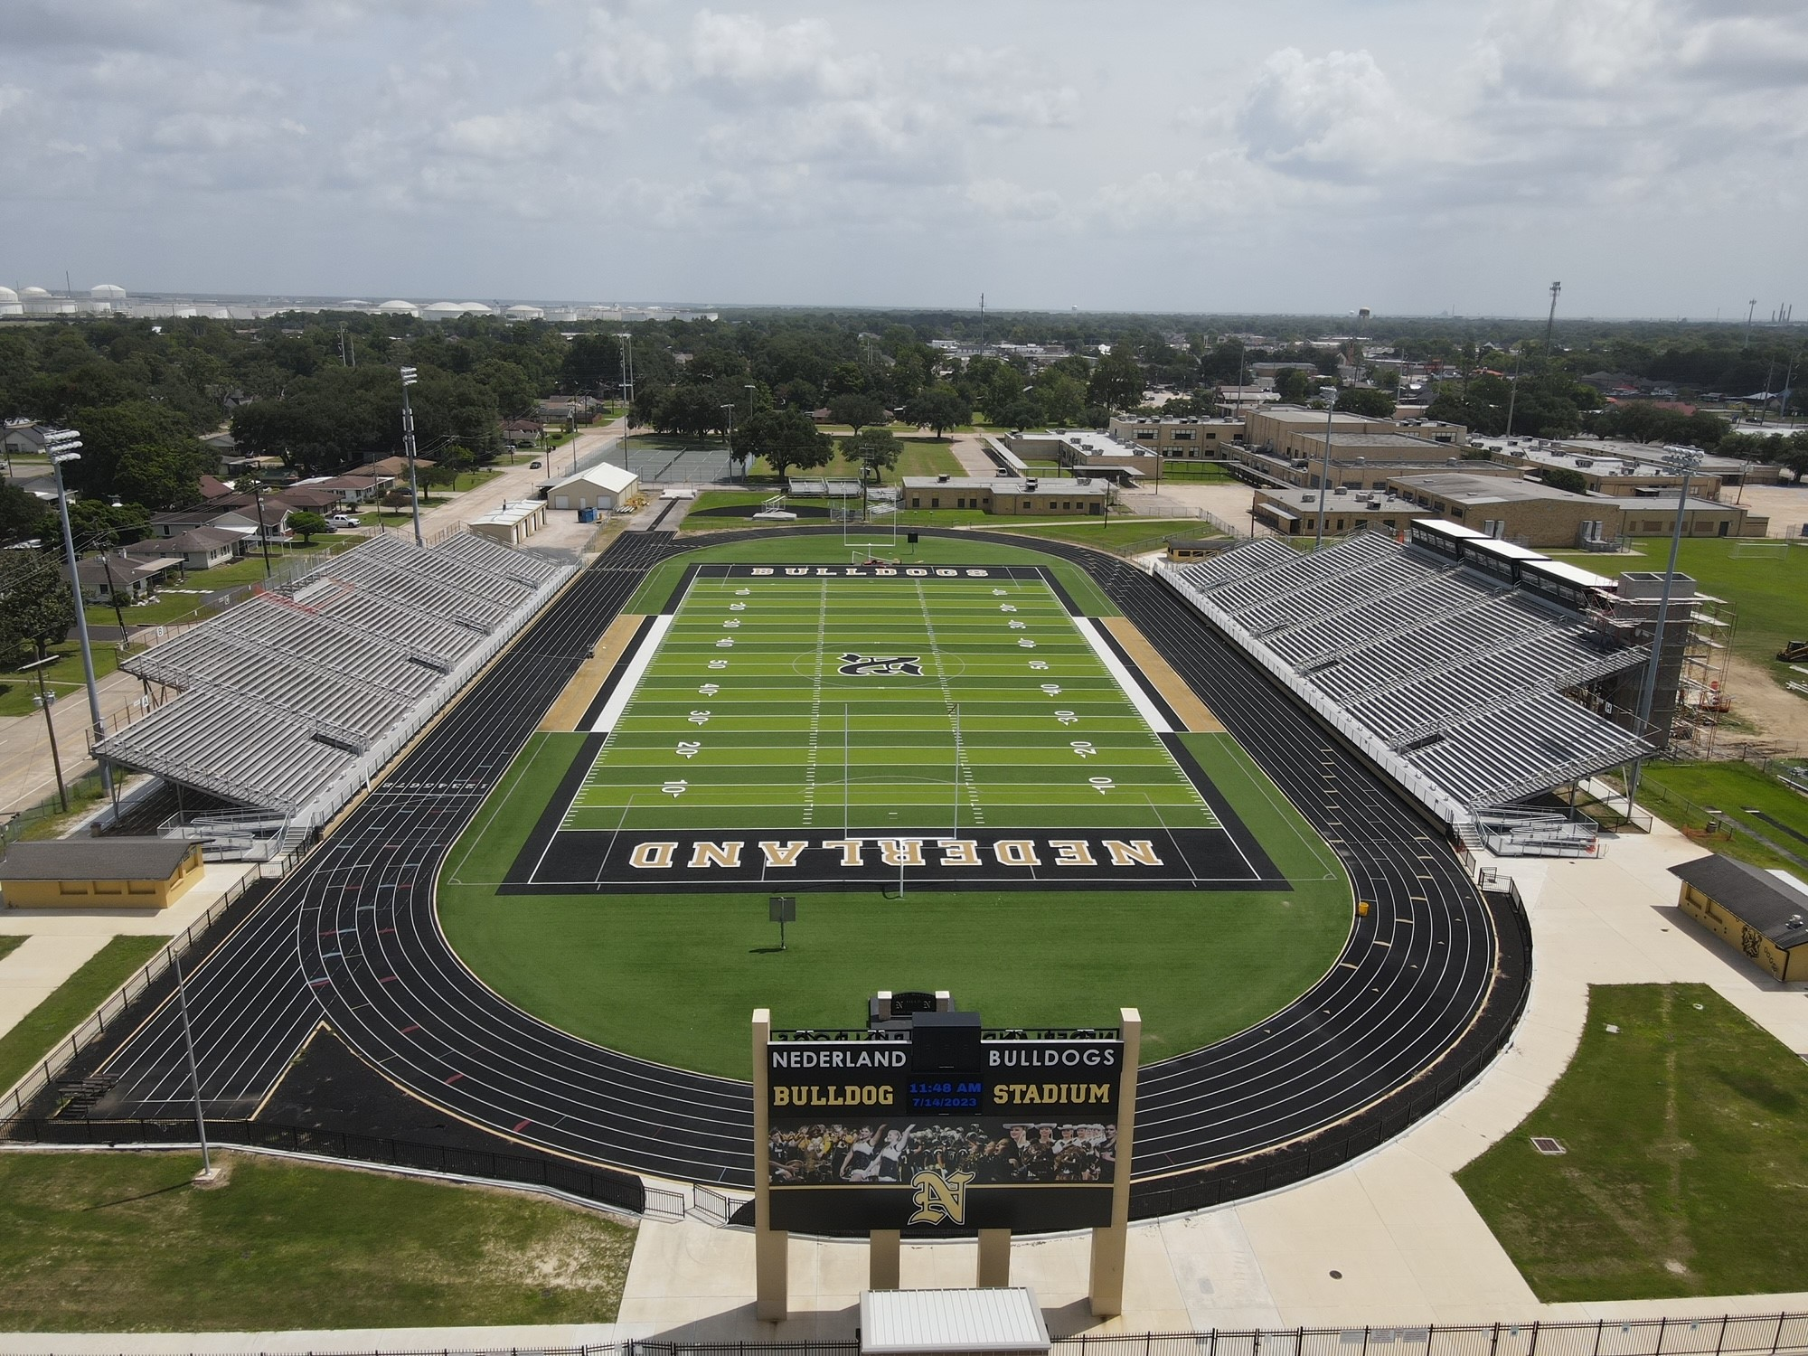
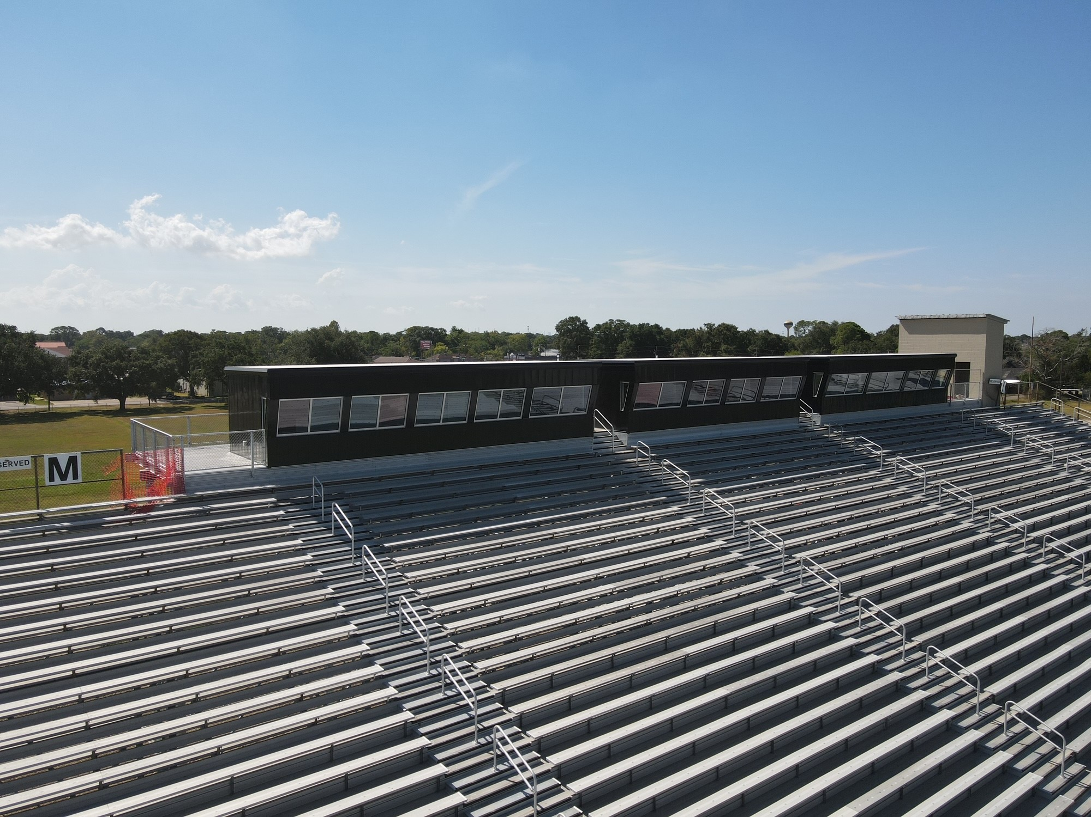
Nederland Bulldog Stadium
Home Side
  Elevator Install
  Electrical Complete
  Install Signage
  Install Canopy coverings
Visitors Side
  SturdiSteel to complete bleacher renovations, inspection.

Slide 14
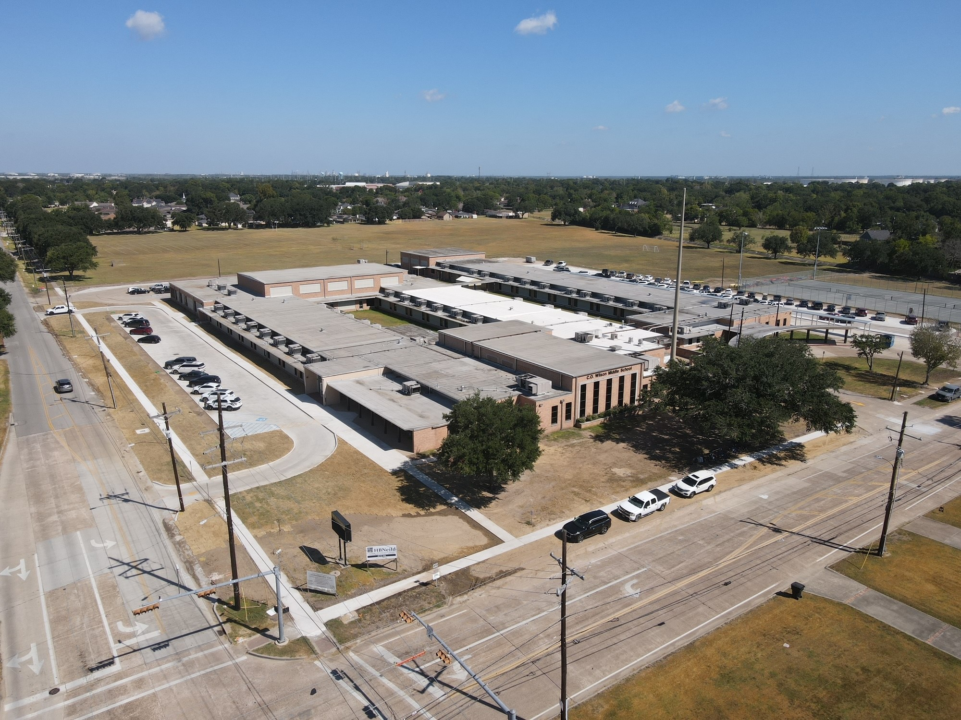
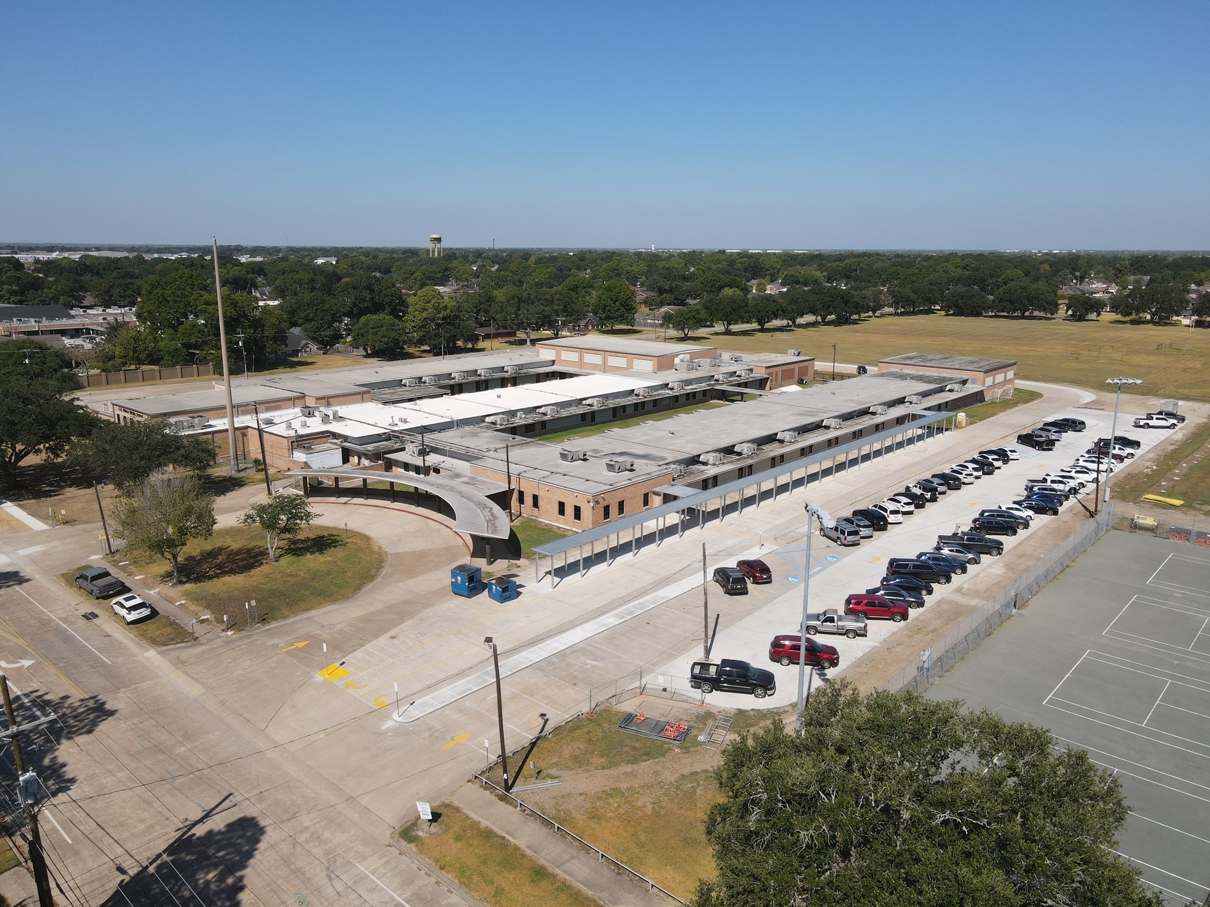
CO Wilson Middle School
Front Office Complete
Laboratories Complete
Toilet Partitions Complete
Complete Trench Drain / Concrete Island
Install Fence & Gates
Remove Entergy Pole

Slide 15
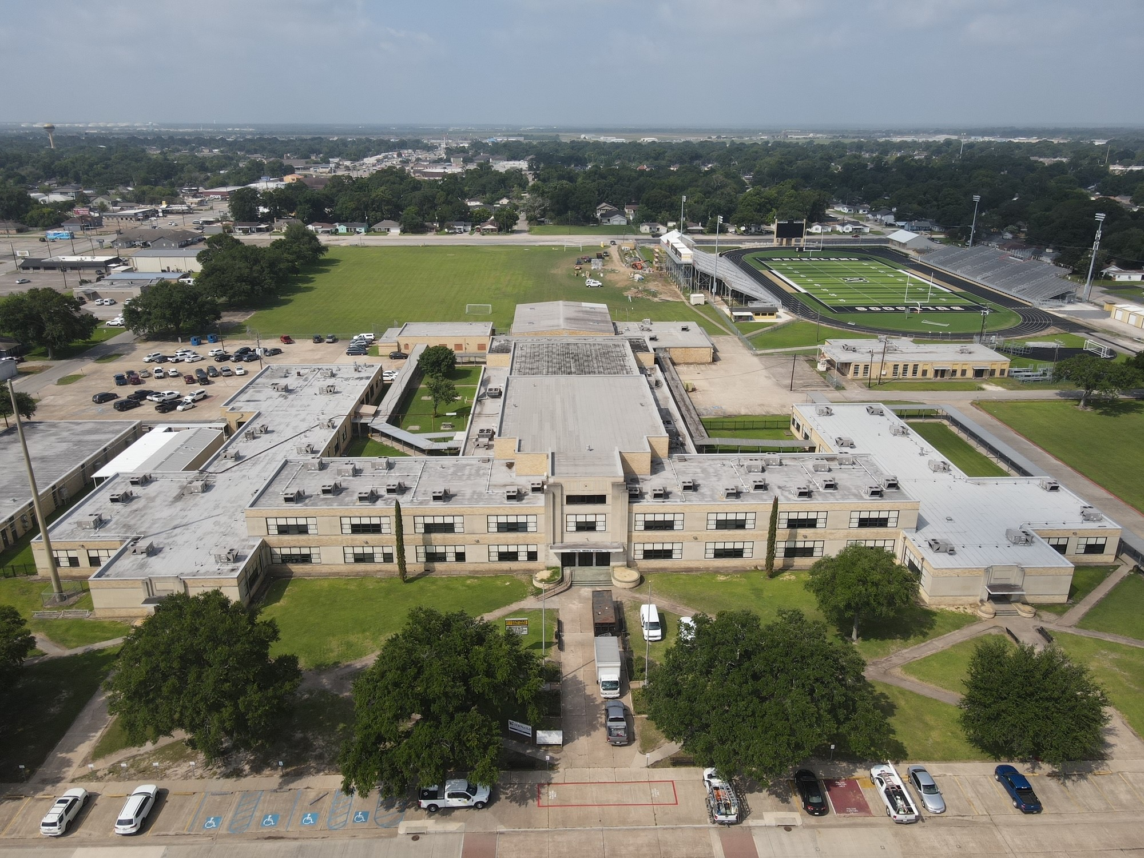
Central Middle School
Front Office Complete
  Installing New Casework
Laboratories Complete
Toilet Partitions Complete
Flatwork & Canopy outside Natatorium
Change Exterior Door for ADA.
Install Wheelchair Lift

Slide 16


