Slide 1




2019 Nederland ISD Bond Project
September 2023

Slide 2

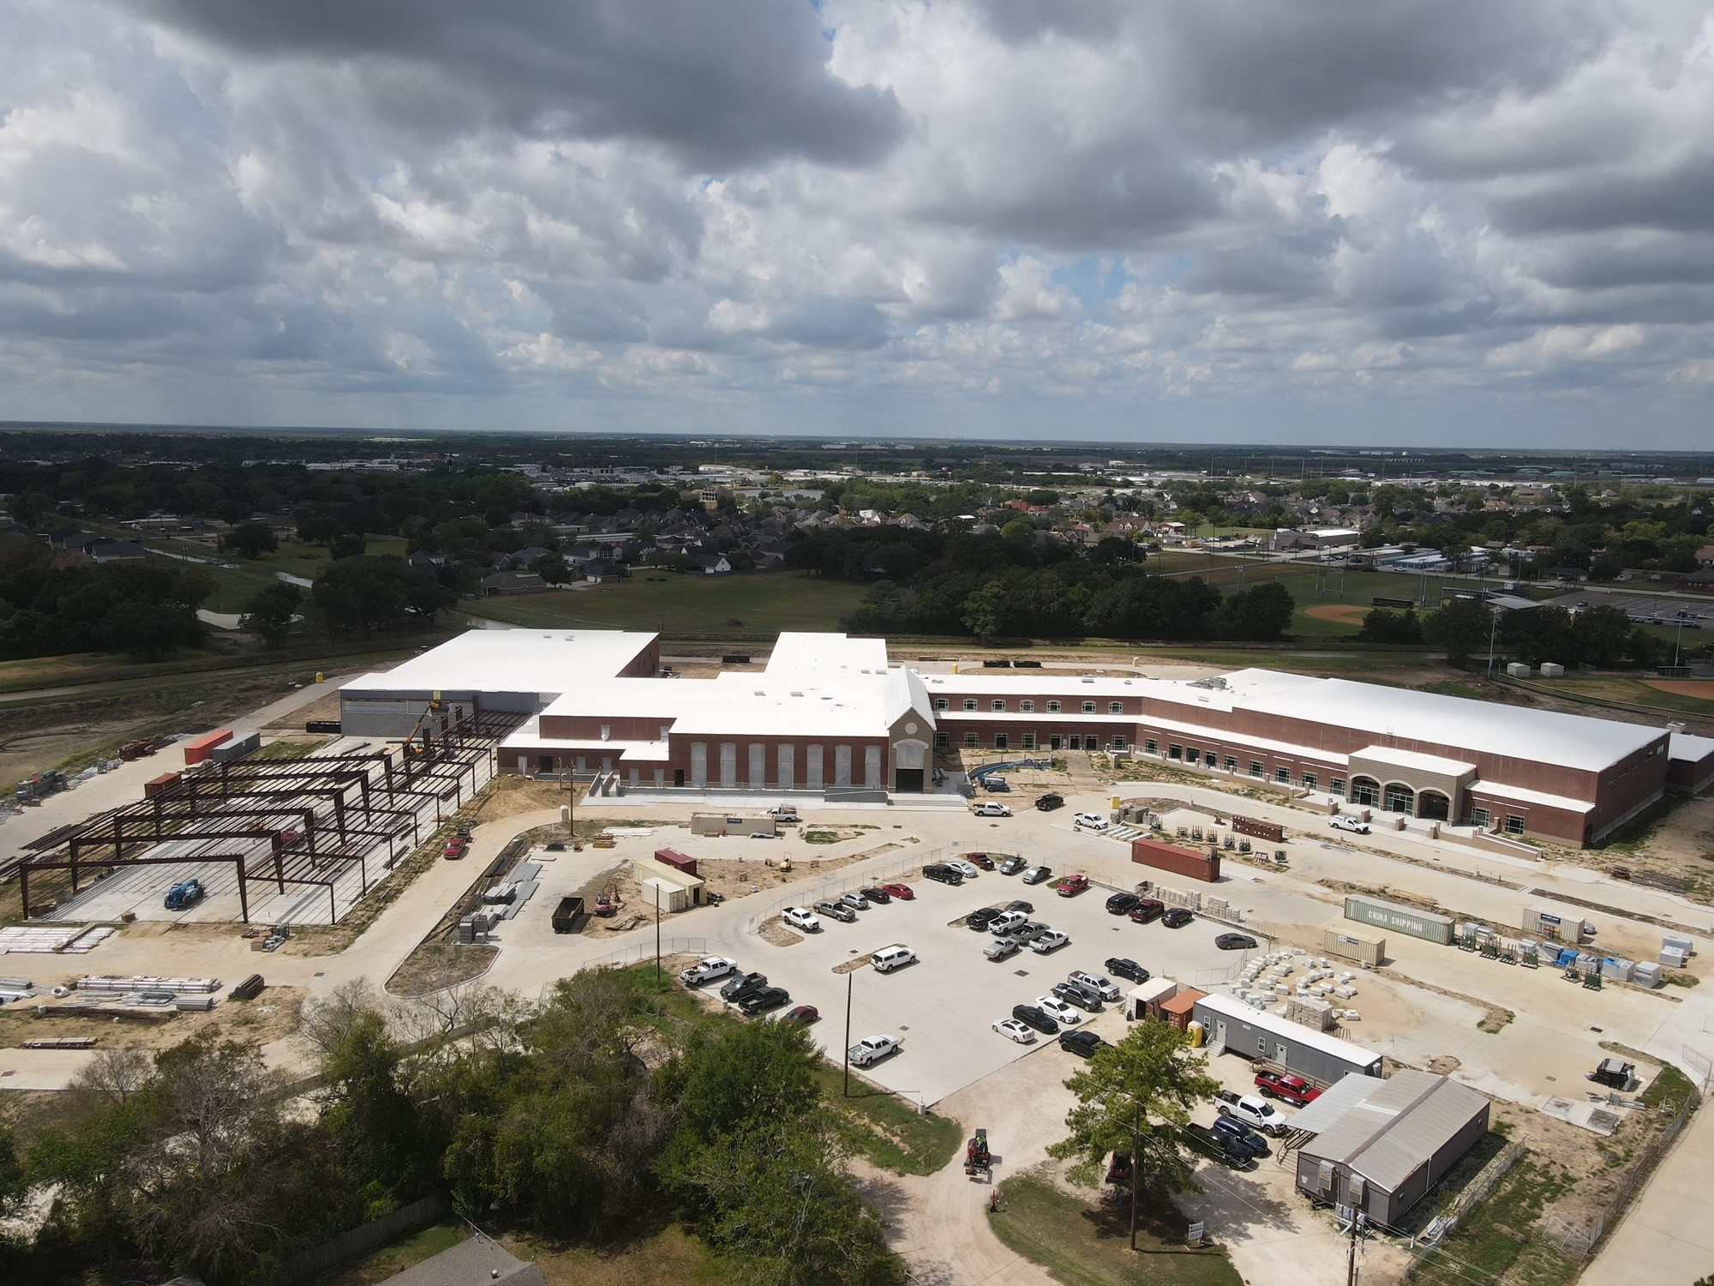
Nederland High School

Slide 3
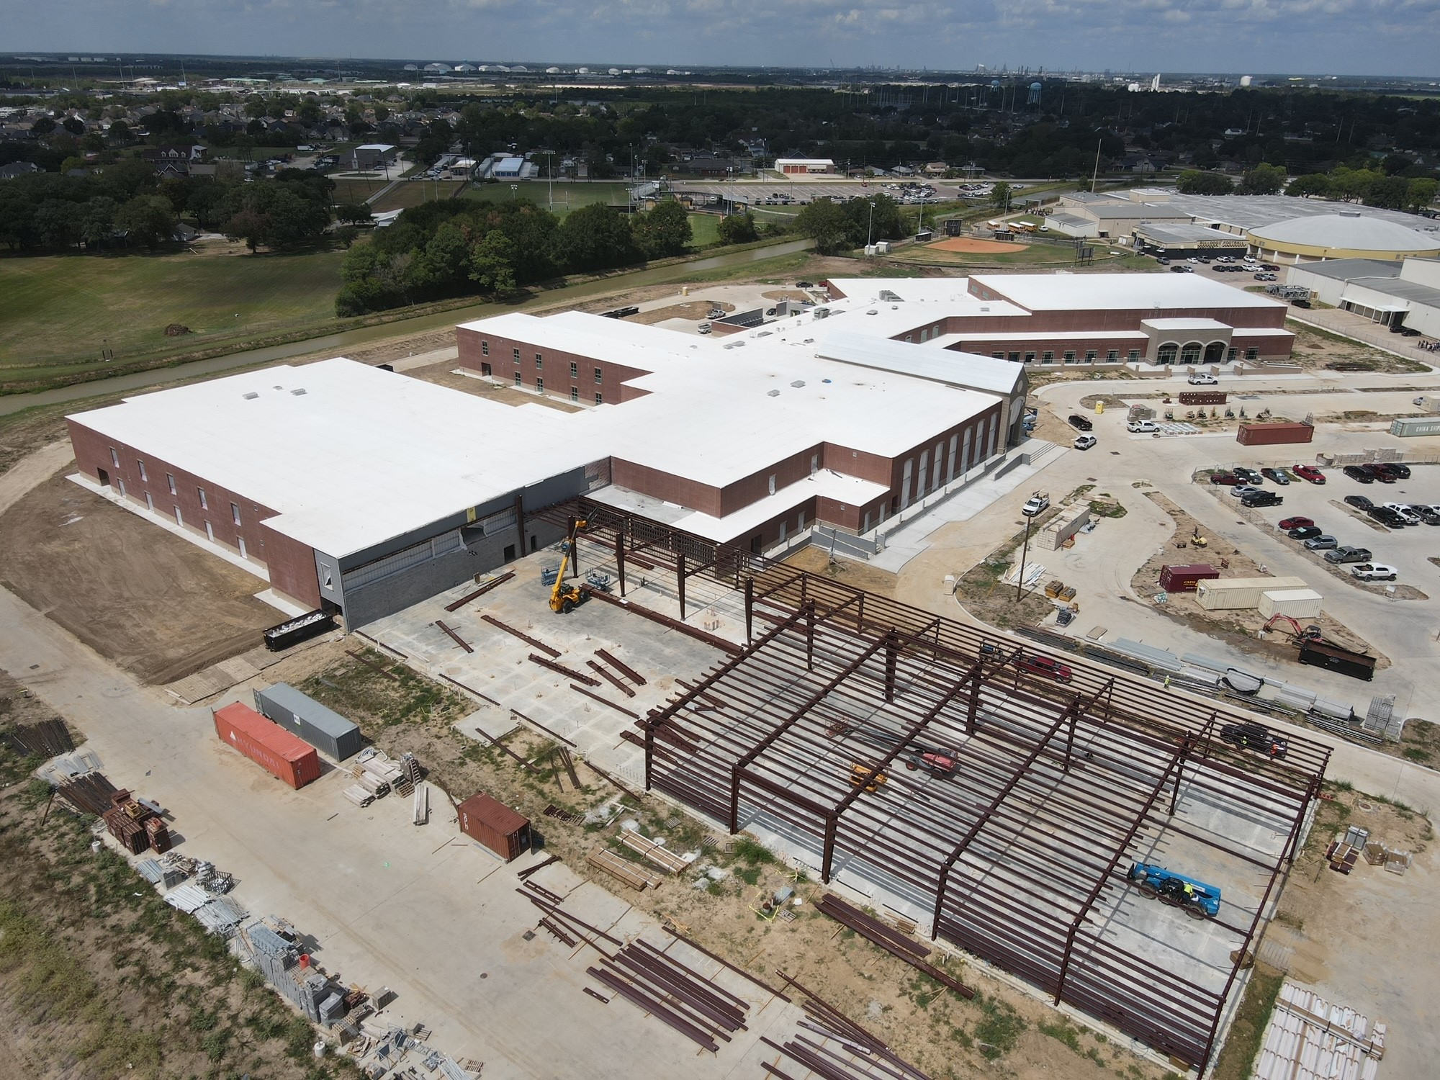
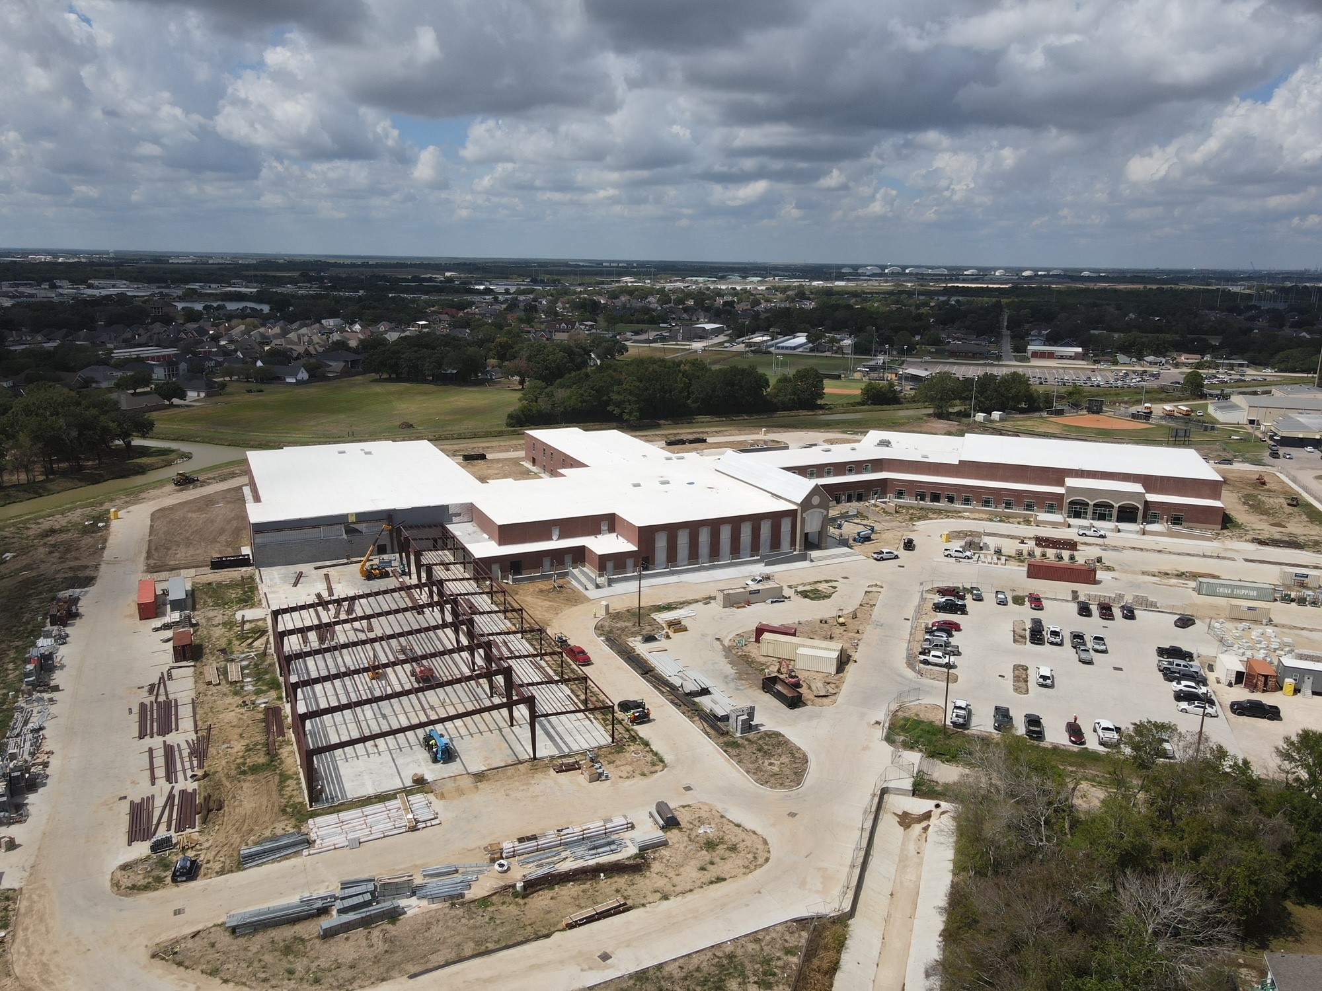
Nederland High School
Exterior
  CTE Building has been delivered and is currently being erected
  Continue Flatwork around main plaza area
  Install Area ‘C’ Windows, Area ‘D’ is in fabrication
  Continue trim out work on roof

Slide 4
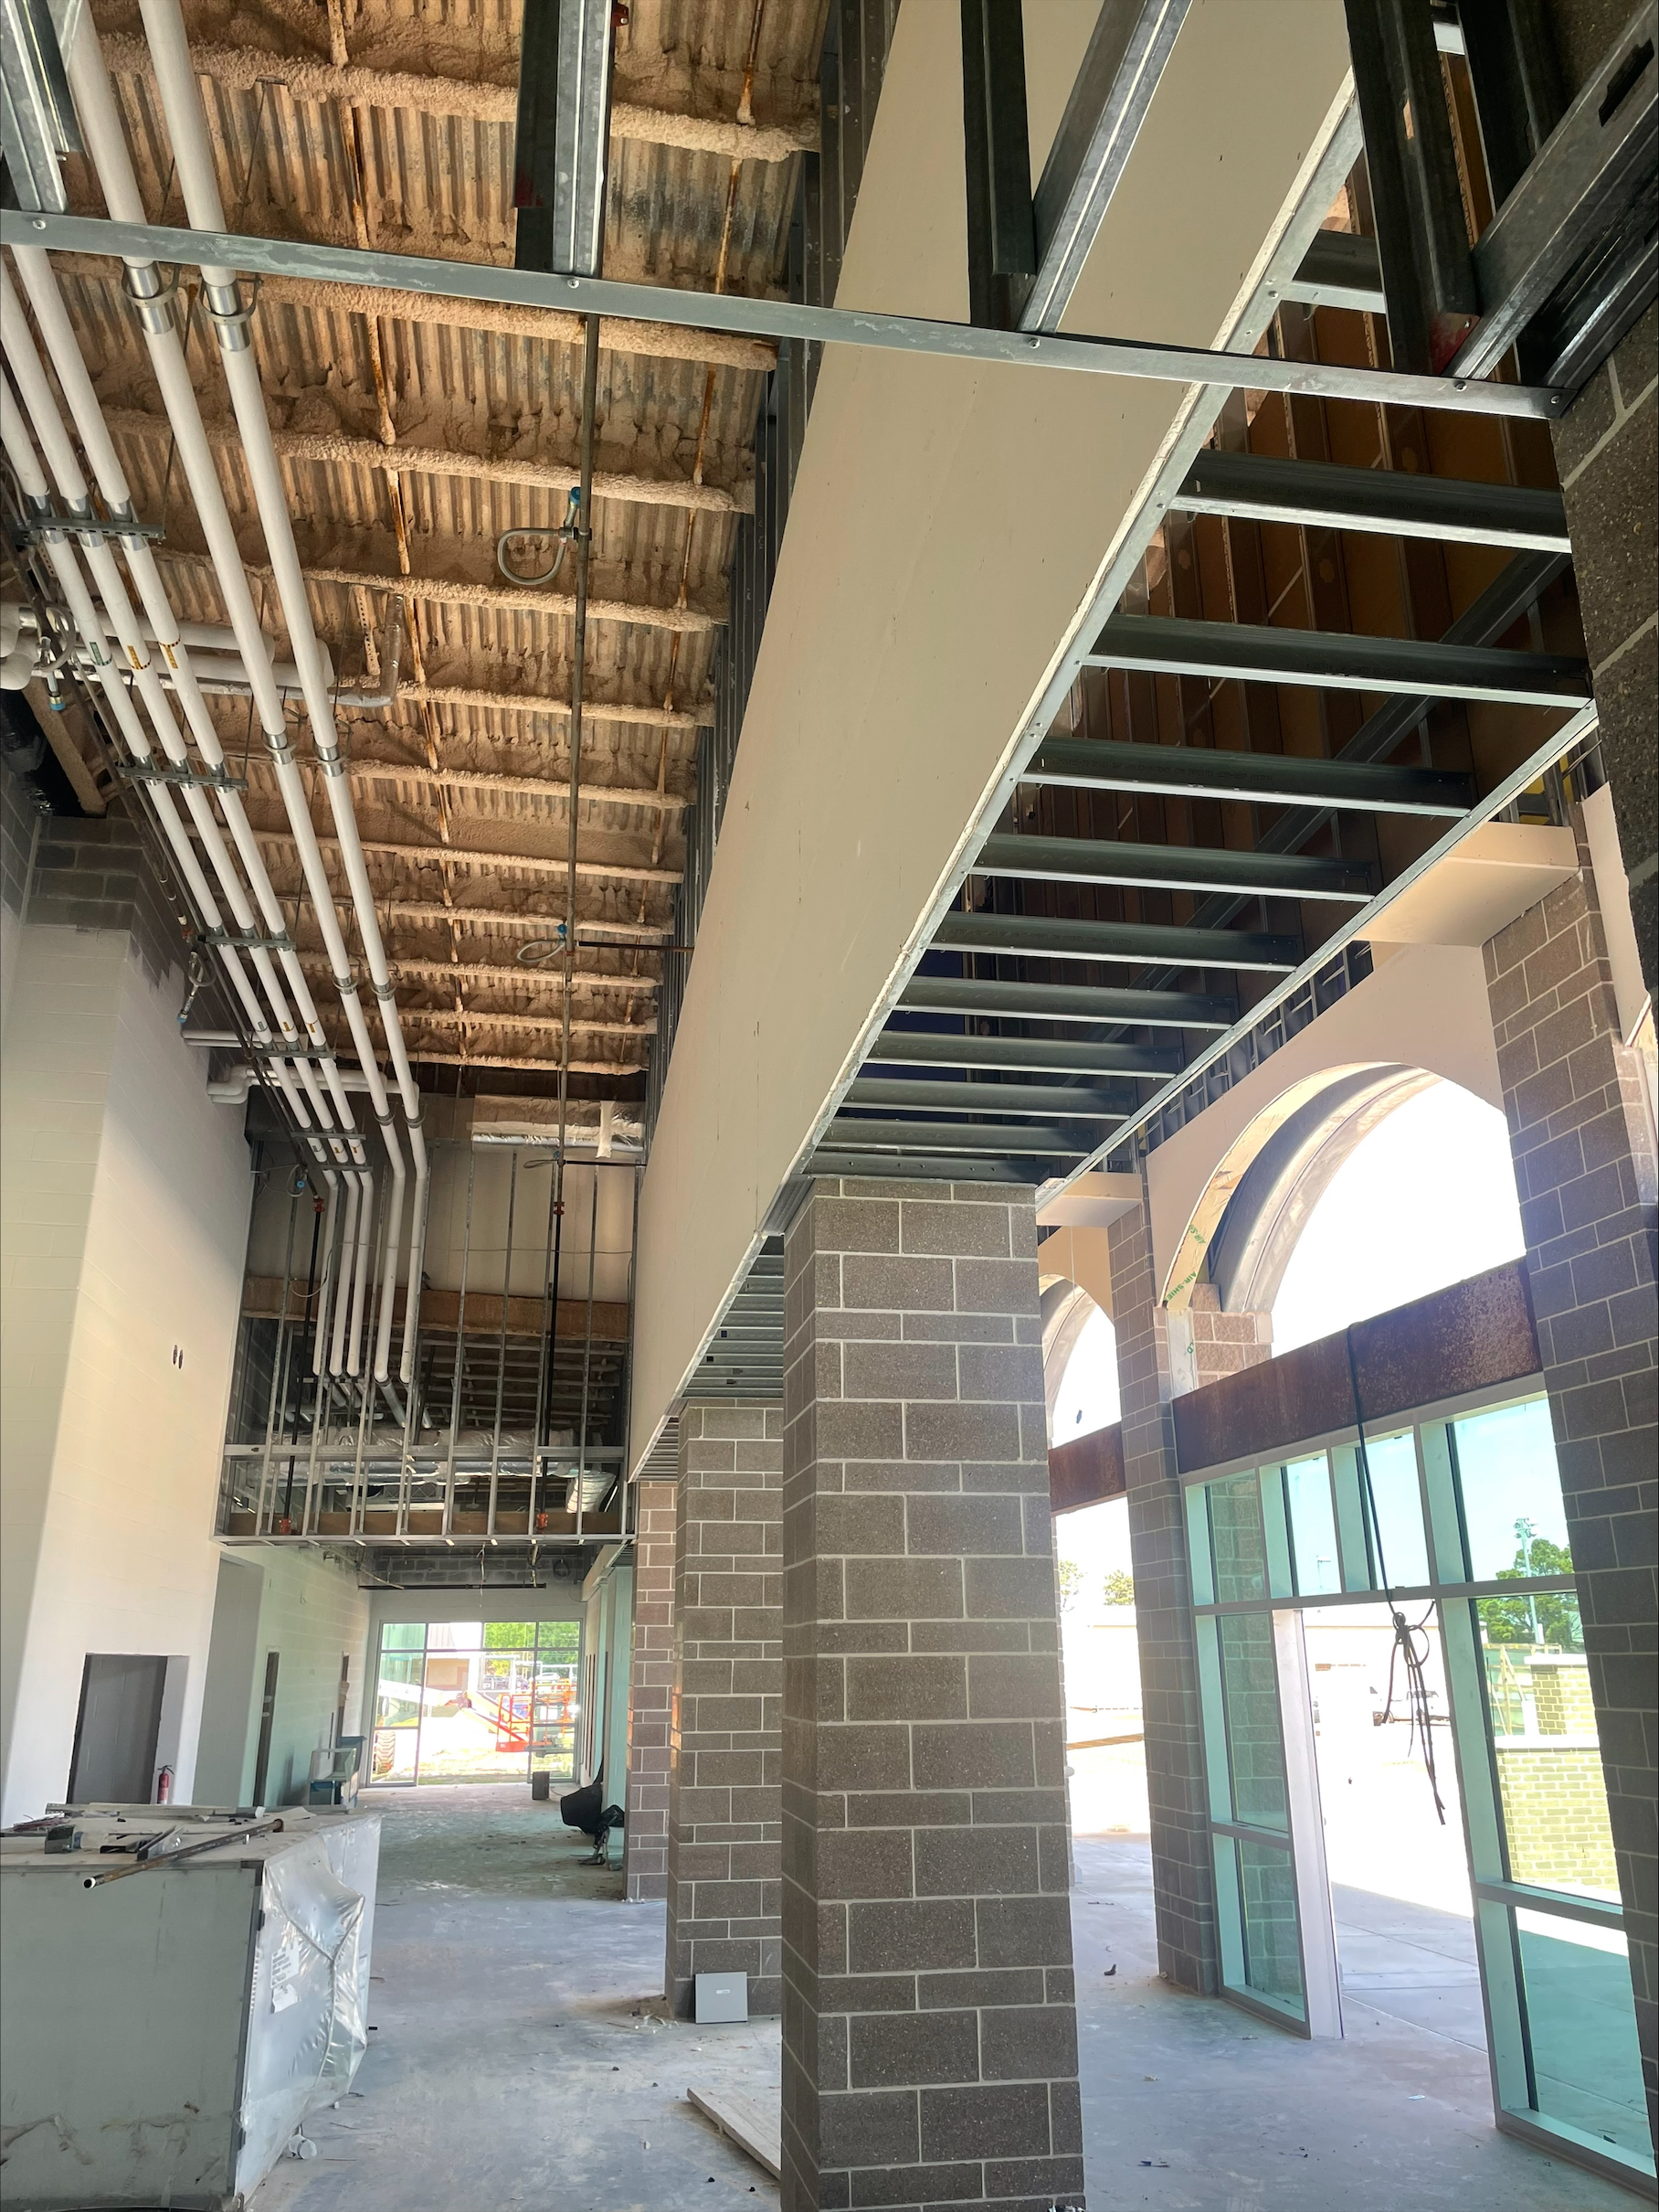
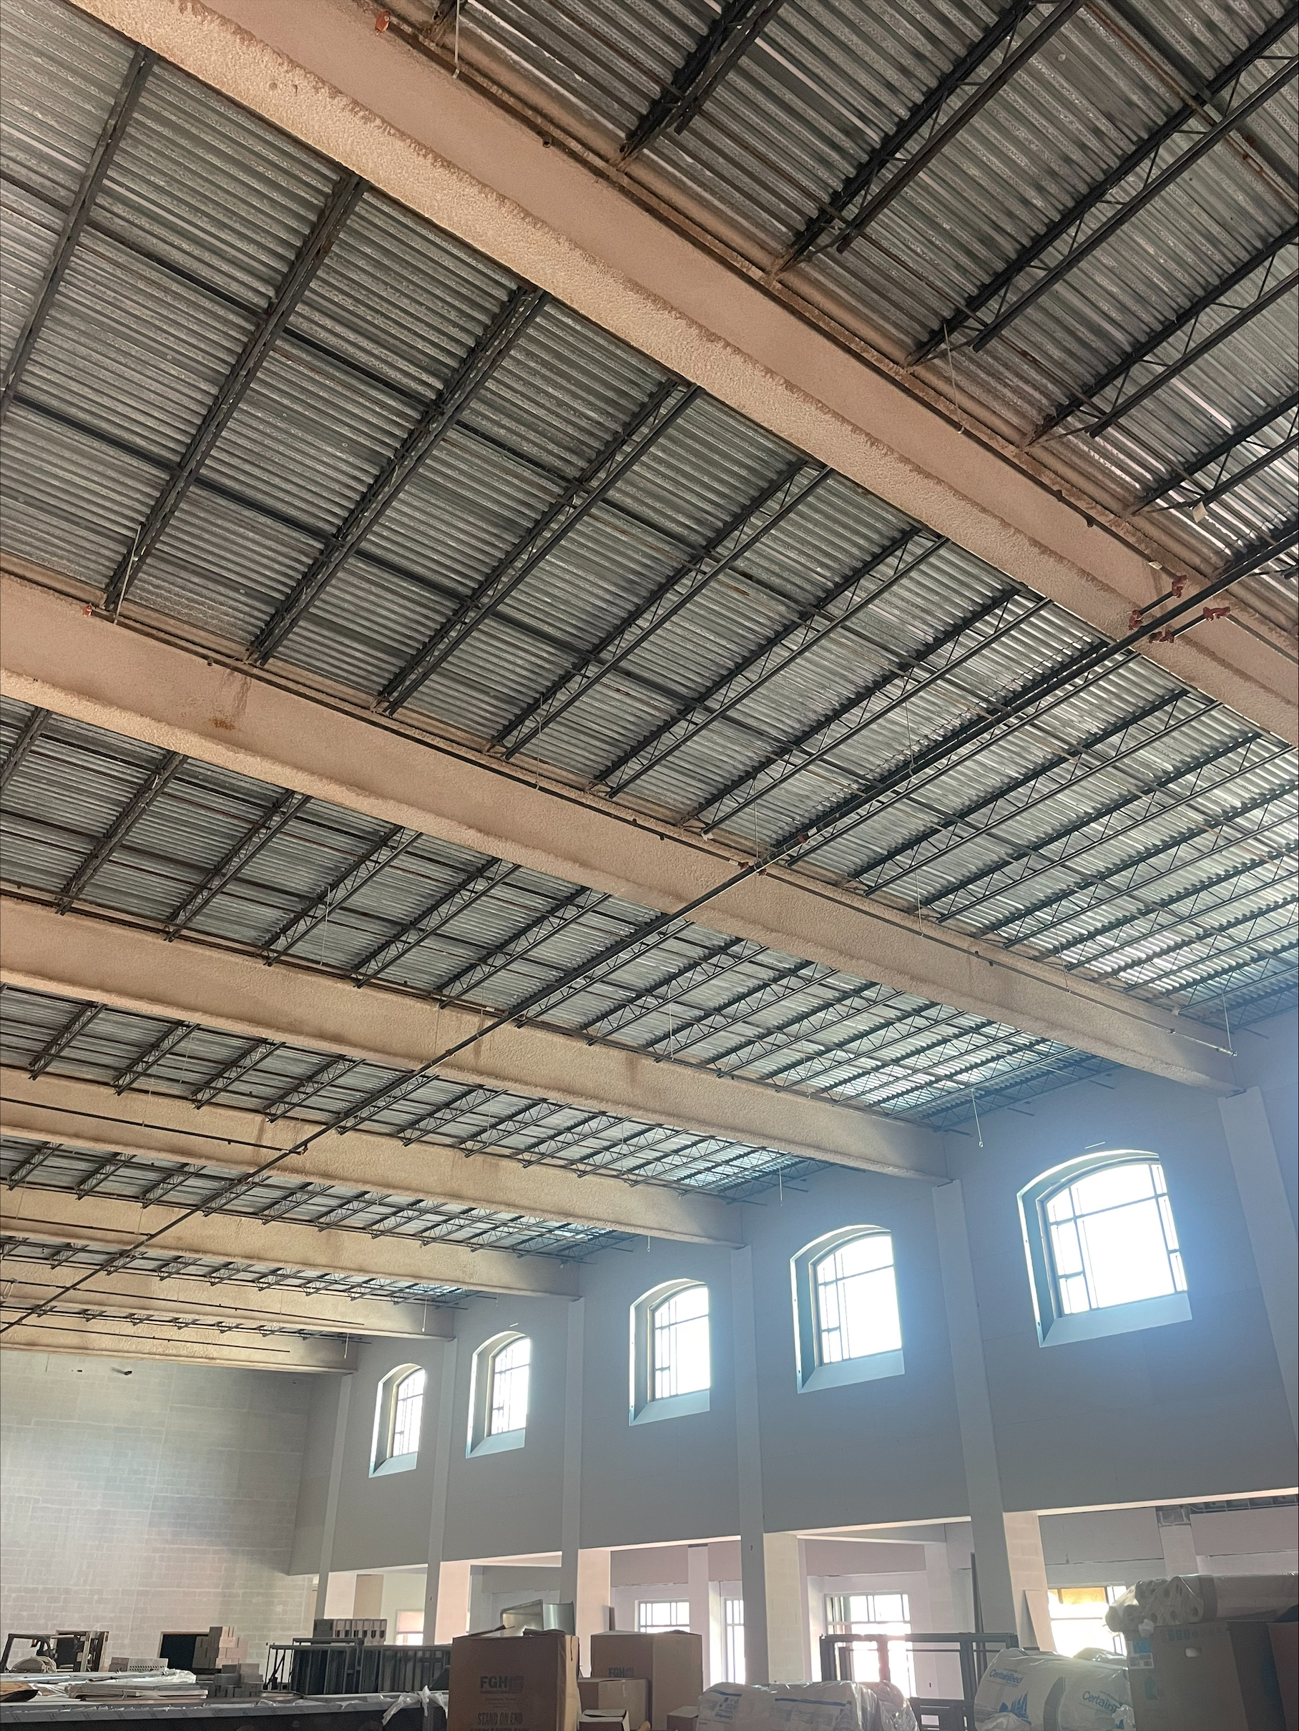
Nederland High School
HVAC piping
  Continue installing duct work in J, H, G, F, E, D, C, and B.
  Continue insulating MEP piping throughout building
  Complete hanging of cassettes in area D1/D2
Sheetrock & Paint
  Finish topping out sheetrock in Area ‘E’
  Continue first coat of paint in area’s J, H, G, F, E, & C
  Continue plater ceilings in Area ‘J/G’
Gas line being installed to building.
Install kitchen hoods in kitchen and culinary area.
Canopy columns being set.
Install standing seam room over high gable area of main entrance.

Slide 5

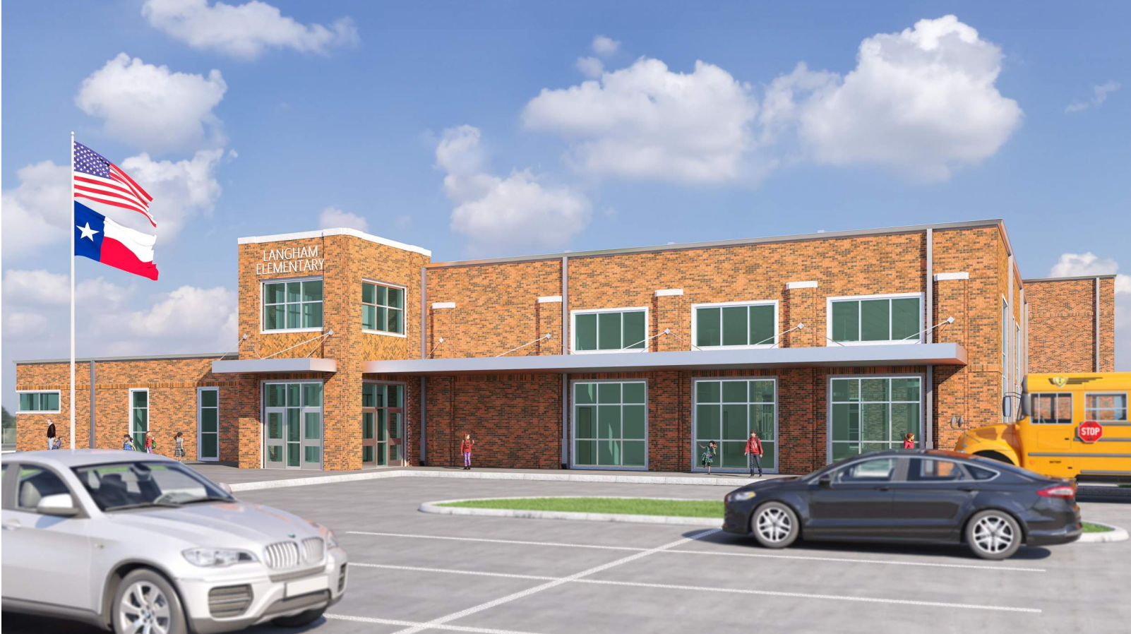
Langham Elementary School

Slide 6
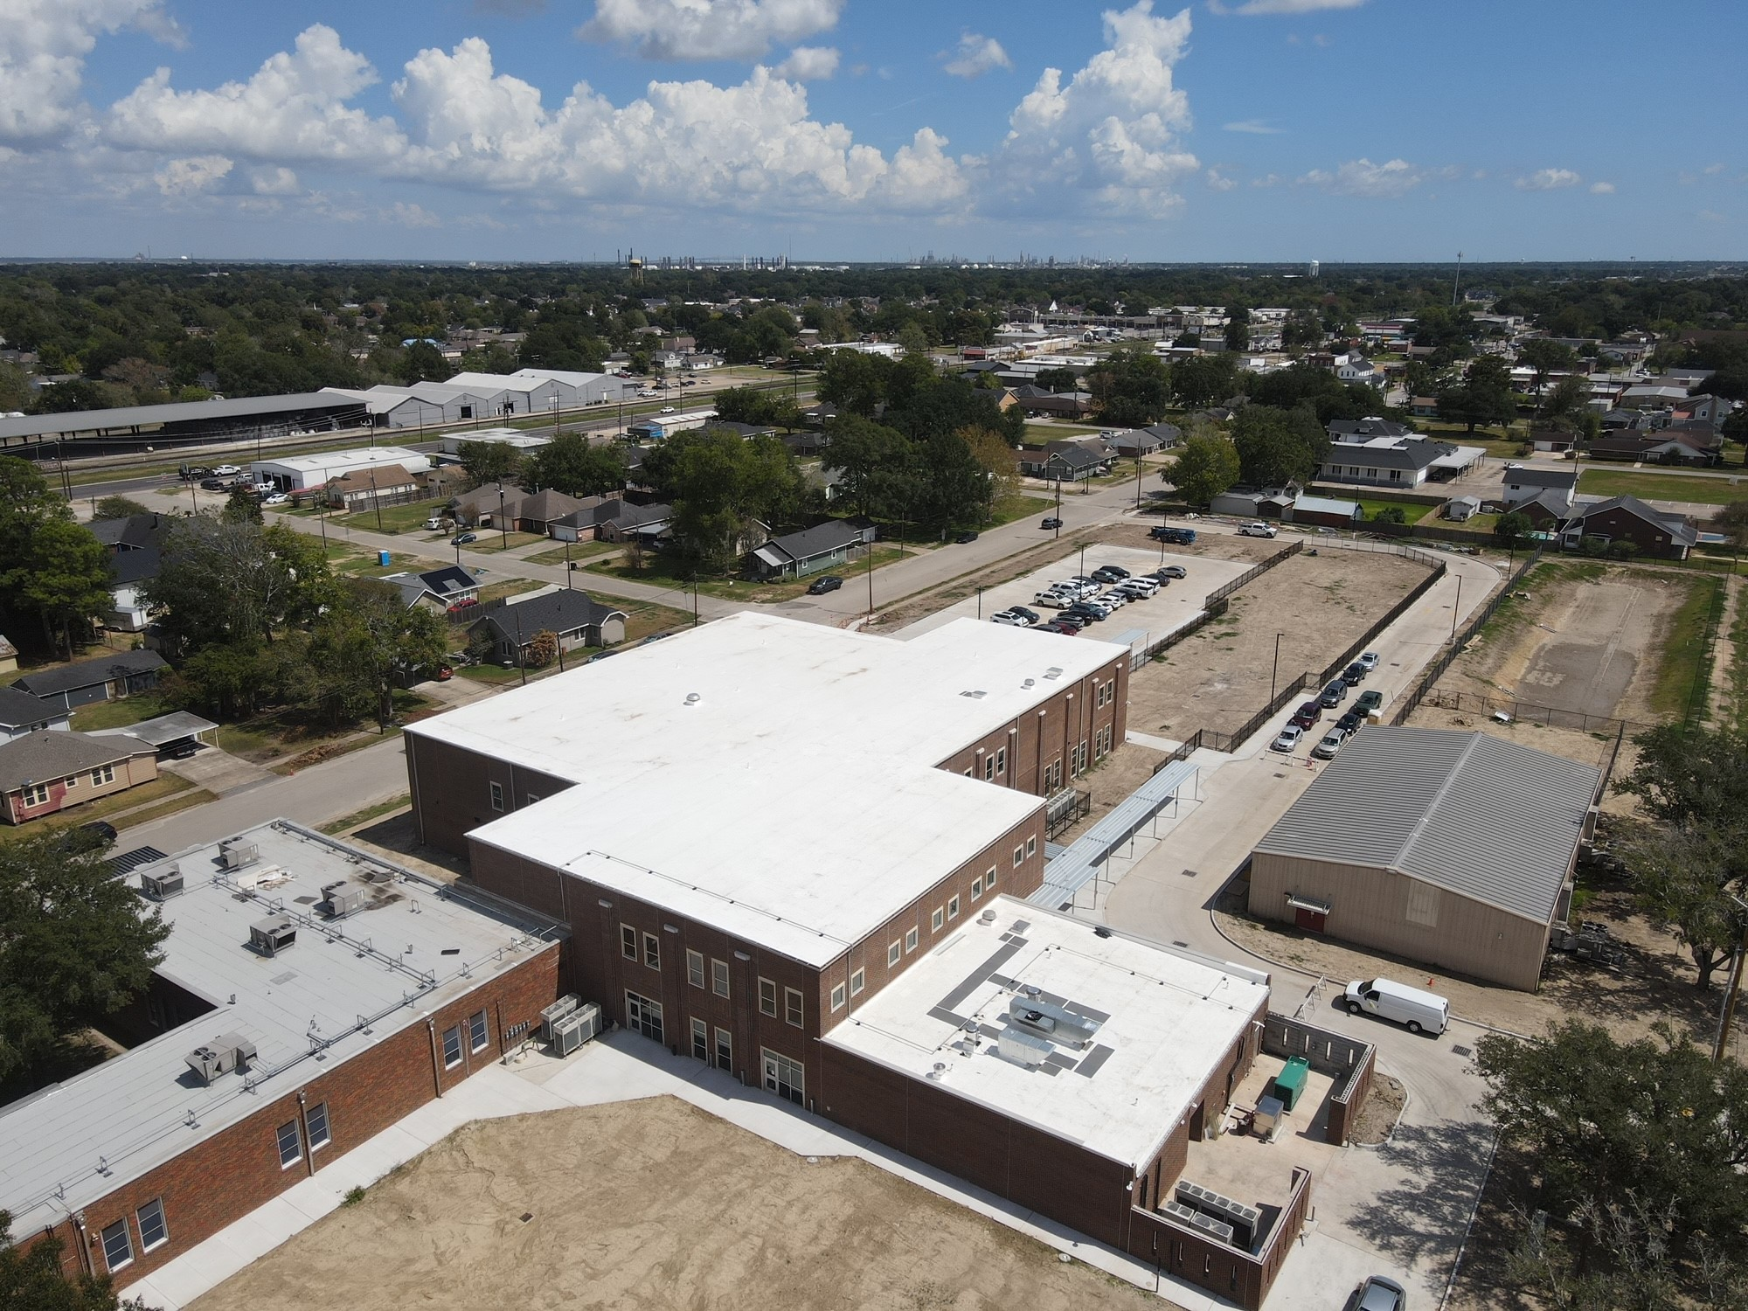
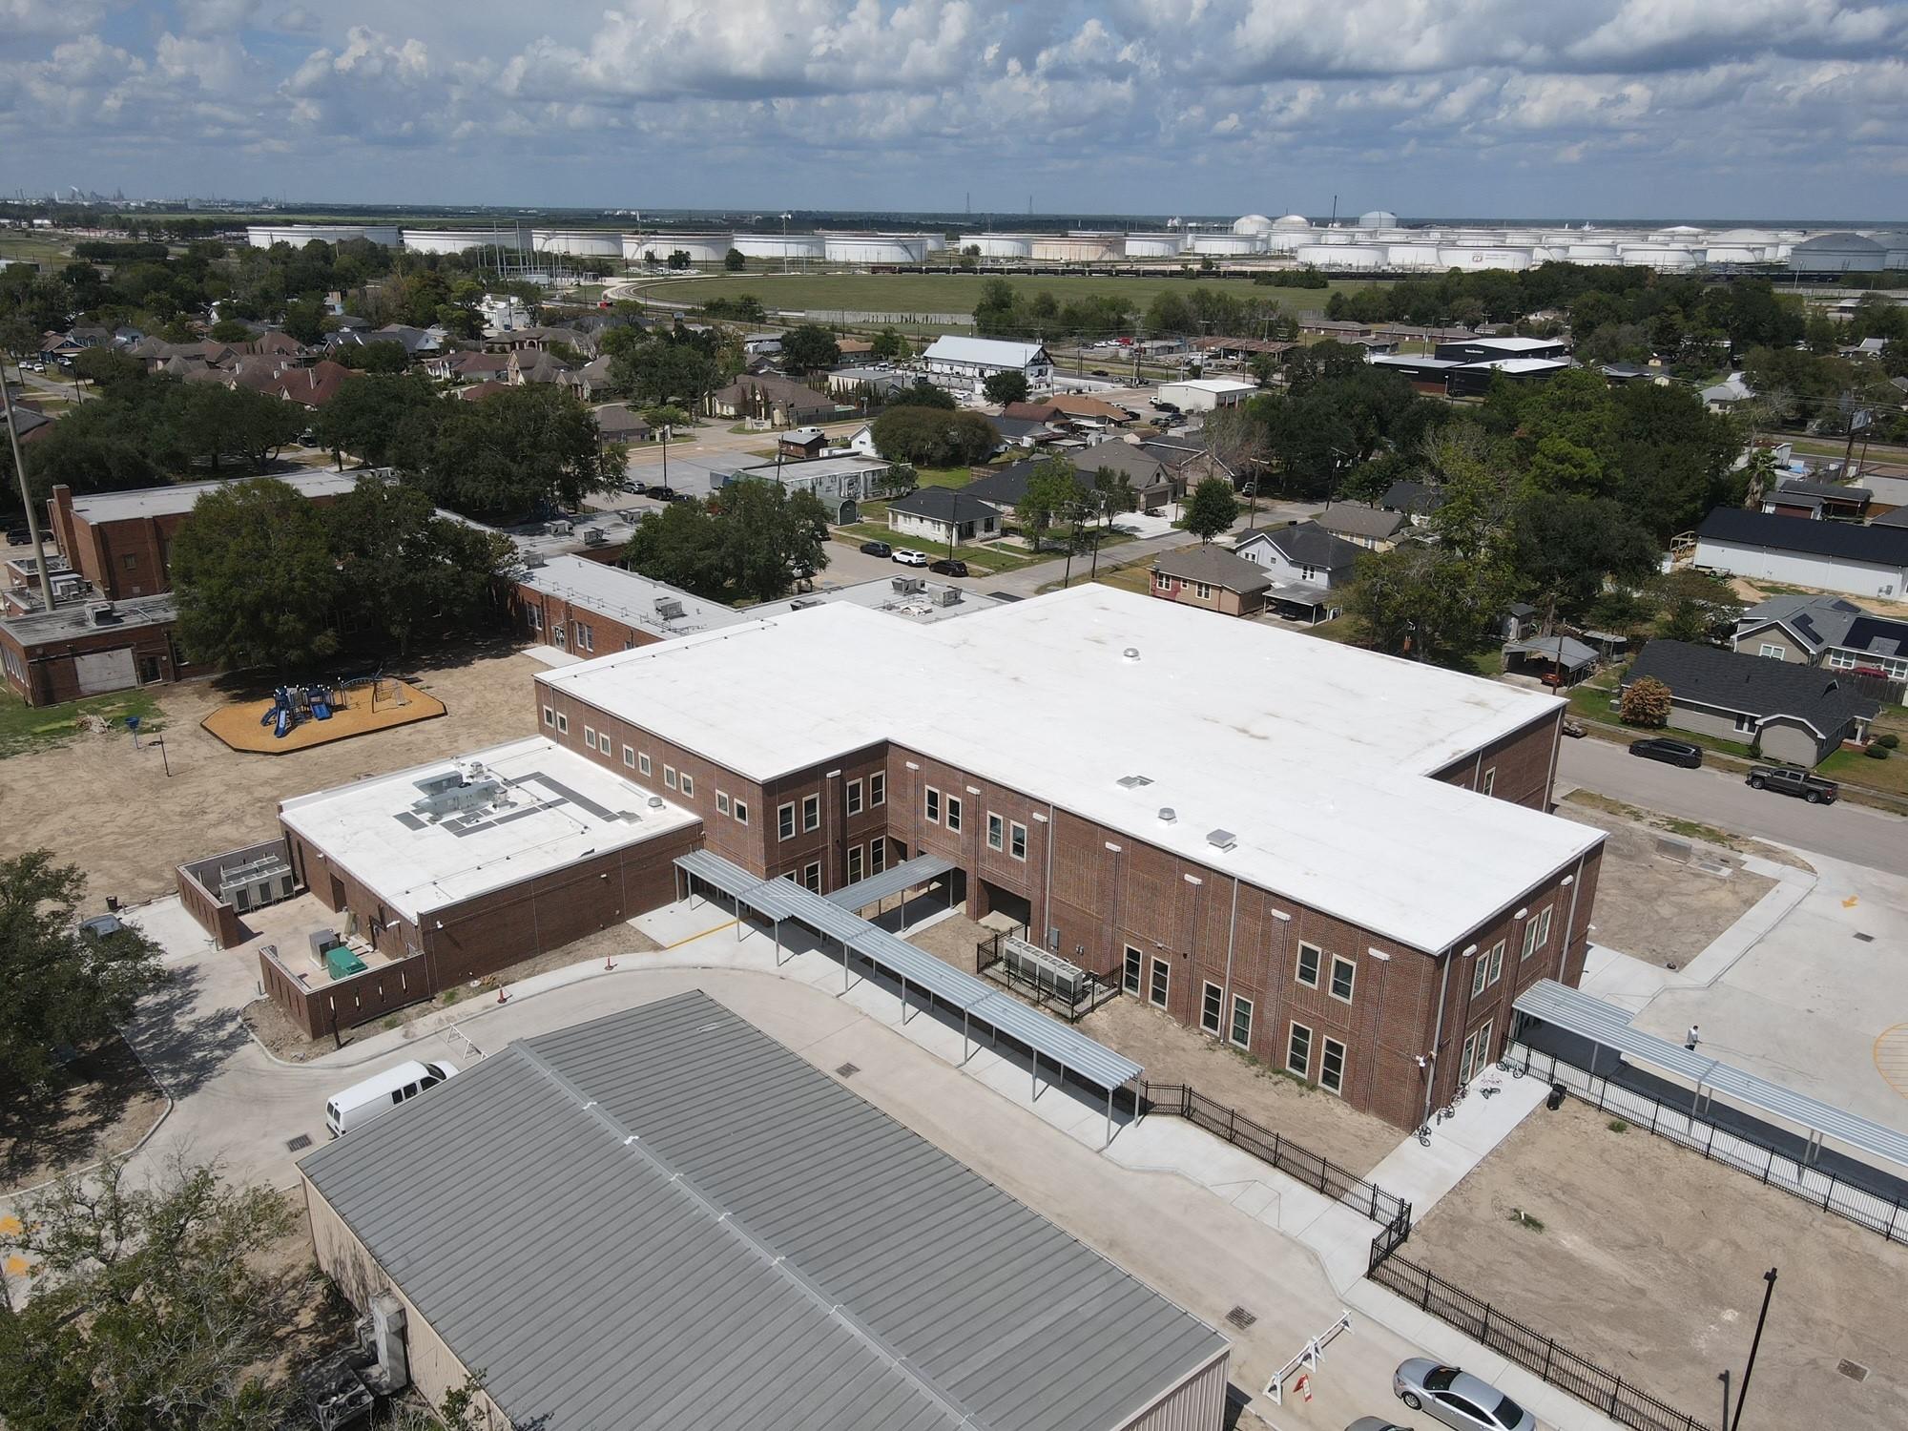
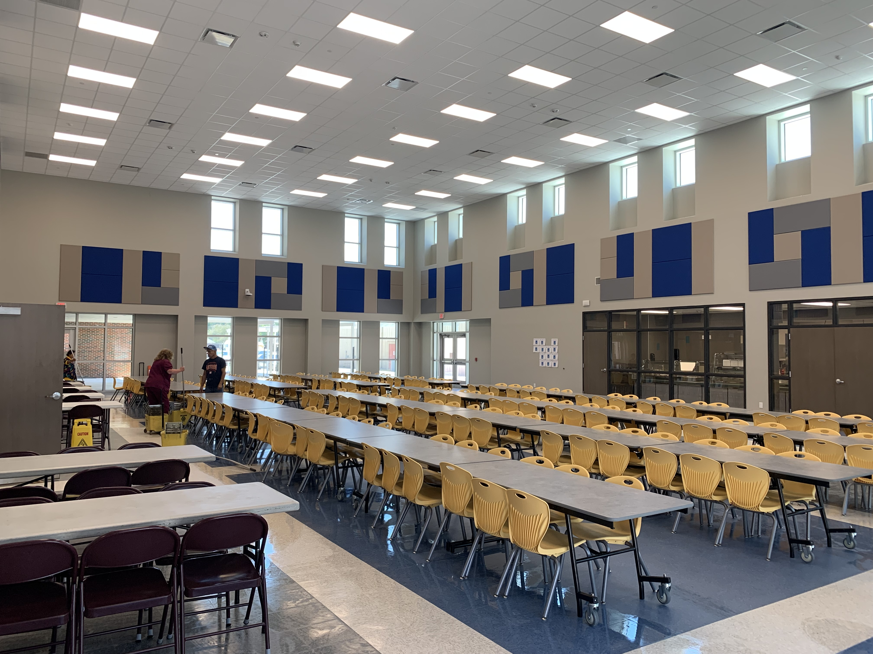
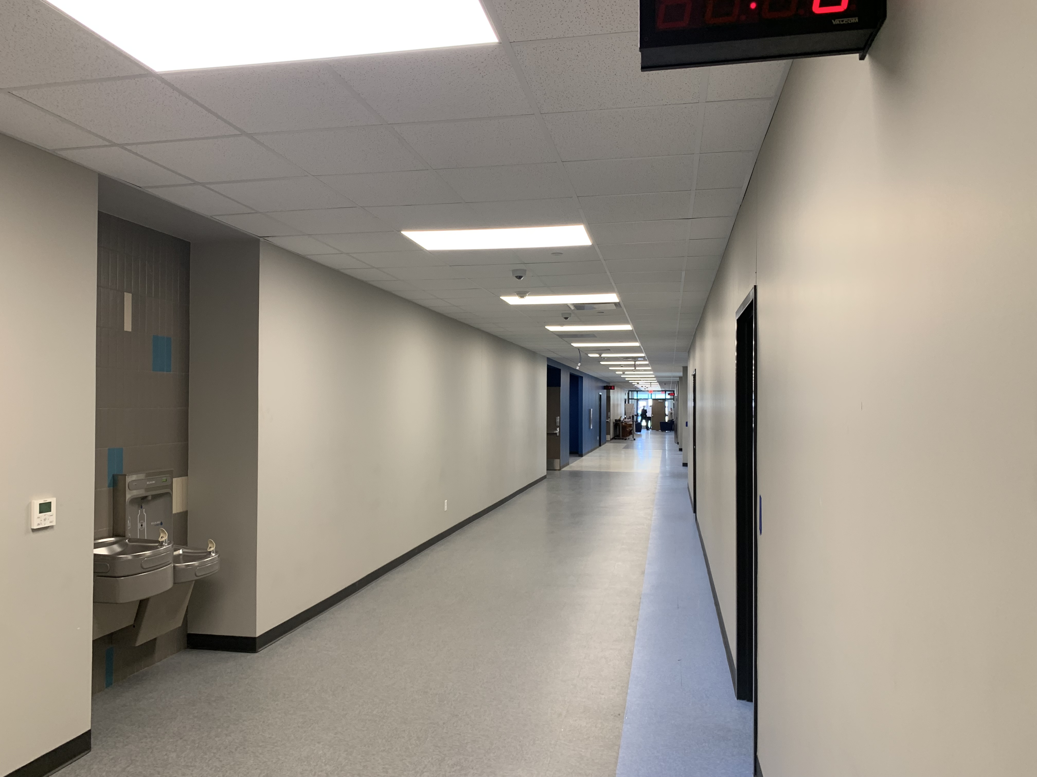
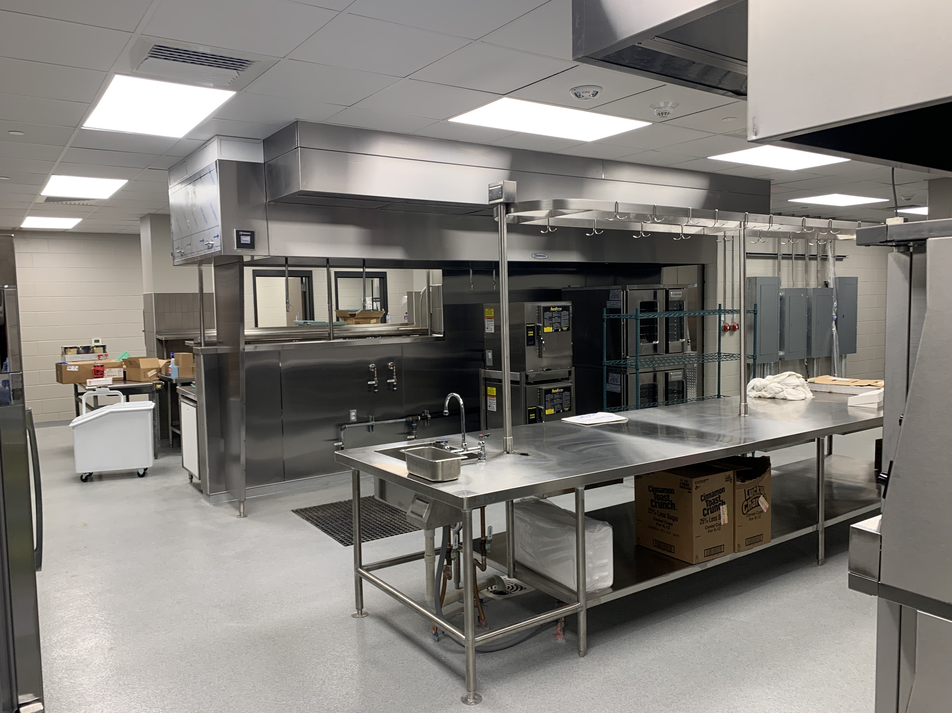
Langham Elementary School
Begin Gym addition
Complete Fence & Gate install
Complete concrete scope of work & final grading
Landscape & Sod
Complete punch list

Slide 7
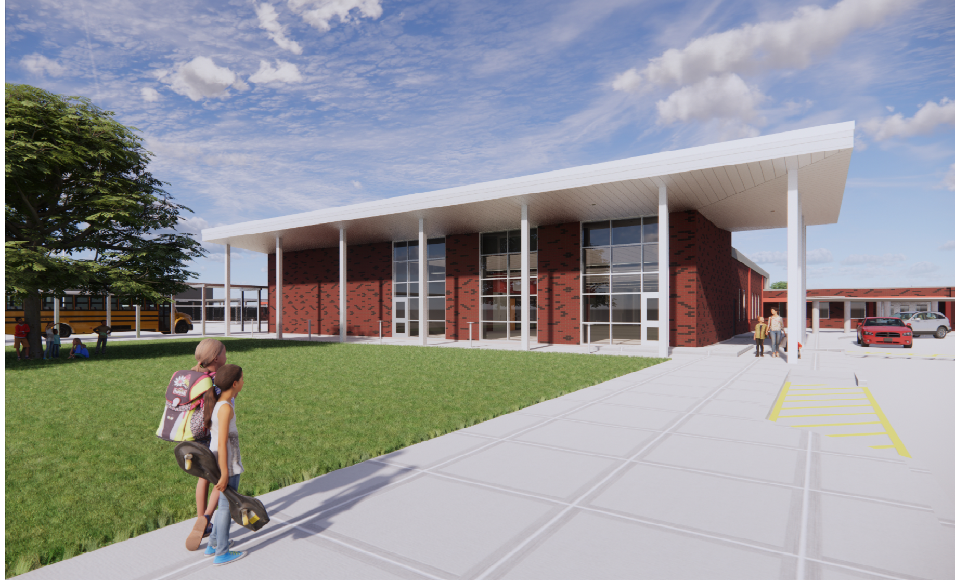
Hillcrest Elementary School

Slide 8
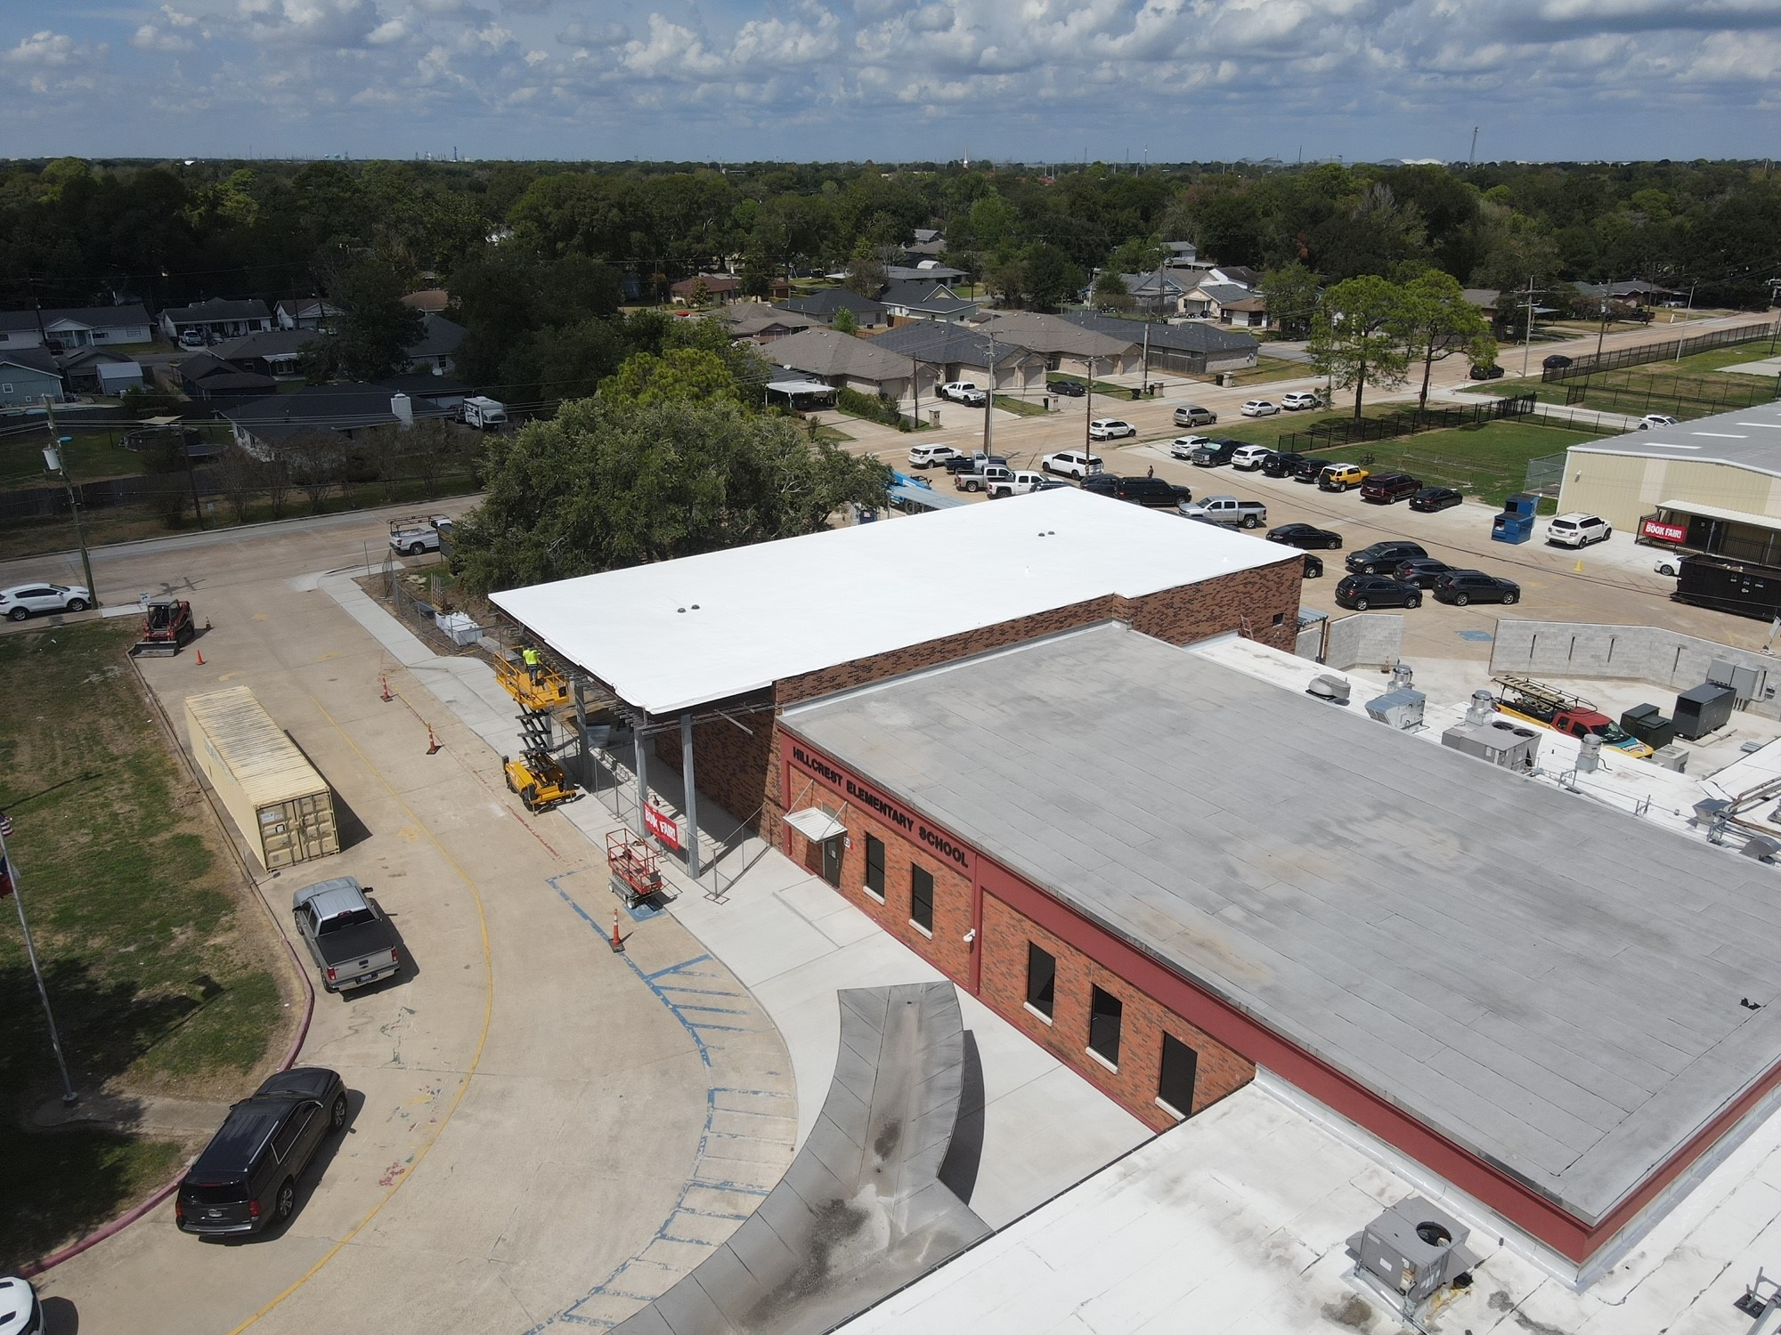
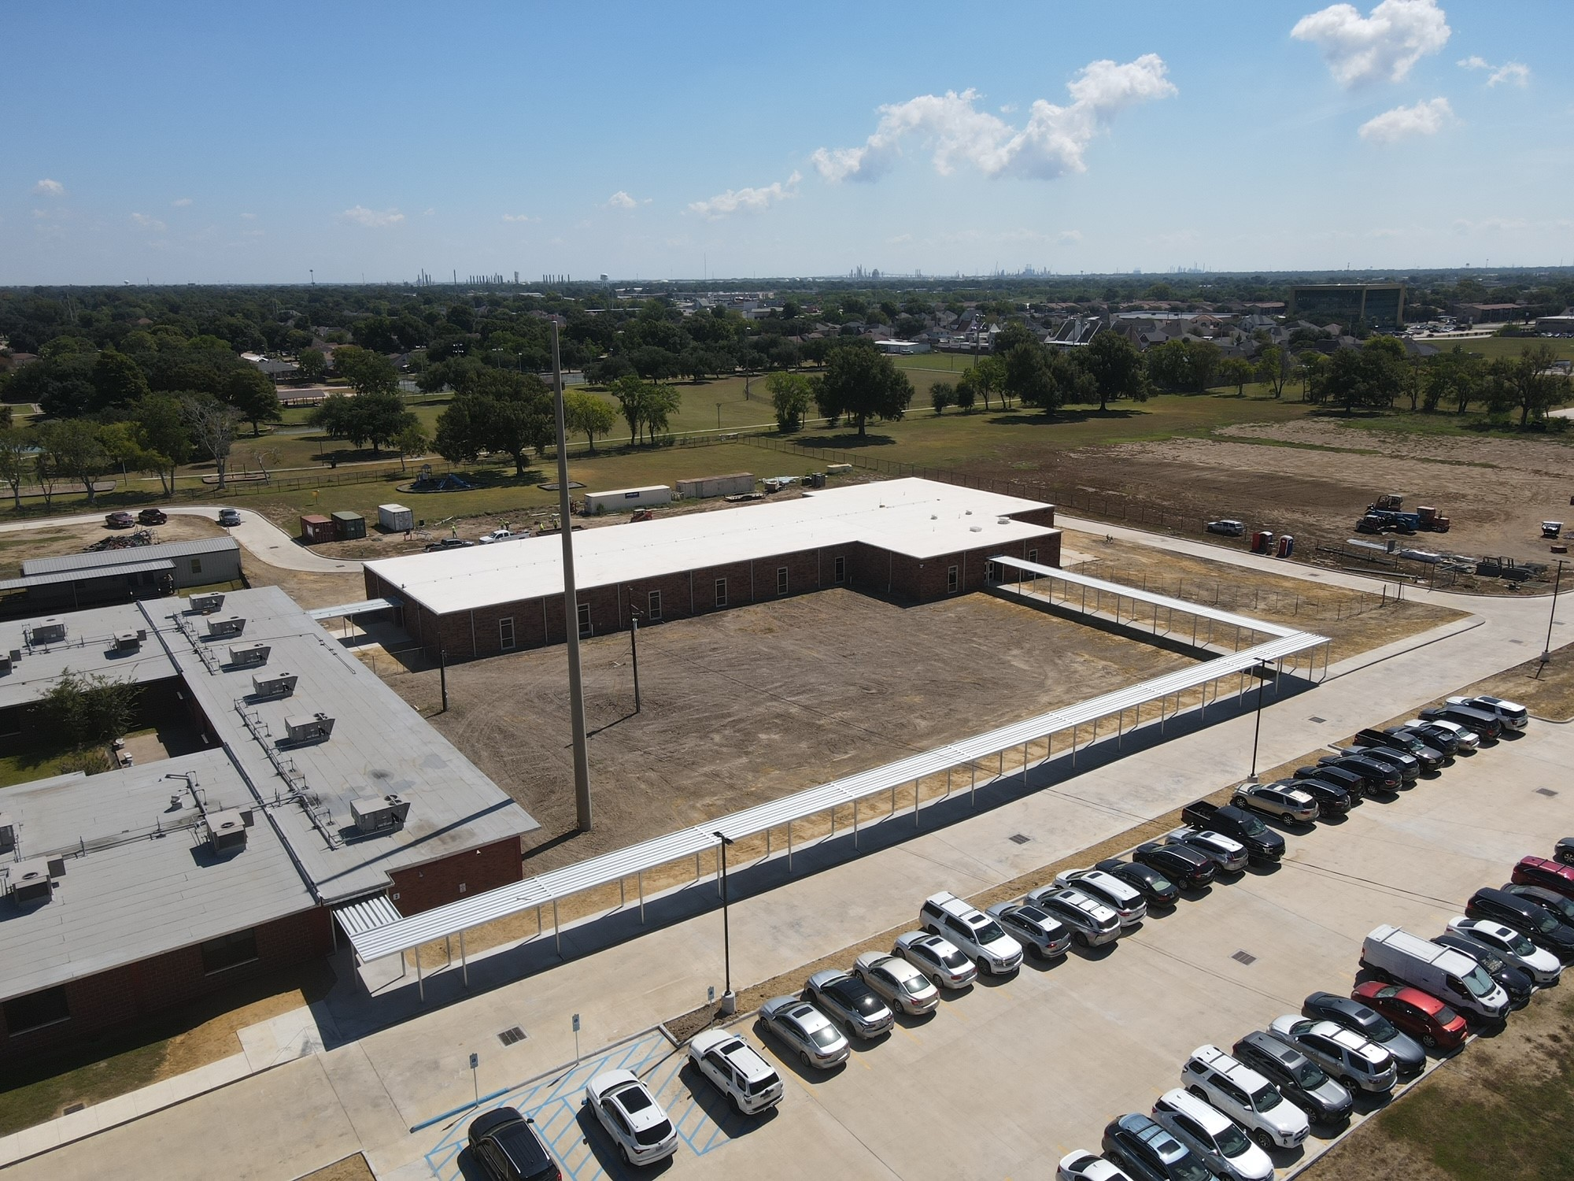
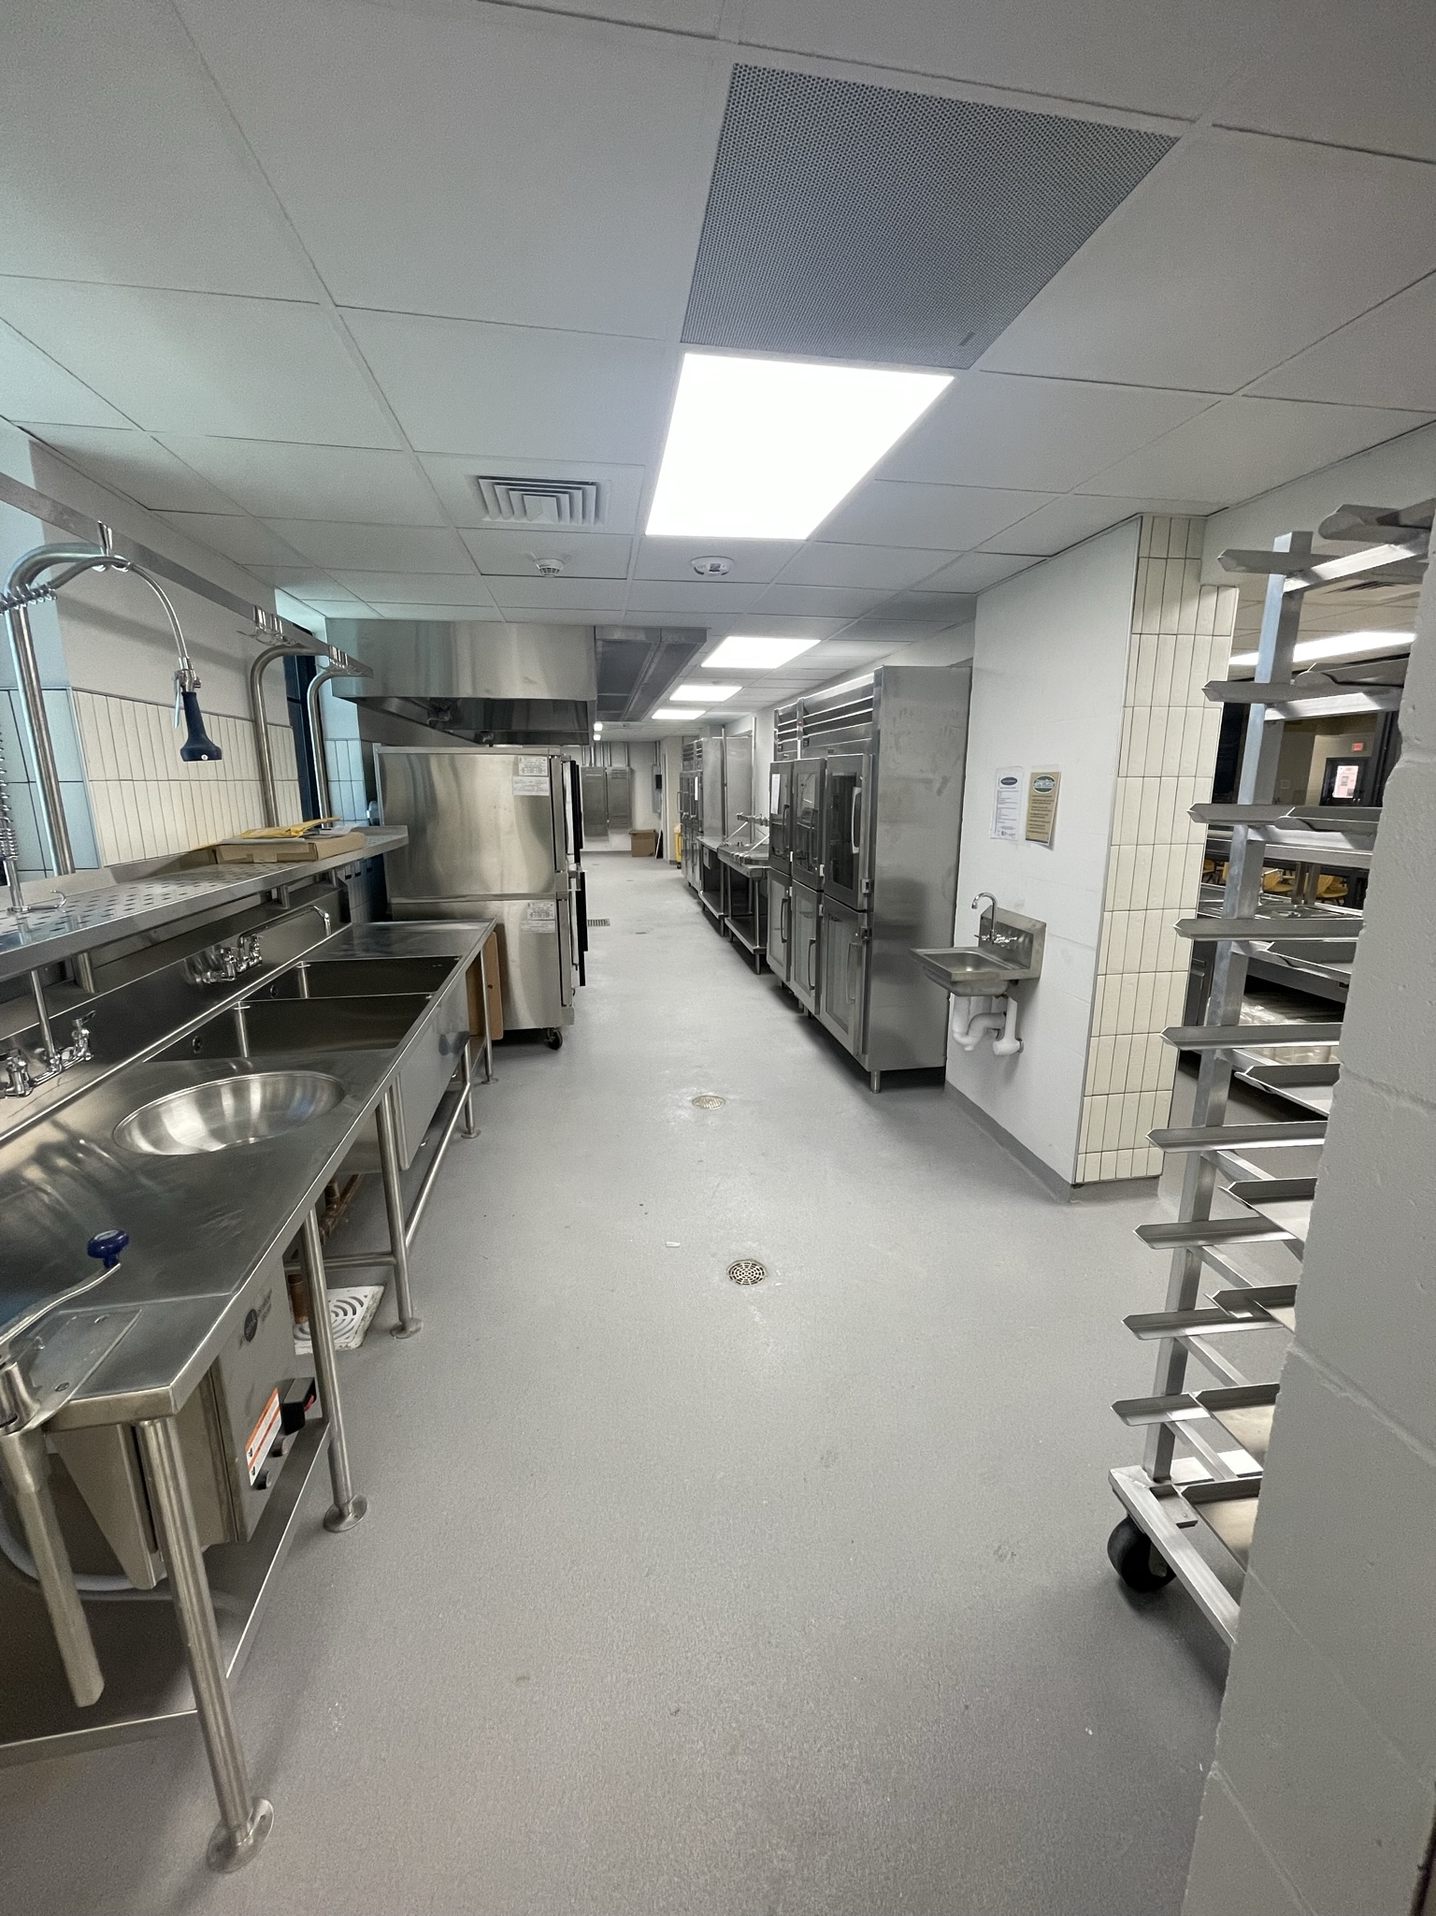
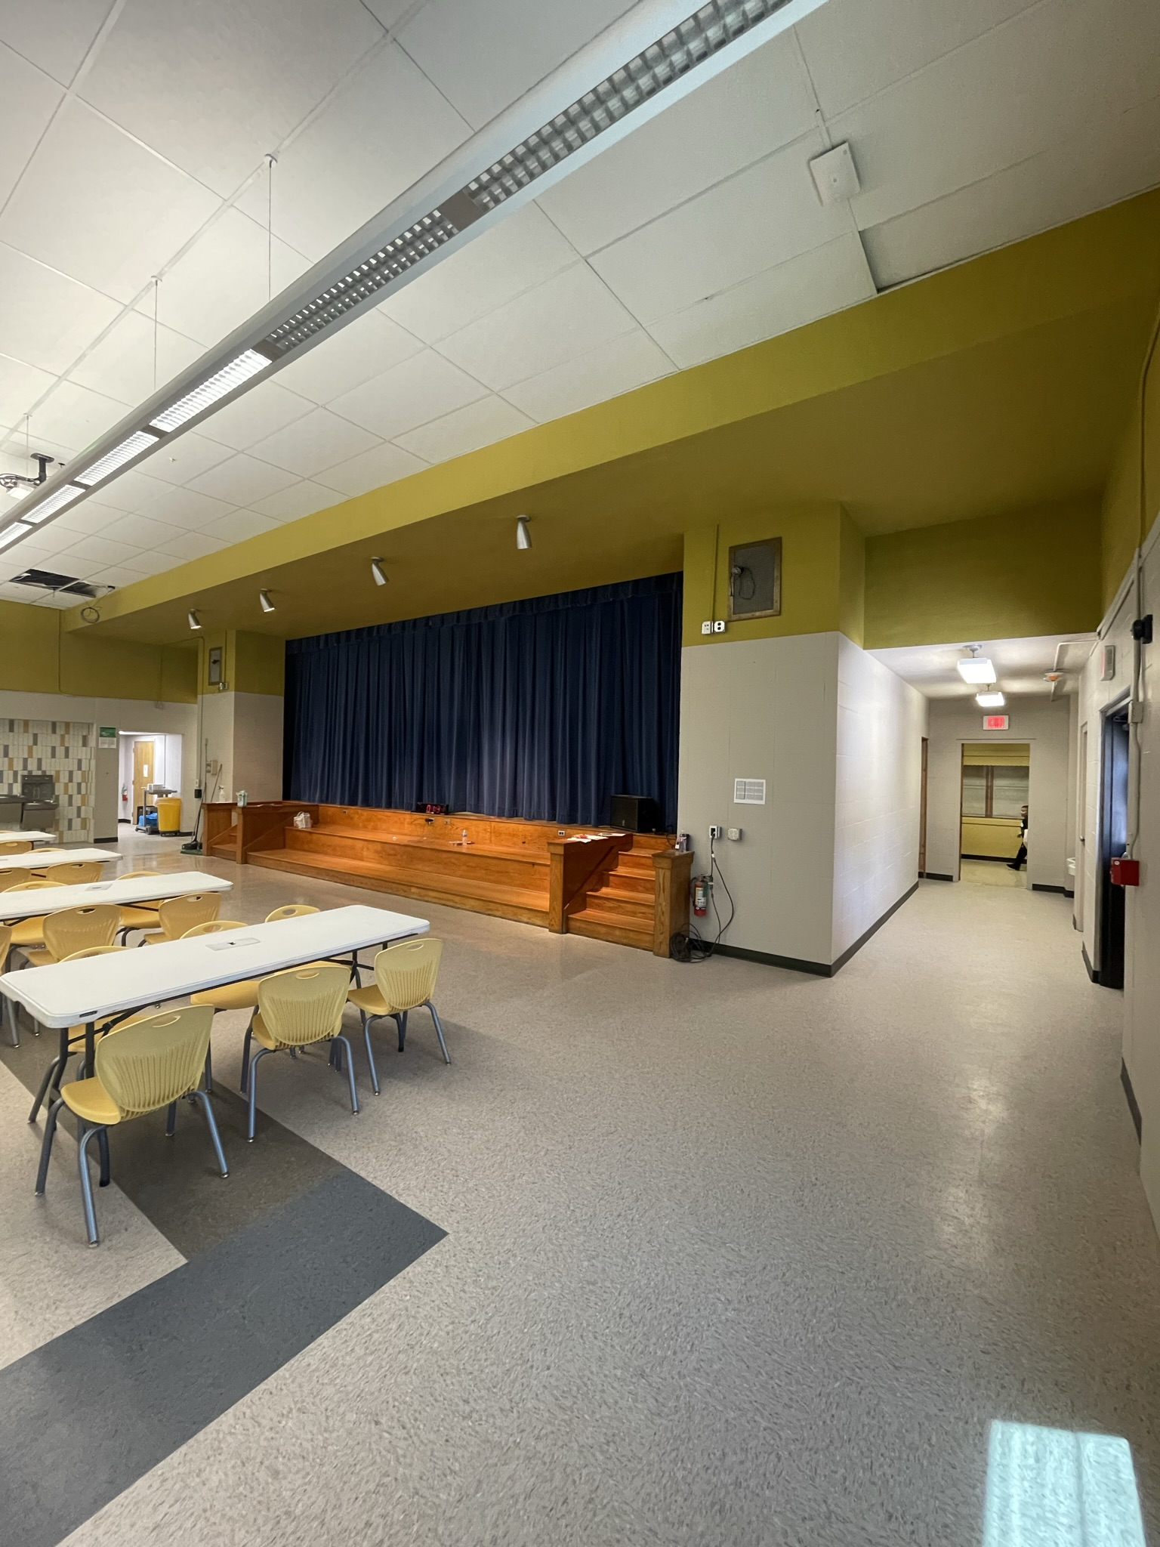
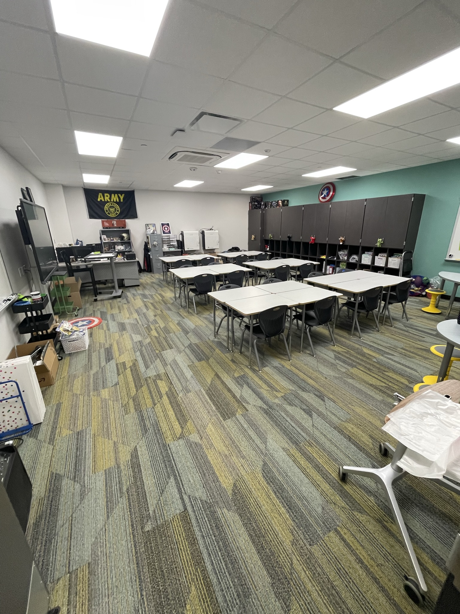
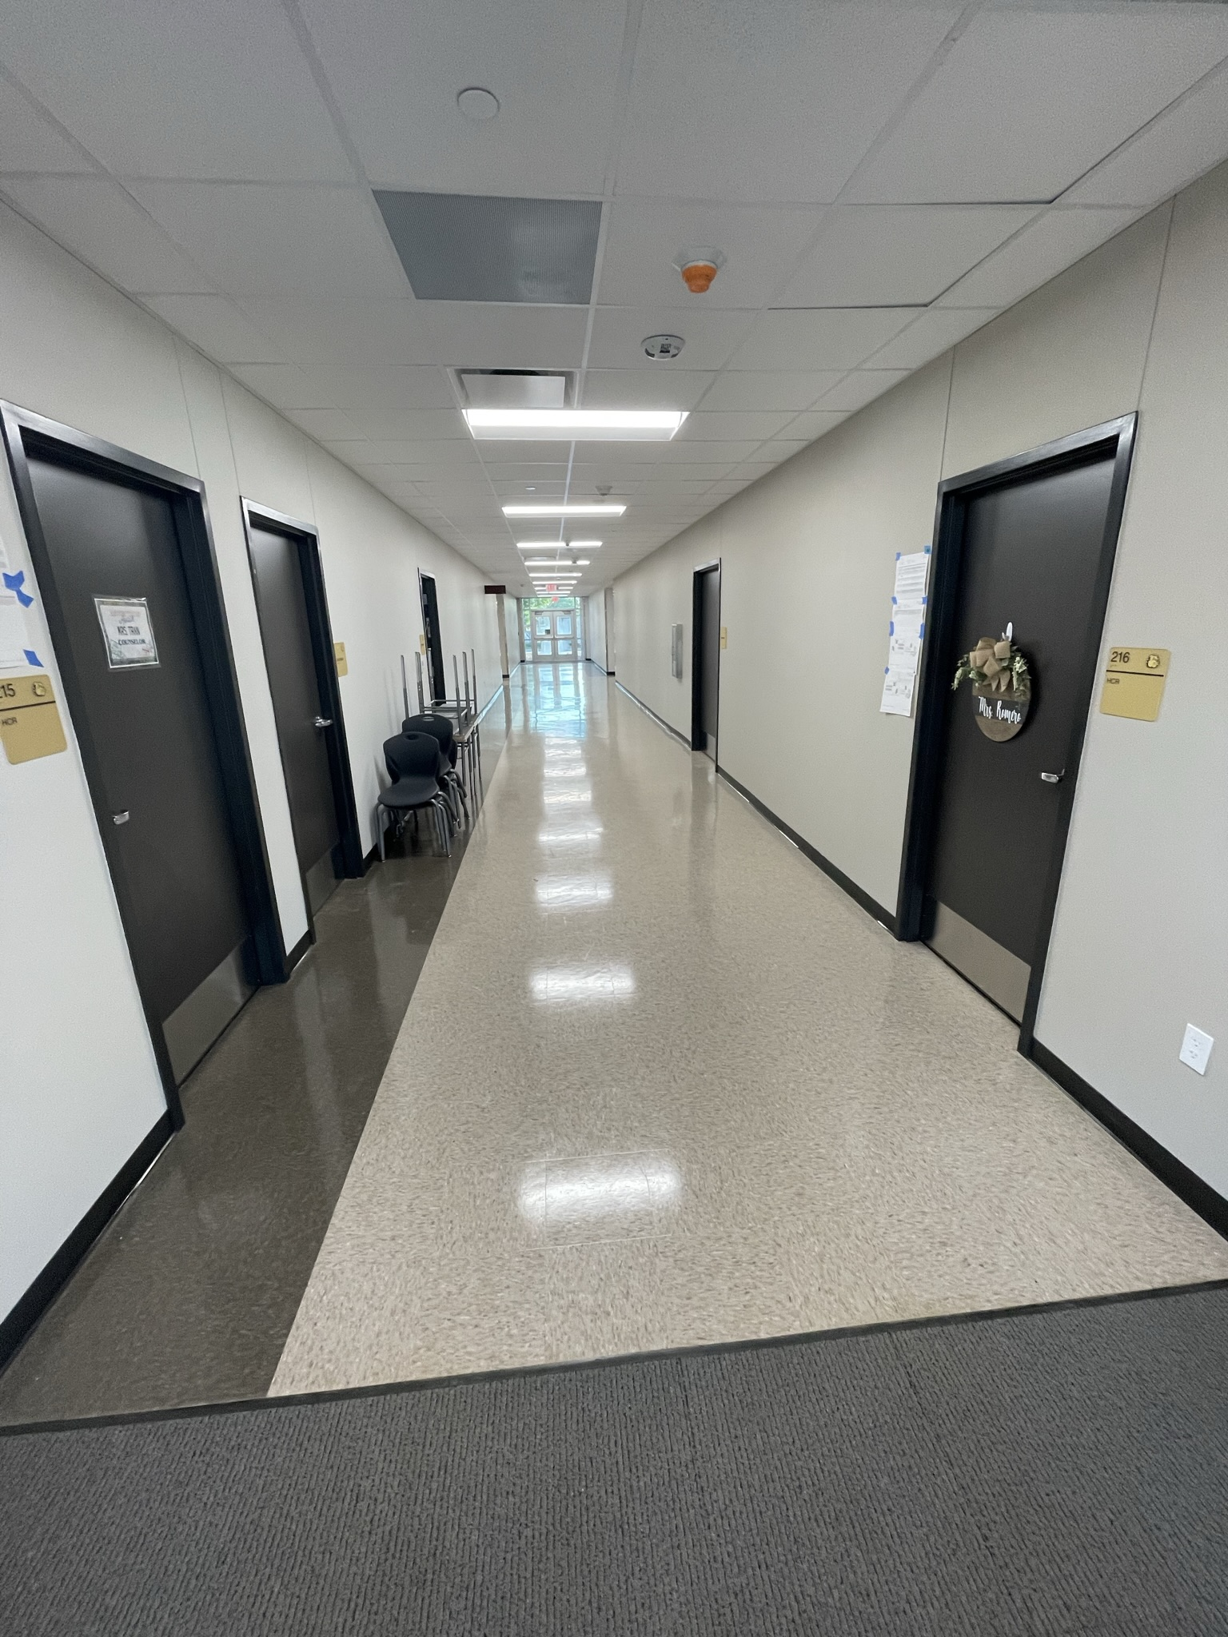
Hillcrest Elementary School
Café/kitchen extension
  Soffit install
  Cooler/Freezer
  Interior finish out
  Wall demo is complete
Complete gym addition
Complete Fence & Gates
Landscape & Sod
Complete Punch List

Slide 9
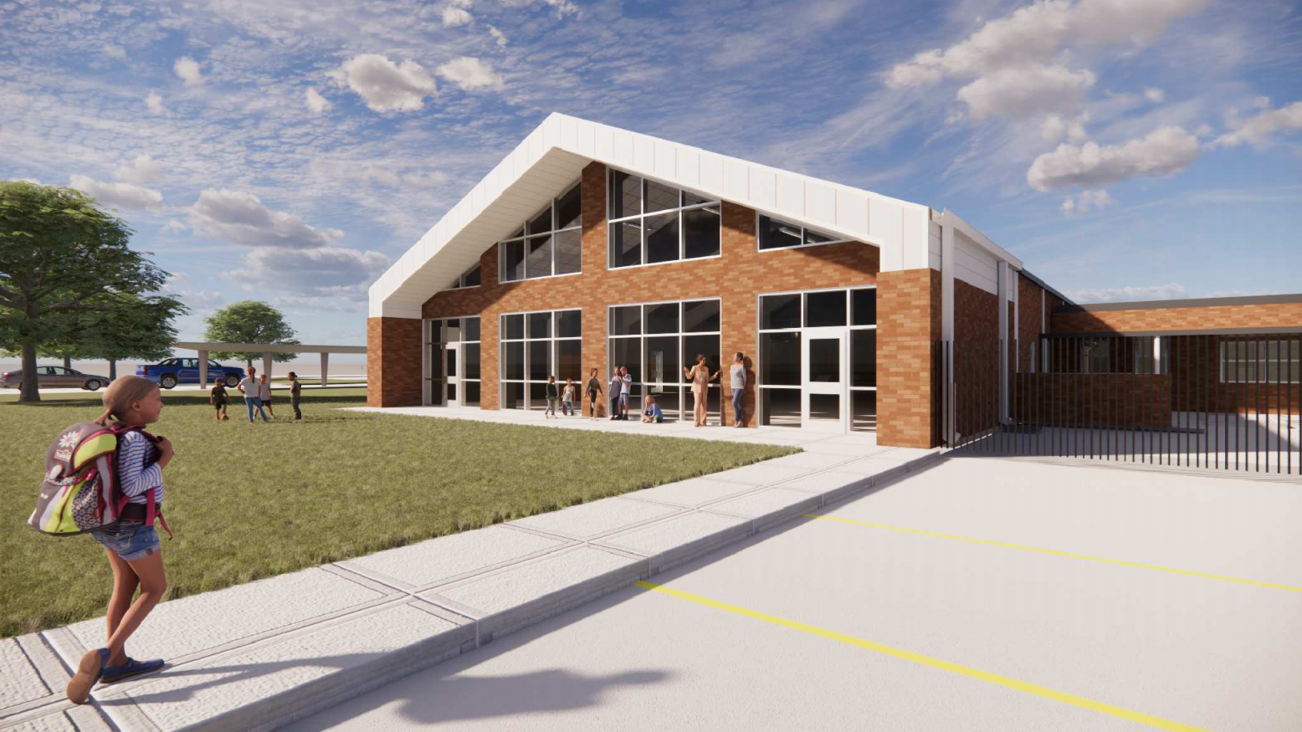
Highland Park Elementary School

Slide 10
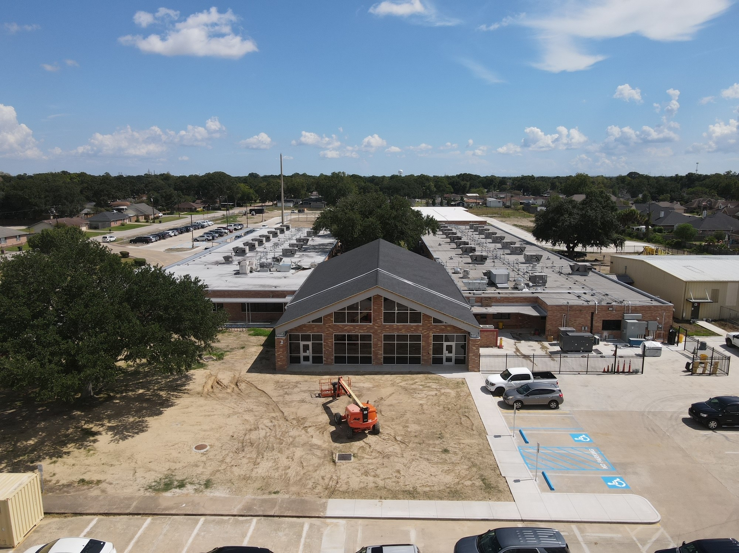
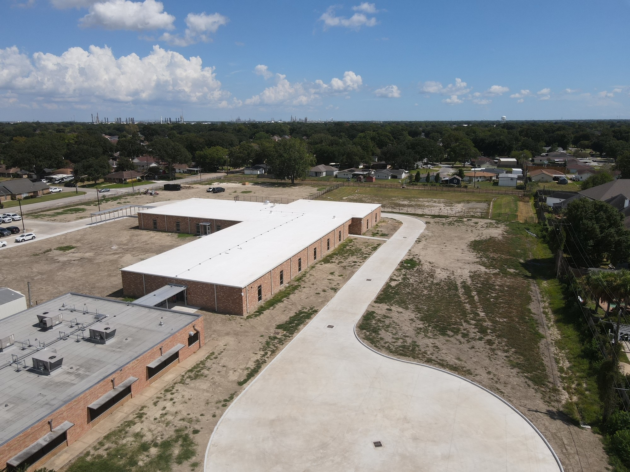
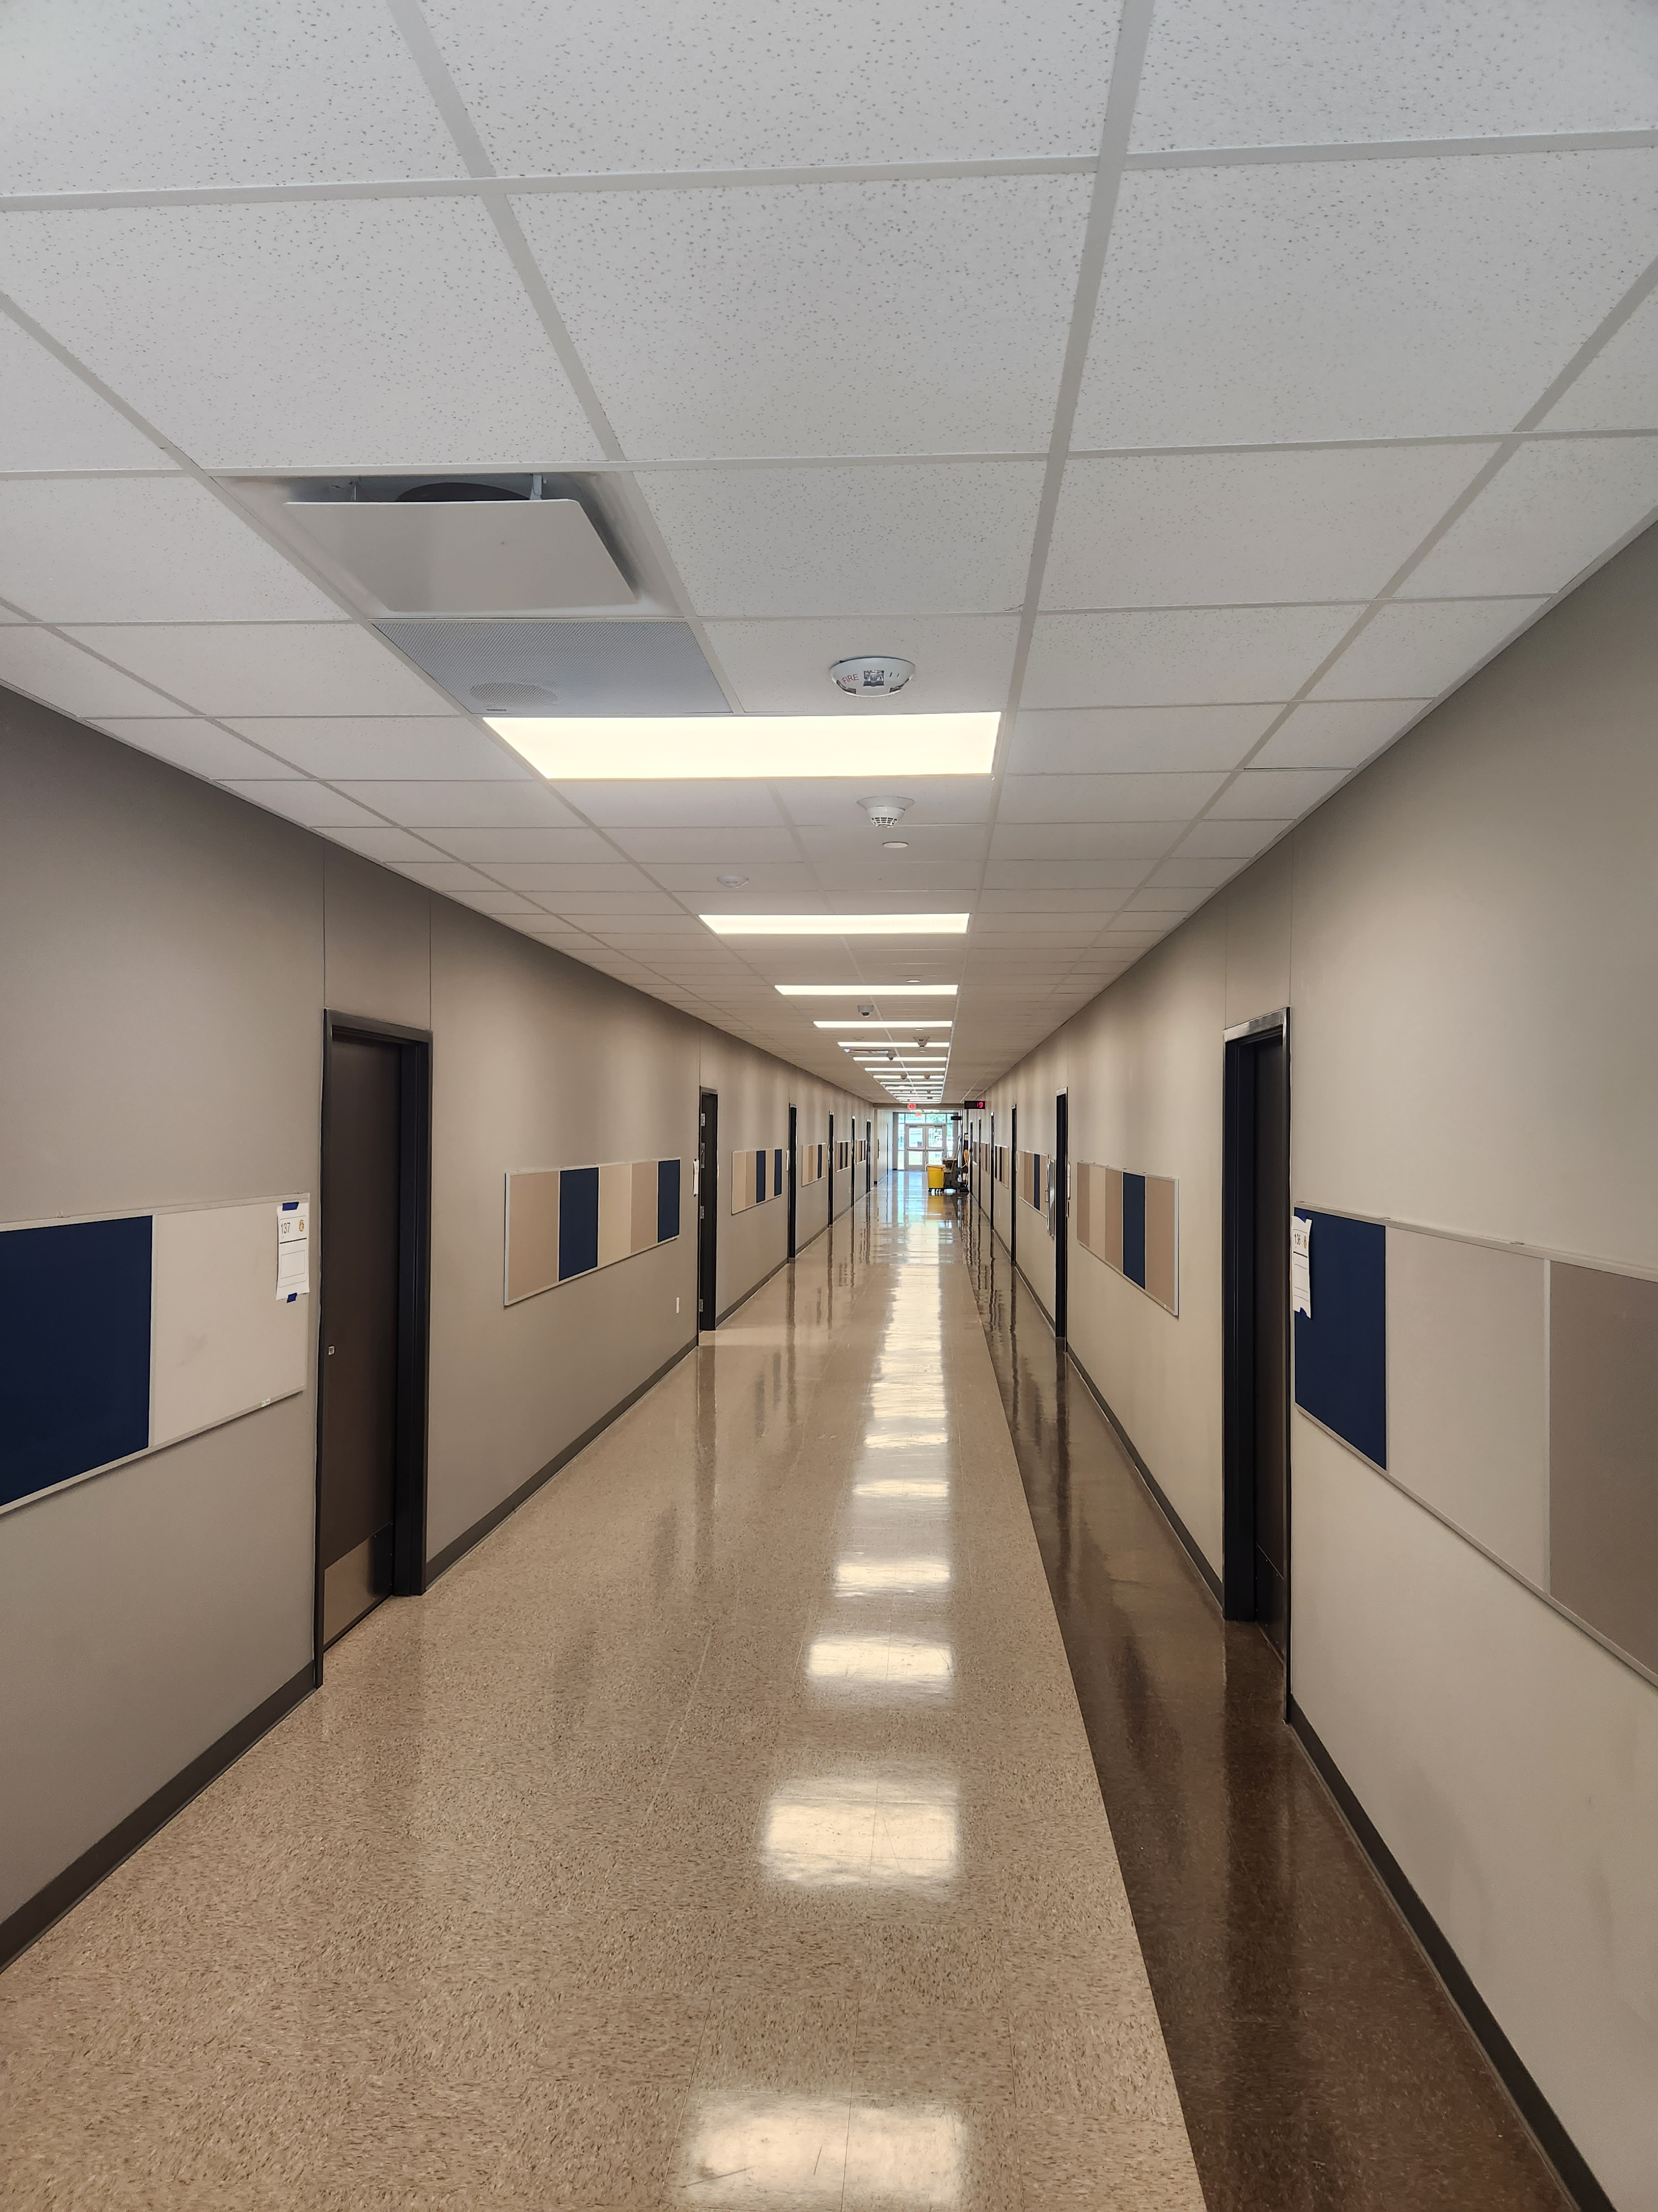
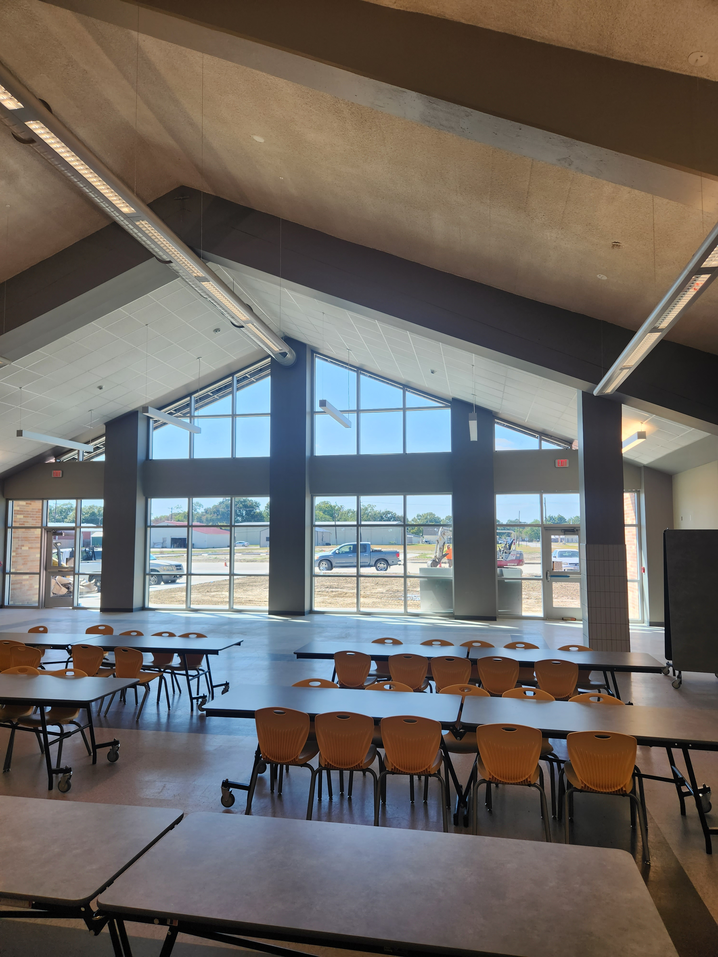
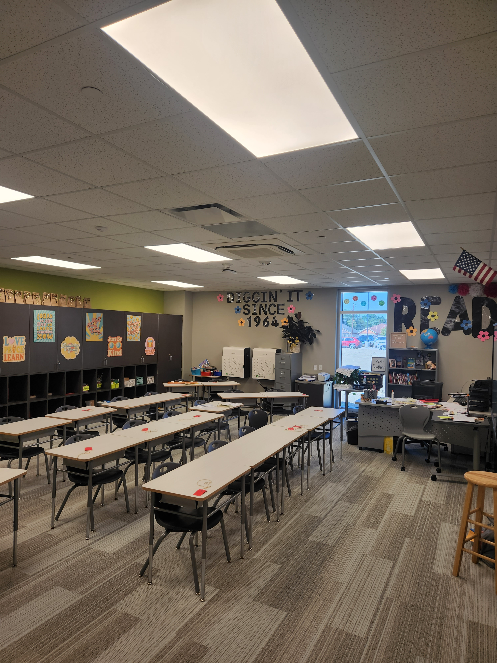
Highland Park Elementary School
Continue with gym addition
Complete soffit install at café
Complete concrete scope of work, final grading
Complete Fence & Gates
Landscape & Sod
Complete punch list

Slide 11
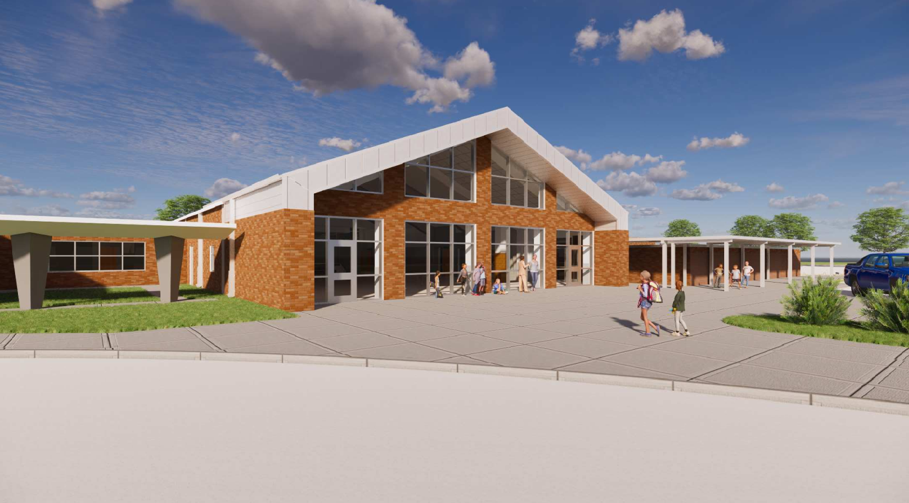
Helena Park Elementary School

Slide 12
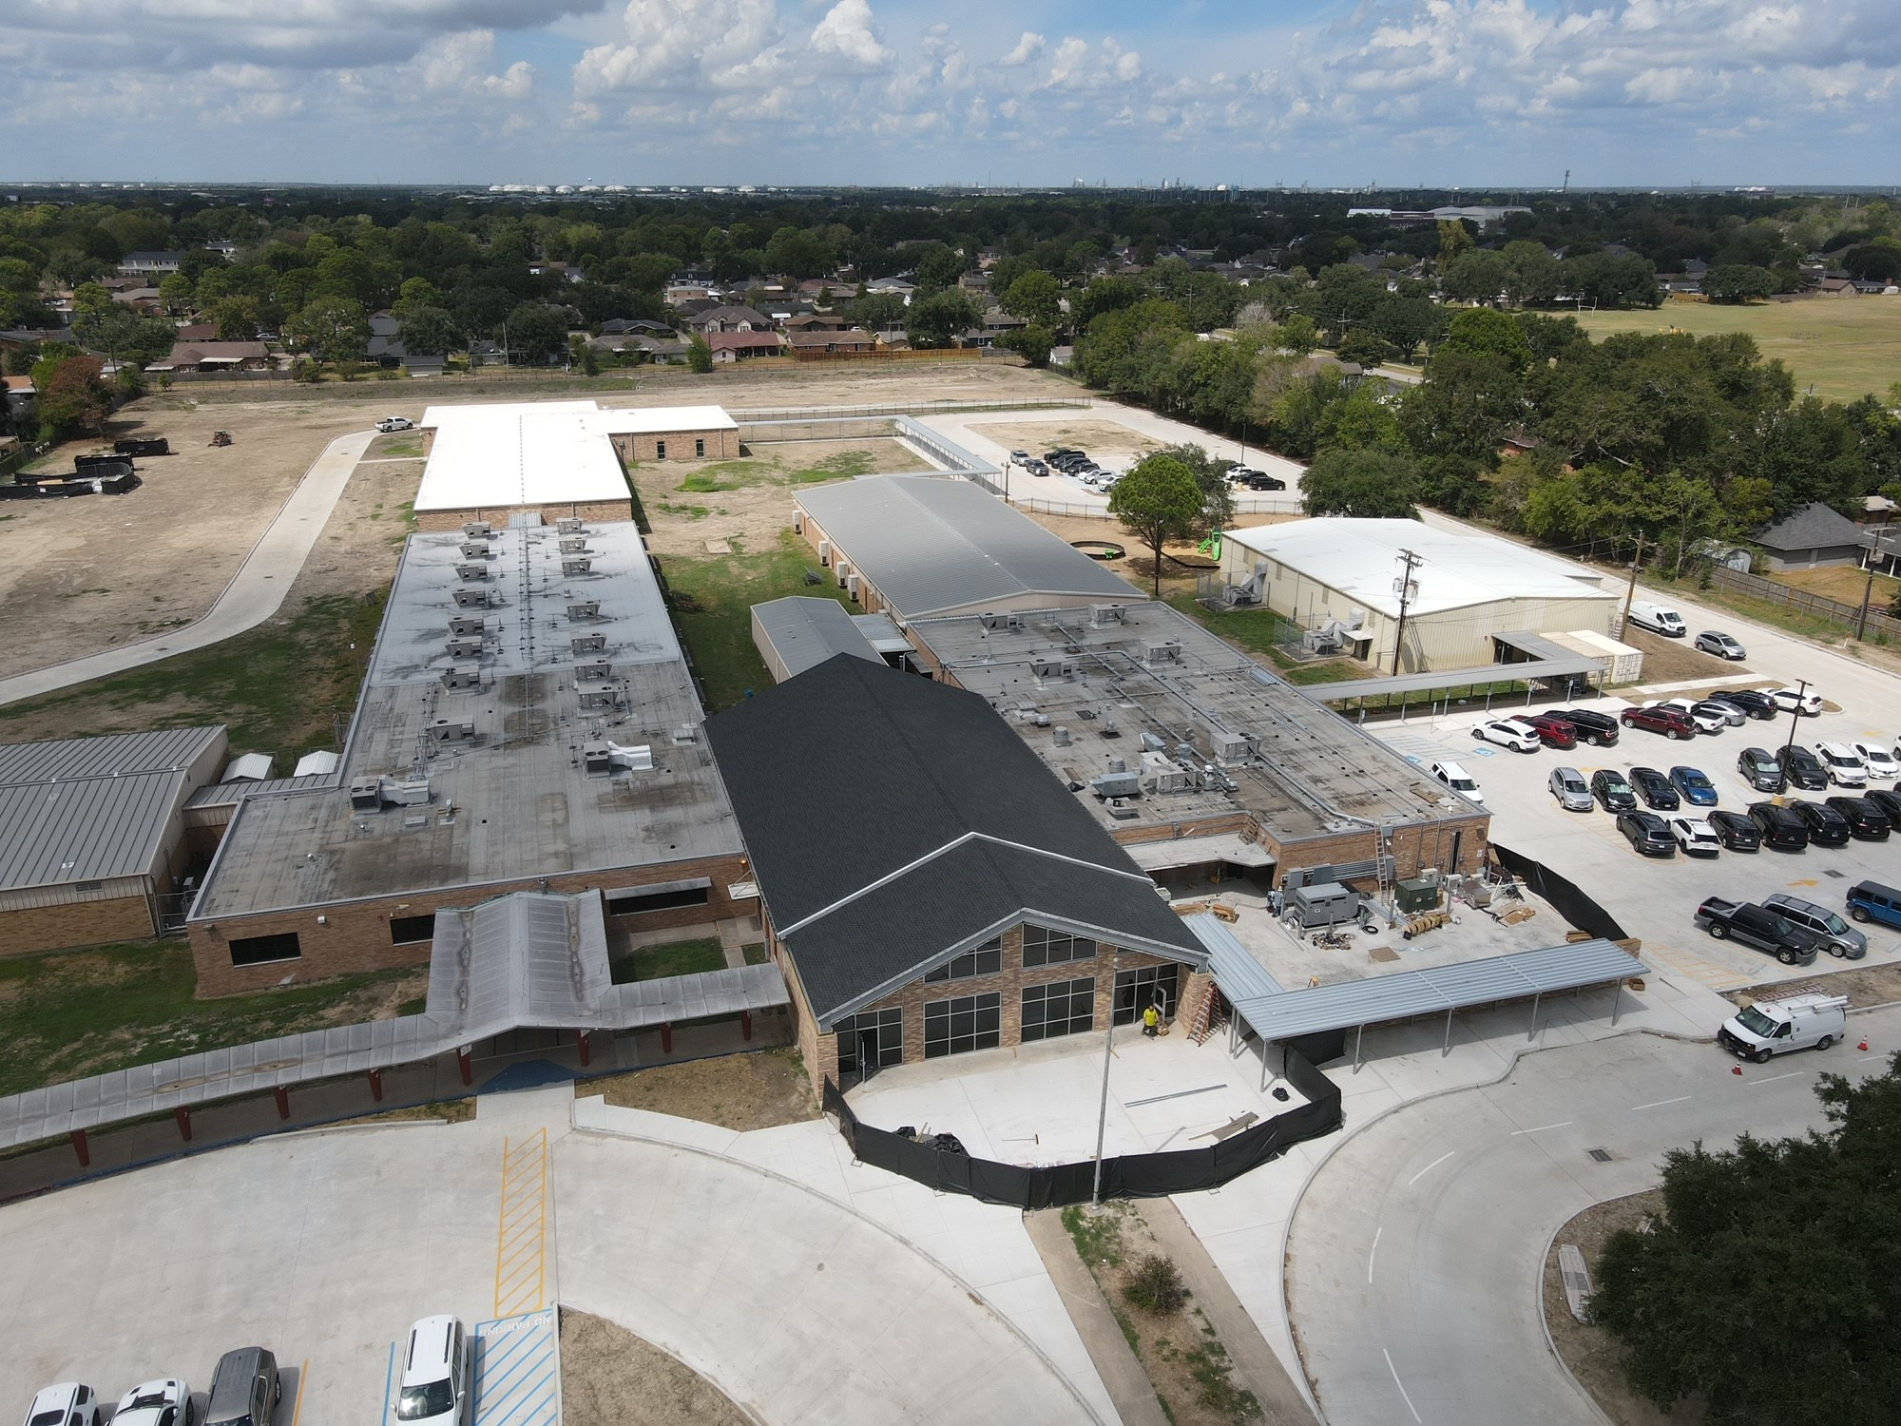
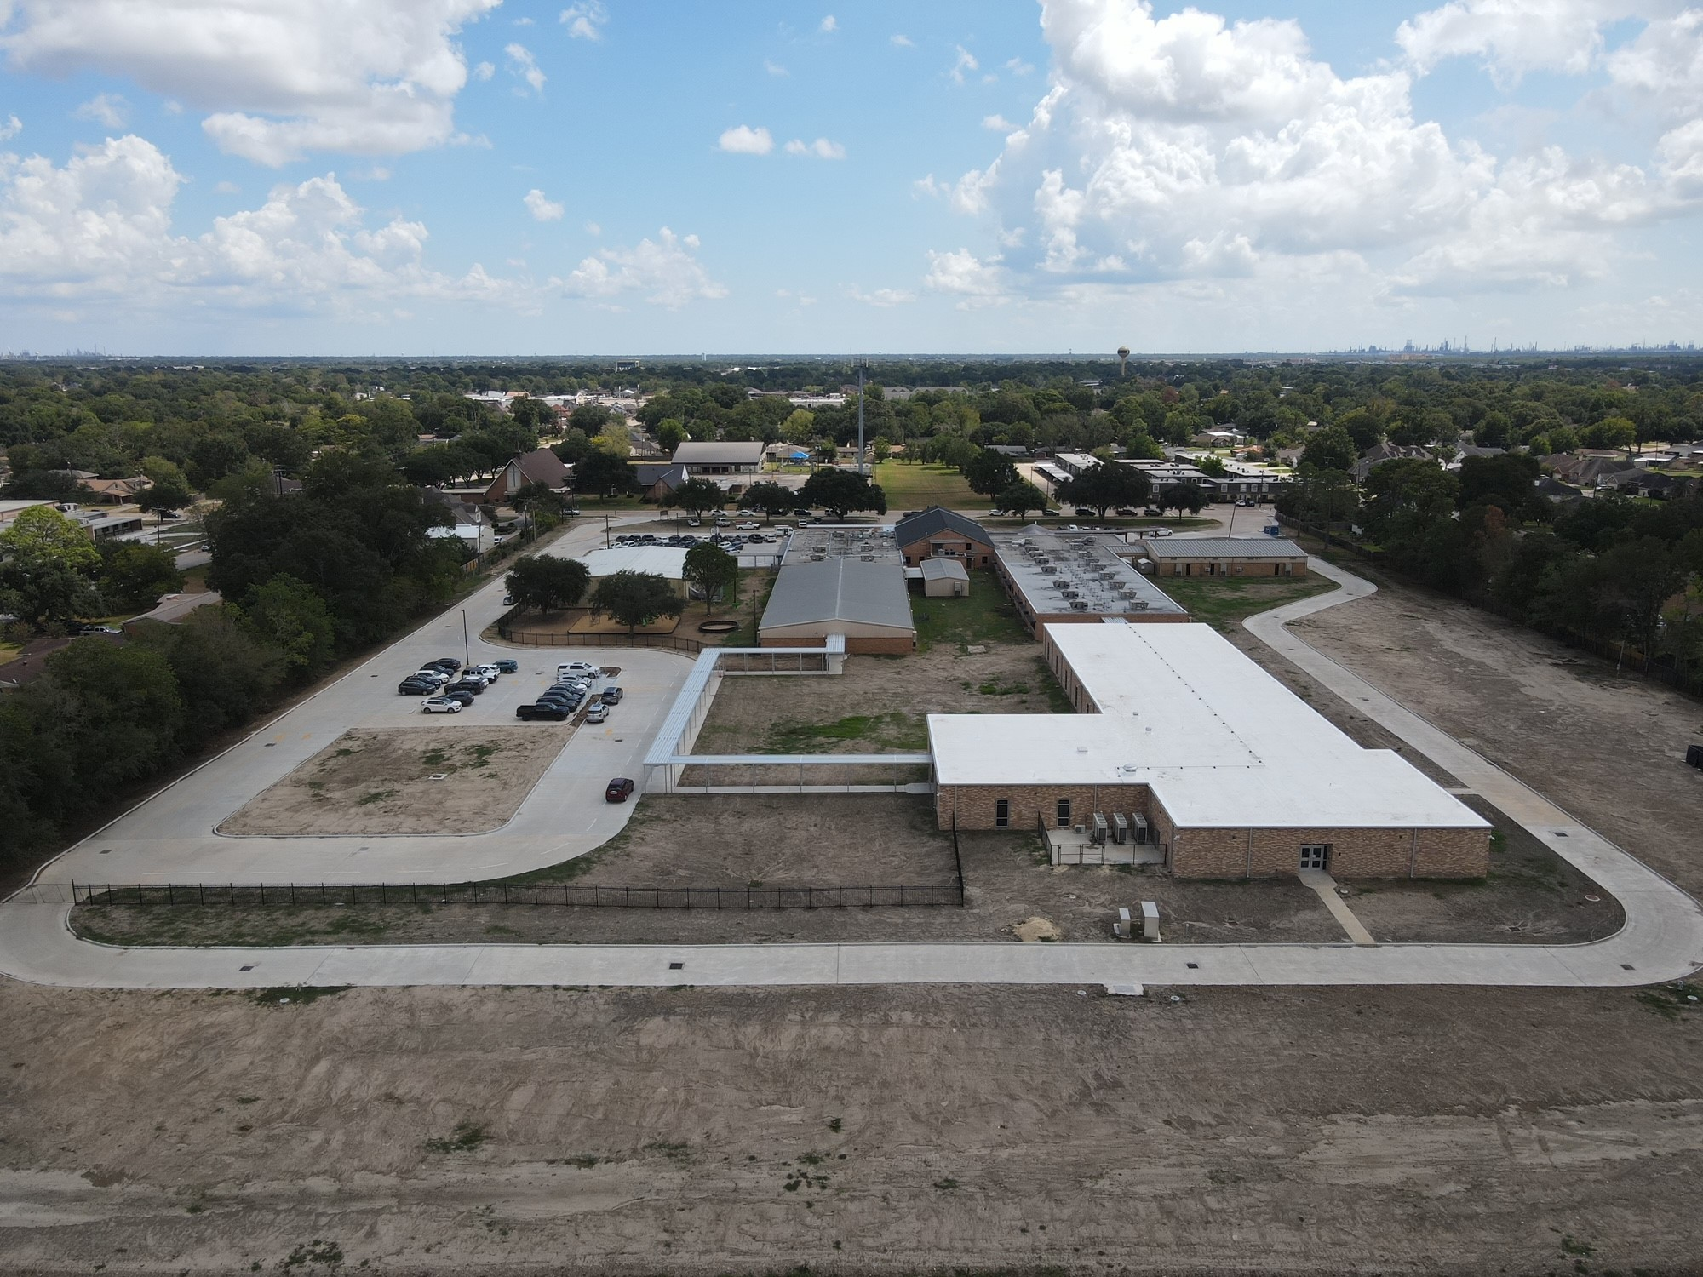
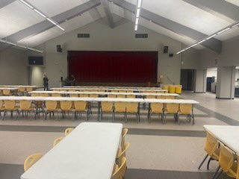
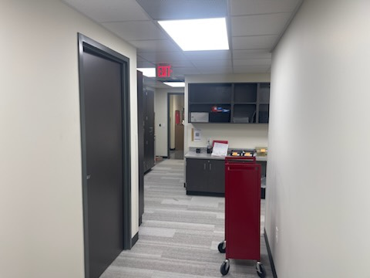
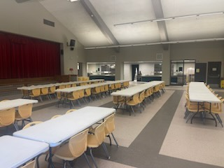
Helena Park Elementary School
Café Extension
  Complete Soffit Panel install
  Demo existing wall
  Interior finish out
Complete concrete scope of work, final grading
Complete Fencing & Gates
Landscape & Sod
Complete punch list

Slide 13
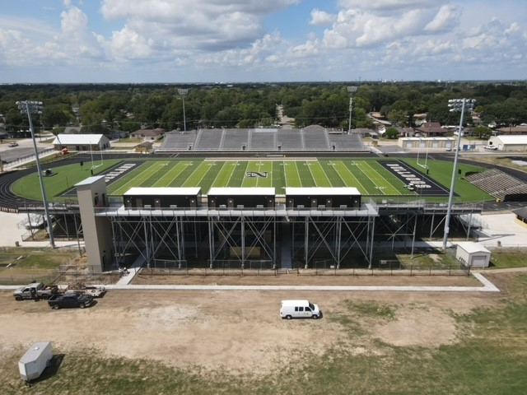
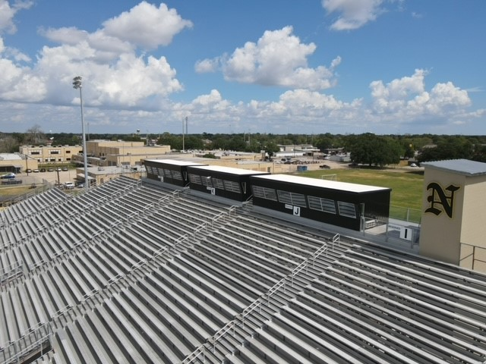
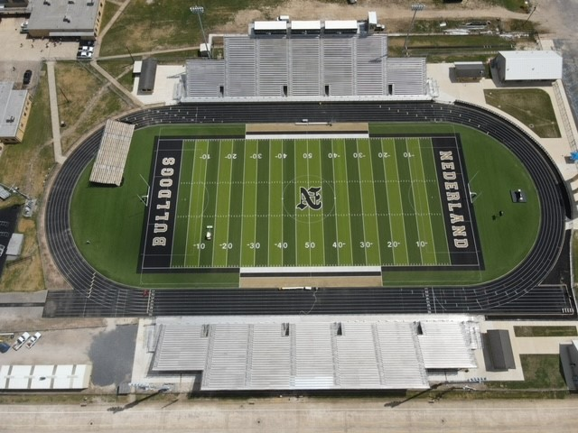
Nederland Bulldog Stadium
Complete elevator install
Electrical complete
Complete signage install
Install Canopy coverings
Complete trim on elevator shaft

Slide 14
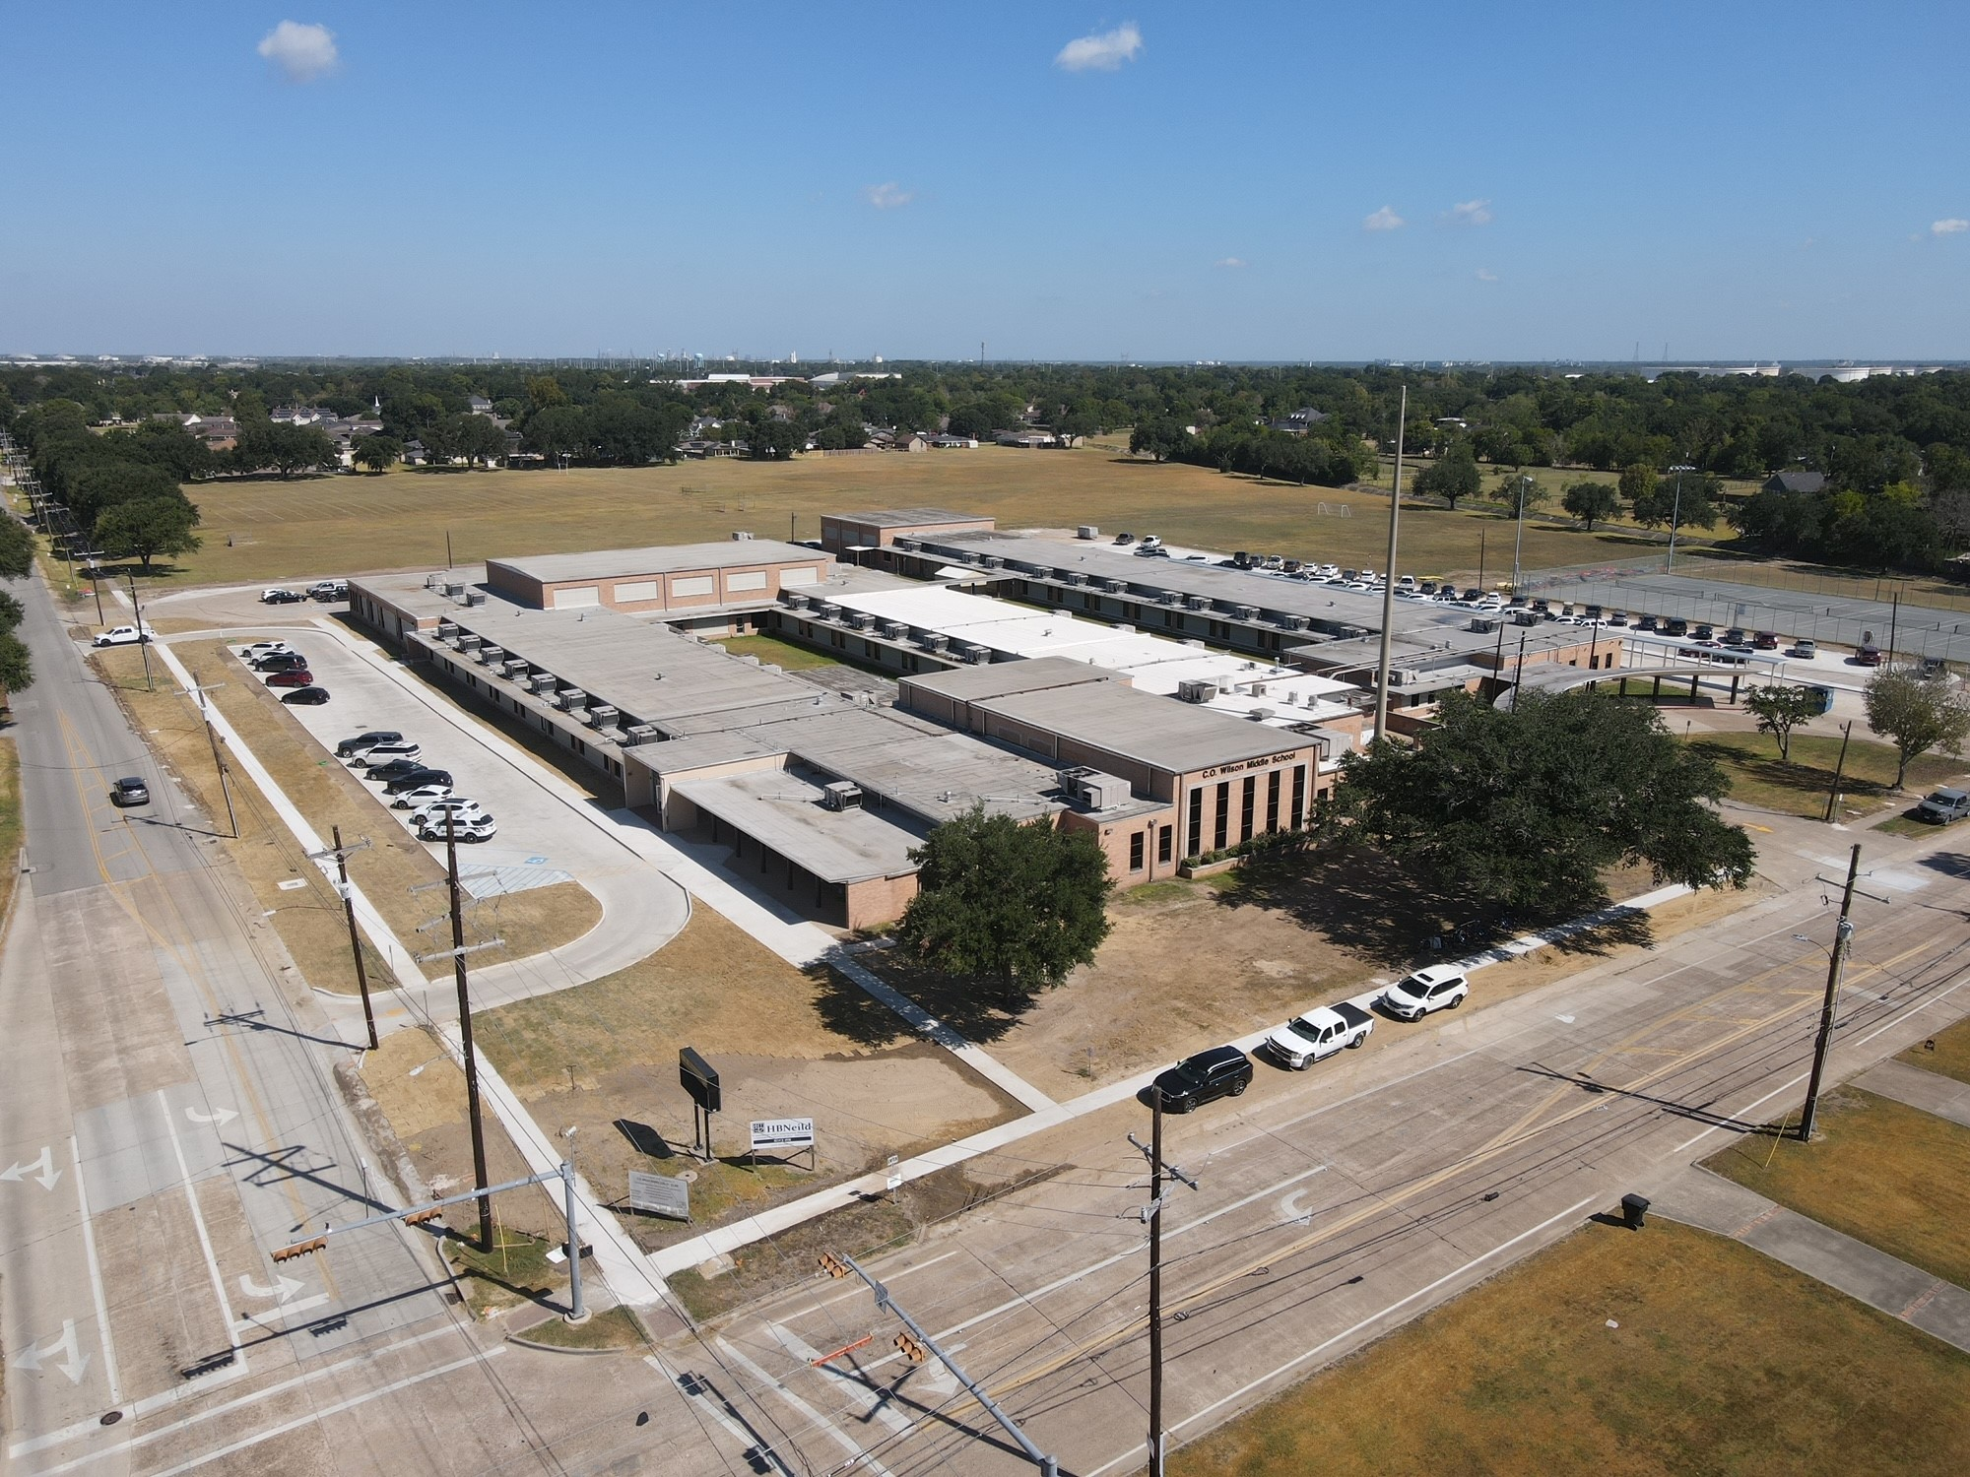
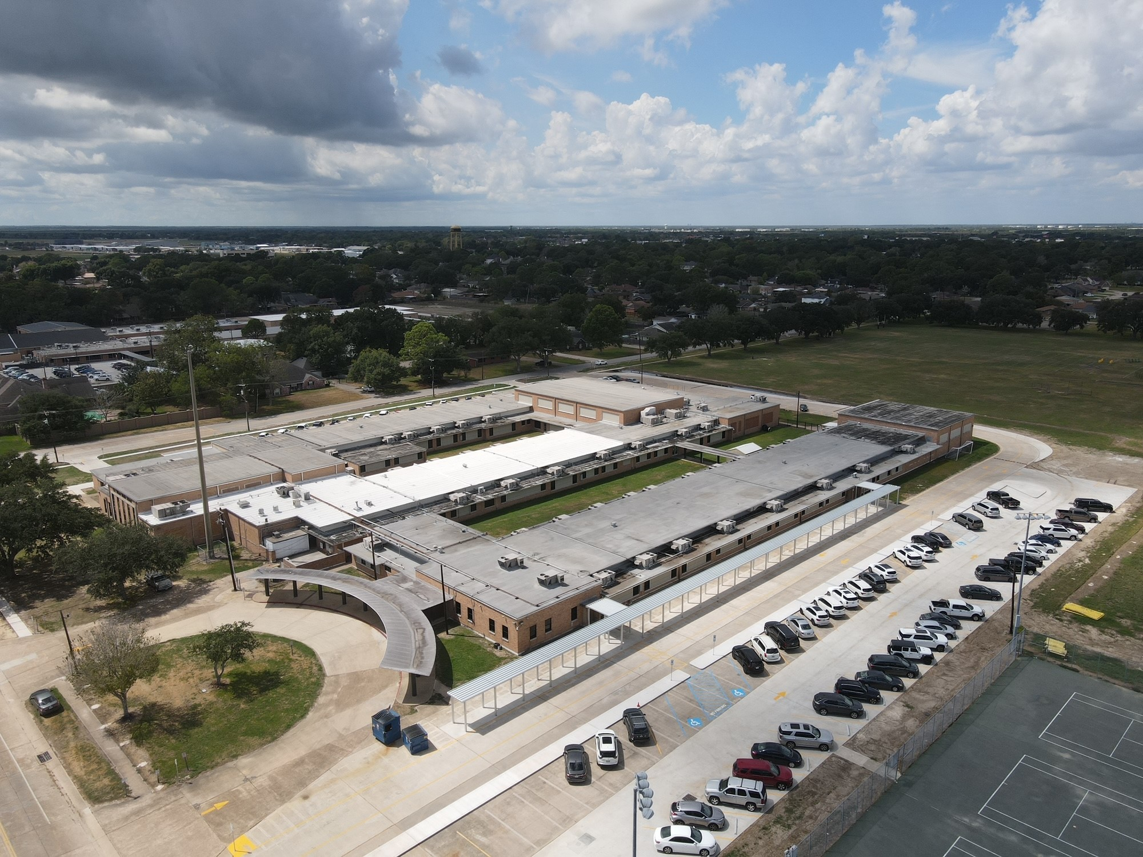
CO Wilson Middle School
Front Office Complete
Laboratories Complete
Toilet Partitions Complete
Complete Trench Drain / Concrete Island
Install Fence & Gates
Remove Entergy Pole

Slide 15
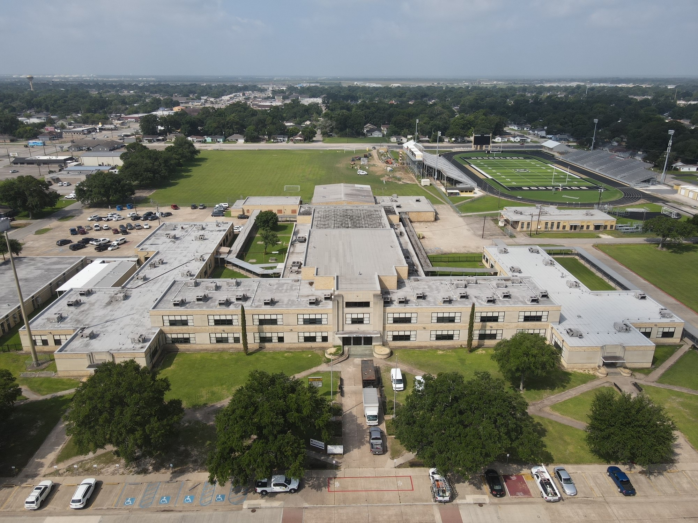
Central Middle School
Front Office Complete
  Installing New Casework
Laboratories Complete
Toilet Partitions Complete
Flatwork & Canopy outside Natatorium
Change Exterior Door for ADA.
Install Wheelchair Lift

Slide 16


