Slide 1




2019 Nederland ISD Bond Project
November 2023

Slide 2

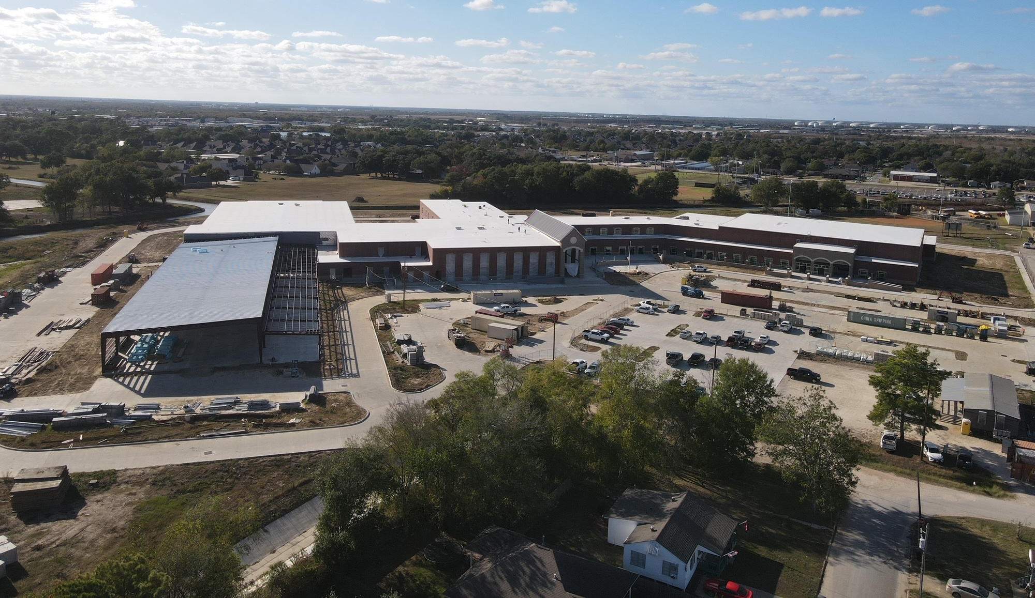
Nederland High School

Slide 3
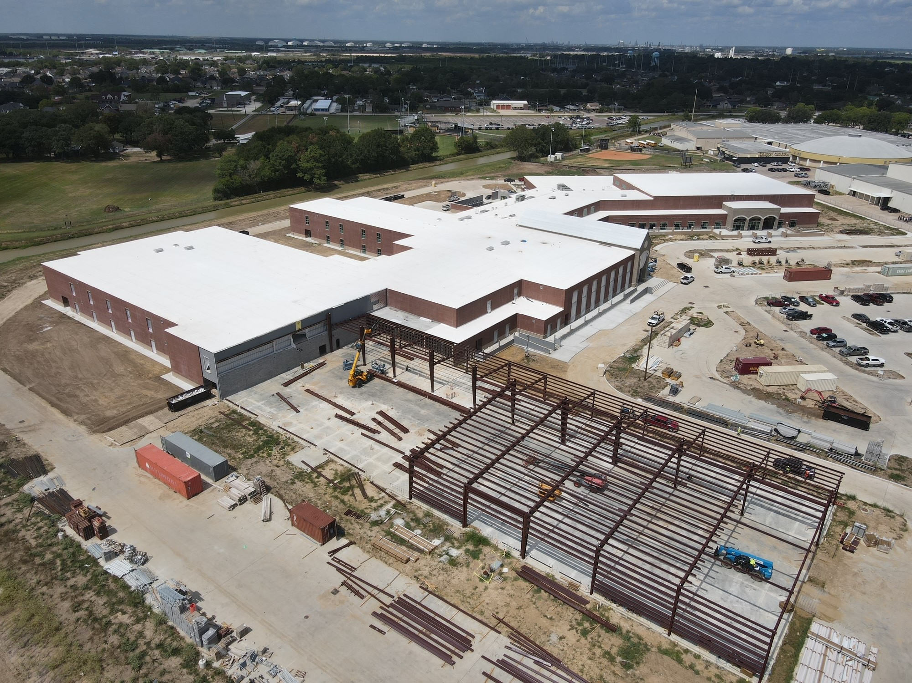
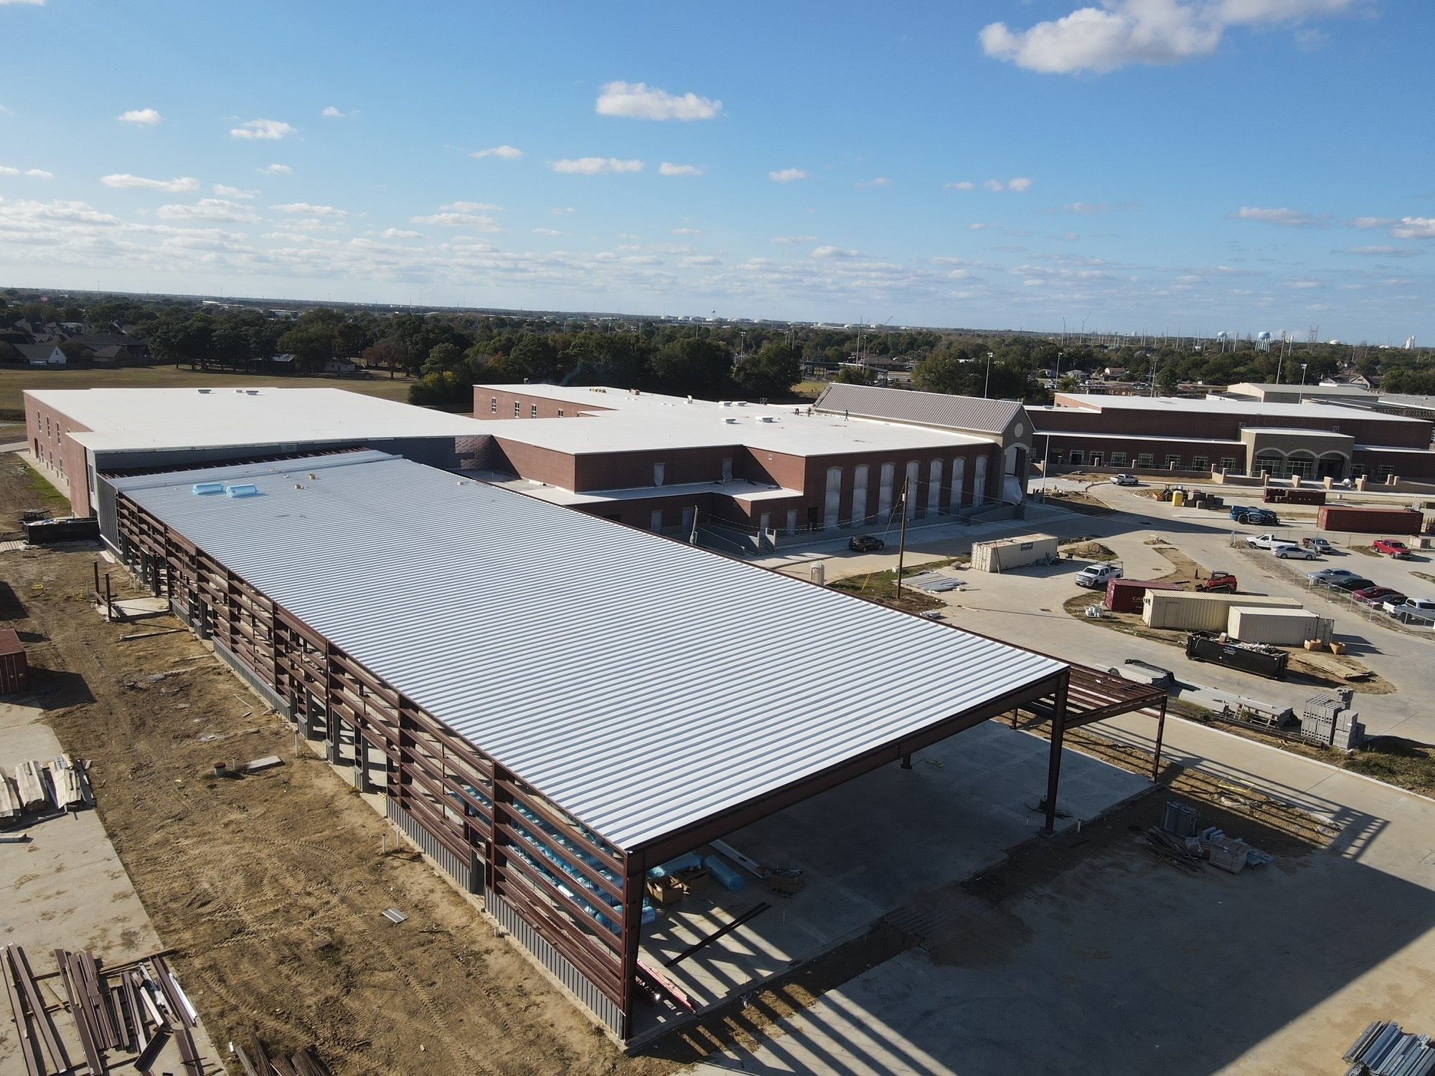
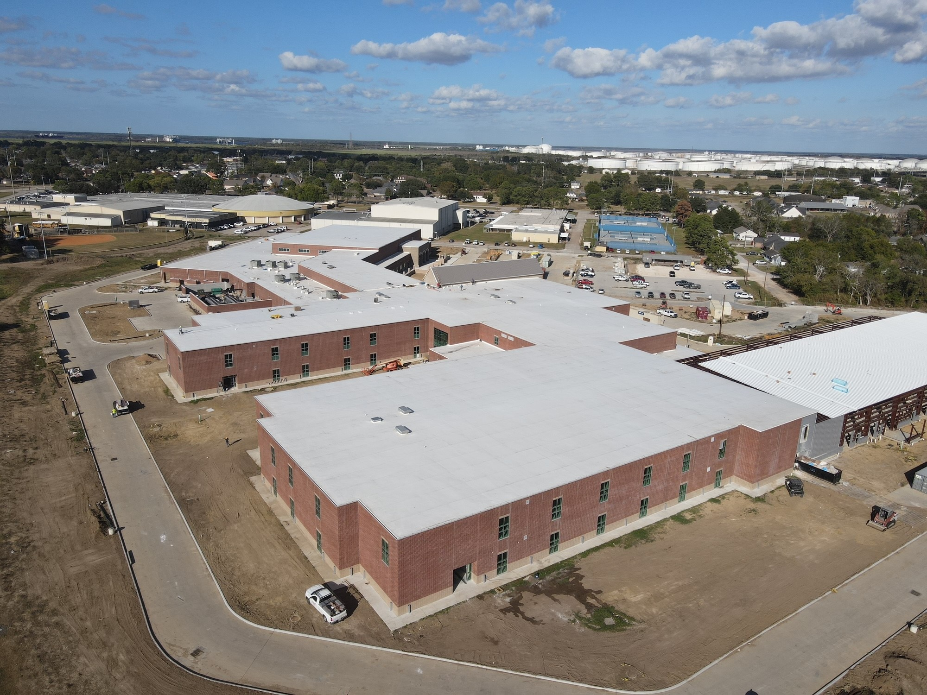
Nederland High School
Exterior
  Erection of CTE Building
  Install Area D Windows
  Mechanical Yard Chilled Water Piping
  Canopy columns being set.

Slide 4
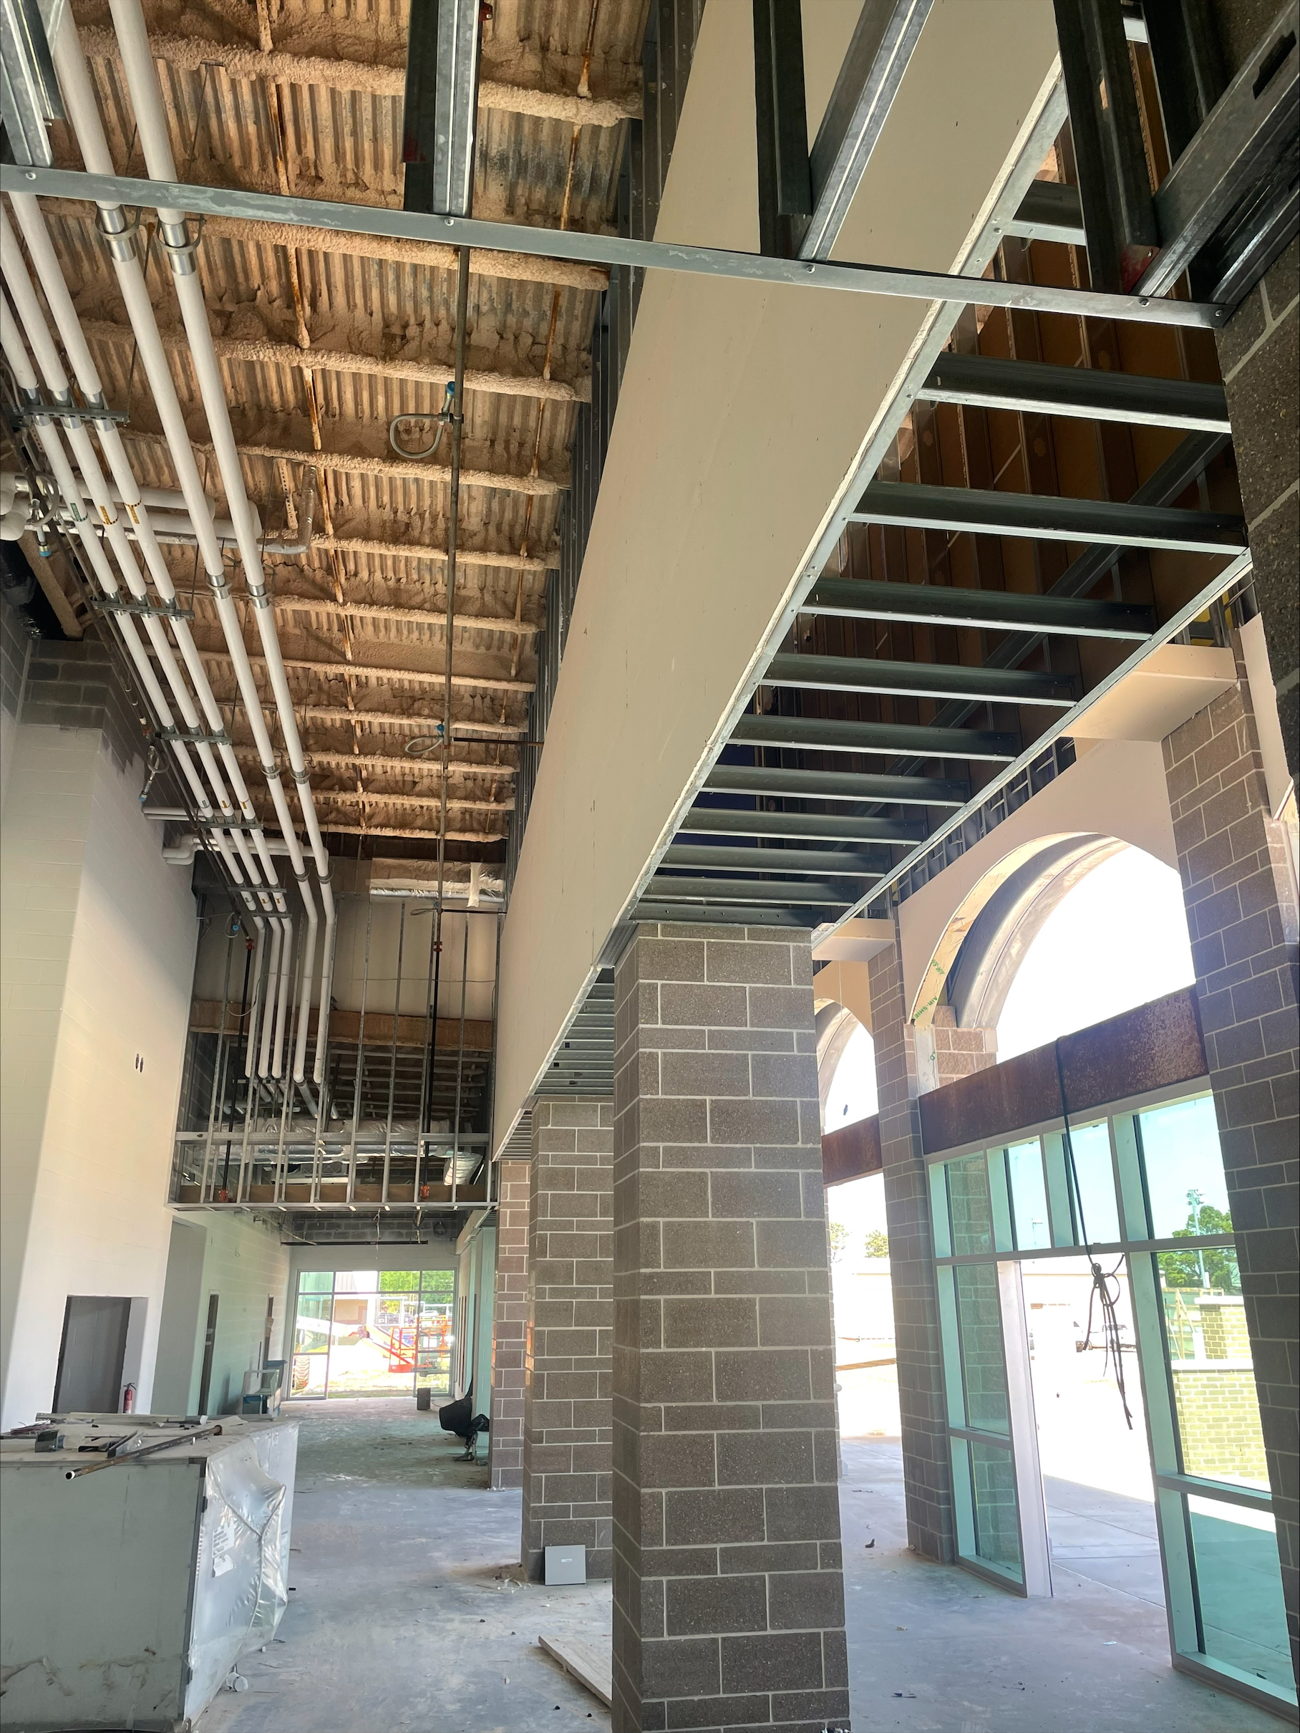
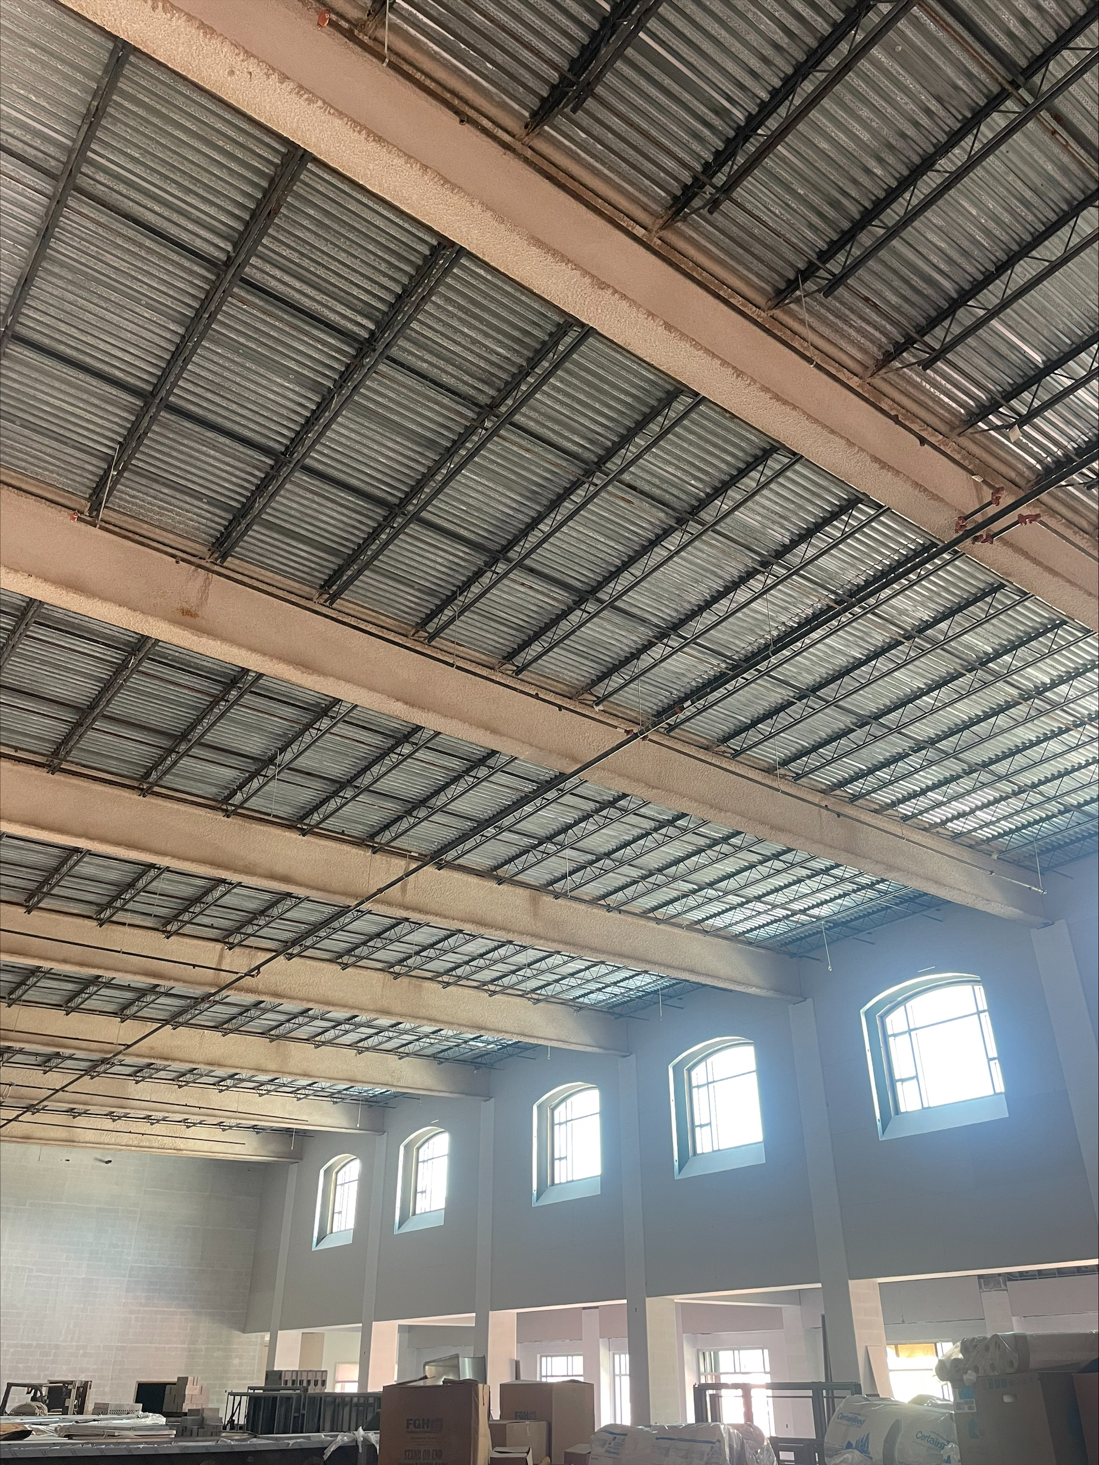
Nederland High School
HVAC piping
  Continue installing duct work in J, H, G, F, E, D, C, and B.
  Continue insulating MEP piping throughout building
  Complete piping of cassettes in area D1
Sheetrock & Paint
  Continue first coat of paint in area’s J, H, G, F, E, & C
  Continue plater ceilings in Area ‘J/G’
Start Tile in Restrooms
Start Ceiling Grid in Labs
Install Gym Scoreboards

Slide 5

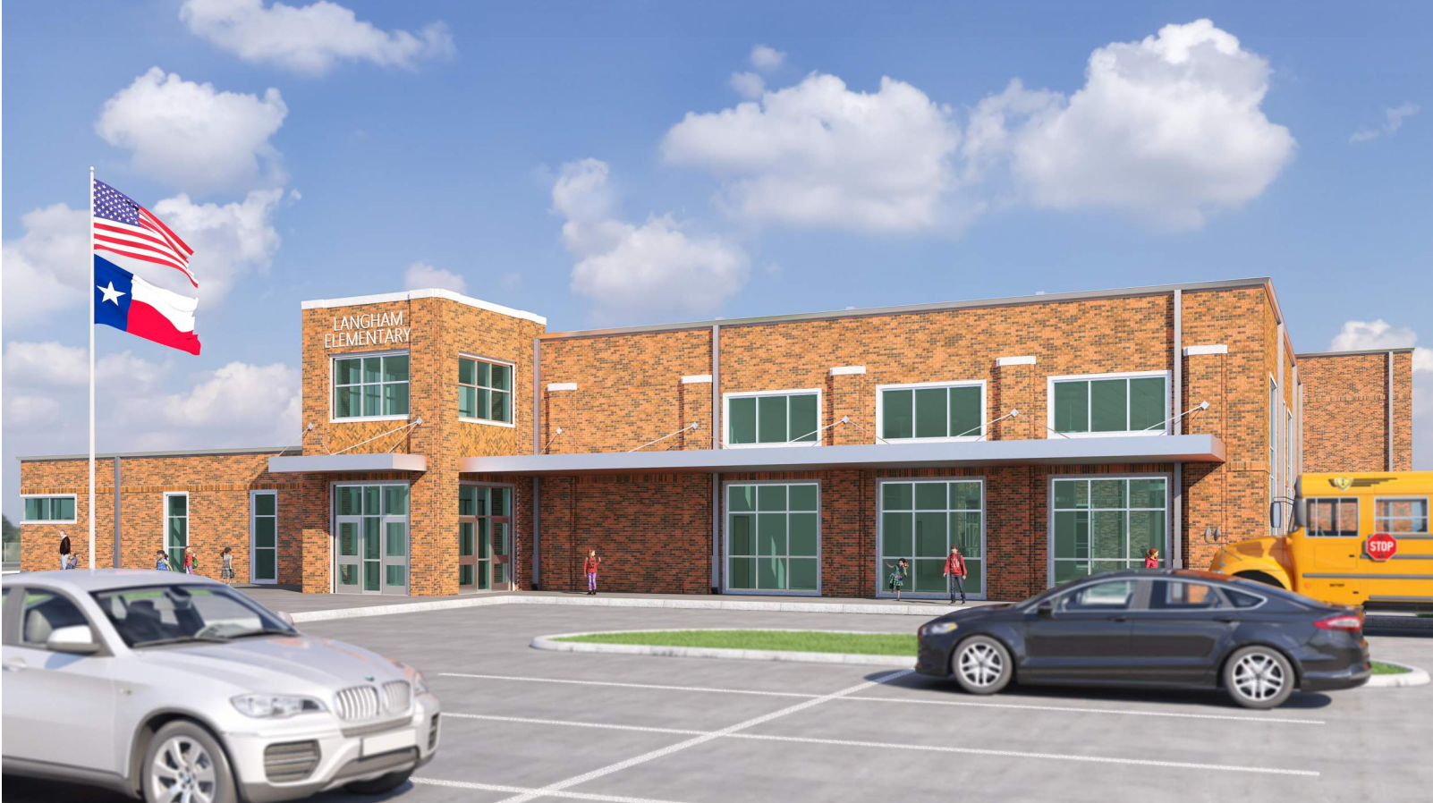
Langham Elementary School

Slide 6
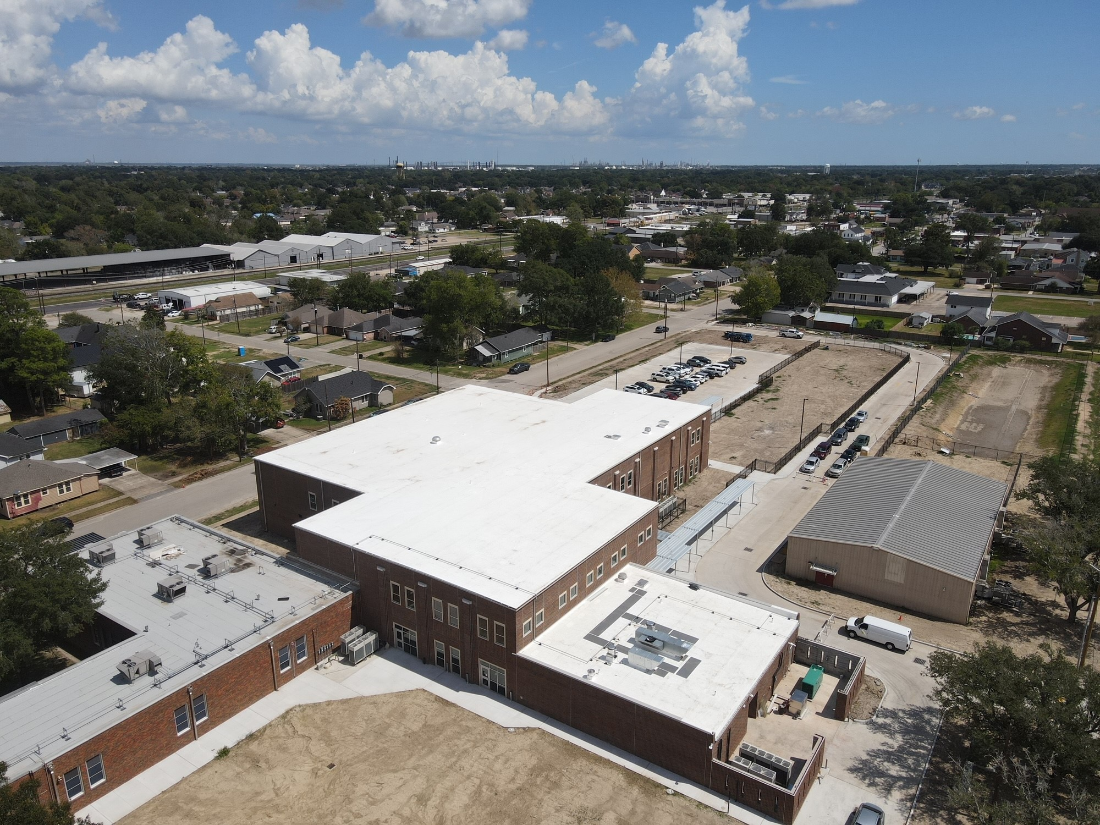
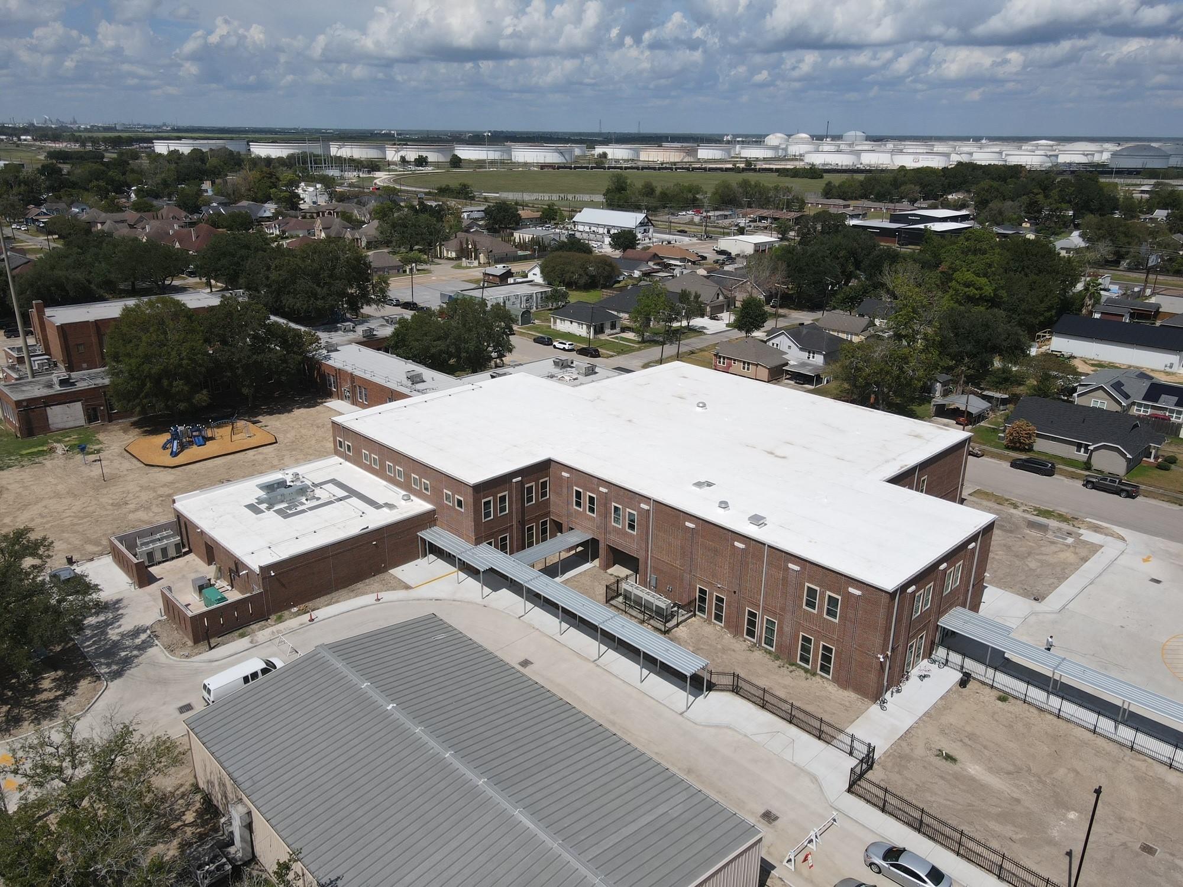
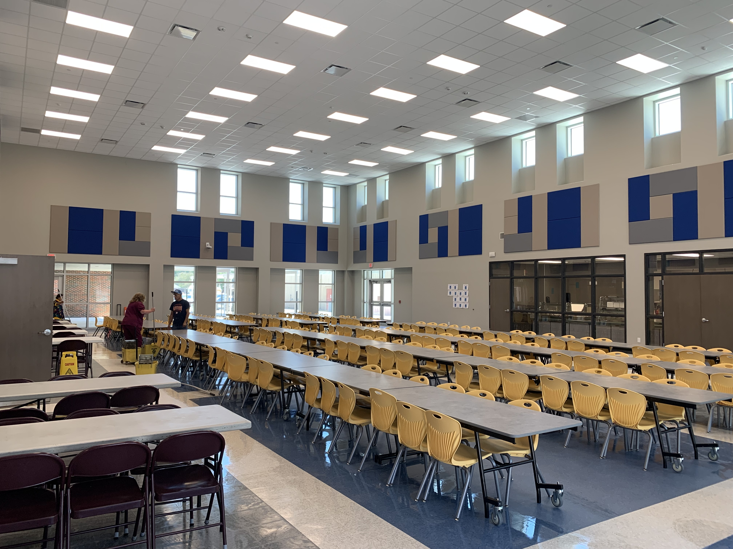
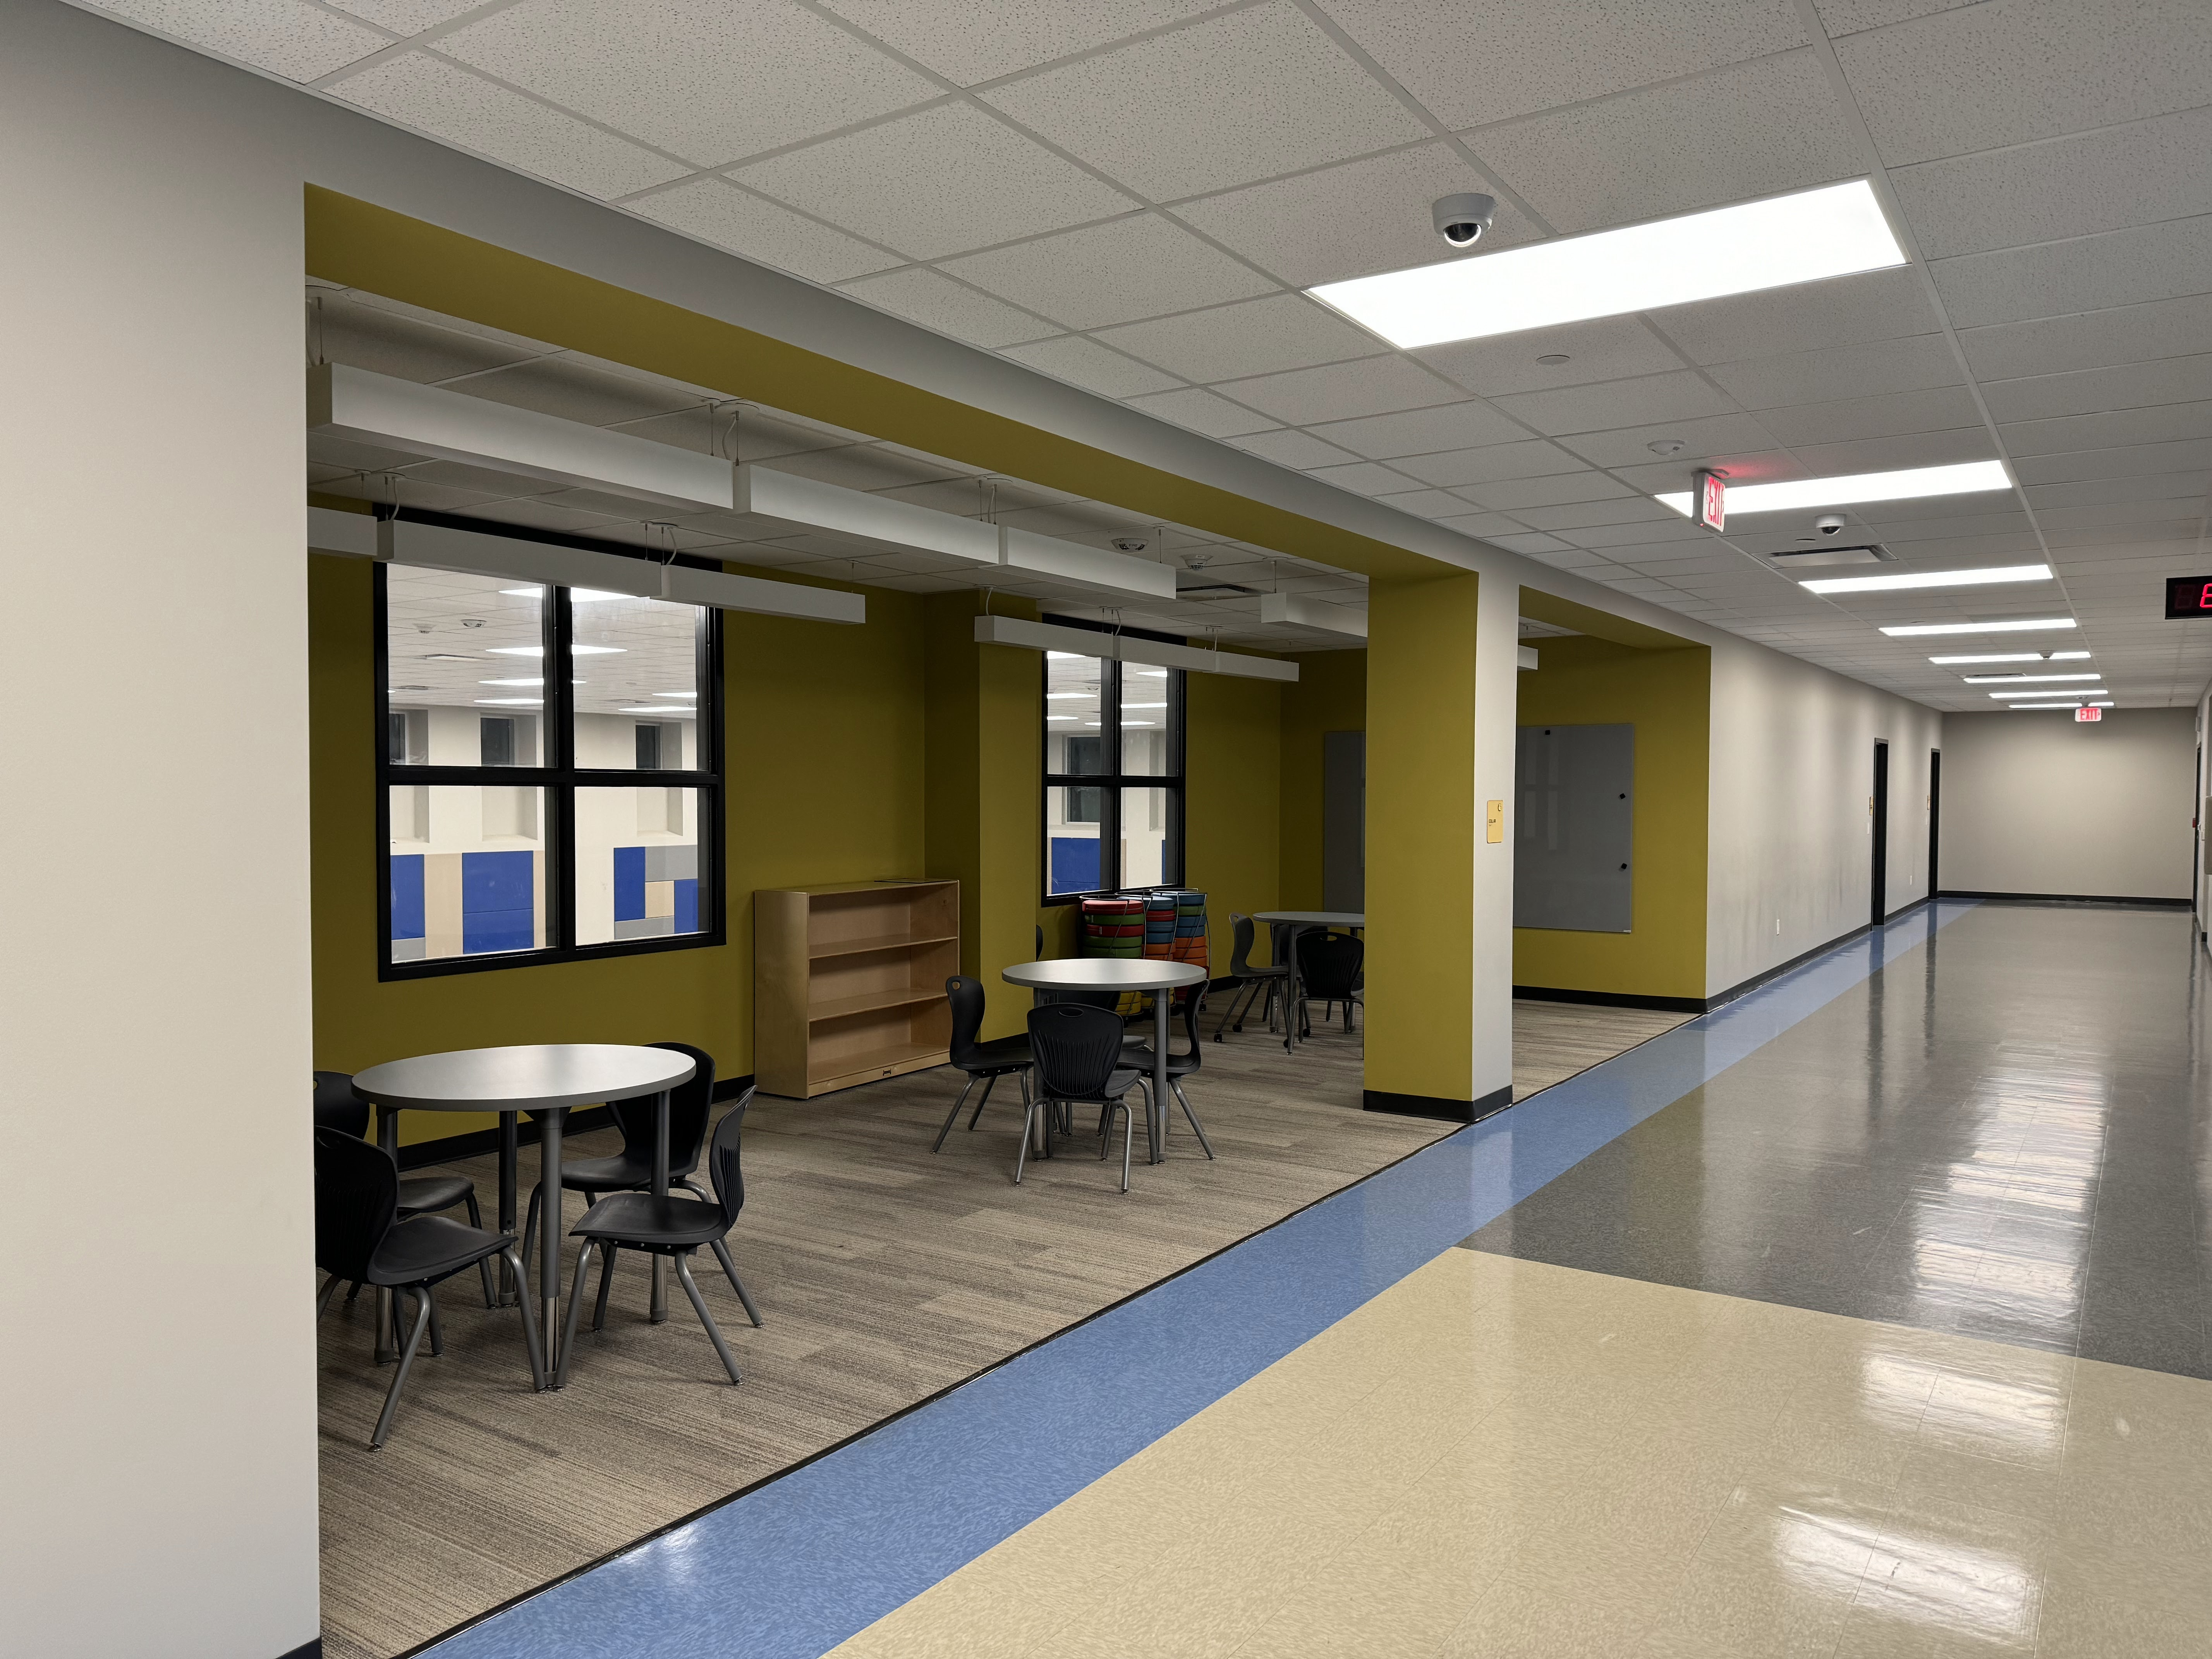
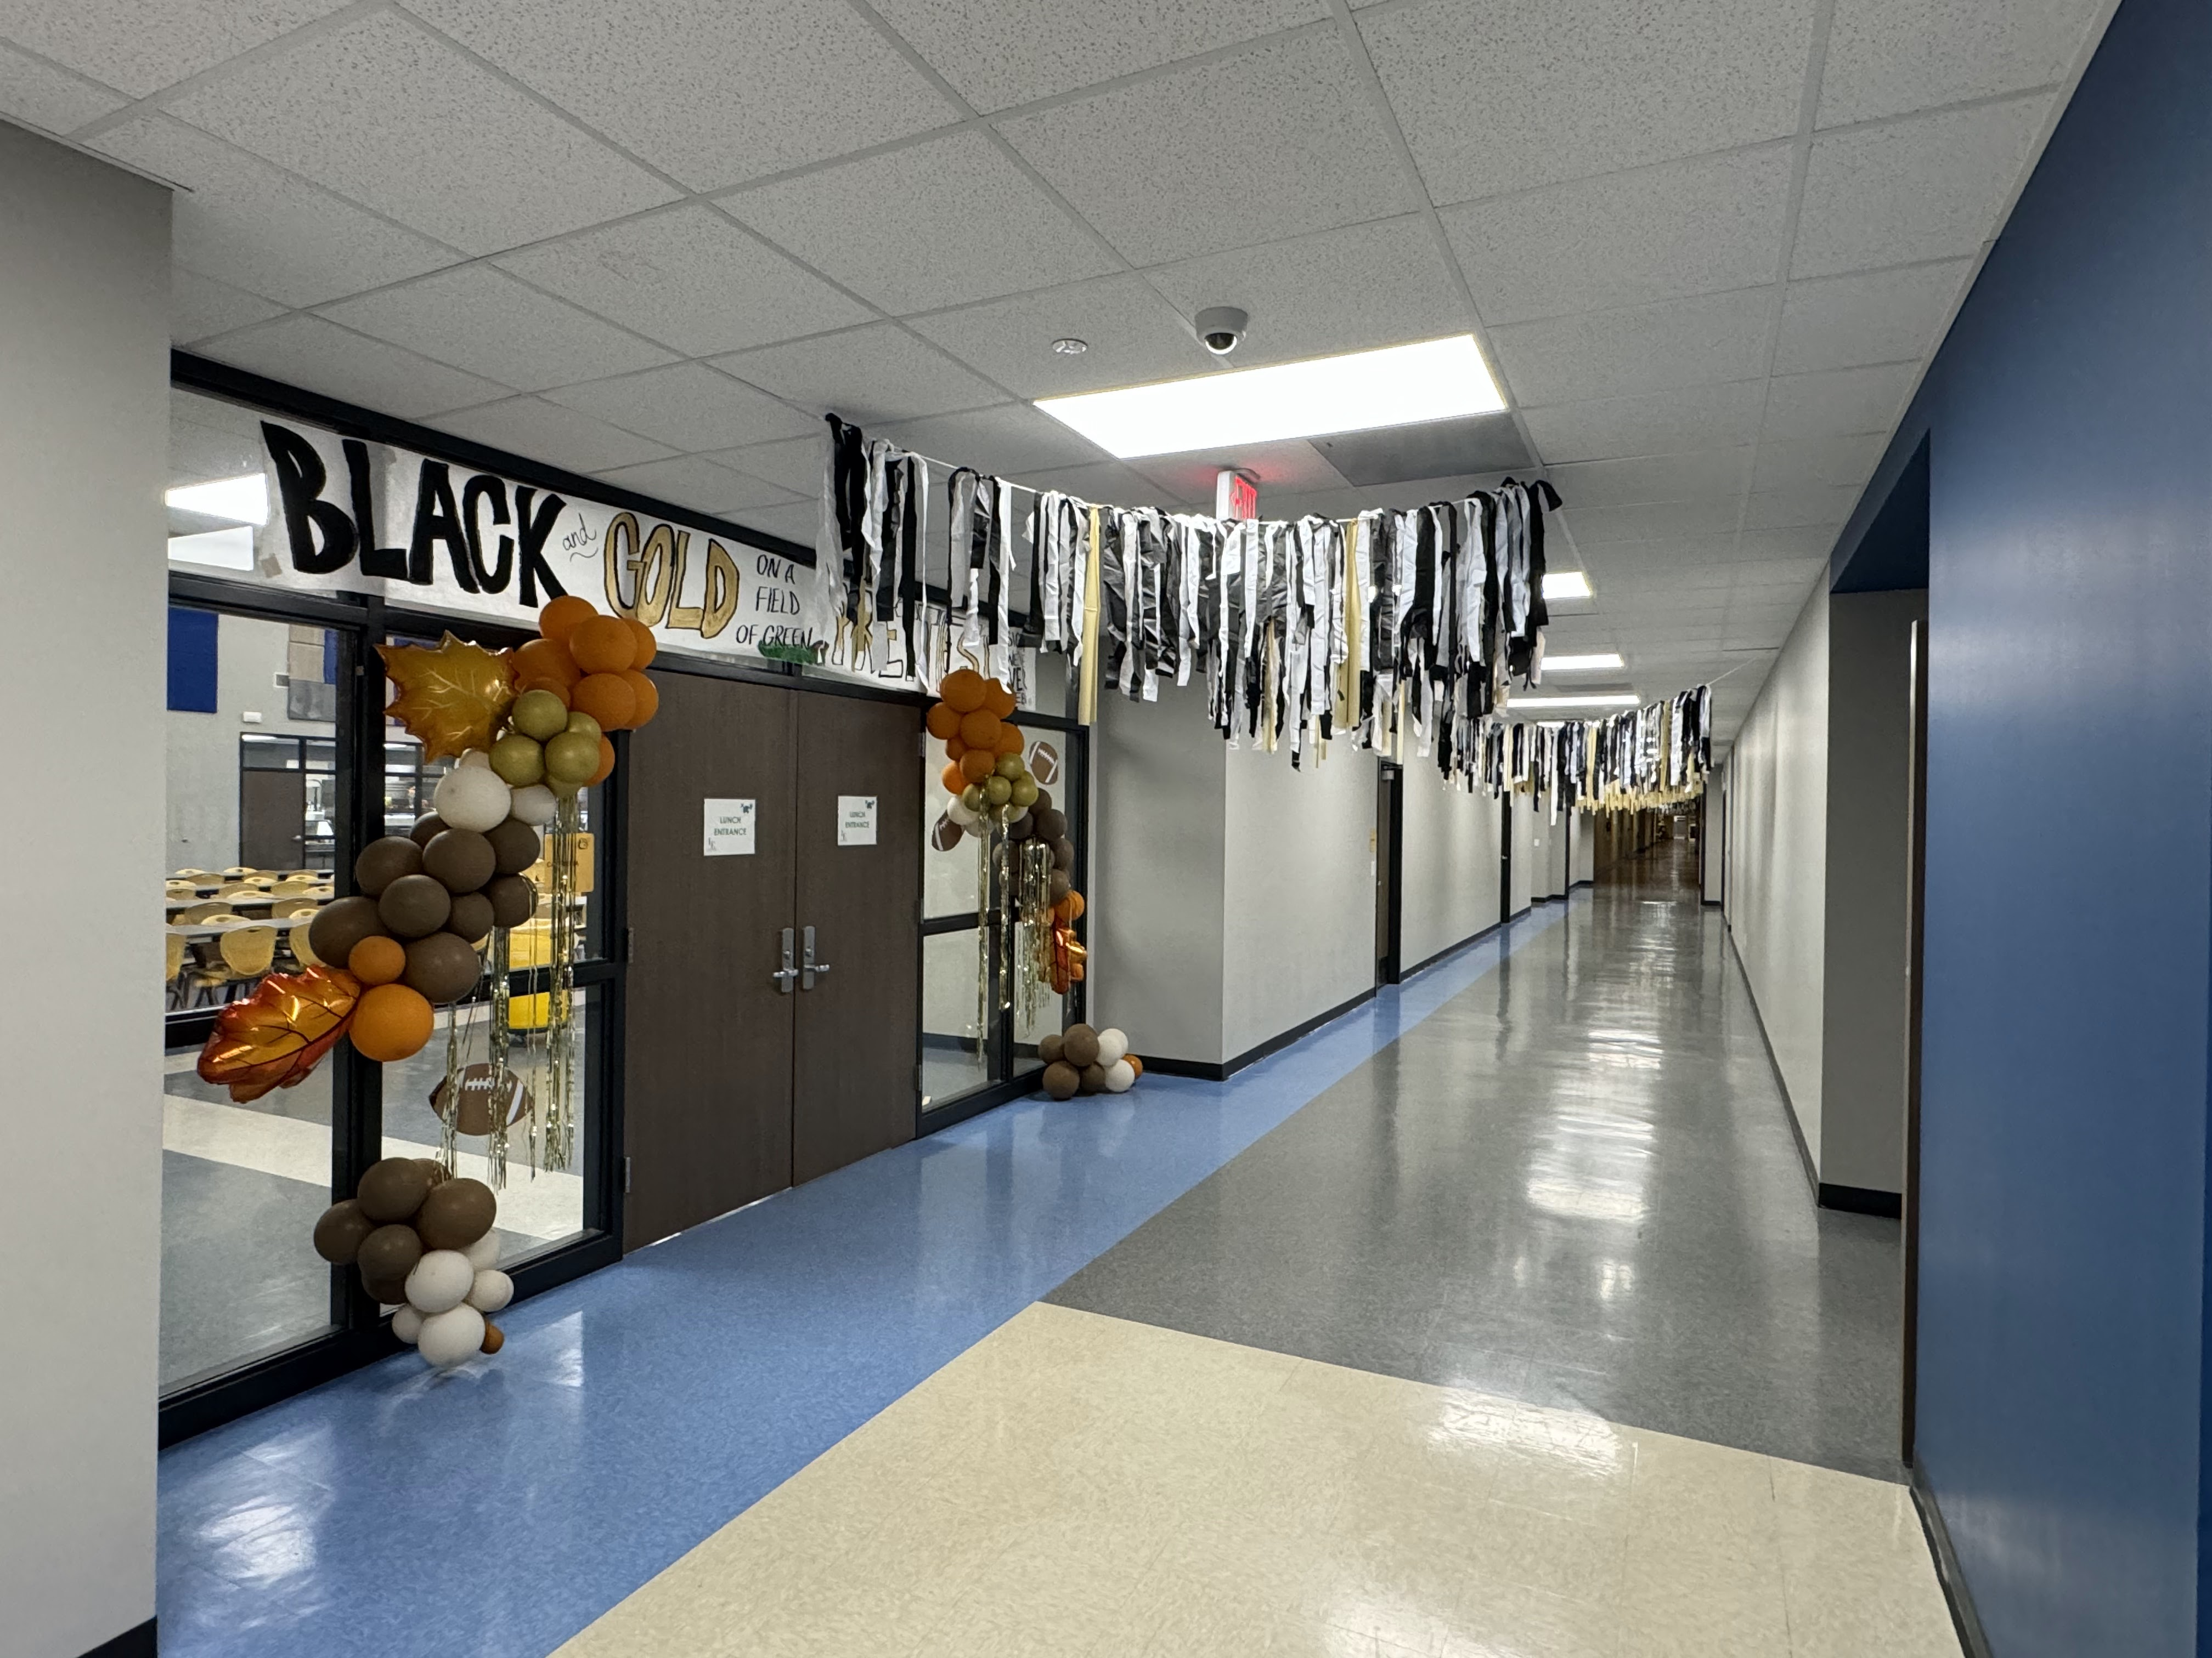
Langham Elementary School
Continue Gym addition
Complete Gate install
Install handrails over Thanksgiving

Slide 7
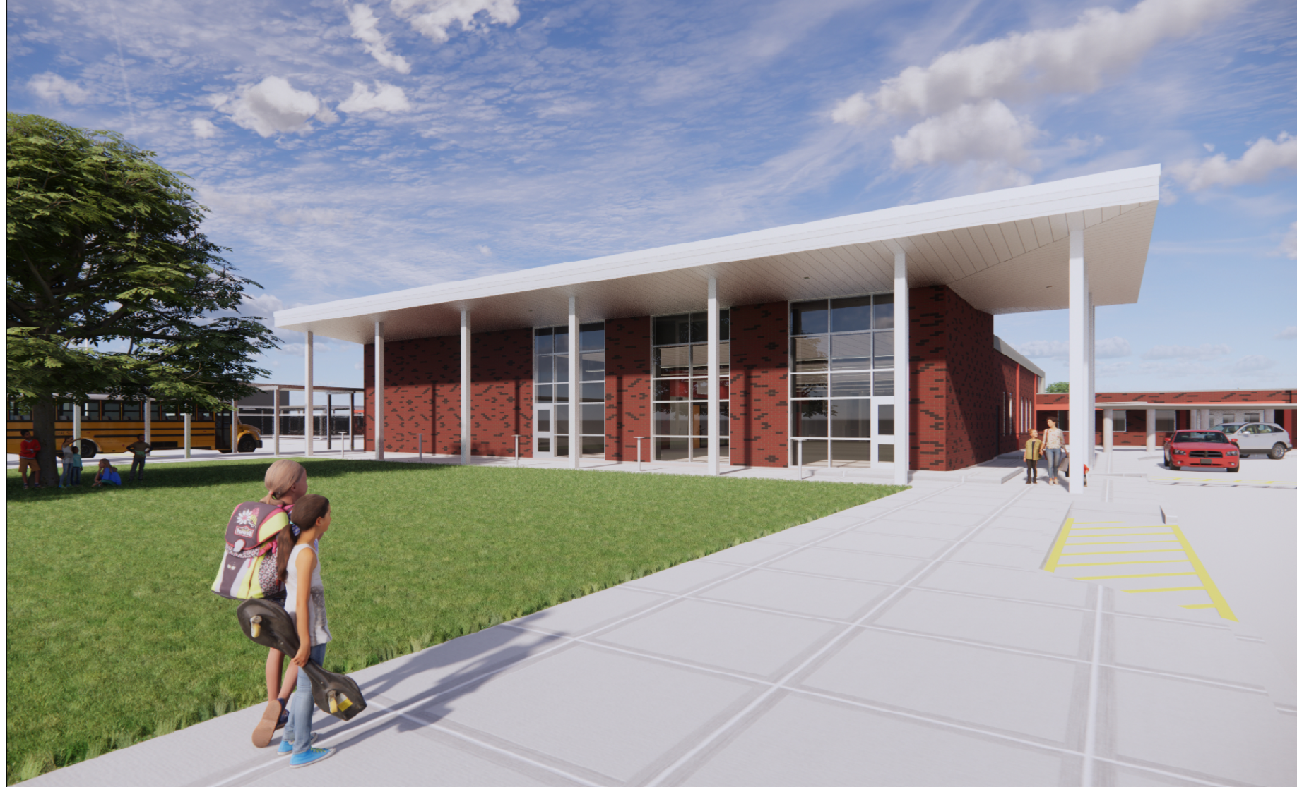
Hillcrest Elementary School

Slide 8
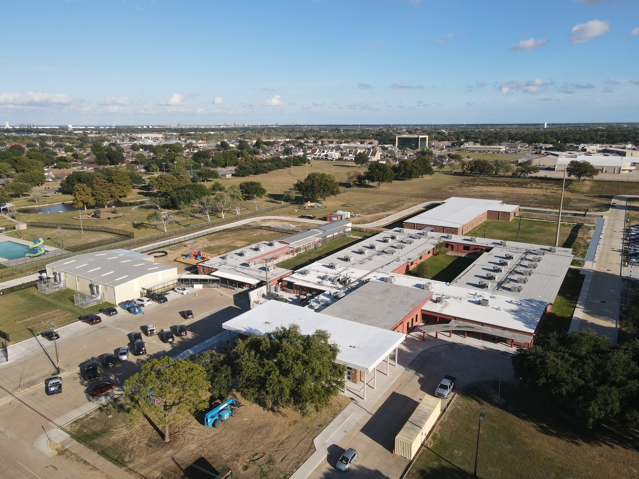
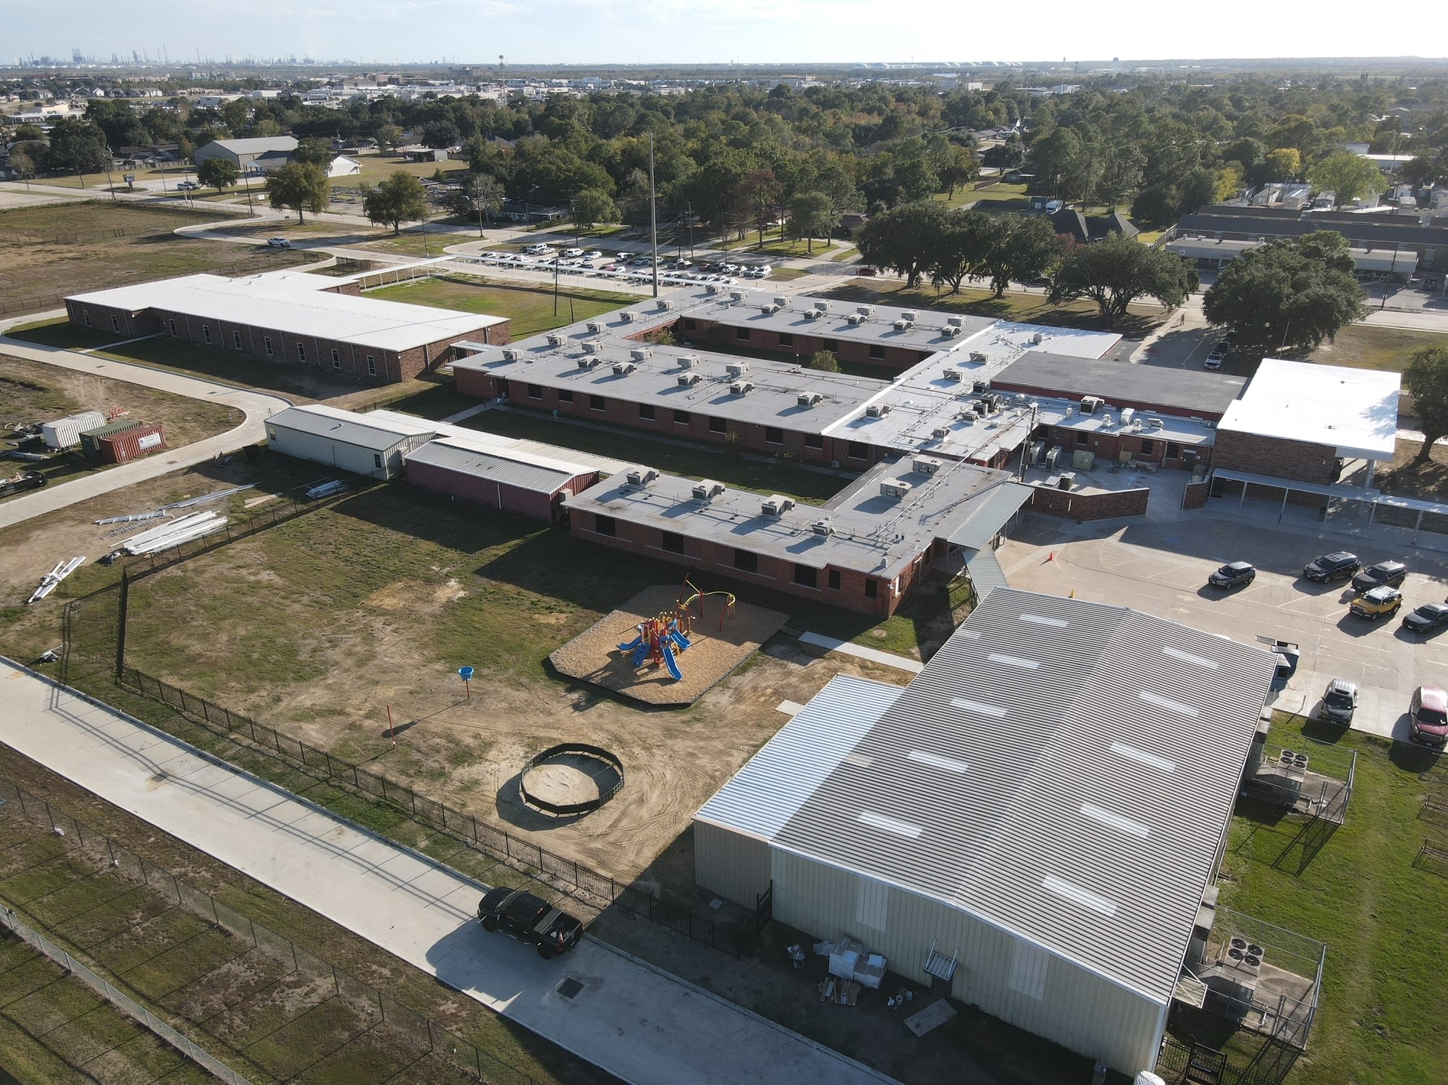
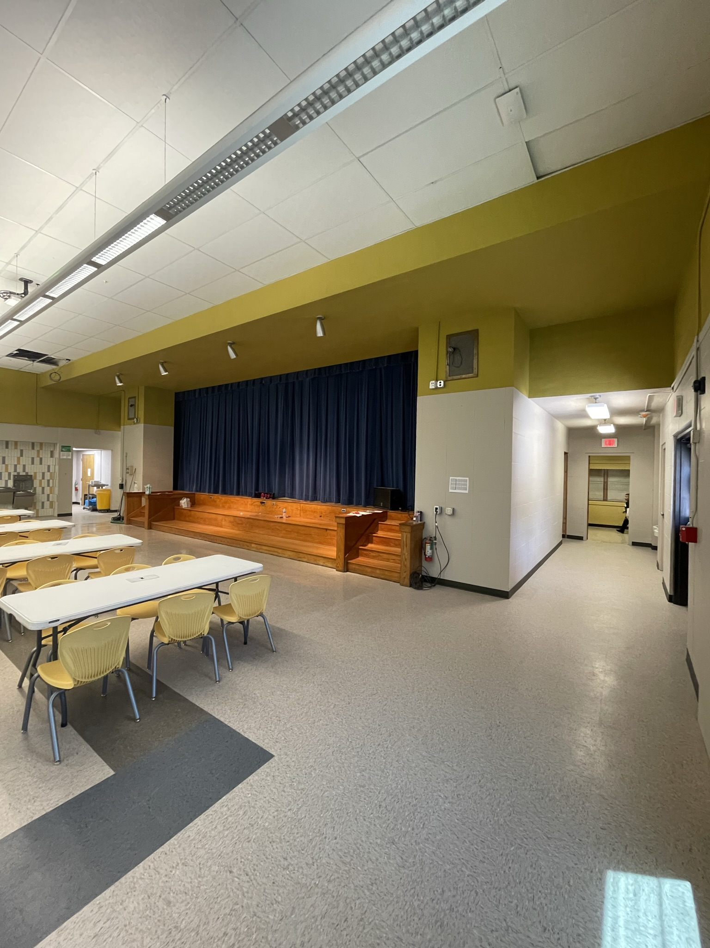
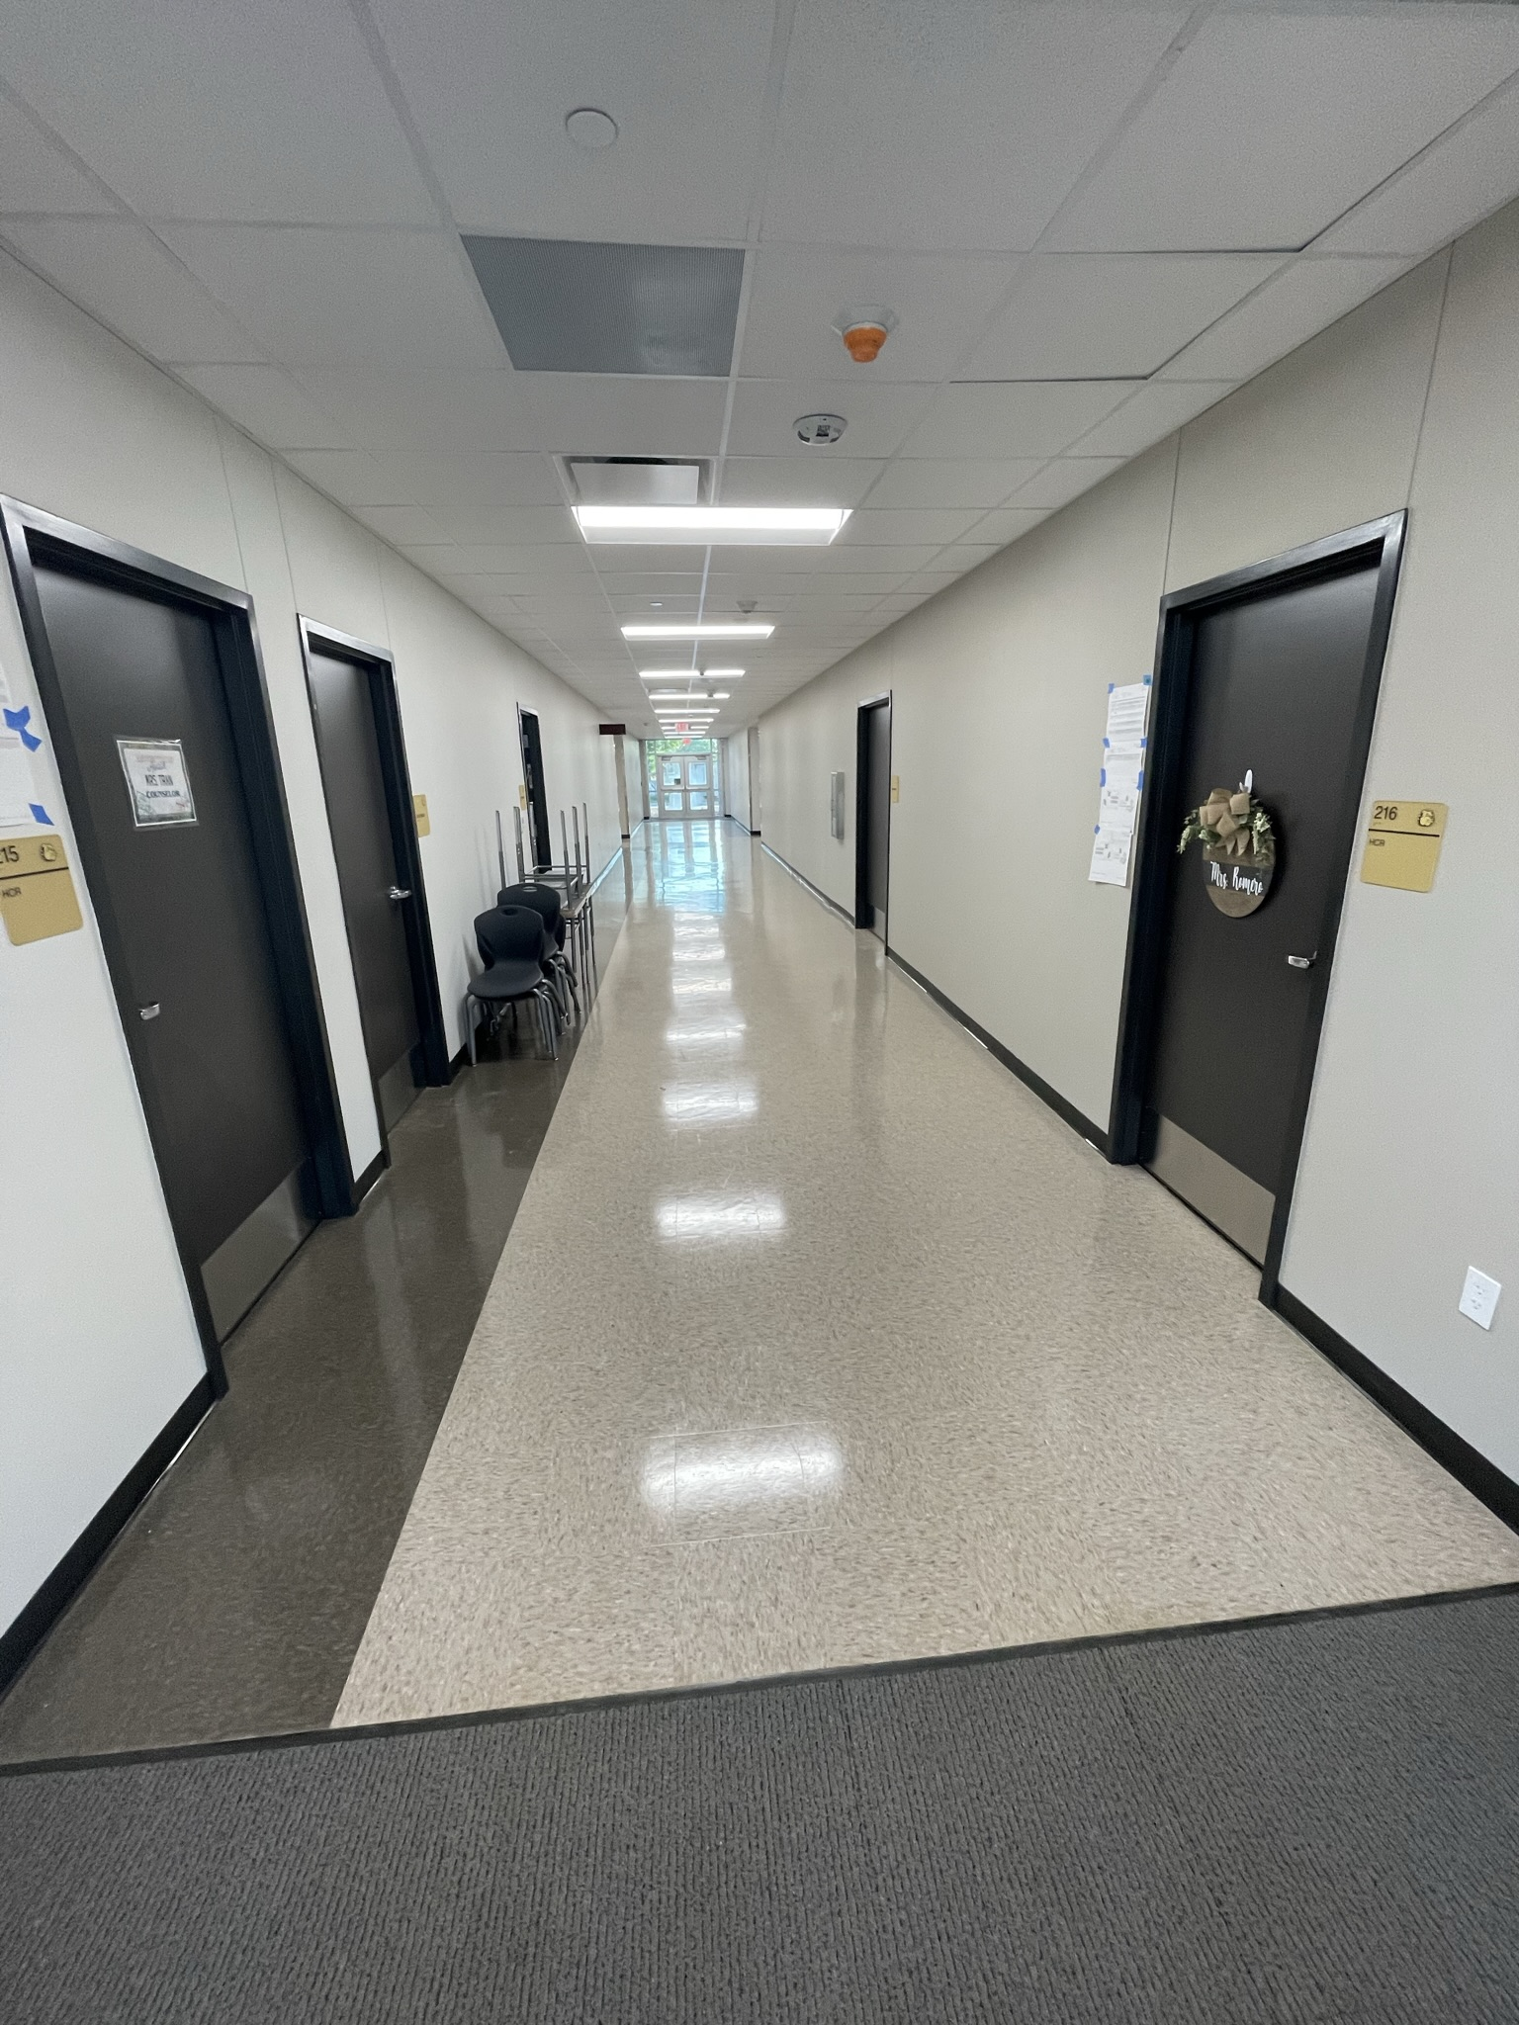
Hillcrest Elementary School
Café/kitchen extension
  Finish Epoxy Floors
  Wax Floors
Complete gym addition
  Epoxy & Fixtures
Landscape & Sod
Begin work in pre-k classroom over thanksgiving break

Slide 9
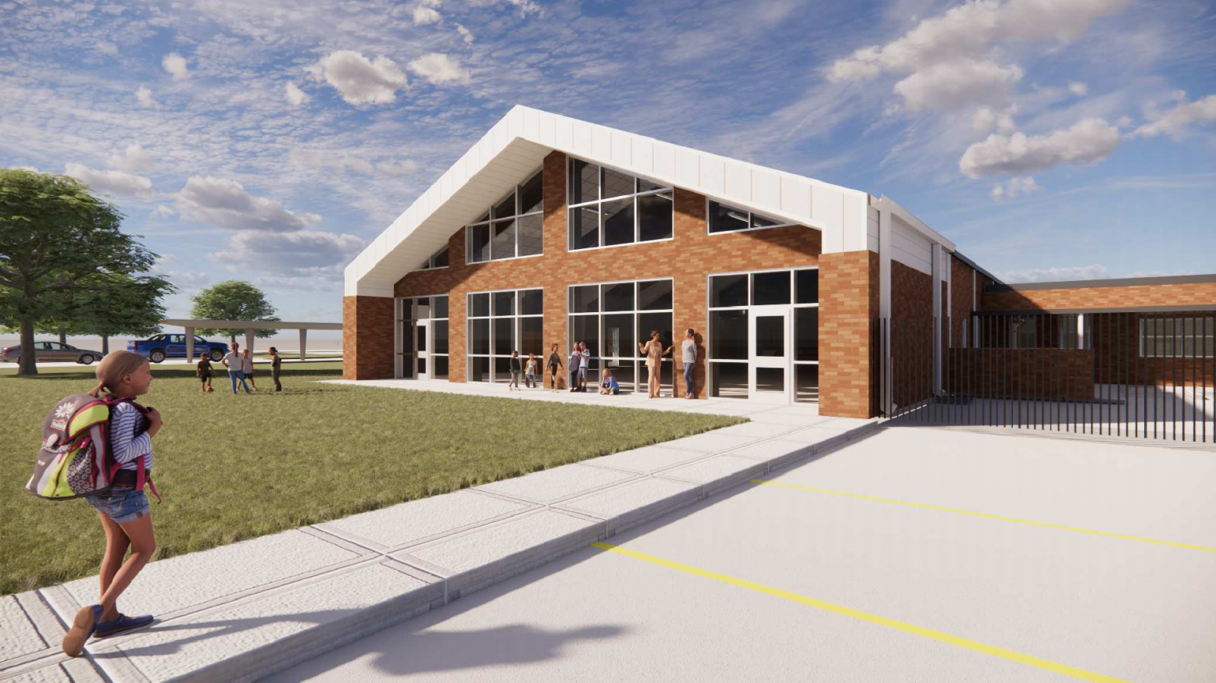
Highland Park Elementary School

Slide 10
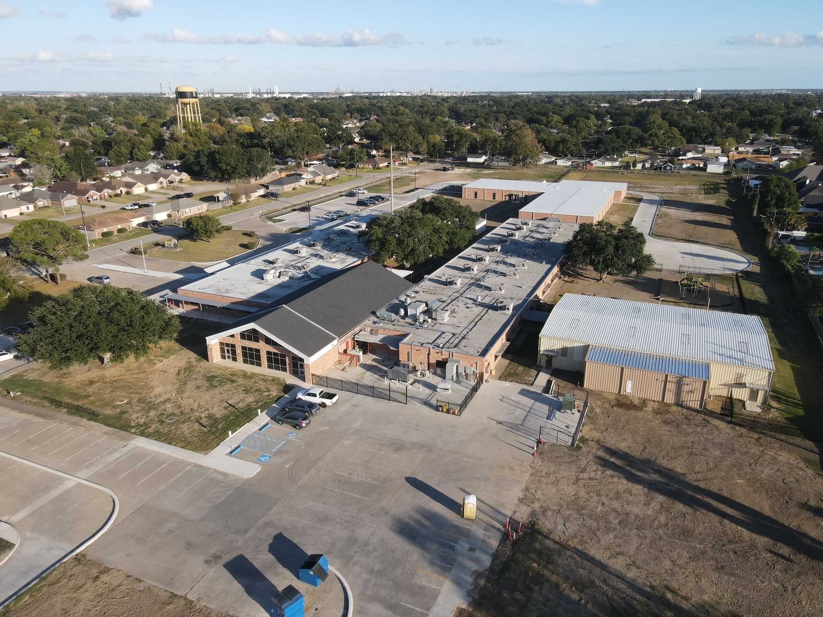
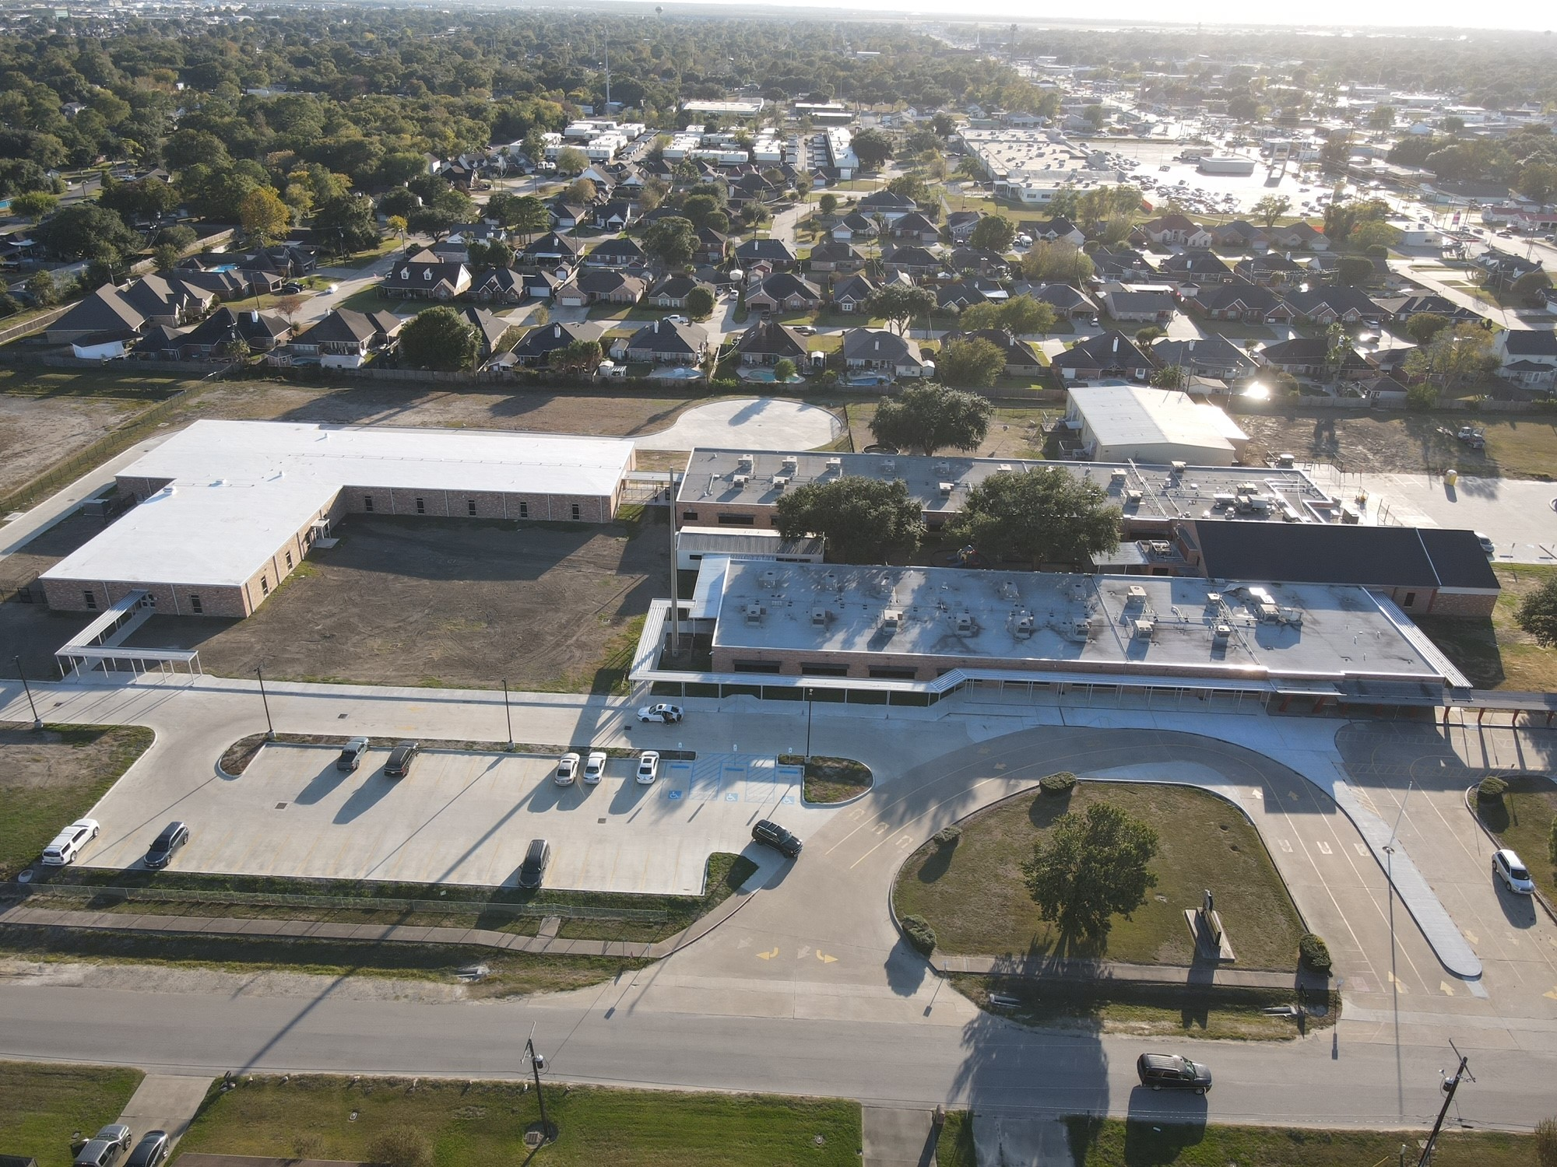
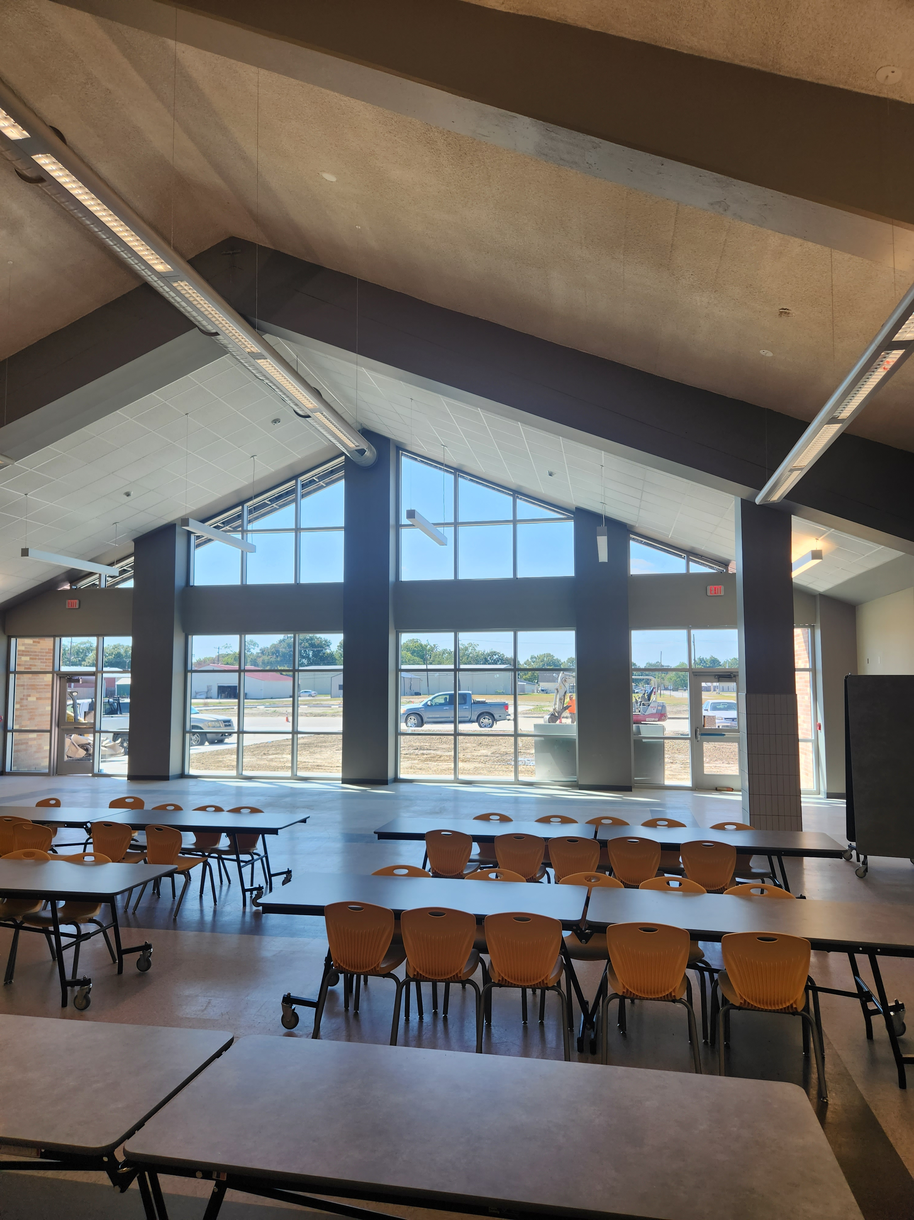
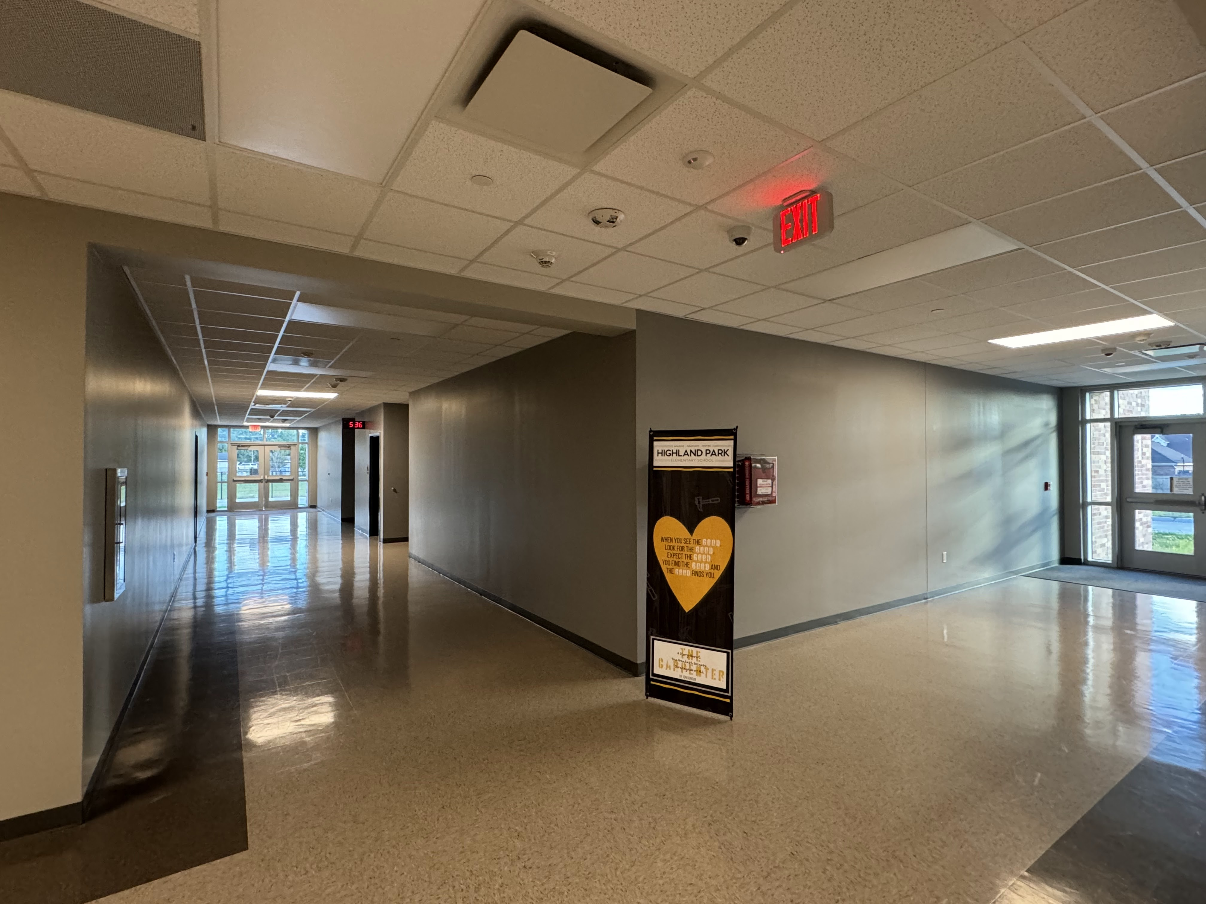
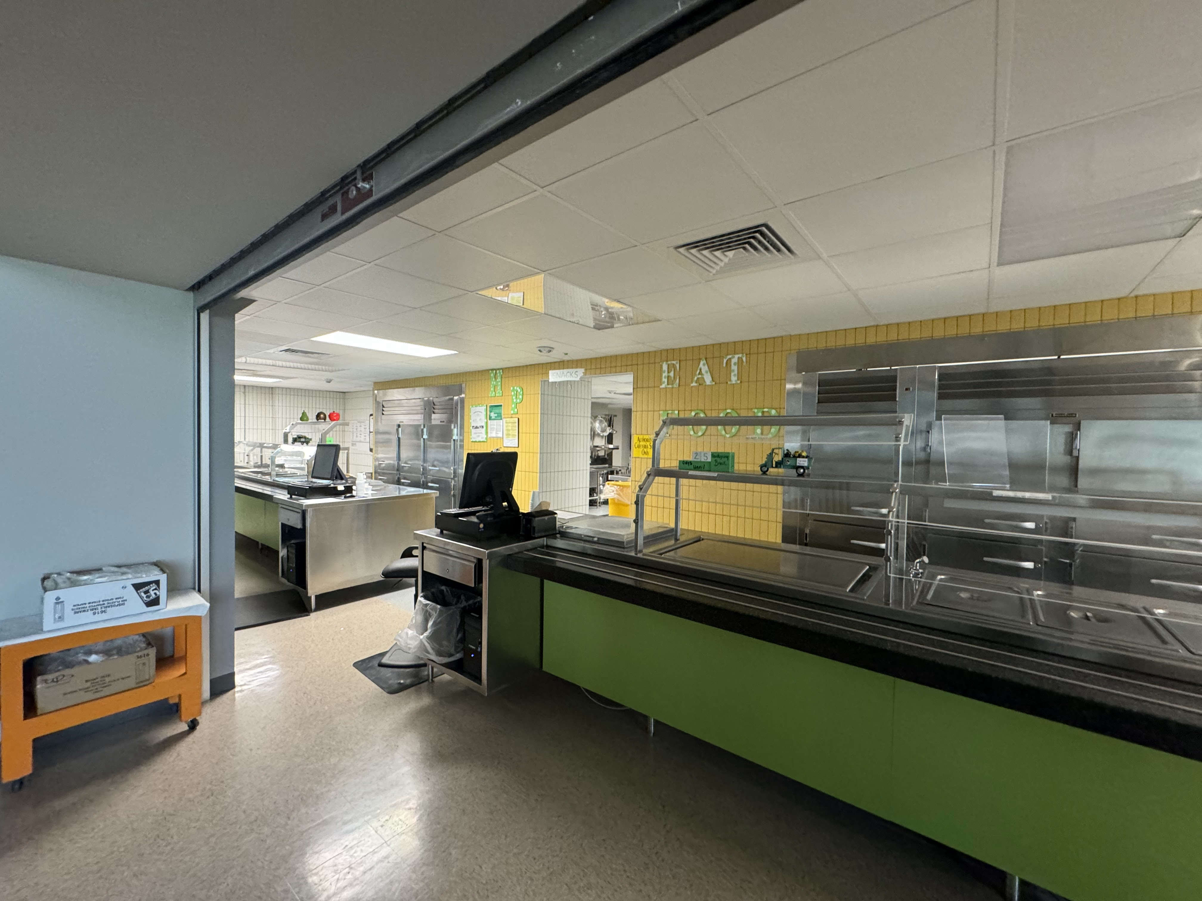
Highland Park Elementary School
Complete concrete scope of work, final grading
Complete Roof Scope
Landscape & Sod

Slide 11
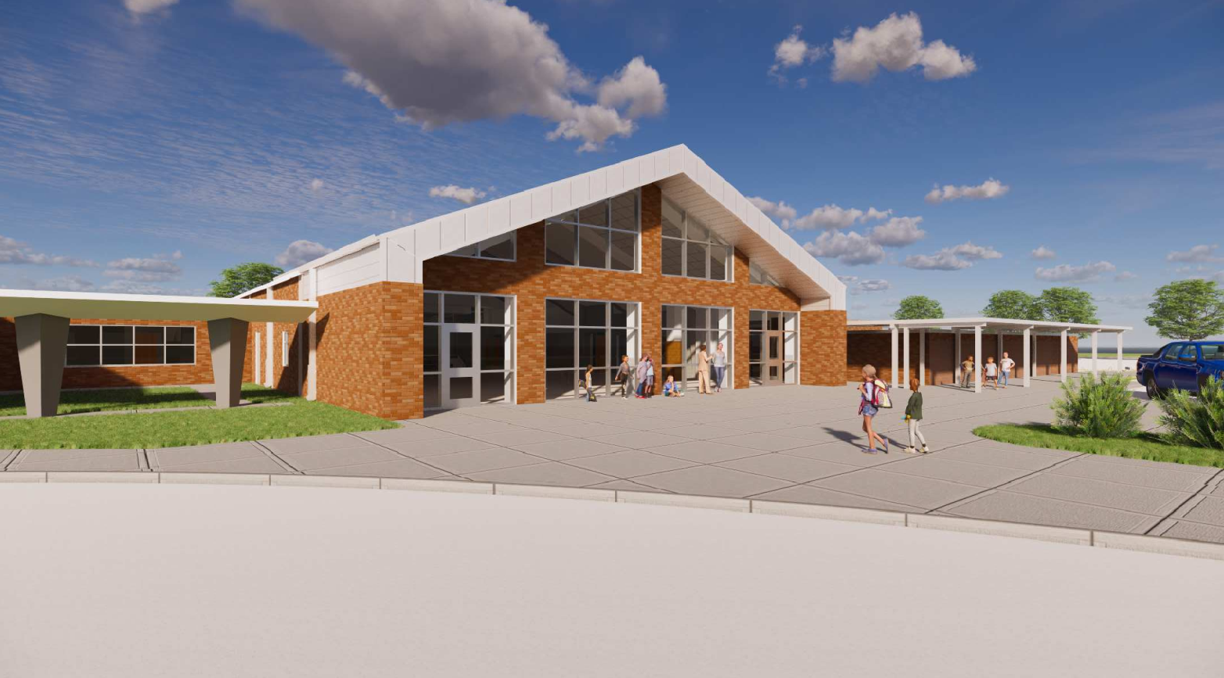
Helena Park Elementary School

Slide 12
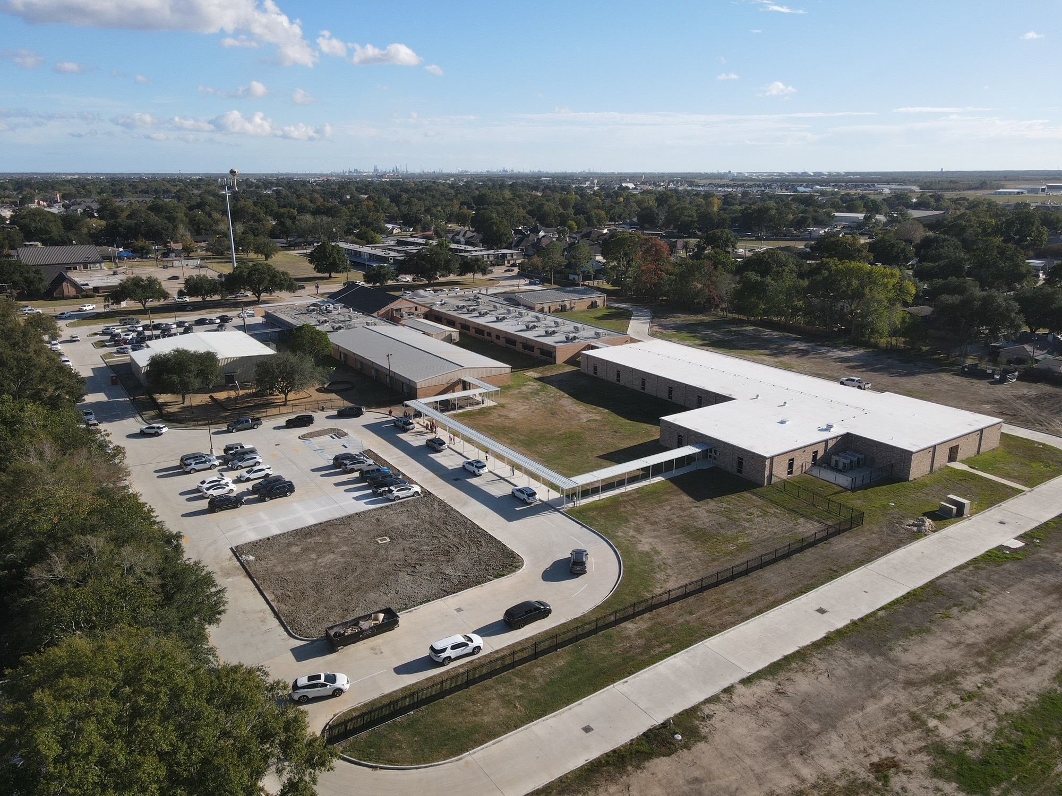
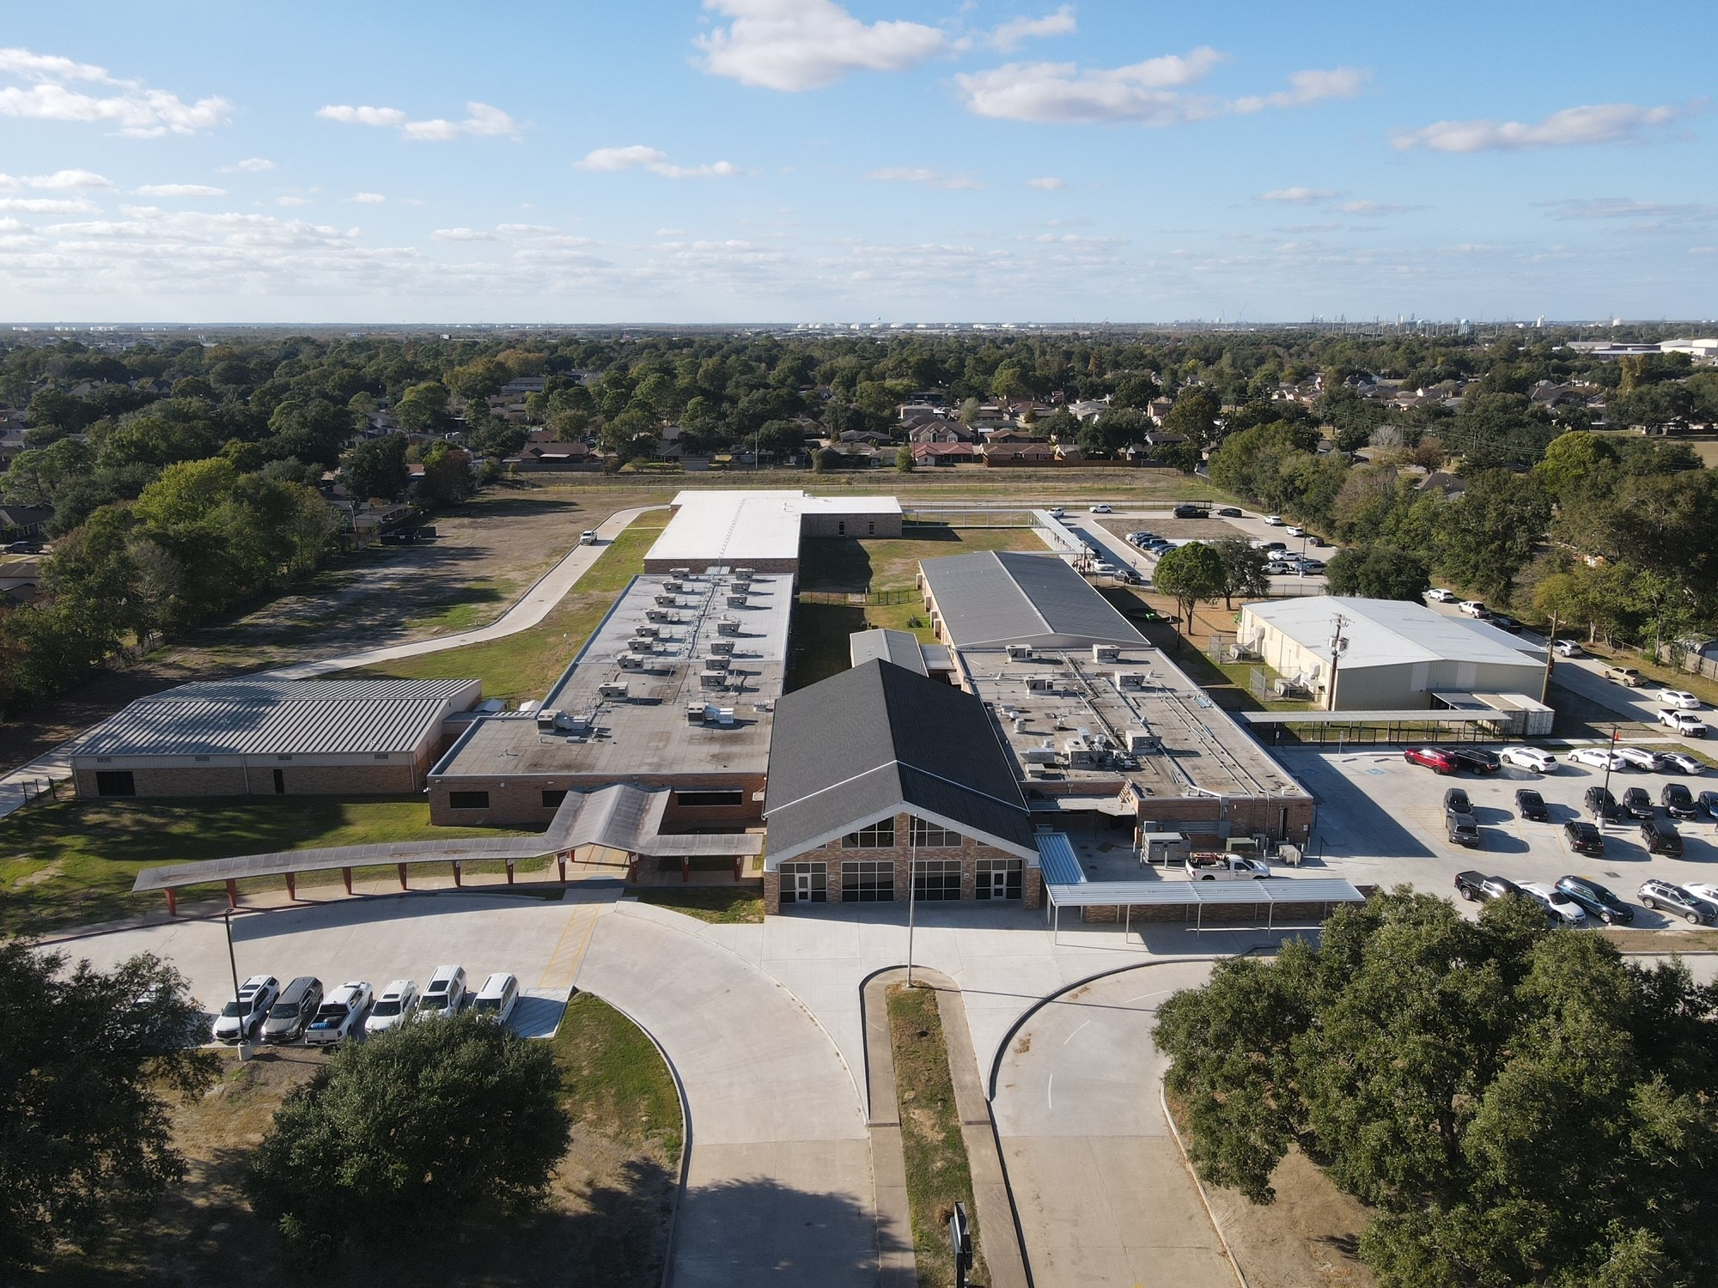
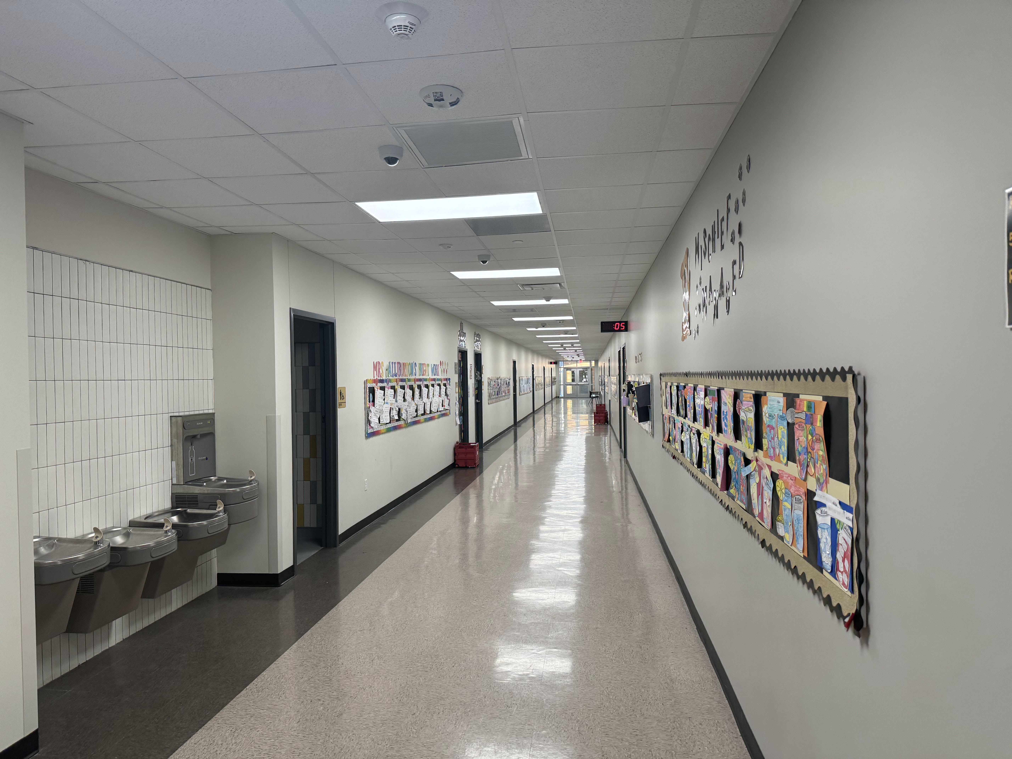
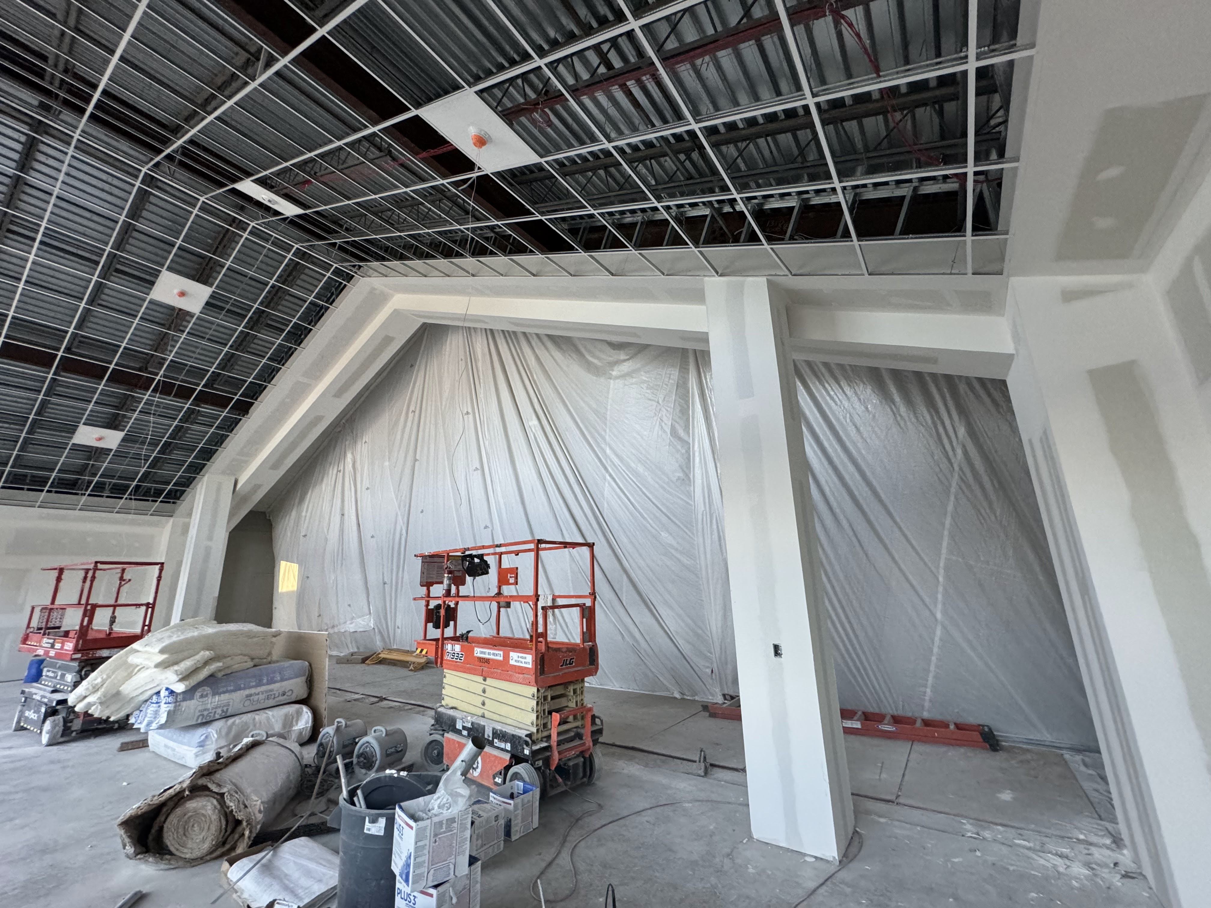
Helena Park Elementary School
Complete Fencing & Gates
Entergy to remove utility pole
  Install Canopy
Landscape & Sod
Complete punch list

Slide 13
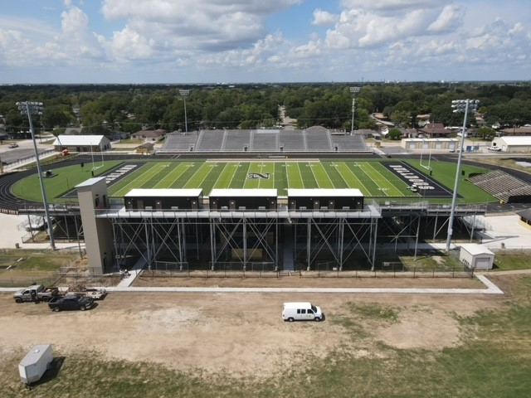
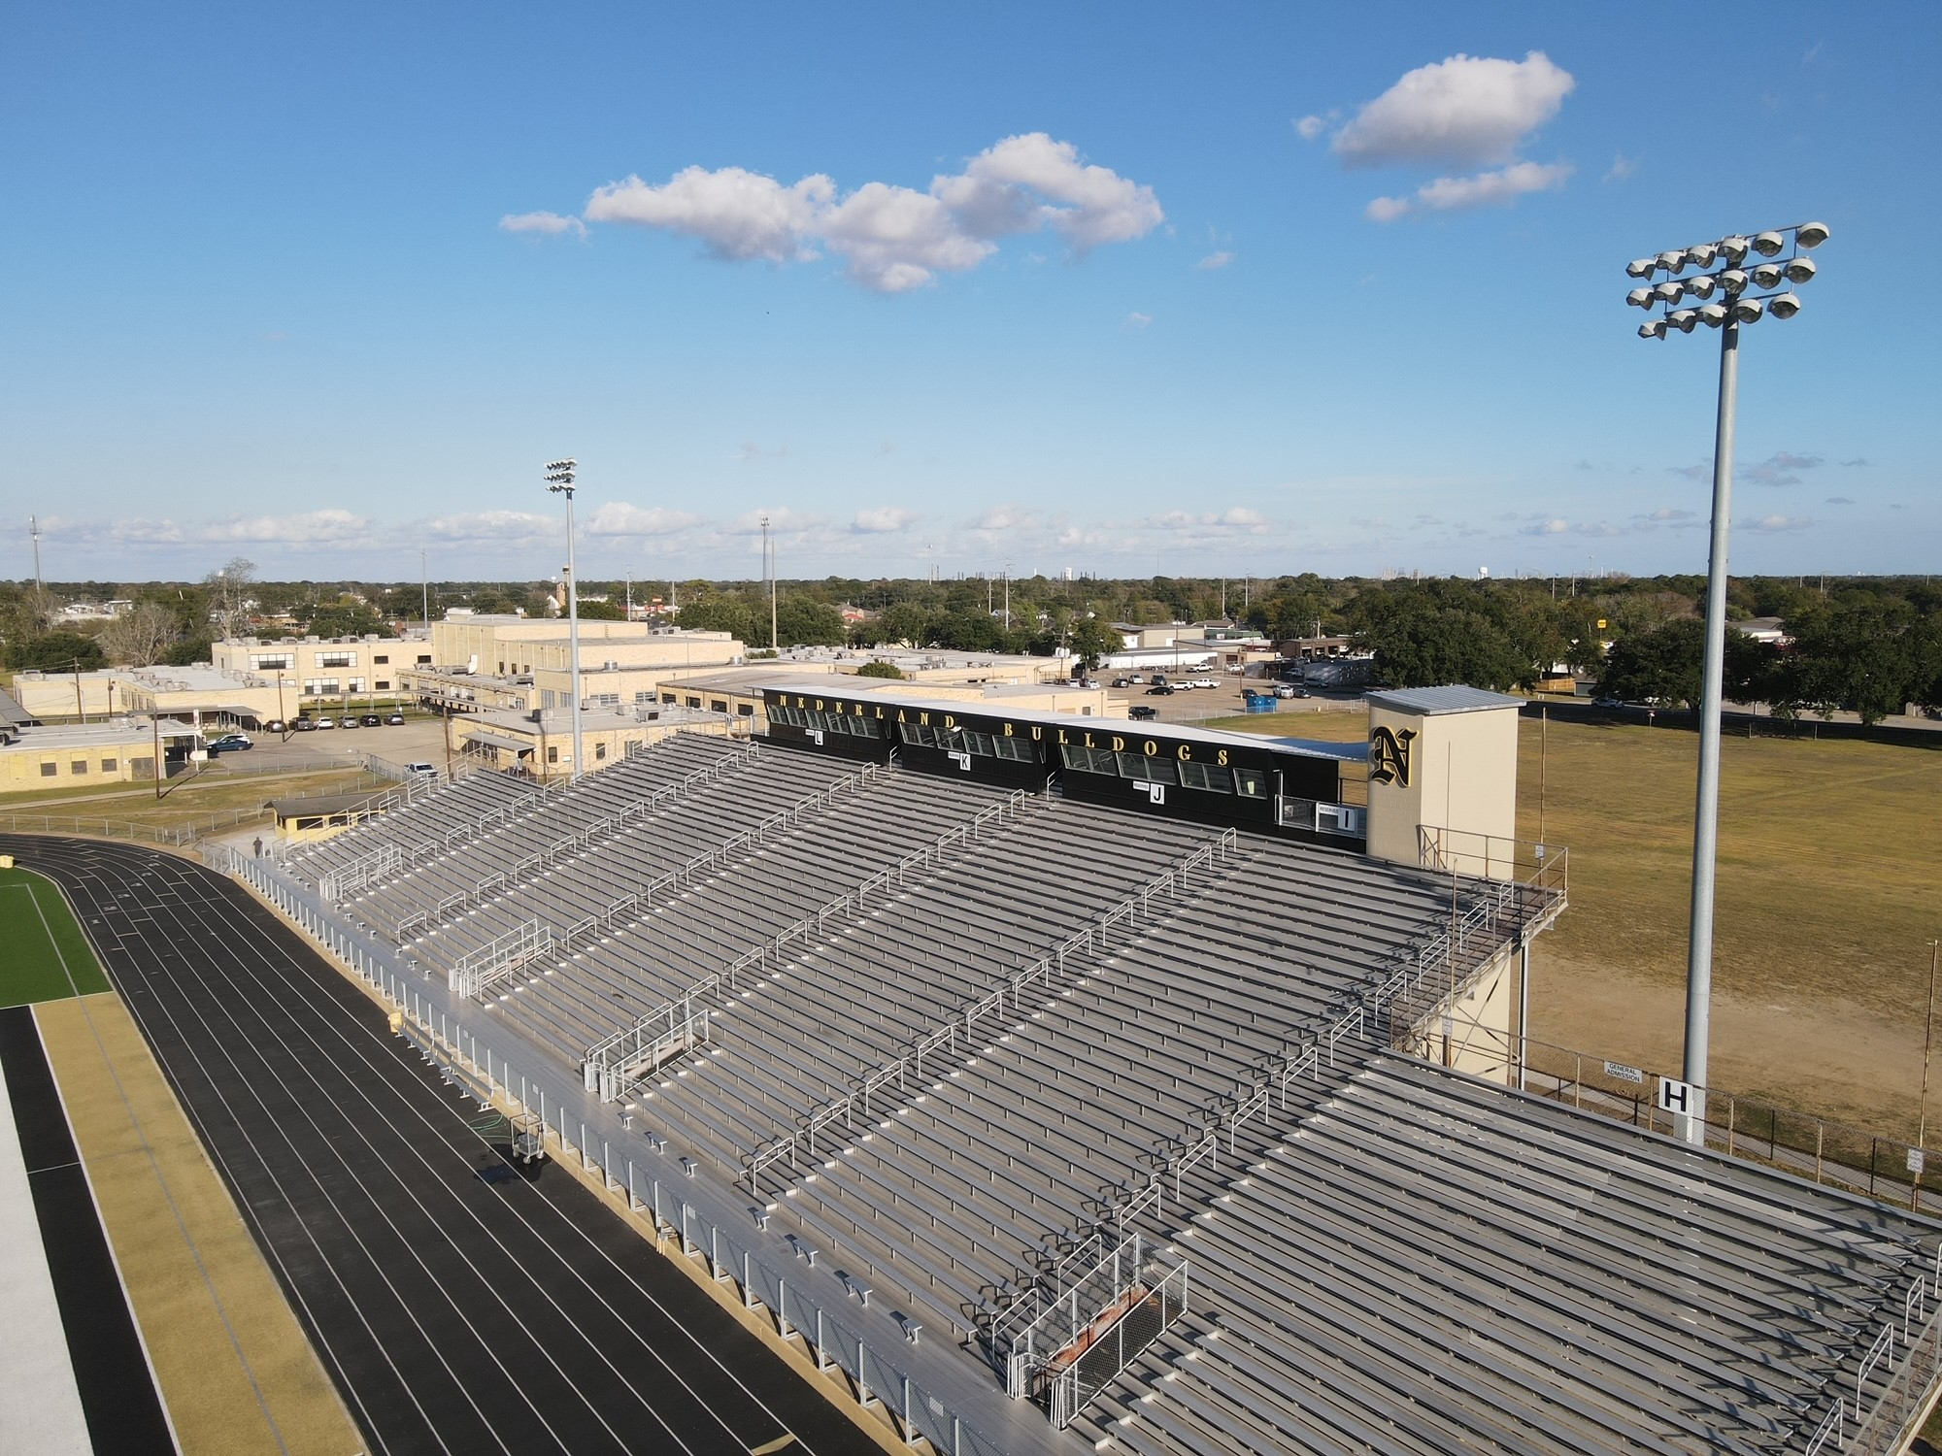
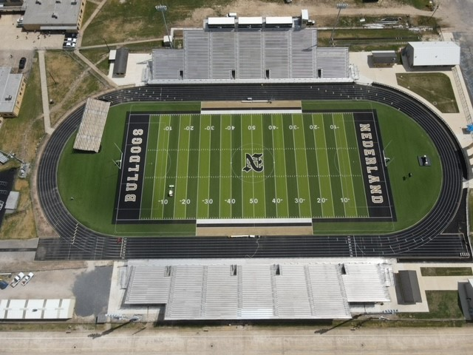
Nederland Bulldog Stadium
Complete trim on elevator shaft
Install Restroom Signage
Complete visitors side gutters

Slide 14
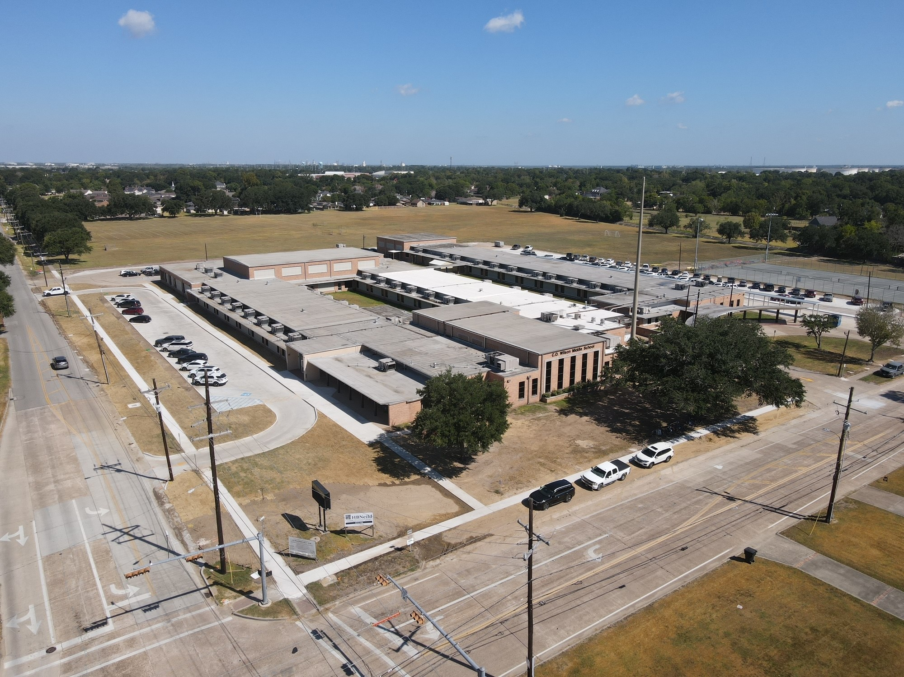
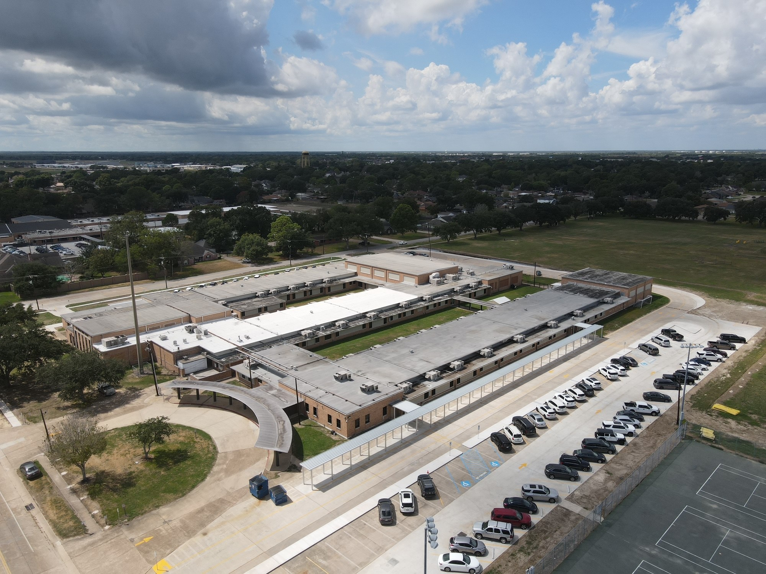
CO Wilson Middle School
Landscaping

Slide 15
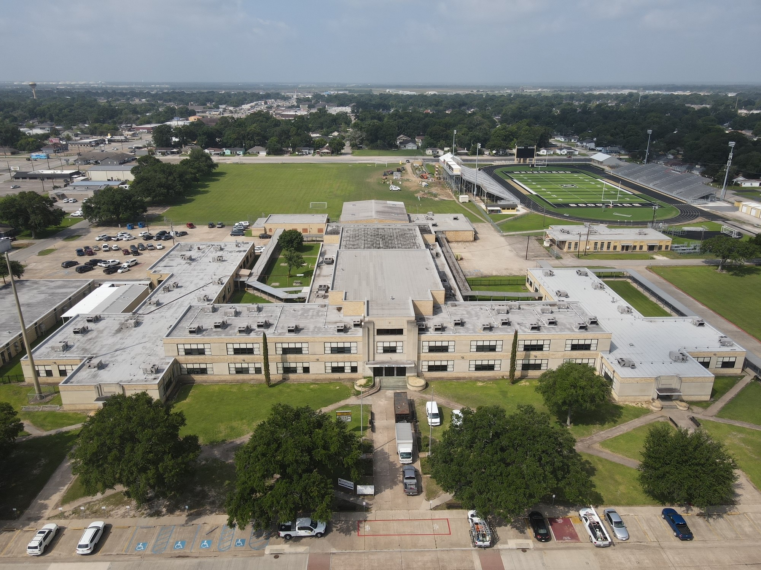
Central Middle School
Install Exterior Natatorium Door glazing
Install Wheelchair Lift

Slide 16


