Slide 1




2019 Nederland ISD Bond Project
December 2023

Slide 2

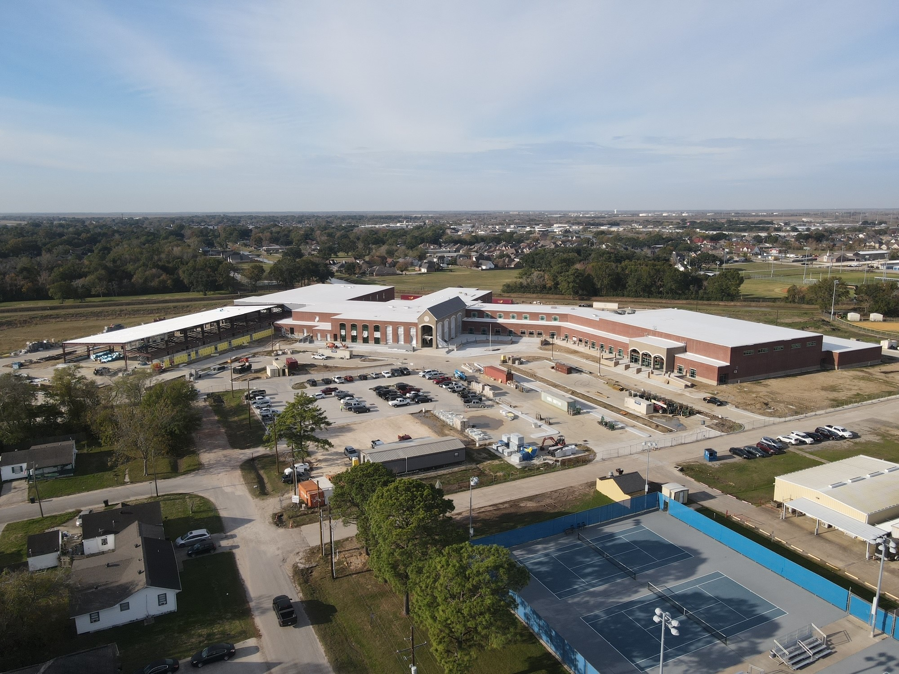
Nederland High School

Slide 3
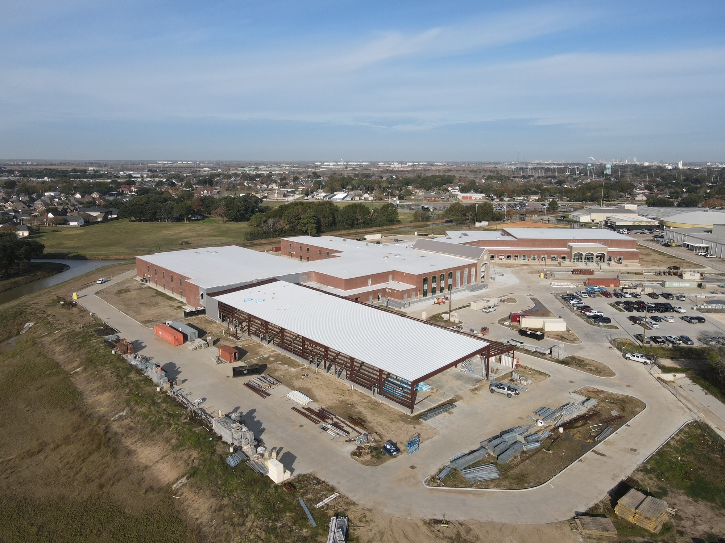
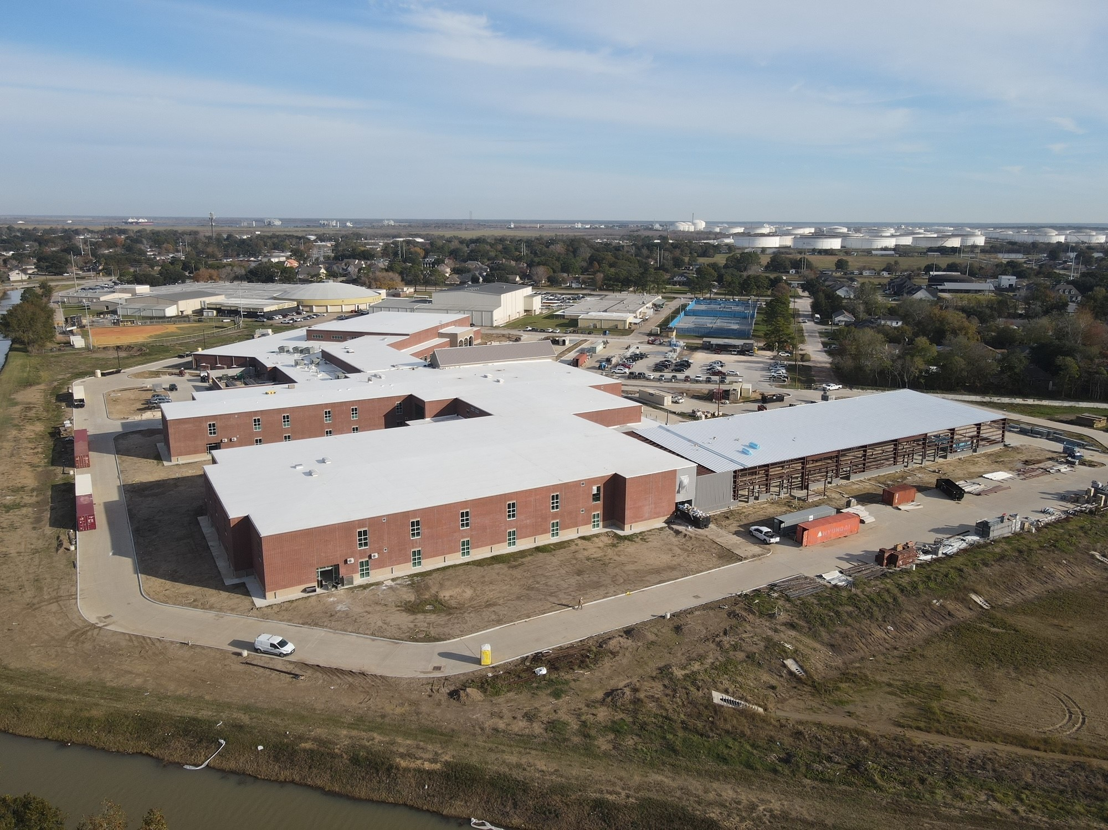
Nederland High School
Exterior
  Continue with exterior metal siding for CTE Wing.
  Begin brickwork for CTE building.
  Continue with brickwork in the front of the school.
  Continue with concrete flatwork around the school.

Slide 4
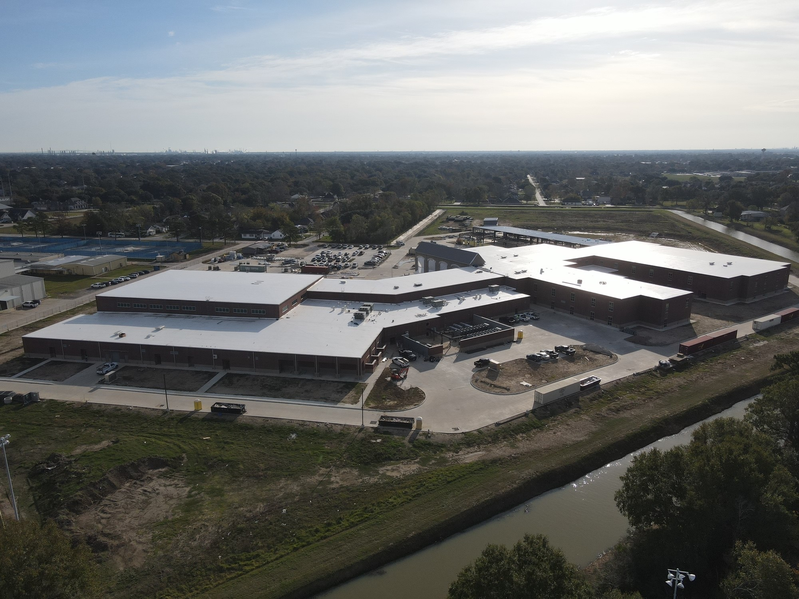
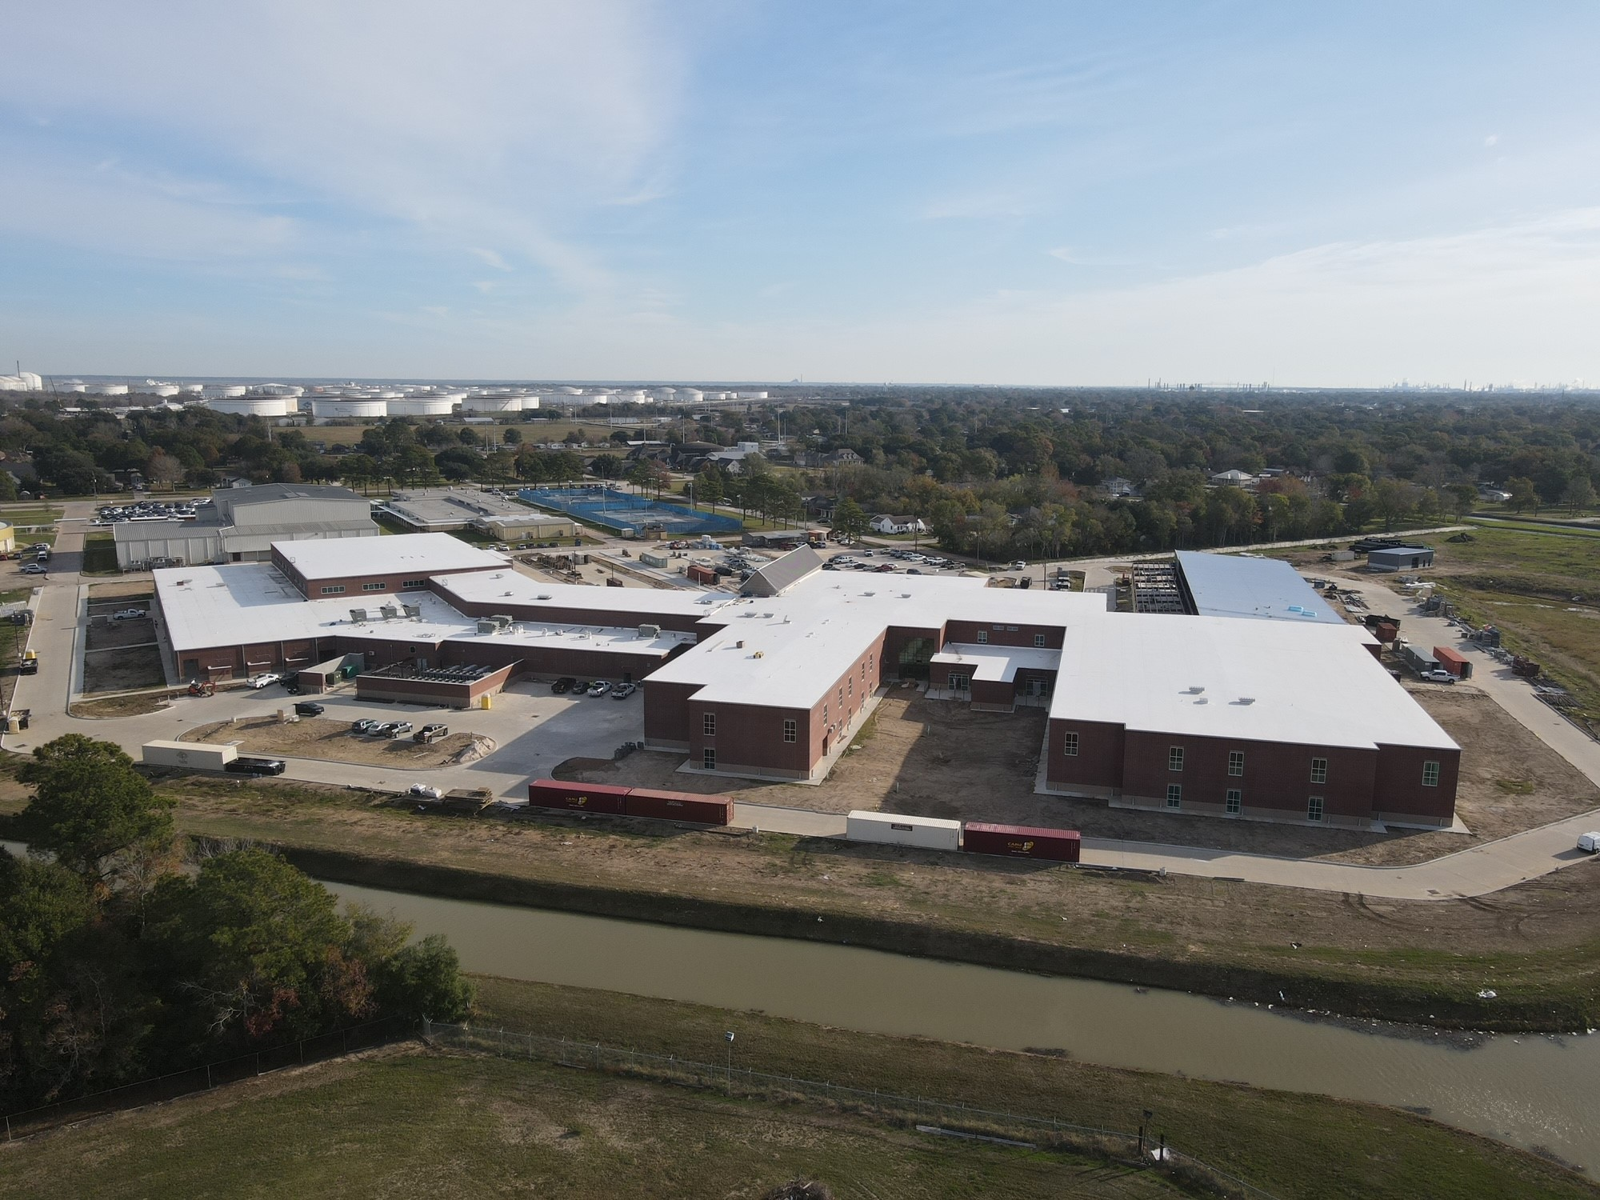
Nederland High School
Exterior
  Continue with gutters and downspouts.
  Begin setting canopy poles.
  Begin installing storefront doors around the building.
  Finish mechanical yard piping/insulation.

Slide 5
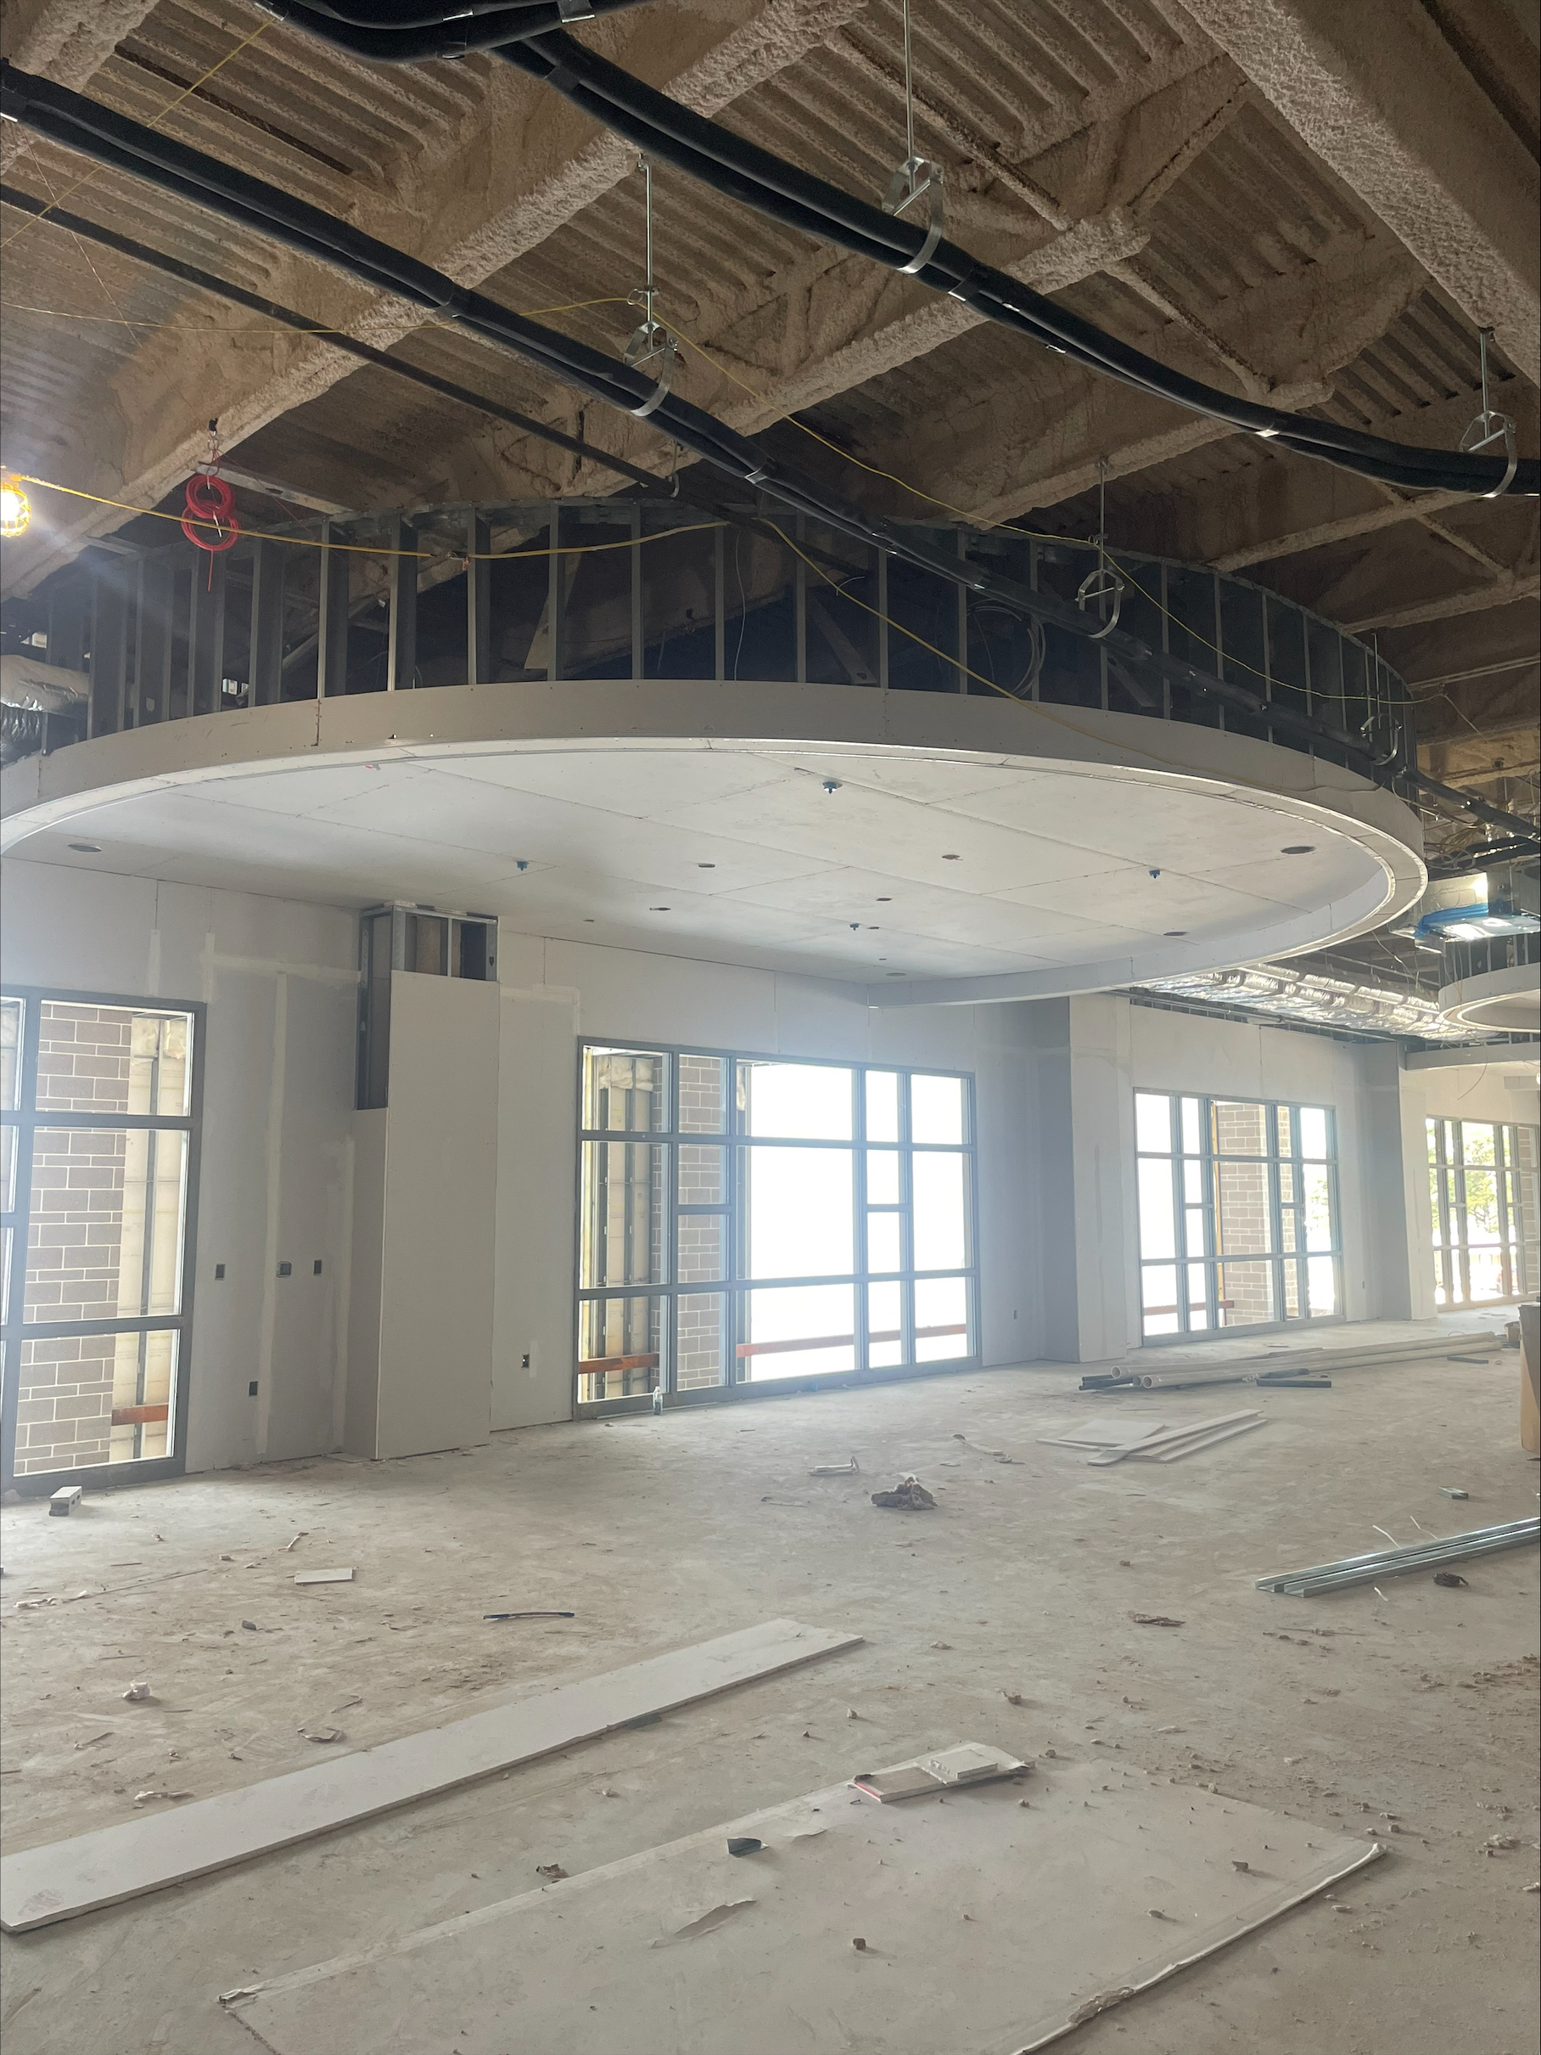
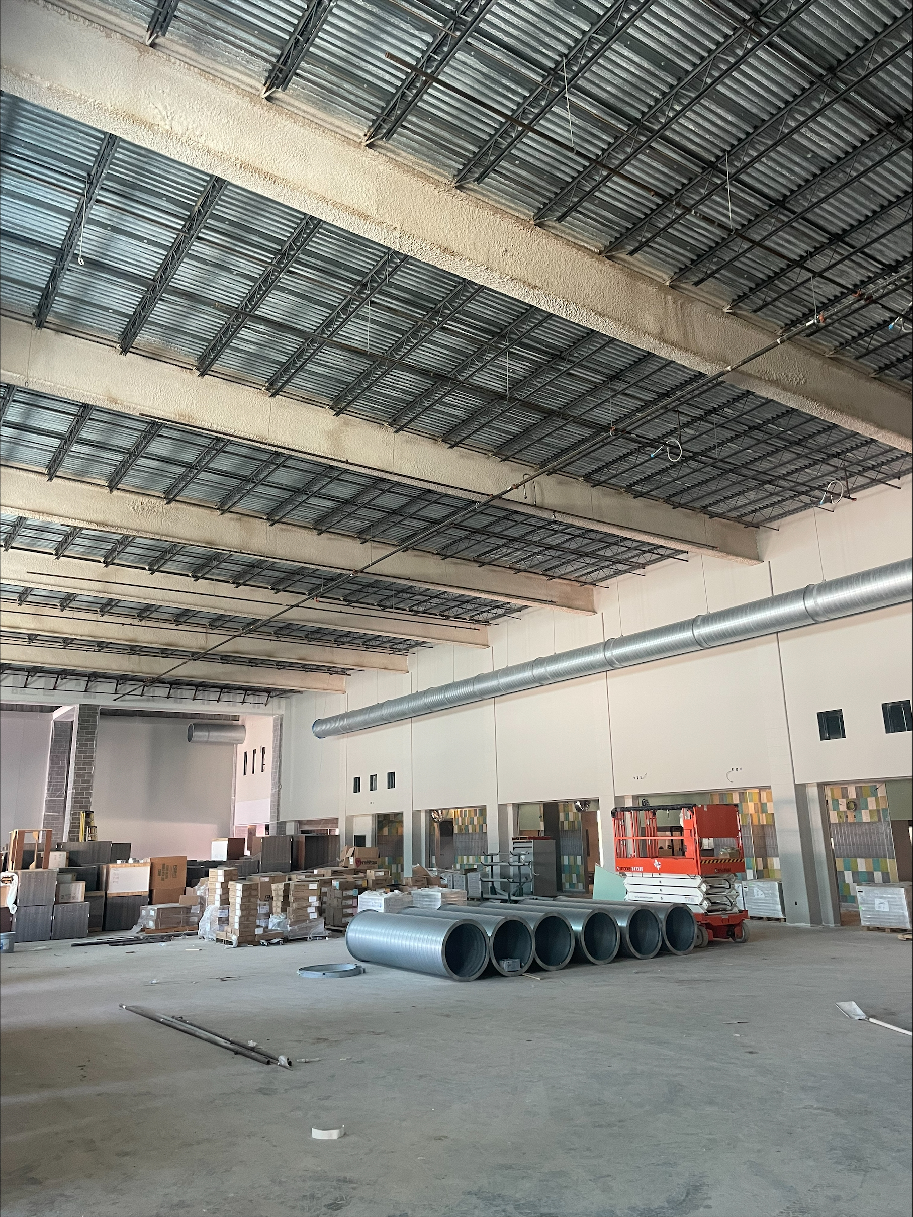
Nederland High School
  Continue installing duct work in J, H, G, F, E, D, C, and B.
  Continue insulating MEP piping throughout building
  Complete chiller piping throughout the building.
  Start up conditioned air throughout the building.
  Continue first coat of paint in area’s J, H, G, F, E, & C
  Complete kitchen hood ductwork.

Slide 6
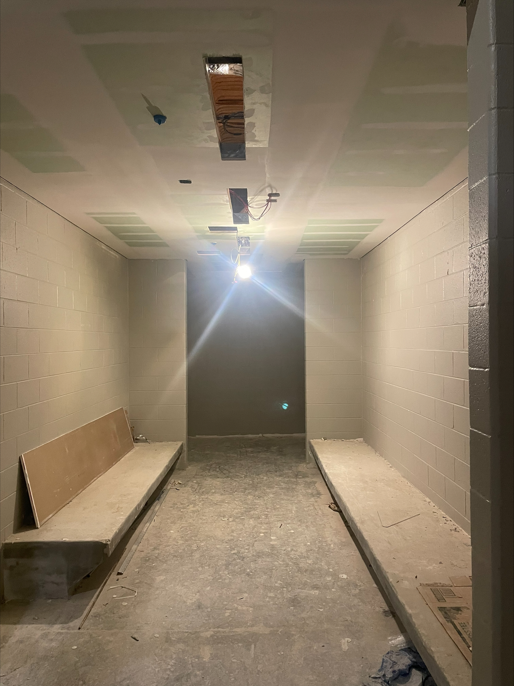
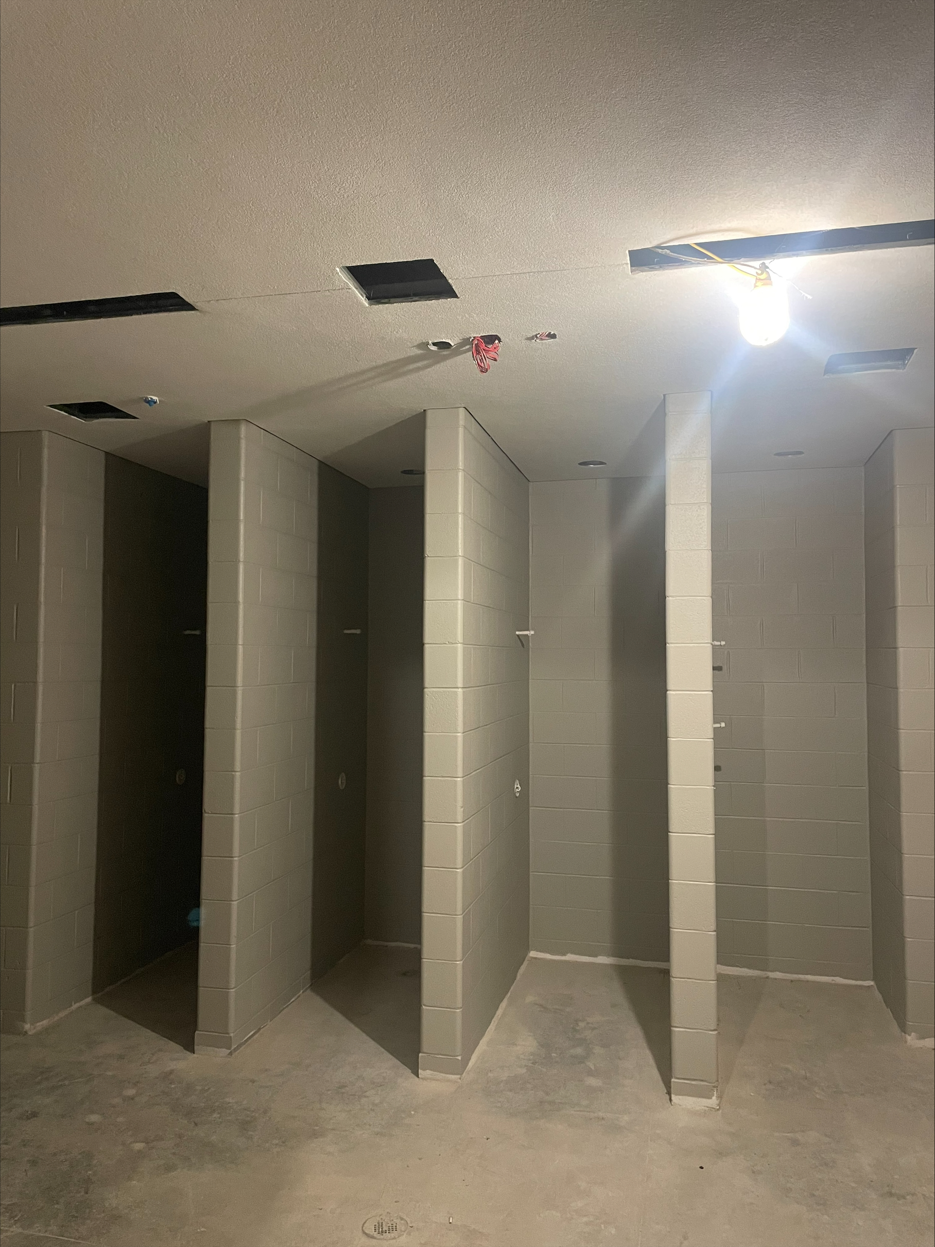
Nederland High School
Complete hard ceilings in locker rooms and bathrooms.
Epoxy paint locker bases.
Install lockers.
Continue with wall tile in bathrooms and serving line area.
Continue with Plumbing rough in.
Continue with Electrical rough in.

Slide 7
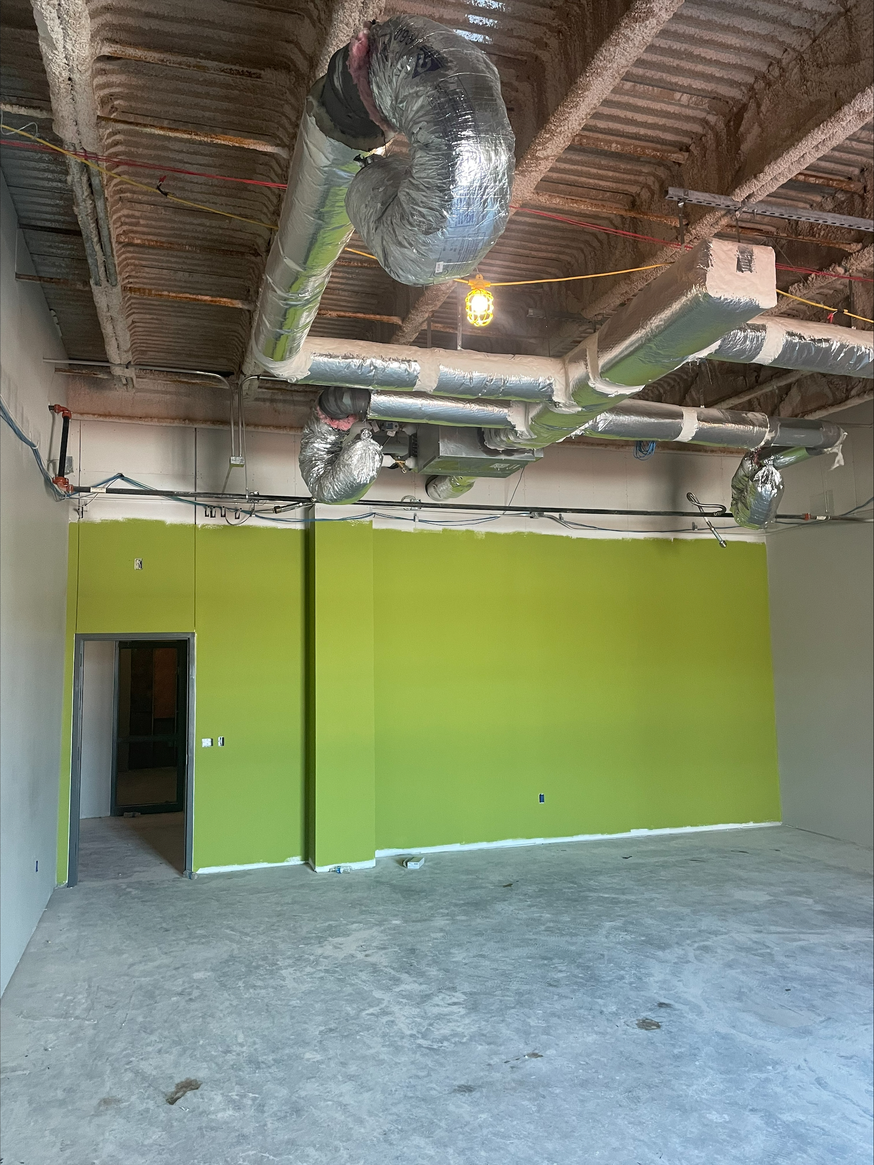
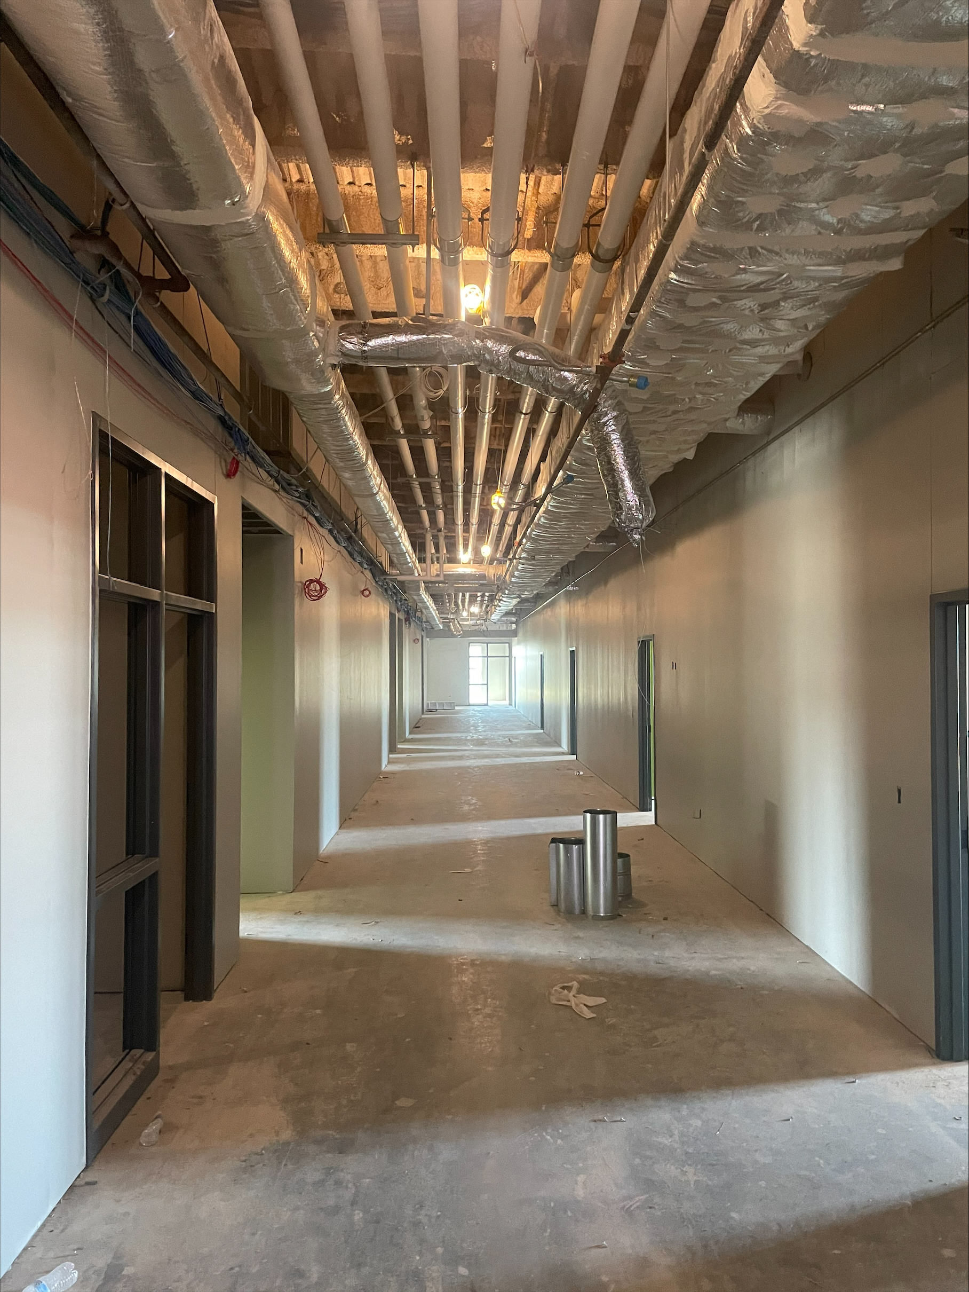
Nederland High School
Continue installing casework throughout the building.
Install Lab ceiling grid first and then begin installing classroom ceiling grid.
Finish paint in cafeteria to begin installing cloud ceilings in the cafeteria.
Receive permanent power to the building.
Begin epoxy flooring once conditioned air is on.

Slide 8


