Slide 1




2019 Nederland ISD Bond Project
January 2024

Slide 2

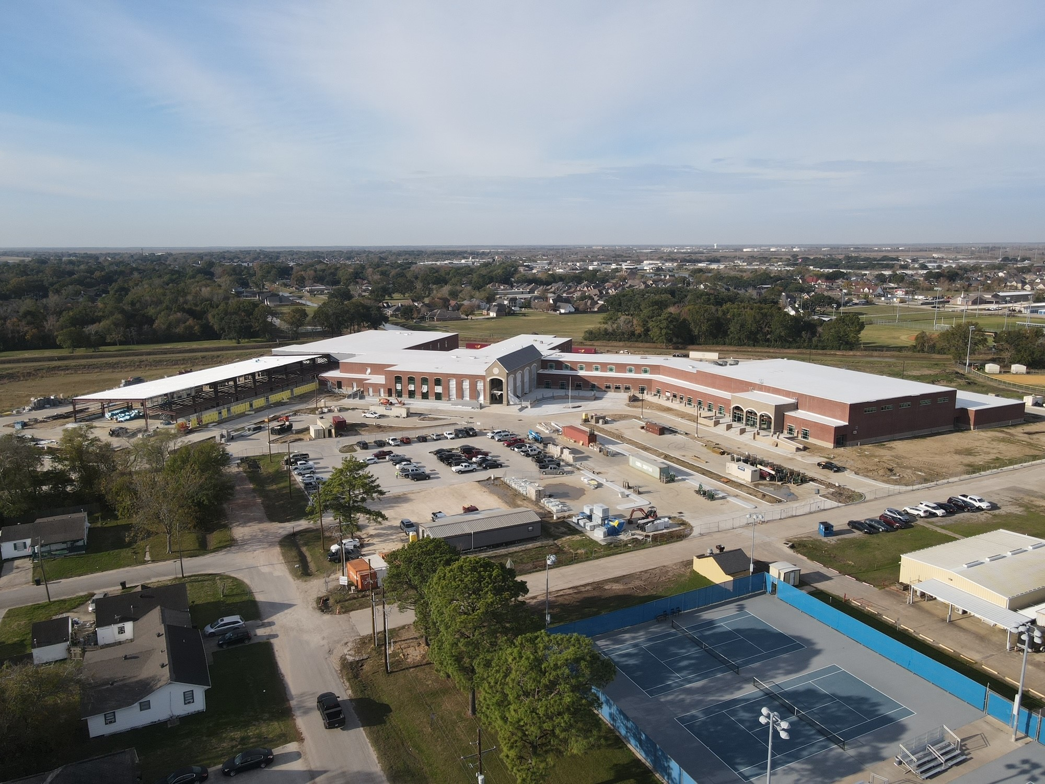
Nederland High School

Slide 3
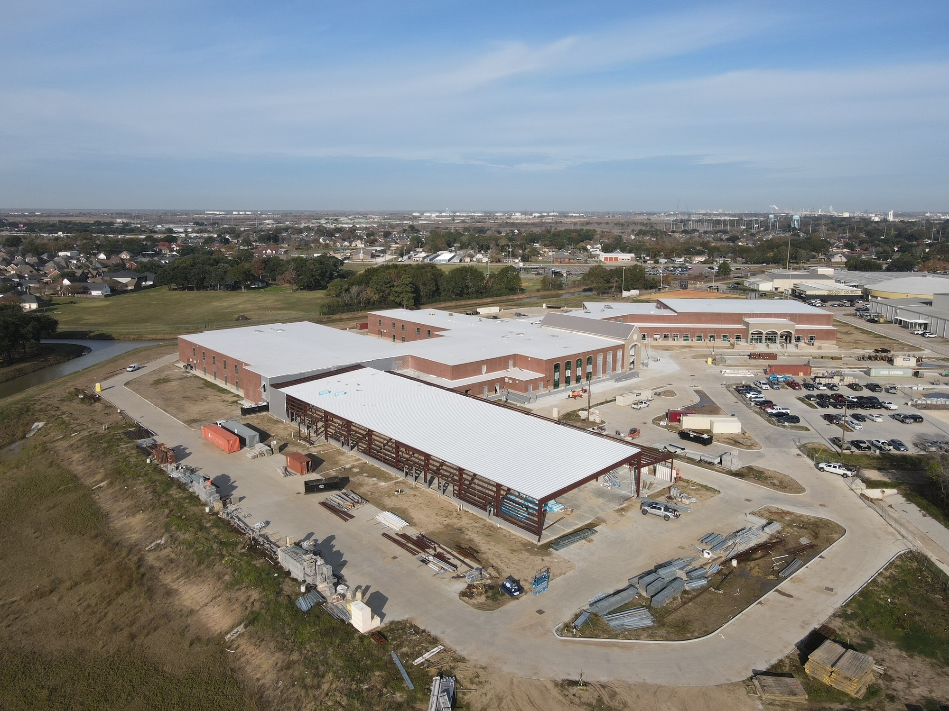
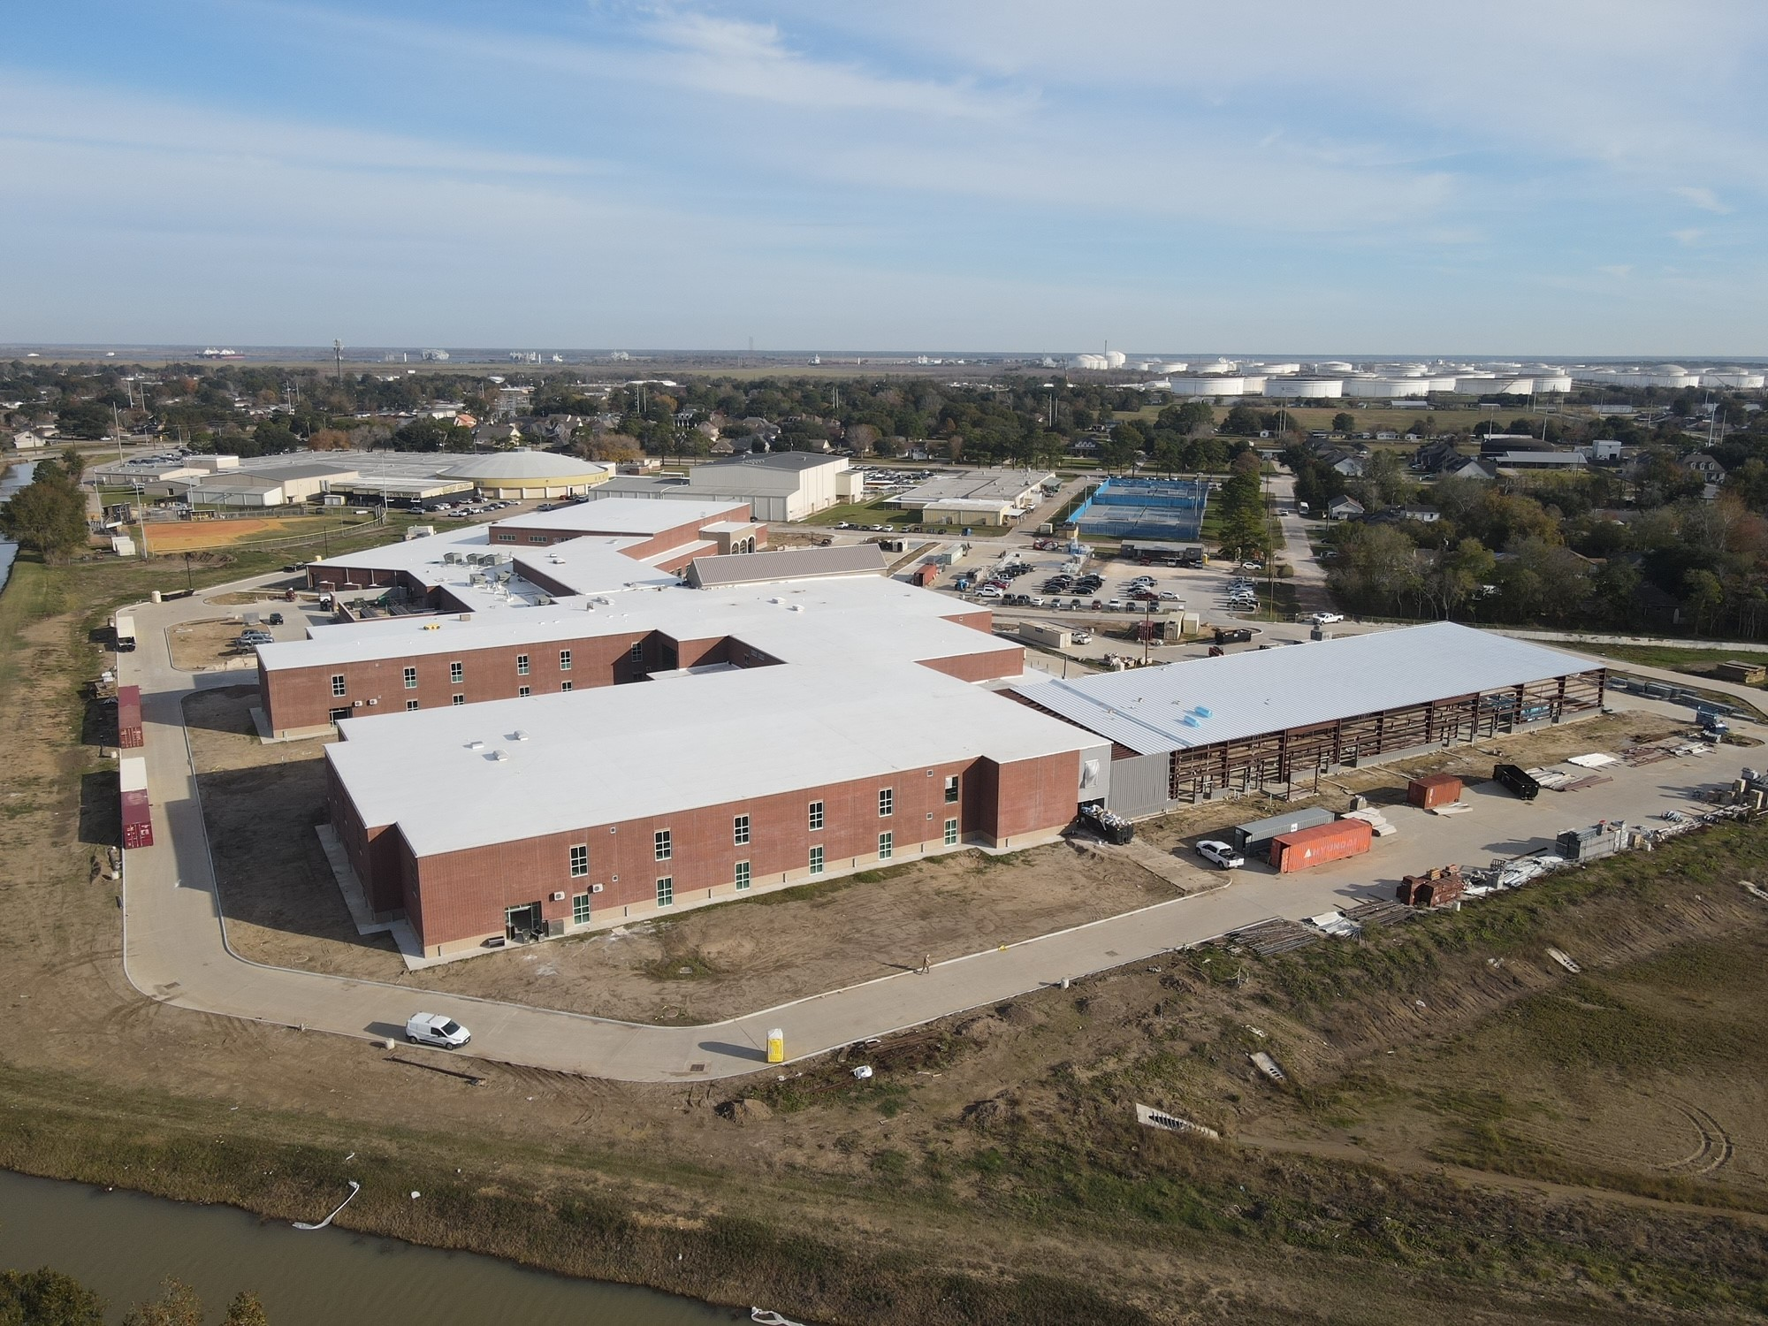
Nederland High School
Exterior
  Complete flashing/waterproofing/insulation for CTE wing.
  Begin brickwork for CTE building.
  Continue with brickwork in the front of the school.
  Continue with concrete flatwork around the school.

Slide 4
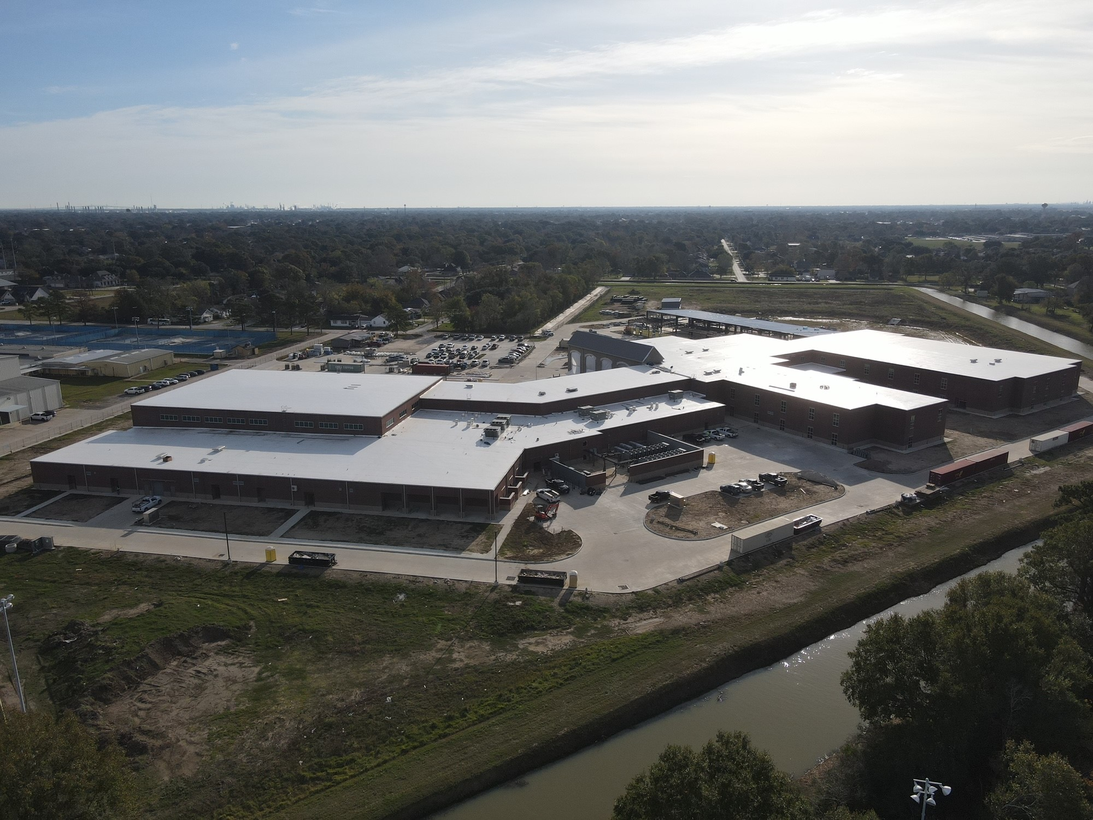
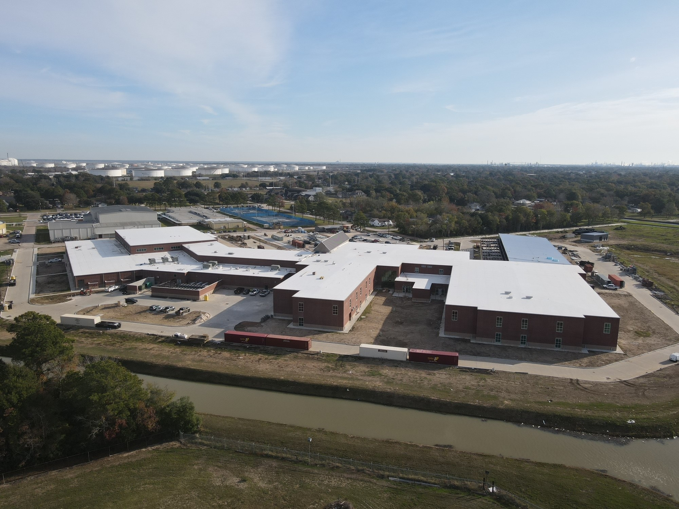
Nederland High School
Exterior
  Complete Gutters and Downspouts.
  Begin setting canopy poles.
  Continue installing storefront doors around the building.
  Finish mechanical yard piping/insulation.
  Finish CTE building roof and tie in to structural steel.

Slide 5
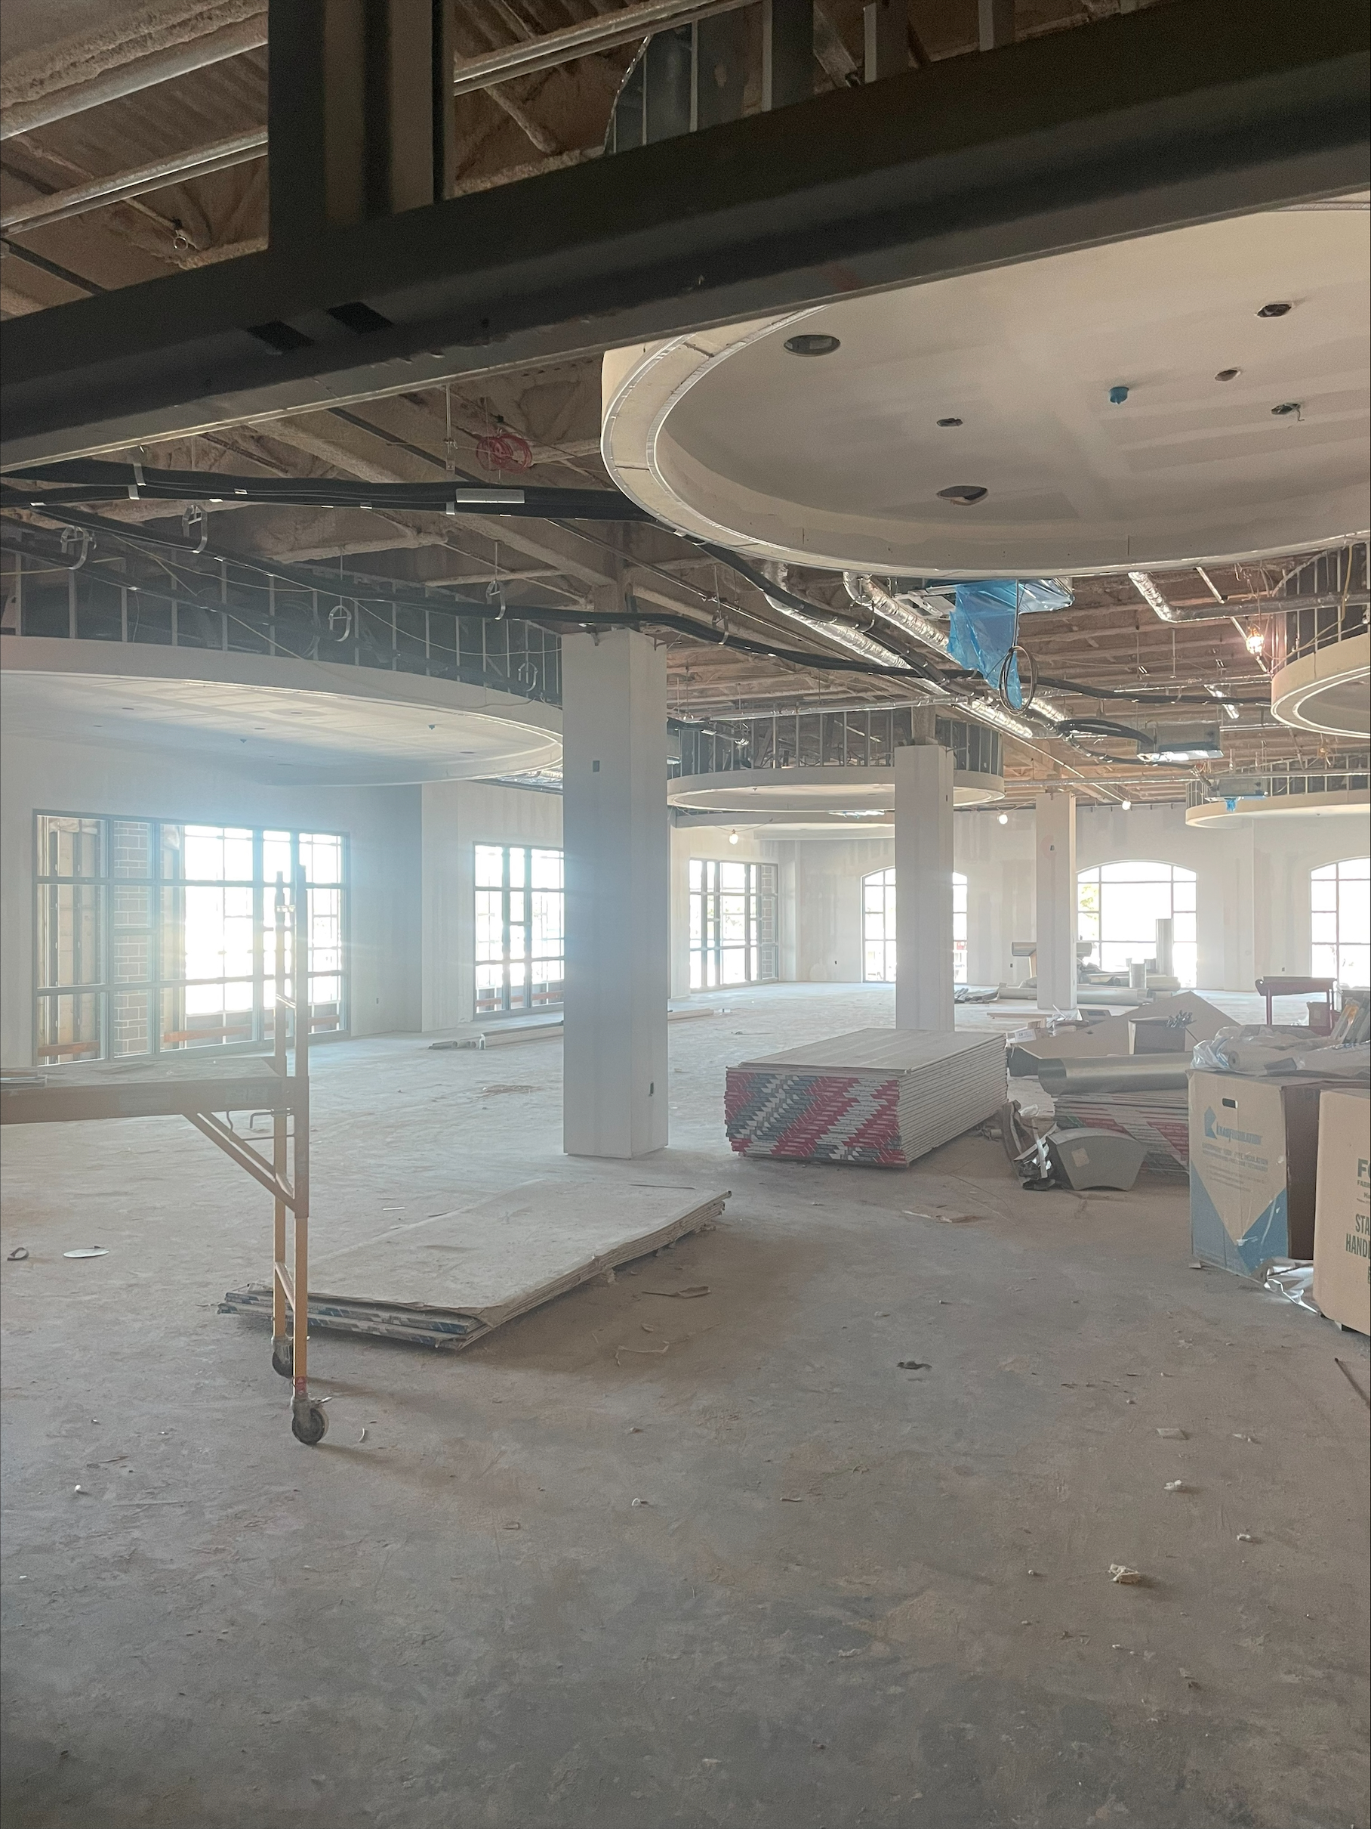
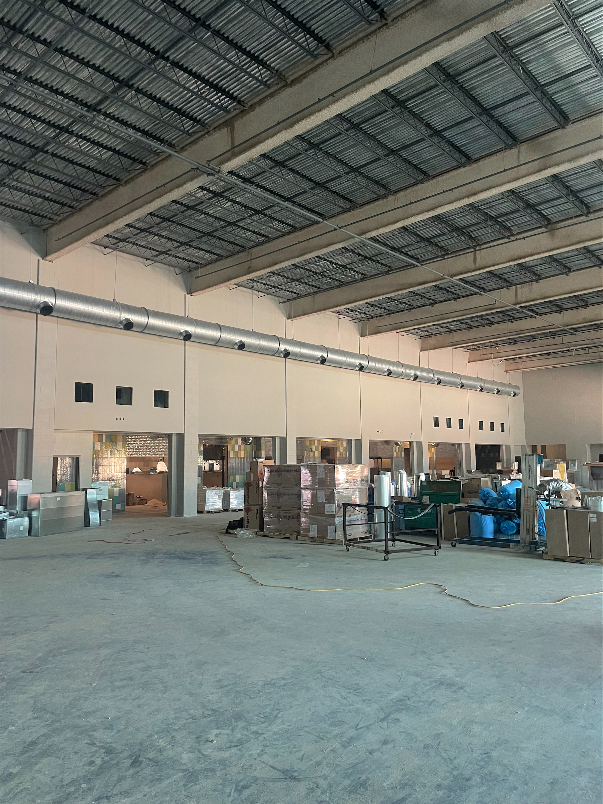
Nederland High School
  Continue installing duct work in J, H, G, F, E, D, C, and B.
  Continue insulating MEP piping throughout building
  Complete chiller piping throughout the building.
  Start up conditioned air throughout the building.
  Continue first coat of paint in area’s J, H, G, F, E, & C
  Complete kitchen hood ductwork.
  Complete admin area sheetrock and begin tape, float, and paint.

Slide 6
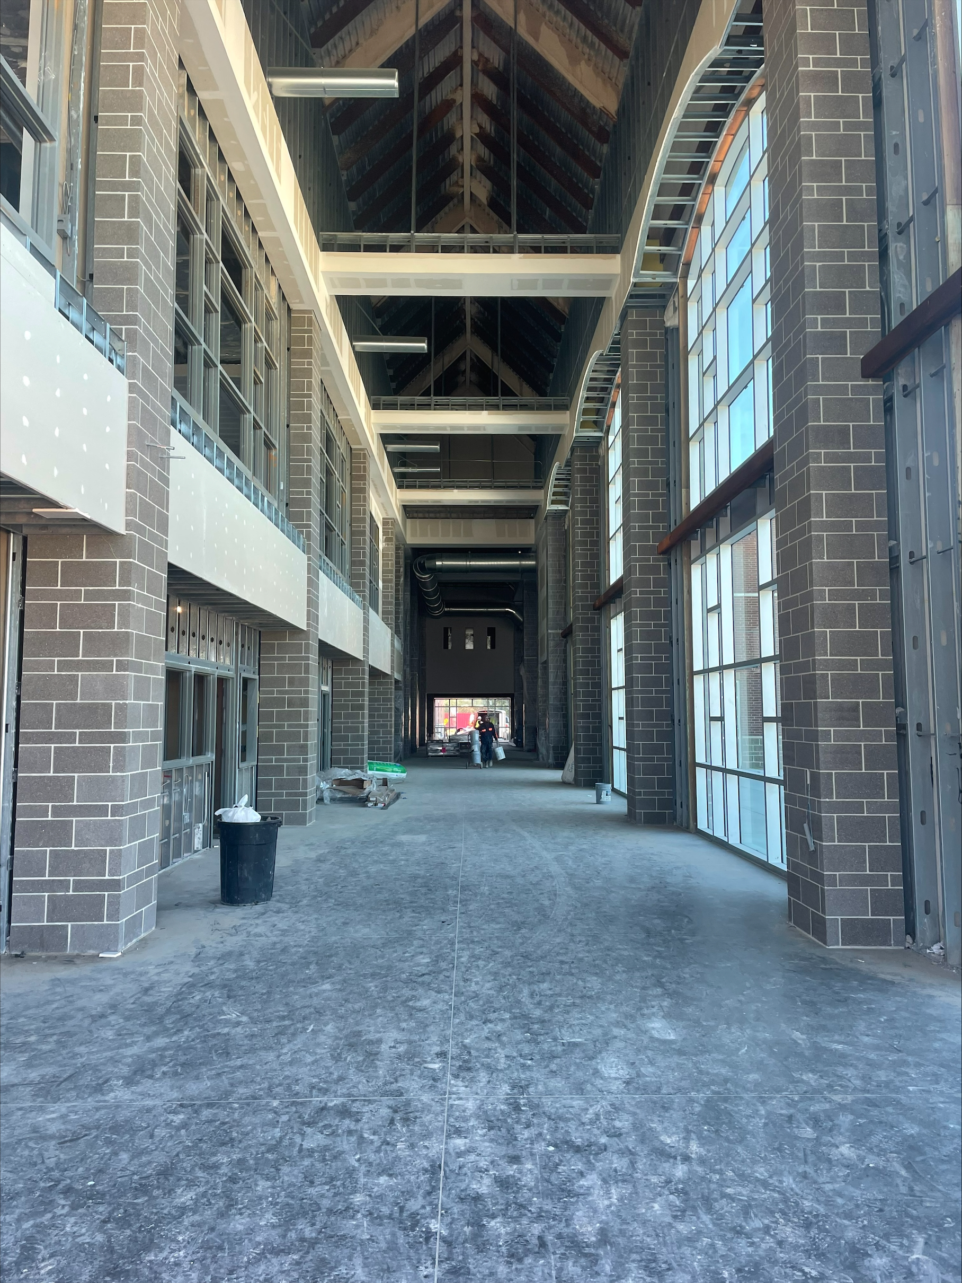
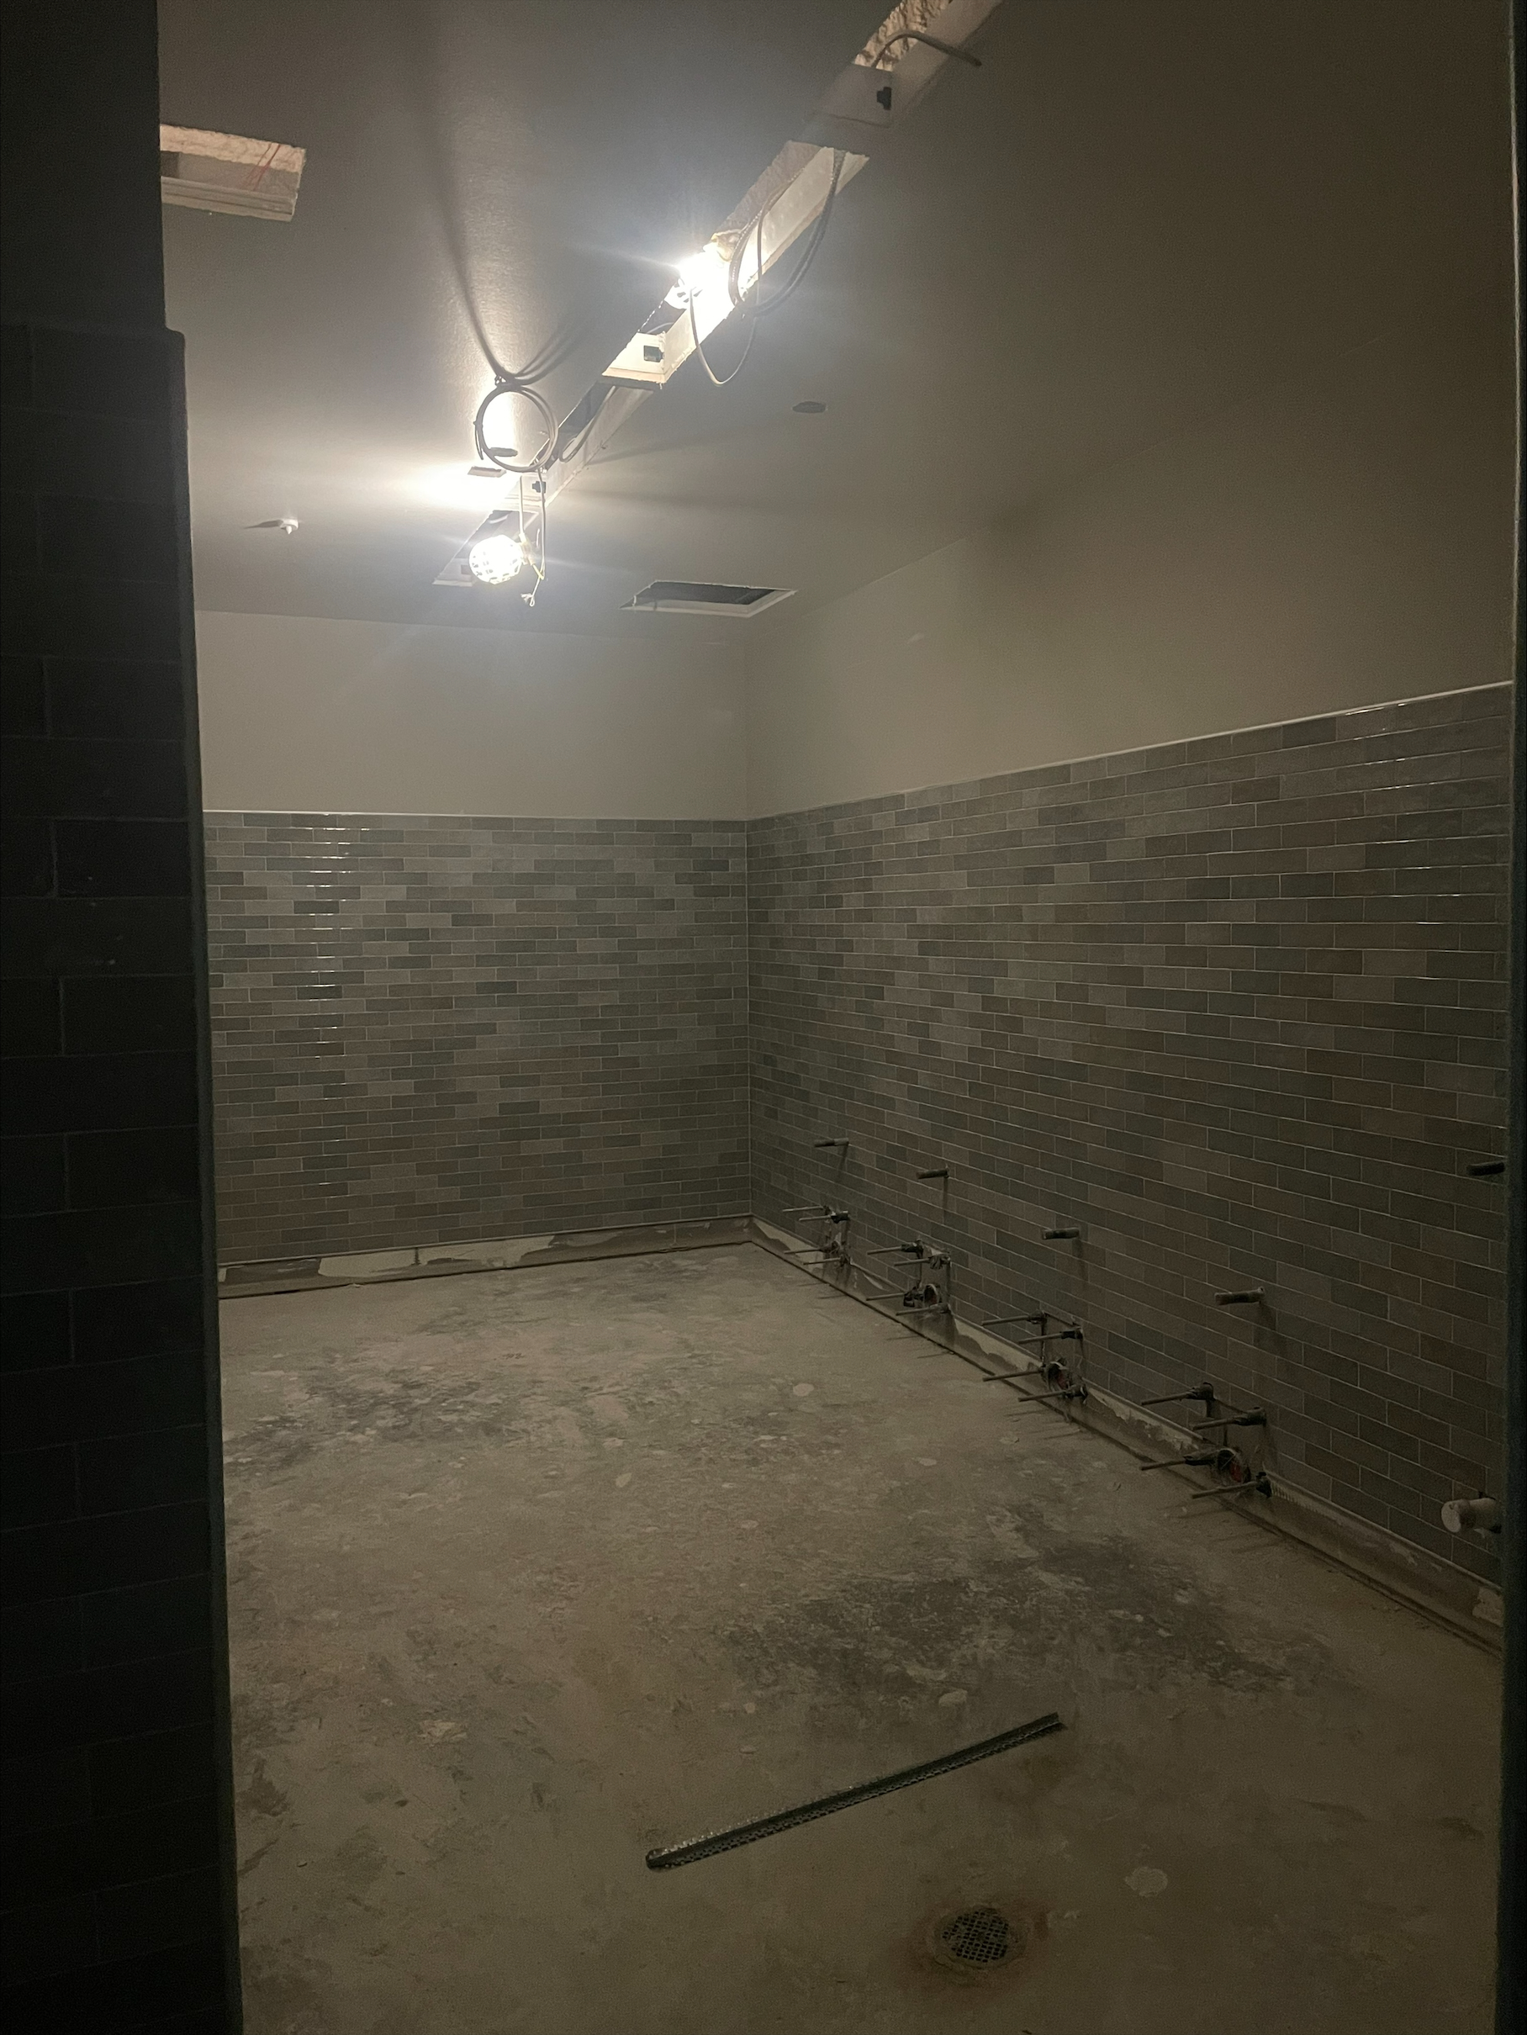
Nederland High School
Paint hard ceilings in locker rooms and bathrooms.
Epoxy paint locker bases.
Install lockers.
Continue with wall tile in bathrooms and serving line area.
Continue with Plumbing rough in.
Continue with Electrical rough in.
Install elevator.

Slide 7
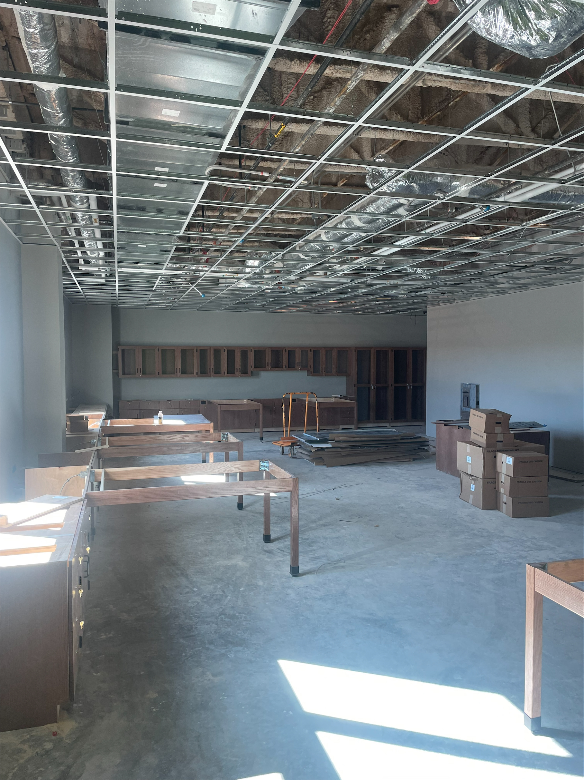
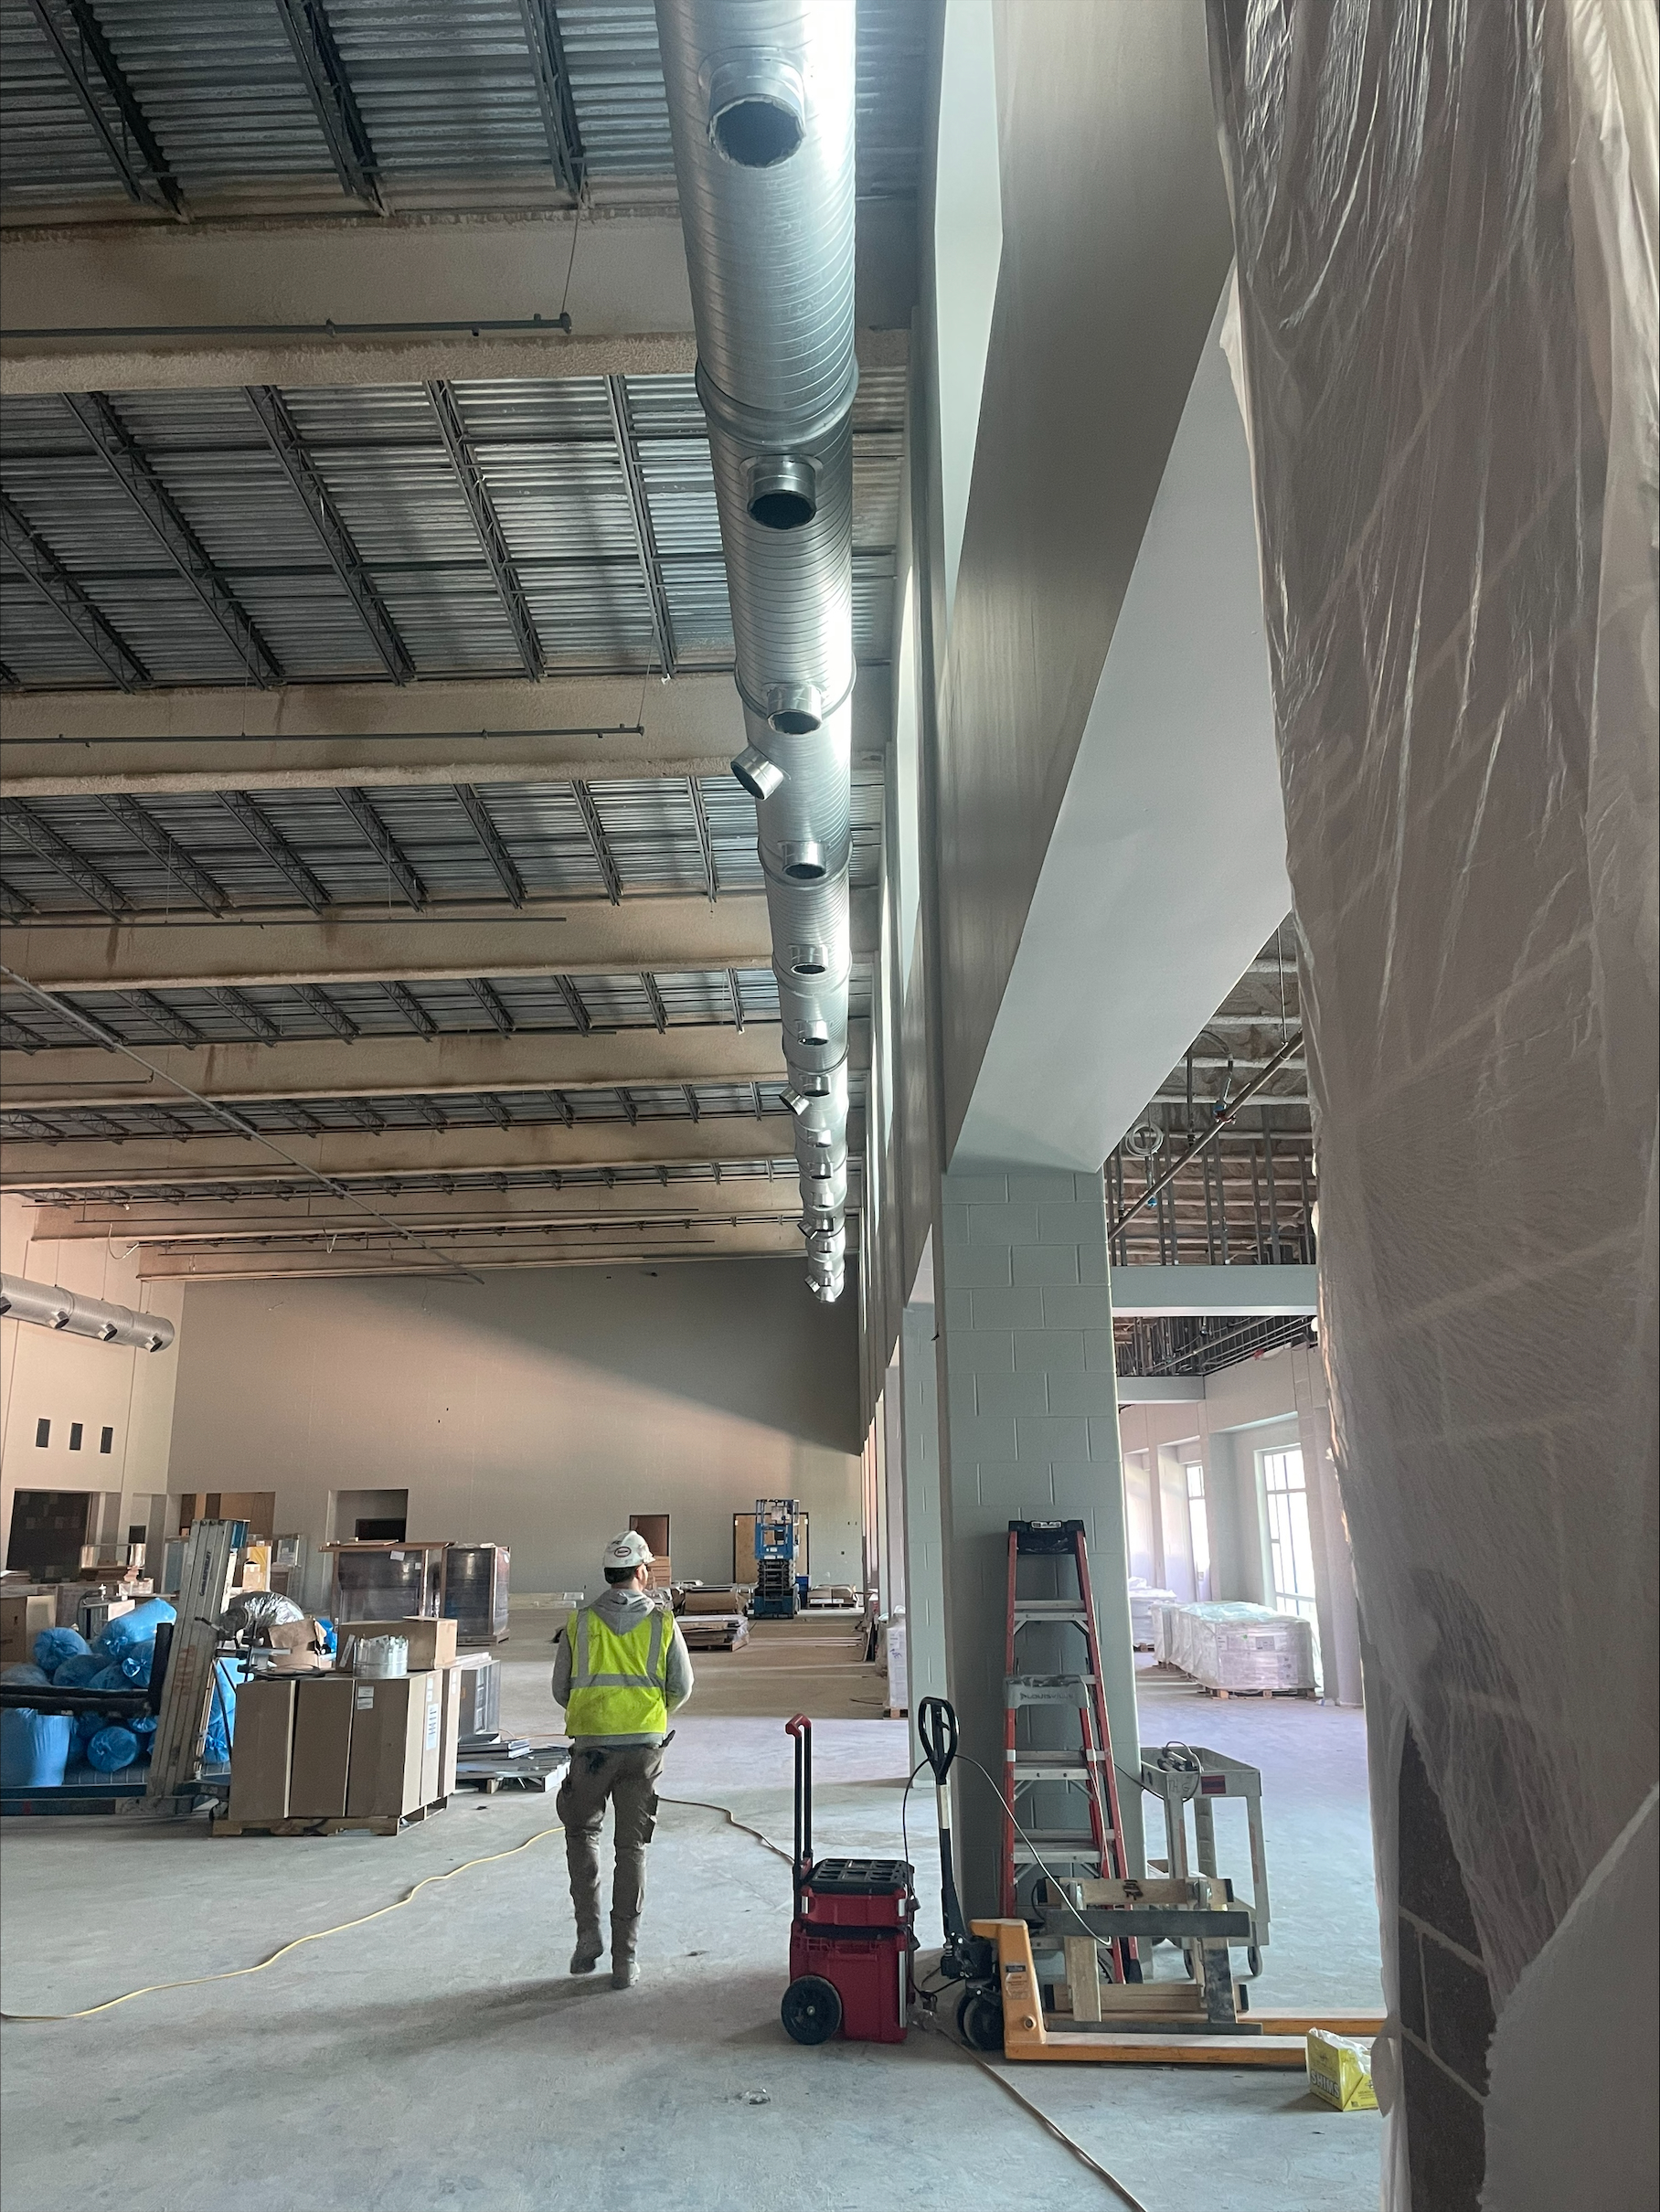
Nederland High School
Continue installing casework throughout the building.
Continue installing classroom grid.
Finish paint in cafeteria to begin installing cloud ceilings in the cafeteria.
Begin epoxy flooring once conditioned air is on.

Slide 8


