Slide 1




2019 Nederland ISD Bond Project
February 2024

Slide 2

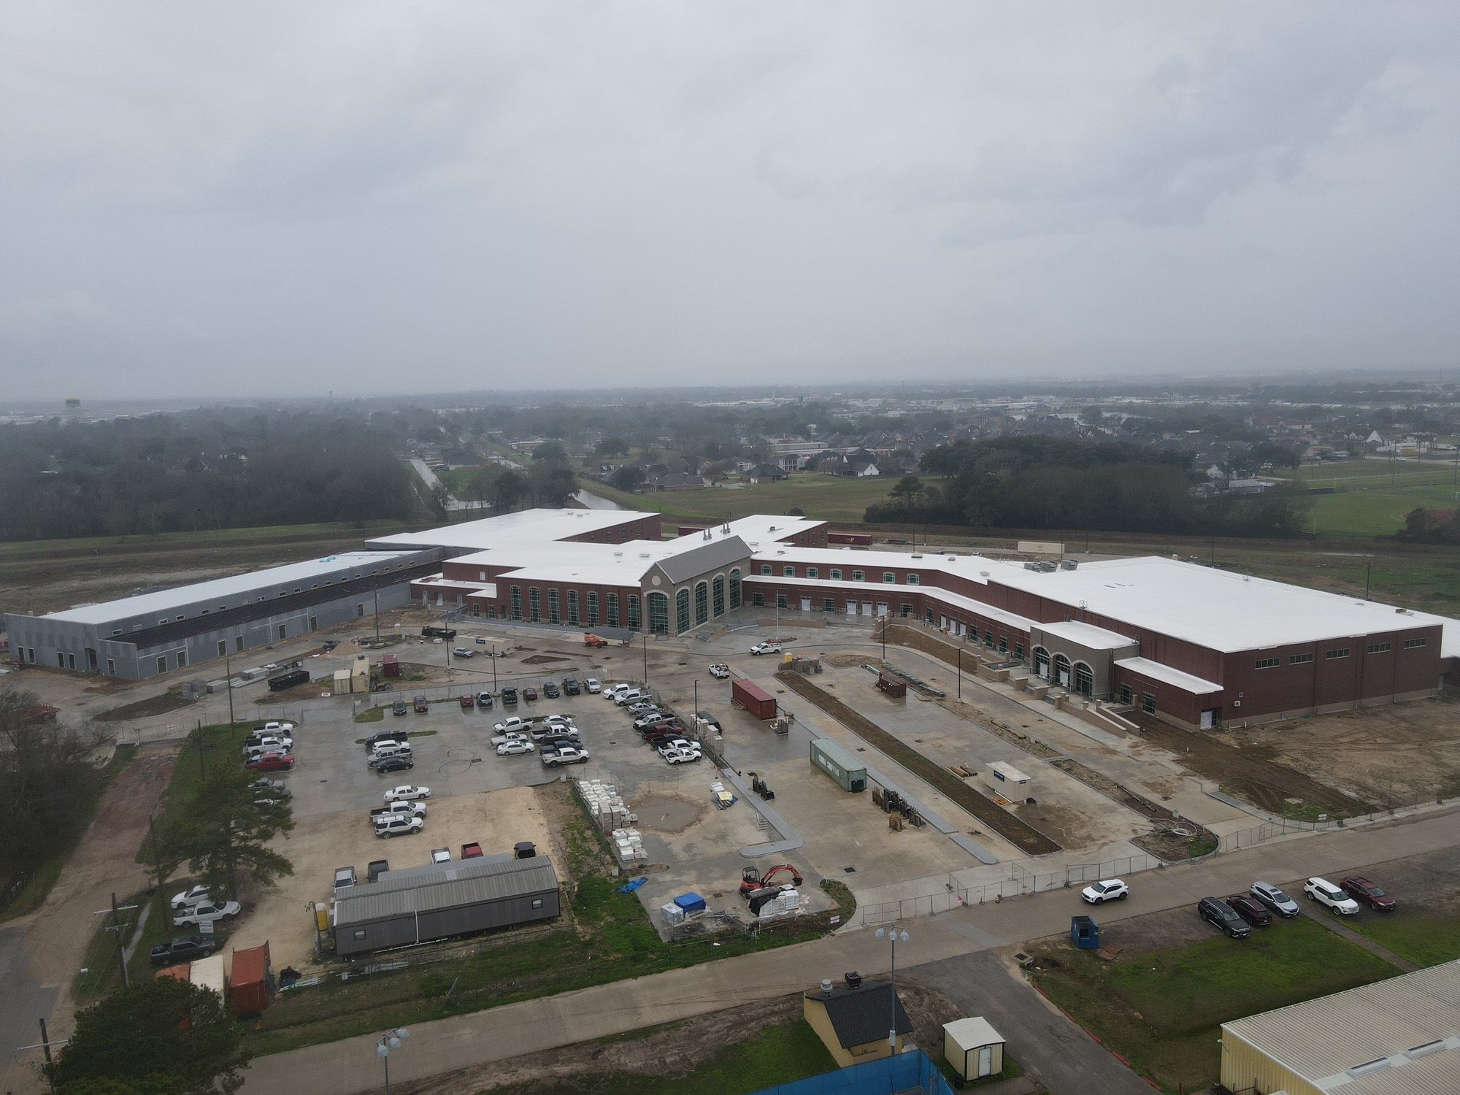
Nederland High School

Slide 3
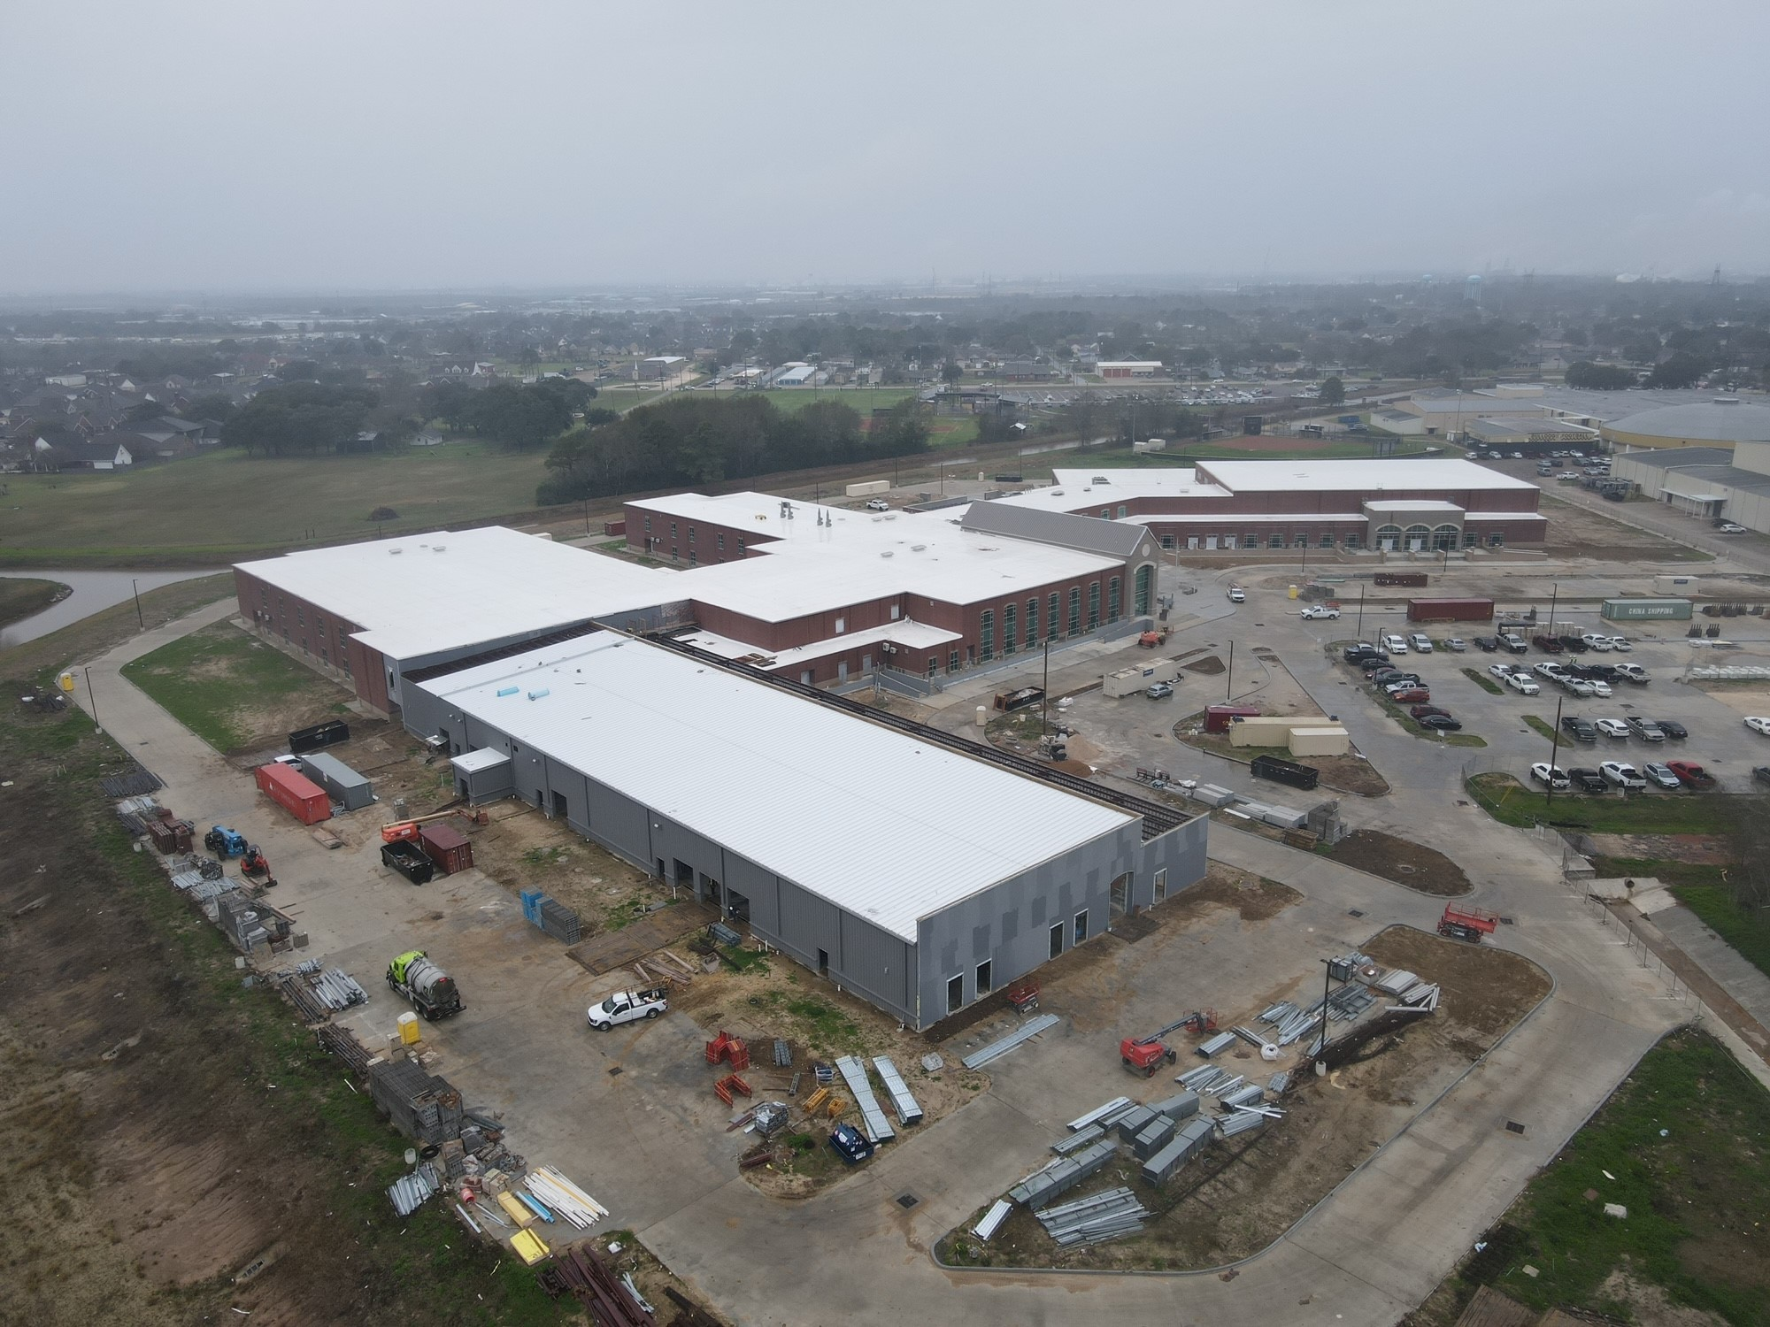
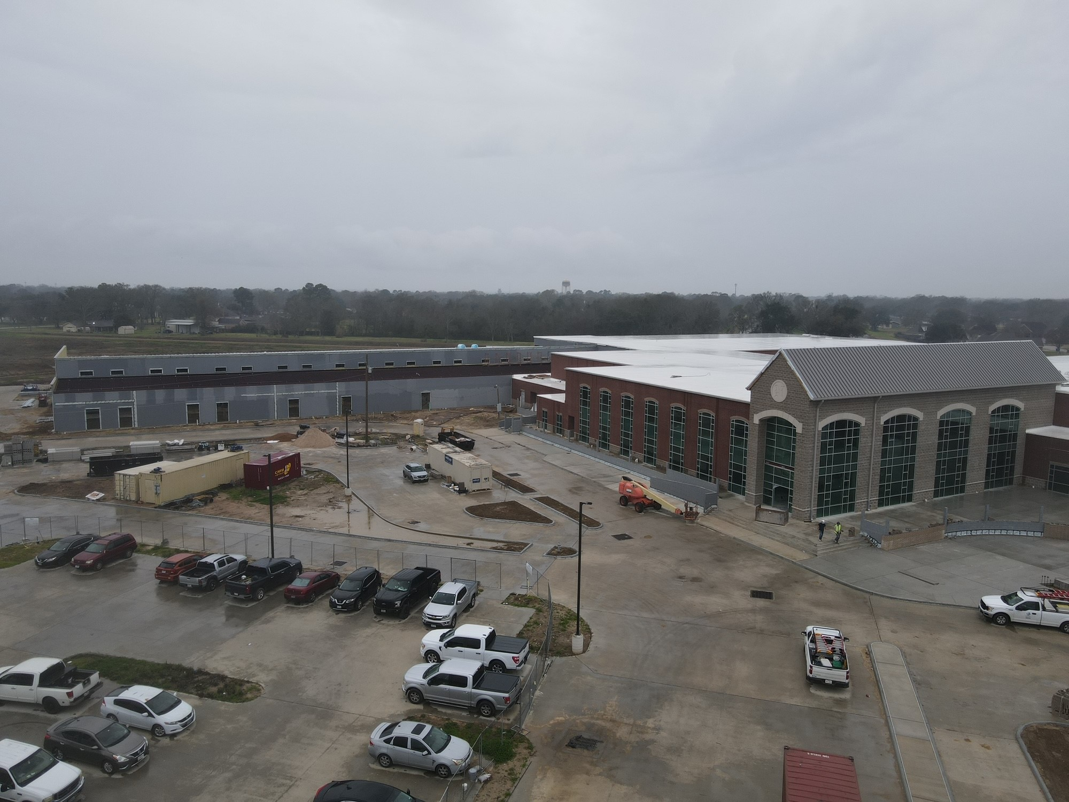
Nederland High School
Exterior
  Complete flashing/waterproofing/insulation for CTE wing.
  Continue with brickwork for CTE building.
  Continue with brickwork in the front of the school.
  Continue with concrete flatwork around the school.

Slide 4
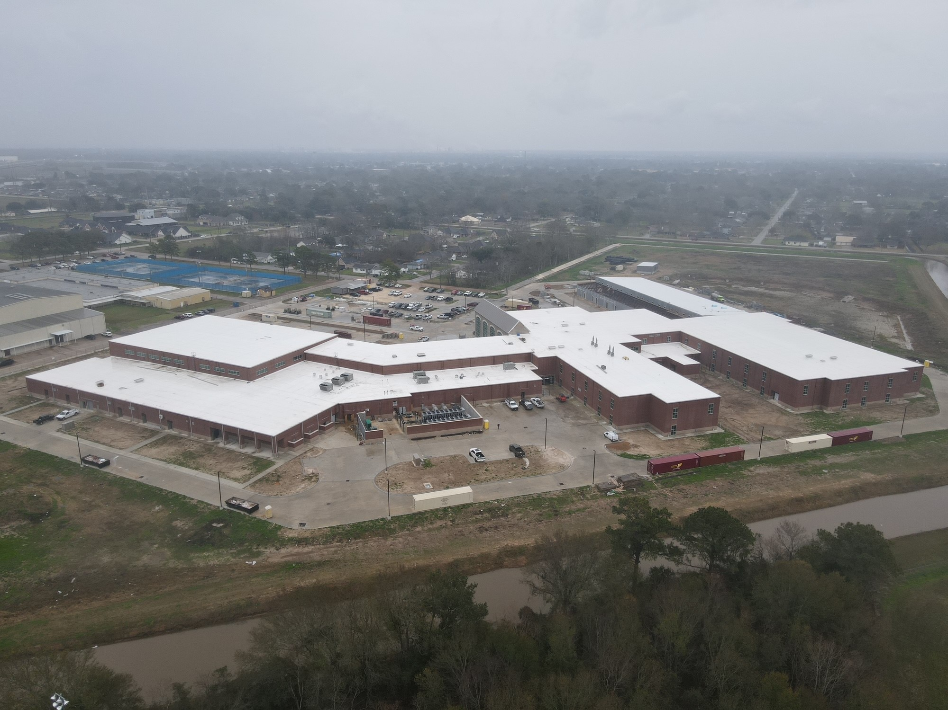
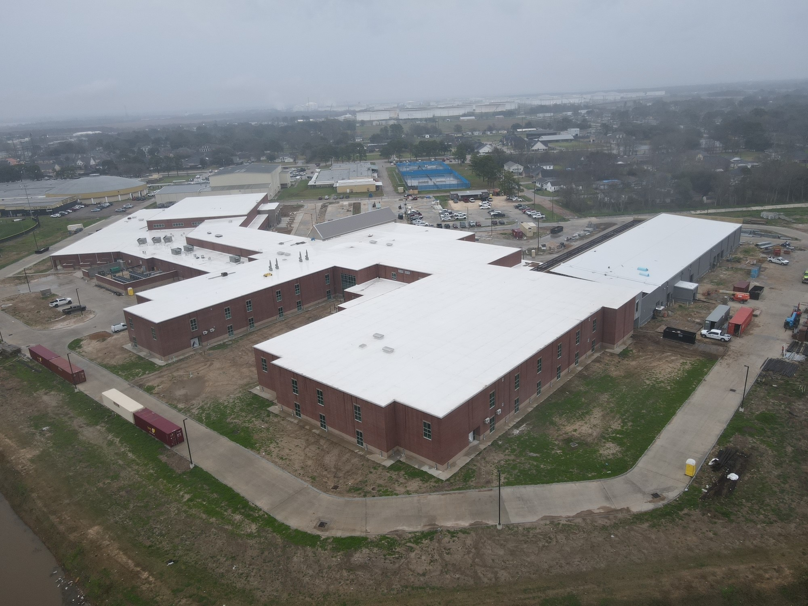
Nederland High School
Exterior
  Continue with Gutters and Downspouts.
  Continue installing storefront doors around the building.
  Finish mechanical yard piping/insulation.
  Finish CTE building roof and tie in to structural steel.

Slide 5
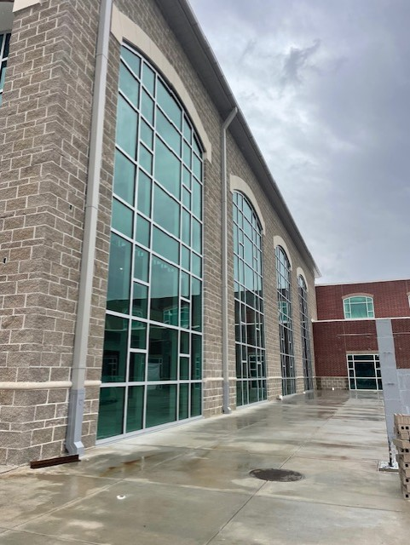
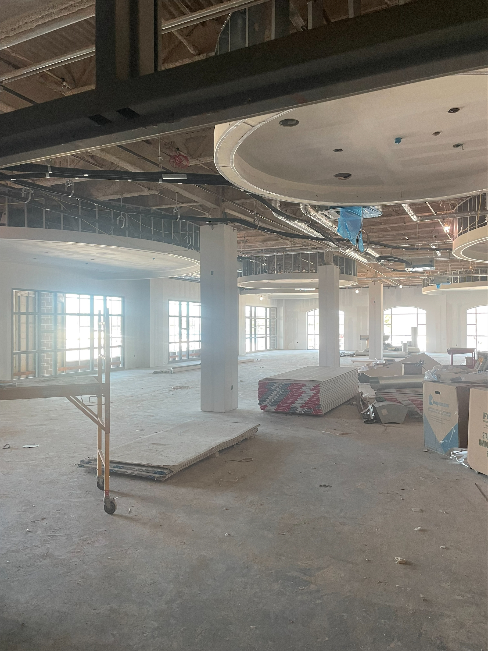
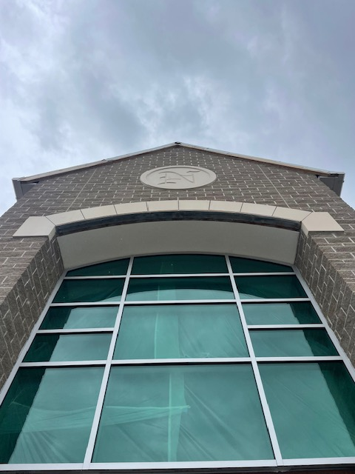
Nederland High School
  Continue installing duct work in J, H, G, F, E, D, C, B & A.
  Continue insulating MEP piping throughout building
  Complete chiller piping throughout the building.
  Start up conditioned air throughout the building.
  Continue first coat of paint in area’s J, H, G, F, E, D, C, & B.
  Complete kitchen hood ductwork.
  Complete admin area with sheetrock, tape, float, and paint.

Slide 6
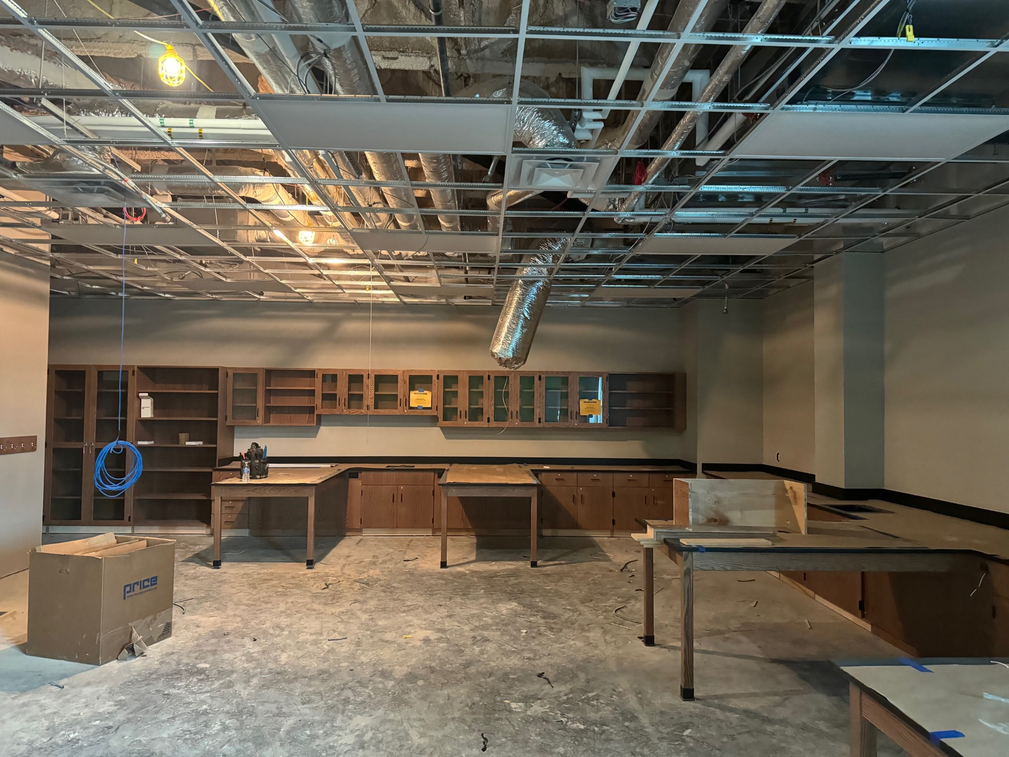
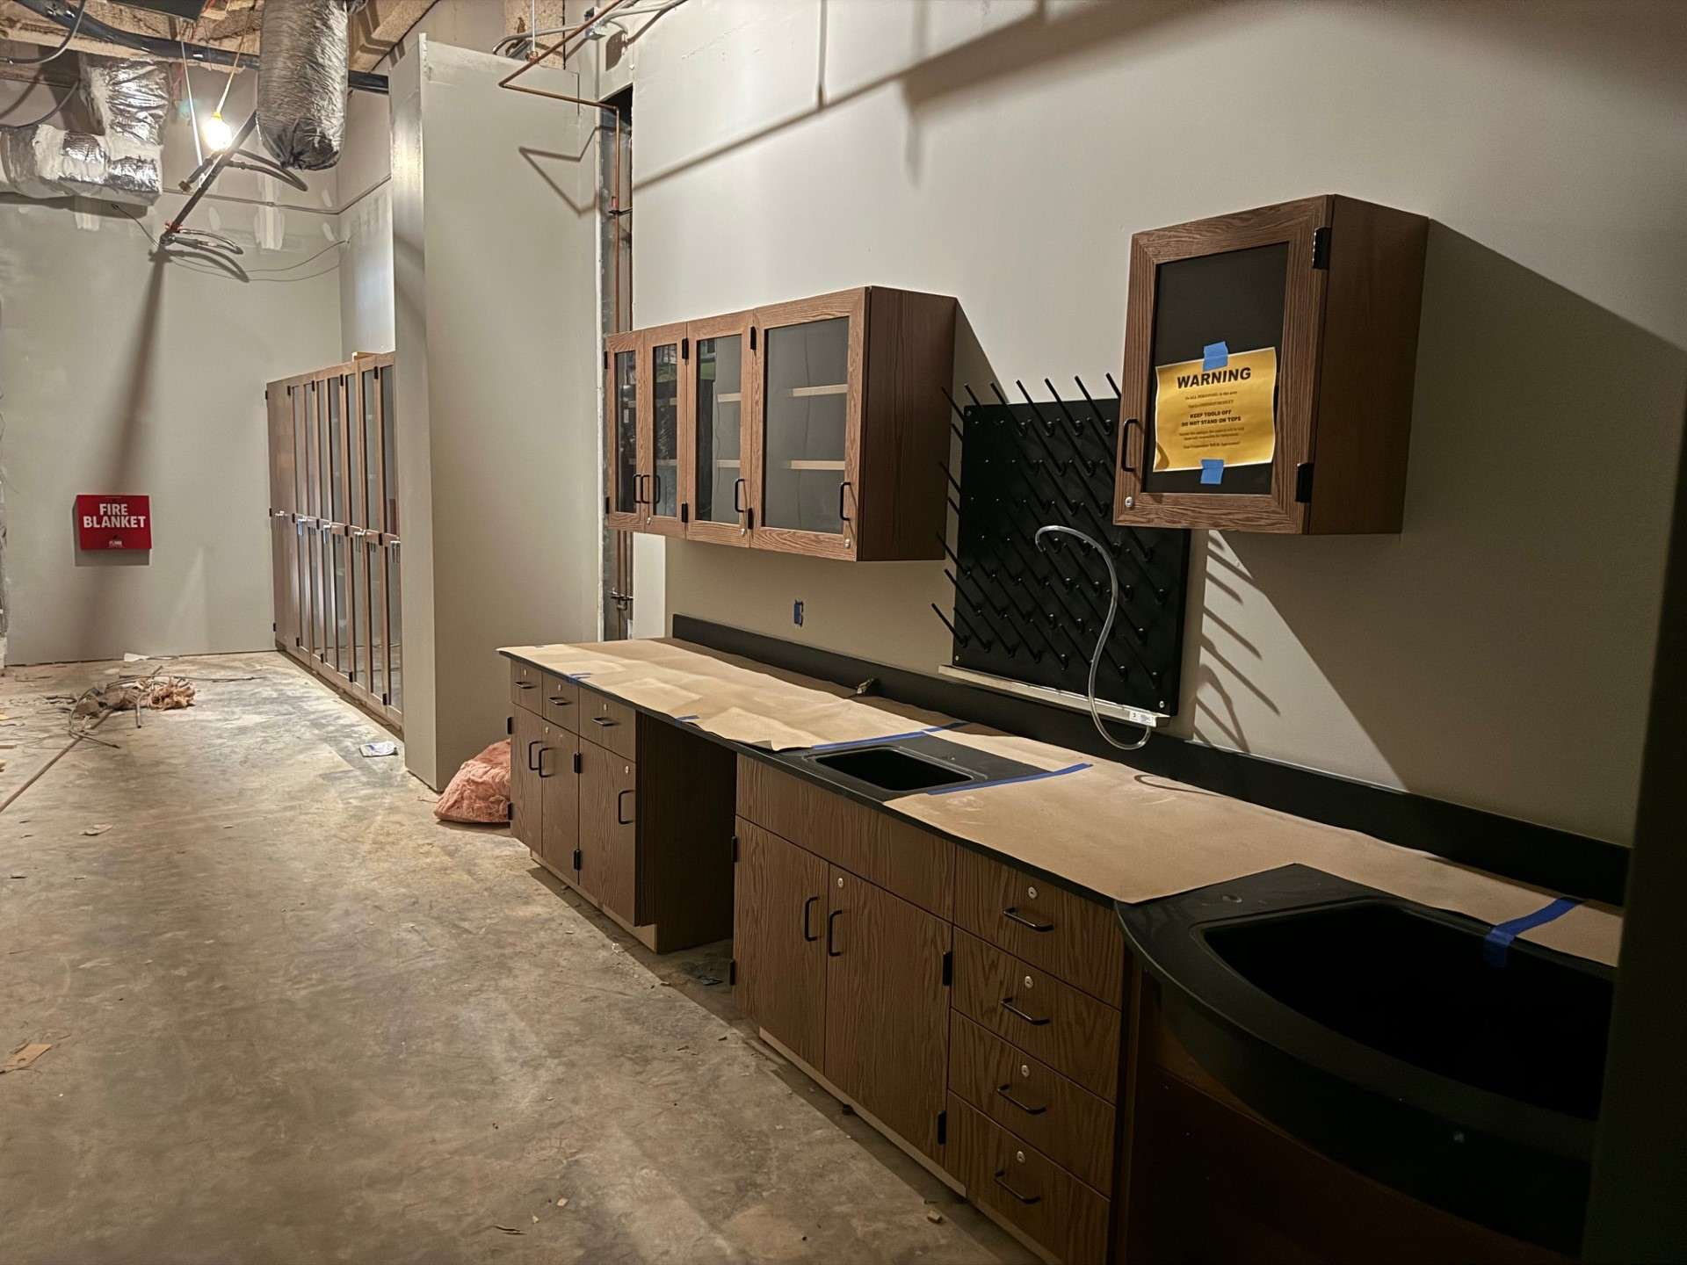
Nederland High School
  Continue installing ceilings in classrooms and hallways.
  Continue installing casework and countertops throughout the building.
  Continue installing light fixtures and grilles throughout the building.
  Begin interior framing and block walls for CTE wing.

Slide 7
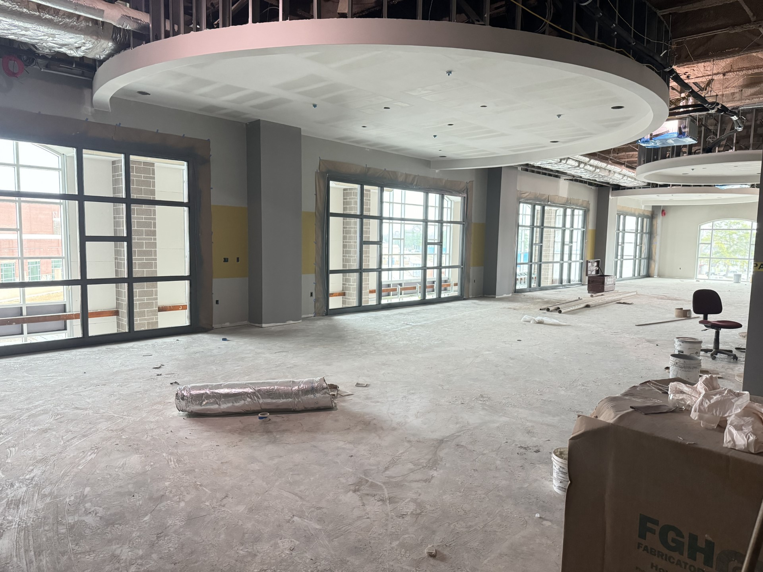
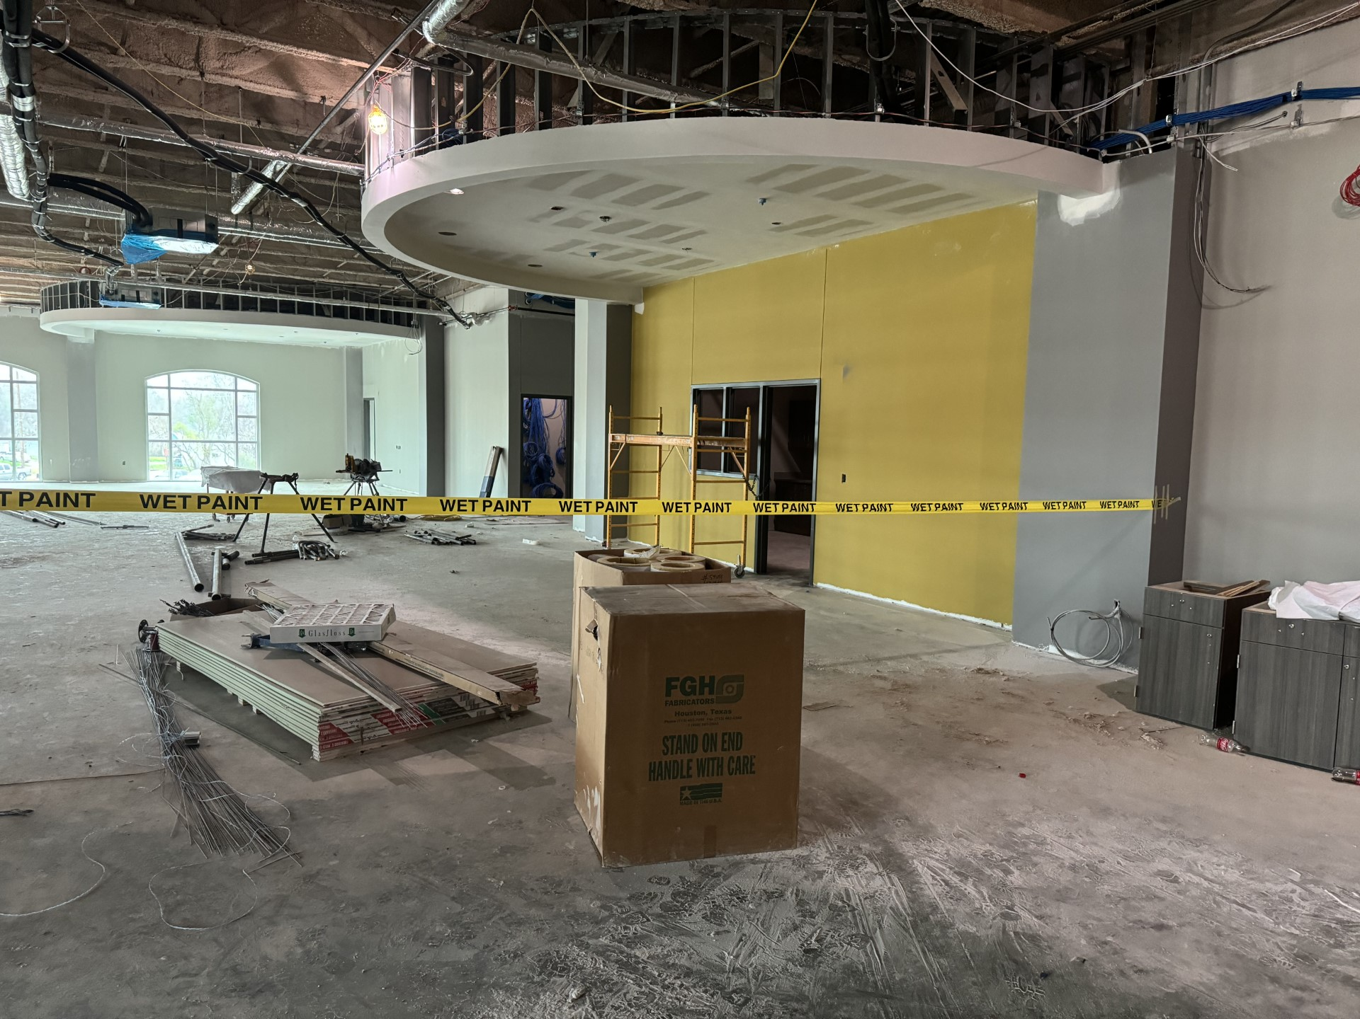
Nederland High School
Continue with Plumbing rough in.
Continue with Electrical rough in.
Install elevator.
Begin installing floors when conditioned air is on.
Begin installing doors throughout the building.

Slide 8
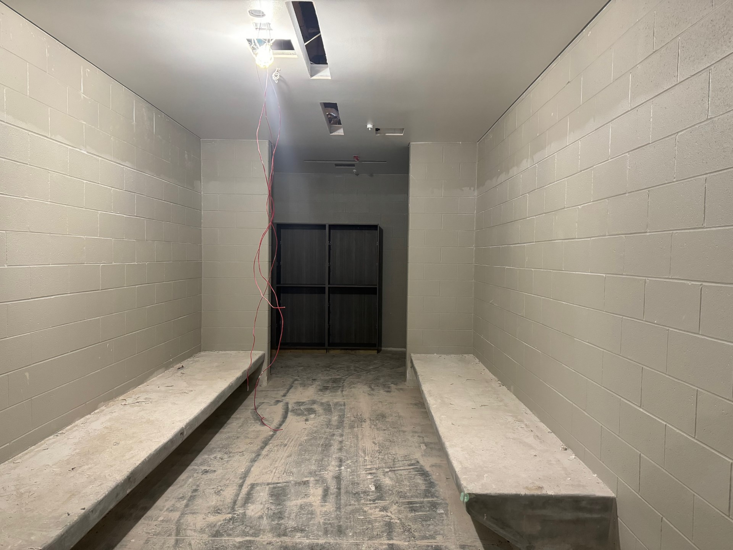
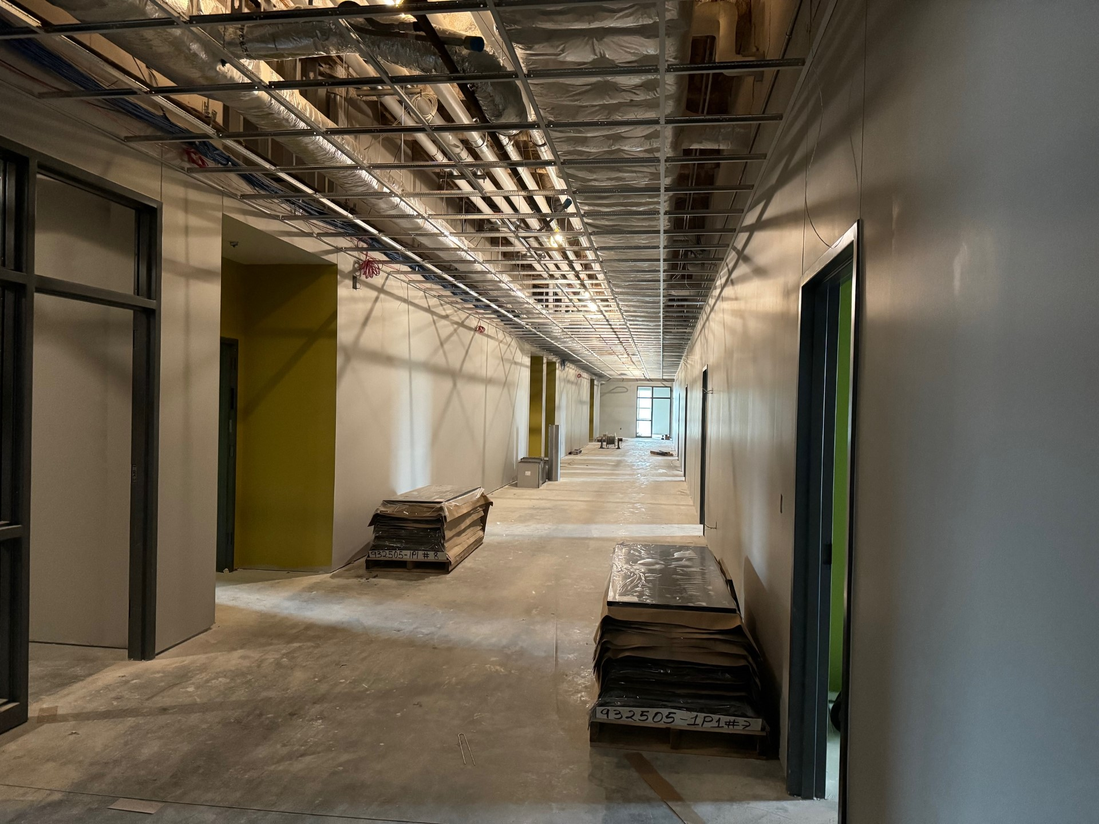
Nederland High School
Continue painting hard ceilings in locker rooms and bathrooms.
Epoxy paint locker bases.
Install lockers.
Begin installing cloud ceilings in the cafeteria.
Begin epoxy flooring once conditioned air is on.

Slide 9


