Slide 1




2019 Nederland ISD Bond Project
March 2024

Slide 2

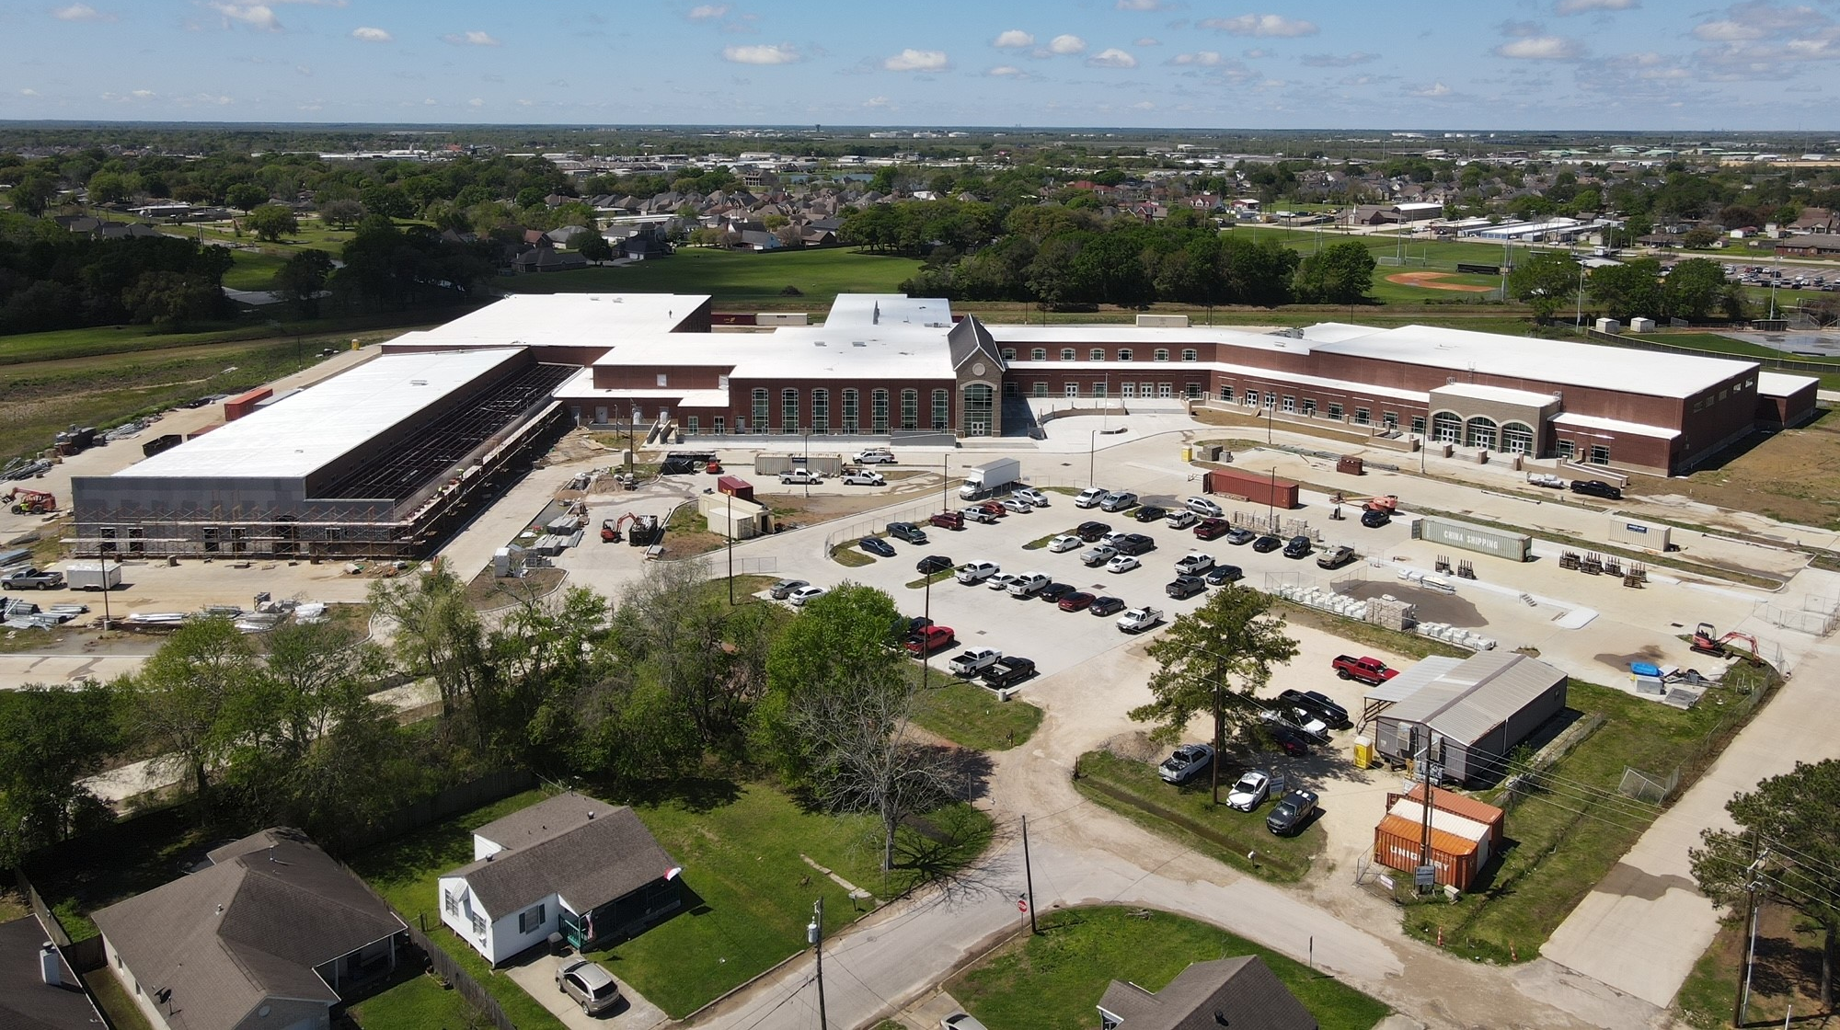
Nederland High School

Slide 3
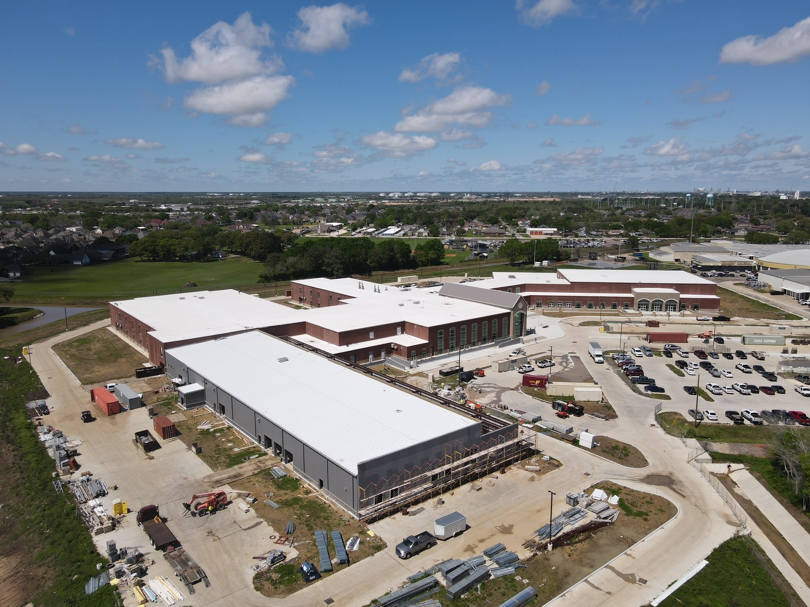
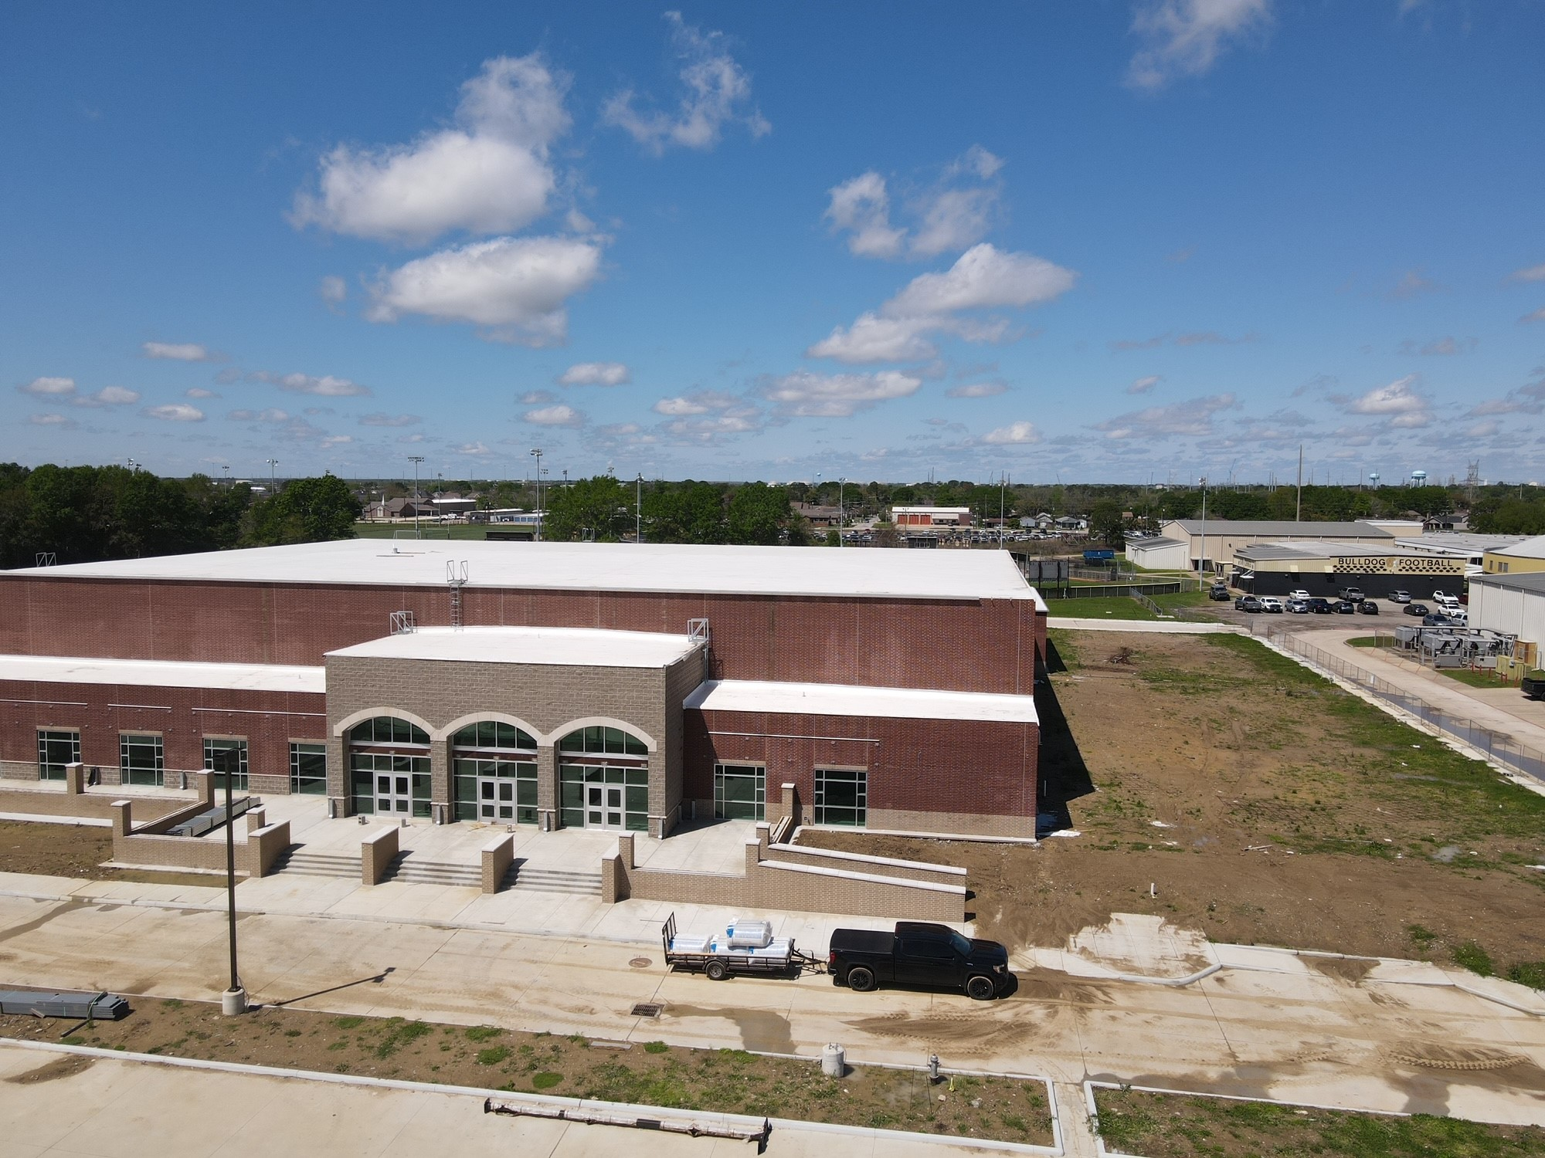
Nederland High School
Exterior
  Complete flashing/waterproofing/insulation for CTE wing.
  Complete brickwork for CTE building.
  Continue with brickwork in the front of the school.
  Continue with concrete flatwork around the school.
  Begin exterior handrails.

Slide 4
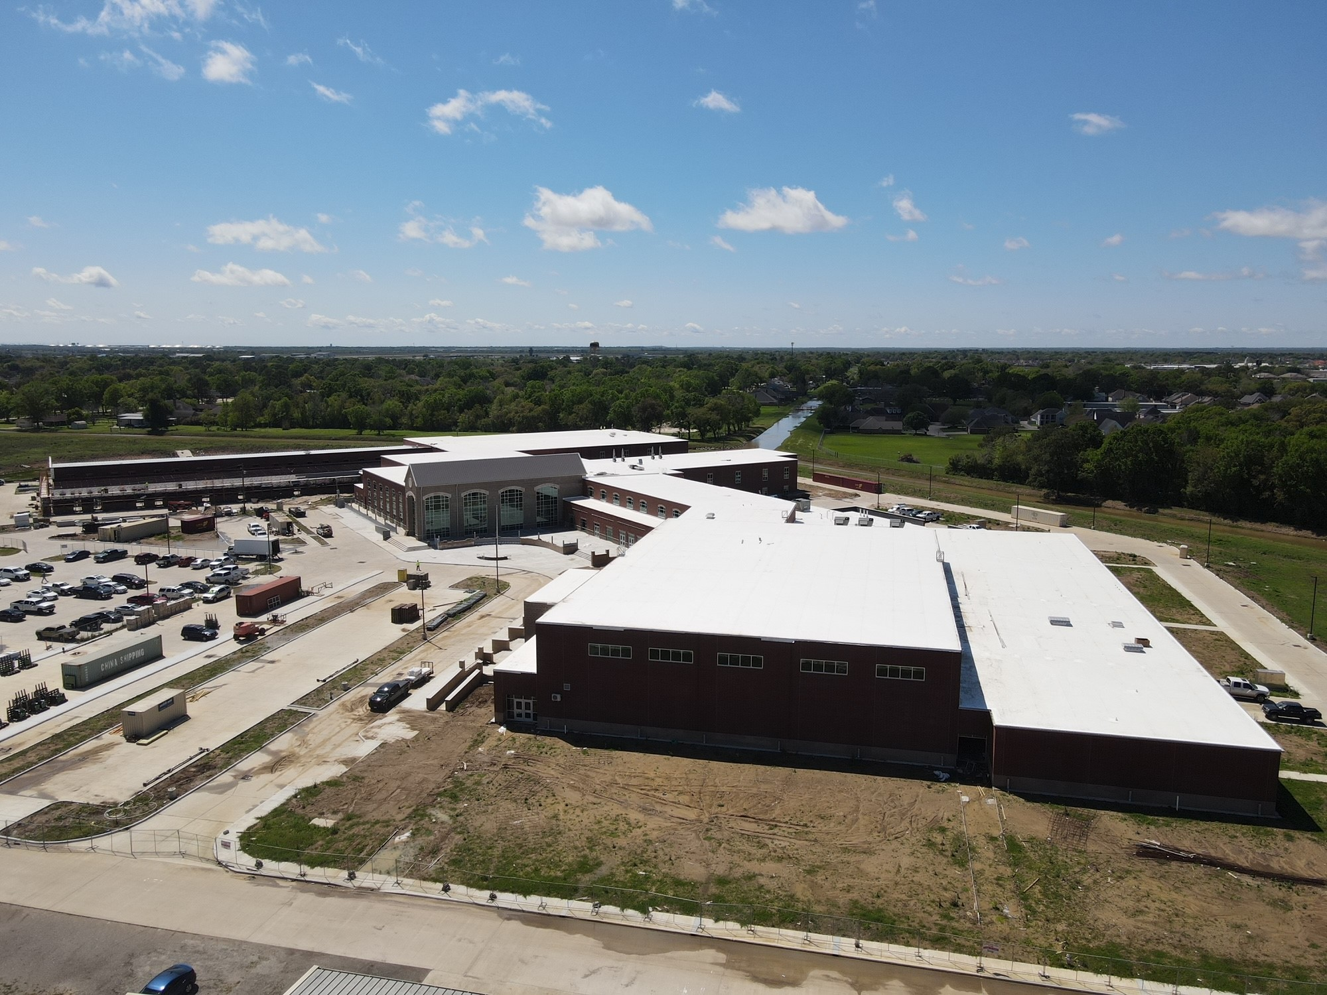
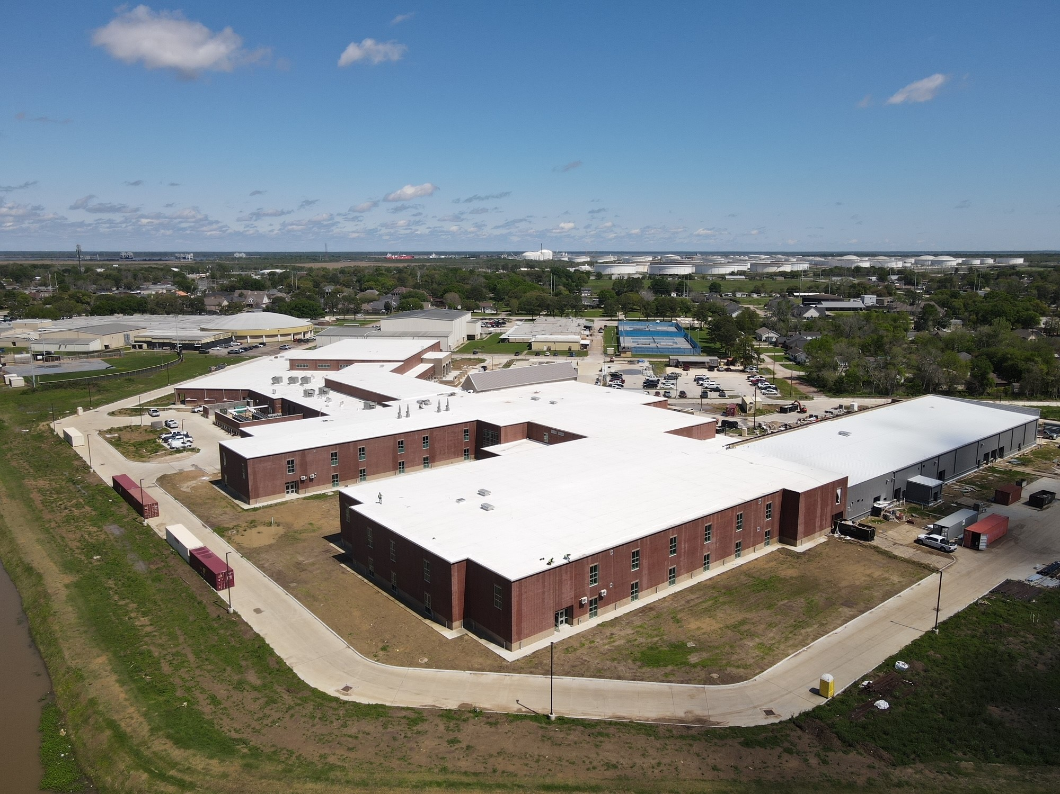
Nederland High School
Exterior
  Continue with Gutters and Downspouts.
  Continue installing storefront doors around the building.
  Finish CTE building roof and tie into structural steel.
  Continue with tying in Gutters with TPO roof membrane.

Slide 5
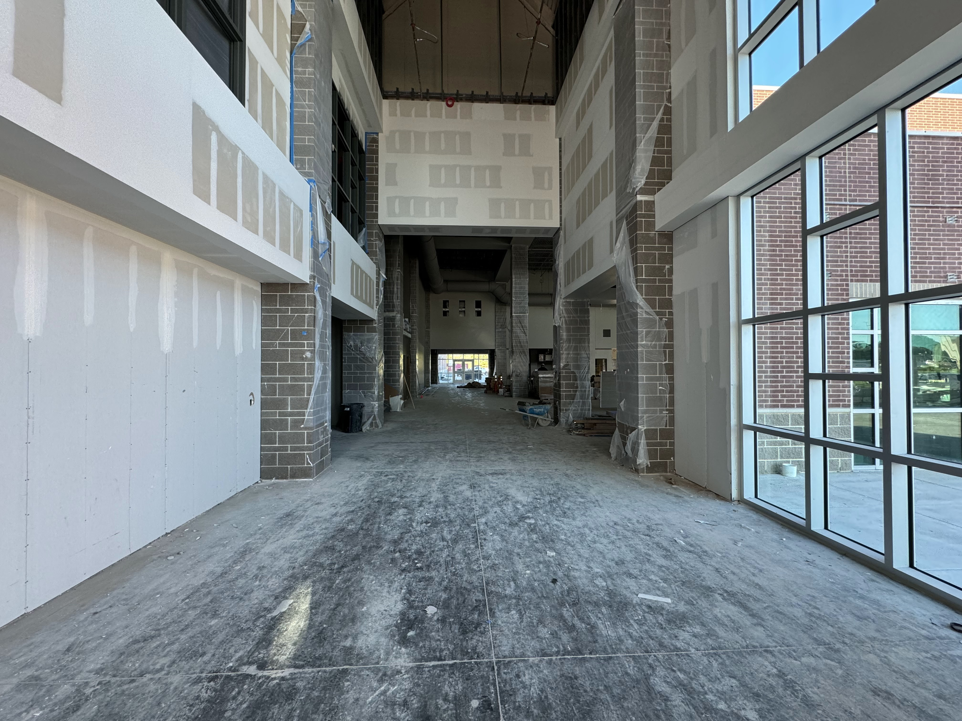
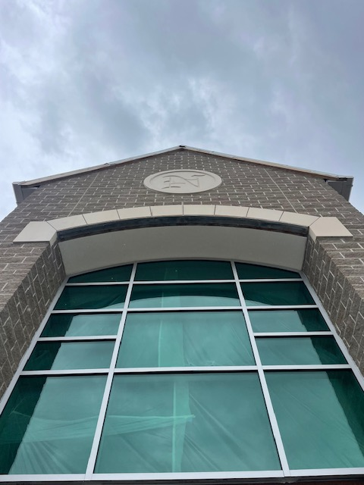
Nederland High School
  Continue installing duct work in B & A.
  Continue insulating MEP piping/ductwork throughout building
  Complete chiller piping throughout A/B.
  Complete ceiling grid in admin area.
  Complete casework in admin area.
  Begin final coat of paint on second floor.
  Begin receiving above ceilings inspections.
  Once inspection passes and final coat of paint is on in the rooms we will begin carpet flooring on the second floor.

Slide 6
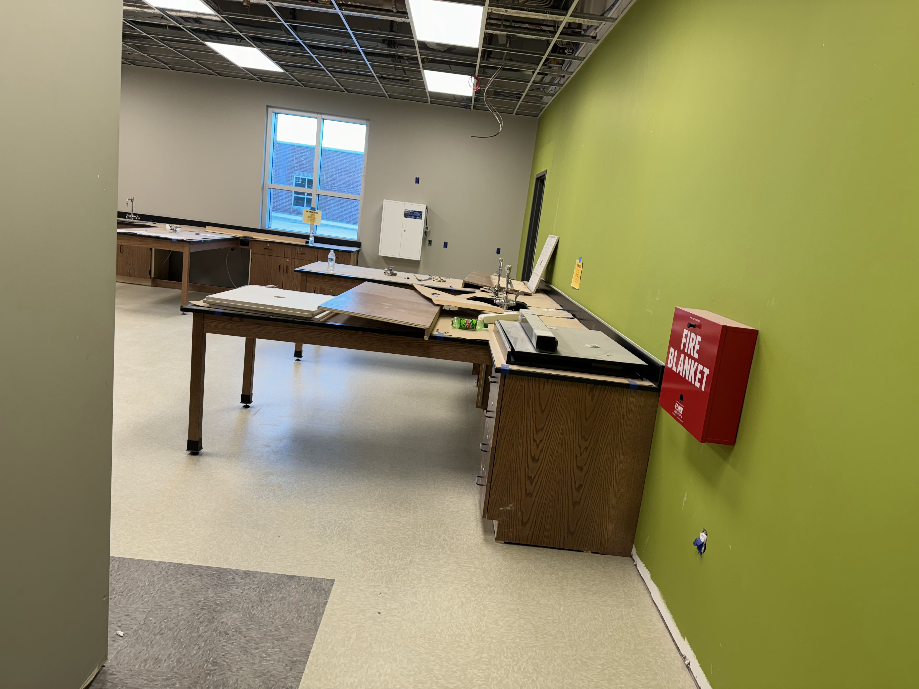
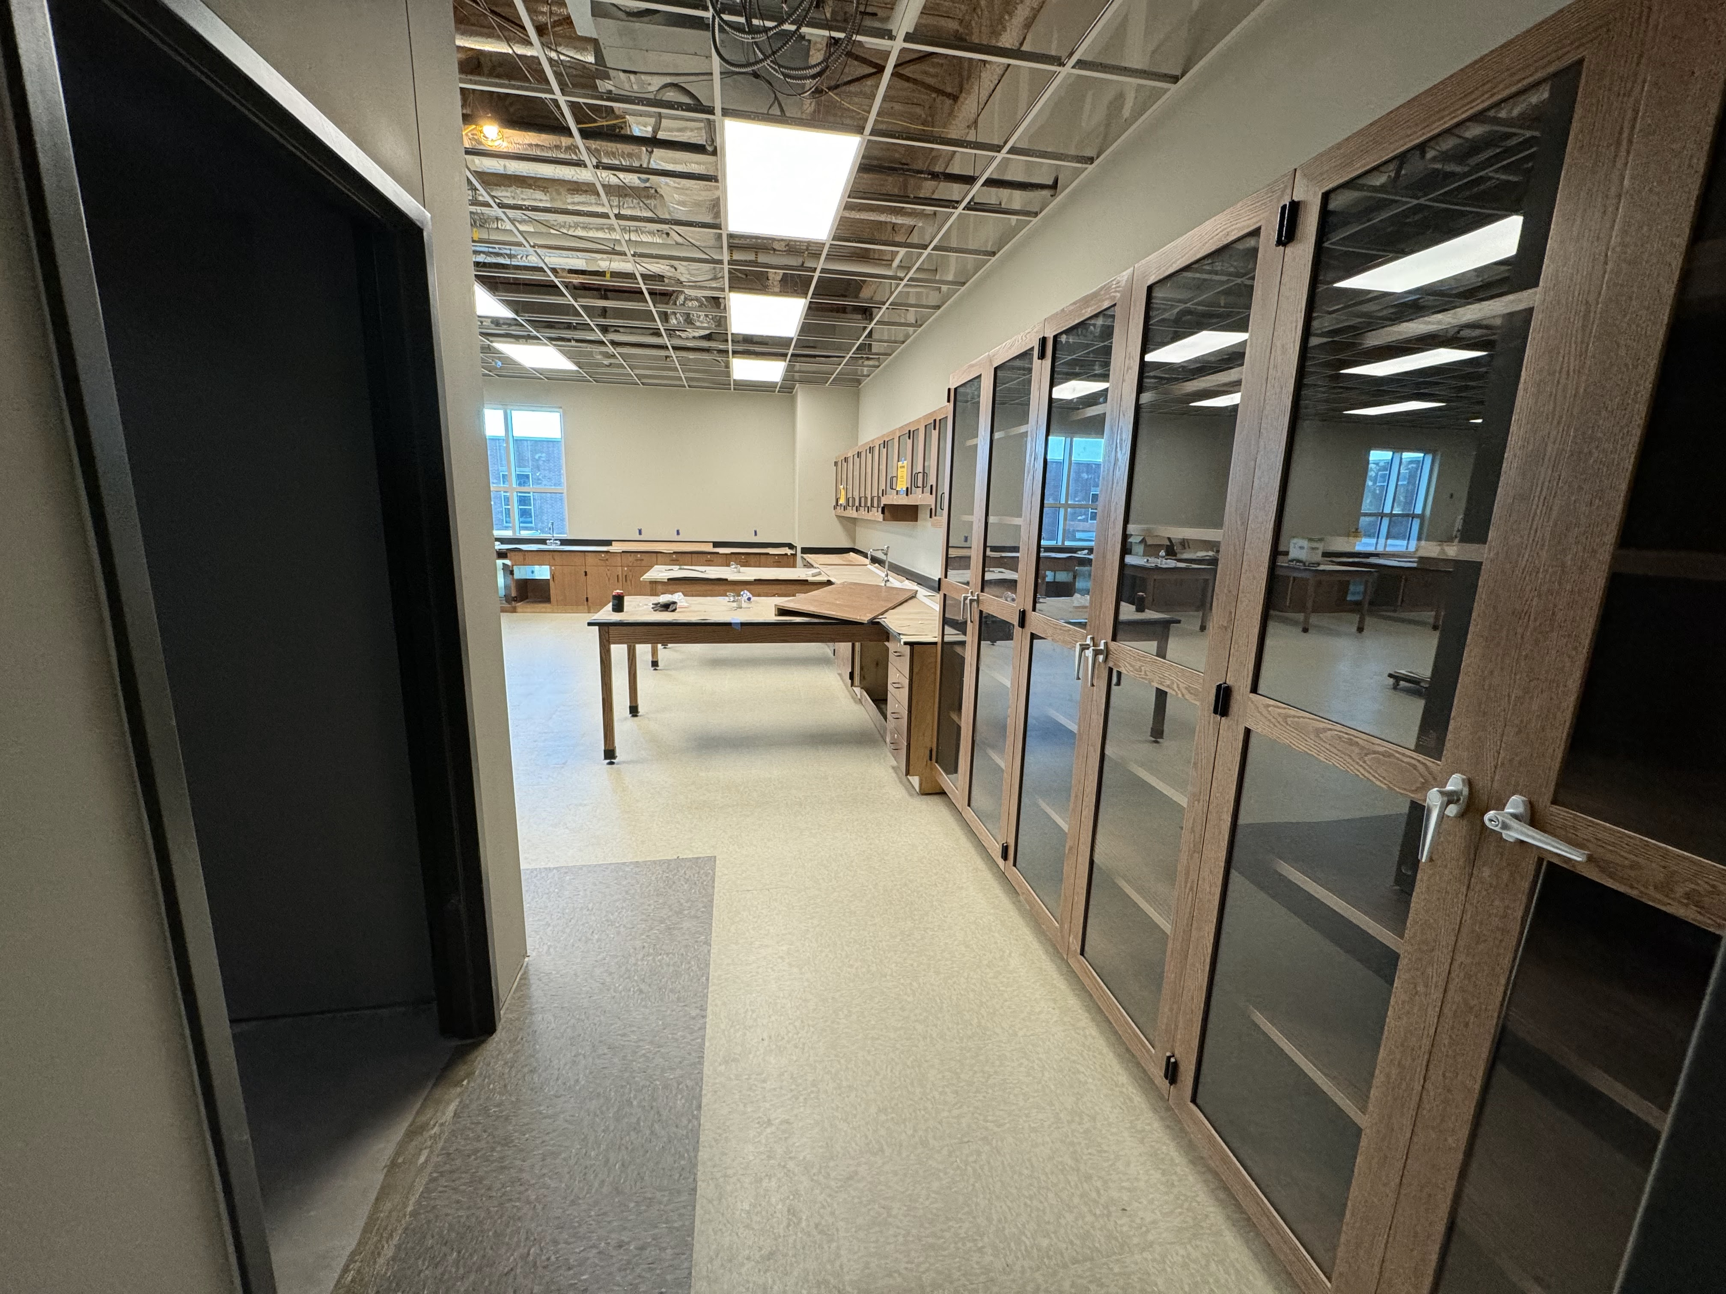
Nederland High School
  Continue installing ceilings in classrooms and hallways.
  Continue installing casework and countertops throughout the building.
  Continue installing light fixtures and grilles throughout the building.
  Continue interior framing and block walls for CTE wing.

Slide 7
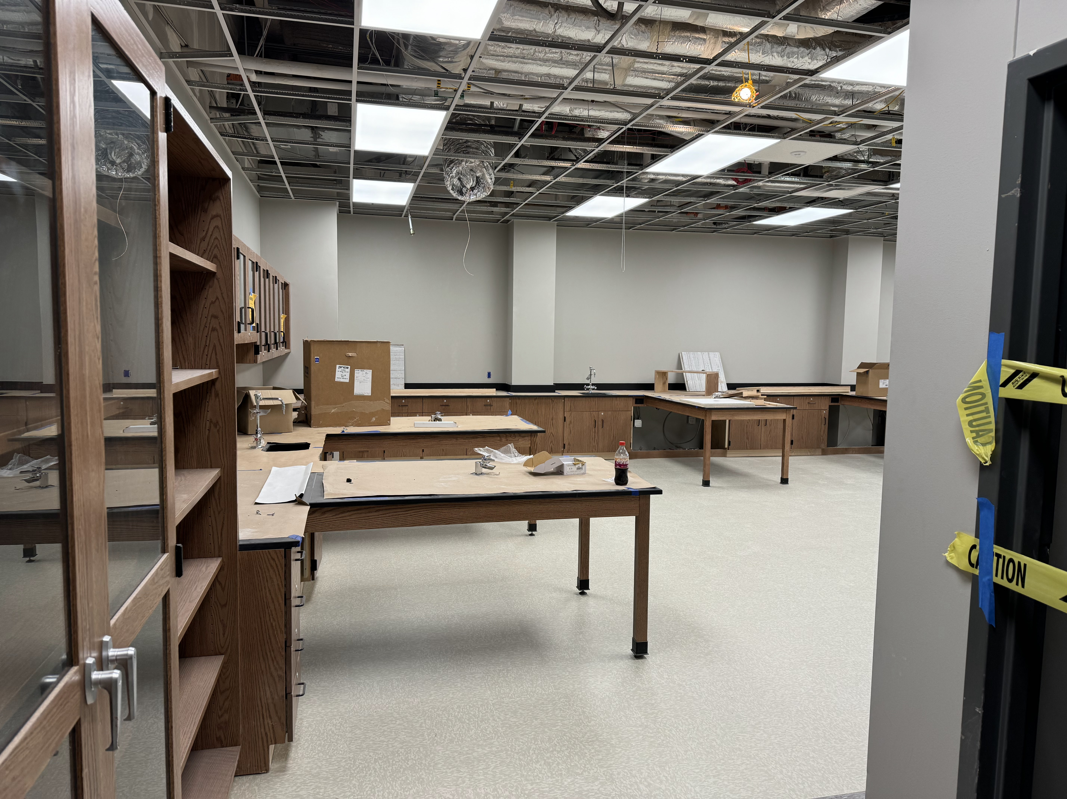
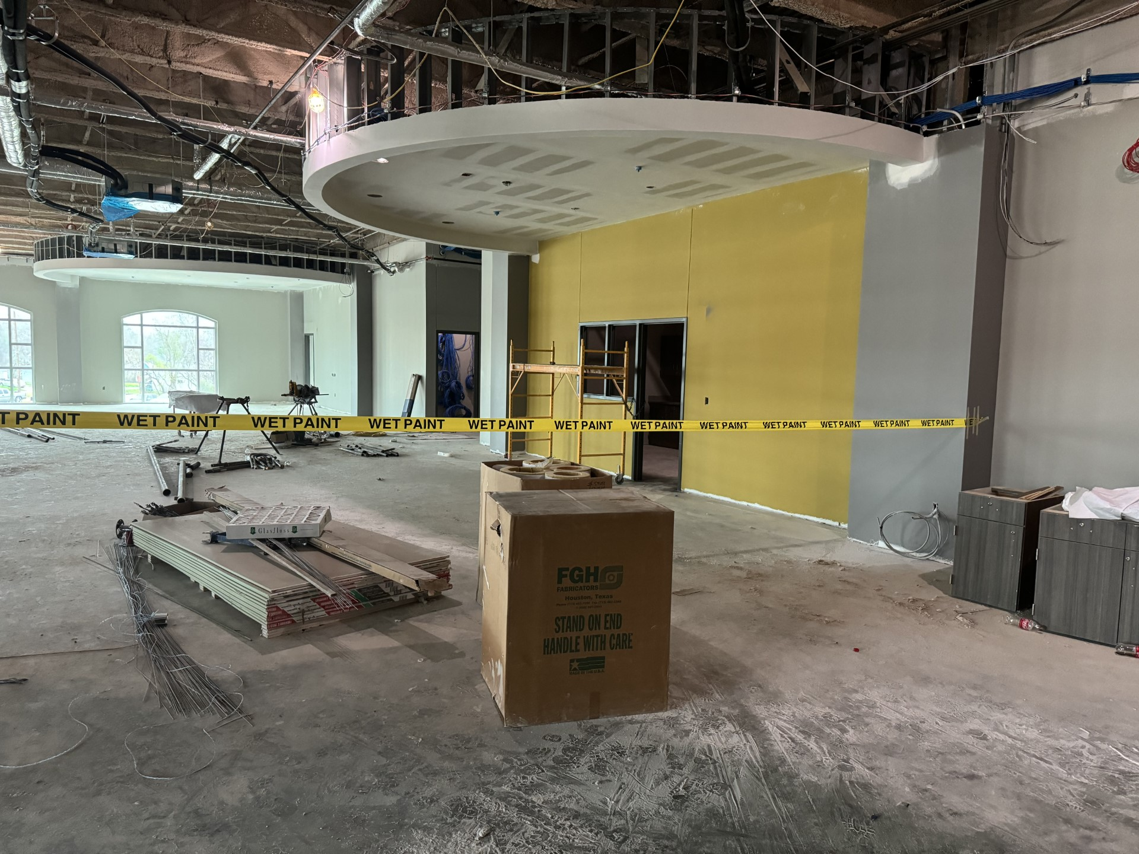
Nederland High School
Continue with Plumbing rough in.
Continue with Electrical rough in.
Install elevator.
Continue installing floors.
Begin installing doors/hardware throughout the building.

Slide 8
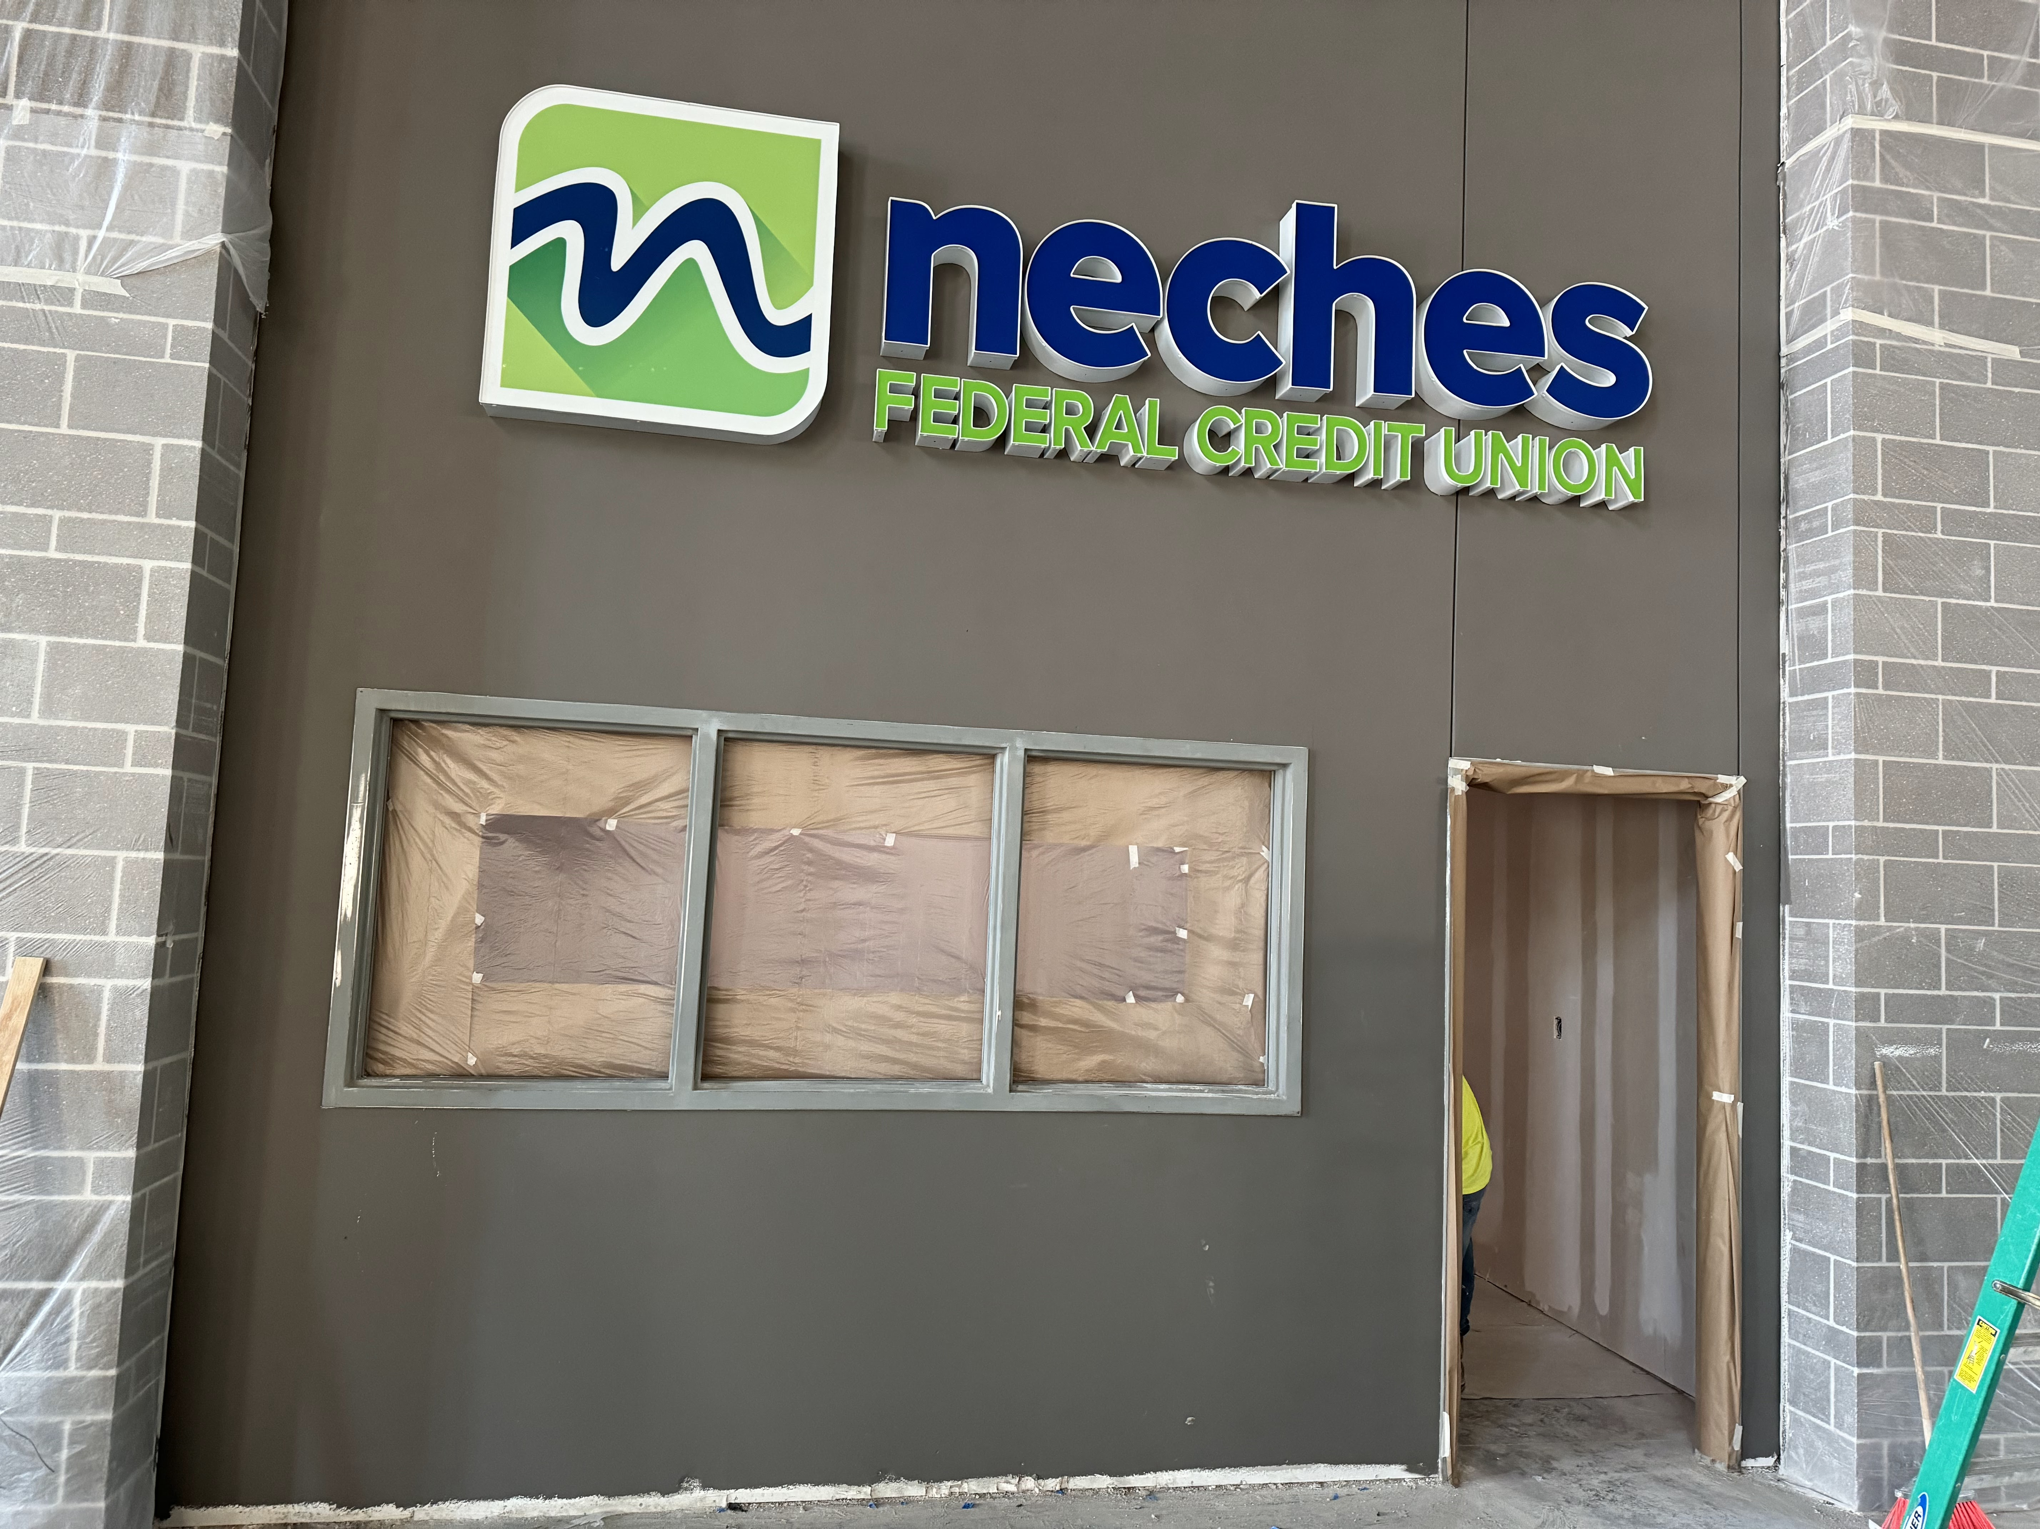
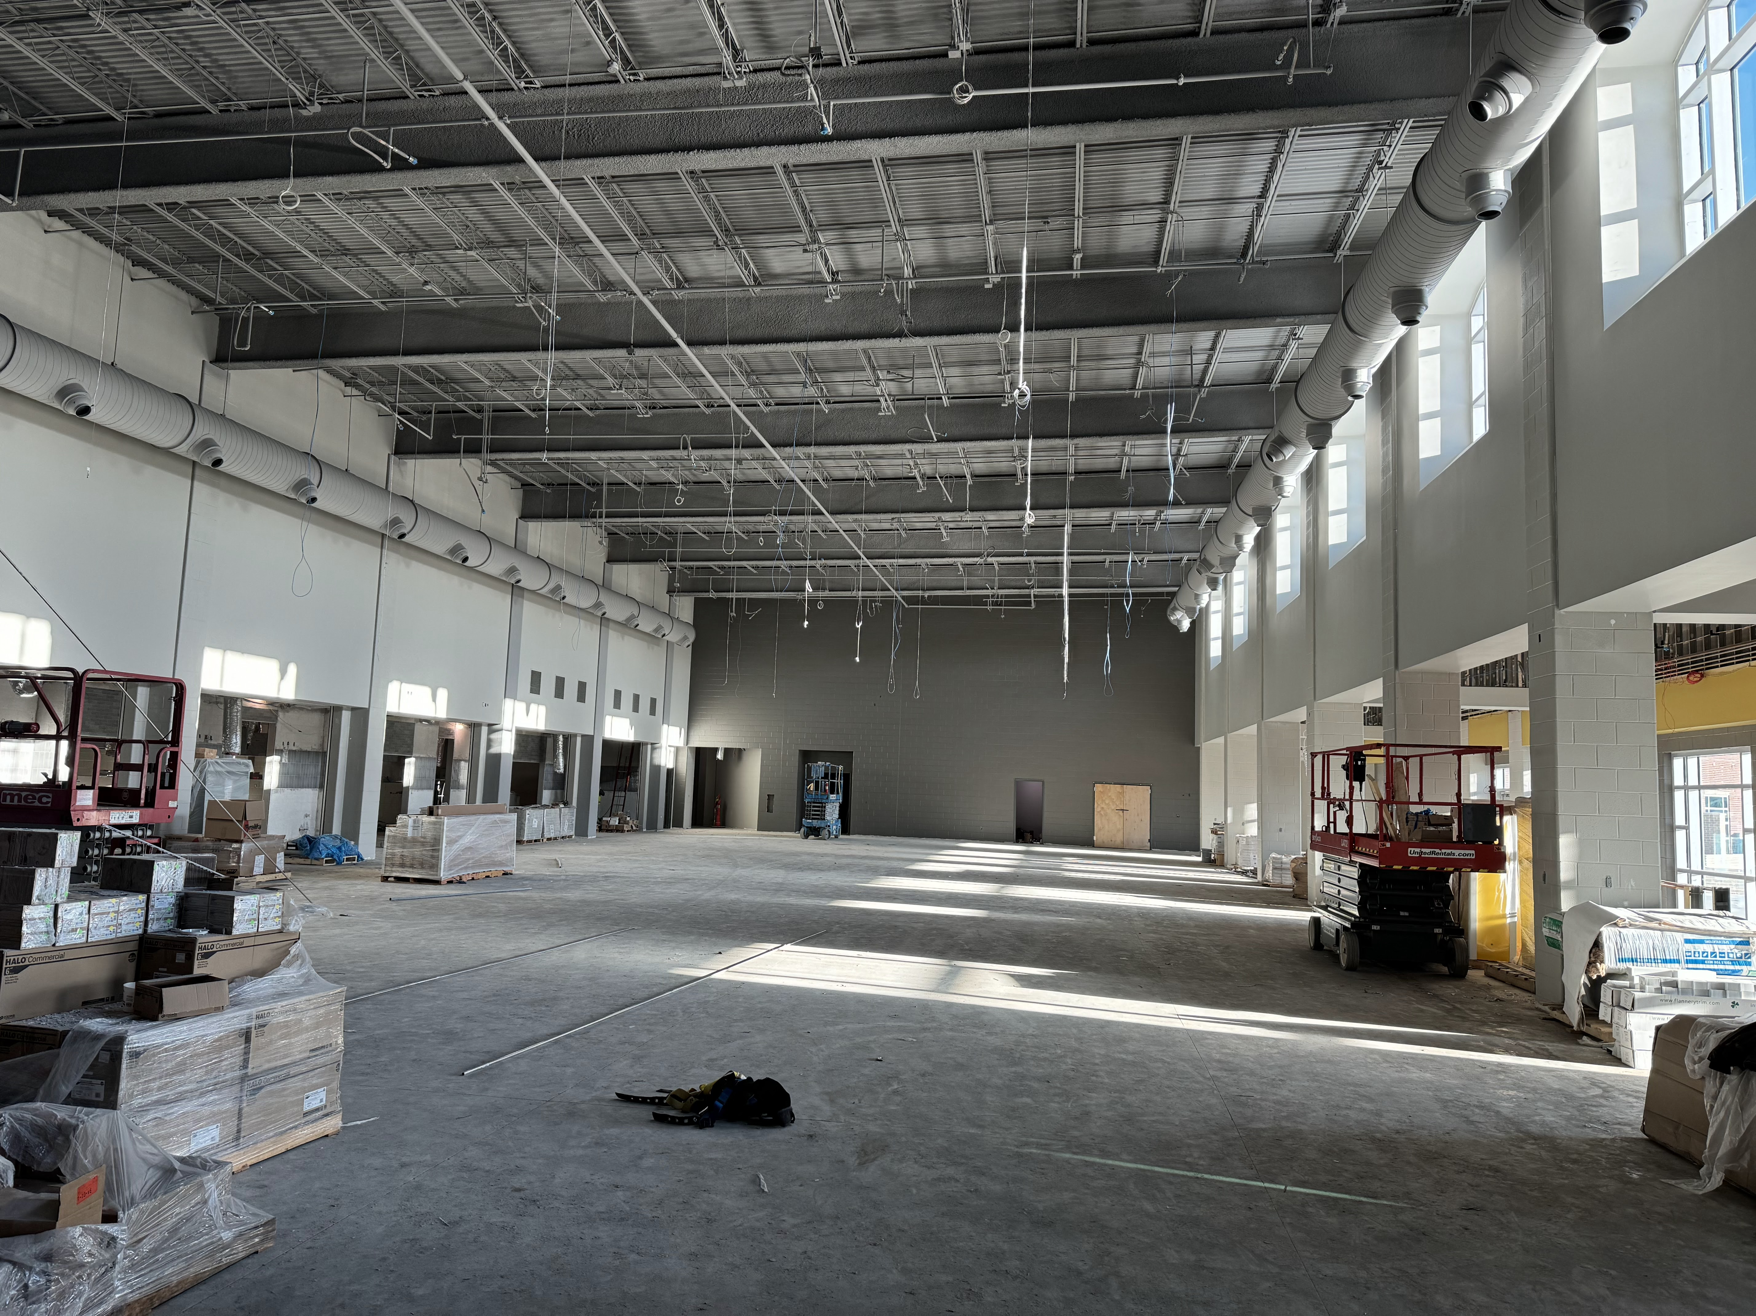
Nederland High School
Install lockers.
Finish installing cloud ceilings in the cafeteria.
Continue with Epoxy flooring.
Finish casework in athletics area.
Complete serving line tile.

Slide 9


