Slide 1




2019 Nederland ISD Bond Project
April 2024

Slide 2

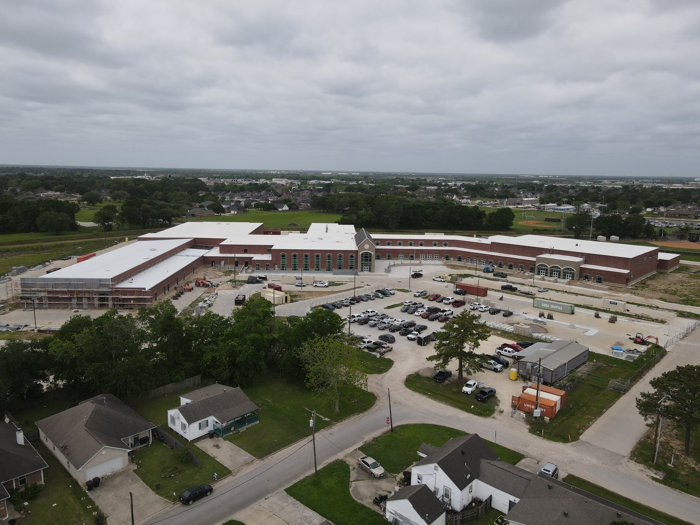
Nederland High School

Slide 3
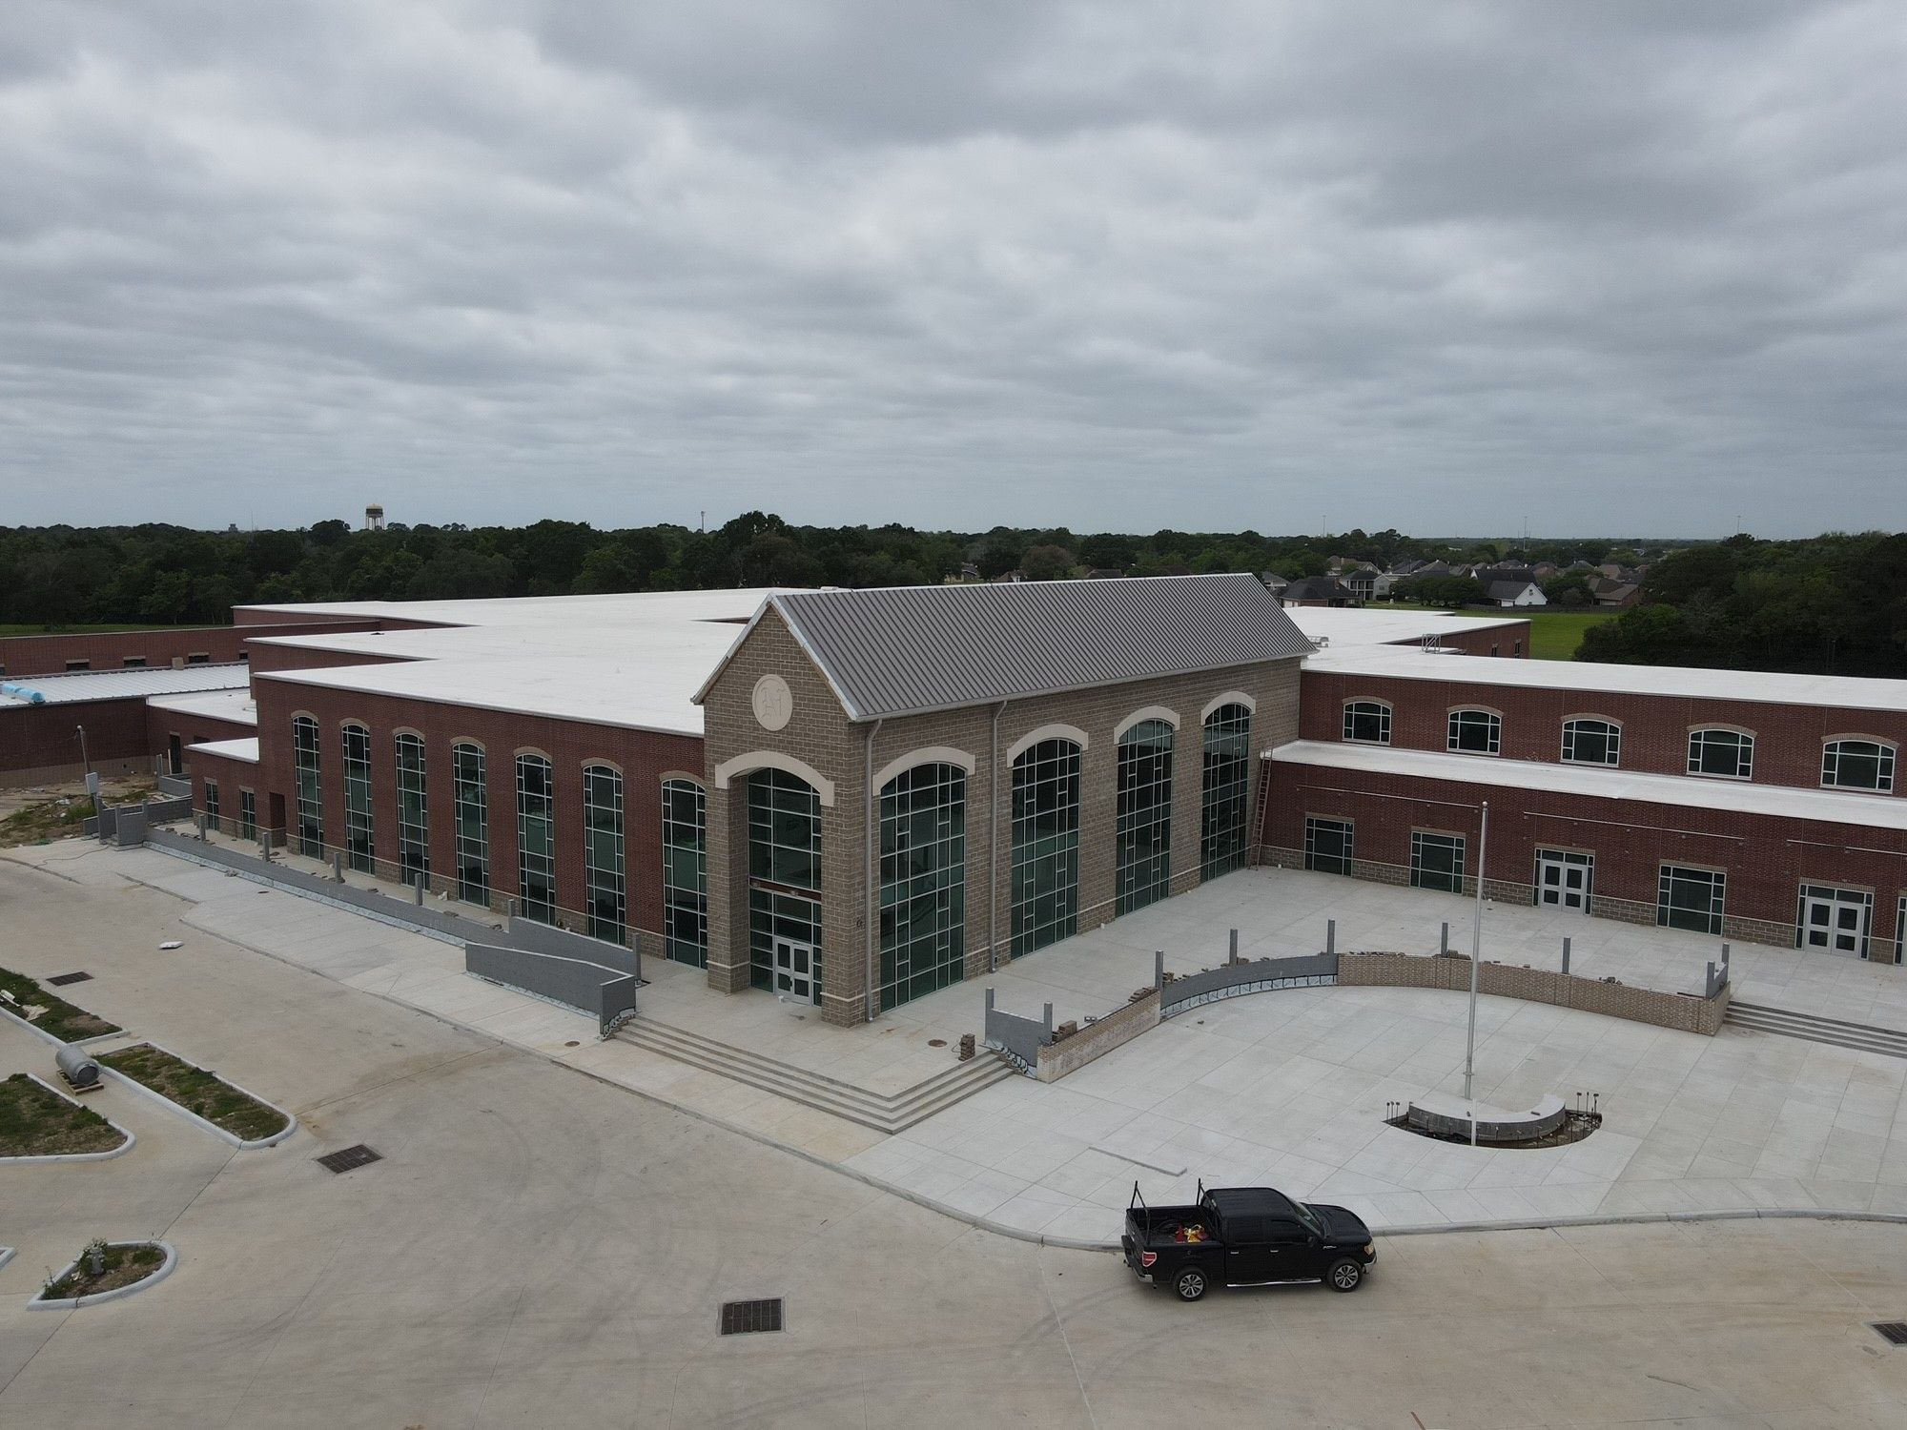
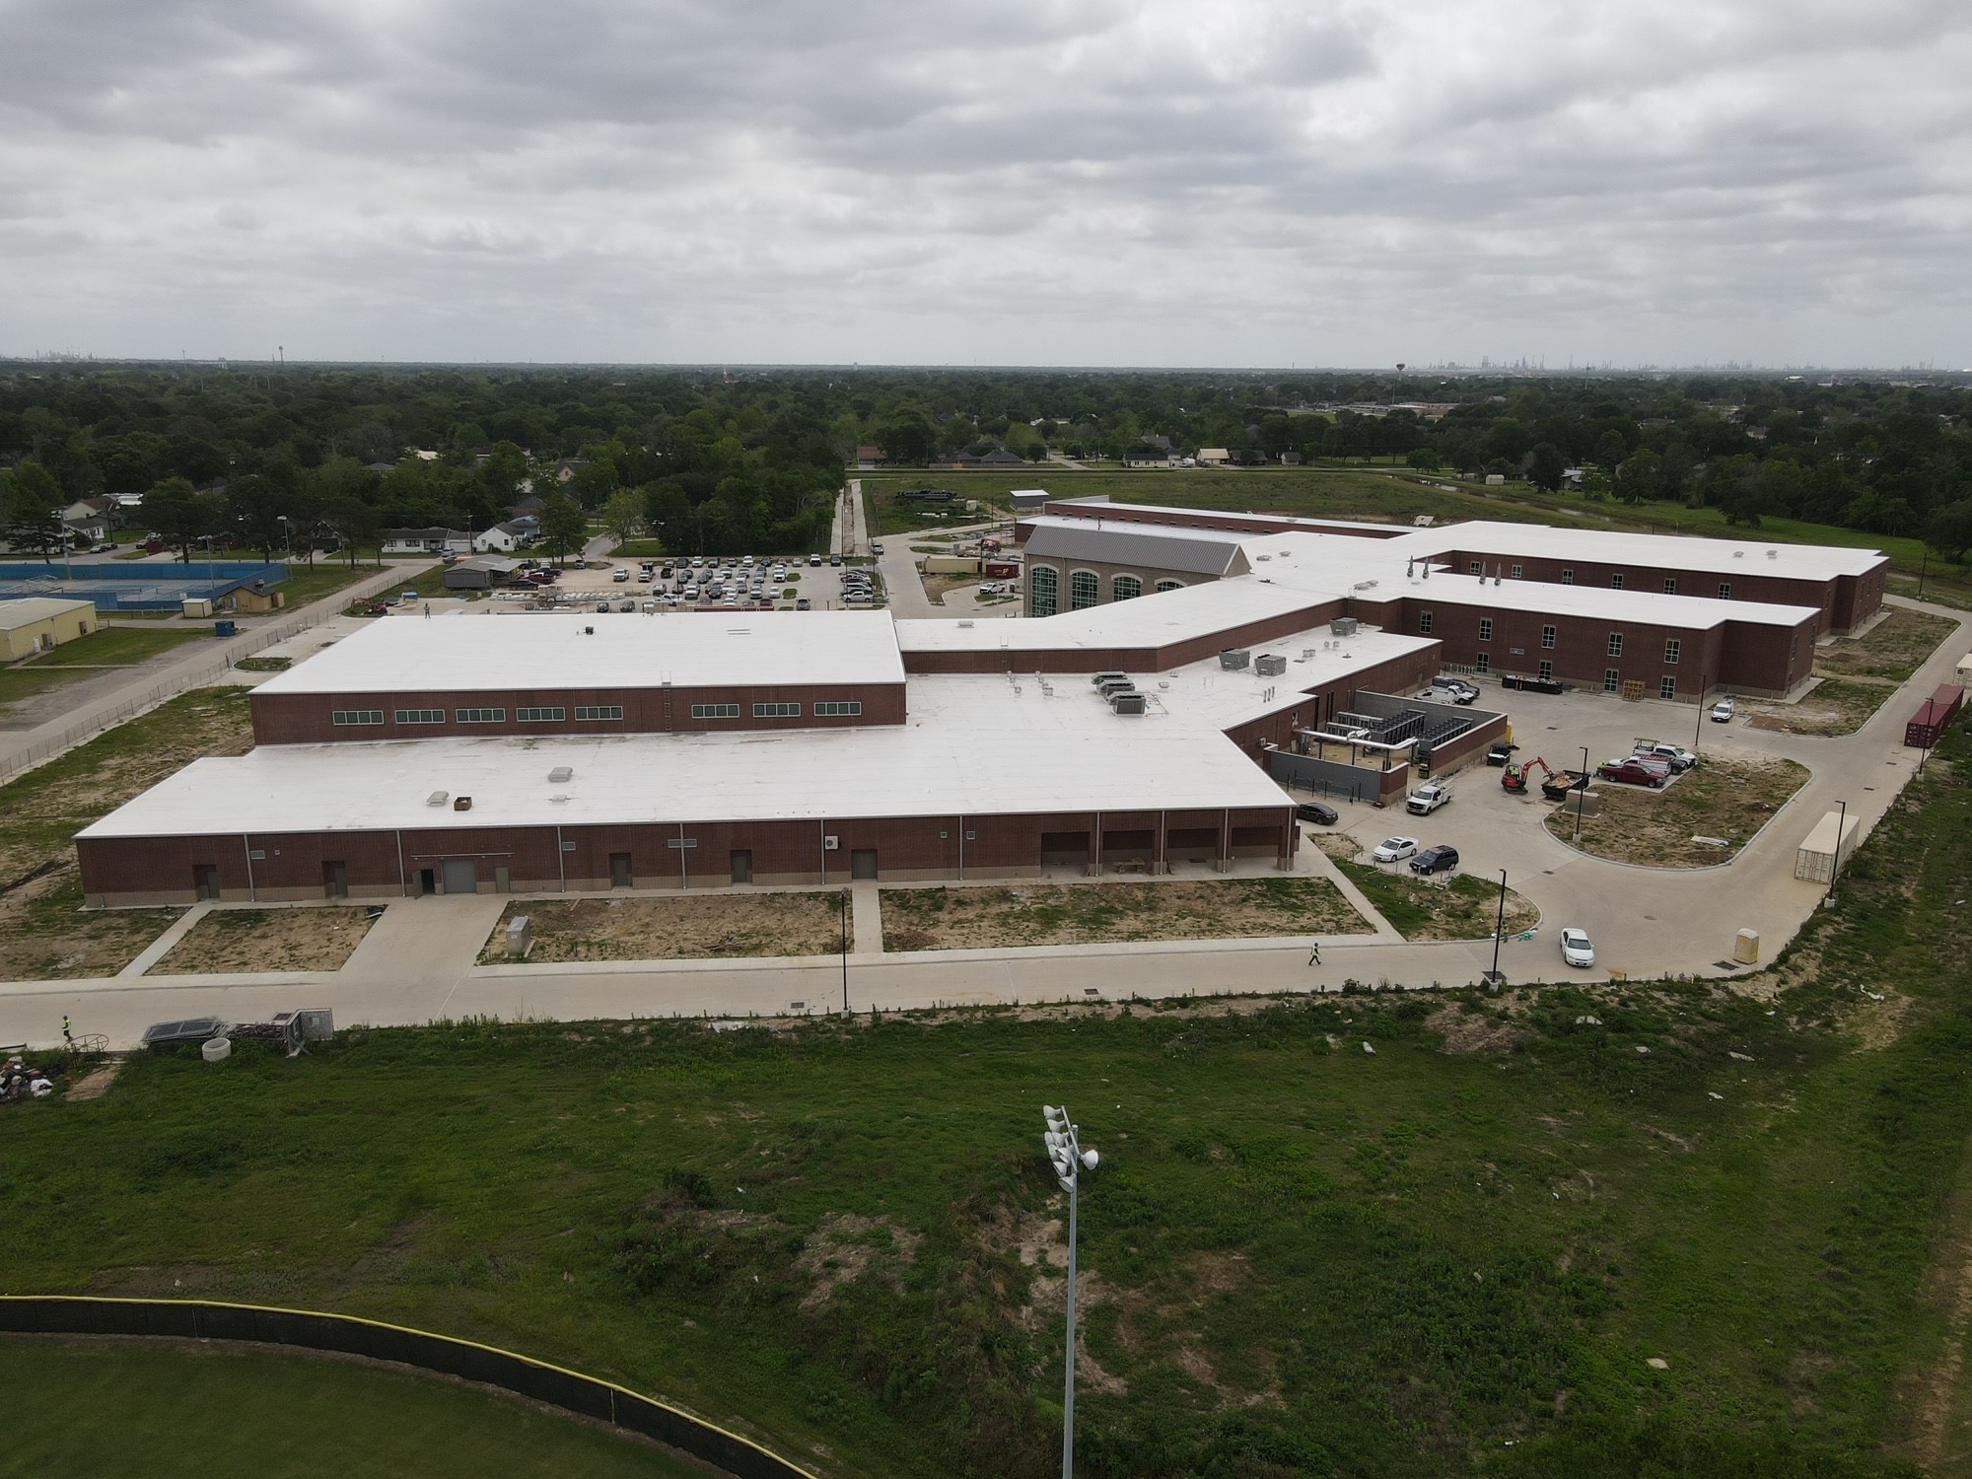
Nederland High School
Exterior
  Complete flashing/waterproofing/insulation for CTE wing.
  Complete brickwork for CTE building.
  Continue with brickwork in the front of the school.
  Continue with concrete flatwork around the school.
  Begin exterior handrails.

Slide 4
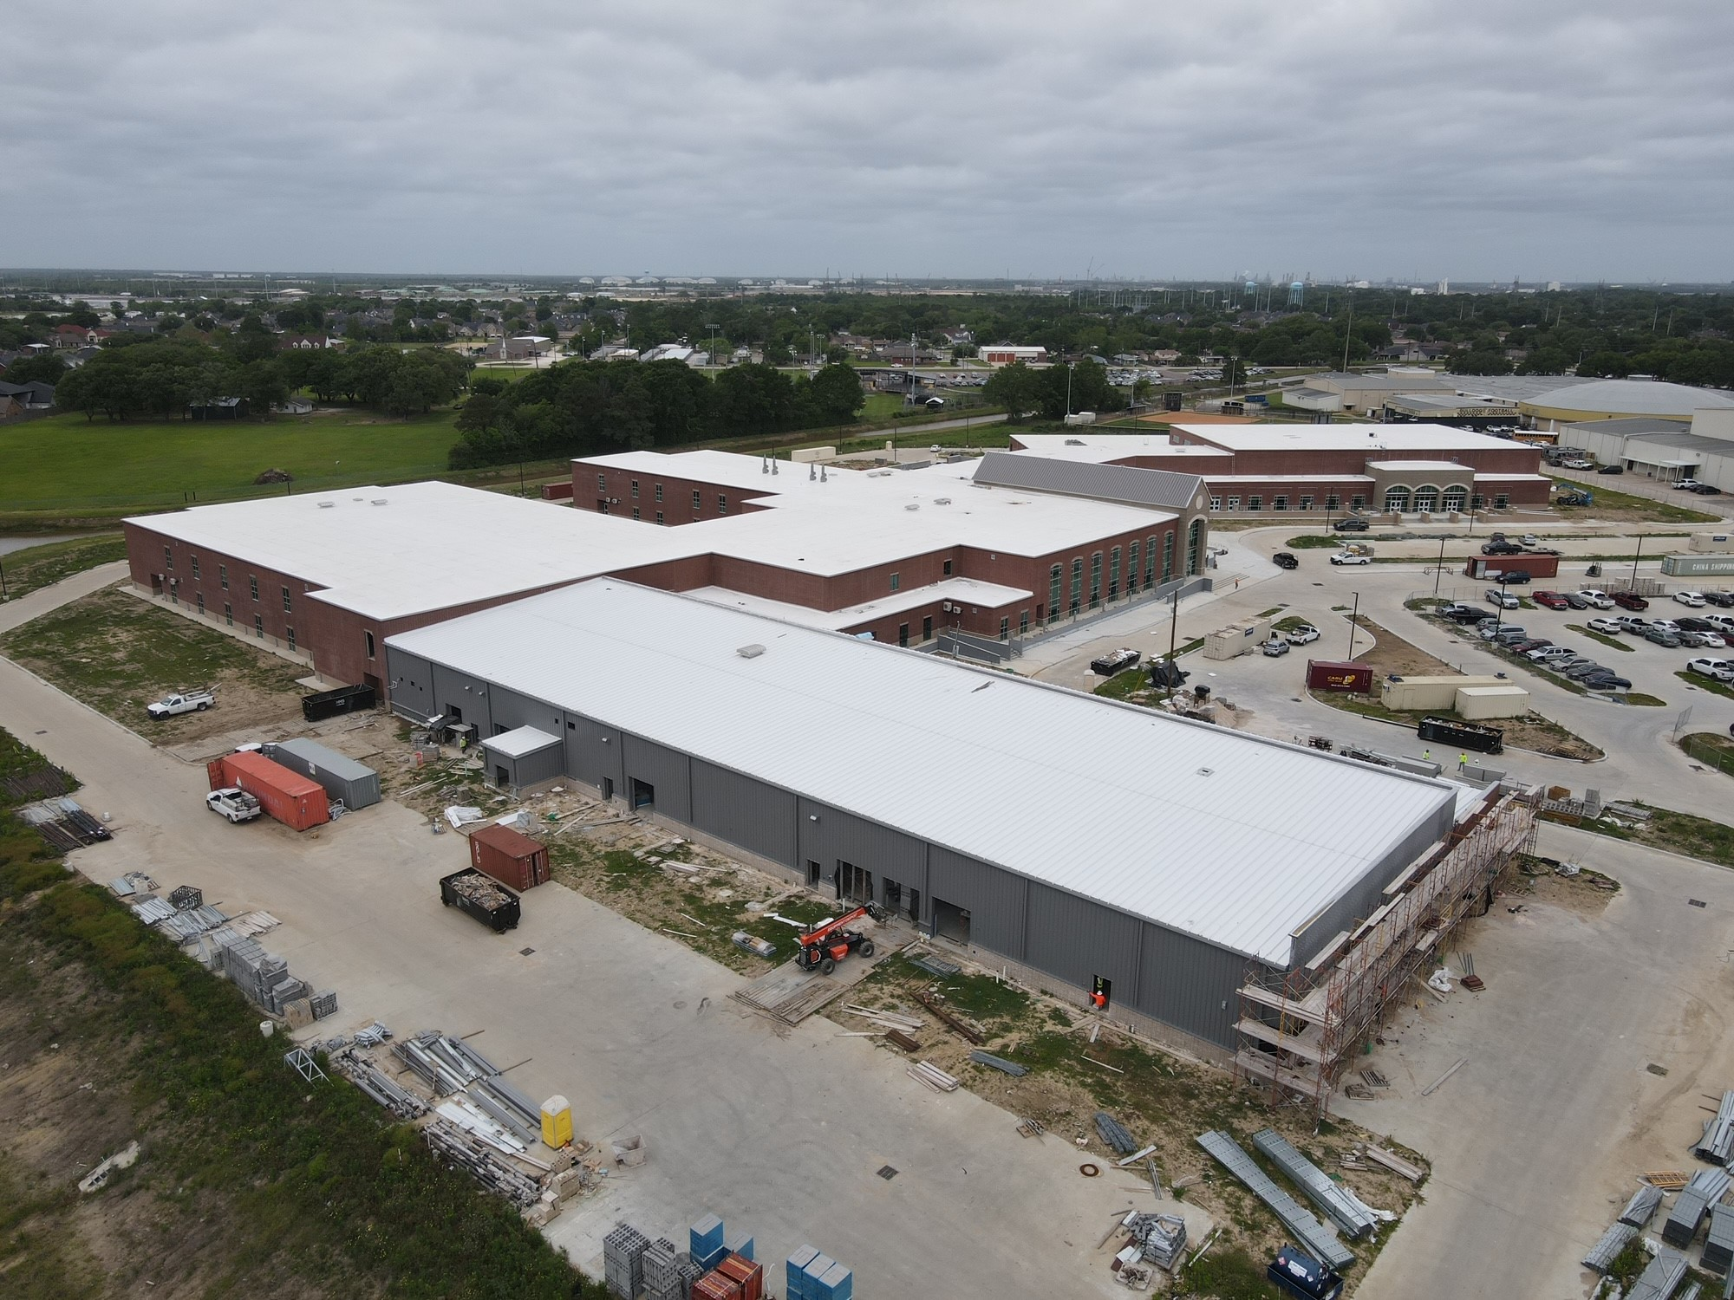
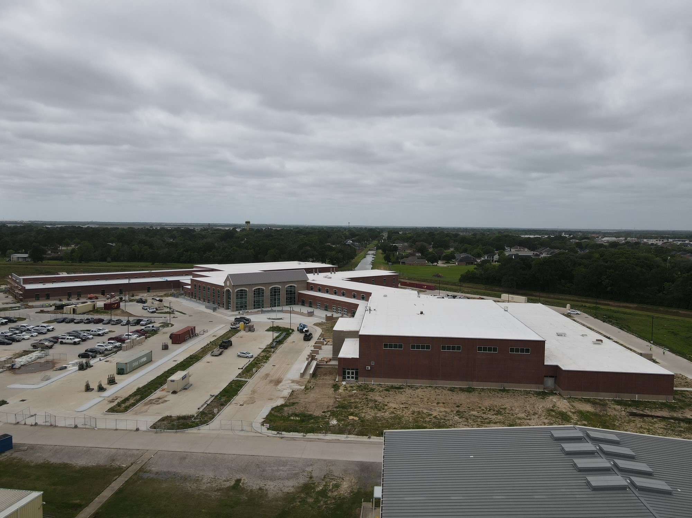
Nederland High School
Exterior
  Continue with Gutters and Downspouts.
  Continue installing storefront doors around the building.
  Finish CTE building roof and tie into structural steel.
  Continue with tying in Gutters with TPO roof membrane.

Slide 5
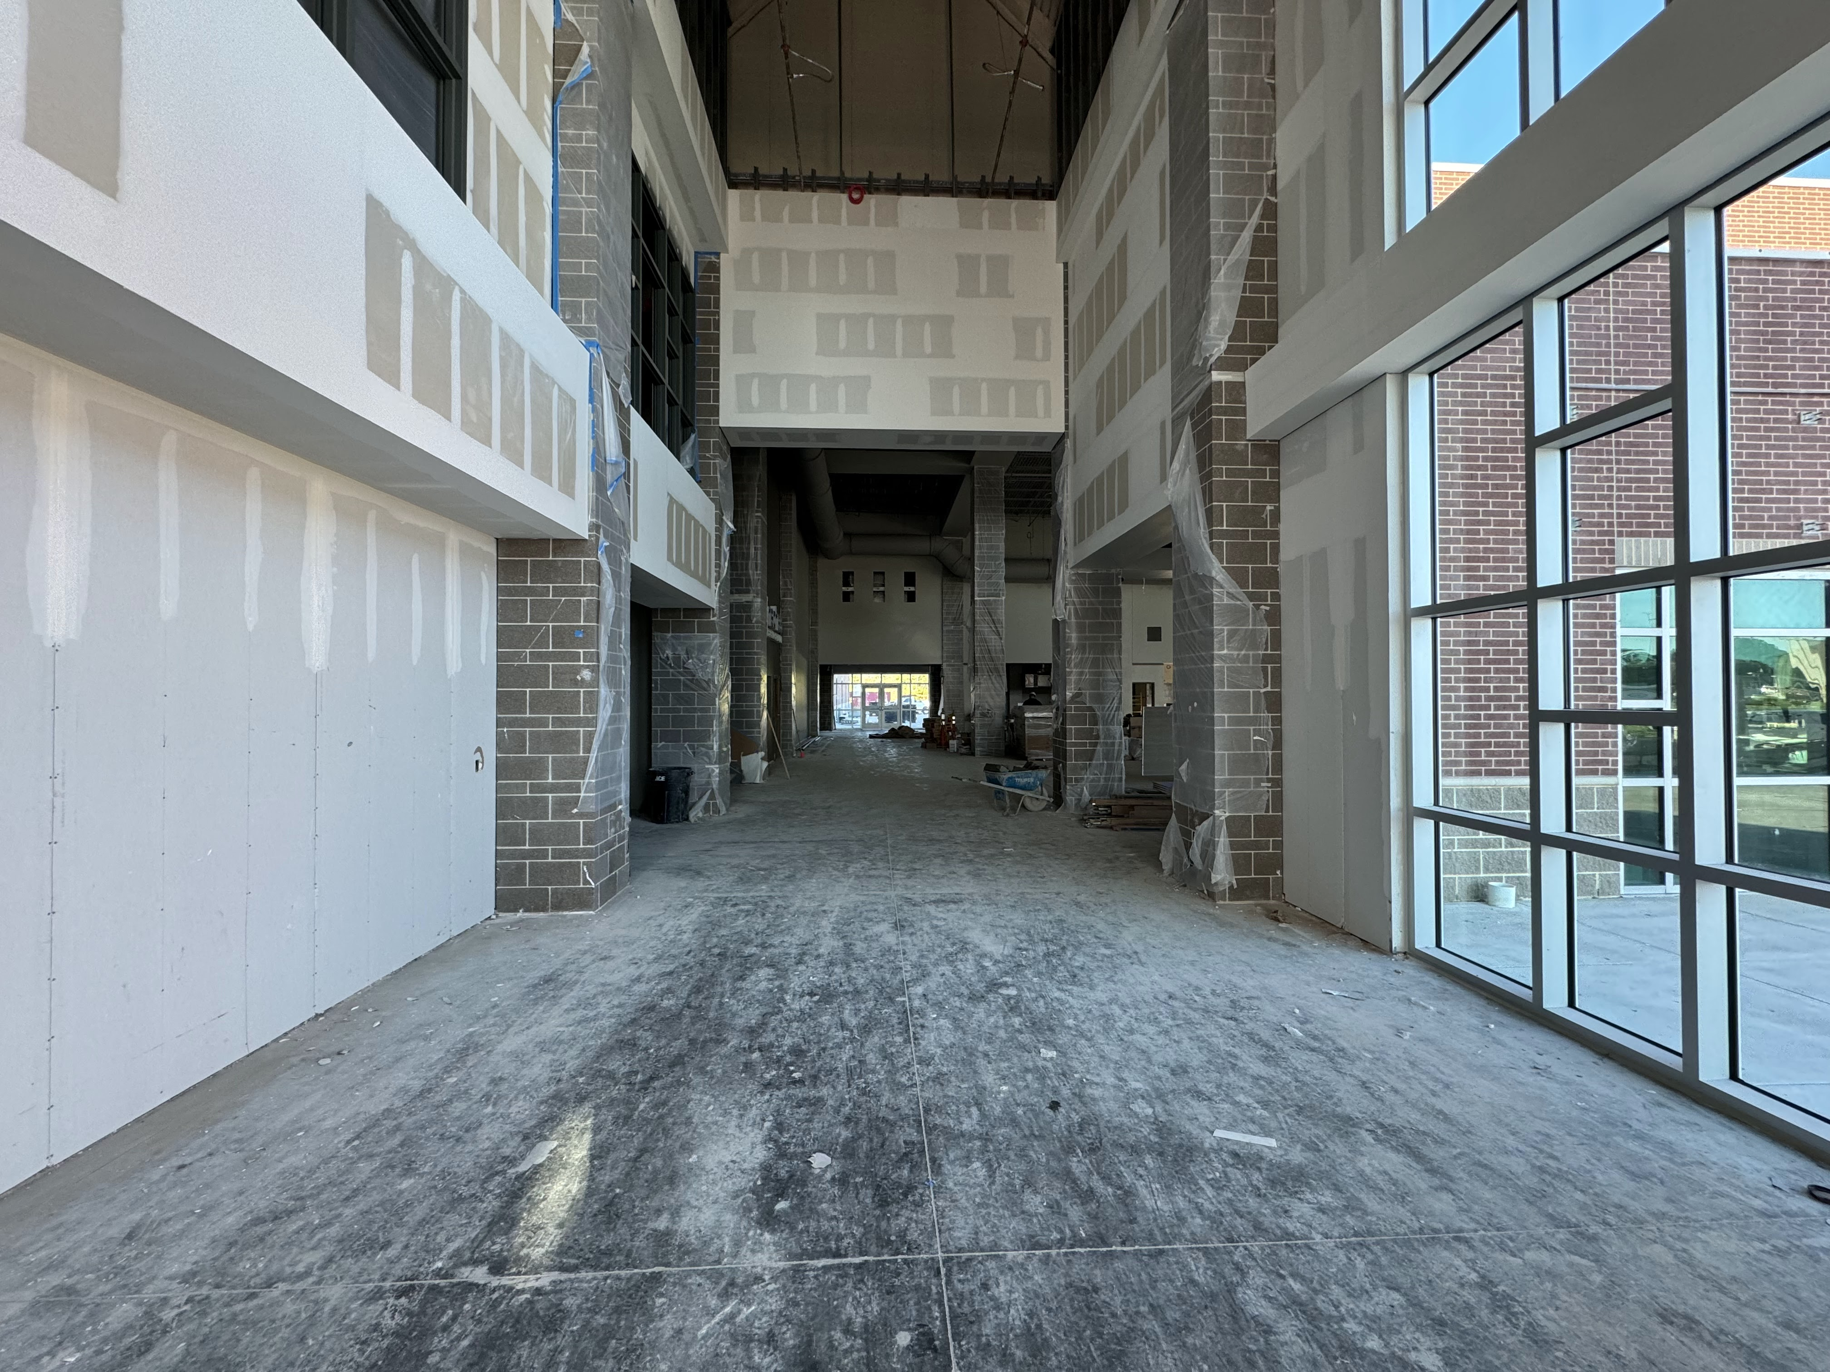
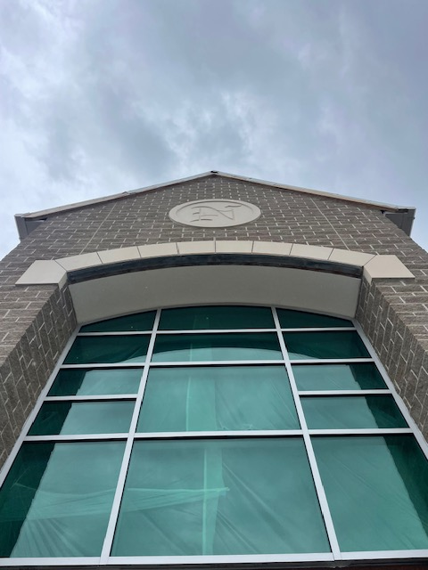
Nederland High School
  Continue installing duct work in B & A.
  Continue insulating MEP piping/ductwork throughout building
  Complete chiller piping throughout A/B.
  Continue with final coat of paint on second floor.
  E2 and C2 above ceiling inspection passed so we are beginning to pad out these areas.
  Begin flooring in E2 and C2 classrooms.
  Installation of roll up doors in CTE wing.

Slide 6
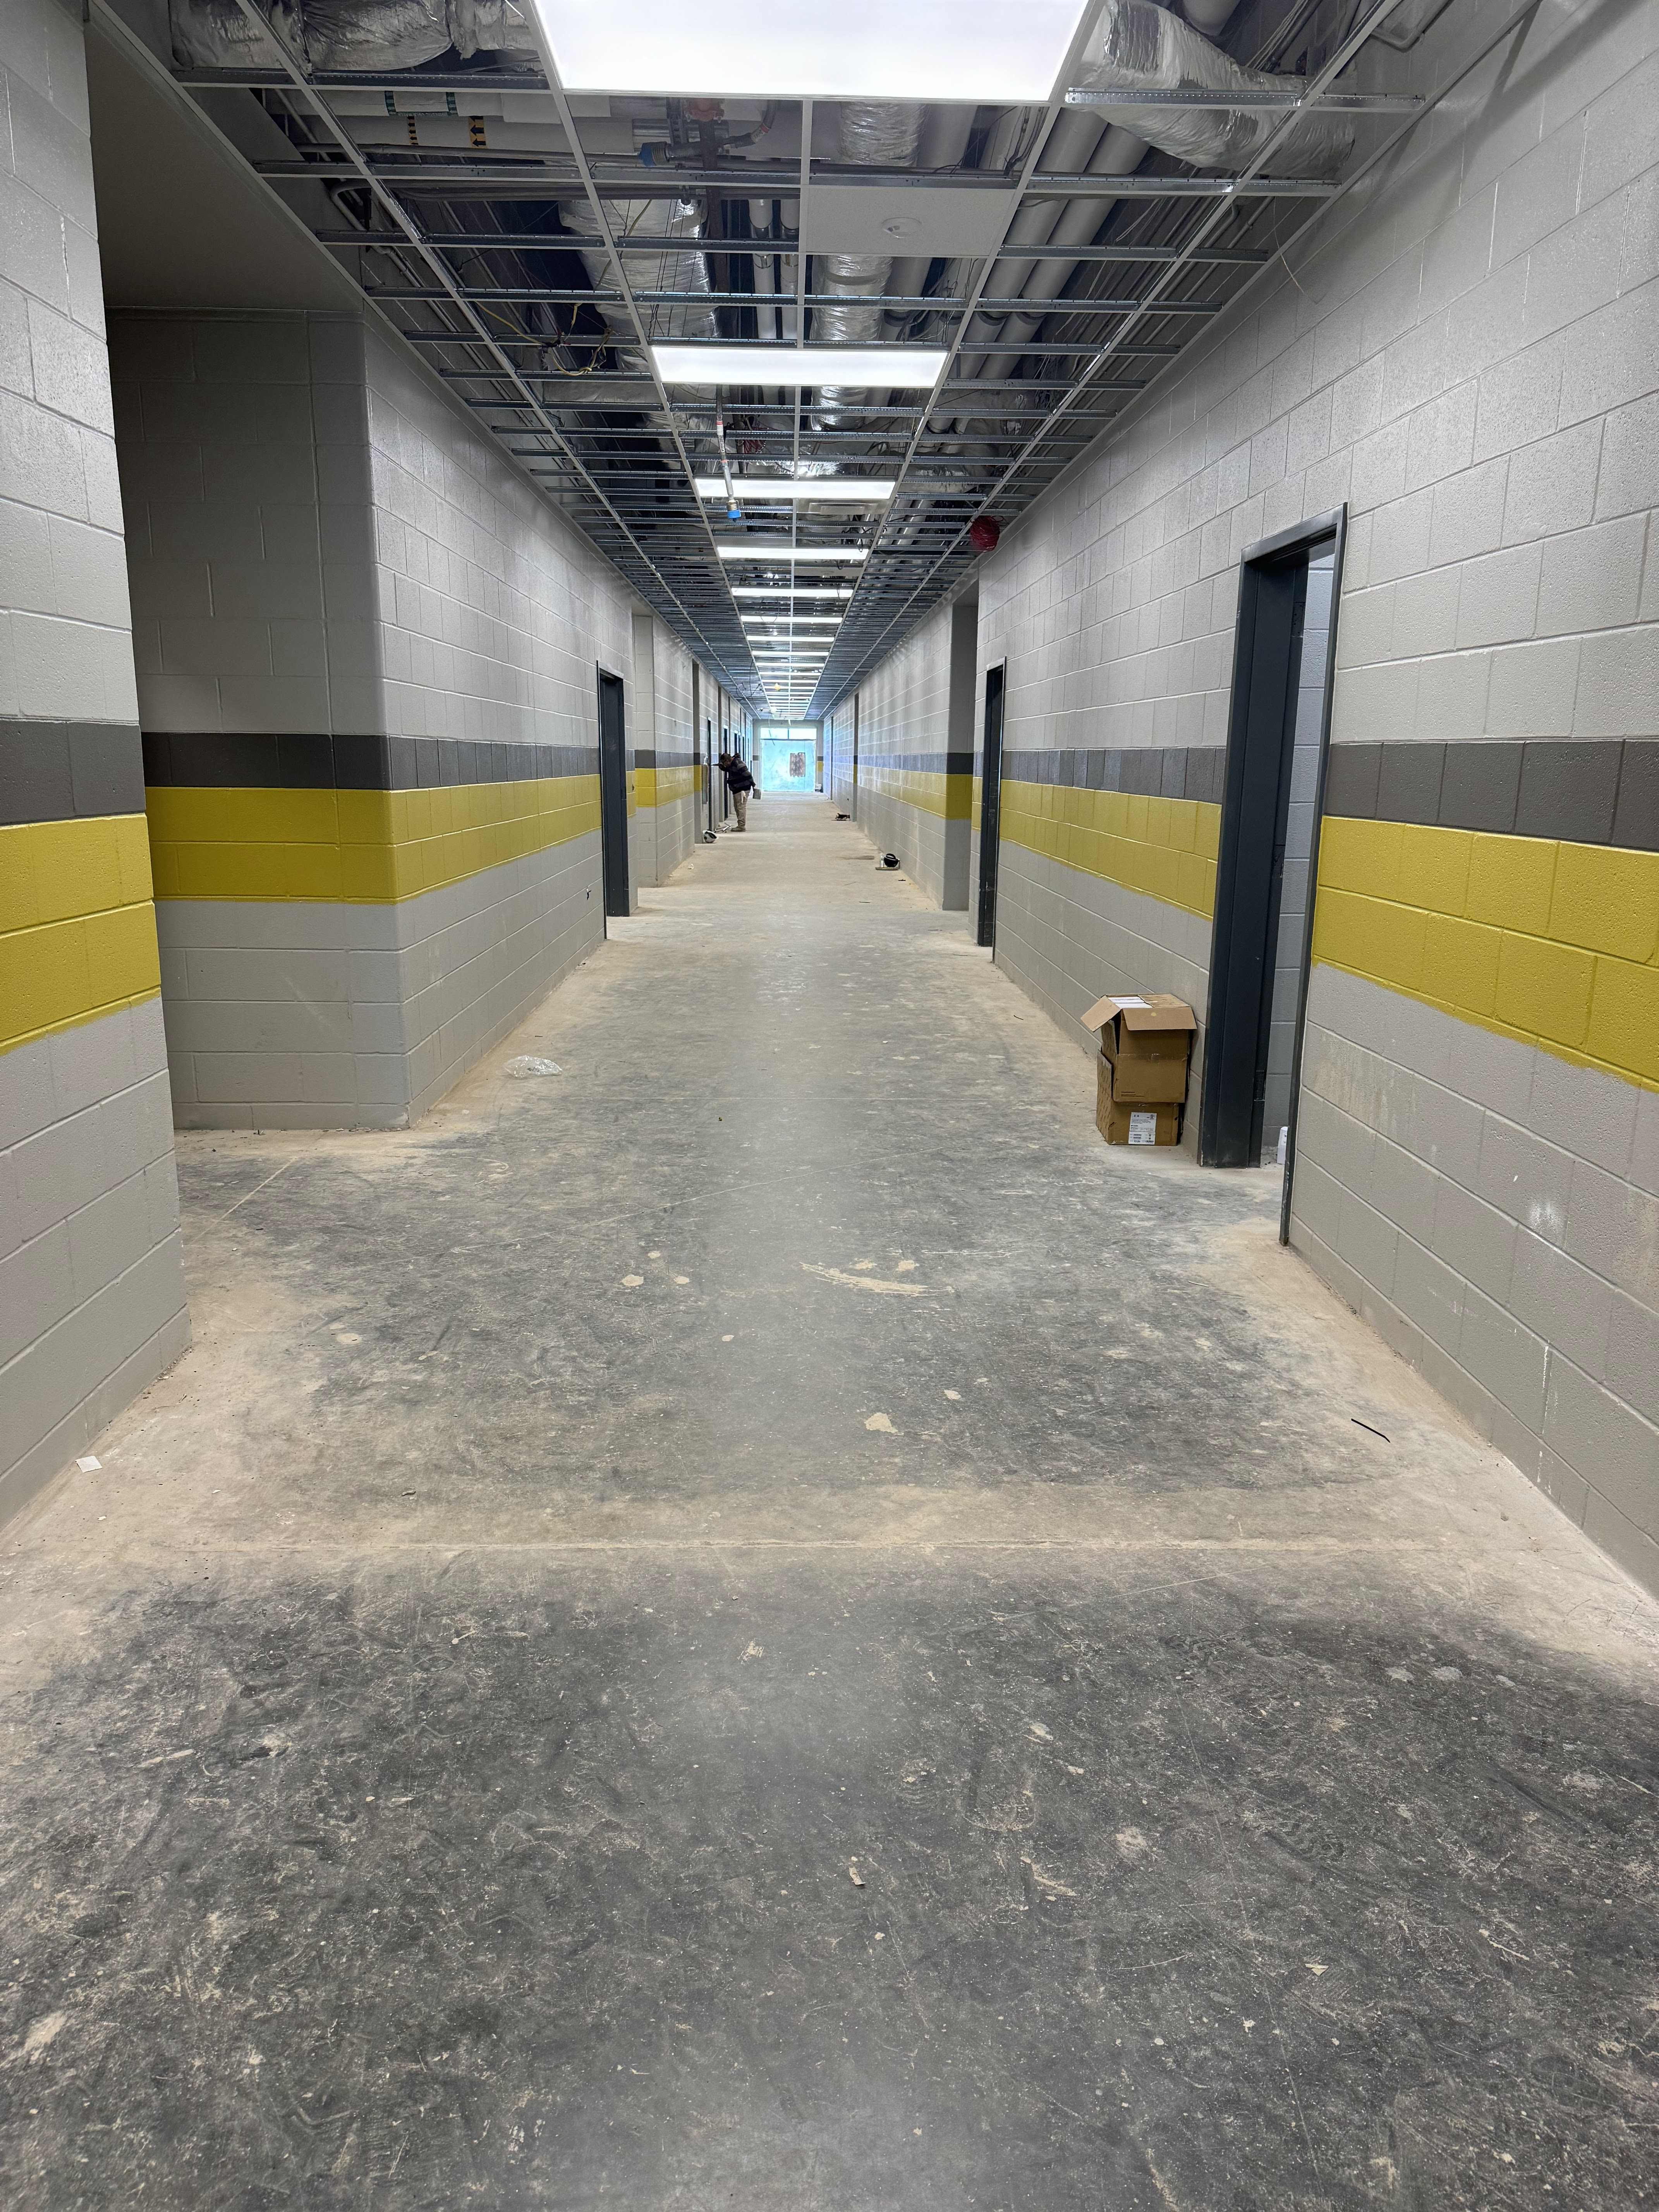
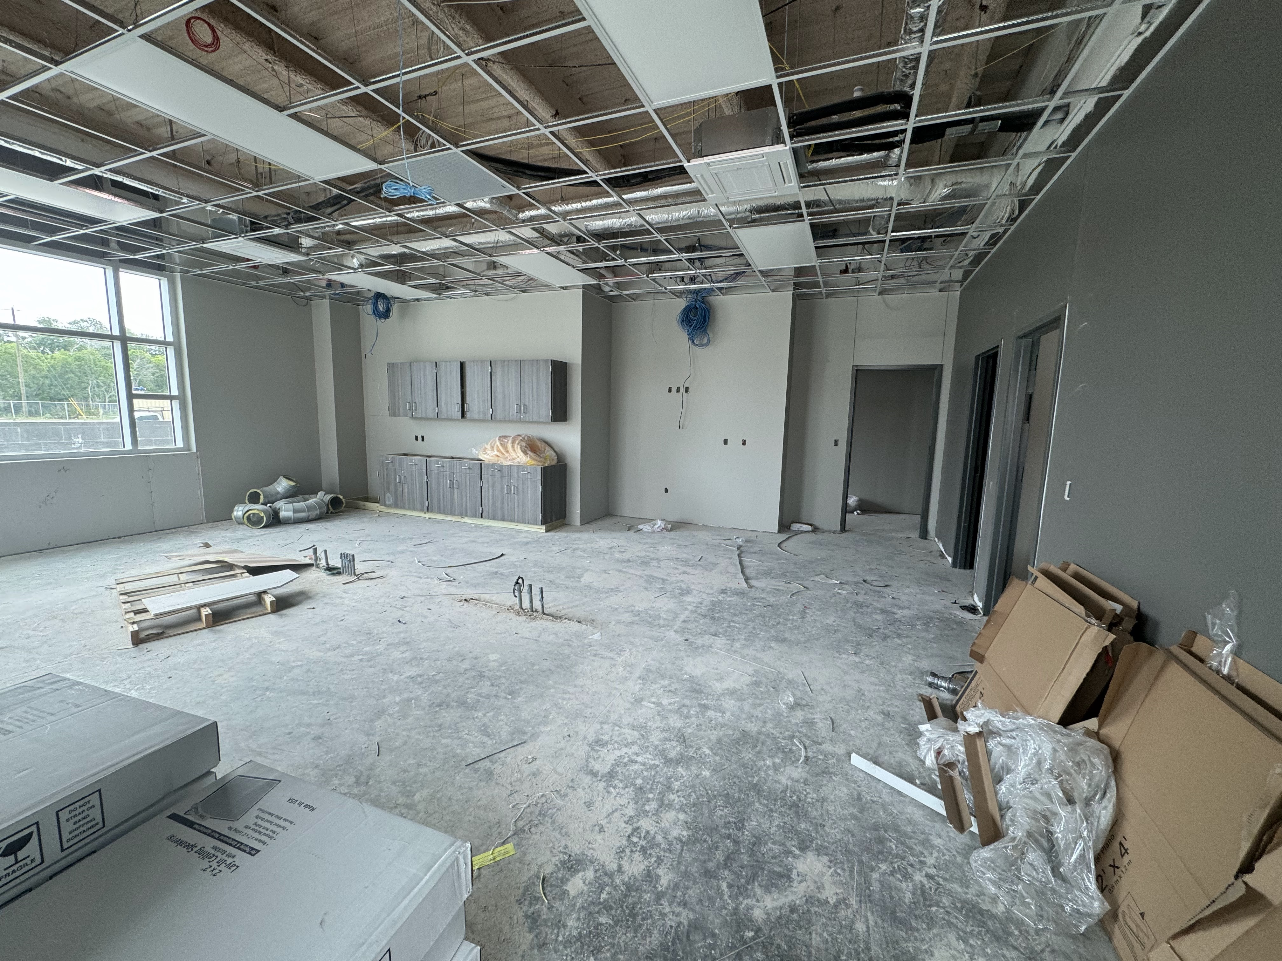
Nederland High School
  Continue installing ceilings in classrooms and hallways.
  Continue installing casework and countertops throughout the building.
  Continue installing light fixtures and grilles throughout the building.
  Continue interior framing and block walls for CTE wing.

Slide 7
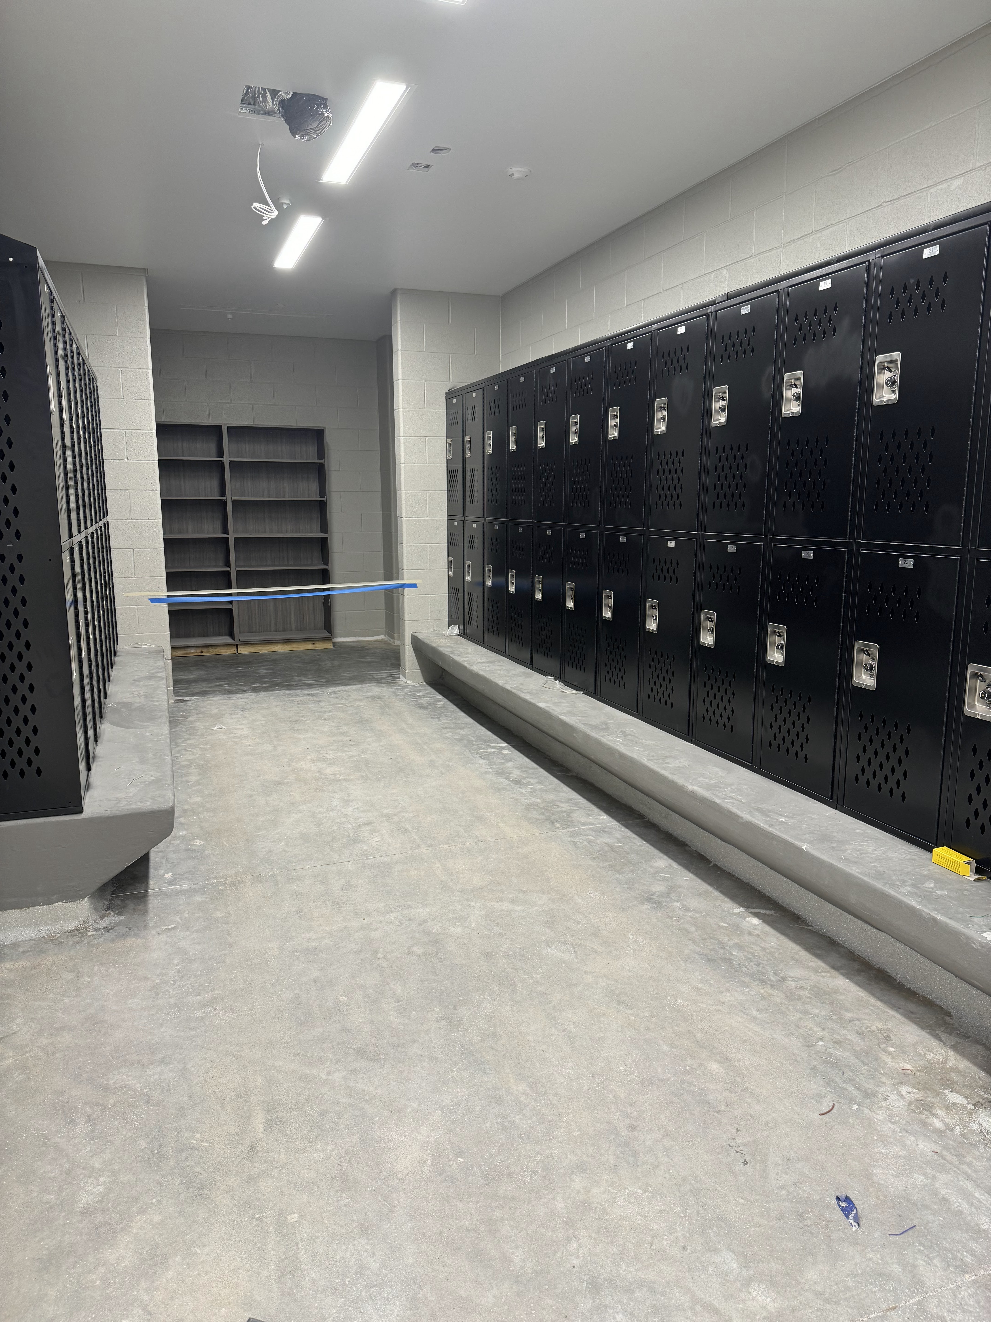
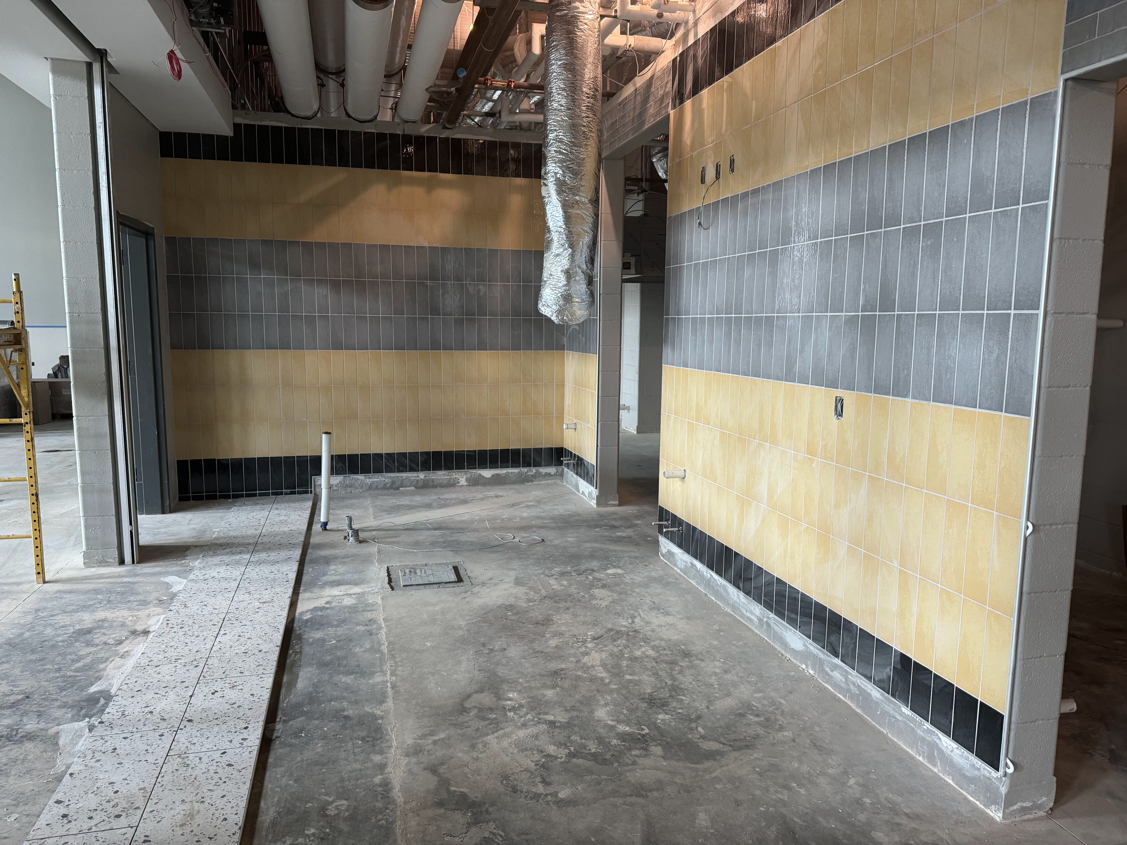
Nederland High School
Continue with Plumbing rough in.
Continue with Electrical rough in.
Begin installing doors/hardware throughout the building.
Continue with plumbing fixture installation.
Continue with AWC & Corner Guards throughout hallways.

Slide 8
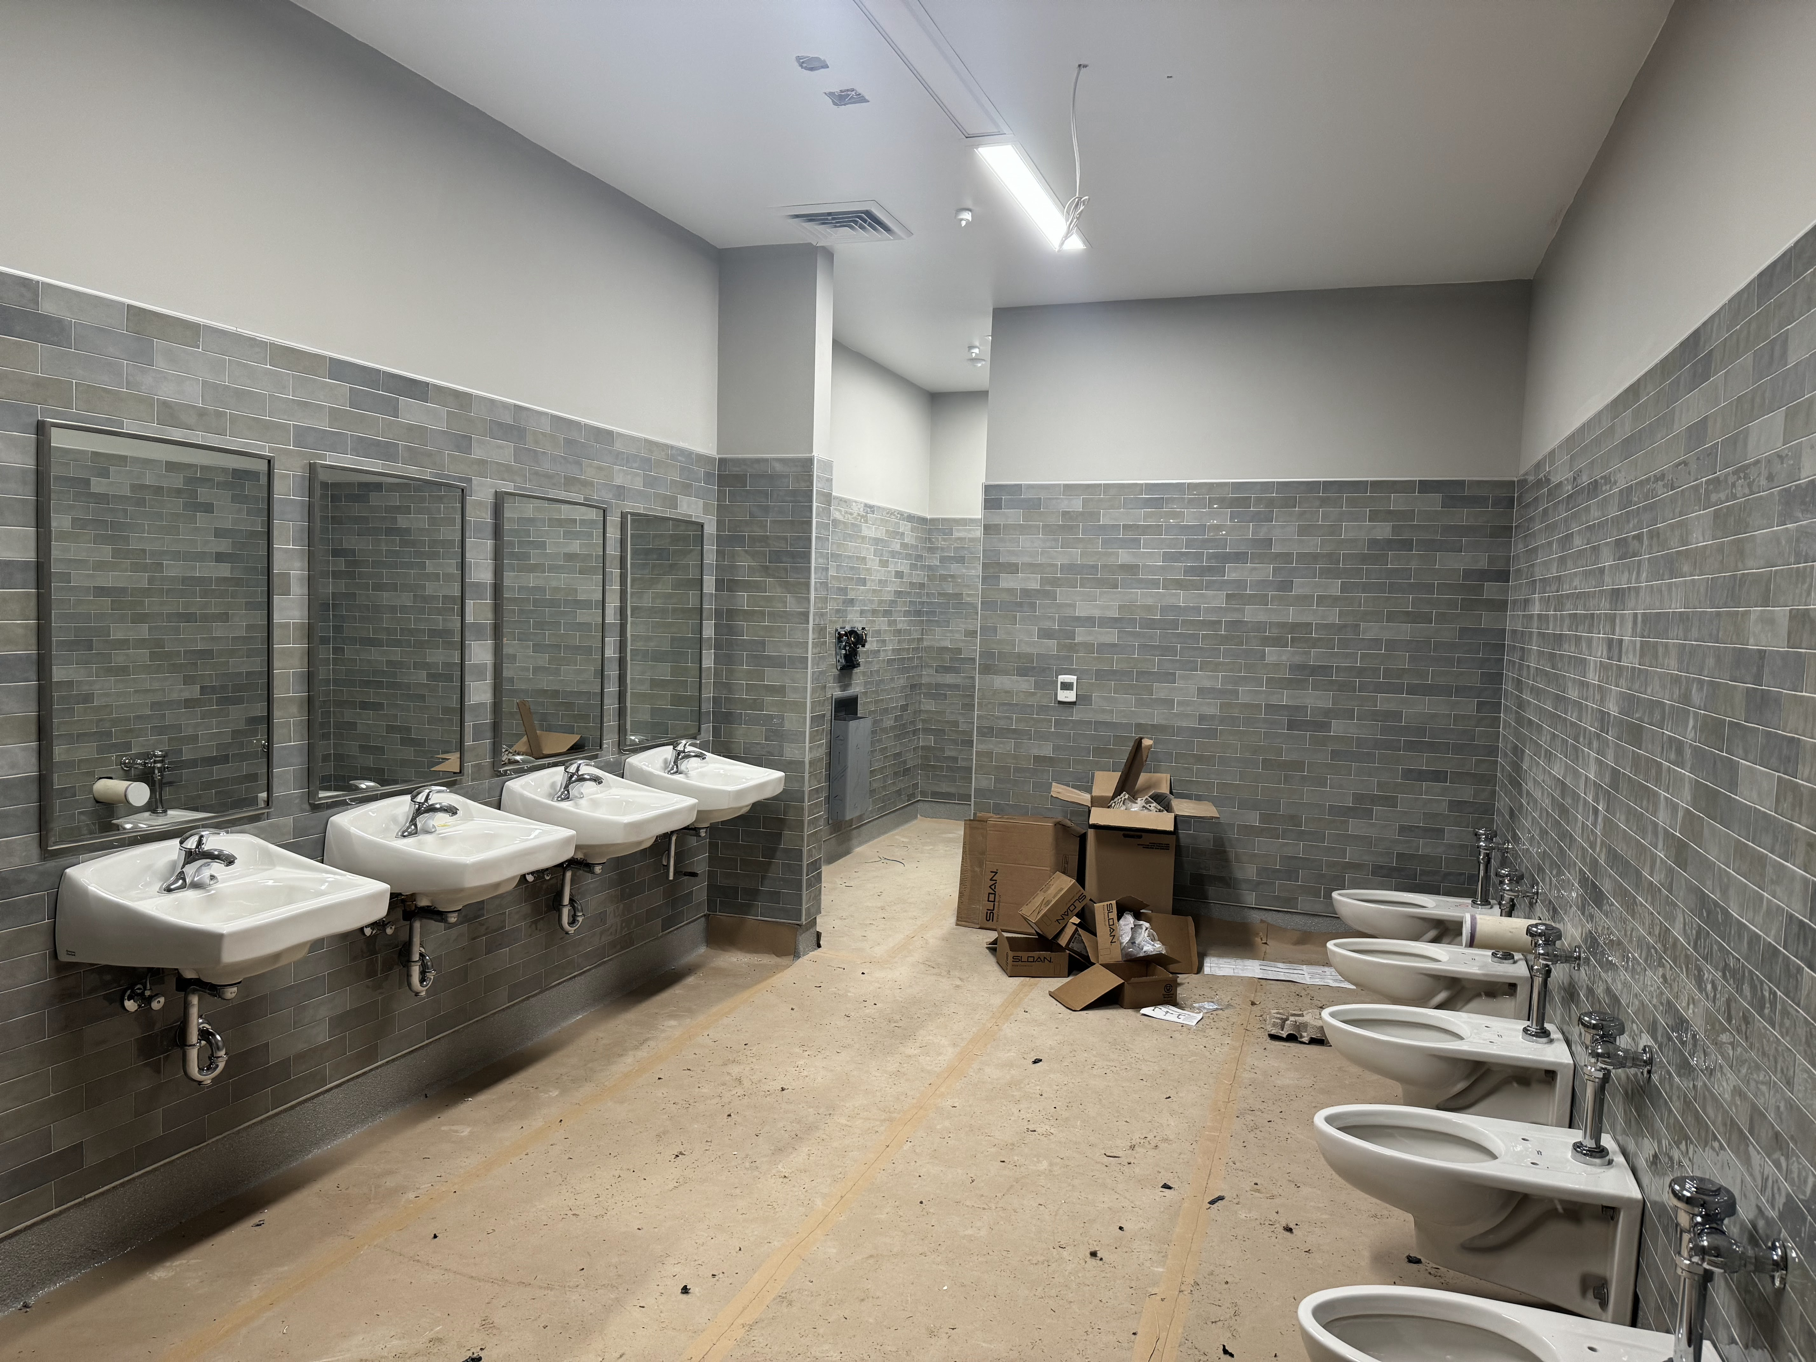
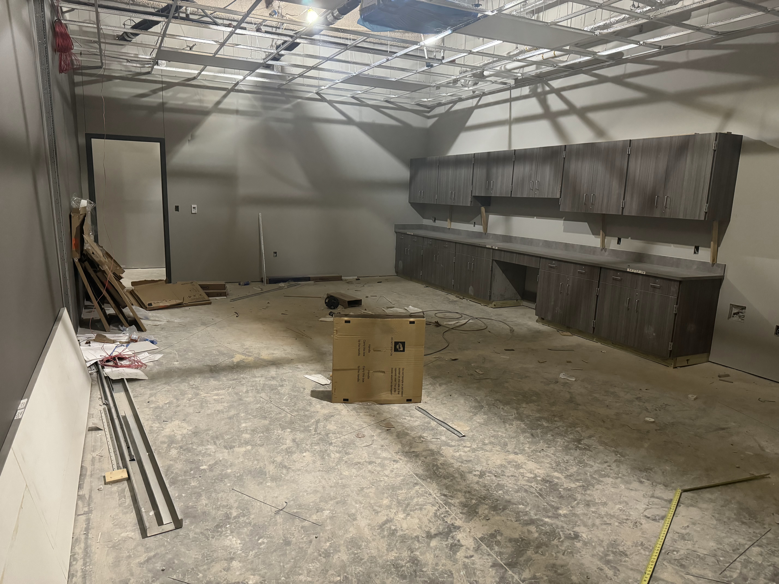
Nederland High School
Continue with Epoxy flooring.
Begin epoxy flooring in Kitchen.
Receive kitchen equipment and begin installation.
Finish casework in athletics area.

Slide 9


