Slide 1




2019 Nederland ISD Bond Project
May 2024

Slide 2

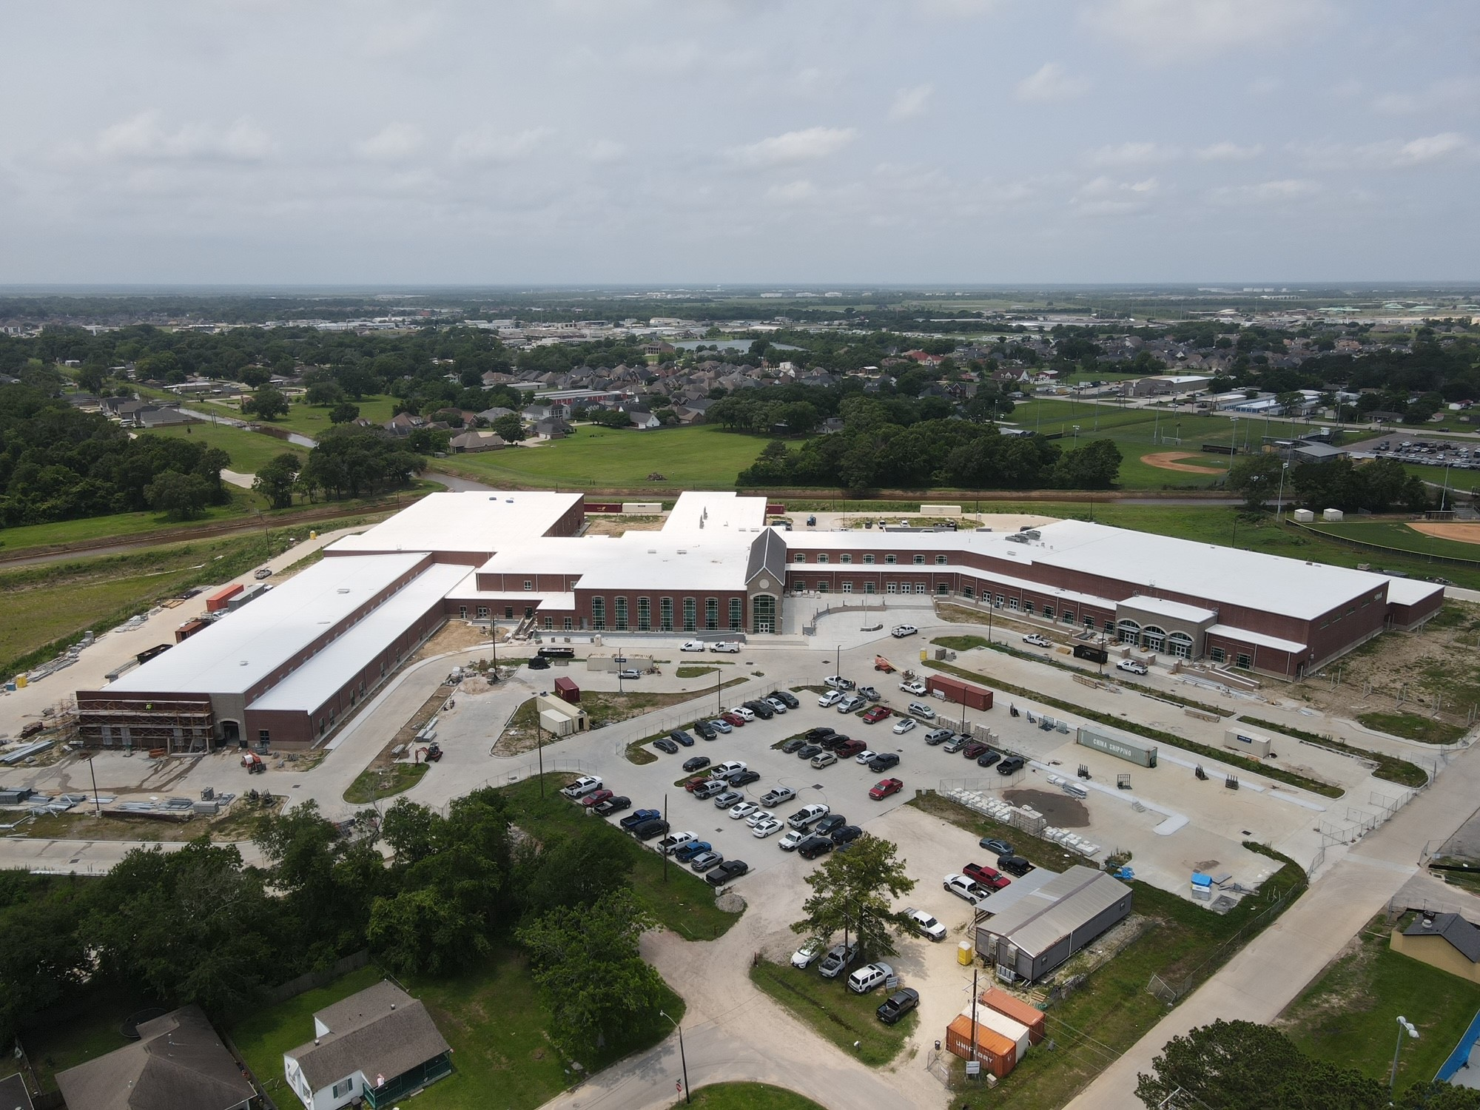
Nederland High School

Slide 3
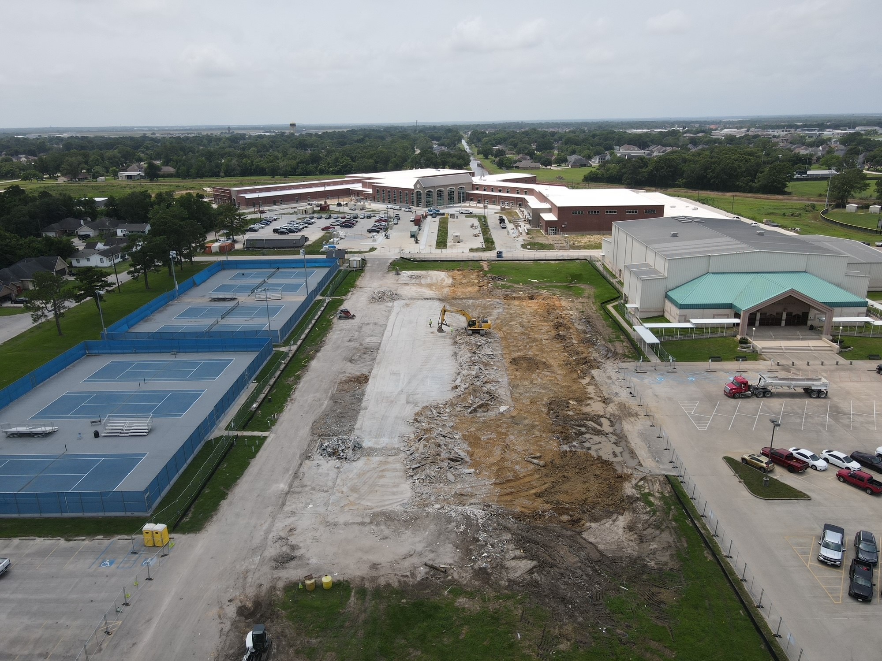
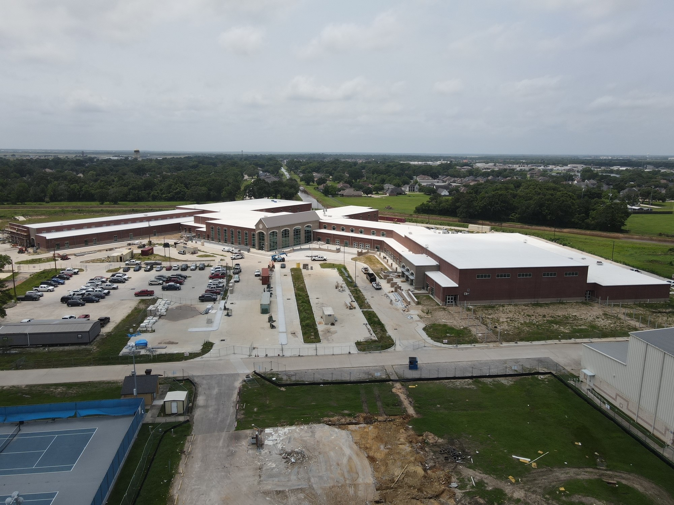
Nederland High School
Exterior
  Complete flashing/waterproofing/insulation for CTE wing.
  Complete brickwork for CTE building.
  Continue with brickwork in the front of the school.
  Continue with concrete flatwork around the school.
  Begin exterior handrails.

Slide 4
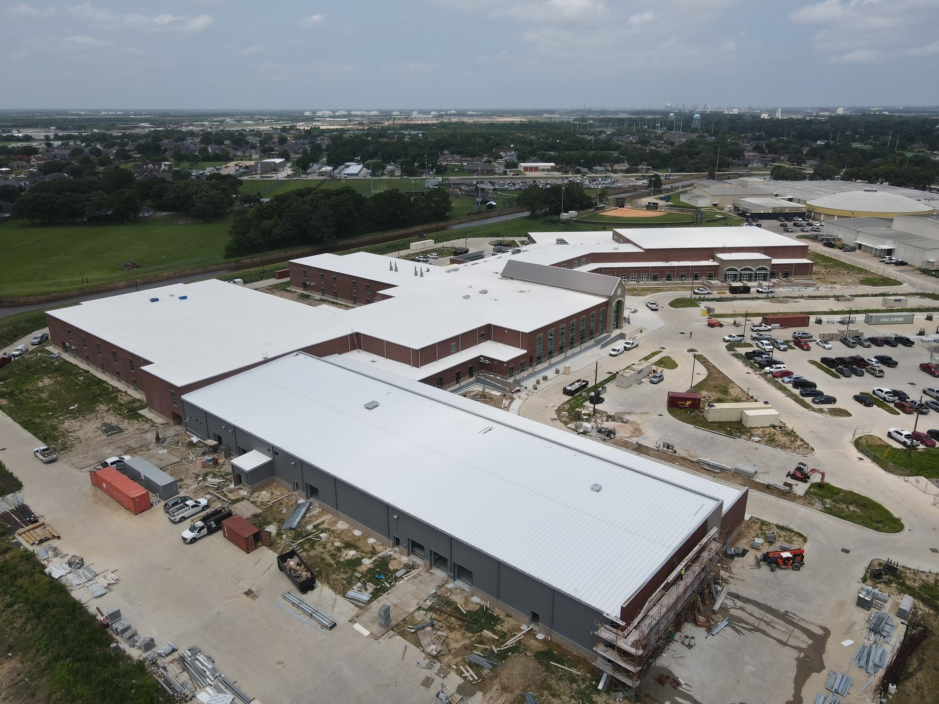
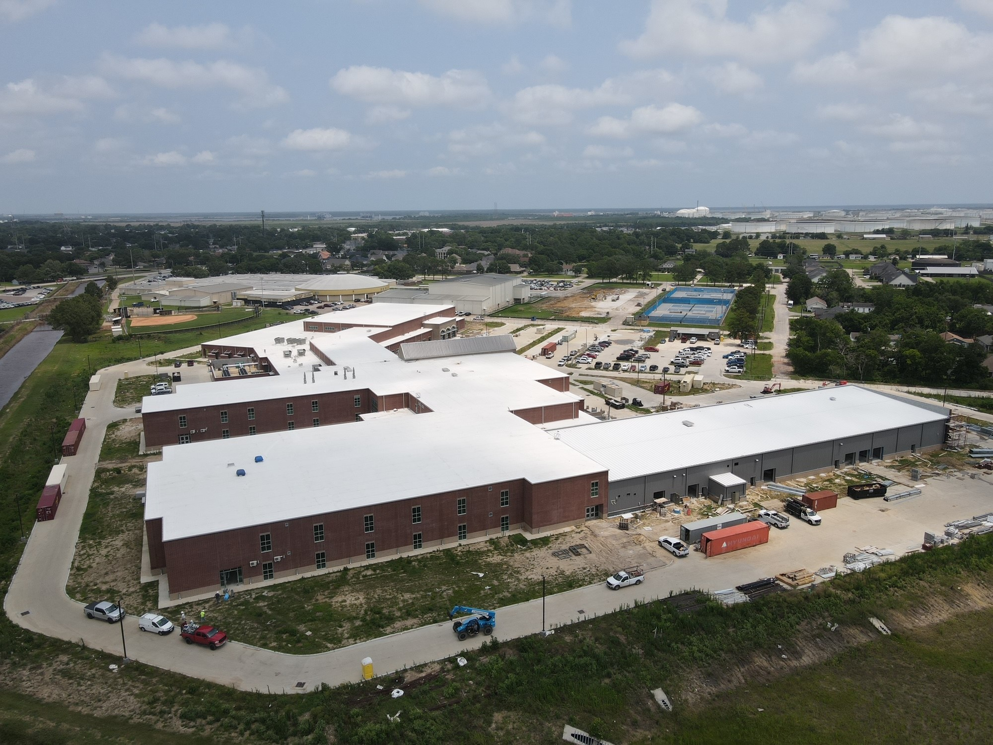
Nederland High School
Exterior
  Continue with Gutters and Downspouts.
  Continue installing storefront doors around the building.
  Continue with tying in Gutters with TPO roof membrane.
Exterior
  Demo Crew to de-mobilize at old CTE wing
  Sitework crew to mobilize next week and begin storm drain under new campus driveway
  Canopy installation to continue around new building

Slide 5
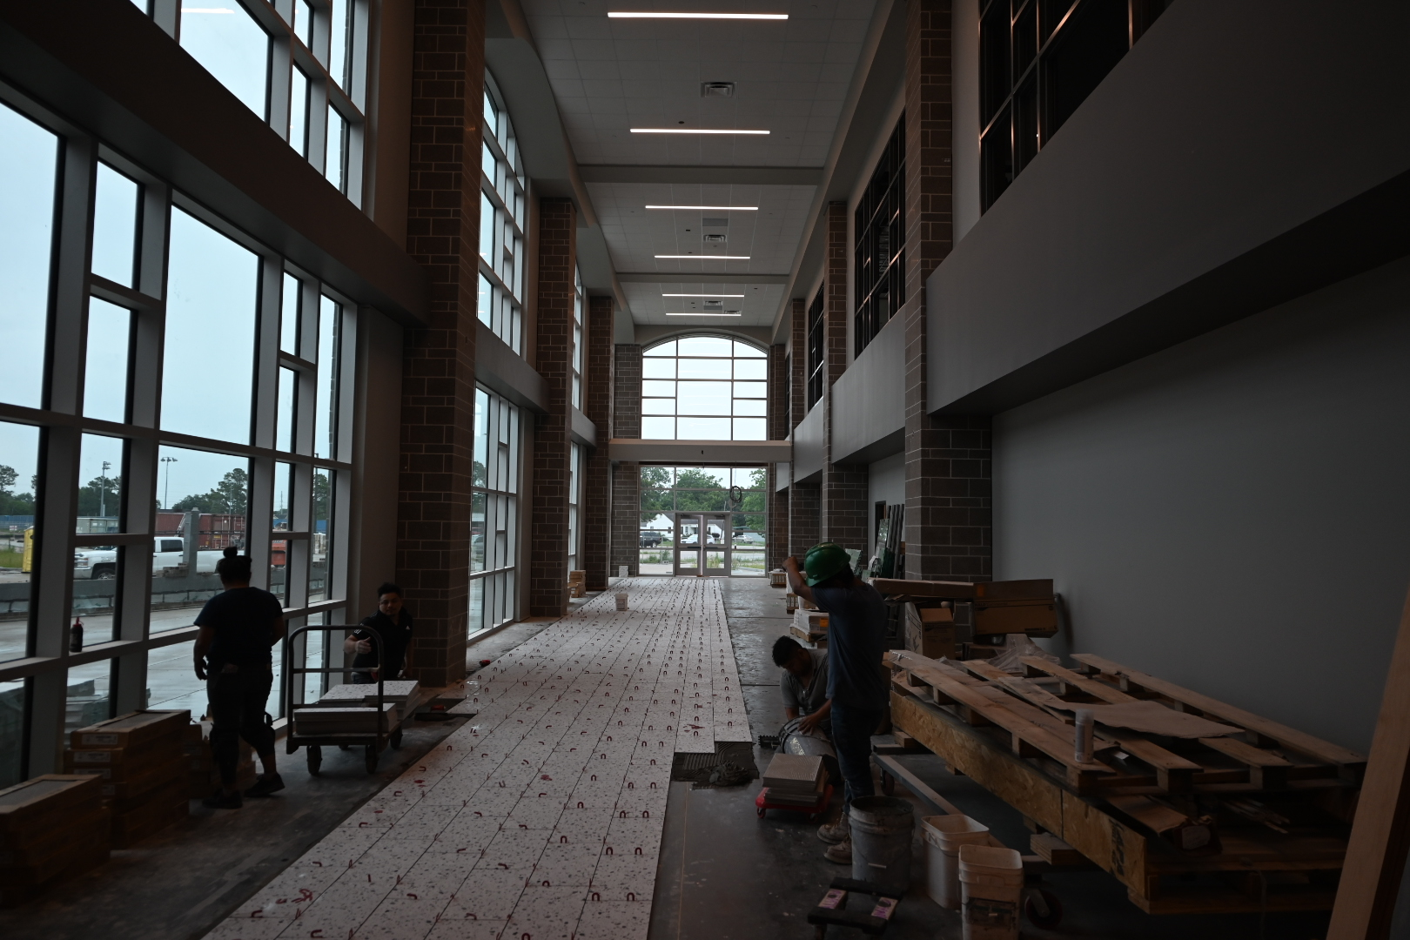
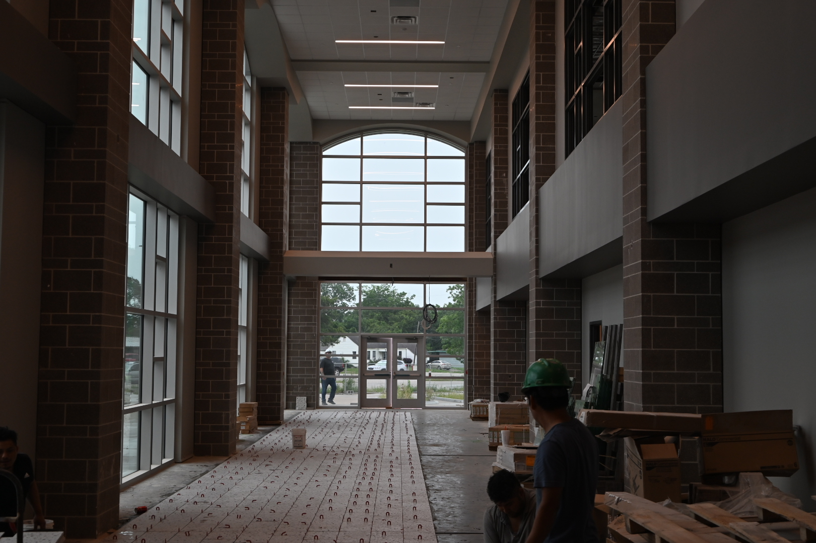
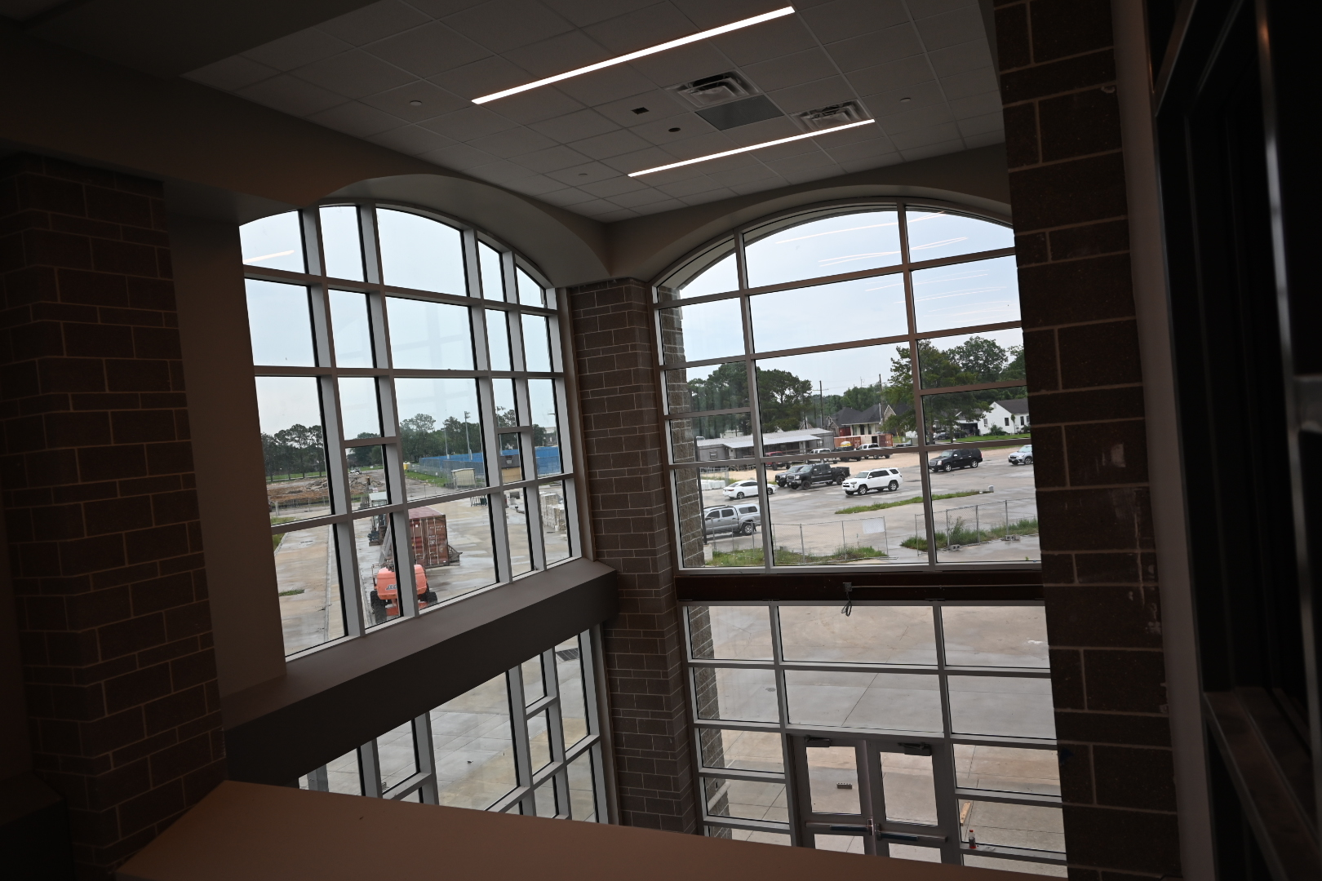
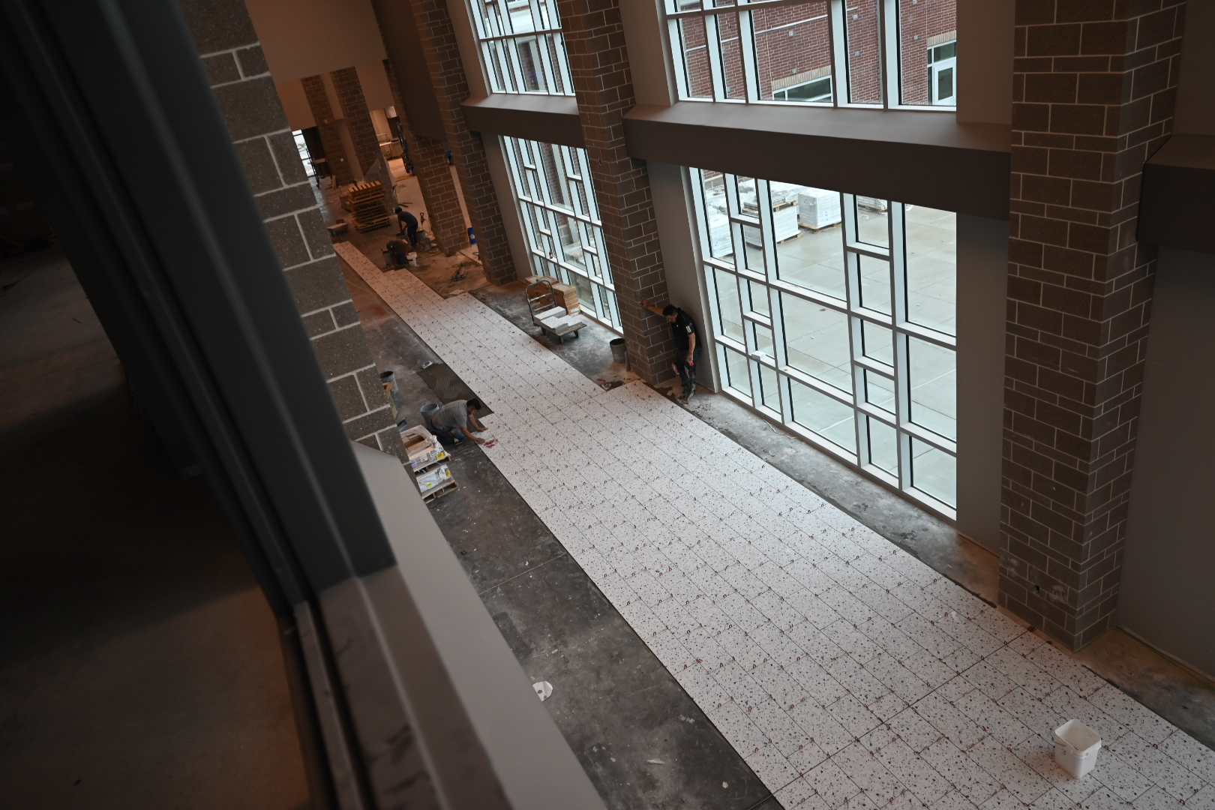
Nederland High School
  Continue installing duct work in B & A.
  Complete chiller piping throughout A/B.
  7/8 VRF units operational Friday 5/17/24
  Last HVAC unit to be operational 5/22/24
  Complete Café/Kitchen Ceilings
  Complete flooring in Area D
  Installation of roll up doors in CTE wing.

Slide 6
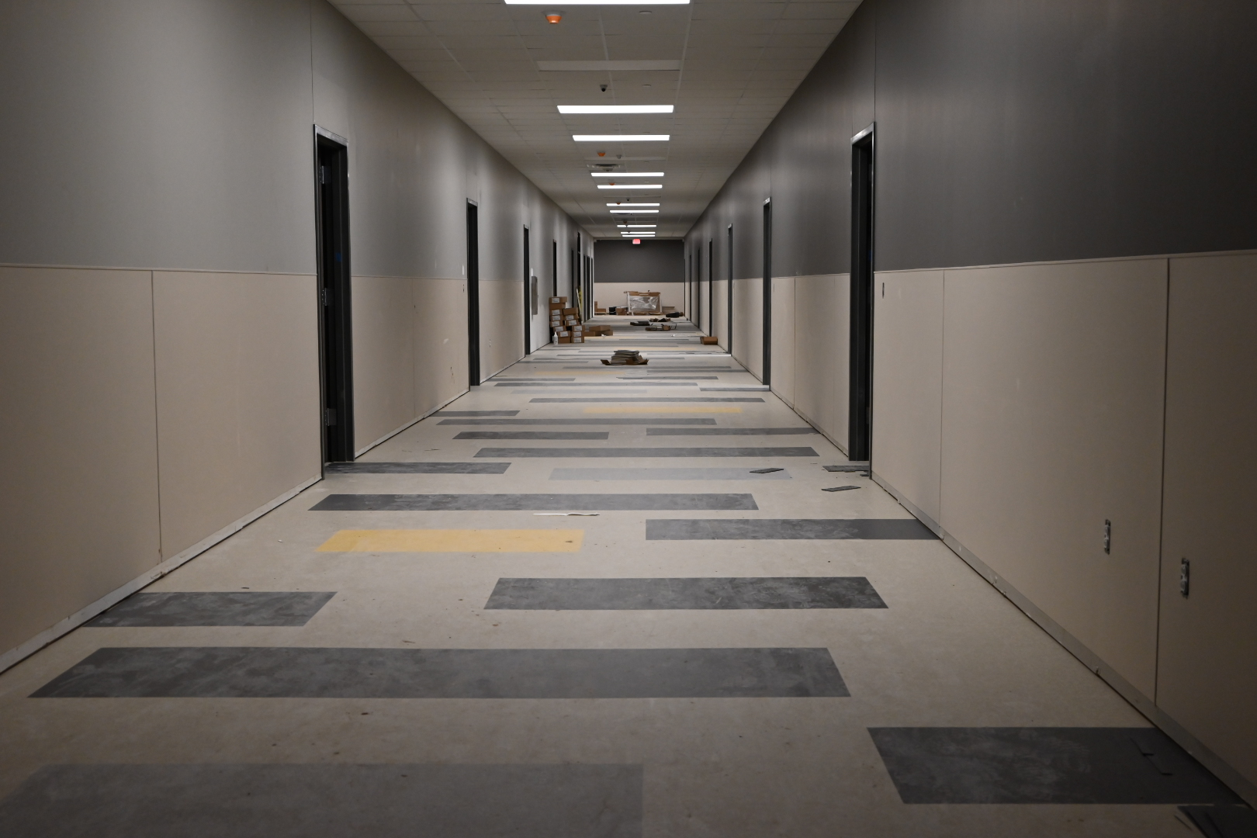
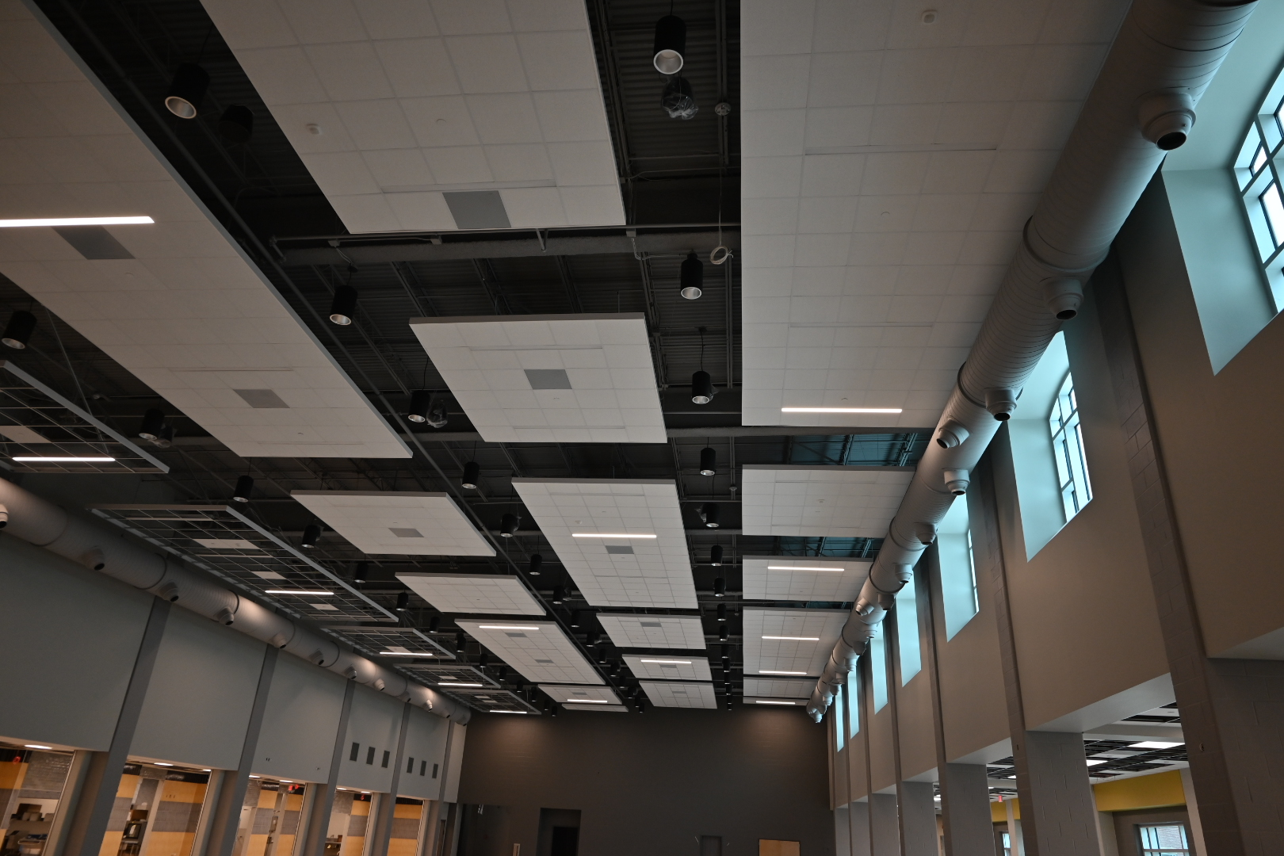
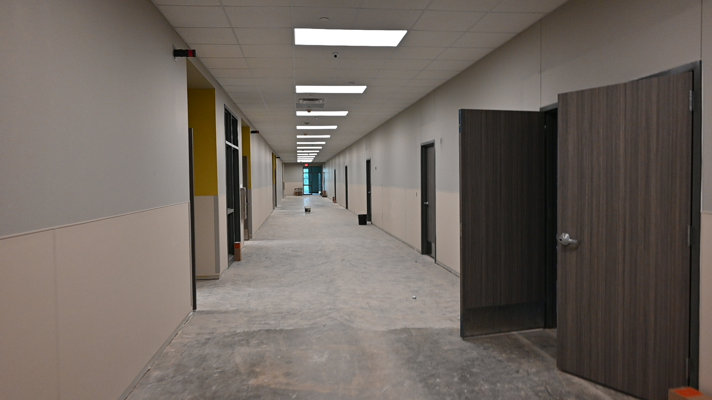
Nederland High School
  Continue installing ceilings in classrooms and hallways in areas C,D,E,F,G,H,J
  Complete installing casework and countertops throughout the building.
  Complete installing light fixtures and grilles throughout the building.
  Continue interior framing and block walls for CTE wing.

Slide 7
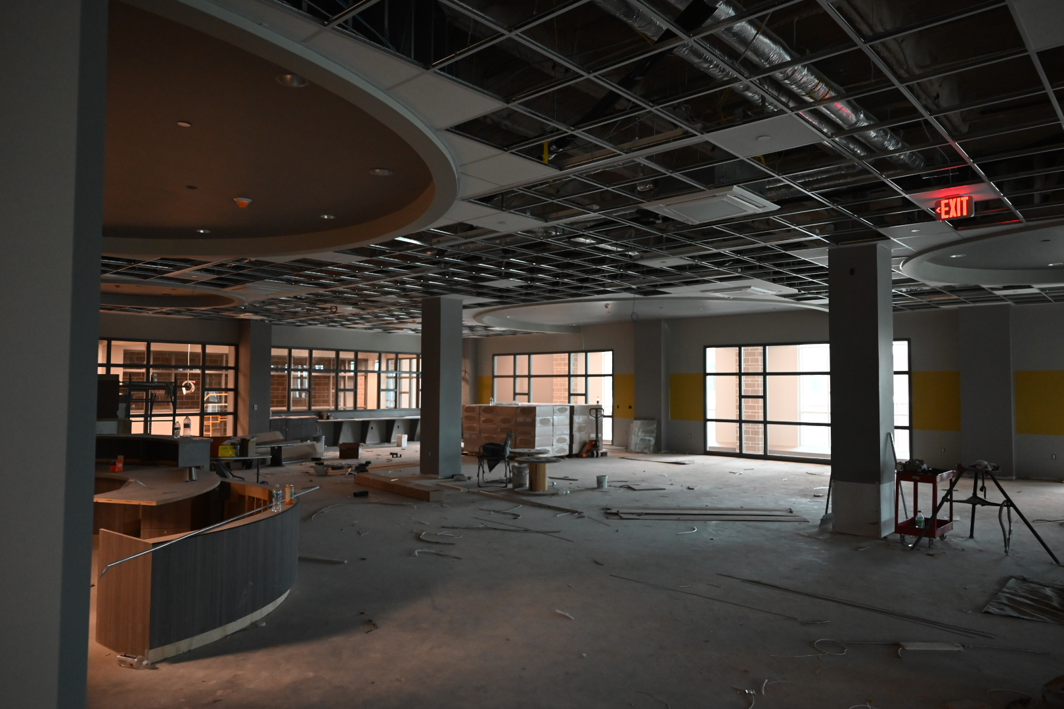
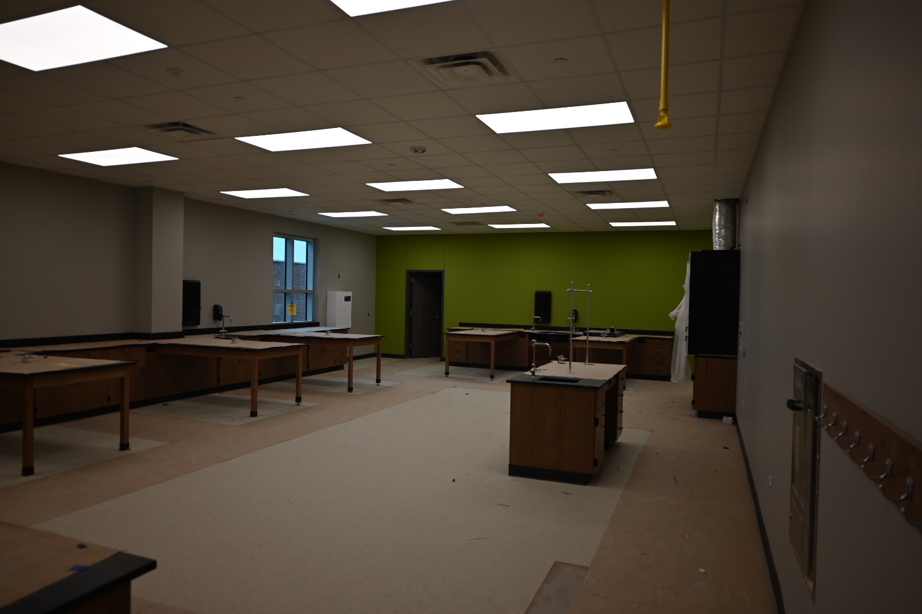
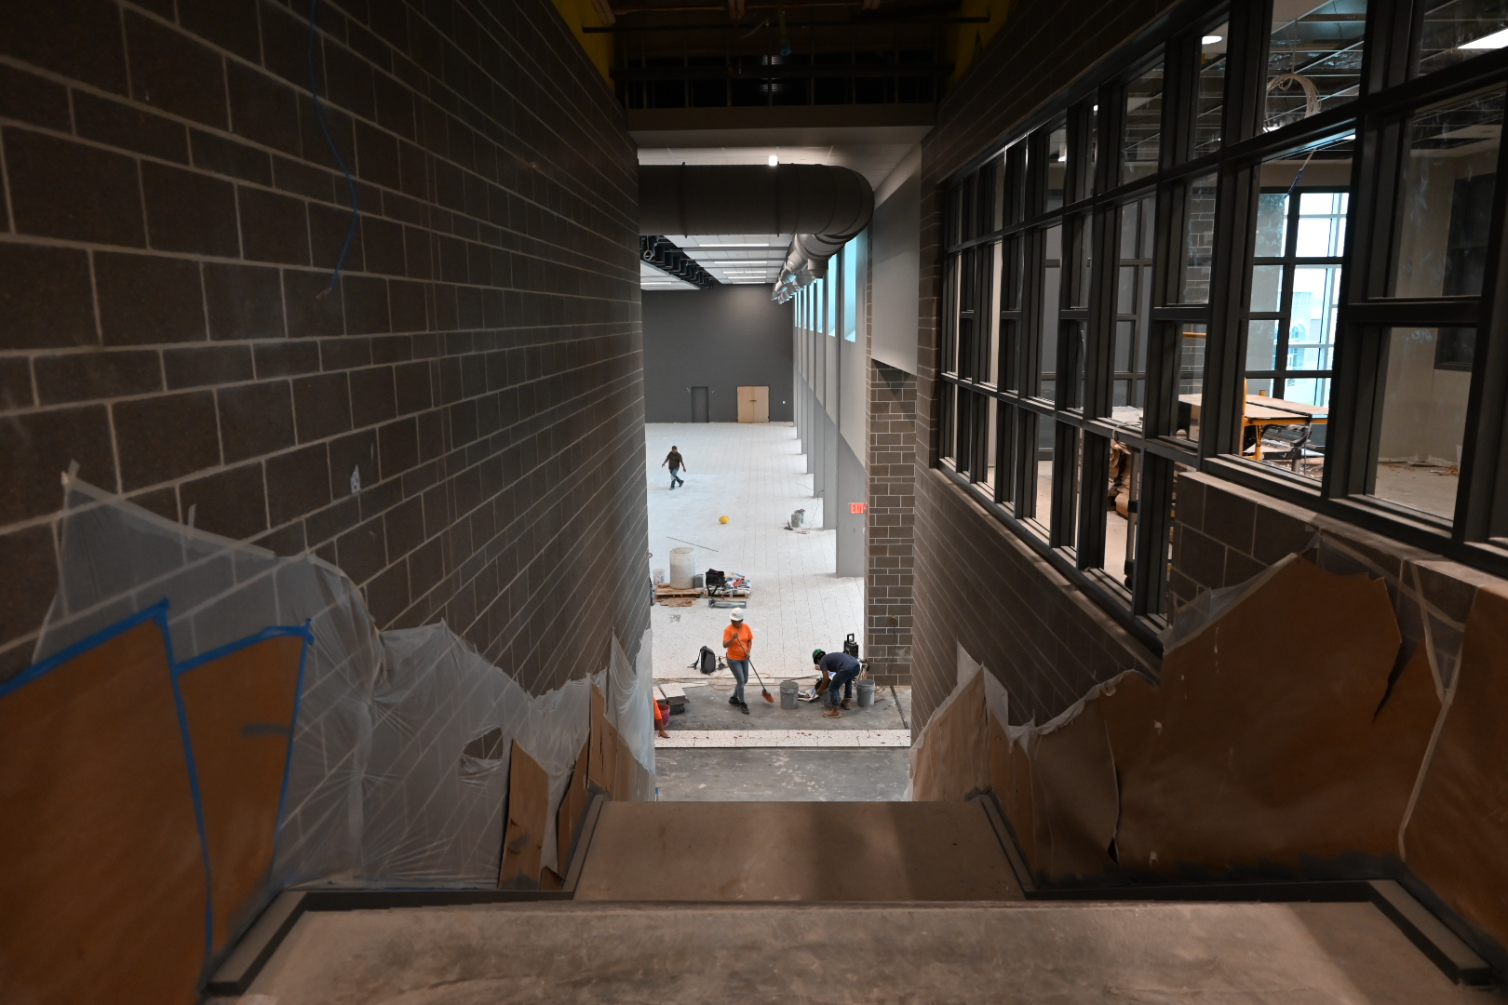
Nederland High School
Continue with Plumbing trim out
Continue with Electrical trim out
Continue installing doors/hardware throughout the building.
Continue with Continue with AWC & Corner Guards throughout hallways.

Slide 8
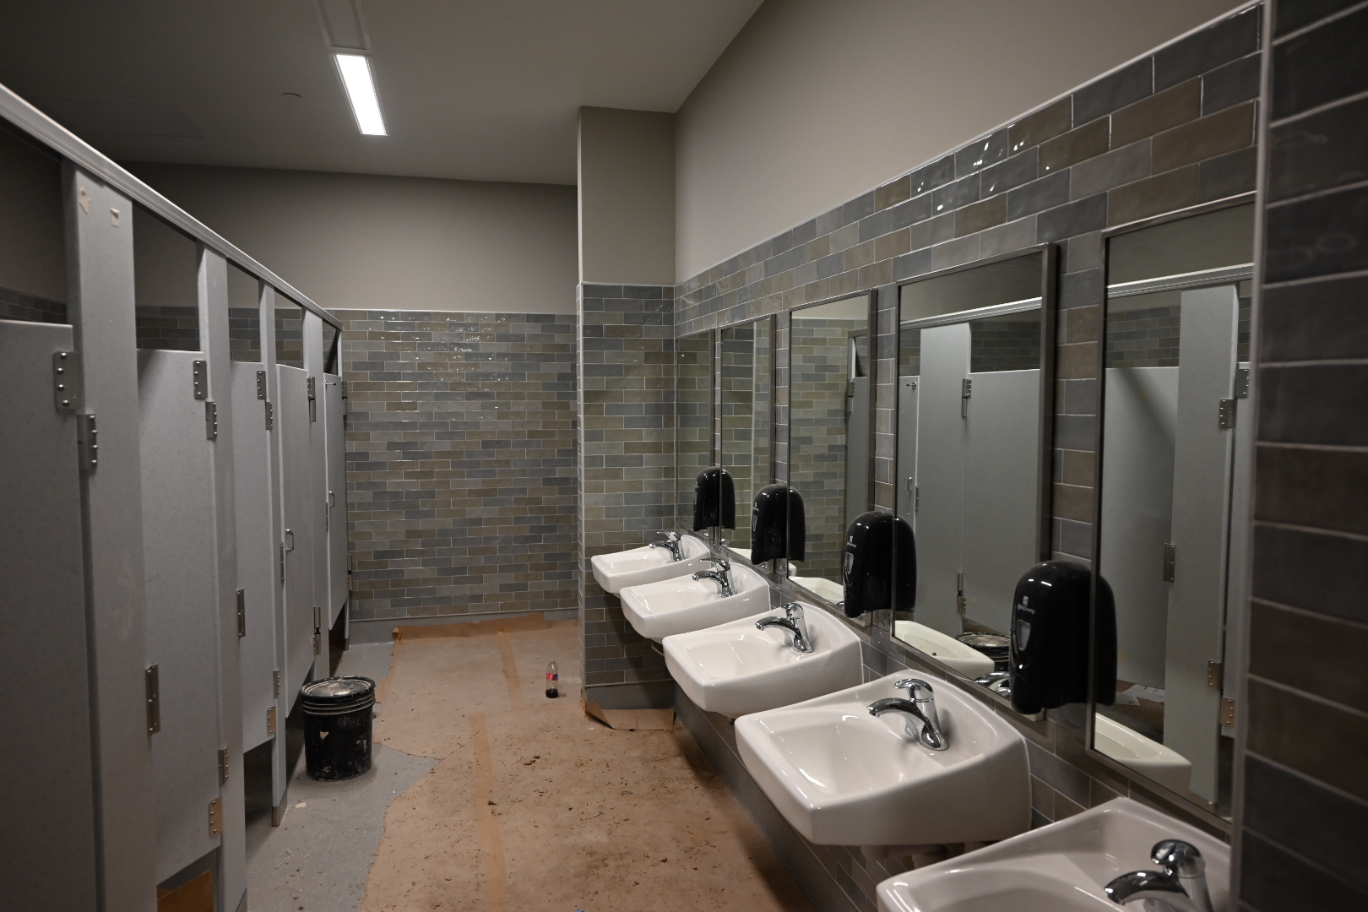
Nederland High School
Continue with Epoxy flooring.
Begin epoxy flooring in area G.
Continue kitchen equipment installation
Finish casework in athletics area.
Prepare gym to receive athletic flooring

Slide 9


