Slide 1




2019 Nederland ISD Bond Project
June 2024

Slide 2

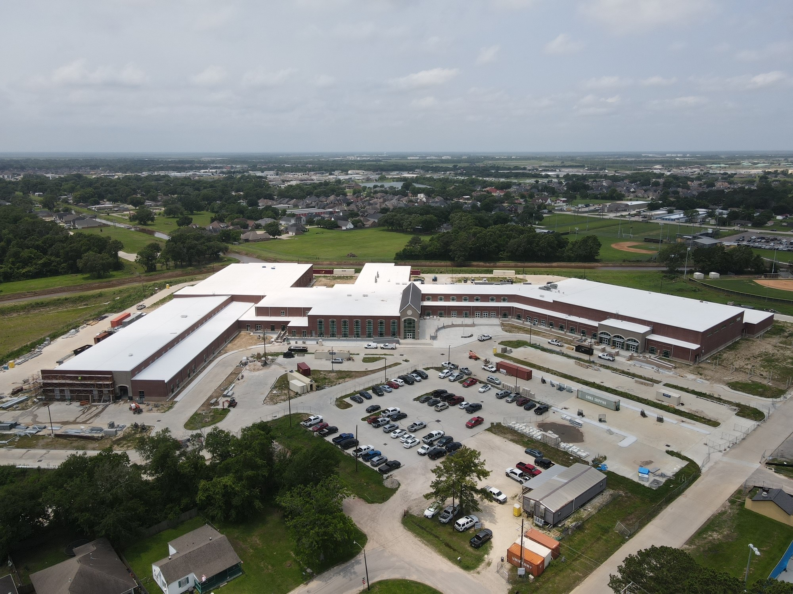
Nederland High School

Slide 3
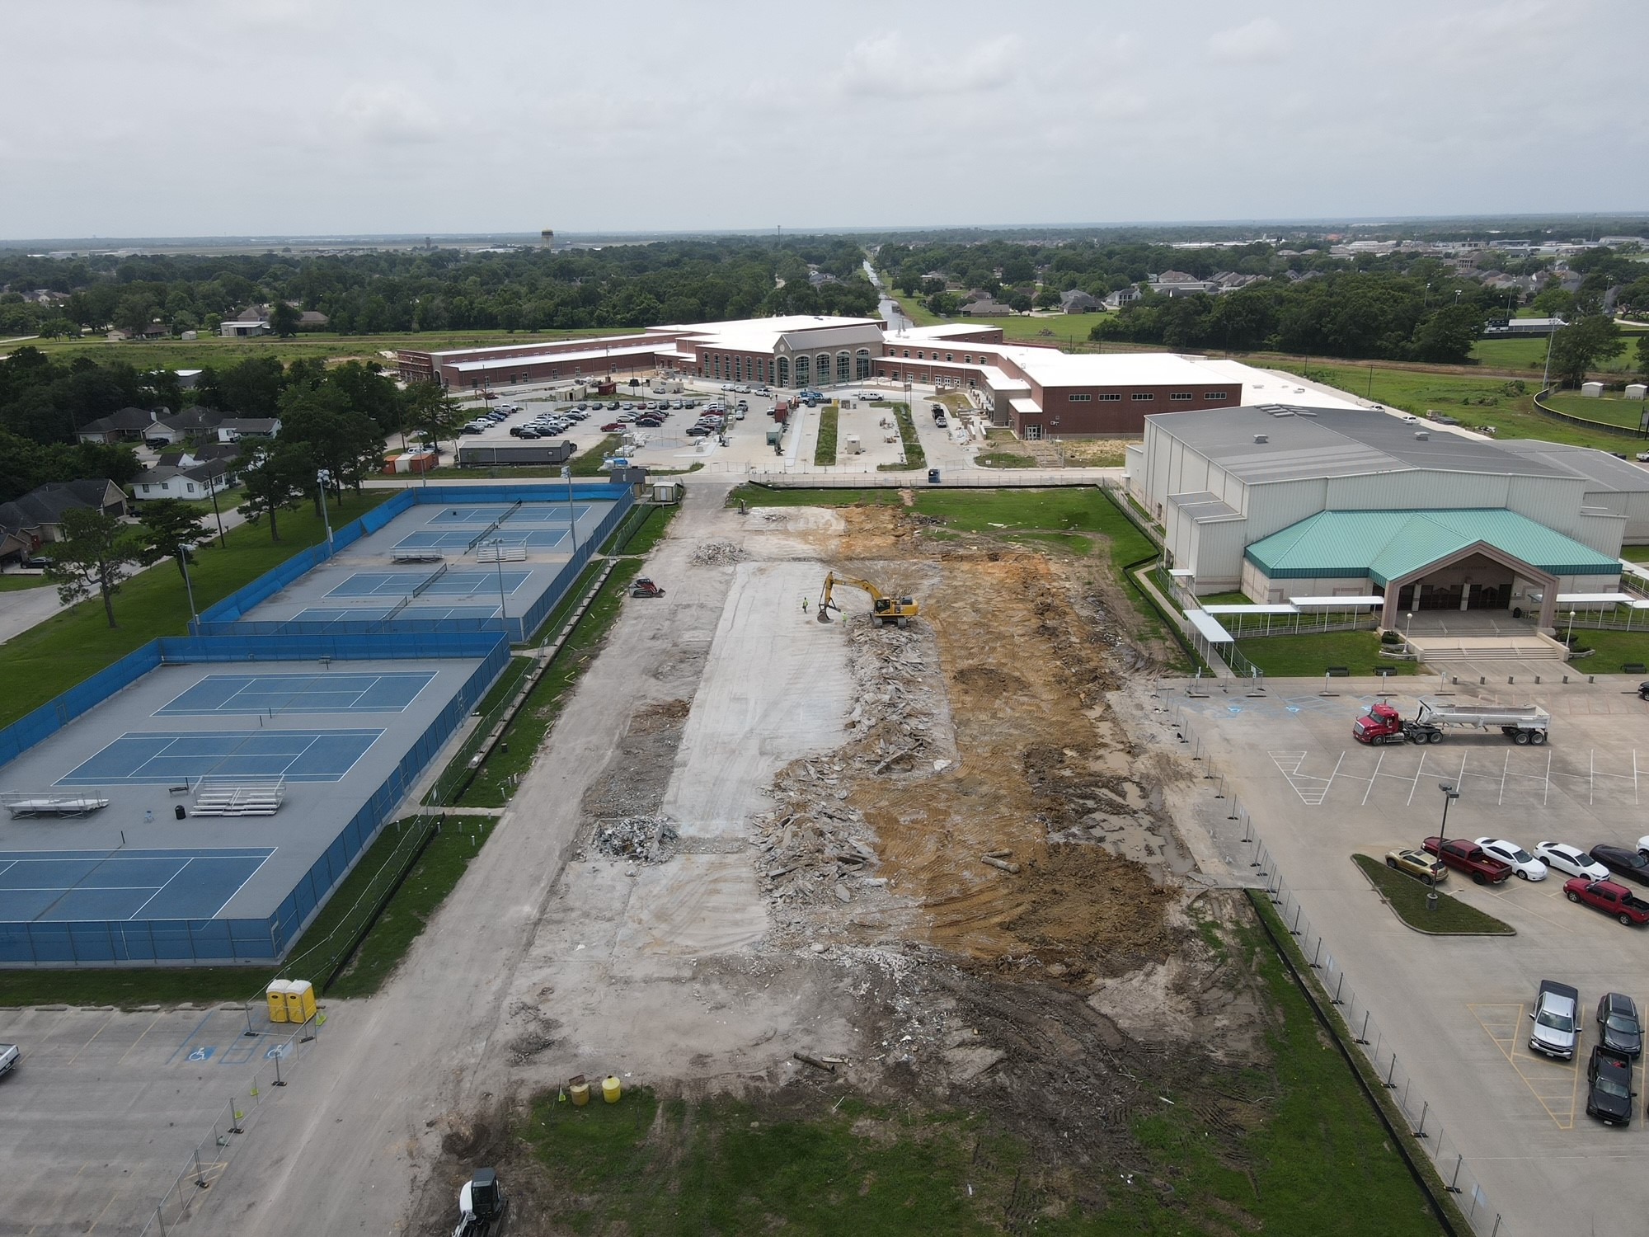
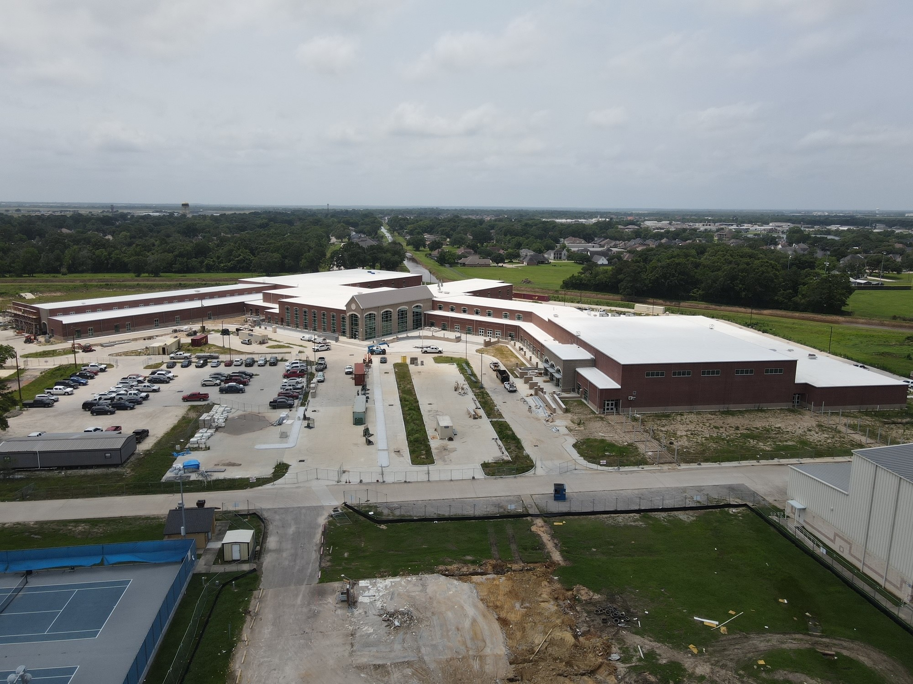
Nederland High School
Exterior
  Continue with Face Brick in the front of the school.
  Continue with concrete flatwork around the school.
  Begin exterior handrails.
  Continue with Storm Water on New Drive/Parking Area
  Demo is complete

Slide 4
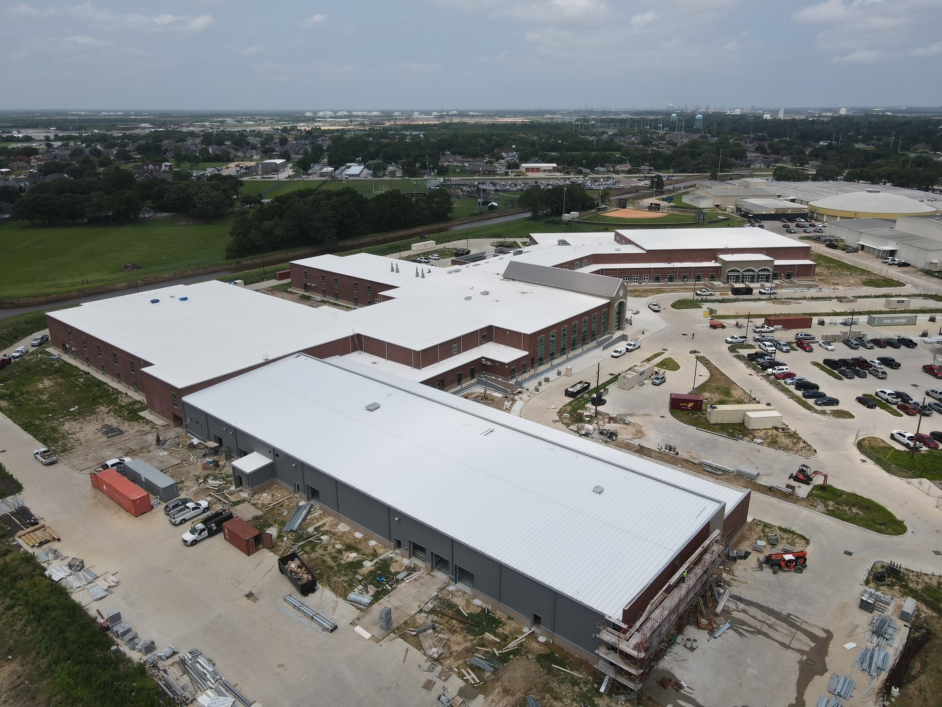
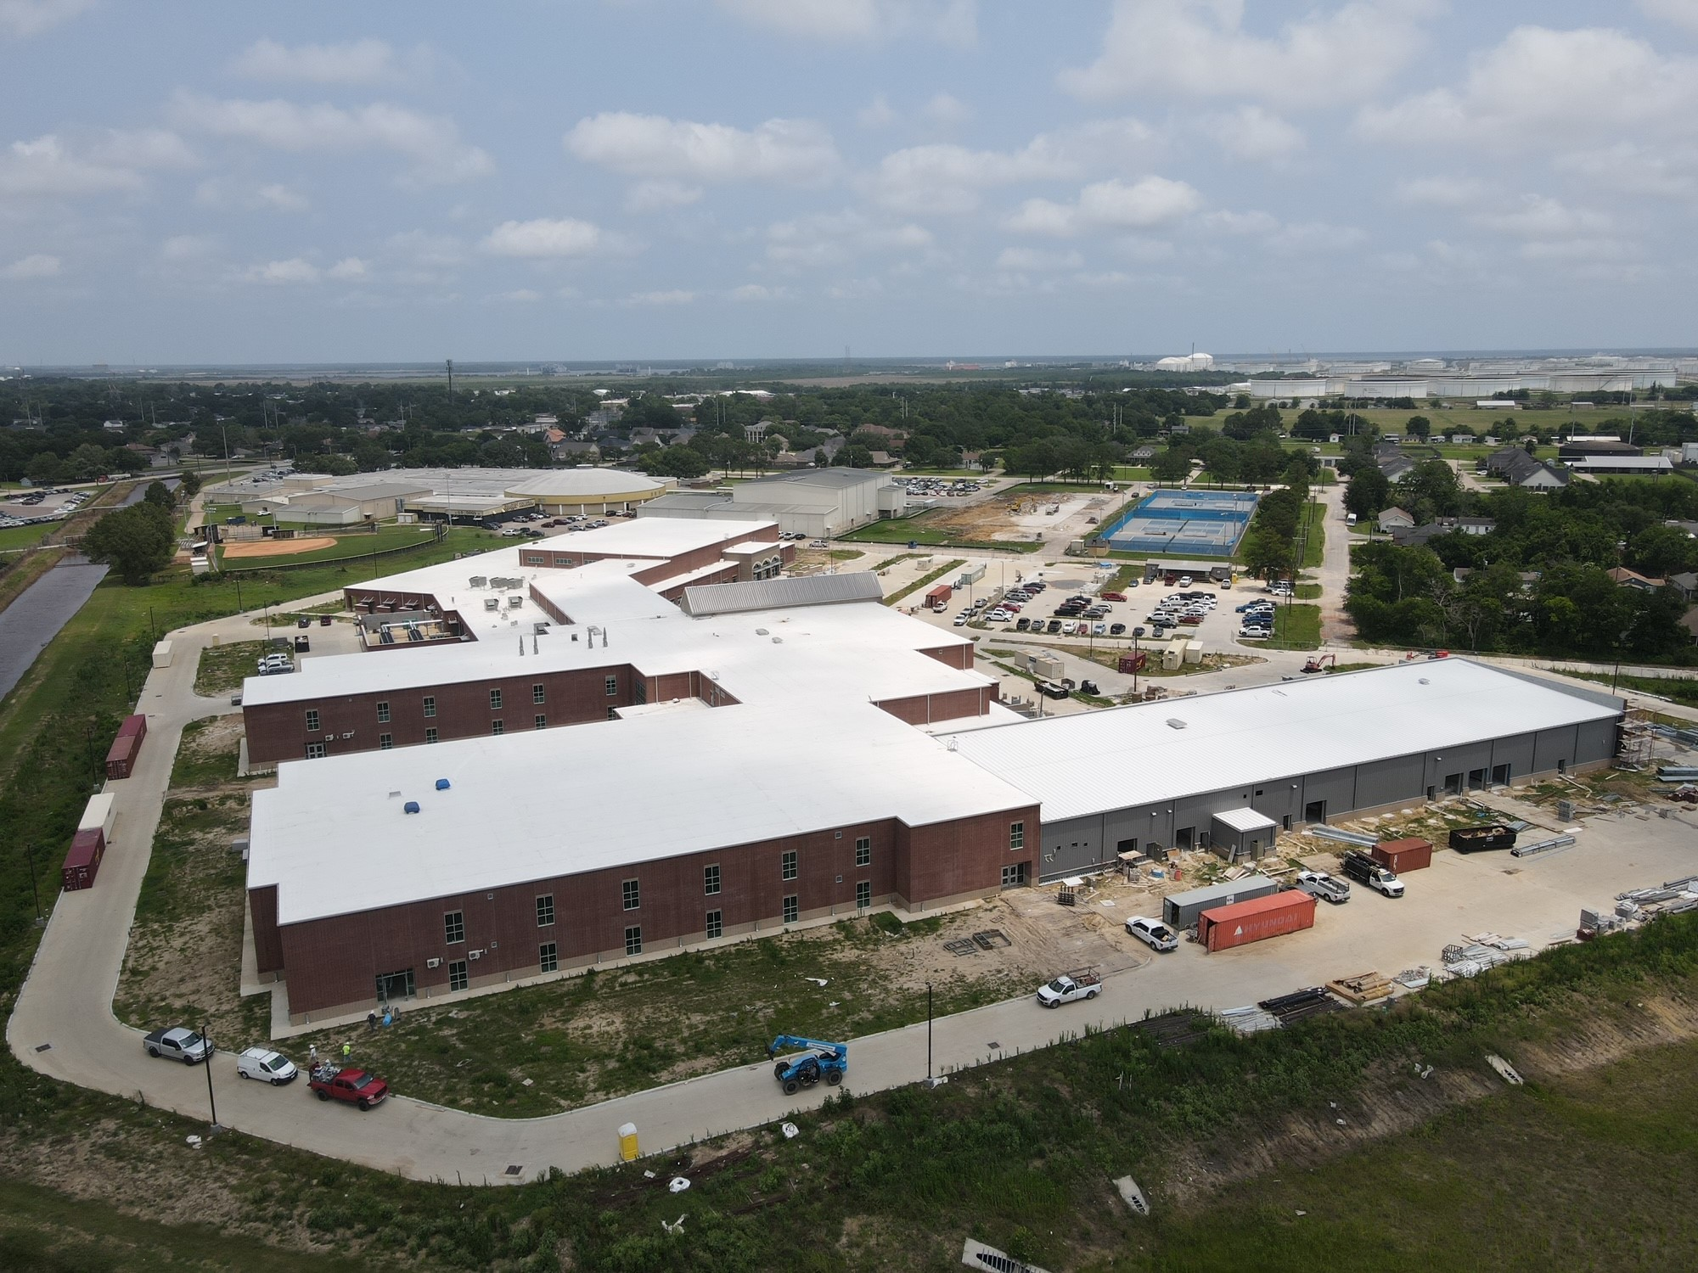
Nederland High School
Exterior
  Continue with Gutters and Downspouts.
  Install CTE Main Entry Store Front Door.
  Continue with tying in Gutters with TPO roof membrane.
Exterior
  Canopy installation to continue around new building
  Landscaping to begin. Prep has started.

Slide 5
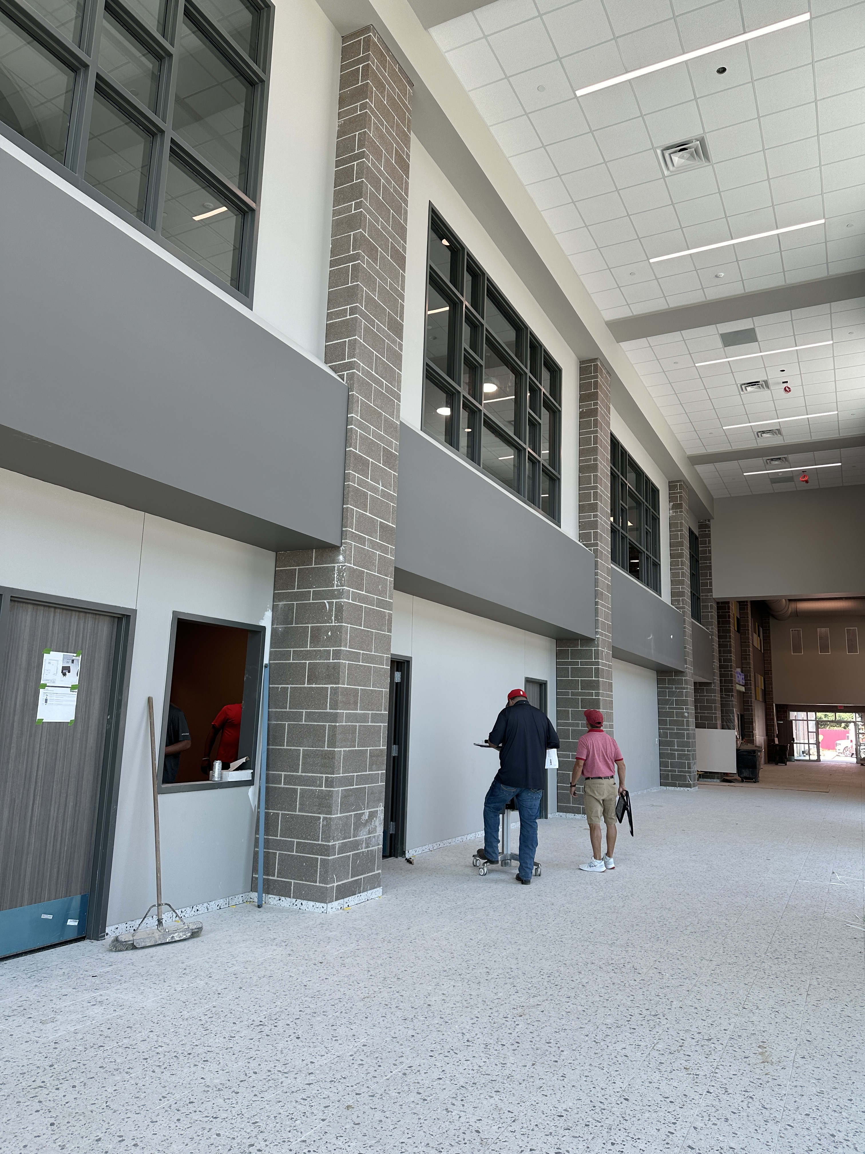
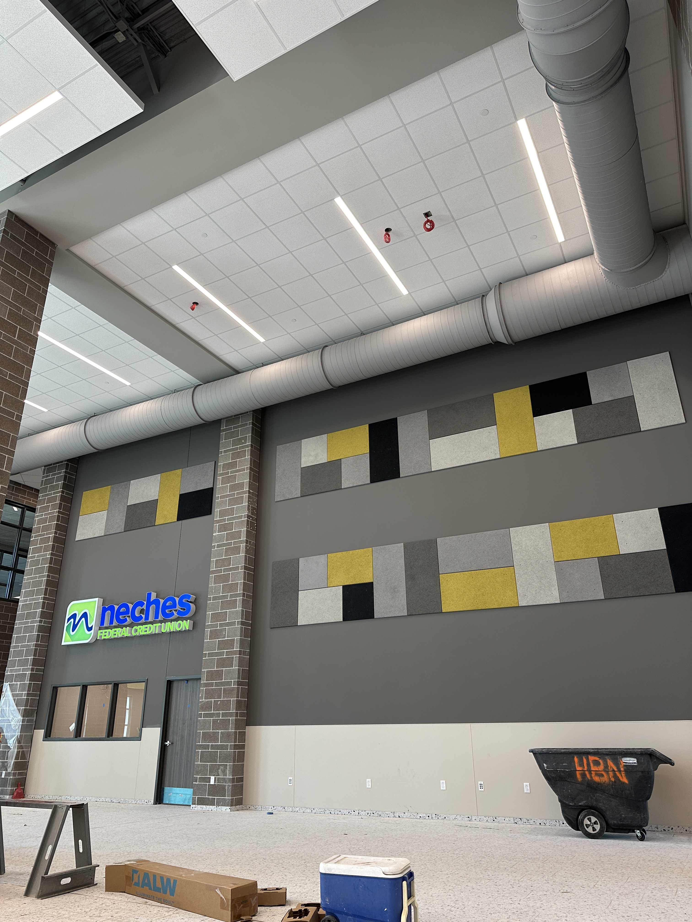
Nederland High School
  Complete flooring in Area D (Today)
  Install Culinary Equipment
  Continue corridor flooring
  Complete epoxy (Thursday)
  Furniture delivery starting today.
  ← Main Entry
  Cafeteria →

Slide 6
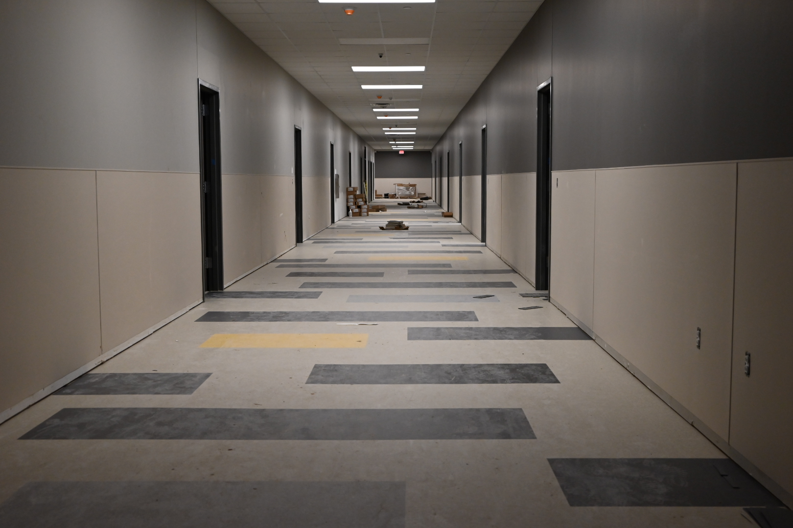
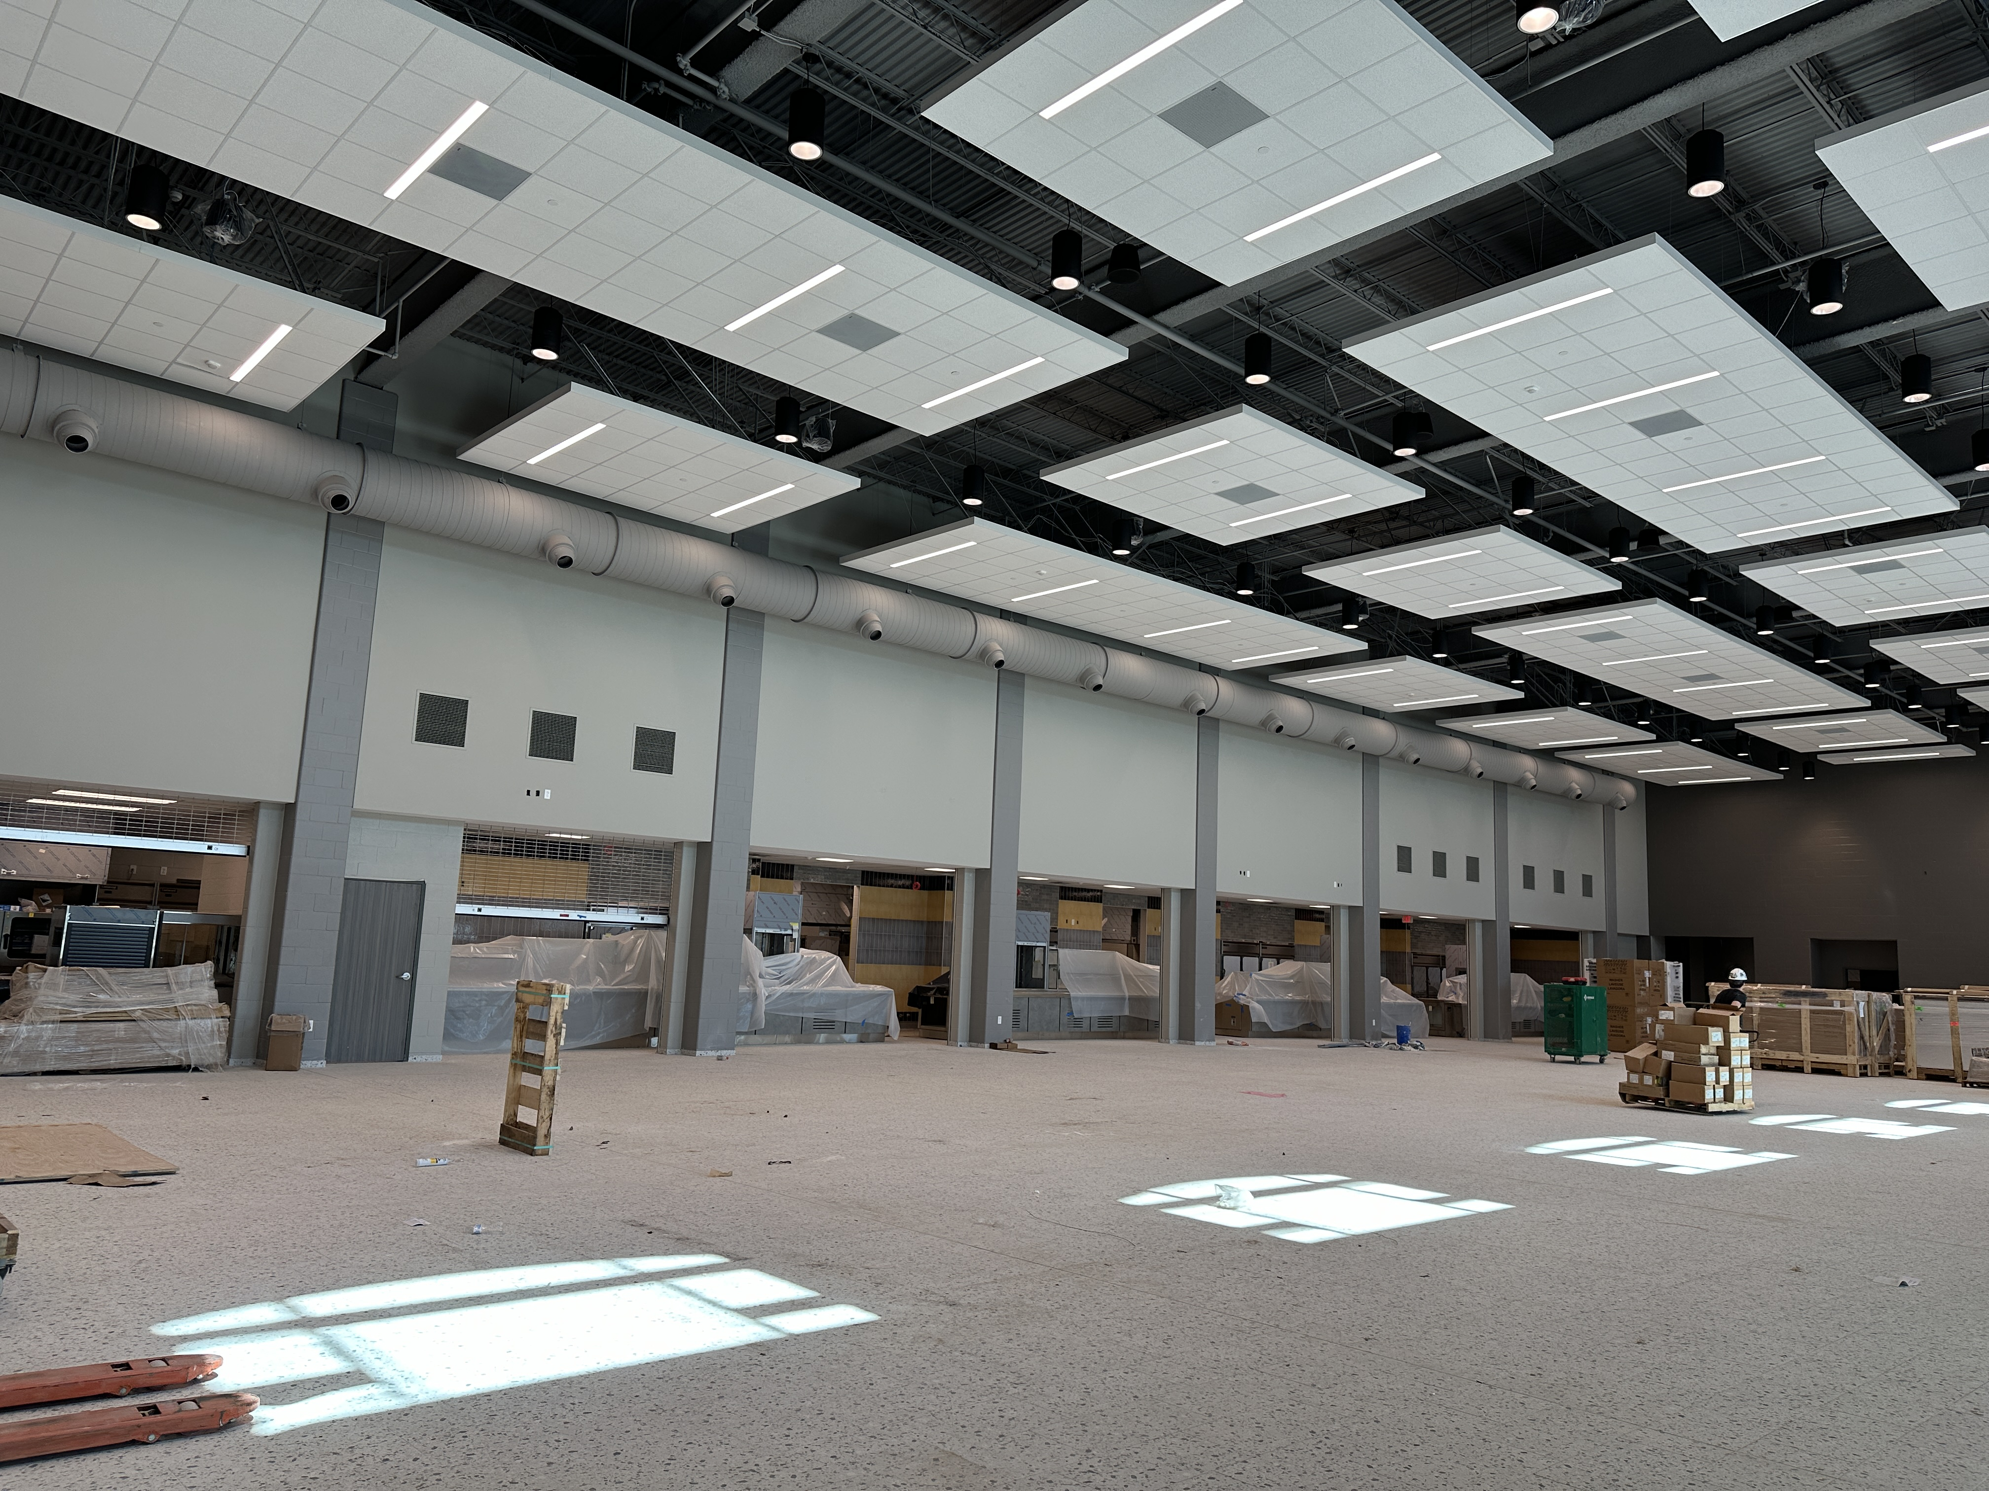
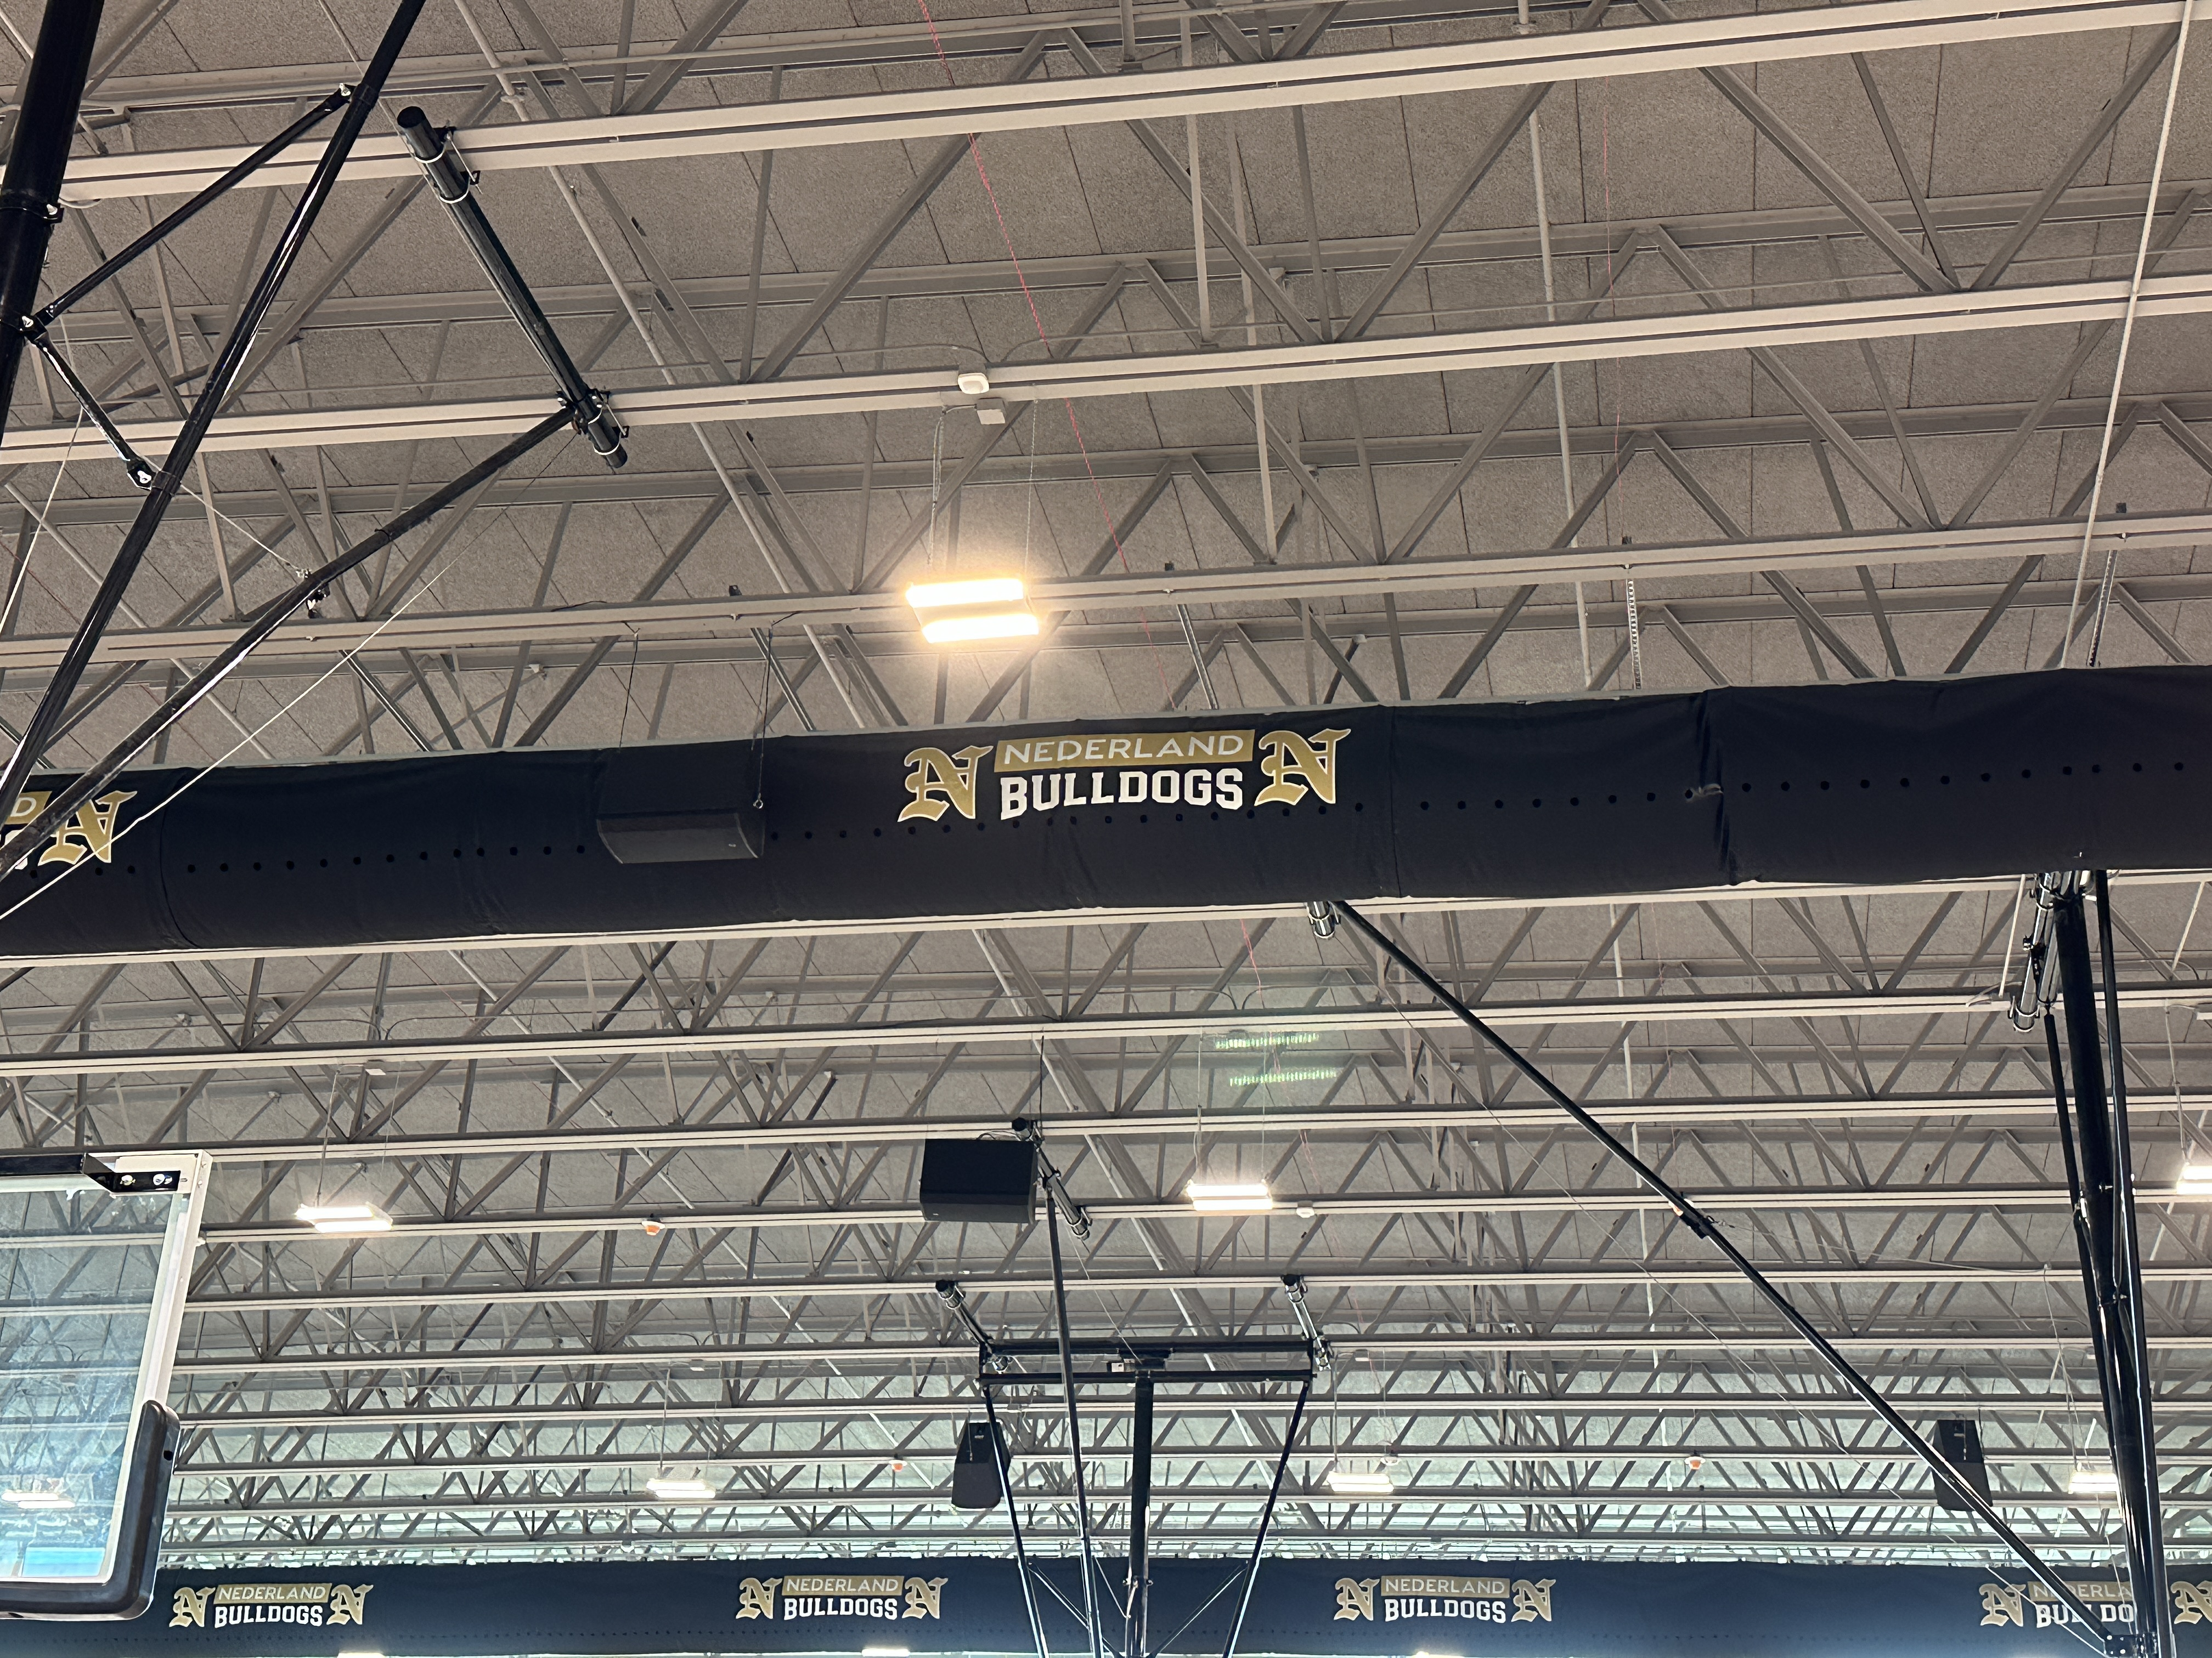
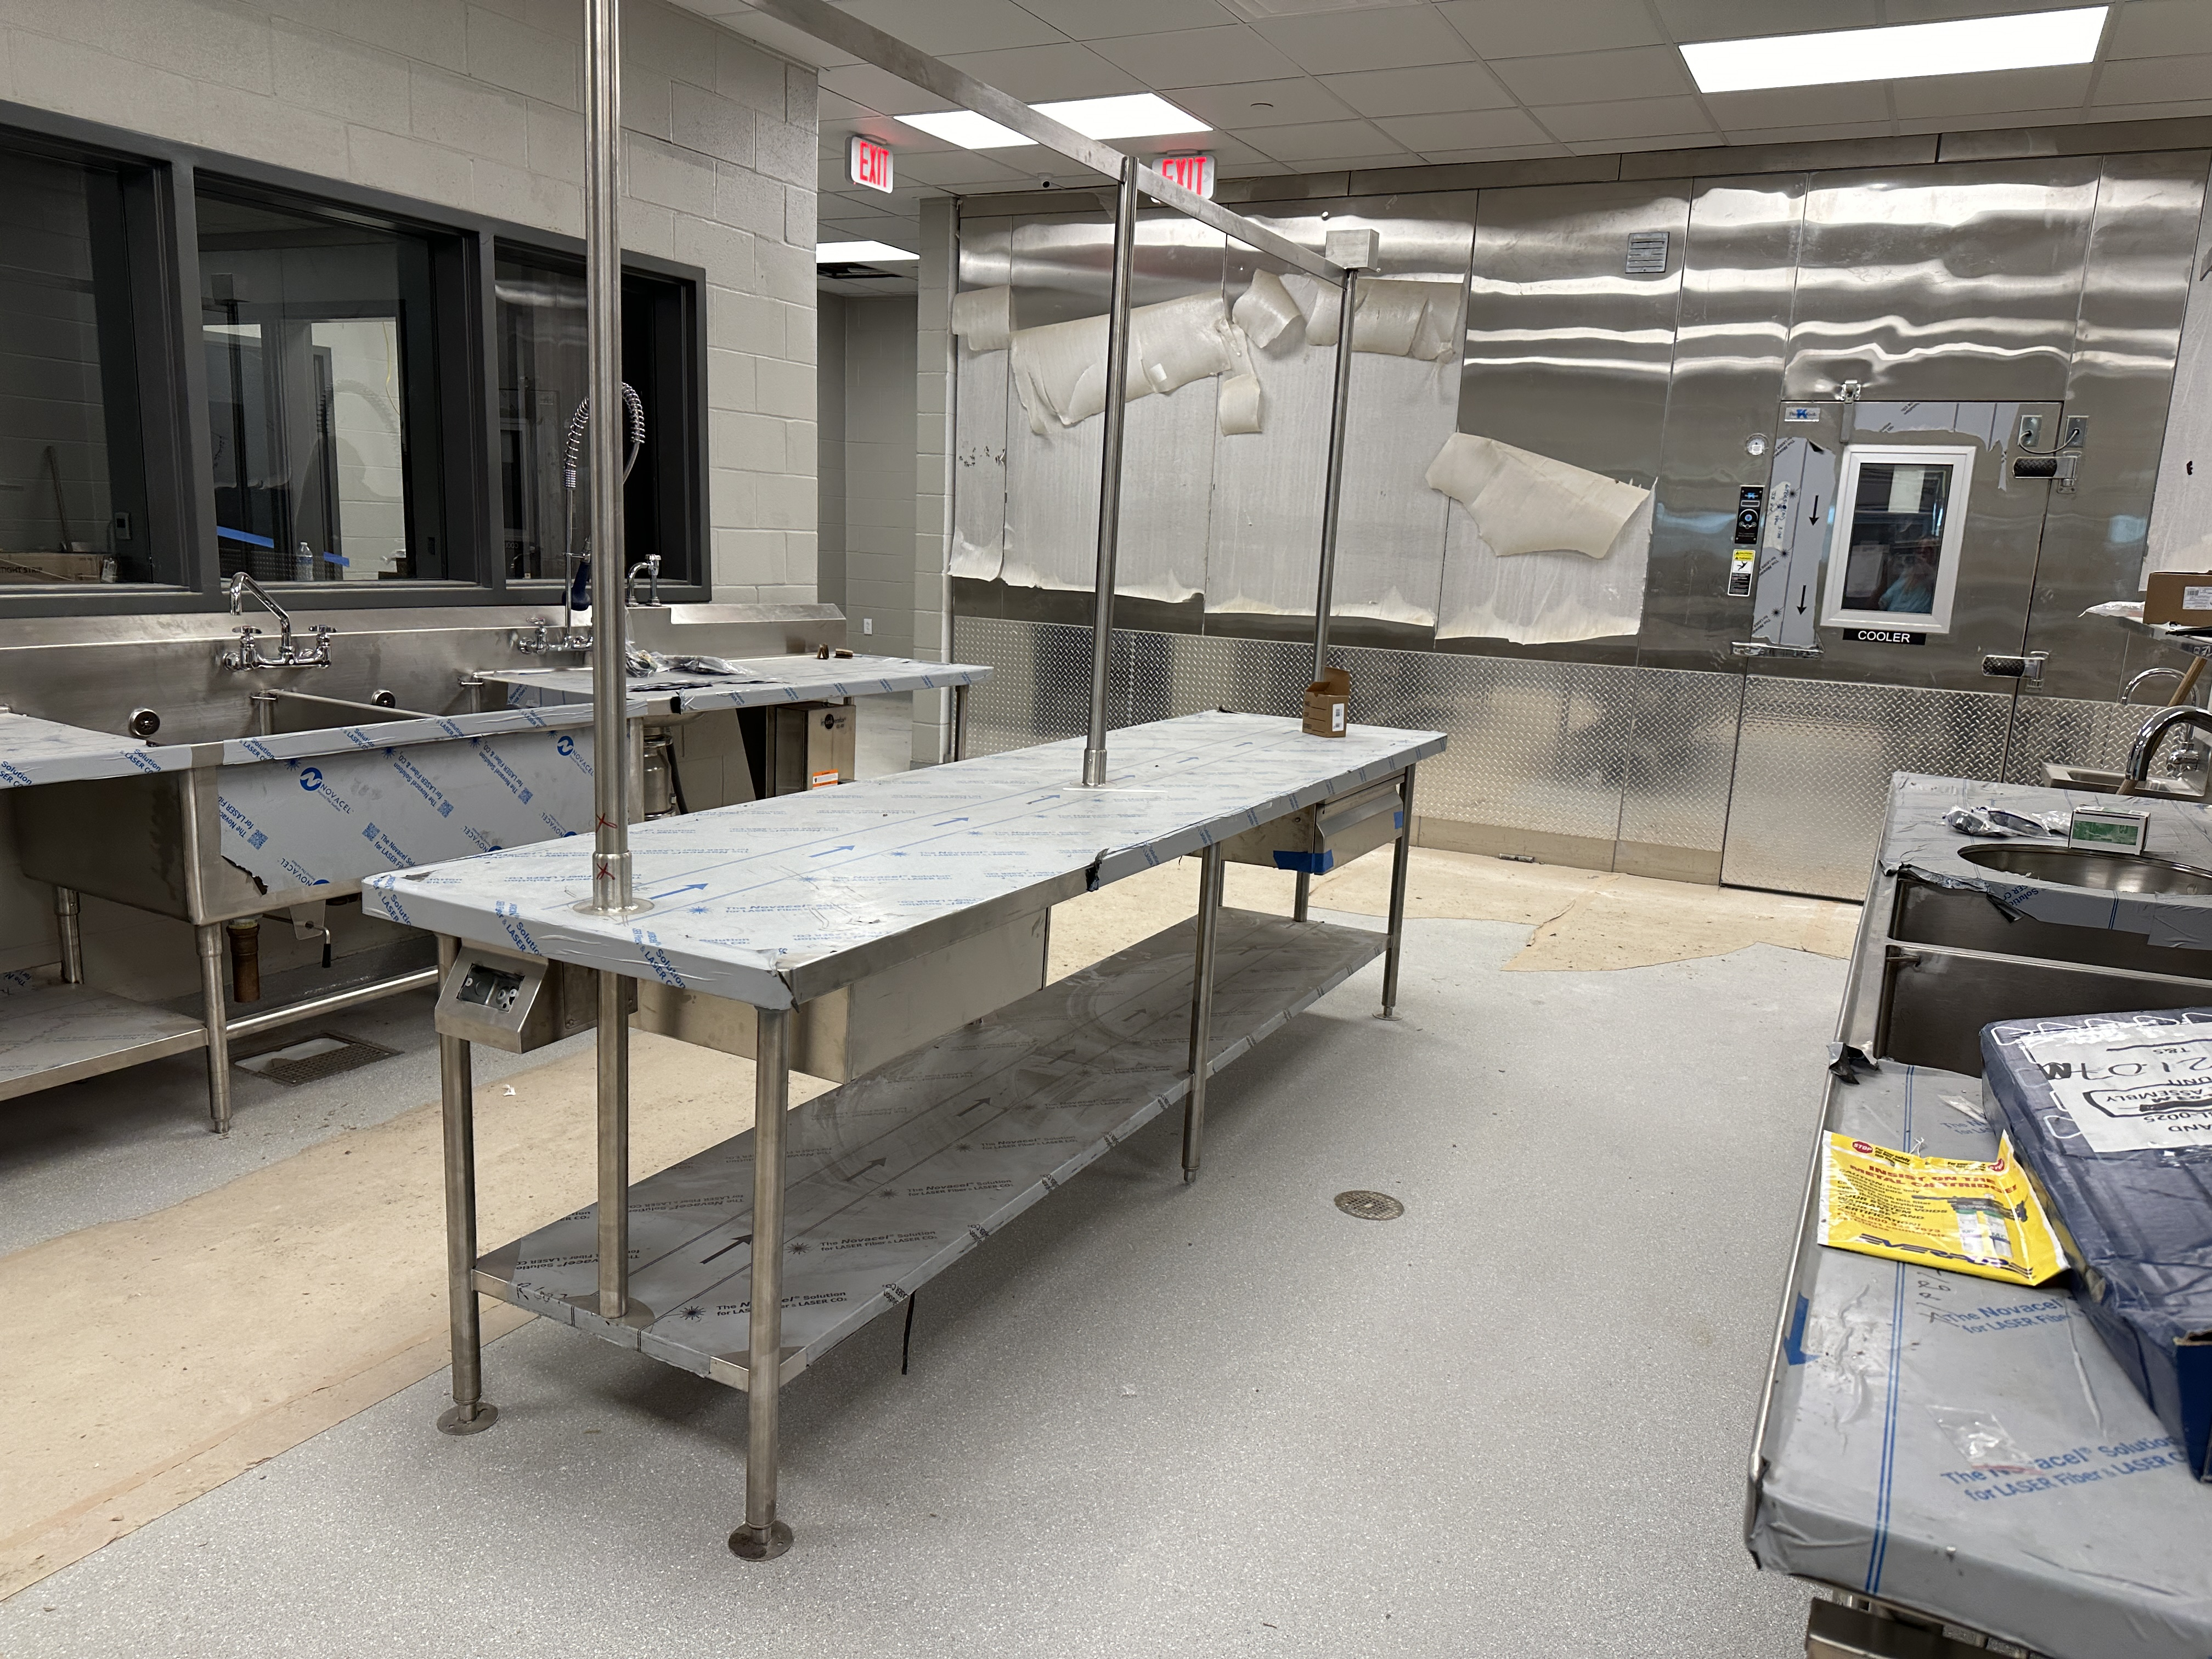
Nederland High School
  Complete installing casework and countertops in Athletics
  Complete installing light fixtures and grilles throughout the building.
  Complete Kitchen Equipment Install & Cooler/Freezer Start up
  Start install of gym floor next week
  Duct sock install complete

Slide 7
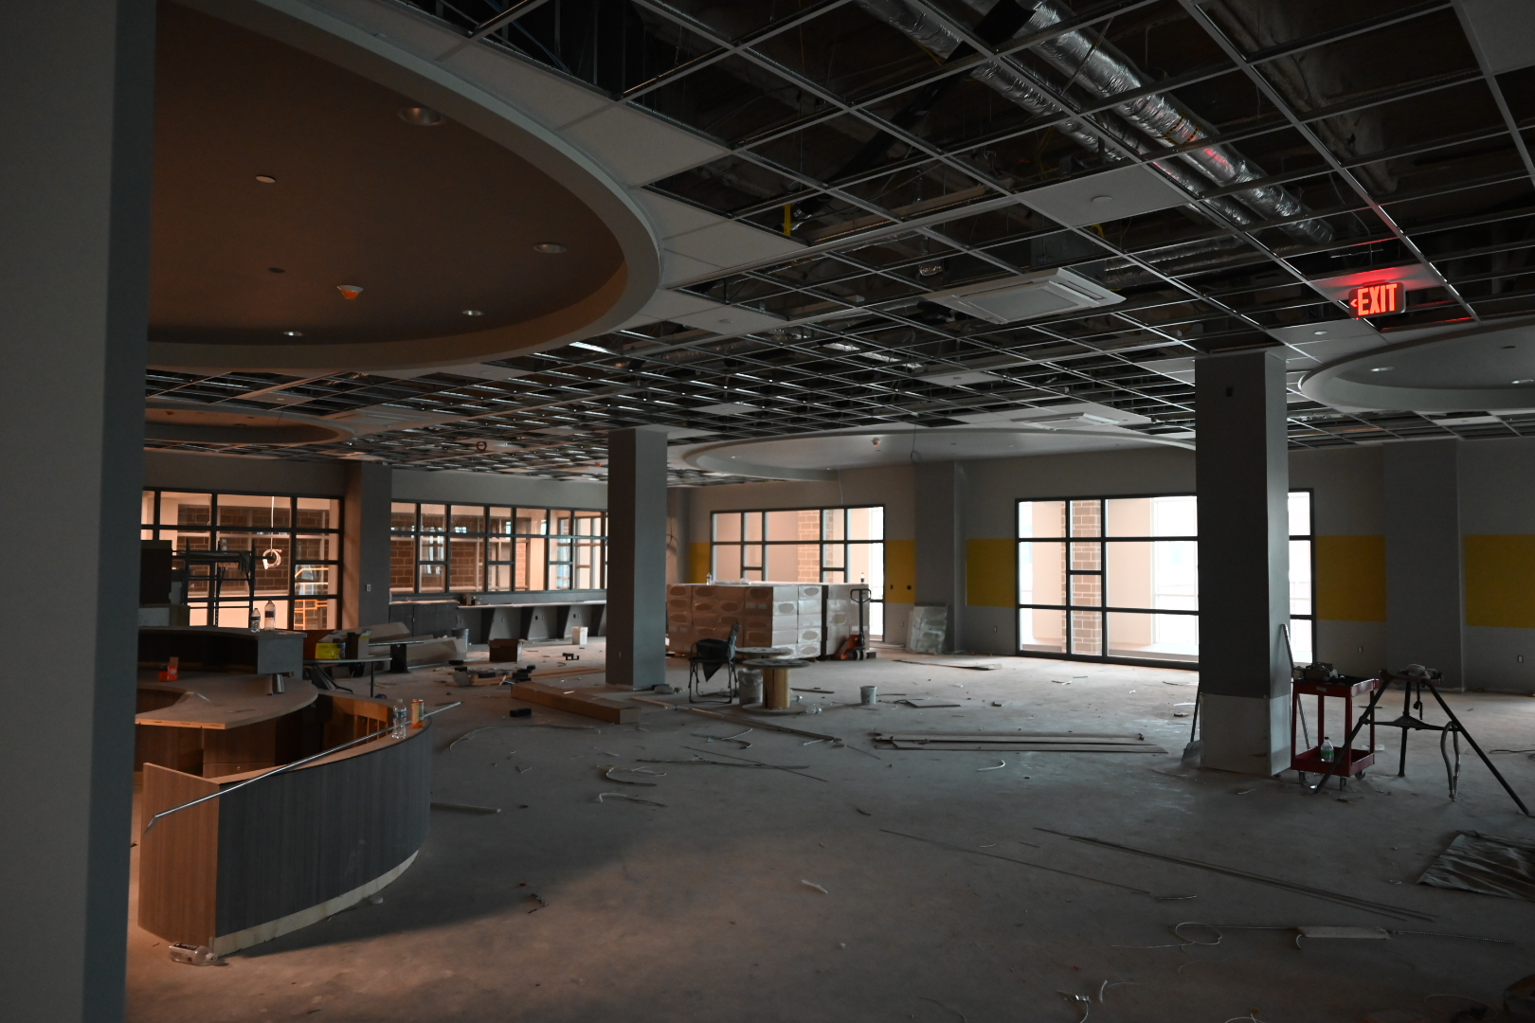
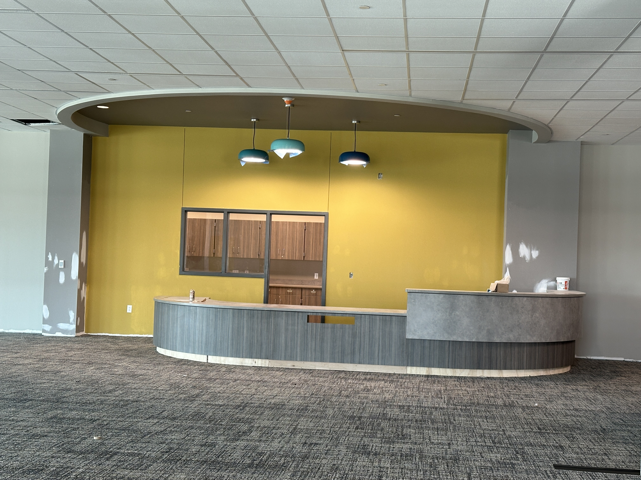
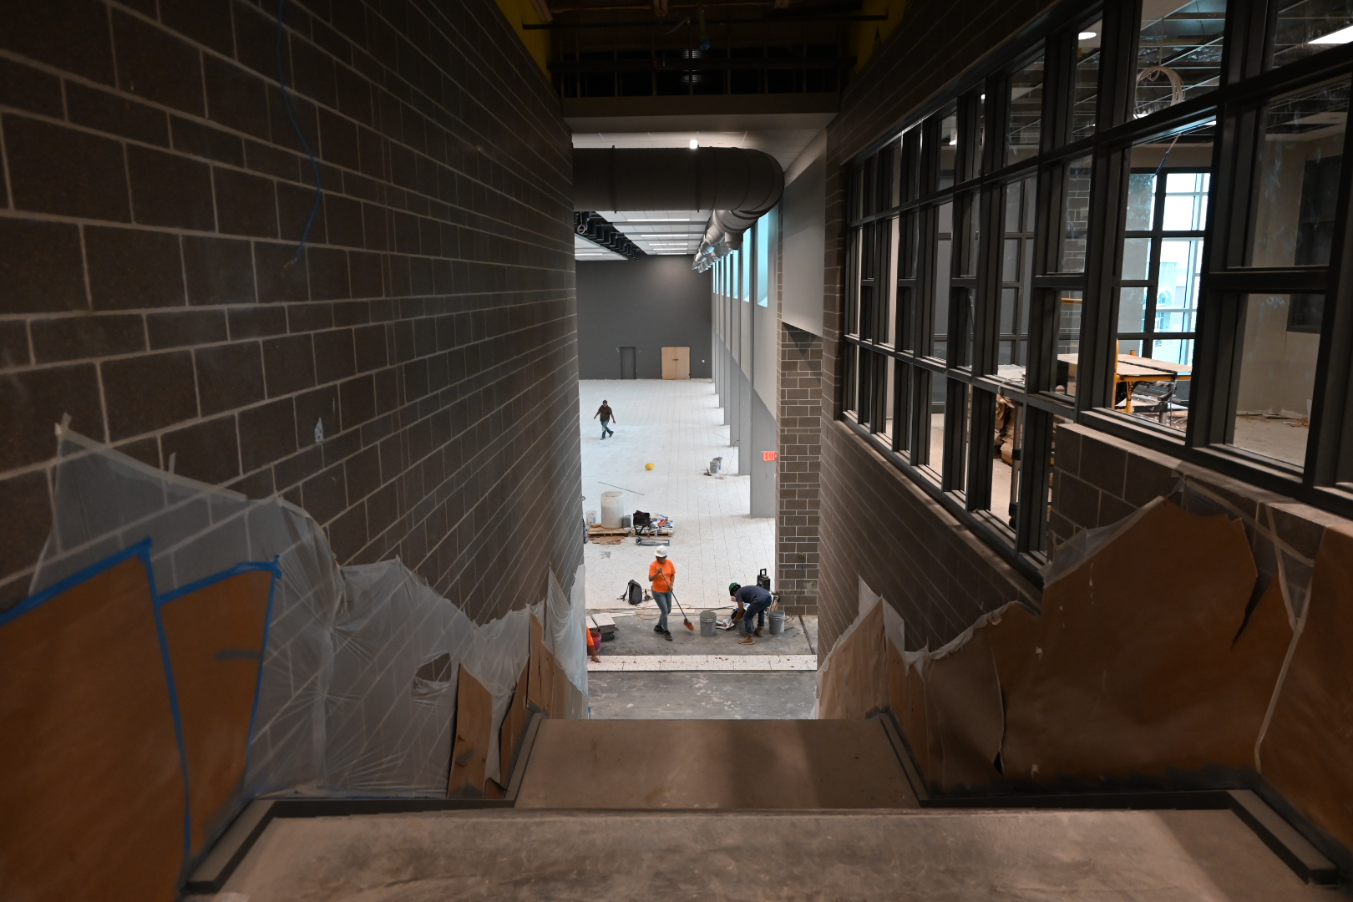
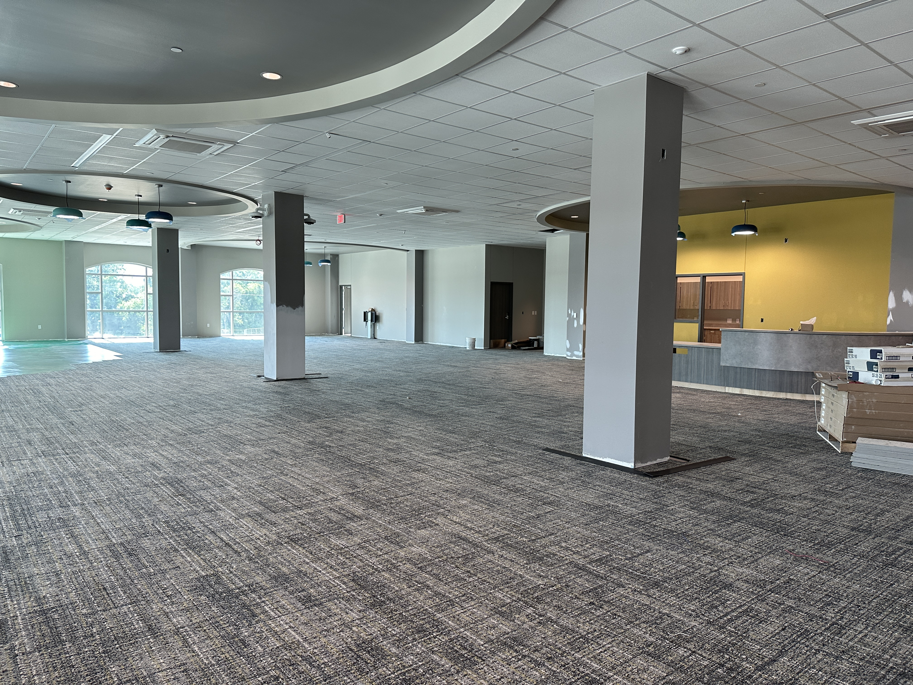
Nederland High School
Continue with Plumbing trim out
Continue with Electrical trim out
Continue installing doors/hardware throughout the building.
Continue with Continue with AWC & Corner Guards throughout hallways.

Slide 8
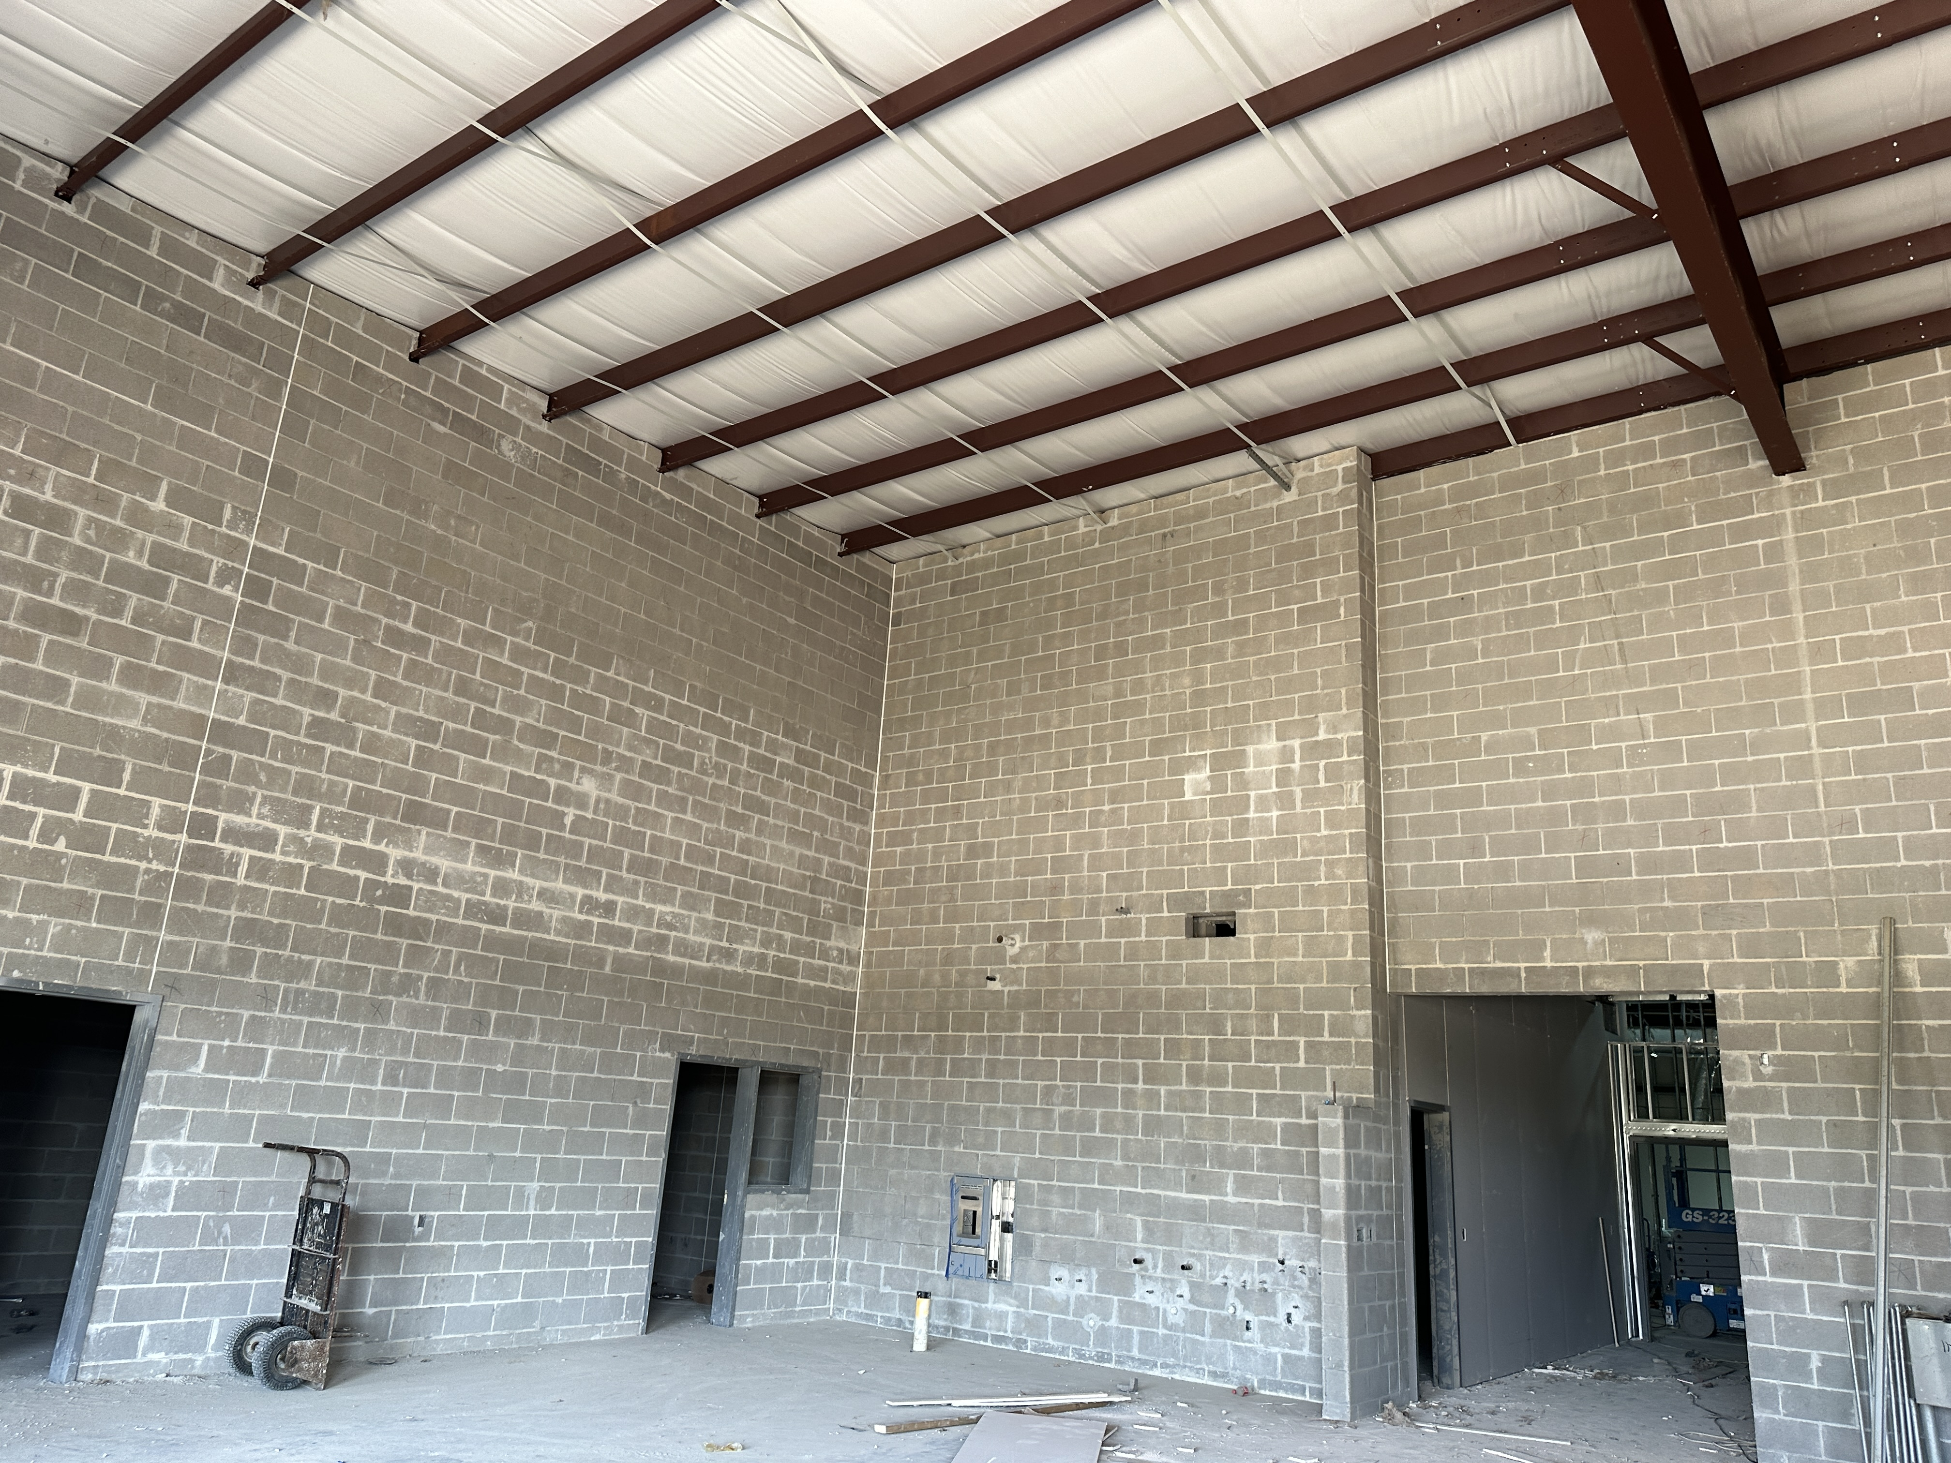
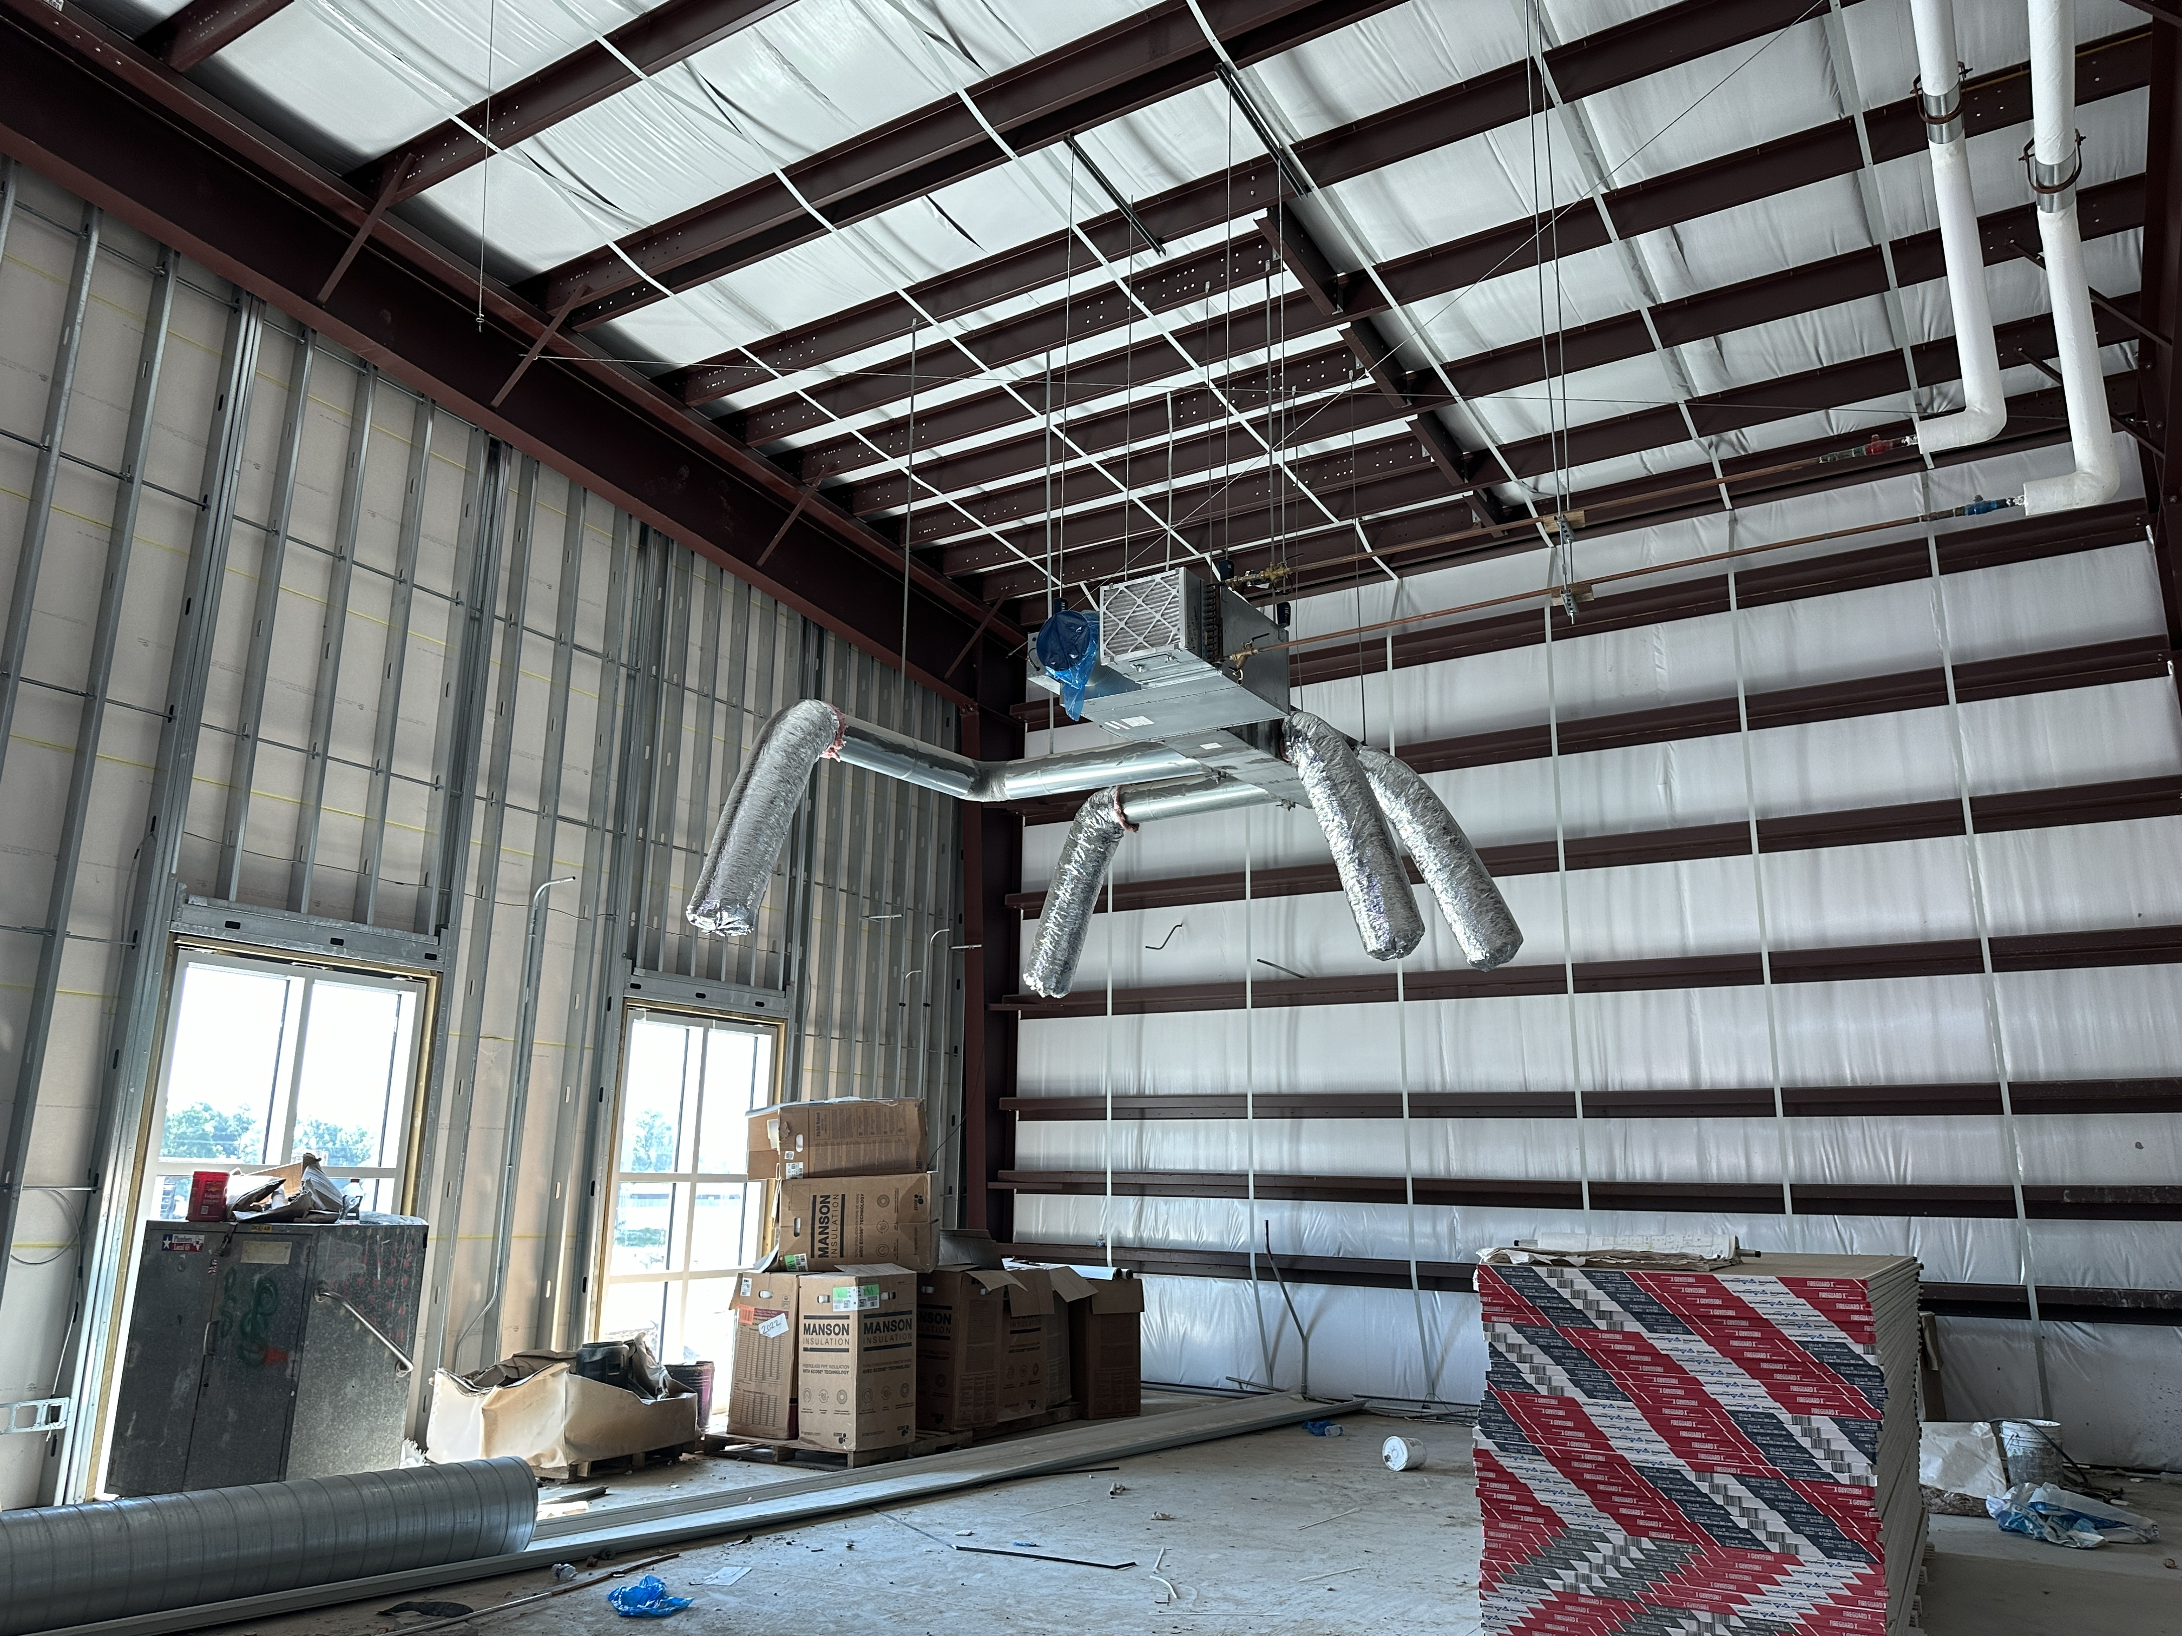
Nederland High School
  Continue installing duct work in B & A.
  Complete chiller piping throughout A/B.
  Continue overhead MEP Runs throughout CTE
  Complete Sheetrocking – Tape & Float
  Continue CMU Paint
  HBN Providing Temp Air to increase airflow through CTE

Slide 9


