Slide 1




2019 Nederland ISD Bond Project
July 2024

Slide 2

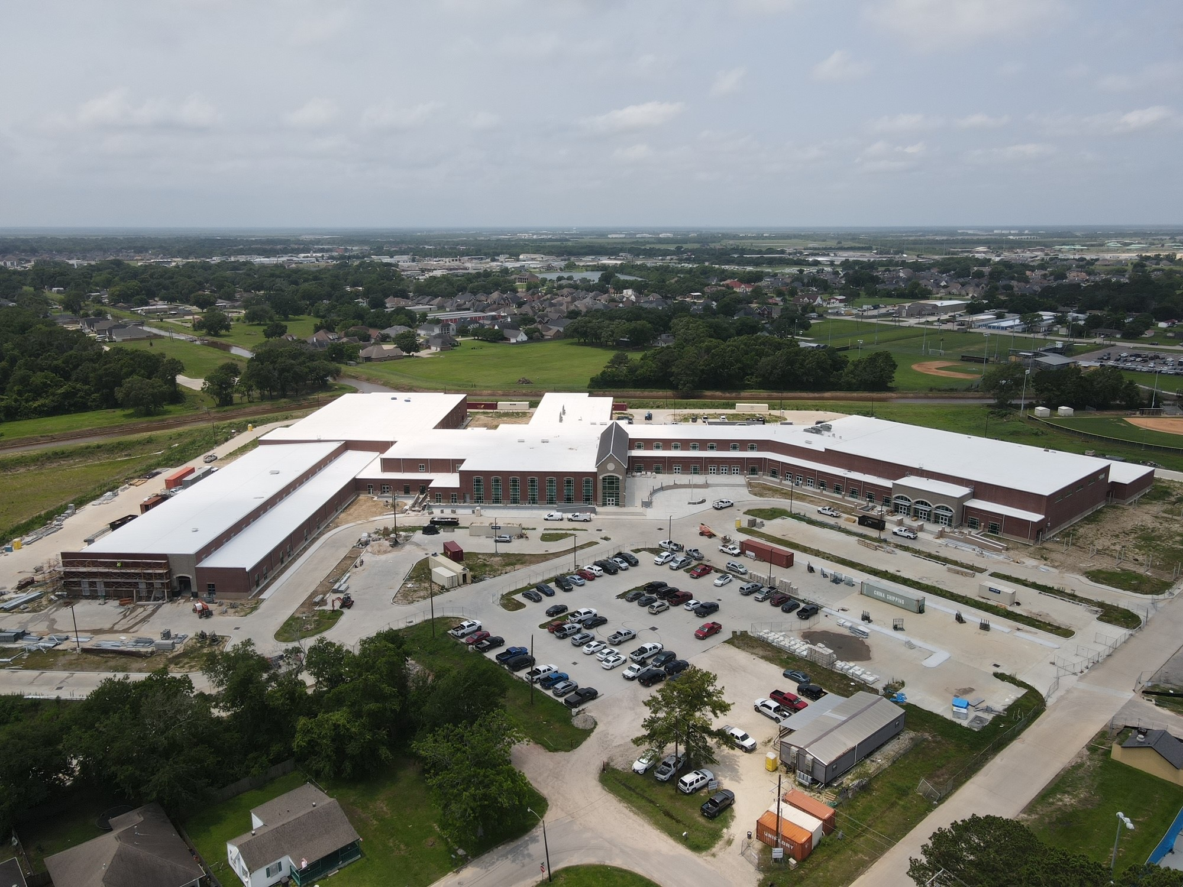
Nederland High School

Slide 3
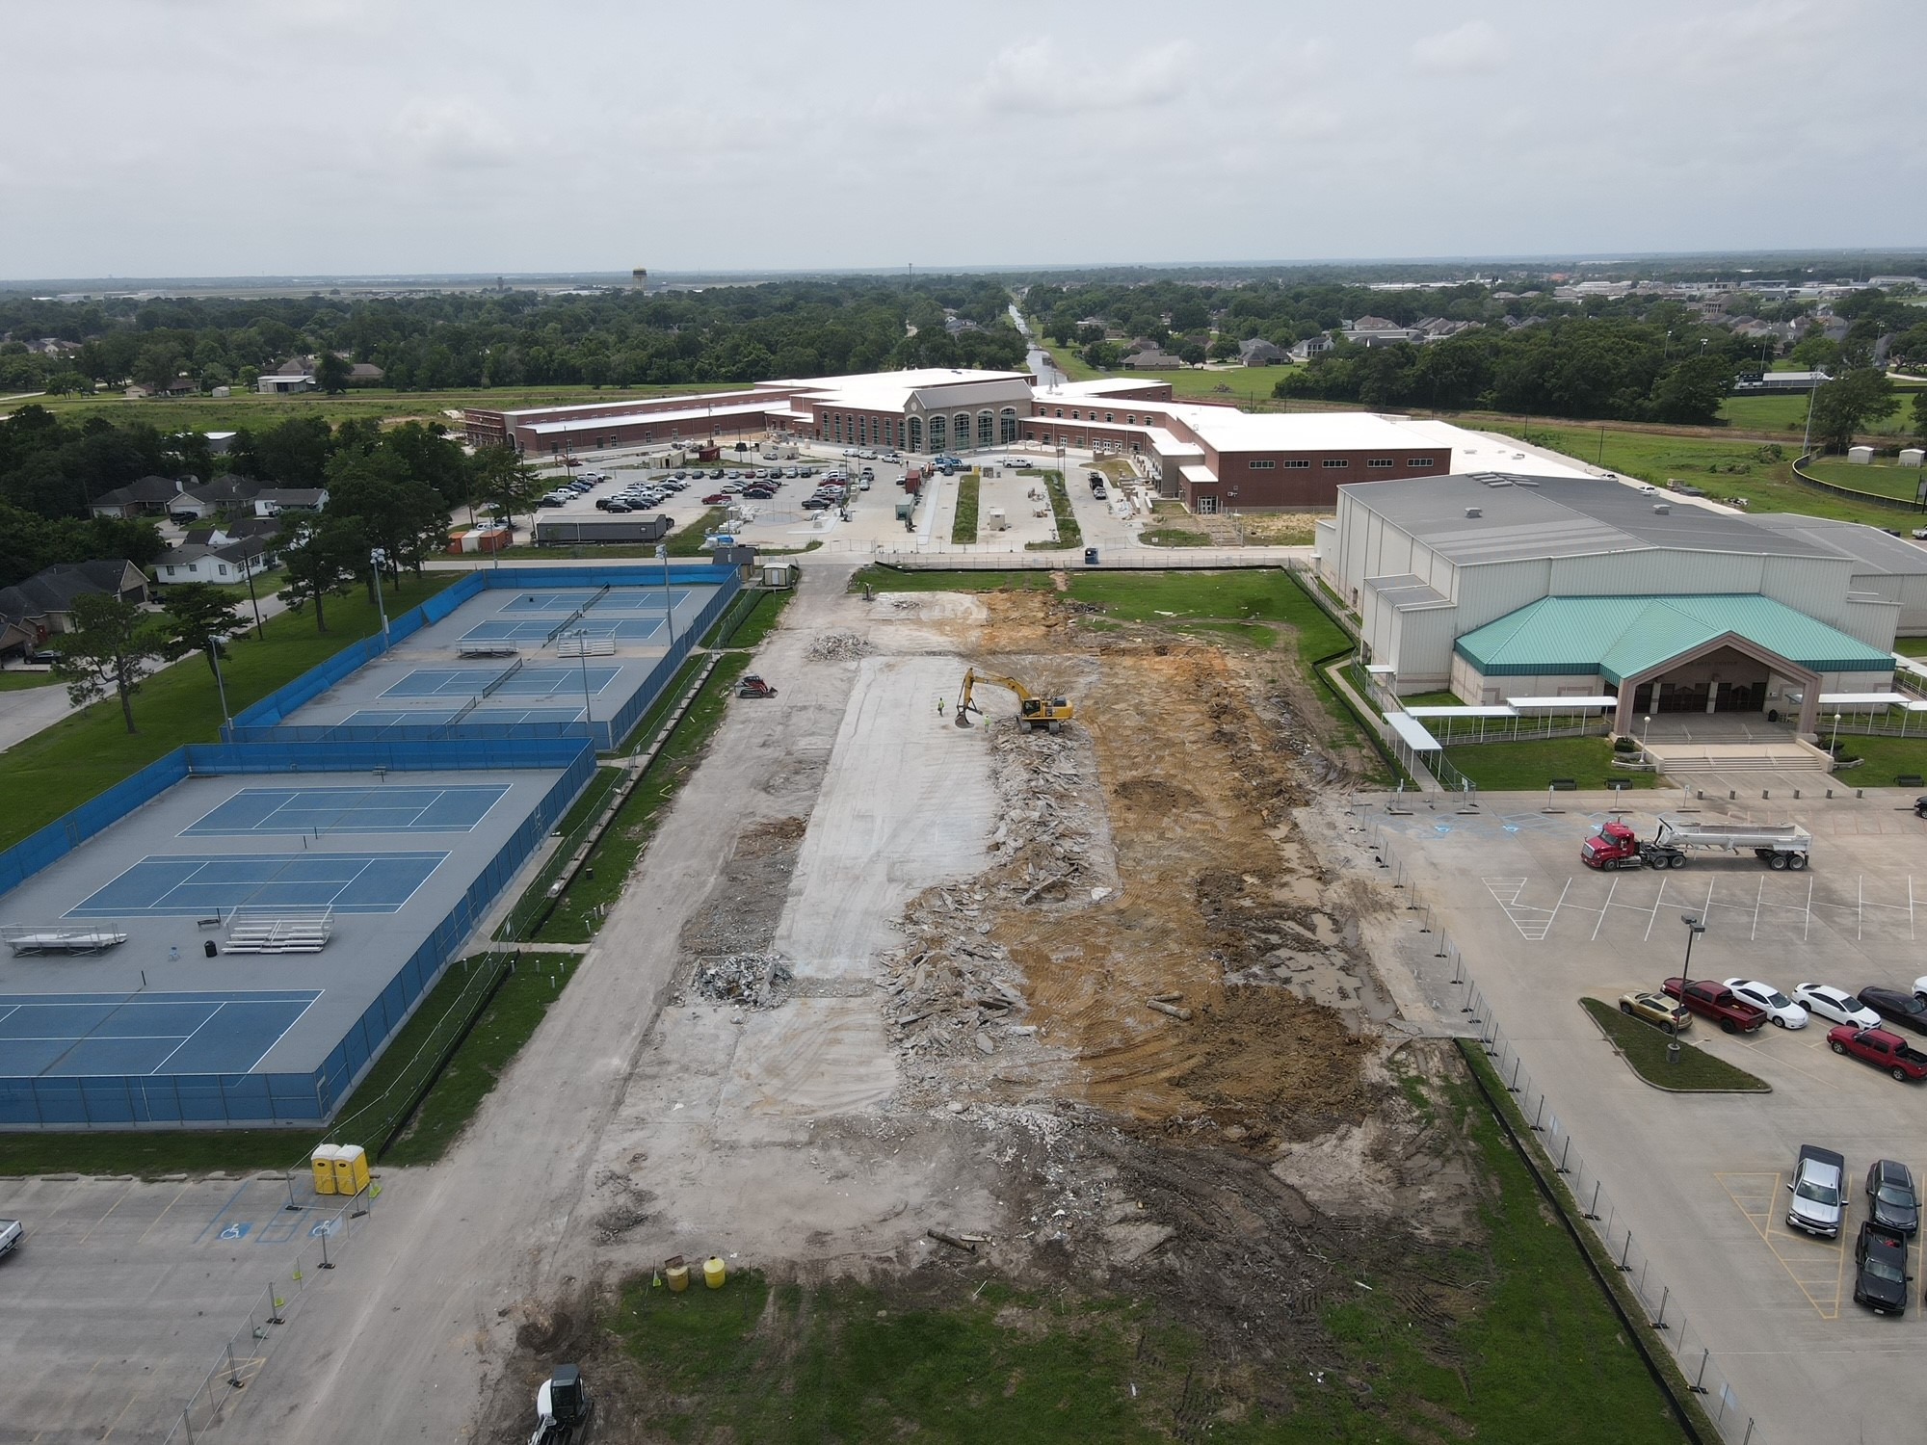
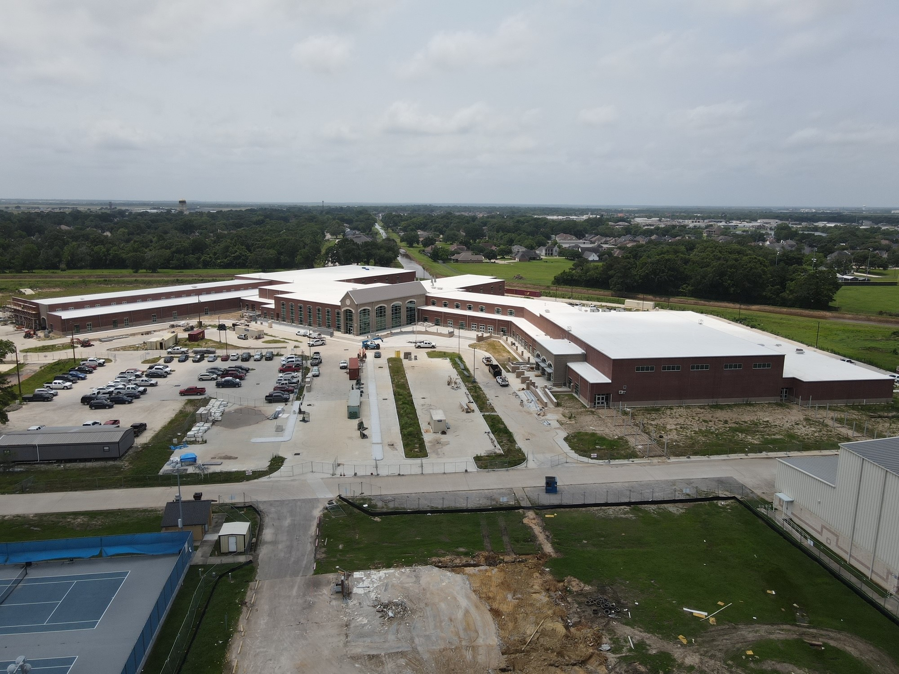
Nederland High School
Exterior
  Begin paving formwork for main drive.
  Begin pouring concrete for main drive.
  Finish southside of area A paving.
  Complete all brickwork around new school.
  Finish setting decorative fence around front of school.

Slide 4
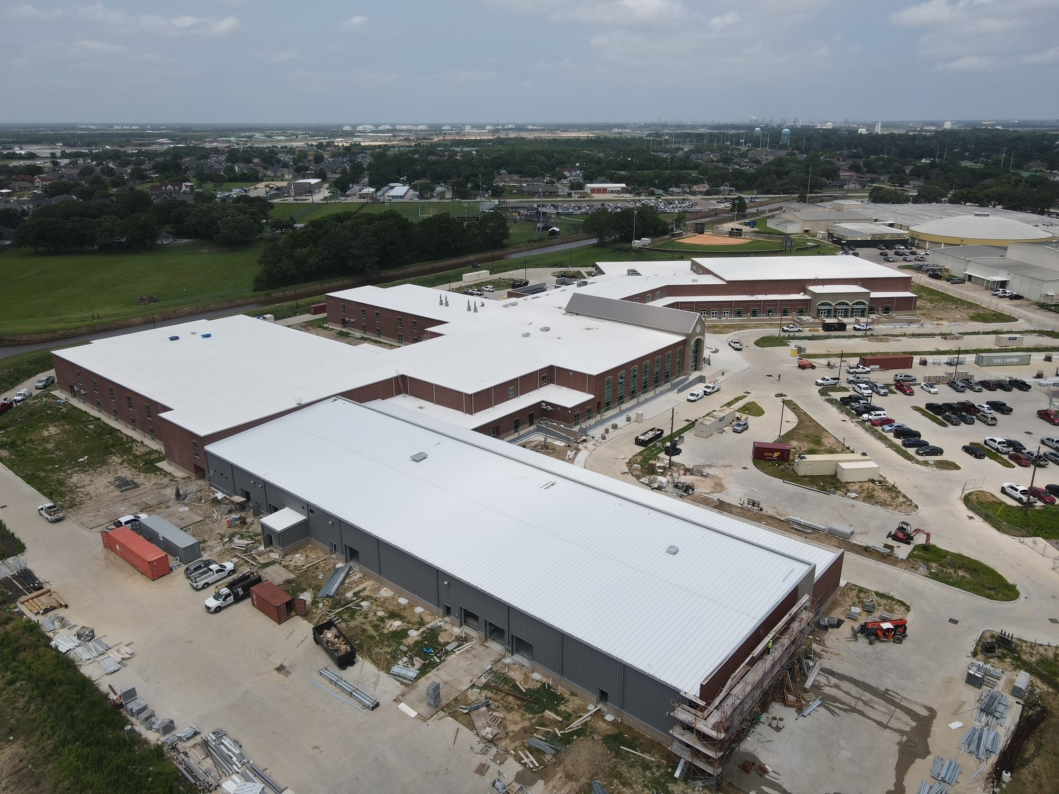
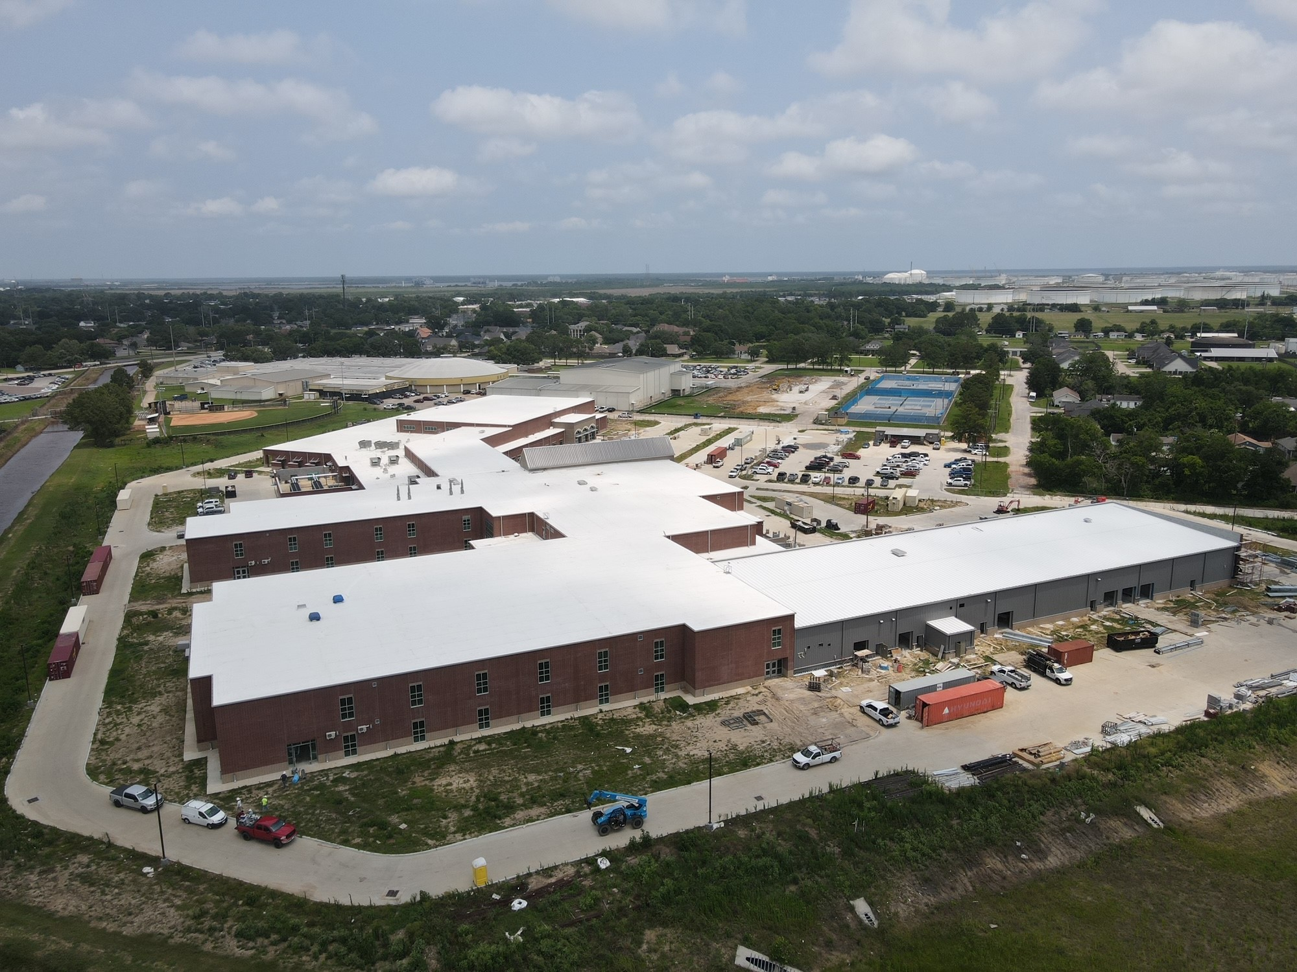
Nederland High School
Exterior
  Continue with canopies/awnings.
  Finish all roof trim work.
  Continue with final grading in islands.
  Finish all curbs around grass islands.
  Continue with landscaping.
Exterior
  Continue with canopy trim work where they tie into the building.

Slide 5
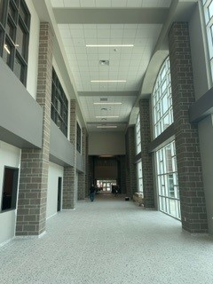
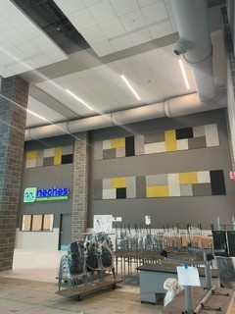
Nederland High School
  Continue final cleaning throughout building.
  Finish rubber base throughout the building.
  Continue with flooring in stairwells.
  ← Main Entry
  Cafeteria →

Slide 6
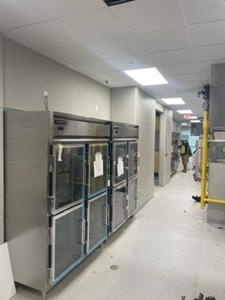
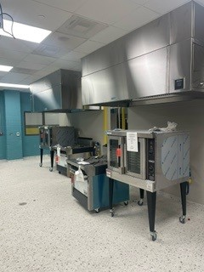
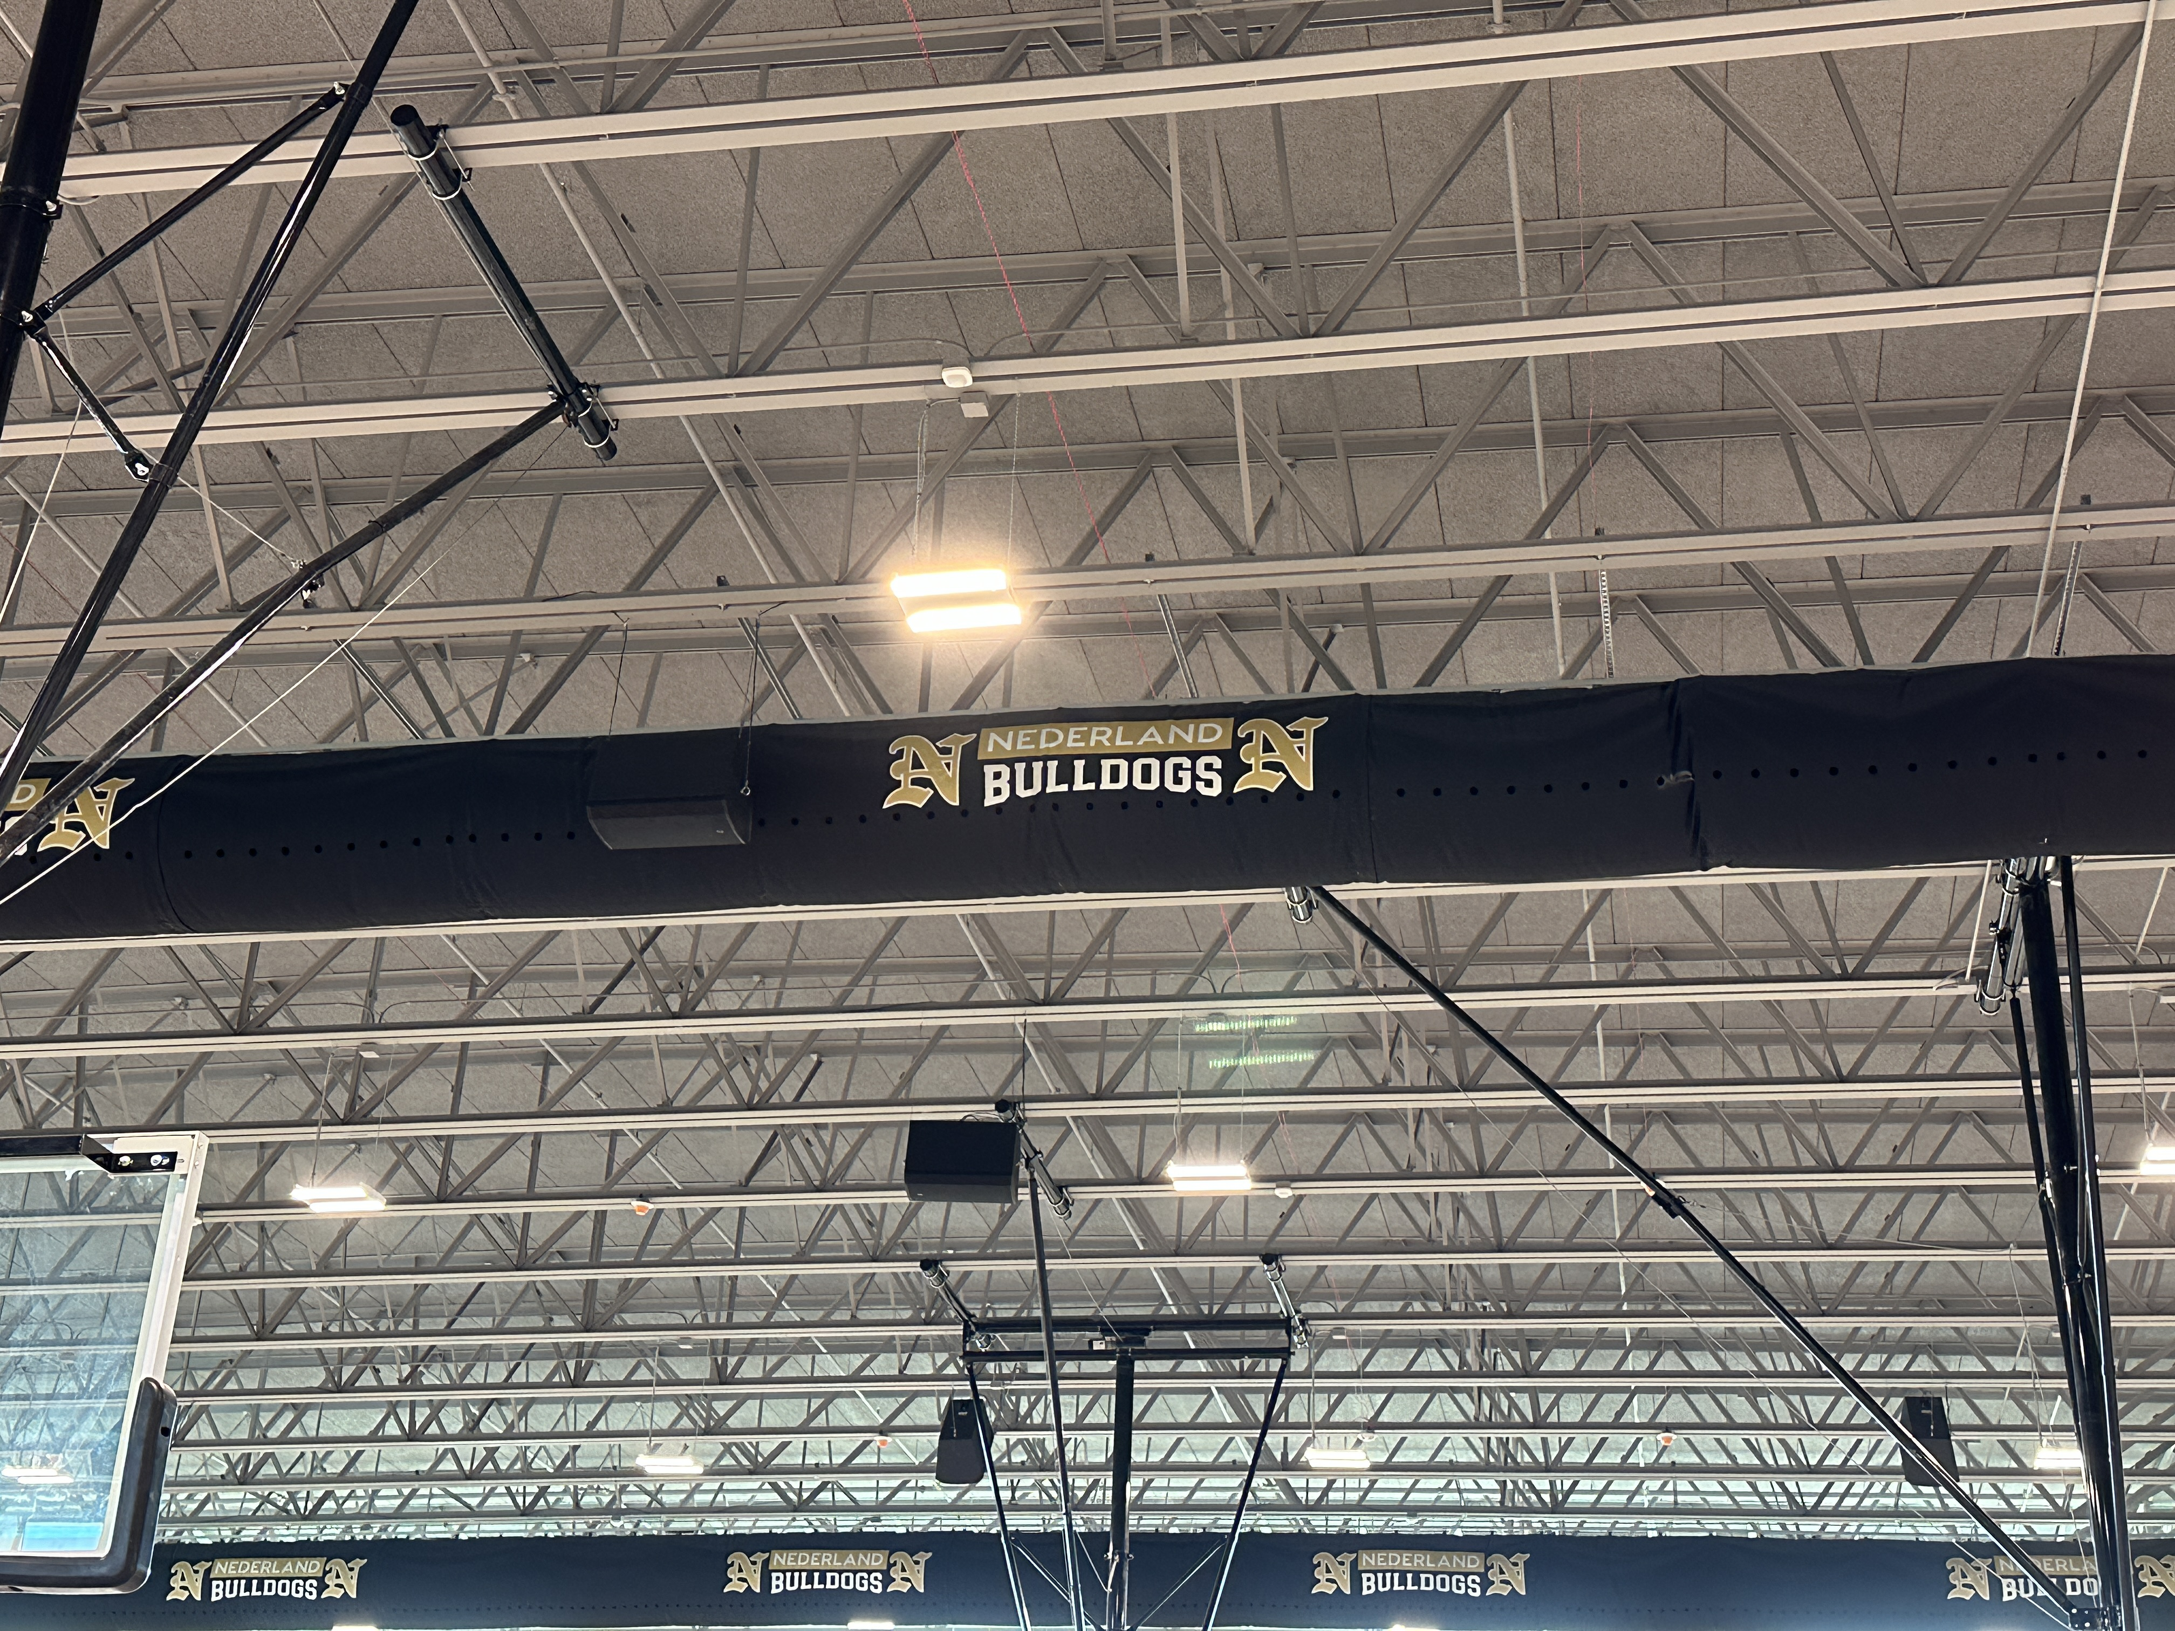
Nederland High School
  Complete culinary equipment tie ins and installation.
  Complete kitchen equipment tie ins and installation.
  Bleacher installation.
  Gym floor installation.

Slide 7
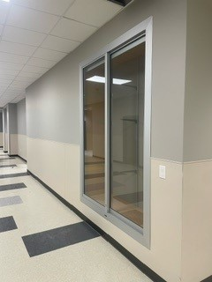
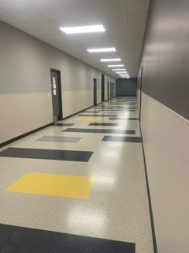
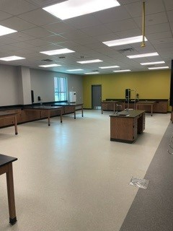
Nederland High School
Install all residential appliances.
Complete touch up paint and final coat of paint throughout the building.

Slide 8
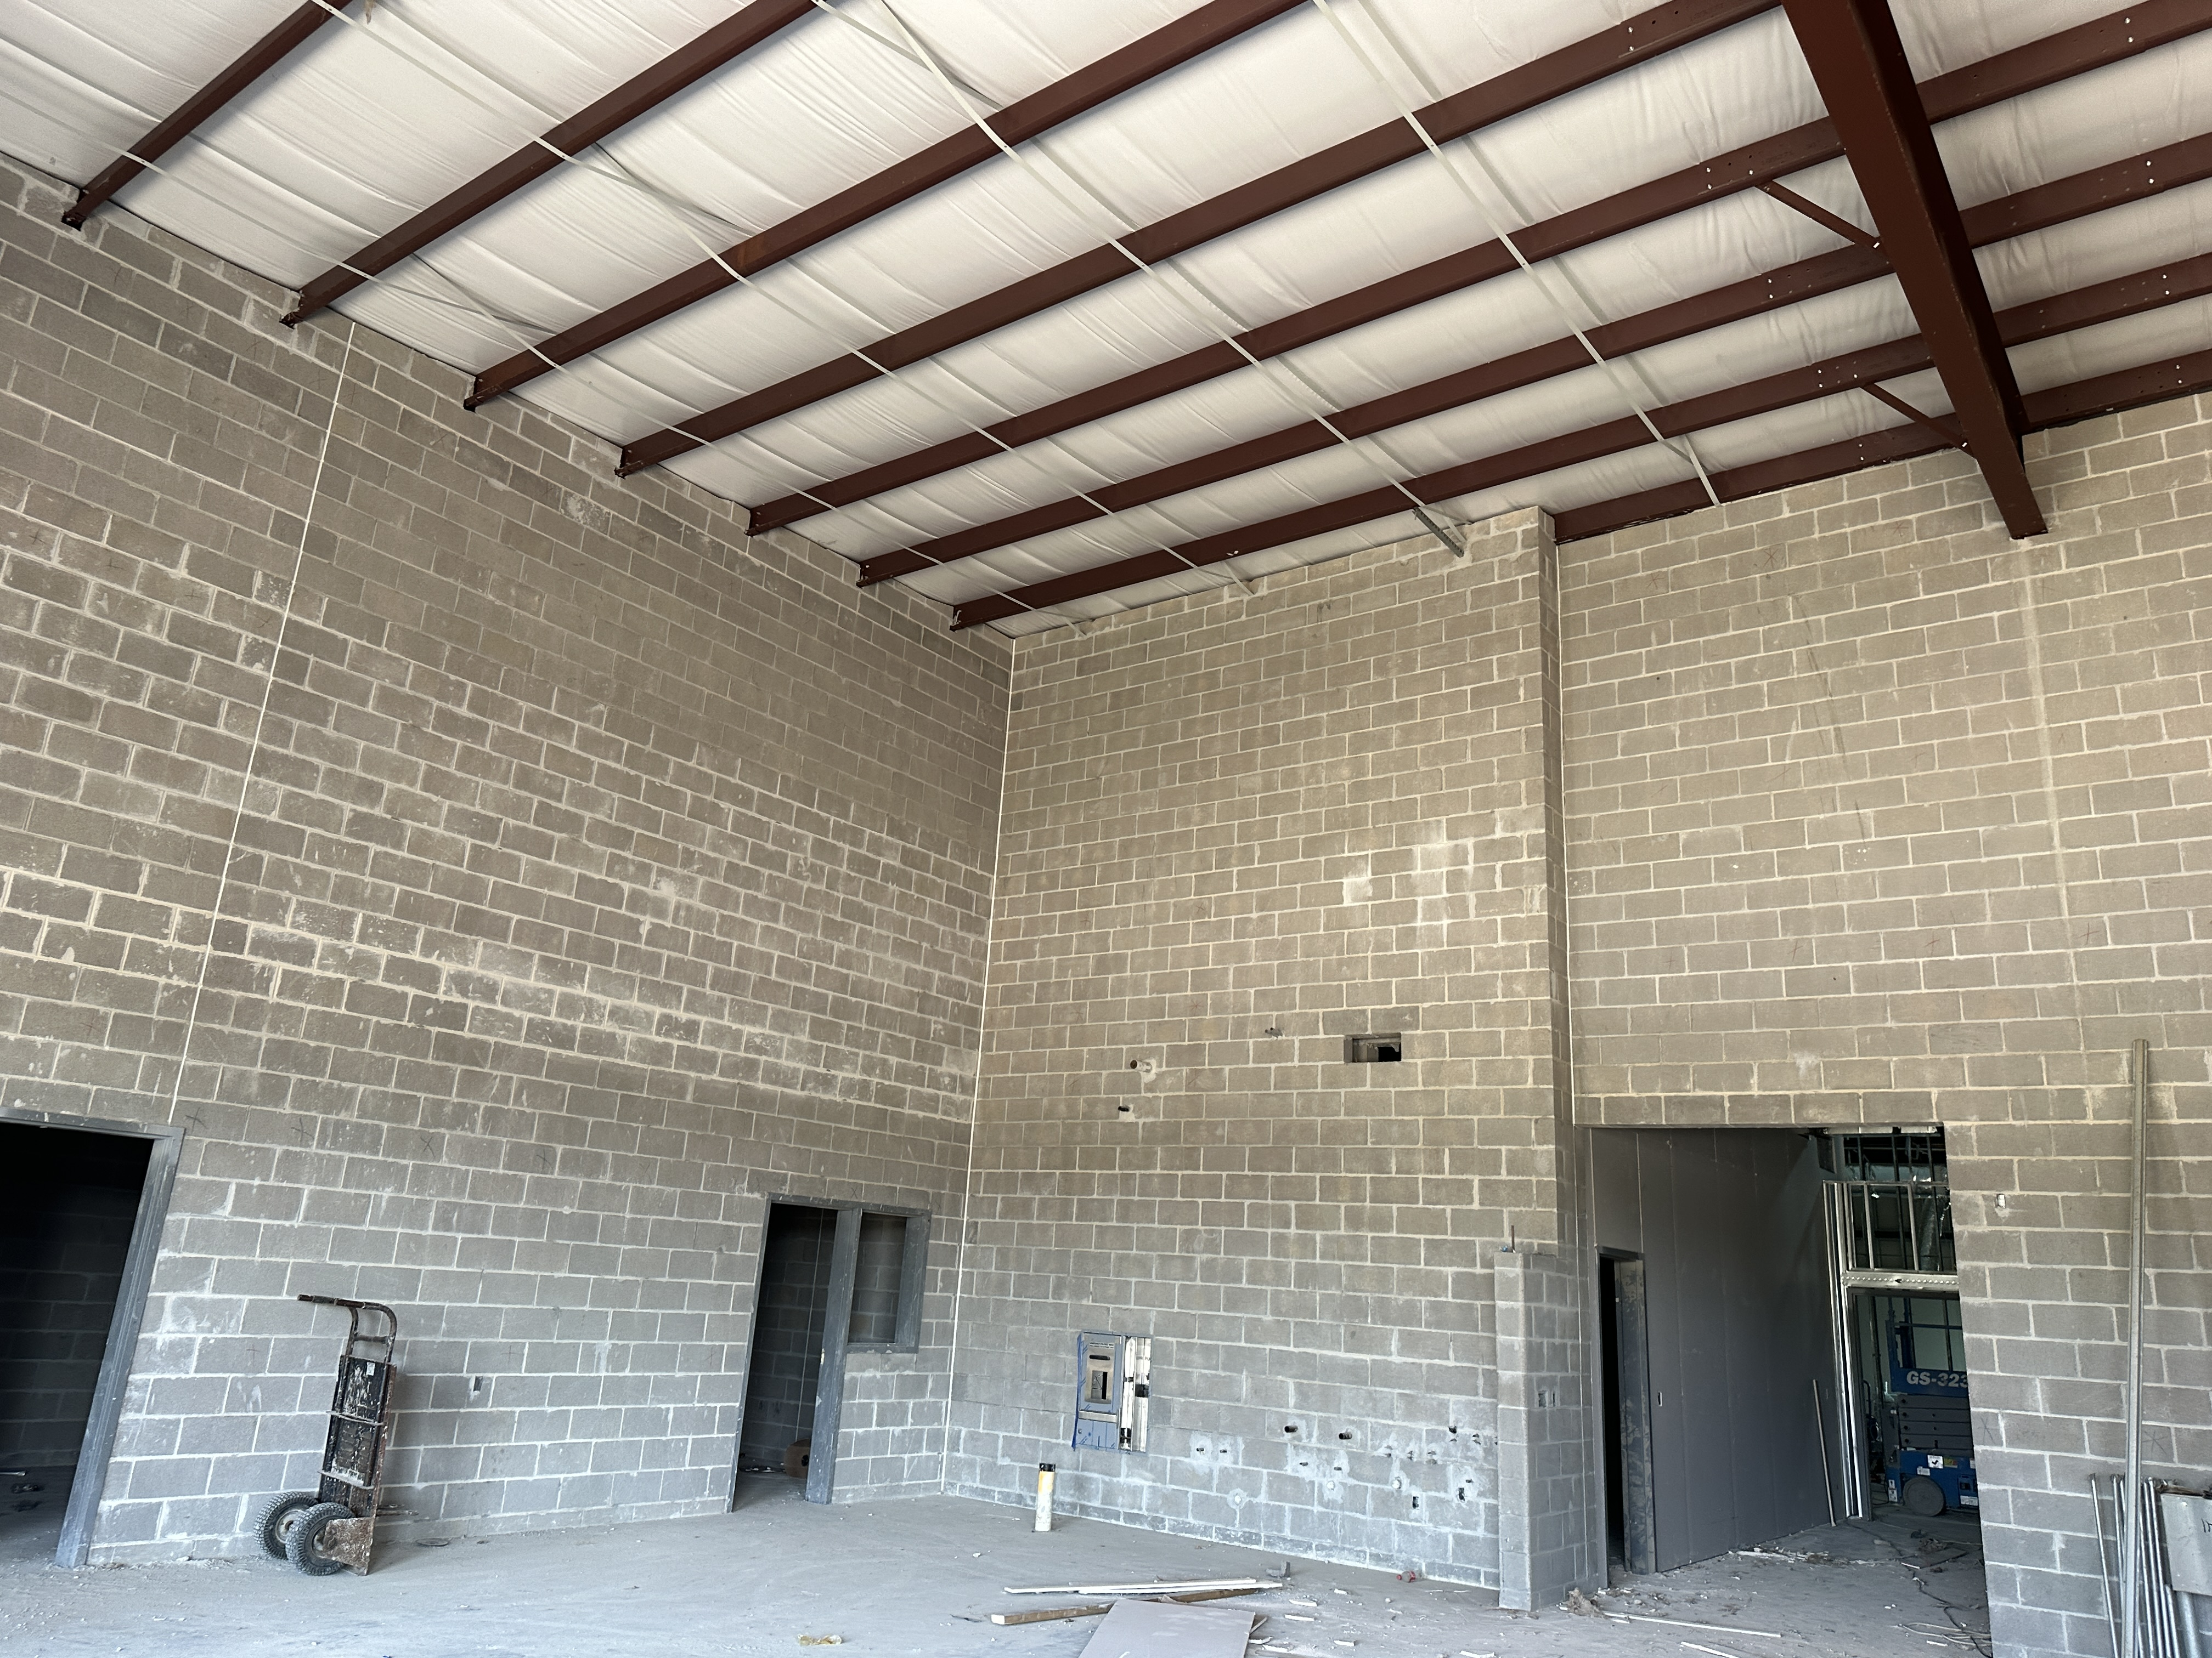
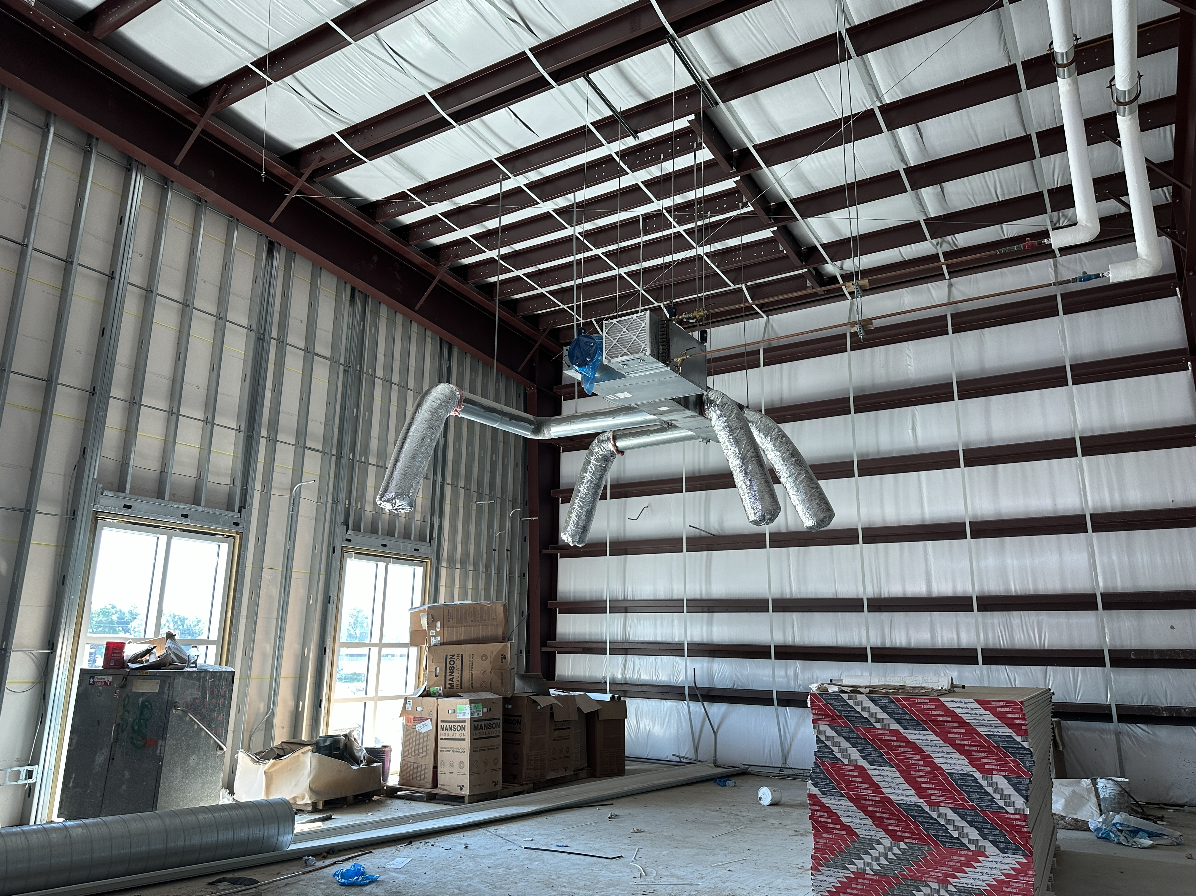
Nederland High School
  Continue installing duct work in B & A.
  Complete chiller piping throughout A/B.
  Continue overhead MEP Runs throughout CTE
  Complete Sheetrocking – Tape & Float
  Continue CMU Paint.
  1st coat of paint on all walls in CTE.
  Begin hard ceiling installation in CTE.
  HBN Providing Temp Air to increase airflow through CTE

Slide 9


