Slide 1




2019 Nederland ISD Bond Project
August 2024

Slide 2

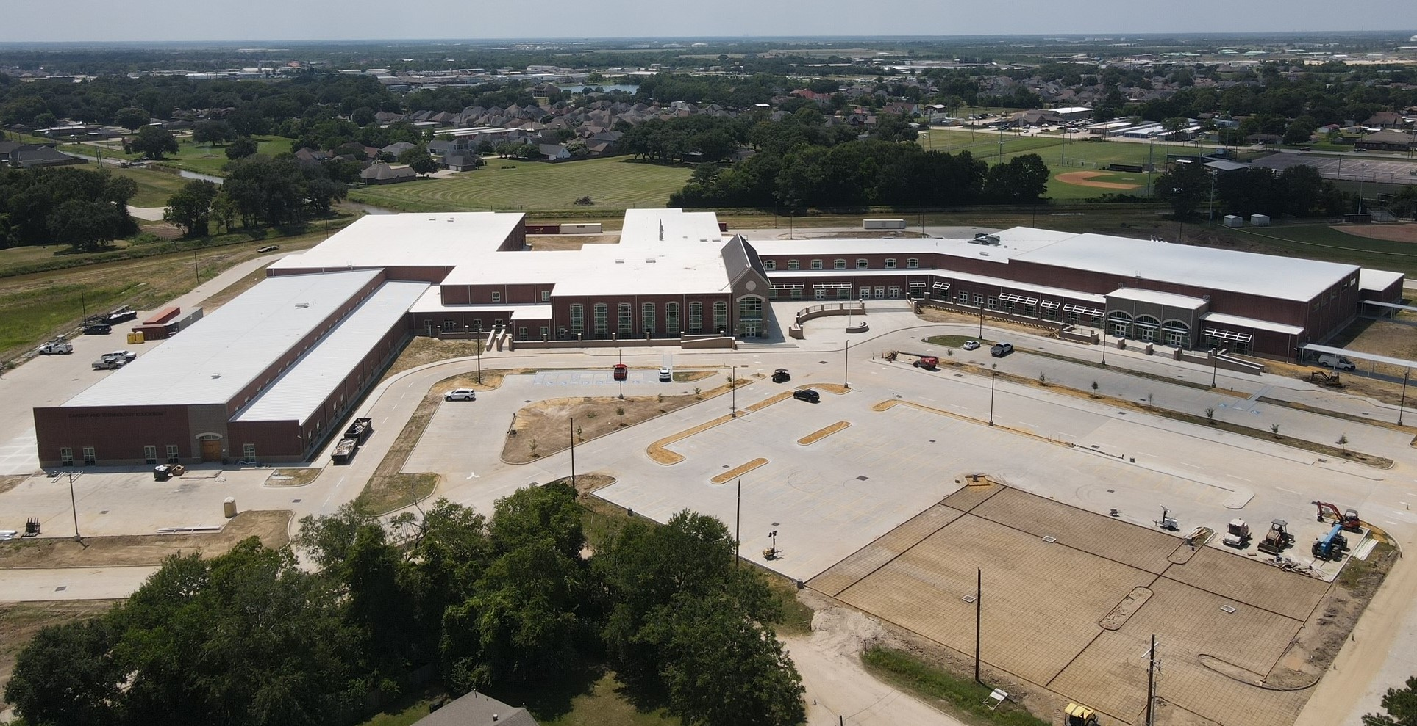
Nederland High School

Slide 3
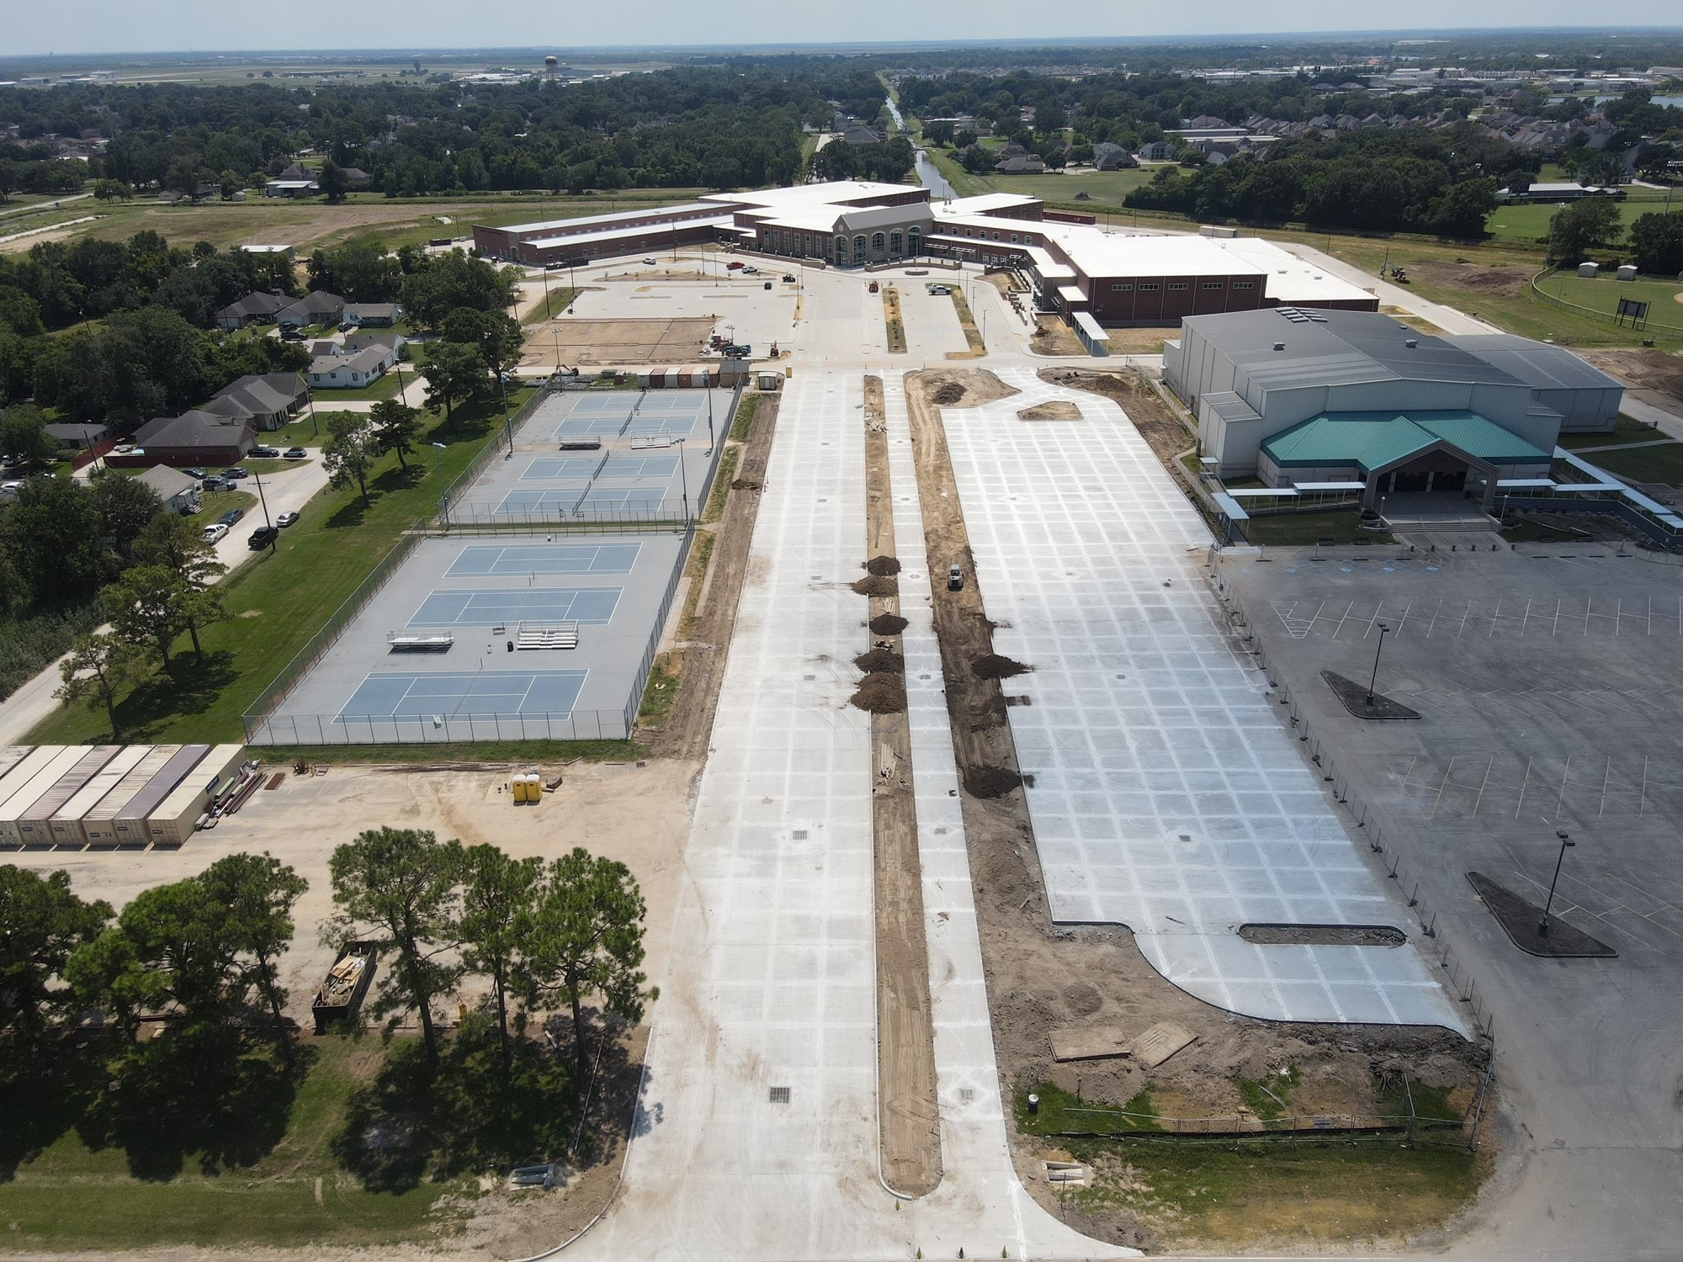
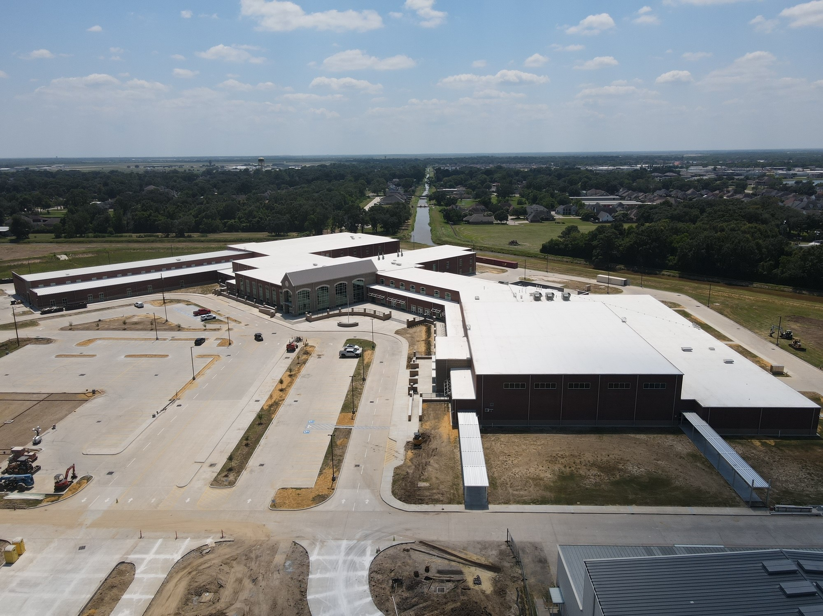
Nederland High School
Exterior
  Complete canopies & awnings.
  Complete landscaping.
  Complete light poles and bases.
  Complete striping around school.

Slide 4
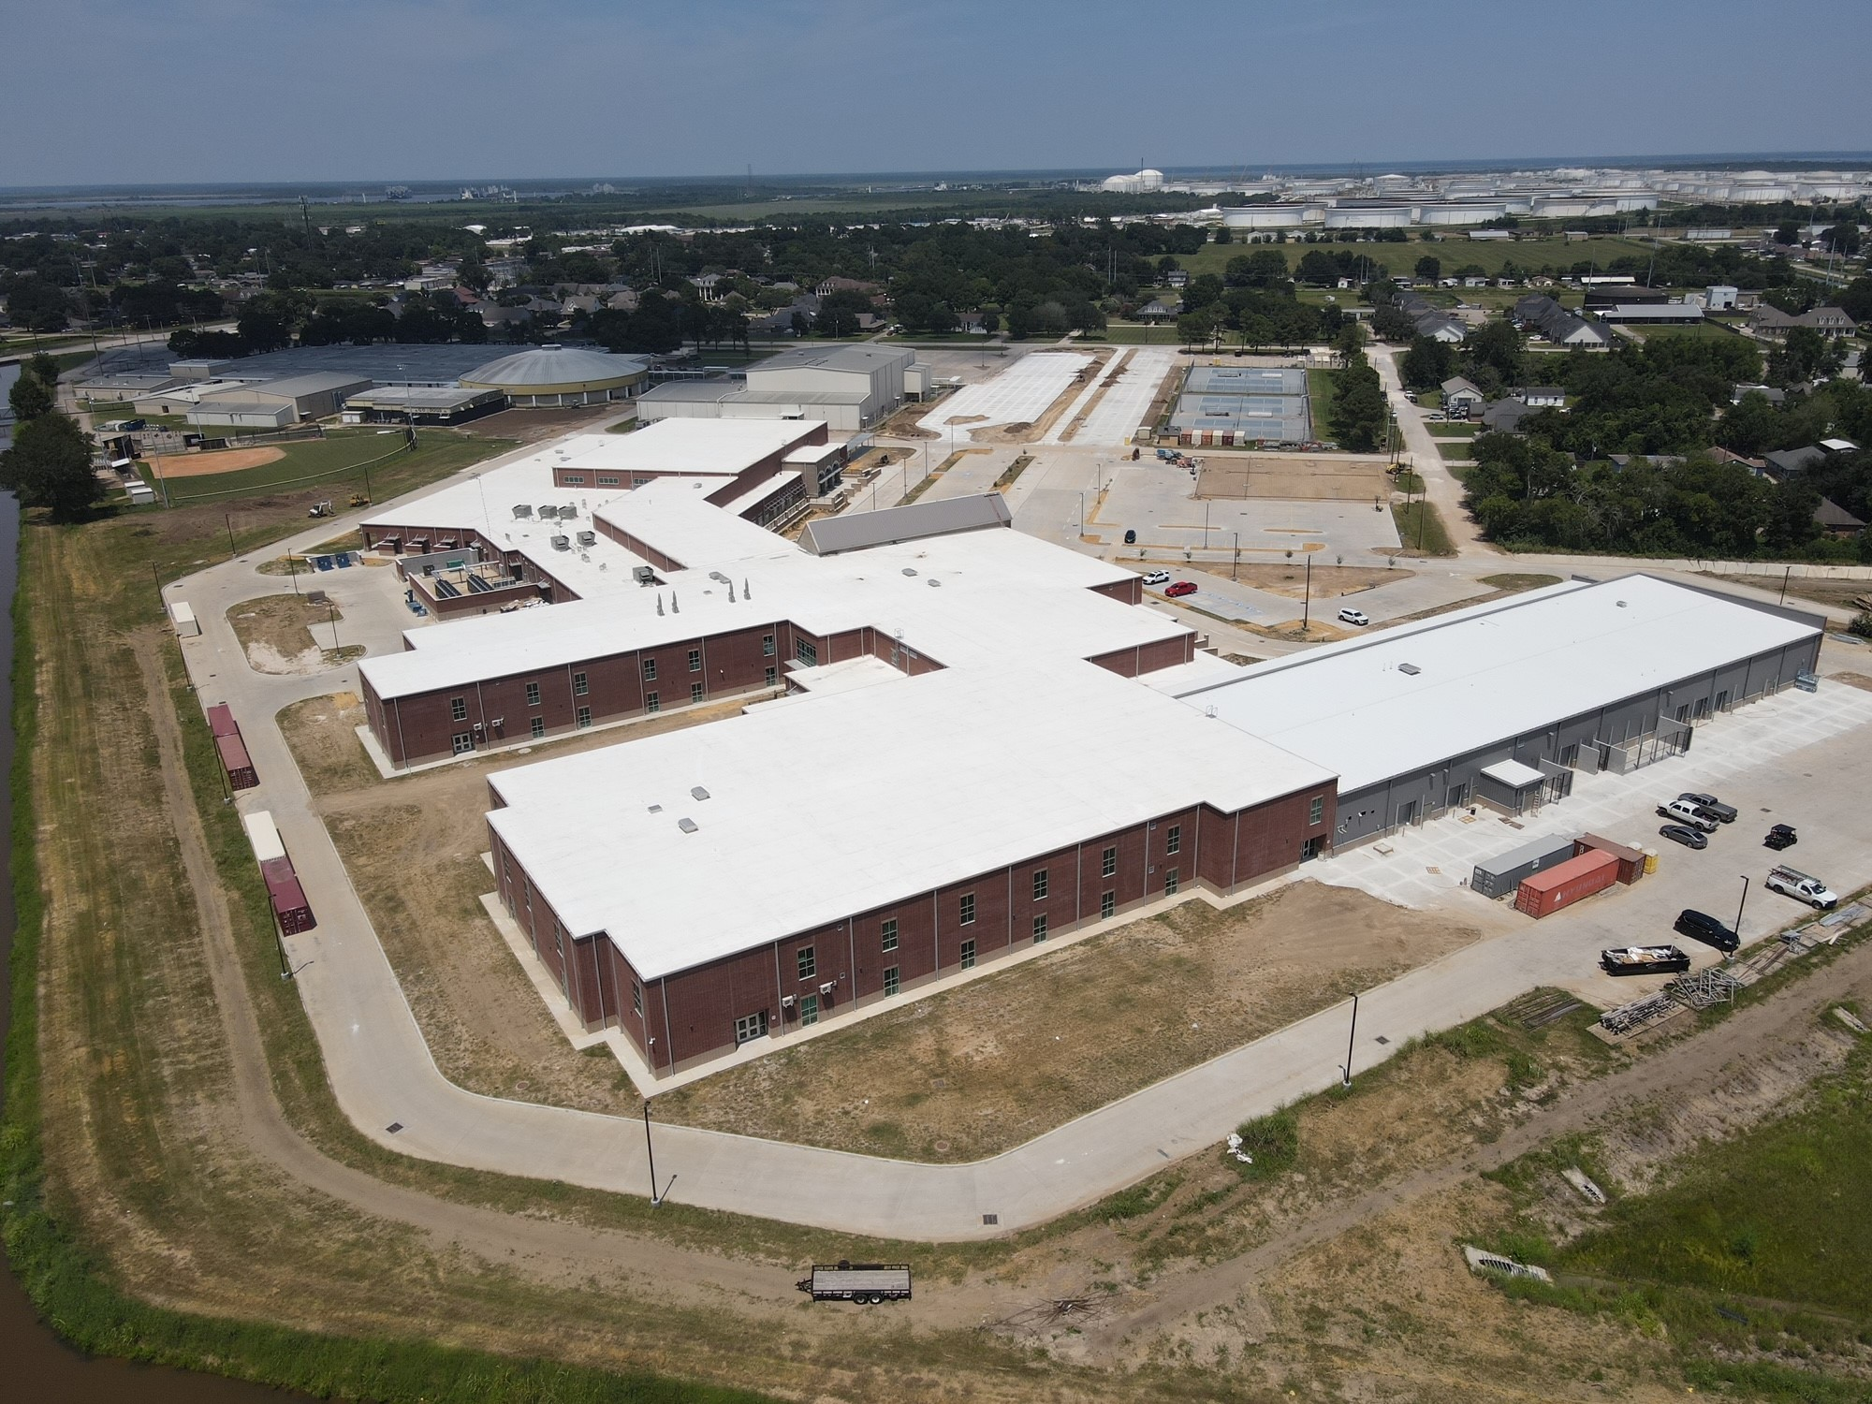
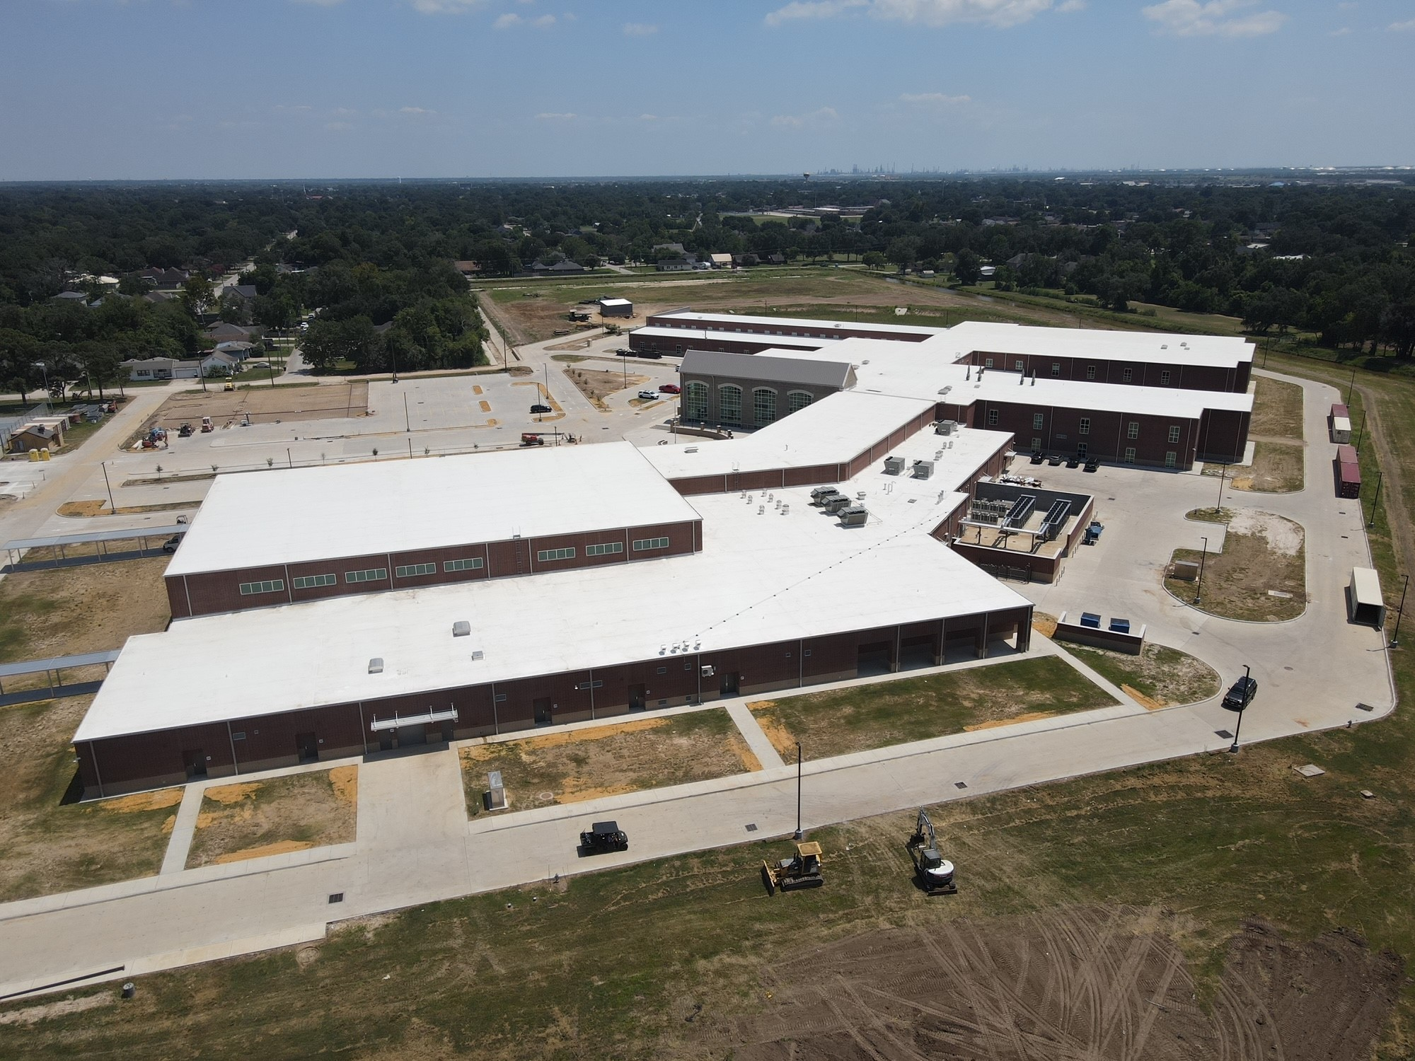
Nederland High School
Exterior
  Finish all roof trim work.
  Finish downspouts.
  Finish exterior fencing around site and pond.

Slide 5
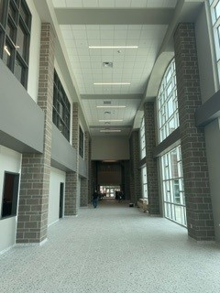
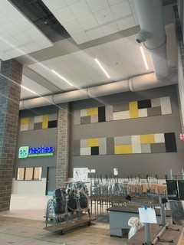
Nederland High School
  Punch list.
  ← Main Entry
  Cafeteria →

Slide 6
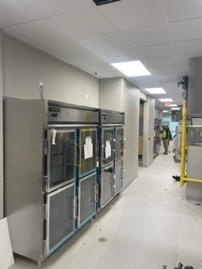
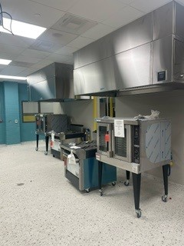
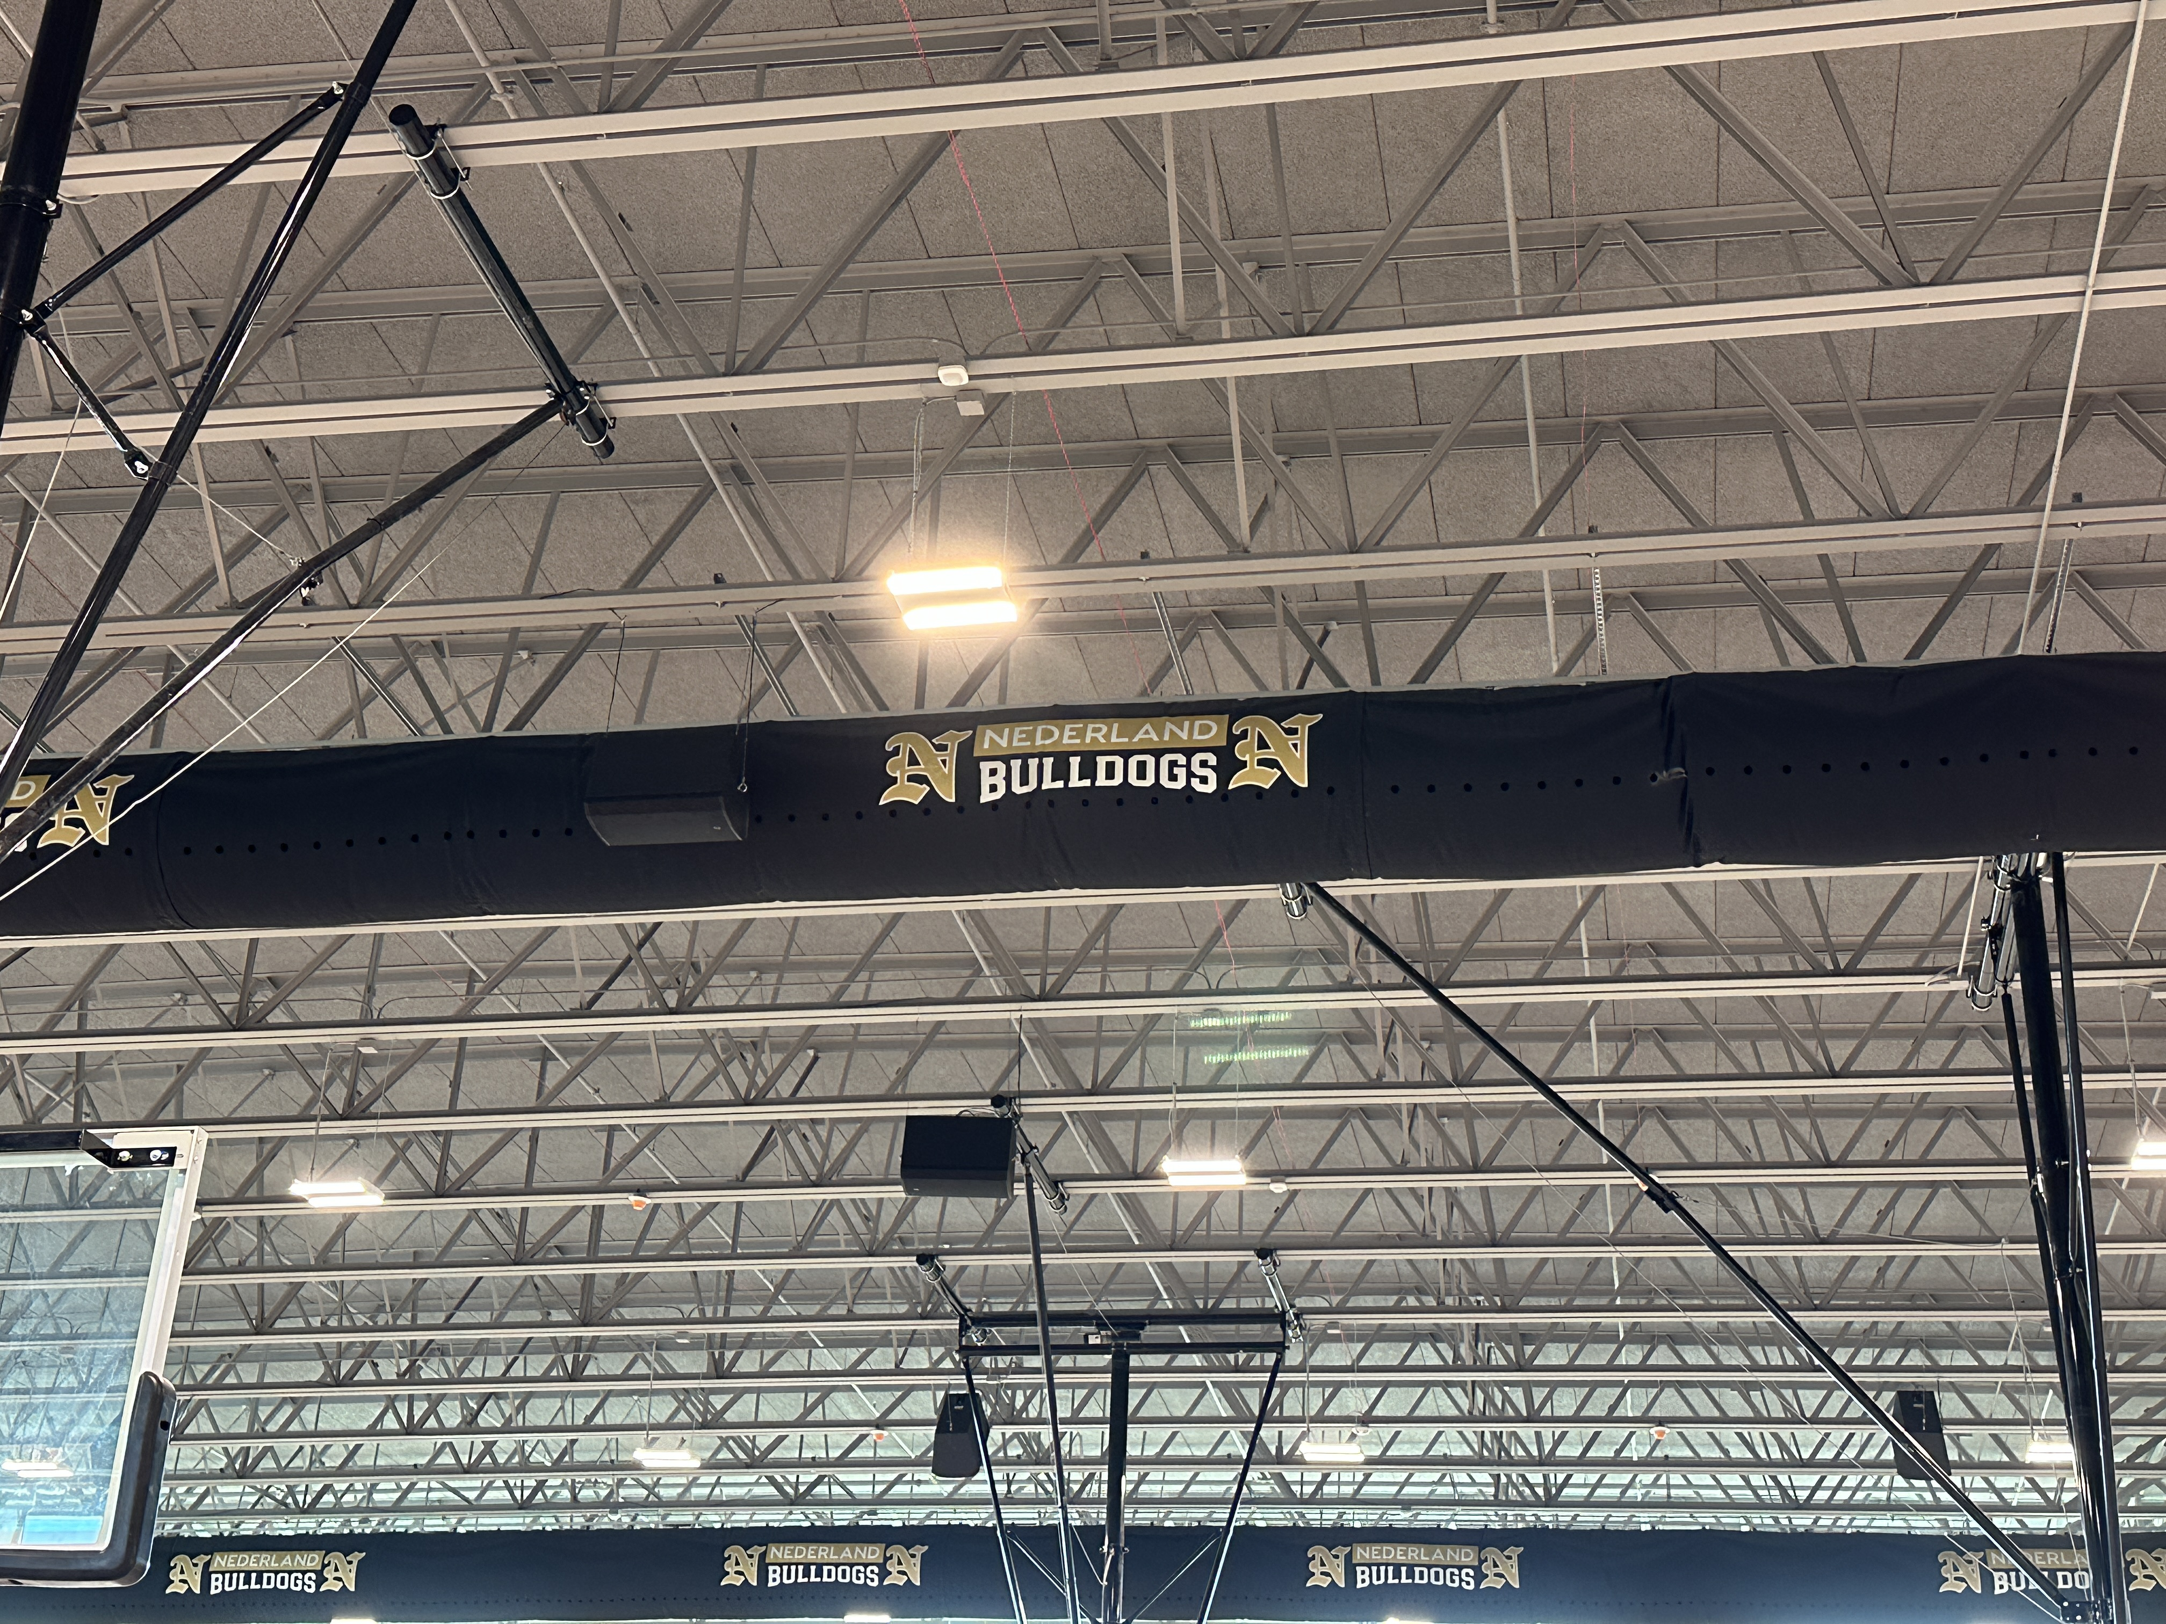
Nederland High School
  Test and balance of the HVAC system.
  Service calls on Kitchen Equipment.

Slide 7
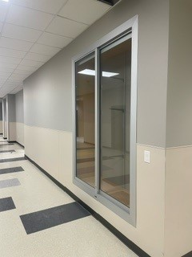
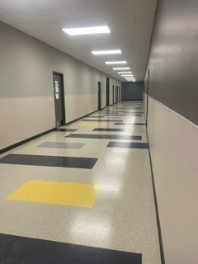
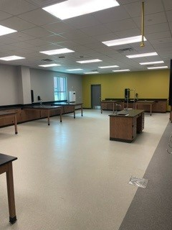
Nederland High School
Install all residential appliances.
Complete touch up paint and final coat of paint throughout the building.

Slide 8
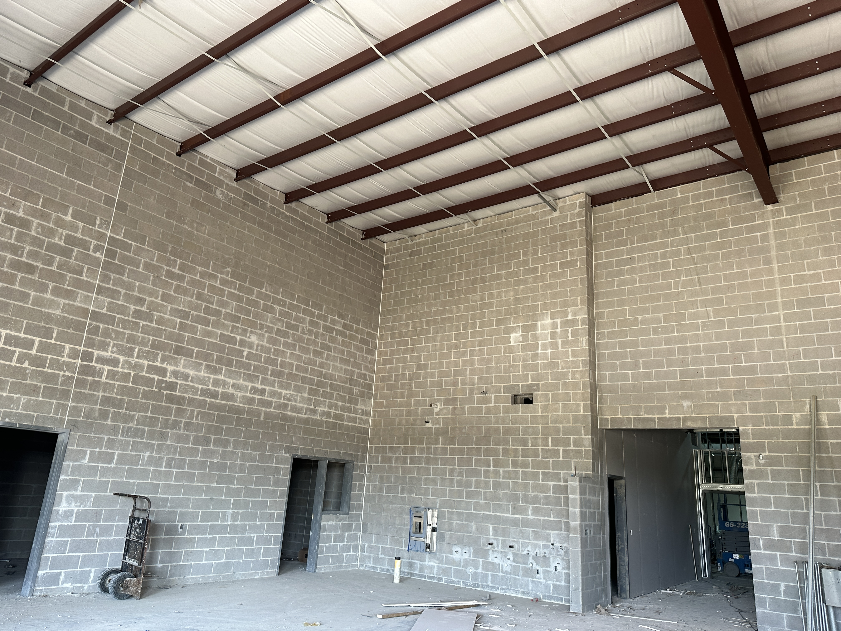
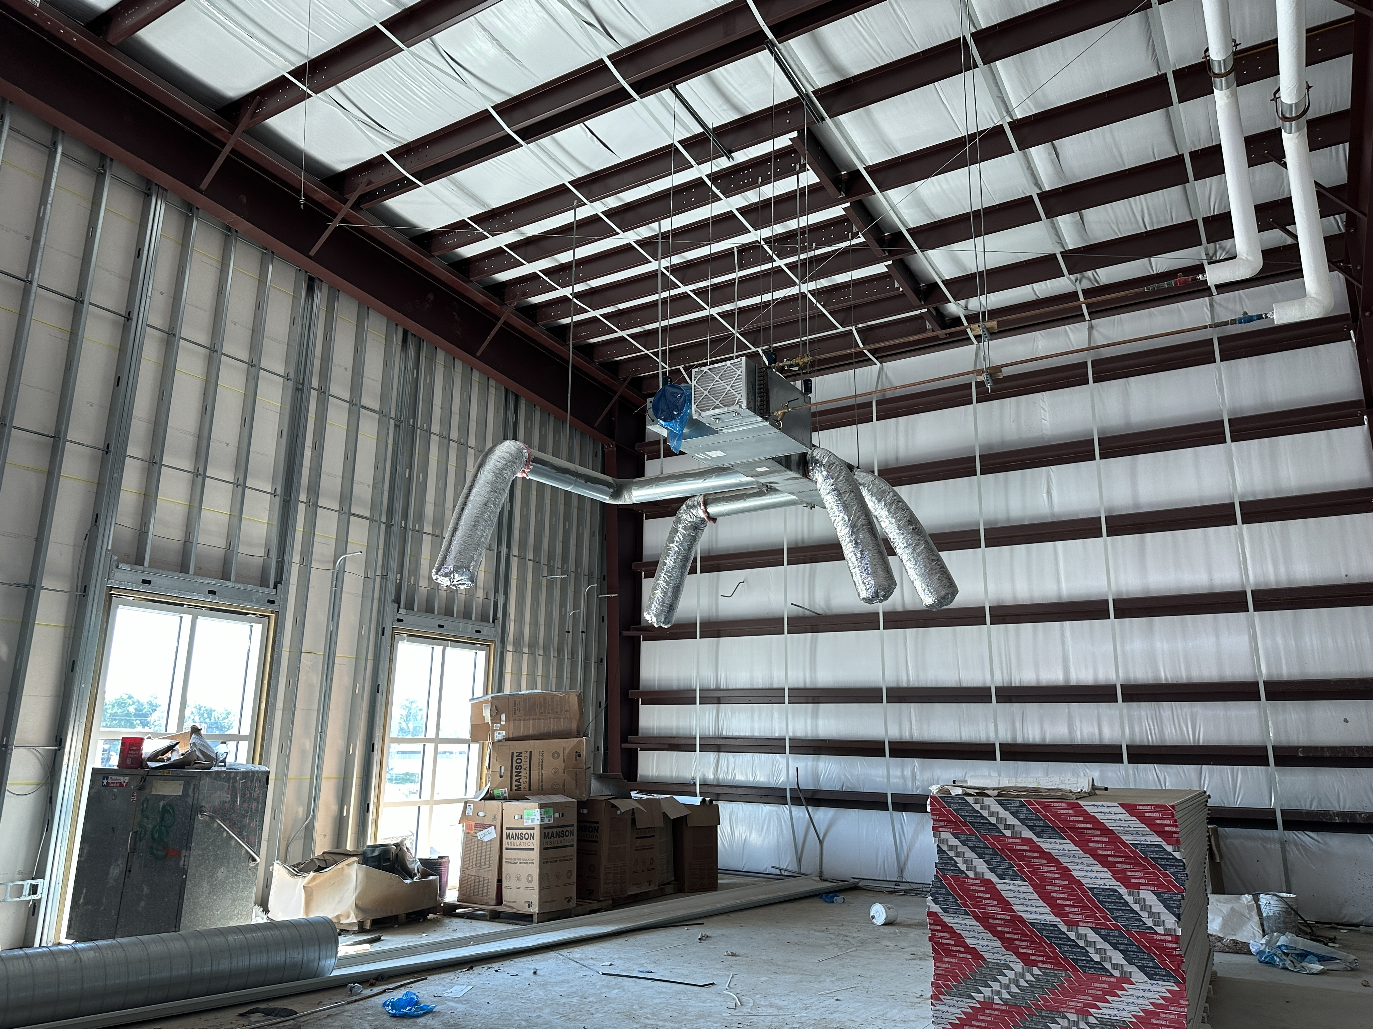
Nederland High School
  Continue installing duct work in B & A.
  Continue overhead MEP Runs throughout CTE
  Begin epoxy flooring.
  Begin hanging doors.
  Begin carpet and VCT.
  Continue setting plumbing fixtures.
  Continue lay in ceilings.(main hallway only)
  Begin installation of all ceiling pads.
  Installation of welding booths.
  Electrical trim out.

Slide 9


