Slide 1




2019 Nederland ISD Bond Project
September 2024

Slide 2

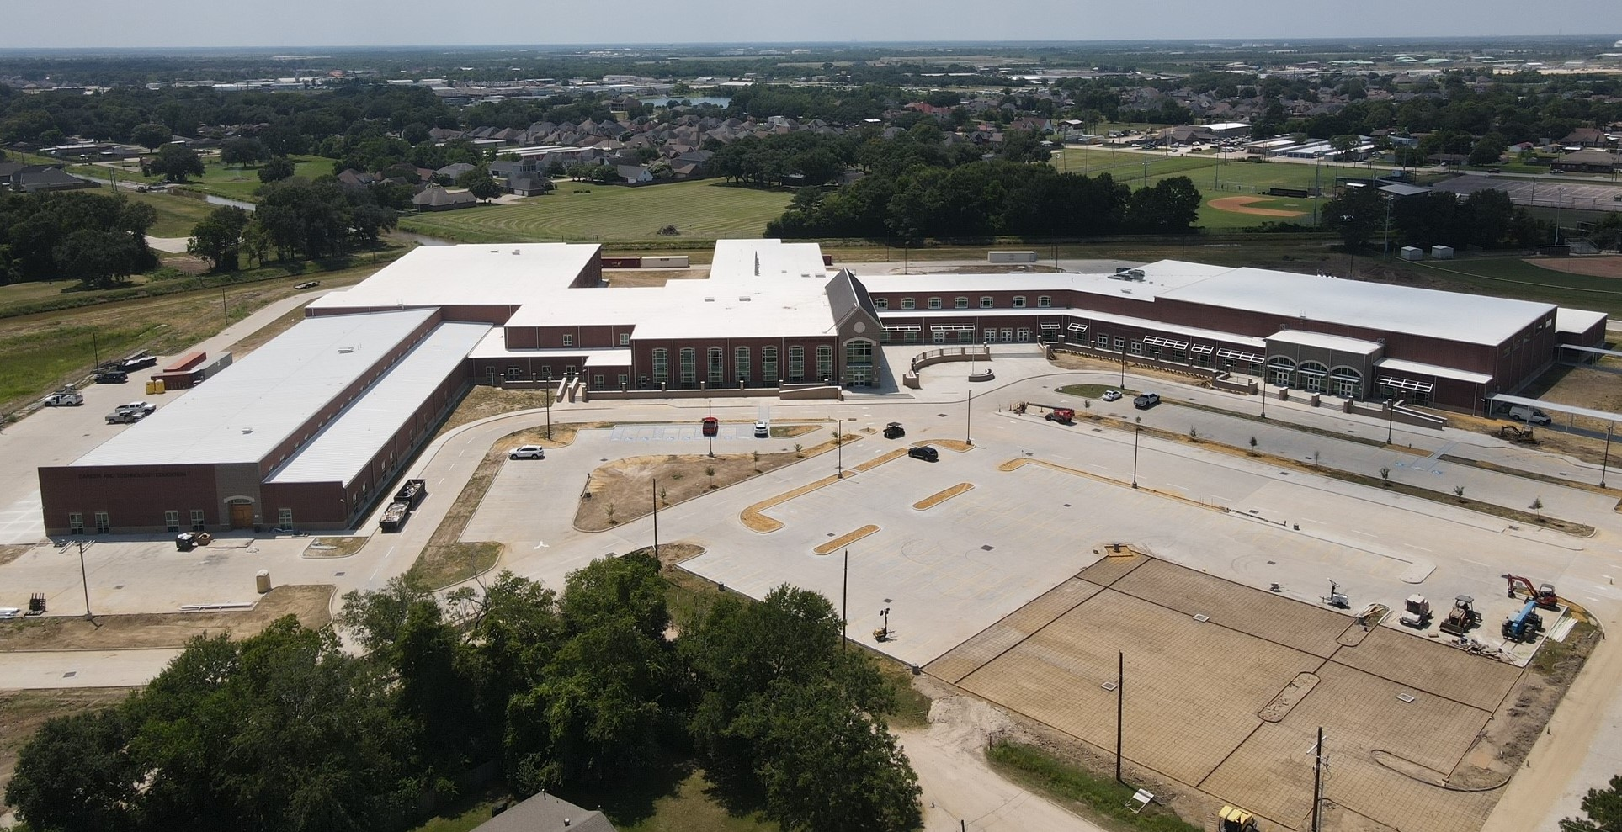
Nederland High School

Slide 3
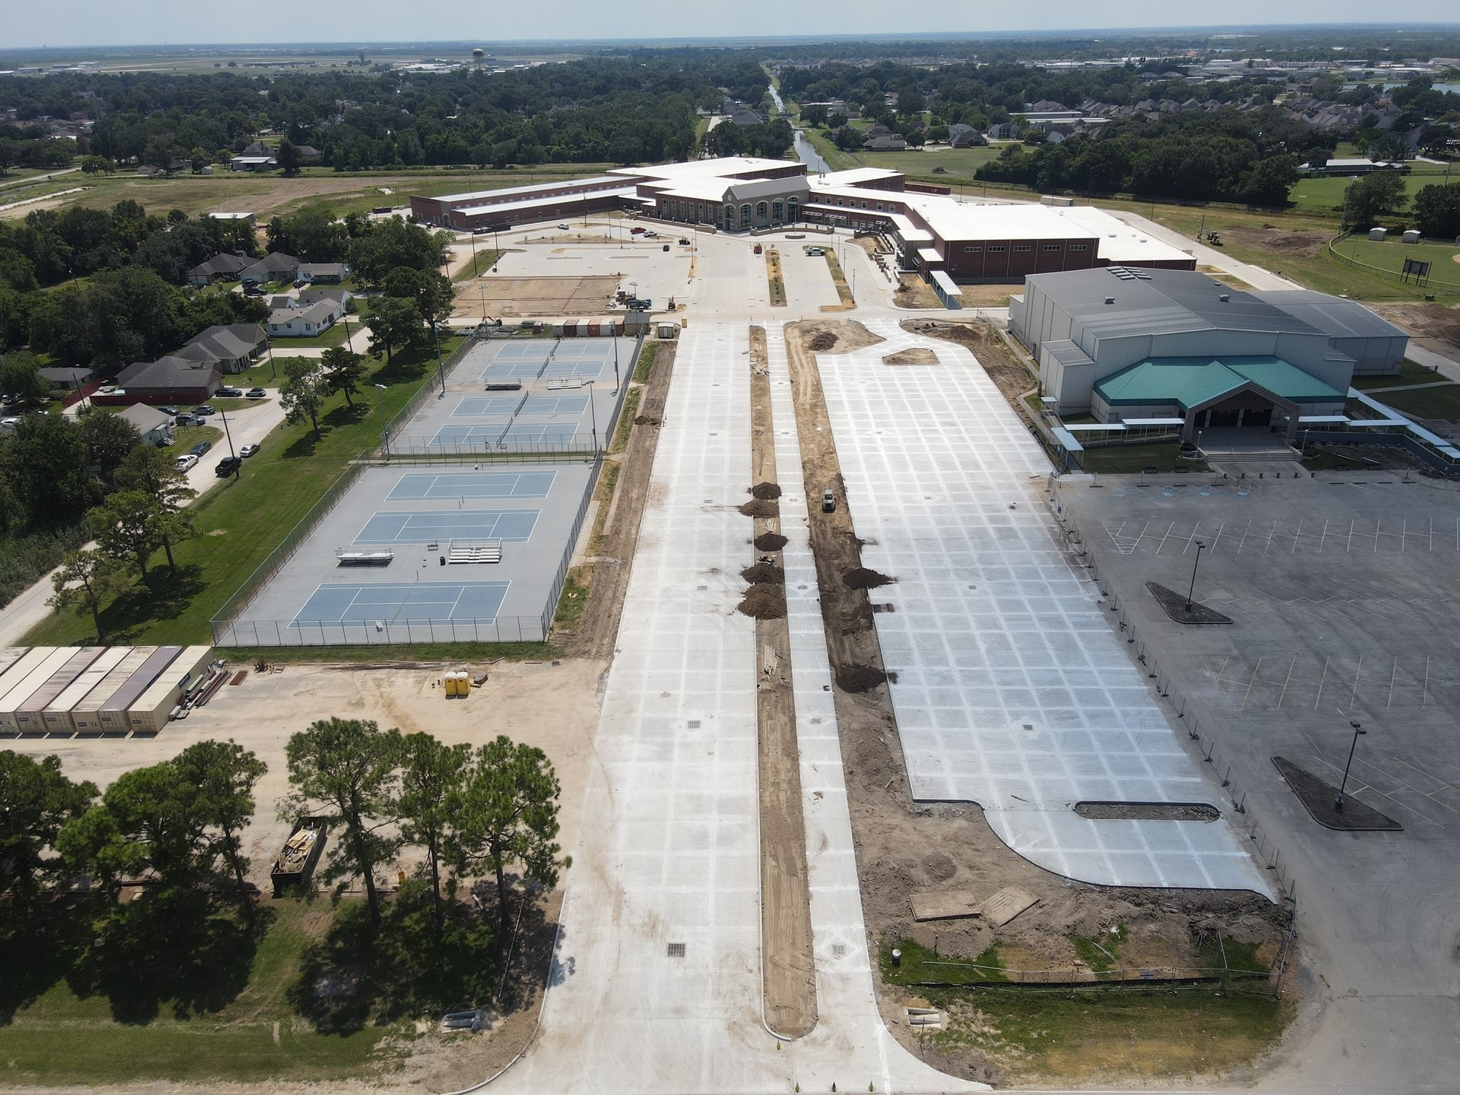
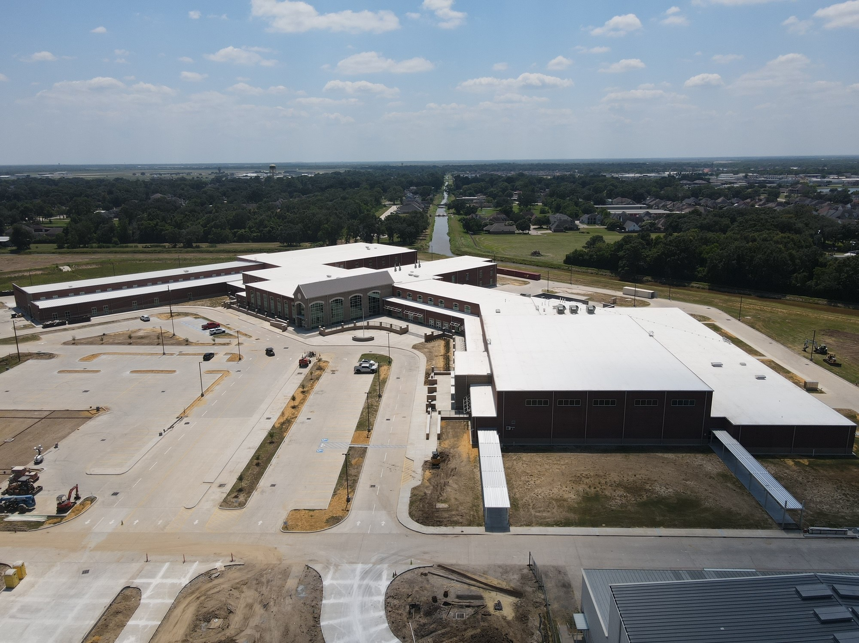
Nederland High School
Exterior
  Complete canopies & awnings.
  Complete landscaping.
  Complete light poles and bases.
  Complete striping around school.

Slide 4
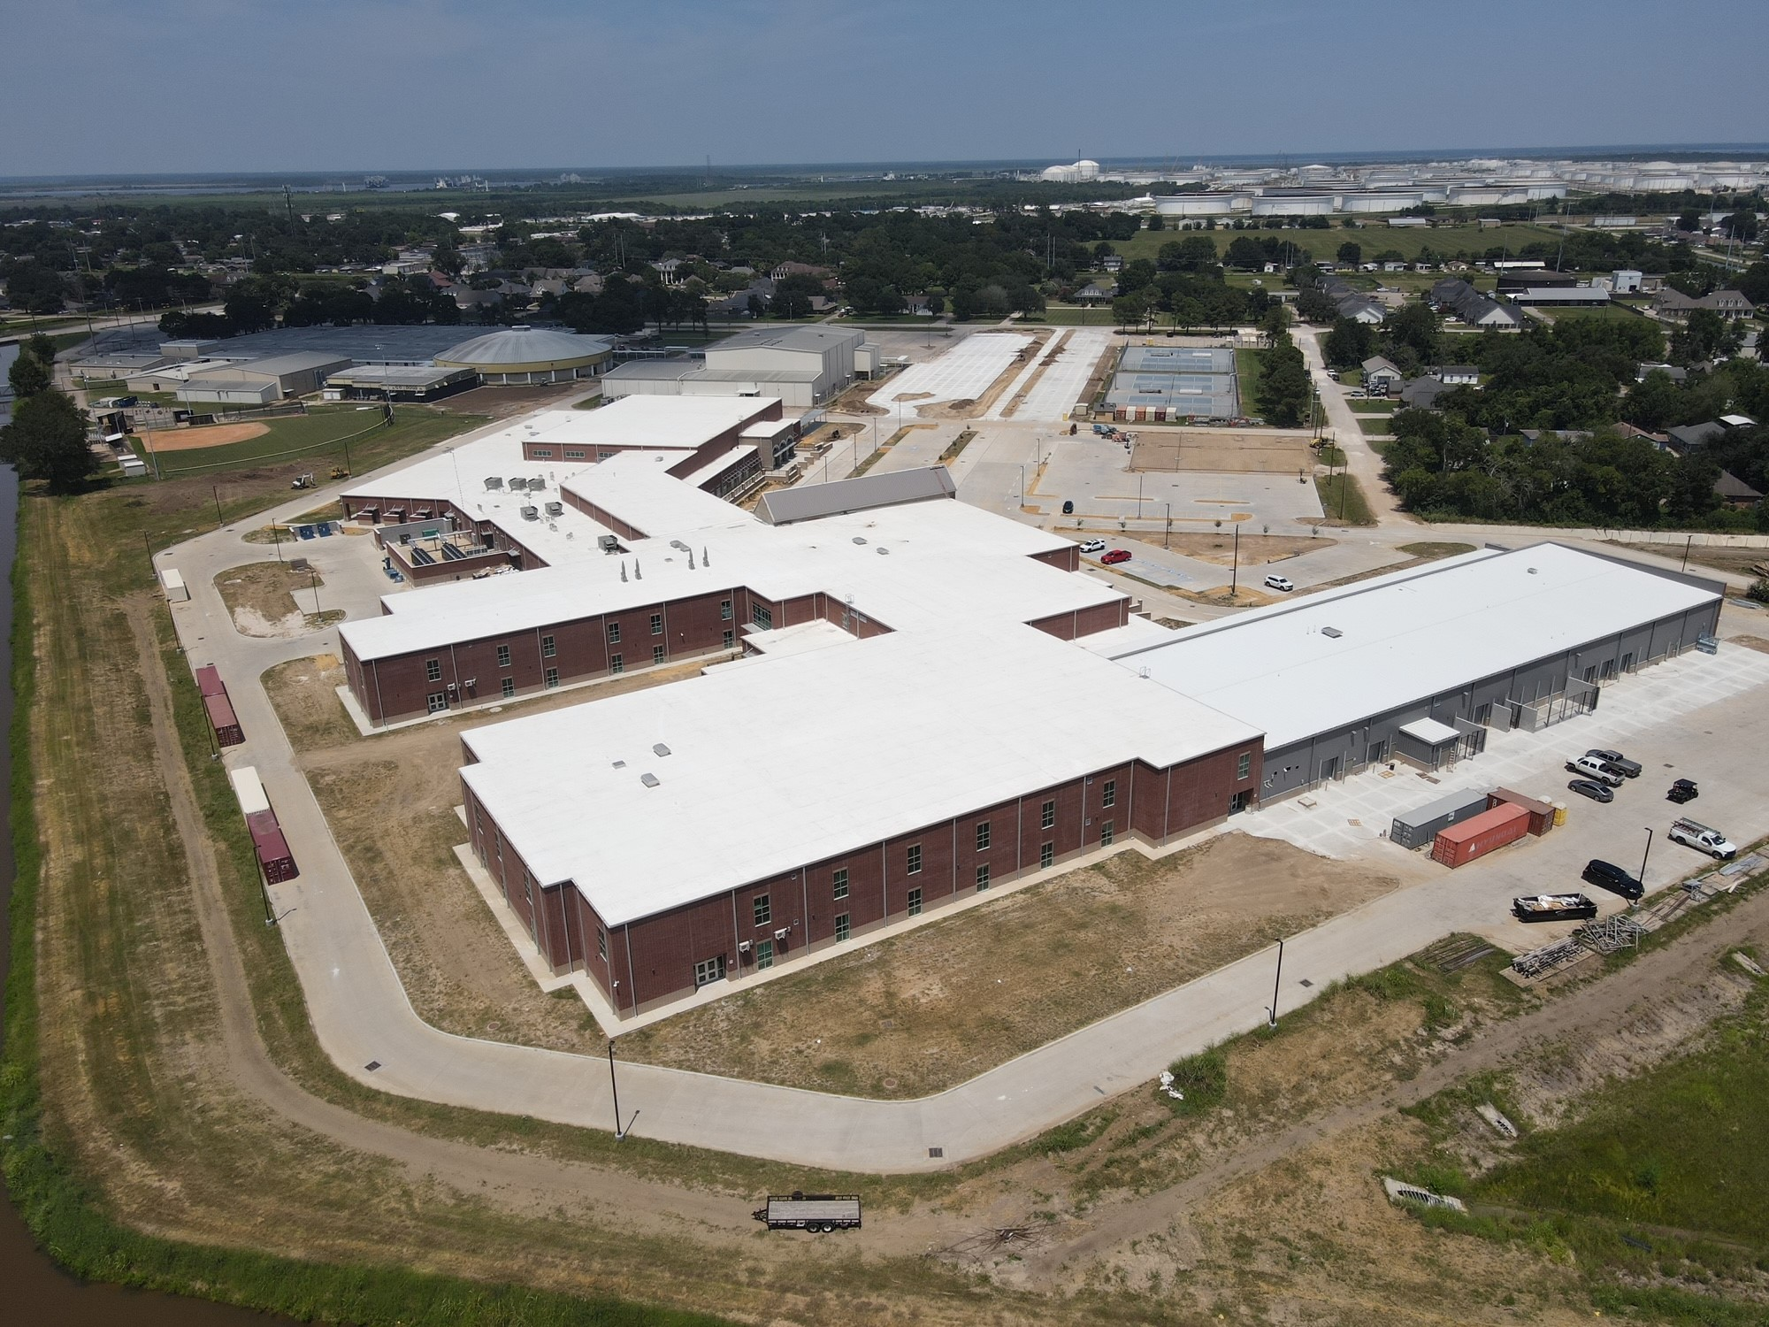
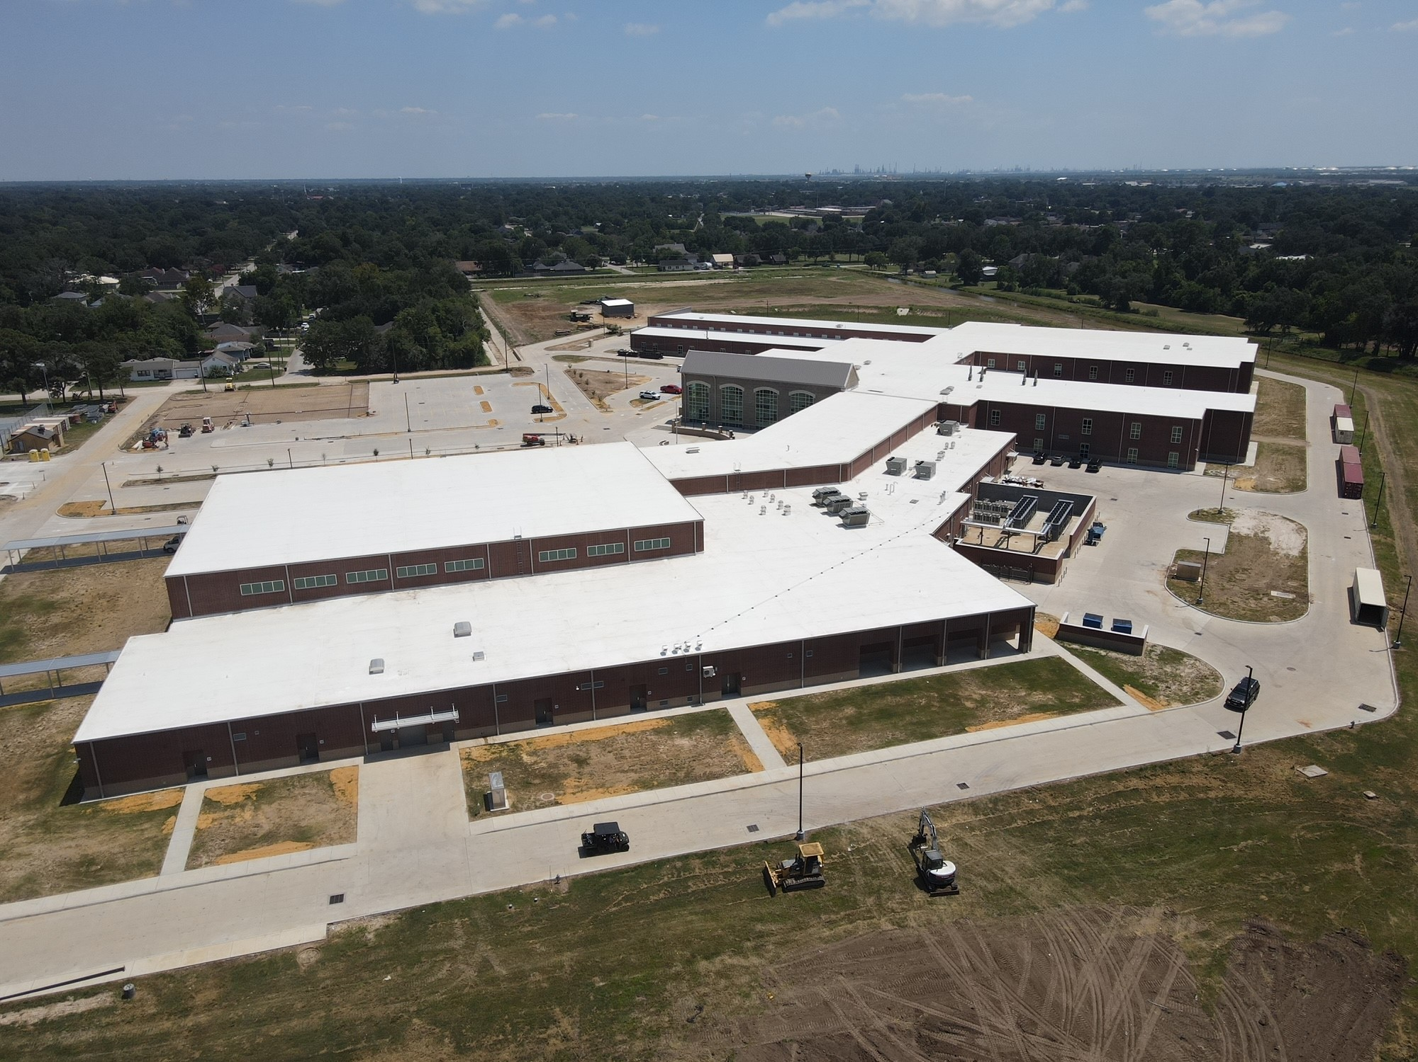
Nederland High School
Exterior
  Finish all roof trim work.
  Finish downspouts.
  Finish exterior fencing around site and pond.

Slide 5
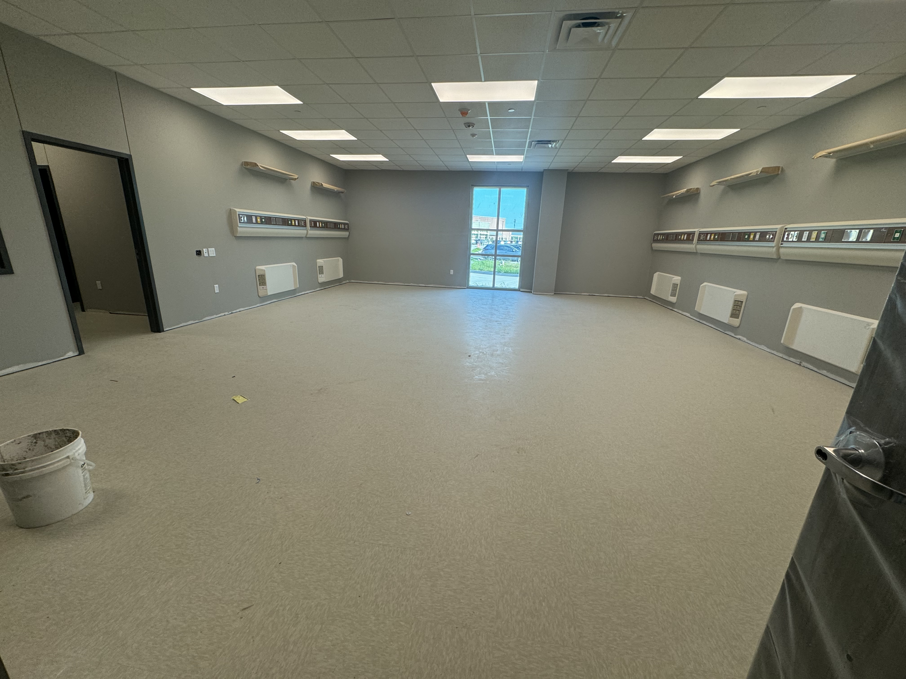
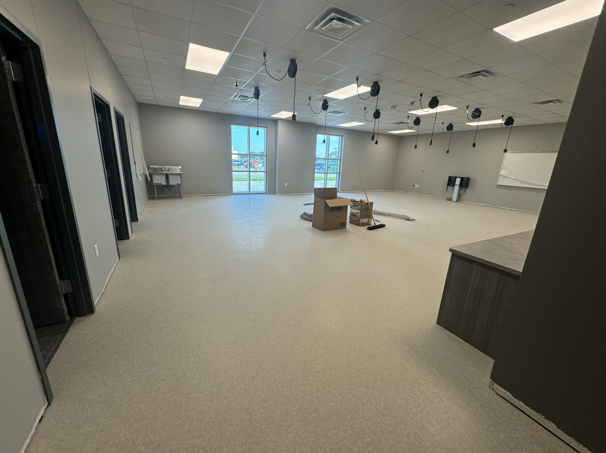
Nederland High School
  Lab Health with Mounted Head Walls
  CTE ↓ APP/SEW Lab

Slide 6
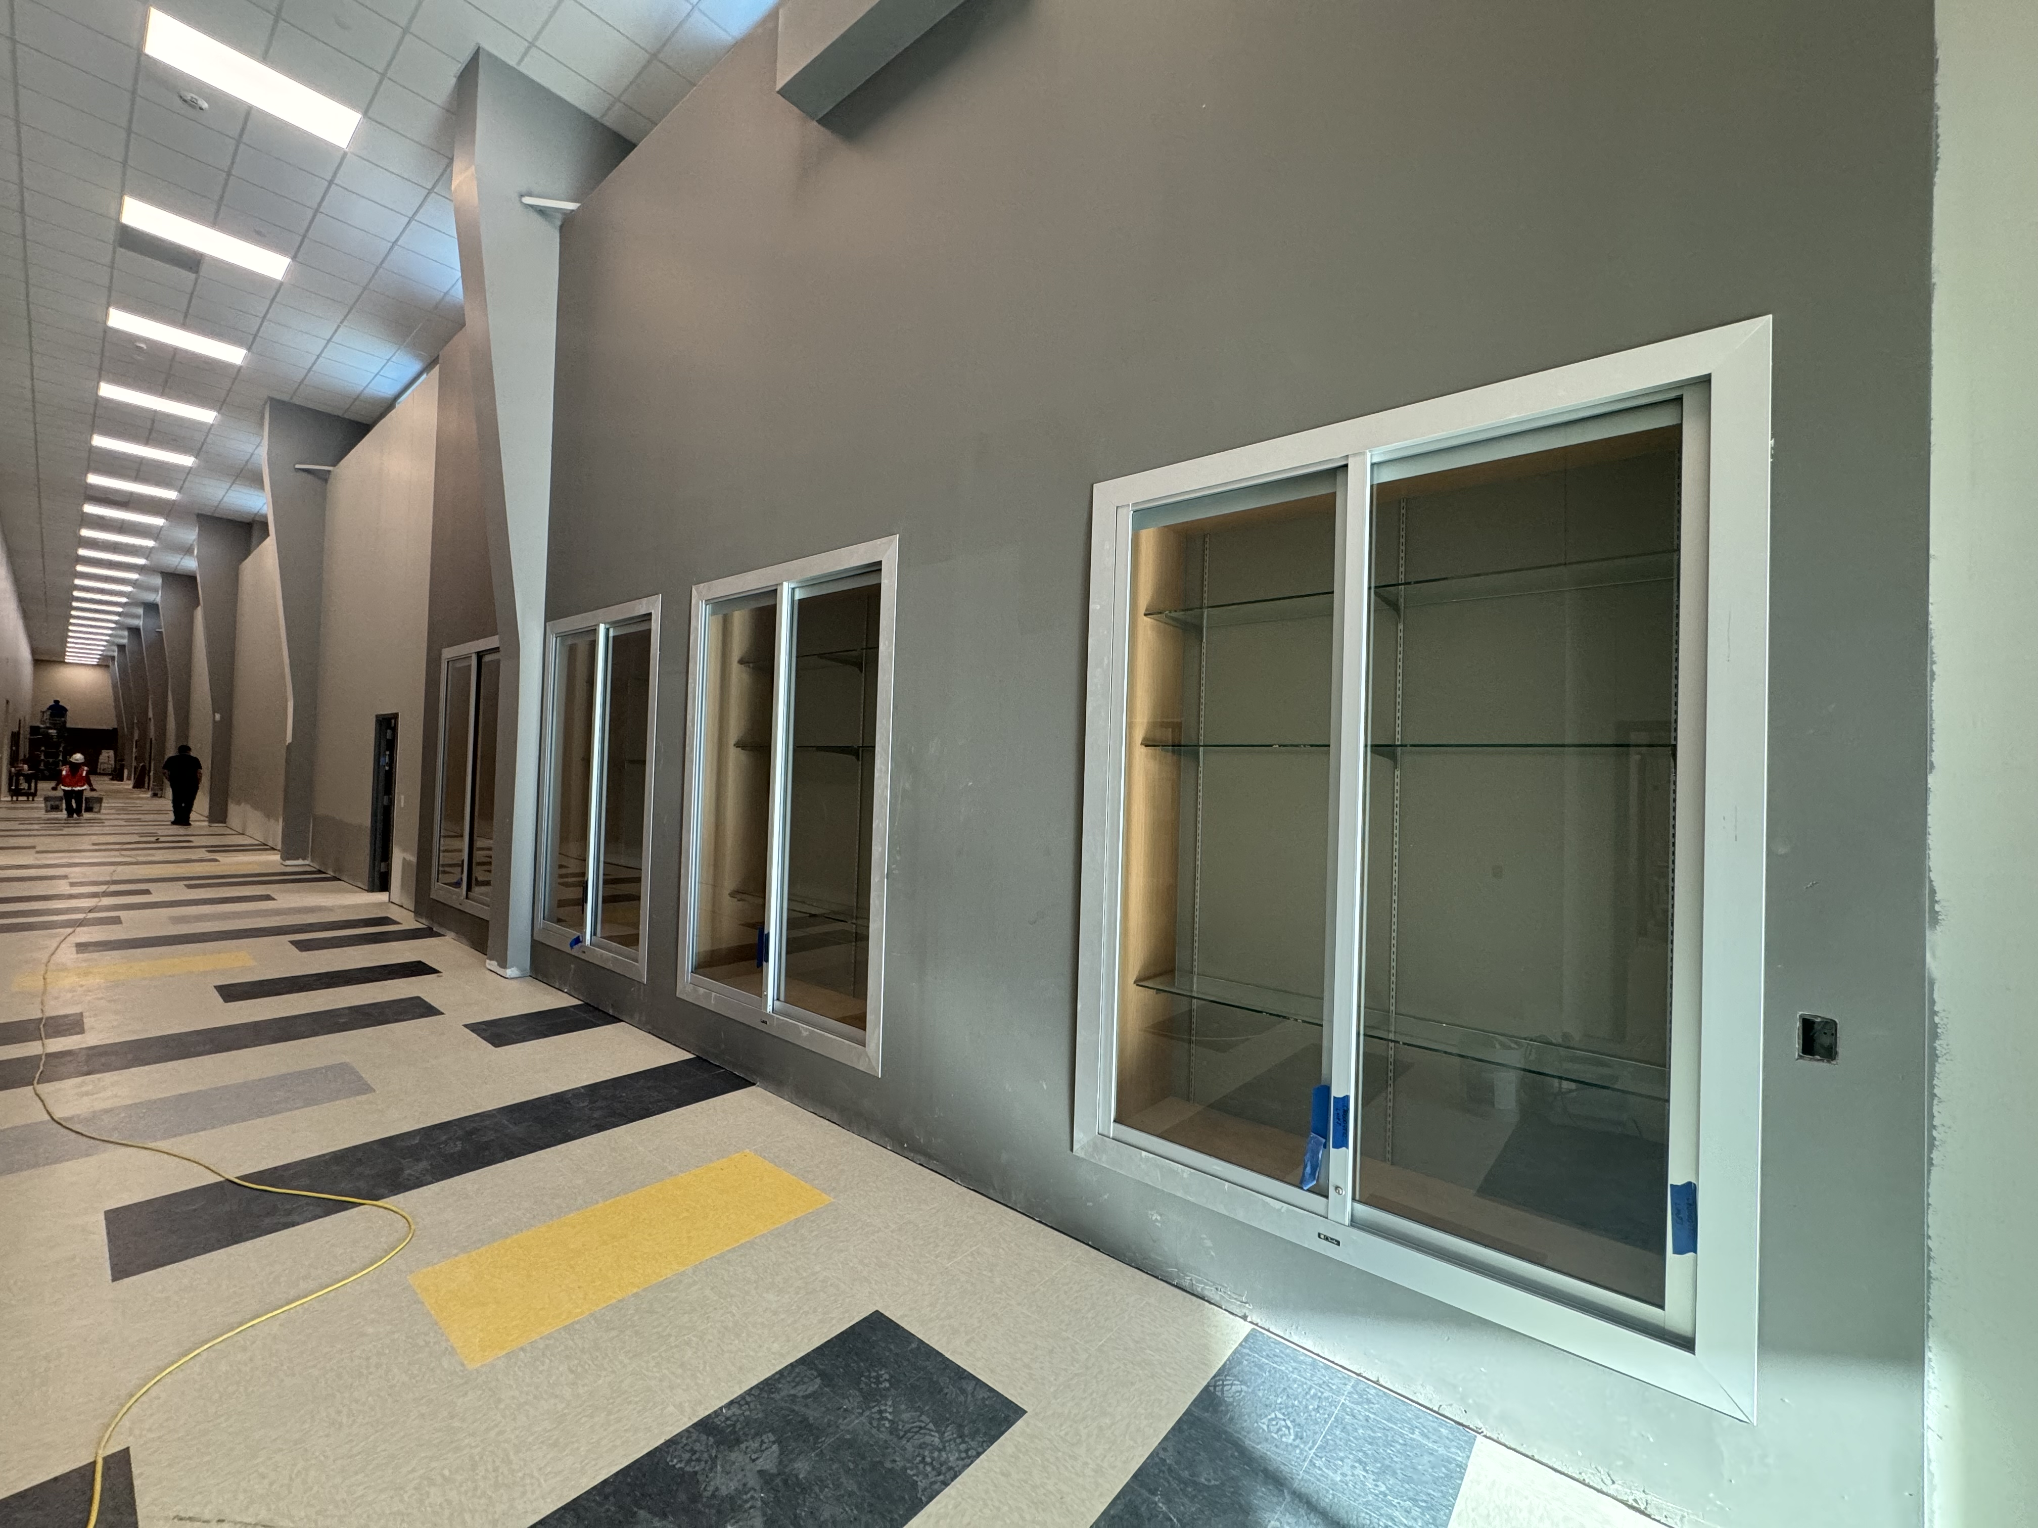
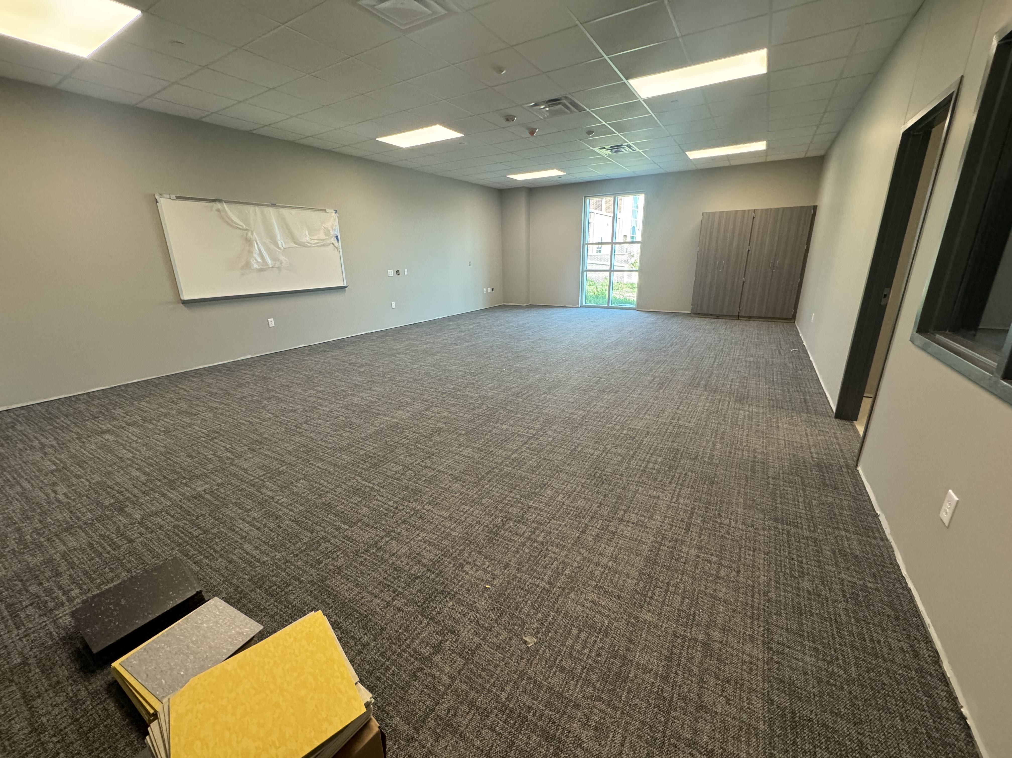
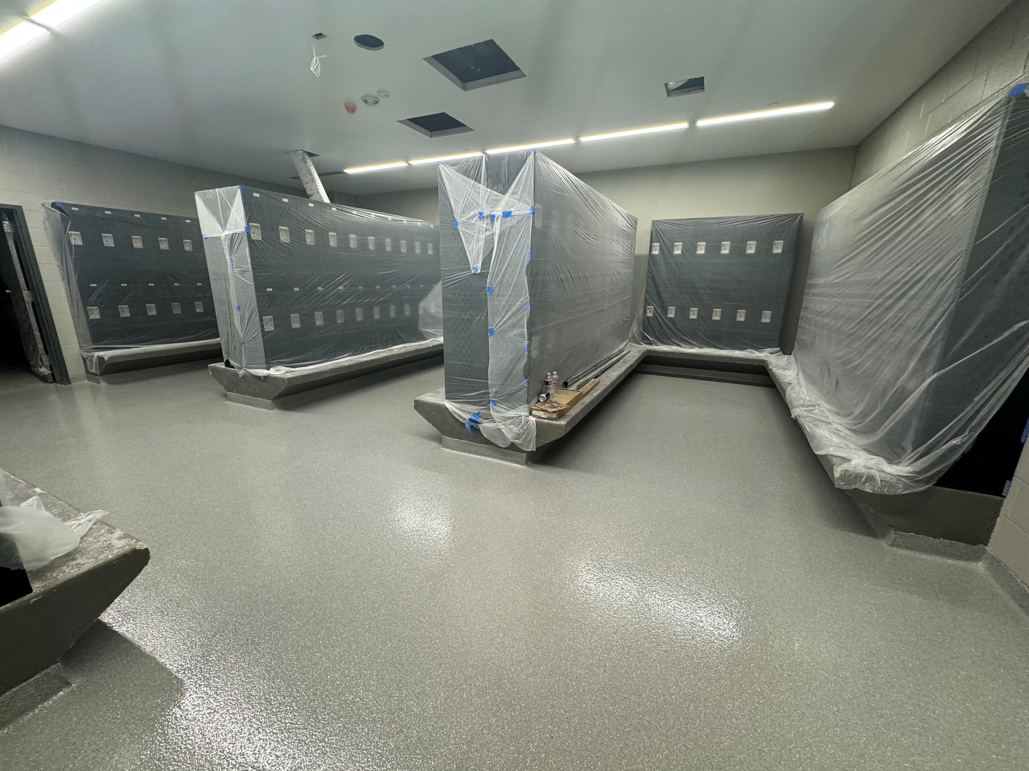
Nederland High School
  Continue with VCT and Carpet floors.
  Complete trim out on lockers.
  Install bathroom partitions.
  Install wall covering in hallway

Slide 7
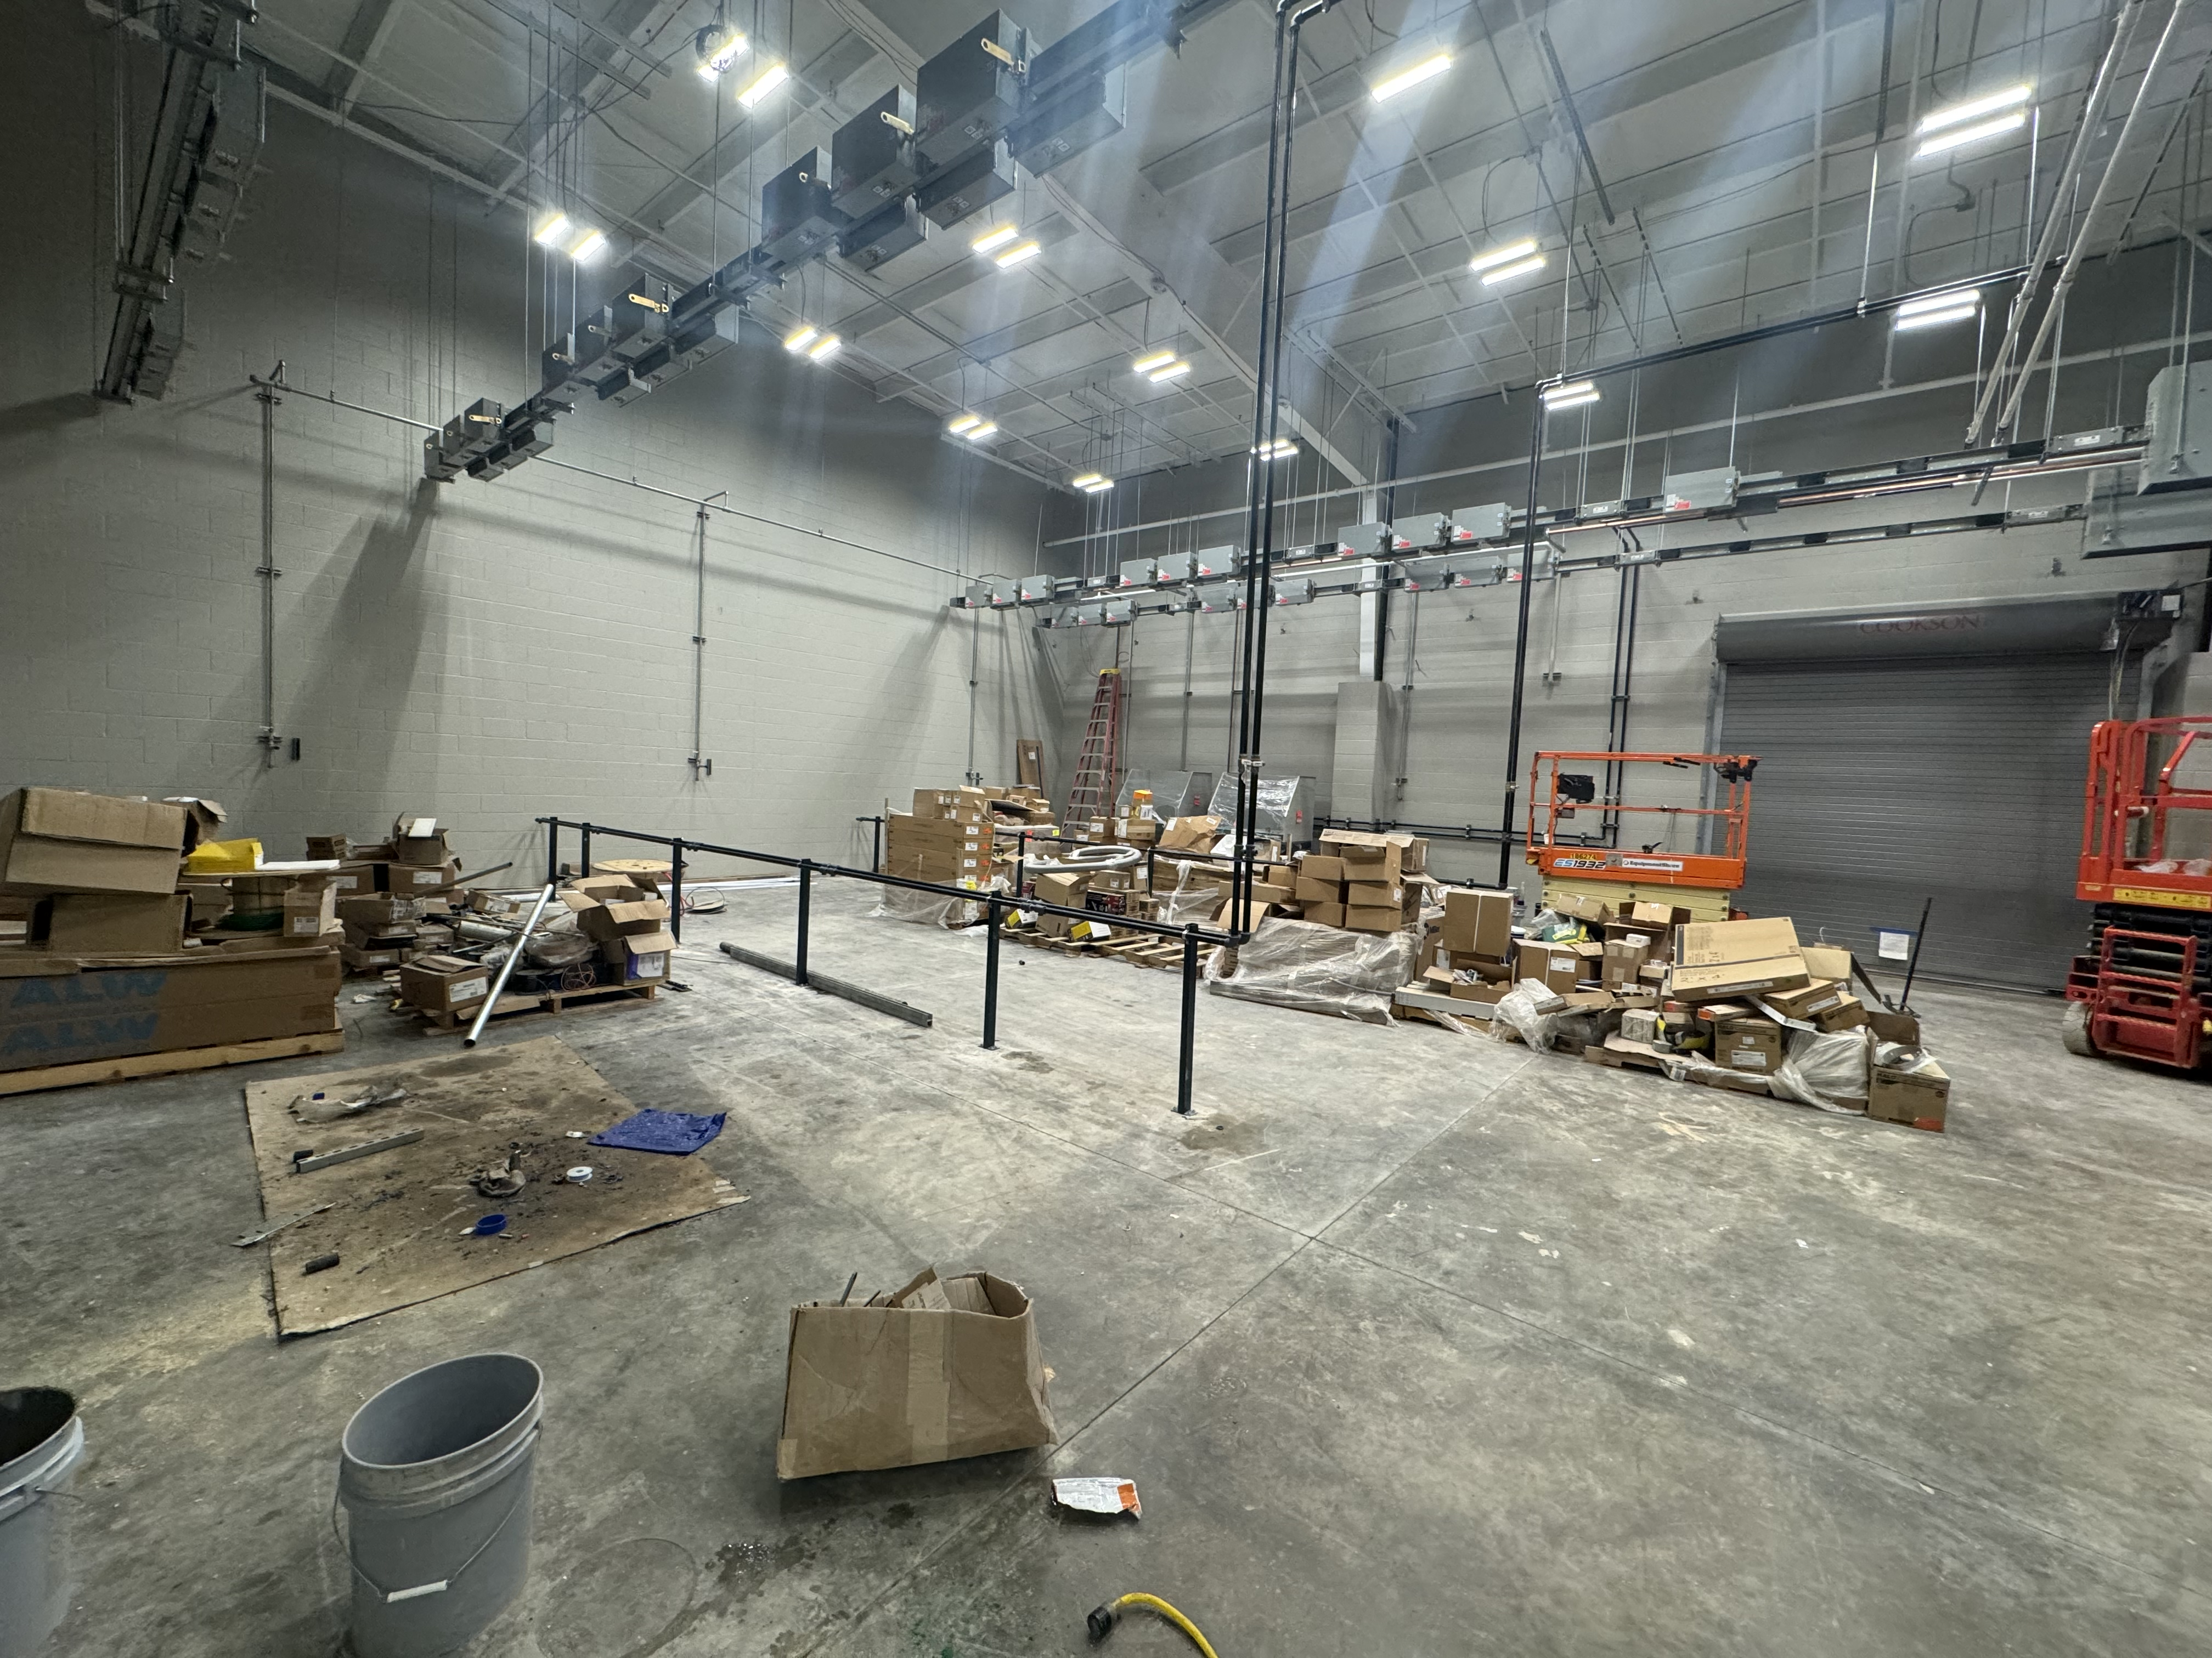
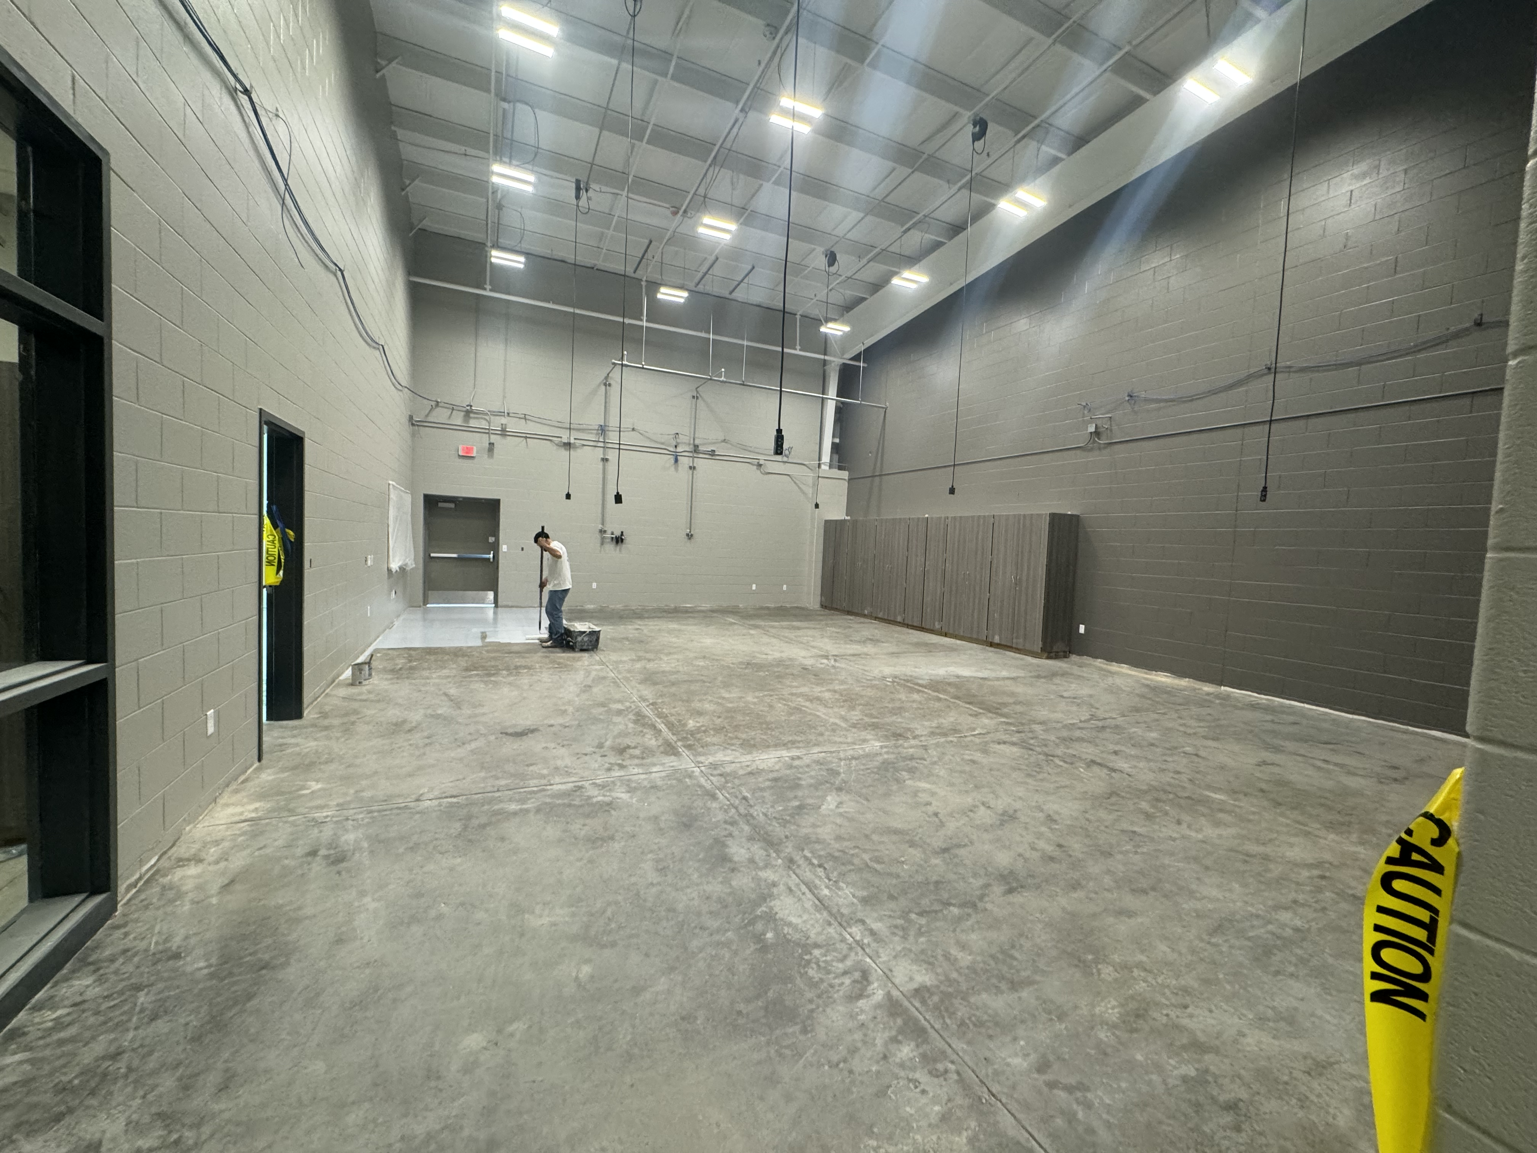
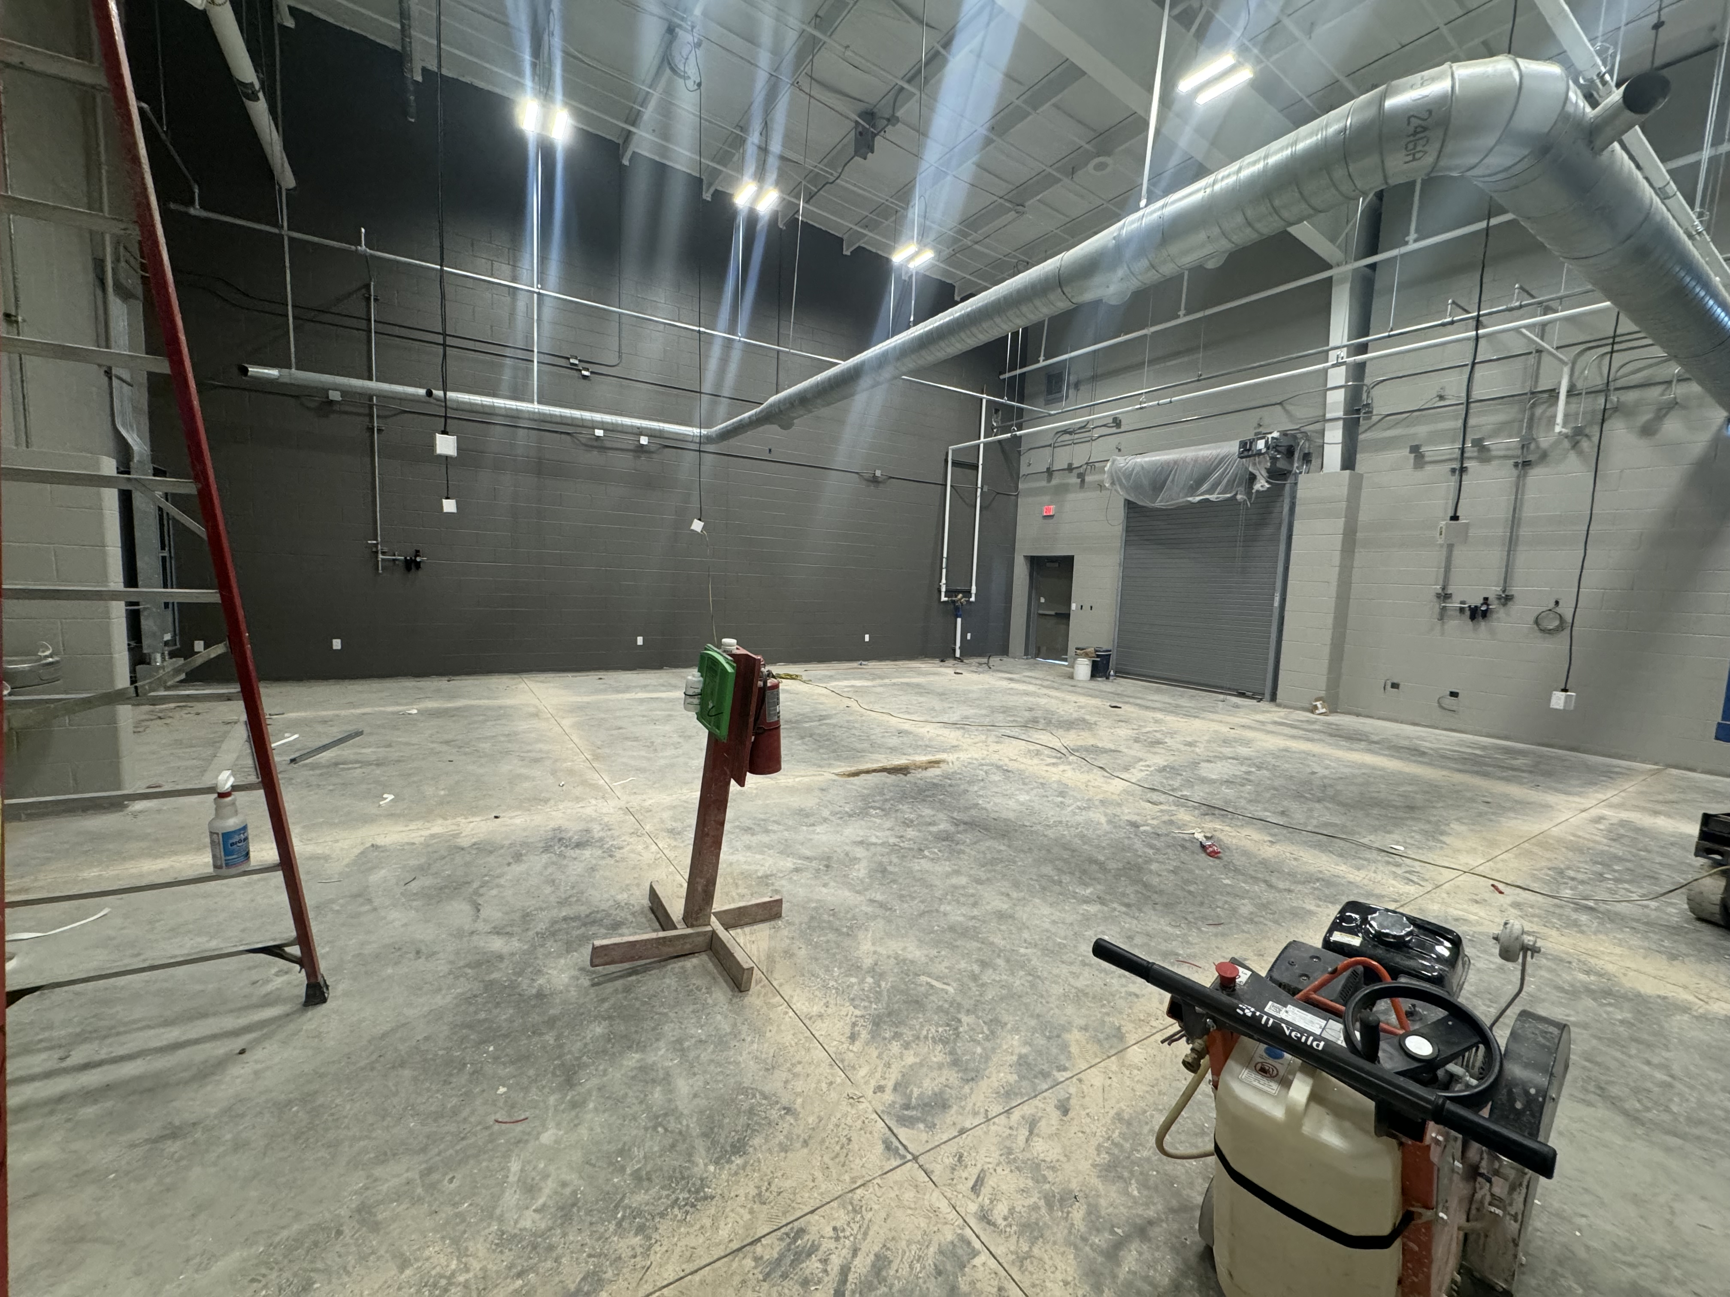
Nederland High School
Continue sealing concrete in shop areas.
Complete touch up paint and final coat of paint throughout the CTE Wing.
Hook up school equipment in CTE wing.

Slide 8


