Slide 1




2019 Nederland ISD Bond Project
October 2024

Slide 2

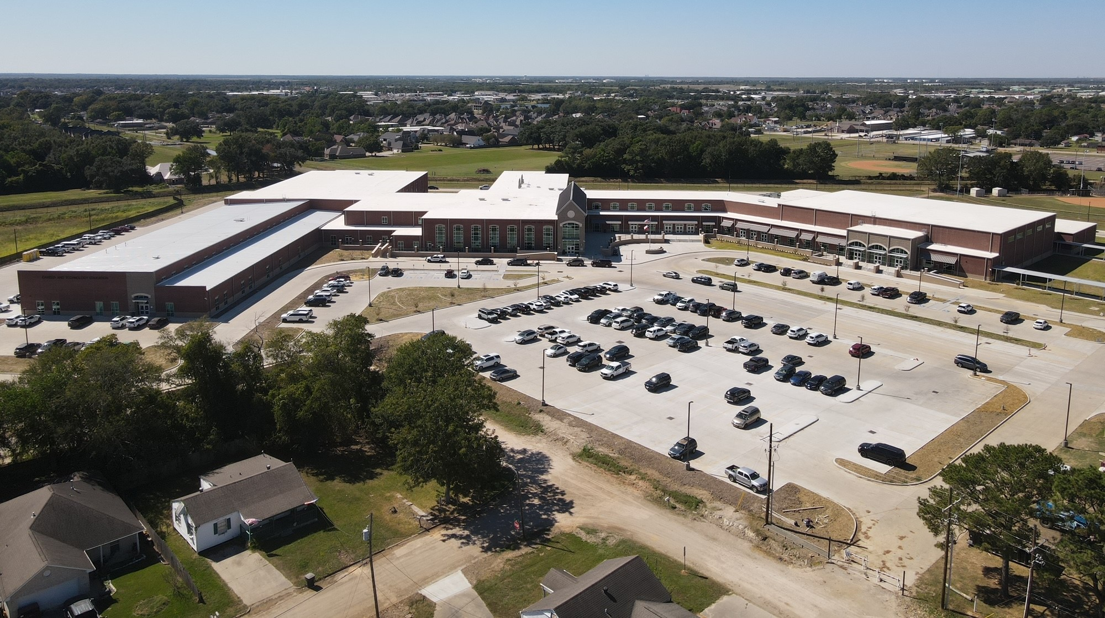
Nederland High School

Slide 3
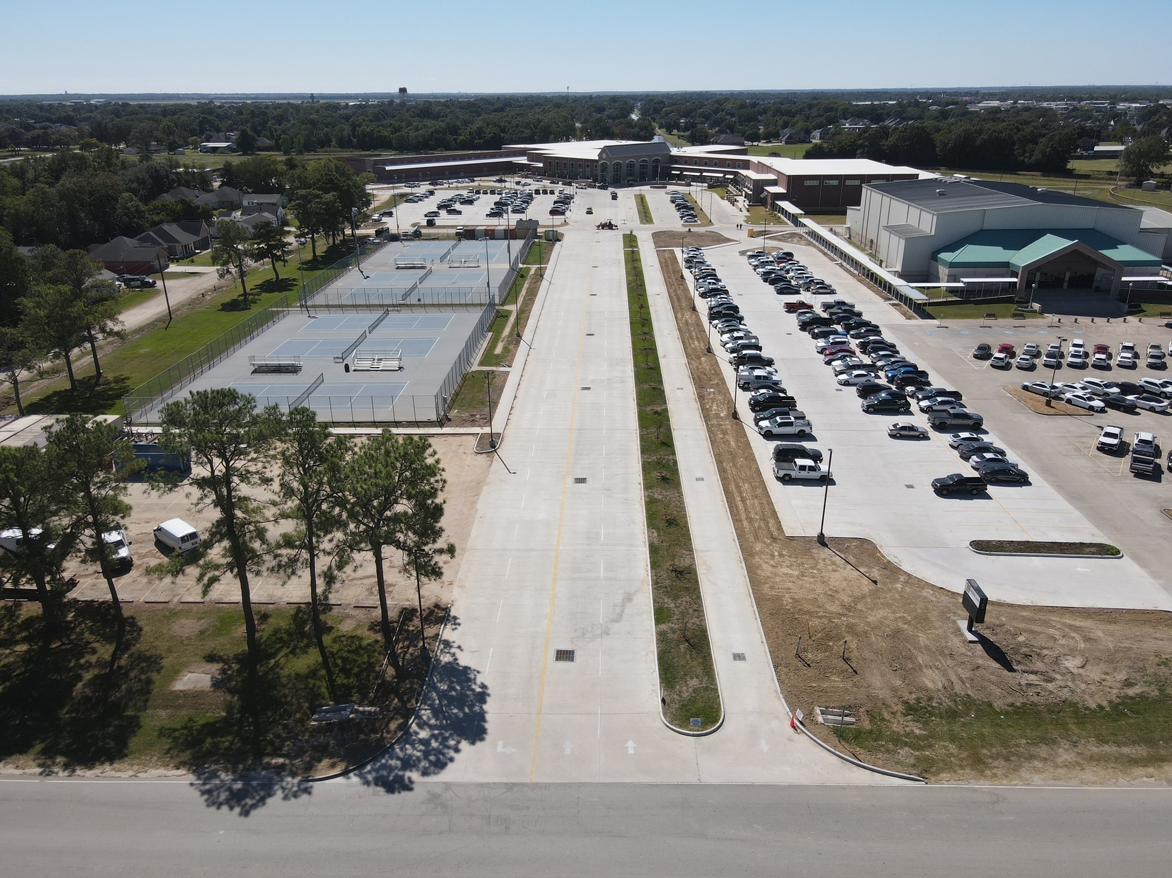
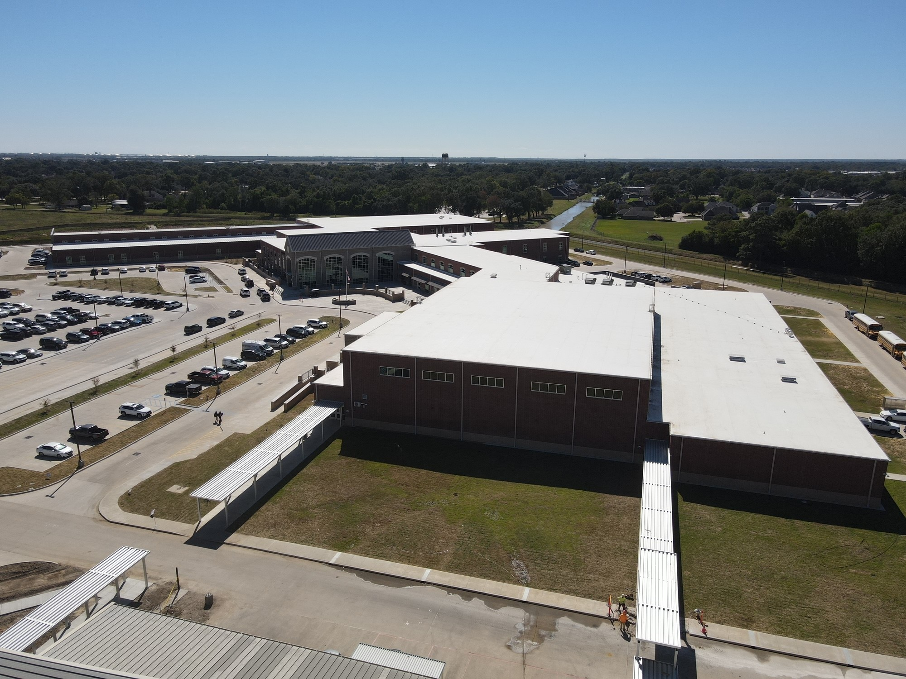
Nederland High School
Exterior
  Complete landscaping.
  Complete light poles
  Complete striping around school.

Slide 4
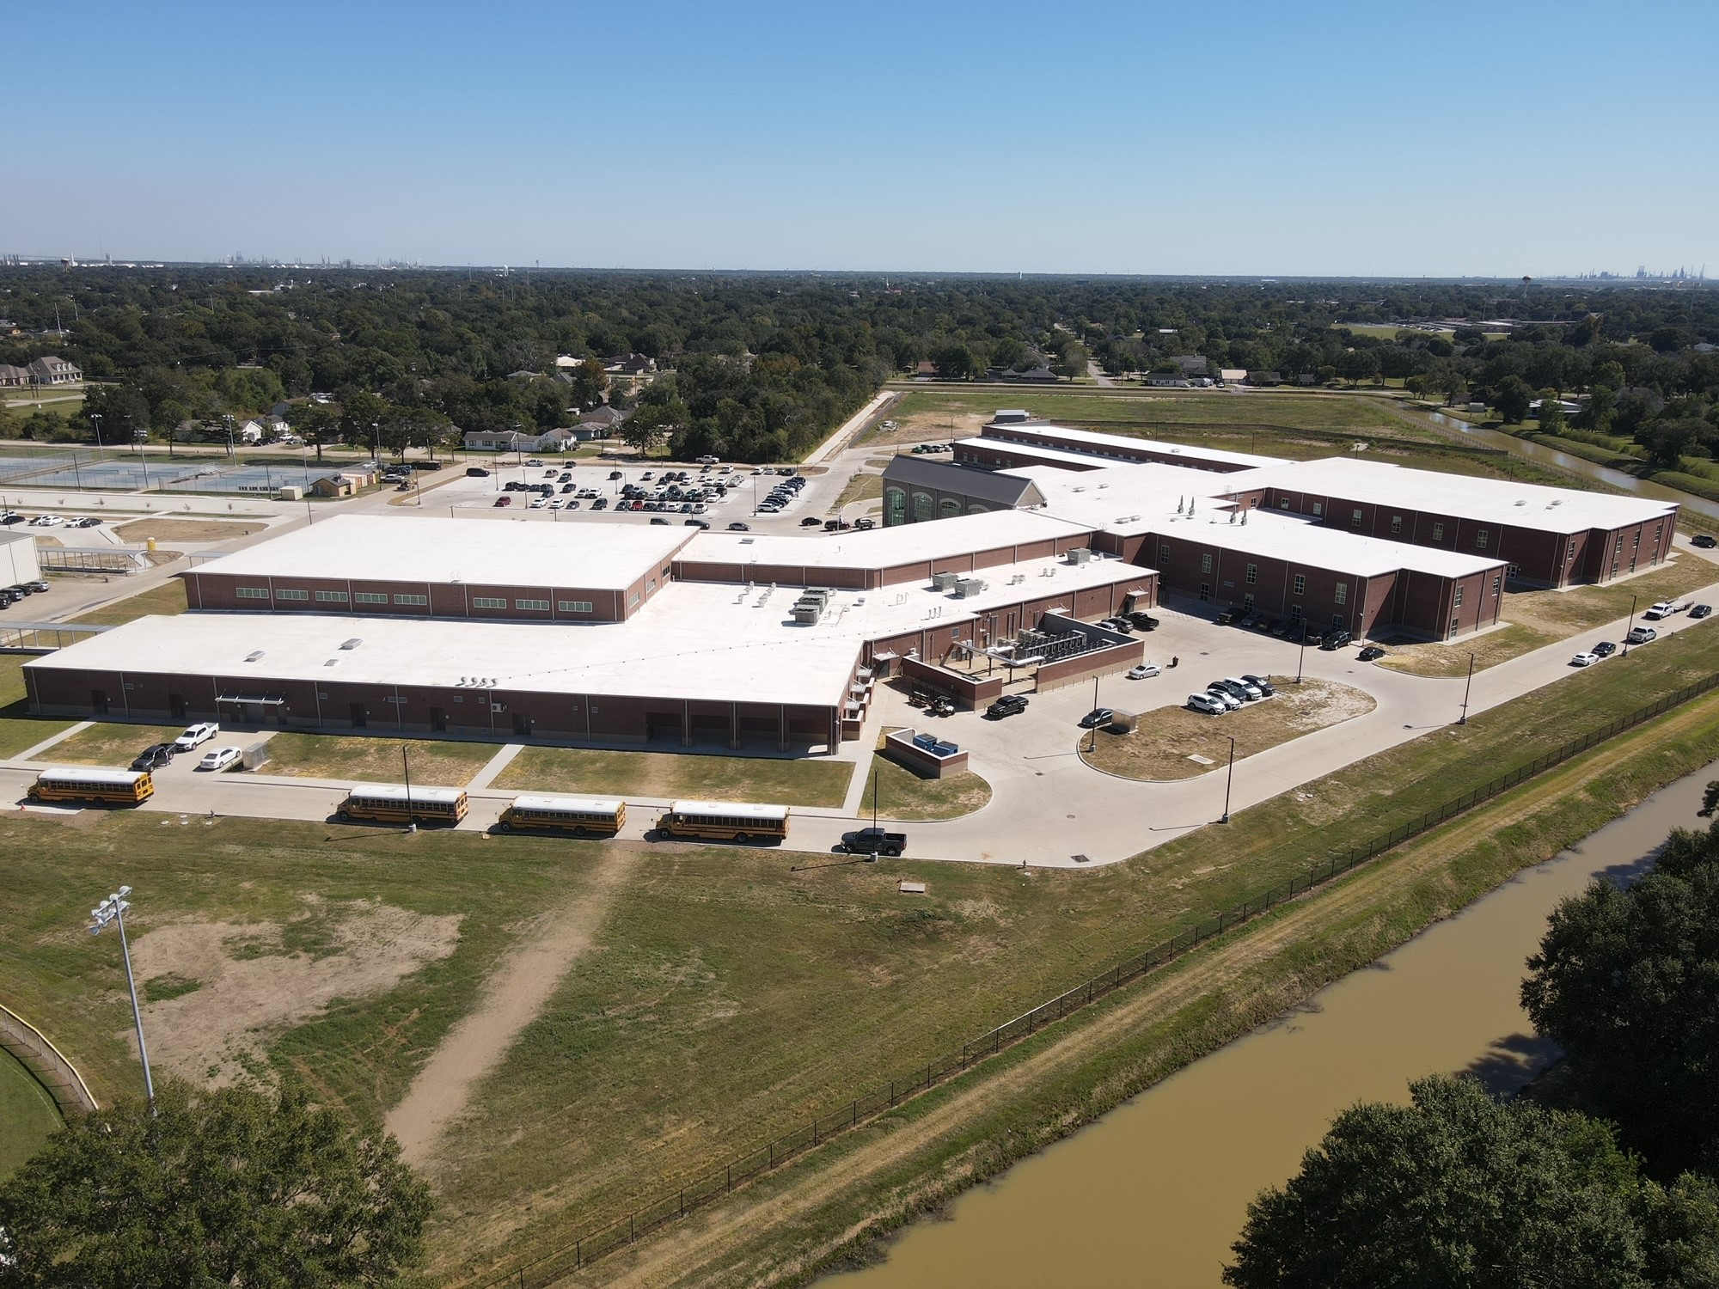
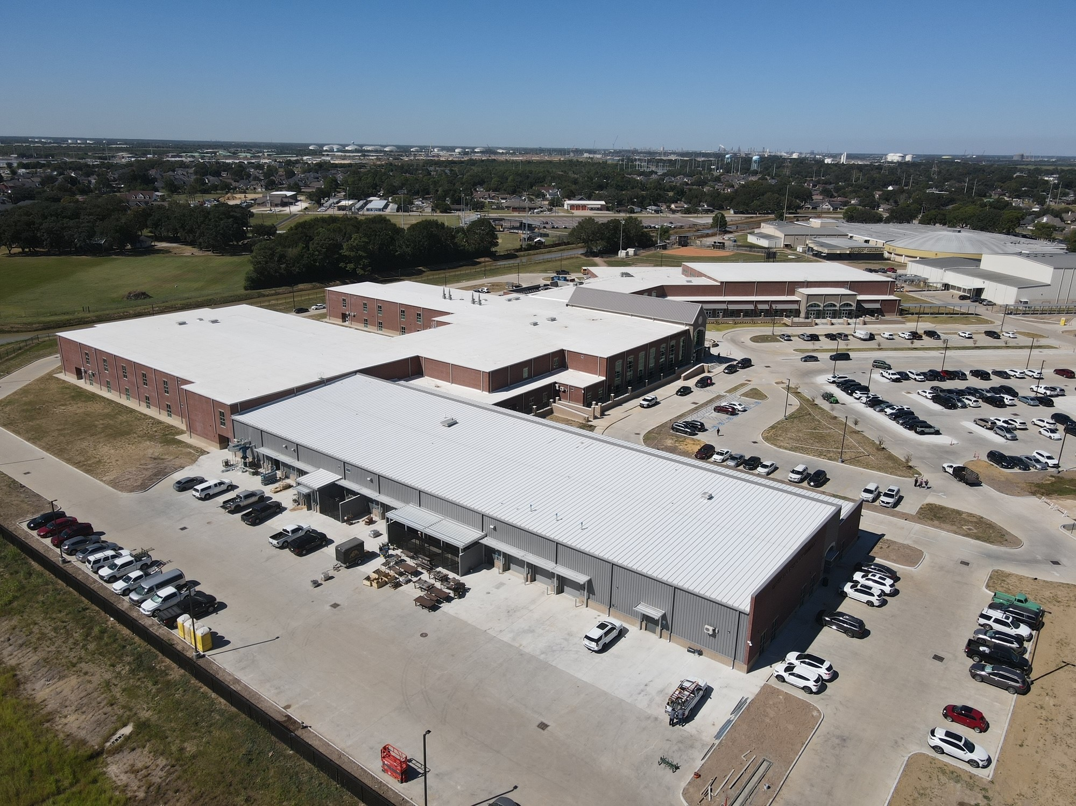
Nederland High School
Exterior
  Finish all roof trim work.
  Finish downspouts.
  Finish exterior fencing around site and pond.

Slide 5
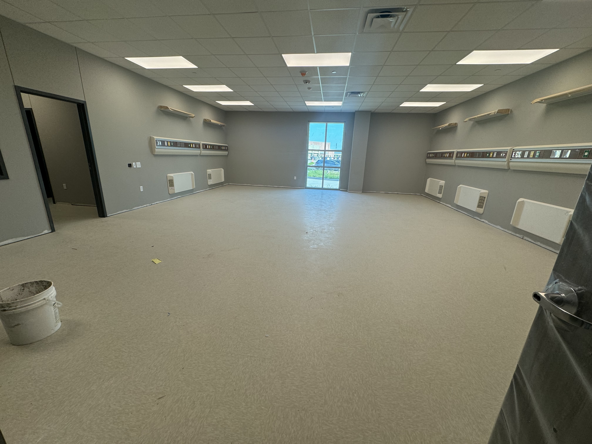
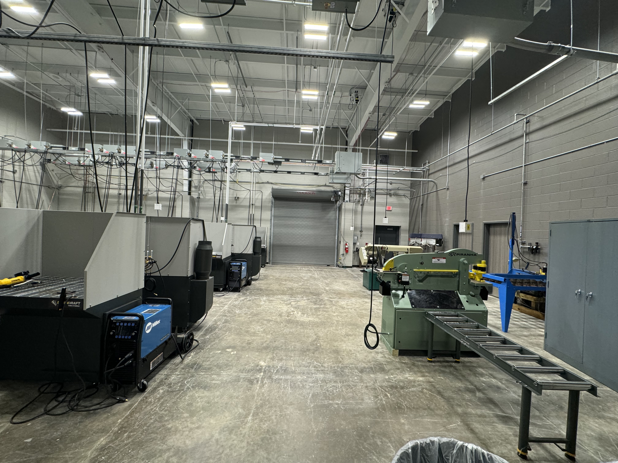
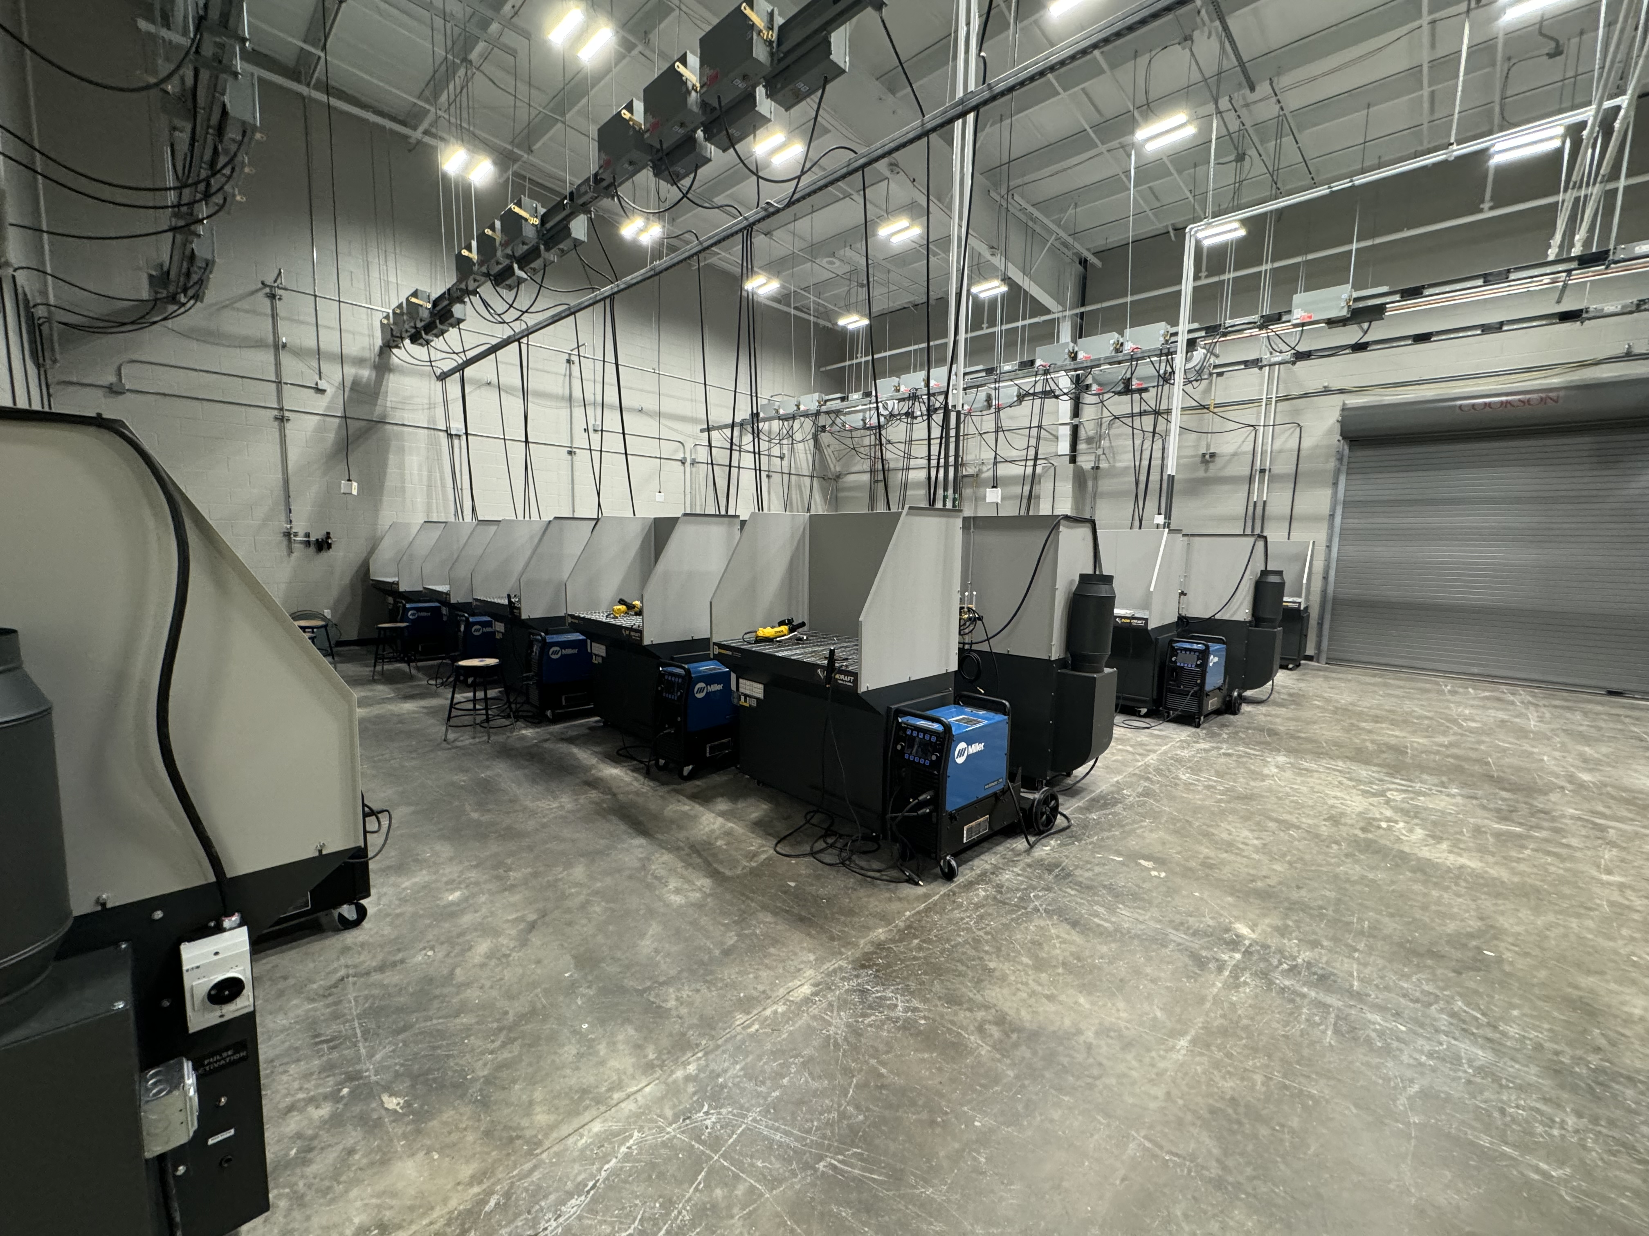
Nederland High School
  CTE Welding Shop Interior
                Continue working on Punch List throughout the New High School.
                Complete installation of Graphics in the building.

Slide 6
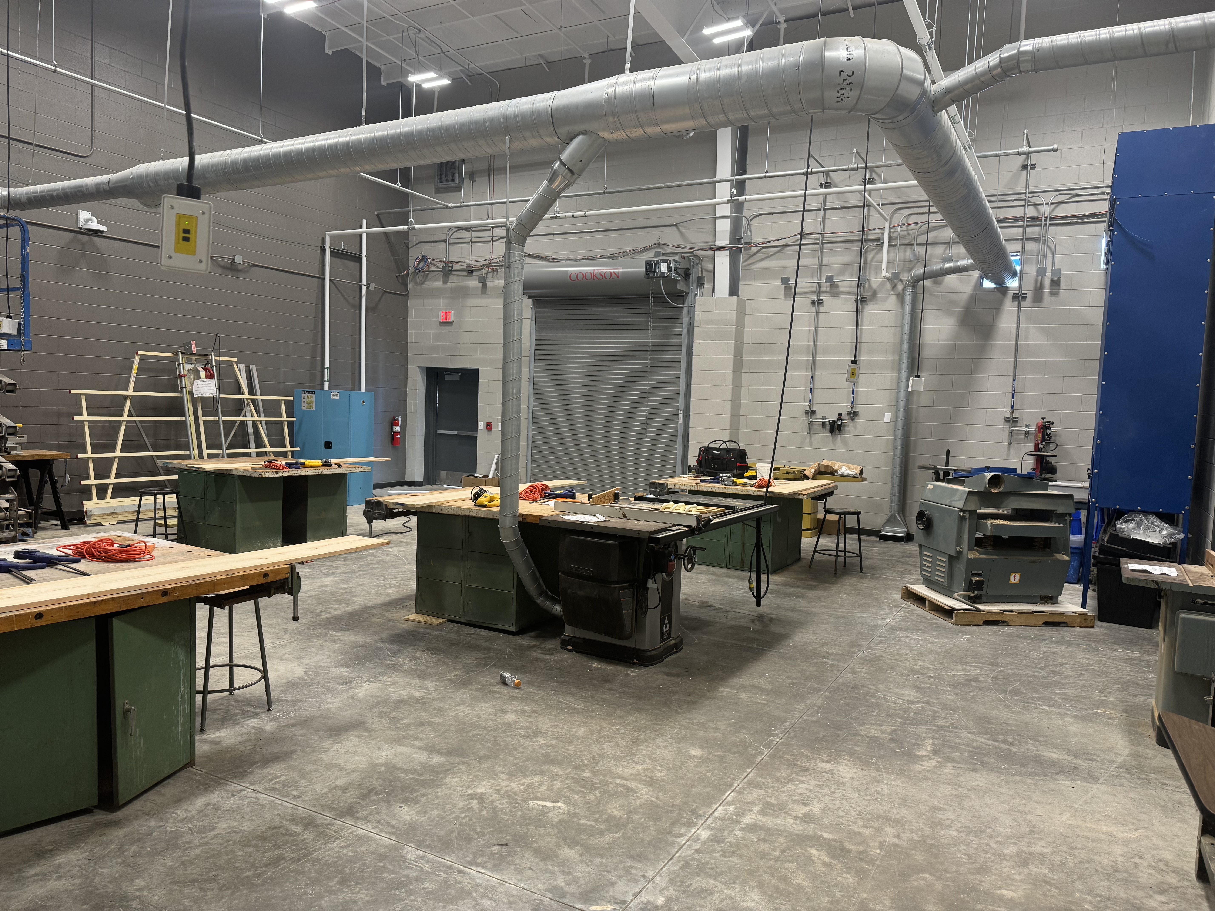
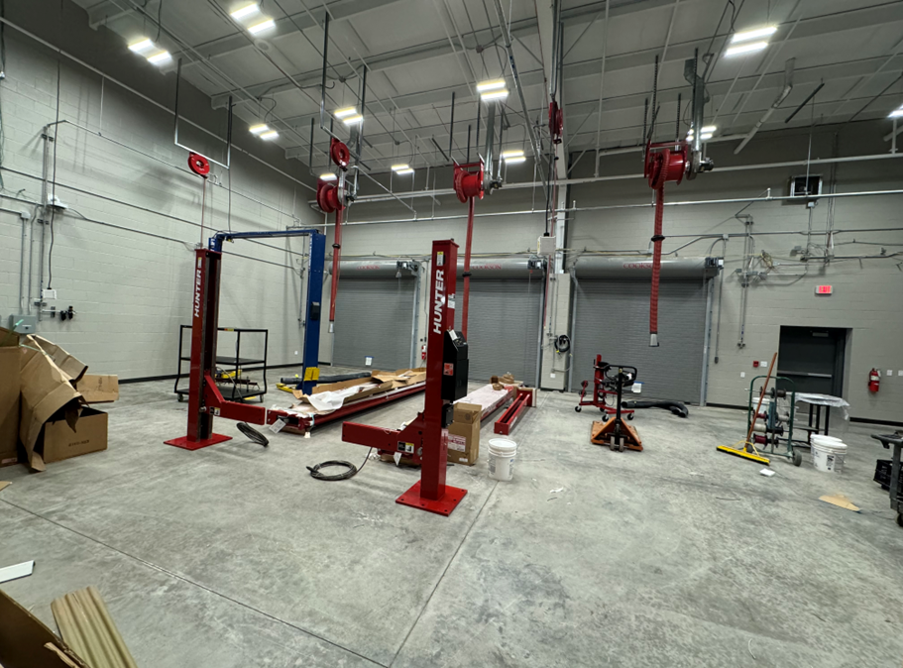
Nederland High School
  CTE
    Complete hook up of Dust Collection Machine in Construction Shop.
    Complete hook up of Electrical and Plumbing for Car Lifts in Auto Shop.

Slide 7
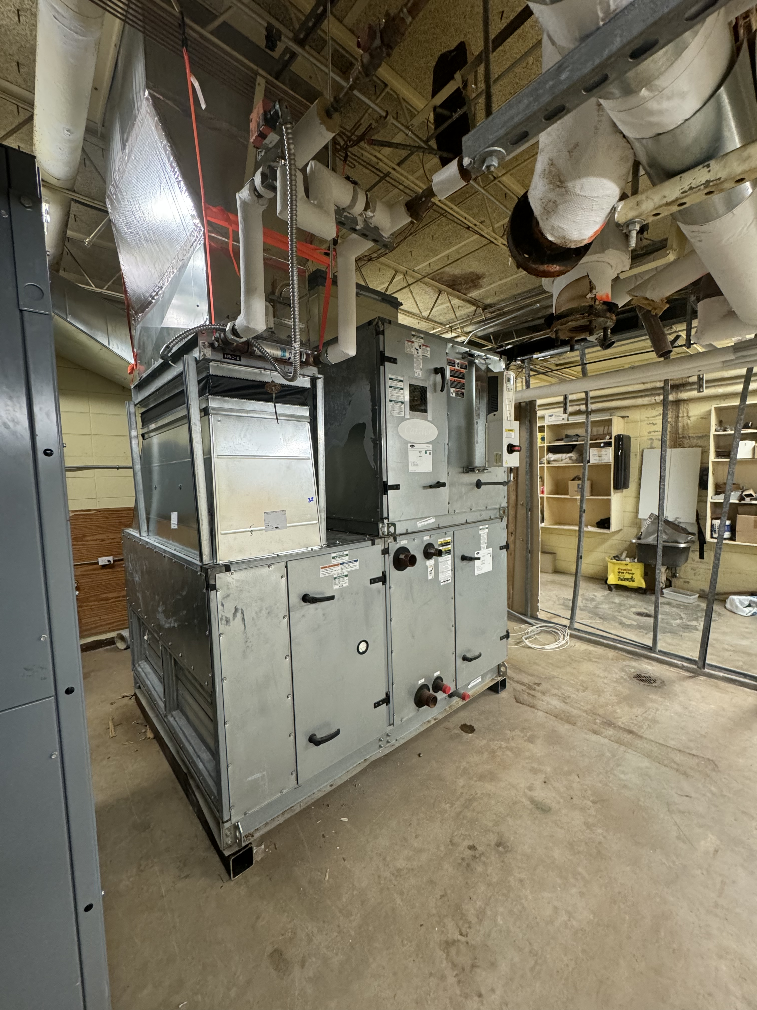
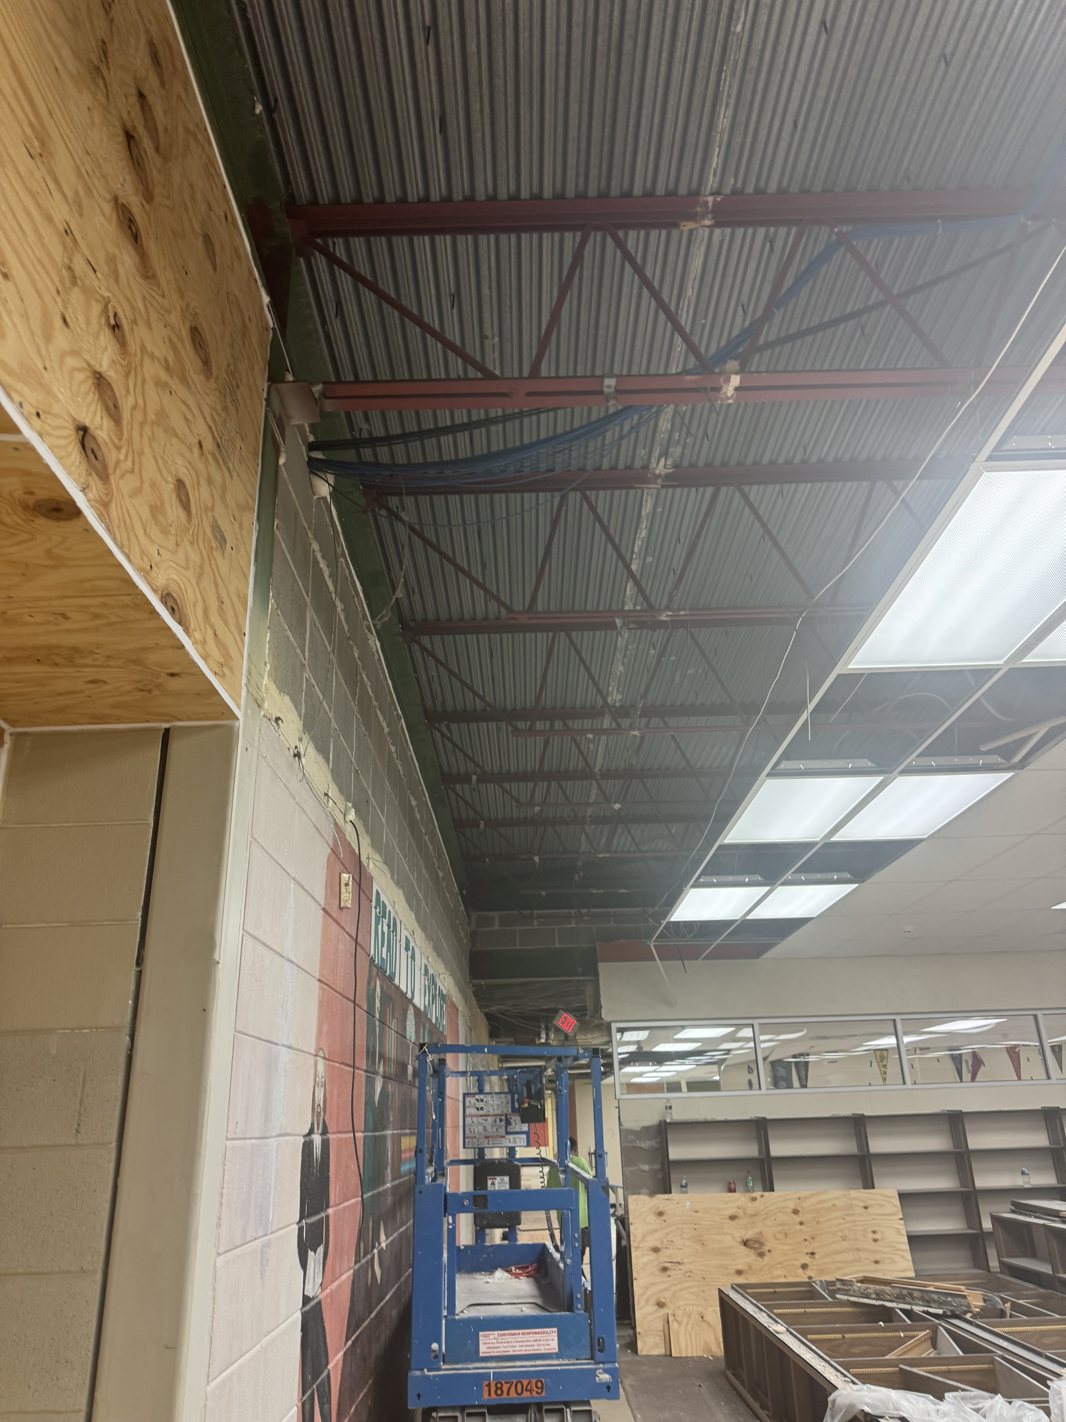
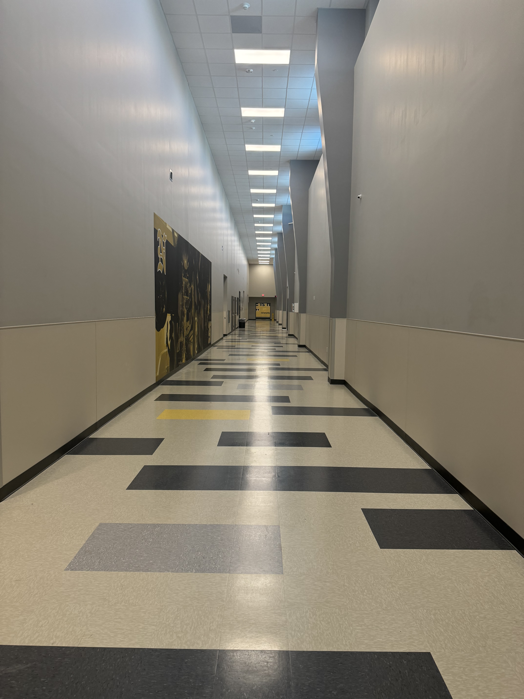
Nederland High School
Continue installation of new HVAC equipment in Old High School.
Continue demolition of Old High School where new exterior wall will be built.

Slide 8


