Slide 1
City of Dallas future growth
Dallas School District - LRFP/Finance Committee
November 13, 2025
-Charlie Mitchell-

Slide 2
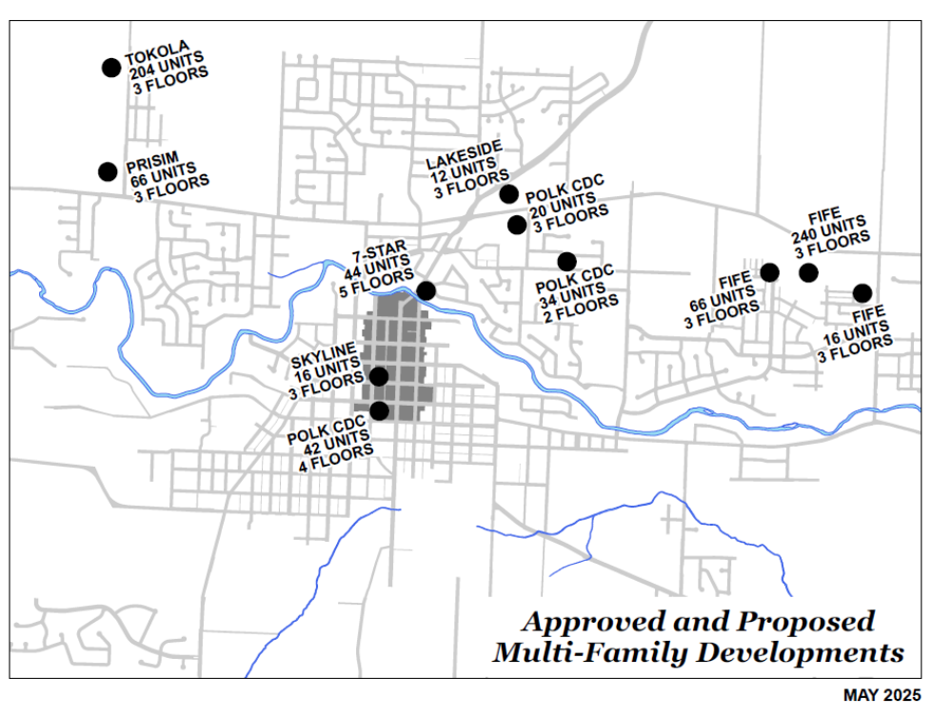
760 UNITS TOTAL

Slide 3
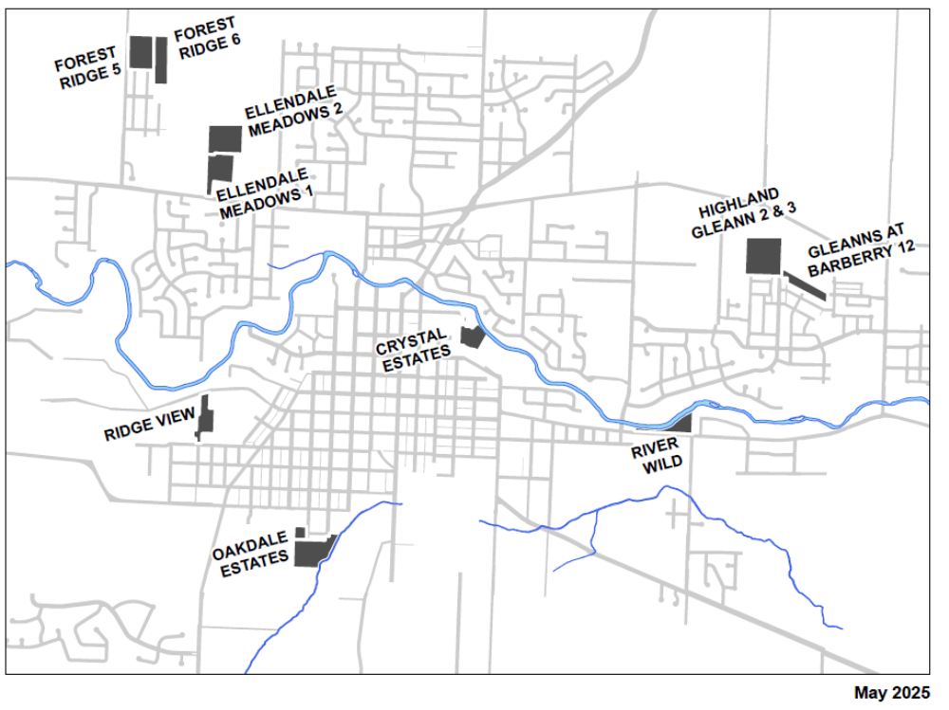
1,500+ housing units projected in La Creole Node

Slide 4
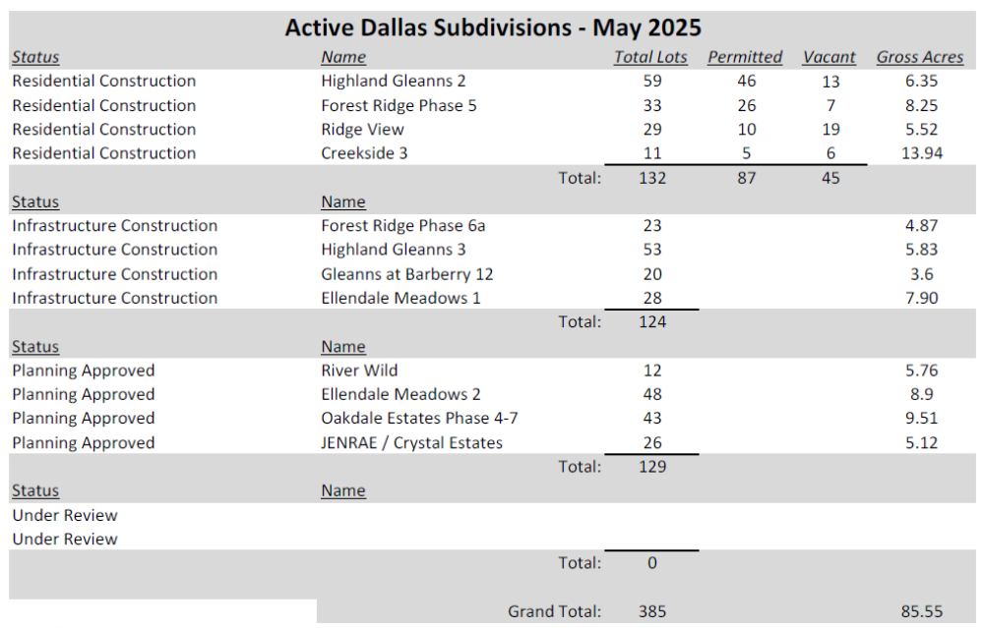

Slide 5
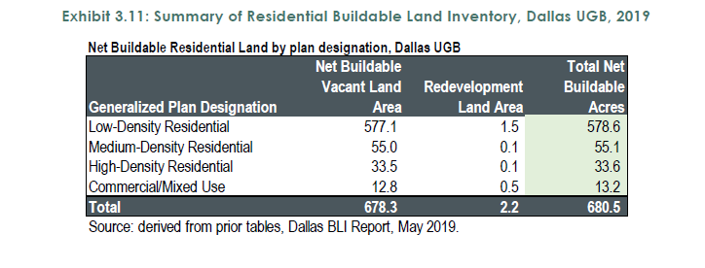
Buildable Land Acreage from the 2019 Housing Needs Analysis
578.6 Acres RL @ 6 Dwellings per Acre = 3,471 Dwellings
55.1 Acres RM @ 9 Dwellings per Acre = 496 Dwellings
33.6 Acres RH @ 16 Dwellings per Acre = 538 Dwellings
Total Capacity = 4,505 Dwellings

Slide 6
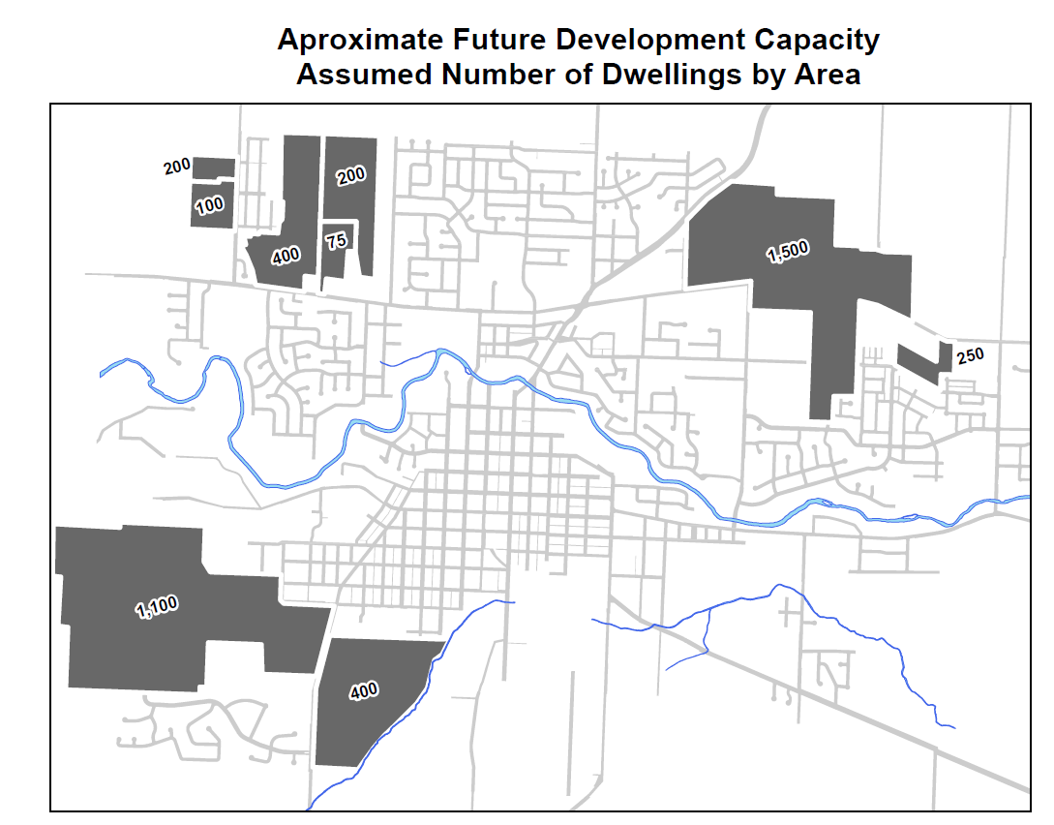

Slide 7
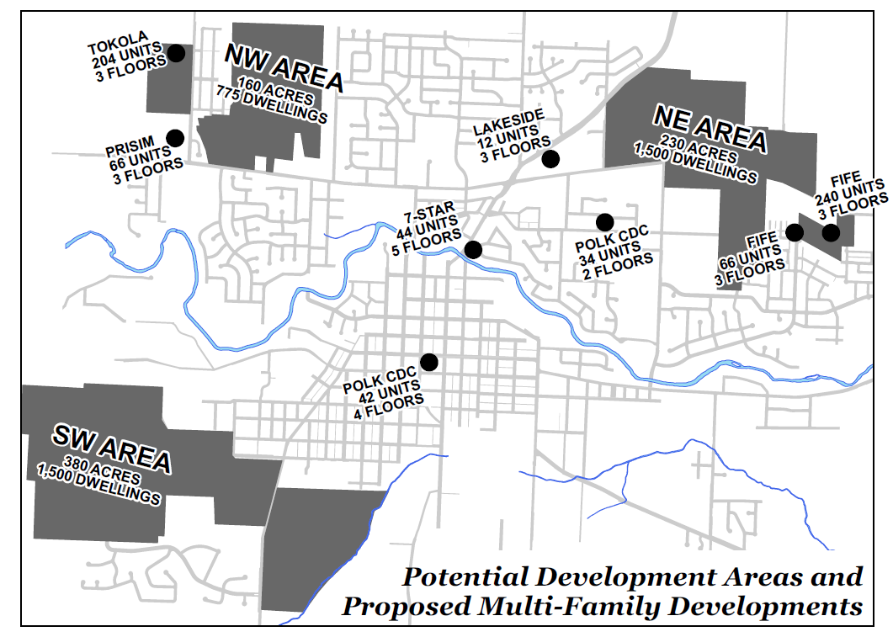

Slide 8
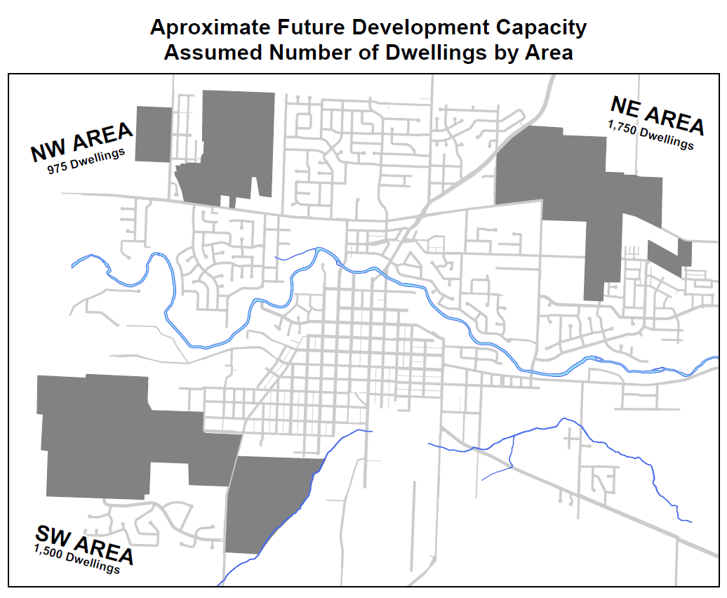
Total: 4,225 Dwellings

Slide 9
CITY OF DALLAS 2016-2025
Building Activity
Permits Issued |  |  | 242 |  | 214 |  | 642 |  | 715 |  | 638 |  | 700 |  | 733 |  | 728 |  | 697 |  | 612
Estimated Value (000's) |  |  | $41,262 |  | $37,976 |  | $45,331 |  | $45,050 |  | $33,006 |  | $54,541 |  | $48,509 |  | $75,048 |  | $51,049 |  | $57,625
Planning Applications |  |  | 175 |  | 136 |  | 118 |  | 112 |  | 110 |  | 117 |  | 111 |  | 113 |  | 106 |  | 138

Slide 10
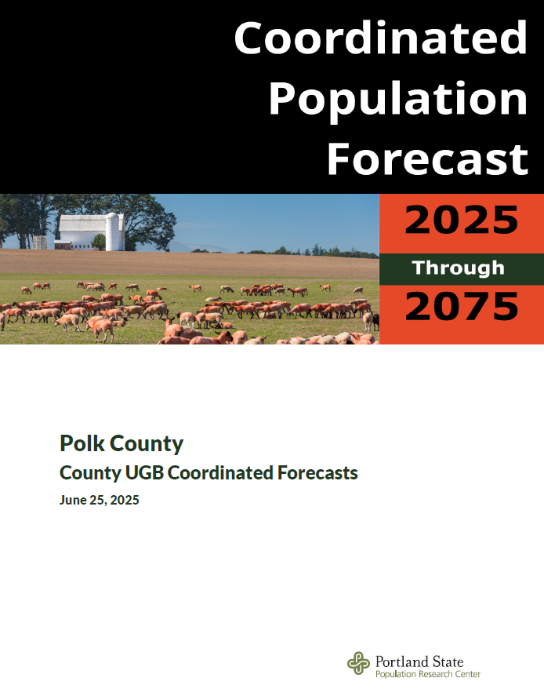

Slide 11
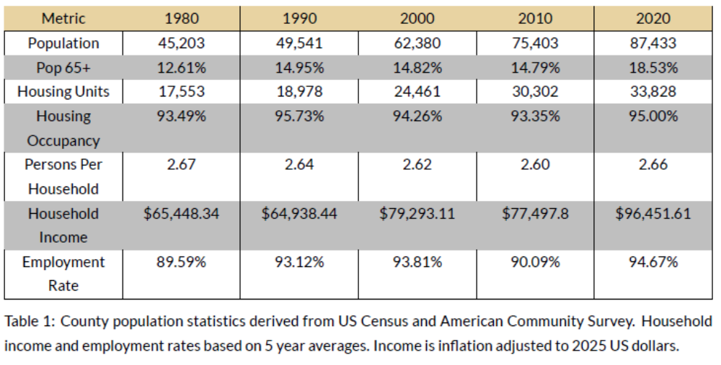

Slide 12
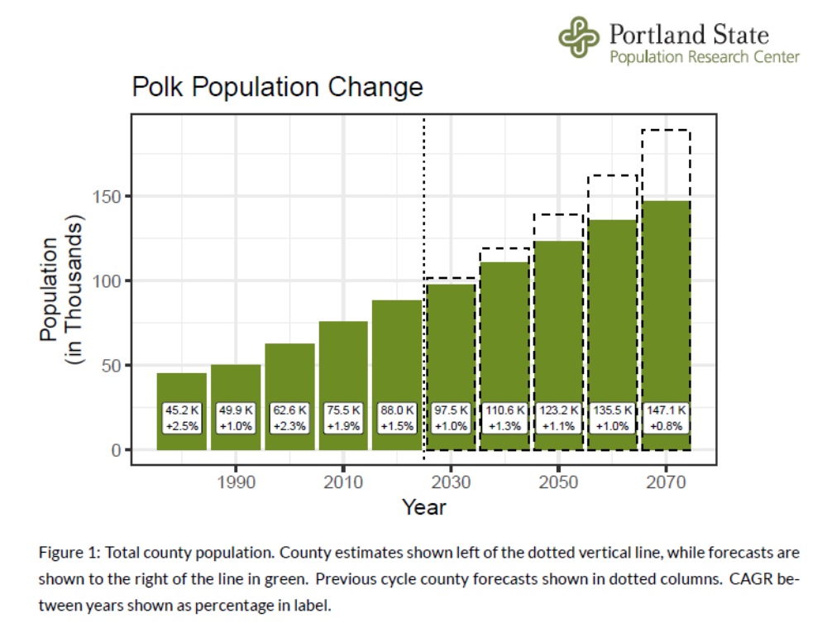

Slide 13
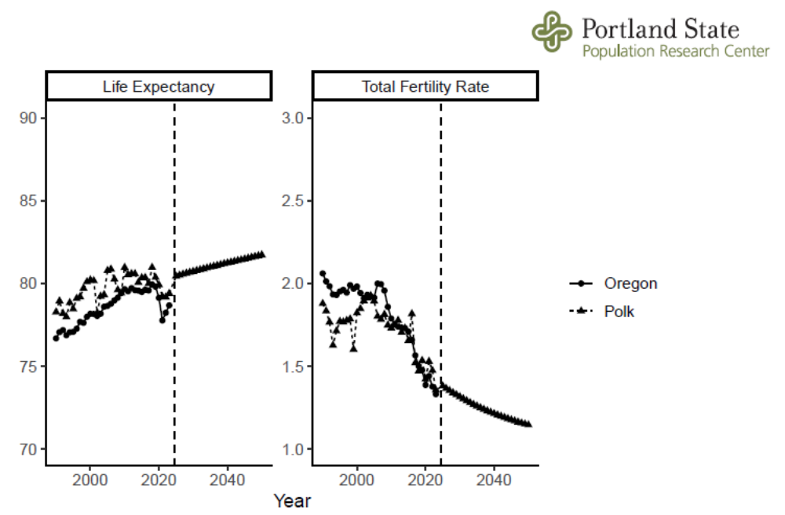

Slide 14
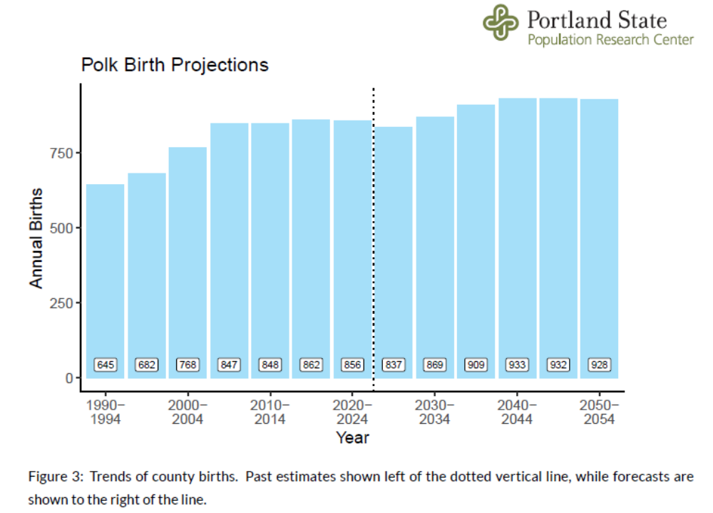

Slide 15
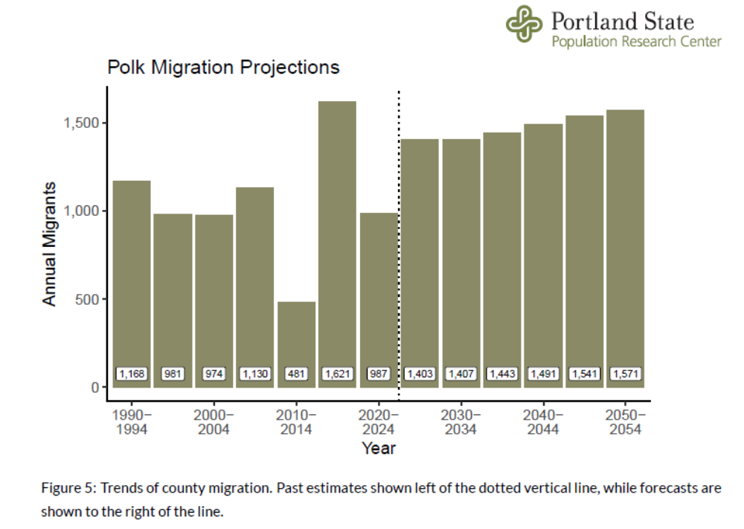

Slide 16
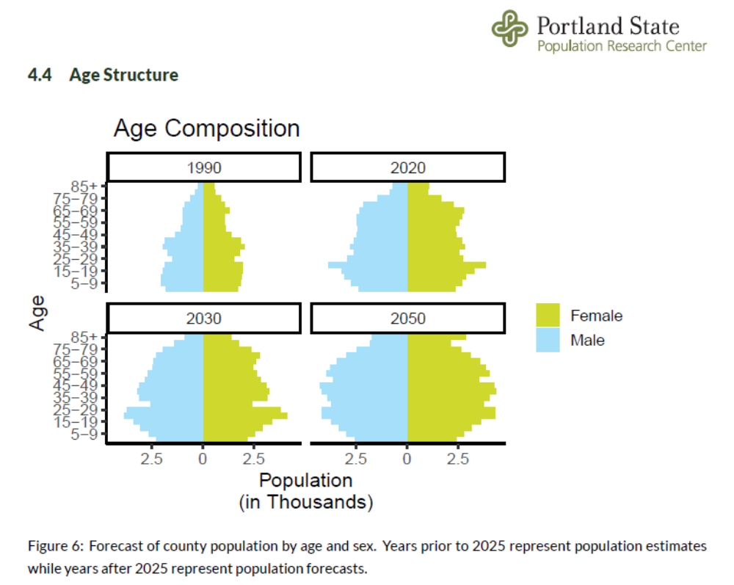

Slide 17
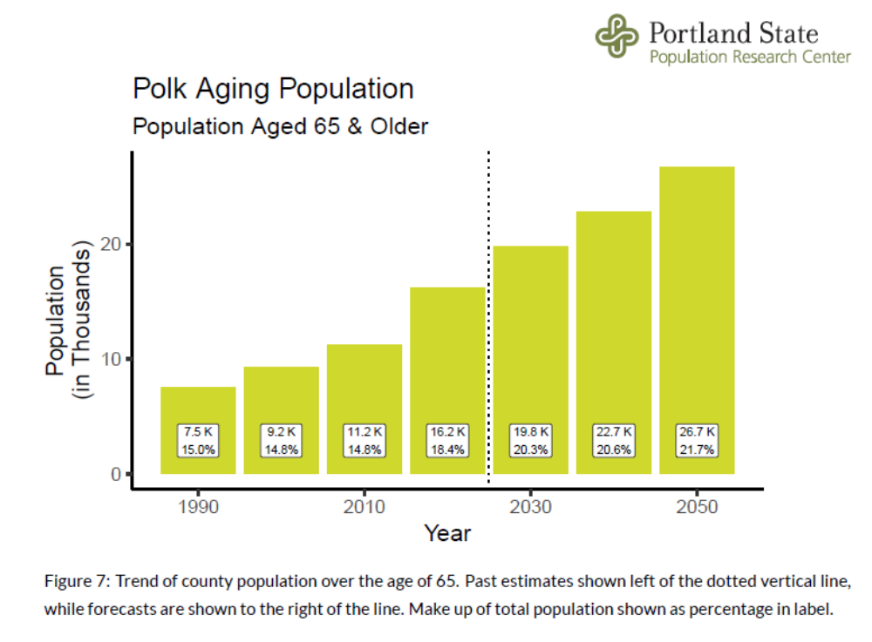

Slide 18
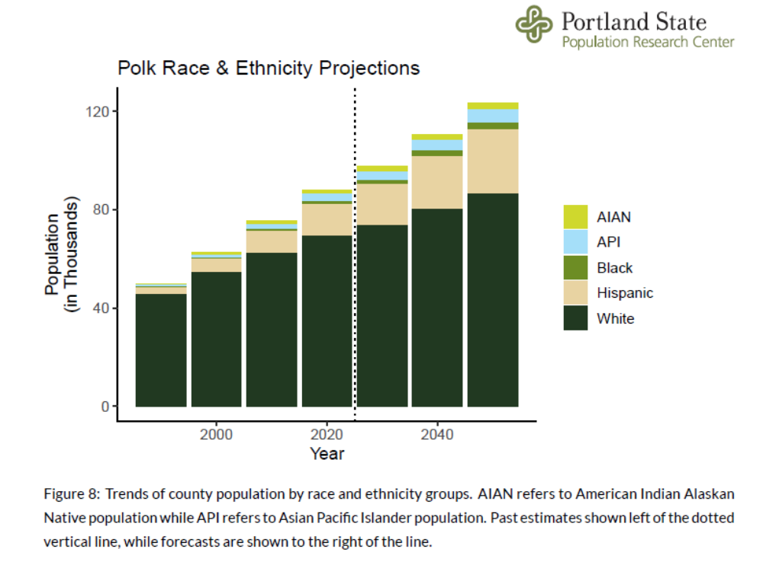

Slide 19
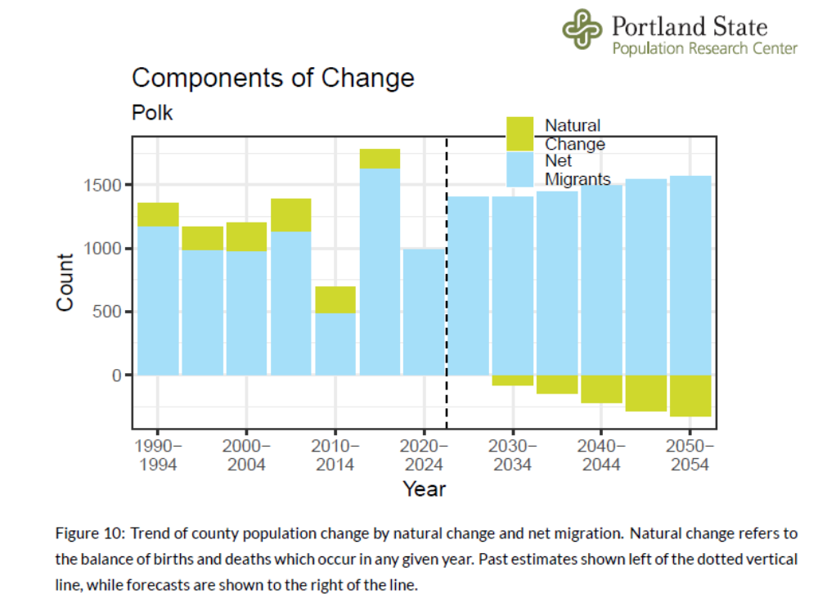

Slide 20
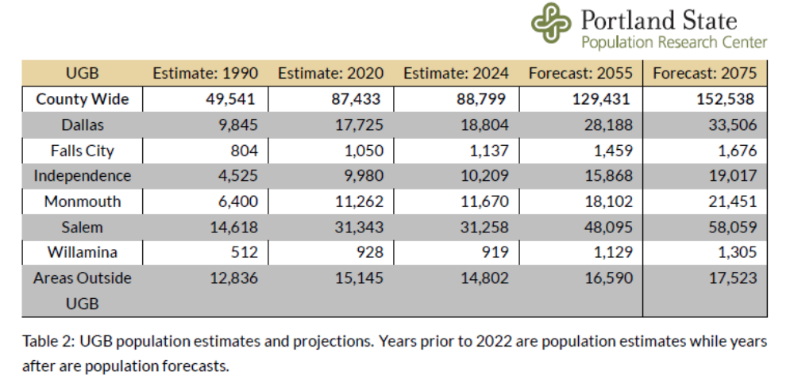

Slide 21
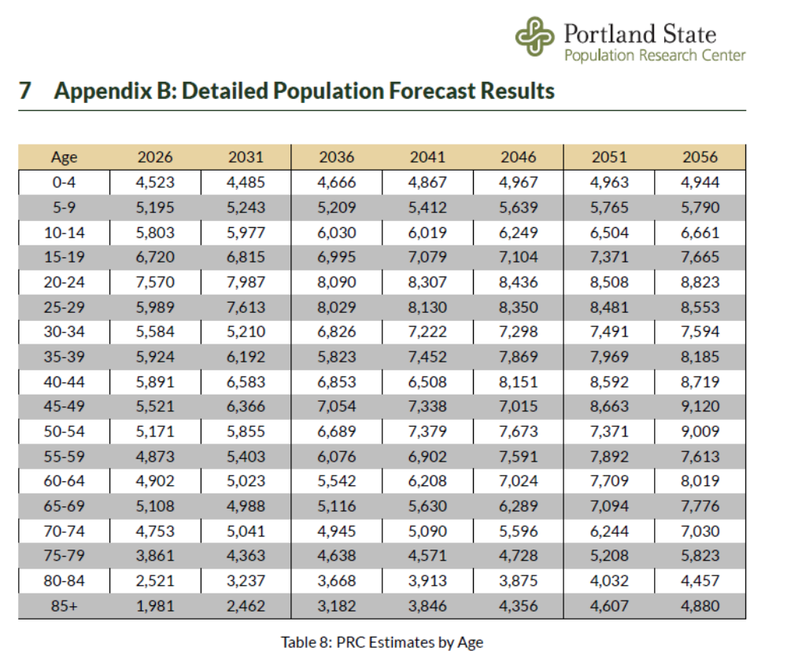

Slide 22
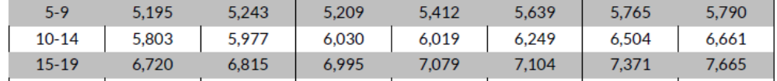

Slide 23
Polk County, total; from PSU Coordinated Population Forecast 2025-2075
 | 2026 | 2031 | 2036 | 2041 | 2046 | 2051 | 2056
5-9 | 5,195 | 5,243 | 5,209 | 5,412 | 5,639 | 5,765 | 5,790
 |  | 48 | -34 | 203 | 227 | 126 | 25
 |  | 0.9% | -0.6% | 3.9% | 4.2% | 2.2% | 0.4%
10-14 | 5,803 | 5,977 | 6,030 | 6,019 | 6,249 | 6,504 | 6,661
 |  | 174 | 53 | -11 | 230 | 255 | 157
 |  | 3.0% | 0.9% | -0.2% | 3.8% | 4.1% | 2.4%
15-19 | 6,720 | 6,815 | 6,995 | 7,079 | 7,104 | 7,371 | 7,665
 |  | 95 | 180 | 84 | 25 | 267 | 294
 |  | 1.4% | 2.6% | 1.2% | 0.4% | 3.8% | 4.0%
5-19 | 17,718 | 18,035 | 18,234 | 18,510 | 18,992 | 19,640 | 20,116
 |  | 317 | 199 | 276 | 482 | 648 | 476
 |  | 1.8% | 1.1% | 1.5% | 2.6% | 3.4% | 2.4%
TOTAL COUNTY GROWTH |  | 7.6% | 6.7% | 6.1% | 5.7% | 5.3% | 5.0%
TOTAL DALLAS GROWTH |  | 8.5% | 7.4% | 6.8% | 6.2% | 5.8% | 5.4%
Dallas stays at around 22% of the county's total population

Slide 25
Dallas has had consistent albeit slowing growth since 1990. This pattern changed somewhat in 2020 when growth in the UGB accelerated.
The next 15 years of growth are expected to be similar to past years.
Beyond this, the growth rate of Dallas is expected to slow as the UGB, and county
population as a whole, ages and fertility rates decline.

