Slide 1
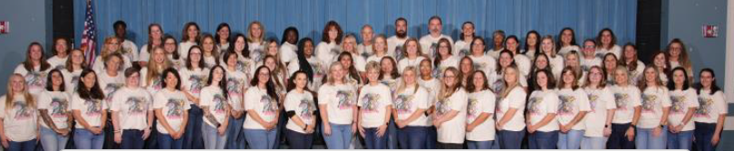

Title 1 at Stateside Elementary
2025-2026

Slide 2
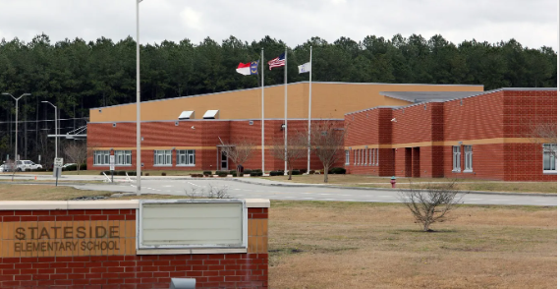


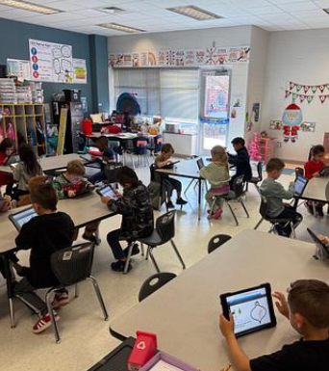
We are fortunate to receive funding as a Schoolwide Title 1 School. Our status is based on the number of students that we have who qualify for free and reduced meals. If you haven’t filled out a form yet, please do so as soon as possible.

Slide 3
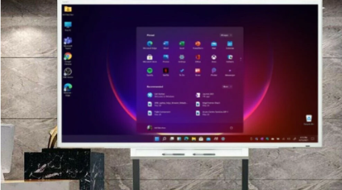

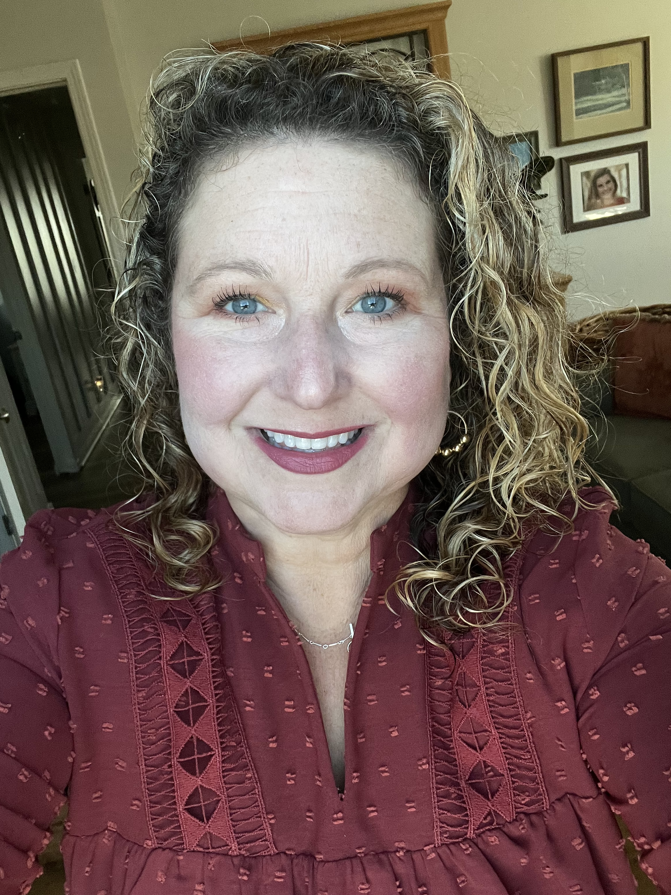
We use our funds to hire tutors and an Instructional Coach as well as to purchase technology, online programs and testing materials.

Slide 4

We’d love to share more information with you. Please reach out to Mrs. Neal with any questions.
Jennifer.neal@onslow.k12.nc.us

