Slide 1

Study Strategies for CHS Exams
How to Reduce Stress and Do Your Best
NHS Workshop Fall 2025

Slide 2


Exam Time can be Stressful
Planning ahead NOW
will help reduce stress
during exam week.
Notes:
Notes to presenter:
What is your purpose for sharing this reflection?
Is it at the end of a unit or project?
Are you sharing this reflection, at the attainment of a learning goal you set for yourself?
Is it at the end of a course?
State your purpose for the reflection or even the purpose of the learning experience or learning goal. Be clear and be specific in stating your purpose.

Slide 3

Have a Plan
Have a Space
Have a Schedule
Use an exam calendar to map out study days.
3-2-1 system:
3 days out: full review
2 days out: work on sections that give you trouble
1 day out: final review
Do the 3-2-1 system for each exam to stagger your studying
Exam Calendar
Designate an area for study
Remove your phone and other distracting items
Good lighting and comfortable, upright chair
Room to spread out materials
Try the FOCUSED STUDY SCHEDULE to organize your time studying.
Focused Study Session Steps
Notes:
Notes to presenter:
What was important about this learning experience?
How is it relevant to your course, yourself, or your society or community?
Why is this significant?
This SmartArt allows you add images and text to help outline your process. If a picture is worth a thousand words, then pictures and words should help you communicate this reflection on learning perfectly! You can always click on Insert>SmartArt to change this graphic or select the graphic and click on the Design contextual menu to change the colors.

Slide 4
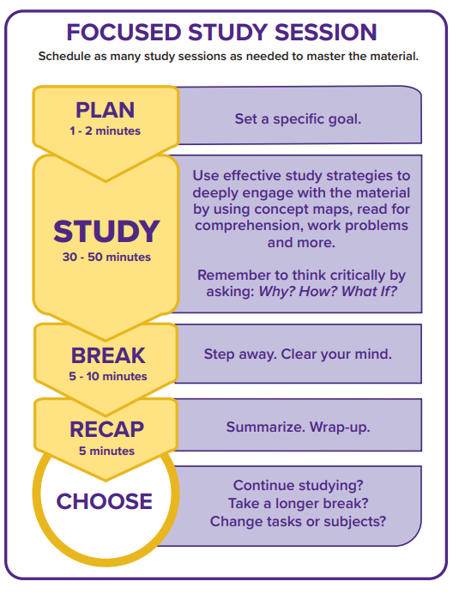
Study Strategies:
Concept maps
Practice problems
Quizlet/Flashcards
Memorize to apply
Use your exam guide!

Slide 5
Using the FSS for CHS exams
Focused Study Session Worksheet

