Slide 1


EASTERN SUFFOLK BOCES REGIONAL INFORMATION CENTER
CBT WORKSHOP #1:
OPENING OF THE NEXTERA SYSTEM FOR 2026 TESTING
Presented by the Eastern Suffolk BOCES
Student Data Services Department

Slide 2
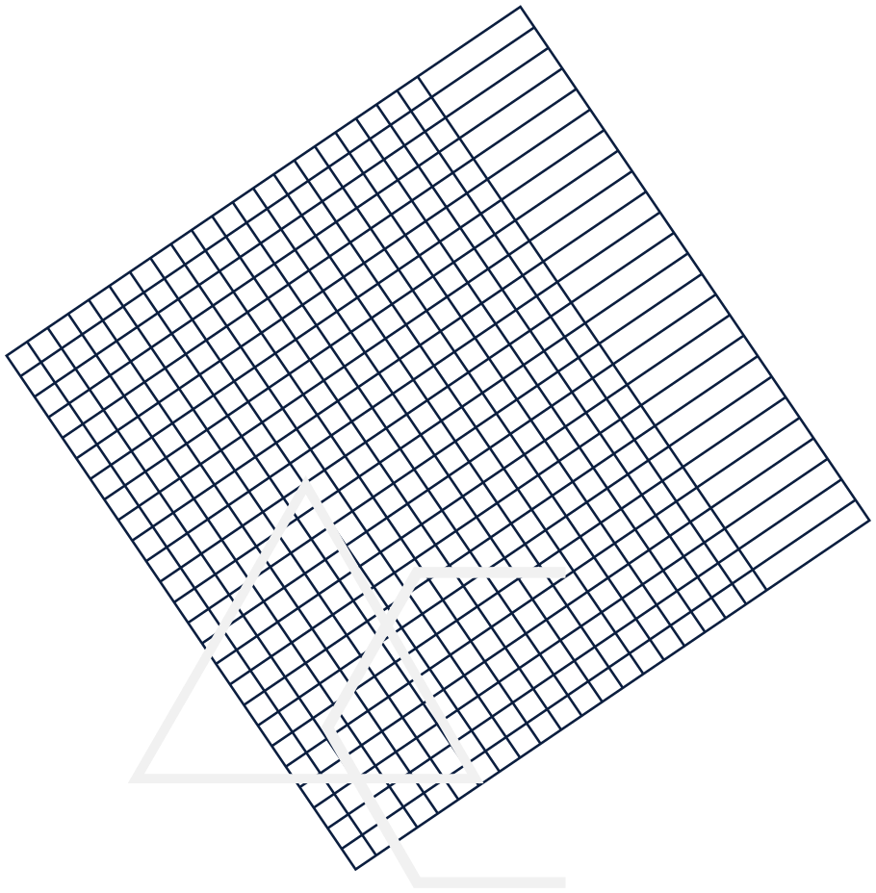
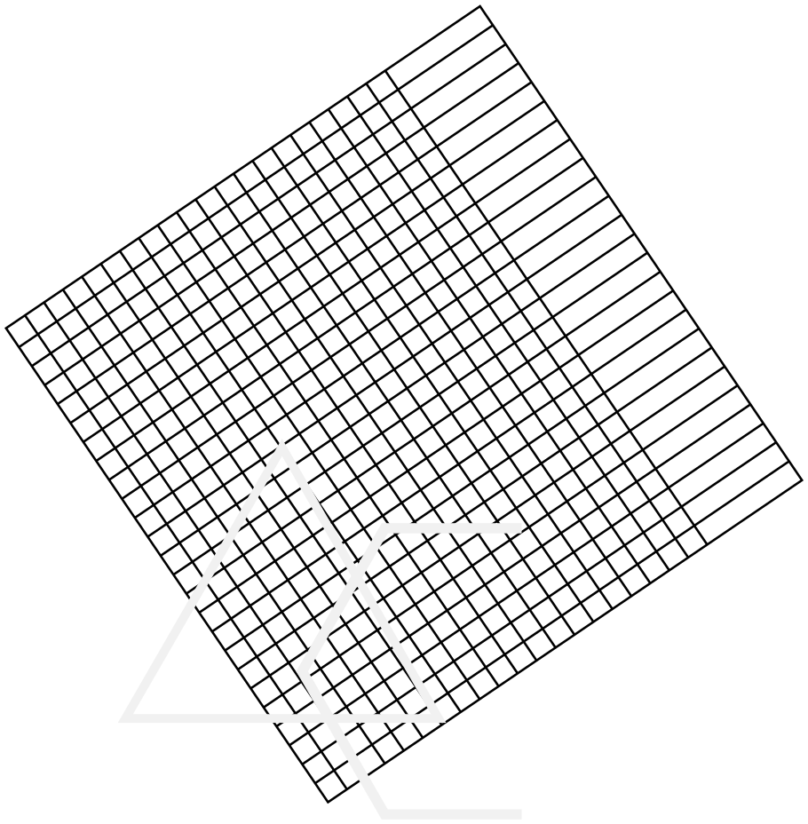
CBT Workshop #1
Agenda
  Welcome and Introductions
  Accessing your NEXTERA account
  CBT Testing Team
    CBT Team Roles
    Assigning Rights
  Completing the Tech Readiness
  Accessing Practice Exams

Slide 3
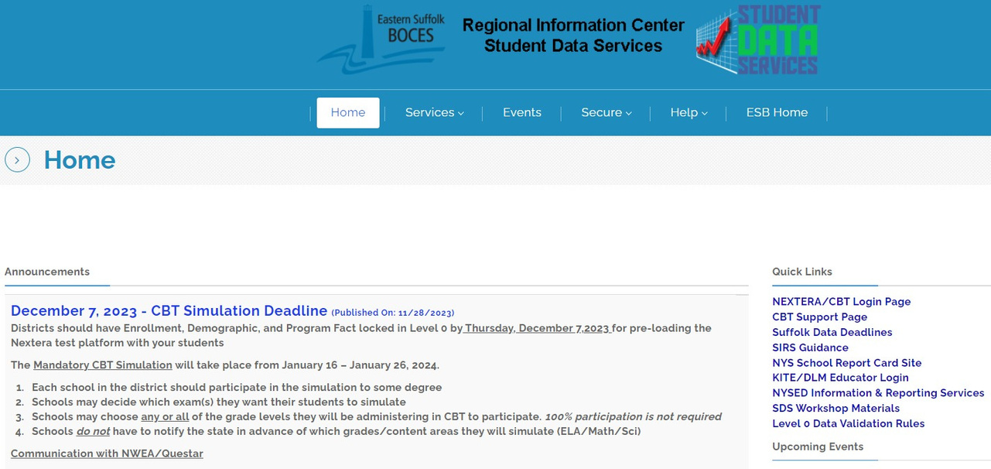

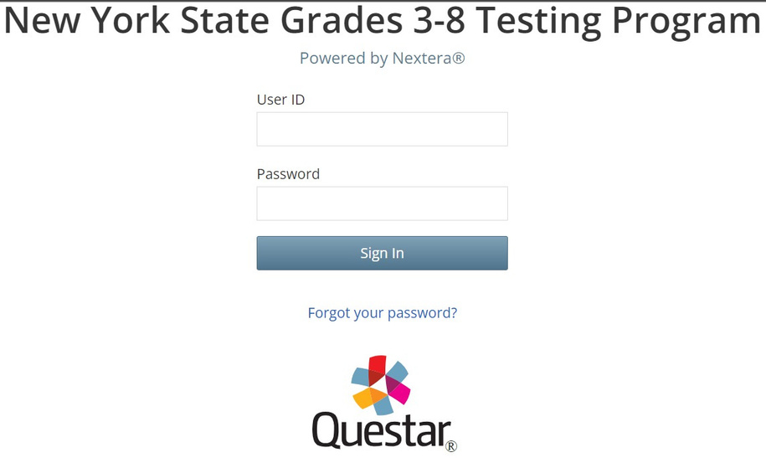
Accessing the Nextera System
SIGNING IN TO THE NEXTERA SYSTEM
DataCentral Quick Links- www.datacentral.esboces.org
NYSED CBT Support Site
This site has everything and a search feature.
Nextera Login Page
Access to the console and testing system Supts & Principals have default accounts
Use the ‘Forgot password’ feature on the Nextera homepage
The site will send a direct reset email
Email Reset did not work?
Account questions can be sent to cbtsupport@nysed.gov

Slide 4
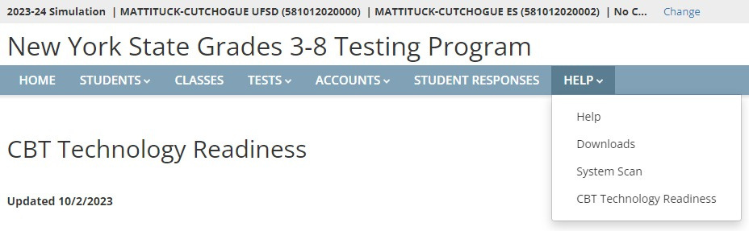

Accessing the Nextera System
THE NEXTERA HELP TAB
1.Help - Contact information, Support
Documentation, and live chat help feature
2.Downloads - Access the Secure Browser file for
installation on your machines
3.System Scan - Checks that hardware is
acceptable
4.CBT Technology Readiness - Brings you to the
questionnaire

Slide 5

COMPLETEING THE BUILDING TECH READINESS ASSURANCE
STEP 1: GATHER YOUR INFORMATION
1. How many students are taking a CBT exam
Use your SMS for a current count
2. How many hours per day are you assuming students will use
3.How many total days are you allotting for testing
4.How many devices will be in use at any given time during
testing
Use your best estimate if you are not sure of the exact count
5.What are the internet speeds in the building
Use https://www.speedtest.net/ - Click ‘GO’ and wait 30 seconds for it to finish
6.Who else besides the principal or DTC should receive
communications from Questar
No more than two additional contacts can be added

Slide 6
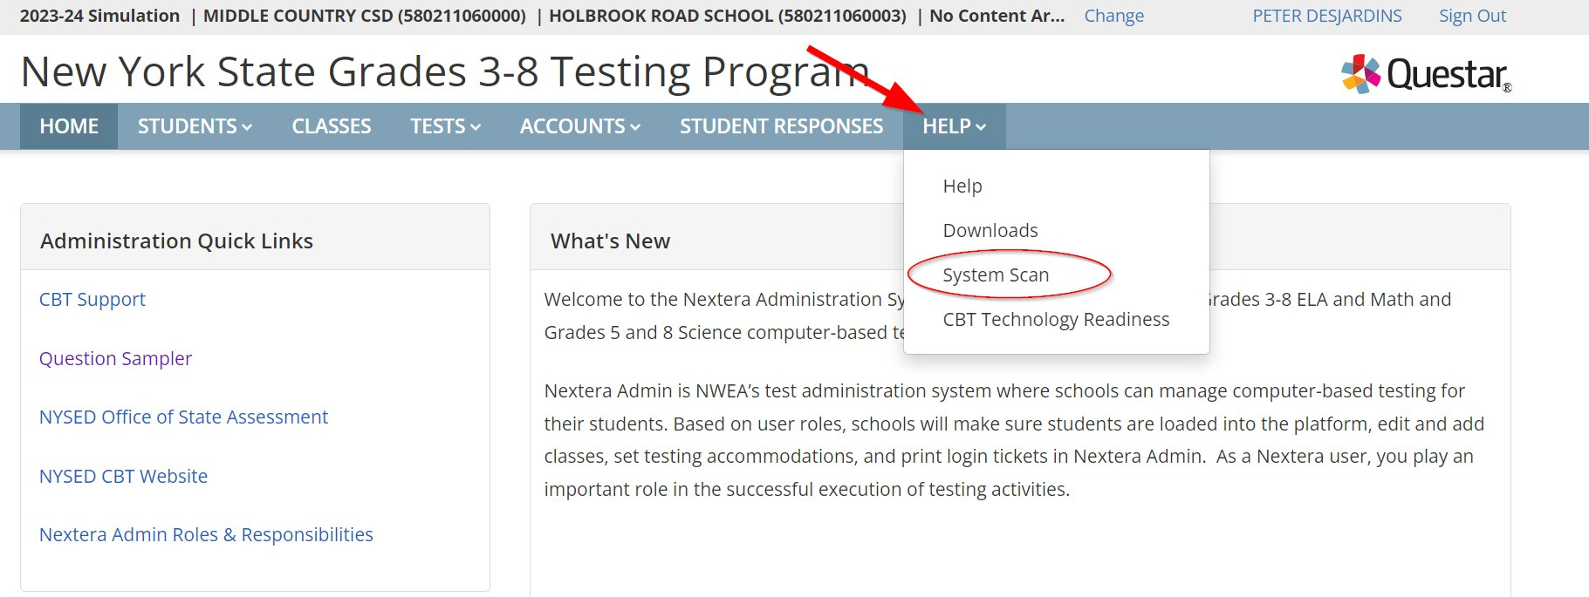

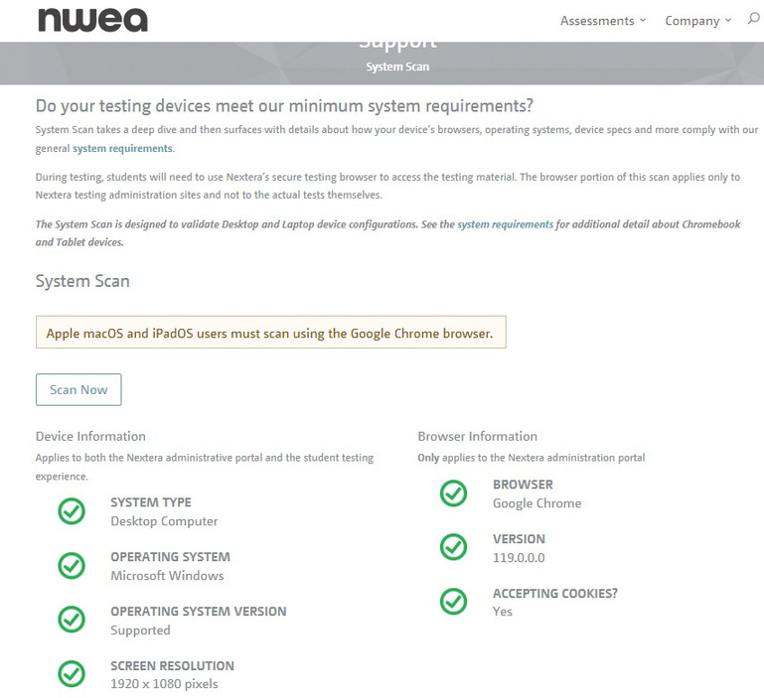

COMPLETEING THE BUILDING TECH READINESS ASSURANCE
Step 2: System Scan
From the help tab, access the System Scan link
If the page looks like this you are ready to move to the next step If your system scan shows Red Xs please contact Questar Support for assistance
NYTesting@nwea.org

Slide 7
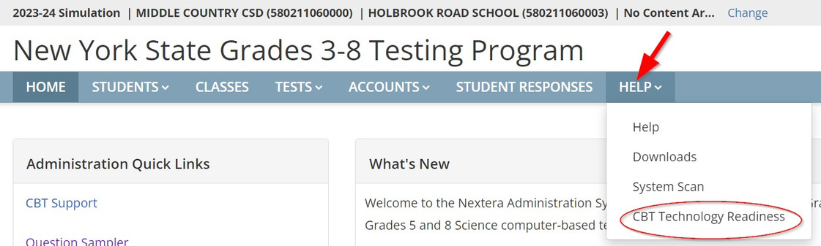
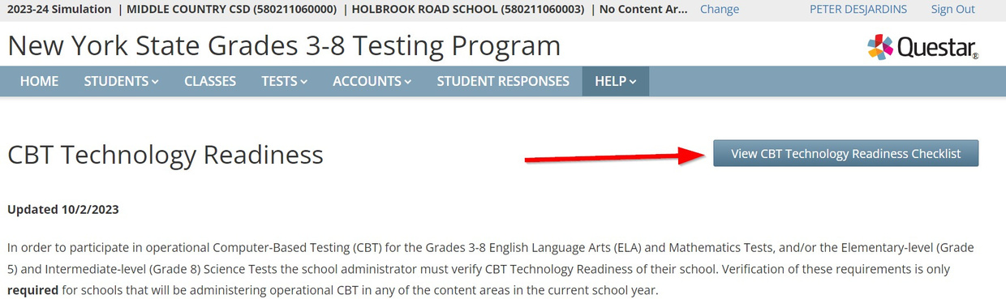
COMPLETEING THE BUILDING TECH READINESS ASSURANCE
Step 3: Start the Tech Readiness Assurance
1.Access the Tech
Readiness Page
2.Access the CBT
Readiness Checklist for reference

Slide 8
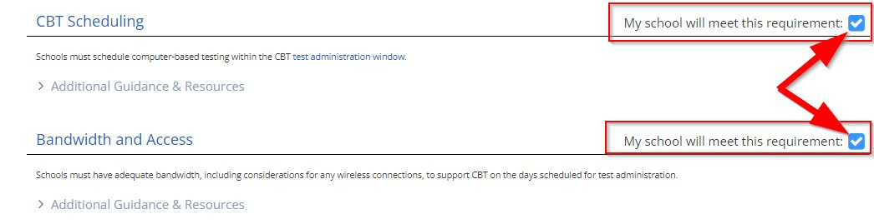
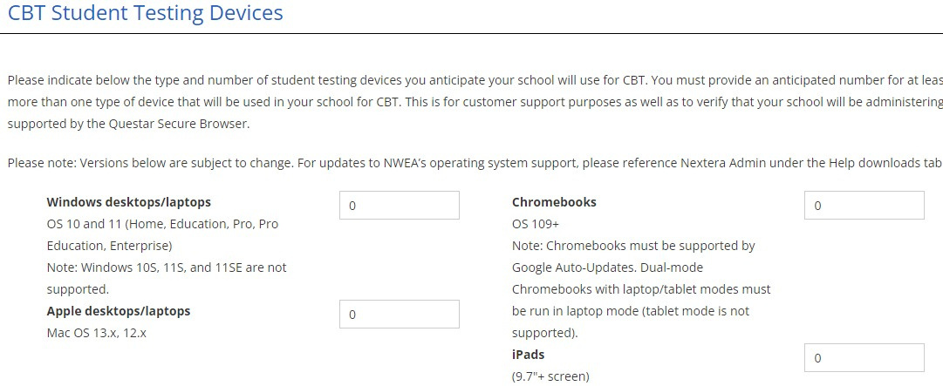
COMPLETEING THE BUILDING TECH READINESS ASSURANCE
Step 3: Start the Tech Readiness Assurance
(Cont.)
1.
2.
3.Refering to your
gathered
information,
complete the
questionnaire
4.Enter the approximate
number of devices expected

Slide 9
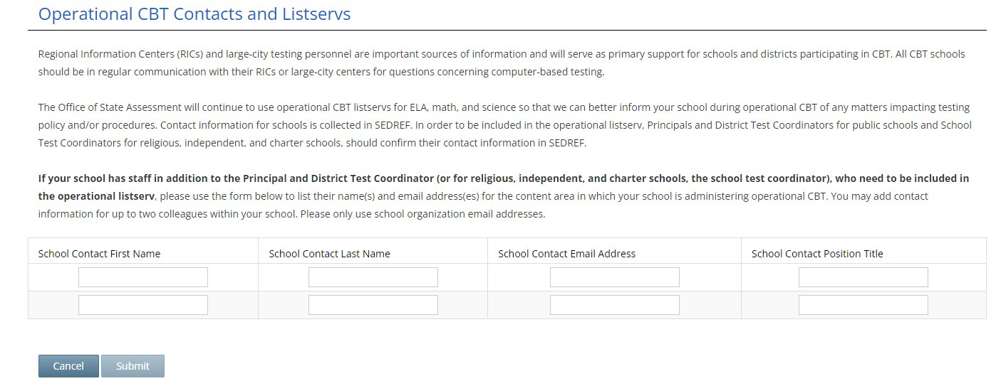


COMPLETEING THE BUILDING TECH READINESS ASSURANCE
Step 3: Start the Tech Readiness
Assurance (Cont.)
1.
2.
3.4
4.5
5.Add additional
email contacts
to recieve
updates from
Questar
6.Submit the
checklist

Slide 10




MOVEMENT OF STUDENT RESPONSE DATA DURING COMPUTER BASED TESTING
Student Device
Questar
Test data is transmitted every 5 min. to Questar If Connection is lost, data remains on the computer
Data that was successfully transmitted is processed Written (typed) responses are sent to your scoring vendor
Hard Drive
Data Warehouse
Varies by device Stores data when connection is lost
MC & Written
response data
combined
Issues with
student data are
fixed before the
final deadline

Slide 11



Nextera Admin User Roles

Slide 12

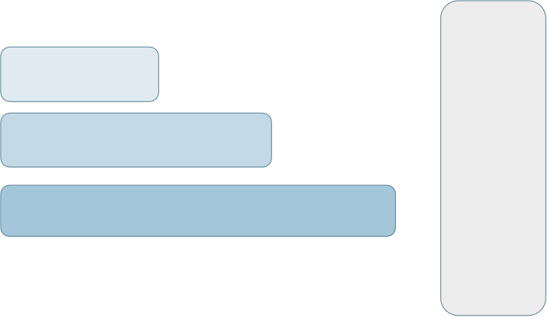




Nextera Admin User Roles
Student
Class
School
District
Region
Teacher
School Level Users
District Level Users
RIC User State Level User

Slide 13
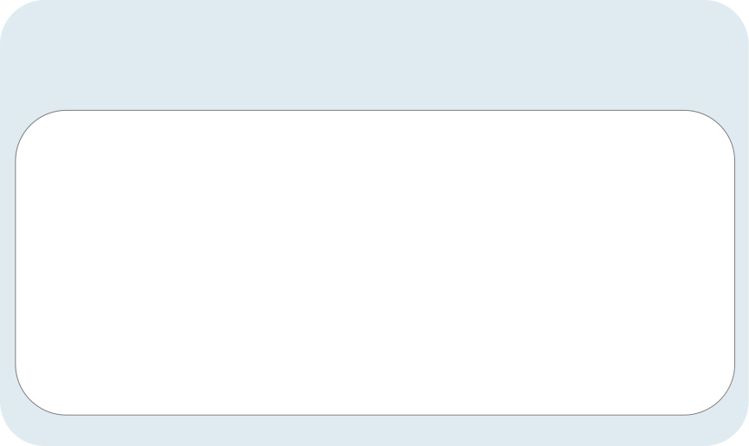
Teacher Role (Not Required)
Teacher
  Can access their class and student information in Nextera Admin
  Responsible for leading the test administration
  Distributes login tickets and reads the directions from the Teacher’s Directions
  Has the Proctor PIN on-hand for students who may need to pause the test
  Note: There is only one teacher per class

Slide 14


School Level Roles
School Level Users
  Principal (PRN) – Responsible for Technology Readiness, visibility to their own school, classes, and students, can create school level users
  School Test Coordinator (STC) – Handles test coordinator responsibilities
  at school level, manages users and students, schedules tests at school level
  Building Level User (BLU) – Same permissions as STC, assists in managing school-level users and students
  School Information Technology Coordinator (SITC) – Information technology point of contact for school, can download the secure browser, helps to troubleshoot, does not have access to students or classes

Slide 15

District Level Roles
District Level Users
  District Test Coordinator (DTC) – Main point of contact at the district for Questar and schools, ensures accuracy of all student data in system, manages district-level accounts and sets up primary school level users
  Superintendent (SUP) – Adviser to the DTC, ensures all student data is correct in system, visibility to own district and school level information
  District Level User (DLU) – Same permissions as DTC, assists in managing
  district-level users and students
  District Information Technology Coordinator (DITC) – Information technology point-of-contact for district, can download the secure browser, helps to troubleshoot, does not have access to students or classes

Slide 16


Basic CBT Team Setup
  District Level User who can assign roles, reset passwords, and transfer students within the district, and assist with accommodations and refusals
  District IT Coordinator who is responsible for district technology, and the installation of the secure browser on all student devices
  A Building Level User who can assign roles, reset passwords, and transfer students within their assigned building, and assist with accommodations and refusals
  School IT Coordinator who is responsible for building technology maintenance, assisting proctors, and monitoring real time tech problems
Nextera Roles and Responsibilities
Video Tutorial
  District Level user can see all school buildings
  School Level can only see their assigned school

Slide 17












CBT Practice Tests
“By failing to prepare, you are preparing to fail.”
― Benjamin Franklin

Slide 18
Two Ways to Practice
Using the Secure Browser
or
Using the online Question Sampler
Practice tests are low-stakes results are not retained

Slide 19
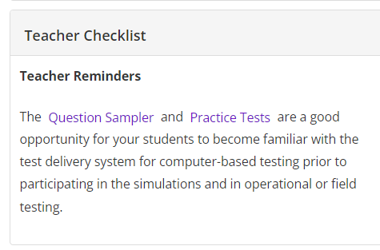
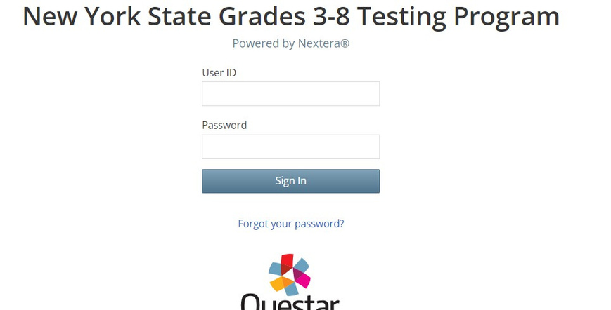
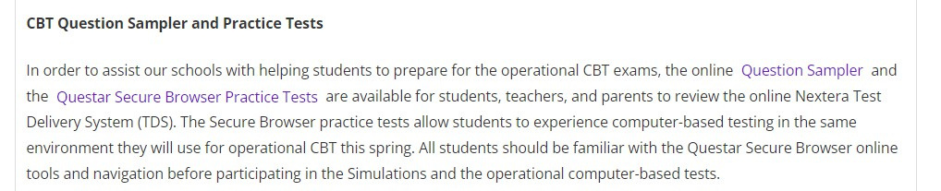
Links
in Nextera Admin

Slide 20
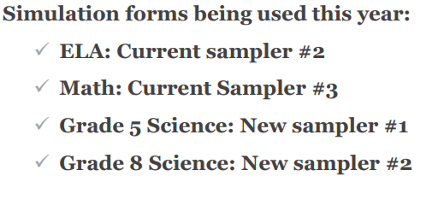
Available Practice Tests
4 practice tests for CBT testing with accommodations for
ELA, Math and Science
Text-to-speech, Initial Zoom, Answer Masking, and Speech-to-text (ELA only)

Slide 21
Secure Browser Practice Tests
Questar Secure Browser must be installed on the students’ testing device
The Secure Browser practice tests allow students to experience computer-based testing in the same environment they will use for operational CBT
The login for each practice test is:
subject + g + grade number
Example:
Mathg03
The password for all practice tests is: practice

Slide 22
Question Sampler
https://ny.nextera.questarai.com/tds/#practice
Not intended to reproduce the test environment
Question Sampler is a way to see the test format and question types
Question Sampler uses questions from previous test for ELA and math
Science questions are aligned to the learning standards

Slide 23
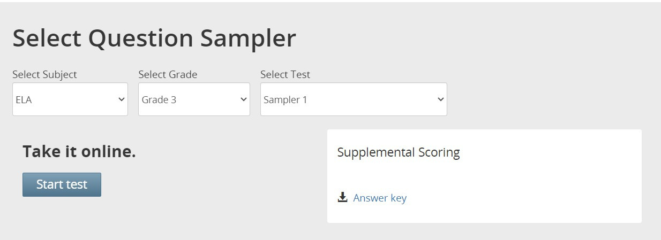

Slide 24
Best Practices
Have the students practice a few times to get used to the tools
Set the Accommodations even for the practice tests to see how they work
Simulation is different from the practice tests To succeed…Practice, Practice, Practice

