Slide 1

Preparing for
FY27 Budget Development
M. Agnes Jones ES
GO Team Business Meeting #4
December 11, 2025

Slide 2
Agenda
Action Items (add items as needed)
  Approval of Agenda
  Approval of Previous Minutes
  Fill Parent Vacancy
  2025-2030 Strategic Plan (After discussion)
  Ranking Strategic Plan Objectives (After discussion)
Discussion Items (add items as needed)
  Finalize 2025-2030 Strategic Plan
  Preparing for the FY27 Budget Development Process
    Review 2026-2027 Strategic Objectives Ranking
Information Items (add items as needed)
  Principal’s Report
    CCRPI Results
    Preliminary Winter MAP results
    2025-2026 Mission and Vision
  APS Forward 2040 – Long-Range Facilities Plan Update (if needed)
Announcements
Adjournment

Slide 3
Action Items
Approval of the Agenda
Ranking Strategic Plan Objectives (After discussion)
Approval of Previous Minutes
2025-2030 Strategic Plan (After discussion)

Slide 4
Parent Vacancy

Slide 5
Discussion Items
Finalize the 2025-2030 Strategic Plan
Preparing for the FY27 Budget Development Process
Review 2026-2027 Strategic Objectives Rankings

Slide 6

2025-2030 School Strategic Plan

Slide 7


Today’s Focus:
School Strategic Planning Process: Step 5
1
Sample GO Team Business Meeting Cadence
Business Meeting 1:
Review Data (MAP, GMAS, Graduation Rate, CCRPI, etc.)
Business Meeting 2:
Review Data (School KPIs)
Align Mission/Vision/ Purpose
Confirm 2030 Goals
Business Meeting 3:
Identify 2025-2030 Strategic Objectives
Business Meeting 4 :
Approve Your Strategic Plan & Rank Your Strategic Objectives for FY27
Review Data
2
Align Mission/Vision/Purpose
3
Confirm 2030 Goals
Create CIP Goals to 2030
Identify Additional Goals
4
Identify 2025-2030 Strategic Objectives
Reflect on 2020-2025 Strategic Plan
Review and Discuss Additional Objectives Going Forward
5
Approve Your Strategic Plan & Rank Your Strategic Objectives for FY27

Slide 8
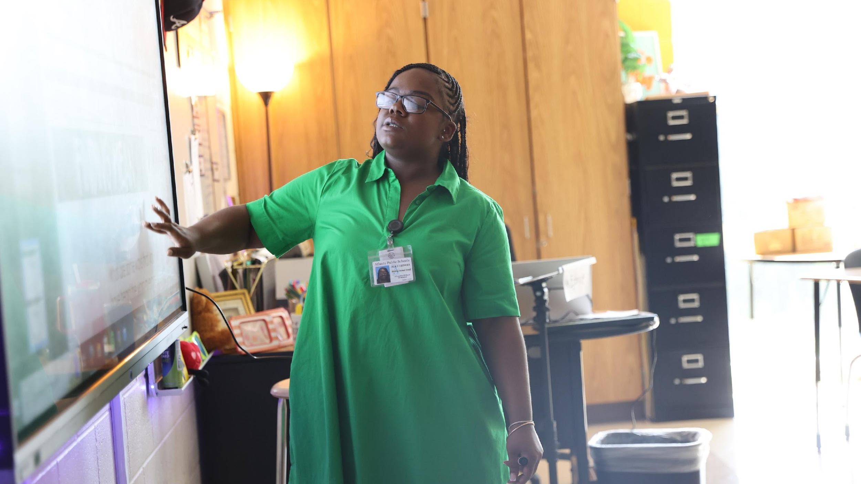

5. Identify 2025-2030 Strategic Objectives
Review and Discuss your school's 2025-2030 Strategic Plan
  Action on your 2025-2030 Strategic Plan
Review and Discuss your 2026-2027 Strategic Plan Objective Rankings
  Action on the 2026-2027 Strategic Plan Objective Ranking
One District. One Goal. Every Child.

Slide 9
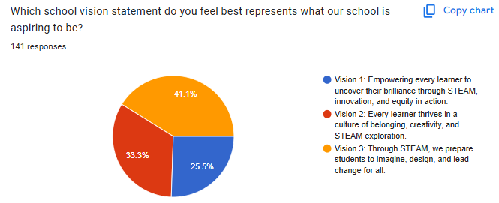
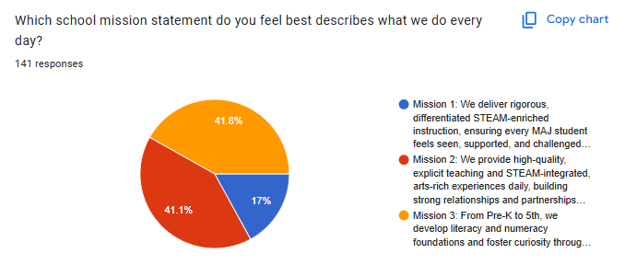
Vision: Through STEAM, we prepare students to imagine, design, and lead change for all.
Mission: From Pre-K to 5th grade, we develop strong literacy and numeracy foundations, foster curiosity through hands-on STEAM instruction, and nurture critical thinking, a growth mindset, and a commitment to excellence.

Slide 10
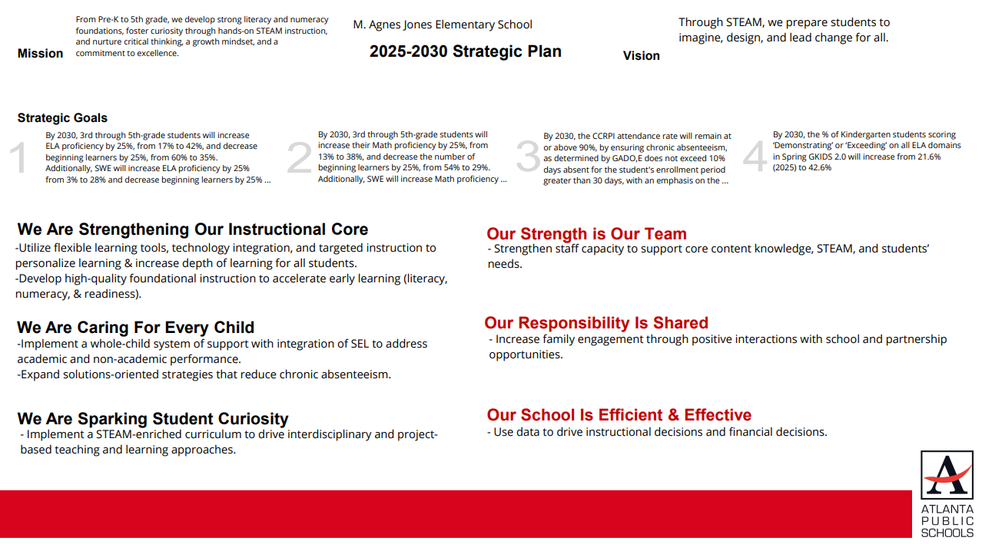

Slide 11

Action on the
2025-2030 Strategic Plan
The GO Team needs to TAKE ACTION (vote) on its new 2025-2030 Strategic Plan.
After the motion and a second, the GO Team may have additional discussion. Once discussion is concluded, the GO Team will vote.

Slide 13
Preparing for the
FY27 Budget Development Process

Slide 14
Discussion
Strategic Plan Objectives Ranking
The GO Team ranked its Strategic Plan Objectives in preparation for the 2026-2027 Budget Development Process (January–March 2026).
The ranked objectives will serve as budget parameters during FY27 budget discussions.

Slide 15
2026-2027 Strategic Plan Objectives Ranking
Insert the school’s objectives from Higher to Lower
Higher
-Utilize flexible learning tools, technology integration, and targeted instruction to personalize learning & increase depth of learning for all students. (4)
-Develop high-quality foundational instruction to accelerate early learning (literacy, numeracy, & readiness). (1)
-Implement a whole-child system of support with integration of SEL to address academic and non-academic performance.(3)
-Expand solutions-oriented strategies that reduce chronic absenteeism (7)
-Implement a STEAM-enriched curriculum to drive interdisciplinary and project based teaching and learning approaches.(5)
-Strengthen staff capacity to support core content knowledge, STEAM, and students’ needs. (2)
-Increase family engagement through positive interactions with school and partnership opportunities. (6)
Lower

Slide 16

Action on the
Strategic Plan Objectives Ranking
The GO Team needs to TAKE ACTION (vote) on its ranked Strategic Plan Objectives. After the motion and a second, the GO Team may have additional discussion. Once discussion is concluded, the GO Team will vote.

Slide 17
Where We’re Going
At our next meeting we will begin the discussion of the 2026-2027 budget.
Let me or the Chair know of any additional information you need for our future discussion.

Slide 18

Questions?

Slide 19
Information Items
APS Forward 2040 – Long-Range Facilities Plan Update (if needed)
Principal’s Report
CCRPI Results (if not previously discussed)
Cluster Advisory Team Report (if not previously discussed)

Slide 20

Principal’s Report

Slide 21
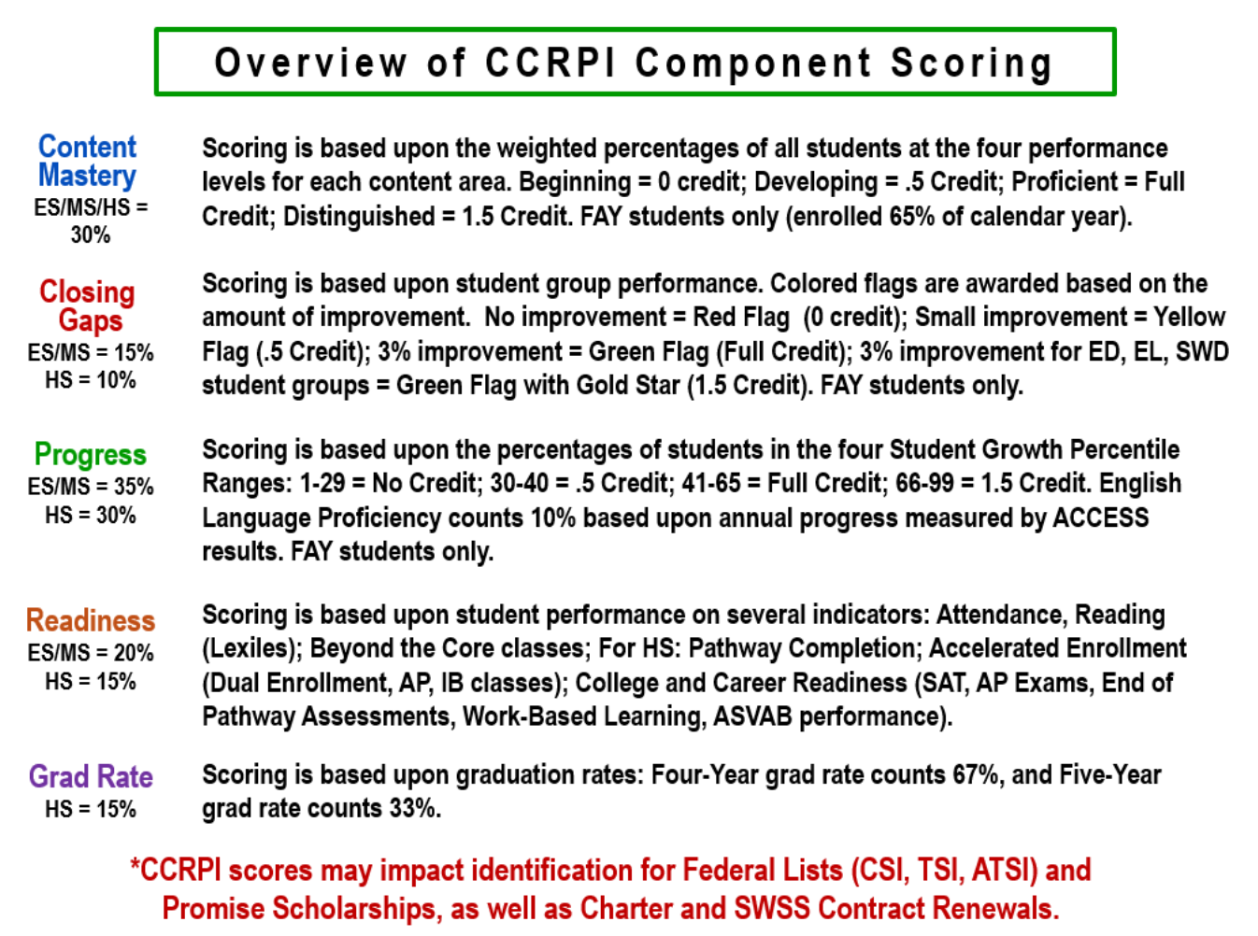

Slide 22
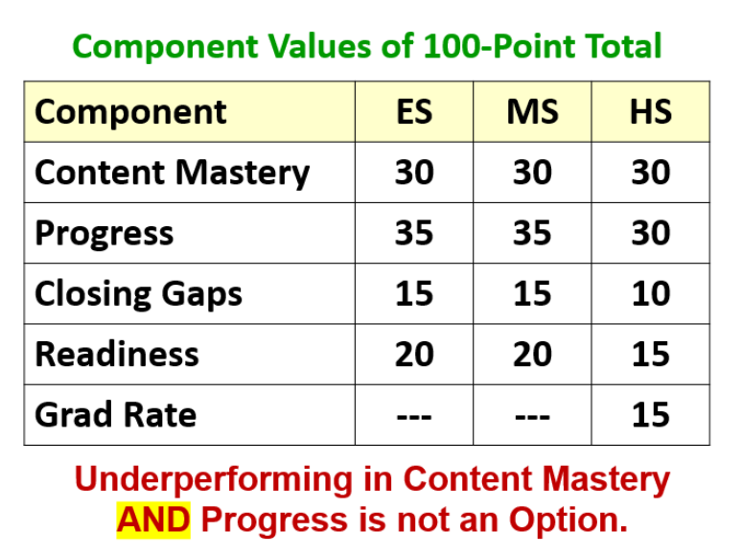

Slide 23
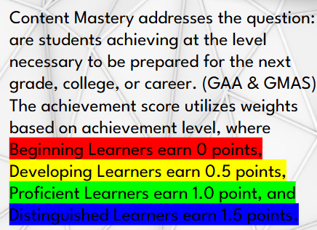
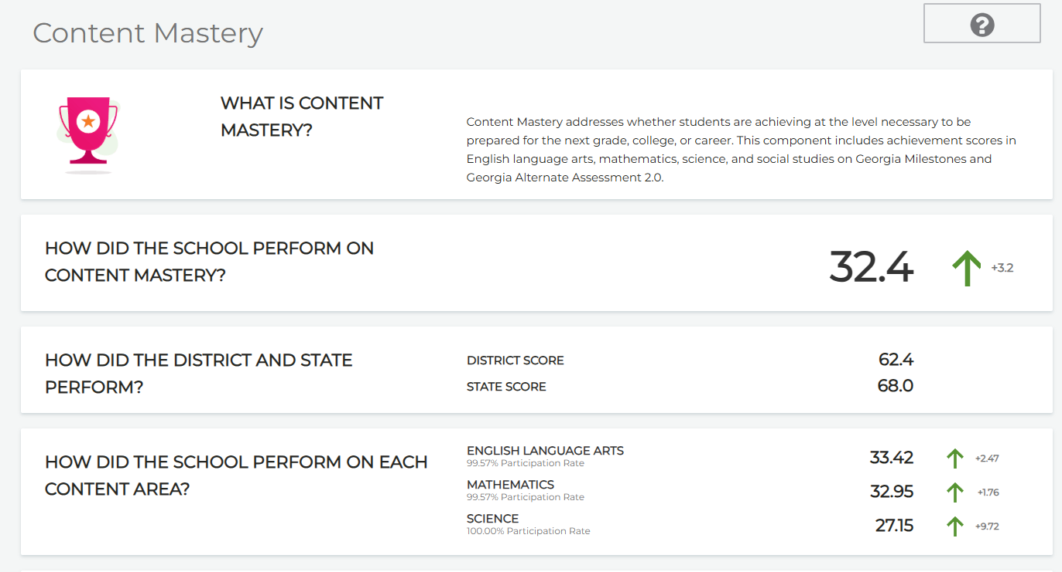
2025 CCRPI Results- Content Mastery

Slide 24
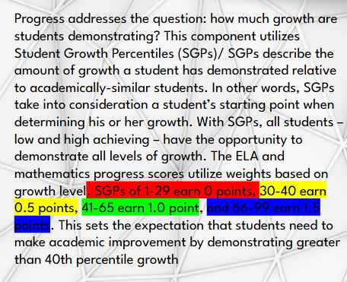
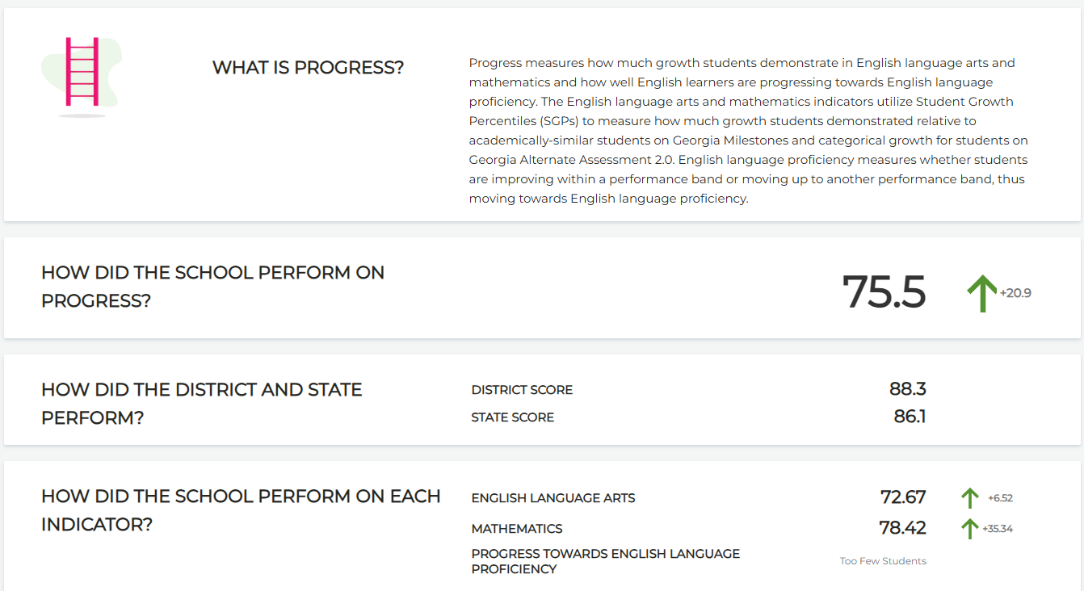
2025 CCRPI Results- Progress

Slide 25
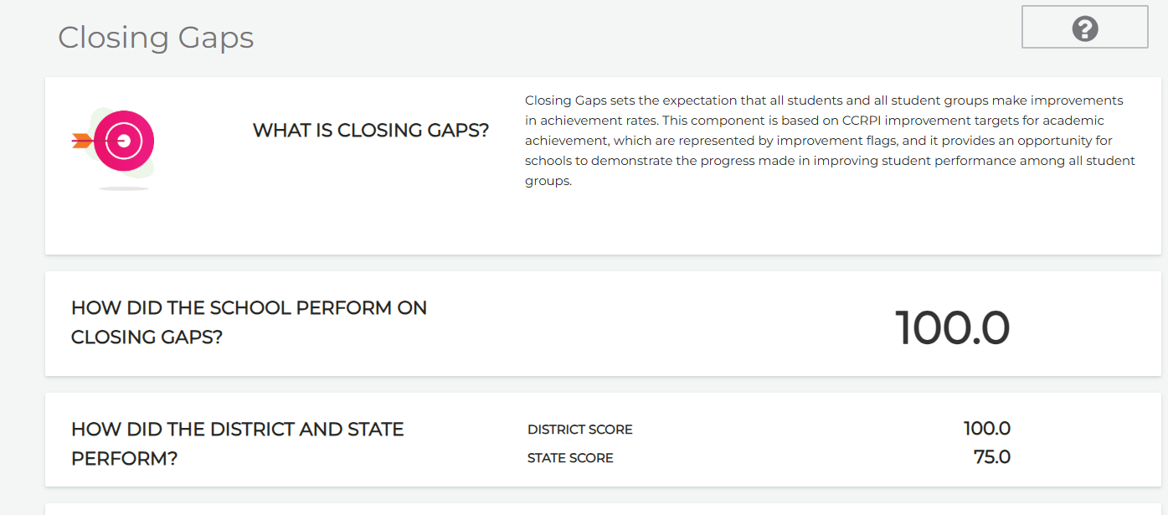
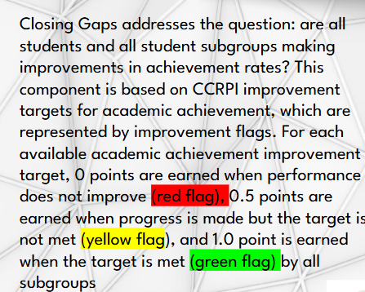
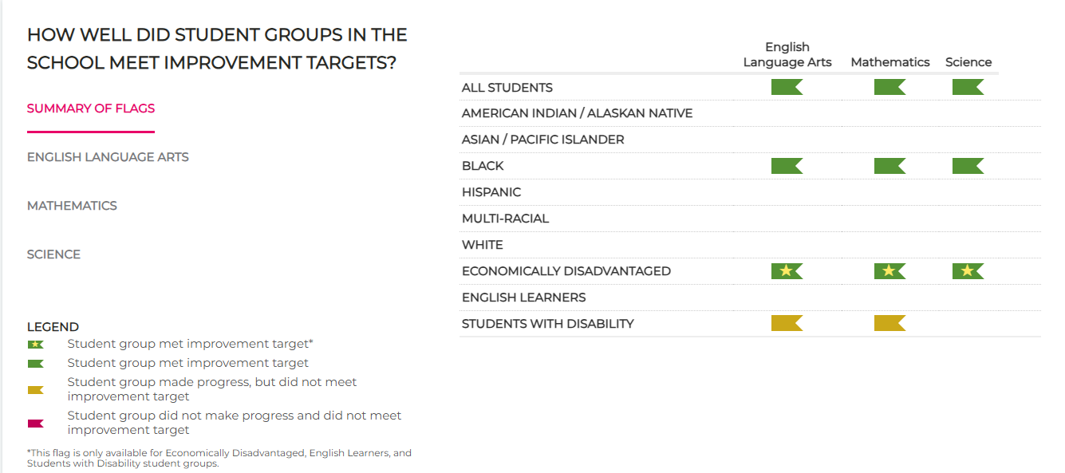
2025 CCRPI Results-Closing Gaps

Slide 26
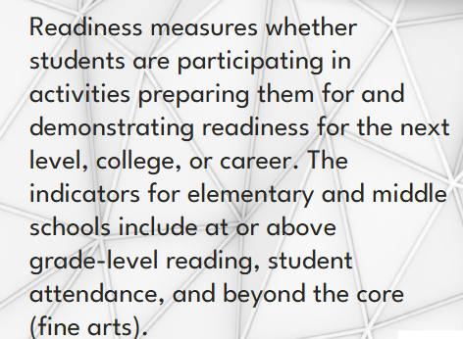
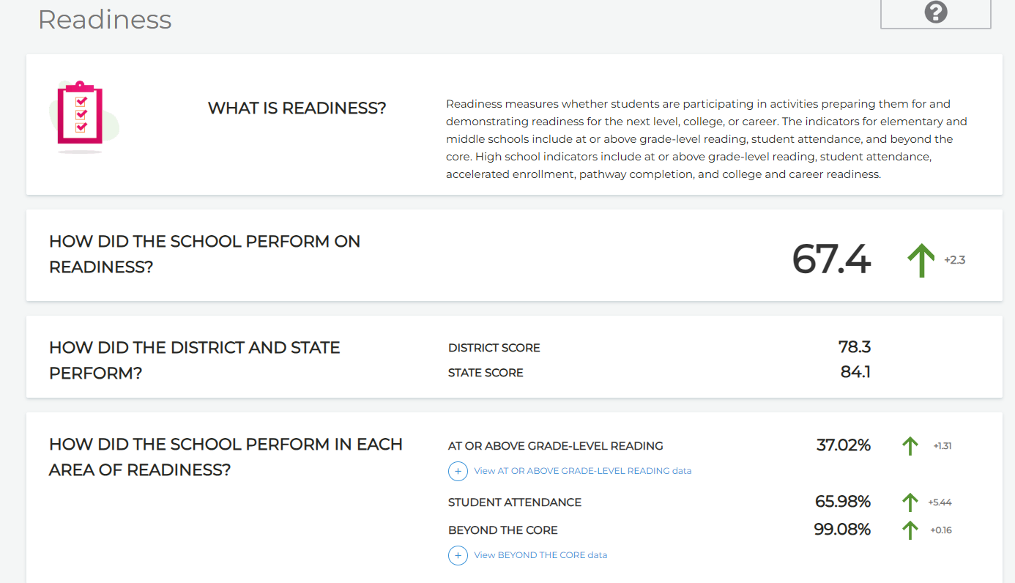
2025 CCRPI Results-Readiness

Slide 27
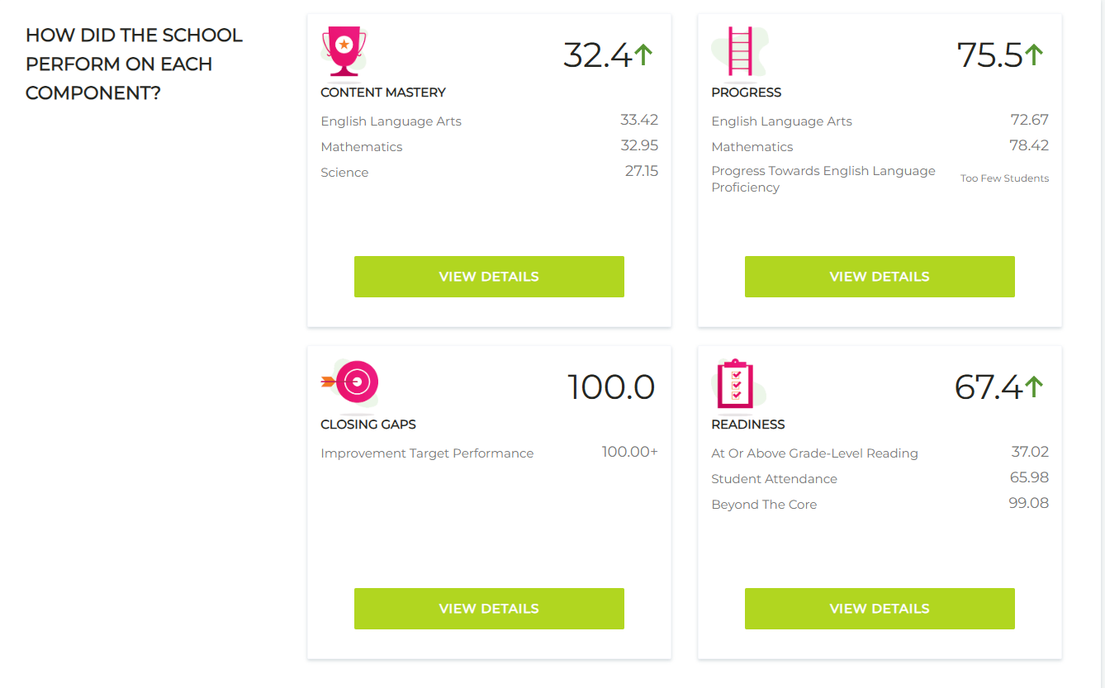
2025 CCRPI Results-Overall!

Slide 28

Cluster Advisory Team Report
Charter System Renewal
FY27 Budget Preparation
Attendance
Notes:
A charter system gives APS flexibility from state/district rules in exchange for higher accountability and increased school-level autonomy.
Charter Renewal CAT Engagement …
GO Teams influence key areas: school improvement goals, budget input, curriculum alignment, personnel feedback, and school operations.
Charter Renewal CAT Engagement …
APS has used flexibilities in staffing, scheduling, TKES cycles, intensives for academics, seat-time waivers, and Student Success Funding.
Charter Renewal CAT Engagement …
Renewal is an opportunity to request additional flexibilities that support MAJ’s STEAM/PBL priorities—such as staffing models, scheduling innovation, and enhanced student supports.
GO Teams are being asked to reflect on what governance structures should be strengthened and what innovations will most benefit the school over the next five years.
Charter Renewal CAT Engagement …
APS’ charter contract ends June 2025; the renewal process includes submitting the Letter of Intent, application, interviews, and updating waivers/innovations for the next contract cycle. APS faces a significant budget gap due to rising costs (salaries, benefits, student services) outpacing revenue growth, with expenditures rising 11% vs. only 5% revenue growth.
Finance_Budget_Commission_Septe…
The district has reduced reliance on fund balance by 84% from FY25 to FY26, limiting one-time fixes and requiring long-term sustainability measures.
Finance_Budget_Commission_Septe…
Major cost drivers include competitive salaries, increased state health insurance and TRS rates, and higher staffing levels due to many small, under-enrolled schools.
Finance_Budget_Commission_Septe…
APS has implemented cost controls, including cutting 146 central office positions, reducing duplicated programs, and constraining utilities and non-personnel spending.
Finance_Budget_Commission_Septe…
External pressures—such as declining enrollment, rising competition, inflation, and shifts in tax digest values—create additional constraints on future budgeting.

Slide 29


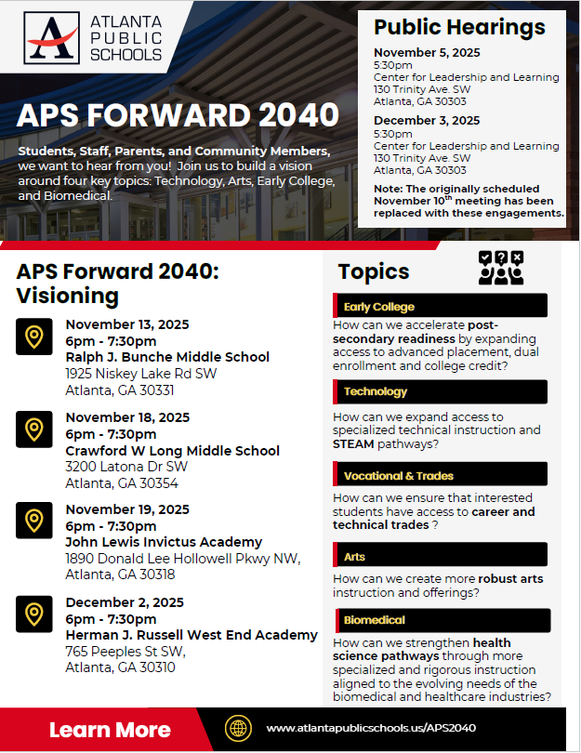

UPDATE
Comprehensive Long-Range Facilities Plan
www.atlantapublicschools.us/APS2040
Notes:
Next on our agenda, we’d like to welcome our representative to the Long-Range Comprehensive Facilities Master Plan Taskforce. As many of you know, this taskforce plays a key role in shaping the future of our district’s facilities — ensuring they are aligned with projected enrollment, instructional needs, safety standards, and long-term community use."
Over the summer, the taskforce has been hard at work reviewing data, exploring options, and engaging in important planning conversations. [Name of Representative] will share an update on what’s been done so far, any key decisions or recommendations that have been made, and what’s ahead — including opportunities for the public to provide input.
[Allow the FMP representative to provide an update and answers questions. After this is concluded:]
Thank you [Name of Representative].
A report will be presented to the Board at its August 11 meeting, and the options will become public the week of August 18.
There are several upcoming public meetings where you can learn more and share your thoughts. The next public meetings are scheduled for: August 25, October 20, and November 10
On each date, there will be a virtual meeting at noon and an in-person meeting at the Central Office at 6PM.
I strongly encourage you all to attend these meetings. This is a critical time for public input, and your voice is essential.

Slide 30

Announcements
STEAM Website
Map/Amira Testing 12/1-12/25
EOTM Assembly 12/19/2025
Winter Break 12/22/2025-1/5/2026
MLK Day (Observed) 1/19/2026
Hundredth Day of School 1/21/2026

Slide 31
Thank you

