Slide 1



K-2
FIREARM SAFETY

Slide 2

ANNOUNCEMENT
Per TCA Code Annotated 49-6-1016(b), beginning with the 2025-2026 school year, each LEA and public charter school shall annually provide students with age-appropratie and grade-appropriate instruction on firearm safety. The instruction must begin with the earliest appropriate grade, as determined by the departments under sub section (a), and must continue in each subsequent grade through grade twelve (12).

Slide 3

INTRODUCTION

Slide 4
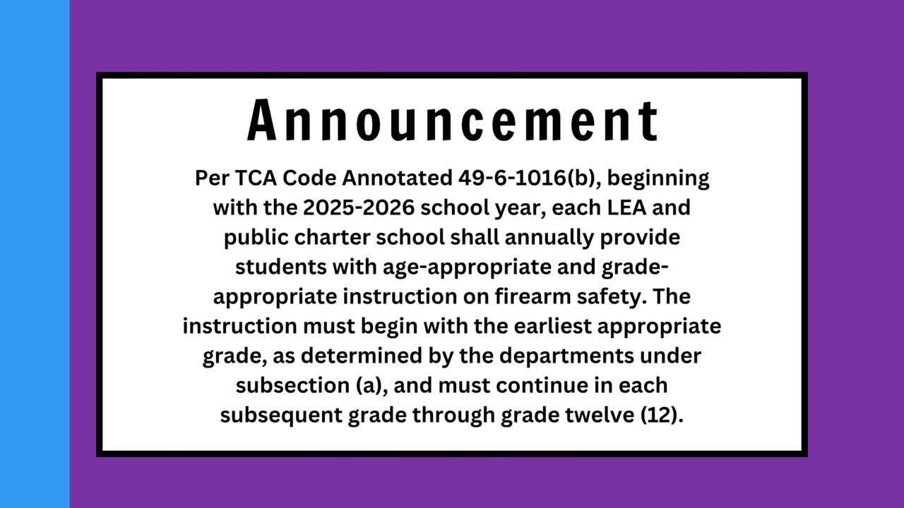

Slide 5

QUESTIONS?

