Slide 1

Getting Started in
Competition

Slide 2

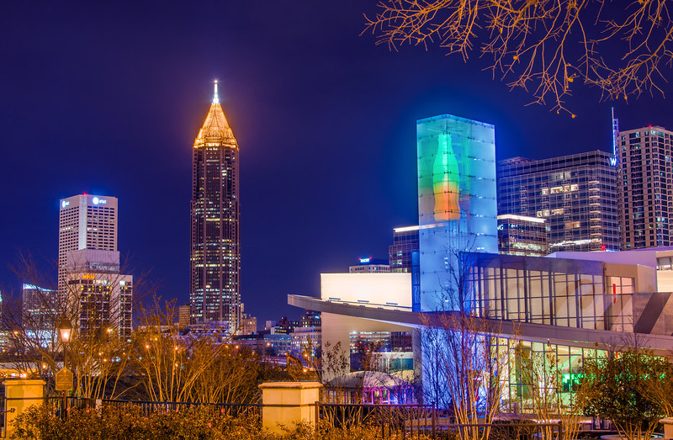
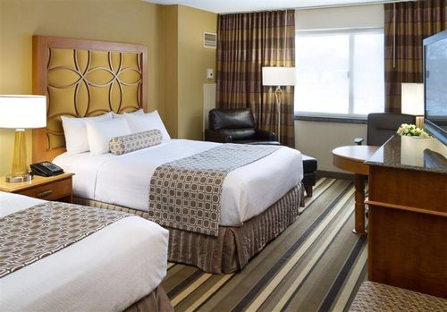
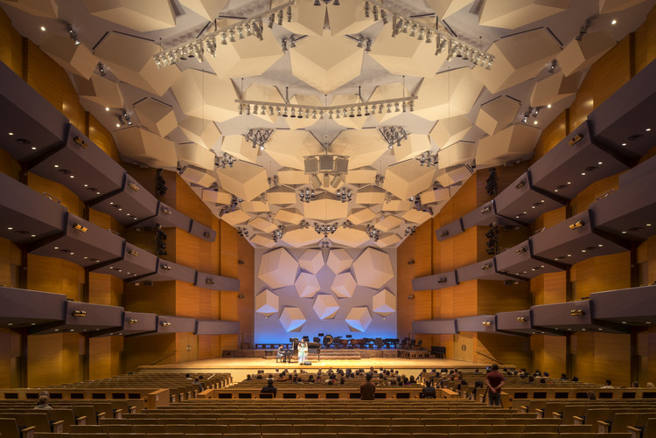
Levels of Competition
  District
  February 10-12
  Plymouth, MN
Crowne Plaza
State
March 4-6
Minneapolis, MN
Hyatt Regency
  Internationals
  April 21-24
  Atlanta, Georgia

Slide 3
Districts is about…
Competition
Activities
and
Fun!
The Events
Preparation
Confidence
Judges
Appearance

Slide 4
The Competition

Slide 5
Required Events
Three Categories of Events
A Events
B Events
C Events
You will need to choose an A, B, and C event

Slide 6
Required Events
Three Categories of Events
A Events
B Events
C Events

Slide 7
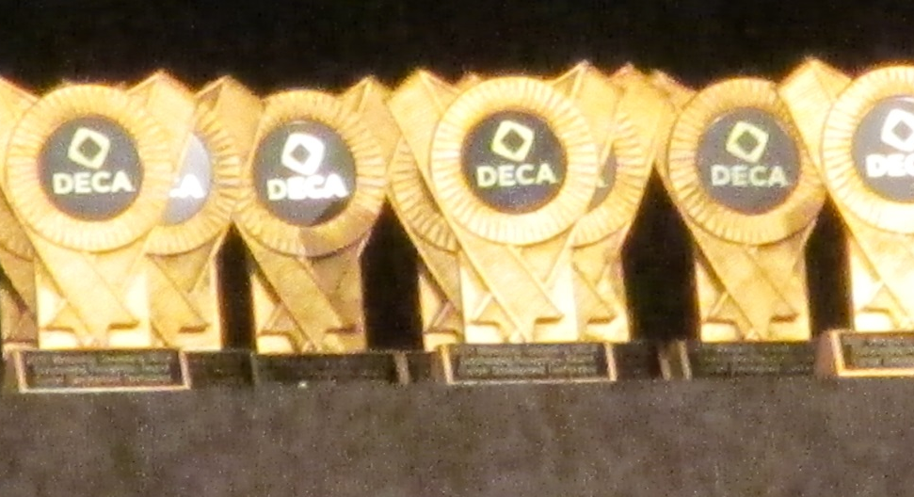

Level A Events
Also called State Only or Skill Events
Performed at district and state levels
  Can NOT advance to compete at the international conference
You have the opportunity to compete in one event from this category.

Slide 8
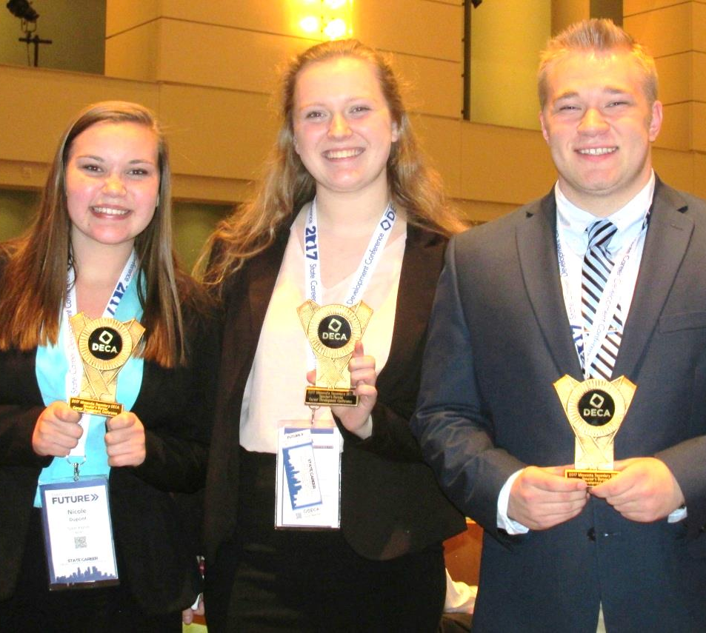
Level A Event Choices
Sales Demonstrations
  Hard Lines
  Soft Lines
  General/Home Service Lines
Employment Interviews
  Entry and Advanced Levels
    Seniors must choose advanced level
No partners for these events

Slide 9
Sample Competition Room Layout and Tips
Competition Rooms
  In most cases, it will be just you and the judges
Arrive ten minutes early
Check-in with event coordinator
Sit in a holding area
  Prepare and practice
Go in and meet your judges
  Make a good impression

Slide 10
Sample room layout for an interview or sales demonstration
C
D
B
A

Slide 11
Questions about level A events?

Slide 12
Required Events
Three Categories of Events
A Events
B Events
C Events
You will need to choose an A, B, and C event

Slide 13
Required Events
Three Categories of Events
A Events
B Events
C Events

Slide 14
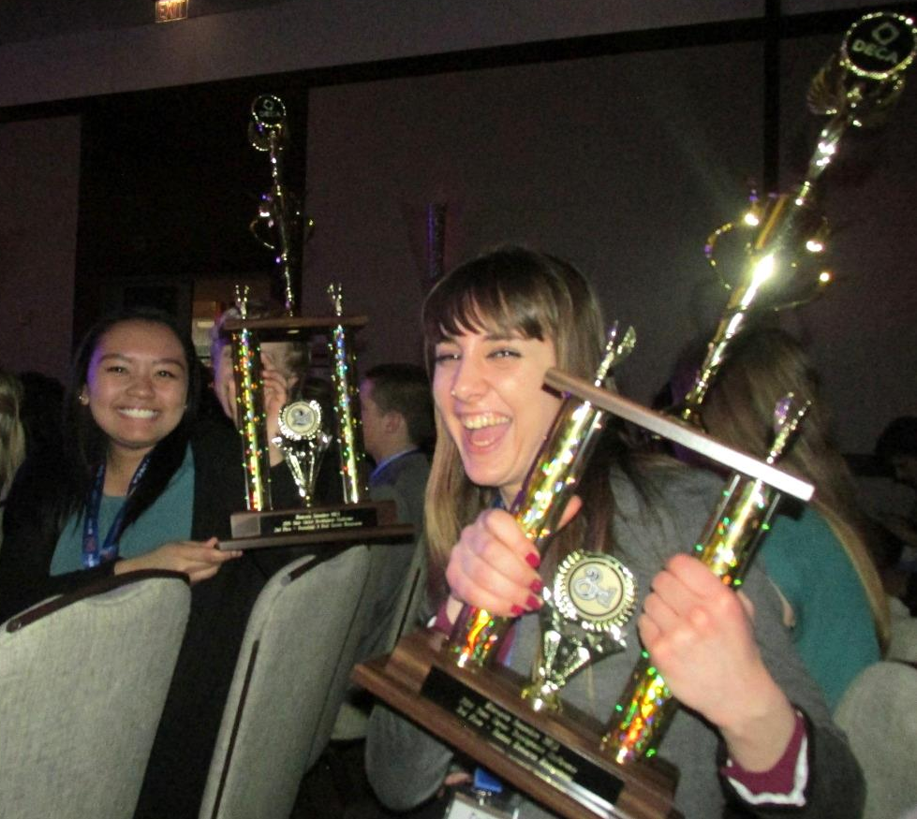
Level B Events
Also called Role Plays
  Team, Individual, and Principles role plays
What are role plays?
  Scenario in which a business problem is given to you
  You (and a partner, for team role plays) are given a short amount of time to solve the problem
  You will then present your solutions to a judge in a role playing situation
These are district, state, and international level events.

Slide 15
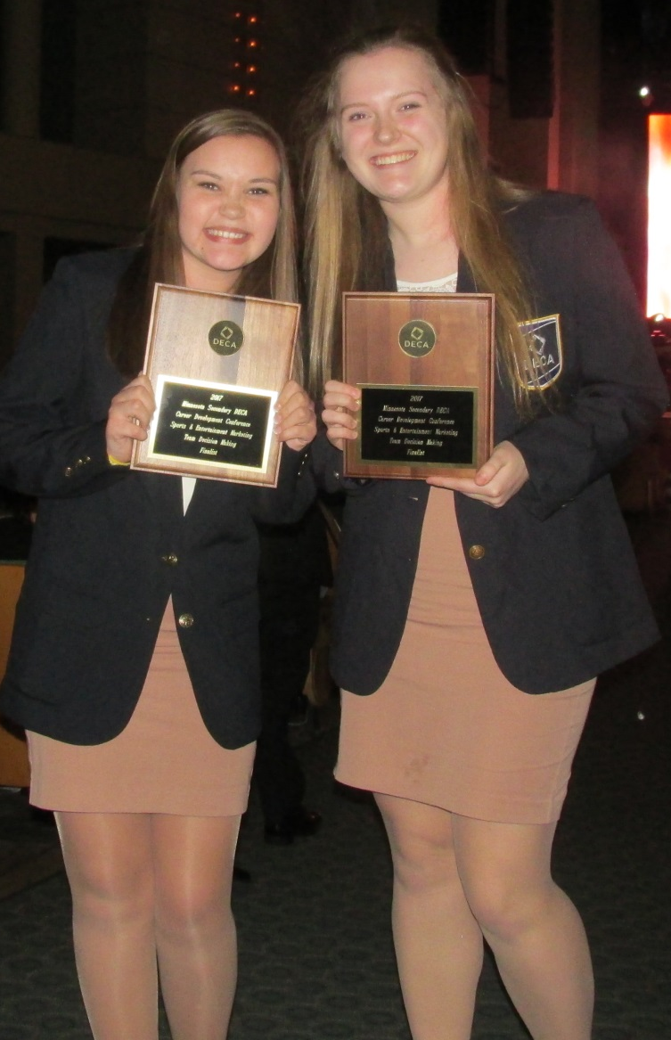
Options for Level B Events
Individual
  No partner for this category
Team
  One partner for this category
Principles of Business
  Option only for first-year DECA members only
  No partner
There are many different business areas for role plays
  If you have a job or interest in one of those areas, compete in it.

Slide 16
Sample room layout for Team Role Play
Judging Room
Prep Room

Slide 17
Questions about B level events?

Slide 18
Required Events
Three Categories of Events
A Events
B Events
C Events
You will need to choose an A, B, and C event

Slide 19
Required Events
Three Categories of Events
A Events
B Events
C Events

Slide 20
Level C Events
Also called Prepared or Written Events
Many of these events involve a written plan and presentation.
You can have 1 to 3 DECA members per group for many of these events.
You can compete in these events in the district, state, and the international levels.
You are allowed to compete in only one of these events.

Slide 21
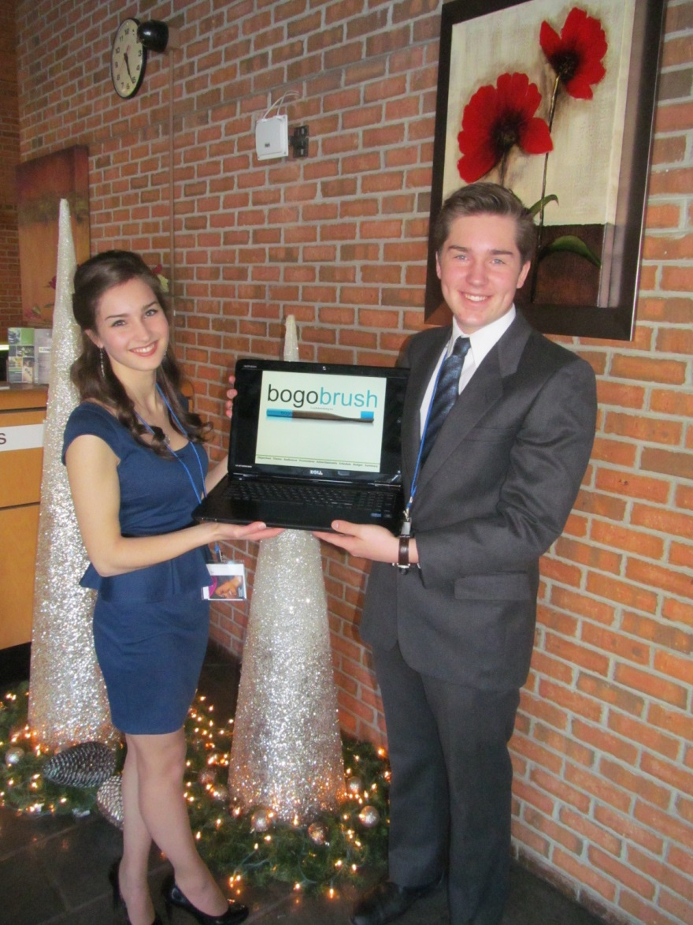
Options for Level C Events
Advertising Campaign
  Create and present a campaign for a real product, service, or business.
  Written Plan
  1 to 3 members per group for this event.

Slide 22
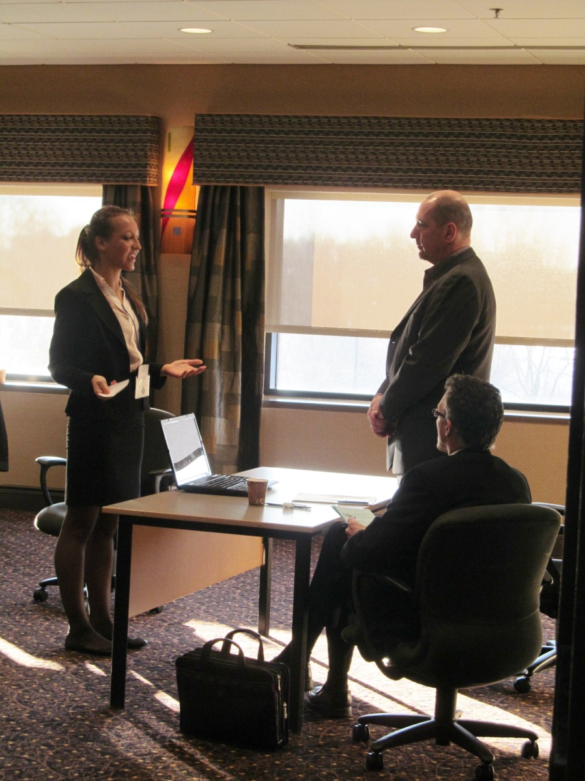
Options for Level C Events
Sports & Entertainment Promotion Plan
  Create and present a promotion plan for an entertainment or sporting event
  Written Plan
  1 to 3 members per group for this event.

Slide 23
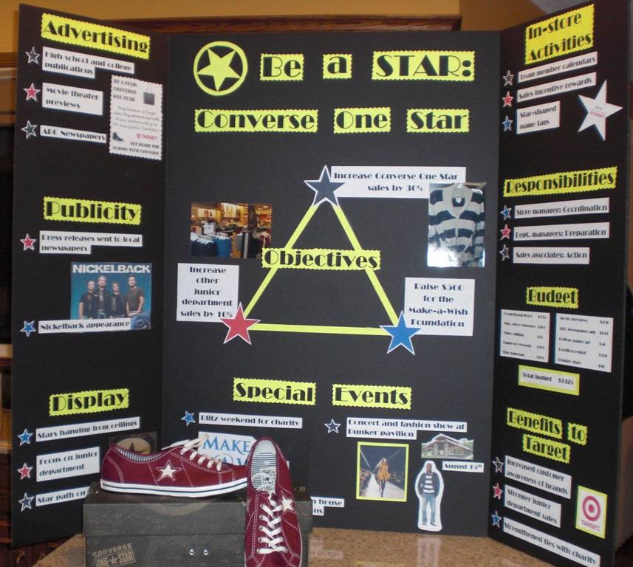
More Options for Level C Events
Fashion Merchandising Promotion Plan
  Present a sales promotion plan, using apparel and accessory items only, for a retail store
  Written Plan
  1-3 members per group for this event

Slide 24
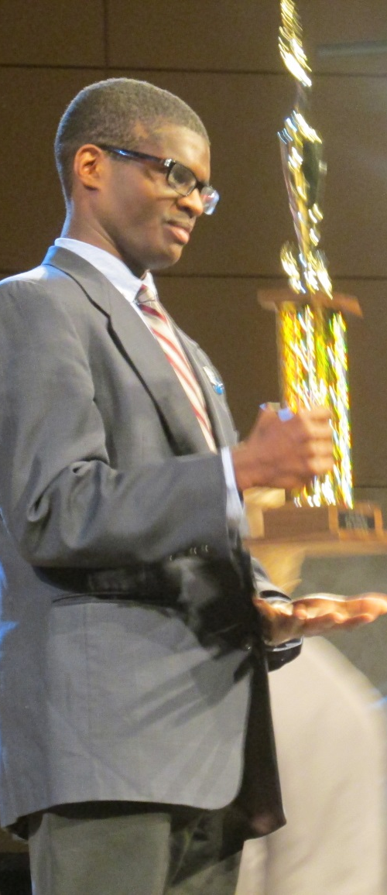
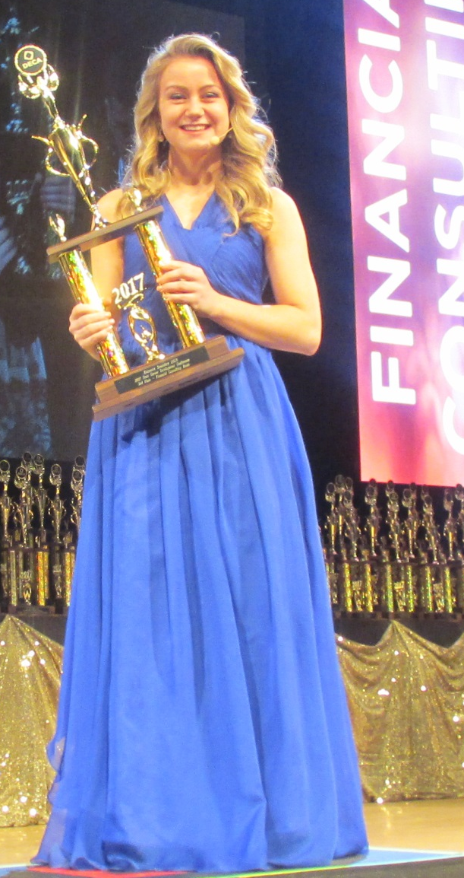
More Options for Level C Events
Professional Selling Event
Hospitality and Tourism Professional Selling Event
Financial Consulting Event
  Organize and deliver a sales presentation for a specified product or service
  No written plans for these events
  No partner allowed for these events

Slide 25

More Options for Level C Events
Research Events
  Business Services
  Buying and Merchandising
  Finance
  Hospitality and Tourism
  Sports and Entertainment Marketing
Choose a business from any of these categories, conduct a survey, record data, and present your recommendations
1 to 3 DECA members per group

Slide 26
More Options for Level C Events
Entrepreneurship Events
Written Plan & Presentation to an investor
1-3 members per group
  Independent or Franchise Business Plan
    Majority of the score comes from Written Plan
  International Business Plan Event
    Majority of the score comes from Written Plan
  Start-up Business Plan
    Majority of the score comes from presentation
  Innovation Plan Event
    Take advantage of a marketplace opportunity for an existing business
  Business Growth Plan
    Must be an owner of a real business

Slide 27
Questions about level C events?

Slide 28
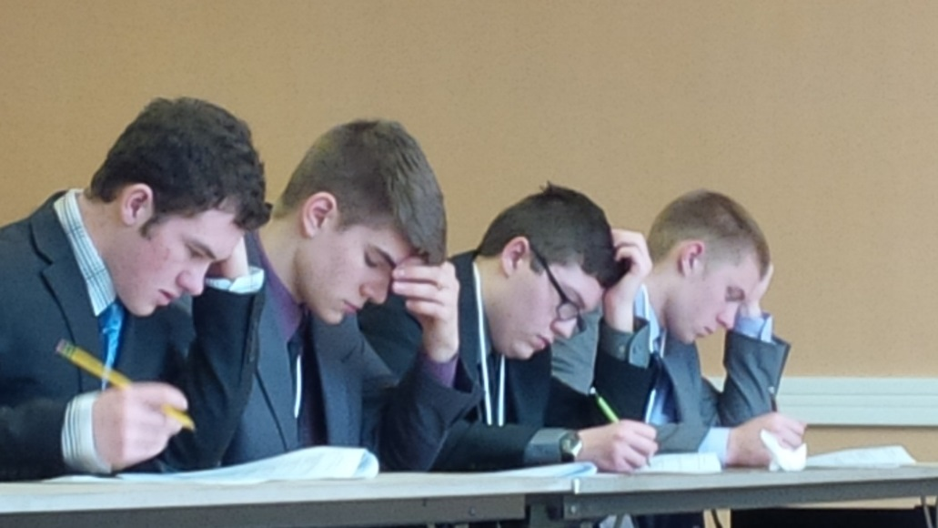
The Comprehensive Exam
Before the conference you will be taking a test that influences your
  Level B Role Play
  Level C Written Event scores
General Marketing Exam districts only
Practice Exams/Kahoot!/Flash Cards/Quizlets
100 multiple choice questions
1 hour to complete
Materials allowed:
  #2 pencils
  Eraser
  4-function calculator

Slide 29
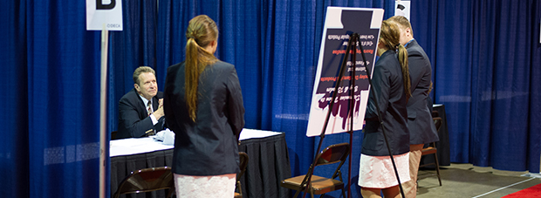
Judges
Judges are qualified mature adults that want to volunteer
  parents
  relatives
  neighbors
  co-workers
  employers…
Must be out of high school for two years
Expertise is helpful but not necessary
  For every three competitors CRHS needs to find one judge.
  This will end up helping you.
You will get 10 lettering points for each judge
  Maximum of 20 points

Slide 30
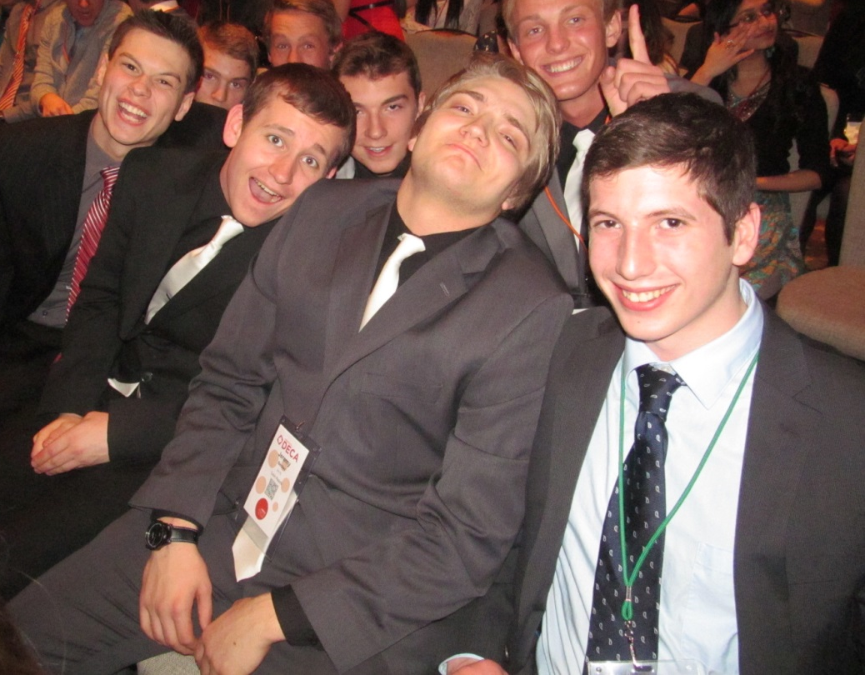
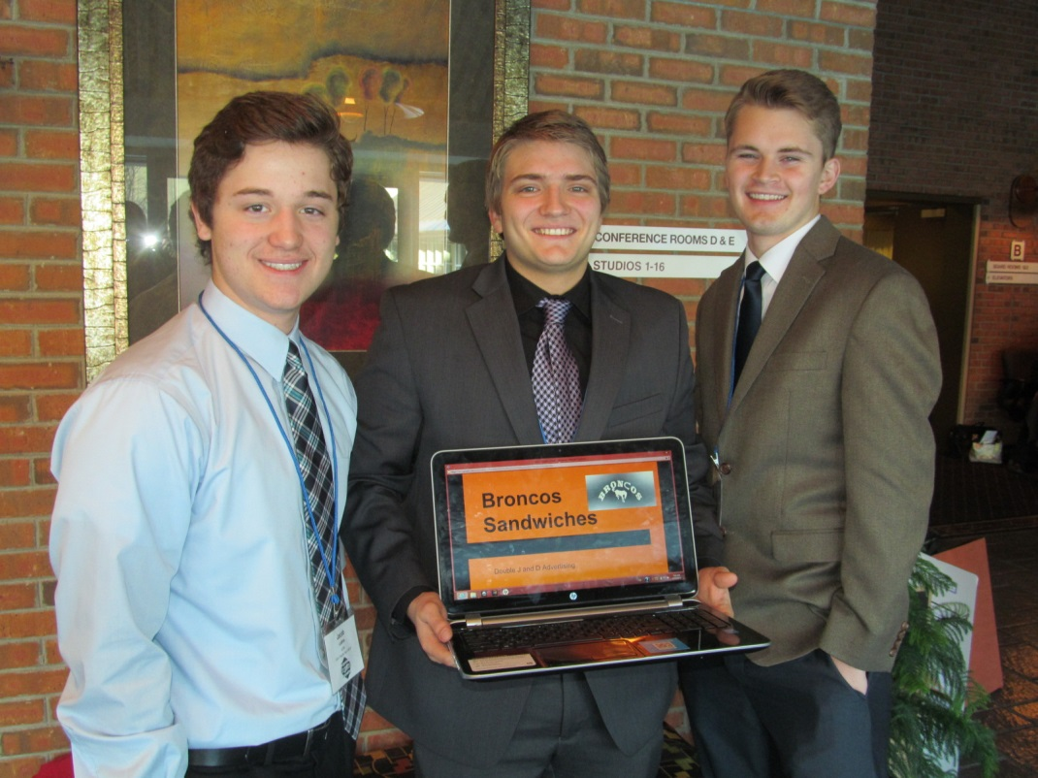
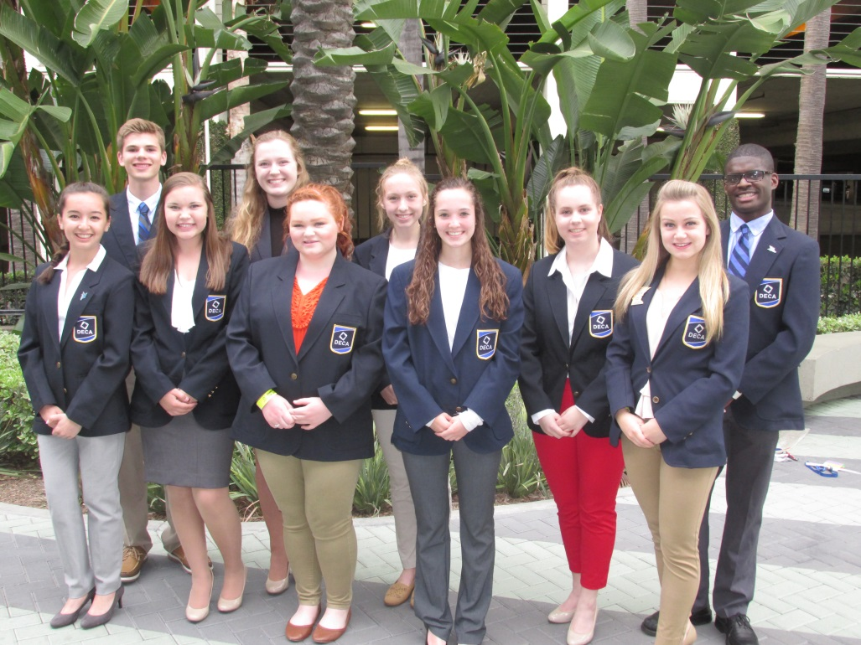
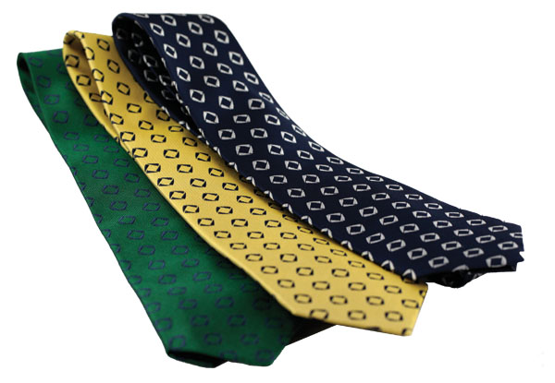
Attire
Dress is business appropriate
  Closed-toed shoes with socks or nylons
  Dress pants or skirt
  Dress shirt or blouse
    Ties and belts are required for guys
Hair and makeup
  Should not be a distraction from your face
  Shave
Piercings and Jewelry
  Rule of 1
Comparison of dress between district and state, International CDCs
  District 60% suits and jackets
  State 90% suits and jackets
  International 100% DECA Blazers

Slide 31
Questions about competition?
Three Categories of Events
A Events
B Events
C Events

Slide 32
Other Activities at Districts

Slide 33
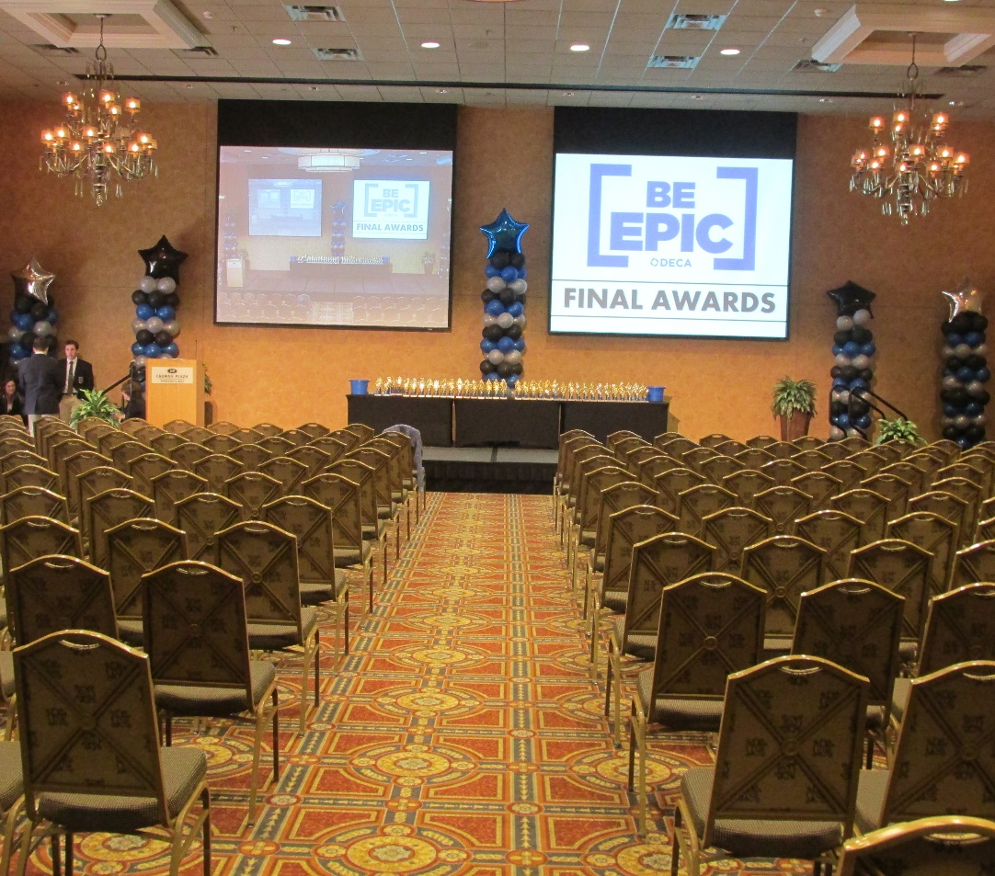
After-Competition Activities
Opening, Finalist Announcement, and Final Awards Sessions
DECA Cup Events
Entertainment
Sunday Brunch
Sunday Dinner
Scavenger Hunt
Sunday Pizza Social
Monday Brunch
Chapter Meetings

Slide 34
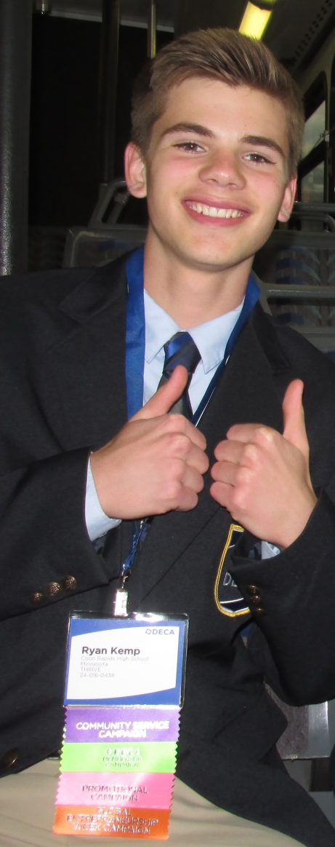
FAQ About Districts
I have a few questions!
Q: How much does it cost?
  A: Price is $175
    Competition/Testing Materials
    Mock competition (January)
    Includes 2 night hotel stay
    4 Conference meals
    Confernce Registration cost
Q: How many events will I be in?
  A: Three. One from each category.
Q: What do I need to wear?
  A: Two days worth of business clothes.

Slide 35
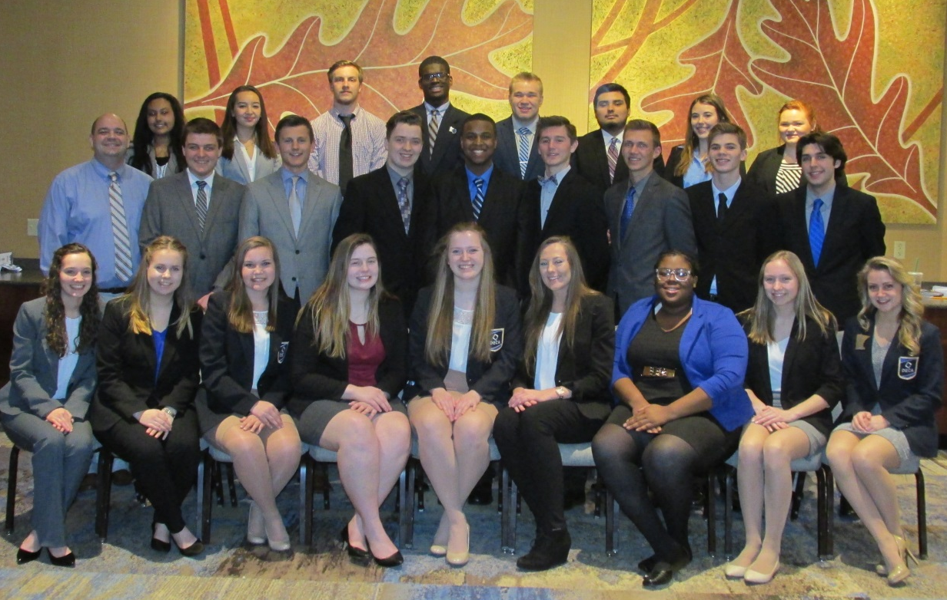
FAQs about Districts
Q: How do I qualify for the state competition?
  A: You need to place
  1st, 2nd, or 3rd in one event, or place in the top 10 in two separate events
  Have a exam score
  above: 65/100
  You must also receive a invitation to attend the state conference from Mr. Bodenburg!

Slide 36
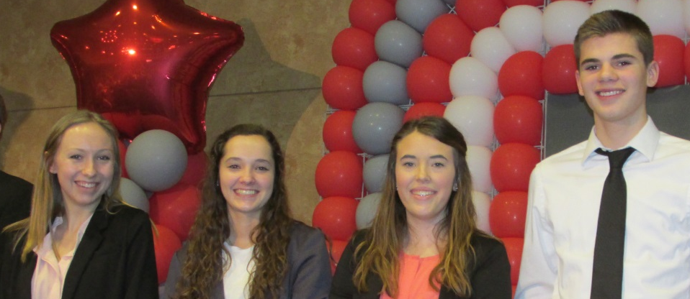
What Should I Do Next?
  Choose an A, B, & C Event
  D Level Events (requires Mr. Bodenburg’s approval)
  Carefully choose partners
  Match your strengths and compatibility
  Consider outside of school commitments
  Work ethic of partners
Turn-in competitive event selection form to Mr. Bodenburg
Event instructions and a practice schedule will be out next week
Start making connections and finding judges NOW!

Slide 37
Final questions?
It’s as easy as A, B, C

