Slide 1



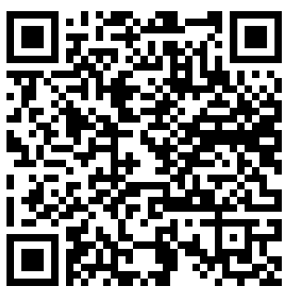
Pequea Valley
Get Your First Choice!
WHERE EACH LEARNER COUNTS
From Birth to 401K
Lay the Foundation of Your Future
Customize Your Learning Path

Slide 2
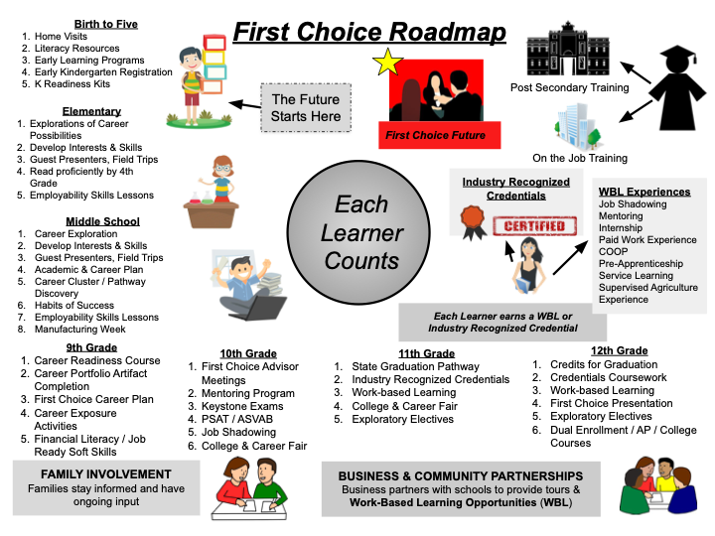

Slide 3
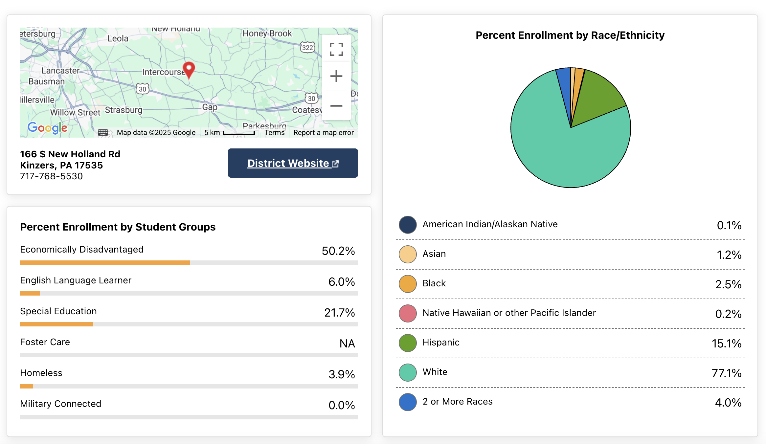

Slide 4

Attendance
PV - 88%
State Average – 80%

Slide 5
Graduation Rate
PV 4 Year Cohort – 96%
State 4 Year Cohort – 88%
PV 5 Year Cohort – 94%
State 5 Year Cohort – 90.55
% Acquiring Current First Choice

Slide 6
Career Ready Artifact Benchmark
(20 total by end of 11th)
PV Average – 100%
State Average – 92%

Slide 7
Industry Based Learning
Credentialing
First Choiced Aligned
PV Average – 99%
State Average – 41%

Slide 8
Industry Based Learning
Credentialing
OSHA – Ag/Constr./Healthcare
Basic Life Support
CPR Pro
Pet First Aid
ServSafe
PA Builders Association of Skills

Slide 9
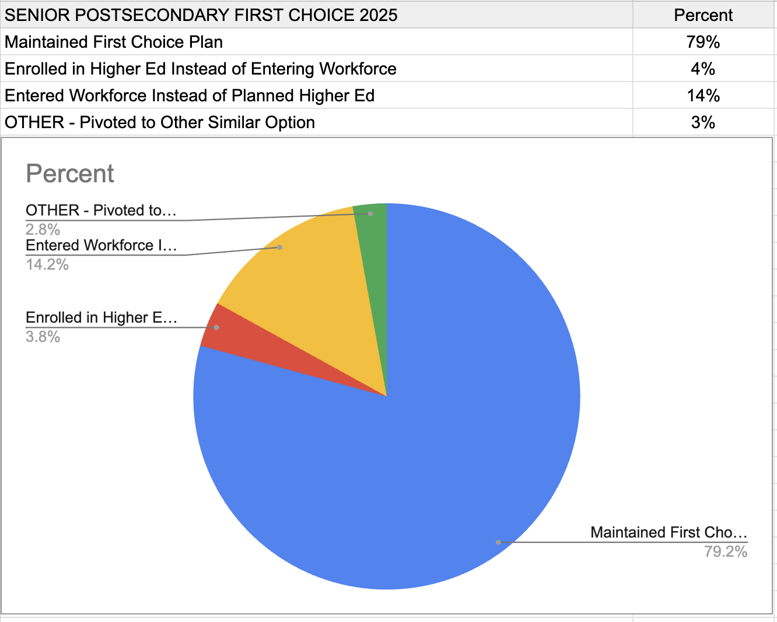
First Choice Data

Slide 10
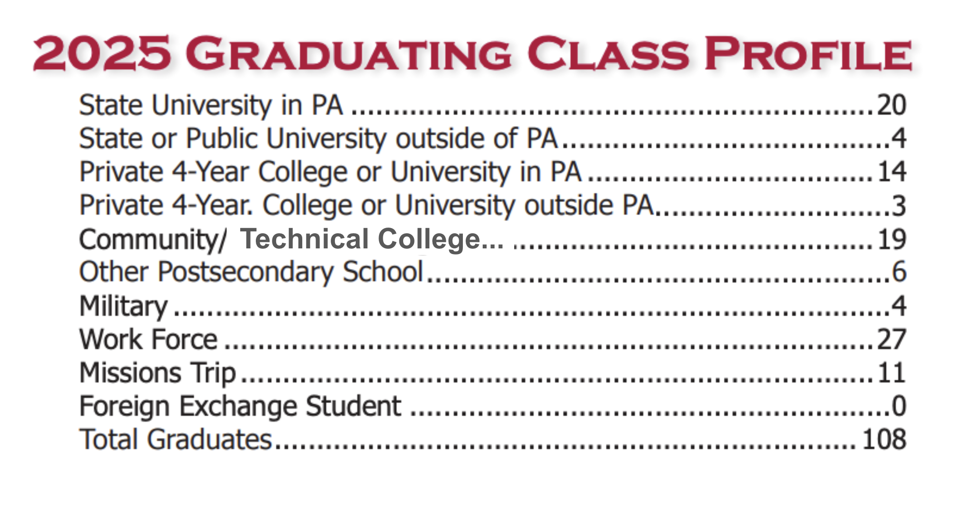
First Choice Data

Slide 11
PA Core State Mandated
Assessment Accountability
3-8th Grade ELA (3 days)
3-8th Grade Math (2 days)
5th and 8th Science (2 days)
Keystones:
Literature (2 modules)
Algebra I (2 modules)
Biology (2 modules)

Slide 12
El. English Language Arts
Proficiency/Growth
PV Elementary Average – 50%
State Average – 50%
-------------------------------------------
PV Elementary Average – 73%
State Average – 75%

Slide 13
El. Math
Proficiency/Growth
PV Elementary Average – 49%
State Average – 42%
---------------------------------------
PV Elementary Average – 76%
State Average – 75%

Slide 14
M.S. English Language Arts
Achievement/Growth
PV Average – 47%
IU13 Average – 49% (13th of 22)
State Average – 50%
------------------------------------------
PV Average – 76%
State Average – 75%

Slide 15
Act 135 and 47 Provision (2028)
PDE Requirements:
Approved:
PD Training
Curriculum Materials
Intervention Materials
Screeners

Slide 16
Act 47 of 2025
Act 47 of 2025, signed in to law in November 2025, codifies PDE’s commitment to structured literacy, requiring evidence-based reading curriculum, teacher trainings, early screenings, and targeted assistance to students with reading deficiencies.

Slide 17
Act 47 of 2025
PDE Requirements:
LEA’s must report to PDE the K-3 reading instruction curricula utilized during the 25-26 school year
LEA’s must identify a lead educator assisting each school with implementing evidence-based reading instruction curricula
LEA’s must report # of K-3 students identified as having a reading deficiency

Slide 18
Structured Literacy
Sound first systemic instruction
Data Informed instruction and progress monitoring
Clear routines for phonics, fluency, vocabulary, and comprehension
Decodable texts
High-frequency
Repeated modeled oral reading
Explicit writing instruction
Build background knowledge

Slide 19
PVSD MTSS Tiers Defined
Tier 3 ELA Qualifiers
K-1 Learner red for PA on mClass
Gr. 2-3 Red for NWF
Gr. 4-6 Red Composite
CLF input
Progress Monitor bi-weekly
Not Learners in Learning Support
Tier 3
Tier 2 ELA Qualifiers
Below proficient on formative & summative assessments
Orange or Red on MAP Growth
Yellow or Red on mClass, either composite score OR targeted area
Progress monitor at least once a month provided by homeroom facilitator using mClass
Tier 2
Whole group and small group instruction- hybrid model
ALL learners, regular and special education
Progress Monitor as needed
CKLA/Amplify Assessment
Tier 1
*Learners should move fluidly between tiers
Notes:
The classroom teachers progress monitor tier 2 kids once a month using M-Class.

Slide 20
PVSD MTSS Tiers Defined
Tiered Instructional Models
Tired Instructional Resources- ELA
High intensity pull out facilitated by MTSS Interventionist and Title Paras (when necessary). Daily intense, direct instruction with progress monitoring
95% Phonics
Heggerty Group
Tier 3
CKLA Assessment/ Remediation Guide,
mClass Intervention Toolkit (during E/I)
More focused skill groups across a grade level where possible
Intensified instruction through push in paras, and small group instruction lead by the classroom learning facilitator
Tier 2
High Qualified Core Instruction,
in regular education, all learners;
whole group, small group,
rotational model utilized
as necessary and
appropriate
CKLA Amplify (K-5),
Amplify ELA (Gr. 6);
Tier 1

Slide 21
M.S. Math
Achievement/Growth
PV Average – 25%
IU13 Average – 33% (16th of 22)
State Average – 42%
------------------------------------------
PV Average – 78%
State Average – 75%

Slide 22
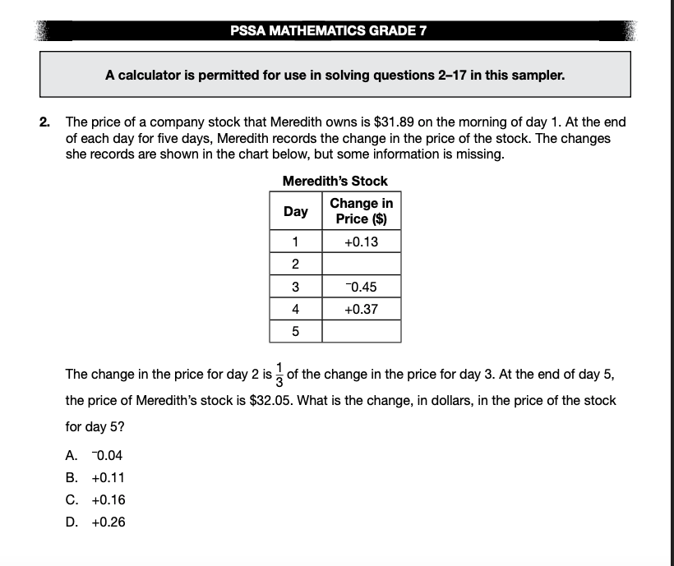
Item Sampler

Slide 23
Literature Keystone
Achievement/Growth
PV Average – 54%
State Average – 50%
--------------------------------------------
PV Average – 61%
State Average – 75%

Slide 24
Algebra I Keystone
Achievement/Growth
PV Average – 41%
State Average – 42%
- - - - - - - - - - - - - - - - - - - - -
PV Average – 100%
State Average – 75%

Slide 25
Science
New Implementation of STEELS (Science, technology, engineering, environmental literacy, and sustainability) Standards
*Therefore, assessment accountability waived. – No Data

Slide 26
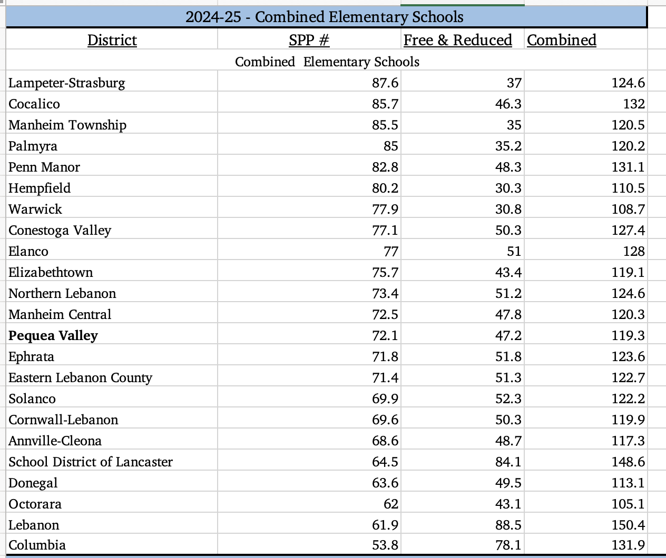
Overall Elementary Rating

Slide 27
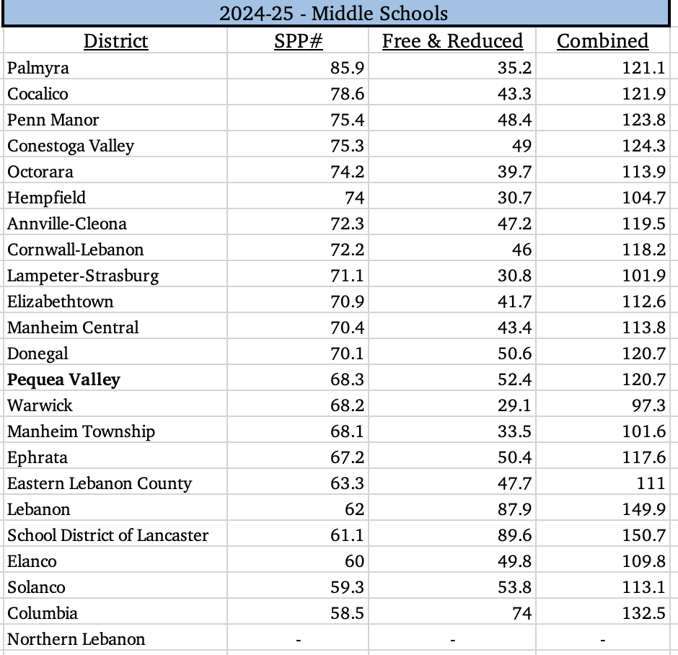
Middle School Overall Rating

Slide 28
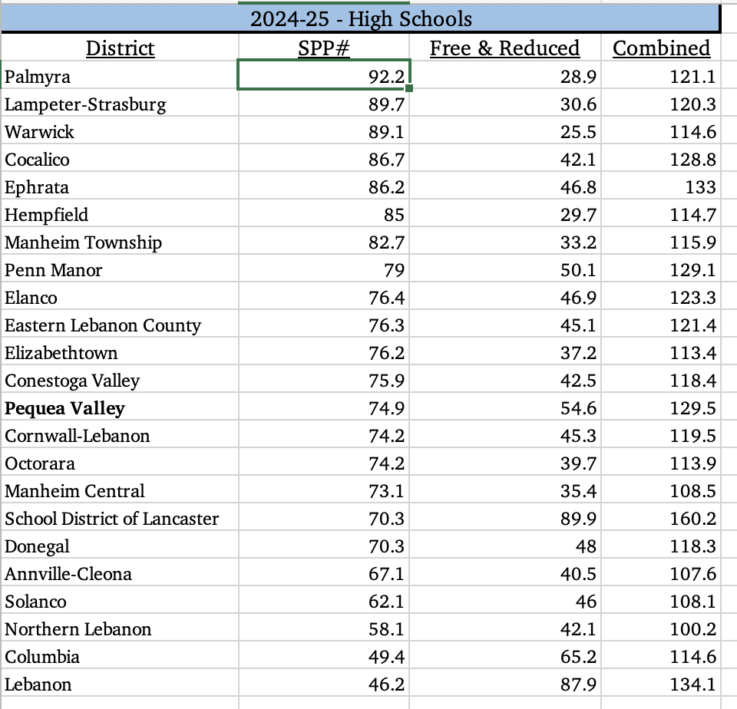
High School Overall Rating

Slide 29
AP Averages
AP US History – PV 3.75 / PA 3.51
AP Physics – PV 2.75 / PA 3.22
AP English Lit and Comp – PV 4.4 / PA 3.4
AP Computer Science – PV 2.25 / PA 3.3
AP Calc AB – PV 3.1 / PA 3.37
AP Stats – PV 3.6 / PA 3.22

Slide 30
Advanced
AP courses – 43 completed a course and AP exam
Harrisburg University – 12 learners
Dual enrollment – 22 learners

Slide 31
Pequea Valley
Get Your First Choice!
WHERE EACH LEARNER COUNTS
From Birth to 401K
Lay the Foundation of Your Future
Customize Your Learning Path

