Slide 1
Site council meeting
12-16-25

Slide 2


Agenda
Welcome to Site Council
Enrollment
Data
2nd Quarter Events/PTO
Looking Ahead
Tax Credit Vote
Questions, Thoughts, Concerns…

Slide 3
Site Council
Welcome
In-Depth Quarterly Summaries (State of the School)
Ideas and Discussion

Slide 4

Enrollment Update
Open-Enrollment: 435
In Boundary: 336
Year 1- 525
Year 2- 700
Year 3- 715
Year 4- 740
Year 5- 723
Year 7- 756
Year 6- 732
Year 8- 775
Year 9- 775
Year 10- 771

Slide 5
Congratulations
We are an
A-Rated School!

Slide 6
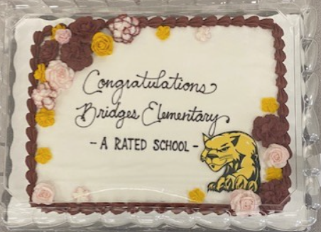
School Letter Grade- A!
Bridges has maintained an A-Rating since opening in 2016

Slide 7
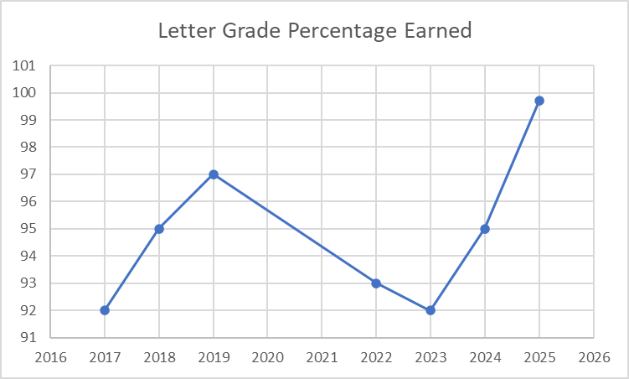

Slide 8
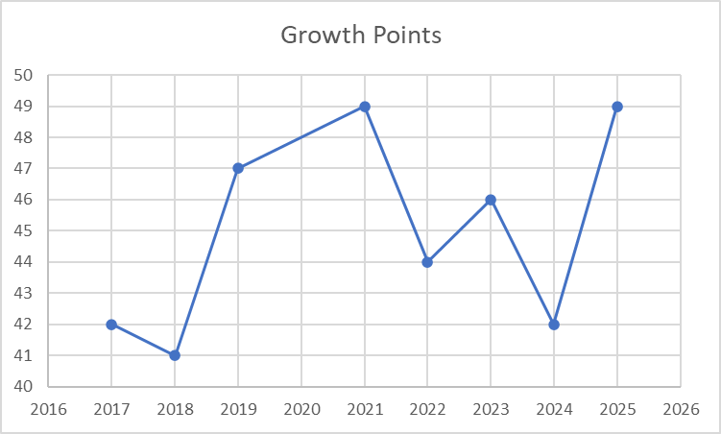

Slide 9
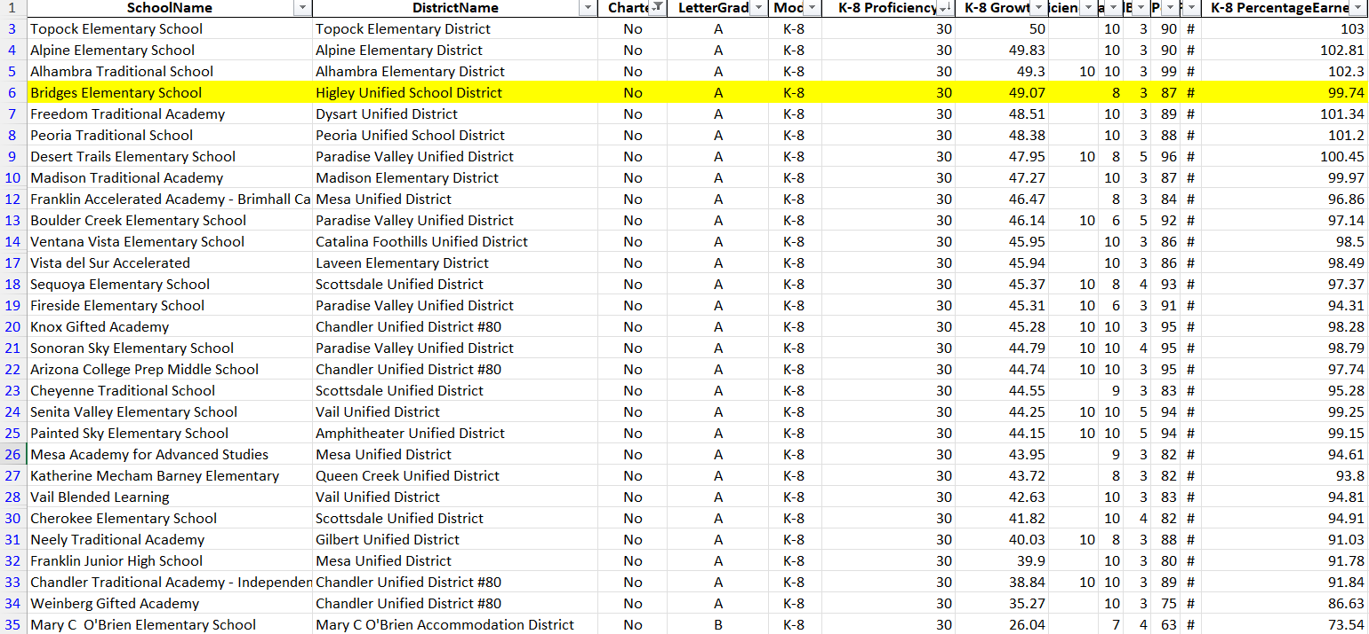
30/30 Proficiency and Growth Scores Comparison

Slide 10

School and district Rating- A!
Bridges was one of 13 HUSD schools rated an A
Our percentage of points has increased in comparison to the last 3 years (93%, 92%, 95% to now 99%)

Slide 11
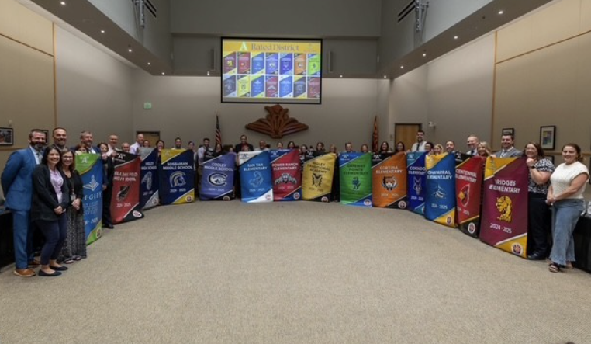
All A-Rated Schools in HUSD

Slide 12
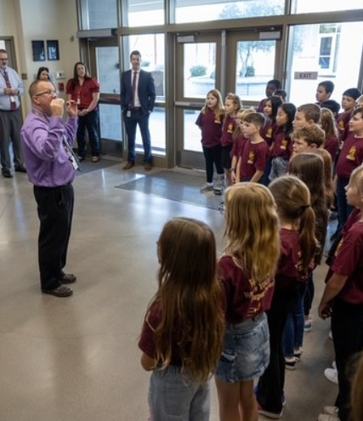
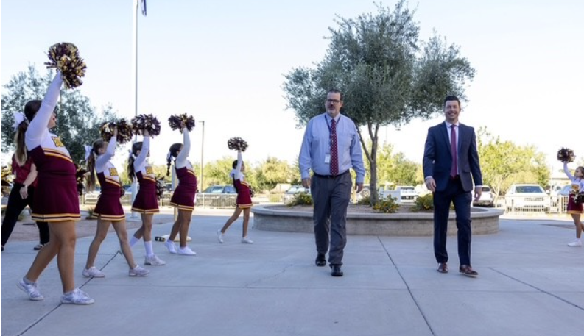
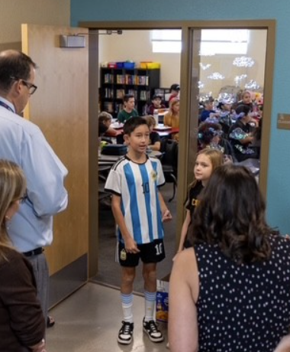
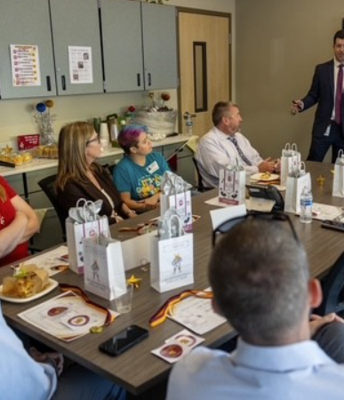
Superintendent’s Visit
Bridges was visited by HUSD Superintendent David Loutzenheiser, Cabinet, and Governing Board President Amanda Wade

Slide 13
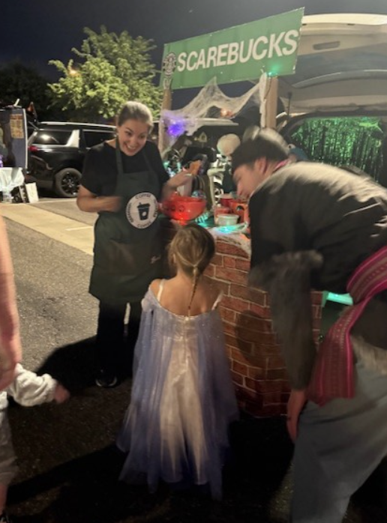
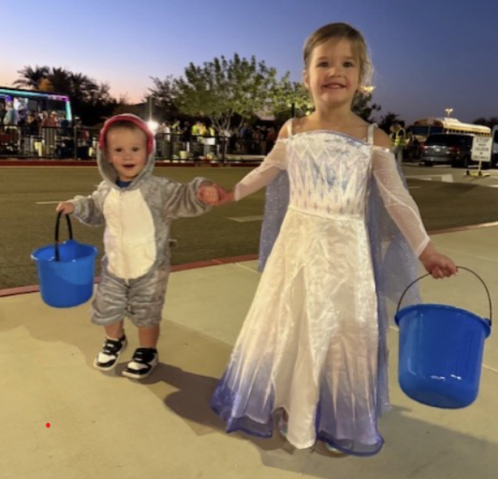
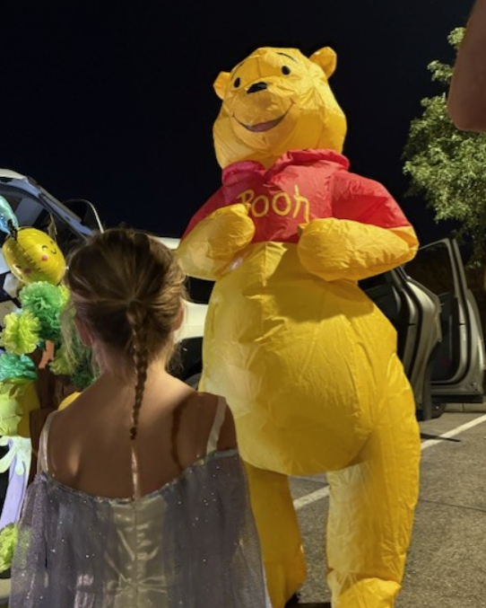
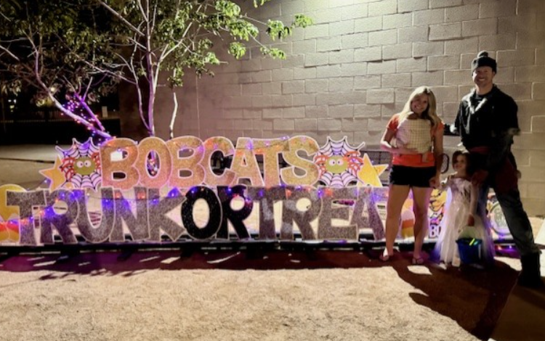
Trunk or Treat
Our biggest Trunk or Treat yet!
PTO rocked the event and threw a fantastic party to kick-off the holiday season

Slide 14
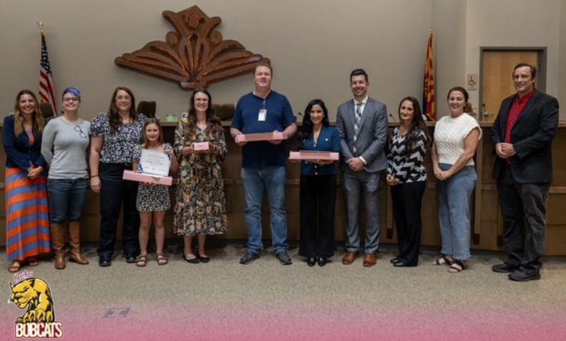
Points of Pride and staff of the month

Slide 15
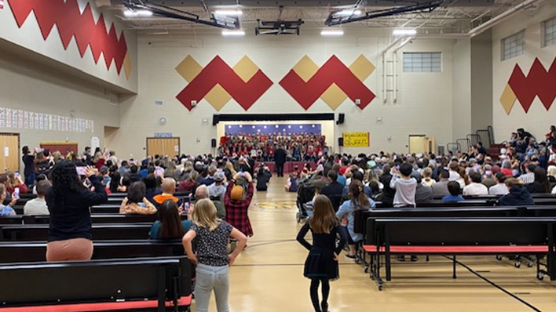
Concerts

Slide 16
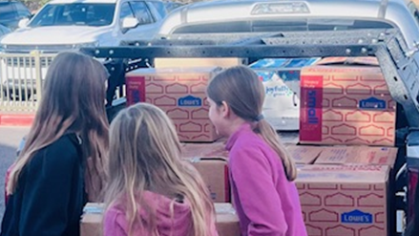
Food drive

Slide 17
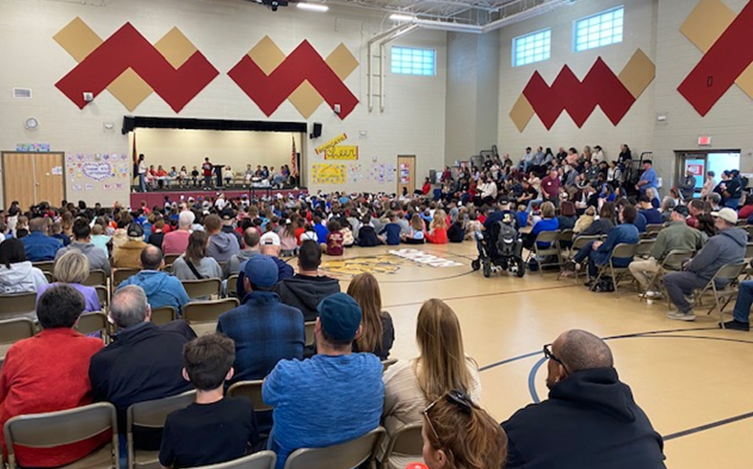
Heroes assembly

Slide 18

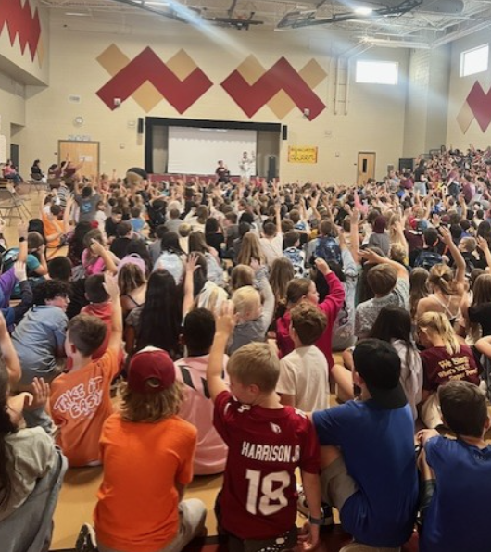
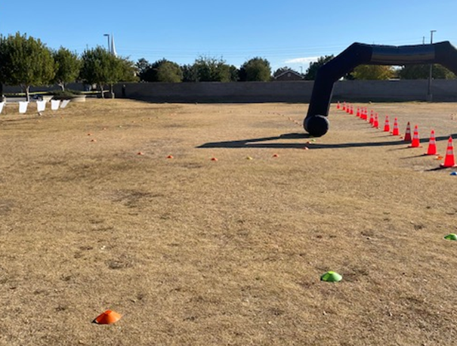
Cosmic dash fundraiser
Thanks to PTO’s dedication and hard work we raised nearly $75,000 for our school!

Slide 19
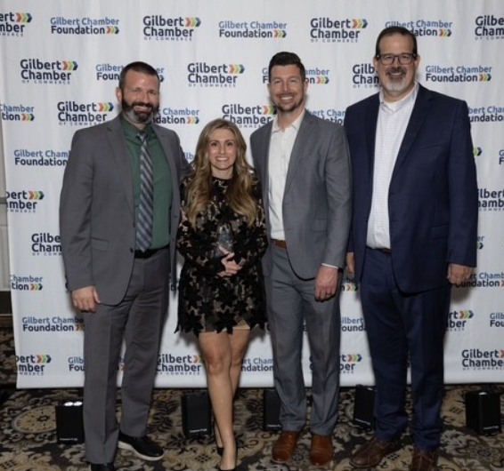
Gilbert Excellence Awards
Maggie Silva HUSD Teacher of the Year

Slide 20
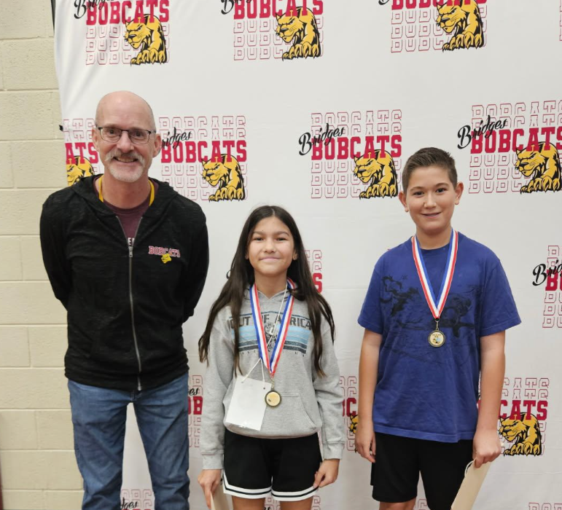
Spelling Bee
1st Place: Lyanna
Runner-Up: Jay

Slide 21
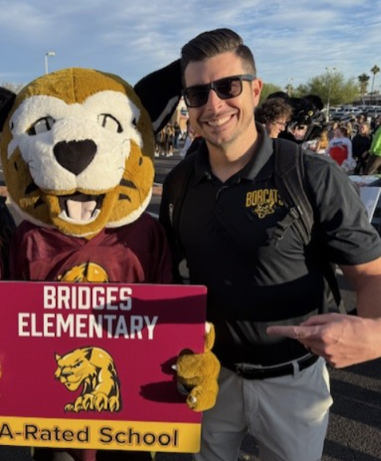
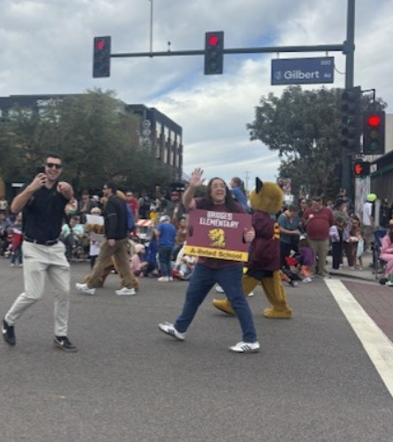
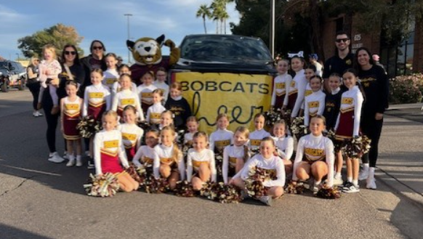
Gilbert Days Parade
Administration and Cheer Represented!

Slide 22

Holiday Movie Night

Slide 23

Positive Student Behavior Encouragement and Recognition Systems
Character Lessons- Specials Team
Ongoing Positive Recognition for Students
  Schoolwide expectation to submit Student of the Month nominations (resulting in 250+ for the year)
  Winners recognized in front of peers each month
  Medals given to winners
  Extra recess for winners
  Tracking system for SOM recipients for their years at Bridges
  Boo-Yah Tickets
  Stickers
  Sharing of ideas and best practices with between staff members

Slide 24
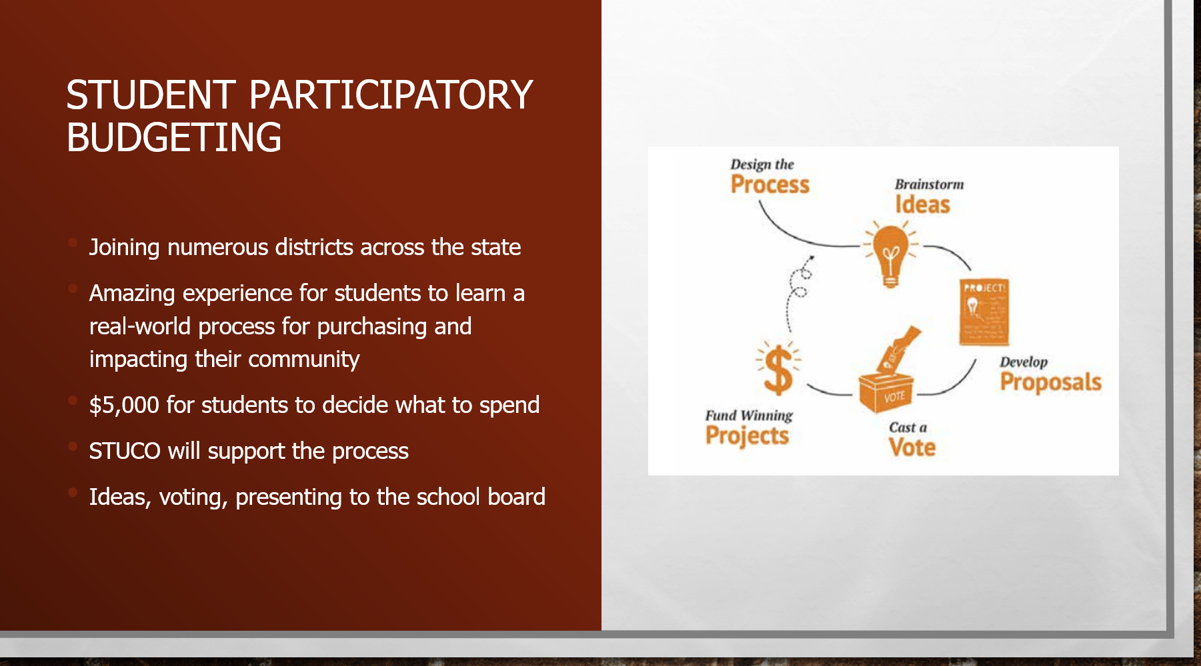

Slide 25
joy
Reconnect with your why: the purpose, passion, and relationships that brought you to education.
Define your why more specifically this year to anchor your mindset and stay centered amid daily challenges.
Choose JOY by focusing on what fulfills you: our work is meaningful and deeply missed when it’s gone, as shown by Todd Berg’s return.

Slide 26
Grit/growth mindset
We overcome adversity not by avoiding it, but by responding with resilience, growth mindset, and a focus on what we can control.
GRIT and continuous learning must remain part of our DNA: we're playing the infinite game of always getting better.
Stay grounded in the Circle of Control: focus on your actions, words, and mindset, and let go of what’s beyond your reach.

Slide 27
professionalism
Professionalism is the foundation of long-term success: model consistency, collaboration, and integrity daily.
Elevate each other through positive support, teamwork, and commitment to shared goals (all build up all).

Slide 28
Targeted, intentional and engaging instruction
Deliver thoughtfully planned, differentiated instruction using data and PLC collaboration.
Use added ELA and Math minutes for impactful Tier 2/3 instruction, and small groups.
Small group instruction will be a point of emphasis this year, and ideally will be seen during observations
Continue our PBL and STEAM focus with four projects annually, Makers' Place time, and a revitalized STEAM Event.

Slide 29
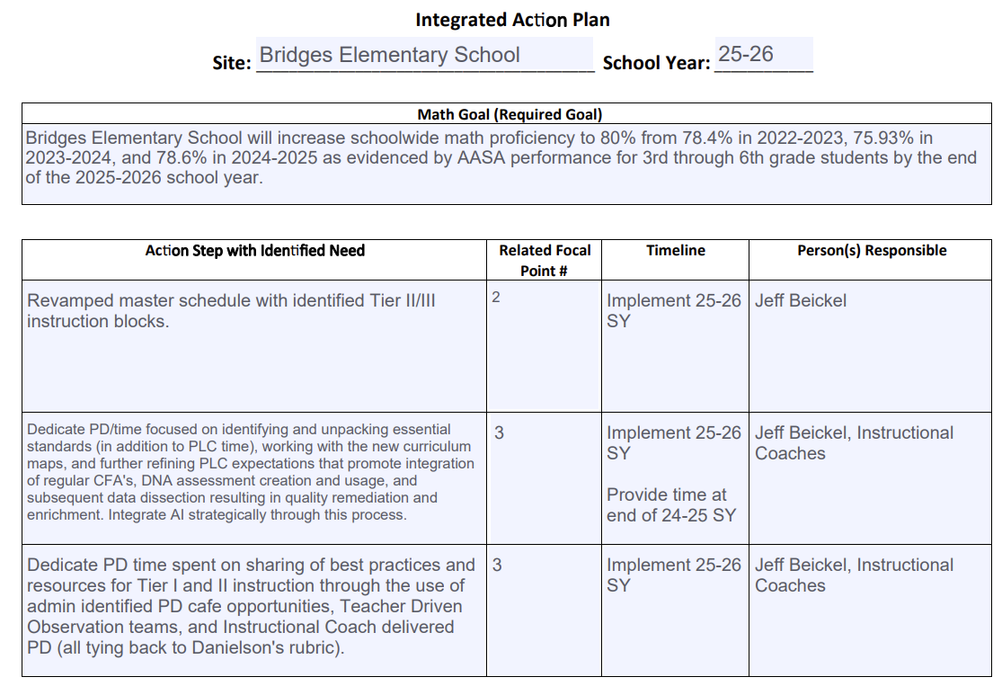

Slide 30
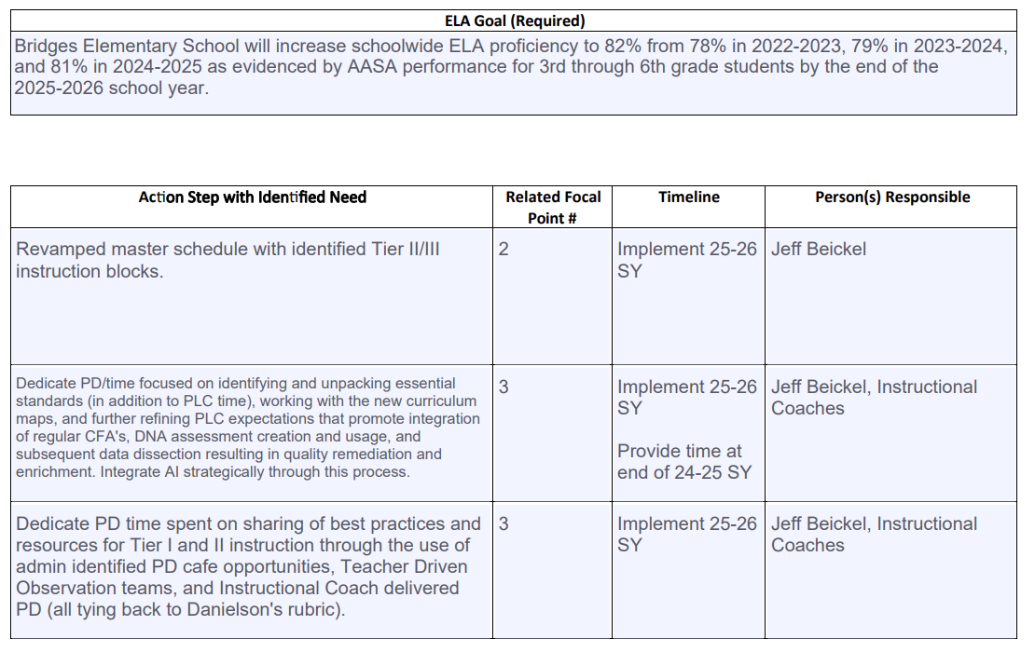

Slide 31
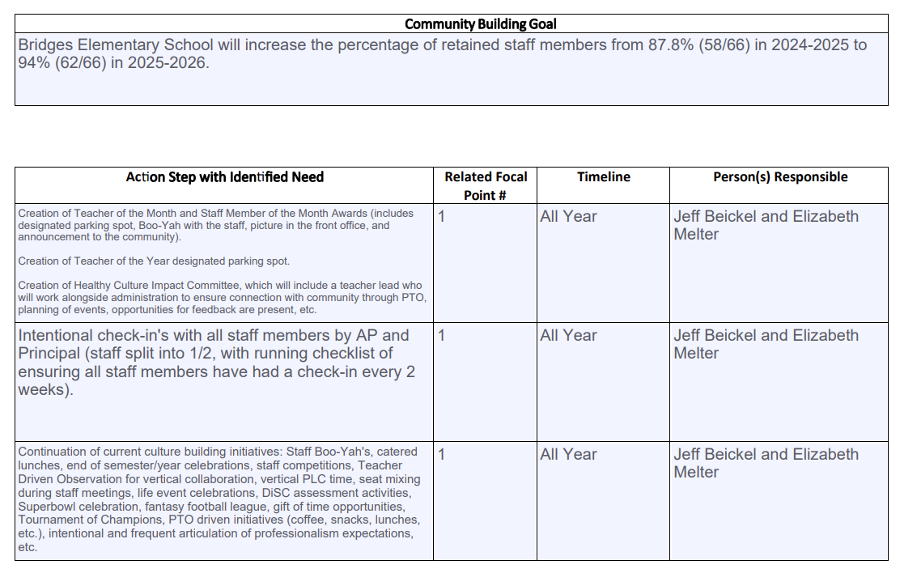

Slide 32
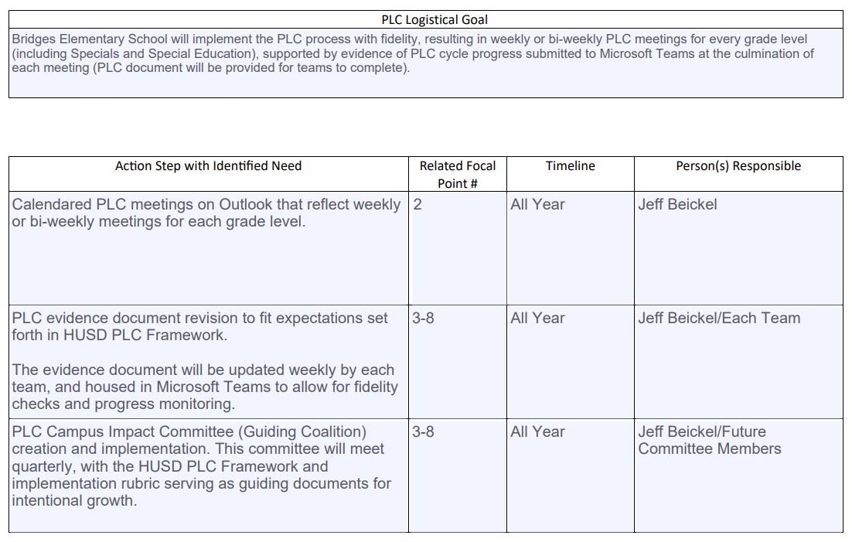

Slide 33

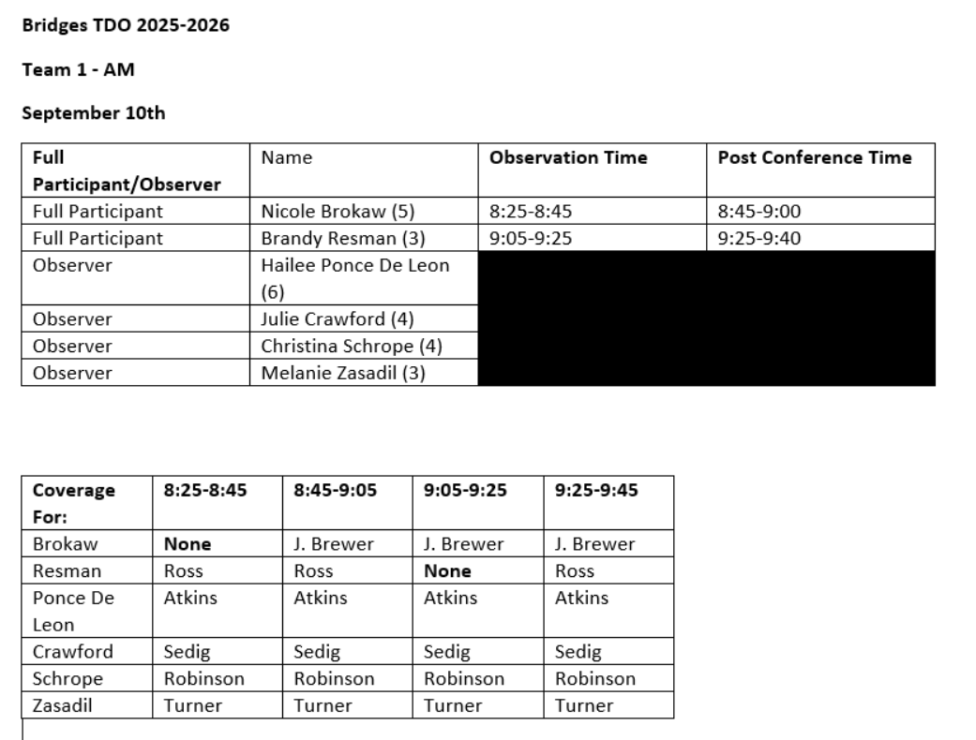
Teacher driven observation
Every Bridges teacher will participate in TDO this year
Takes place on Wednesdays with a New team of teachers (approximately 5-8 per group) during each rotation

Slide 34
Campus Impact committees
Leadership Team
PLC IMPACT Committee
Healthy Culture and Climate IMPACT Committee
MTSS-B and Safety IMPACT Committee
STEAM/PBL Future-Focused Instruction IMPACT Committee

Slide 35
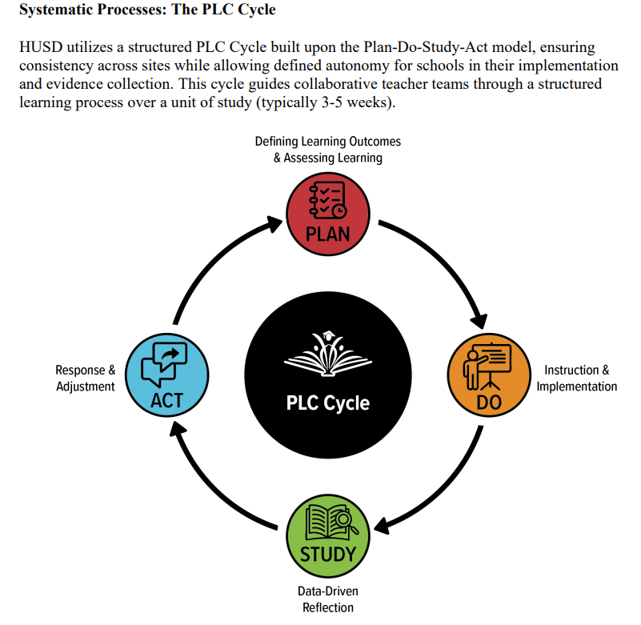

Slide 36
Where do we go from here?
Continued emphasis on positive connections between all humans on campus (staff, students, parents, community)
Ensure all students are growing
Targeted instruction to fill gaps, reinforce, and enrich:
Ongoing and targeted cumulative review
Reincorporation of target standards
Creation and implementation of CFA’s
Utilization of modified intervention systems based on achievement data

Slide 37
Looking ahead
Variety Show
Locked in Academics
Clubs
Science Center STEAM Day

Slide 38
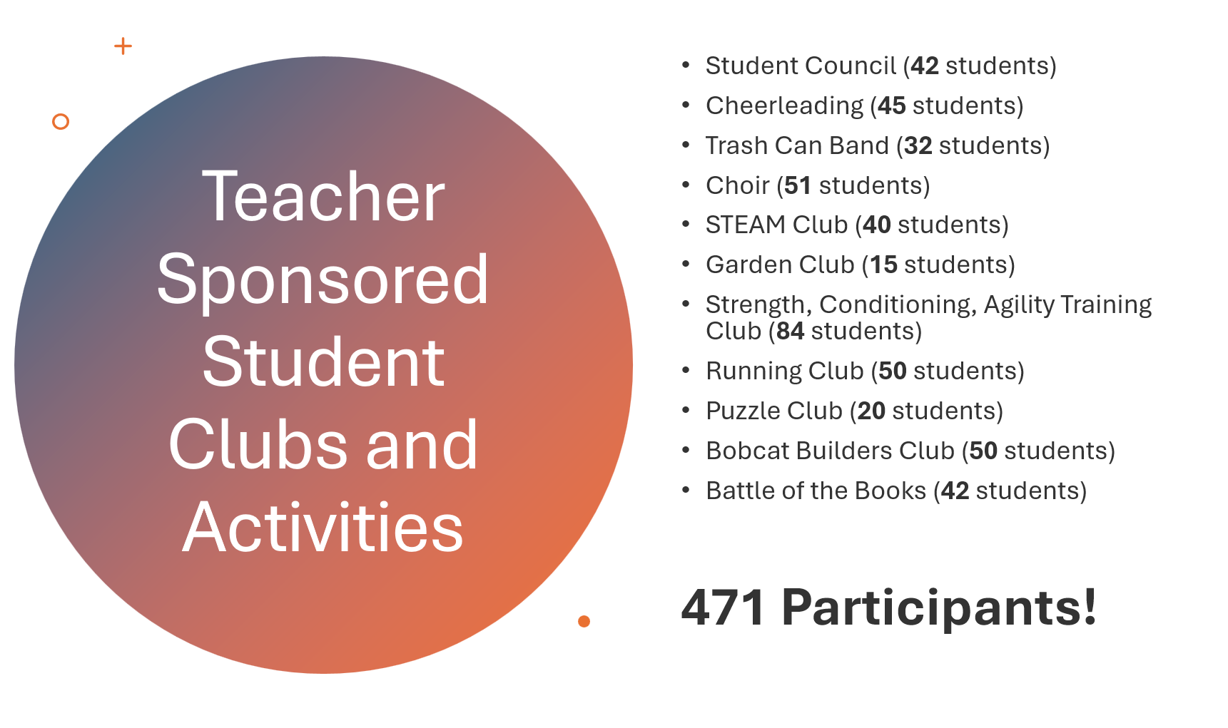

Slide 39
Tax credit vote
Club Advisor Stipends
Moore and S. Hamman - Garden Club - $531.00 each
Resman and C. Henze - STEAM Club - $505.50 each
Total amount = $2,073.00

Slide 40
Questions, Comments, thoughts?
Thank You For
Your Time!

