Slide 1
Associated Student Body (ASB) Compliance
2024-25 School Year

Slide 3
Presenter
Natalie Wells, CPA, CFE
Manager –
Fraud and Forensics

Slide 4

Examples of Schemes to avoid
Over $200,000 of cash was missing or not deposited.
The ASB Bookkeeper did not perform bank reconciliations, keep proper support documentation for receipts, or store money in a safe.
Purchases were made with undeposited funds.
Cash receipts were deposited but not recorded.

Slide 5

Examples of Schemes to avoid
$12,000 went missing from a high school.
The ASB Bookkeeper was at fault and blamed it on two students.
Coaches were interfering with the use of student funds.
Bank reconciliations were not being performed.
Fundraising forms were missing.

Slide 6

Examples of Schemes to avoid
No theft occurred…however, 5 years of ASB transactions were missing.
An $80,000 unresolved discrepancy existed between the bank balance and the book balance.
The problem cost the district $50,000 in CPA accounting fees.
The district reimbursed the ASB for some clubs overspending $25,000 worth of items that went undetected.

Slide 7

Learning Objectives
Creating an ASB or Club
Cash Receipting
Fundraising
Sports
Ticket Sales
Expenditures
Monthly Reconciliation
Booster Club Basics

Slide 8

Creating an ASB or Club

Slide 9

Purpose of an ASB
Promote the general welfare, morale, and educational experiences of the student body.
Great Outcomes:
  Field-trips;
  Class projects;
  School improvements;
  Class and school activities.
Board approval required for entity and bank account.

Slide 10

Unorganized VS. Organized ASB
  ORGANIZED
  Student council responsible for making decisions.
  Necessary approvals for
    adoption of budget,
    approval of expenditures,
    authorization of fundraising activities.
  Meeting minutes are required!
  UNORGANIZED
  Students do not govern the ASB organization.
  Principal is the Administrator, unless stated by the Board.
  Allowed to have clubs…could result in more administrative tasks.

Slide 11

Governing Documents
Some organizations have a constitution only, some have bylaws only, and others have both. In any case, it's important to keep the bylaws separate from the constitution because they change more frequently.
Constitution
The constitution outlines the fundamental principles of an organization, such as its membership, elections, finances, and discipline. It's a higher authority than the bylaws, and the bylaws must comply with it.
Bylaws
The bylaws are the detailed rules and procedures that govern the day-to-day operations of an organization.

Slide 12

Questions to consider for Governing documents
Will the current bylaws allow for prevention and / or early detection of fraud?
What is the disposition of funds when a club dissolves or a class graduates?
Are the ASB activities distinctly separate from Booster organization activities?
Is there a statement describing the funds the organization is allowed to accept?
What is the procedure for amending the Constitution and / or Bylaws?

Slide 13

What is the CLUB’s PUrPOSE and scope?
Plan anticipated club purchases.
Identify expenses that are not allowed in the governing documents.
Is the club’s purpose/scope permitted to change?
Does the club operate within the district’s jurisdiction and scope?

Slide 14

So, what can go wrong?
Old or outdated governing documents are not kept.
Governing documents are not updated yearly, resulting in possible loopholes for fraudsters.
Principals of Unorganized ASB programs fail to monitor the program.
Items are purchased for clubs that are outside the scope.
Records are not kept in accordance with the record retention policy.
Students are not aware of the content of governing documents and can’t enforce it.

Slide 15

Record
Retention
Permanent – Electronic Formats Permitted:
  ASB Constitution, Bylaws and Charters.
  Equipment Inventory.
4 Years:
  Club and Council Minutes.
  Budgets.
  Invoices and Approval Documents.
  Bank Statements, Deposit Slips.
  Cancelled Checks and other Banking Records.
  Financial statements and other Accounting Records.

Slide 16

Pop Quiz #1
What is the main factor in an Organized ASB program?
The students are governing the program. They make all the decisions.
Can a scope for a club be updated?
Yes, but how to do that is written in the Constitution.
How long must the records for the ASB program be kept?
4 years

Slide 17

Receipts

Slide 18

BASICS of receipts
Lock cash in a safe, even for brief periods of time unattended.
  That way, it will be there when you return!
Validate all transactions with two people
  Always have a witness present.
Properly approve documents with authorized signatures.
  An audit trail is designed to protect you and others.
  An audit trail makes it easier to detect fraud and mistakes.

Slide 19
Segregation of duties - ARC
A
Authorization/Approval
R
Recording
Are you recording anything?
C
Custody/Cash
Are you touching the money?
Are you approving or reviewing anything?
No one person should have two or more of these letters. If they do, a FRAUD RISK exists and should be eliminated by updating the process.
Example of an opportunity for fraud when an individual collects and records money. The person could collect $10 and record $5.

Slide 20

Master Receipt Book Log-Main Office/ASB Bookkeeper:
  Issue receipt book to all active teachers and advisors:
    Record name, class/club and receipt number series in log.
    Collect receipt books:
      Before issuing new receipt book.
      At year-end and log them..

Slide 21

The levels of the 3-tier receipt book
White Copy = Issued to the person who provided the ASB program with the money.
Yellow Copy = Issued internally to the person in charge of depositing the funds.
Pink Copy = Remains in the receipt book. There is no reason these should be removed. If they have been, treat this as a huge red flag.

Slide 22

Electronic Payments:
Personal Party Managing
  Venmo
  Paypal
  GoFund Me
  Zelle
Third Party Managing
  GoFans
  Ticket Spicket
  Honey Ticket
  Credit Card Companies
Internal Controls
  All electronic payments are required to be recorded in the accounting system.
  Support documentation is required for all transactions that use electronic payment.
  No disbursements should be made through the Personal Party Tools.
  Explicit approval is needed to use electronic payments.

Slide 23
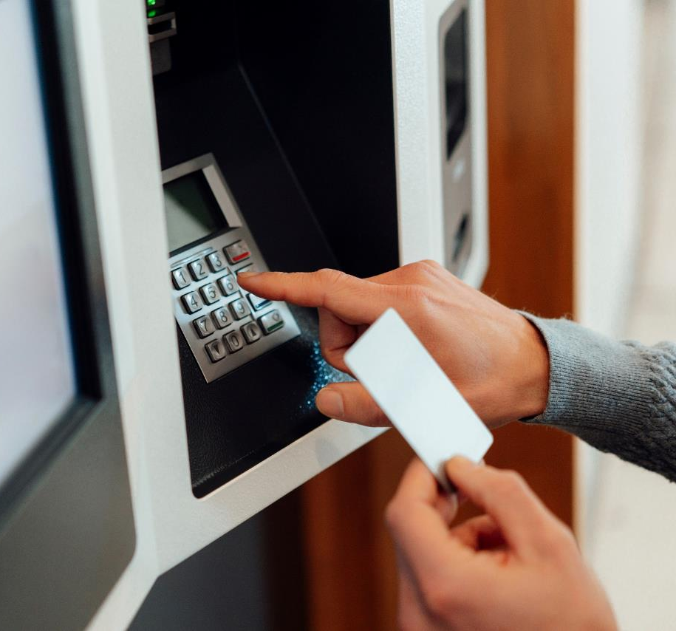
Pop quiz #2
What is the timeline your District requires for ASB Programs to have receipts deposited into the ASB Account?

Slide 24

ASB ACCOUNTING 101 – Cash Receipts
Require mandatory check-ins with the undeposited funds account!
Receipts should be documented.
The public provides funds to the ASB Program for a specific purpose, but it is not deposited yet.
  Increases the undeposited funds balance.
This means that the ASB program owes the money for that specific purpose.
  Increases the club liability account for the purpose.
When the funds are deposited into the bank…
  Increases the cash account and decreases the undeposited funds balance.

Slide 25

ASB Bookkeeper: Receipts and Deposits
Deposit is verified:
  Cross out the “unverified” on the receipt.
  Put “verified" on the receipt & initial.
  Give a copy of the verified receipt to the teacher/advisor:
    Discrepancy noted - contact the teacher/advisor before finalizing verification.
    Verification should be performed by end of day.
  File Cash Count Sheet & sub-receipts and secure cash in safe.
    Do not place paperwork and money in the safe together.

Slide 26

ASB Bookkeeper: Receipts and Deposits
All deposit paperwork must be filed:
  All sub-receipts.
  All class rosters/cash logs.
  All cash count sheets.
  All receipts & ten-key tapes.
  Bank deposit slip.
  Bank deposit receipt.

Slide 27

ASB Bookkeeper: Receipts and Deposits
It is recommended to have a combination safe and not a key safe.
Have a limited number of individuals that know the combination. If the money goes missing, make the suspects or persons to interview small.
Organize the safe as best as you can.
Examine and completely empty the safe once a year (recommended to do at the end of the school year).
Do not have multiple safes. This could cause confusion of where the money is being kept.

Slide 28

So, what can go wrong?
Money is missing with no audit trail.
Receipts are not properly recorded in the system.
Deposit amounts do not match the bank statement deposits.
Cash receipts are recorded incorrectly as income, instead of as a liability to the club accounts.
Cash is being collected and stored, with no support documentation that supports the transaction.
Cash is undeposited in the bank, remaining in the local safe, creating a theft opportunity.
Money is not stored in a filing cabinet, when it should be in a safe.
Checks are being held for other deposits.

Slide 29

Pop Quiz #3
Where is the pink copy for the receipt book supposed to go?
  It should remain in the book.
District policy does not address electronic payments. Can I use electronic payment transaction processes?
  No. It is only allowed when the District policy explicitly permits.
What is one of the best ways the ASB bookkeeper can protect themselves from false accusations of fraud?
  Documentation proving money was received or deposited.
What happens when the ASB does not have support for a deposit?
  Not having support for a deposit is important to research and should not stop until resolved. The site principal should be notified and be involved when other avenues are exhausted. If nothing can be found, this would be a sign of potential fraud or, at the very least, poor chain of custody of cash.

Slide 30

Fundraising

Slide 31
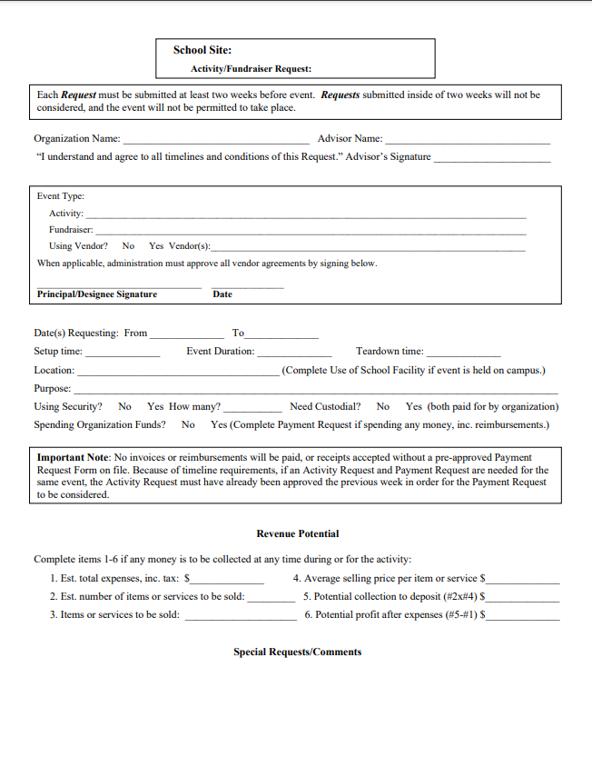
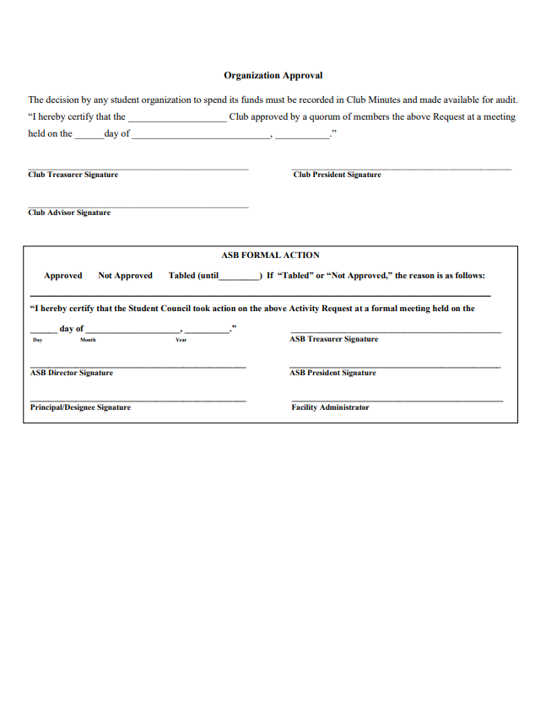
Activity Request– Unorganized ASB

Slide 32
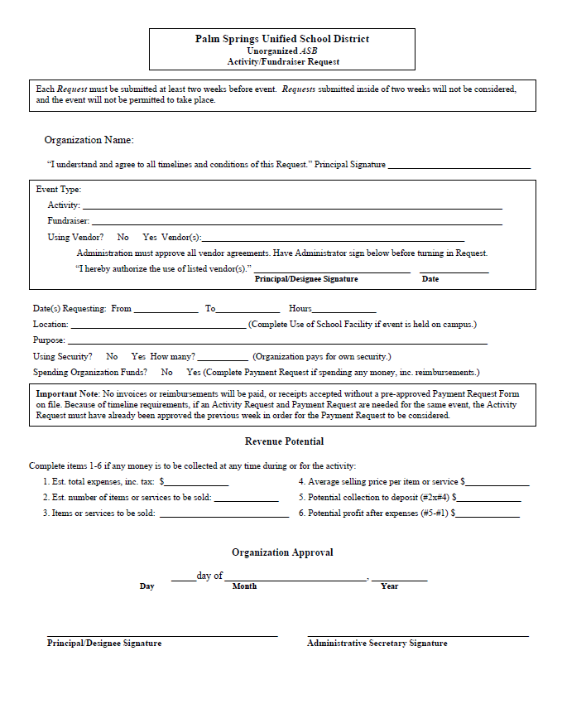
Activity Request – Organized ASB

Slide 33

Basics of fundraising
Must contribute to the educational experience.
Must not conflict w/educational programs.
Must have voluntary student participation
  If students do not to fundraise, then they can not be excluded from an activity
Must benefit the entire ASB or club.
  Proceeds cannot be attributed to a specific student based on what they raised.
The fundraisers must be approved before the event!
Cash overages or shortages must be completely researched with two parties.
  Unresolved items must be documented and reported to higher authorities.

Slide 34

pupil fEes
CDE Fiscal Management Advisory 23-02 defines pupil fees allowed and unallowed.
The California Education Code Section49011(a) provides that a pupil enrolled in a public school shall not be required to pay a pupil fee for participation in an educational activity.
“Educational activity” is defined as an activity offered by the LEA that constitutes an integral fundamental part of elementary and secondary education, including, but not limited to, curricular and extracurricular activities. (EC 49010(a)).

Slide 35

PERMITTED PUPIL FEES
Unless specifically permitted by law, fees are not to be charged. Partial list below:
  Direct costs of materials to fabricate something for students to keep
  Protective safety glasses for hazardous activities.
  Sale or lease of internet appliances or personal computers so that the pupil may access the educational network for supplemental educational programs.
  Home to school transportation fees permitted with some restrictions.
  Food, per meal program restrictions.
  Lost or damaged property.
  Field Trips.
  Community service classes, usually for adults, unless specifically identified for minors.
  Athletic team insurance.
  School camp.

Slide 36

FEES NOT PERMITTED
Partial list below:
  High school graduation cap & gown.
  Forced parent “volunteers.”
  Deposits in anticipation of loss or damage.
  Reimbursement for “lost student attendance.”
  School supplies (Ed Code 38118).

Slide 37

Basic cash collection rules
Funds collected must be deposited in their entirety.
Expenditures should NEVER be made from un-deposited monies.

Slide 38
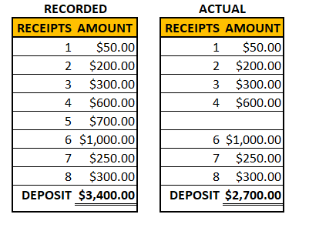
Negative effects of Expending from Undeposited funds
How it goes undetected
Example
The documentation is altered to match the actual amount, instead of what happened.
The receipts are not recorded individually, but in a lump sum.
No one is reviewing the information, so it goes undetected.
The reconciliation is forced with adjustments or journal entries recorded.

Slide 39
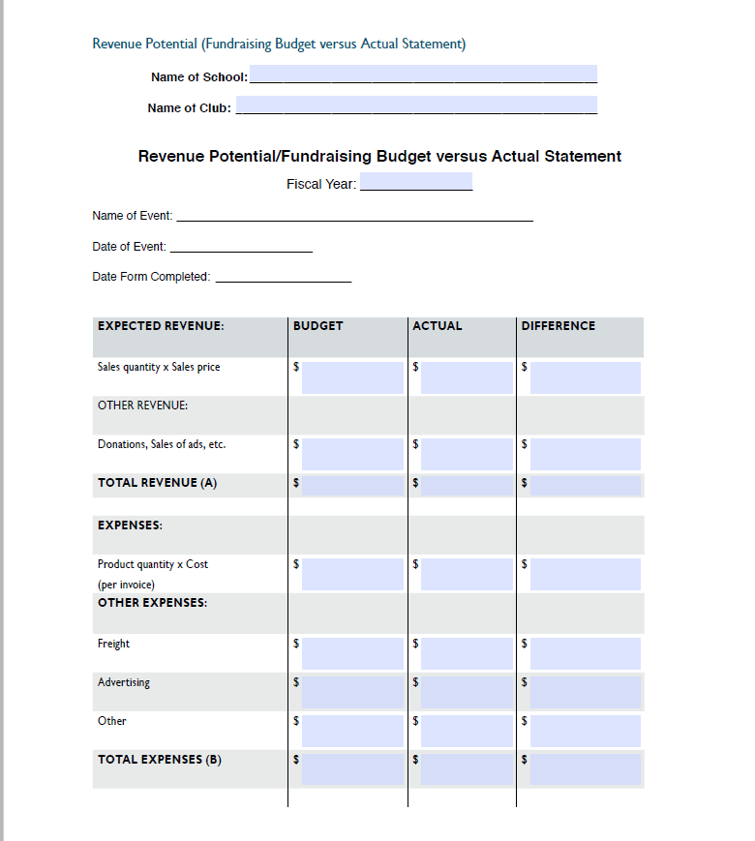
Revenue Potential Form Example
It is a great way to determine what fundraisers were successful and which ones shouldn’t be repeated.
This is the number one way to determine if cash is missing from the fundraiser.
Helps the person planning the fundraiser to get an idea of what is needed.
A one stop shop way of following the District and FCMAT policies.

Slide 40
Important Education codes
CA Education Code Section 51520 - (a) During school hours, and within one hour before the time of opening and within one hour after the time of closing of school, pupils of the public school shall not be solicited on school premises by teachers or others to subscribe or contribute to the funds of, to become members of, or to work for, any organization not directly under the control of the school authorities, unless the organization is a nonpartisan, charitable organization organized for charitable purposes by an act of Congress or under the laws of the state, the purpose of the solicitation is nonpartisan and charitable, and the solicitation has been approved by the county board of education or by the governing board of the school district in which the school is located.

Slide 41
Important Education codes
CA Education Code Section 51521 - No person shall solicit any other person to contribute to any fund or to purchase any item of personal property, upon the representation that the money received is to be used wholly or in part for the benefit of any public school or the student body of any public school, unless such person obtains the prior written approval of either the governing board of the school district in which such solicitation is to be made or the governing board of the school district having jurisdiction over the school or student body represented to be benefited by such solicitation, or the designee of either of such boards.
The prohibitions of this section shall not apply with respect to any solicitation or contribution the total proceeds of which are delivered to a public school, nor to a solicitation of a transfer to be affected by a testamentary act.
The prohibitions of this section shall not apply with respect to any solicitation or contribution the total proceeds of which are delivered to a public school, nor to a solicitation of a transfer to be affected by a testamentary act.

Slide 42
Cash Box
Start
Determine the starting amount
Count and verify starting amount is present
Record
Have two individuals count the cash.
Document the amount and have both individuals sign
Complete
Provide documentation to bookkeeper
Put profits in the safe to be deposited
Verify
Reconcile the sales with the cash count
Pull the cash to replenish the Change fund

Slide 43

Petty Cash
Money set aside for emergency purchases
Small amount usually less than $300
Should be counted and returned to the issuing authority annually, i.e., the site or district office, depending on local policy.
Receipts must support authorized purchases.

Slide 44

Change Funds
  Money set aside for providing change for ASB purchases or services.
  Usually a larger amount – Between $500 and $2,000.
  Is reimbursed after every event.
  Support documentation required: Cash count sheets or revenue potential funds

Slide 45

Bingos, Raffles, and Auctions
Schools & Districts cannot conduct Bingos, Raffles & Auctions for Fundraisers.
This includes joint events with Booster Clubs or Parent- Teacher- Organizations.
Non-district, non-ASB nonprofit groups, may, under certain conditions, be permitted to conduct games of chance.
  Revenue & Taxation Code 23701(d)
  Penal Code Sections 320.5 & 326.5

Slide 46

Unallowed Fundraisers
Best policy and some insurance provisions include a list of unallowed fundraisers:
  Dunk tanks;
  Games where objects are thrown at people;
  Use of pointy objects; and
  Trampoline activities.

Slide 47

So, what can go wrong?
Revenue potential forms are not completed or used. Cash cannot be validated as 100% collected.
Cash is stolen from the event.
Cash is taken from the cash box and used to purchase items that are not in compliance with the ASB or club.
Unallowable pupil fees are charged, resulting in district lawsuits.
Students or schools are performing fundraisers that are not profitable.
Unauthorized games of chance result in prison time, felony convictions, and fines.

Slide 48
Pop Quiz #4
Money is pulled from the safe and put into a cash box for a fundraiser event. Would this be from a Change Fund or a Petty Cash fund?
  Change Fund
What do you do when you discover cash was used/taken from undeposited funds?
  Document the amount that was taken
  Have the person who used or took the money to sign the fundraising form stating they did
  Review prior forms for the same account to see if a pattern is forming.
True or False: Goods purchased for fundraisers can be provided to adults at the completion of the event.
  False. Items and funds are only to provide for students.
Can the ASB fundraise money to be used to for school supplies?
  No. School supplies are not permitted to be paid for by school fees.

Slide 49
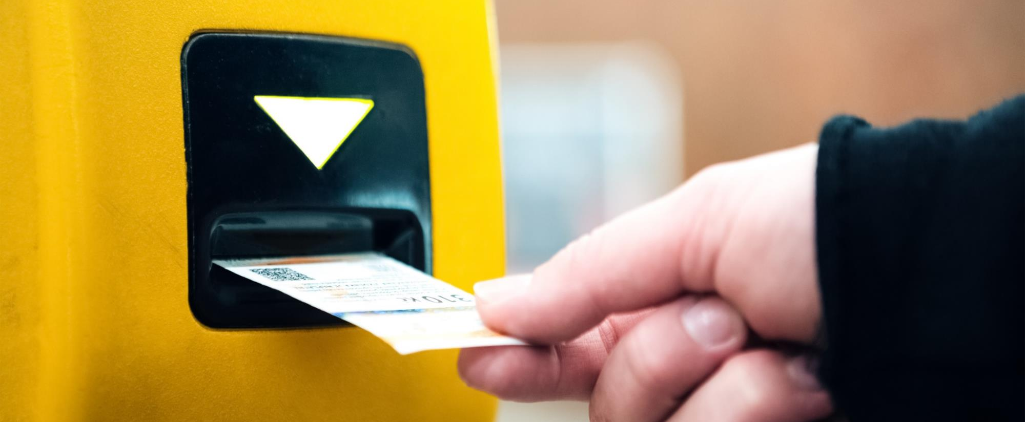
Ticket sales

Slide 50

Ticket Sales:
  Manual Method
    Maintain ticket rolls in secure location.
    Maintain a Master Ticket Log.
    When issuing tickets, record beginning ticket numbers, colors and price on Ticket Sales Recap
  Electronic Sales Method
    Reach out to the vendor at the end of the year and request the total amount paid to the school.
    Compare this amount to what is recorded in the general ledger.

Slide 51
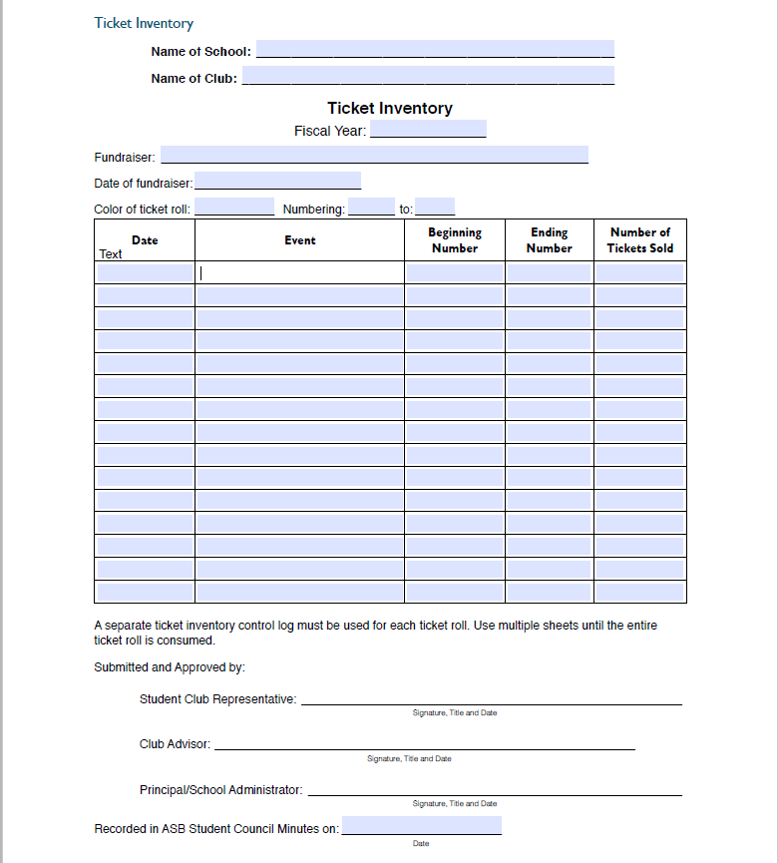
Ticket Log Example
When issuing tickets, record beginning ticket numbers, colors and price on Ticket Sales Recap

Slide 52

Inventory
Perform physical inventory no less than quarterly
  Count items on hand with more than two employees and a supervisor.
  Summarize description, number of items, cost of items.
  Perform sales analysis and reconcile to physical count.
  Beginning inventory, plus purchases, less sales (net of profit), should be the physical inventory cost value.
  Discrepancies should be resolved by the two employees and the supervisor.
  Any unresolved discrepancies should be reported to the District Office

Slide 53

DONATIONS
Donations for a non-profit is normally not allowable.
Chapter 14 – P.181 defines allowable donations.
Allowable fundraisers must clearly indicate the recipient charity.
Checks must be written to the charity and not the ASB. Otherwise an ASB trust account is needed.
Contributions for PTA, Boosters should not be received by ASB.
No donations for individuals or needy families are permitted.

Slide 54

Sports

Slide 55
ASB sports programs
Individual
Collective
One delegate is elected for each sport to attend a meeting where all sports programs are discussed.
Only one constitution, advisor, budget, and other information is required.
Money collected for each sport is placed into one athletic account, which pays for all sports.
The students make the decisions regarding the spending association with each sport.
Each sport is one club.
Each sport must have its own constitution, advisor, budget, and other necessary requirements for an ASB program.
Money collected by each sport belongs to each sport.
The students make the decisions regarding the spending association with each sport.

Slide 56

Special Issues
  A coach can not transfer funds from one sports club to the other, without prior approval from the students.
  ASB/the sports program has priority over snack bar proceeds, not Booster Clubs or other organizations.
  Use wristbands and tickets to determine the number of event attendees.
  ASB can pay for the student's banquet, but not for parents.
  Agreements made by coaches, without documented student approval, are void.

Slide 57

So, what can go wrong?
Coaches may transfer funds to benefit themselves.
Cash is stolen before the deposit.
ASB funds are used for district purchases, against Education Code.
ASB funds are used to purchase parent meals.
Money is transferred to Booster Clubs or PTO groups, instead of the students in ASB.

Slide 58

EXPENDITURES

Slide 59
All expenditures for budgeted items Must receive Approval before spending
Unorganized
Site Administrator/Principal
Organized ASBs
Student body representative, in-charge certificated advisor, and designated employee

Slide 60
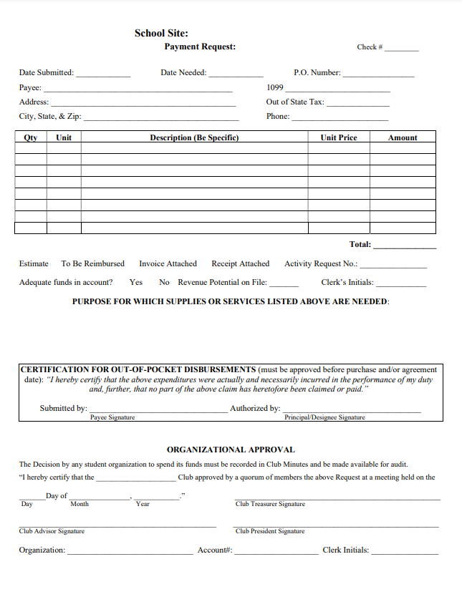
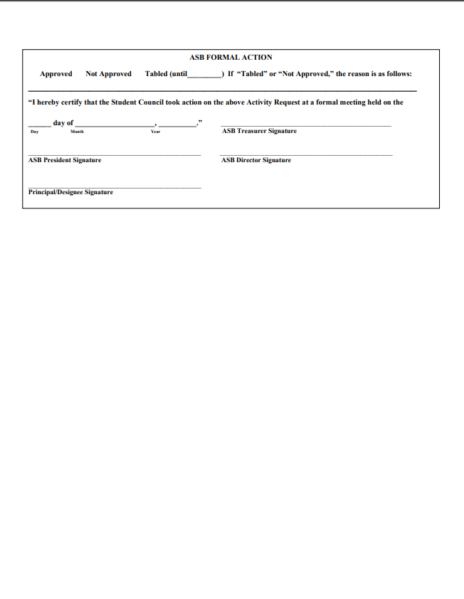
Payment Requests – Organized ASB

Slide 61
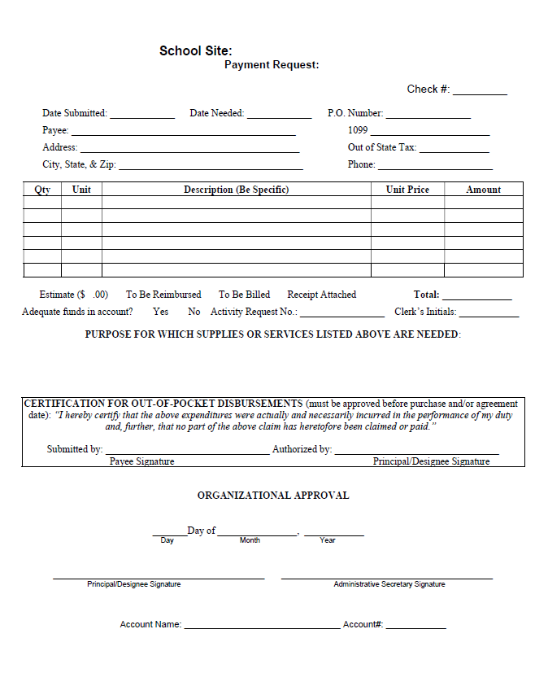
Payment Requests – Unorganized ASB

Slide 62
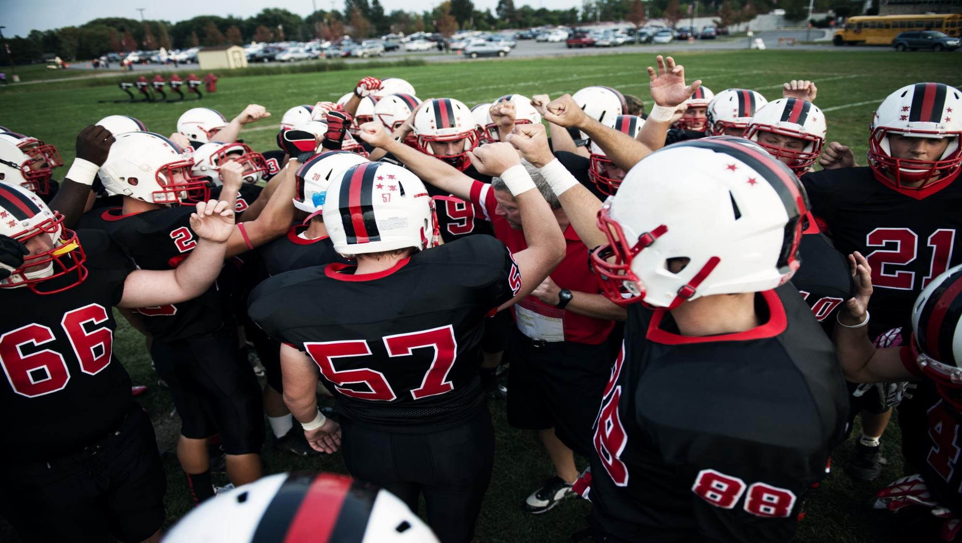
Reimbursements
  Should be pre-approved before the purchase is done.
  Receipts are required to be provided. No reimbursement should be provided without it.
  Recommend a timeframe to achieve documentation.
  Reimbursement purchases after the event, with no pre-approval, should be limited.
Documentation
Documented in the club board minutes
Purchase Requisition Forms
Reimbursement Forms
Purchase Orders
  Closed / Open

Slide 63

Allowability of Expenditures
  Expenditures must comply with the district policy.
  Must benefit entire student body or group of students.
  Cannot be a “gift of public funds.”
    Cannot pay for individual gifts.
    Cannot pay for parent or staff appreciation meals.
  Cannot pay for district responsibilities.
  Cannot commingle funds with PTA, Boosters, and other nonprofits.
    The nonprofits are separate, and apart, from the district.

Slide 64

Helpful Hints for expenditures
Can the expenditure withstand public scrutiny?
When unsure about appropriateness, contact the district office business officials.
Expenditures must support the purpose of the club.
Government Accounting Standards Board 34? (GASB34):
  Must report equipment purchases over $10,000 to District office, or the Board approved capitalization threshold, whichever is less.
$500 Equipment purchases:
  Education code 35168 requires a compliant inventory.

Slide 65
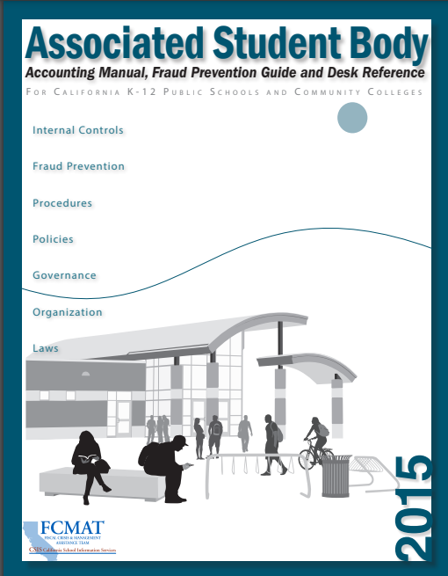
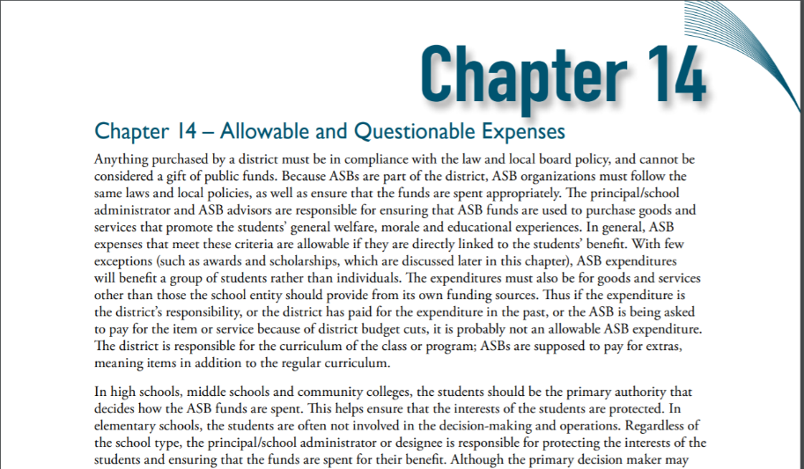
FCMAT Manual Chapter 14
Where is the best place to go to find out what is allowed and what is not allowed?

Slide 66

ASB ACCOUNTING 101: Cash Disbursements
Person reviewing the bank reconciliation, should verify that all support documentation is provided.
  Student approvals, Board minutes, purchase orders, invoices.
Goods and services are purchased for the purpose of the club.
  Club account decreases and accounts payable increases
The check is issued to the vendor.
  Accounts payable and cash decrease.
Check is outstanding and needs to be voided.
  Cash and club account increase.

Slide 67

So, what can go wrong?
Cash is used to purchase noncompliant items.
No support documentation for the purchase.
Only one person is signing the check.
Checks are being issued for items outside of the scope.
Payments are transferred to a Booster Club or PTO.
Unapproved transfers are made between clubs.
Negative club balances exist in the general ledger.

Slide 68
Pop Quiz #6
Imagine you are the High School ASB bookkeeper.
Review the expenditures listed below and determine if they would be allowable for not:
ASB paid to fix the flooring in the ASB office that was damaged due to plumbing issues.
  This is not allowable. This expense is the responsibility of the District. It is part of a District owned building.
The students noticed teachers working hard and would like to show appreciation by purchasing their lunch.
  This is not allowable. Purchases should benefit students.
The Class of 2024 graduated and the ASB transferred it to the class of 2025.
  This is allowable if the class of 2024 approved, or it is stated in the governing documents that remaining funds will be transferred to the next graduating class.
Cheer club is requiring all members to purchase uniforms to participate.
  This is not allowable; a school must provide a free uniform to any student who is a member of a school team.
An ASB reimbursement check was issued with the ASB treasurer and certificated advisor’s approval.
  This is not allowable; a designated employee needs to approve the reimbursement.

Slide 69

Monthly reconciliations

Slide 70

Bank Reconciliation 1
Bank reconciliation does not guarantee accuracy.
The general ledger could post one vendor payee and the check could display another.
Checking for Completeness
  Begin with the Bank Statement Ending Balance.
  Deduct outstanding checks (from bank statement date back).
  Add deposits in transit (added to checking account but not on statement).
  Add or Subtract Other Credits and Debits (monthly banking fee, non-sufficient funds fee).
  For Electronic Payments, input the appropriate information
  This will not show money collected, not recorded, and not deposited.
  Two signatures are required. If not, a red flag should be raised.

Slide 71
Bank Reconciliation 2
Bank Statement
General ledger detail
Beginning Balance: $70,000
Deposits: $20,000
Checks/Payments: -$30,000
Ending Cash Balance: $60,000
Total Club Balance > Ending Cash
Small amount – Outstanding deposits
Large amount – Missing entries, undeposited cash used, or fraud
Total Club Balance < Ending Cash
Enough money to cover club debts
Total Club Balance = Ending Cash
Enough money to cover club debts
Football: $7,000
Basketball: $3,000
Baseball: $6,000
Cheer: $13,500
Chess: $1,500
Pokemon Club: -$1,000
Disc Golf Club: $3,000
2024 Funds: $15,000
2025 Funds: $6,000
2026 Funds: $5,500
2027 Funds: $2,500
Total Club Balance: $62,000

Slide 72

Checklist for the District performing the bank reconciliation
Request a copy of the completed bank reconciliation.
Perform Bank Reconciliation 2 at the site.
Verify the Outstanding Bank Deposits/Checks appear to be correct.
Look at the Outstanding checks to verify if any are stale. If so, cancel and reissue.
Add any missing bank adjustments or interest to the general ledger.

Slide 73

So, what can go wrong?
Bank reconciliation are not being performed. Transactions are being missed, causing all the club balances to be incorrect.
Bank reconciliation is being performed, but no one is reviewing it.
Bank reconciliation adjustments are being recorded in the general ledger to force the reconciliation to match.
Large unreconciled differences between the Total Club Balance and Ending Cash Balance.
The same person preparing the Bank reconciliation is also collecting and recording the cash.

Slide 74

booster club basics

Slide 75

What DO you need to know?
Booster Clubs are non-profit organizations.
Booster Clubs are not affiliated with the District. They are a relationship that can be dissolved at anytime.
Donations to the Booster Club are controlled by the Booster Club, not the students.
The Booster Club has no control over the student body. The student body has no control over the Booster Club. The District has limited control over the Booster Club.
No school employee should be on the Booster Board or have a controlling interest in a Booster Club at a site where they are employed.

Slide 76

Cash flow
Students
Booster Club
ASB

Slide 77

authority
Students
Booster Club
ASB

Slide 78
Booster Raffle RULES
Information on how to conduct a legal raffle can be obtained from the California attorney general’s website at www.ag.ca.gov.
Legal raffles are held by eligible nonprofit organizations that have their own tax identification number, register with the attorney general annually, and disburse 90% of the gross profits generated by the sale of the raffle tickets to a charitable purpose.
50/50 raffles are illegal per Penal Code 320.5 and 320.6.
Booster raffle tickets can not be sold over the internet.
Only Booster Club personnel should be assisting with the raffle. District, school, or student body employees should not assist.

Slide 79

So, what can go wrong?
Booster Clubs have ASB staff on their Boards.
Booster Clubs are using ASB resources to benefit their organization without documented student approval.
Booster Clubs and ASB’s operating in proximity result in commingled funds.
ASB personnel are paid to assist with the raffle.
Booster Clubs are supervising ASB advisors or vice versa.
Payments are transferred from ASB to the Booster Club.
ASB funds are provided to the Booster Club to circumvent district policies and procedures.

Slide 80
Pop Quiz #7
True or False:
A booster club can deny a request from an ASB club.
  True.
50/50 raffles are illegal for both Booster Clubs and the District.
  True
ASB purchased T-shirts for the students. The money for those T-shirts can be given to the Booster Club.
  False
Students have a say in what the Booster Club purchases.
  False
The coach can cast a vote on whether a Booster Club should make a purchase.
  False

Slide 81

Red Flags for District
No documentation for reimbursements requested
Undeposited cash being used for purchases
Revenue potential forms not being used.
Negative club account balances.

Slide 82

Red Flags for Auditors
  Bank reconciliations are not being performed.
  Undeposited fund balance is large.
  Reimbursement purchases after the event, with no pre-approval.

Slide 83

QUESTIONS?

Slide 84
THANK YOU
Our firm offers both accounting consulting to train staff one on one at both the site and District level. Should the District determine it needs further investigation into any suspected fraud or misappropriation of assets, our firm has a team trained in fraud and forensic accounting to investigate. Please contact: Caroline Larson, Accounting Consulting Partner calarson@eidebailly.com, Brandon Waldren, Fraud & Forensics Senior Manager, bwaldren@eidebailly.com, or Natalie Wells, Fraud & Forensics Manager, nwells@eidebailly.com for more information.

