Slide 1
M. Agnes Jones ES
GO Team Business Meeting #3
November 13, 2025

Slide 2

Agenda
Action Items
  Approval of Agenda
  Approval of Previous Minutes
  Mission and Vision Vote
  Discussion Items
  2025-2030 Strategic Plan Development
    Confirm Mission/Vision, Goals from Previous Meeting
    Develop 2025-2030 Strategic Plan Objectives
Information Items
Principal’s Report
  Cluster Advisory Team Report
  APS Forward 2040 –Facilities Plan Update (if needed)
Announcements
Public Comment
Adjournment

Slide 3

Action Items
Approval of Agenda
Approval of Previous Minutes
Mission and Vision Selection

Slide 4
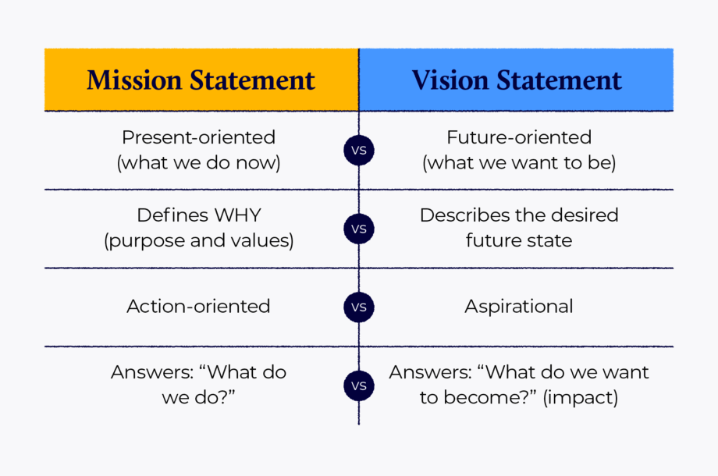
M. Agnes Jones Proposed Updates to School Vision:
We agreed to narrow the six proposed options down to three finalists, which will then be shared with students for a final vote.
1. Every child shines through equitable STEAM and arts-based learning that builds confidence, curiosity, and community.
2. Empowering every learner to uncover their brilliance through STEAM innovation and equity in action.
3. Building confidence, creativity, and excellence through authentic STEAM experiences.
4. Every learner thrives in a culture of belonging, creativity, and STEAM exploration.
5. Developing compassionate problem-solvers who lead with equity, empathy, and a STEAM mindset.
6. Through STEAM, we prepare students to imagine, design, and lead change for all.

Slide 5
M. Agnes Jones Proposed Updates to School Mission:
We agreed to narrow the six proposed options down to three finalists, which will then be shared with students for a final vote.
1)We deliver rigorous, differentiated STEAM-enriched instruction, ensuring every MAJ student feels seen, supported, and challenged to think critically, collaborate, and solve real-world problems.
2)We provide high-quality, explicit teaching and STEAM-integrated, arts-rich experiences daily, building strong relationships and partnerships so every child grows academically, socially, and creatively.
3)From Pre-K to 5th, we develop literacy and numeracy foundations and foster curiosity through hands-on STEAM instruction, nurturing critical thinking and a growth mindset so students set goals and own their progress.
4)We combine rigorous, data-informed teaching with STEAM integration, ensuring each student belongs, learns deeply, and practices collaboration, creativity, and problem-solving.
5)We cultivate inclusive classrooms and deliver explicit instruction through STEAM-focused, arts-infused learning, engaging families and partners to advance every child’s achievement and well-being.
6)Through daily, high-quality instruction and real-world STEAM learning, we partner with families and the community so every student sets goals, meets them, and contributes positively to the greater society.

Slide 6
Discussion Items

Slide 7
Continuing the
2025-2030 School Strategic Plan Development Process

Slide 8
School Strategic Planning Overview
Purpose
To cascade the district strategic plan to the school level, while grounding our focus in the school’s Continuous Improvement Plan. This will create alignment, reduce confusion, and simplify our efforts.
Timeline
Our school’s 2030 Strategic Goals and Objectives should be updated, approved and ranked by January 2026. Schools will focus on the strategies as part of FY27 Budget and Continuous Improvement Plan processes.

Slide 9
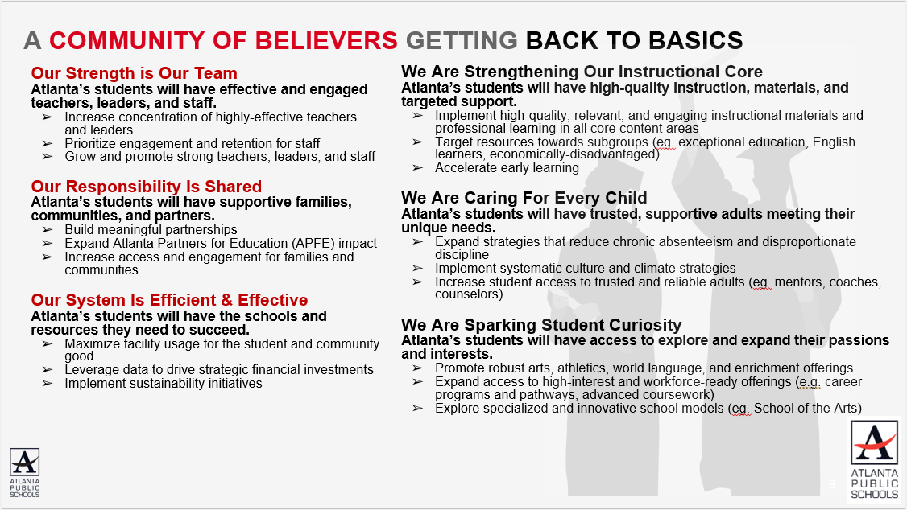
Revisiting the APS 2025-2030 Strategic Plan
Notes:
As a reminder this is the district's 2025-2030 Strategic Plan. We will use this as a guide as we continue our work today to develop our school's 2025-2030 Strategic Plan that is aligned to the district's new plan.

Slide 10
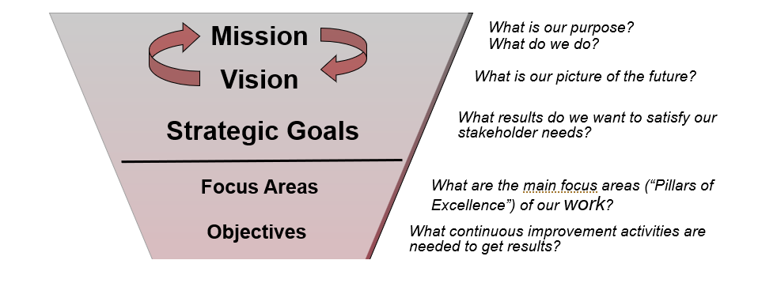
GO Team’s Focus (Governance)
Notes:
These are the governance-aligned portions of the school strategic plan that the GO Team will develop. We will dive into specific strategies and actions, as a part of our budget development process that starts in January.

Slide 11

School Strategic Planning Process Overview
1
Review Data
Sample GO Team Business Meeting Cadence
Business Meeting 1:
Review Data (MAP, GMAS, Graduation Rate, CCRPI, etc.)
Business Meeting 2:
Review Data (School KPIs)
Align Mission/Vision/ Purpose
Confirm 2030 Goals
Business Meeting 3:
Identify 2025-2030 Strategic Objectives
Business Meeting 4 (Budget Allocation):
Approve Your Strategic Plan & Rank Your Strategic Objectives for FY27
2
Align Mission/Vision/Purpose
3
Confirm 2030 Goals
Create CIP Goals to 2030
Identify Additional Goals
4
Identify 2025-2030 Strategic Objectives
Reflect on 2020-2025 Strategic Plan
Review and Discuss Additional Objectives Going Forward
5
Approve Your Strategic Plan & Rank Your Strategic Objectives for FY27

Slide 12
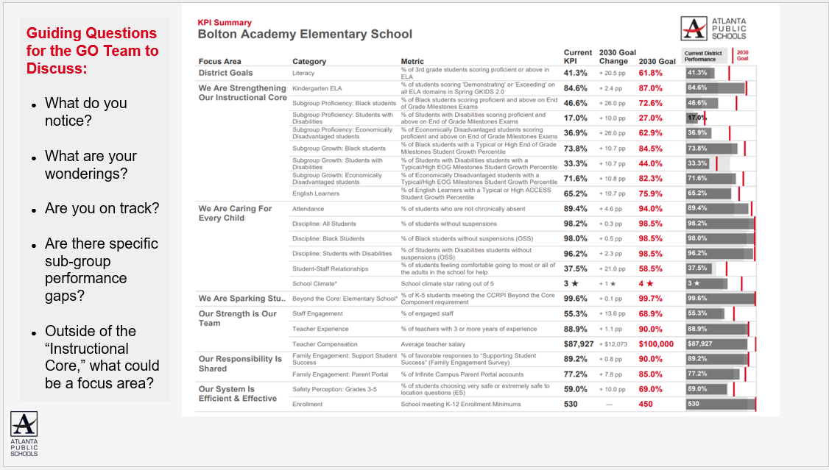
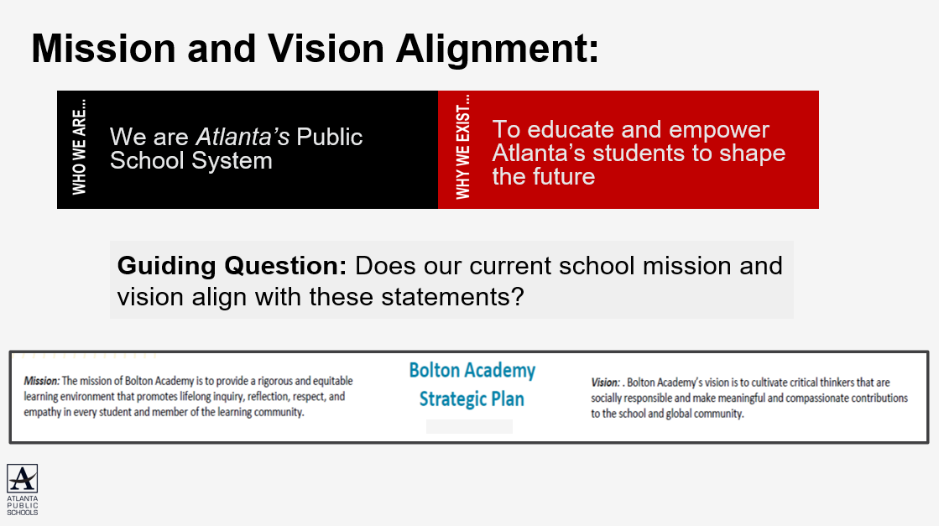
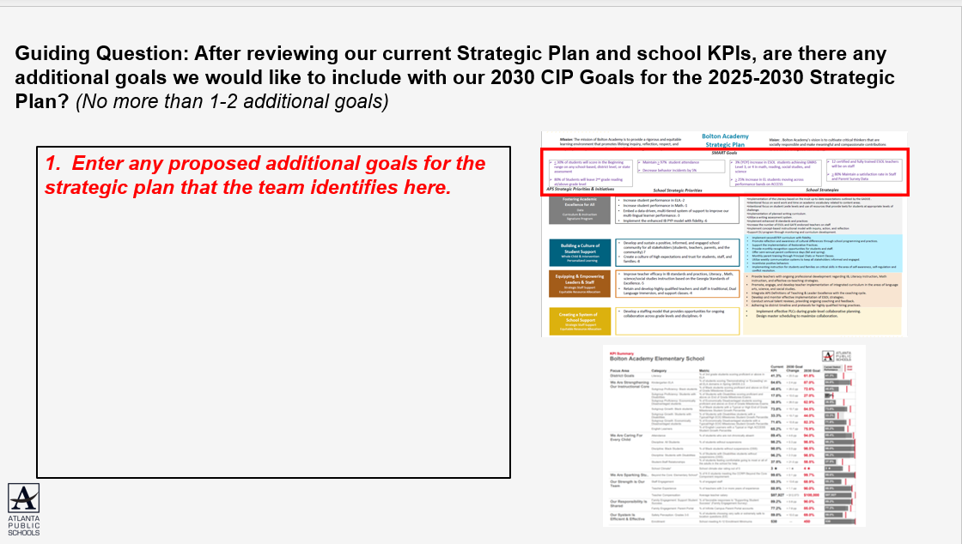
In Our Last Meeting We…
1
Reviewed Our
School Data
2
Aligned Our
Mission and Vision
3
Confirmed Our
2030 Goals

Slide 13

M. Agnes Jones ES Proposed Goals for the 2025-2030 Strategic Plan:
By 2030, 3rd-5th grade students will increase ELA proficiency by 25% from 17% to 42% and decrease beginning learners by 25% from 60% to 35%. Additionally, SWD will increase ELA proficiency by 25% from 3% to 28% and decrease beginning learners by 25% from 88% to 63%.
By 2030, 3rd-5th grade students will increase Math proficiency by 25% from 13% to 38% and decrease beginning learners by 25% from 54% to 29%. Additionally, SWD will increase Math proficiency by 25% from 6.1% to 31.1% and decrease beginning learners by 25% from 91% to 66%
By 2030, the CCRPI attendance rate will remain at or above 90%, by ensuring chronic absenteeism as determined by GADOE does not exceed 10% days absent for the student's enrollment period greater than 30 days, with an emphasis on the following subgroups: SWD (76.2) Black (77.2)
By 2030, Staff engagement will increase from 33.3 to 49.1%

Slide 14

Today’s Focus:
School Strategic Planning Process: Step 4
1
Sample GO Team Business Meeting Cadence
Business Meeting 1:
Review Data (MAP, GMAS, Graduation Rate, CCRPI, etc.)
Business Meeting 2:
Review Data (School KPIs)
Align Mission/Vision/ Purpose
Confirm 2030 Goals
Business Meeting 3:
Identify 2025-2030 Strategic Objectives
Business Meeting 4 (Budget Allocation):
Approve Your Strategic Plan & Rank Your Strategic Objectives for FY27
Review Data
2
Align Mission/Vision/Purpose
3
Confirm 2030 Goals
Create CIP Goals to 2030
Identify Additional Goals
4
Identify 2025-2030 Strategic Objectives
Reflect on 2020-2025 Strategic Plan
Review and Discuss Additional Objectives Going Forward
5
Approve Your Strategic Plan & Rank Your Strategic Objectives for FY27

Slide 15
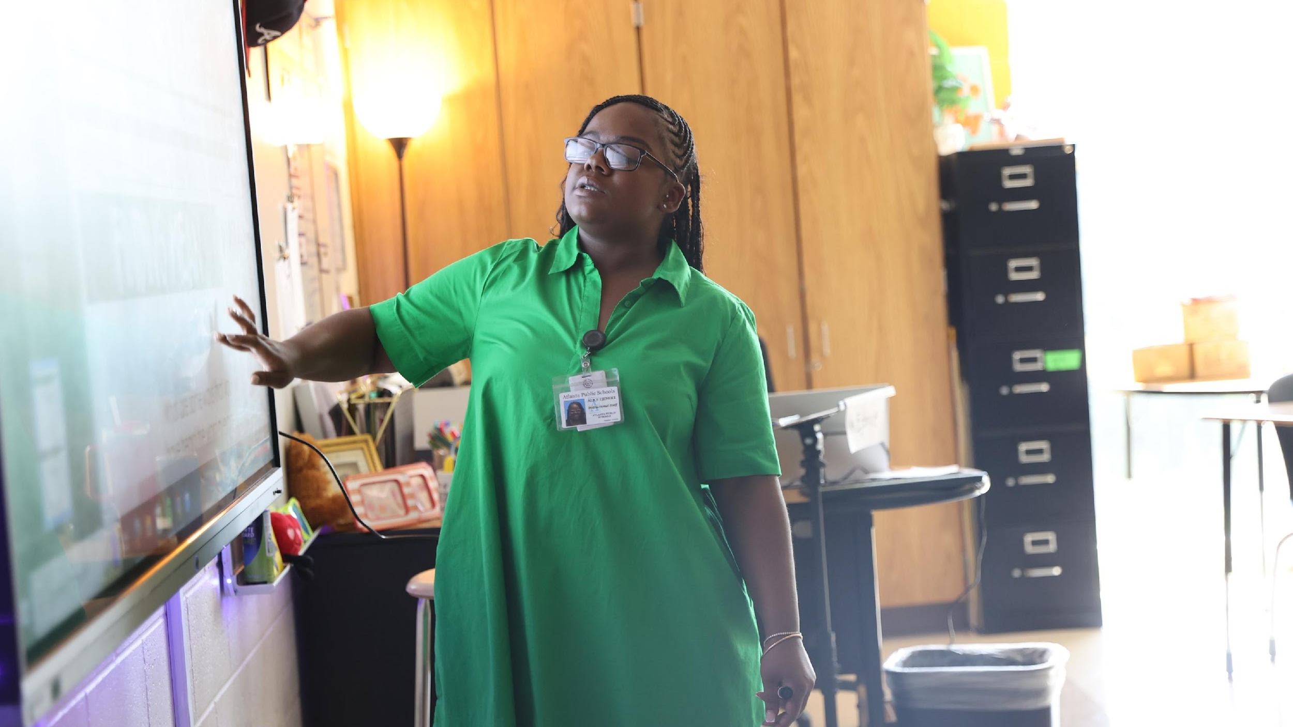

4. Identify 2025-2030 Strategic Objectives
Reflect on 2020-2025 Strategic Plan (Stop, Continue)
Align Objectives to the District's new Focus Areas
Review and Discuss Additional Objectives Going Forward (Start)
One District. One Goal. Every Child.

Slide 16
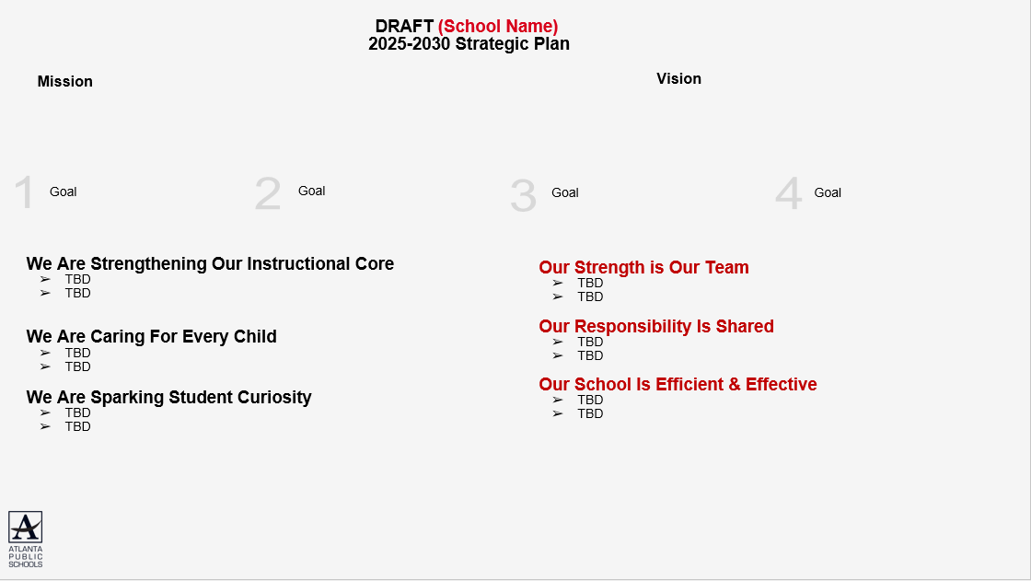
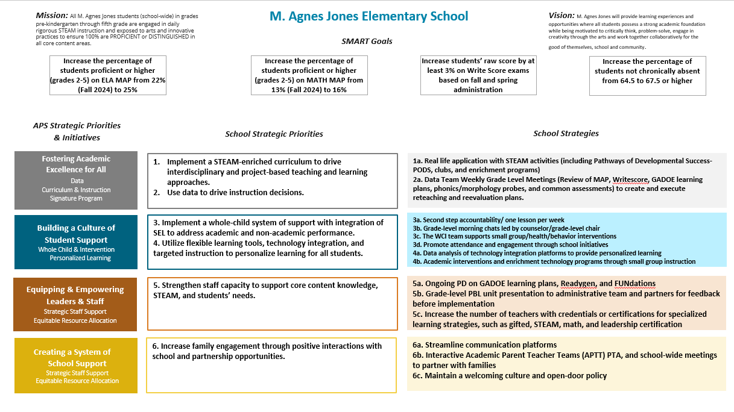
4
Using our new, 2025-2030 Strategic Goals as a guide we will complete a Start, Stop and Continue exercise to review our current “Strategic Priorities” and identify our 2025-2030 Strategic Objectives

Slide 17
Notes:
High level overview of current strategic priorities and complete start, stop and continue on next slide

Slide 18
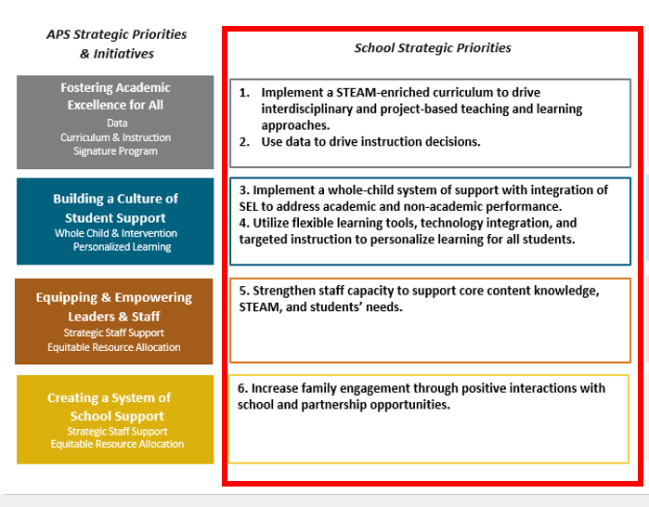
Identifying 2025-2030 Strategic Objectives: Stop Discussion
Guiding Questions:
Stop
- What current priorities/activities are not having the needed impact and should be stopped?
- Are there any priorities/activities that are no longer aligned with our mission, vision, goals or focus areas?
Notes:
Think about what has been working; has been completed; or never started.
If your goals for 2030 are bigger than what you have achieved so far, then what must you do differently going forward?

Slide 19

Identifying 2025-2030 Strategic Objectives: Continue Discussion
Guiding Questions:
Continue
- What current priorities/activities are working well and should be maintained?
Notes:
Think about what has been working; has been completed; or never started.
If your goals for 2030 are bigger than what you have achieved so far, then what must you do differently going forward?

Slide 20
Identifying 2025-2030 Strategic Objectives: Continue Discussion
Notes:
Enter the “Strategic Priorities” from your 2020-2025 Strategic Plan that you and your GO Team think should continue as “Strategic Objectives” on your 2025-2030 Strategic Plan based on today’s discussion.

Slide 21
Aligning Your Objectives to the District's New Focus Areas
“Getting Back to Basics”
“Community of Believers”
We Are Strengthening Our Instructional Core
TBD- Strategic Objective
TBD- Strategic Objective
We Are Caring For Every Child
TBD- Strategic Objective
TBD- Strategic Objective
We Are Sparking Student Curiosity
TBD- Strategic Objective
TBD- Strategic Objective
Our Strength is Our Team
TBD- Strategic Objective
TBD- Strategic Objective
Our Responsibility Is Shared
TBD- Strategic Objective
TBD- Strategic Objective
Our School Is Efficient & Effective
TBD- Strategic Objective
TBD- Strategic Objective
You will now move the Objectives (previously Priorities) you want to “Continue” to the appropriate Focus Area
Use your 2020-2025 Strategic Plan, the APS 2025-2030 Strategic Plan (slide 7) and your school KPI sheet to help categorize your objectives. Please note:
  Fostering Academic Excellence for All is likely aligned to “We Are Strengthening Our Instructional Core” or “We Are Sparking Student Curiosity”
  Building a Culture of Student Support is likely aligned to “We Are Caring For Every Child”
  Equipping & Empowering Leaders & Staff is likely aligned to “Our Strength is Our Team”
  Creating a System of School Support is likely aligned to “Our Responsibility is Shared” or “Our School is Efficient & Effective”
Notes:
Use the APS 2025-2030 Strategic Plan (slide 7) and your school's KPI sheet to help guide your team's discussion of how your objectives align to the district's new focus areas.

Slide 22
Identifying 2025-2030 Strategic Objectives: “Start” Discussion
After you have aligned your Objectives to the appropriate Focus Area, identify any new Objectives the school must start to address the goals in your plan
You should have 1-2 Objectives for each Focus Area.
Use the APS 2025-2030 Strategic Plan (slide 7) and your school KPI sheet for ideas if you need to identify new Objectives.
Focus on the “Getting Back to Basics” Focus Areas first (Strengthening Our Instructional Core, Caring For Every Child, and Sparking Student Curiosity)
Make sure you have something in the “Community of Believers” Focus Areas that support your core work (Strength is Our Team, Responsibility is Shared, System is Effective & Efficient)

Slide 23
Guiding Questions: Are there any new “objectives” we must START to completely address our 2025-2030 Strategic Goals? Do we have 1-2 Objectives to support each Focus Area?
“Getting Back to Basics”
“Community of Believers”
We Are Strengthening Our Instructional Core
TBD- Strategic Objective
TBD- Strategic Objective
We Are Caring For Every Child
TBD- Strategic Objective
TBD- Strategic Objective
We Are Sparking Student Curiosity
TBD- Strategic Objective
TBD- Strategic Objective
Our Strength is Our Team
TBD- Strategic Objective
TBD- Strategic Objective
Our Responsibility Is Shared
TBD- Strategic Objective
TBD- Strategic Objective
Our School Is Efficient & Effective
TBD- Strategic Objective
TBD- Strategic Objective
Notes:
Please Note:
Complete the discussion about what you should “Start” after you have moved the “Continue” Objectives (previously Priorities) to the appropriate “Focus Areas."

Slide 24
DRAFT M. Agnes Jones ES
2025-2030 Strategic Plan Template
Mission
Vision
1
By 2030, 3rd-5th grade students will increase ELA proficiency by 25% from 17% to 42% and decrease beginning learners by 25% from 60% to 35%. Additionally, SWD will increase ELA proficiency by 25% from 3% to 28% and decrease beginning learners by 25% from 88% to 63%.
2
By 2030, 3rd-5th grade students will increase Math proficiency by 25% from 13% to 38% and decrease beginning learners by 25% from 54% to 29%. Additionally, SWD will increase Math proficiency by 25% from 6.1% to 31.1% and decrease beginning learners by 25% from 91% to 66%
3
By 2030, the CCRPI attendance rate will remain at or above 90%, by ensuring chronic absenteeism as determined by GADOE does not exceed 10% days absent for the student's enrollment period greater than 30 days, with an emphasis on the following subgroups: SWD (76.2) Black (77.2)
4
By 2030, Staff engagement will increase from 33.3 to 49.1%
We Are Strengthening Our Instructional Core
TBD- Strategic Objective
TBD- Strategic Objective
We Are Caring For Every Child
TBD- Strategic Objective
TBD- Strategic Objective
We Are Sparking Student Curiosity
TBD- Strategic Objective
TBD- Strategic Objective
Our Strength is Our Team
TBD- Strategic Objective
TBD- Strategic Objective
Our Responsibility Is Shared
TBD- Strategic Objective
TBD- Strategic Objective
Our School Is Efficient & Effective
TBD- Strategic Objective
TBD- Strategic Objective

Slide 25
Where we’re going
At our next meeting we will:
Vote on the 2025-2030 Strategic Plan
Rank our 2025-2030 Strategic Objectives
Begin the discussion of the 2026-2027 budget
Let me or the Chair know of any additional information you need for our future discussion.

Slide 26

Questions?

Slide 27
Information Items

Slide 28
Principal’s Report

Slide 29
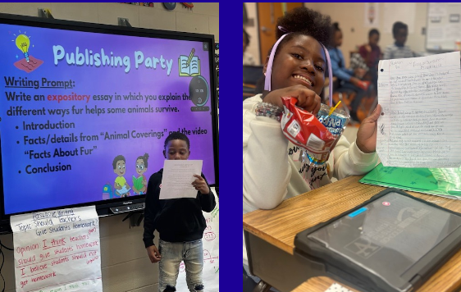
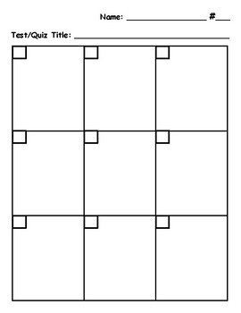
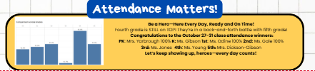
SCHOOL UPDATES
ELA Focus:
Apply PLC takeaways in classroom instruction (transfer).
Support explicit writing instruction through bi-weekly writing portfolio checks and monthly publishing parties.
Strengthen small group instruction through differentiated, data-driven, and intentional work, supported by professional learning and monitoring.
Math Focus:
Engage in professional learning on small groups, specifically CRA (Concrete-Representational-Abstract) and use of appropriate technology tools.
Conduct data binder checks during PLCs on 10/24, 11/21, and 12/19 to ensure fidelity.
Analyze student work using the ATLAS protocol bi-weekly and implement the 8-box scratch paper method during all assessments.
Attendance Focus:
Utilize daily dialer reports and refine early dismissal logging to track trends.
Implement daily check-ins with a Check & Connect partner to improve CCRPI attendance.
Continue public tracking by grade level with the Attendance Traveling Trophy and monitor staff attendance in leadership meetings to identify and address patterns.

Slide 30
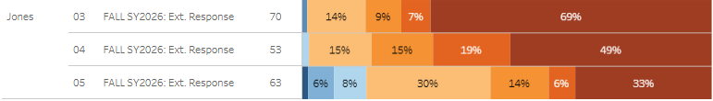
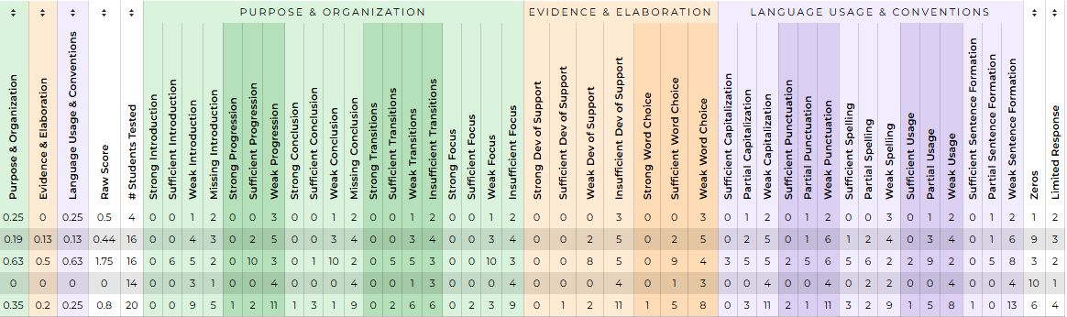
WRITE Score DATA
Trend Analysis: Write Score data indicates a positive upward trend—as students matriculate through grade levels, their writing proficiency improves.
Targeted Support: Teachers are conducting individual writing conferences with every student to provide personalized feedback and goal setting.
Resource Integration: Instructional teams are leveraging Write Score rubrics, feedback reports, and GaDOE writing resources to strengthen student writing skills.
Instructional Focus: Conferences emphasize specific writing domains (ideas, organization, conventions, and style) to ensure consistent growth across grade levels.
Continuous Improvement: Teachers are using insights from Write Score to adjust instruction, reteach writing strategies, and monitor progress over time.

Slide 31
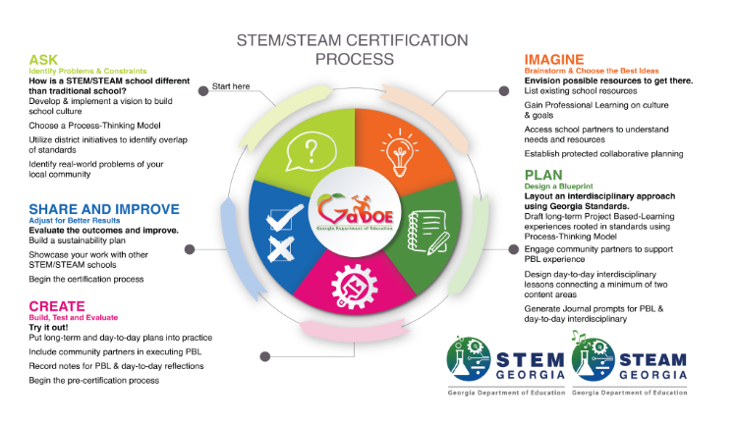
STEAM Walkthrough Feedback- 10/22
School-Wide STEAM Trends
Glows:
Students are excited and engaged in STEAM learning.
Journals show reflection and documentation.
Driving questions are guiding lessons and projects.
Grows:
Math connections not always clear.
Students need to explain what and why they’re learning.
Limited feedback and reflection in journals.
Next Steps:
Review driving questions daily.
Strengthen math and STEAM integration.
Add rubrics and reflection prompts.
Build student voice and ownership of learning.

Slide 32
Cluster Advisory Team Report- 10/21 4:30-6:00 PM
Chair: Mrs. Melanie Sithole
Vice Chair: Mrs. Tiauna Crooms
Secretary: Dr. Teruko Dobashi
CAT Business Meeting #1: Tuesday, November 18, 2025
CAT Business Meeting #2: Tuesday, February 24, 2026
CAT Business Meeting #3: Tuesday, April 21, 2026
General Sessions Discussion Points:
Vertical Alignment: Cluster Focus Areas
Share cluster-wide data (attendance & behavior)
Strengthen district-wide attendance strategies within our control
Highlight promising practices from similar or high-performing schools
Ensure PK–5 literacy goals are met
Align tracking systems (Benchmark vs. HMH)
Use data to predict needs across grade bands
Define what success looks like at each grade band (matriculation plans)

Slide 33


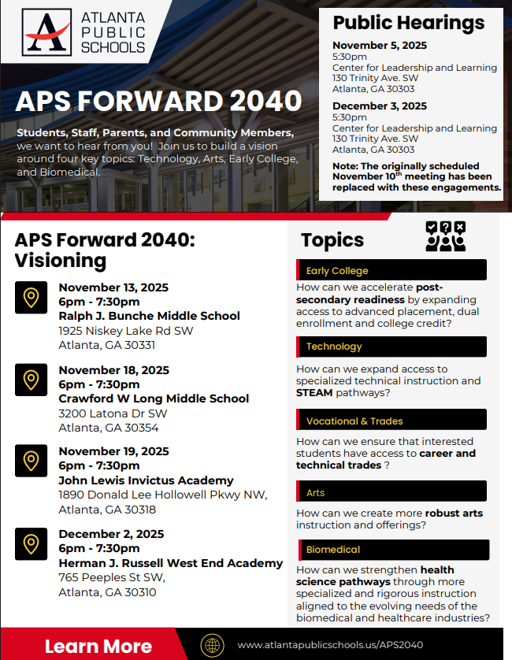

UPDATE
Comprehensive Long-Range Facilities Plan
atlantapublicschools.us/APS2040
Notes:
Next on our agenda, we’d like to welcome our representative to the Long-Range Comprehensive Facilities Master Plan Taskforce. As many of you know, this taskforce plays a key role in shaping the future of our district’s facilities — ensuring they are aligned with projected enrollment, instructional needs, safety standards, and long-term community use."
Over the summer, the taskforce has been hard at work reviewing data, exploring options, and engaging in important planning conversations. [Name of Representative] will share an update on what’s been done so far, any key decisions or recommendations that have been made, and what’s ahead — including opportunities for the public to provide input.
[Allow the FMP representative to provide an update and answers questions. After this is concluded:]
Thank you [Name of Representative].
A report will be presented to the Board at its August 11 meeting, and the options will become public the week of August 18.
There are several upcoming public meetings where you can learn more and share your thoughts. The next public meetings are scheduled for: August 25, October 20, and November 10
On each date, there will be a virtual meeting at noon and an in-person meeting at the Central Office at 6PM.
I strongly encourage you all to attend these meetings. This is a critical time for public input, and your voice is essential.

Slide 34
Announcements
Math Bowl 11/14
STEAM Night 11/20
Science Fair 11.20
Publishing Party 11/20
Thanksgiving Break 11/24-28
BETA Trip 12/1-4
MAP/AMIRA Testing 12/1-12

Slide 35
Thank you

