Slide 1
Welcome
Welcome and land acknowledgement
Introductions
Phoenix Indian Center: L2W presentation
Reminder Qtr. 3 supplies
Activity with Mrs. Begay
Next meeting-January 22nd-VIRTUAL
Wrap and Questions

Slide 2
Winter stories/activities
Navajo games
shoe game(night and day)-endurance, teamwork, and loyalty
string game(creation stories and celestial bodies)-patience, focus and coordination
Stories-creation stories, ways of life, reasons for natural occurrences
O’odham-Buzzard and the flood
Navajo-Changing Woman
Reason: the beings in those stories are resting, the land is quiet, and families gather together
Maintain Hózhó
Notes:
stories-So’ahots’ii- pinching or doubtful stars- Twin Sisters in Hyades Taurus
meanings-Náhookos Bika'ii is a man lying down on one his side. He represents the father & protector of the home.
characteristics-Atse etosh- first big one- Scorpius (upper) represents strength and stablility
planting/hunting-Gah hahat’ee- rabbit tracks- Scorpius (lower curve)

Slide 3
NAVAJO CONSTELLATIONS
Navajo relationships with the stars can be very personal. Star constellations can be utilized for healing body, mind and spirit. Many Navajo constellations are depicted in human form, providing principles and values for living. The Náhookòs constellations represent family relationships, similar to that of a mother and father in their home. Náhookòs Bikò‘, the North Star, stands for the central fire in a home, providing warmth, stability and security.
Many Navajo constellations are directly connected to animals. Constellations such as Porcupine, Gila Monster, Mountain Sheep, Snake, Butterfly, Bear, Turkey, Coyote and Horse (Carrier of the Moon and the Sun) illustrate attributes of the animals and show how animals interact with human life. Coyote occupies a special place within Navajo cosmology, as trickster and balancer. Although Coyote often creates chaos, at the same time on a larger plane he provides harmony and balance.
Each constellation is associated with stories, meanings, characteristics of people and indication of seasons and planting; and some constellations are associated with figures in the Navajo String games.
Winter storytelling season only, October through February

Slide 4
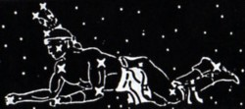
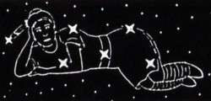
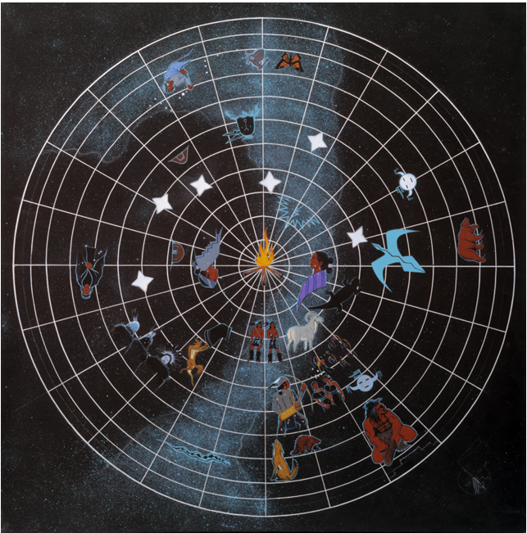
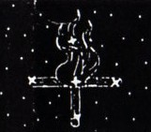
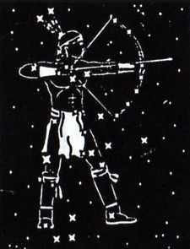
Náhookos Bika'ii (Northern Male)
This figure is synonymous with the "Big Dipper"
Náhookos Bi'áadii (Northern Female)
This figure is synonymous with the Greek constellation "Cassiopeia"
Náhookos Biko' (Northern Fire)
This is synonymous with the "North Star"
Altse Alts’oosi (Northern Fire)
This is synonymous with the "OIrion"
Notes:
https://www.youtube.com/watch?v=ZIl0Nqpt41A

Slide 5
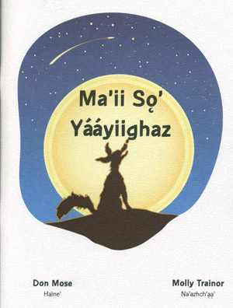
Coyote Tosses the Stars
The trickster Ma’ii, or Coyote, is often known for creating chaos—which, in turn, helps shape the larger order of the universe.
Long ago, the Holy Beings were carefully forming the constellations using crystals that would become the stars. Black God, was placing each star with intention and precision in the Upper Darkness, what we now call the sky.
Before long, Coyote wandered over and asked what they were doing. As in many stories, Coyote’s curiosity often leads him into trouble. The Holy Beings explained that they were creating order and light in the sky. Coyote immediately grew excited and asked if he could help. They agreed, and he began taking crystals from the buckskin and placing them in the sky.
He proudly put one star in the south and declared, “That will be my star—the Coyote Star.” He placed a few more stars, claiming them as his, including the red North Star, which ended up dividing the north and south.
But Coyote soon became impatient. When no one was watching, he grabbed the buckskin and flung it high into the sky. All the remaining crystals scattered in every direction. The careful placement and naming of the stars was ruined.

Slide 6
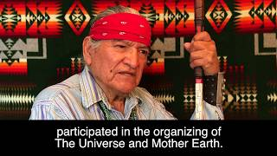
Coyote Tosses the Stars
Notes:
https://www.youtube.com/watch?v=ILNA1aO30Qk

Slide 7
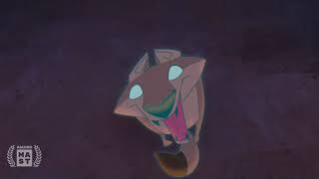
Coyote Tosses the Stars
Notes:
https://www.youtube.com/watch?v=ZIl0Nqpt41A

Slide 8
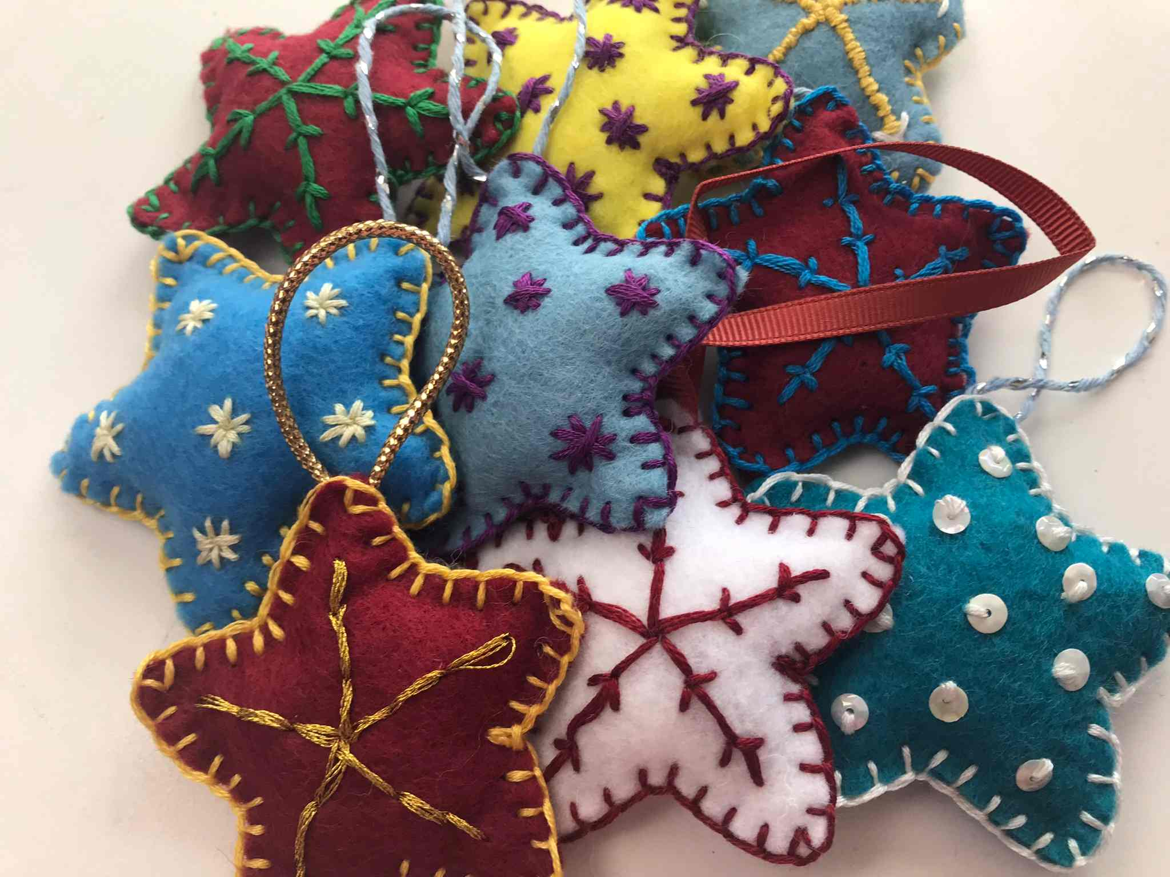
Felt Star Ornament

Slide 9
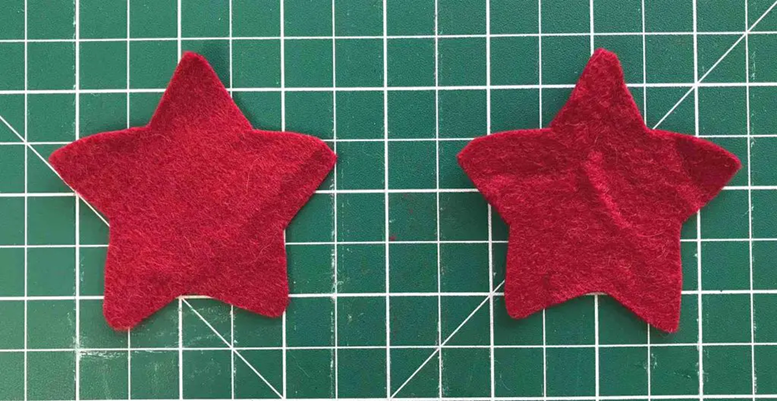
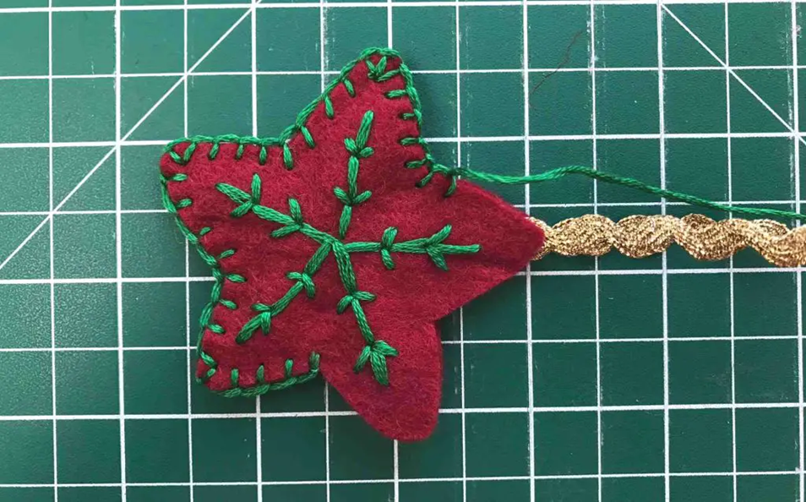
Felt Star Ornament
Cut out the star shape and that is your pattern. Use your pattern to cut out 2 felt stars. They can be in the same felt or different colors
Take your 2 stars and place one on top of the other making sure that the wrong sides are together. Start sewing your star closed using a blanket stitch.

Slide 10
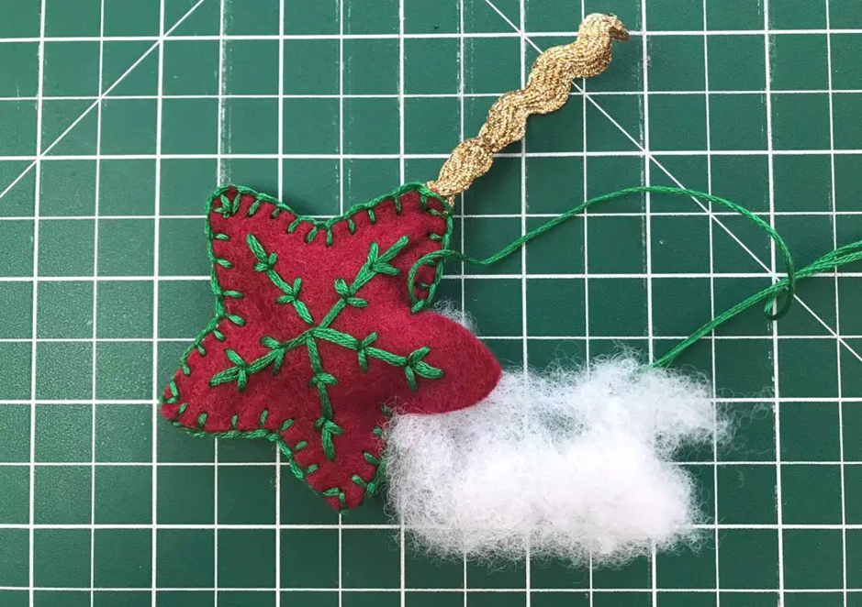
Felt Star Ornament
Before you complete the star, perhaps with one point to go, it is time to add some stuffing. Add as much or as little as you like. Once you are happy complete your blanket stitch around the edge. Complete stuffing the last point as you sew around it.

