Slide 1
Southwind High School
Annual Title I Meeting
Presented by:
Mrs. TEMEKA DICKENSON, TITLE I / PLCc

Slide 2
Purpose of Title I
The purpose of Title I is to ensure that all students have a fair, equal, and significant opportunity to obtain a high-quality education.
Title I:
Provides federal funding to schools and districts with high percentages of children from low-income families.
Helps close the achievement gap between disadvantaged students and their peers.
Supports programs that improve academic achievement.
Encourages parent and family engagement in their child’s education.
Funds additional services, such as tutoring, after-school programs, and instructional support.

Slide 3

Southwind High is a Title 1 school.
We are eligible for a School-Wide Title I Program
We qualify to receive federal funds under the Every Student Succeeds Act (ESSA), for the 2025 – 2026 school year (Title I, Part A).

Slide 4

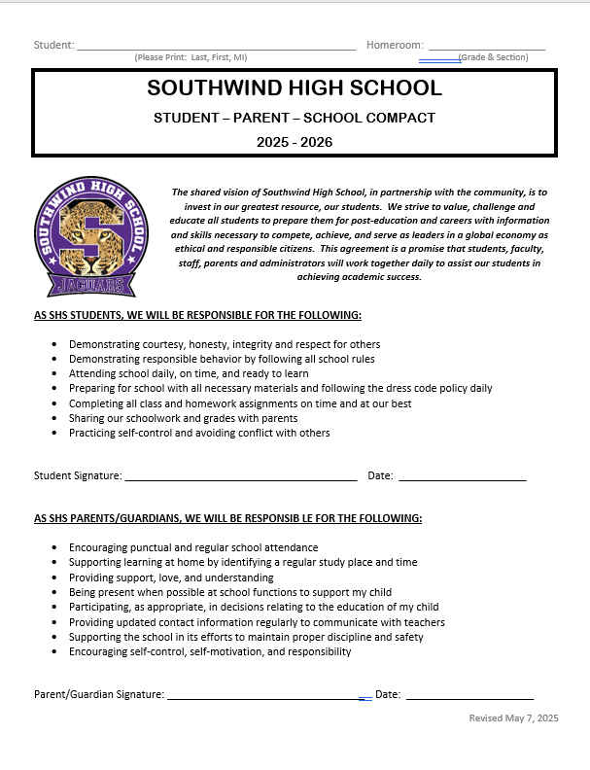
School/Parent Compact
The compact has been jointly developed and agreed upon by students, parents, teachers, and administrators of Southwind High School.
School Compact – English
School Compact - Spanish

Slide 5

Family Engagement Plan
Shelby County Schools’ Family Engagement Policy #4502
  Provide meaningful, two-way communication
  Reduce barriers
  Provide training opportunities and informative sessions
Family Engagement Plan - English
Family Engagement Plan - Spanish

Slide 6

Opportunities for Parental Involvement
Parental Involvement is the participation of parents in a regular, two-way, meaningful communication involving student academic learning and other school activities, ensuring that parents:
  are full partners in their child’s education
  assist in their child’s learning
  (ESSA § 4108)

Slide 7

Parent’s Right to Know
A teacher’s professional qualifications
A teacher’s baccalaureate and/or graduate degree
A paraprofessional’s qualifications
Child’s name, address, and telephone number will not be released to military recruiters
Parent’s Right to Know (English & Spanish)

Slide 8
Parent’s Right to Know
child’s academic achievement level
option to request a transfer to another school within the district
Timely notification that their child has been assigned to, or has been taught for four or more consecutive weeks by a teacher who does not meet the required licensing and endorsement of the subject being taught
Parent’s Right to Know (English & Spanish)

Slide 9

Student Code of Conduct (Policy 6022)
Each Shelby County School should:
Develop and implement a School-Wide Intervention Behavior Plan
Strive to promote and support appropriate behavior in students
Utilize various prevention and intervention strategies; and progressive discipline
Include a parental engagement component and shared responsibility of a child’s conduct
https://go.boarddocs.com/tn/scsk12/Board.nsf/files/BJ9V2S7EAC1E/$file/6022%20Student%20Conduct.pdf

Slide 10
Availability of Parent Training Sessions
Southwind High School is committed to strengthening partnerships with families by offering flexible meeting times that accommodate parents’ diverse schedules and needs.
We schedule family meetings, conferences, workshops, and training sessions through morning sessions for families who prefer early hours and evening sessions for working parents.
We offer some of our meetings through virtual platforms. This promotes flexibility that allows families to join from home or work, eliminating transportation and childcare barriers.
We communicate upcoming meetings well in advance through multiple channels, such as text alerts, phone calls, and social media, so that families can plan for attendance.

Slide 11
Reporting Student Progress
Report Cards (issued every 9 weeks) - Shows academic grades, conduct, and attendance. (review student calendar for specific dates)
Progress Reports (issued mid-way every 9 weeks) - Give updates on current performance before final grades are issued. (review student calendar for specific dates)
Parent-Teacher Conferences (offered once each semester) - Allow direct discussion about student progress, strengths, and areas needing support. (review student calendar for specific dates)
PowerSchool – Gives families real-time access to grades, assignments, and attendance.
Informal Communication
Emails, phone calls, or class newsletters to highlight achievements or address concerns early.

Slide 12
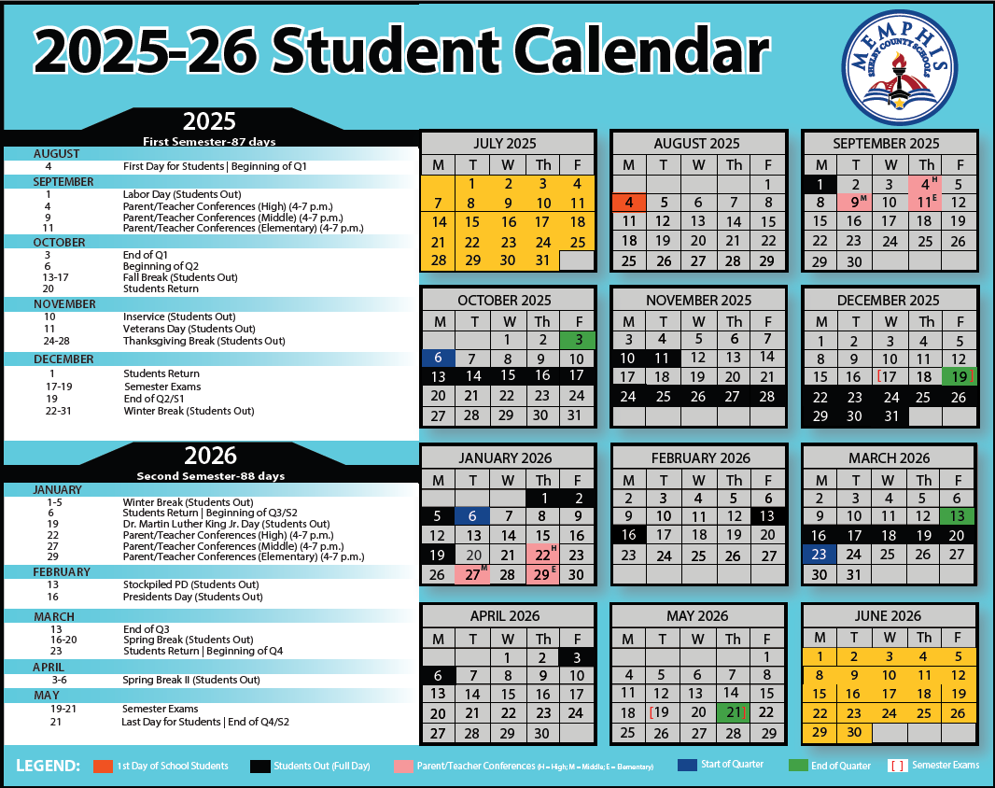
IMPORTANT DATES:

Slide 13
Southwind High
ACADEMIC PROGRESS
END-OF-COURSE RESULTS
2024 – 2025

Slide 14
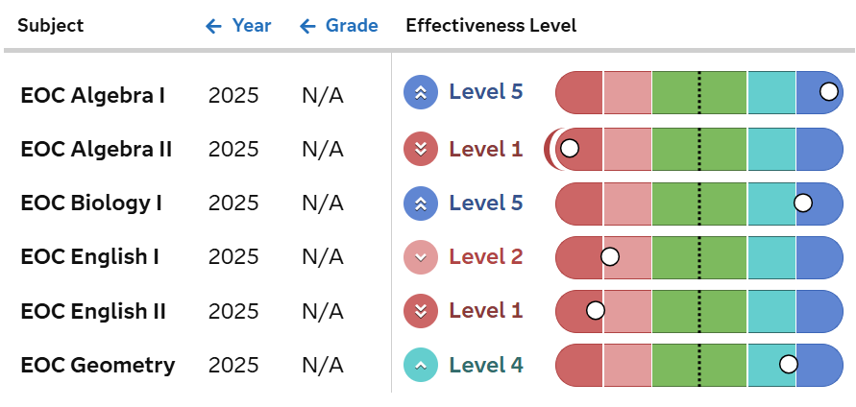
TVAAS GROWTH SCORE
2024 - 2025
LEVEL
2

Slide 15
School Improvement Plan
(SIP)
The SIP documents:
  Academic Successes
  Academic Challenges
  Academic Goals
  Action Steps/Strategies

Slide 16
School Improvement Plan
The SIP is updated annually by the Administrators, Instructional Coaches, teachers, parents, and students of Southwind High.
Temeka Dickenson,
Title I/PLC Coach dickensontl@scsk12.org

Slide 17


