Slide 1
Sex Education
Raise your hand if you have any questions
Be respectful
Courtney Finneman RN

Slide 2
Sexually Transmitted Infections
Communicable diseases that spread from one person to another during sexual activity are called sexually transmitted infections (STIs)
  Engaging in sexual activity one time is all it takes to contract an STI
  People with more sexual partners have greater chances of getting an STI
Goodheart-Willcox Publisher

Slide 3
How People Contract STIs
STI transmission can occur through
Sexual touching
STI transmission cannot occur through
Casual contact, such as using the same toilet seat
Sexual intercourse
Kissing (for certain oral STIs)
Sexual activity (any contact with a person’s reproductive organs)

Slide 4

Do teenagers get STI’s ?
Young people ages 15-24 accounted for 53% of new STI’s in 2022.

Slide 5
STI’s
STI’s
Live Trichomonas vaginalis in Diamond's medium (youtube.com)
STI | SYMPTOMS | TREATMENT
Chlamydia | Pain or burning with urination, unusual discharge, vaginal bleeding between periods, testicular pain. Can infect genitals, eyes, throat or rectum. | Must see a healthcare provider for antibiotic treatment. (Bacterial )
Gonorrhea | Pain or burning with urination, unusual discharge, pain or swelling of testicle, abdominal pain, vaginal bleeding between periods. Can infect genitals, eyes, throat or rectum. | Must see a healthcare provider for antibiotic treatment. ( Bacterial )
Herpes | HSV1- Oral Herpes ( cold sores) fever blisters around the mouth and lips. HSV 2- Genital herpes, painful sores around the genitals, that often itch. Spreads from skin-to-skin contact | Viral – No treatment but there is medication that can decrease outbreaks and lessen symptoms.
Trichomoniasis | Caused by a parasite. May cause itching, burning, redness or soreness of genitals. Discomfort with urination, unusual discharge. Men typically have no symptoms. | Must see healthcare provider for antibiotic treatment.

Slide 6
STI’s Continued
STI | SYMPTOMS | TREATMENT
HPV/ GENITAL WARTS | Pink bumps in genital area, can be flat, raised or cauliflower looking. Can cause cancer in men and women ( cervical , anal, oral and throat cancer) . | Warts can be removed by a Dr but virus remains in the body for life and can have flare ups.
PUBIC LICE | Itching in genital area. Crab shaped parasitic insects in pubic hair area. | Over the counter treatment available.
HIV/ AIDS | Fatigue, fever, cough, sweating, Immune system can not fight of common colds, flu, or other illness | NO CURE. Treatment to manage symptoms.

Slide 7
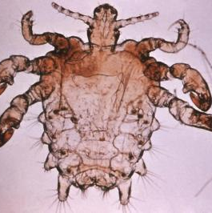
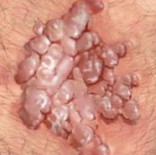
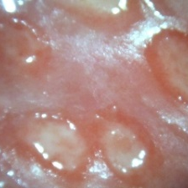
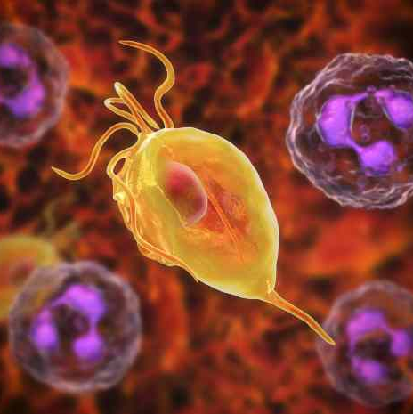
STD’s Continued
Public Lice
Genital warts
Herpes
Trichomoniasis

Slide 8
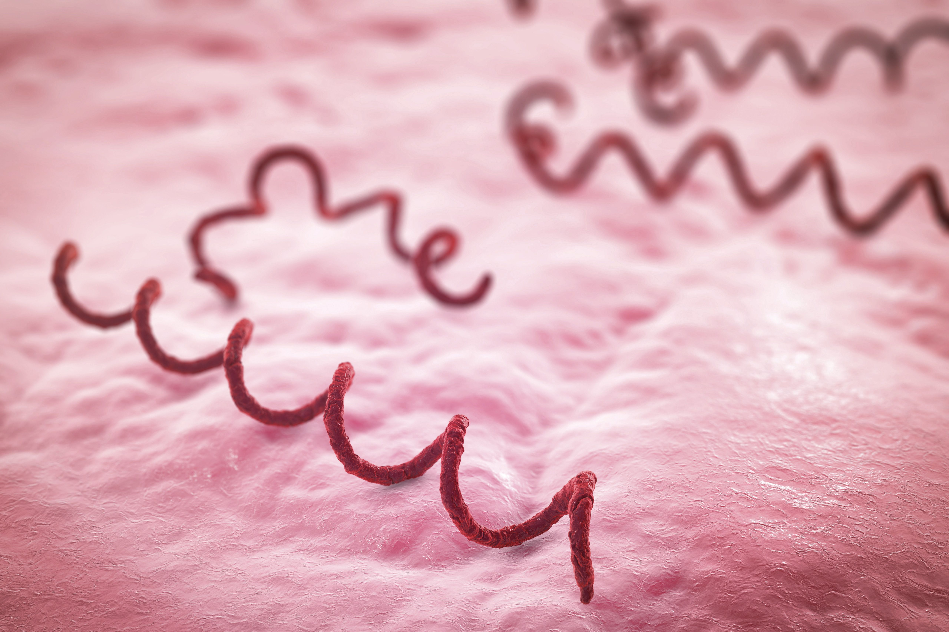
Syphilis
Caused by a bacteria Treponema Pallidum
Primary- 2-12 weeks post exposure, painless chancer.
Secondary- 1-6 months post after primary. Rough bumpy rash, does not itch. Fever, headache, weight loss.
Latent- NO SYMPTOMS. Damages heart, bones, nerves and other organs. Can last up to 20 years.
Tertiary- 20% of people without treatment progress to tertiary syphilis. Brain damage, movement disorders, heart disease, seizures, death.

Slide 9
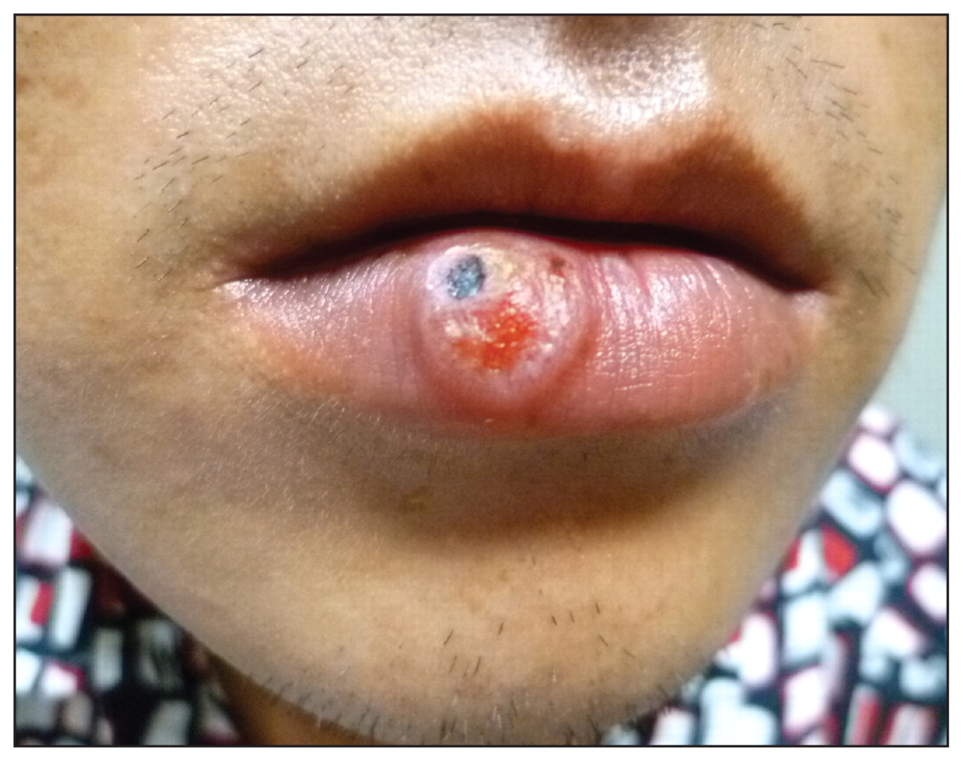
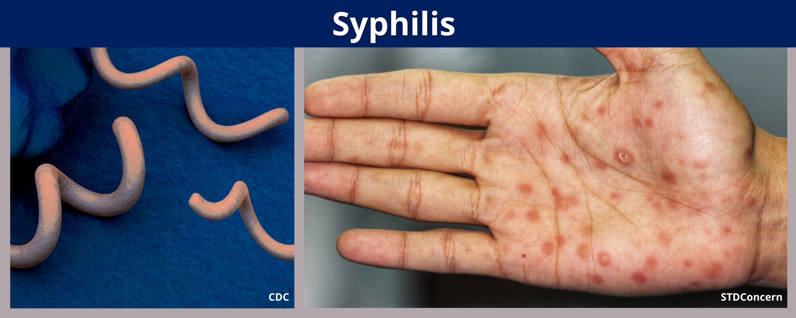
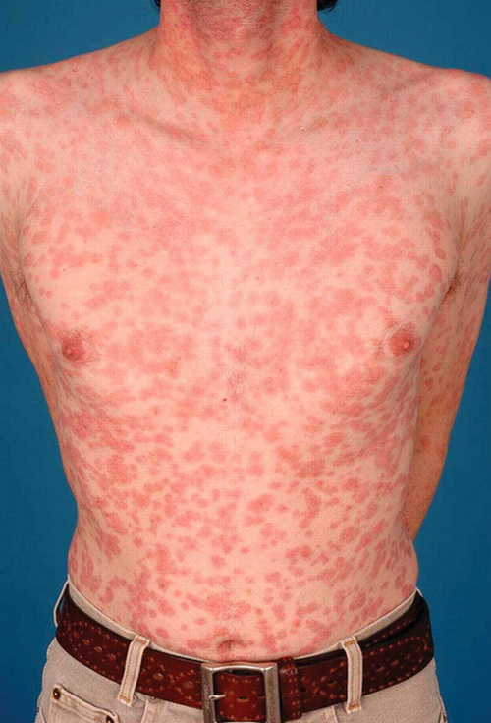
Syphilis Continued
Chancer
Syphilis rash
://www.youtube.com/watch?v=foUUeARe2f8

Slide 10
Prevalence in Montana
Table 21. Primary and Secondary Syphilis — Reported Cases and Rates of Reported Cases by State, Ranked by Rates, United States, 2022
Rank* | State | Cases | Rate per 100,000 Population
1 | South Dakota | 767 | 84.3
2 | New Mexico | 761 | 36.0
3 | Arkansas | 1,001 | 32.9
4 | Oklahoma | 1,278 | 31.8
5 | Mississippi | 913 | 31.1
6 | Arizona | 2,151 | 29.2
7 | Montana | 325 | 28.9

Slide 11
How much do you know ?
STIs quiz | Be in the KNOW

Slide 12
Pregnancy prevention
After studying this lesson, you will be able to
10.6-1 Recognize pregnancy prevention facts and myths.
10.6-2 Understand the effectiveness of abstinence in preventing pregnancy.
10.6-3 Identify barrier methods for preventing pregnancy.
10.6-4 Describe how hormonal methods and IUDs prevent pregnancy.
10.6-5 Explain how natural methods and sterilization reduce the risk of pregnancy.

Slide 13
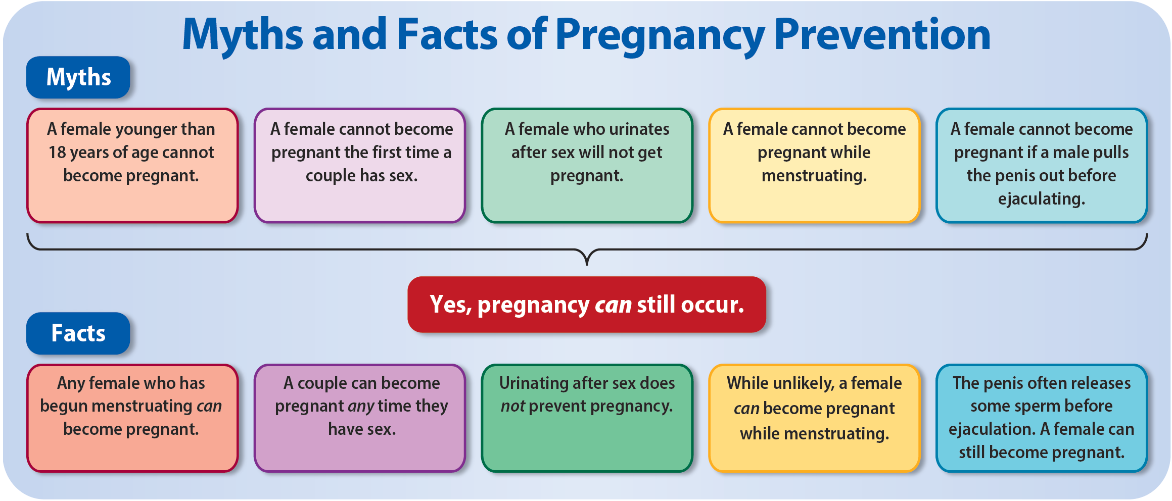
Myths and Facts About Pregnancy Prevention
Birth control, or contraception, is any method that reduces the risk of pregnancy from sexual activity
Goodheart-Willcox Publisher

Slide 14
Factors Affecting Birth Control
Each birth control method has benefits and drawbacks to consider
How much does
it cost?
How easy is it to get and use?
Is it reversible or permanent?
Does it prevent pregnancy?
Are there side effects?
Is it effective in preventing STIs?

Slide 15
Abstinence
https://www.youtube.com/watch?v=A25s1RO4J8g&t=3s
Abstinence is the most effective form of birth control, and it also:
  Prevents STIs
  Encourages social and emotional growth
  Is free and always available
  Carries no risks
  Is reversible, so people can have children if they want in the future

Slide 16
Benefits of Abstinence from Sexual Activity
How effective is abstinence in
preventing STIs and pregnancy?

Slide 17
Skills Check: Refusing Sexual Activity
Practice
Refuse
Seek advice
Use a short, simple, honest, assertive response
You can also walk away from the situation
Remember you do not need to face this alone
Talk to a trusted adult for guidance
Reflect on potential risky situations
Consider the words you might use ahead of time

Slide 18
Think About It…Methods Of Birth Control
Do other methods of birth control share the benefits of abstinence?
What influences might cause a young person to choose a less effective or helpful method?

Slide 19
Barrier Methods
Barrier methods physically block sperm from reaching the egg
  External condom
  Internal condom
  Contraceptive sponge
  Diaphragm
  Cervical cap

Slide 20
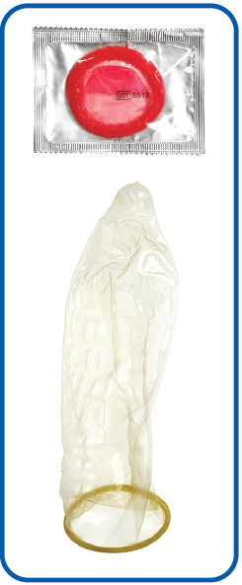
External Condom
The external condom is worn on the penis during sexual intercourse
  Reduces the risk of pregnancy and STIs
  Materials effective against STIs include latex, polyurethane, or polyisoprene, not sheepskin or lambskin
  Cannot be reused
  Stop working when damaged or expired
Top to bottom: kaarsten/Shutterstock.com; Dragan Milovanovic/Shutterstock.com

Slide 21
Internal Condom
The internal condom is a plastic pouch inserted into the vagina or rectum
  Reduces the risk of pregnancy and STIs
  Should not be worn with an external condom

Slide 22
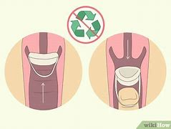
Contraceptive Sponge
The contraceptive sponge is inserted into the vagina and contains spermicide
  Less effective than condoms
  Does not protect against STIs

Slide 23
Diaphragm and Cervical Cap
The diaphragm and cervical cap are flexible cups that cover the cervix
  Require prescriptions from a doctor
  Must be inserted several hours before intercourse
  Come with directions for insertion, removal, and care
lauramntg/Shutterstock.com

Slide 24
Hormonal Methods and IUDs
Several birth control methods rely on female hormones
  All inhibit ovulation to help prevent pregnancy
  Some also treat medical conditions such as menstrual pain
  Do not prevent transmission of STIs

Slide 25
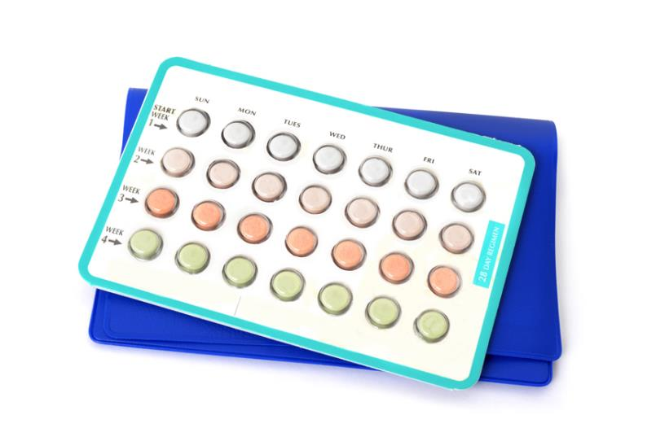
Oral Contraceptives
Oral contraceptives are called “birth control pills” or “the pill”
  Requires a medical exam and prescription
  Taken in pill form every day
  Also thickens cervical mucus, which slows down sperm
Kim Reinick/Shutterstock.com

Slide 26
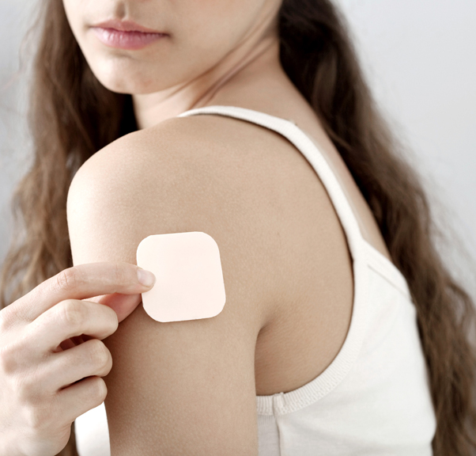
Birth Control Patch
The birth control patch is applied to the skin like a bandage
  Worn for three weeks
  On the fourth week, no patch is worn and the female should menstruate
  Does not prevent STI’s
Image Point Fr/Shutterstock.com

Slide 27

Vaginal Ring
The vaginal ring is a small, flexible ring inserted into the vagina for three weeks
The ring is discarded in the fourth week, and the female should menstruate
Does not prevent STI’s
Image Point Fr/Shutterstock.com

Slide 28
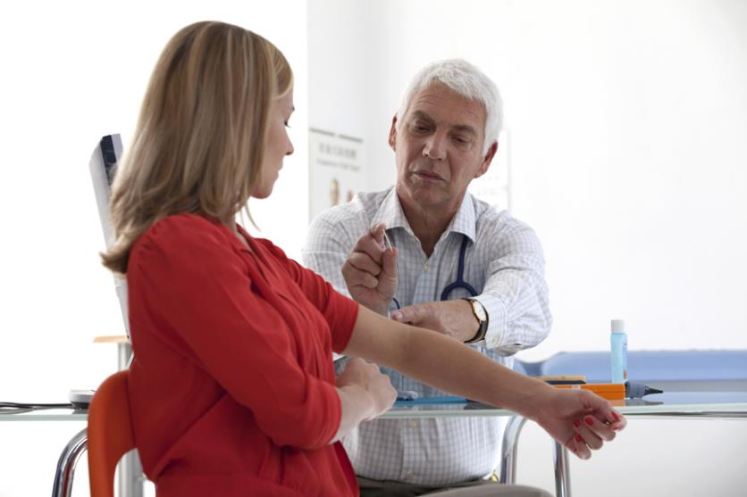
Birth Control Shot and Implant
A birth control shot is a hormone injection
The birth control implant is inserted into the upper arm for up to three years
Does not prevent STI’s
Image Point Fr/Shutterstock.com

Slide 29
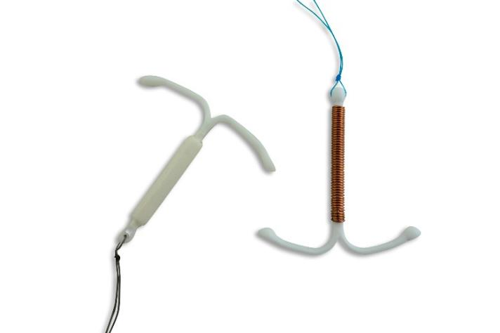
Intrauterine Device (IUD)
An intrauterine device (IUD) is a T-shaped device inserted by a doctor
  Copper IUD interferes with sperm movement, fertilization, and implantation
  Hormonal IUD inhibits ovulation
  Lasts for 3-10 years, but can always be removed
  Does not prevent STI’s
iStock.com/Lalocracio

Slide 30
Withdrawal
The most commonly used birth control method is withdrawal, or pulling out.
  Pulling the penis out of the vagina before ejaculation
  Is NOT an effective method of birth control
  Difficult to time
  Sperm often leaks from the penis before ejaculation
  Does not protect against STIs

Slide 31
Health Alert! Withdrawal
When withdrawal
is used
22% of females still become pregnant

Slide 32
Sterilization
The permanent method of birth control is sterilization
  Procedure performed by a doctor to prevent sperm and egg
  from uniting
  Prevents pregnancy, but not STIs
  Difficult, and sometimes impossible, to reverse
  Young people under 21 can not receive sterilization

Slide 33
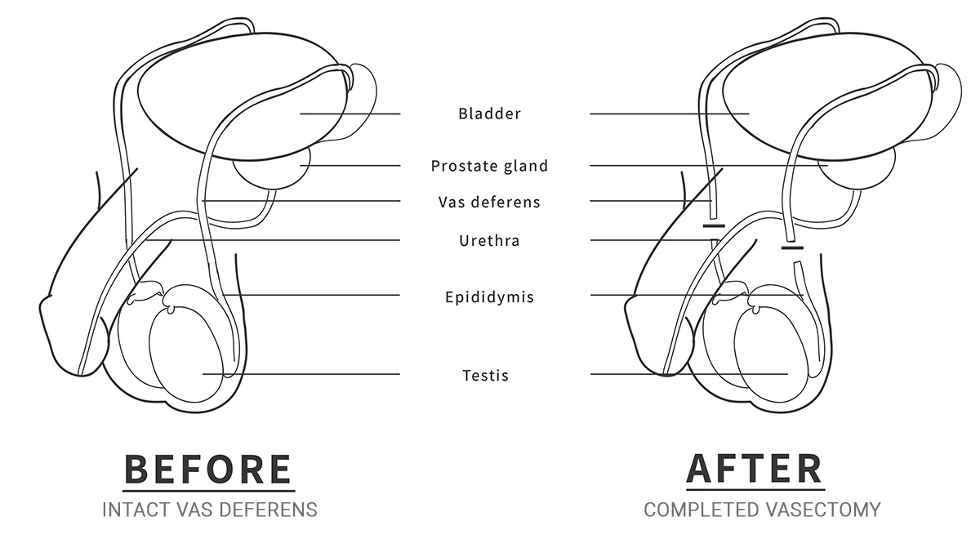
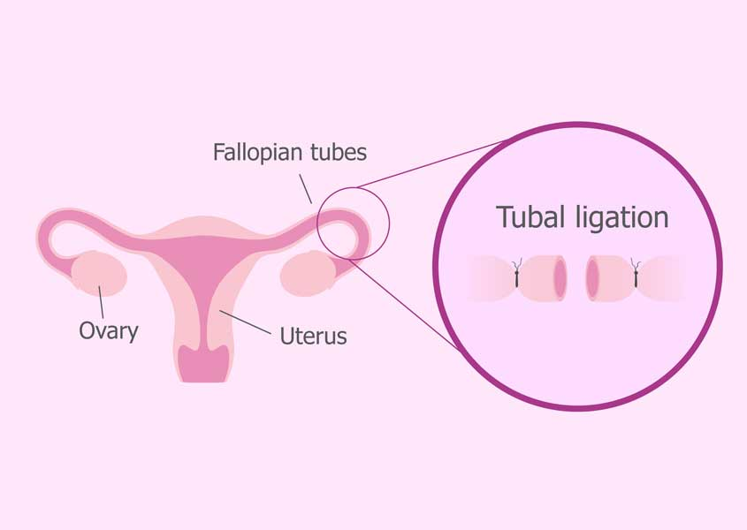
Male and Female Sterilization
Male sterilization is called a vasectomy
  Closes the vas deferens to prevent sperm from leaving the testes
Female sterilization is called tubal ligation
  Cuts and seals off parts of the fallopian tubes

Slide 34
Pregnancy prevention review
True or false? Someone cannot become pregnant while menstruating.
Which method of birth control is free, most effective, and always available?
Birth Control Guide (Chart)

Slide 35
Pregnancy prevention review
Which birth control method is called the “birth control pill” or “the pill”?
__________ is permanent birth control.
True or false? Withdrawal is an effective method of birth control.

Slide 36
Teen pregnancy
What factors and challenges are associated with teen pregnancy and parenthood?

Slide 37
Risk Factors for Teen Pregnancy
Little knowledge about sexual health and contraception
Parent who had a child before age 20
Unprotected sexual activity
Living in a home with frequent family conflict
Use of alcohol and drugs
Low self-esteem

Slide 38
Protective Factors for Teen Pregnancy
Family discussions about sexual health and contraception
Healthy family relationships and mental health
Accurate knowledge about sexual health and contraception
Continuous abstinence

Slide 39
Challenges of Teen Pregnancy and Parenthood
Many physical challenges of teen pregnancy result from poor prenatal care
Parent | Child
STIs from sexual intercourse Anemia High blood pressure Complications during childbirth | Low birthweight Death within first year of life Dependence on addictive substances Slow growth Infections

Slide 40
Behaviors of Pregnancy
To maintain health during pregnancy

Slide 41
Social and Emotional Challenges of Teen Pregnancy
Difficulty balancing responsibilities as parents, family members, and friends
Intense emotions and stress
Less time for social and extracurricular activities
To maintain health, adolescents can maintain healthy relationships and get professional help, if needed

Slide 42
Economic Challenges of Teen Pregnancy
Trouble completing school and finding a job with enough income
Financial strain from caring for child
It is valuable for adolescent parents to complete their education

Slide 43
Healthy relationships
https://youtu.be/b_MiEz5sjdo

Slide 44
Questions ?

Slide 45
Hormones
Do you know anything about the male hormone cycle?
What is the menstrual cycle ?
Do you know anything about how the menstrual cycle affects emotions?

Slide 46
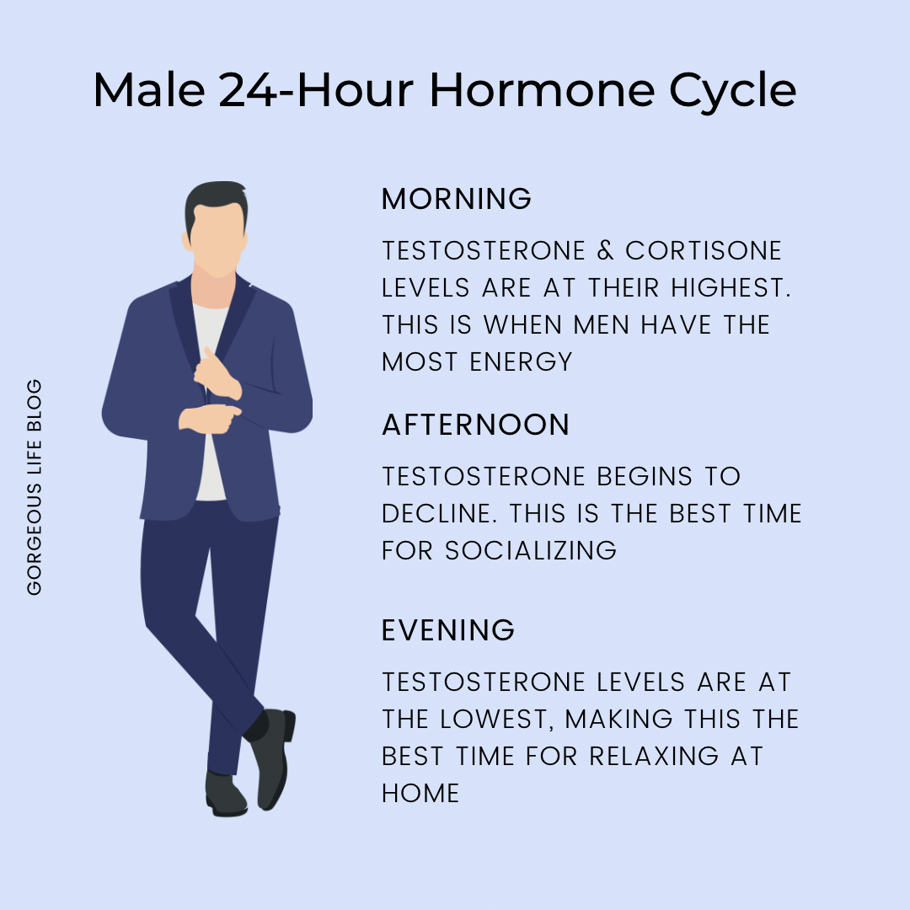
Male hormones
Memory and cognitive function.
Muscle mass and bone density.
Mood and behavior.
Growth of body hair.
Development of a deeper voice.
Energy levels.

Slide 47
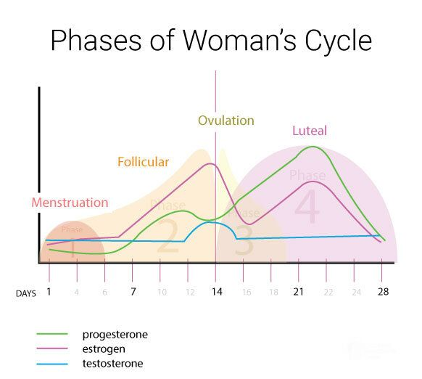
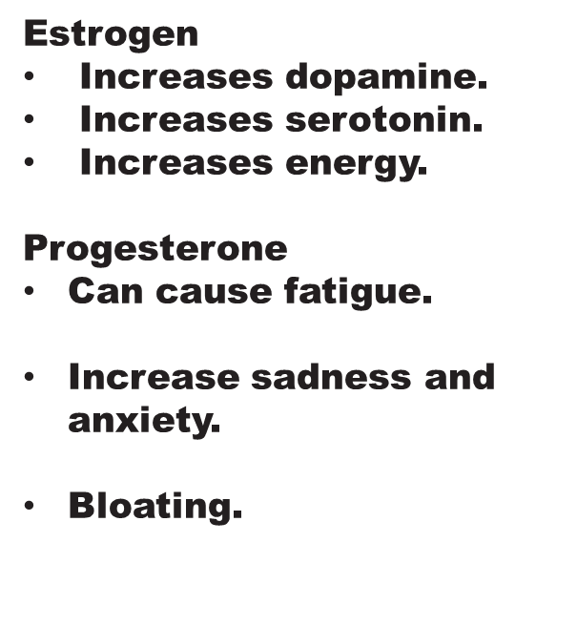
Female hormones

Slide 48
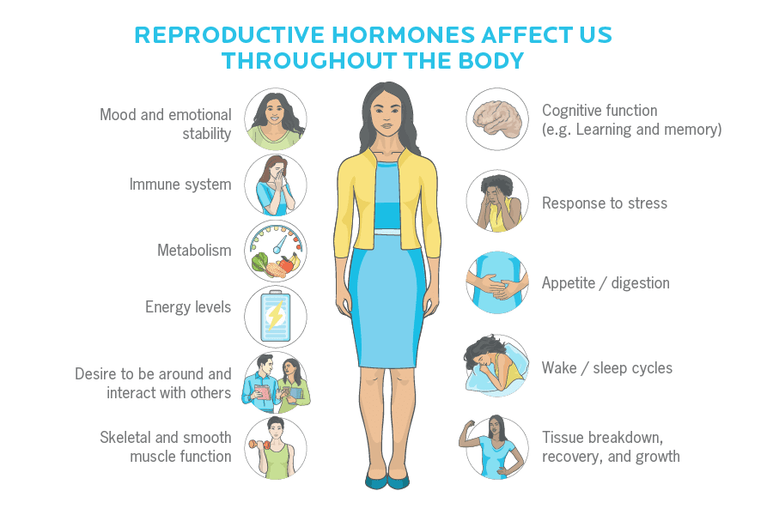
Hormones continued
Hormones effect all aspects of our lives.

Slide 49
8th grade video
THE TEEN FILES: SEX 101 THE TRUTH (youtube.com)

