Slide 1


2026-2027 Course Selection
December 5th

Slide 2
Registration Timeline
Launch Your Future Night 4:00-7:00
Registration Kick Off to 9th-11th Grade
December 5th
December 21st
December 5th
December 10th
Registration Window Opens
Registration Closes at 3:30pm

Slide 3
Launch Your Future Night
December 10th
4:00pm - 7:00pm
Tonight you will be able to see and experience our IB World School MYP, DP, and CP courses and programs in-person and hands-on!
​Welcome- top of each hour (Commons)
4:00, 5:00, and 6:00pm - Mr. Paul Menard, RHS Principal
Welcome, high level overview of our pathways
Information on how to navigate the building and the evening
College credit information
4:00-7:00 pm- RHS Classrooms
​Teachers from all departments will be available to answer questions about classes and academics at Rockford High School. Learn about our career pathways, college credit opportunities, and overall course curriculum. Tour classrooms, enjoy a quick course lesson, or see the results of student work in the classroom.
Ask a student! Students will be on hand to answer questions about RHS life and courses
Rocket School Store will be open
Individual school tours available upon request

Slide 4
Graduation Requirements
Total of 50 Required Credits
Class of 2027 & 2028
8 English
7 Social Studies
6 Science
6 Math
2 Fine Arts
1 Health
1 Phy Ed
1 CTE
18 Electives
Class of 2029 & 2030
8 English
7 Social Studies
6 Science
6 Math
2 Fine Arts
1 Health
1 Phy Ed
1 CTE
1 Personal Finance
17 Electives
*If you are pursuing the Full Diploma program, we recommend that you take your Fine Arts in 9th grade, Health, Phy Ed and Personal Finance in 10th grade

Slide 5
Transcript
Review your transcript carefully at the end of every semester
The majority of you will have more credits than required for graduation
Check to make sure you do have any incompletes
Your GPA is cumulative (it builds each year)
Valedictorian/Salutatorian are calculated after 1st semester of your senior year

Slide 6
What happens if you get an “F”
If you received an “F” in one of your core classes, you will need to repeat the class or make it up in Summer School
The “F” will stay on your transcript
Make sure to keep track of your grades and transcript. You will have to complete the required classes to graduate.

Slide 7
Educational Pathways for 11th/12th Grade

Slide 8
Questions to consider as you move forward in high school
What are the different options for earning college credit?
  What educational pathways can I take?
  How can I align these with my future career?
How can I earn college credit and save money in High School?
Do I qualify for any of the options?
How do I know what is best for me?

Slide 9
All RHS Students have the opportunity to
earn college credit.

Slide 10
IB Pathways at RHS
IB Course Work
Career-related Program
Full Diploma Program
Students can pick & choose courses from any of these pathway
Students can earn certificates and college credit in each pathway and an additional Diploma
Students pursuing this option have the opportunity to earn an additional Diploma
Students can decide to not pursue the Full Diploma or Career-related certificate and still take coursework from either area
Students can earn an additional Diploma through IB, contingent upon the successful completion of all the components below and receiving a minimum score of 24.
15 Different Career Pathways to choose from
Great way to explore potential career pathways
Earn college credits and/ or a certification
Complete 2 DP Courses & Exams
Complete Personal & Professional Skills 11
Complete Personal & Professional Skills 12
Language and Cultural Awareness
Community Engagement
Reflective Project
3 Higher Level (HL) DP courses & exams
3 Standard Level (SL) Courses & exams
Core: Extended Essay, Theory of Knowledge (2 semesters), Creativity, Action, Service (CAS)

Slide 11
IB Courses : All students have the opportunity to:
Sit for an IB exam with the potential to earn college credit
  Classes with the label “DP” in the title have college credit attached to them
  Students have the potential to earn college credit by participating in Internal Assessments (Assessments given & graded by teachers in class) & External Assessments (Taken at RHS & sent to IB for grading)
  Students will receive an overall score (1-7) from IB based on these assessments. Each college awards credits differently based on exam type and score.
    Ex. Augsburg awards 4 college credits for Biology (HL) if a student scores 5, 6 or 7.
    Ex. NDSU awards 8 college credits for Biology (HL) if a student scores a 4 or higher.
For more information on IB College Credit opportunities, see the IB website -and for info on IB credit click here Colleges/Universities-IB credit

Slide 12
Did you know that students have the ability to take multiple exams through the IB program to attempt to earn college credit? Each course varies on prerequisite requirements, exam requirements, etc. For more detailed information, please read the course description in the course guide.
2 Year Courses | 1 Year Courses | 1 Year Electives
DP Lang & Lit HL | DP Lang & Lit SL | DP Film SL
DP European History HL | DP Economics SL | DP Theater SL
DP Biology HL | DP Physics SL | DP Visual Arts SL
DP Analysis & Approaches HL | DP Application & Interpretations SL | DP Business Management SL
 | DP Spanish SL | DP Music SL
DP Course Offerings

Slide 13
All students have the opportunity to:
Take an IB class co-seated with a College in the Schools (CIS) class to earn college credit
  Classes that contain the word “College” have additional opportunity to earn college credit through our CIS program
  CIS classes are taught by high school teachers that have partnered with a college (St. Cloud State, UMD, U of M)
  Students get the opportunity to experience a college level course and earn college credit while the getting the support of their high school teacher
  Students earn the credit by successfully completing the course with a passing grade
For a full list of CIS opportunities, and requirements to take these courses, see page 15 of the Course Description Guide

Slide 14
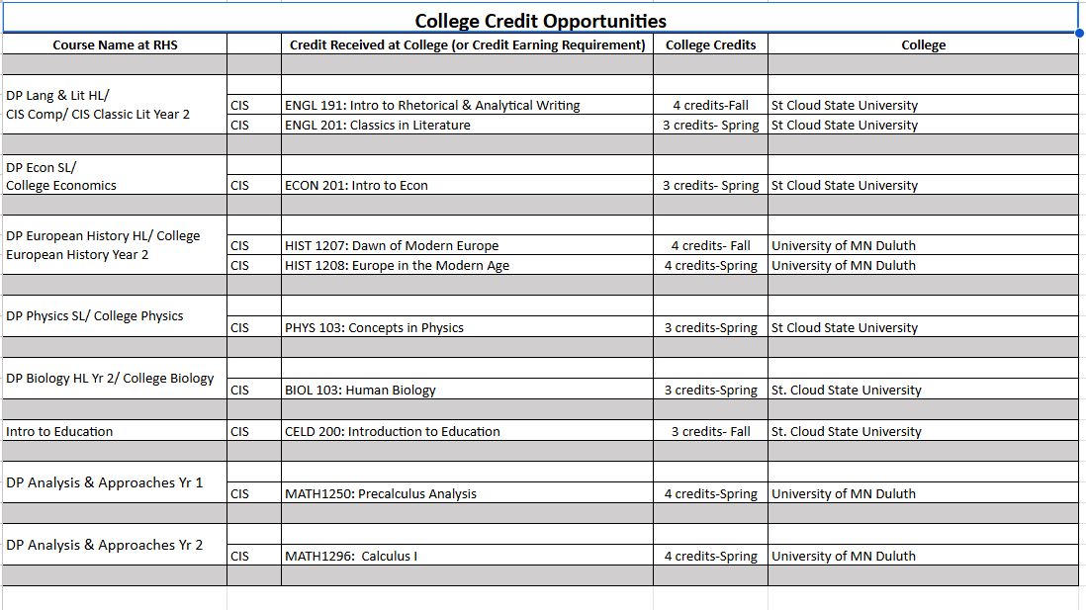
Did you know that students have the ability to earn at least 35 college credits while staying on campus at RHS? They are able to participate in this unique partnership because the school district partners with Universities and pays for the college credit in our co-seated college courses.

Slide 15
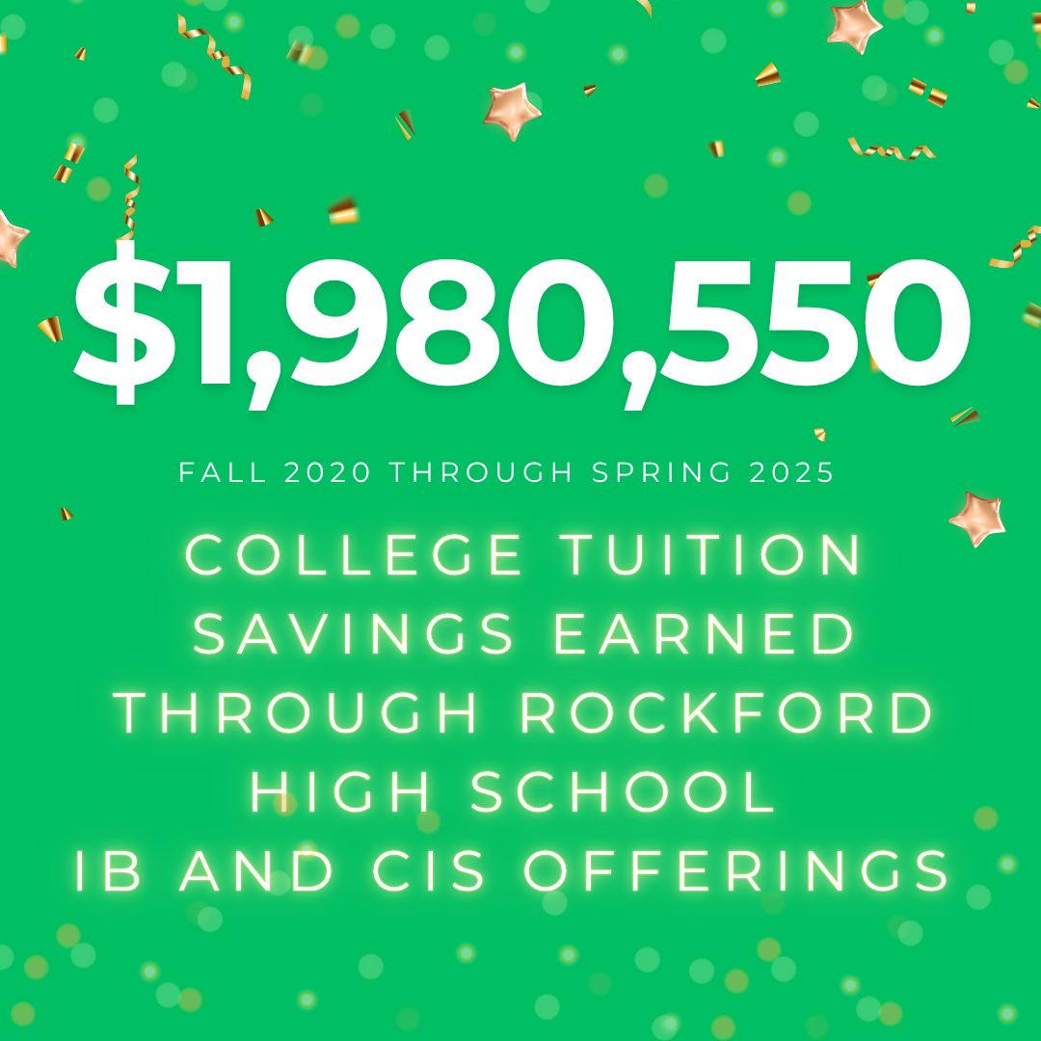
All students have the opportunity to:
Transfer their earned college credits to their post-secondary institution for consideration
  To find out how credits transfer within the state of Minnesota, students can use Transferology
    Create an account on transferology.com
    Search for courses and matches at each college & university
    Download a transfer guide
  To find out how credits transfer outside the state of Minnesota
    Contact the admissions office for the college/university you are interested in attending
For more information on IB College Credit opportunities, Colleges/Universities-IB credit

Slide 16
Educational Pathways for 11th/12th Grade
International Baccalaureate Programme (IB)
Post - Secondary Education Option (PSEO)
College in the Schools (CIS)
Ms. Bloom will host a Rocket Block informational session in December - sign up!
Full Diploma Program (DP)
Career-related Program (CP)
IB Course Options
Come to Launch Your Future to learn about the Educational Pathways available in 11th & 12th Grade from your teachers

Slide 17
Career Related Pathways

Slide 18



Launch your Future at RHS
RHS aligns our RHS aligns our pathways with the State of Minnesota Career Fields, Clusters and Pathways

Slide 19
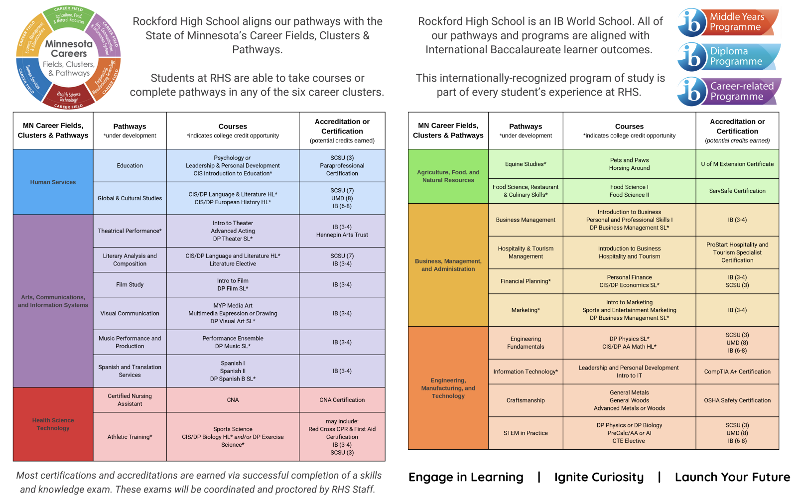

Slide 20
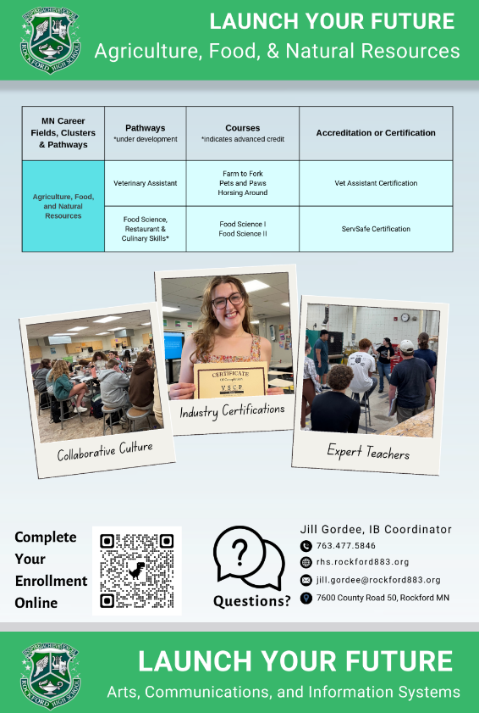
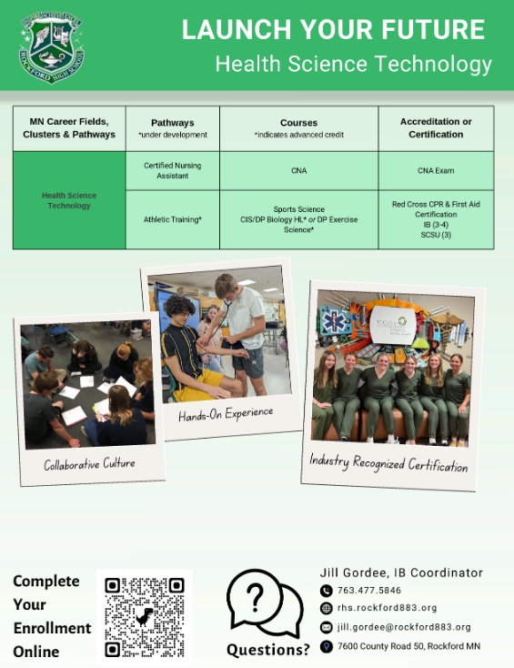

Individual Pathways - 15 different choices at RHS

Slide 21
Full Diploma

Slide 22
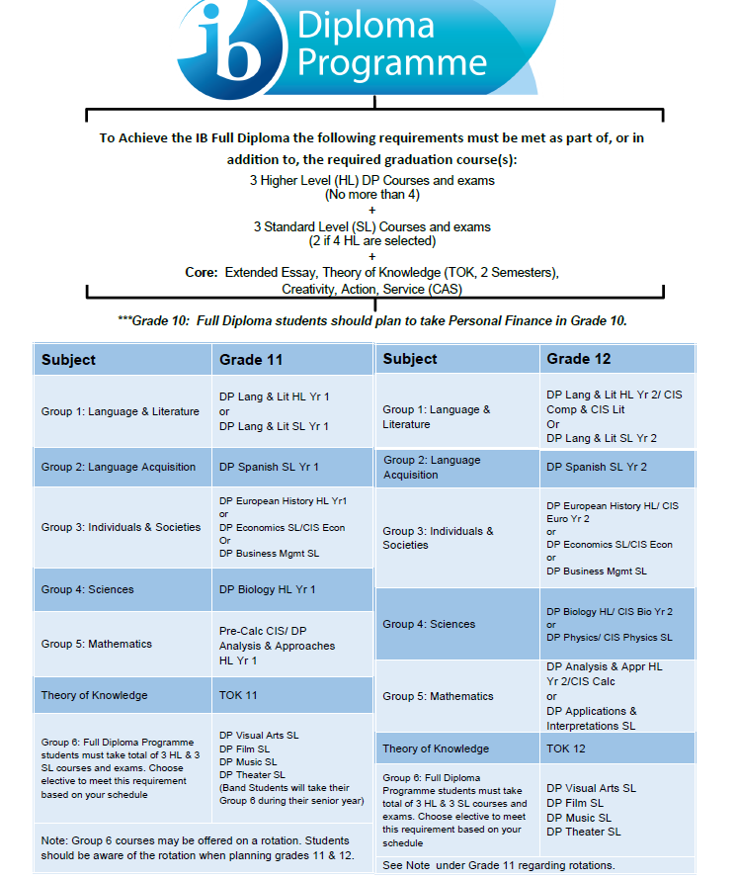
Full Diploma
There will be a responsive session Thursday December 11th to offer more information on the Full Diploma, if you are interested in learning more about it, please complete the form and Ms. Gordee will add you to the Rocket Block.
Contact Information
Email - jill.gordee@rockford883.org
Phone - (763) 477-5846 ext. 3003

Slide 23

10th Grade
Full Diploma and Career Related Pathway
International Baccalaureate
Full Diploma or Career Related Pathway Certificate
Interest Form
___________________________________ ______________
Name Date
I am interested in learning more about about the:
Full Diploma
Career Related Pathways Certification
  Add your Pathway interest (if you have one): ___________________________________
****Turn in today or to the counseling office and Ms. Gordee will follow up with you in Rocket Block

Slide 24
And there is one more choice….

Slide 25
Next Steps
Consider which pathway is the best fit for you
  How do additional requirements fit into your schedule (i.e are you involved in sports or activities, do you work outside of school etc)?
  What is an appropriate amount of advanced level coursework for you to handle?
Attend the Launch Your Future Night on December 10th to ask questions
Complete your 4 year plan on Academic Planner (Infinite Campus)
Set up meetings with Ms. Bloom or Ms. Gordee for more information
  Sign up on December 11th during Rocket Block

Slide 26
Registration for the 2026-2027 school year

Slide 27
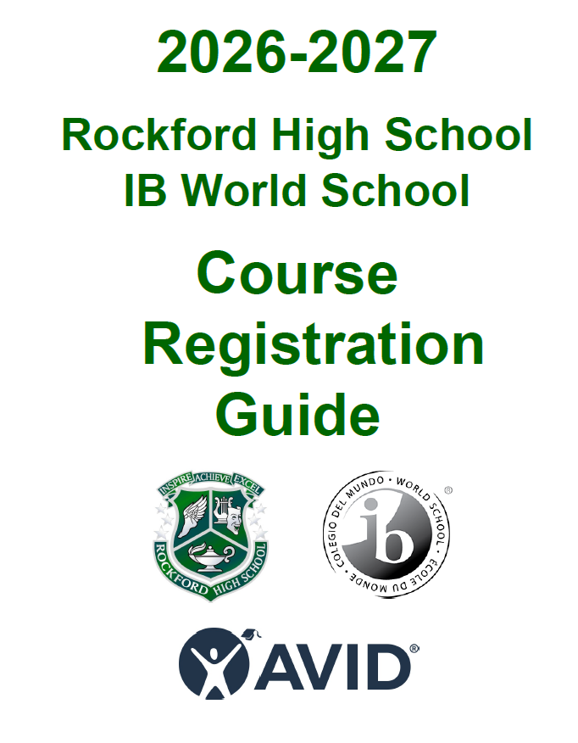
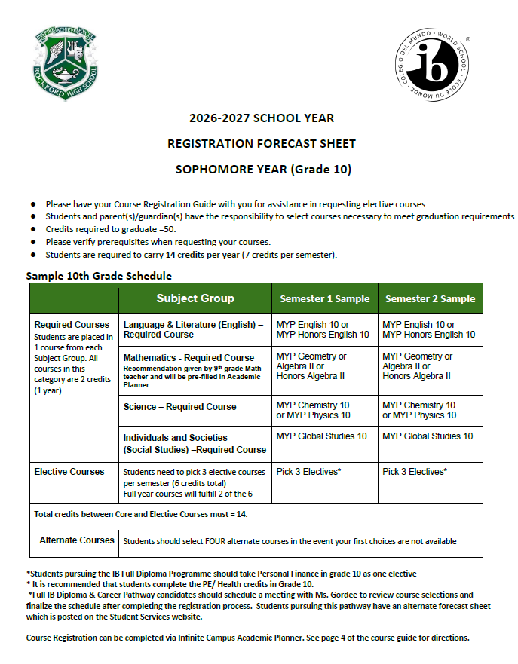
Registration Materials
Registration Worksheet - Tool to complete your online registration. Lists classes and electives required for next year
Course Guide - Lists the graduation requirements, course descriptions and a full list of offerings

Slide 28
10th Grade
Social Studies
MYP Global Studies 10
Science
MYP Physics 10
MYP Chemistry 10
Should I take Chemistry or Physics as a 10th grader?
1. Are you planning to take any college credit-earning science courses as a junior or senior?
Biology HL or SL? Need Chem 10
Physics SL? Need Physics 10
2. What careers are you interested in at this point?
Any medical-related job? Chem
Any math, tech, engineering? Phys
Law enforcement or forensics? Either or both
3. Which seems more interesting to you?
English
English 10
Honors English 10
Math
Based on your teacher's recommendation
*If you are pursuing the Full Diploma program, we recommend that you take your:
Fine Arts in 9th grade
Health, Phy Ed and Personal Finance in 10th grade

Slide 29
11th Grade
English
DP Lang & Lit SL (2 years)
DP Lang & Lit HL (2 years)
Math
Based on your teacher's recommendation
Social Studies
Economics & Government
DP Economics SL (1 year)
DP European History HL (2 years)
Science
General Biology
DP Biology HL (2 years)
Notes:
If you want to take DP Physics, make sure to take physics 10.

Slide 30
12th Grade
English
DP Lang & Lit SL
DP Lang & Lit HL
Math (Optional)
Probability & Statistics (1 semester)
Pre-Calculus / DP A & I SL
DP A & A HL (Year 2)
Social Studies
Civics (1 semester)
DP European History HL (Year 2)
Science (Optional)
DP Biology HL (Year 2)
DP Physics SL

Slide 31
New Courses
Adv Drawing
Adv Painting
Food Science II
Blues to Beats
World Art & Culture / DP Visual Arts SL
Lifelong Physical Wellness
Intro to Athletic Training
Name Changes
MYP World History is now MYP Global Studies 10
New next year!
Physical Education can only be taken one time. Gym electives (Team & Dual or Peak Performance) are the only gym classes that can be repeated
OJT
You must be part of a Career Pathway to qualify for OJT
All students will complete an application & interview
Juniors can take up to 1 block per semester
Seniors can up to 2 blocks per semester
You must be employed for a business at the start of the class time

Slide 32
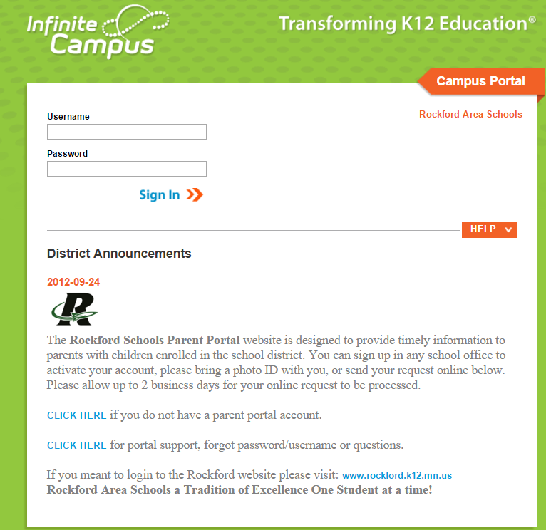
Students will register using the Academic Planner in Infinite Campus. The first step will be to login to your account

Slide 33
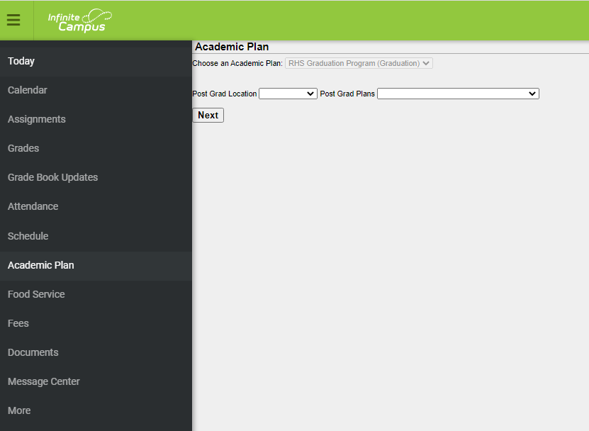
Online Directions
Login to your Infinite Campus Student Portal Account
Enter the students Username & Password
Select “Academic Plan” in the menu on the left hand side
2 Post Grad Plans questions will appear. These are optional . Click on “Next”
Have your 2025-26 Course Description Guide available for course descriptions and pre-requisite courses

Slide 34
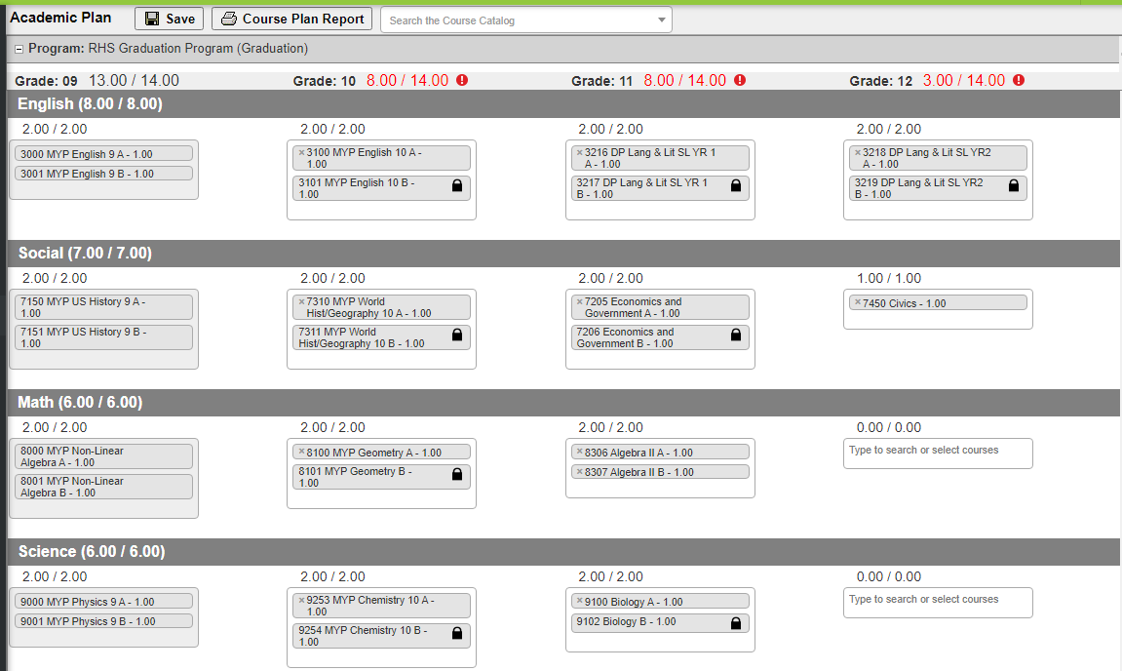
How to register
Review each subject for the upcoming grade you are registering for.
If a course number is entered in error, click on the (x) by the course name to remove it.

Slide 35
Core Classes
Some Core Classes will be pre-filled and some will be based on your choosing. For the courses you can choose, review the course guide to determine the best fit for you.
 | 9th | 10th | 11th | 12th
English | Prefilled with MYP English 9 | English 10 OR Honors English 10 | DP Lang & Lit SL OR DP Lang & Lit HL | DP Lang & Lit SL OR DP Lang & Lit HL
Math | Prefilled with MYP NonLinear Alg OR MYP Geometry | Prefilled with MYP Geometry OR Honors Alg II OR Alg II | Prefilled with Algebra II OR Teacher Recommendation | Optional
Science | Prefilled with MYP Science 9 | MYP Chem 10 OR MYP Physics 10 | Biology OR DP Biology HL | Optional
Social Studies | Prefilled with MYP US History 9 | Prefilled with MYP Global Studies 10 | Economics & Gov OR DP Economics SL OR DP European History HL | Civics OR DP European History HL

Slide 36
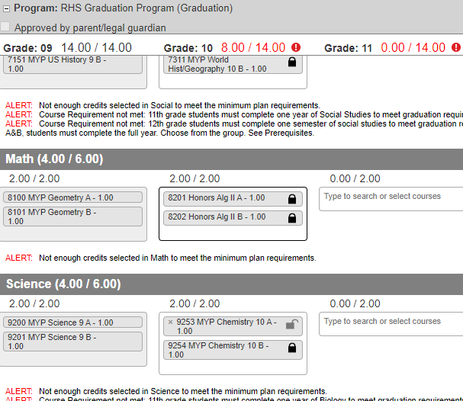
How to Register:
Pre-filled Courses -
With a lock icon are pre-determined based on teacher recommendation and cannot be changed during the registration process.
With no lock icon give you the choice to enroll in a different course than the pre-filled course. To change the course:
  Click the “x” next to the course name to delete the course
  After the course is deleted, click in the box and a drop down list will appear of available courses. Select the course you wish to enroll in. If you select an “A” semester course, the “B” course will auto fill. If it does not, make sure to select the “B” semester course as well.

Slide 37
Non Pre-filled courses
When a course is not pre-filled, click within the box and a drop down list of available courses will appear. Select the course you wish to enroll in. If you select an “A” semester course, the “B” course will auto fill. If it does not, make sure to select the “B” semester course as well.

Slide 38
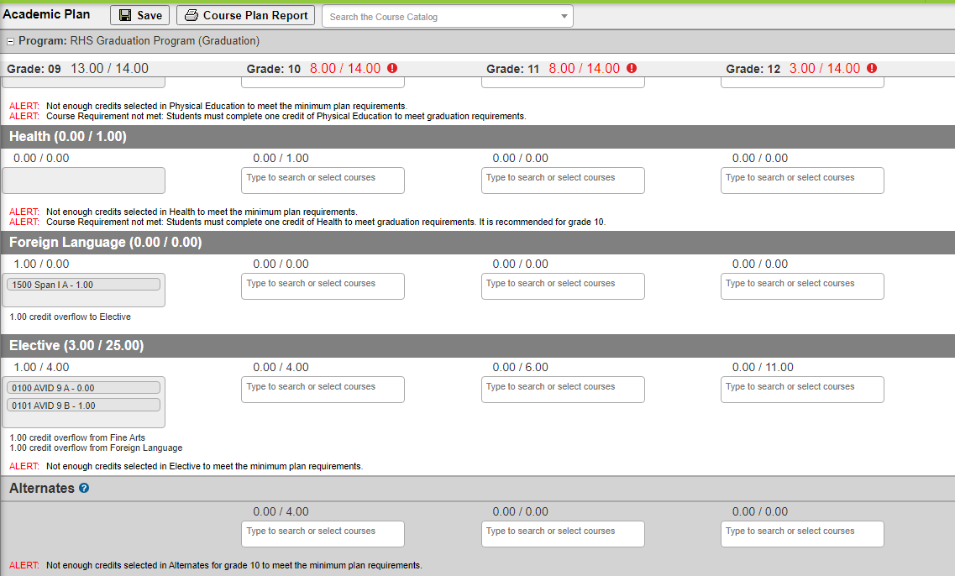
Electives & Alternates
You can register electives & alternates in 2 ways.
Search the course by name under “Course Catalog”
Click on the Elective category to search the options
If you select an “A” semester course, the “B” course will auto fill. If it does not, make sure to select the “B” semester course as well.
Pick 3-5 alternates or back up classes in case one or more of your elective choices is not available

Slide 39
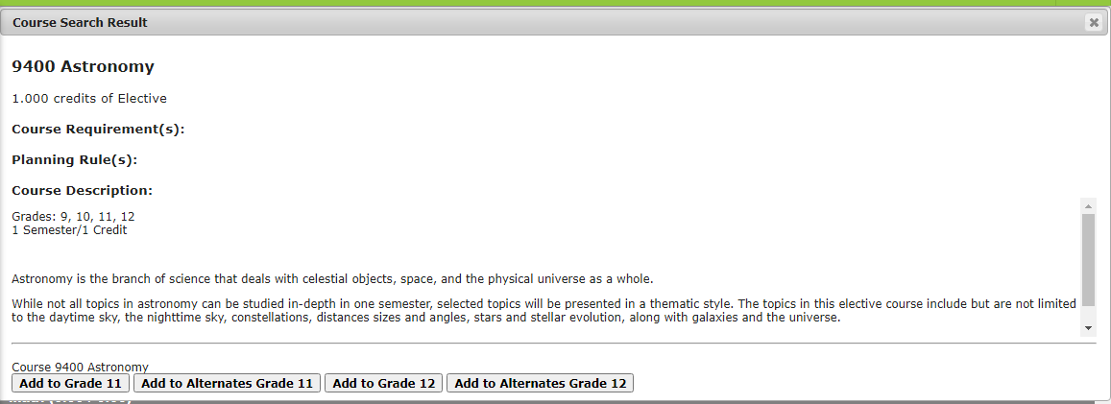
Searching for a Course

Slide 40
FINAL STEPS!
You are finished when you have 14.0/14.0 Credits at the top of the column AND the required credits from each subject area are met.
  You only need to register for next school year, you can plan future years if you would like
  Courses for next year will be locked on 12/20 at 3:30pm
  You can still make changes to future years, just not the courses for the 2025-26 school year
Review your Course Plan
Click “SAVE” in the top menu bar. It should say “Course Plan Saved”. You may come back and review your choices at any time.
Congratulations! Your registration is complete!
IMPORTANT: Final schedules are based on student demand. Courses that did not have enough interest may not be offered and you may be asked to select an alternative course.

Slide 41
Thank you for your time!
If you need additional help with registration, please contact someone from the Guidance Office for help, or stop down!
Ms. Bloom - samantha.bloom@rockford883.org
Ms. Engstrom - ellie.engstrom@rockford883.org
Ms. Roehl - aimee.roehl@rockford883.org
Ms. Gordee- jill.gordee@rockford883.org
Registration will close on Friday, December 19th at 3:30!

Slide 42


