Slide 1
2025 USPS
Calendar Year End

Slide 2
REMINDER
ACCESS will continue to submit all Federal, Ohio, RITA, and Canfield (if requested) submission files to the respective entities on behalf of the districts.

Slide 3
PRELIMINARY CYE
CLOSING PROCEDURES
Notes:
Check Legal Name Field

Slide 4
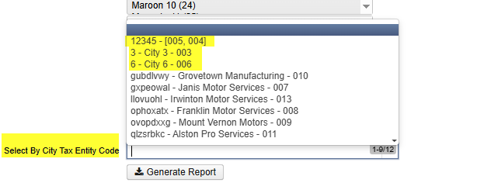
NEW LAST YEAR
1. If payroll item total is zero, it will not print on W2
2. W2 Report and W2 City will be updated to display and allow selection of Tax Entity Codes from a dropdown.
If the same Tax Entity Code is used on multiple Payroll Item Configurations, they will combine
Notes:
For example, if rate is zeroed out, but there is no stop date, the applicable and total gross amounts will continue to be tracked, even though nothing has been withheld.
Used to have to type in, not it is a dropdown

Slide 5
UPDATES
State of West Virginia does not accept an EFW2 file with a value in position 27 of the RE record.
W2 State Options > West Virginia submission file was updated to accommodate this.
Formerly, this was an optional field used by SSDT to identify medicare and non-medicare employees by using a value of Q or R in position 27, which has now been removed.
Notes:
For those who have to submit WV file, let us know before you create the file so we can update configuration for you to submit your own file

Slide 6

UPDATES CTD.
Report summary section of W2 report now includes additional totals
Notes:
-Box 12, multiple State, and/or multiple cities can cause employees to have more than 1 W2.
-”Total Number of Digital W2 Forms” only for districts using Digital Delivery w/ESS

Slide 7
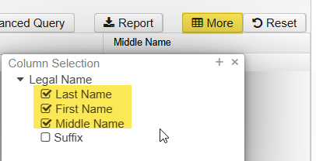
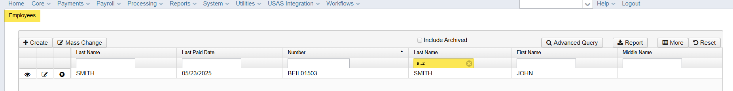
CHECK LEGAL NAME
Go to Core > Employee > make sure the Legal Name columns are on the grid > enter “a..z” under the columns, and verify or correct.

Slide 8
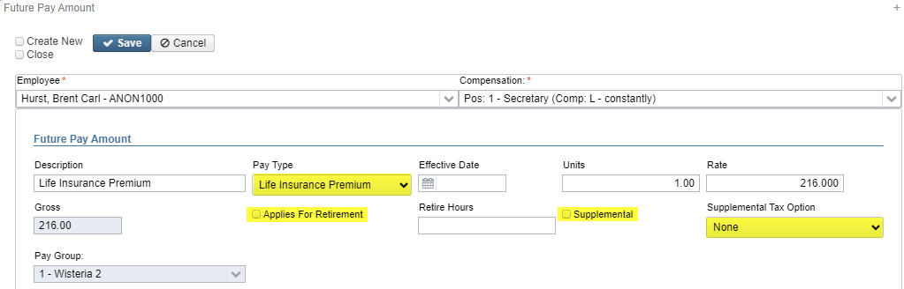
LIFE INSURANCE
PREMIUM
Process Life Insurance Pay Types for employees that are provided life insurance premiums over $50,000 before your last payroll of the calendar year
Notes:
According to the IRS, the cost of group-life insurance an employer provides to an employee for coverage over $50k is to be included in wages reported for the employee.
Description – Life Insurance Premium
Pay Type – Life Insurance Premium
Effective Date – leave blank to pull in on next payroll
Units – 1
Rate – calculated life insurance premium amount
Applies For Retirement – unchecked
Retire Hours – blank
Supplemental – leave unchecked
Supplemental Tax Option - none
The tax amounts for Medicare and SS will be calculated, but no Federal, State, or OSDI tax amounts will be calculated. The software provides ability to withhold city tax and can be activated by checking the “Tax Non Cash Earn” box on the city tax record box under Core > PR Item Configuration.

Slide 9
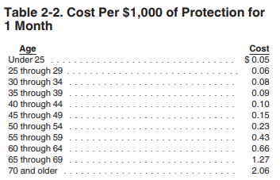
IRS PUBLICATION 15-B
Example: 35 year old principal has $250,000 group term life insurance for an entire calendar year
$200,000 - $50,000 = $200,000 excess coverage
$200,000 / $1000 = 200
$.09 cost per month x 12 months = $1.08
$1.08 x 200 = $216 non-cash earnings amount
2025 Publication 15-B (irs.gov)
Notes:
Link to IRS documentation for how to calculate the amount.
If the Life Insurance Premium Pay Type was not posted prior to the last pay, then adjustments will need made to the 001 Federal Payroll Item under Core > Adjustments. Put in a ticket and we will provide directions.

Slide 10
Final Reminders
Deadline to upload files to the secure site:
Friday, January 9, 2026
        Federal - W2 Form Data.xml AND W2Tape.txt
        State – W2OH.txt, W2PA.txt, W2WV.txt
        RITA – W2RITA.txt
        CCA – W2CCA.txt
        City – W2CITY_CANF.txt, W2CITY_EAST.txt
* Reminder – ACCESS only submits Federal, Ohio, RITA,
and Canfield (if requested) on your behalf

Slide 11
Final Reminders
CTD.
Send ACCESS copies of Ohio IT3 and RITA Form 17 (we do NOT submit these for you)
Ohio minimum wage updates to $11/hour Jan. 1, 2026
Upload Q4 ODJFS file to secure site as part of Quarter End processing

Slide 12
Discussion &
UPDATES FOR 2026
* Reporting overtime on W2 requirements *
* Digital delivery of W2s *
* W2 Corrections *

Slide 13
Merry Christmas
& Happy Holidays

